Slide 1

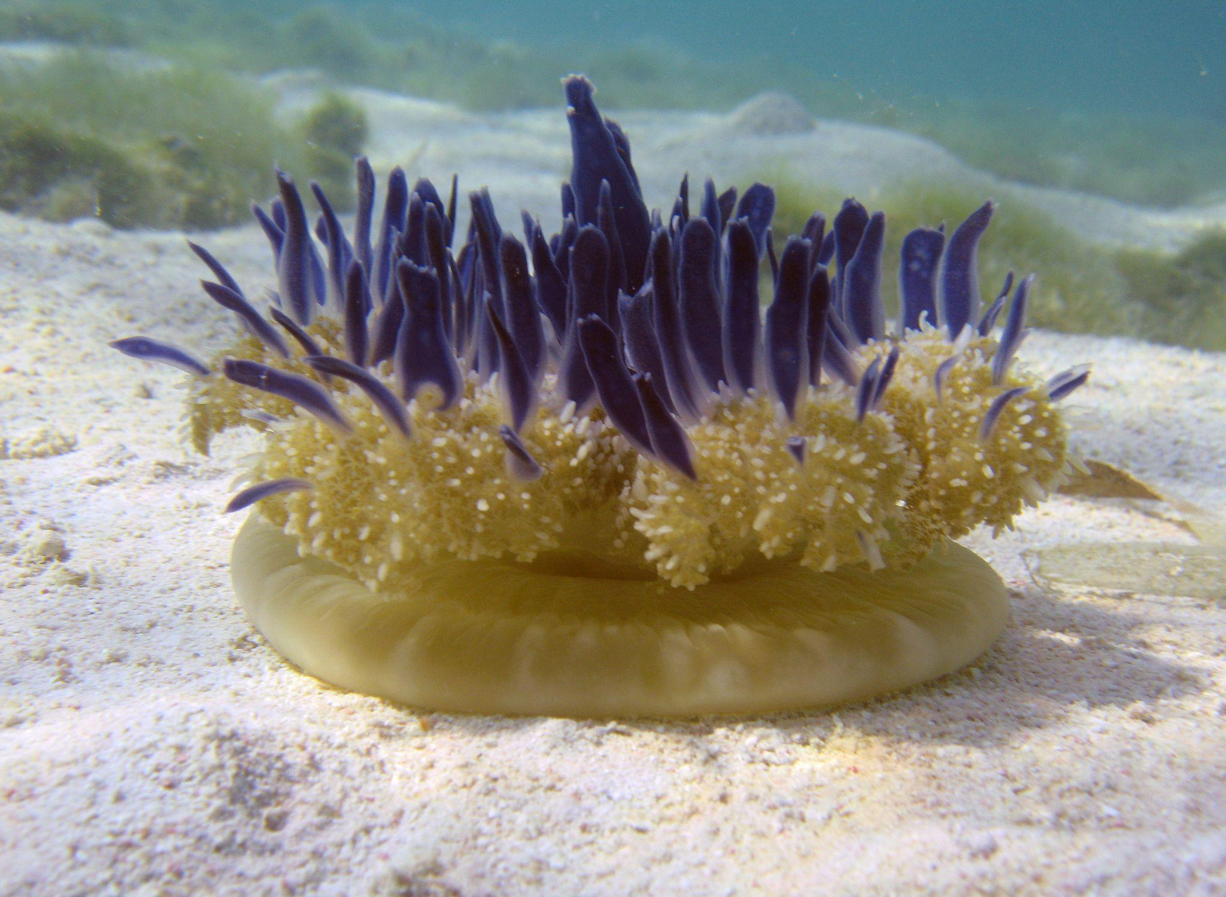

In vivo evaluation of bioenergetic parameters in heat-stressed Cassiopea
University of Liège
InBios, Phytosystems
ECOP-ISOP meeting – Vienna 13.07.23
Edmée Royen
1

Slide 2
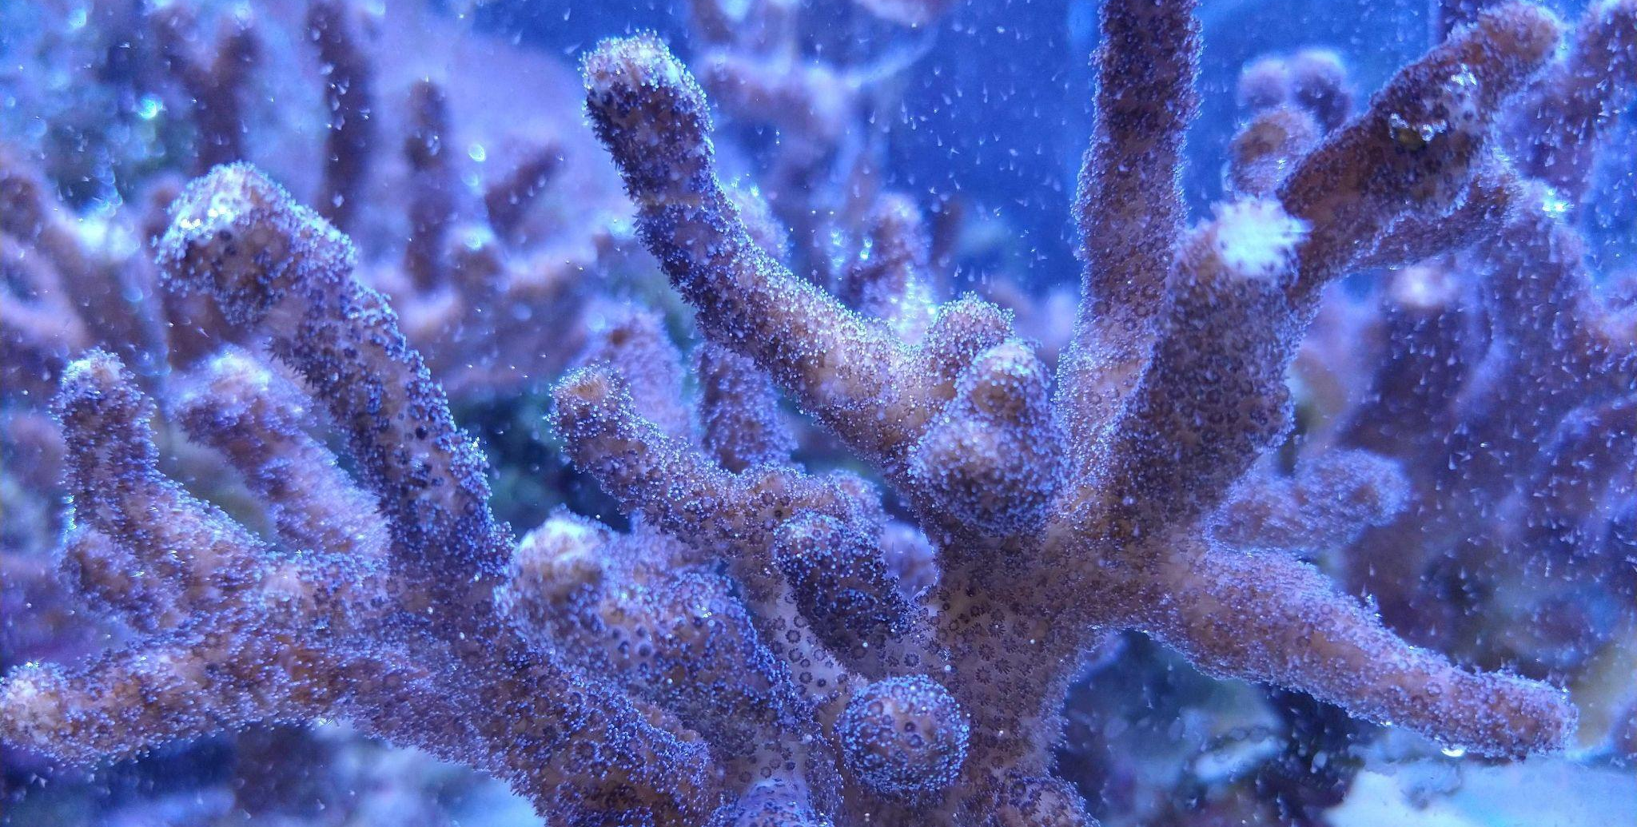
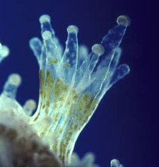
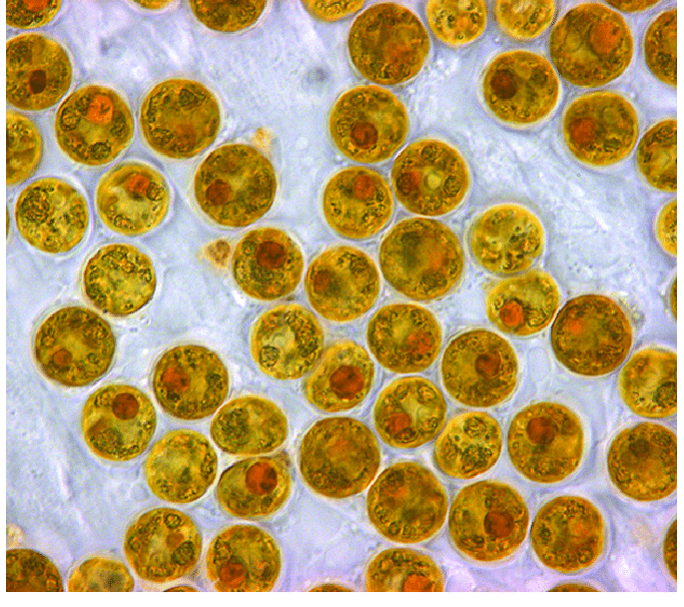
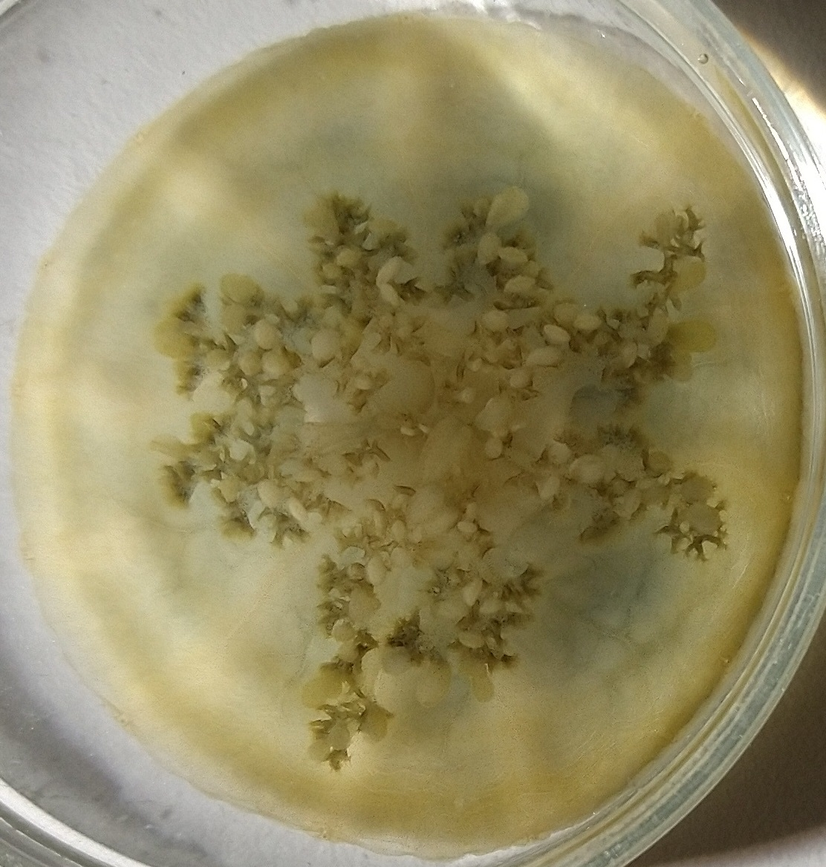
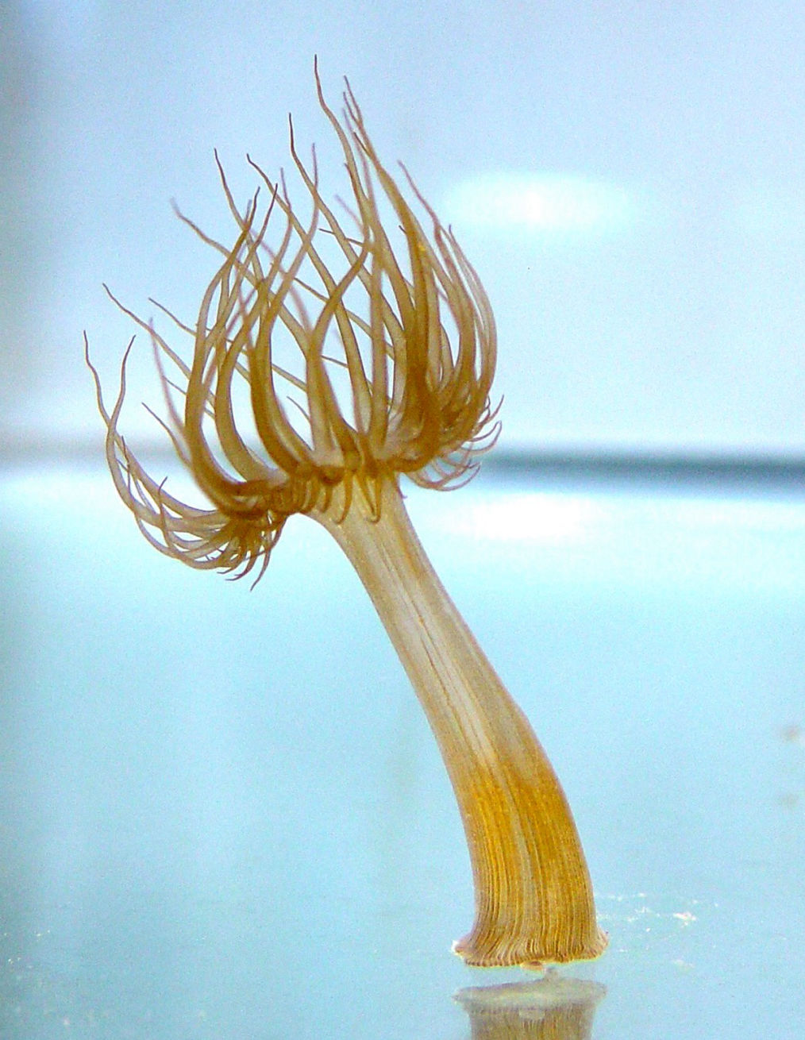
1. Introduction
1
2
3
Cnidarian
Host
Symbiotic Microalgae
1
4
1.

Slide 3
1. Introduction
1
2
3
Respiration
Respiration
Cnidarian
Host
Symbiotic Microalgae
Photosynthesis
1
4
1.

Slide 4
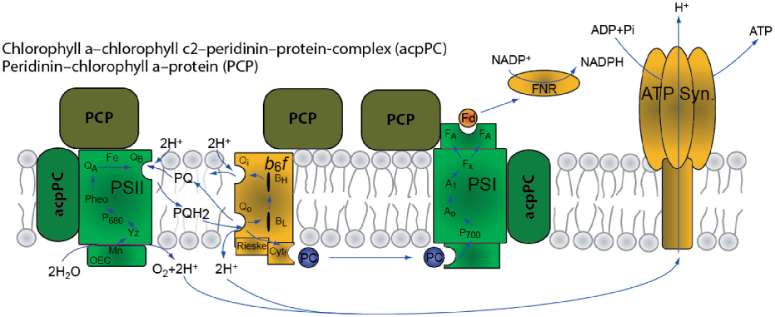
1. Introduction - photosynthesis
2
CBC
Respiration
Respiration
Cnidarian
Host
Symbiotic Microalgae
Photosynthesis
adapted from 5.

Slide 5
1. Introduction - photosynthesis
2
CBC
½ O₂ H₂O
O₂ O₂⁻
Respiration
Respiration
?
Cnidarian
Host
Symbiotic Microalgae
PTOX
Photosynthesis
adapted from 5.

Slide 6

1. Introduction - photosynthesis
2
CBC
½ O₂ H₂O
O₂ O₂⁻
Respiration
Respiration
?
Cnidarian
Host
Symbiotic Microalgae
PTOX
Photosynthesis
adapted from 5.

Slide 7


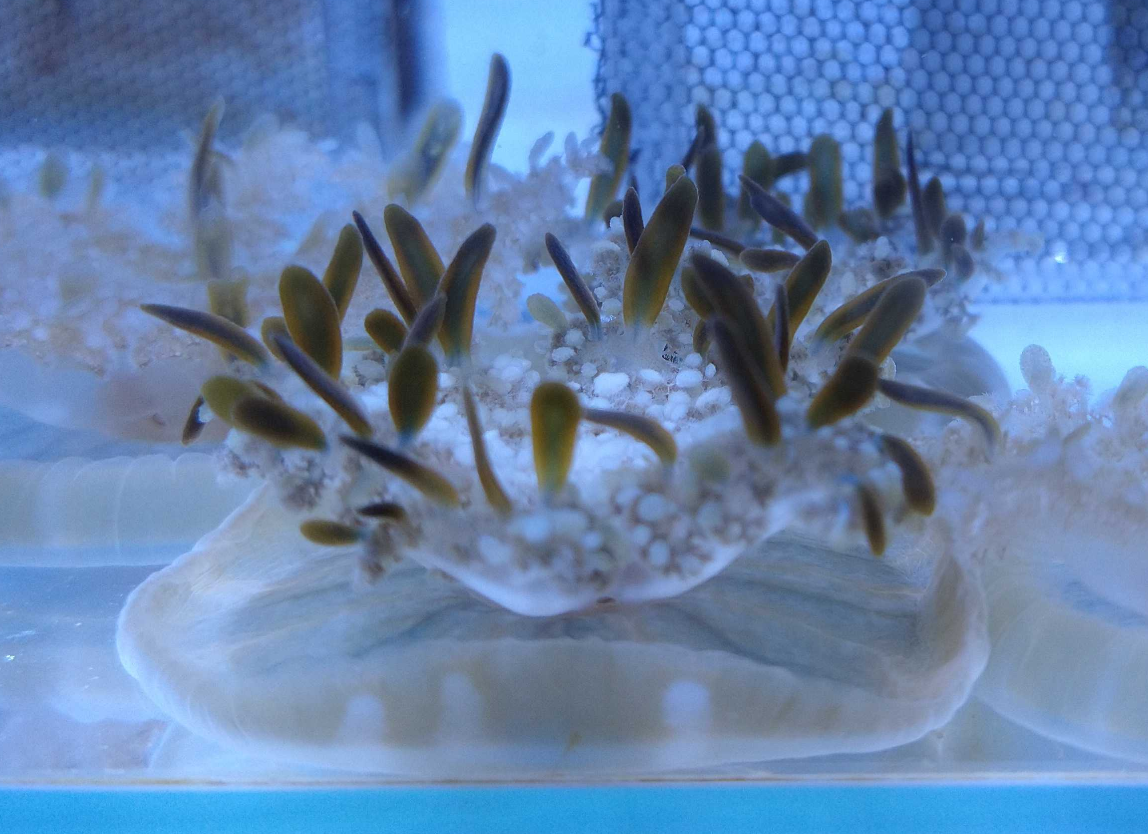
2. Materials and methods - setup
3
28 days
26°C
32°C
General features
Photosynthesis
Respiration

Slide 8
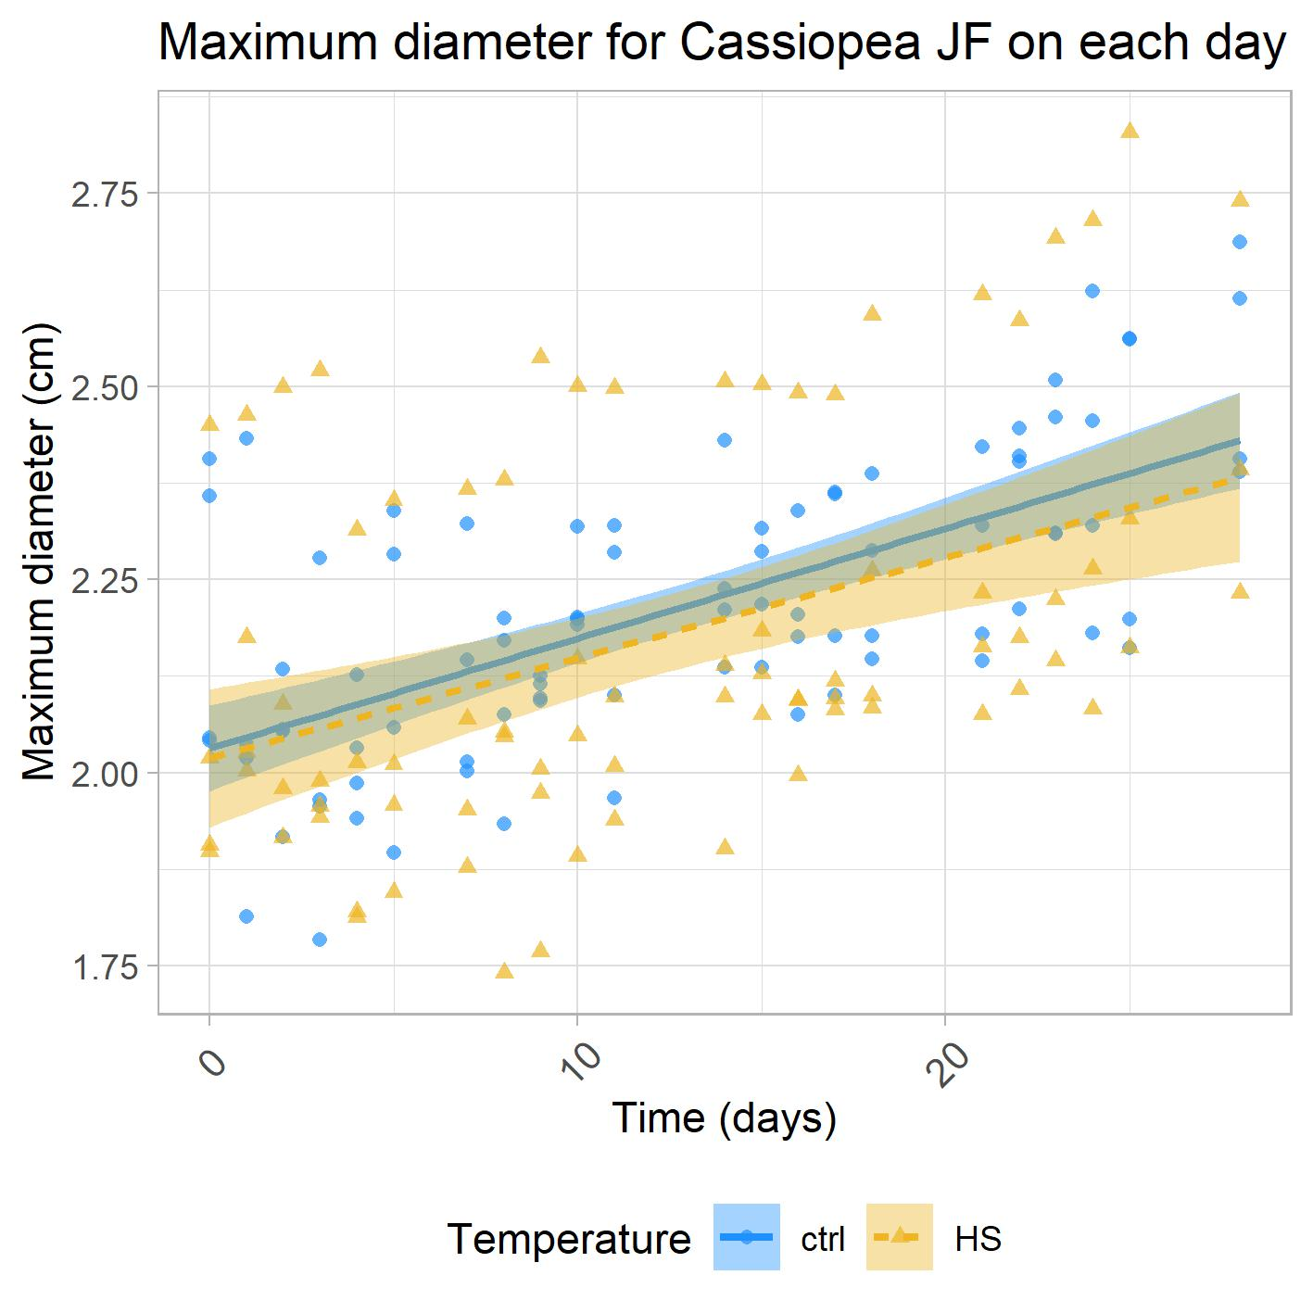
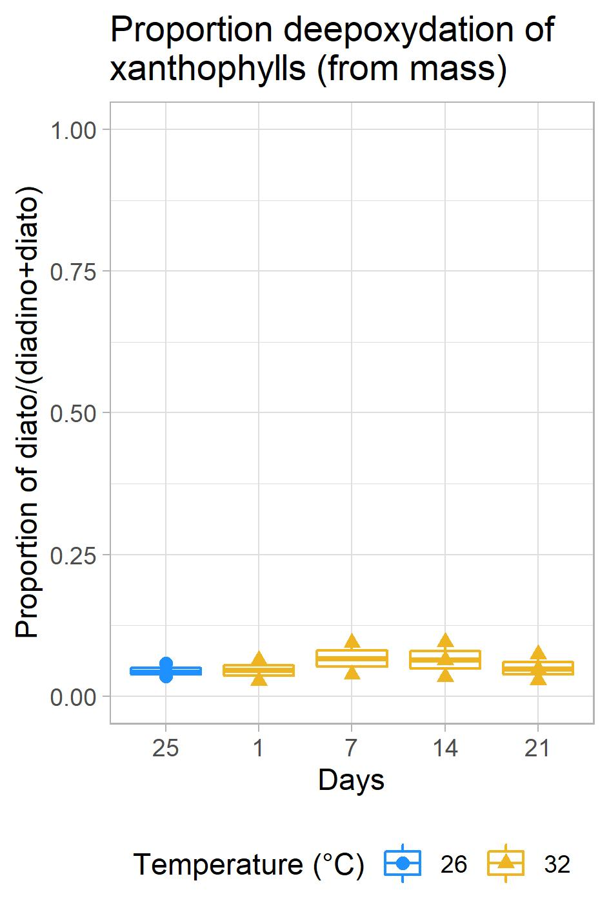
3. Results – General features
4
n=4

Slide 9
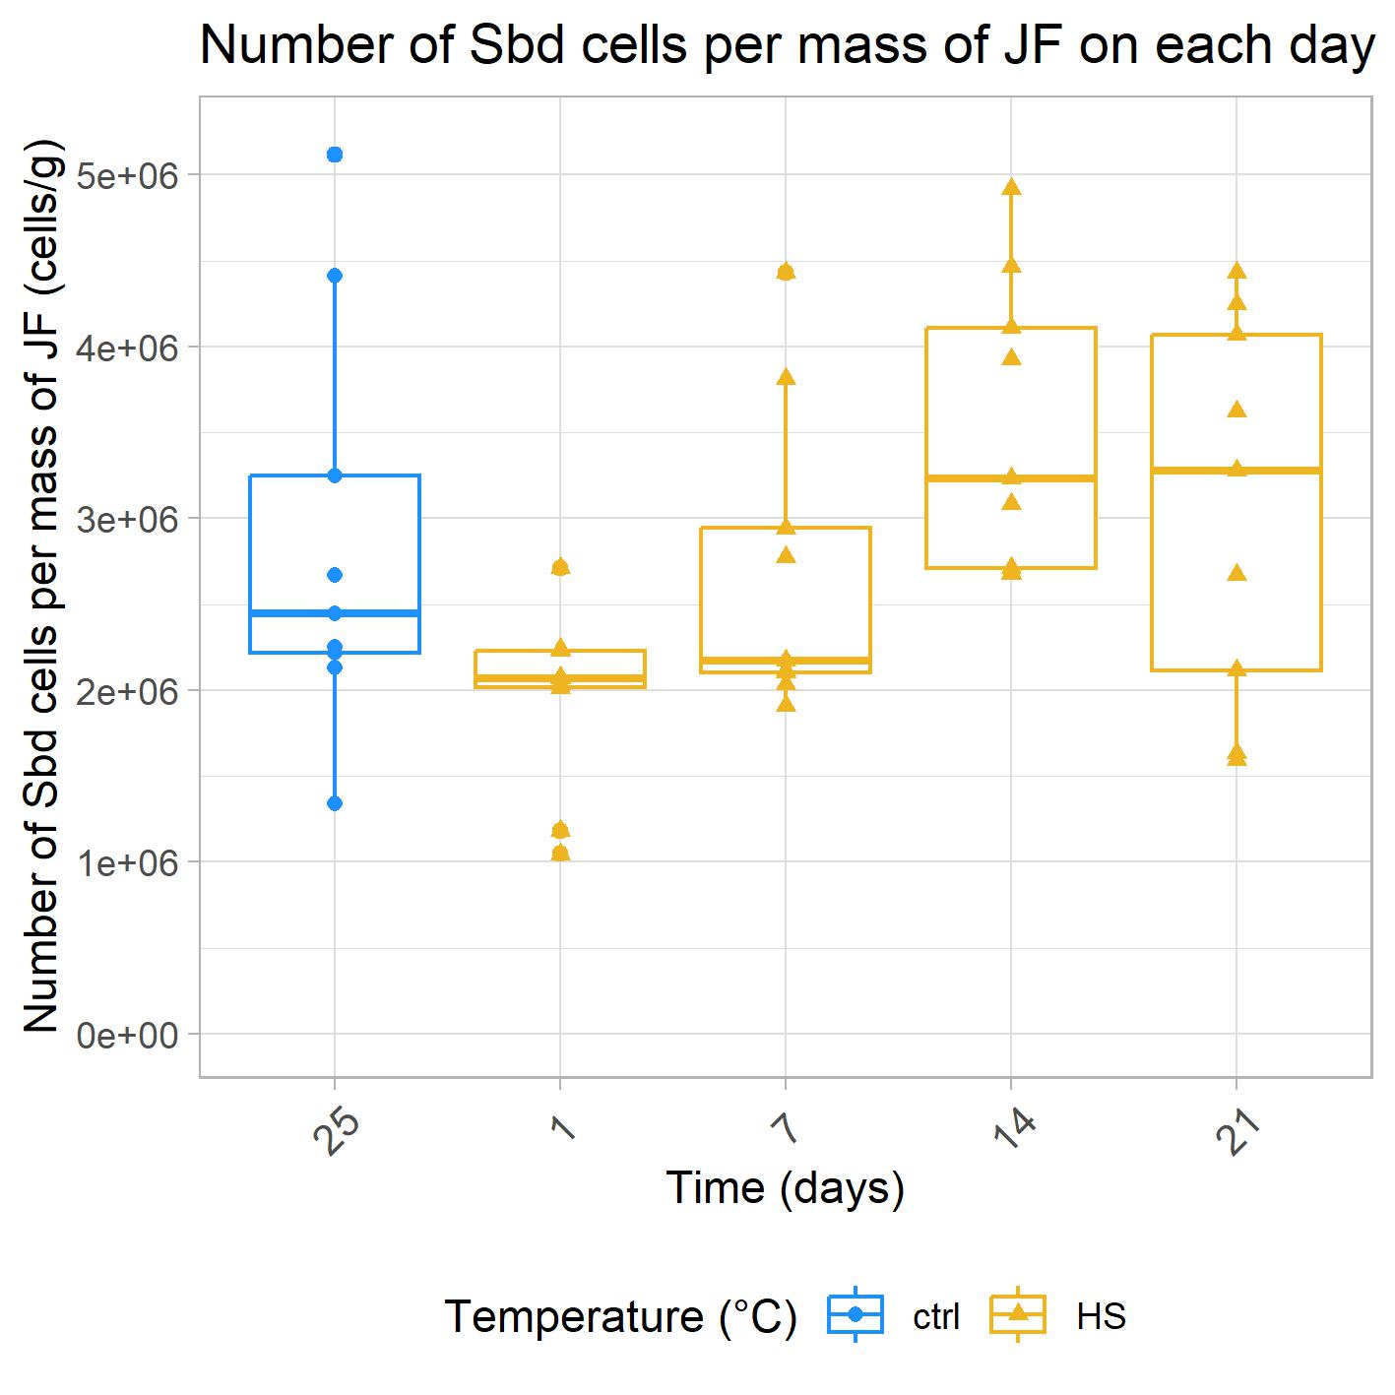
3. Results – General features
4
n=4
n=9

Slide 10
3. Results – Pigments
5
Chlorophyll a/c2 peridinin protein complex
Chlorophyll a
Chlorophyll c2
Peridinin
3
Peridinin chlorophyll a protein
Chlorophyll a
Peridinin
PCP
adapted from 5.

Slide 11
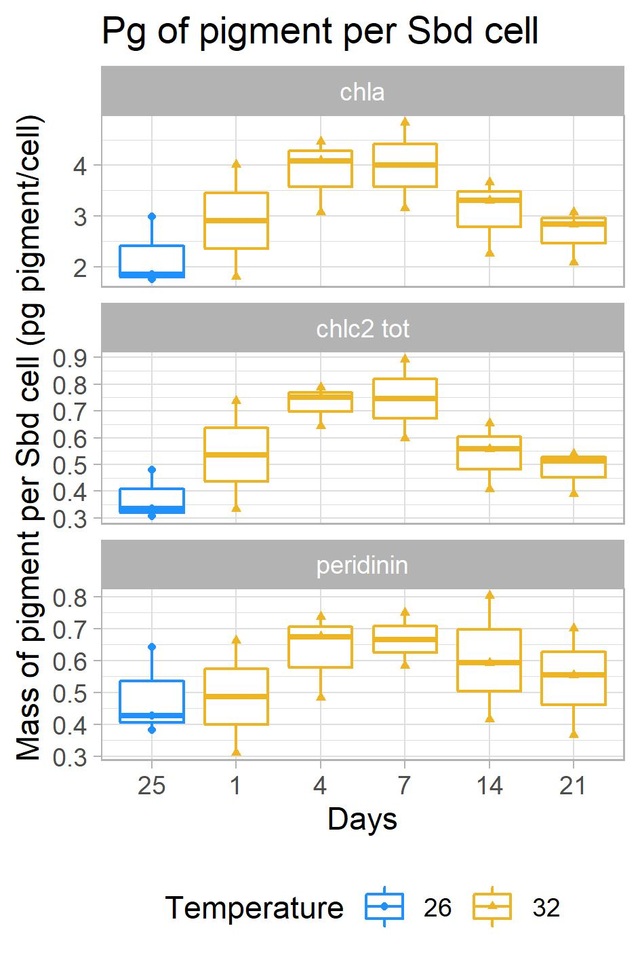
3. Results – Pigments
5
Chlorophyll a/c2 peridinin protein complex
Chlorophyll a
Chlorophyll c2
Peridinin
3
Peridinin chlorophyll a protein
Chlorophyll a
Peridinin
PCP
n=3
adapted from 5.

Slide 12
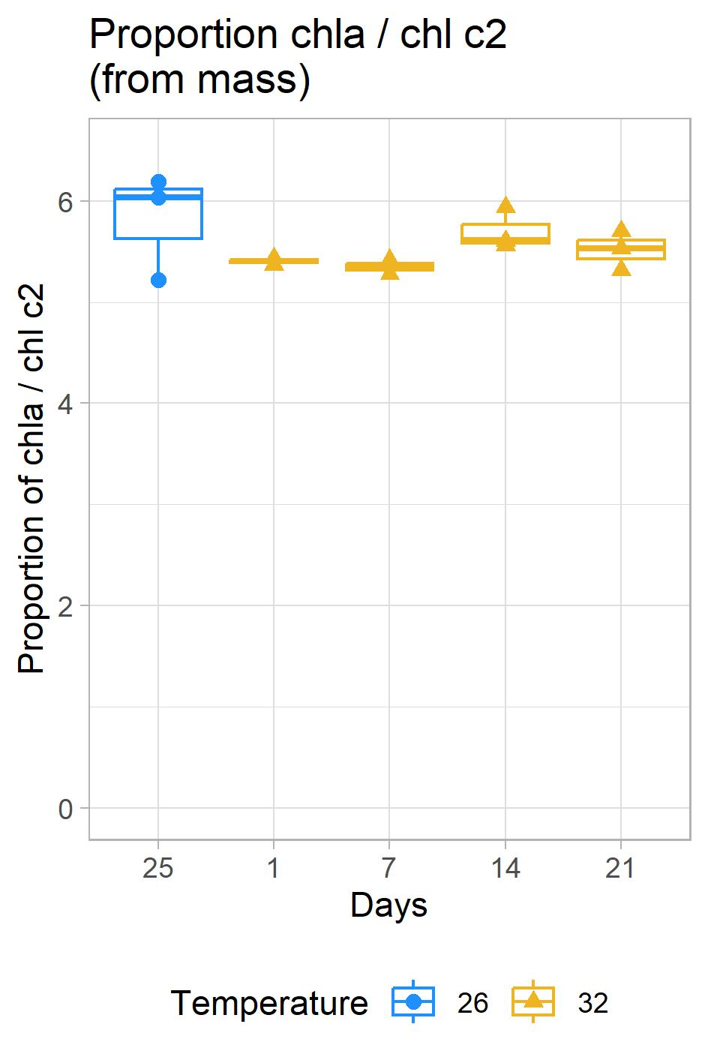
3. Results – Pigments
5
3
Chl a, chl c2, Per
PCP
n=3
Chl a, chl c2, Per
n=2-3
adapted from 5.

Slide 13
3. Results – Activity of PSI and PSII
6
CBC
adapted from 5.

Slide 14
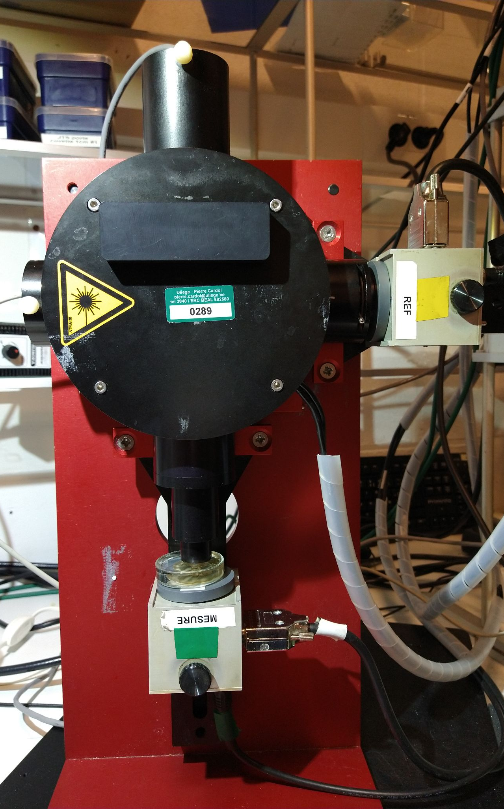
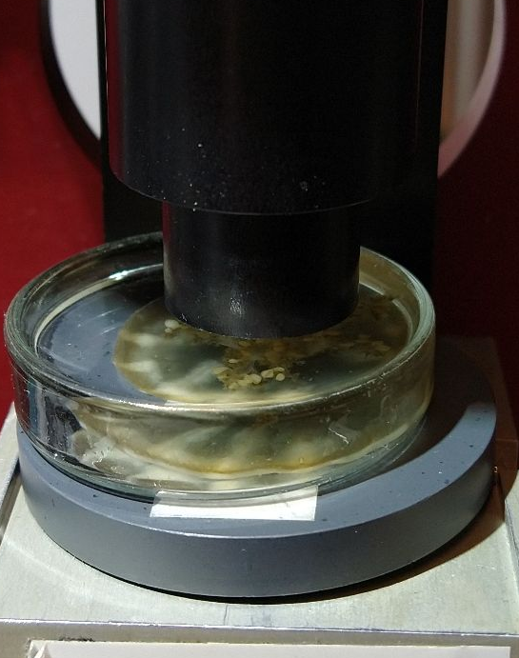
3. Results – Activity of PSI and PSII
6
Absorbance variation of P700 linked to its redox state
Variable chlorophyll a fluorescence
CBC
adapted from 5.
JTS-10 (BioLogic)

Slide 15
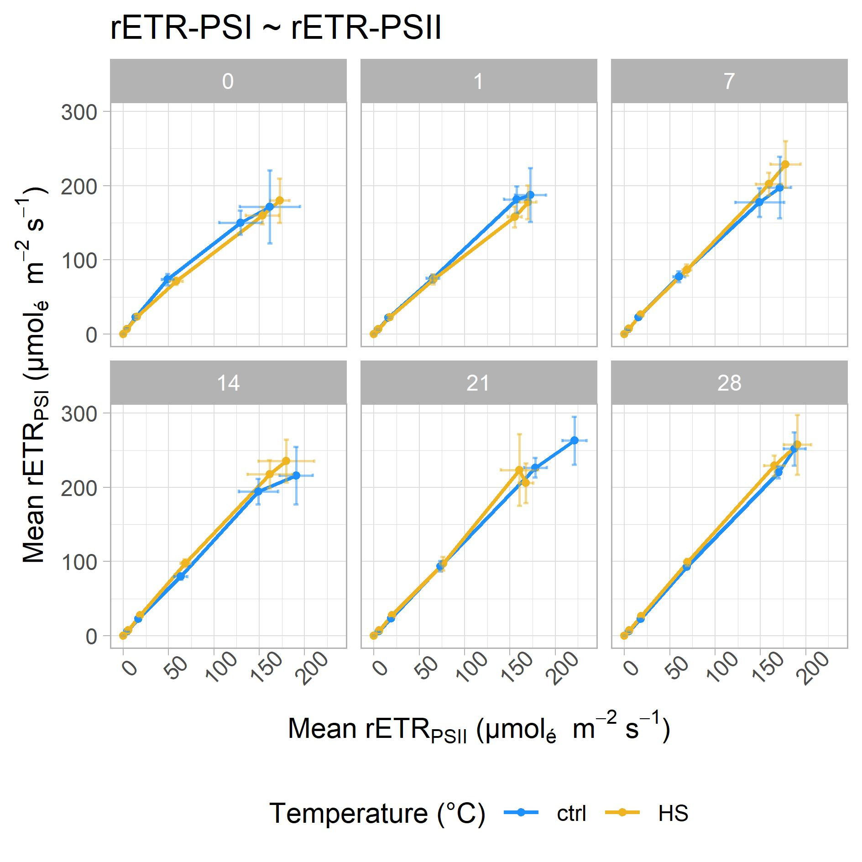
3. Results – Activity of PSI and PSII
6
CBC
PPFD max = 700
n=3-4
adapted from 5.

Slide 16
3. Results – Activity of PSII and oxygen production
7
CBC
adapted from 5.

Slide 17
3. Results – Activity of PSII and oxygen production
7
CBC
½ O₂ H₂O
O₂ O₂⁻
?
PTOX
adapted from 5.

Slide 18
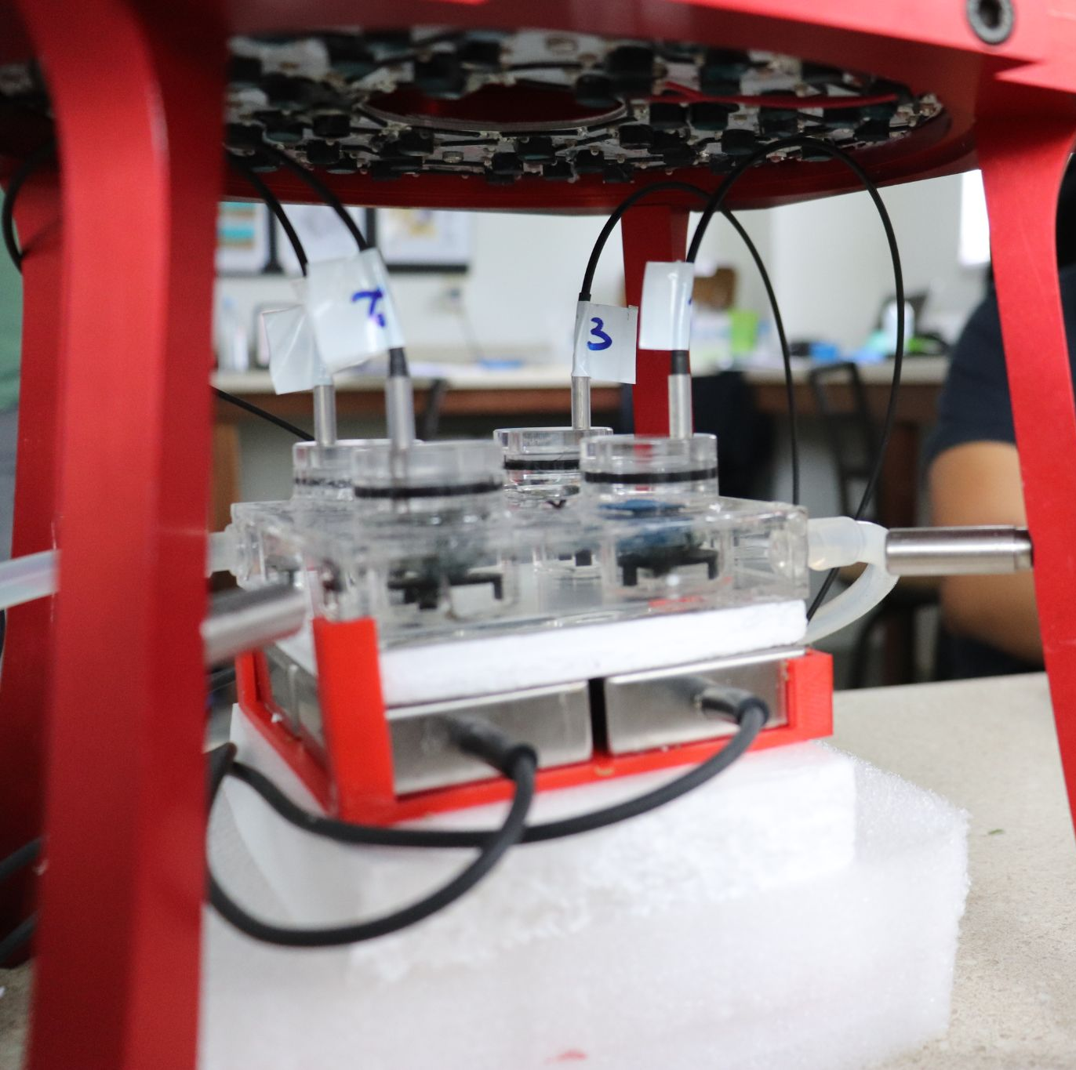
3. Results – Activity of PSII and oxygen production
7
Variable chlorophyll a fluorescence
Oxygen exchanges
CBC
½ O₂ H₂O
O₂ O₂⁻
?
PTOX
Speedzen (Beam-Bio/API)
+ Firesting (Pyroscience)
adapted from 5.

Slide 19
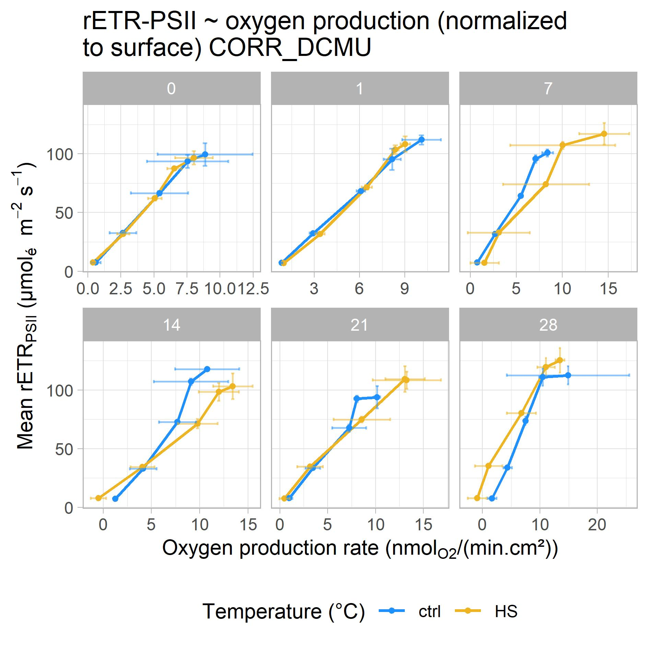
3. Results – Activity of PSII and oxygen production
7
day:
CBC
½ O₂ H₂O
O₂ O₂⁻
?
PTOX
PPFD max = 475
n=3-4
adapted from 5.

Slide 20
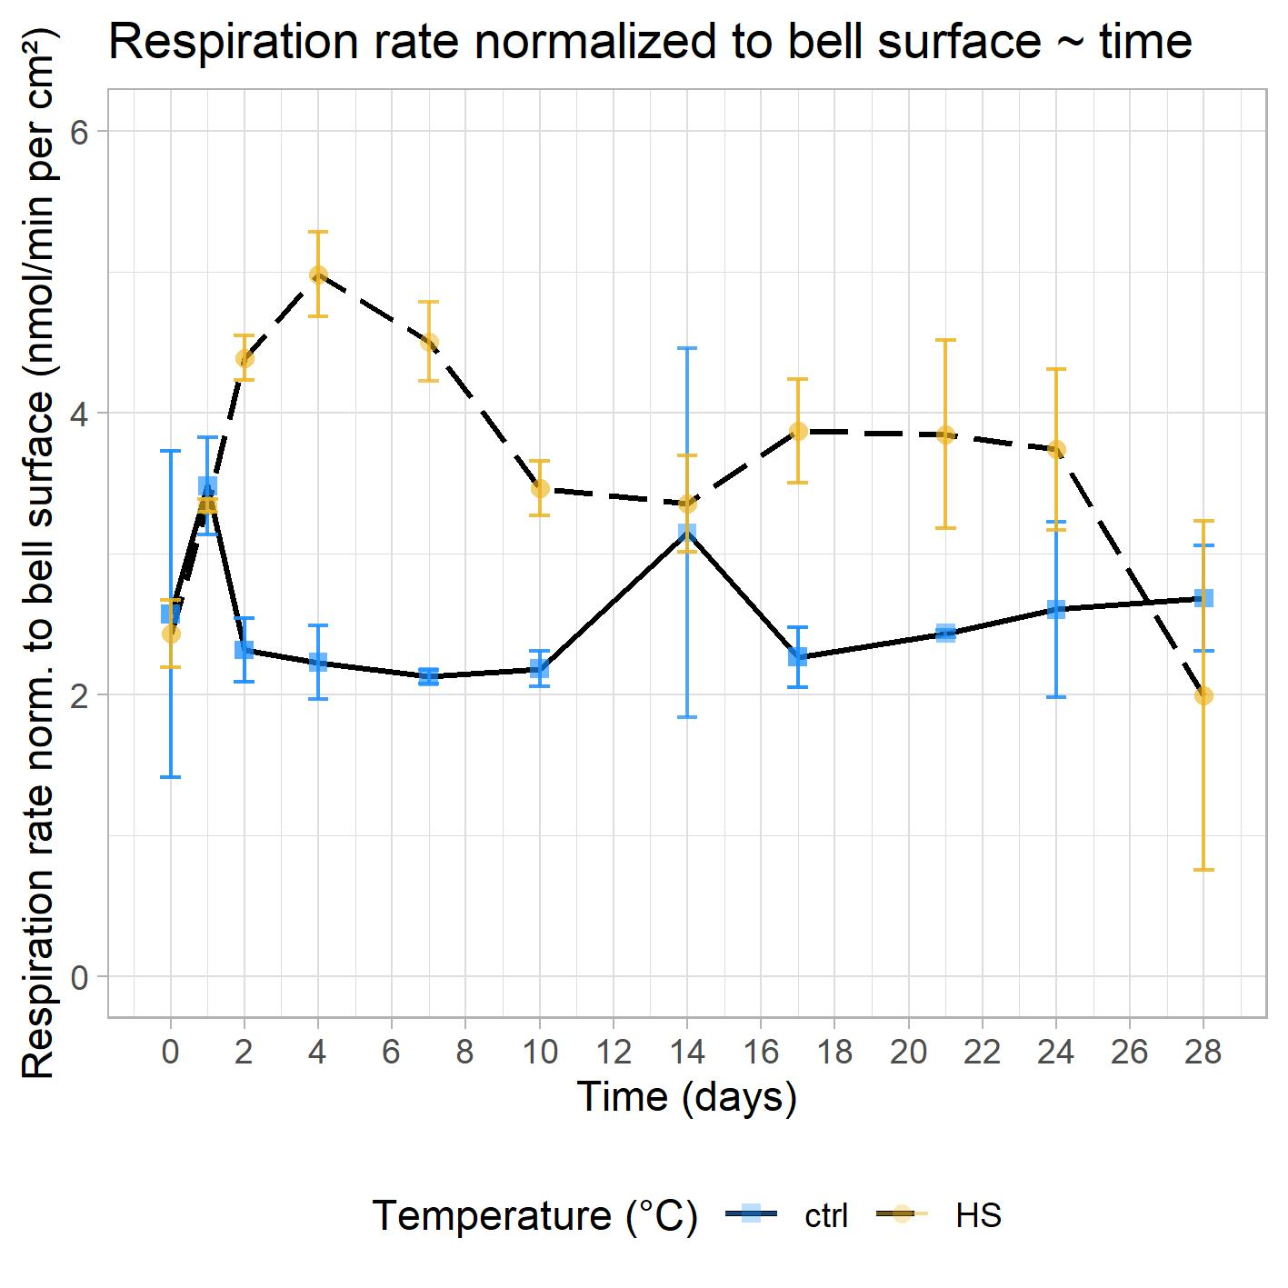
3. Results – Respiration
8
n=2-4

Slide 21
3. Results – Respiration
8
General acceleration of cellular processes?
Increased energetic demand to cope with heat stress ?
n=2-4

Slide 22
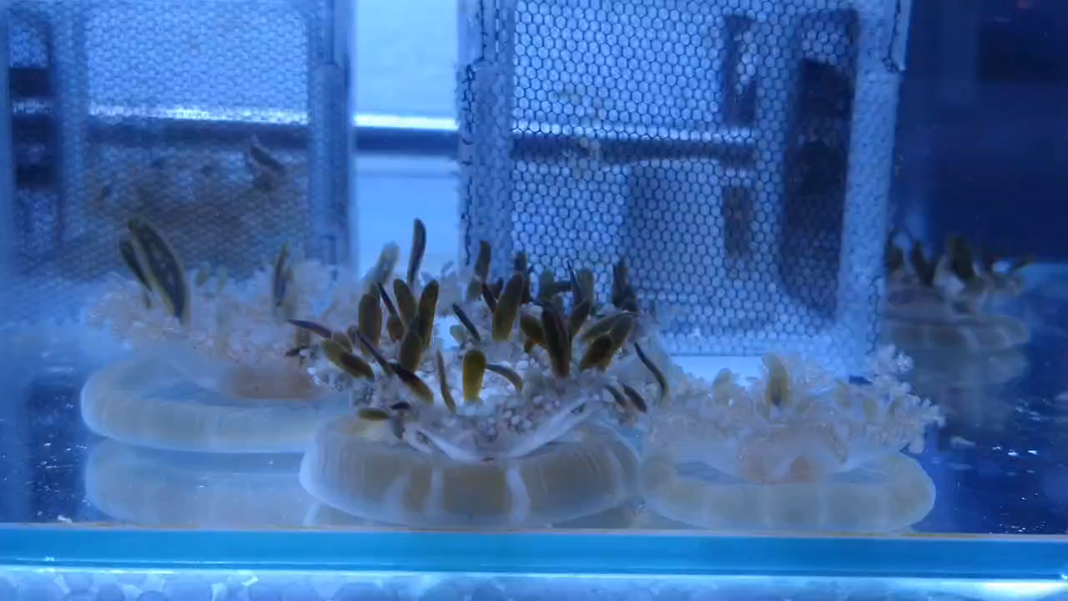
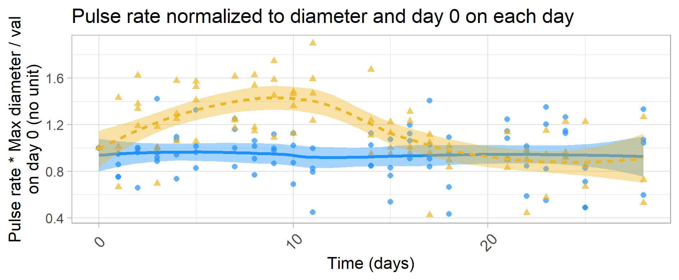
3. Results – Respiration
8
n=2-4
n=4

Slide 23
4. Conclusion
9
High tolerance to moderate heat stress
  With transient adjustments
  New questions:
  How is photosynthesis maintained?
  What is happening in the first days of stress?
  What mechanisms ensure tolerance?
What’s next: explore…
          … functional adaptation
          (bottom-up proteomics)
… membrane fluidity adjustment
(fatty-acids composition)

Slide 24
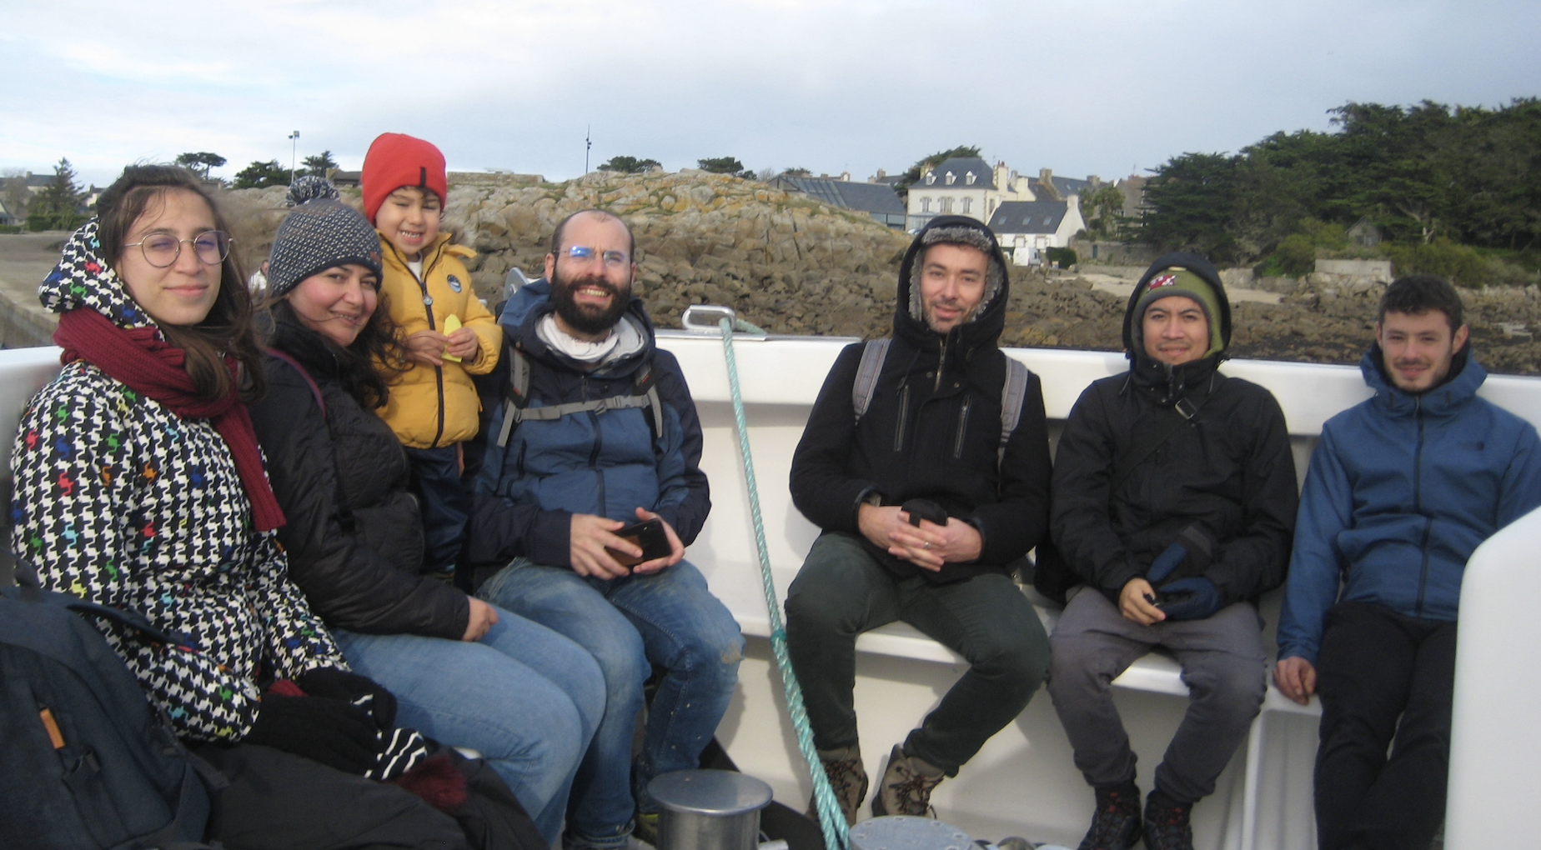
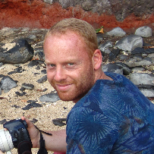


Thanks for your attention!
Thanks to my colleages
Agnieszka Misztak
Félix Vega de Luna
Tom Feller
Malika Chabi
Stéphane Roberty
Pierre Cardol
Edmee.Royen@doct.uliege.be

Slide 25
References
Doug (Flickr), “Cassiopea (species?), Upside-down jellyfish, Boca Chica, Dominican Republic”, picture taken on the 8/5/2010, accessed on 08/03/21, available at https://www.flickr.com/photos/shyzaboy/4615199835/
Oxford Scientific, “Coral pocillopora sp. expanded polyps with symbiotic zooxanthellae”, Getty Image, accessed on 20/02/22, illegally available at https://ocean.si.edu/ocean-life/invertebrates/zooxanthellae-and-coral-bleaching
Baums, Iliana & Devlin-Durante, Meghann & LaJeunesse, Todd. (2015). Baums et al.2014 MOLECECOL.
Bateman Tim, “Exaiptasia diaphana”, accessed on 09/06/20, available at http://udel.edu/~tbateman/page6.html
Einbinder, Gruber, D. F., Salomon, E., Liran, O., Keren, N., & Tchernov, D. (2016). Novel adaptive photosynthetic characteristics of mesophotic symbiotic microalgae within the reef-building coral, Stylophora pistillata. Frontiers in Marine Science, 3. https://doi.org/10.3389/fmars.2016.00195
Picture taken by Stéphane Roberty in March 2020 in Palau.

Slide 26
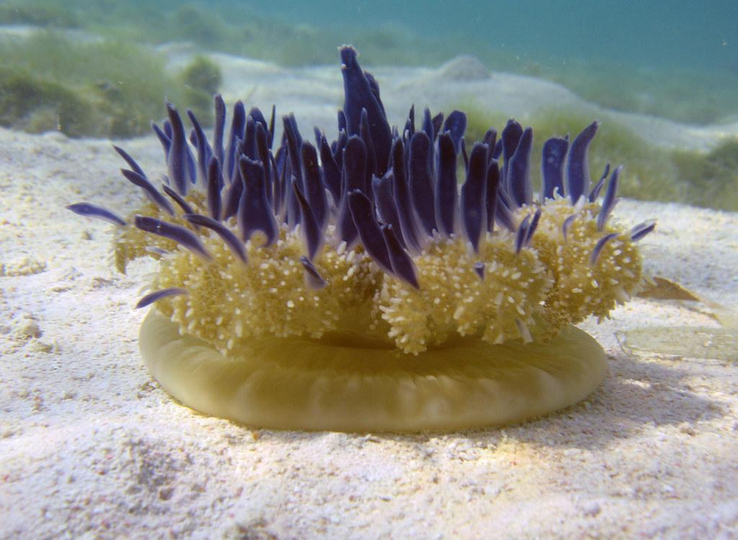
4. Getting to know Exaiptasia and Cassiopea
Cassiopea sp. (Schyphozoa, Rhizostomeae)
Colored vesicles
Model organism for:
Symbiosis with Symbiodiniaceae (+ resistance to environmental fluctuations)
Cnidome
Quiescence-like stage
Biomonitor and bioindicator
Fluid dynamics
Umbrella
Arms
1

Slide 27
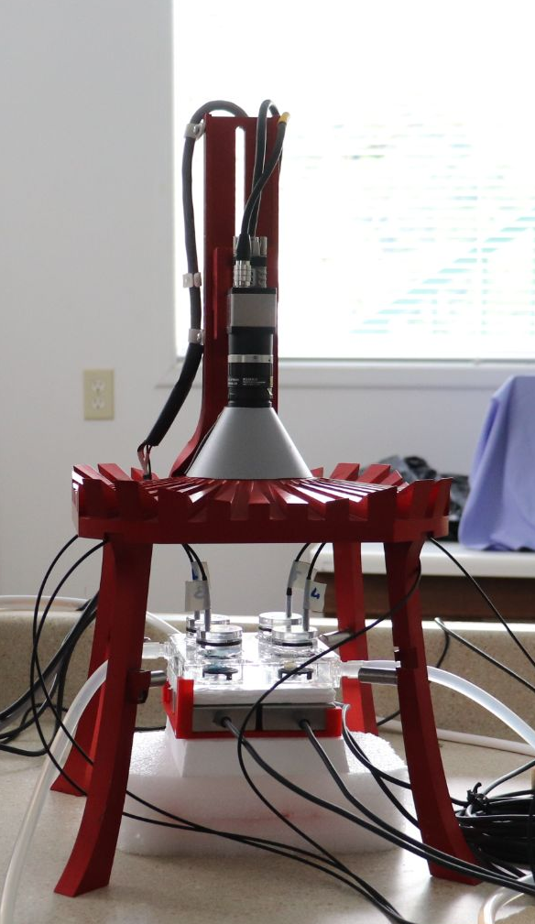
2. Heat stress in Cassiopea - Methods
Speedzen (Beam-Bio/API)
CCD camera
LEDs
Optical O₂ sensor (Firesting O₂)
Oximetry chamber (with water mixing)
Water bath
(control of T°)

Slide 28
2. Heat stress in Cassiopea - Methods
Fluorescence mode
Spectrophotometer mode
JTS-10 (BioLogic)
PSII
PSI

Slide 29
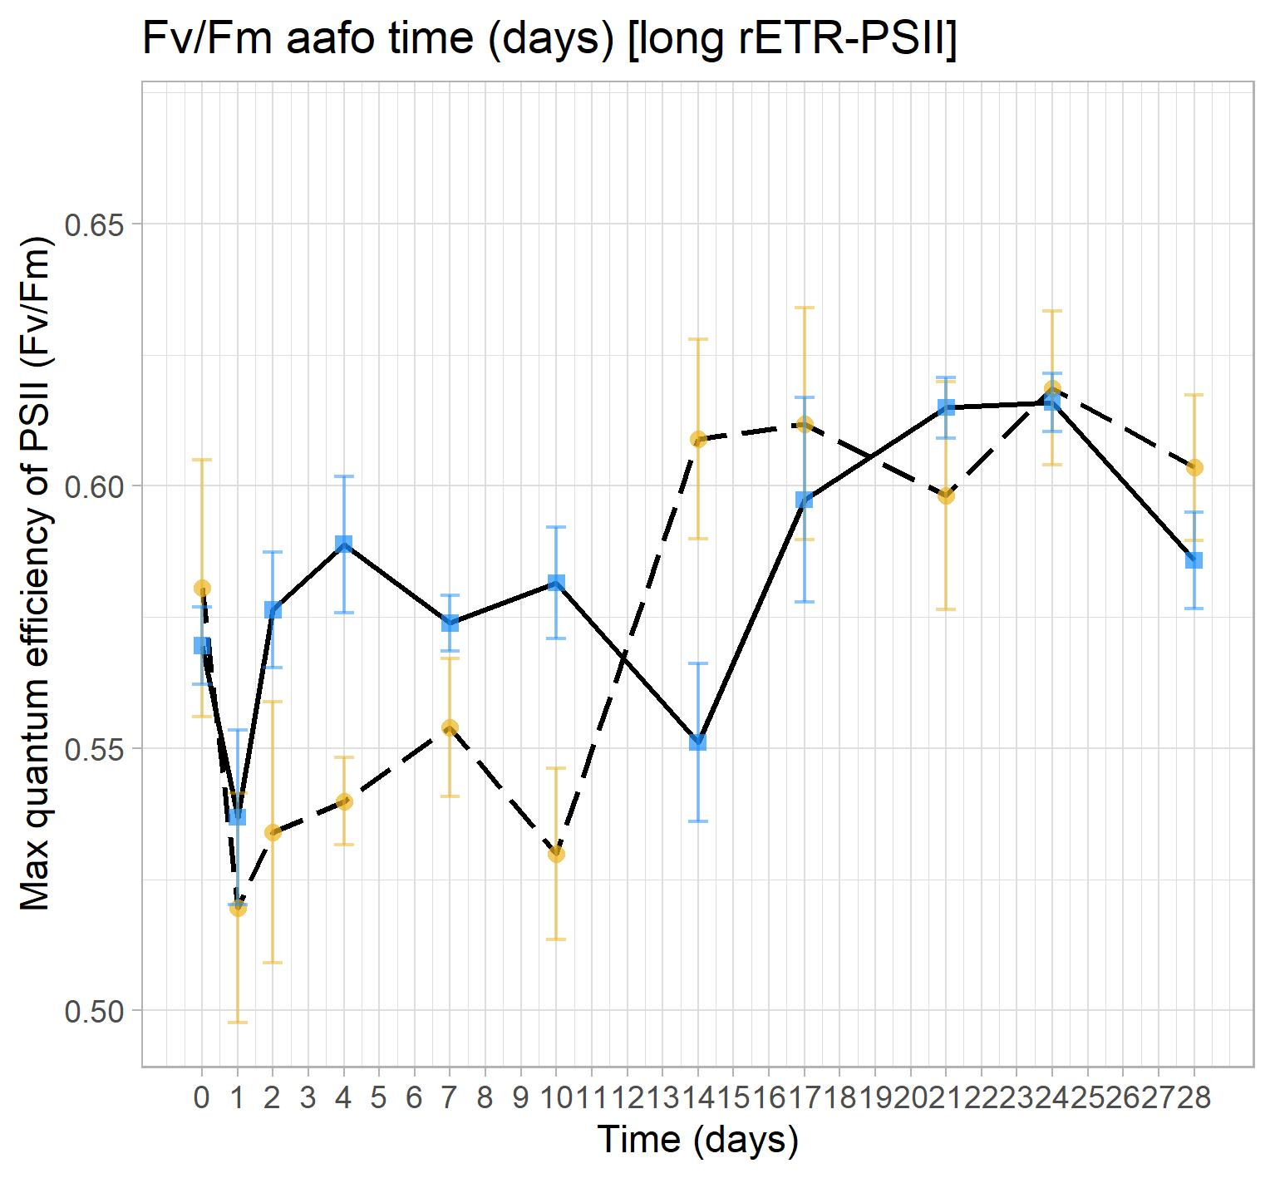
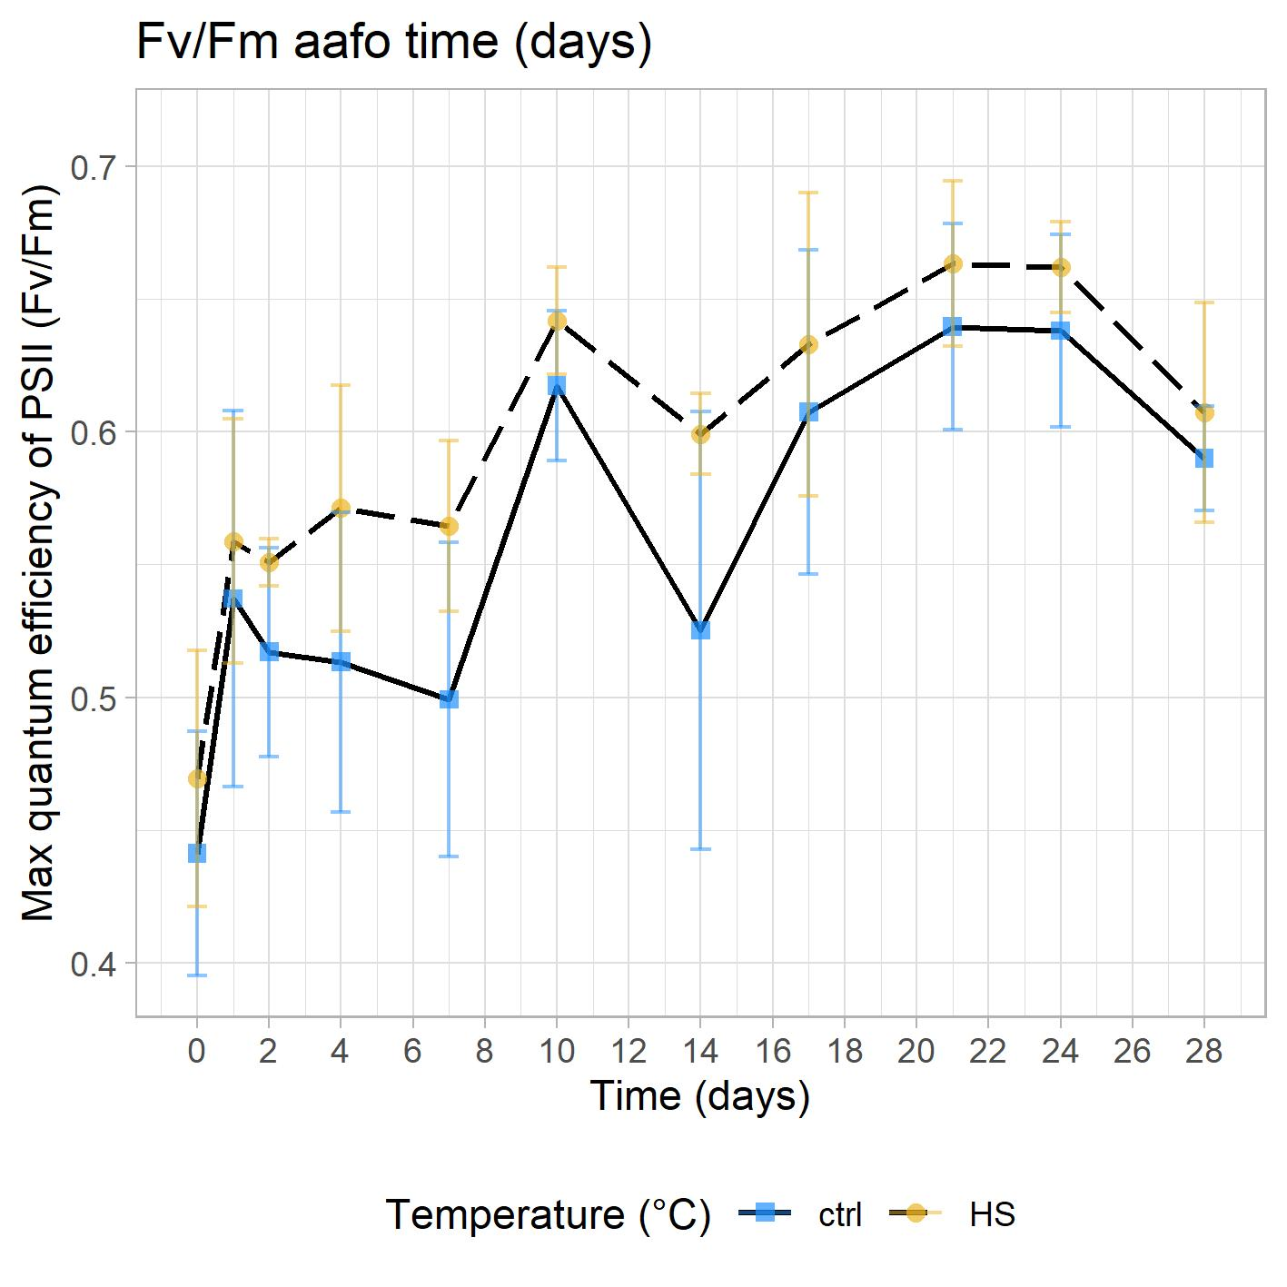
2. Heat stress in Cassiopea - Fv/Fm
(from JTS data)

Slide 30
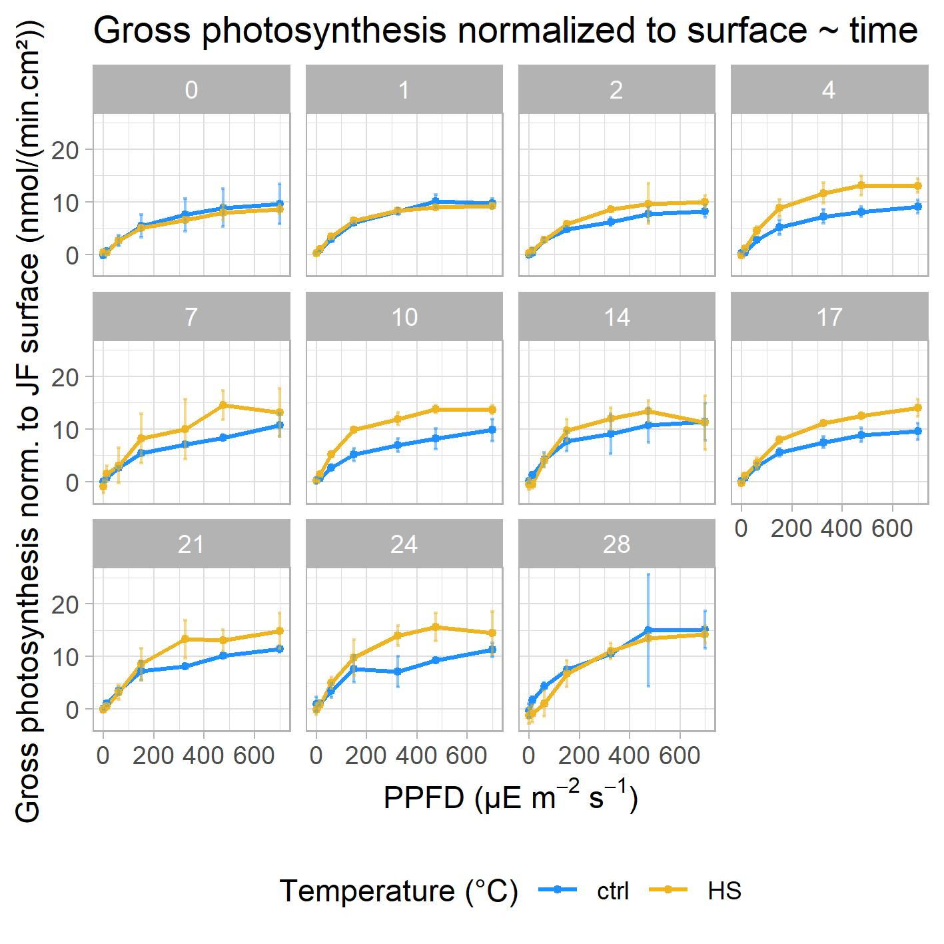
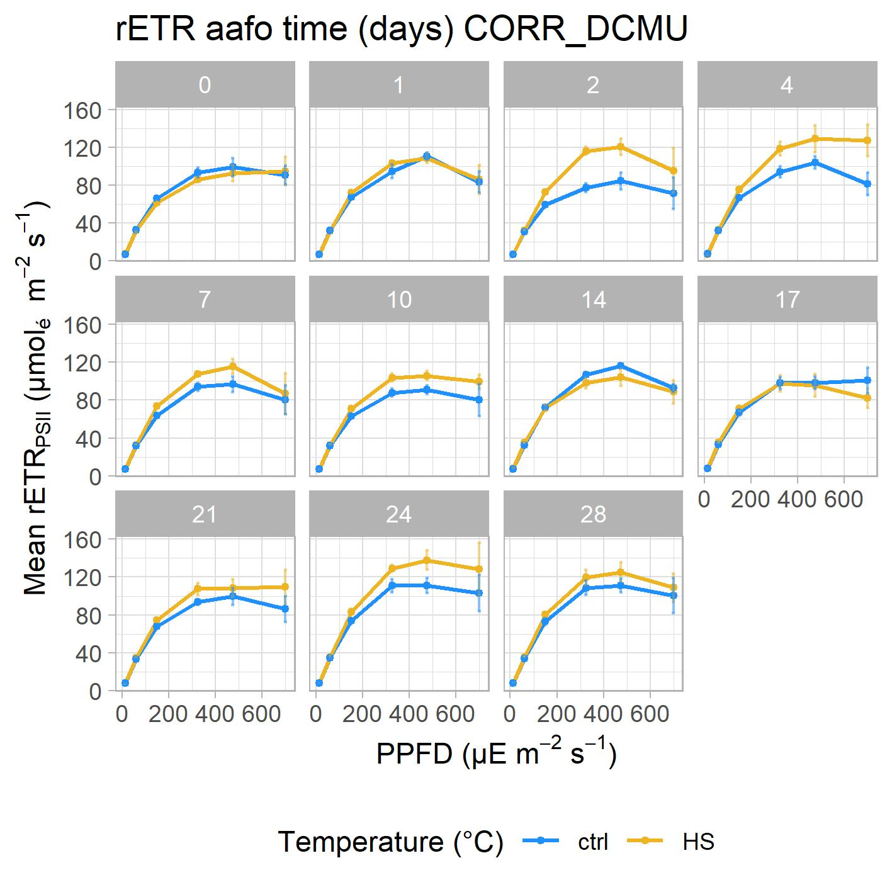
2. Heat stress in Cassiopea - PSII activity
n=3-4
n=4

Slide 31
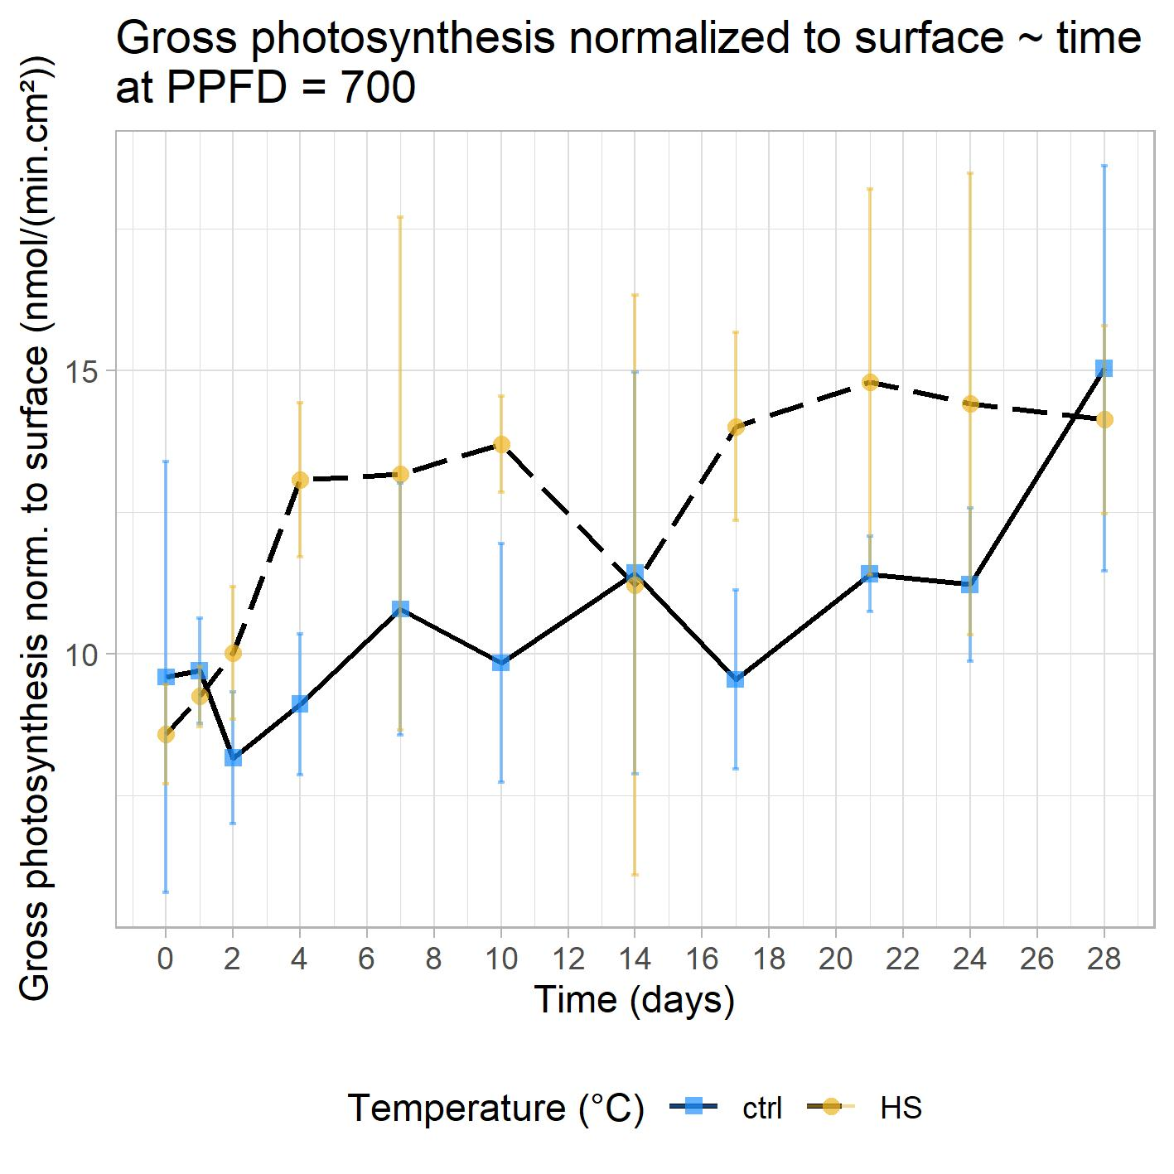
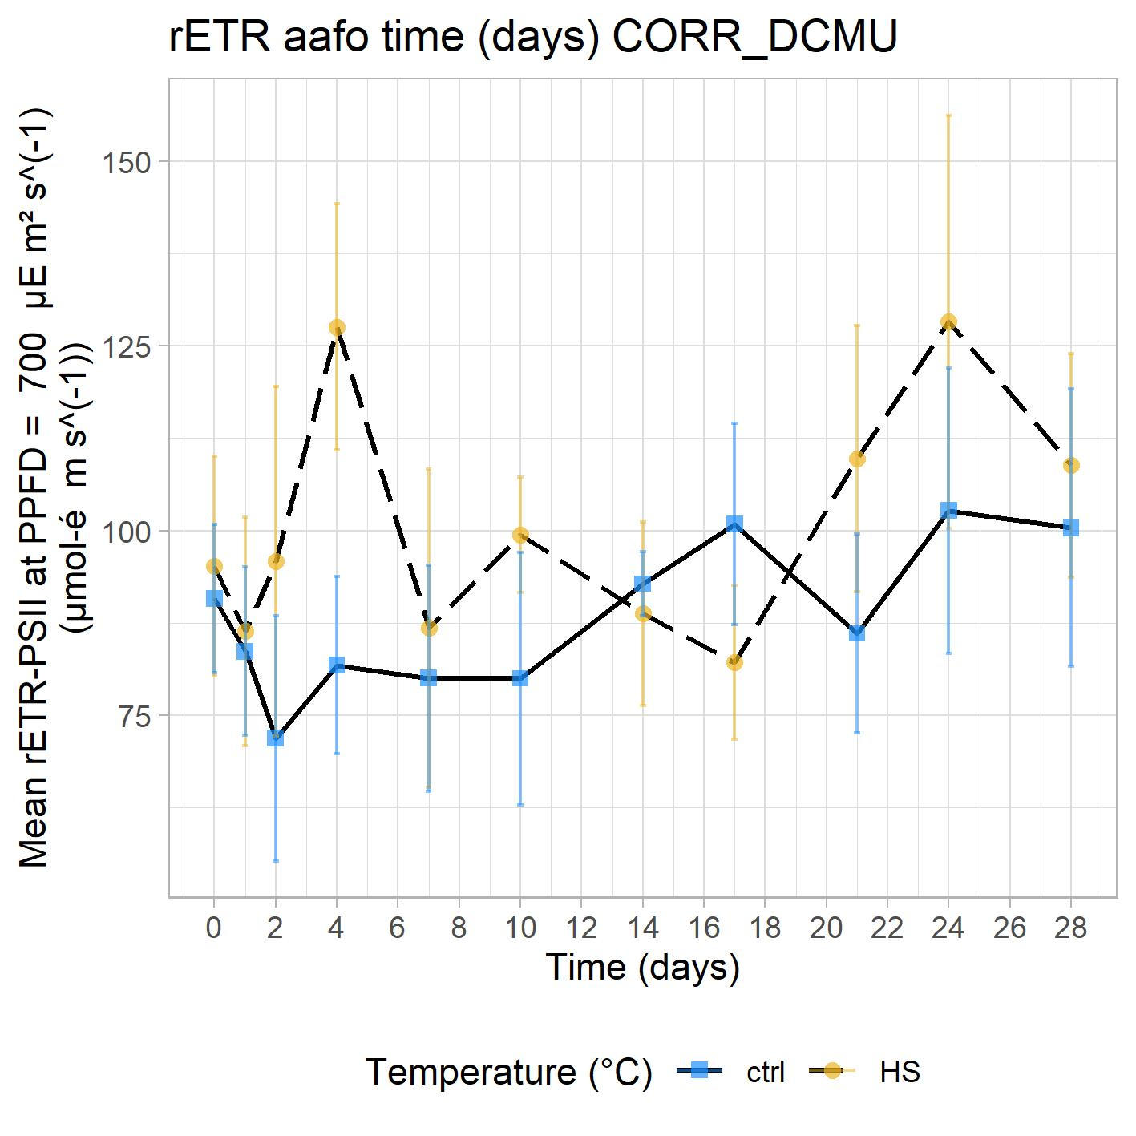
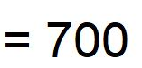
2. Heat stress in Cassiopea - PSII activity
n=3-4
signif ↗
no signif ≠
n=4
no signif ≠

Slide 32
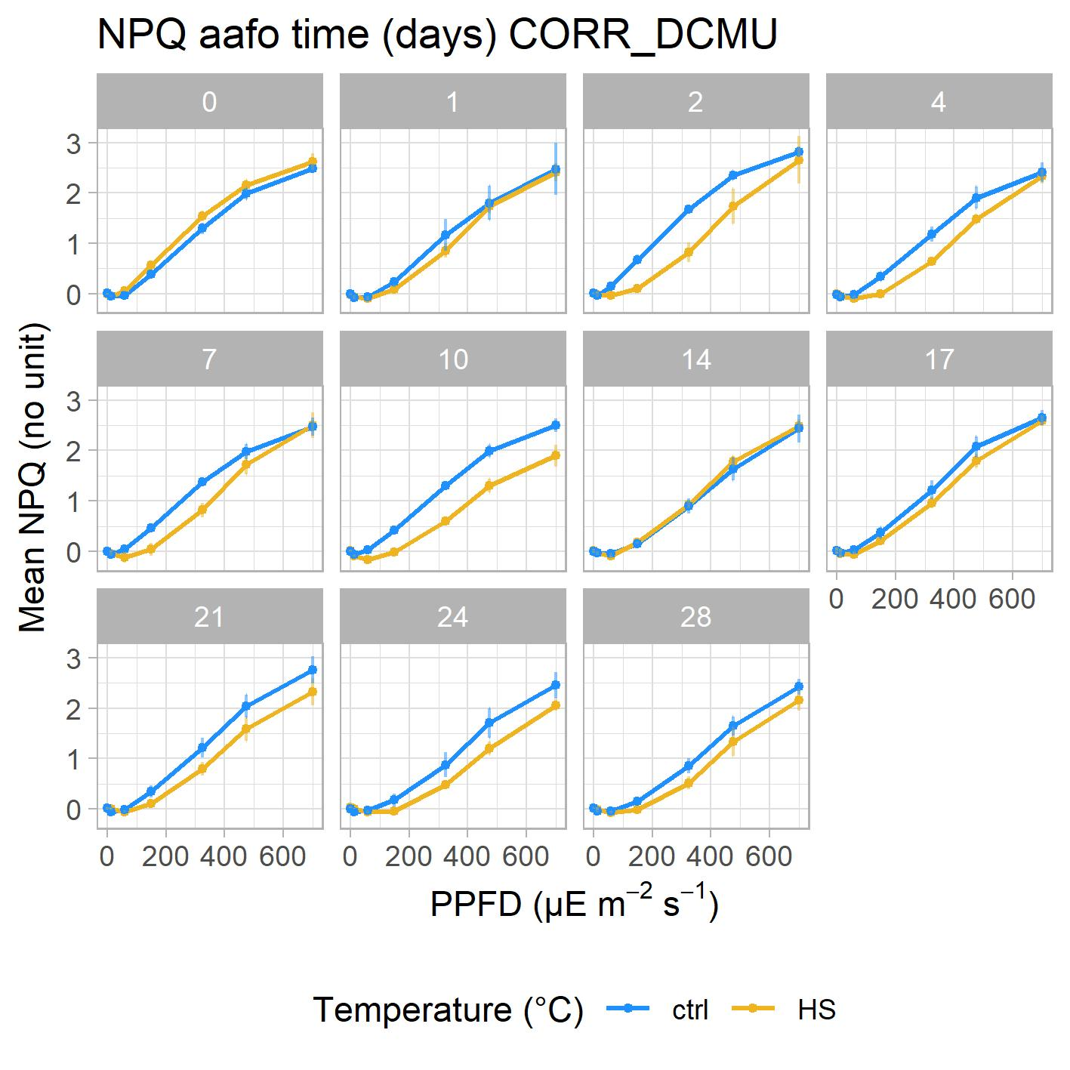
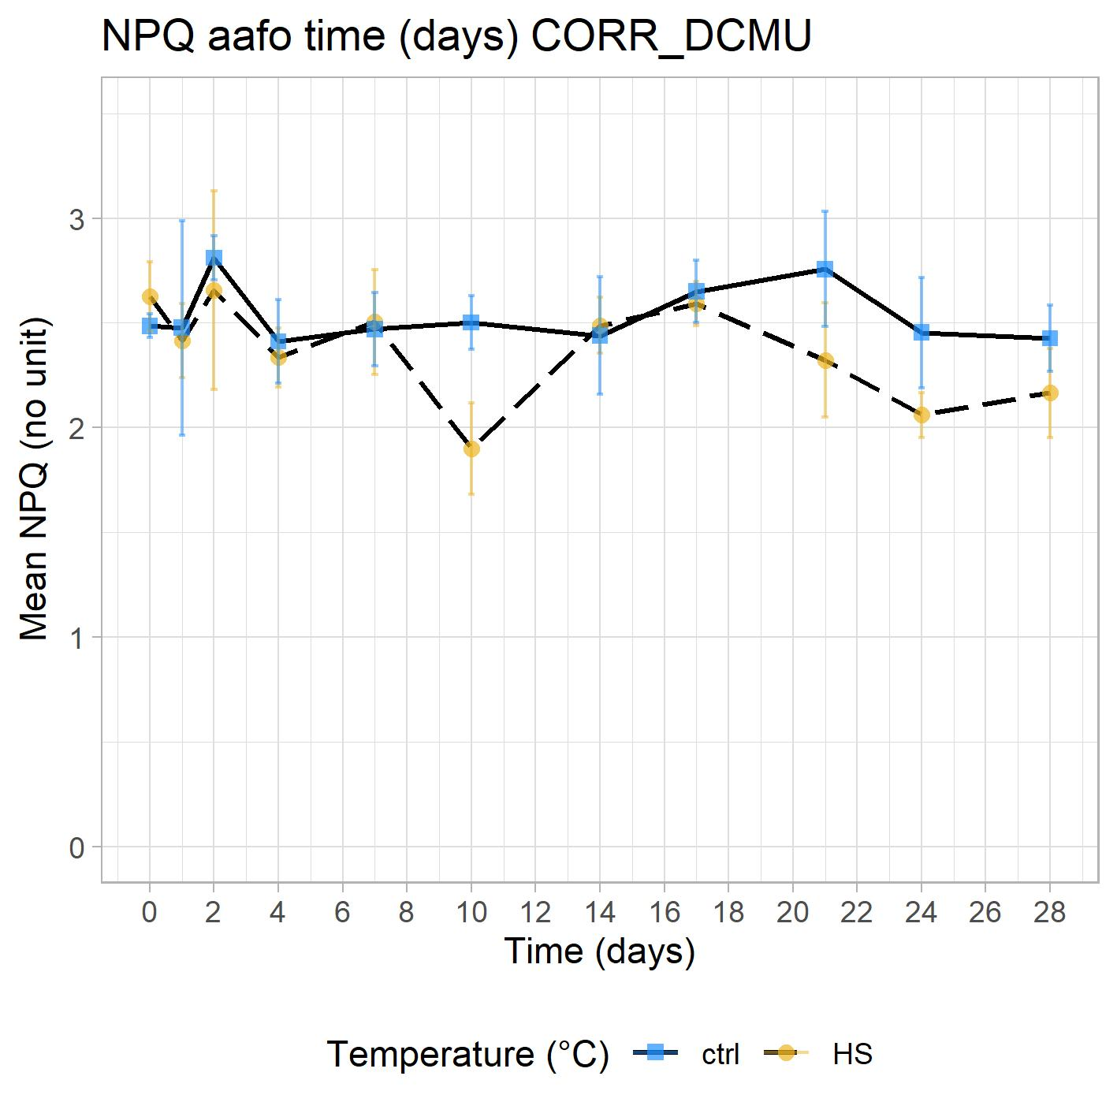
2. Heat stress in Cassiopea - Non-Photochemical Quenching
n=3-4
no signif ≠
n=3-4

Slide 33
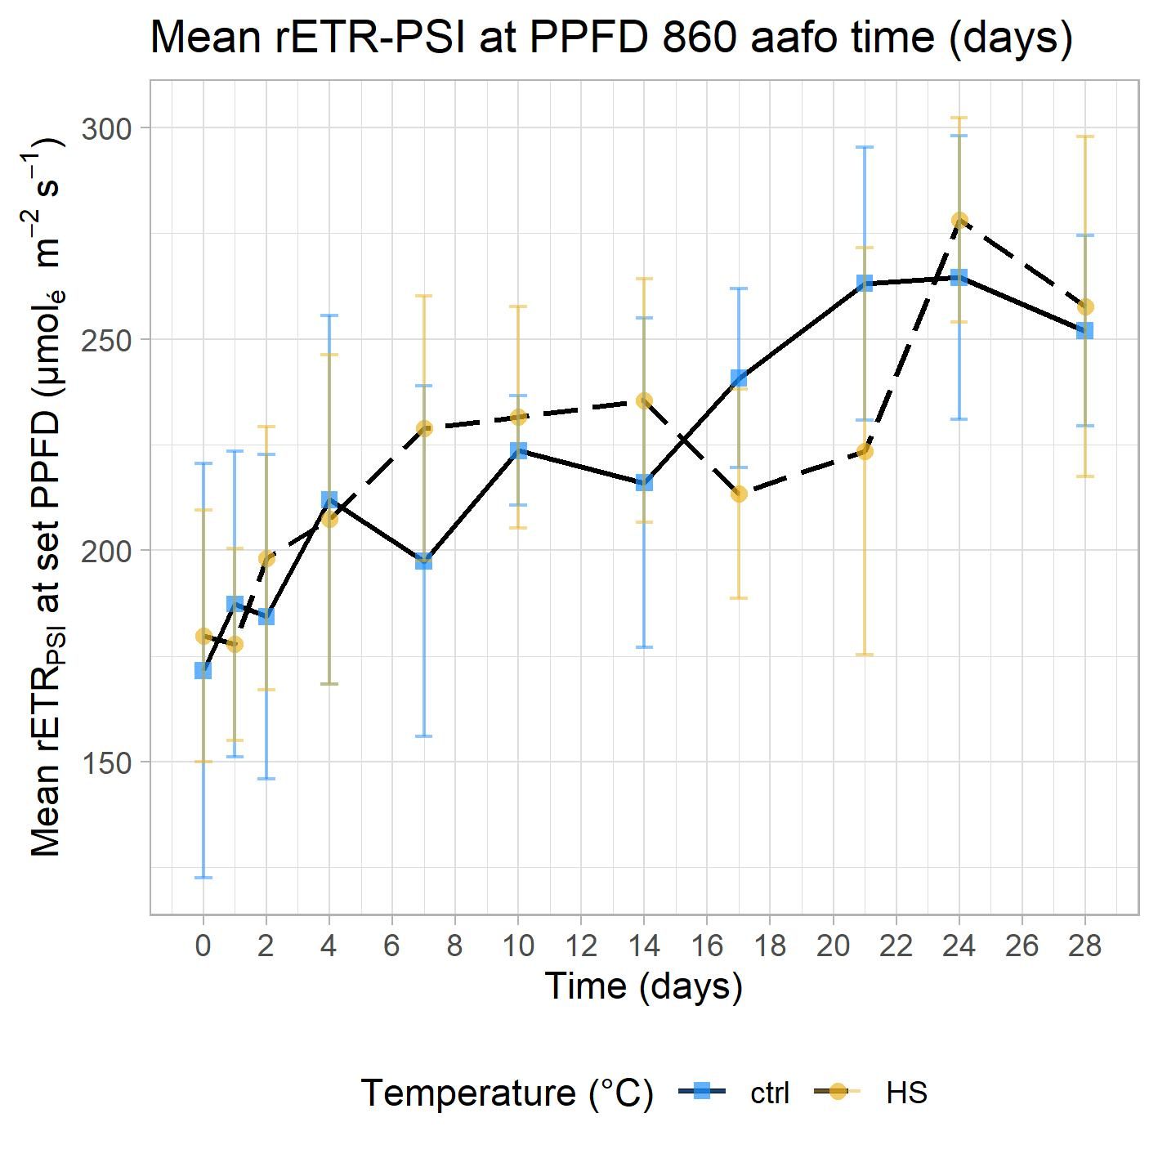
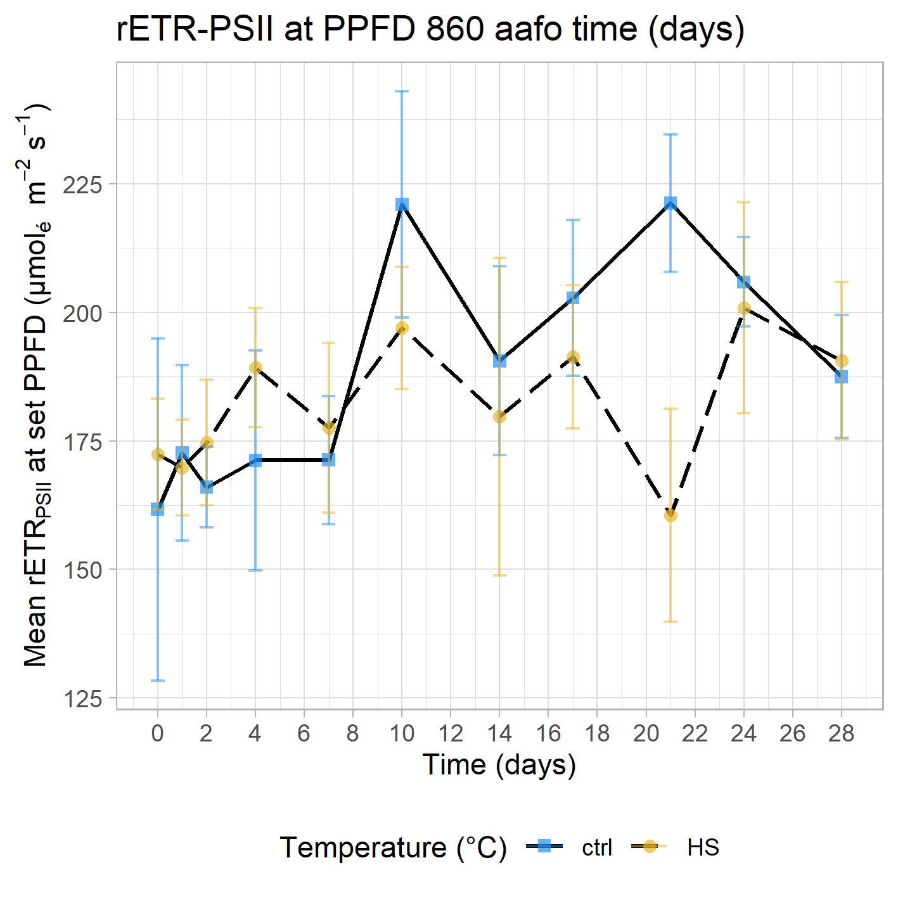
2. Heat stress in Cassiopea - rETR-PSII and PSI
n=3-4
signif ↗
no signif ≠
n=4
no signif ≠

Slide 34
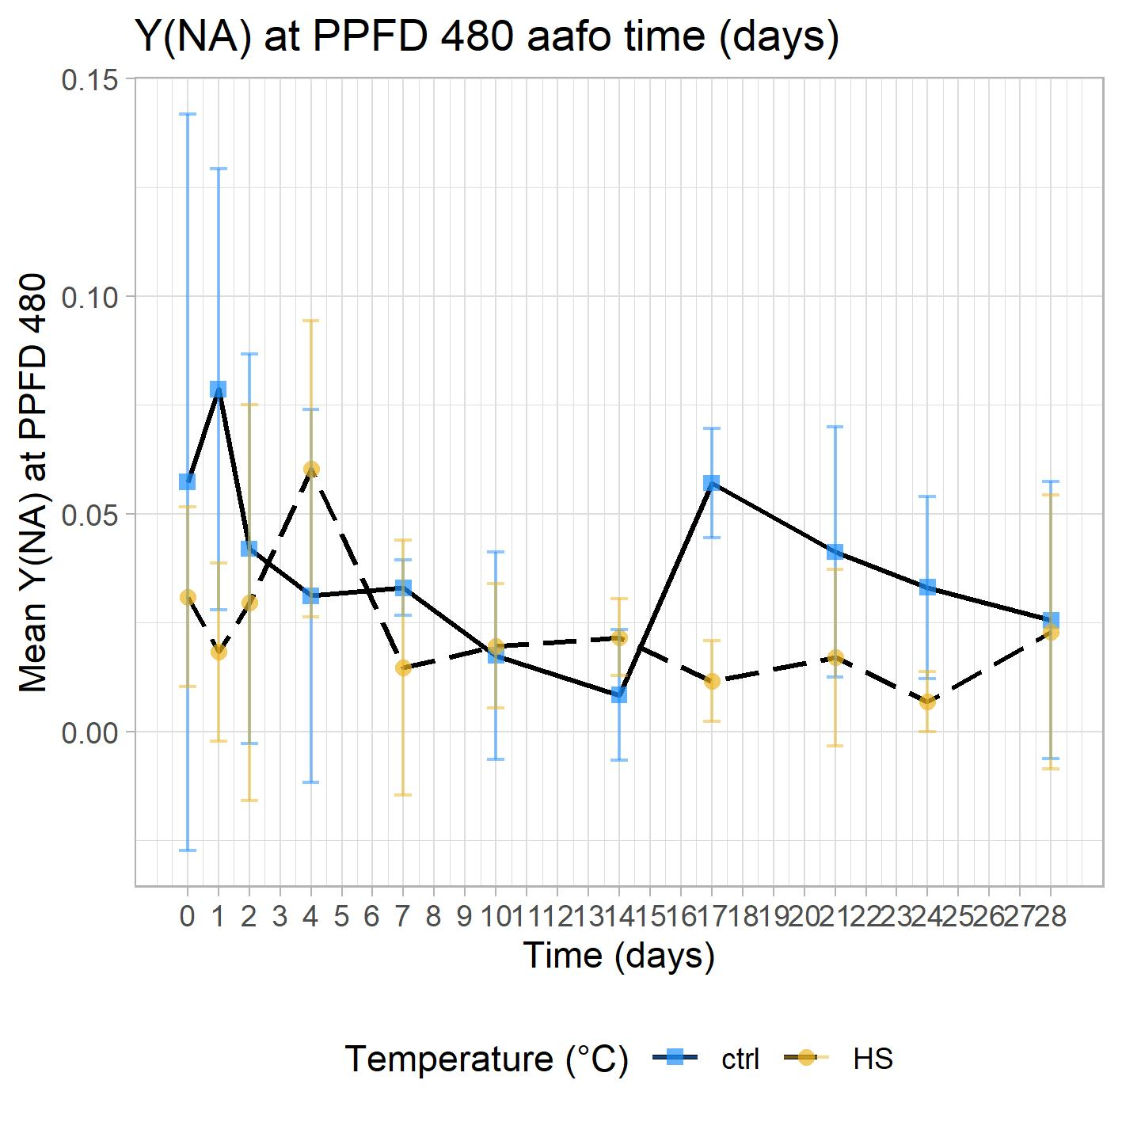
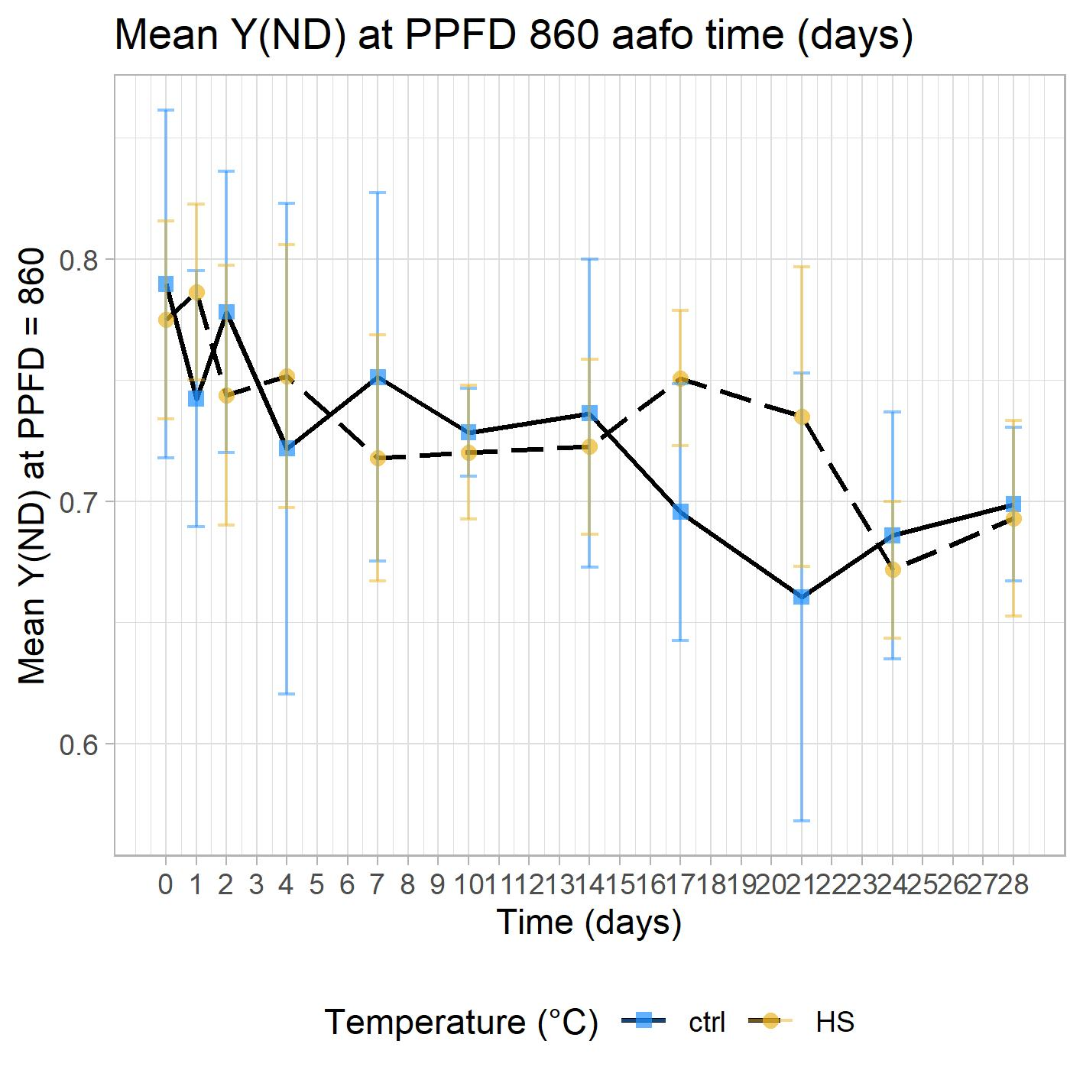
2. Heat stress in Cassiopea - Y(NA) and Y(ND)

Slide 35
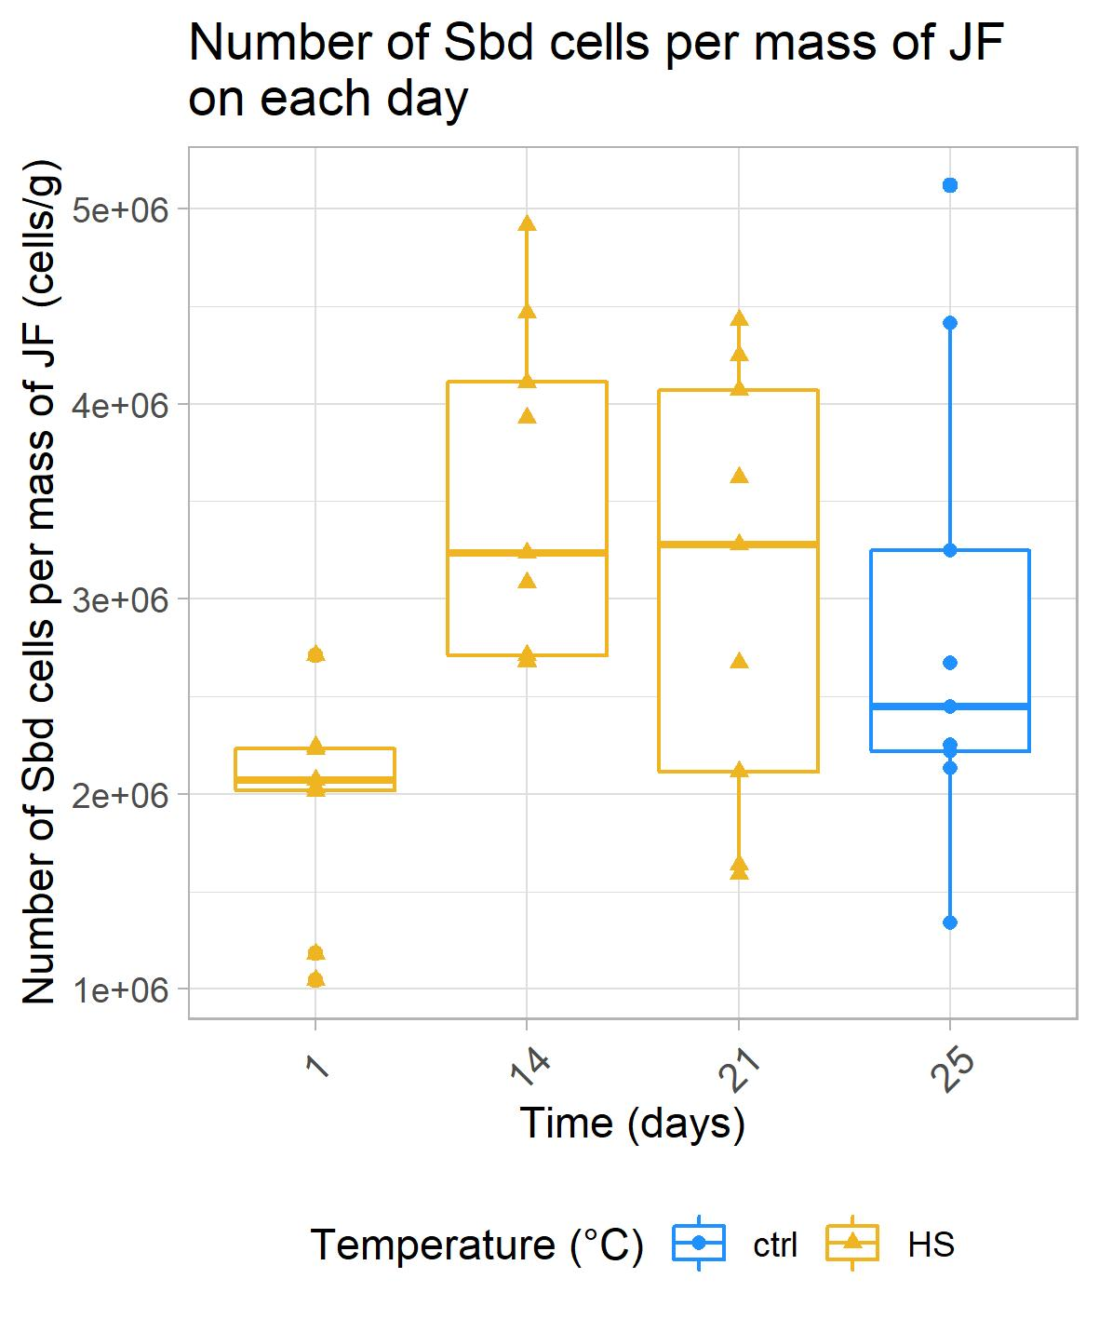
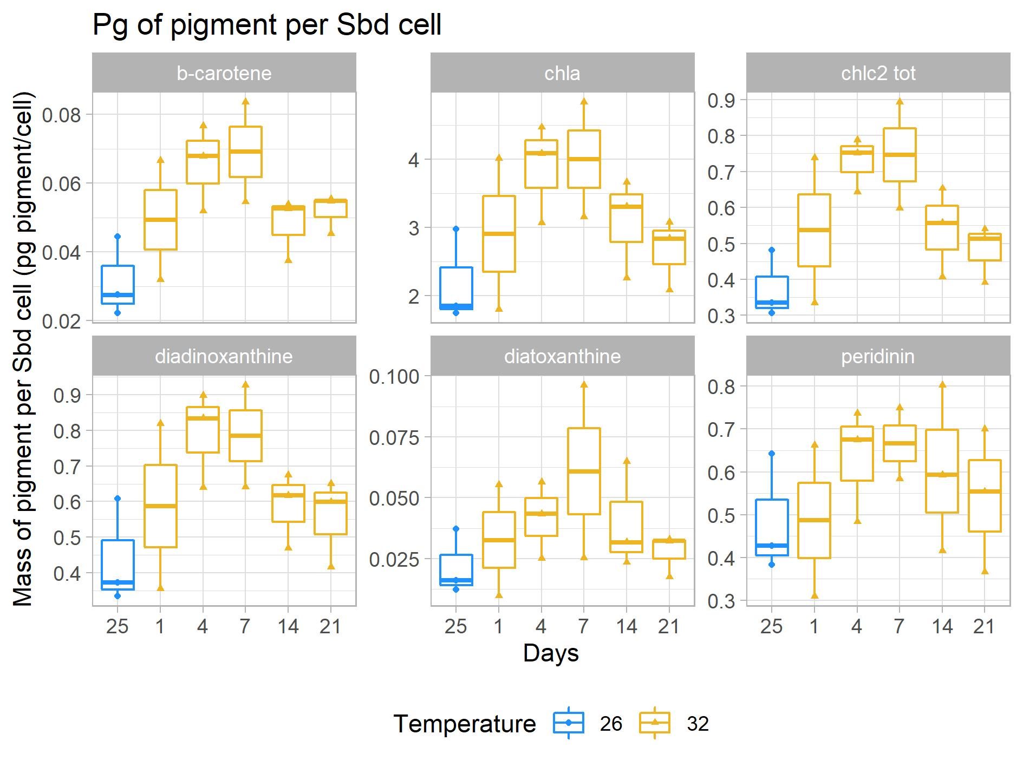
2. Heat stress in Cassiopea - Sbd density and pigments
(HPLC)
**
n=9,
**pval= 0.003
n=3

Slide 36
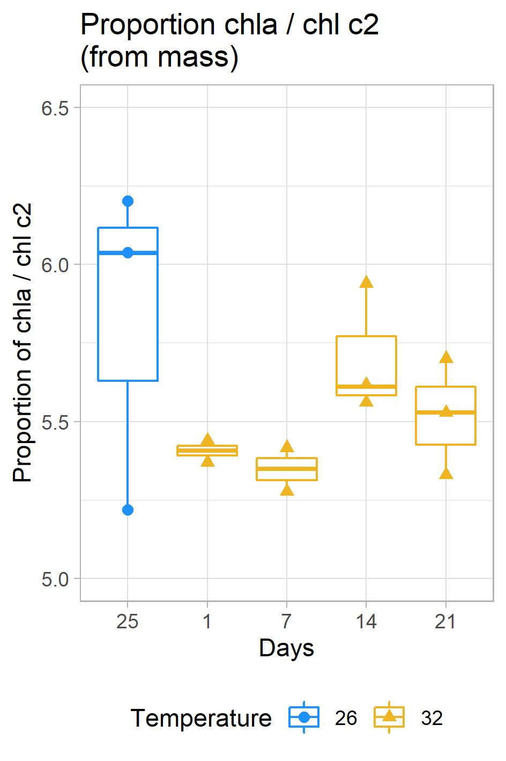
2. Heat stress in Cassiopea - context
4
3
n=2-3
n=3
adapted from 5.

Slide 37
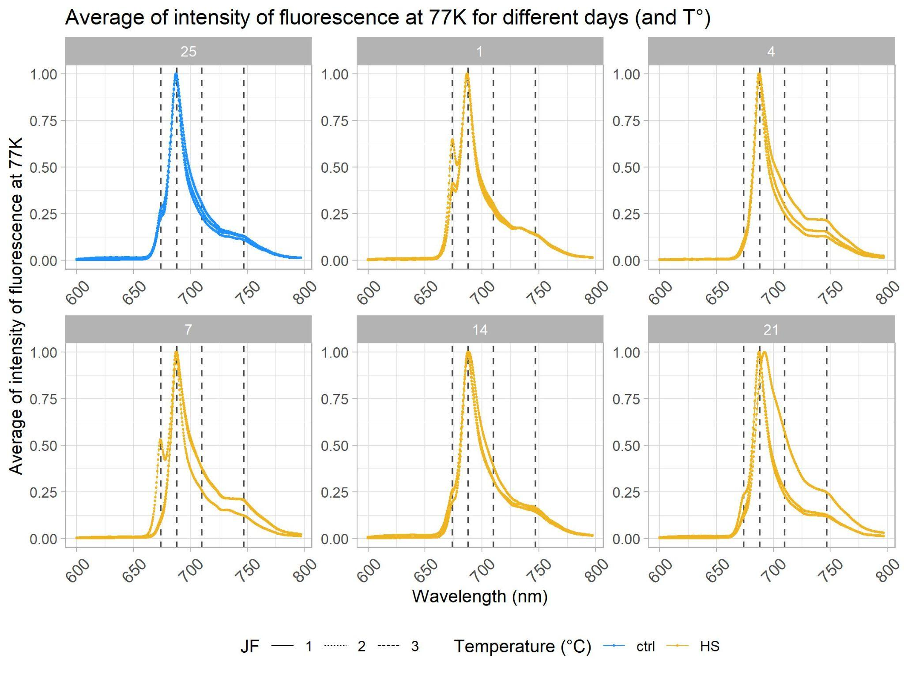
2. Heat stress in Cassiopea - 77K fluorescence emission
adapted from 5.
n=3
(see Kanazawa 2014)

Slide 38
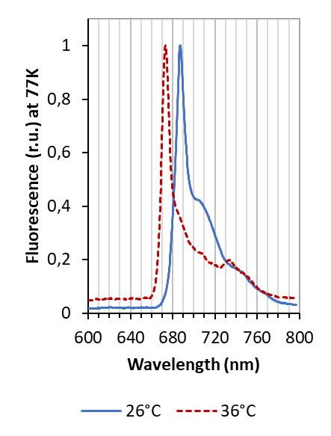
2. Heat stress in Cassiopea - 77K fluorescence emission
(see Kanazawa 2014)
n=3
A re-organization of the light-harvesting complexes of the dinoflagellate is also suggested by the variation of the relative importance of peaks corresponding to the main antennae on fluorescence spectra measured at 77K

