Slide 1



When the mind goes nowhere:
Predicting Mind Blanking with Neuroimaging
Agustina Aragón Daud
PhD student - FNRS Aspirant
a.aragondaud@uliege.be
Physiology of Cognition Lab
GIGA CRC In vivo Imaging, University of Liège
Supervisor: Dr. Athena Demertzi, PhD
Applied Machine Learning Lab
Institute of Neuroscience and Medicine: Brain & Behaviour (INM-7), Forschungzentrum Jülich
Supervisor: Dr. Federico Raimondo, PhD
25th March 2025

Slide 2
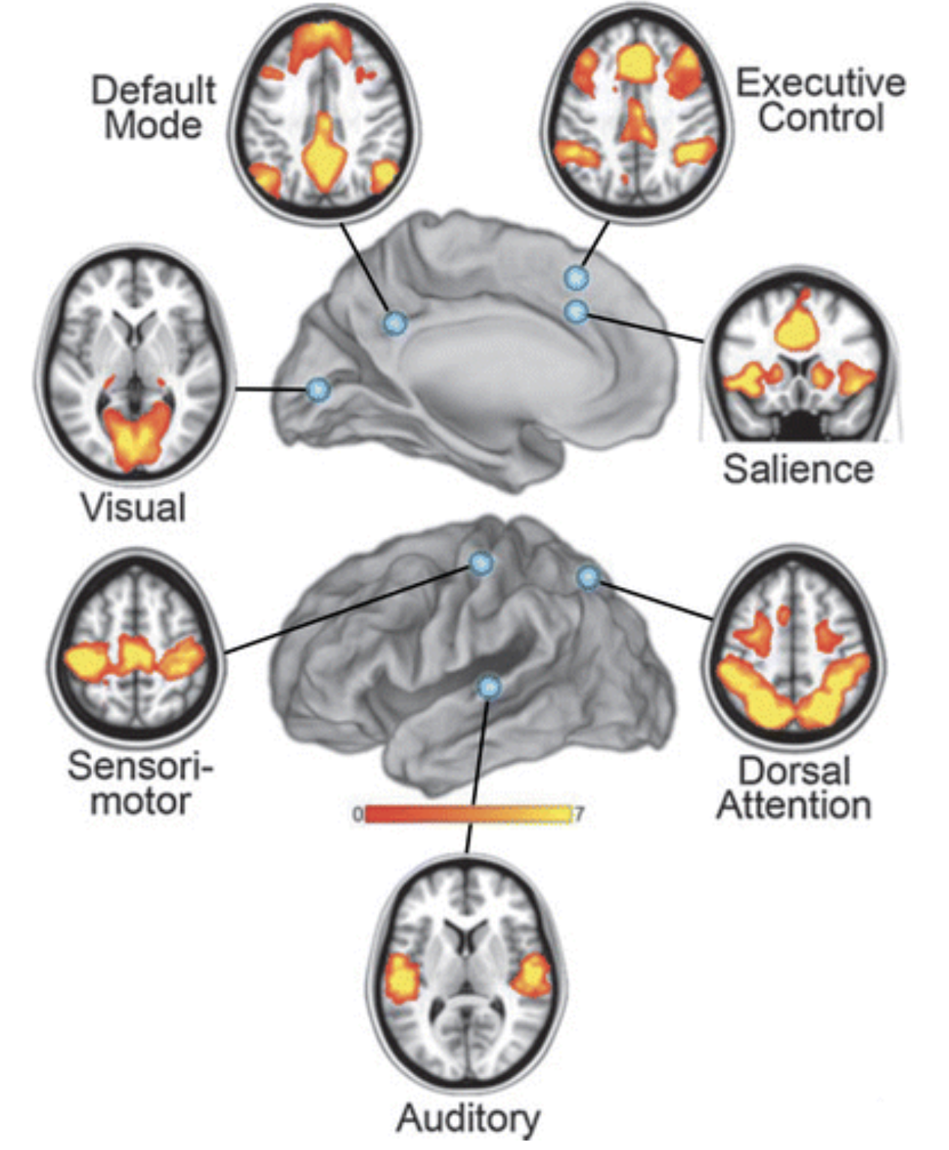
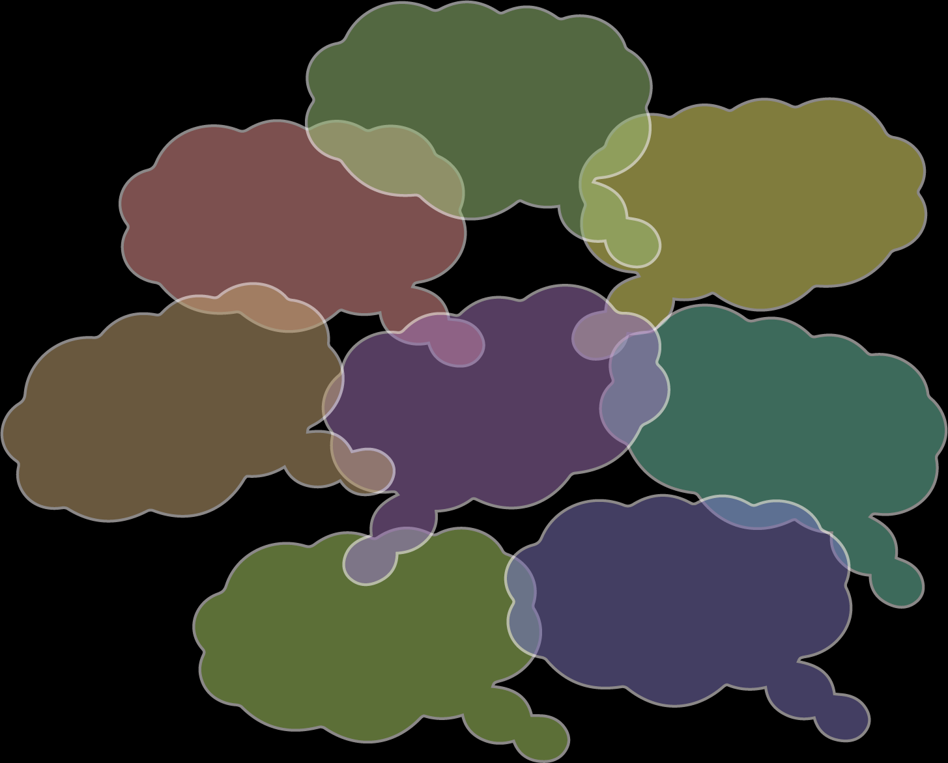
Background
Resting State is Dynamic
Mind
Brain
Barkhof, Haller, & Rombouts. Radiology. 2024
2

Slide 3
Background
Mind Blanking
“mental state where people have nothing to report or are unable to report anything about their immediate experience”
Boulakis & Demertzi, 2025
3

Slide 4
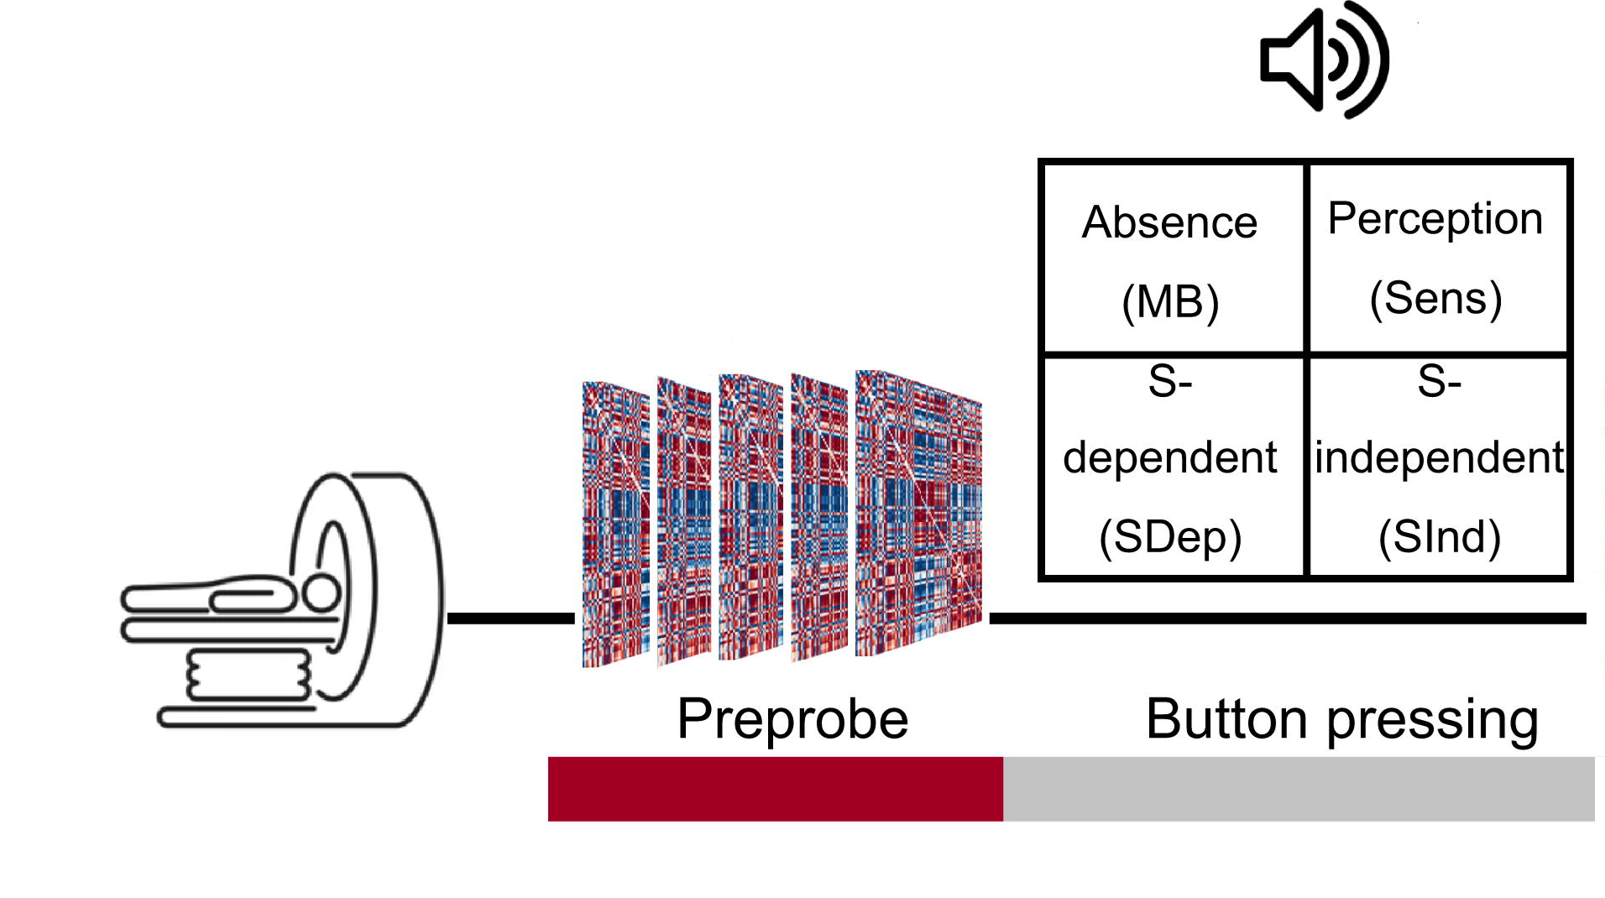
Background
How do we study spontaneous Mind Blanking?
Experience Sampling
Adapted from Mortaheb et al., PNAS 2022
4

Slide 5
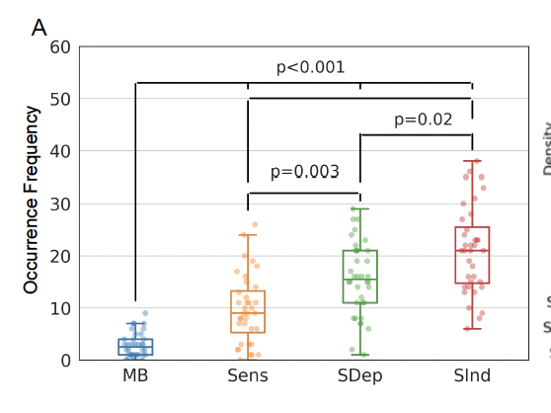
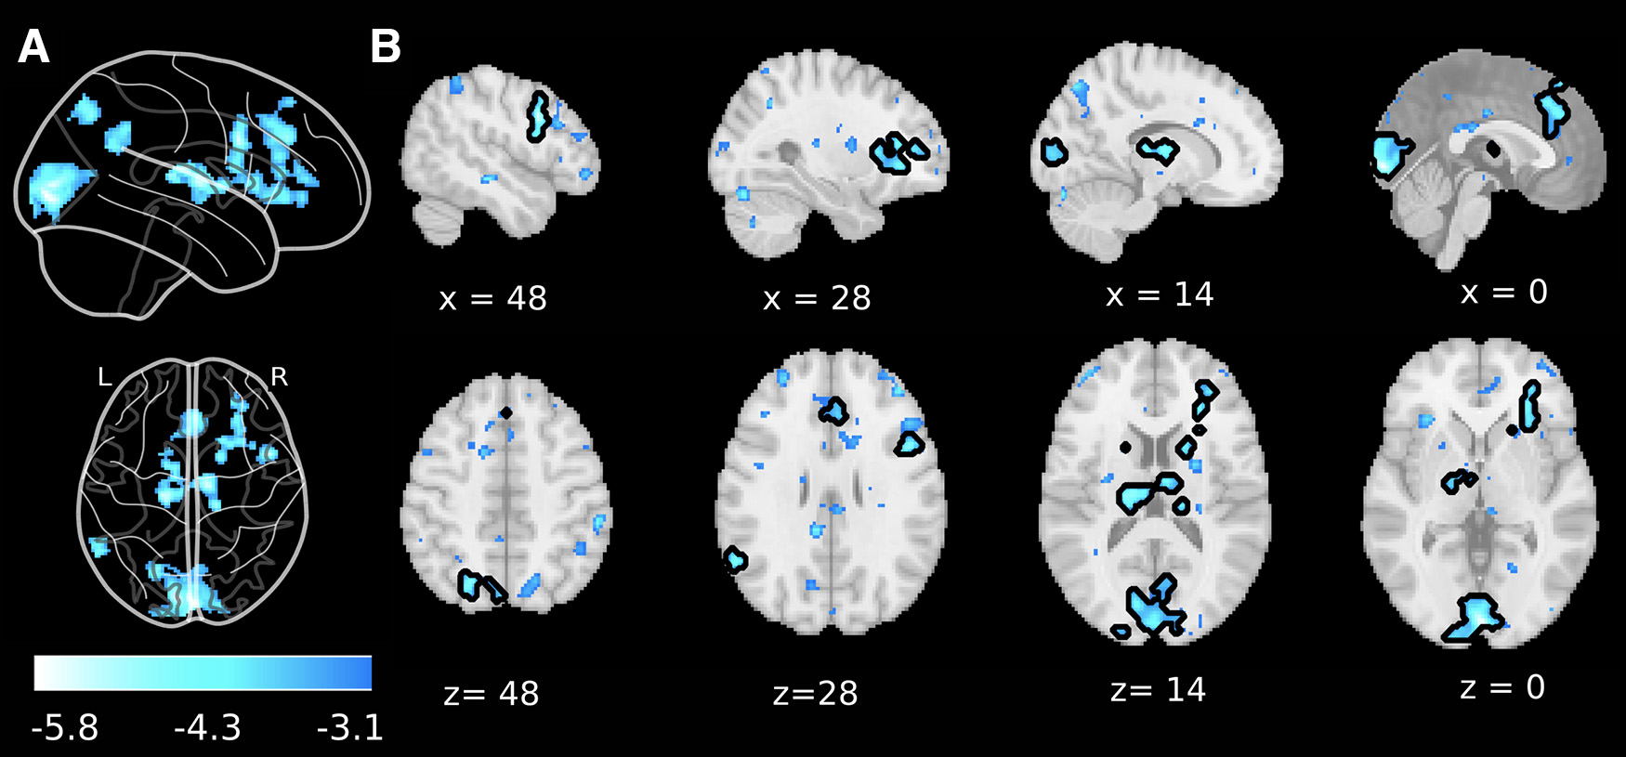
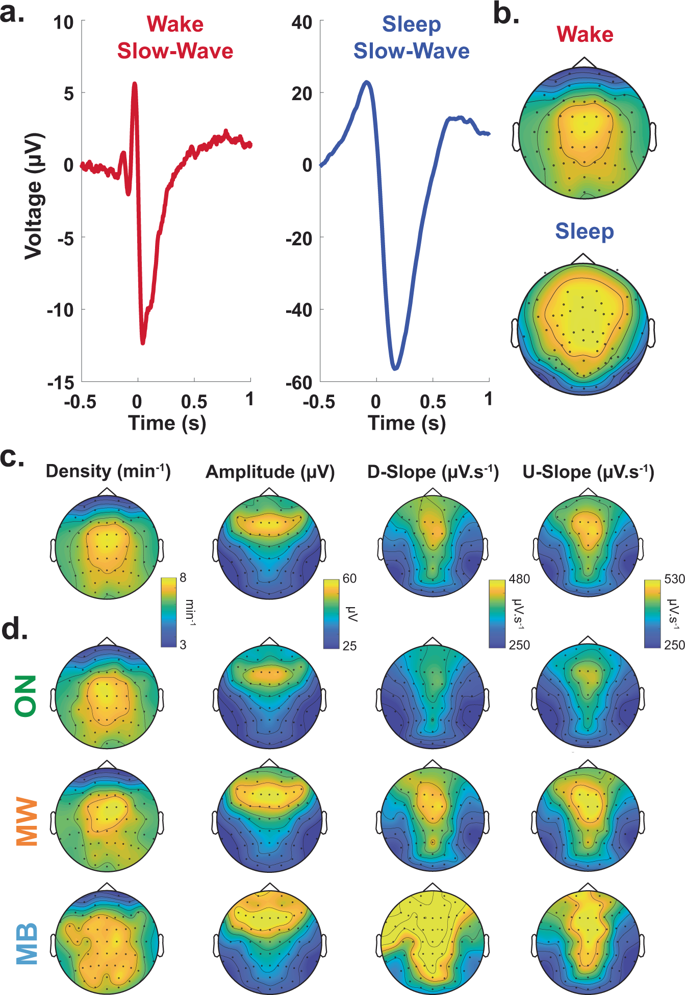
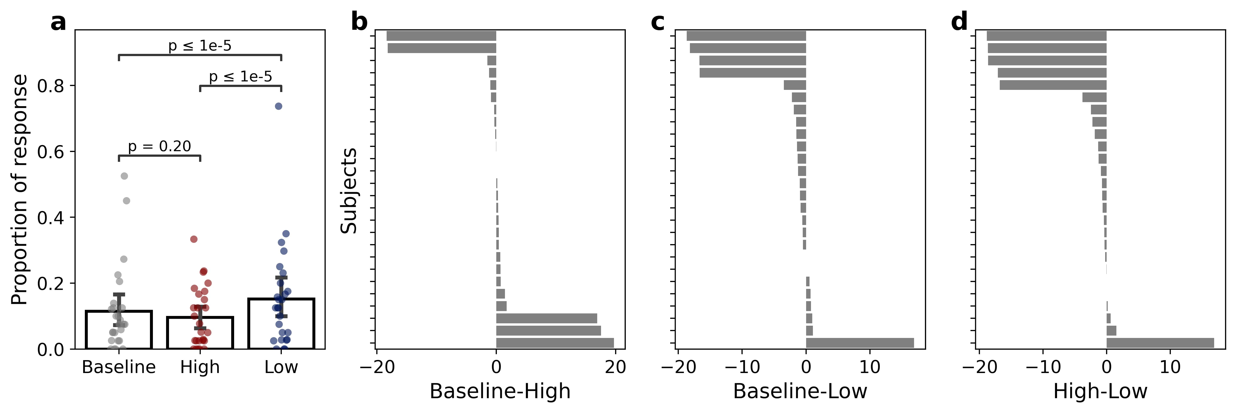
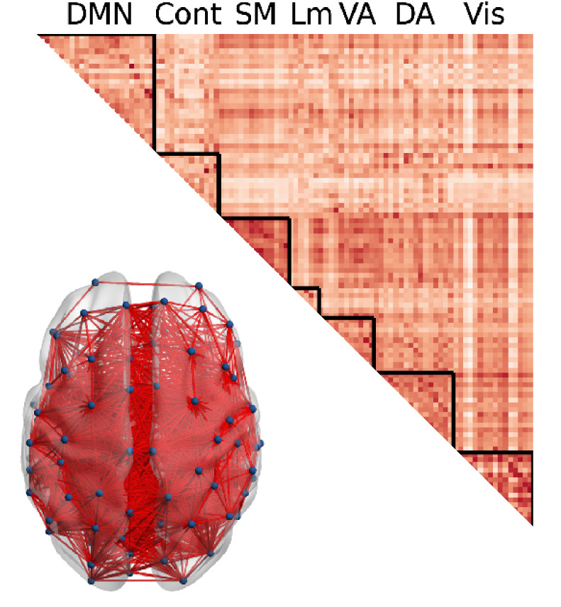
Background
Spontaneous Mind Blanking
Behavior
Occurs infrequently
Neural correlates
Deactivations across DMN
Physiology
Reduced arousal
3
1
2
Hyperconnected state
4
1
Mortaheb et al., 2022
Boulakis et al., 2023
Andrillon et al, 2021
Boulakis et al., 2024
4

Slide 6
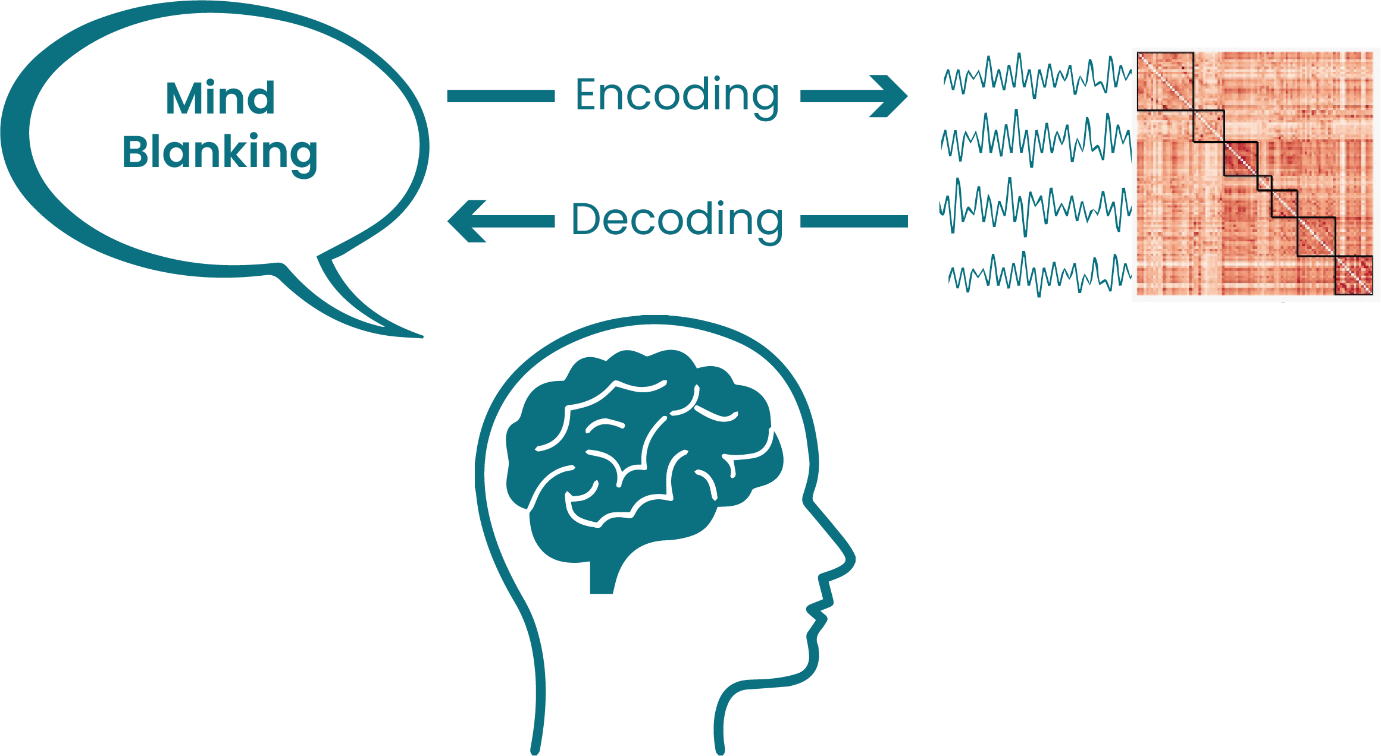
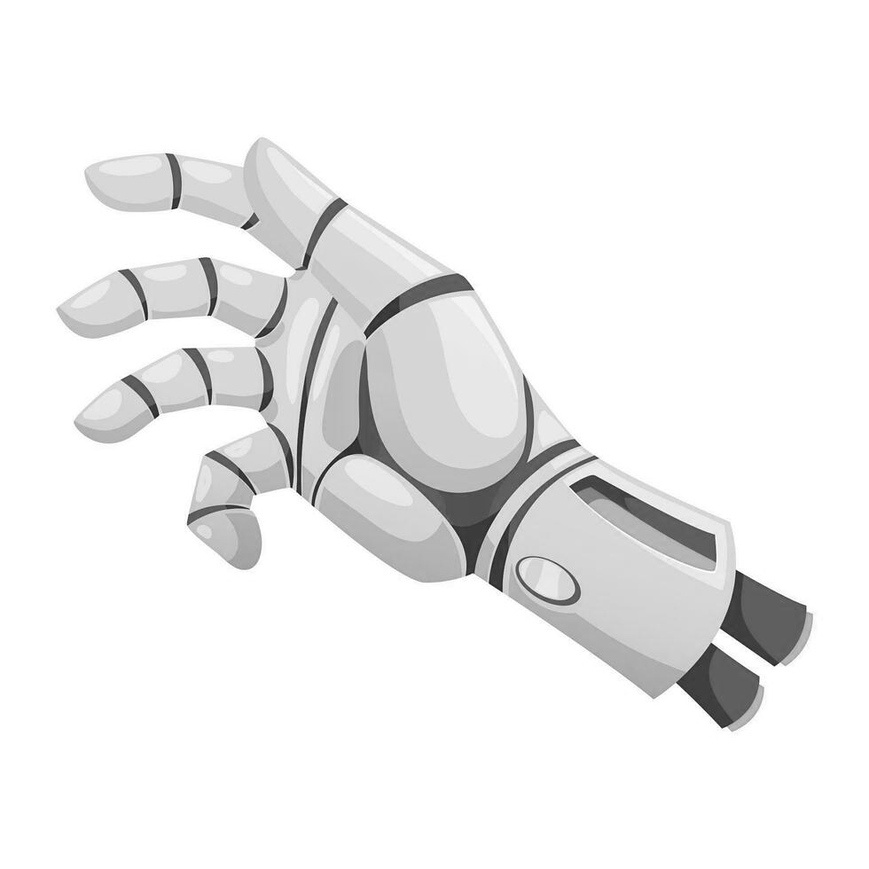

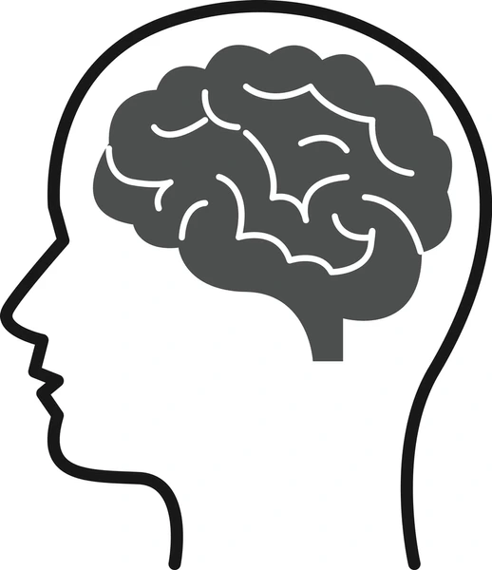
My PhD Project
Decoding Mind Blanking
Decoding
9

Slide 7
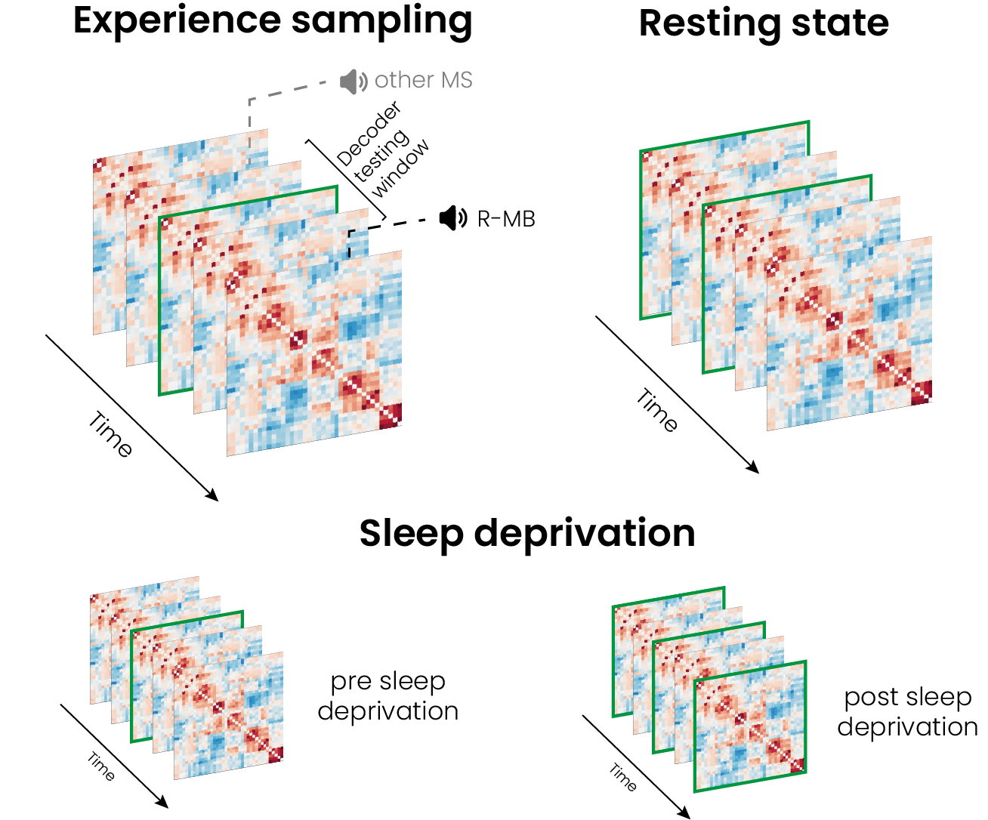
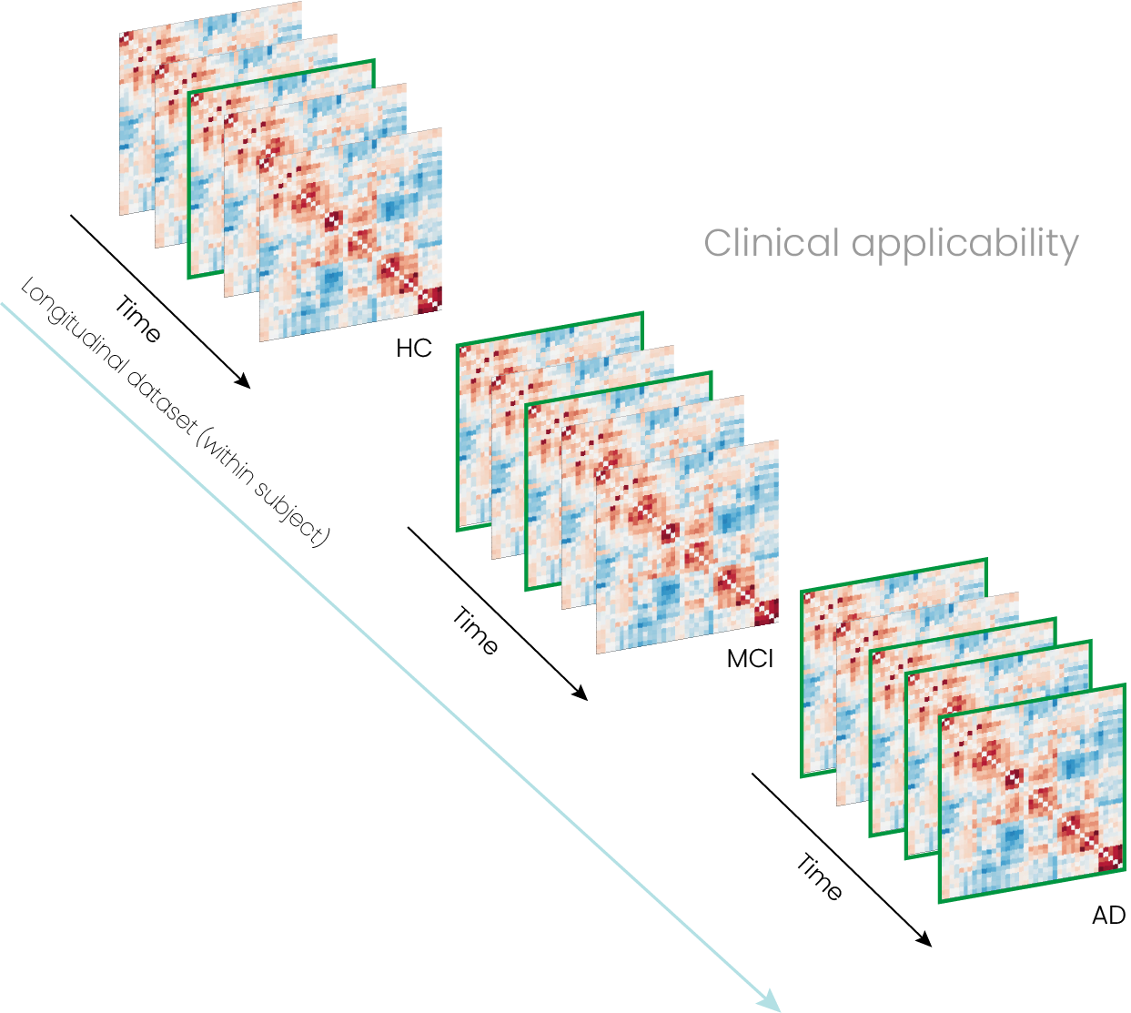
My PhD Project
Decoding Mind Blanking
WP 1
Decoder
Development
WP2
Decoder
Validation
WP3
Clinical Applicability
10

Slide 8
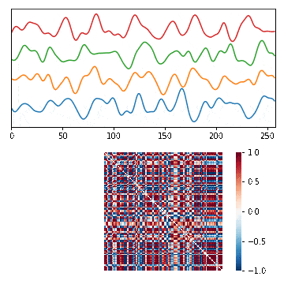
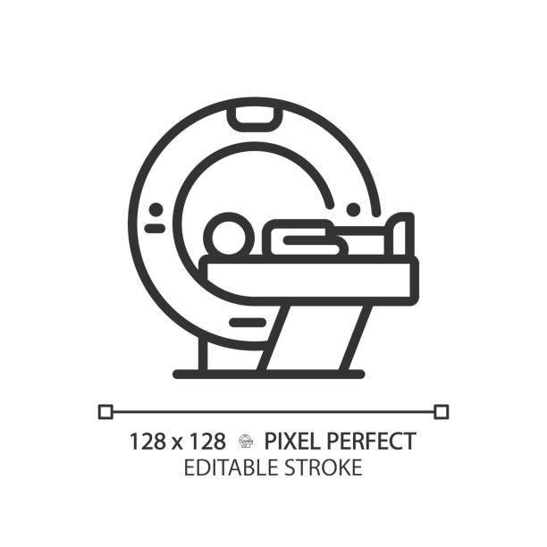
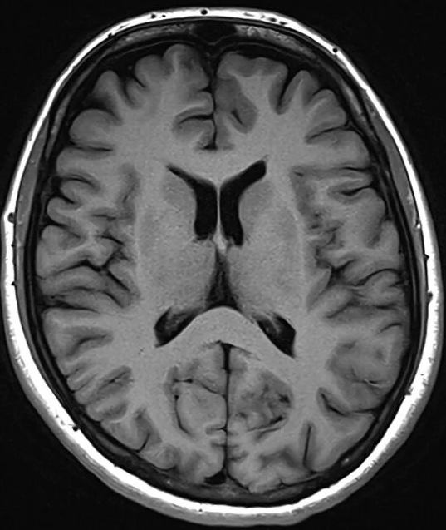
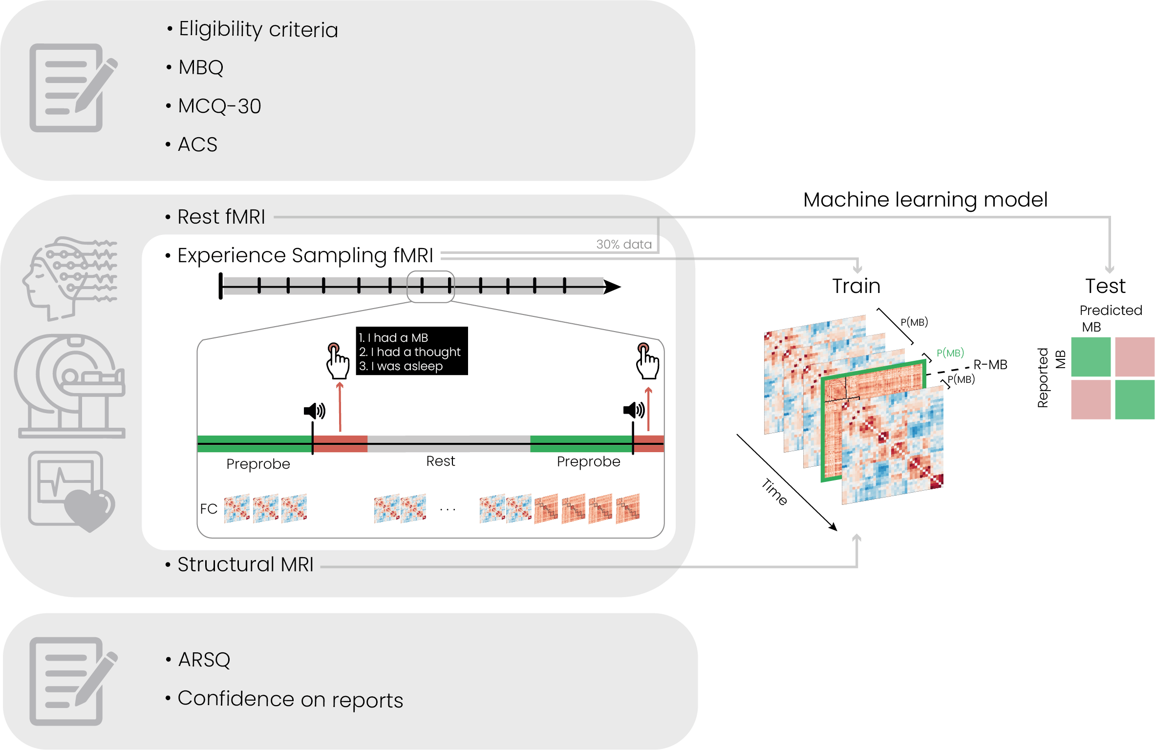
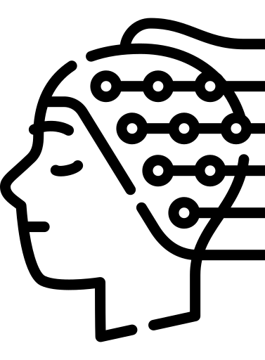
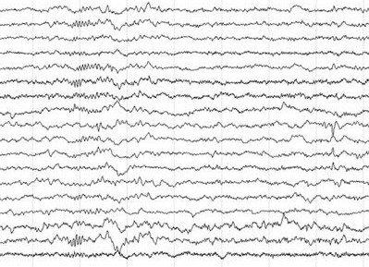
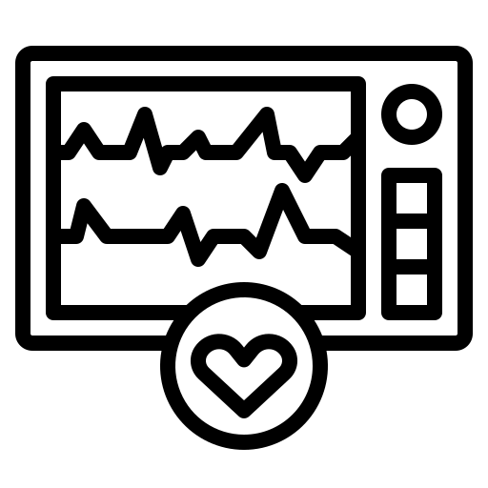
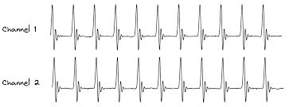
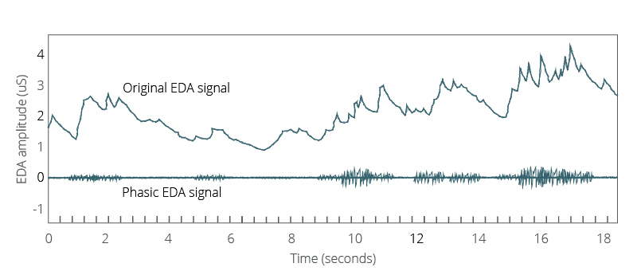
My PhD Project
Decoding Mind Blanking:
Develop a Model
MB Decoder
(Machine Learning)
WP 1
Decoder
Development
Courtesy of Dr. Boulakis
Validate MB episodes
Data to be acquired at CRC
11

Slide 9
My PhD Project
Decoding Mind Blanking: Validate Model
WP 1
Decoder
Development
WP2
Decoder
Validation
WP3
Clinical Applicability
12

Slide 10
My PhD Project
Decoding Mind Blanking: Validate Model
WP2
Decoder
Validation
Experience Sampling
Sleep Deprivation
12

Slide 11
My PhD Project
Decoding Mind Blanking: Validate Model
WP 1
Decoder
Development
WP2
Decoder
Validation
WP3
Clinical Applicability
12

Slide 12
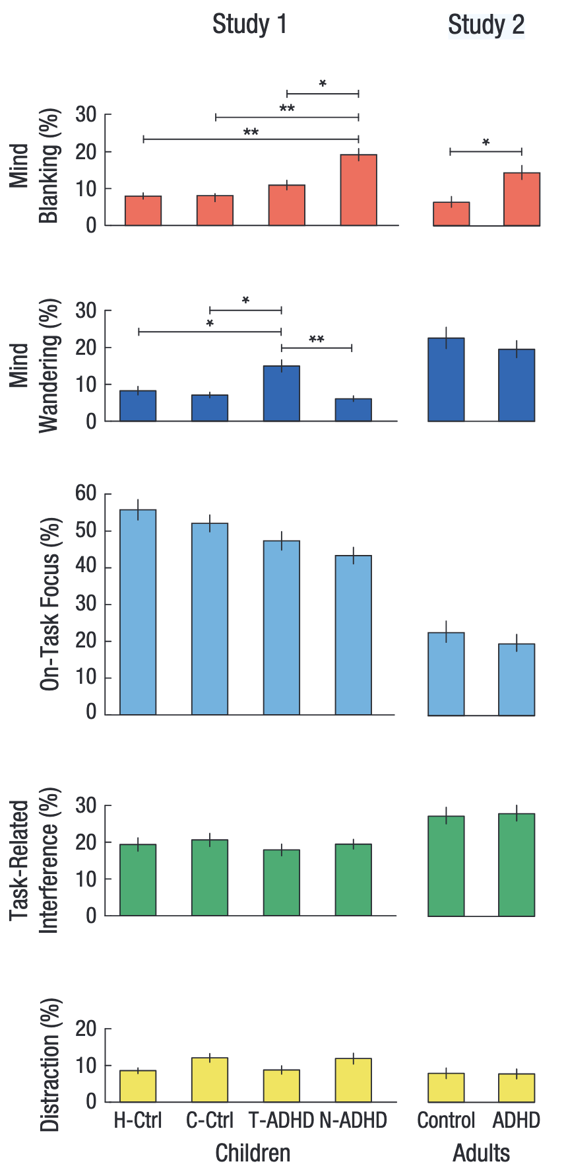
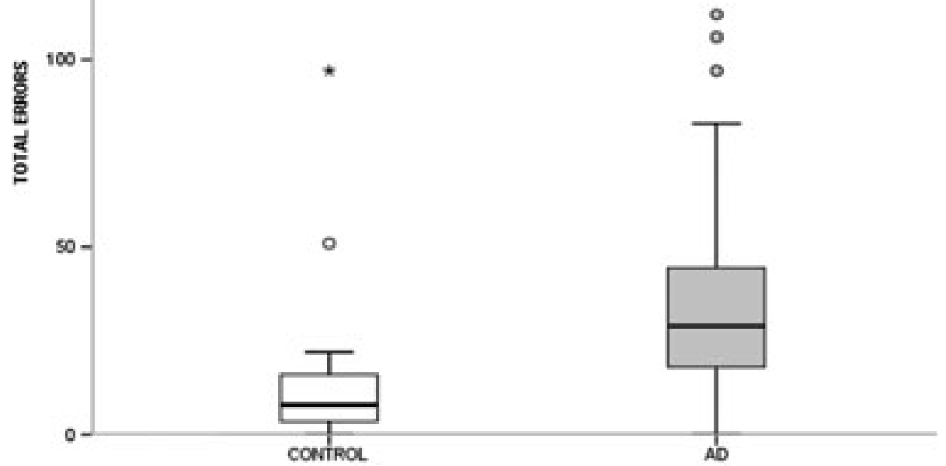


My PhD Project
Decoding Mind Blanking:
Assess Clinical Utility
WP3
Clinical Applicability
ADHD
Dementia?
Van den Driessche et al., APS 2017
Huntley et al, Int J Geriatr Psychiatry 2017
Useful when reportability is impaired or not possible
12

Slide 13
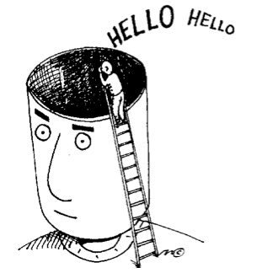
Summary
Mind Blanking:
A newly-defined mental state
Brain is silenced and hyperconnected
Related to low arousal levels
Prediction
Clinical Application

Slide 14


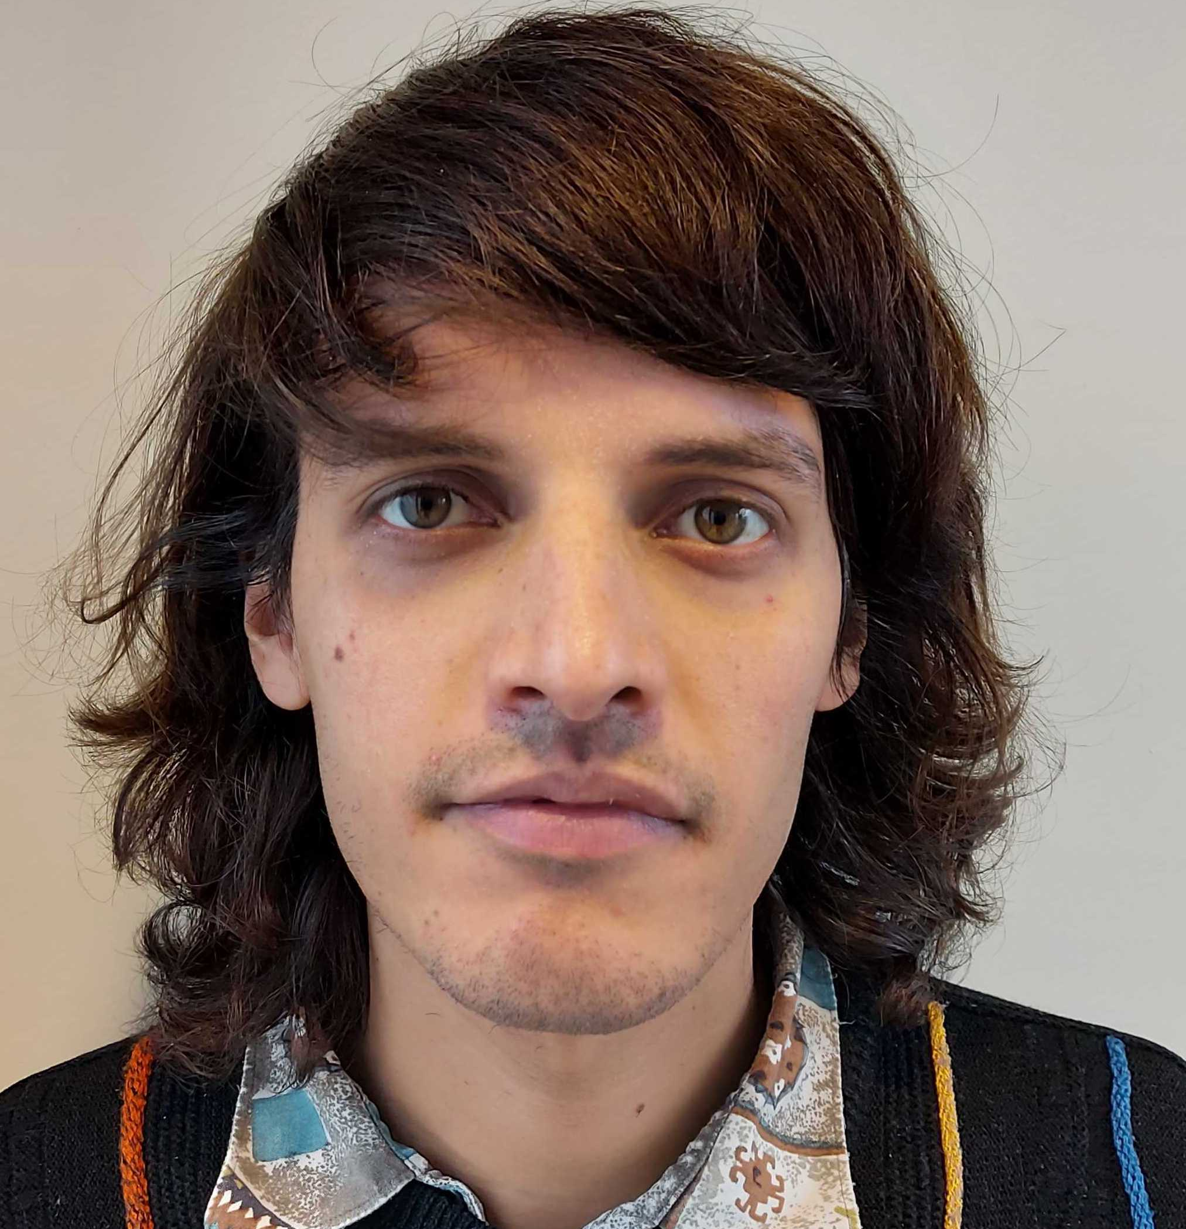
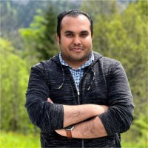
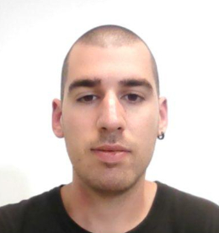
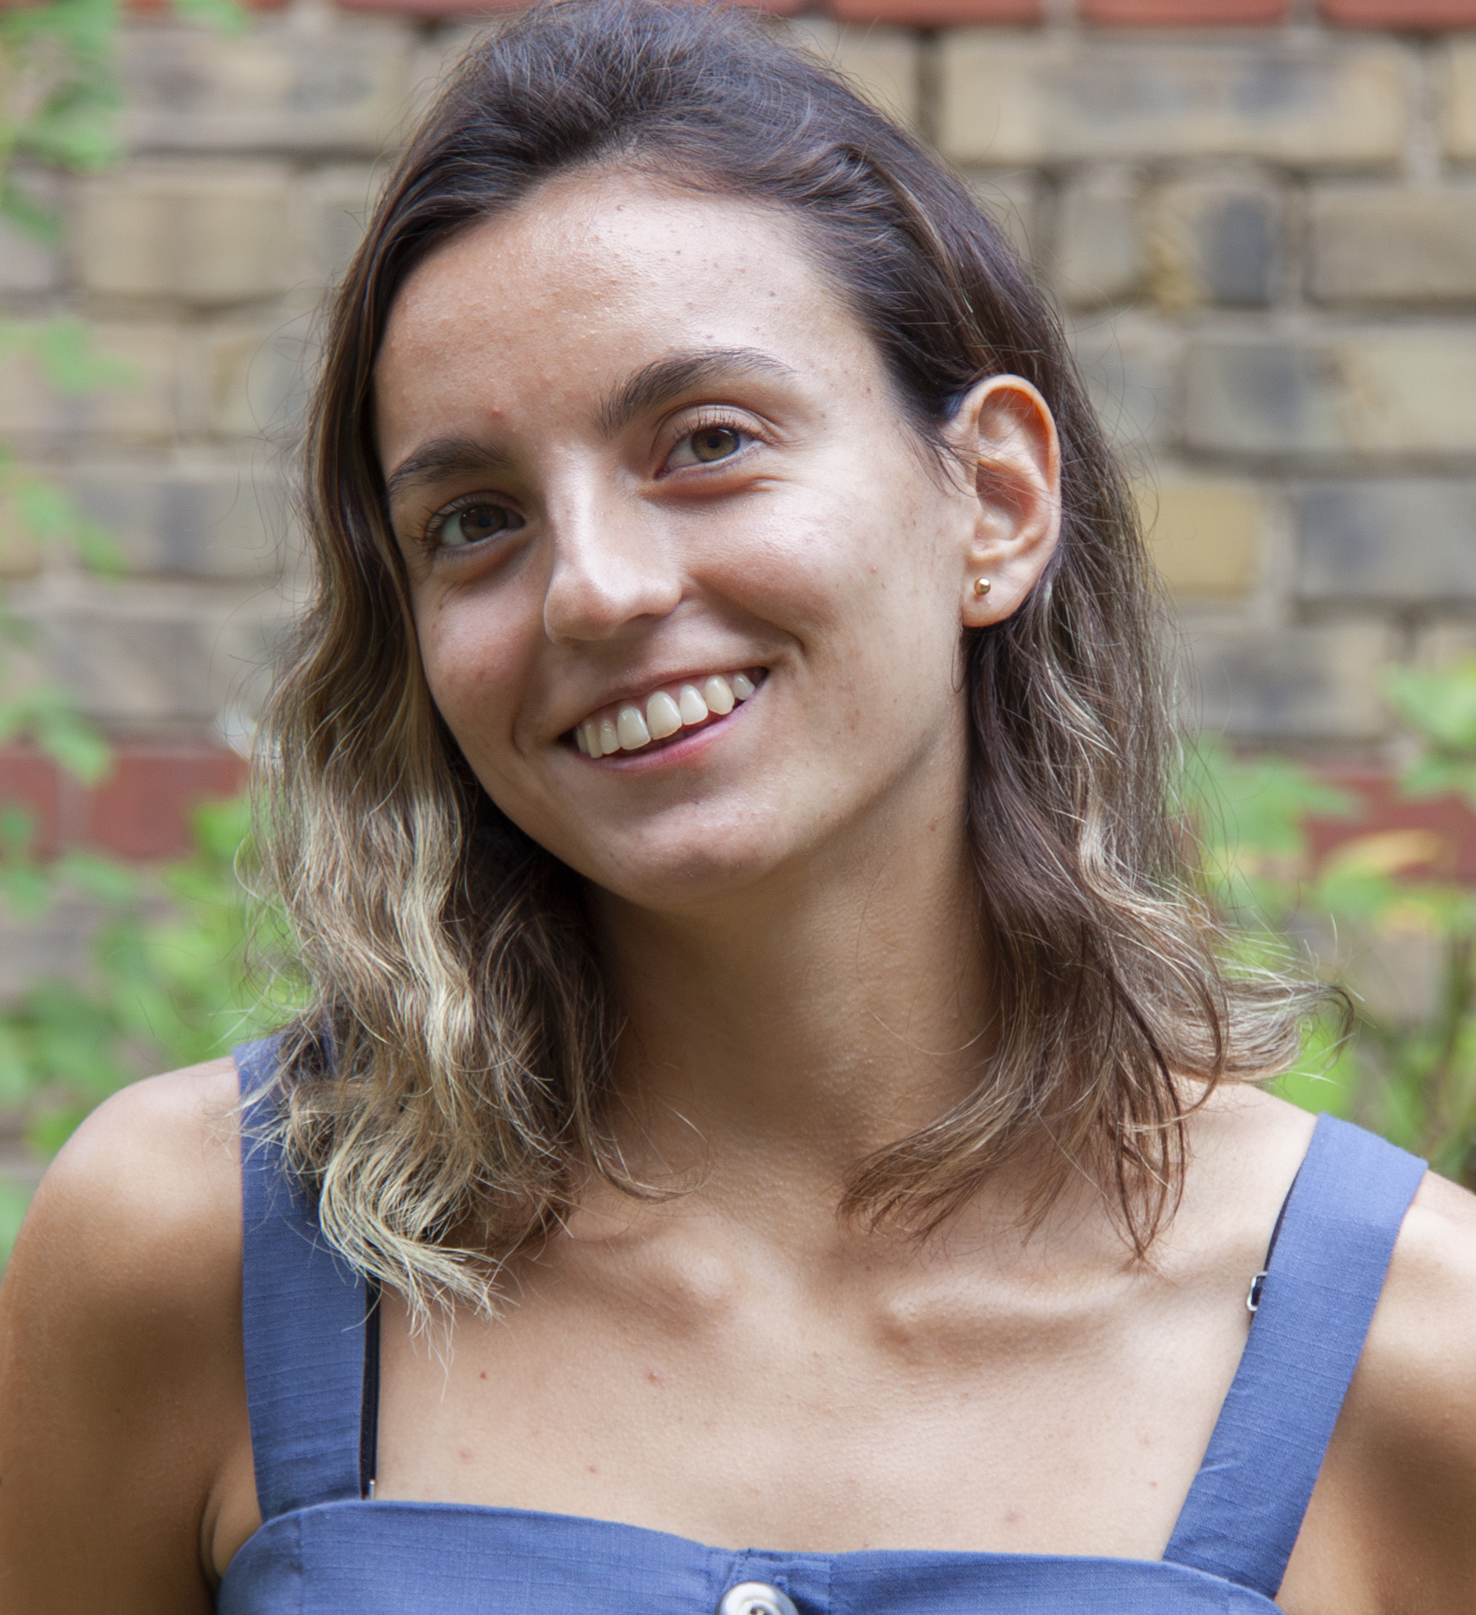
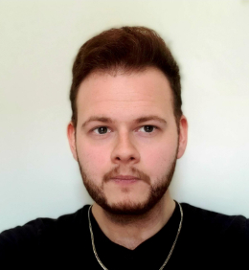




Physiology of Cognition Lab
Athena Demertzi, PI
Matthieu Koroma, PhD
Sepehr
Mortaheb, PhD
Paradeisios
Boulakis, PhD
Agustina Aragón Daud
Larry D
Fort
Nikos J
Simos
Stefania
Zoi
Venia Giamala
Varya Strizhneva
CRC HUMAN IMAGING UNIT
INTERNATIONAL COLLABORATORS
Christina SCHMIDT
Christine BASTIN
Christophe PHILLIPS
Gilles VANDEWALLE
Fabienne COLLETTE
Federico RAIMONDO (FZ Jülich)
Thomas ANDRILLON
Jenny WINDT
Antoine LUTZ
Nao TSUCHIYA
Aniko KUSZTOR
Kristian SANDBERG
Timo TORSEN SCHMIDT
Marzia DE LUCIA
Andria PELENTRITOU
Christine BLUME
Jan REMAEKERS
Natasha MASON
Pablo MALLARONI

