Slide 1

Prospective analysis of the evolution of agronomic, environmental and nutritional performances of contrasting crop rotations when facing climate change
Mathieu Delandmeter, Jérôme Bindelle, Caroline De Clerck, Benjamin Dumont
Gembloux Agro-Bio Tech – University of Liege (Belgium)

Slide 2

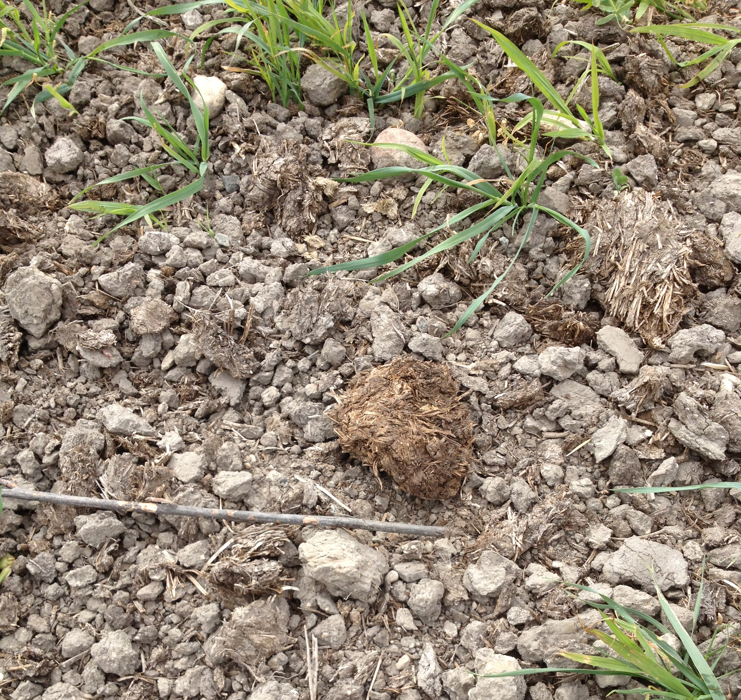
Why?
Picture from https://cropwatch.unl.edu

Slide 3
Overview
Material and Methods
Historical climatic conditions
Future climatic conditions
Conclusion

Slide 4

Research framework
Cropping systems design

Slide 5
Research framework
Cropping systems design
Cropping systems modelling

Slide 6





Research framework
Cropping systems
comparison
Cropping systems design
Agronomic impacts
Environmental impacts
Dietary impacts
Cropping systems modelling

Slide 7
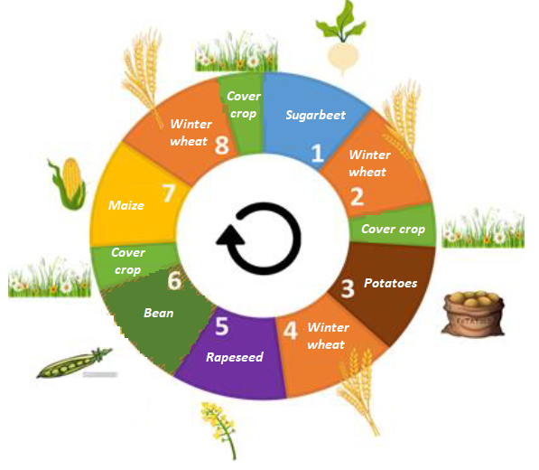
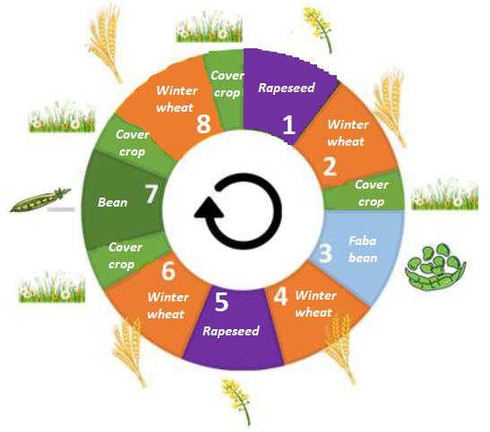
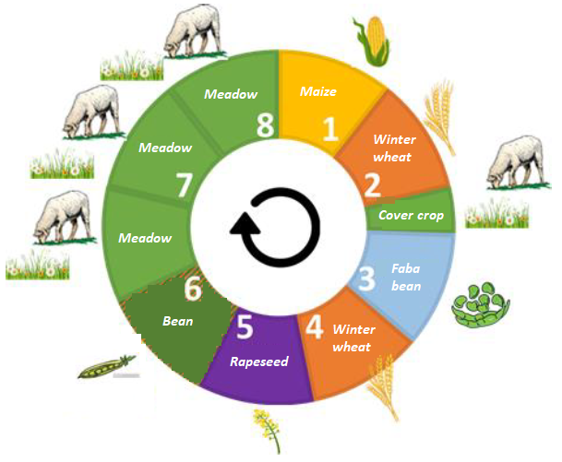



Crop rotations
Business-as-usual (BAU) Vegan Integrated Crop-Livestock (ICLS)
Animal-crop
flow:
External connexion
No connexion (no animals)
Internal connexion

Slide 8




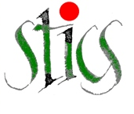


The STICS crop model
INPUTS
Model daily computation
OUTPUTS
Plant
Yield
Plant development module
Soil
Stresses
Climate
Soil bio-chemical state (SOC, N…)
Water balance module
Nutrition module
Initialization
Water balance
Management

Slide 9
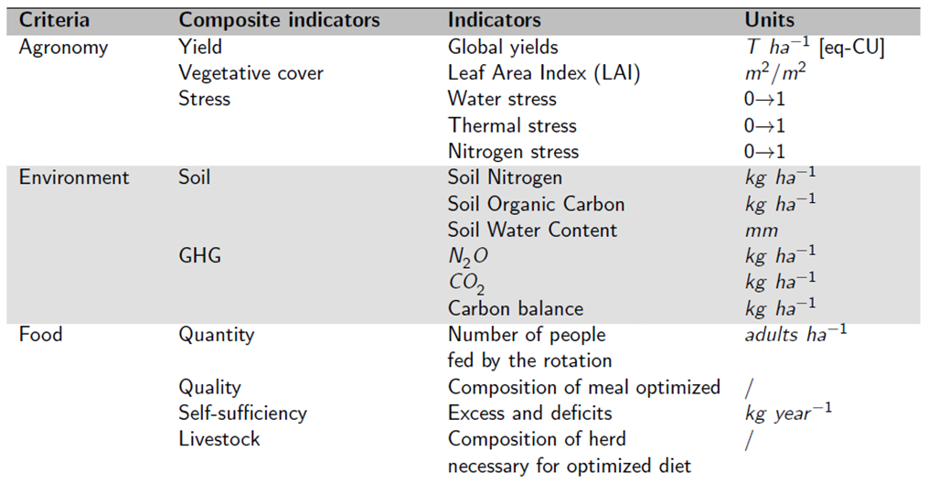


Comparison methodology

Slide 10
Comparison methodology

Slide 11
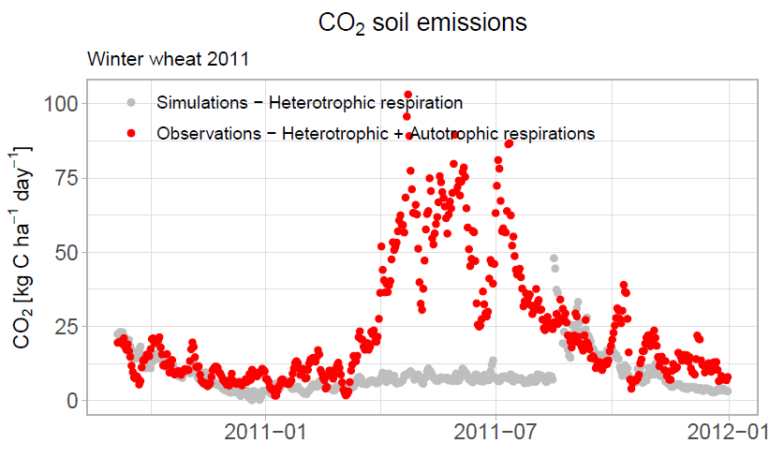
Simulating carbon balance
→ Problem: The model only simulates soil heterotrophic respiration.

Slide 12
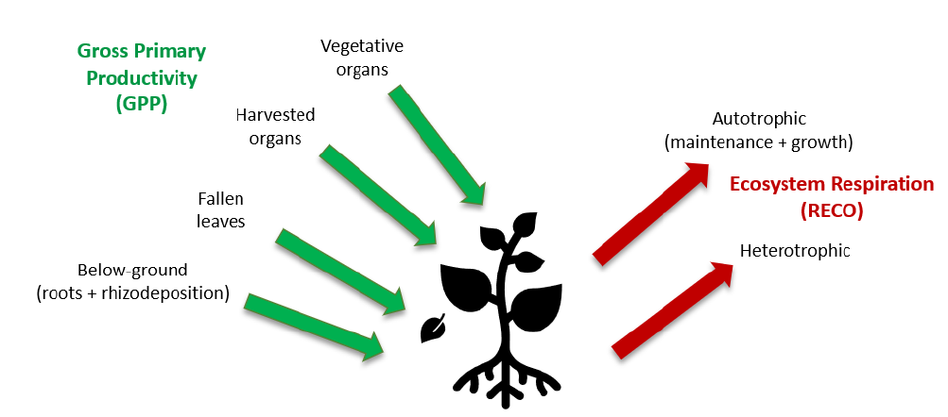
Simulating carbon balance
→ Solution: Estimate the carbon balance (Net Ecosystem Exchange (NEE), Ecosystem Respiration (RECO) and Gross Primary Productivity (GPP)) from model outputs.

Slide 13
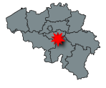

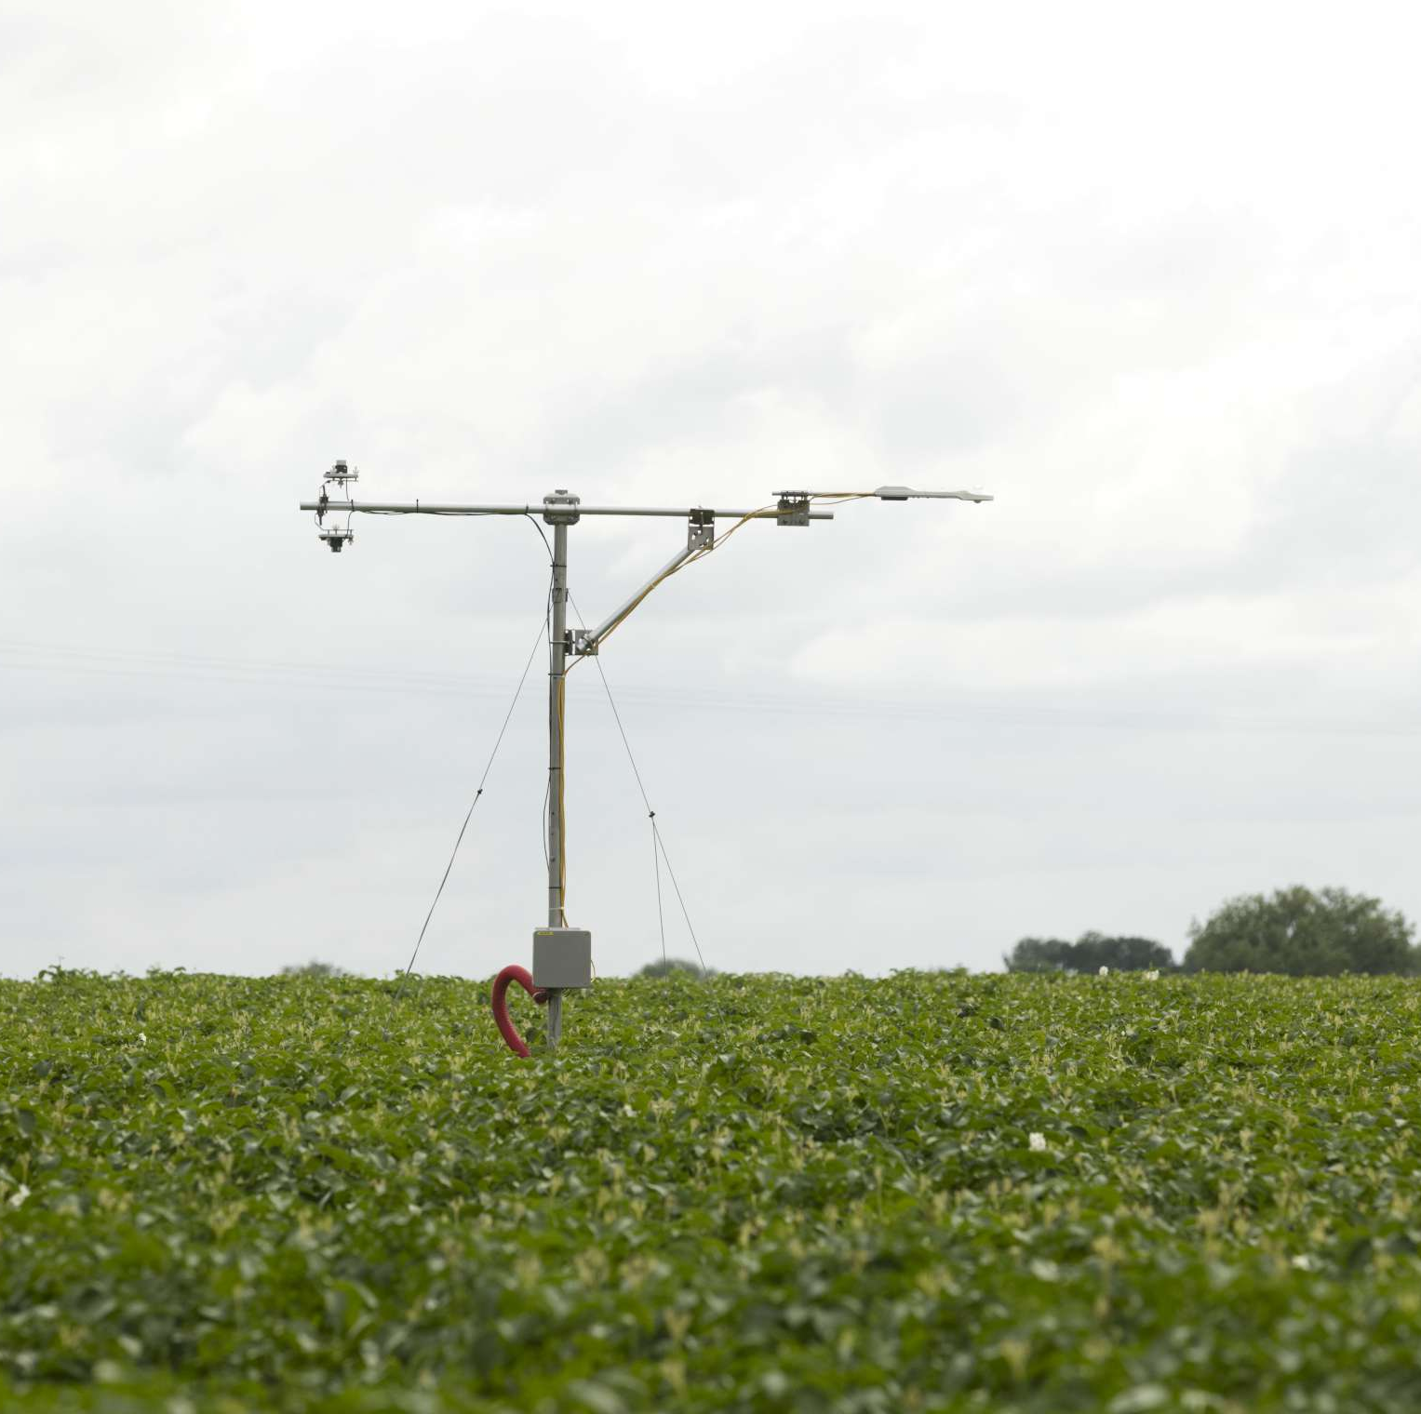


Simulating carbon balance
The experimental site in Lonzée
4-year crop rotation: sugarbeet, winter wheat and potatoes
Experiment started in 2004
Data collected: yield, crop growth, soil variables…
But also CO₂ and N₂O exchanges
  ICOS network (Integrated Carbon Observation System)
  Data freely accessible on https://data.icos-cp.eu/portal
https://www.icos-belgium.be/ESLonzee.php#Lonzee

Slide 14
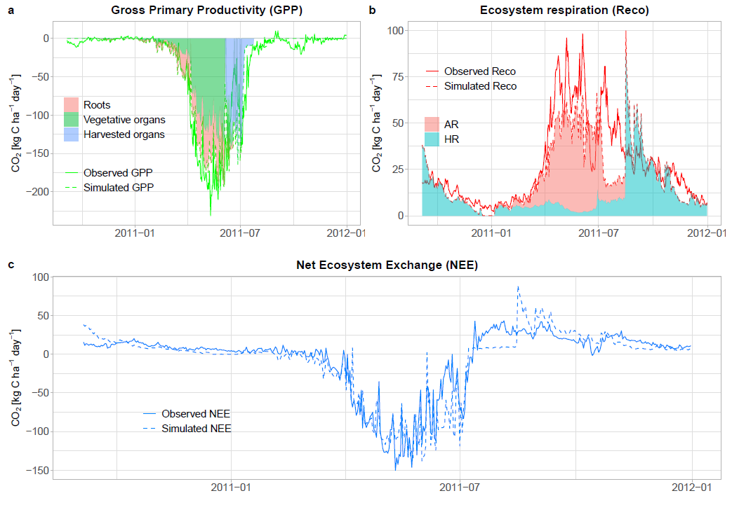
Simulating carbon balance
Results

Slide 15
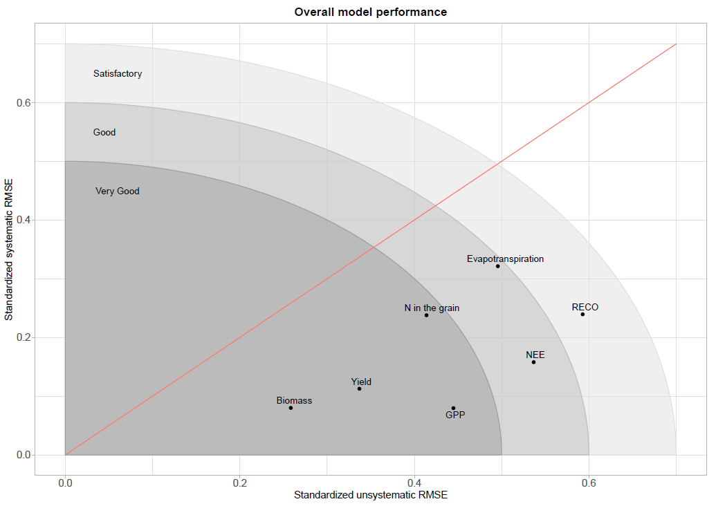
Simulating carbon balance
Results

Slide 16
Simulating carbon balance
Results
→ Next step: Applying the methodology to grasslands to also estimate their carbon balance.

Slide 17
Let’s go back to EcoFoodSystem!
Cropping systems
comparison
Cropping systems design
Agronomic impacts
Environmental impacts
Dietary impacts
Cropping systems modelling

Slide 18
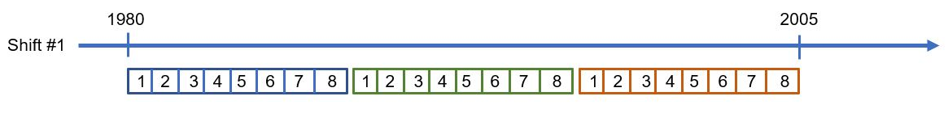
Accounting for climatic variability
Simulation of 3 successive 8-year rotations…

Slide 19
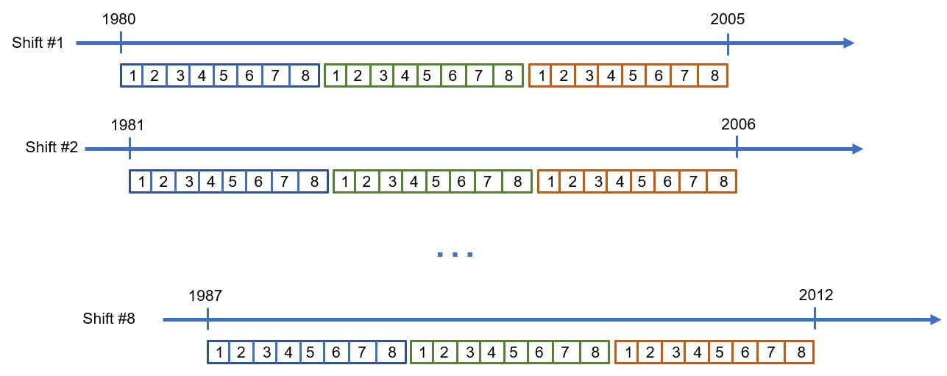
Accounting for climatic variability
Simulation of 3 successive 8-year rotations… … shifted 8 times

Slide 20
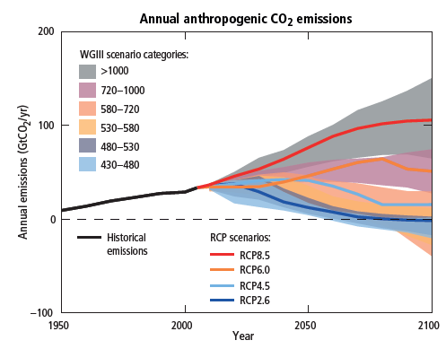
Future climatic conditions - Methodology
Prospective analysis in future climatic conditions, facing climate change:
  Two time periods:
    2040-2070
    2070-2100
  Two climatic scenarios:
    RCP 4.5
    RCP 8.5
IPCC, 2014: Climate Change 2014: Synthesis Report. Contribution of Working Groups I, II and III to the Fifth Assessment Report of the Intergovernmental Panel on Climate Change [Core Writing Team, R.K. Pachauri and L.A. Meyer (eds.)]. IPCC, Geneva, Switzerland, 151 pp.

Slide 21
Results
Cropping systems
comparison
Under historical
climatic conditions
(1980-2010)
Agronomic impacts

Slide 22
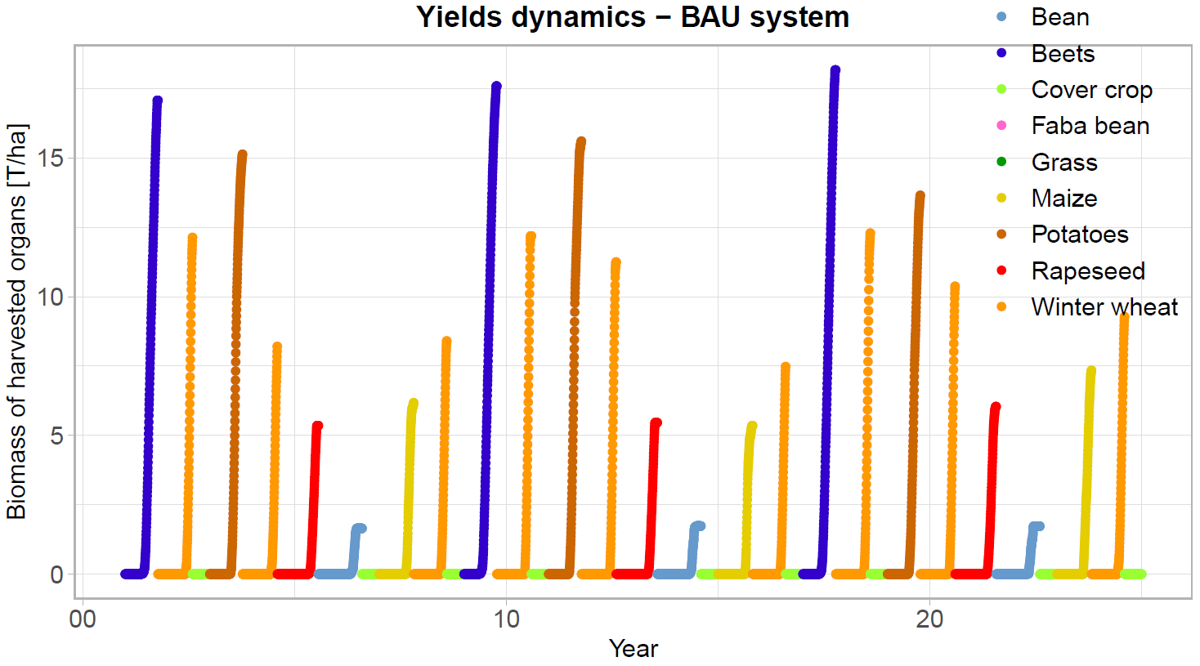
Yields

Slide 23
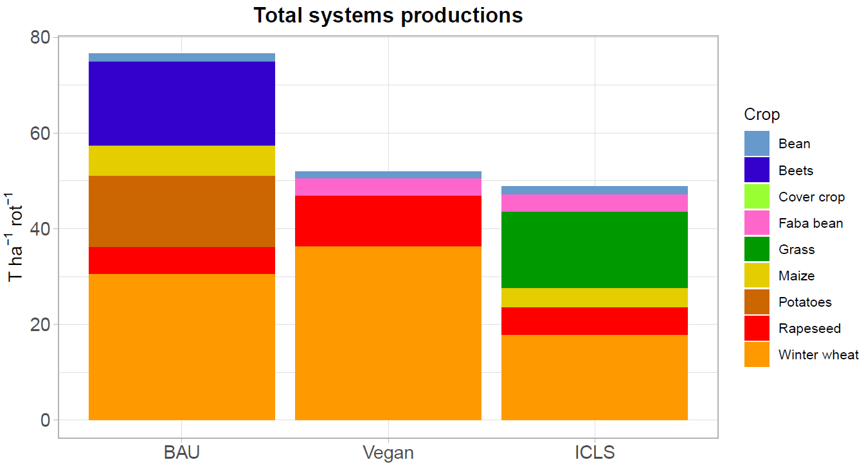
Yields

Slide 24
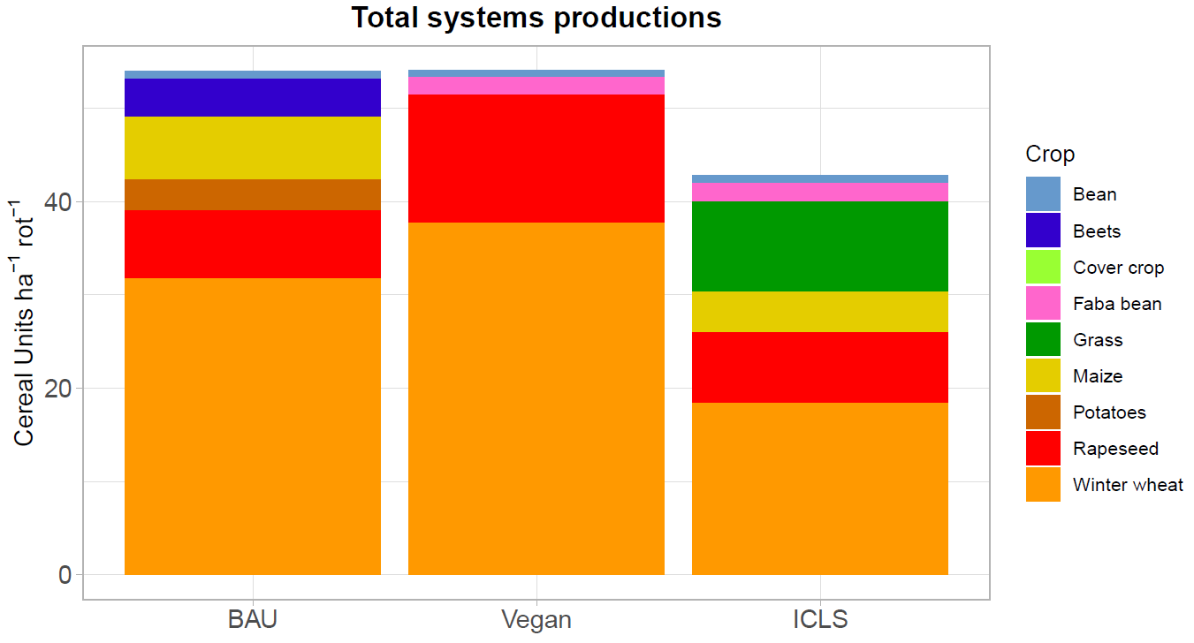
Yields
In order to compare different products altogether, we use the concept of Cereal Units, based
on metabolizable energy for feed¹.
BAU and Vegan systems productions are almost equal.
Because of its pastures, the ICLS is less productive, purely in terms of yields.
1 - Brankatschk and Finkbeiner (2014)

Slide 25
Results
Cropping systems
comparison
Under historical
climatic conditions
(1980-2010)
Environmental impacts

Slide 26
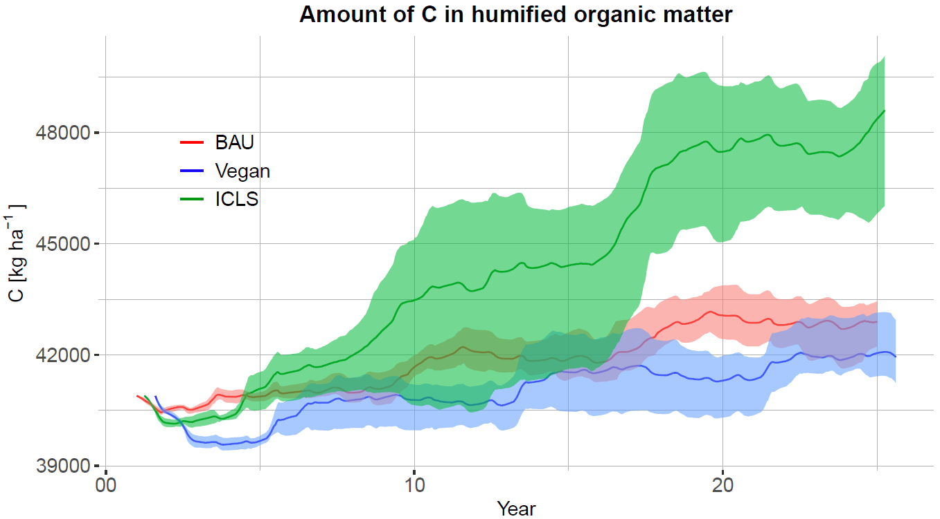
Soil Organic Carbon

Slide 27
Soil Organic Carbon
With moderated tillage and incorporation of residues, BAU and Vegan systems succeed to have a small increase in SOC.
But it is the ICLS system that is most adequate to stock carbon into the soil, mostly thanks to pastures.

Slide 28
Results
Cropping systems
comparison
Under historical
climatic conditions
(1980-2010)
Dietary impacts

Slide 29
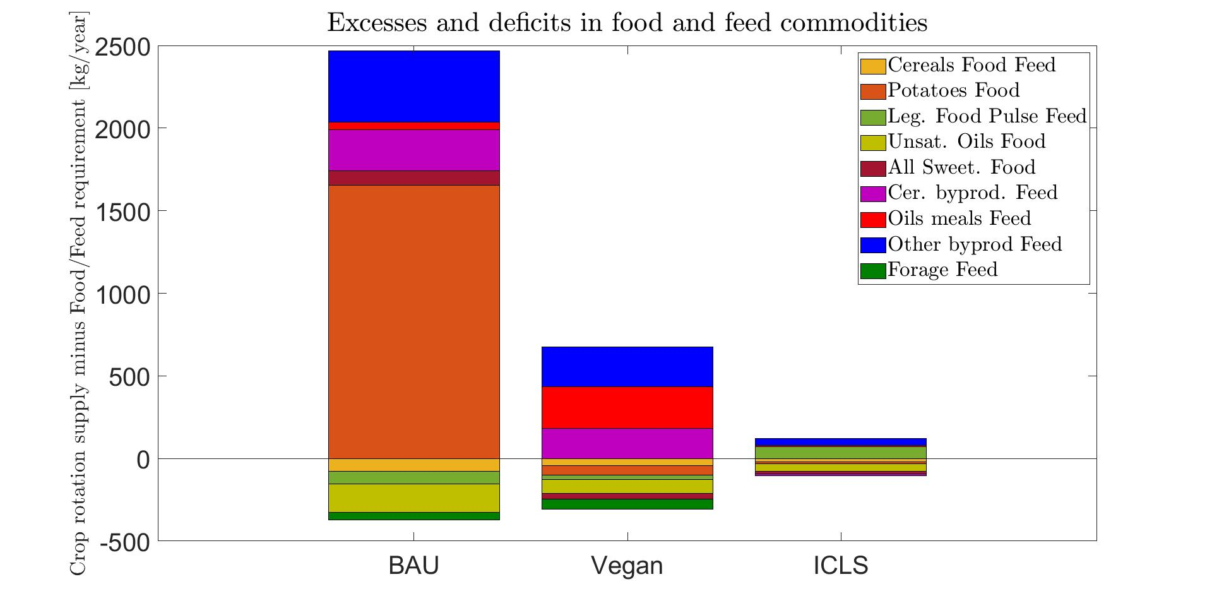
Self-sufficiency
Satisfying EAT-Lancet requirements¹, ensuring human health and planetary boundaries…
1 - Willett et al. (2019)

Slide 30
Self-sufficiency
Satisfying EAT-Lancet requirements¹, ensuring human health and planetary boundaries…
The BAU system relies on important exports and imports.
The ICLS system is the most self-sufficient by far.
1 - Willett et al. (2019)

Slide 31
Results
Cropping systems
comparison
Under future
climatic conditions
(2040-2070 and 2070-2100)
Agronomic impacts

Slide 32
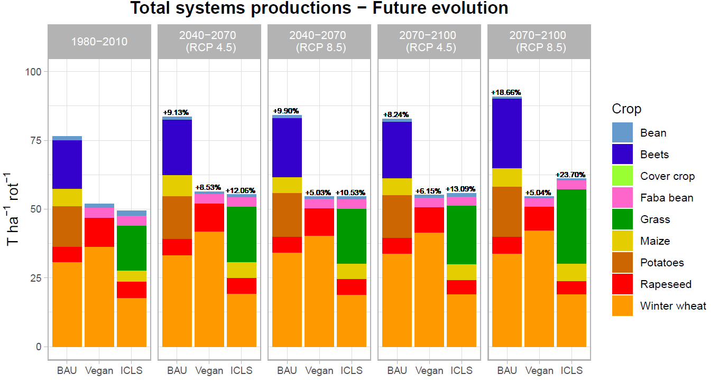
Yields evolution

Slide 33
Yields evolution
In tons per ha, global yields increase, from +5.04% (Vegan) to +23.7% (ICLS) in 2070-2100 (RCP 8.5) compared to 1980-2010.
It is due to the increase of CO₂ concentration and globally less thermal stress.
Global yields increase

Slide 34
Results
Cropping systems
comparison
Under future
climatic conditions
(2040-2070 and 2070-2100)
Environmental impacts

Slide 35
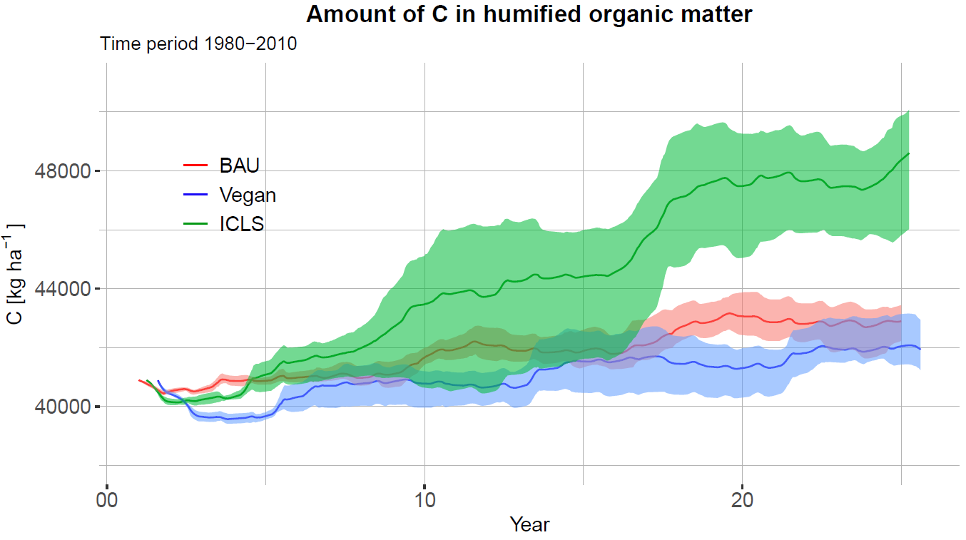
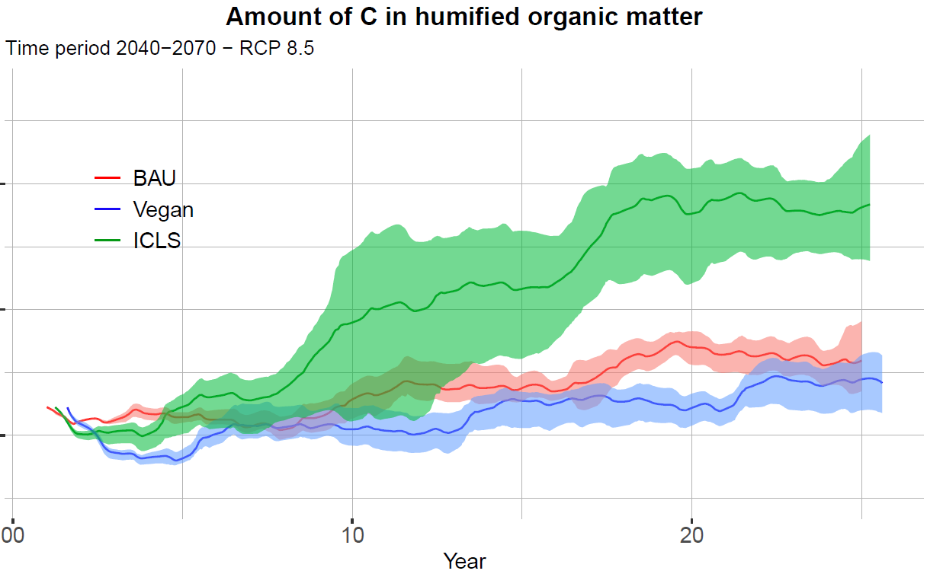
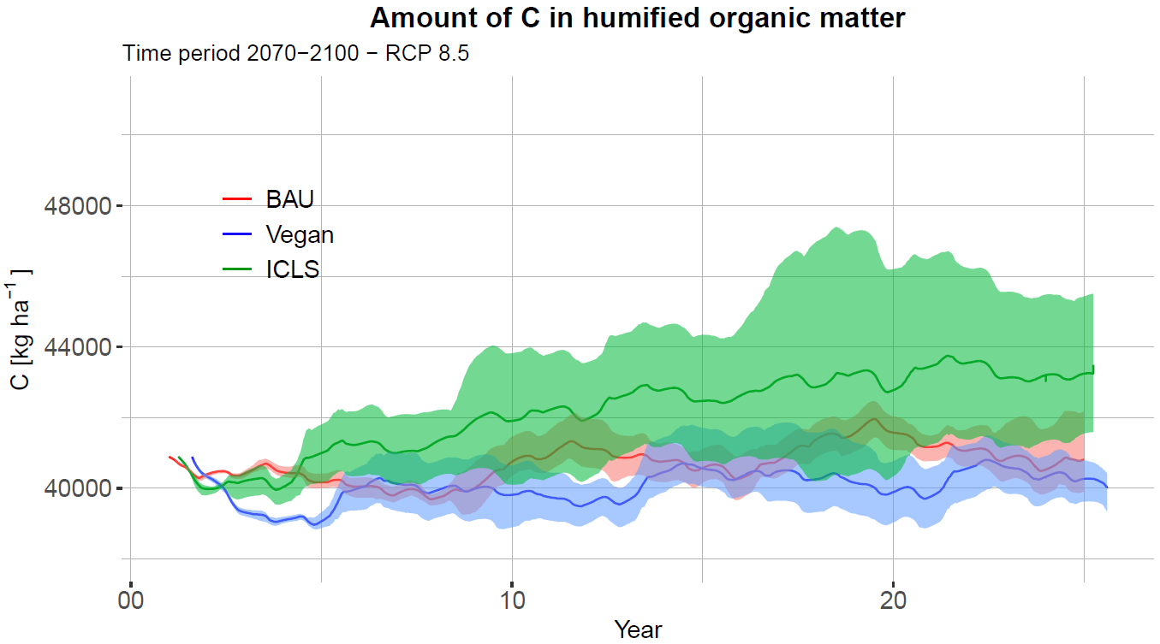
Soil Organic Carbon evolution
1980-2010
1980-2010
2040-2070
(RCP 8.5)
2070-2100
(RCP 8.5)
Higher temperatures lead to soil microorganisms activity increase, accelerating organic matter mineralization.
SOC stocks reduce with climate change.

Slide 36
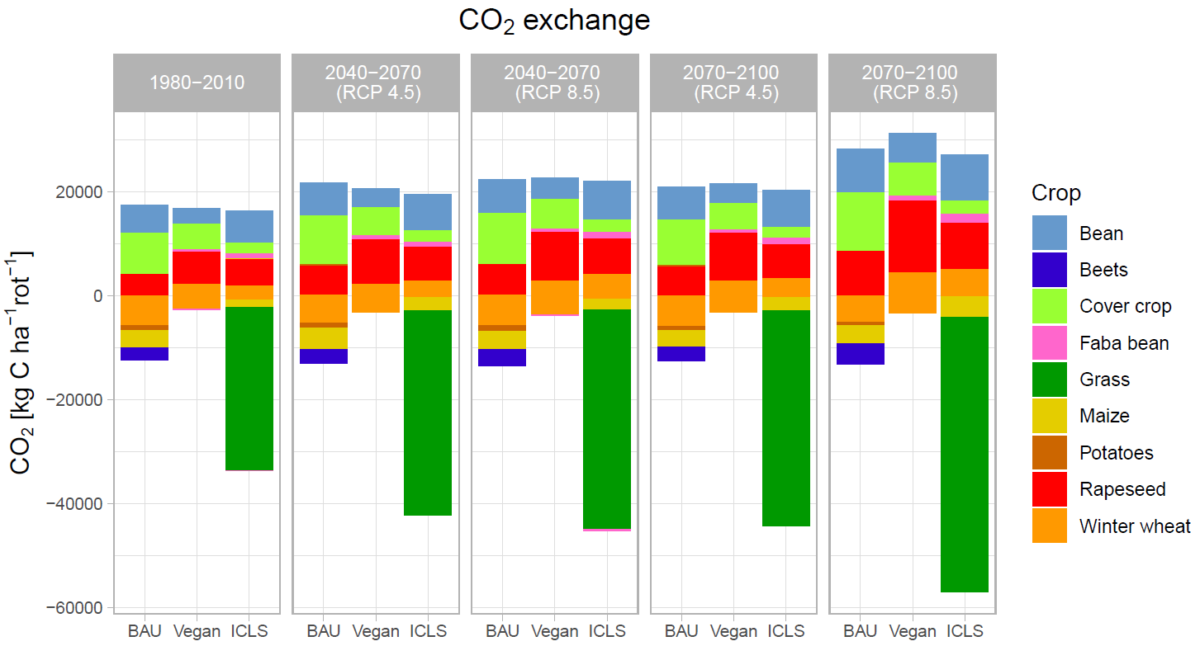
Carbon balance evolution

Slide 37
Carbon balance evolution
The net carbon balance of BAU and Vegan systems is more and more positive, exacerbating climate change…
In the opposite, the ICLS system sink capacity increases.
Respiration increases…
… But C stocking increases too!

Slide 38
Multi-criteria summary
For historical climatic conditions

Slide 39
Multi-criteria summary
For historical climatic conditions
Many more indicators included in the comparison.
Such a multi-criteria comparison emphasizes the contrasted performances.

Slide 40
Conclusion
Whereas agriculture as-usual in Belgium produces more, it is the ICLS system that is the most self-sufficient.

Slide 41
Conclusion
Whereas agriculture as-usual in Belgium produces more, it is the ICLS system that is the most self-sufficient.
The ICLS rotation, including pastures and agroecological levers, is ideal to adapt to climate change, but also to mitigate it (C stocking).

Slide 42

Conclusion
Whereas agriculture as-usual in Belgium produces more, it is the ICLS system that is the most self-sufficient.
The ICLS rotation, including pastures and agroecological levers, is ideal to adapt to climate change, but also to mitigate it (C stocking).
Crop models constitute great tools to investigate climate change impact on agriculture and its potential to mitigate it.

Slide 43

Conclusion
Whereas agriculture as-usual in Belgium produces more, it is the ICLS system that is the most self-sufficient.
The ICLS rotation, including pastures and agroecological levers, is ideal to adapt to climate change, but also to mitigate it (C stocking).
Crop models constitute great tools to investigate climate change impact on agriculture and its potential to mitigate it.
Systemic comparisons are required for highlighting the contrast between the different indicators.

Slide 44


Prospective analysis of the evolution of agronomic, environmental and nutritional performances of contrasting crop rotations when facing climate change
Mathieu Delandmeter, Jérôme Bindelle, Caroline De Clerck, Benjamin Dumont
Gembloux Agro-Bio Tech – University of Liege (Belgium)
Acknowledgments:
Belgian Fund for Scientific Research (F.R.S-FNRS) for funding my PhD thesis (reference FC 44221)
University of Liege (Gembloux Agro-Bio Tech)
mathieu.delandmeter@uliege.be

