Slide 1
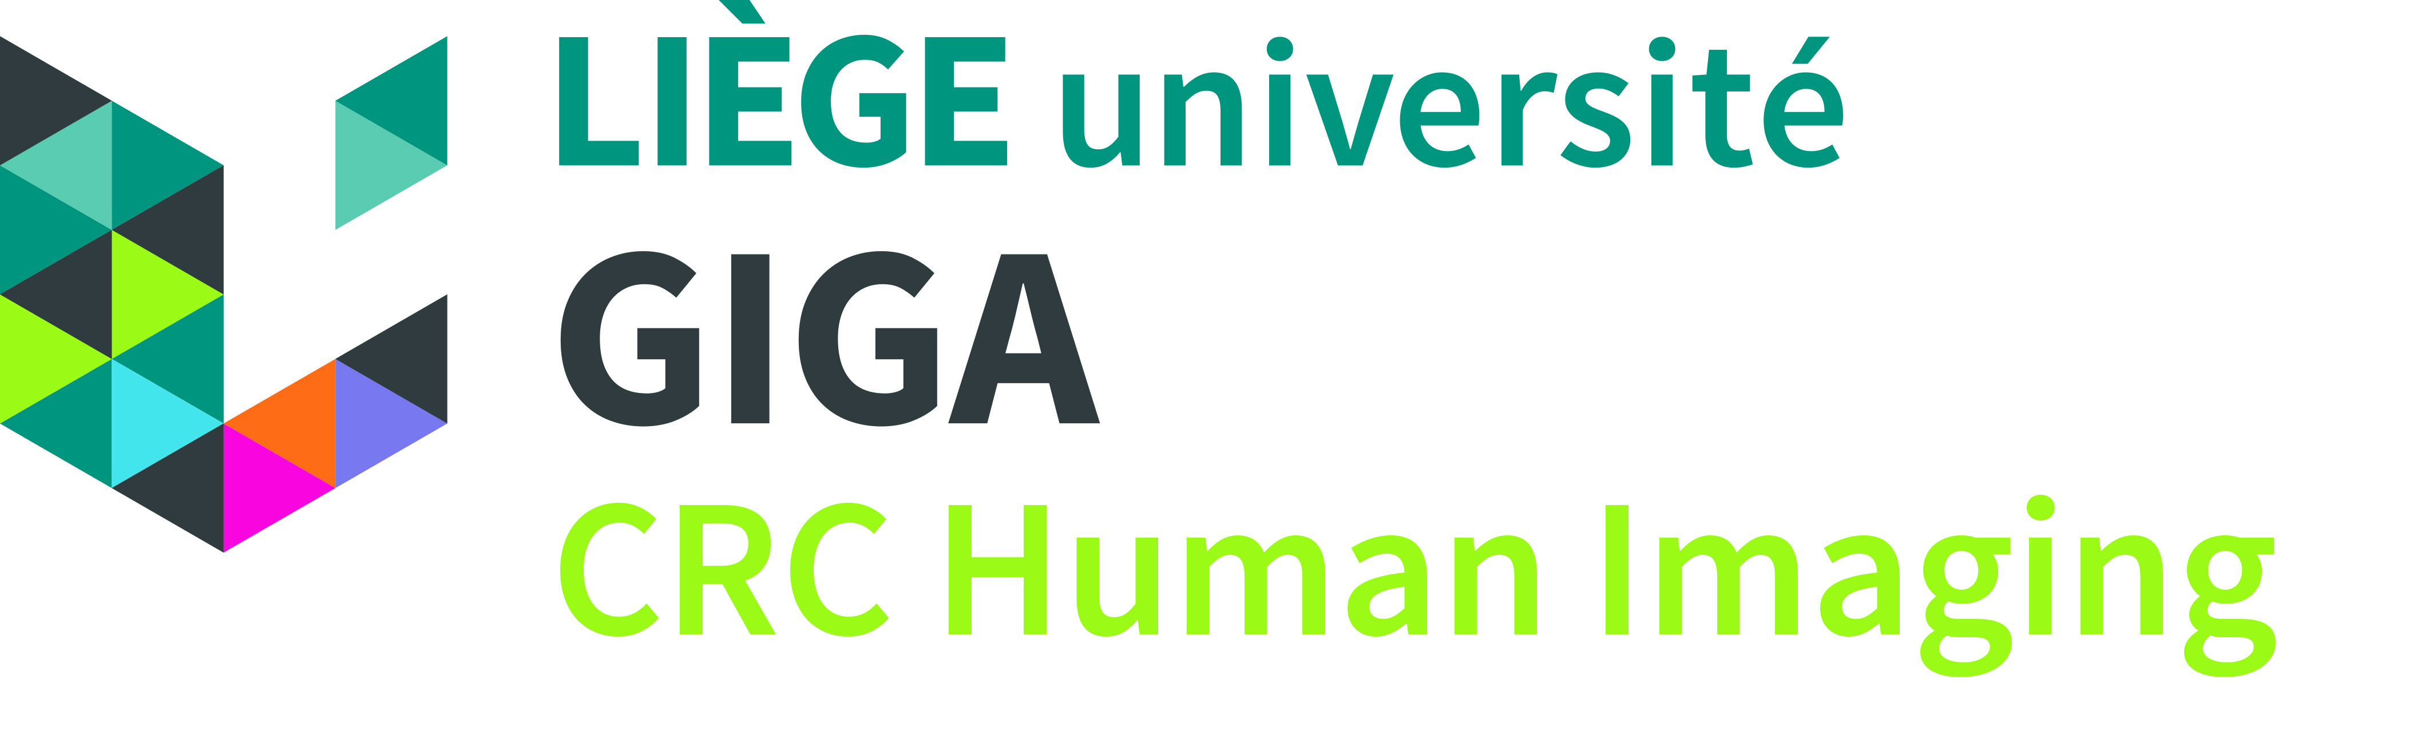
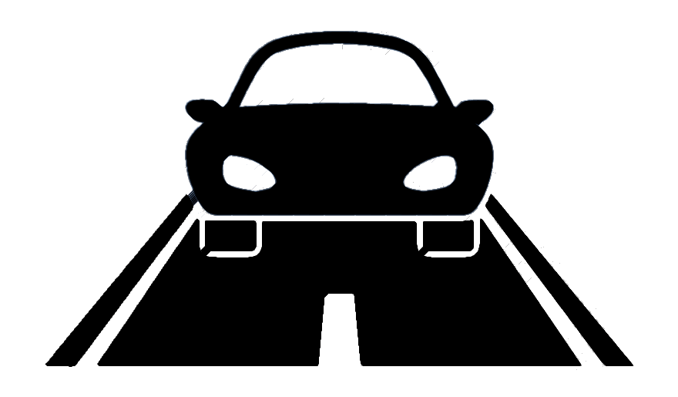
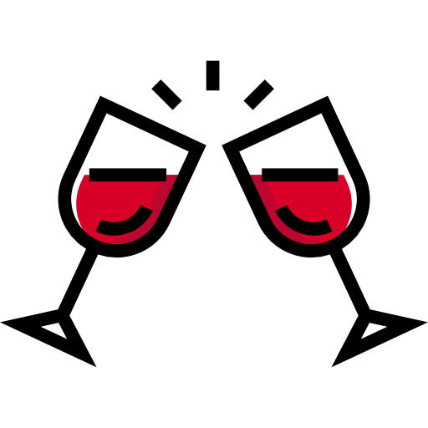
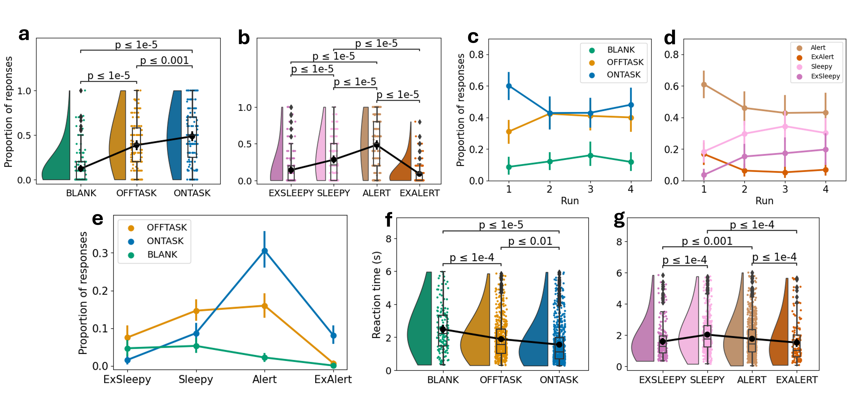

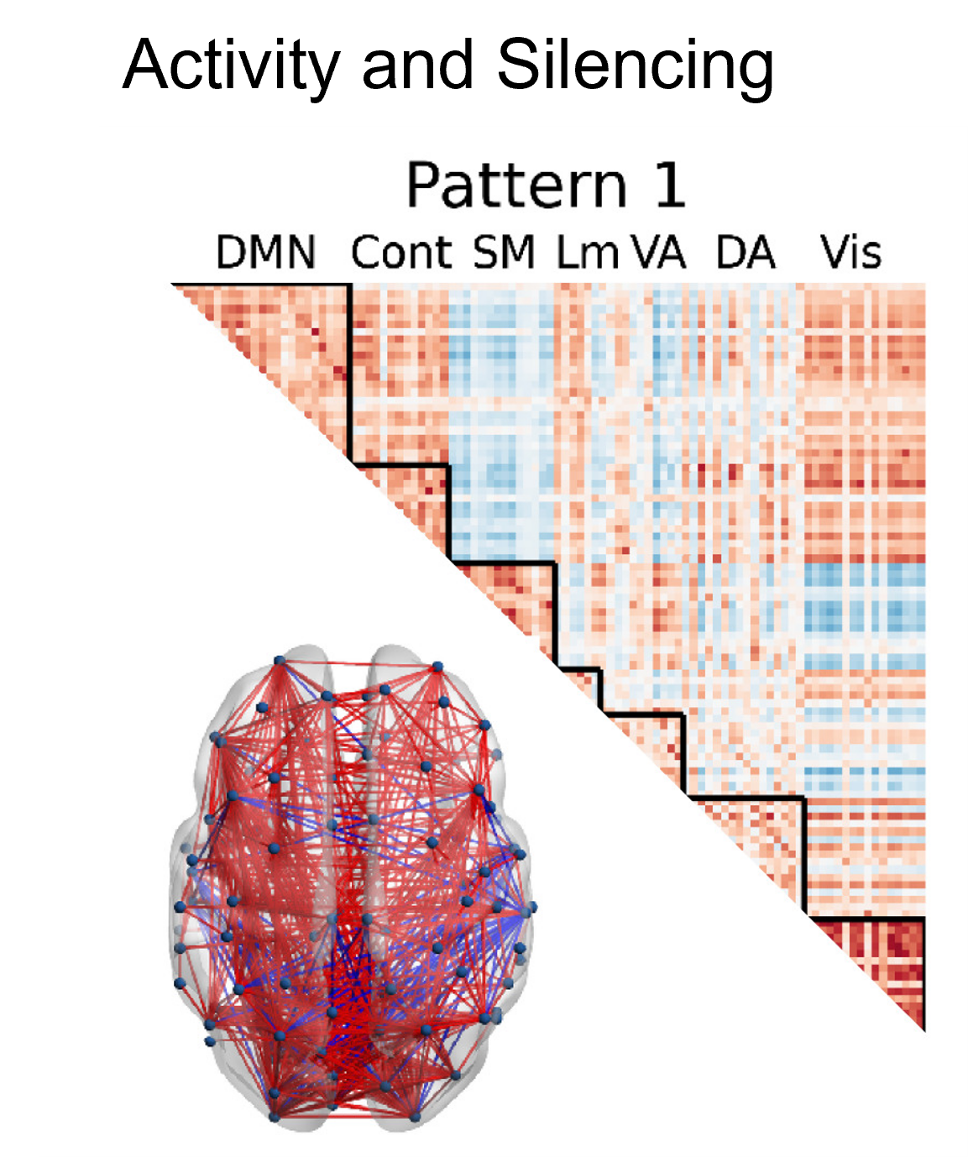
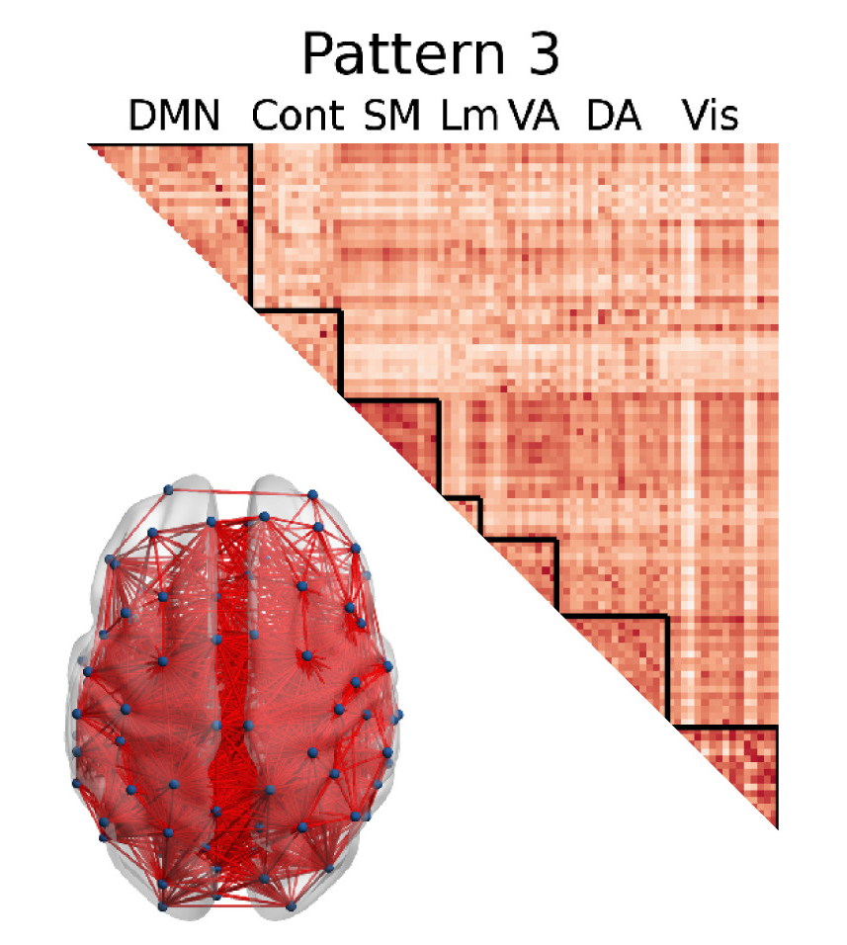
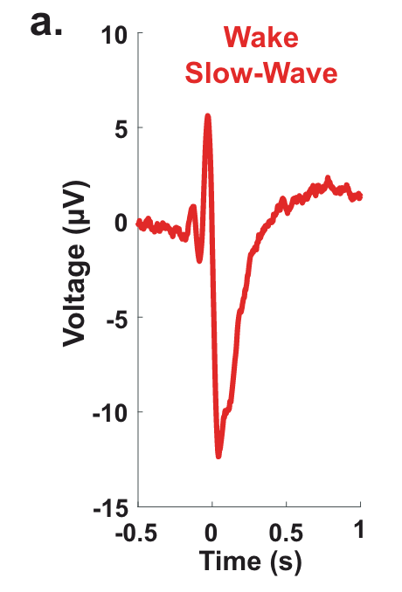
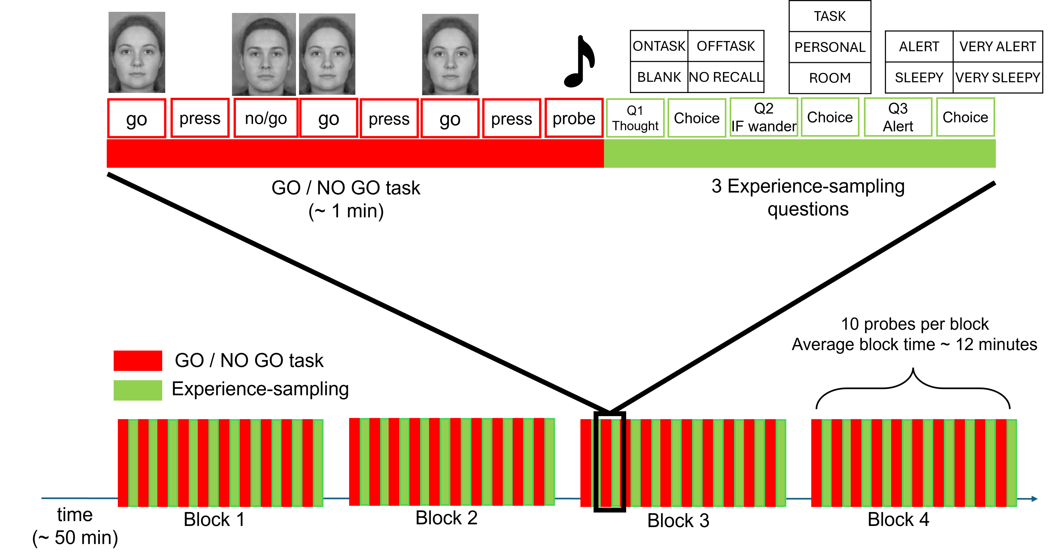
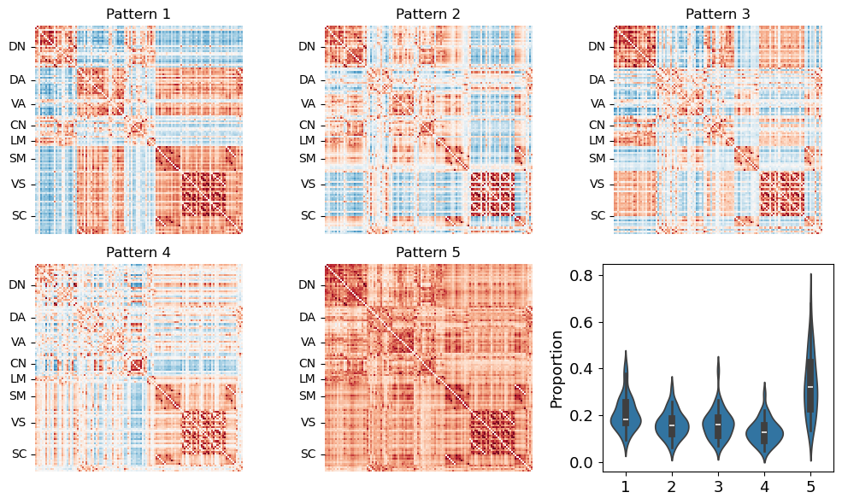
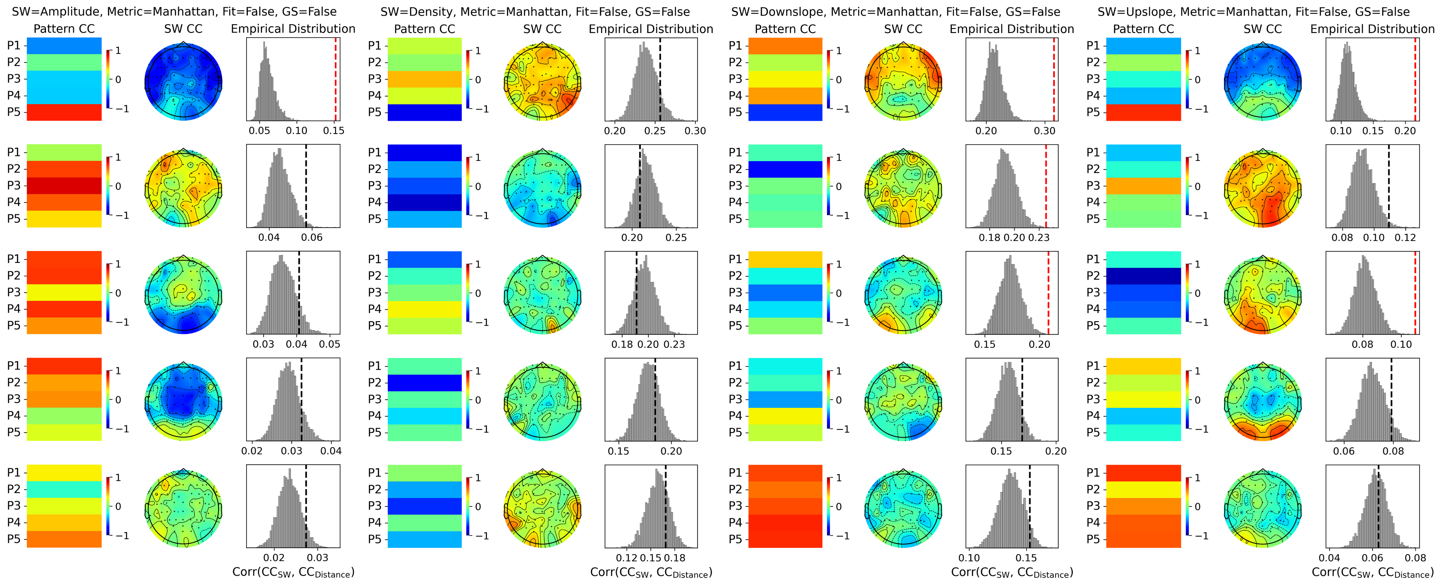
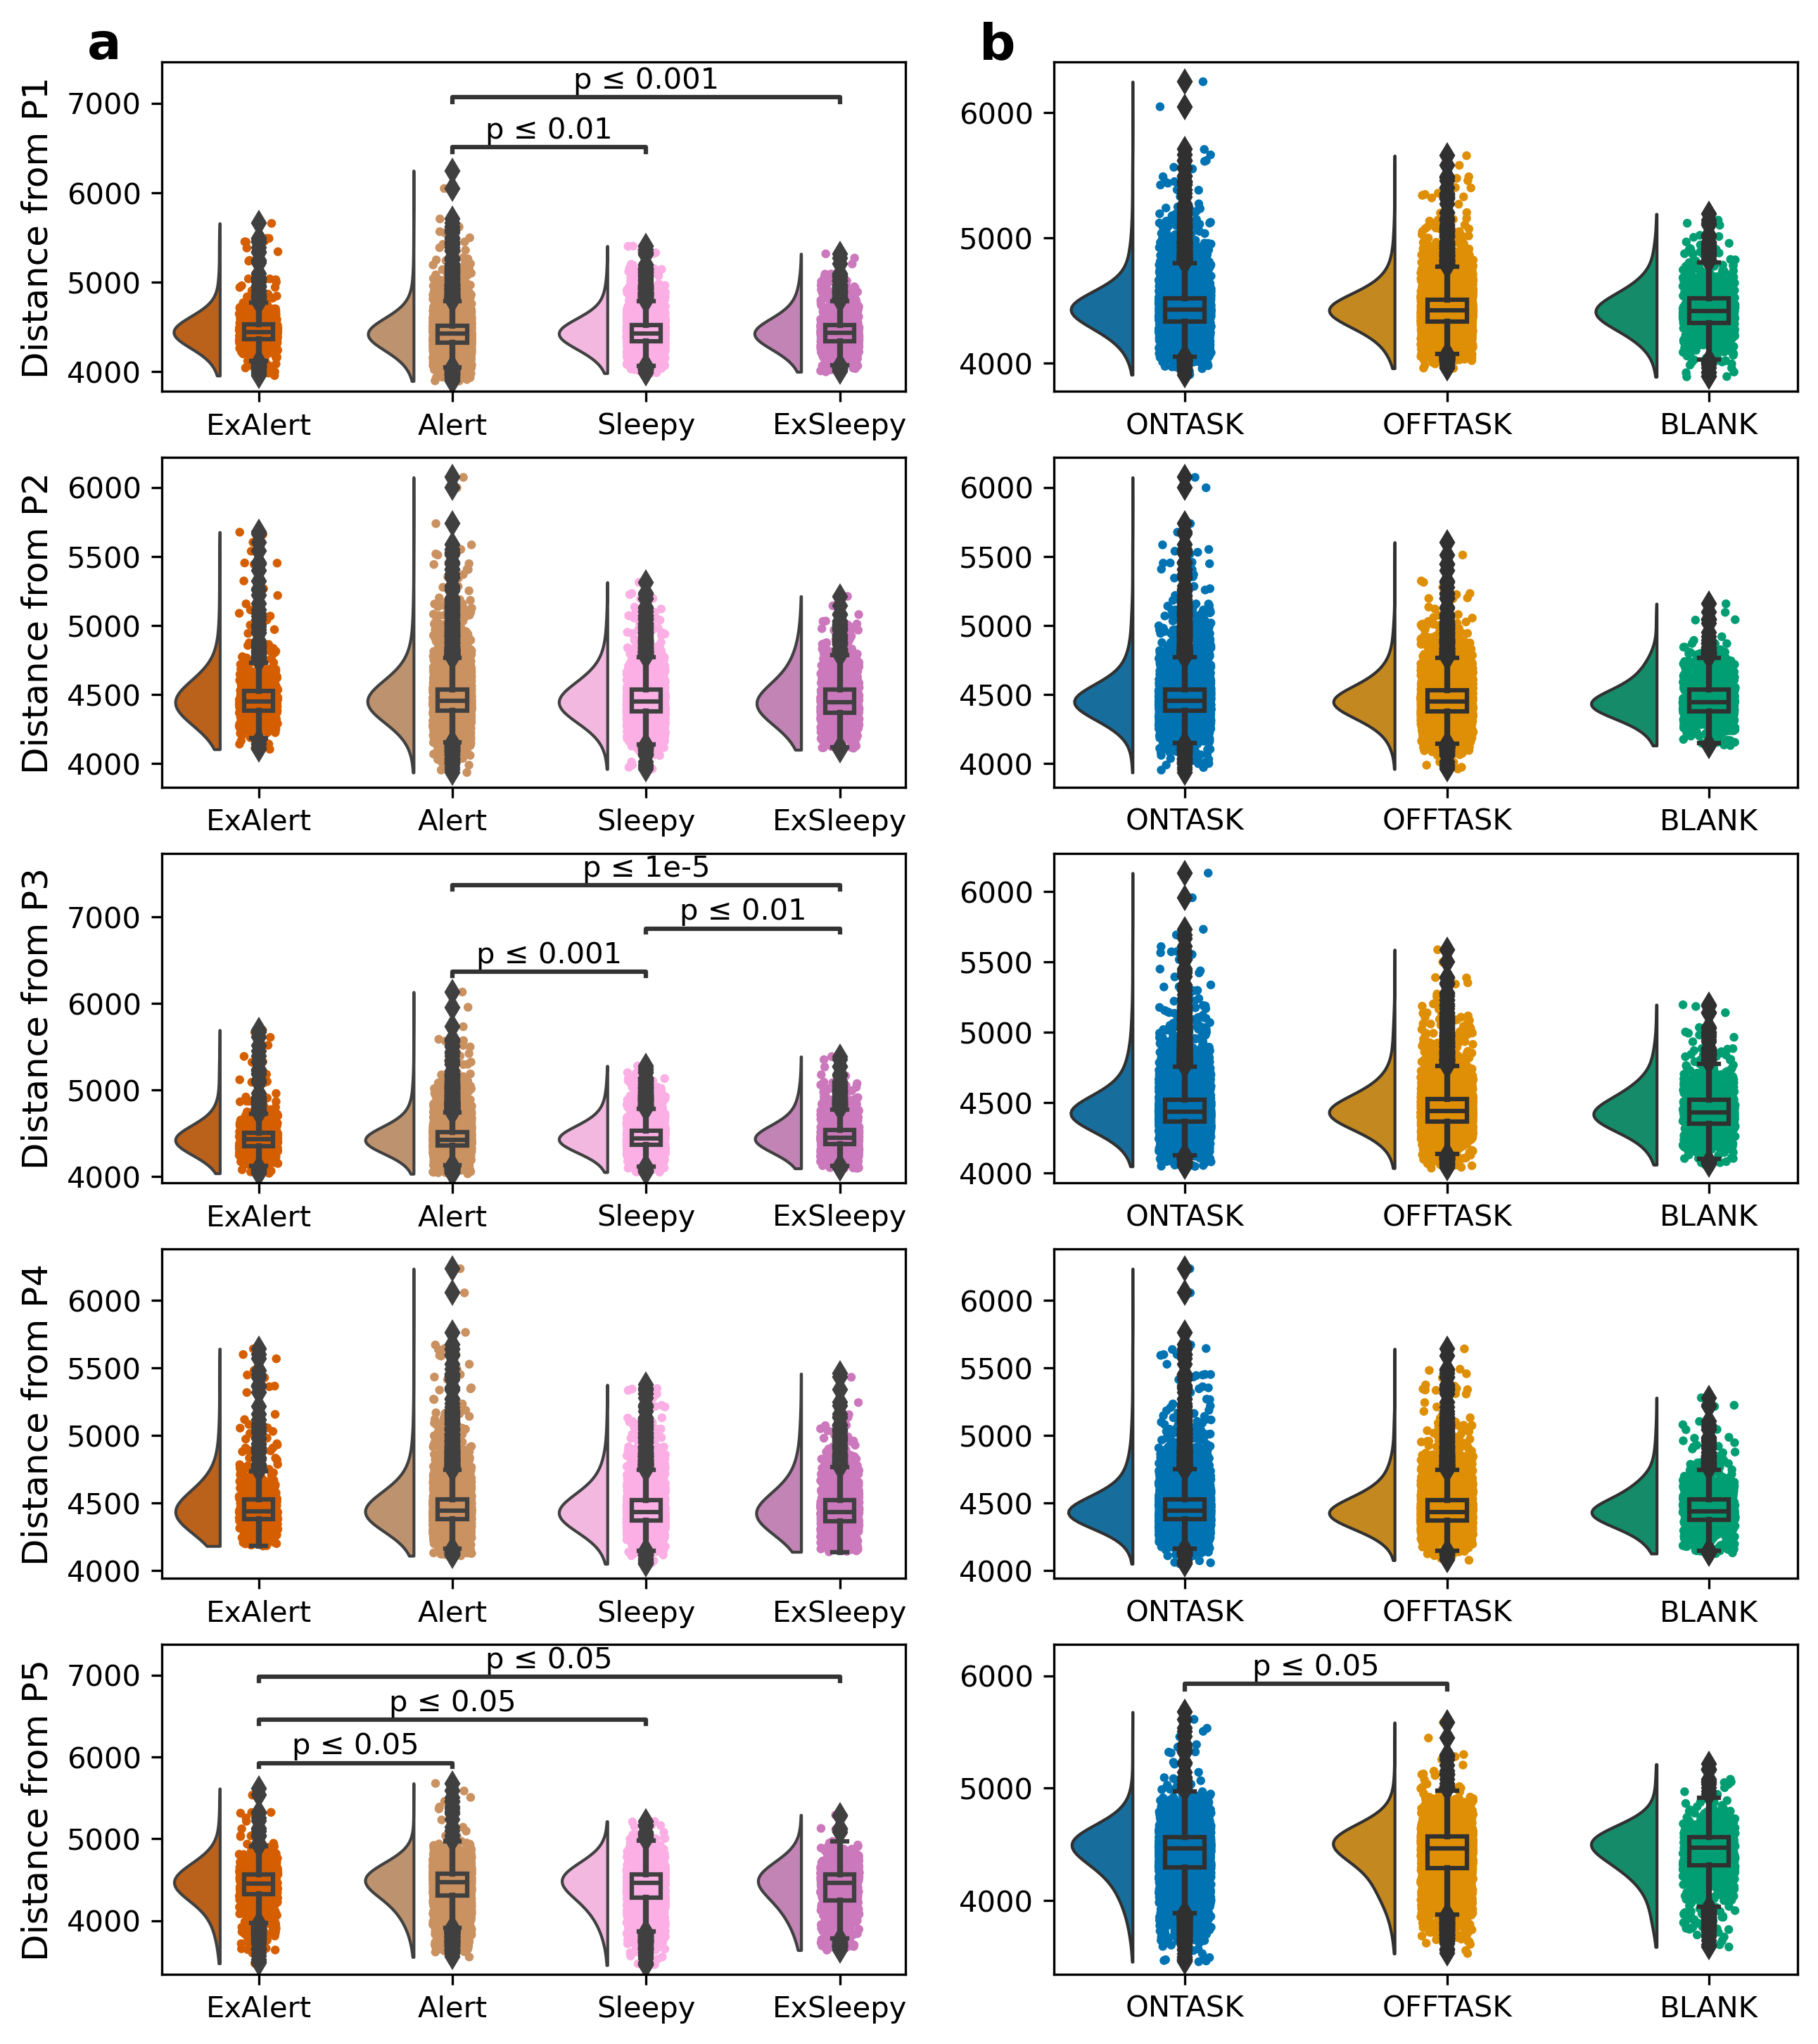
Bridging electrophysiology and neuroimaging to understand
the neuronal correlates of spontaneous thinking and alertness during task-engagement
Mind blanking reports are infrequent, but increases in lower self-reported arousal
Slow wave-like activity correlates with hyperconnectivity
Anticorrelations
Hyperconnectivity
Slow wave-like
Time-varying FC organizes in distinct patterns
Hyperconnectivity tracks alertness
Boulakis, P. A., Kustzor, A., Tsuchiya, N., Andrillon, T., Demertzi, A. In prep.

