Slide 1
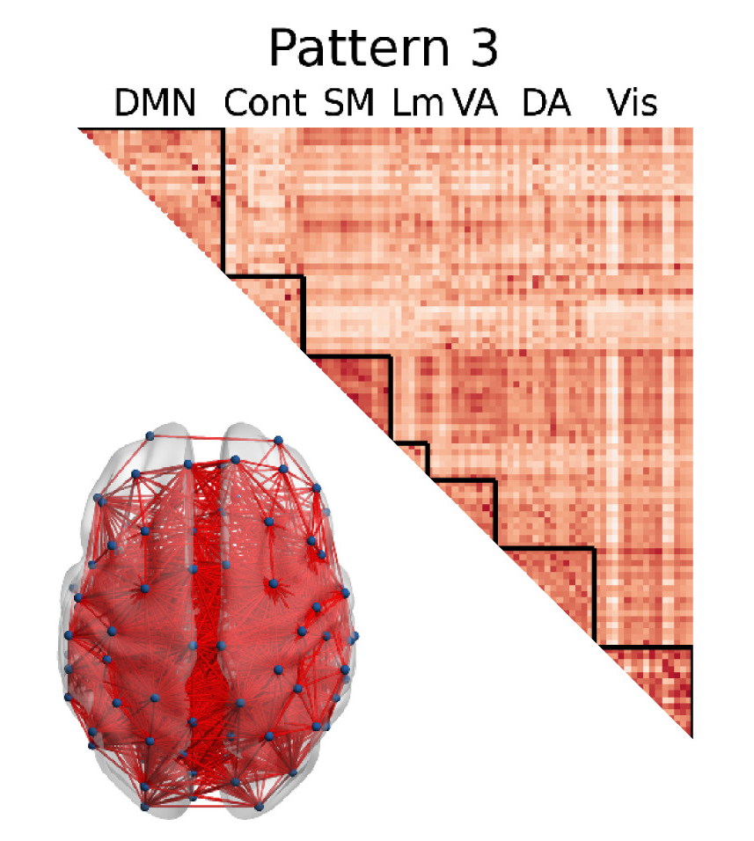
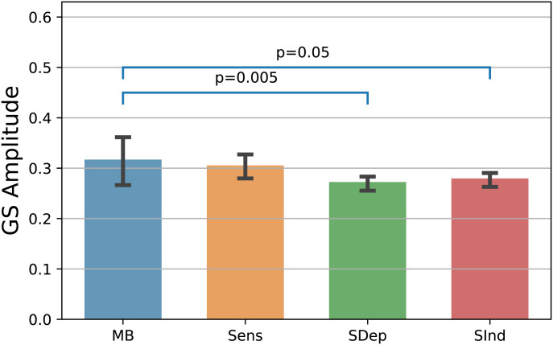
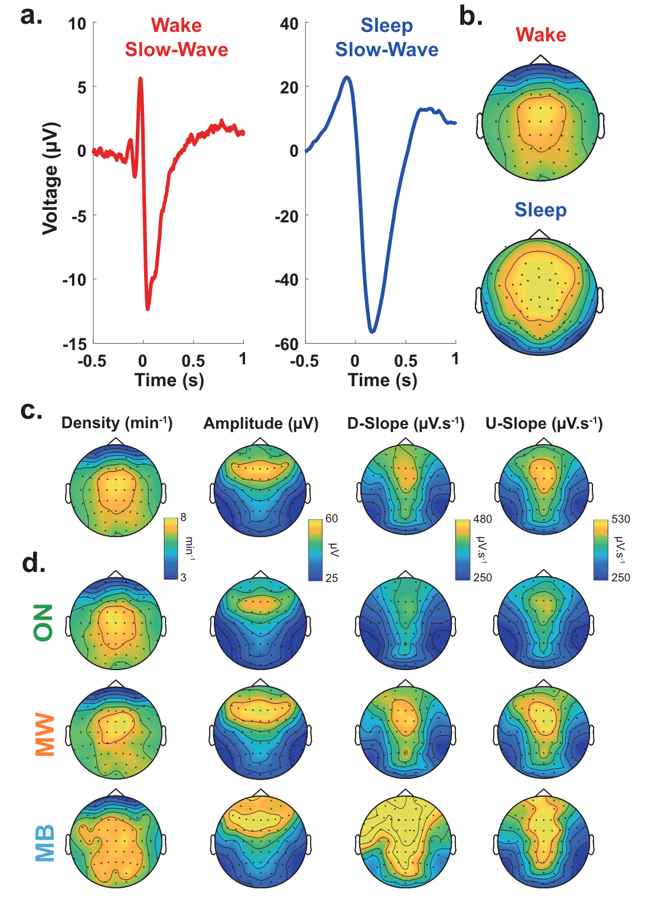
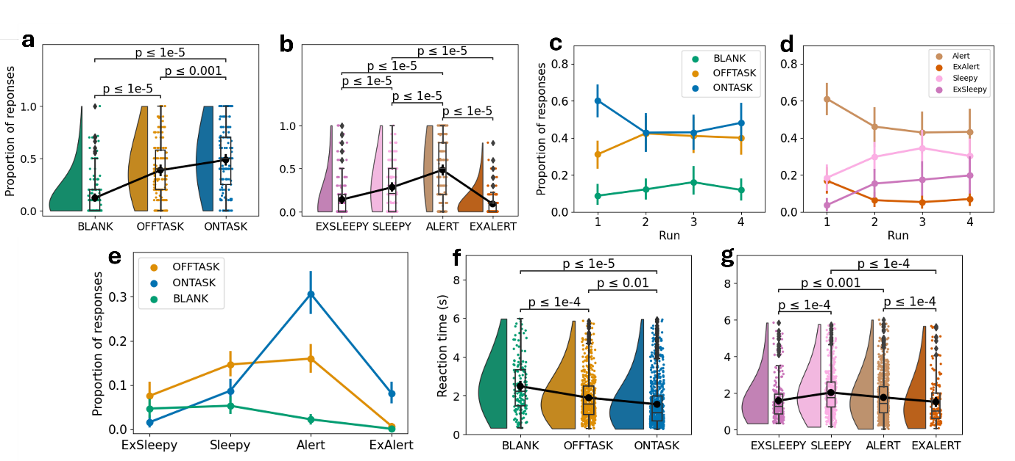
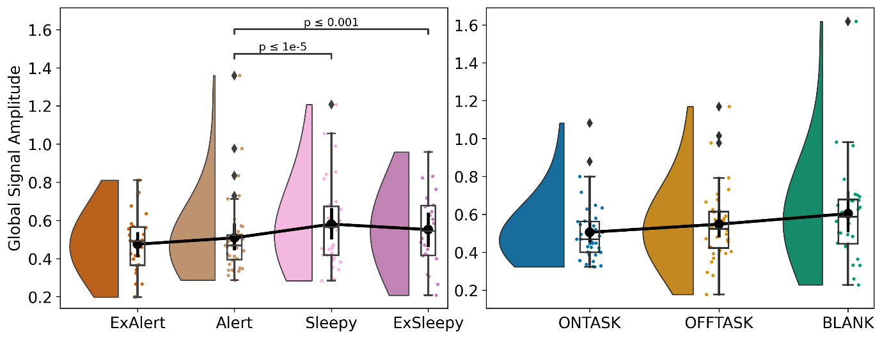
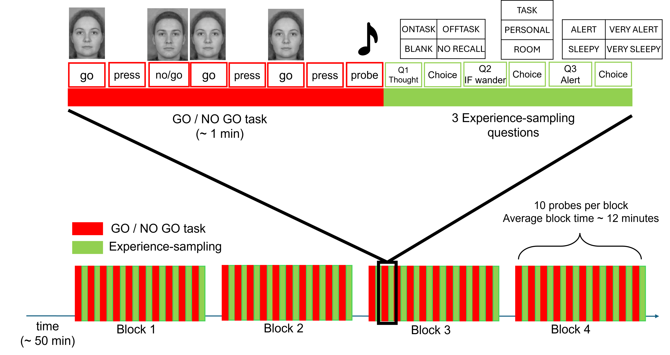
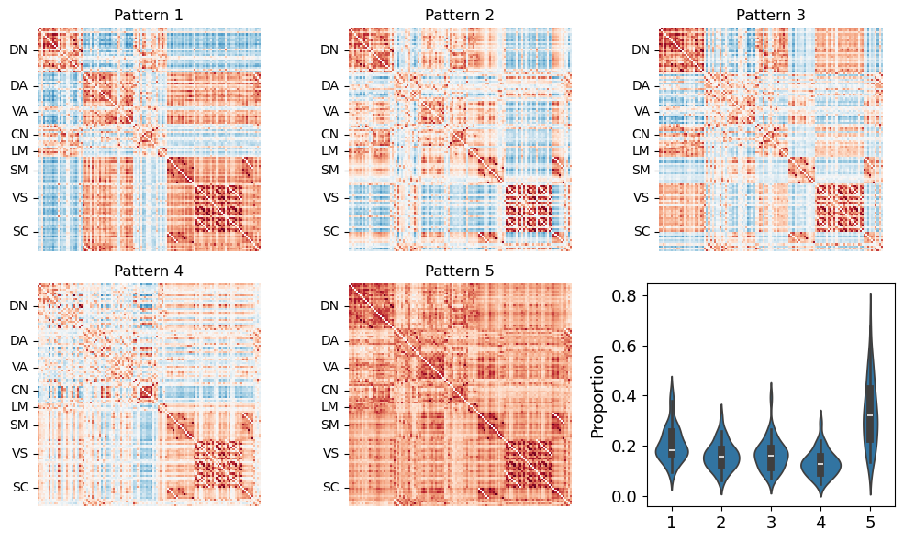
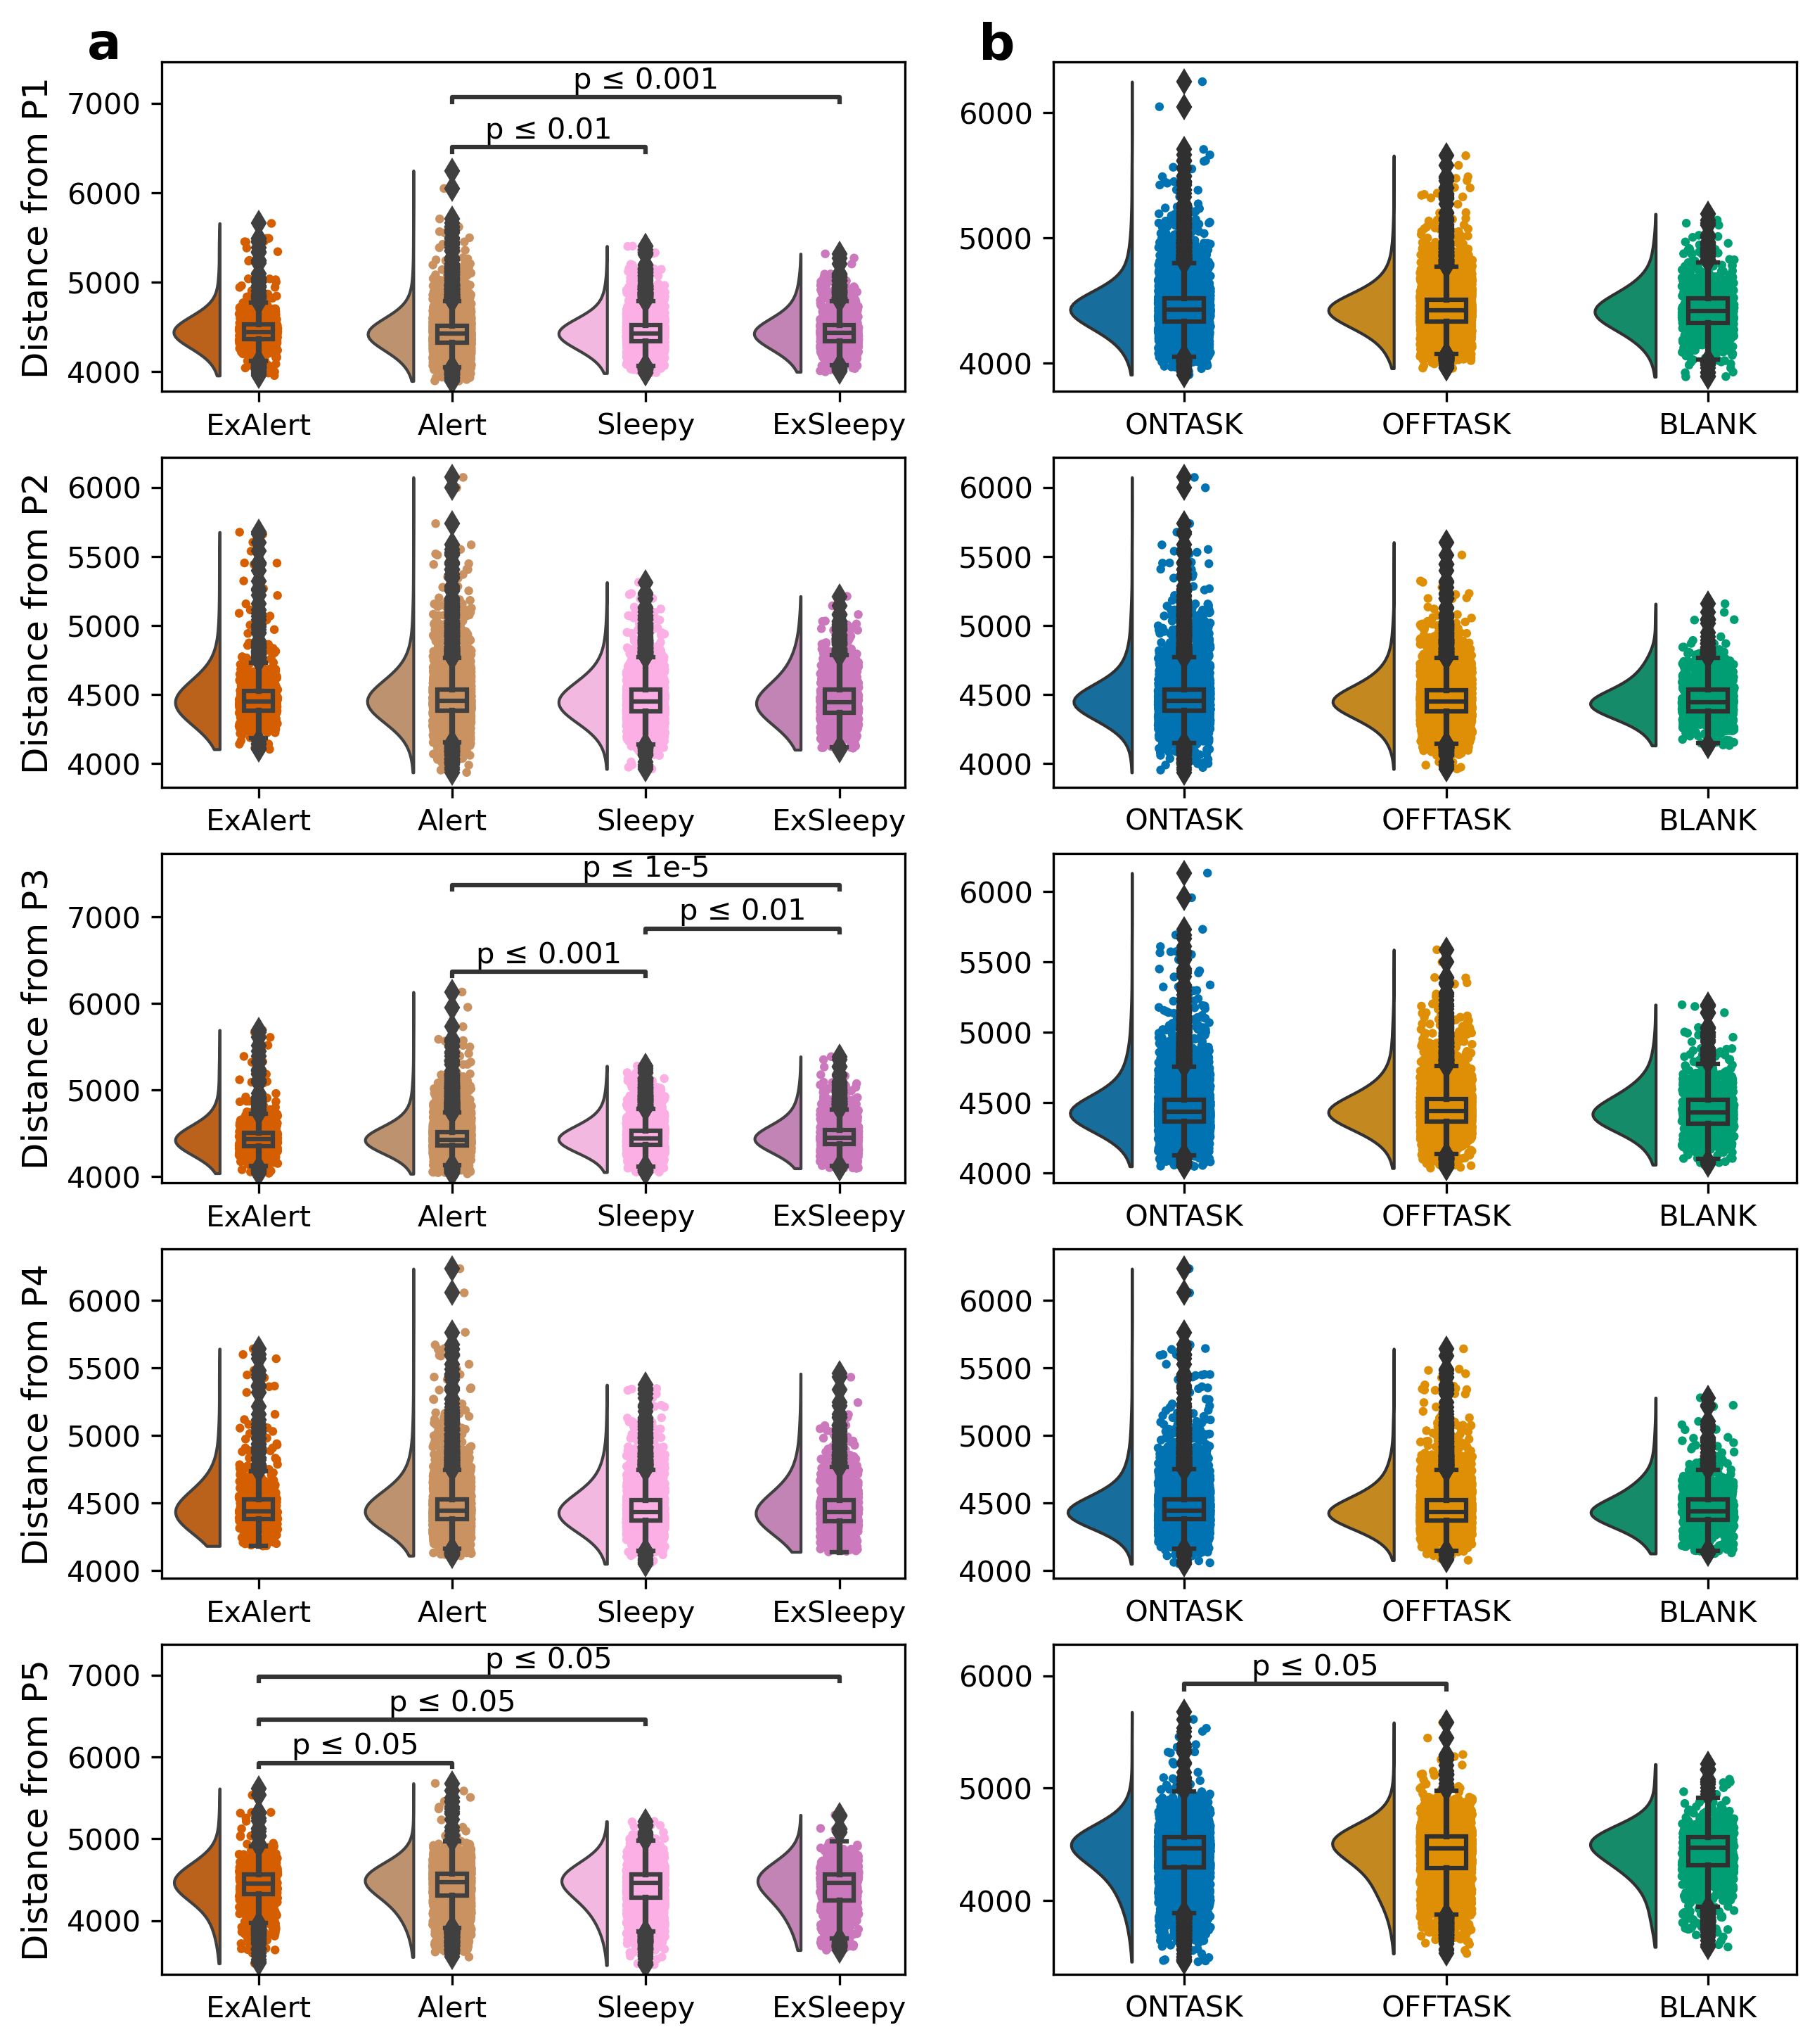
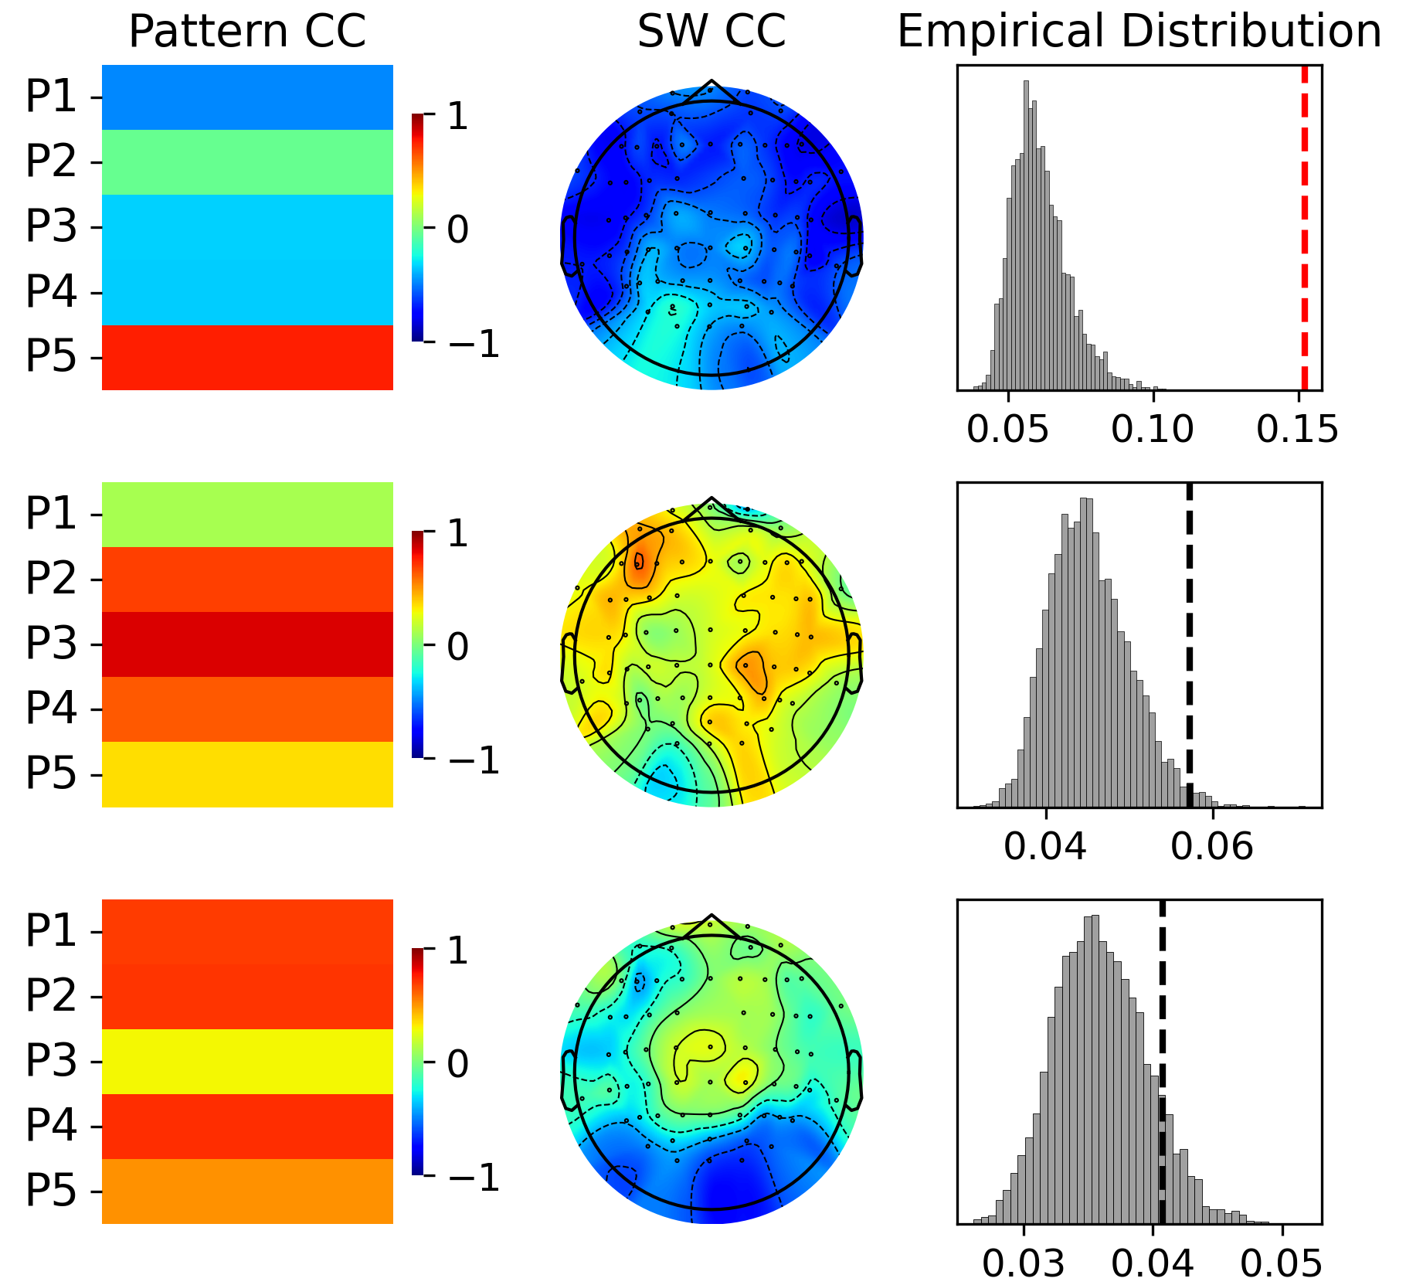
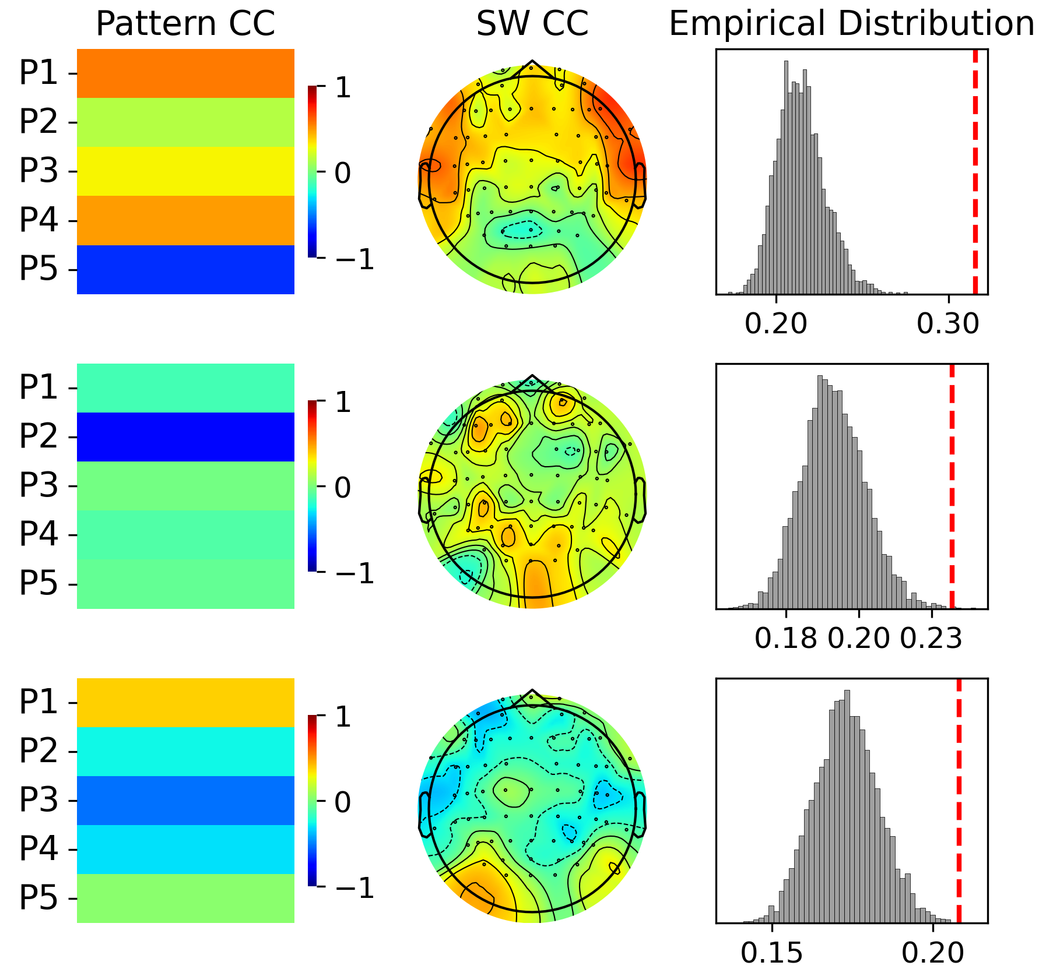
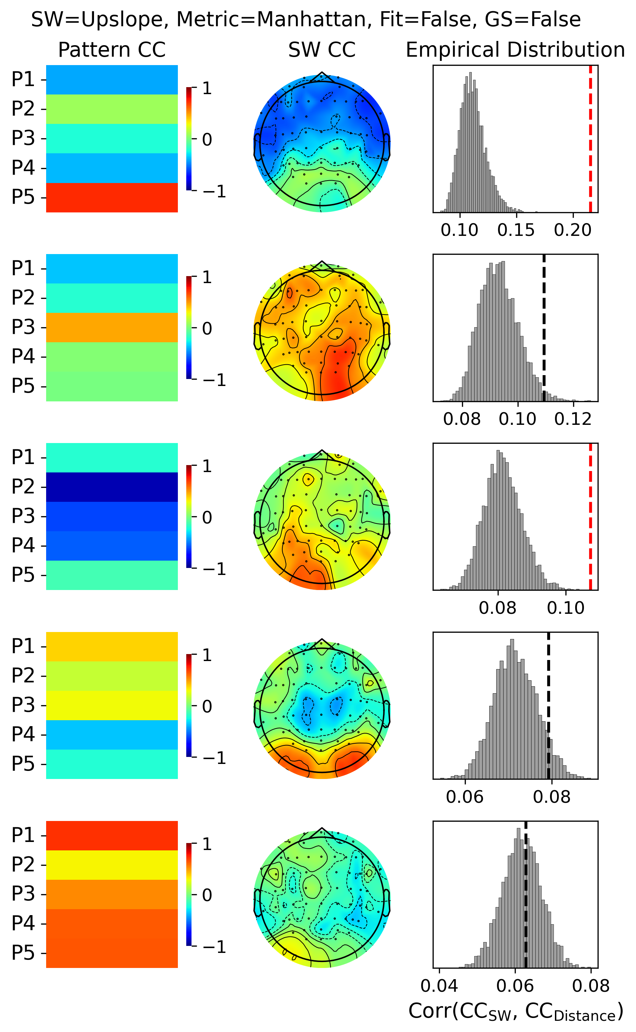
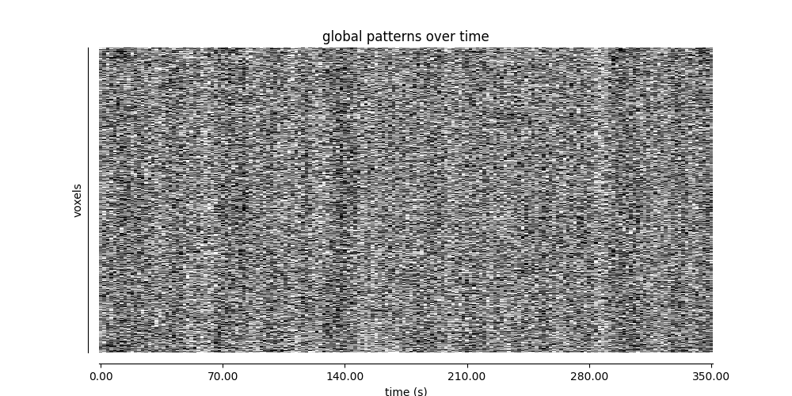
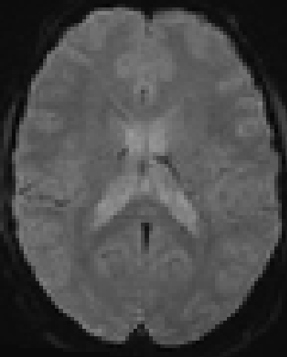
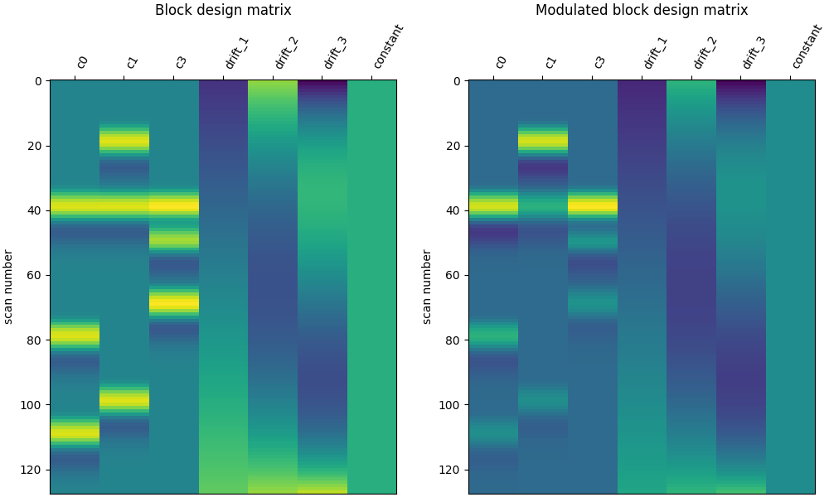
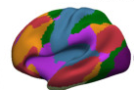
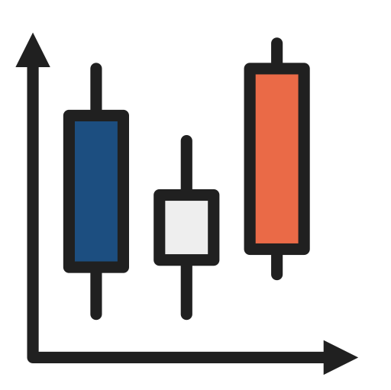
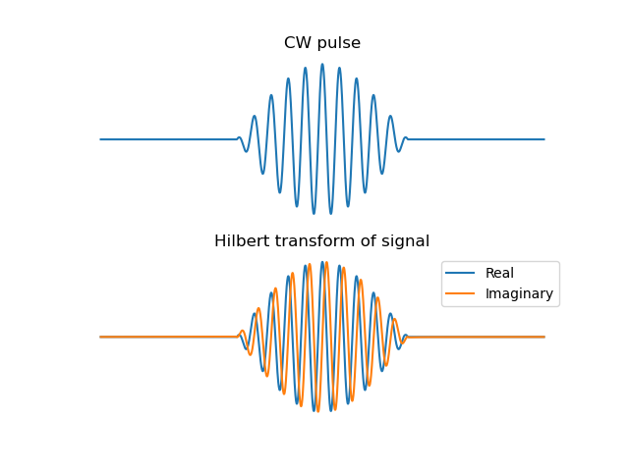
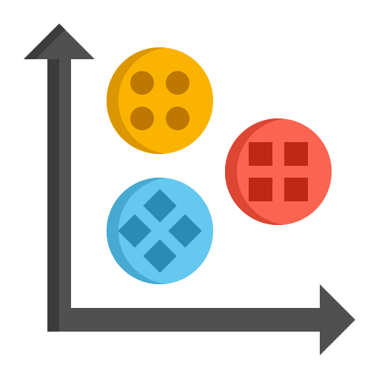
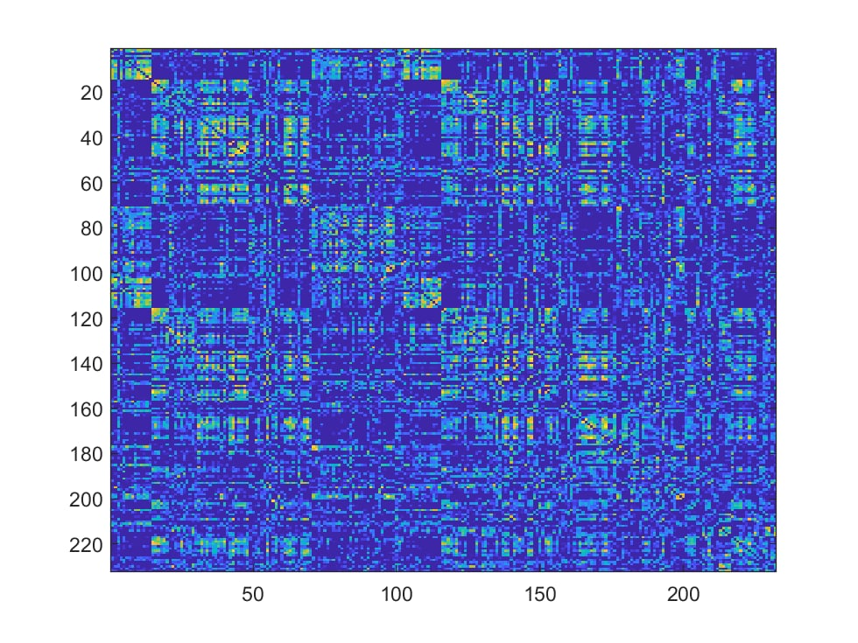
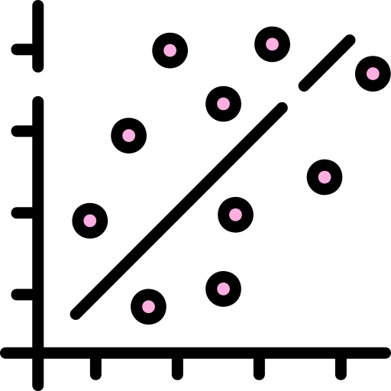




Bridging electrophysiology and neuroimaging to understand
the neuronal correlates of spontaneous thinking and alertness during task-engagement
Paradeisios Alexandros Boulakis ^{1,2,3}, Aniko Kusztor ⁴, Naotsugu Tsuchiya ^{4,5,6}, Thomas Andrillon ⁷, Athena Demertzi ^{1,2,3}
¹Physiology of Cognition Lab, GIGA-Human Imaging Center, Allée du 6 Août 8 (B30), 4000, University of Liège, Belgium
²Fund for Scientific Research FNRS, Rue d’Egmont 5, B –1000, Brussels, Belgium
³Psychology and Neuroscience of Cognition Research Unit, Place des Orateurs 3 (B33), 4000, University of Liège, Belgium
⁴School of Psychological Science, Monash University, Melbourne, Victoria 3168, Australia
⁵Center for Information and Neural Networks (CiNet), National Institute of Information and Communications Technology (NICT), Suita, 565-0871, Osaka, Japan
⁶Advanced Telecommunications Research Computational Neuroscience Laboratories, Soraku-gun, 619-0237, Kyoto, Japan
⁷Institut du Cerveau—Paris Brain Institute—ICM, Inserm, Sorbonne Université, CNRS, APHP, Hôpital de la Pitié Salpêtrière, 75013 Paris, France
paradeisios.boulakis@uliege.be
Introduction
Results
Mind blanking (MB): no reportable or inability to report immediate past content¹
Gap in knowledge: What is the link between hyperconnectivity and SW-like activity?
    H1: MB report frequency will increase in low alertness.
    H2: MB and low alertness BOLD scans will show higher GS.
    H3: MB and low alertness FC will be linked to hyperconnectivity
    H4: Hyperconnectivity will correlate to the presence of SW-like activity.
MB reports are infrequent, but increase in lower self-reported arousal
Cortical Arousal
Task
MW
MB
Global Signal Amplitude²
Arousal GS
Slow wave-like (SW)³
Marker of NREM sleep
Neuronal correlates of MB are associated with reduced cortical arousal
Hyperconnectivity²
Functional Integration
Functional Segregation
GS gradually increases with lower alertness, but does not differ across mental states
Methods
Experimental Design
Hyperconnectivity is linked to sleepiness
K-means parameters
manhattan distance
N clusters examined =3-8
The hyperconnected pattern 5 is linked to the presence of SW-like activity
N = 36, within-subject design
Sustained attention-to-response (SART) during fMRI (Siemens) /EEG (Brain Products)
Intermittent experience sampling of mental states + alertness levels
4 SART blocks with 10 probes per block = 40 probes / participant
SW Amplitude
SW Downslope
SW Upslope
Analysis
*
*
*
ROI Signal Extraction
Voxels
Raw BOLD
fMRIPrep
Denoise
Signal Extraction
Time
Fit events : [True, False]
Remove GS: [True, False]
Parcels: [100, 400]
Discussion
Global Signal Amplitude Analysis
States ~ GS amplitude
GLM
Hilbert -Amplitude
MB is an alertness-modulated mental state.
As people become less alert, the chance to report MB increases
Hyperconnectivity is linked to lower alertness.
Time-varying FC organizes in replicable patterns.
Hyperconnected pattern tracks sleepiness, not MB per se.
GS does not only track cortical and physiological arousal, but also experienced alertness.
Neuronal component of GS reflects arousal.
Arousal propagates -> cortical synchronization and increase in GS amplitude.
SW topology promoted distinct connectivity patterns.
All SW markers are linked to the hyperconnected brain pattern.
Fundamental mode of cortical organization ?
Brain-Behavioral Coupling
Lags: [0,1,2]
States ~ Distance
GLM
FC Clustering
Time-varying FC
FC
Hilbert - Phase
Canonical Correlations
Clusters: [3,4,5,6,7,8]
Pattern Distance
Systematic variation of preprocessing / analysis
Generalized mixed-effects modeling
Compared against null models
FDR-corrected contrasts
Equivalence tests for H0 support
References
SW-like activity
Boulakis, P. A., & Demertzi, A. (2025). Relating mind-blanking to the content and dynamics of spontaneous thinking. Current Opinion in Behavioral Sciences, 61, 101481.
Mortaheb, S., Van Calster, L., Raimondo, F., Klados, M. A., Boulakis, P. A., Georgoula, K., Majerus, S., Van De Ville, D., & Demertzi, A. (2022). Mind blanking is a distinct mental state linked to a recurrent brain profile of globally positive connectivity during ongoing mentation. Proceedings of the National Academy of Sciences, 119(41), e2200511119.
Andrillon, T., Burns, A., Mackay, T., Windt, J., & Tsuchiya, N. (2021). Predicting lapses of attention with sleep-like slow waves. Nature Communications, 12(1), 3657.

