Slide 1
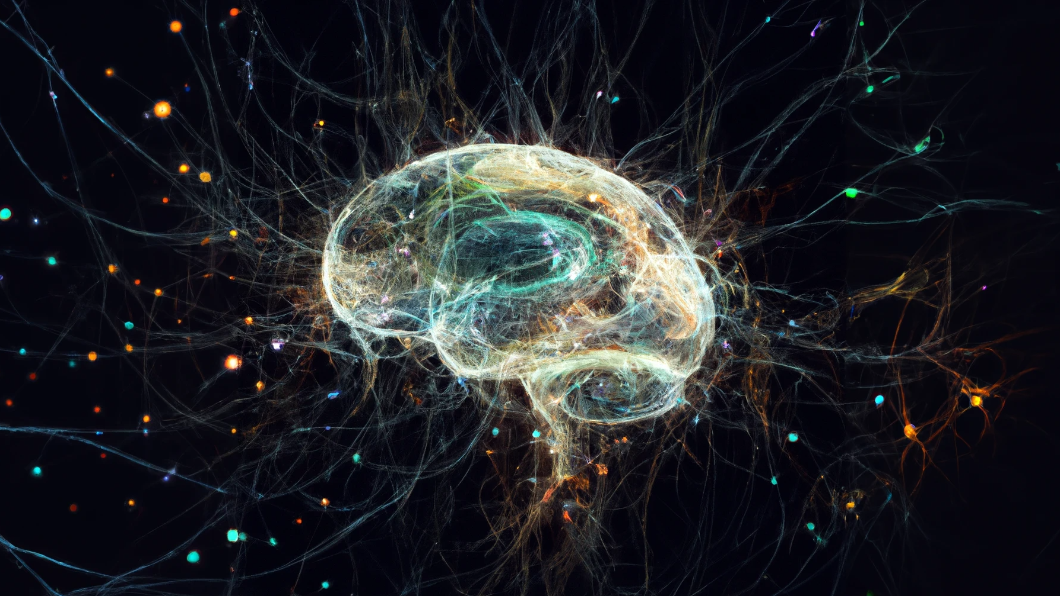



Neuromodulation and homeostasis: complementary mechanisms for robust neural function
Arthur Fyon & Guillaume Drion
March 20th 2025
Notes:
This thesis is about neurons but we need first to understand what they are

Slide 2

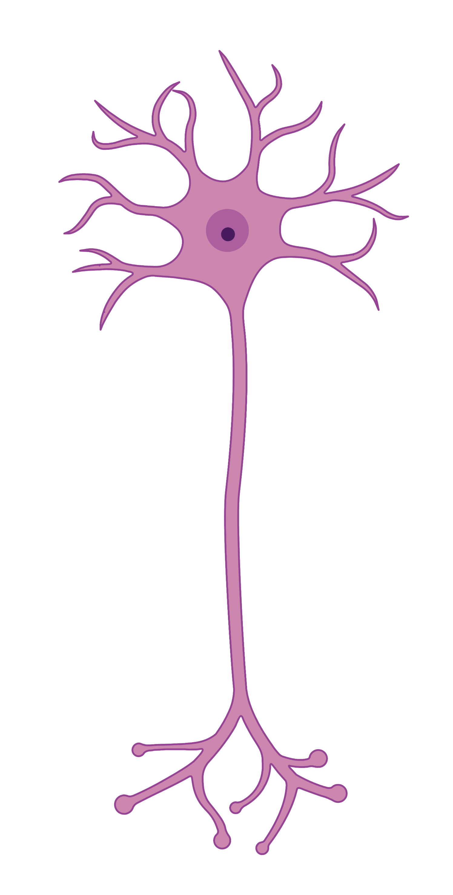

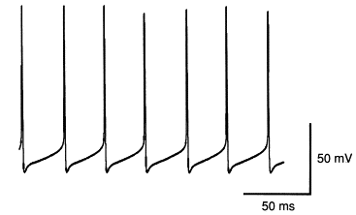
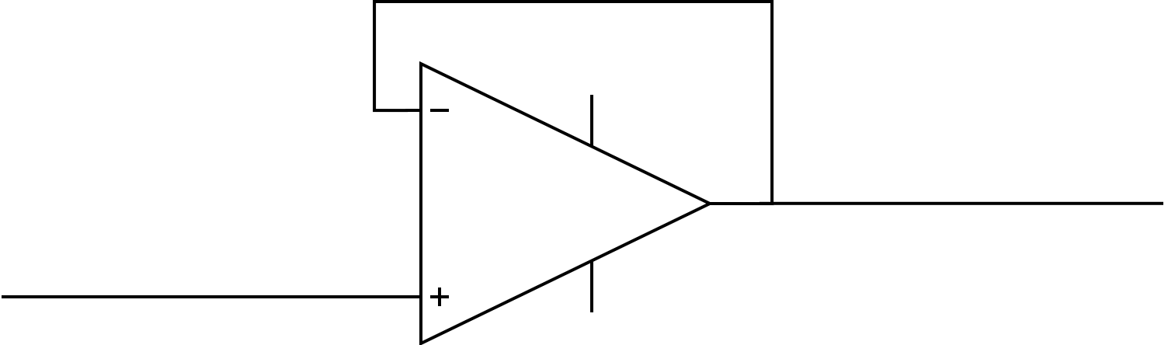
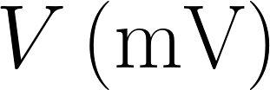

Neurons use spikes to communicate
Jefferys et al., 1996
1
Notes:
Neurons are the cells processing the information and responsible for cognition. It uses electrical signal to communicate. Information is transmitted during a spike. Don’t need to describe the spike.

Slide 3
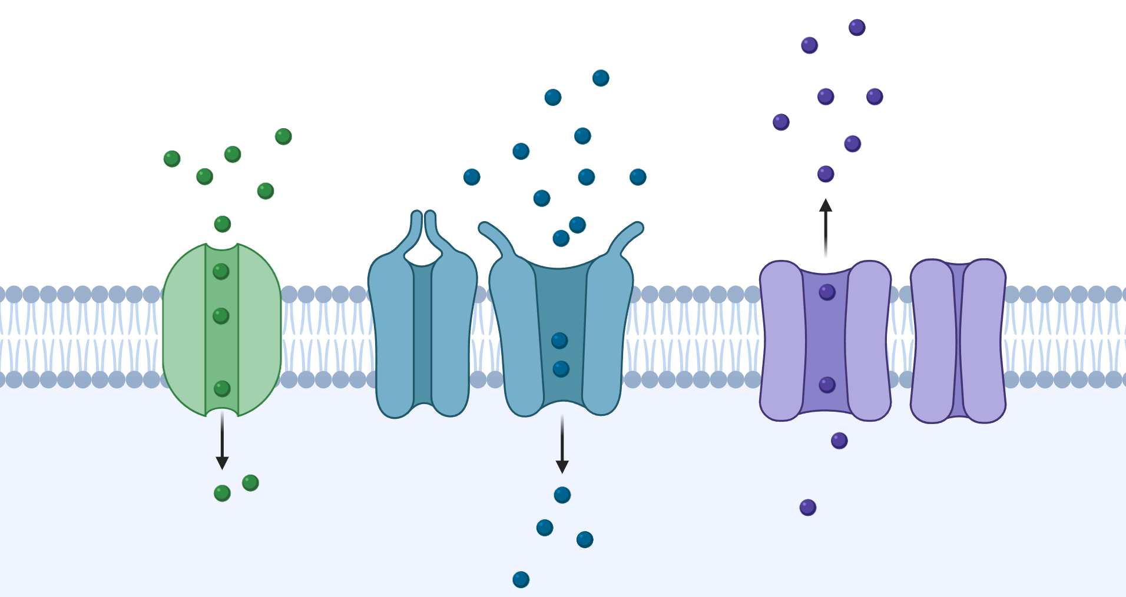
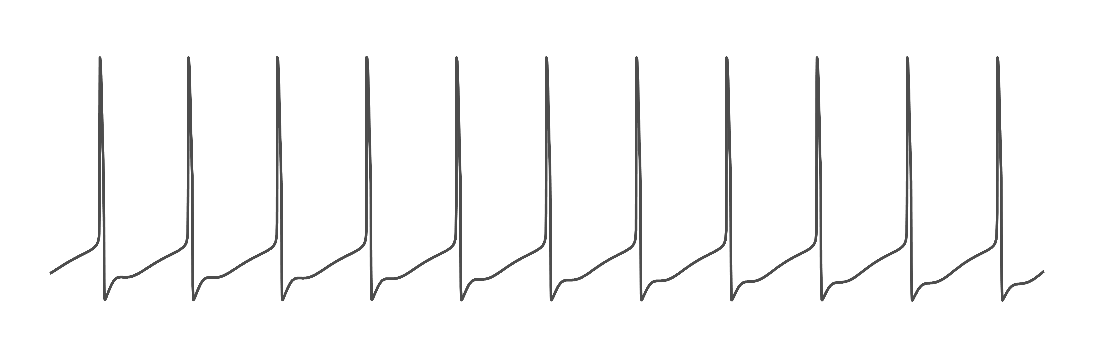
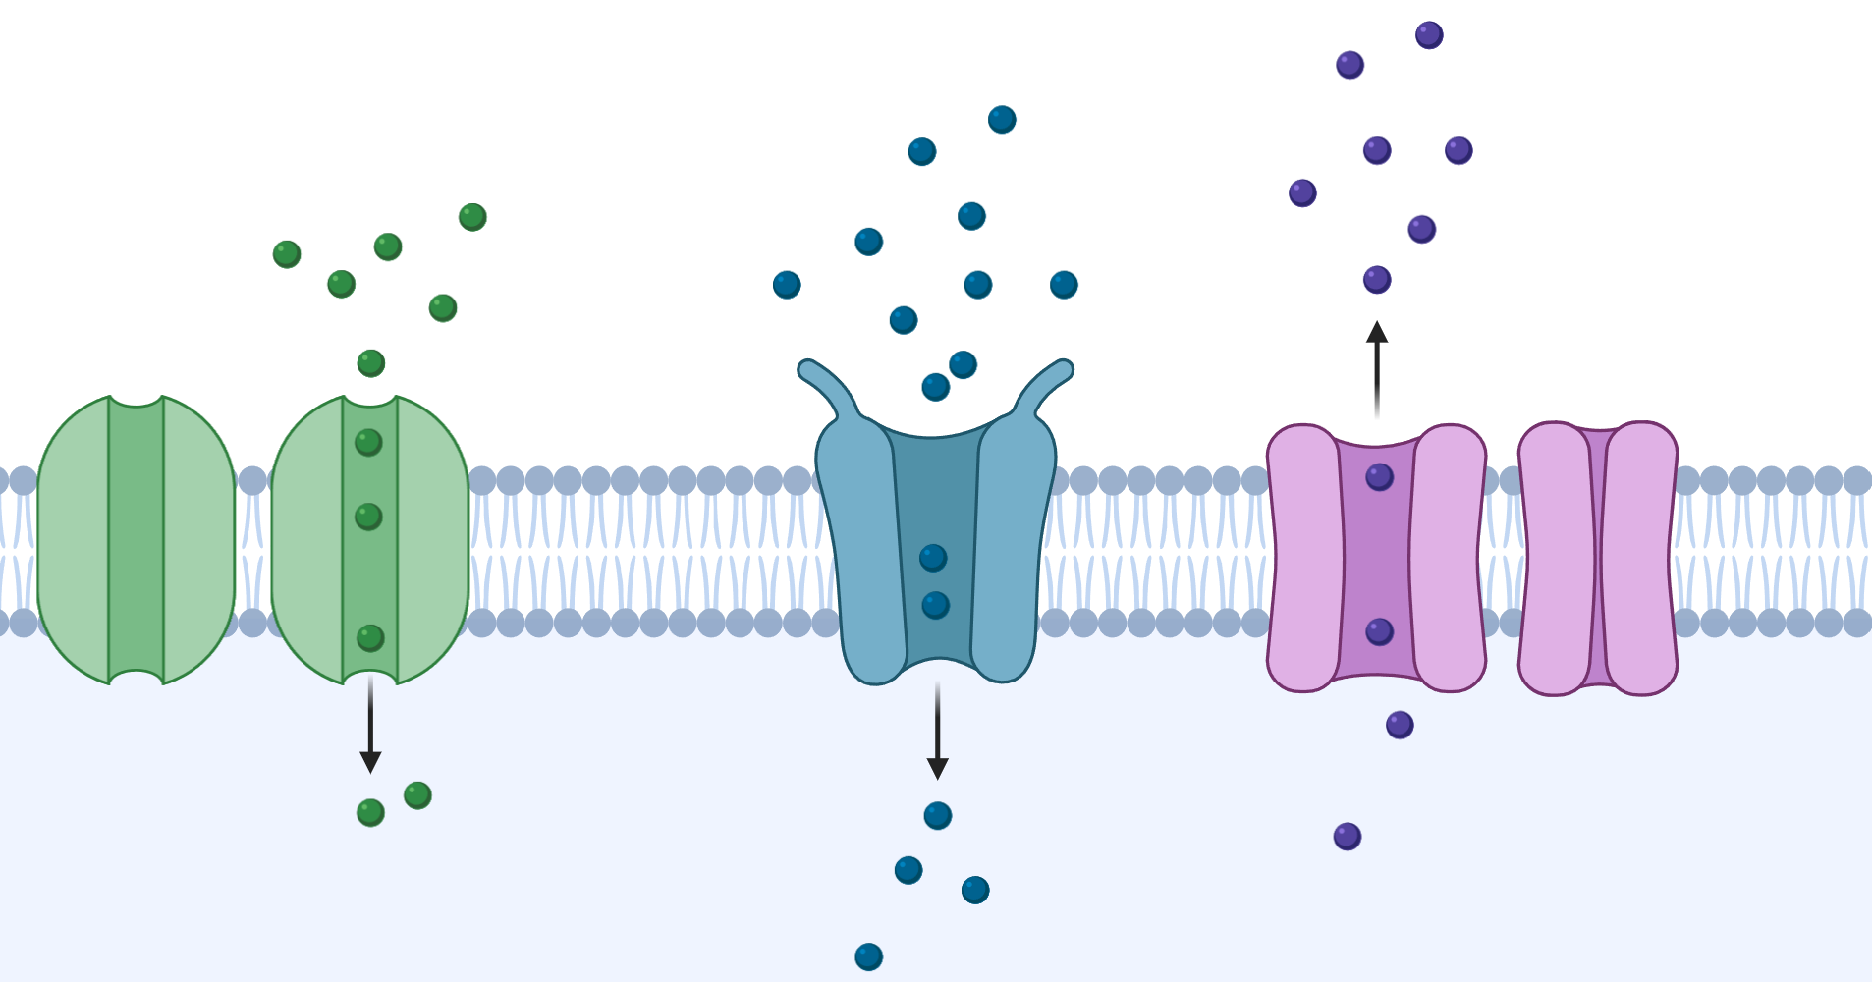
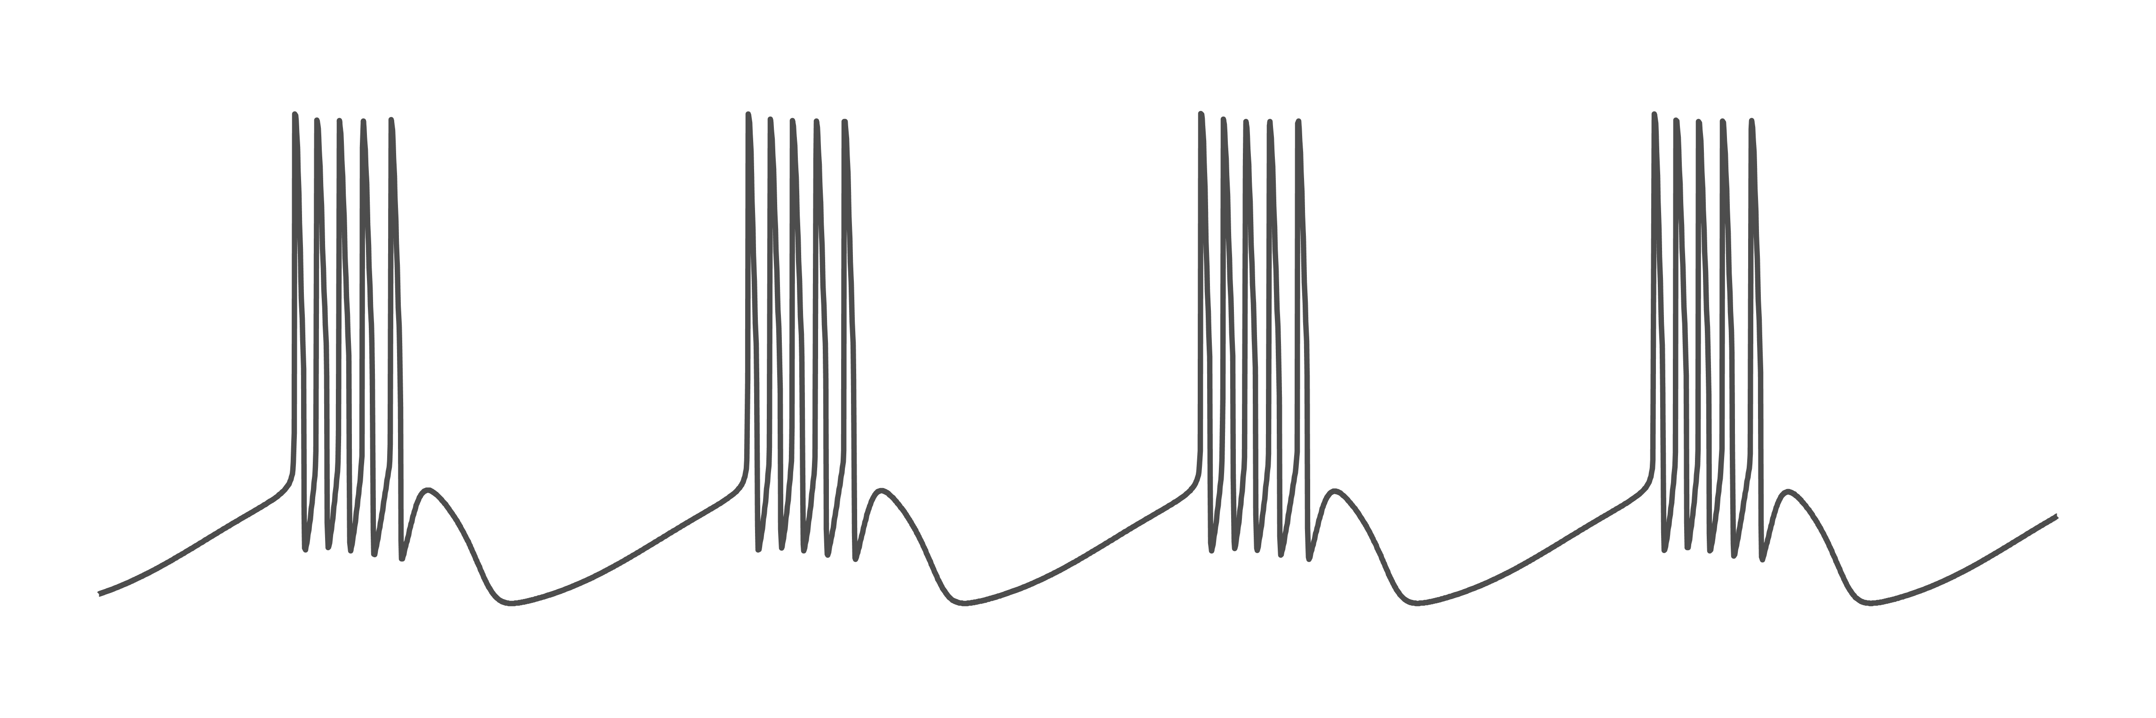



Ion channels determine spiking activity
$$Na^{+}$$
$$Ca^{++}$$
$$K^{+}$$
2
Notes:
How does that work ? Ion channels are responsible of this electrical signal. No change in ion. Change type of channel by changing the kinetics of the channel. They are voltage gated, and produce a current, which affects the voltage and so on. Only change in type and density.

Slide 4

Voltage gated ion channels are involved in a feedback loop
Voltage
Channel current
Voltage gated ion channel
Voltage activity
3
Notes:
Voltage gated ion channel opening depends on the membrane voltage. However, once they change their permeability, they will produce a channel current, that, in turn, affect the membrane voltage, and so on. So, we already see that this is involved in a complex feedback loop.

Slide 5
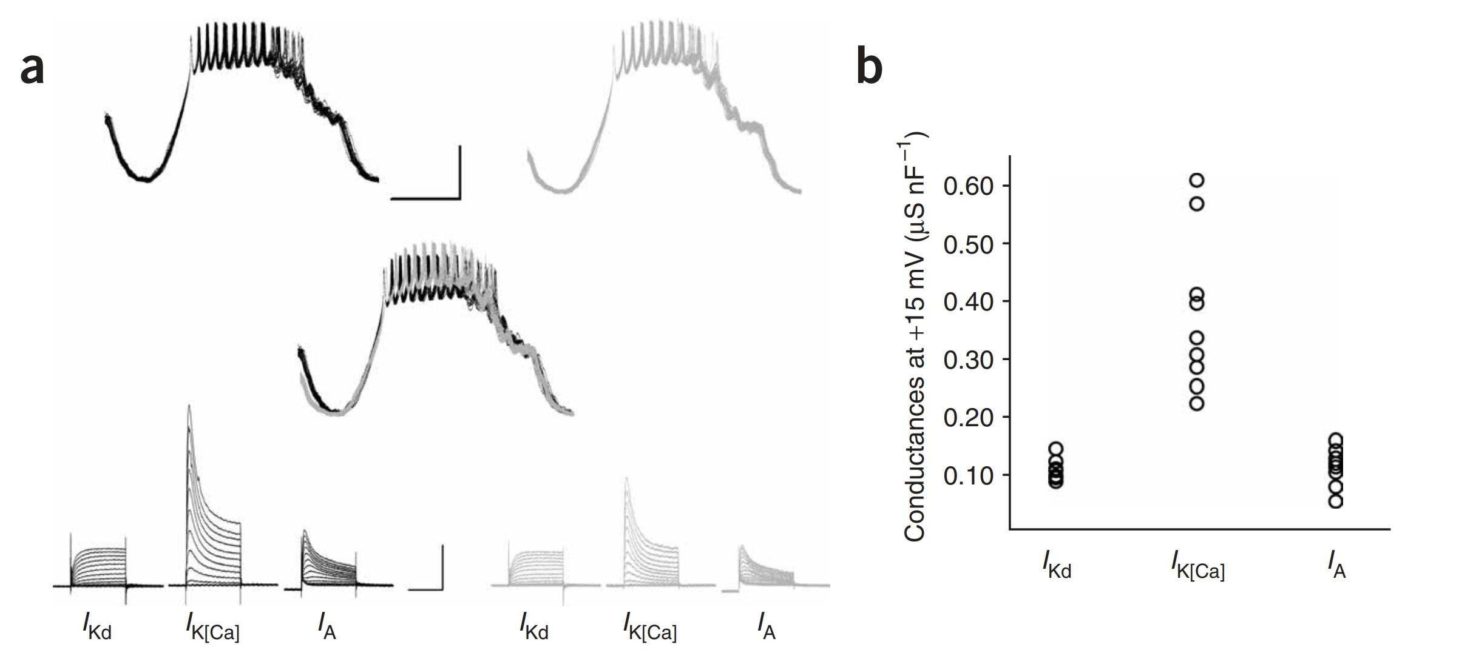
Degeneracy consists in similar activities emerging from different channel densities
Up to several folds !
Schulz et al., 2006
3
Notes:
Not use exact

Slide 6
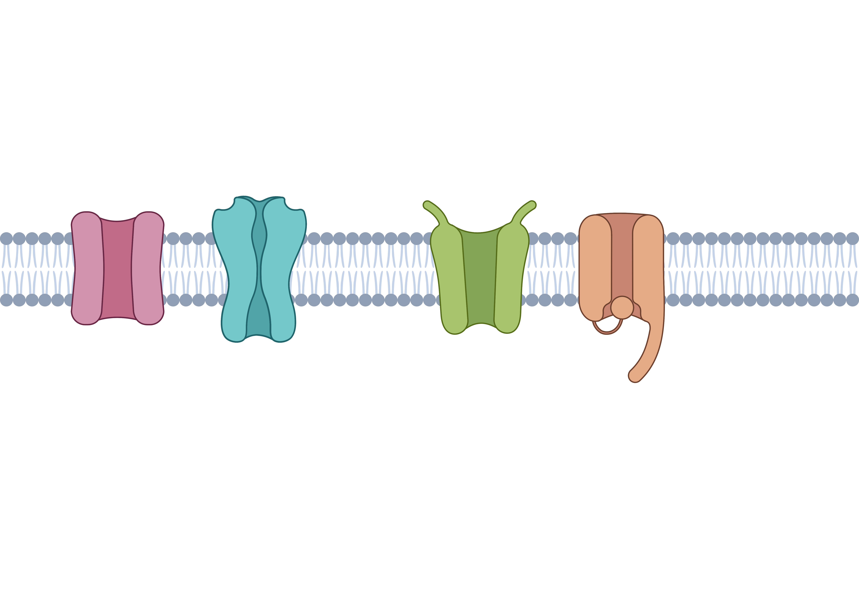
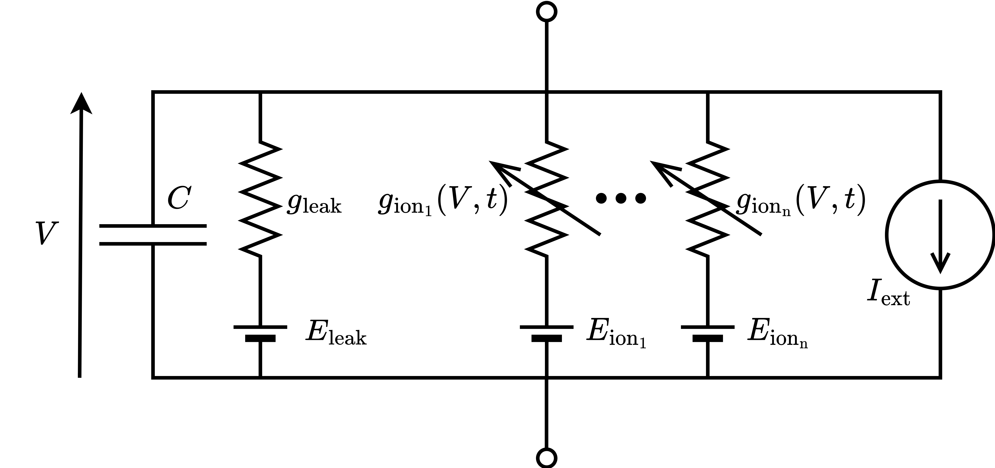
Conductance based models are composed of ion channels
4
Notes:
We chose to study the effect of nmod on g_bar, which is dominant

Slide 7
I. Neuromodulation seen as a controller
How can neuromodulation and homeostasis cooperate to produce robust function ?
II. Homeostasis seen as a controller
III. Cooperation to robust neural function
5
Notes:
There are many answers but no real agreement on that question.

Slide 8
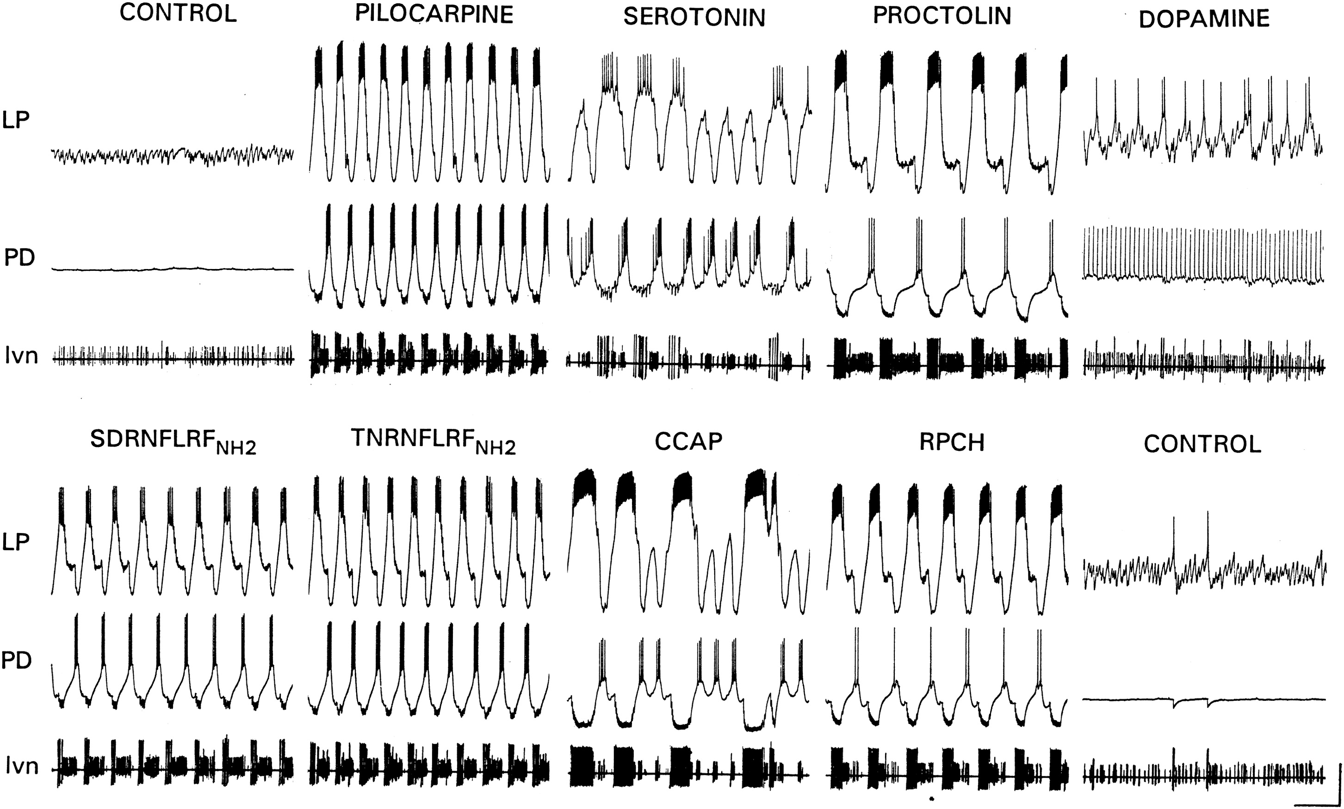
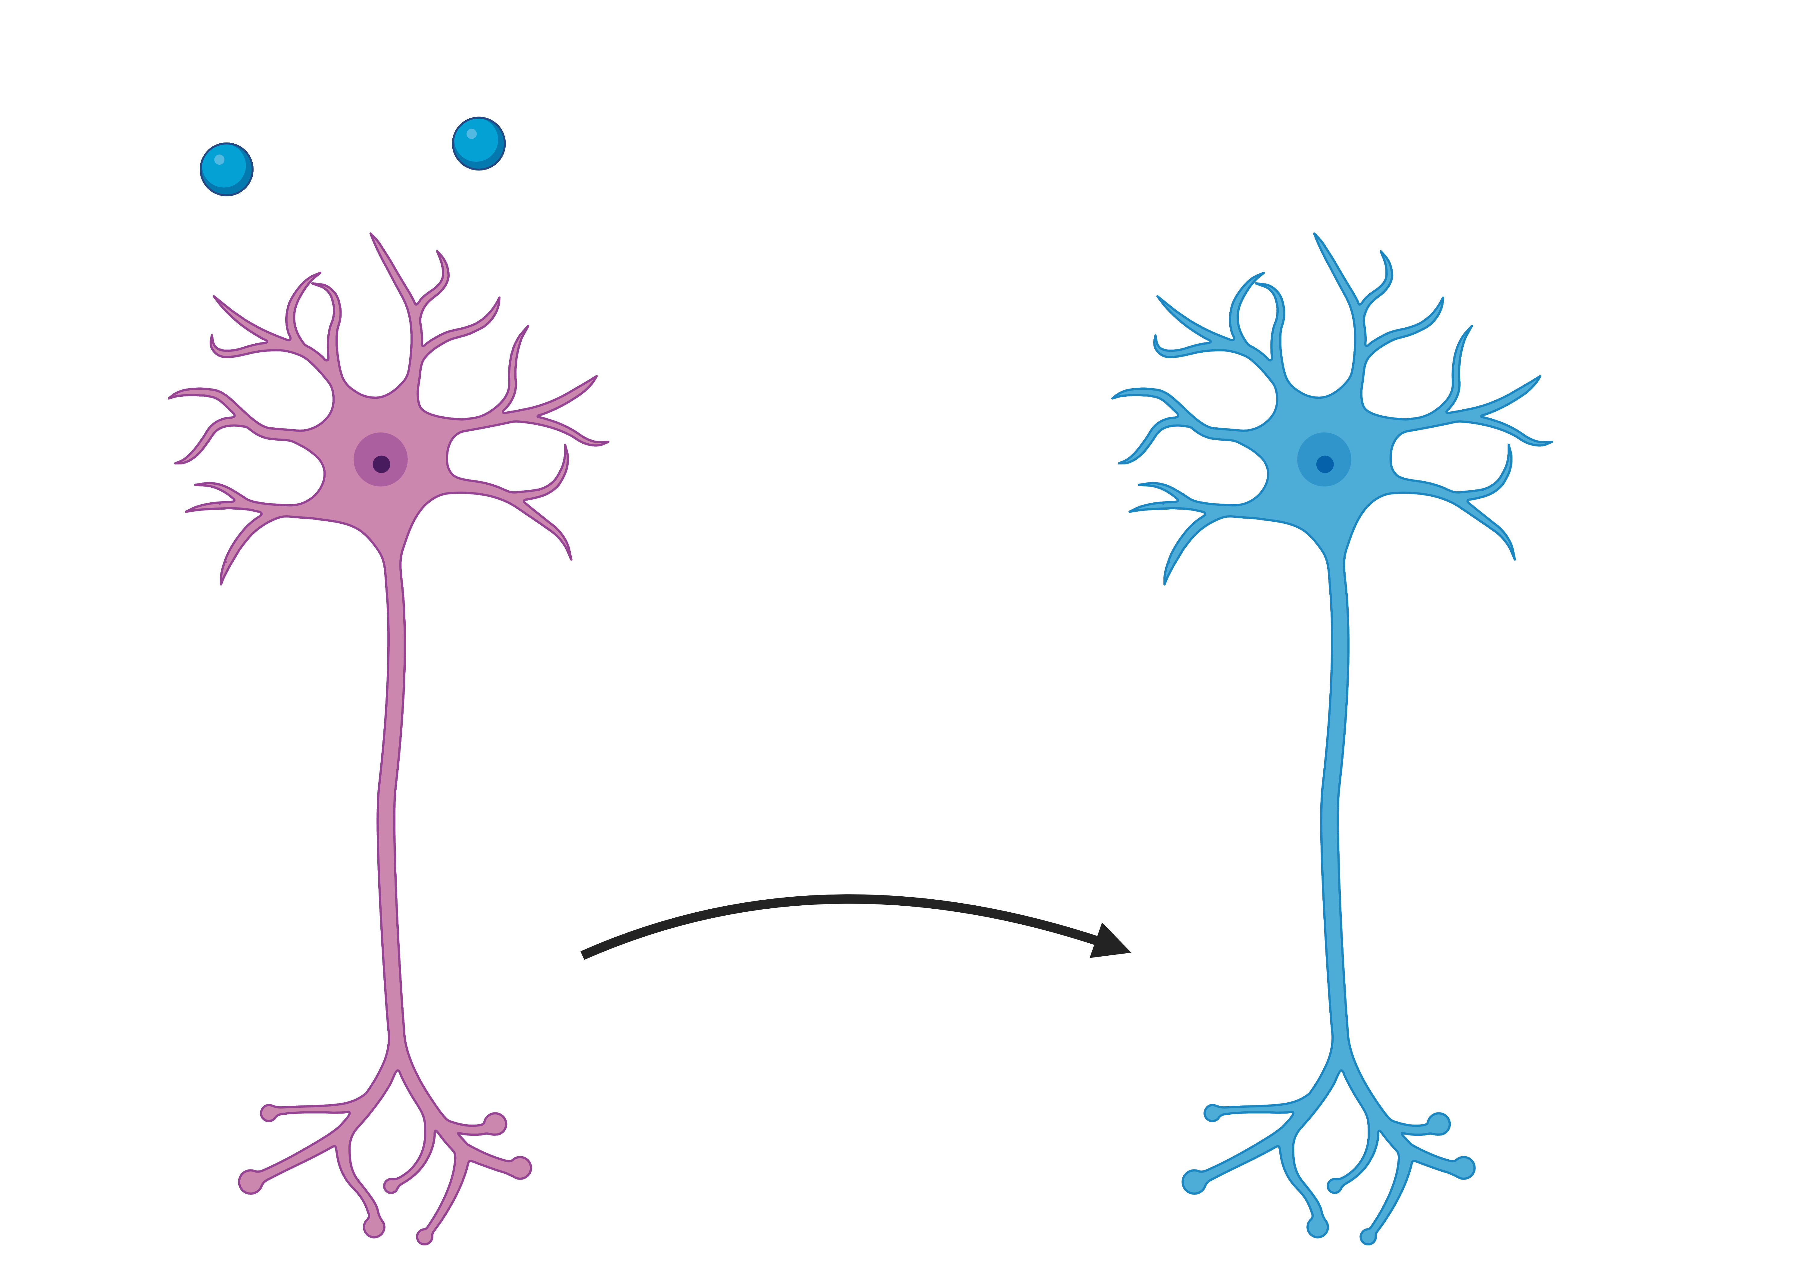
Neuronal activity is highly modulated
Control activity
Pilocarpine
Dopamine
Neuromodulation
Crustacean Cardioactive Peptide
Marder, 2012
7
Notes:
This activity is very plastic and neuromodulated. Don’t cite neuromodulators. There are many neuromodulators, here is an example of 3. Why is that useful ? On the left, motor circuit OFF, on the right, sometimes ON.

Slide 9
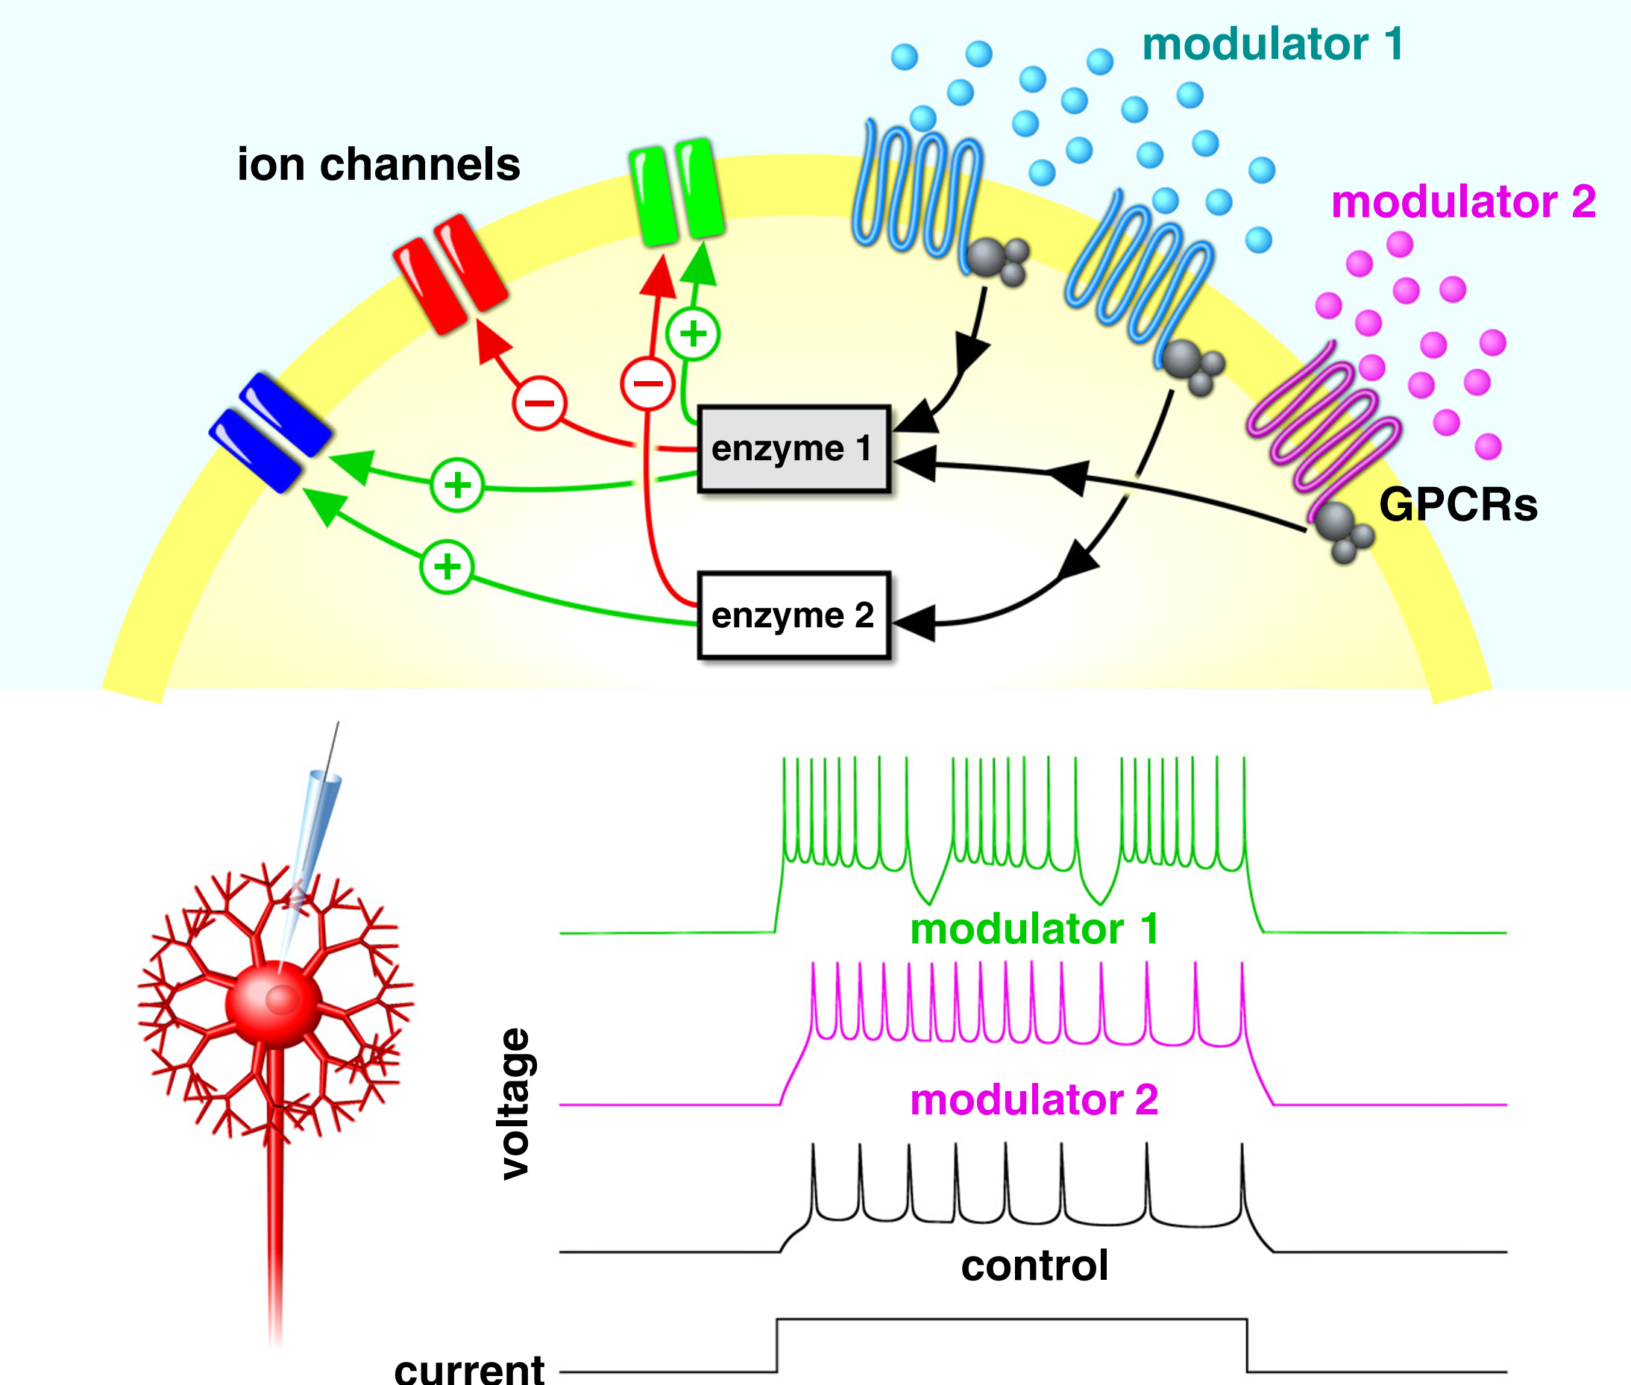
Neuromodulation affects ion channels
molecular cascade 1
molecular cascade 2
Nadim and Bucher, 2014
6
Notes:
We don’t know everything, and it has never been modeled.

Slide 10
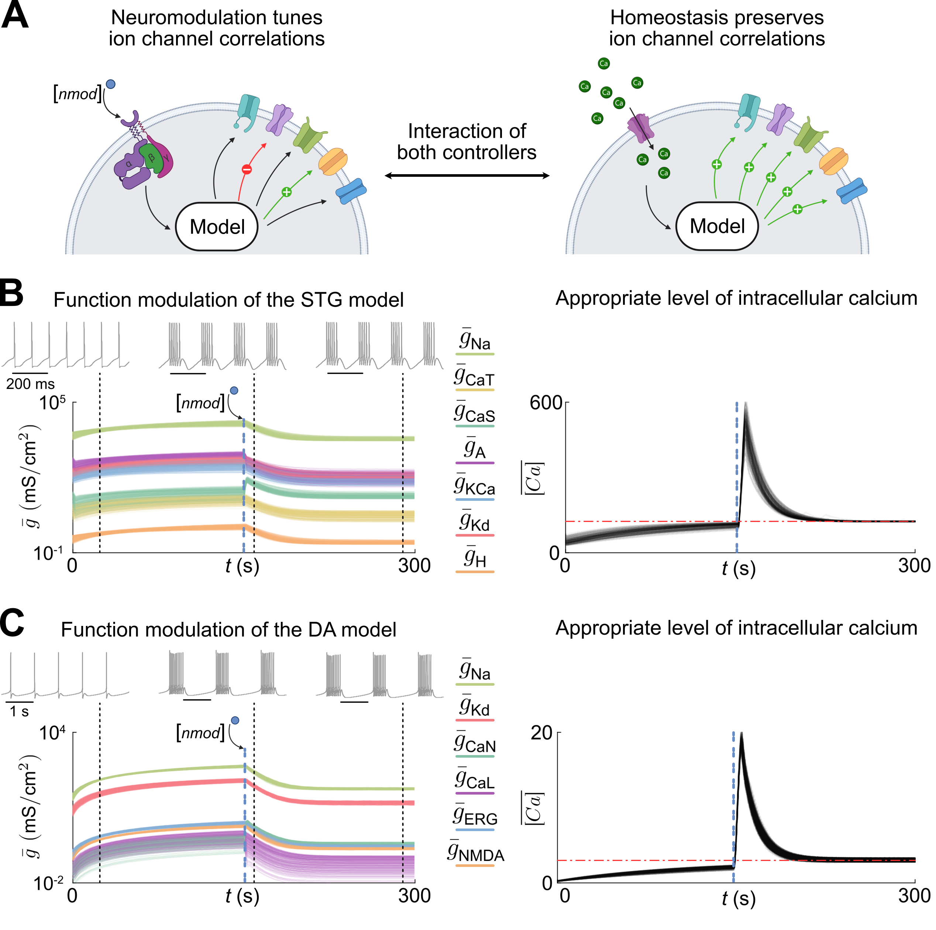
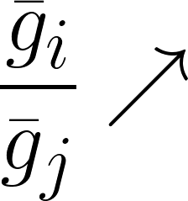
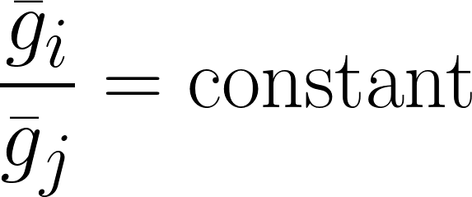
Neuromodulation as a controller
Fyon et al., 2023
7
Notes:
Speak about both controllers timescales

Slide 11
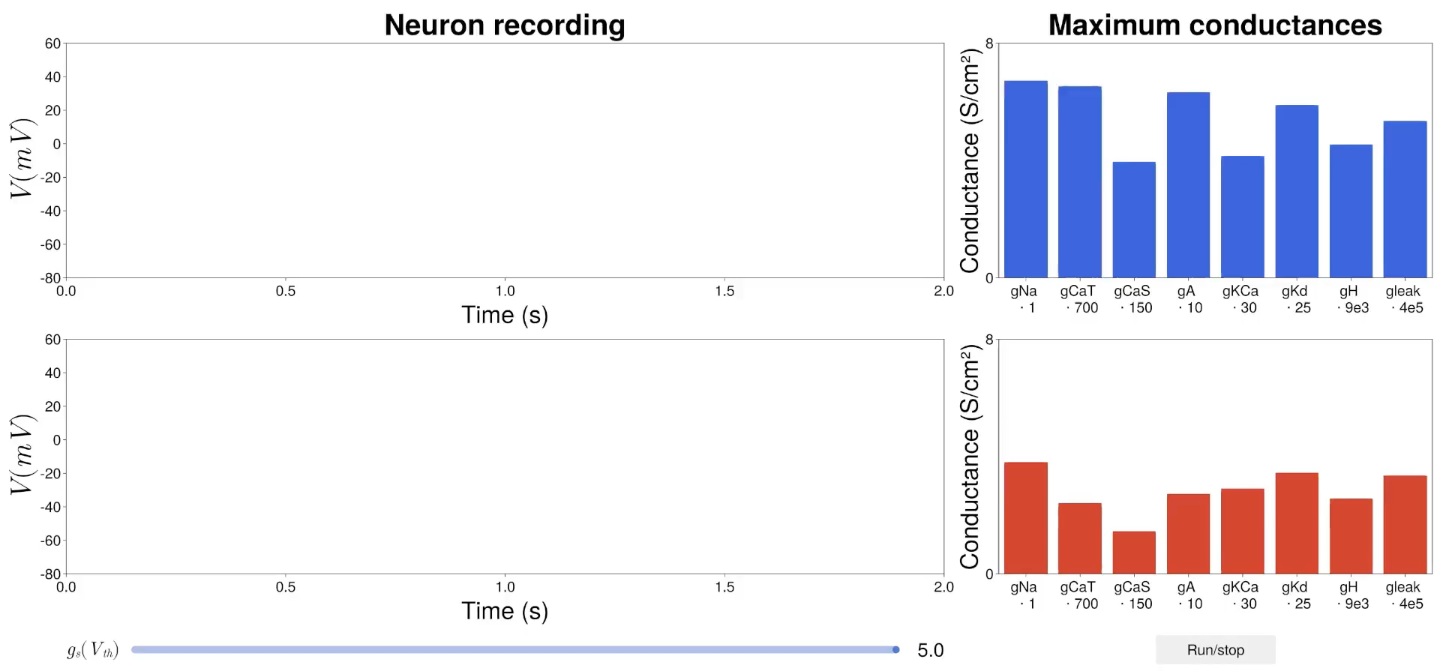
Two degenerate neurons are modulated in a similar way
8

Slide 12
I. Neuromodulation seen as a controller
How can neuromodulation and homeostasis cooperate to produce robust function ?
II. Homeostasis seen as a controller
III. Cooperation to robust neural function
9
Notes:
There are many answers but no real agreement on that question.

Slide 13
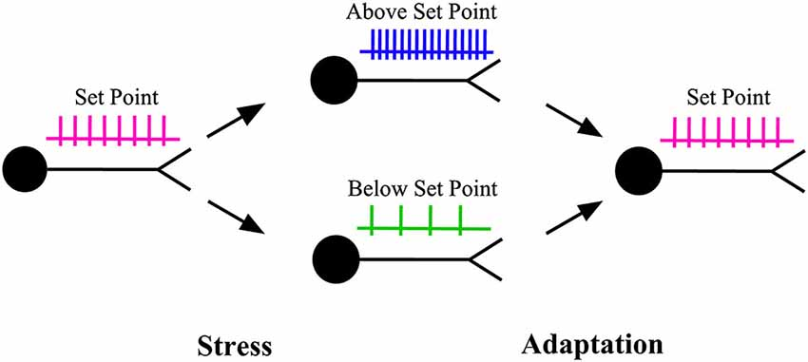
Homeostatic plasticity preserves function
Karunanithi and Brown, 2015
10
Notes:
Sensor of mean intracellular calcium to up or downregulate. Ratios of conductances are genetically encoded. Physiological origin of homogeneous scaling.

Slide 14
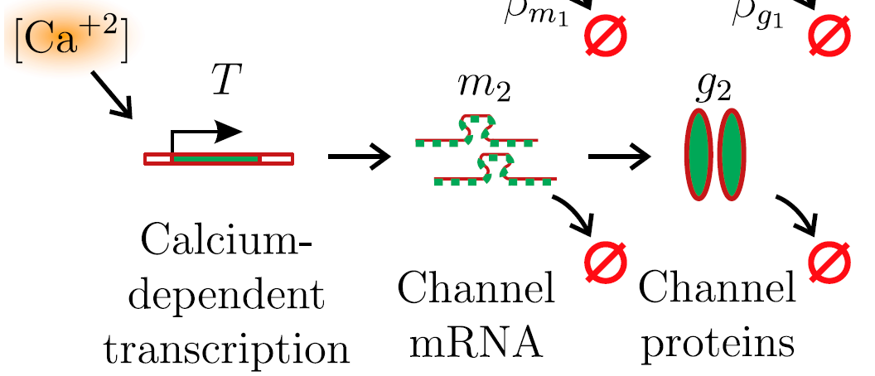


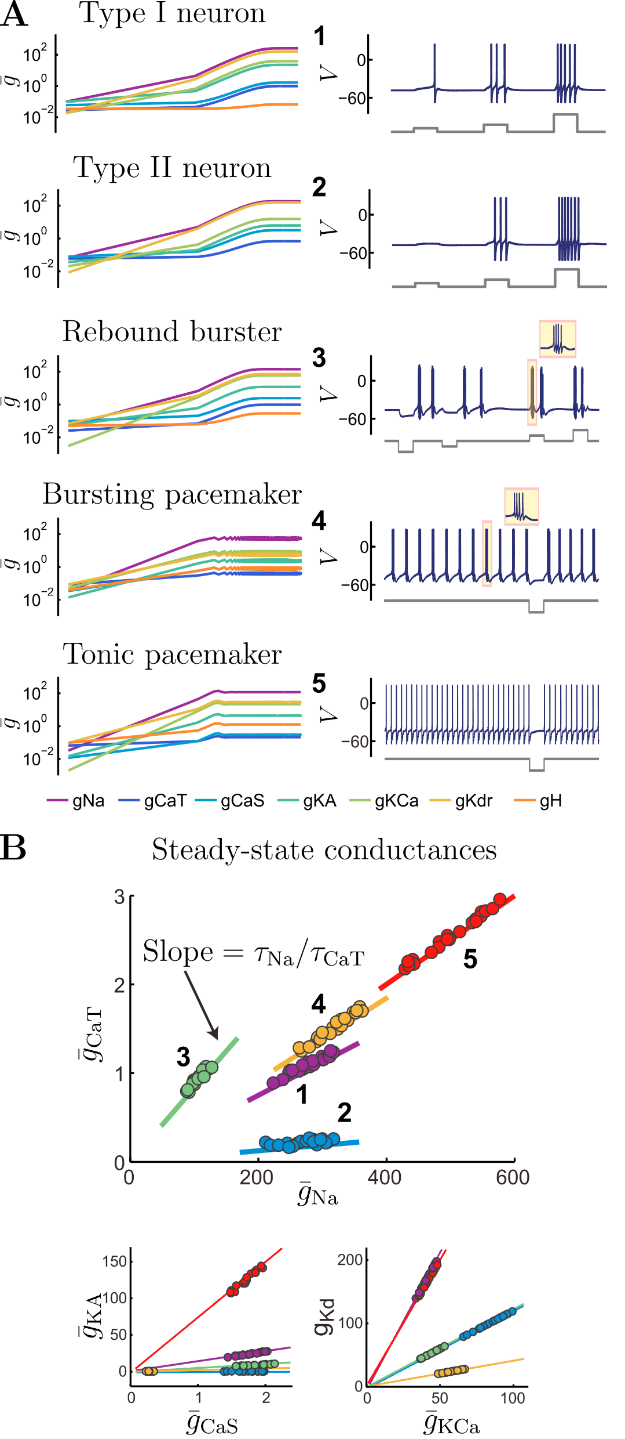
A model of homeostatic control
O’Leary et al., 2014
11
Notes:
Sensor of mean intracellular calcium to up or downregulate. Ratios of conductances are genetically encoded. Physiological origin of homogeneous scaling.

Slide 15
Homeostasis as a controller
12
Notes:
Speak about both controllers timescales

Slide 16
I. Neuromodulation seen as a controller
How can neuromodulation and homeostasis cooperate to produce robust function ?
II. Homeostasis seen as a controller
III. Cooperation to robust neural function
13
Notes:
There are many answers but no real agreement on that question.

Slide 17
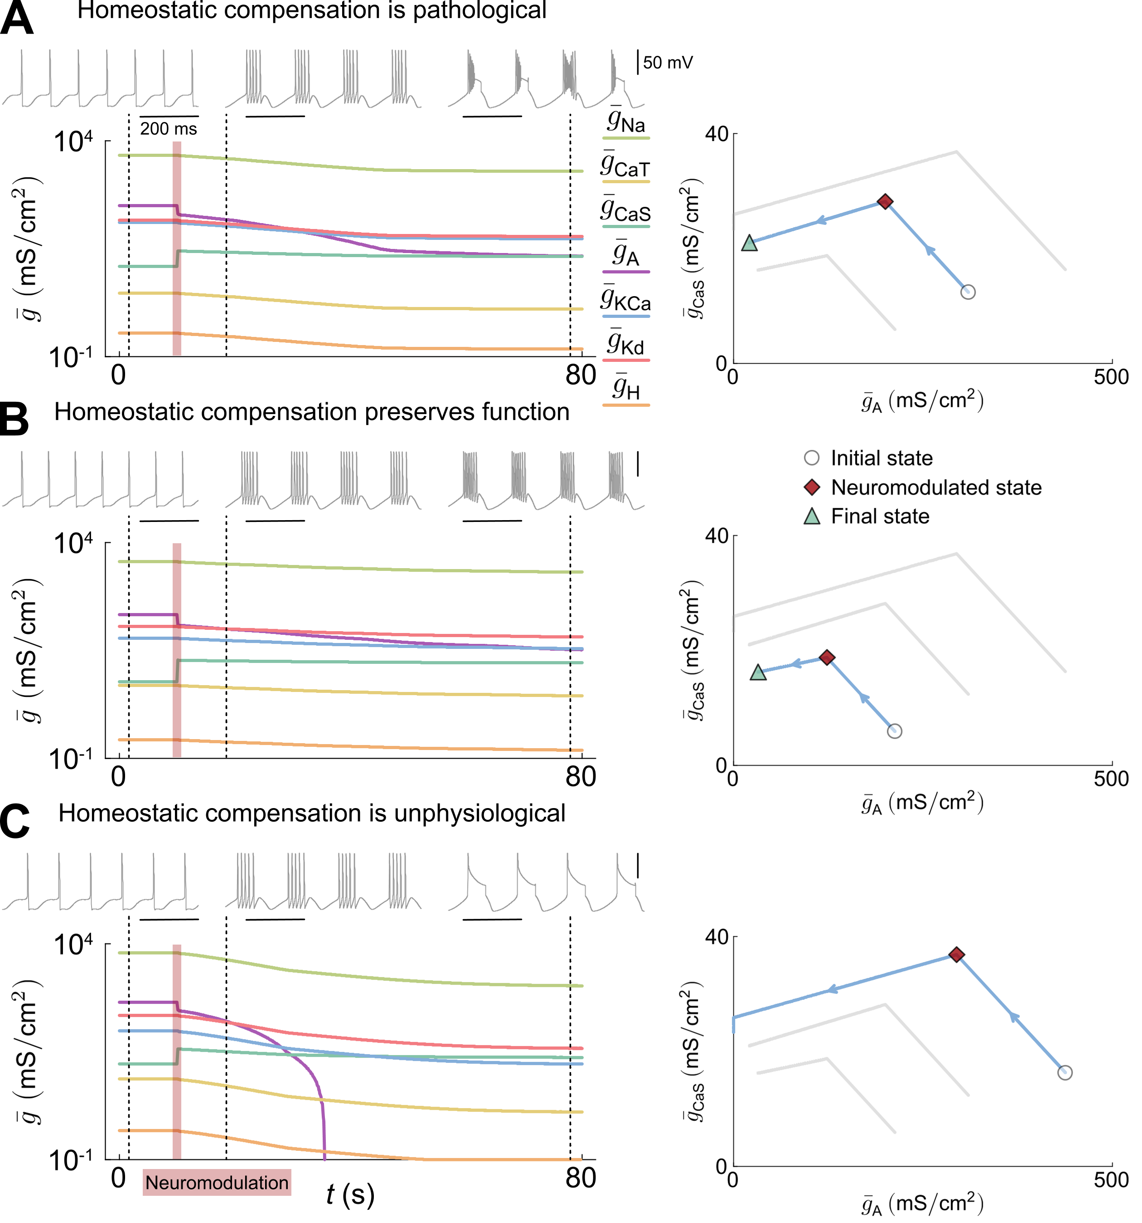
Homeostasis can lead to pathological excitability in the presence of sharp neuromodulation
14
Notes:
Naïve way of nmod

Slide 18
Homeostasis can lead to pathological excitability in the presence of sharp neuromodulation
14

Slide 19
Homeostasis can lead to pathological excitability in the presence of sharp neuromodulation
14

Slide 20
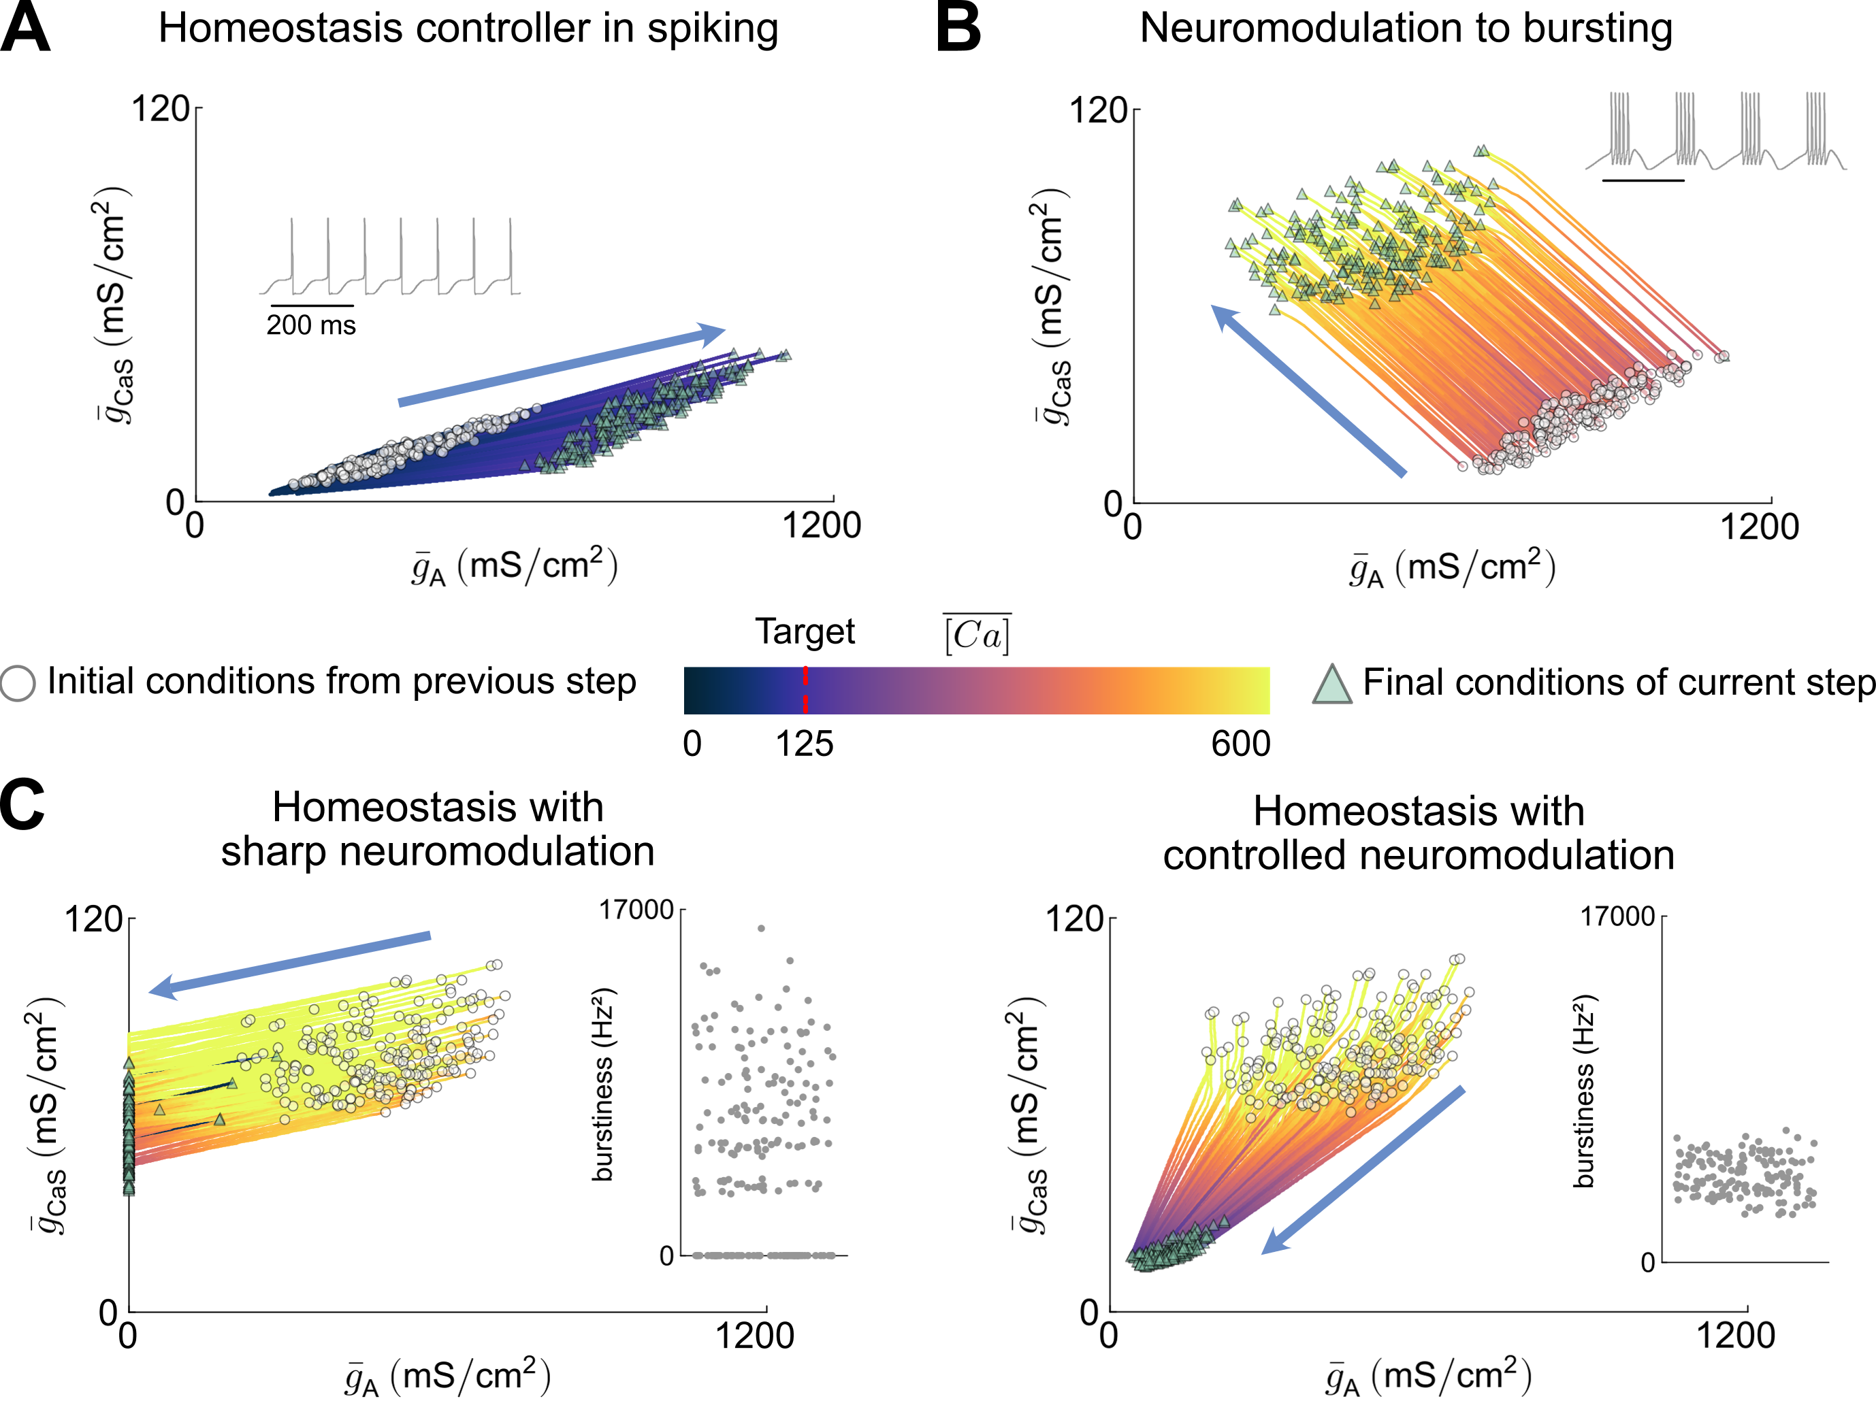
Why do sharp neuromodulation and homeostasis do not lead to robust neural function?
15

Slide 21
Controlled neuromodulation and homeostasis naturally lead to robust neuronal function
Interaction
N = 200
16
Notes:
Speak about both controllers timescales

Slide 22
Why do controlled neuromodulation and homeostasis lead to robust neural function?
17

Slide 23
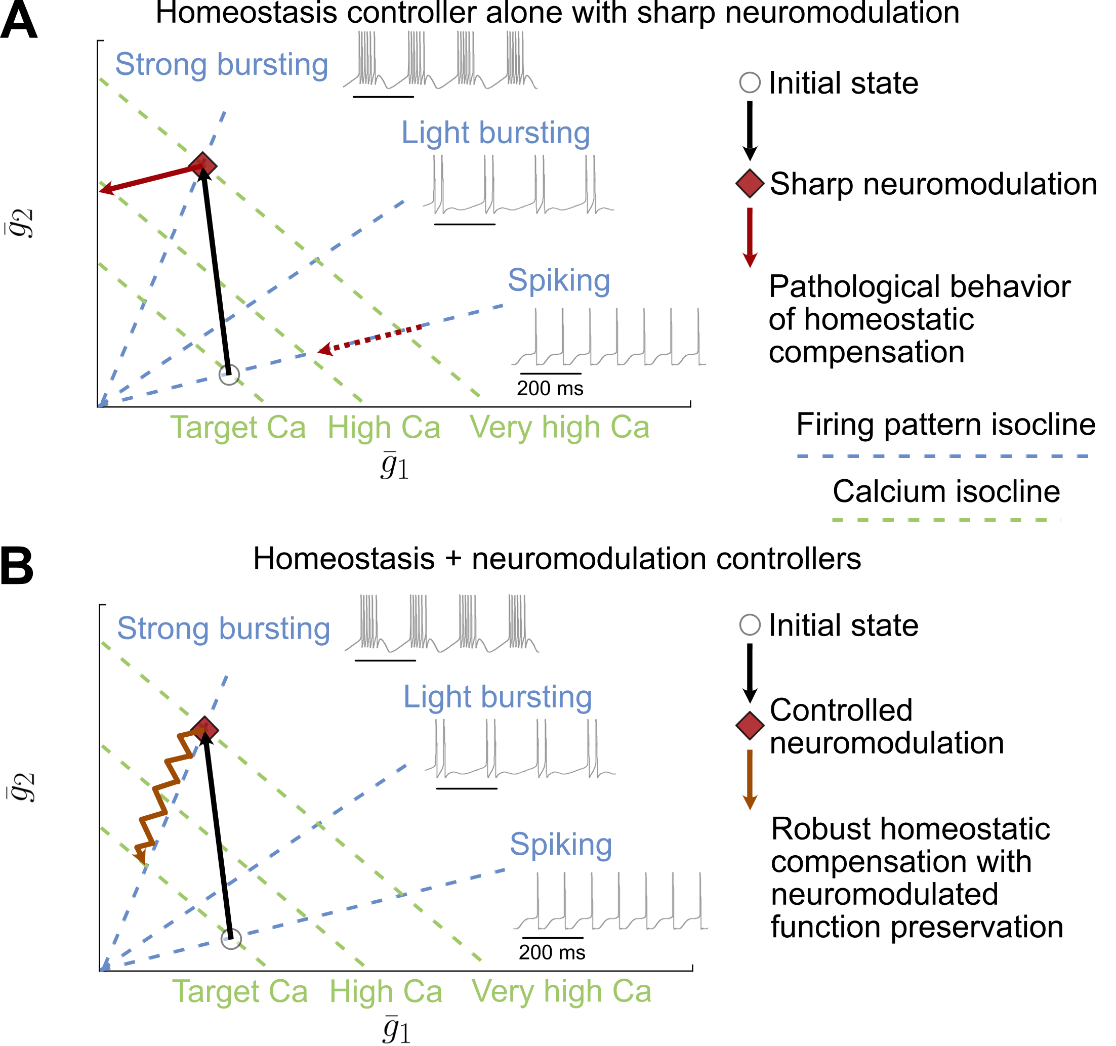
Why do controlled neuromodulation and homeostasis lead to robust neural function?
18

Slide 24
I. Neuromodulation seen as a controller
How can neuromodulation and homeostasis cooperate to produce robust function ?
II. Homeostasis seen as a controller
III. Cooperation to robust neural function
19
Notes:
There are many answers but no real agreement on that question.

Slide 25
Supplemental material

Slide 26
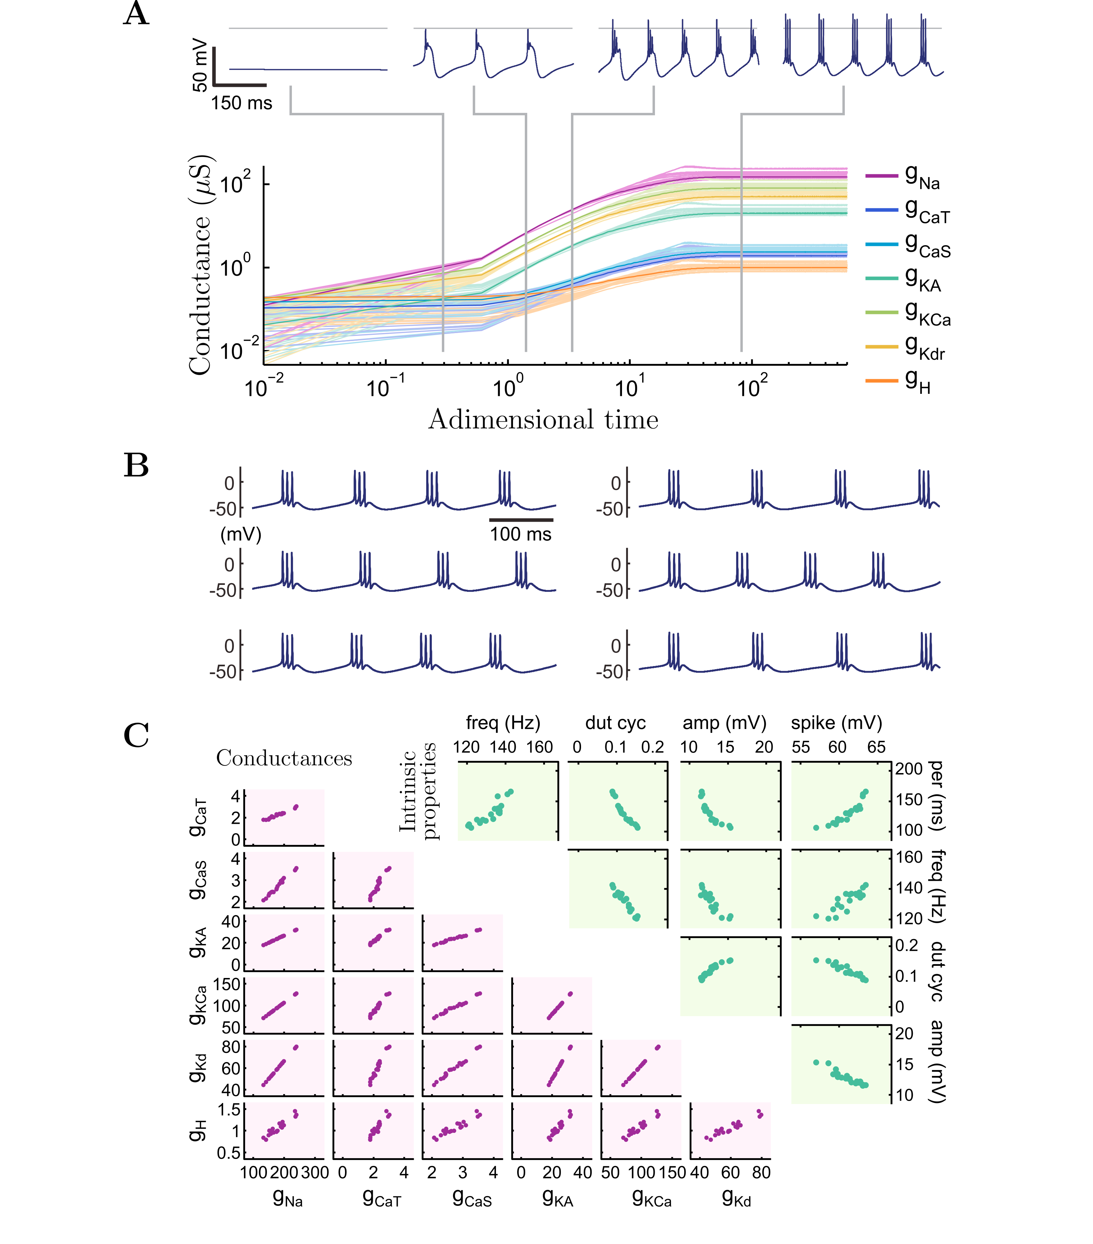
O’leary et al., 2014

Slide 27
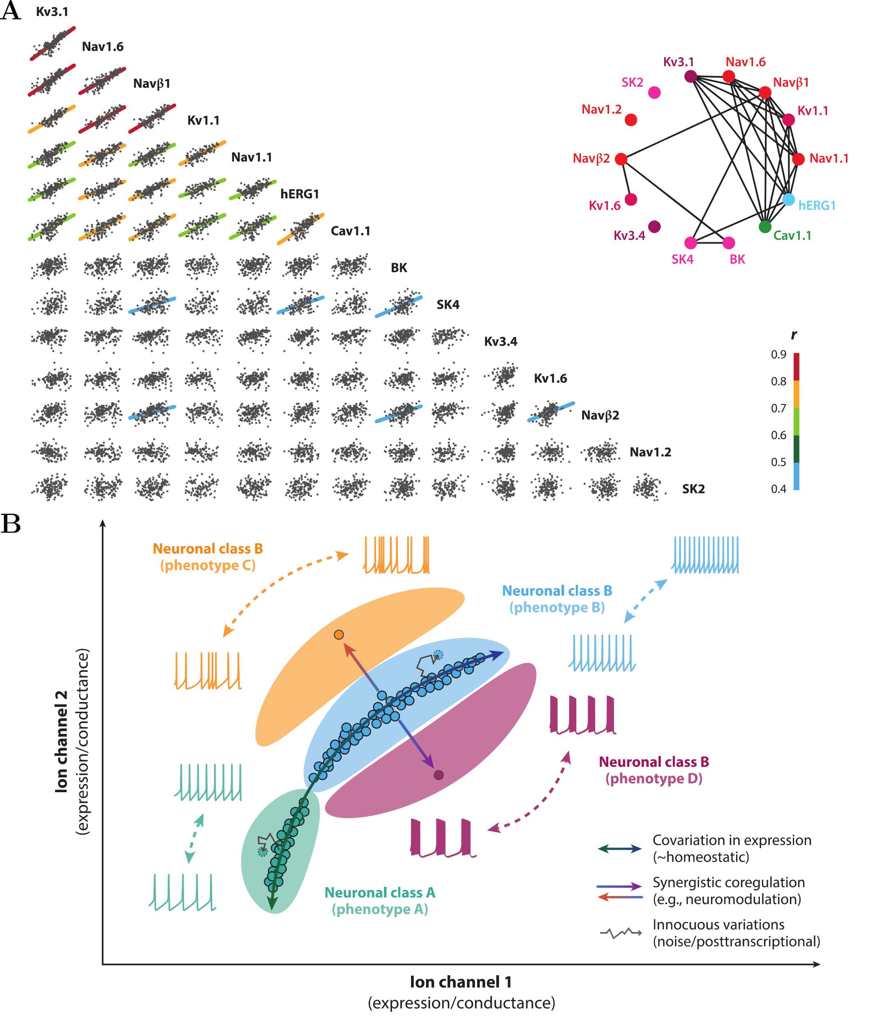
Kodama et al., 2020 & Goaillard and Marder, 2021

Slide 28

O’Leary et al., 2014
Notes:
Different ratios encoded lead to different firing excitabilities. Population built with this model align on homogeneous scaling where the slope depends on the encoded ratio.

Slide 30
Interaction

Slide 31
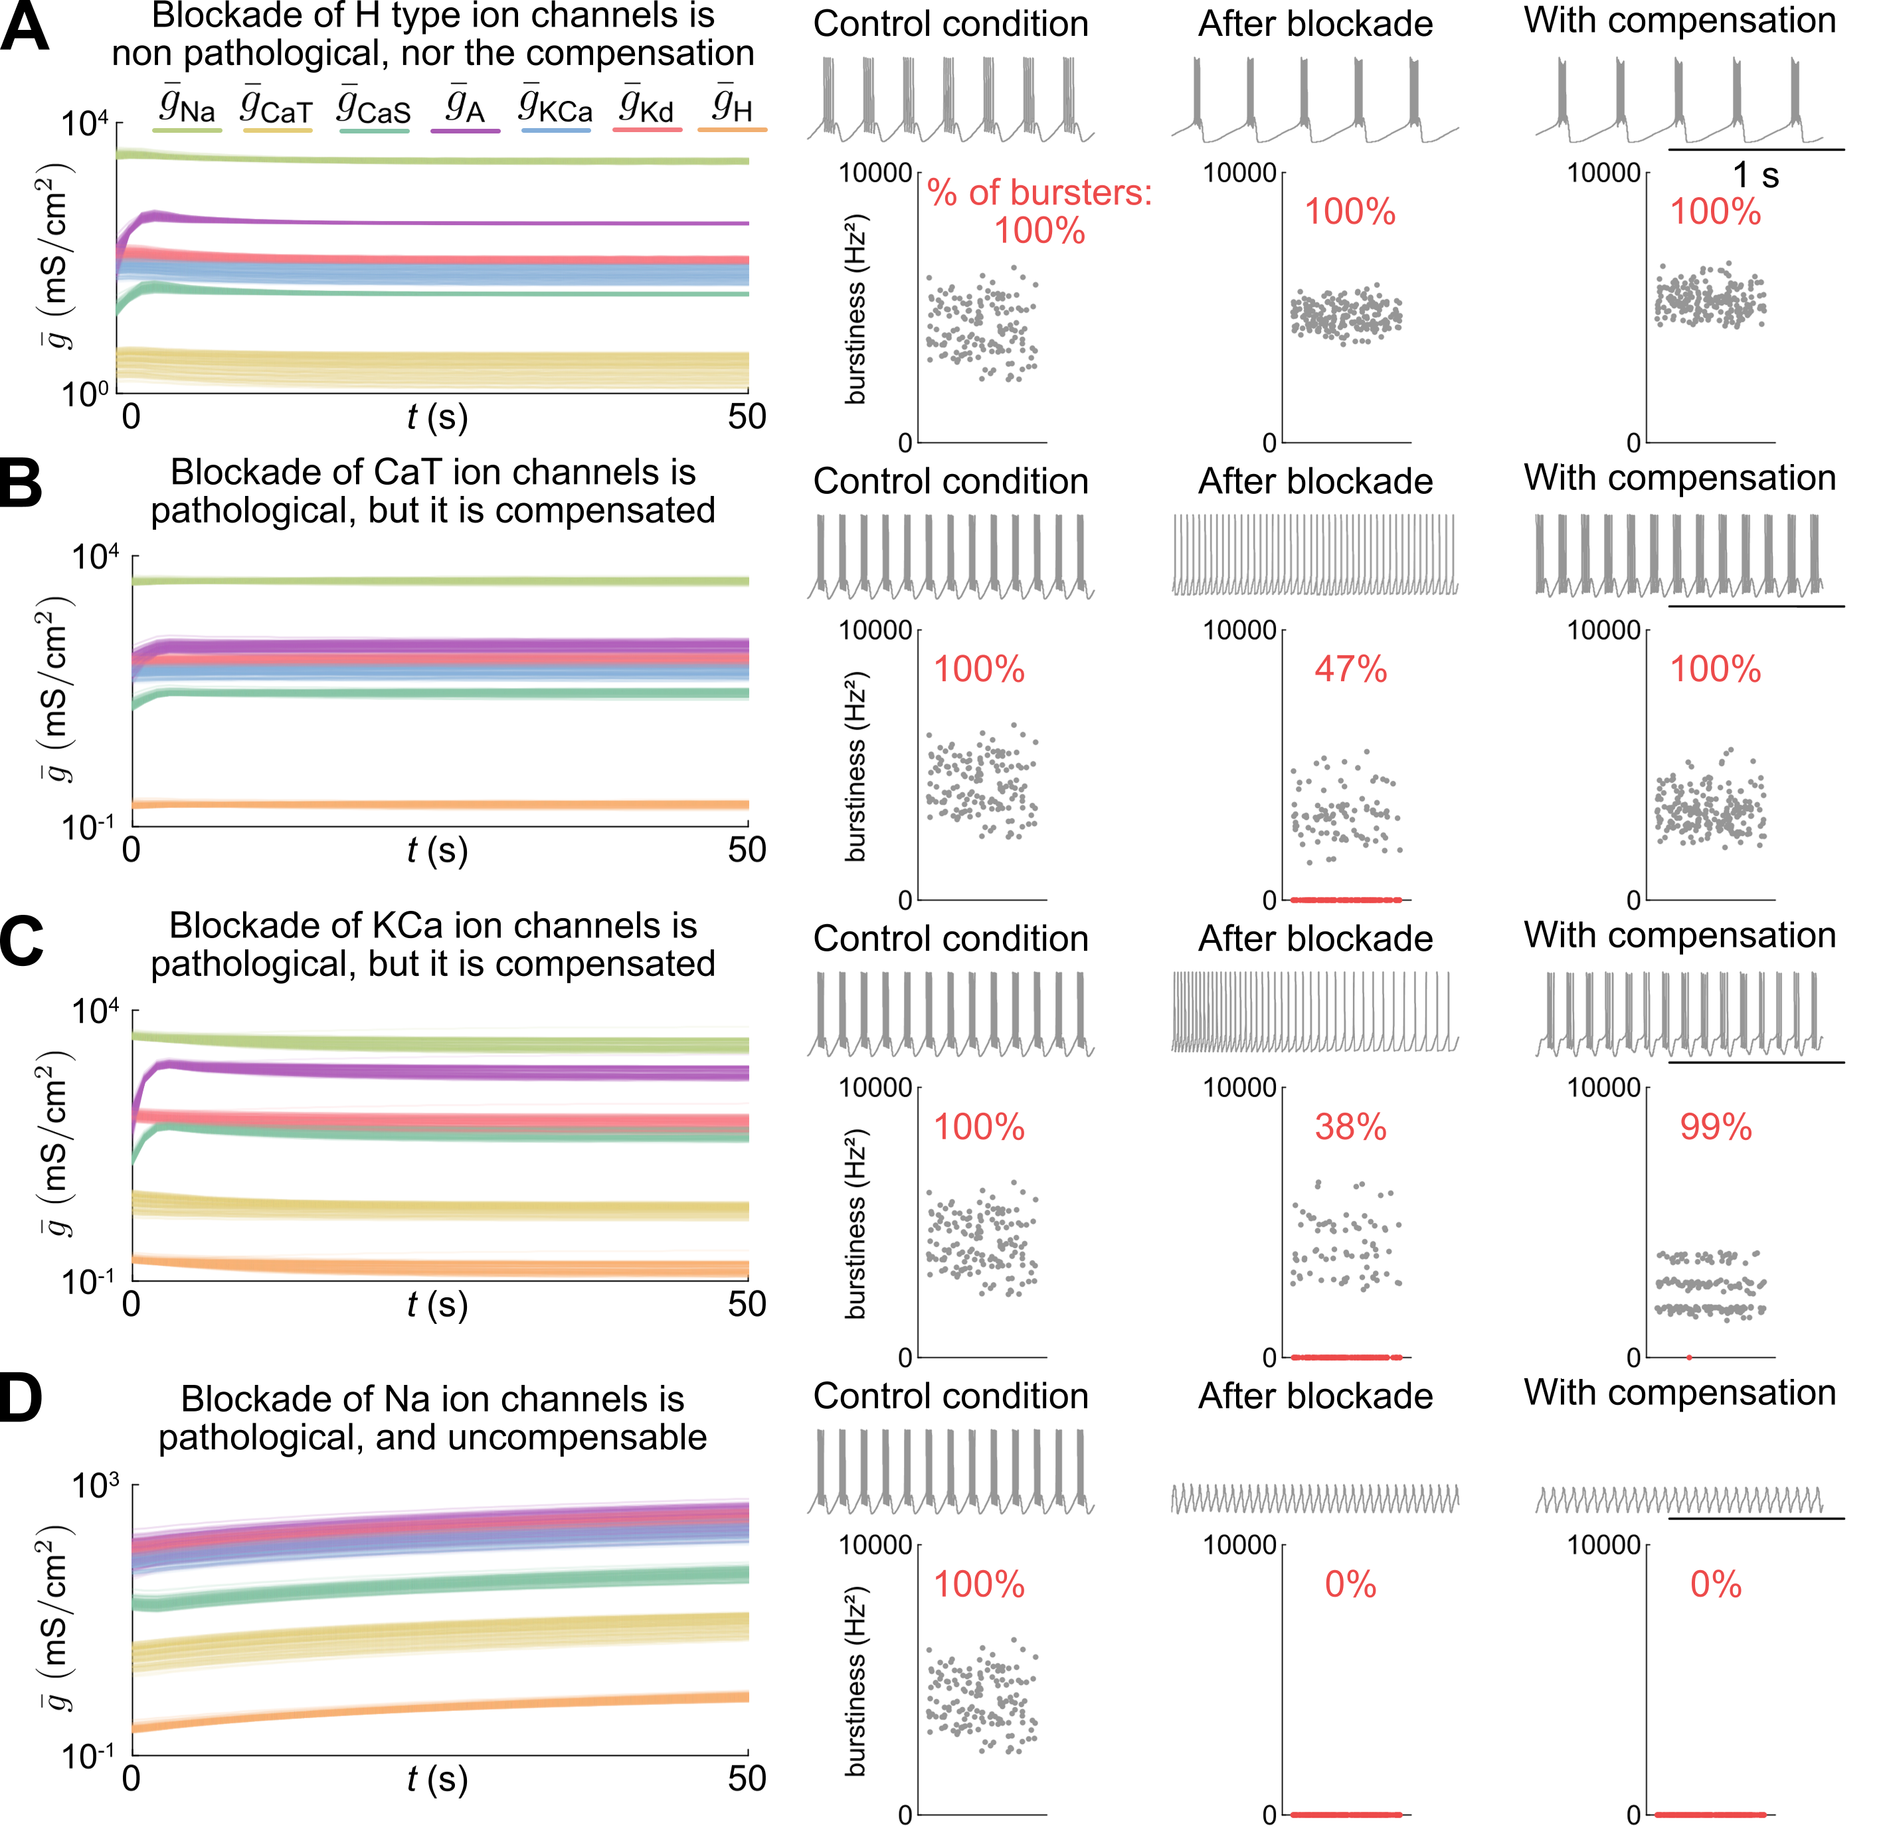

Slide 32
