Slide 1

Which Futures for the Welfare State? Three Scenarios Mapping the Complex Interactions between Climate Change and Policies against Child Poverty in the Walloon Region by 2050
Vincent CALAY & Frédéric CLAISSE
Anticipation Conference
Lancaster, UK
11th September 2024

Slide 2
Contextual Keys
The rise of child poverty as a political issue
1989: adoption of the UN Convention on the Rights of the Child
Since the late 1980’s, a transformation of the institutional landscape
Child poverty becomes progressively a key political issue
From the 2010’s: adoption of new political programs to fight child poverty
By contrast during the same period of time : a constant decrease in the universal protection provided by the Welfare State
A COVID disruption?

Slide 3
Child Poverty and the Action to Fight It as Foresight Objects
Which futures for the fight against child poverty?
A 2050-2060 foresight project
Commissioned by the Walloon Government
What might happen? Investigation of possible and contrasted futures, not a desirable future
Exploratory scenarios
Participatory process with experts and stakeholders

Slide 4
Child Poverty and the Action to Fight It as a Systemic Reality

Slide 5
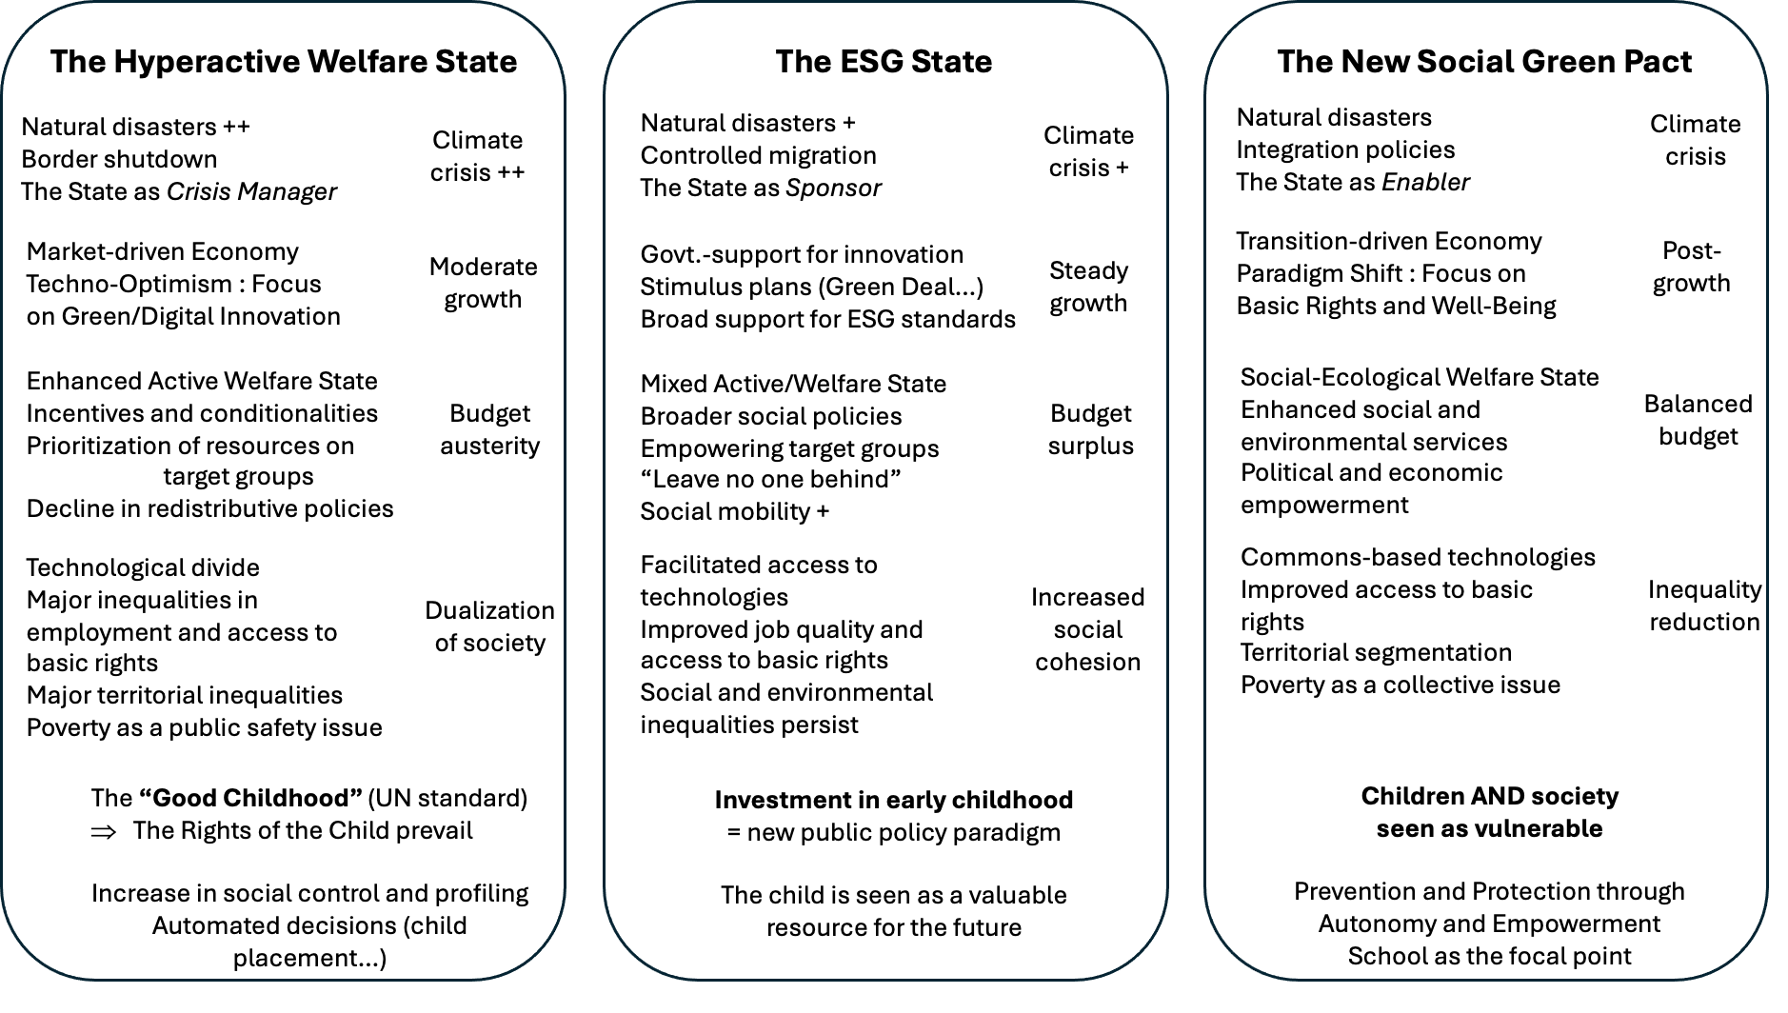
Three Scenarios
Climate change
Economy
Welfare State
Inequalities
Notes:
Visuels: équipe projet, experts, CS

Slide 6
Thank you for your attention !
v.calay@iweps.be

