Slide 1
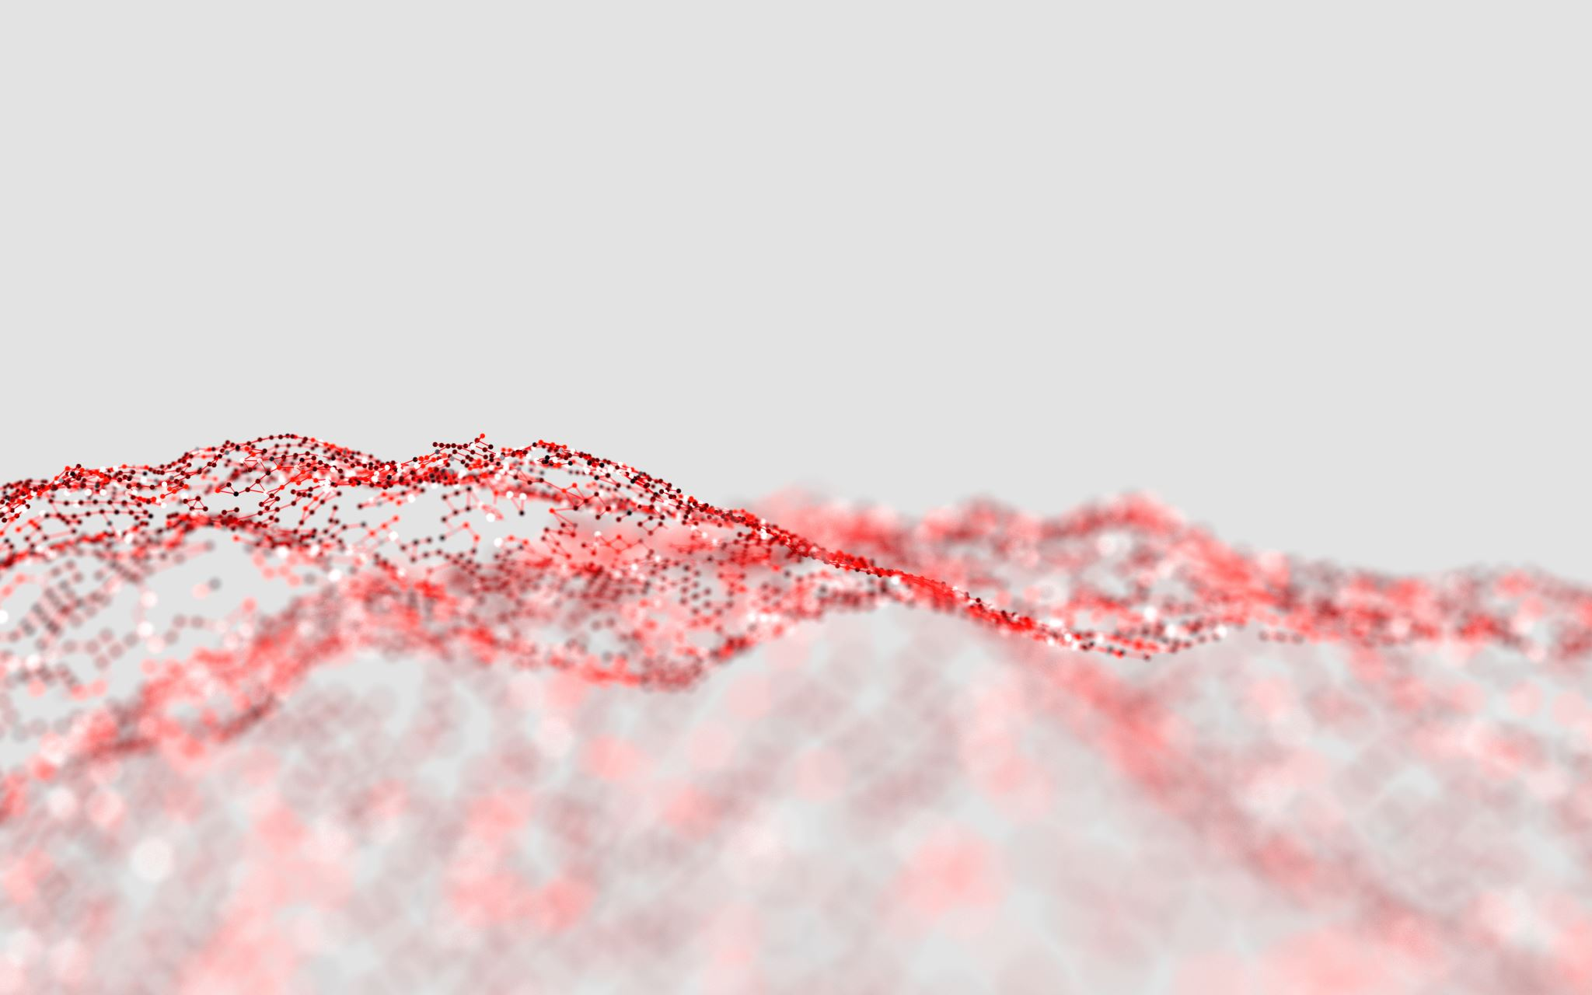
Second-line successful transvenous embolization of vermian Cognard type 3 dAVF through an ipsilateral trans-torcula approach.
M. MOÏSE, MD; B. OTTO, MD
University Hospital of Liège, BELGIUM

Slide 2
Case introduction
48-year-old caucasian male
High blood pressure treated with amlodipine 5mg + perindopril 5mg
188 cm (6’2’’) and 90 kg (198,5 lbs) : BMI = 25.5 kg/m² (light overweight)
No other cardiovascular disease risk factor
No history of head trauma or meningitis
List of abbreviations:
ICA: Internal Carotid Artery
ECA : External Carotid Artery
OA: Ophtalmic Artery
OccA : Occipital Artery
APA: Ascending Pharyngeal Artery
MMA : Middle Meningeal Artery
IVV : Inferrior Vermian Vein
fr. : frontal (view)
lat. : lateral (view)

Slide 3
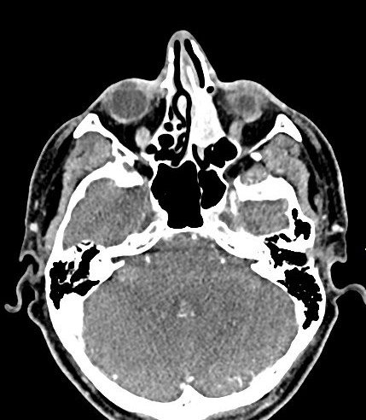
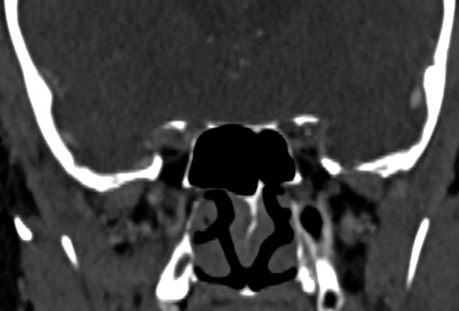
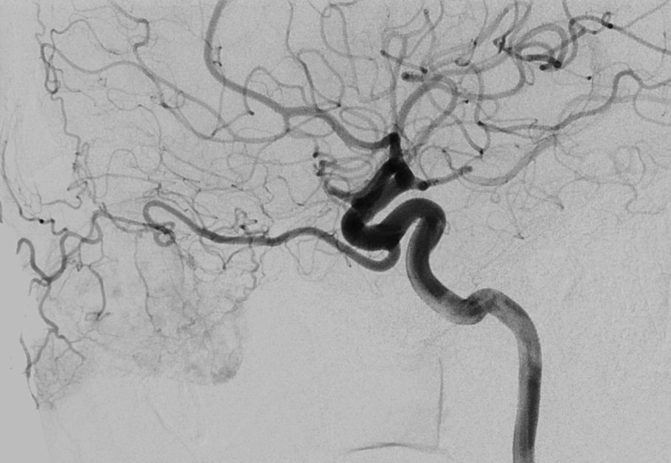
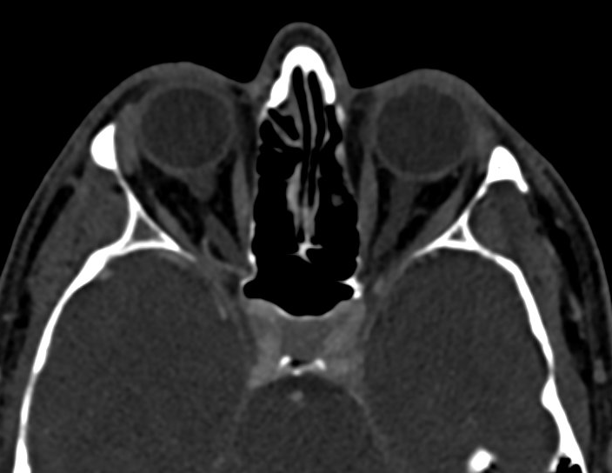
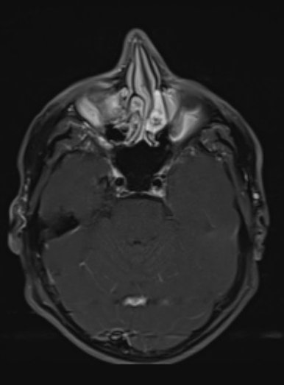
dAVF diagnosis as an incidental finding
t = 0
Pre-operative embolization of a left naso-ethmoidal tumor (cavernous angioma)
CT +C
MRI T1 +Gd
Left ICA lat.
Exclusive tumoral vascularization by branches of a left primitive OA: abstention
Retrospectively, the left primitive OA is depicted within the superior orbital fissure on cross-sectional imaging

Slide 4
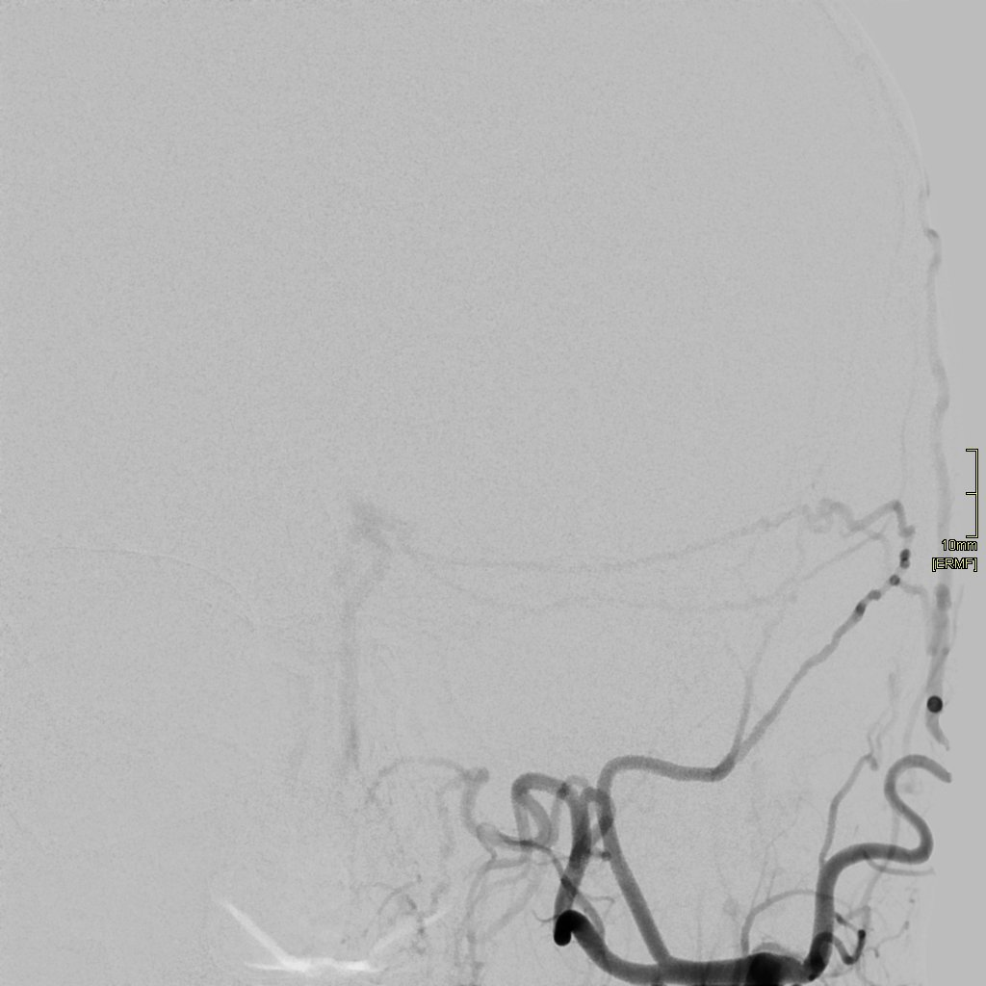
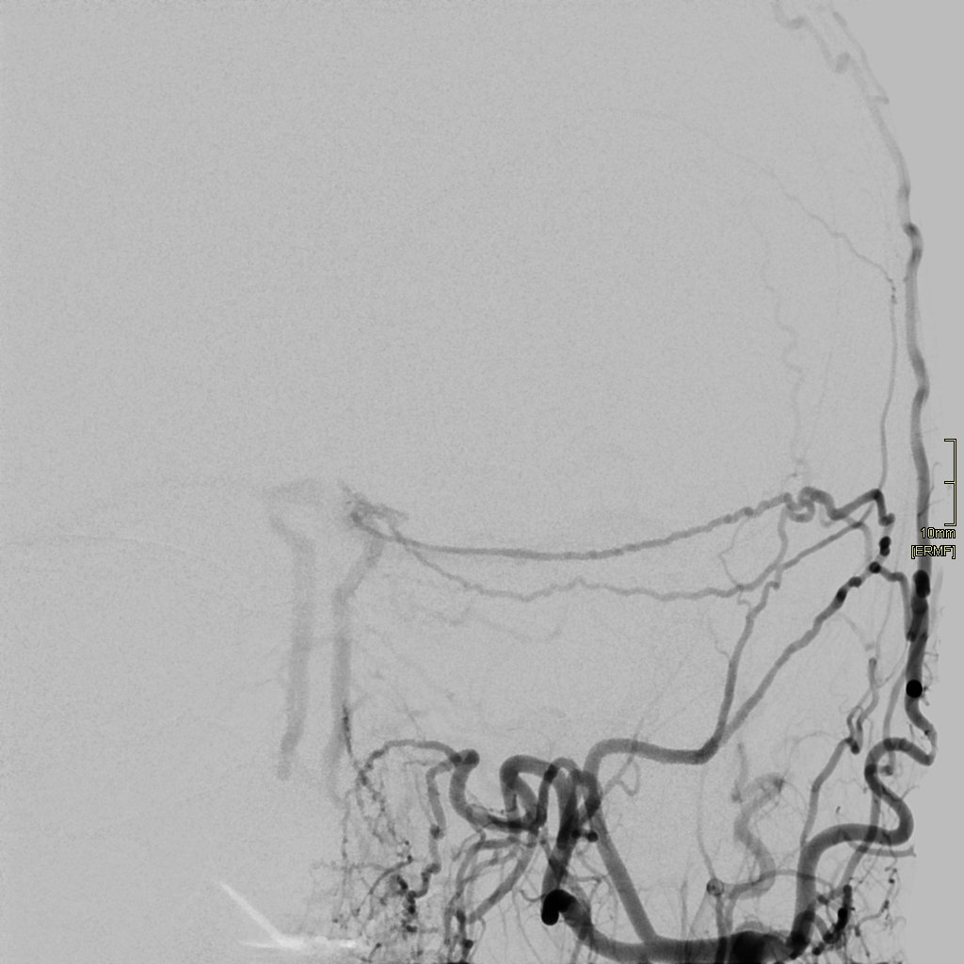
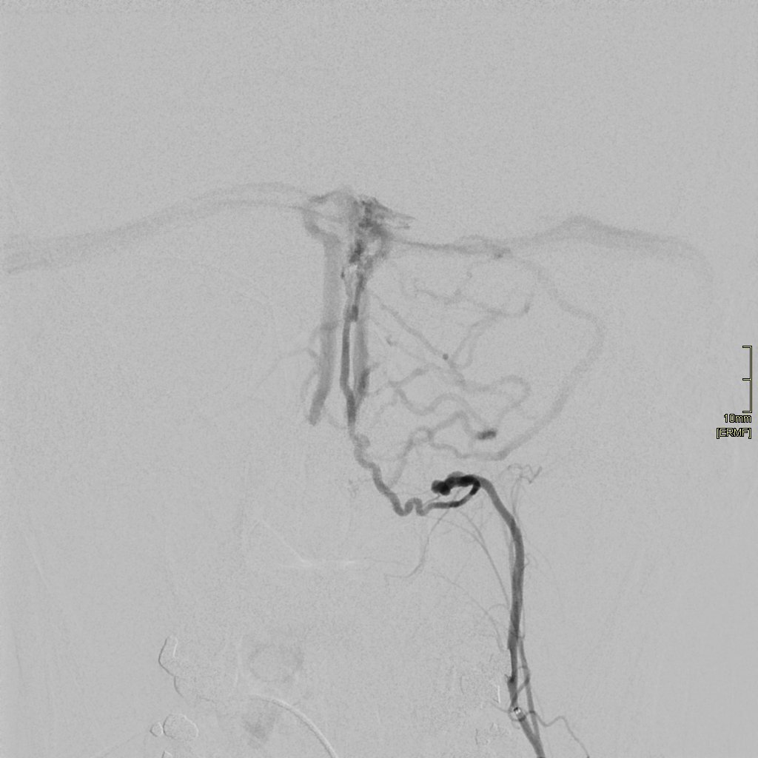
t = 0
dAVF diagnosis as an incidental finding
Pre-operative embolization: thorough angiographic work-up also unravelled a vermian dAVF !
Early arterial phase
Arterial phase
Late(r) arterial phase
Left ECA fr.
Left ECA fr.
Left APA fr.
*
Shunt is located on the upper part of the left IVV (Cognard type 3) with retrograde drainage.
Secondary drainage into the right IVV (anterograde flow) through a small transverse connecting vein (*). Cerebellar cortical reflux can be suspected at this stage.
Finally, anterograde drainage is observed within both transverse sinuses. Left hemispheric cerebellar cortical reflux is now obvious.

Slide 5
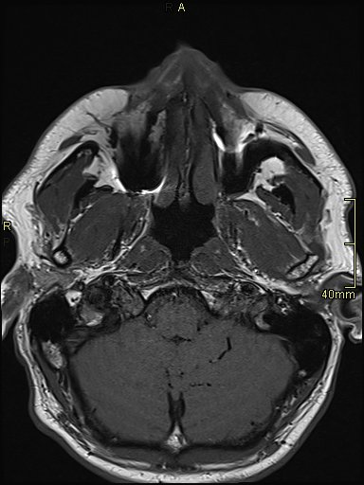
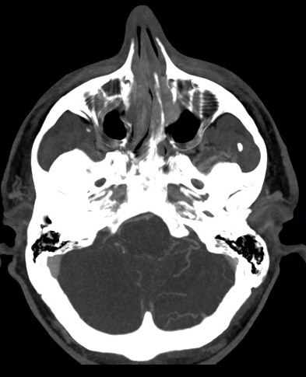
dAVF diagnosis as an incidental finding
Restrospectively, venous repercussions of the dAVF was noticeable on previous cross-sectional imaging
MRI T1
CT +C (5mm-MIP)
Left APA fr.
t = -2 months
t = -3 months

Slide 6
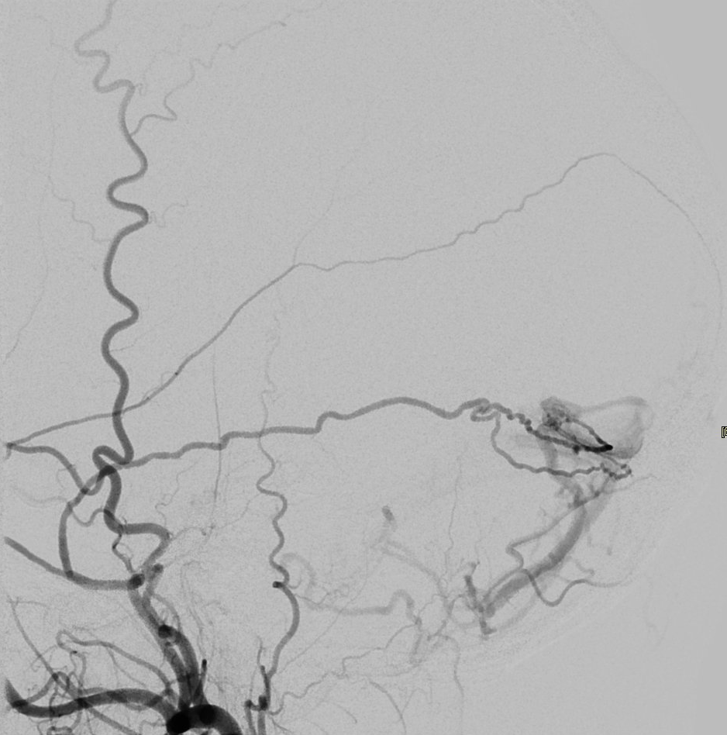
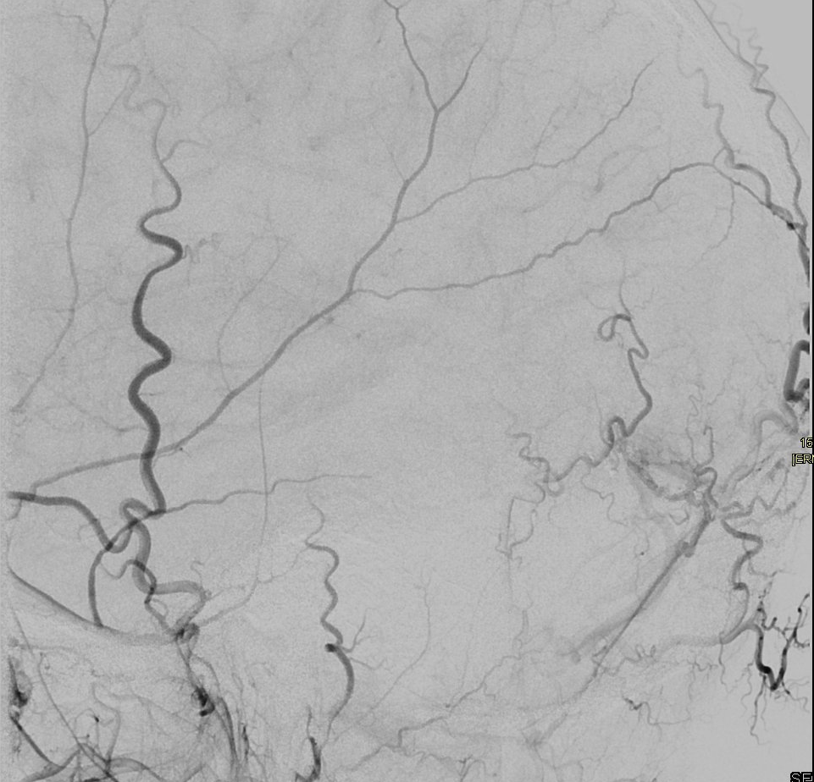
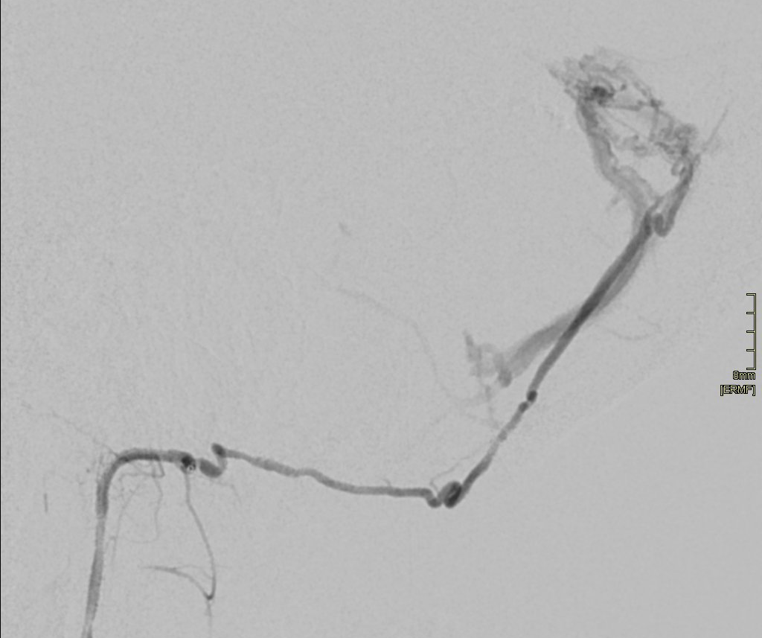
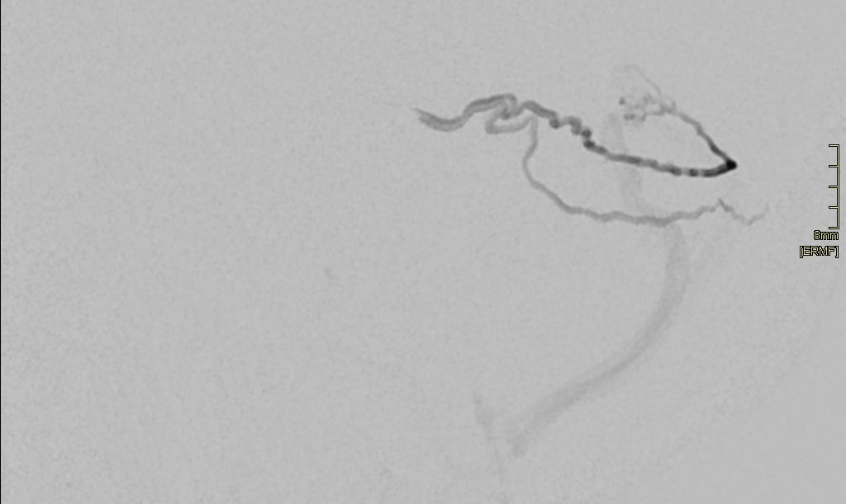
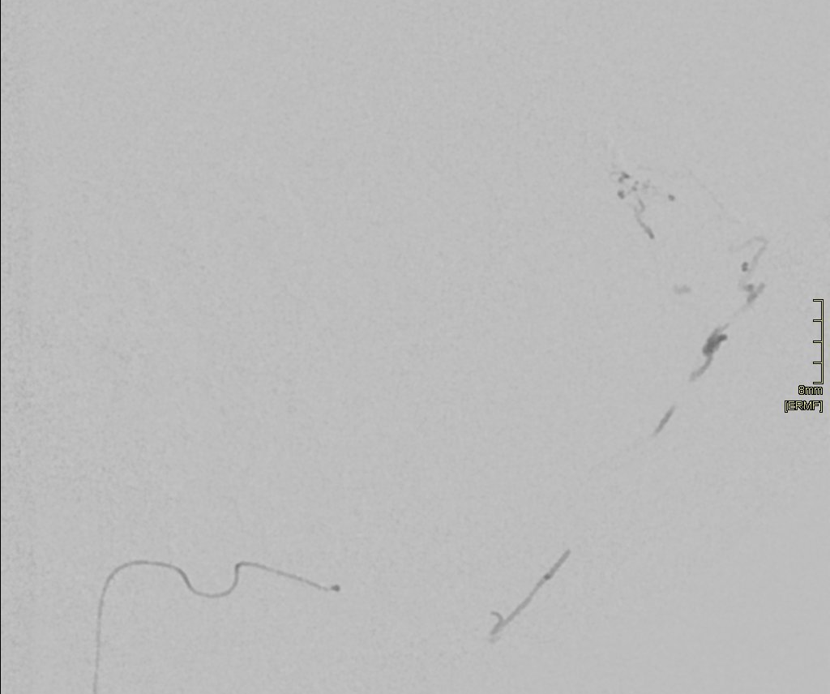
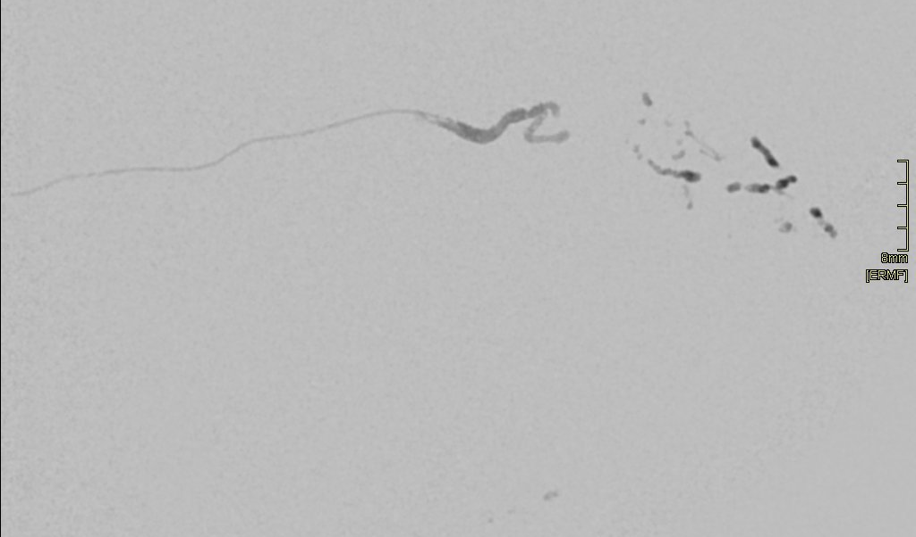
Transarterial embolization
t = + 2 months
1° attempt
Final control
2° attempt
Left ECA lat.
Left ECA lat.
Multiple arterial feeders
-- both AMMs
-- left APA
-- both OccAs (trans-osseous branches)
Left APA lat.
Glubran 1:8 Lipiodol
Proximal access devices:
-- 6F femoral sheath
-- 95cm Envoy DA XB catheter-guide
Failure to reach the shunt (purple circle) resulted in persistant early venous opacification of the left IVV at least via the neuromeningeal trunk of the APA. Follow-up unsurprisingly showed persistant AV shunt.
Glubran 1:4 Lipiodol
-- Apollo microcatheter
-- X-pedion 10 guidewire
-- 167cm Headway Duo microcatheter
-- Double angulation .012’’ Radiofocus guidewire

Slide 7
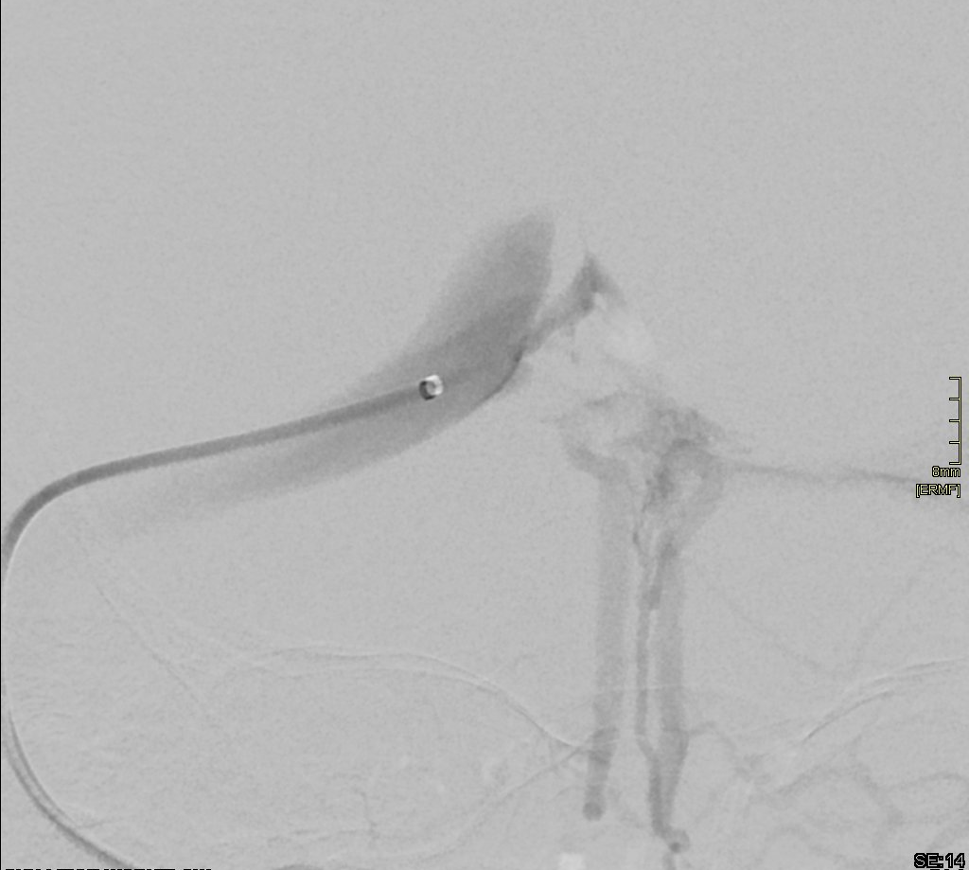
t = + 8 months
Transvenous embolization (1)
Arterial access:
-- 6F femoral sheath
-- 95cm Envoy DA XB catheter-guide in the left ECA
-- straight .021 Headway microcatheter in the left neuromeningeal trunk of the APA.
Failure in catheterizing both IVVs from the right transverse sinus:
-- on the left side (transtorcula), the joining end of the IVV is occluded (red cross). As a reminder, dAVF drainage is retrograde towards the right IVV instead of anterograde into the torcula)
-- on the right side, the angle of the IVV’s joining end is unfavorable (dotted arrow).
First venous access:
-- 8F right jugular sheath
-- 80cm AXS Infinity long sheath (OD 8F) under the jugular golf
-- 115cm 5F Sofia within the right transverse sinus

Slide 8
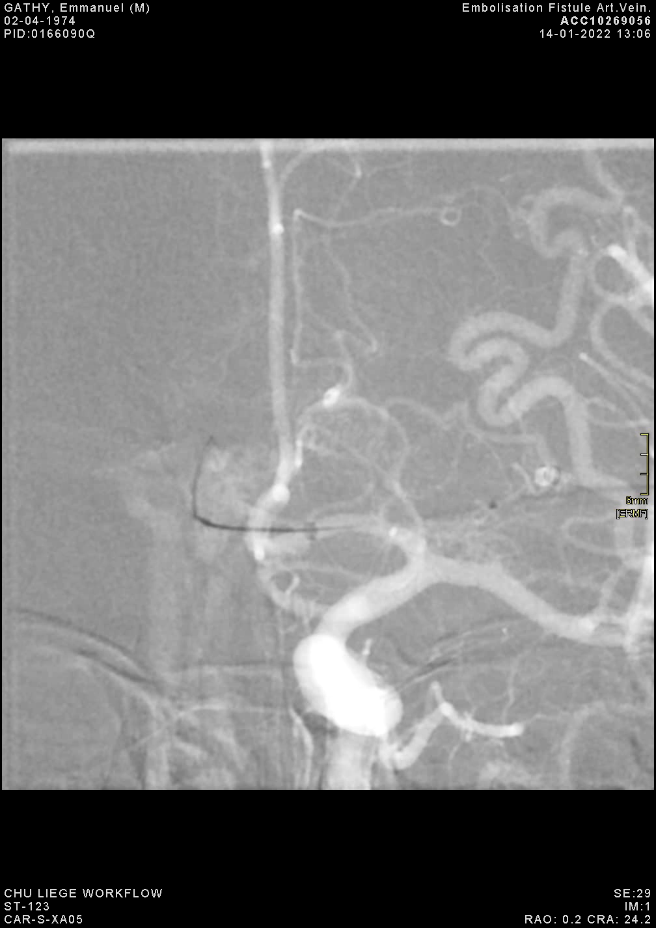
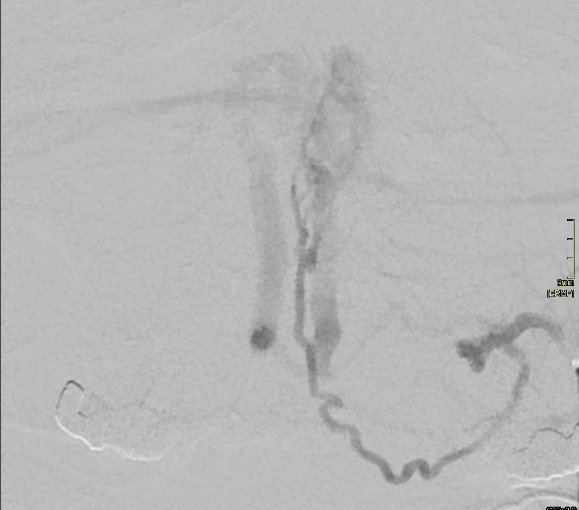
t = + 8 months
Transvenous embolization (2)
The right IVV is catheterized using a 90° .017 Headway microcatheter (trans-torcula route).
Second venous access:
-- 8F femoral sheath
-- 90cm AXS Infinity long sheath (OD 8F) in the left internal jugular vein
-- 115cm 5F Sofia within the left transverse sinus
Left APA fr.

Slide 9
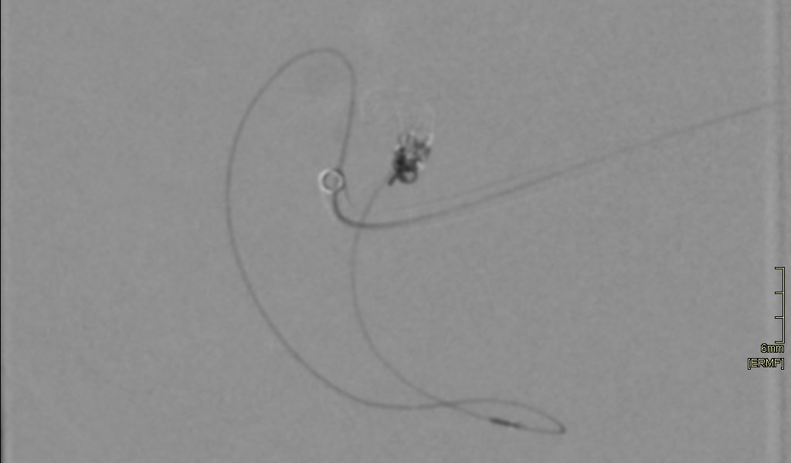
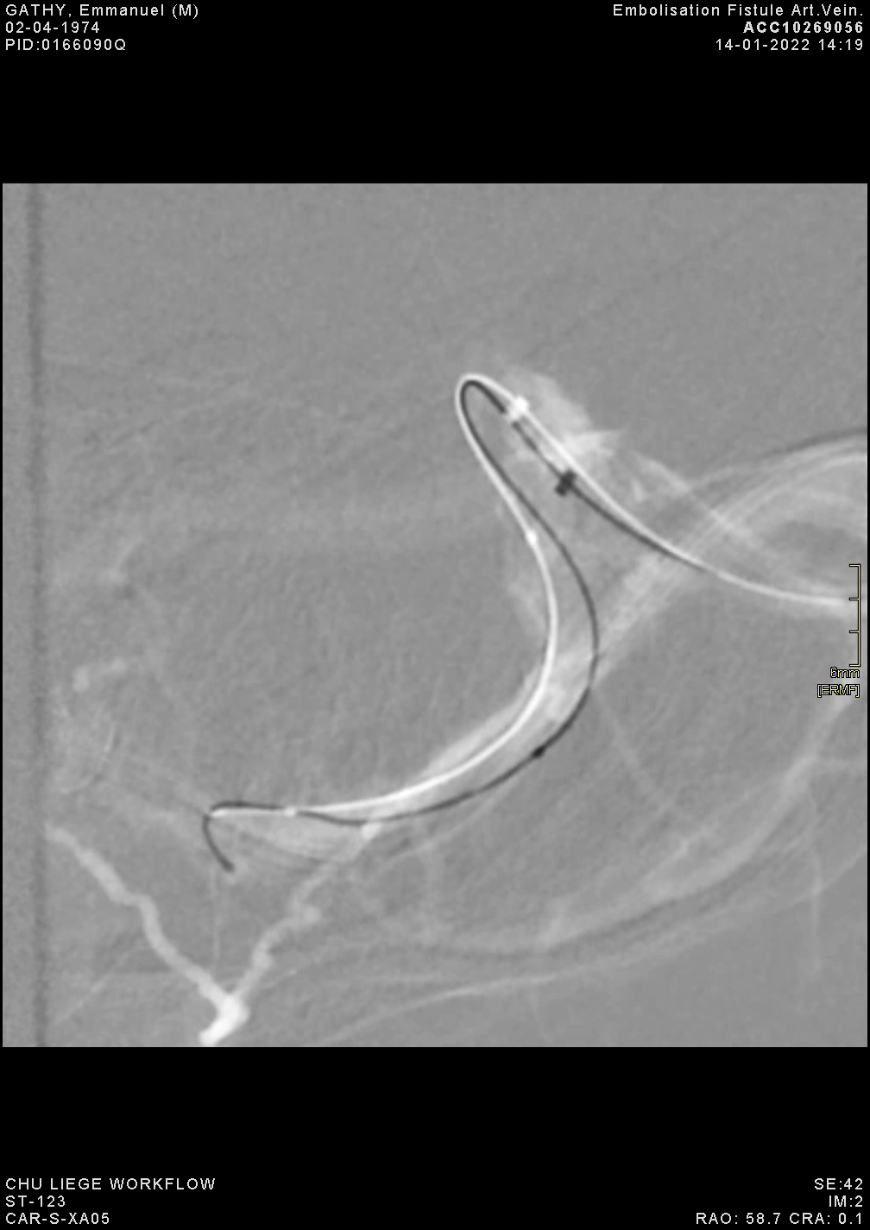
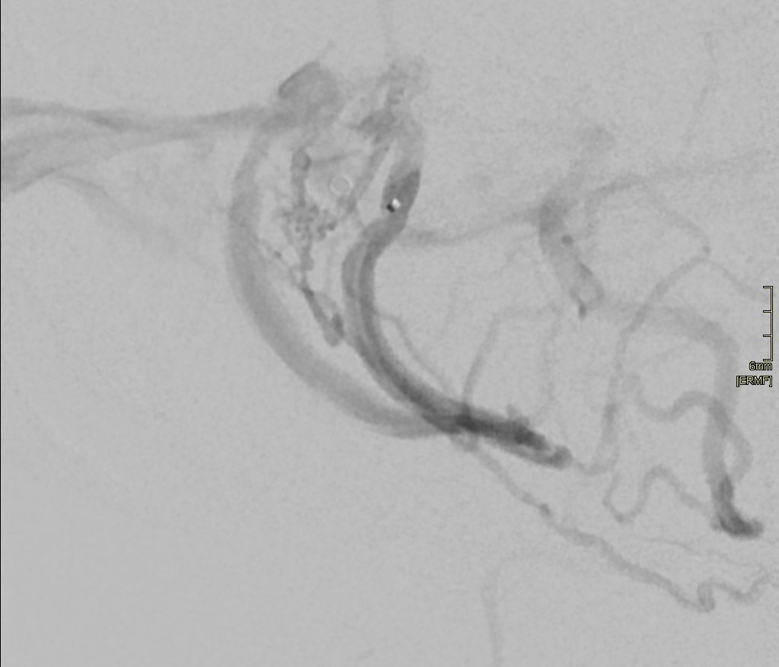
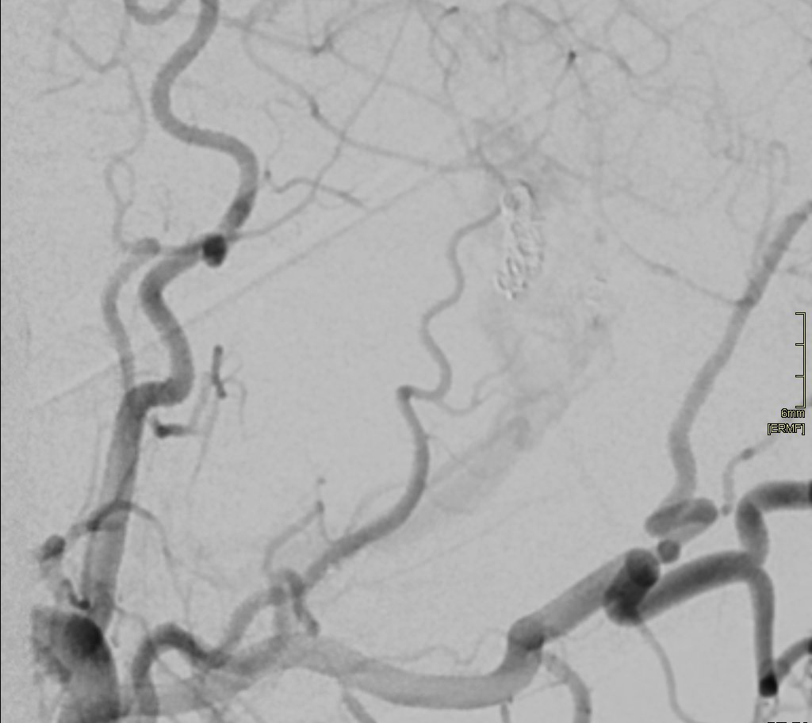
t = + 8 months
Transvenous embolization (3)
Left oblique
Subsequent coiling of the vein directly adjacent to the shunt allowed immediate near-complete embolization. Remote complete embolization was confirmed by follow-up angiogram (+9 months). No venous infarction occured.
Right oblique
The connnecting vein betweens IVVs couldn’t be catheterized by the angulated microcatheter (step-like stenosis?).
After an exchange over a 300cm .012 Hybrid wire, a 156cm Headway Duo was successfully advanced within the left IVV to reach the venous side of the shunt.

Slide 10
Discussion / take home messages
Transvenous dAVF embolization targeting venous outlet immediately adjacent to the shunt is an efficient approach (similar in concept to surgical ligature of sub-arachnoid draining veins).
Thorough work-up of venous drainage dynamics is mandatory to preserve functionnal veins/sinuses and avoid venous infarction.
In keeping with these statements, complex embolization route (for instance double crossing of the midline as in the present case) shoudn’t be considered as a drawback.

Slide 11
t = + 8 months
Transvenous embolization (4)
Double crossing of the midline was necessary to reach the shunt:
-- trans-torcula route from ipsilateral-to-shunt venous access
-- second crossing through connecting vein between IVVs.

Slide 12

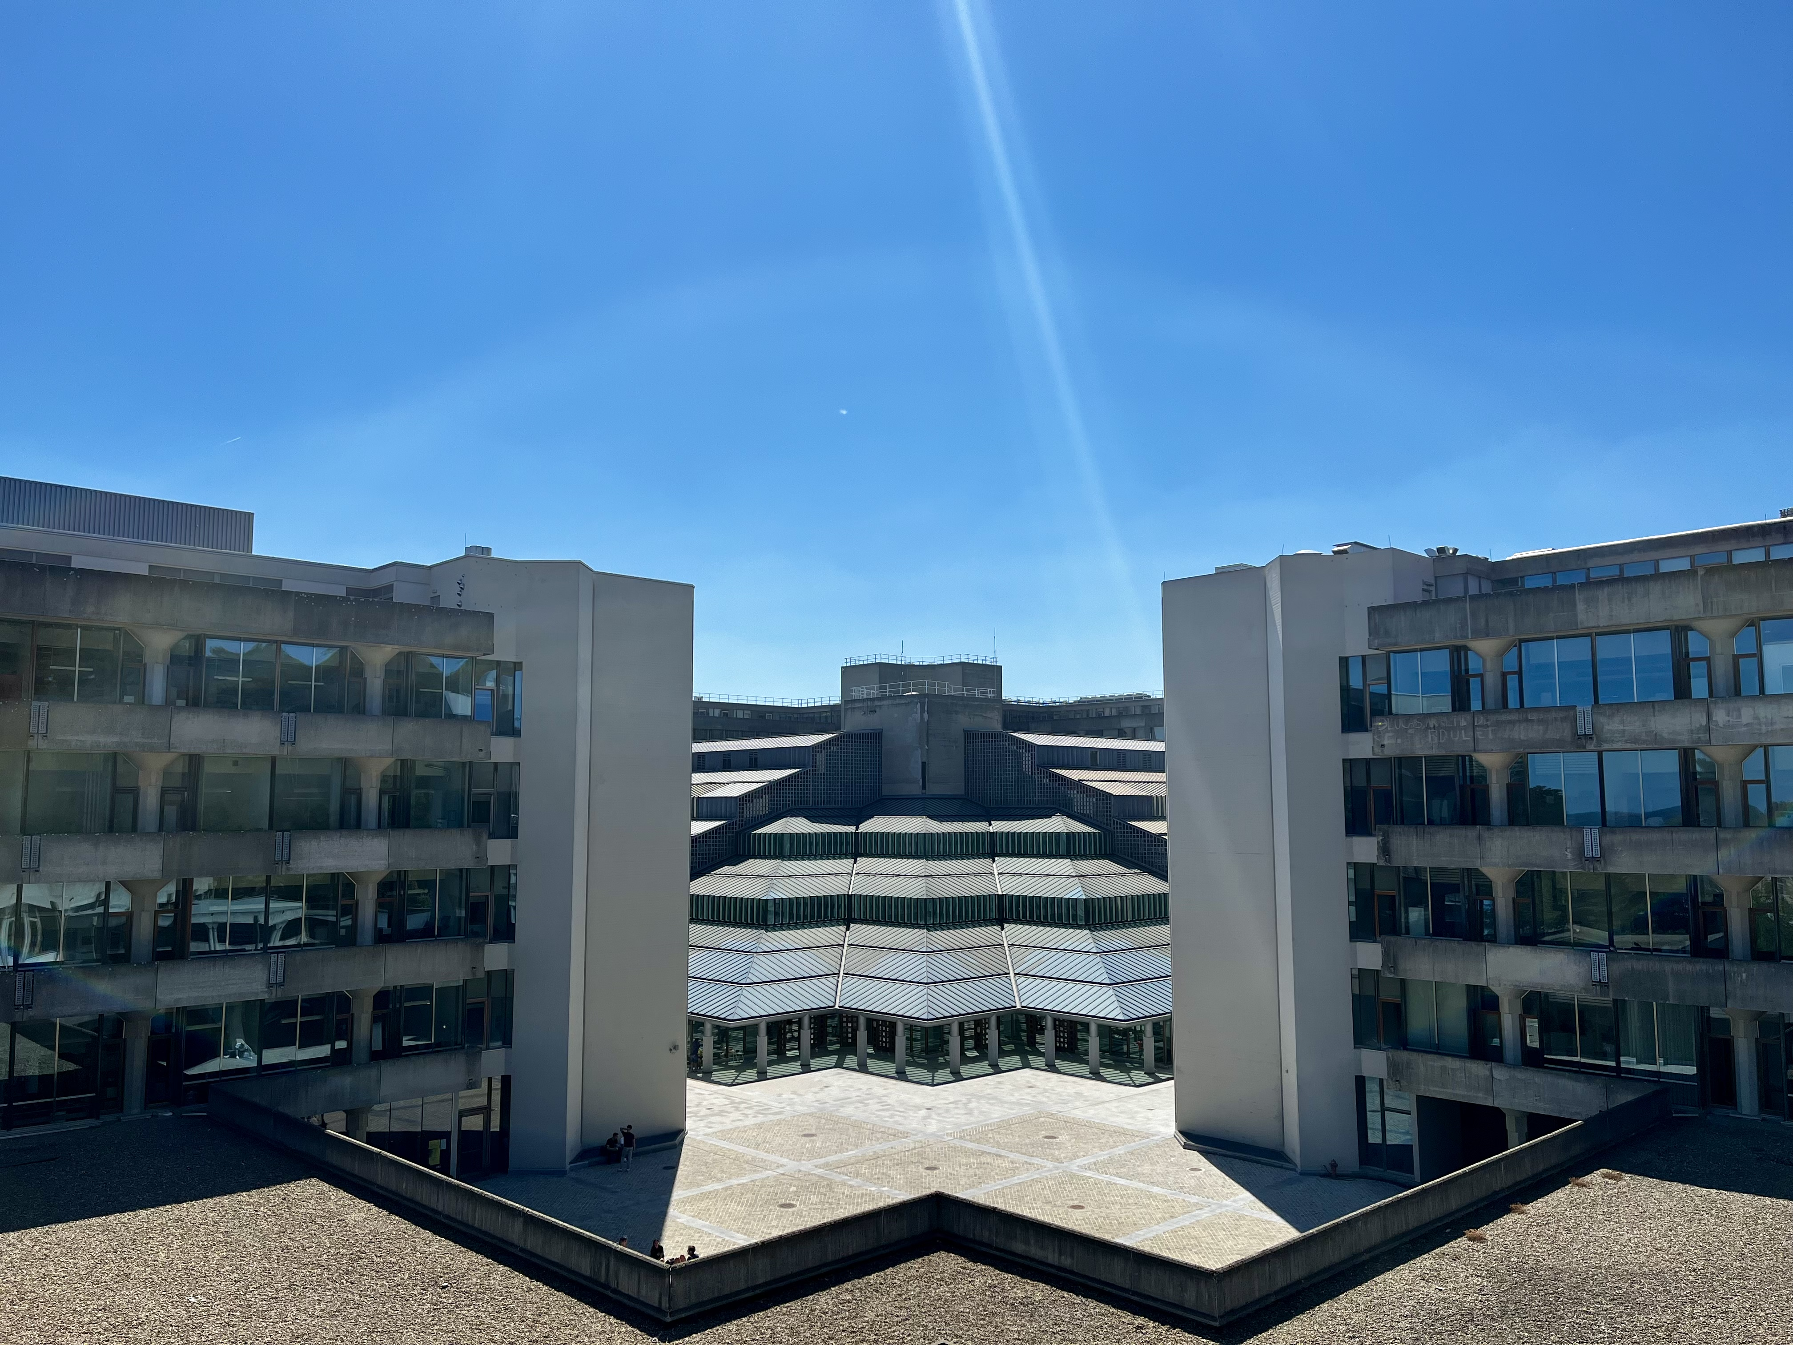
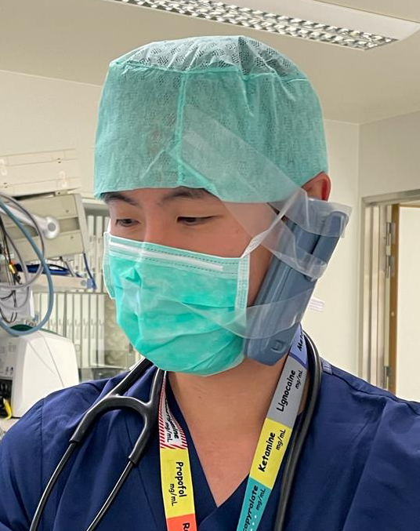
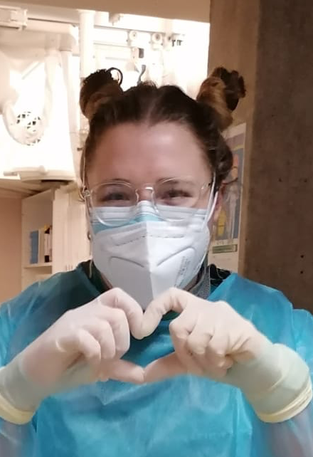
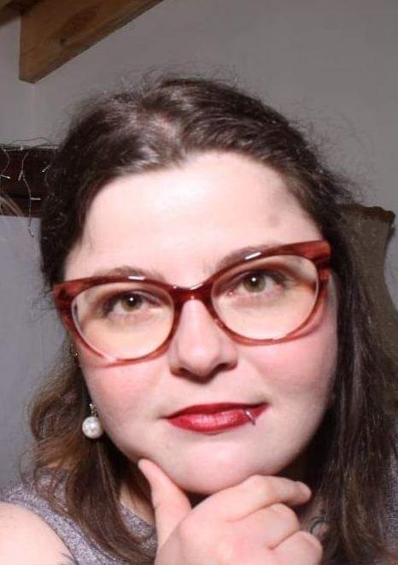
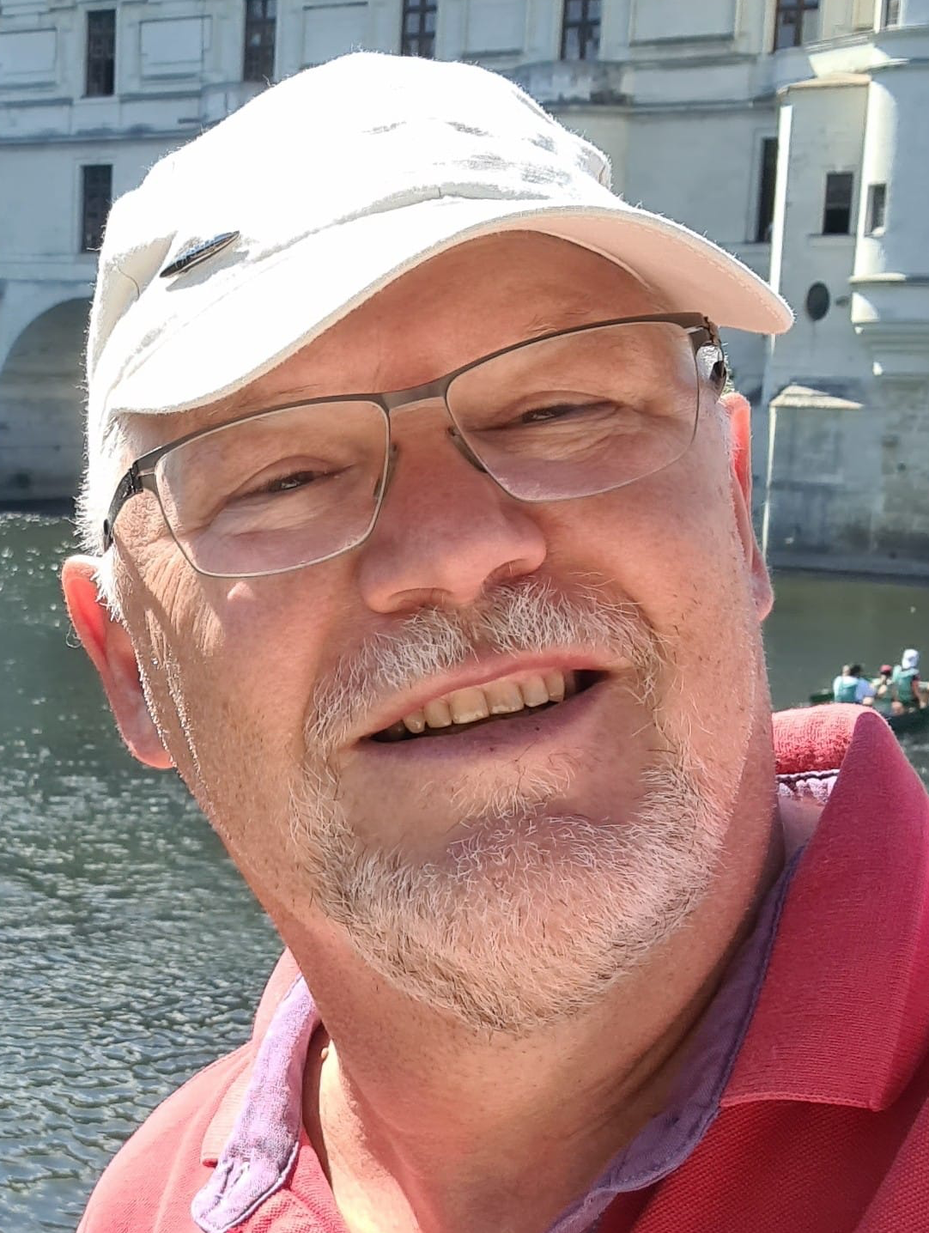
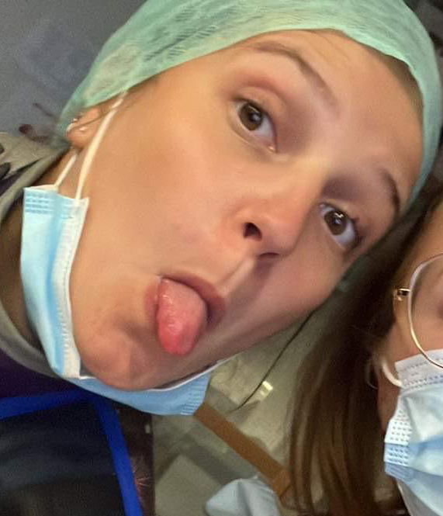


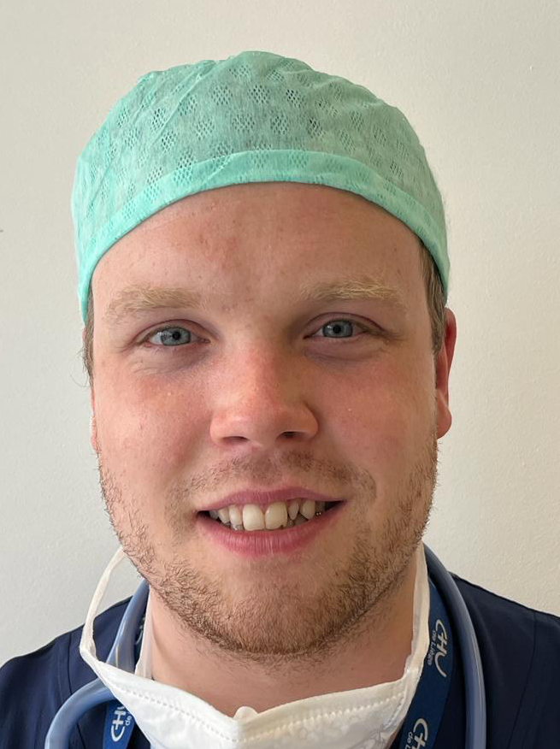
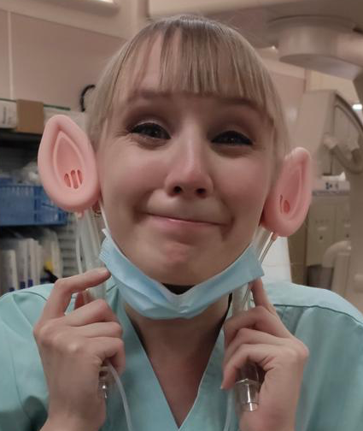



Acknowledgment

Slide 13

Conflict of interests
The lead presenter has the following conflicts of interest concerning the subject(s) to be presented:
Scientific grants, research support: none
Honoraria, consulting fee: none
Company sponsored speakers bureau: none
Stock shareholder: none
Other commercial support: none
Travel support: none
Invited speaker by Congress: none

