Slide 1



Remote Renewable Energy Hub: a concept for improving energy security
Talk given on the 11th of March 2025 in the context of a working session on
decarbonization between the Walloon Parliament (Belgium) and
the Parliament of North Rhine-Westphalia (Germany)
Authors: Ir. Victor DACHET and Prof. Dr. Ir. Damien ERNST

Slide 2
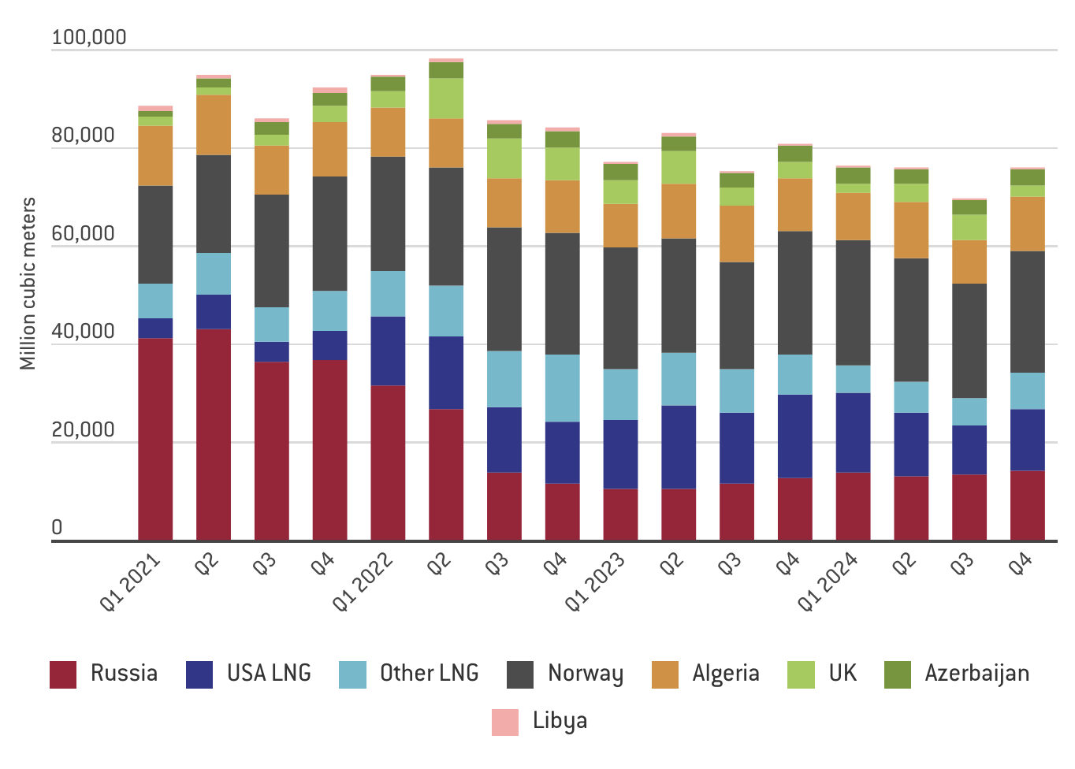
Energy security needs for the EU
The war in Ukraine has demonstrated how a state, like Russia, can use energy as a geopolitical tool to exert pressure on the EU during an armed conflict on its borders [3].
In response to this situation, it has become imperative for member states to reduce their significant dependence on certain energy-exporting countries.
1
Source: https://www.bruegel.org/dataset/european-natural-gas-imports
1

Slide 3
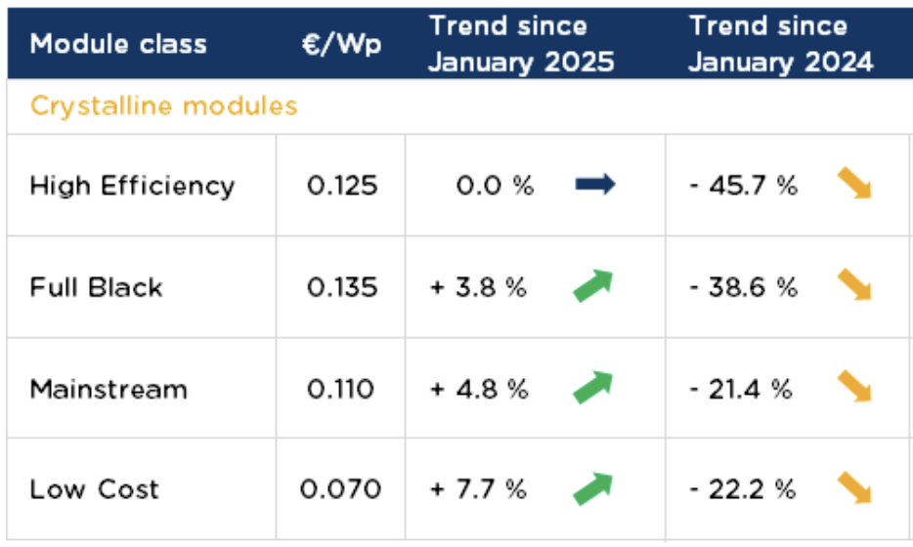
Clean technologies for harvesting renewable energy (RE) are extremely cheap
For example, photovoltaic (PV) panels now cost around 0.1 €/Wp.
Source: https://www.pvxchange.com/Price-Index
2

Slide 4
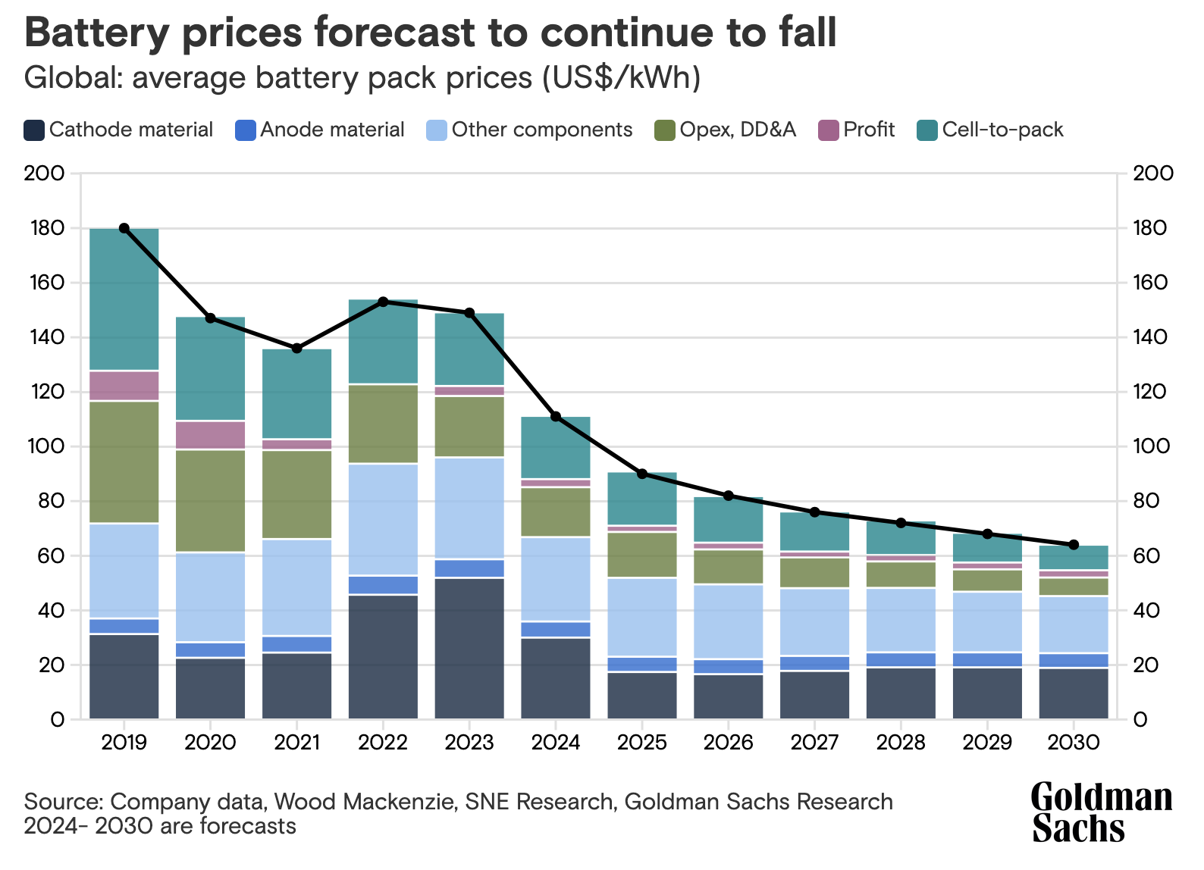
Clean technologies for storing RE are also extremely cheap
It is reported that in China, factories are already able to produce battery packs at around 50 €/kWh.
3

Slide 5
Pricing PV + battery for electricity at the Equator
Let us estimate the cost of electricity produced by a 1 MWp PV installation combined with batteries to smooth out fluctuations in PV generation.
We assume that these PV panels are installed near the Equator, where a capacity factor of 25% can be reached, and that they produce every day the same quantity of electricity (minimal seasonal variation at the Equator). The battery system is sized to store half of the daily electricity generation. Given that a 1 MWp PV installation produces 1 × 0.25 × 24 = 6 MWh/day, this setup would require a 3 MWh battery pack.
The total CAPEX cost for the PV installation and battery pack is calculated as:
(0.1 × 1,000,000) + (3 × 1,000 × 50) = 250,000 €.
Assuming no battery losses, the total electricity generated over a 20-year lifetime is:
1 × 8,760 × 20 × 0.25 = 43,800 MWh.
That would lead to an average CAPEX cost of approximately 6 €/MWh.
4

Slide 6
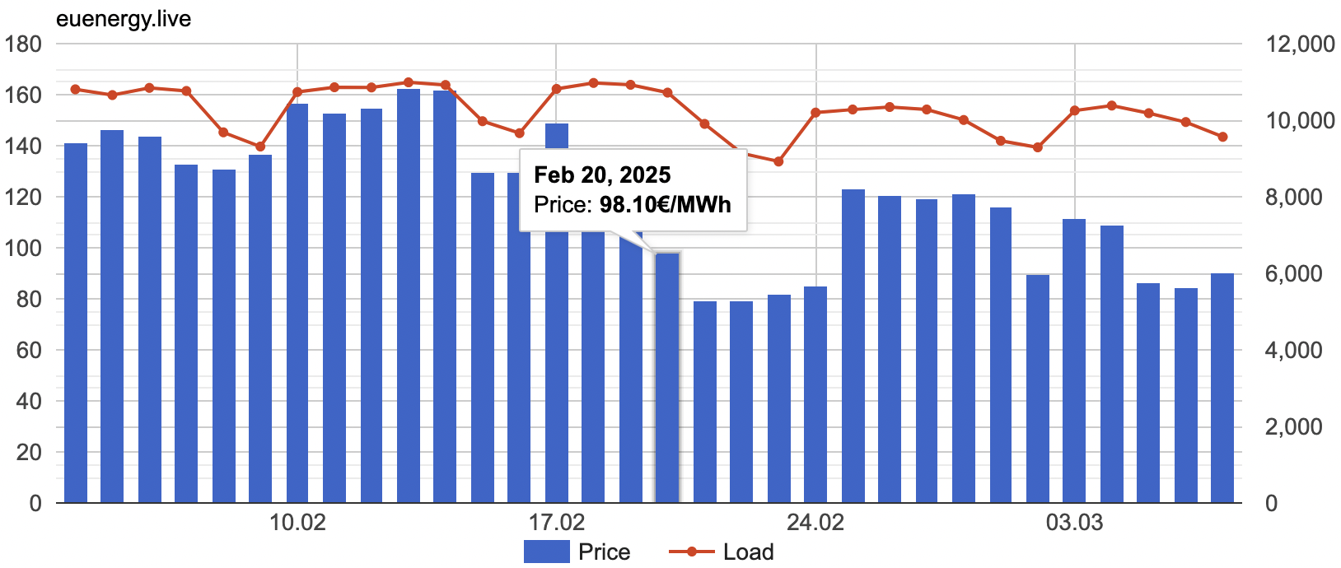
Electricity prices in Belgium
Day-ahead prices on the Belgian electricity market were around 100 €/MWh in February 2025.
Source: https://euenergy.live/country.php?a2=BE
5

Slide 7
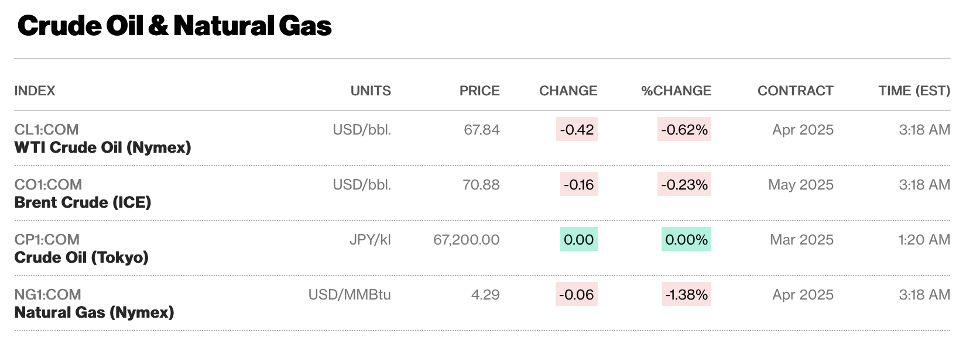
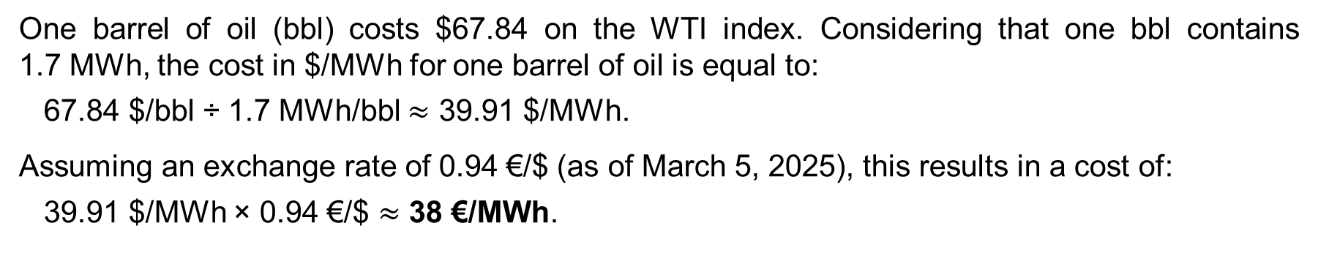
Oil prices
One barrel of oil (bbl) costs $67.84 on the WTI index. Considering that one bbl contains 1.7 MWh, the cost in $/MWh for one barrel of oil is equal to:
67.84 $/bbl ÷ 1.7 MWh/bbl $≈$ 39.91 $/MWh.
Assuming an exchange rate of 0.94 €/$ (as of March 5, 2025), this results in a cost of:
39.91 $/MWh × 0.94 €/$ $≈$ 38 €/MWh.
Source: https://www.bloomberg.com/energy
6

Slide 8
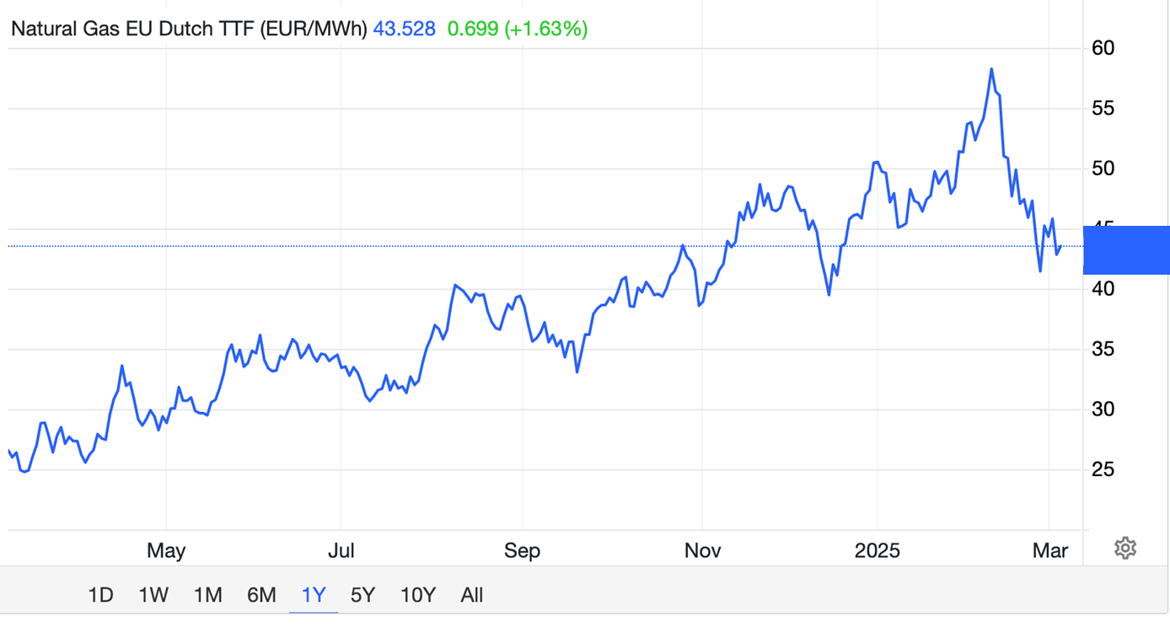
Dutch TTF Natural Gas Price Index
~44 €/MWh
Source: https://tradingeconomics.com/commodity/eu-natural-gas
7

Slide 9
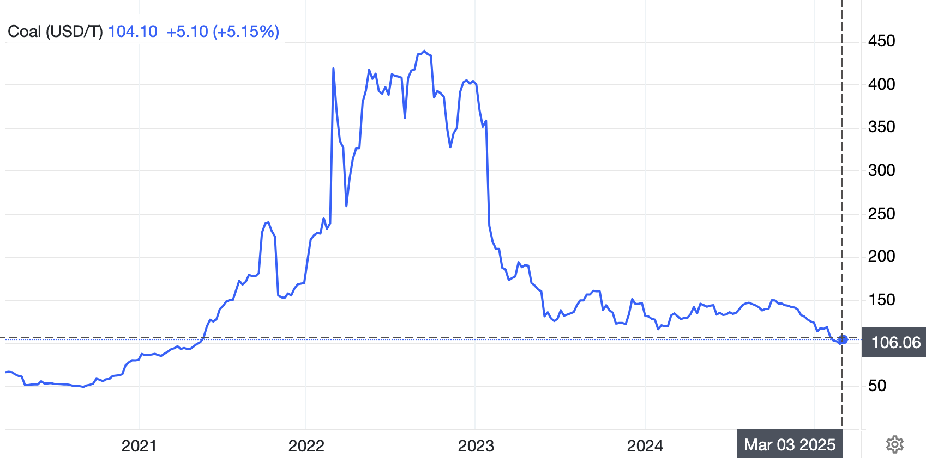
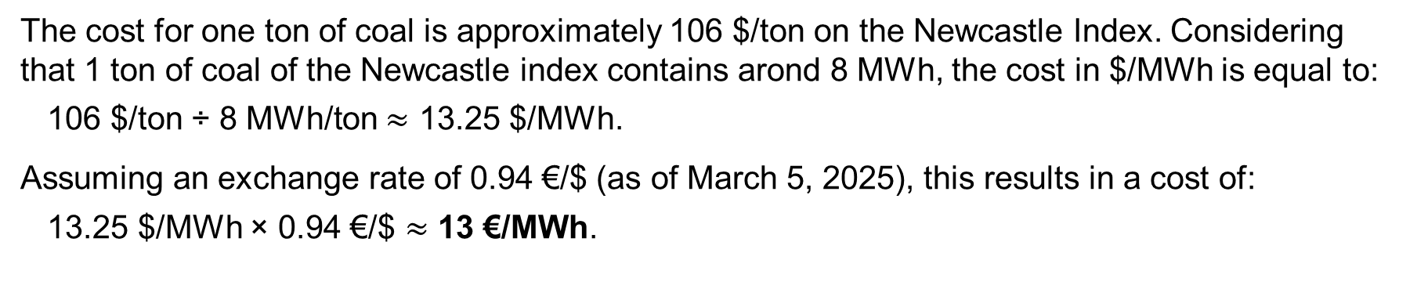
Coal prices
The cost for one ton of coal is approximately 106 $/ton on the Newcastle Index. Considering that 1 ton of coal of the Newcastle index contains arond 8 MWh, the cost in $/MWh is equal to:
106 $/ton ÷ 8 MWh/ton $≈$ 13.25 $/MWh.
Assuming an exchange rate of 0.94 €/$ (as of March 5, 2025), this results in a cost of:
13.25 $/MWh × 0.94 €/$ $≈$ 13 €/MWh.
Source: https://tradingeconomics.com/commodity/coal
8

Slide 10
Summary of prices
Coal | Oil | Gas | Electricity from gas (50% efficiency) | Electricity (wholesale market) | PV + battery for electricity at the Equator
13 €/MWh | 38 €/MWh | 44 €/MWh | 88 €/MWh | 100 €/MWh | 6 €/MWh
We observe that a PV + battery installation in a region with abundant renewable resources, such as the Equator, can provide a very cheap and constant energy supply.
An important question: What strategies should the EU put in place for benefiting from such cheap renewable energy?
Note that electricity is a high-grade energy source compared to oil and gas. Oil and gas must be burned to produce electricity, resulting in energy losses. However, some applications, such as heavy maritime transport, cannot yet run on electricity.
9

Slide 11
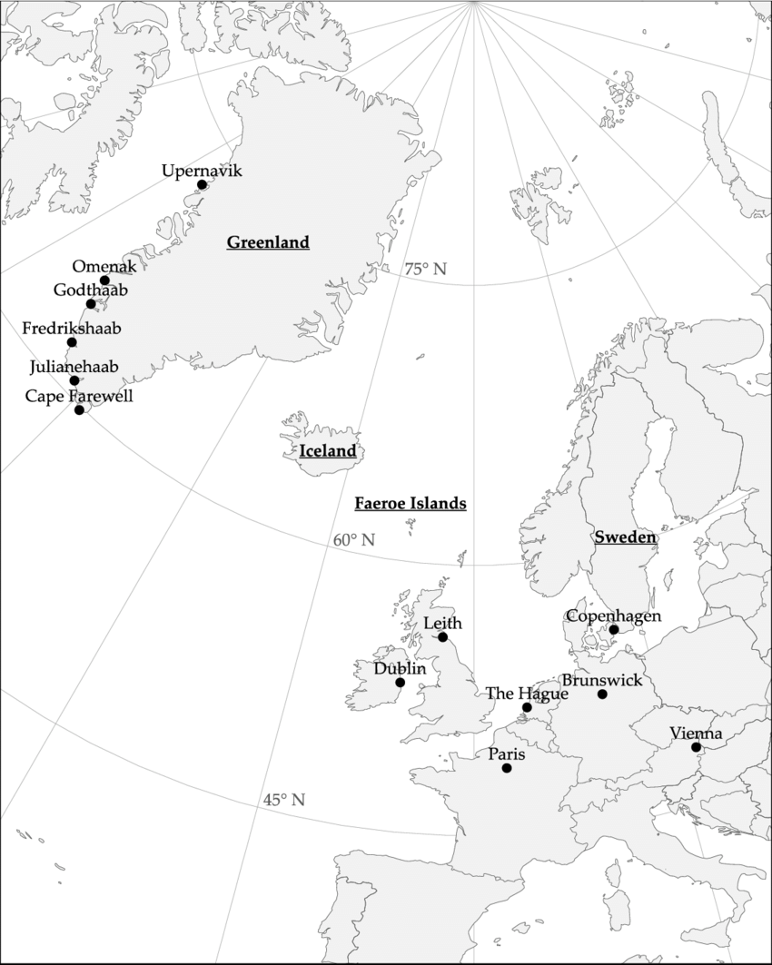
RE potential in the Blue Banana region is limited
The Blue Banana is a densely populated and highly industrialized corridor extending from Milan to London through Germany, characterized by a high energy demand.
The region faces challenges in developing local renewable energy due to limited natural resources and NIMBY (Not In My BackYard) issues.
As a result, there is a need to import cheap renewable energy in this region, either via electrical lines, whose development can also be hampered by NIMBY issues, or e-fuels.
10

Slide 12
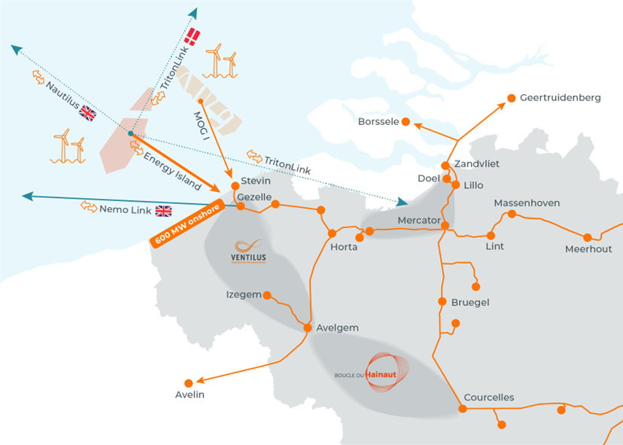
Example of NIMBY issue: Boucle-du-Hainaut
The Boucle-du-Hainaut project is a new 85 km overhead AC power line operating at 380 kV with a transmission capacity of 6 GW. It faces opposition due to concerns over environmental impact and aesthetic disruption.
Why is this project important?
Increasing offshore wind capacity in the Belgian part of the North Sea by more than 2 GW would not be possible without reinforcing the grid.
There is no 380 kV infrastructure in the province of Hainaut, leading to many congestion issues in the area. As a result, its industrial development is significantly hampered.
Source: https://www.elia.be/fr/infrastructure-et-projets/projets-infrastructure/ventilus
11

Slide 13
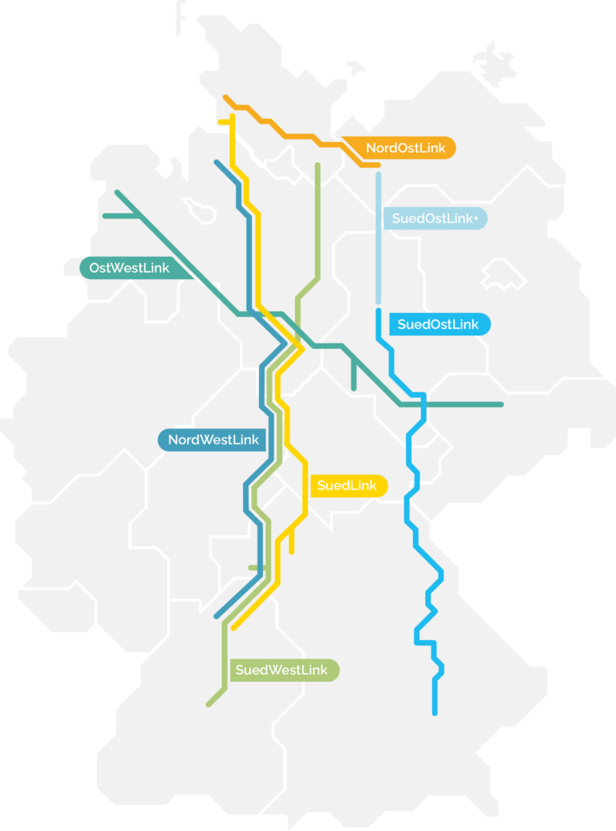
Example of NIMBY issue: SuedWestLink
The SuedWestLink project is part of the German network development plan for 2037/2045. The line will be 730 km long, with a voltage level of 525 kV DC, and a transmission capacity of 2×2 GW. Residents oppose its implementation near their homes.
Why is this project important?
Transporting surplus wind energy from the North to the South of Germany.
Addressing the imbalance between energy production in the North, where wind energy continues to expand in Schleswig-Holstein, Lower Saxony, and the North Sea, and energy demand in the South. This imbalance is being exacerbated by the German phase-out of nuclear and coal.
Source: https://www.stromnetzdc.com/
12

Slide 14
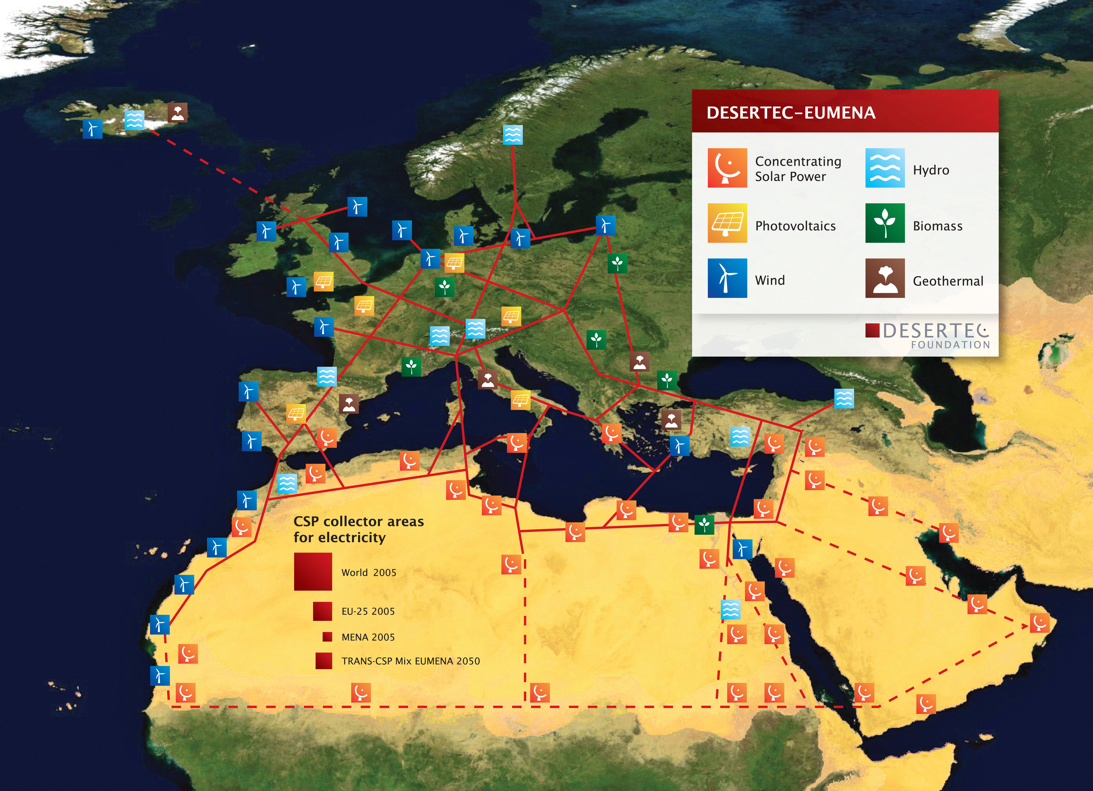
A pioneering project for benefiting from cheap RE
in the EU: the DESERTEC project
The German DESERTEC project (2003) focused on harvesting abundant solar energy in North Africa using concentrated solar power (CSP) and transmitting it back to Germany via power lines [17].
In principle, it would have faced minimal NIMBY issues in North Africa.
However, the project never materialised due to the massive investment required, the decline of CSP in favour of PV, and the challenges of establishing the transmission infrastructure to bring the electricity back to Germany.
Source: https://fr.wikipedia.org/wiki/Projet_Desertec
13

Slide 15
Remote Renewable Energy Hubs (RREH)
Definition 1: An energy hub integrates input and output of commodities, conversion, and storage functionalities, enabling coupling between different energy systems. An energy hub can also encompass production/consumption units, and transportation infrastructure, allowing the exchange of multiple energy carriers.
Definition 2: A renewable energy hub is an energy hub that relies on renewable energy sources for energy production.
Definition 3: A Remote Renewable Energy Hub (RREH) is a renewable energy hub located in a remote area.
Based on the idea of tapping into abundant, high-quality renewable energy sources, we introduced the concept of RREH. It extends the DESERTEC concept to export not only electricity but also e-fuels (electrical fuels). Large transmission lines to demand centres are no longer necessary, as these commodities can be transported by sea. These RREHs can be located in Europe for energy security or in remote locations outside of the EU.
14
The definitions given here are taken from [6].

Slide 16
Example of RREHs for e-fuels
These RREHs can produce electricity from renewable energy sources to synthesize CO₂-neutral gases and liquids such as hydrogen (H₂), ammonia (NH₃), methanol (CH₃OH), or methane (CH₄) fuels using technologies like direct air capture (DAC), electrolysis, and Fischer-Tropsch processes to simplify energy storage and transport. Such fuels are called e-fuels [9],[11].
An example of an RREH where solar and wind energy is collected in the Morocco desert, carried to the shore via an HVDC link, transformed into carbon-neutral CH₄ e-fuel and then shipped to Europe.
Source: the image comes from [9]
15

Slide 17
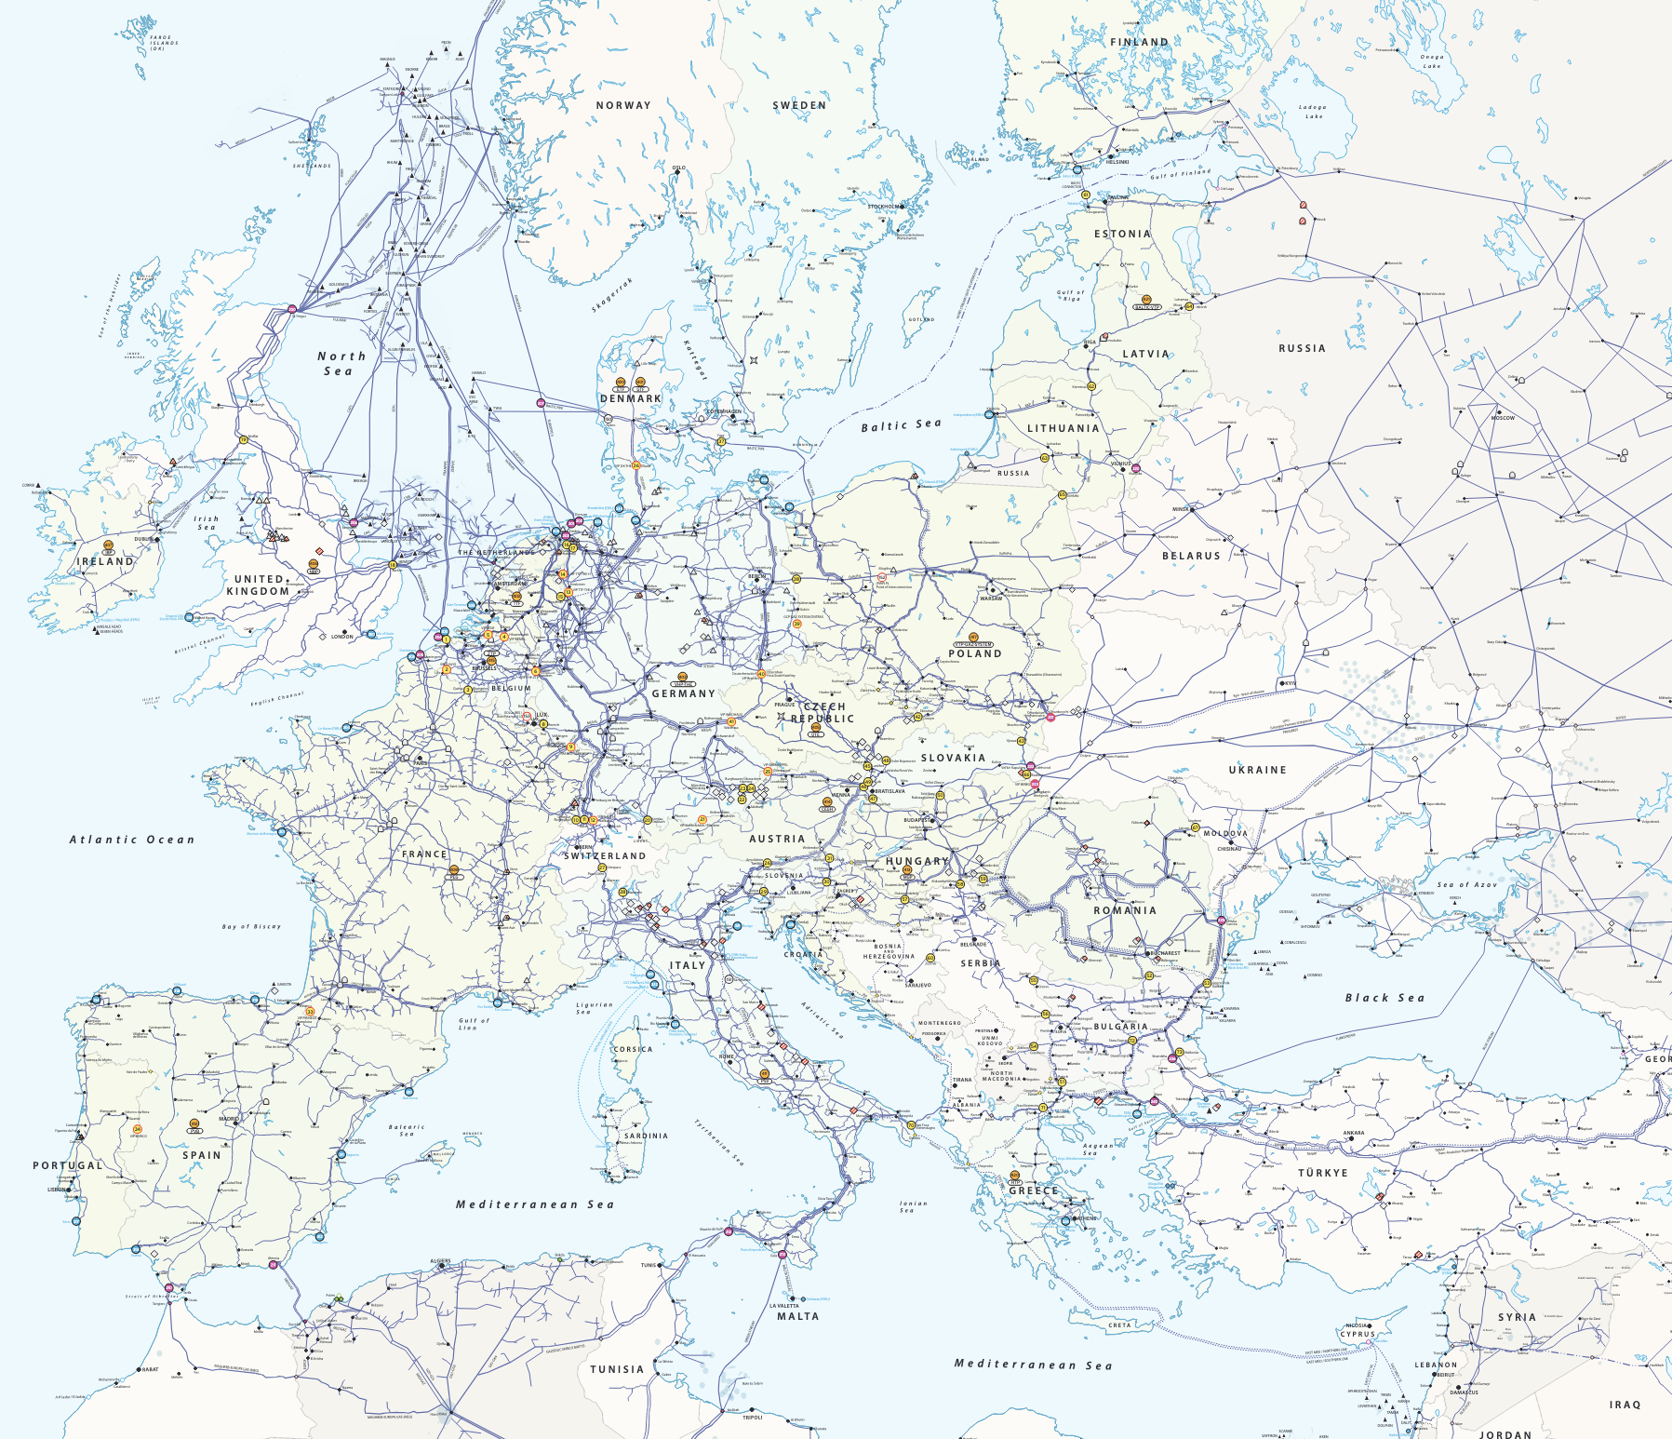
Why produce e-fuel in an RREH? (1/2)
An RREH transforming renewable electricity into e-fuels offer several advantages:
These e-fuels can be used in industries that require high-temperature processes (e.g., the steel industry).
All the existing infrastructure for transporting and storing fossil fuels can be reused. For example, the huge gas network in Europe could be reused without adaptation if the e-fuel produced is CH₄, as it is the same molecule as natural gas.
Source: https://www.entsog.eu/sites/default/files/2025-01/ENTSOG_GIE_SYSCAP_2025_1600x1200_FULL_114_FLAT.pdf
16

Slide 18
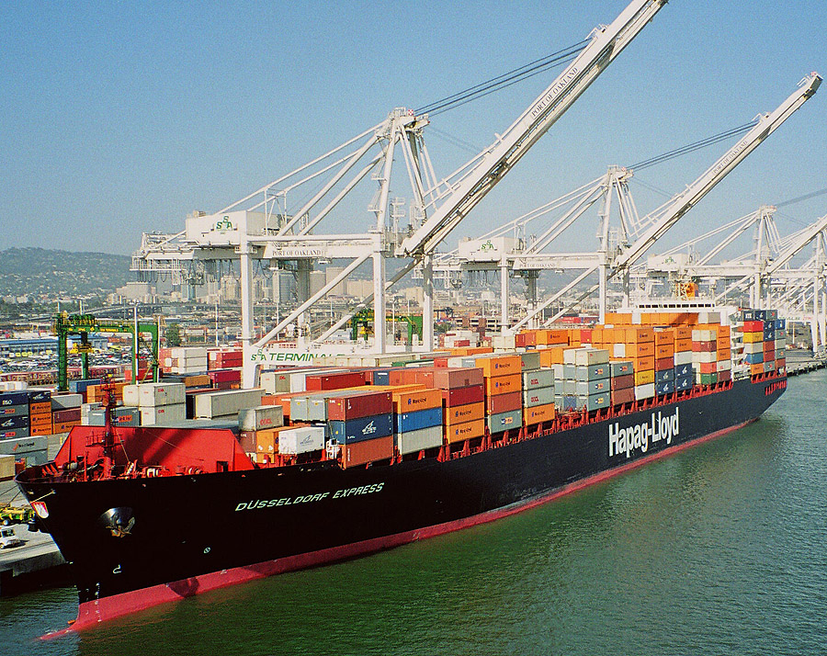
Why produce e-fuel in RREH? (2/2)
E-fuels can help decarbonize maritime and aviation transport.
E-fuels can provide a solution for seasonal energy storage.
The Haber-Bosch process can be used to synthesize e-NH₃ that can be used as a basis for nitrogen fertilizers.
RREHs can be rapidly constructed in parallel at multiple locations worldwide using standardized technology.
German Hapag-Lloyd AG ship
Source: https://fr.m.wikipedia.org/wiki/Fichier:Hapag-Lloyd-Ship.jpg
17

Slide 19
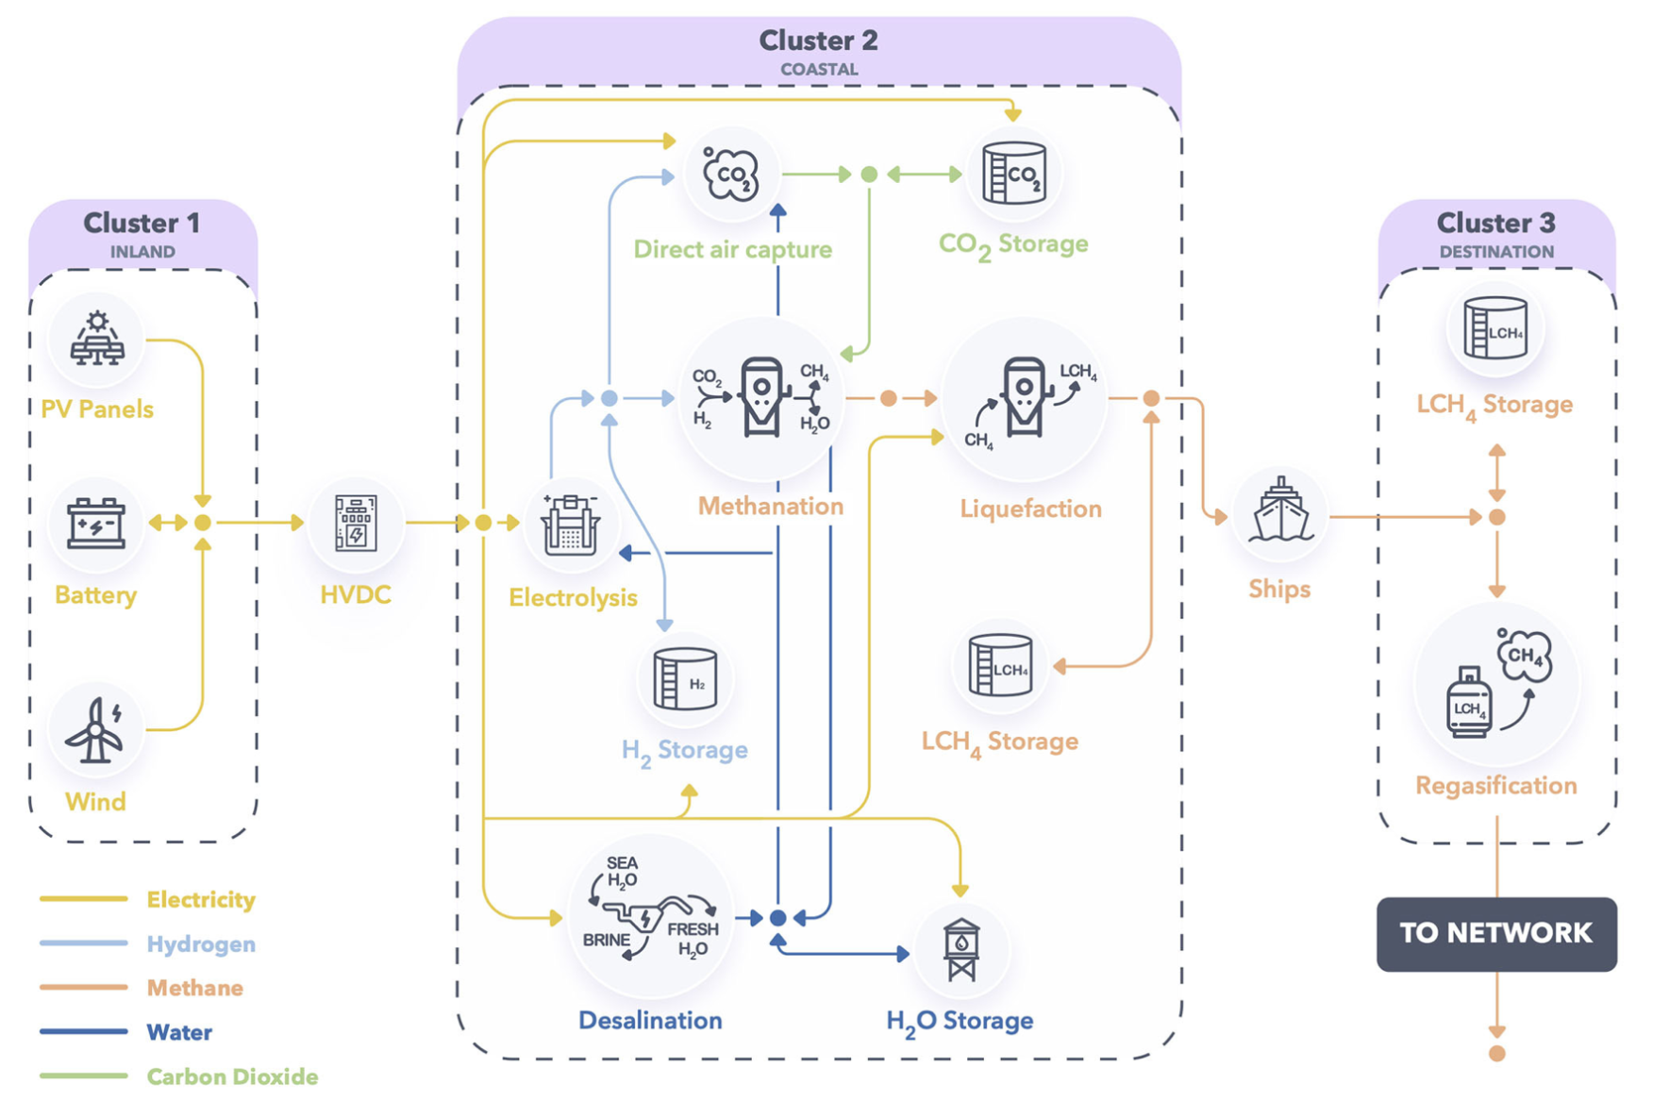
Example of hub for CH4 production based on Direct Air Capture (DAC)
Source: the image comes from [2]
18

Slide 20
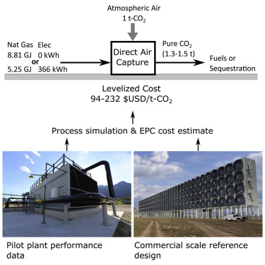
Direct Air Capture (DAC)
DAC technologies can extract CO₂ directly from the atmosphere at any location. To date, 27 DAC plants have been commissioned worldwide, capturing nearly 0.01 Mt CO₂ per year.
Capacity in ktCO₂/year of DAC plants for several companies
Company | Headquarters | 2022 | 2030 (projected)
Climeworks | Switzerland | 5.0 | 1,300
1PointFive/Carbon Engineering (Oxy) | United States/ Canada | 0.4 | 55,300
CarbonCapture | United States | 0 | 5,000
Global Thermostat | United States | 2.5 | -
Source: https://www.iea.org/energy-system/carbon-capture-utilisation-and-storage/direct-air-capture
Source: https://doi.org/10.1016/j.joule.2018.05.006
19

Slide 21
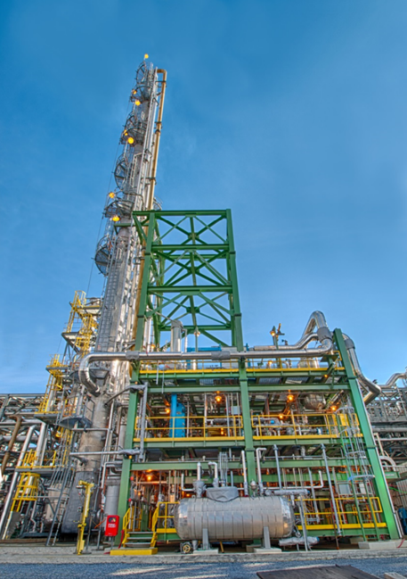
Post-Combustion Carbon Capture (PCCC)
DAC is not the only way to source CO₂ in these hubs. CO₂ could also be captured with Post-Combustion Carbon Capture (PCCC) units, which filter flue gases to extract CO₂.
Capturing CO₂ from exhaust fumes is easier than from the air, as the concentration of CO₂ in exhaust fumes is higher.
Linde-BASF 1 MWe pilot PCCC plant in Wilsonville, USA.
20

Slide 22
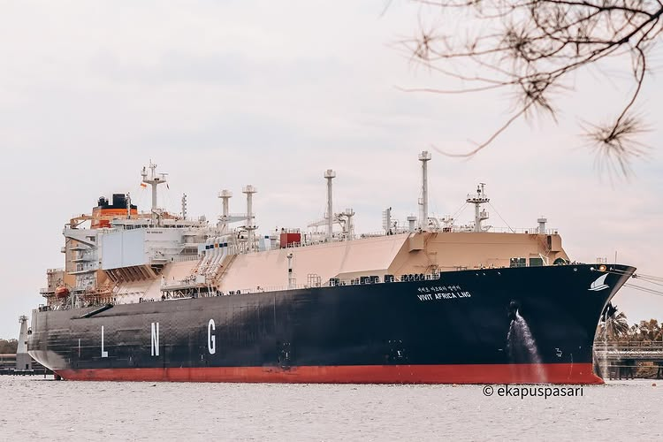
LNG tankers
PCCC facilities will likely be located in load centres where industries are emitting CO₂. Therefore, this CO₂ could be transported to the RREH to supply a Fischer-Tropsch process for synthesizing hydrocarbon chains such as CH₄.
One could envision a dual carrier, a boat capable of transporting both CO₂ and CH₄. This boat could bring CO₂ from the load centre to the hub and return with CH₄ from the hub to the load centre.
This dual carrier could reduce the energy requirements and the investments in shipping by roughly a half.
Source: https://www.instagram.com/_ekapusssss/p/DDZHkbMS_g0/
21

Slide 23
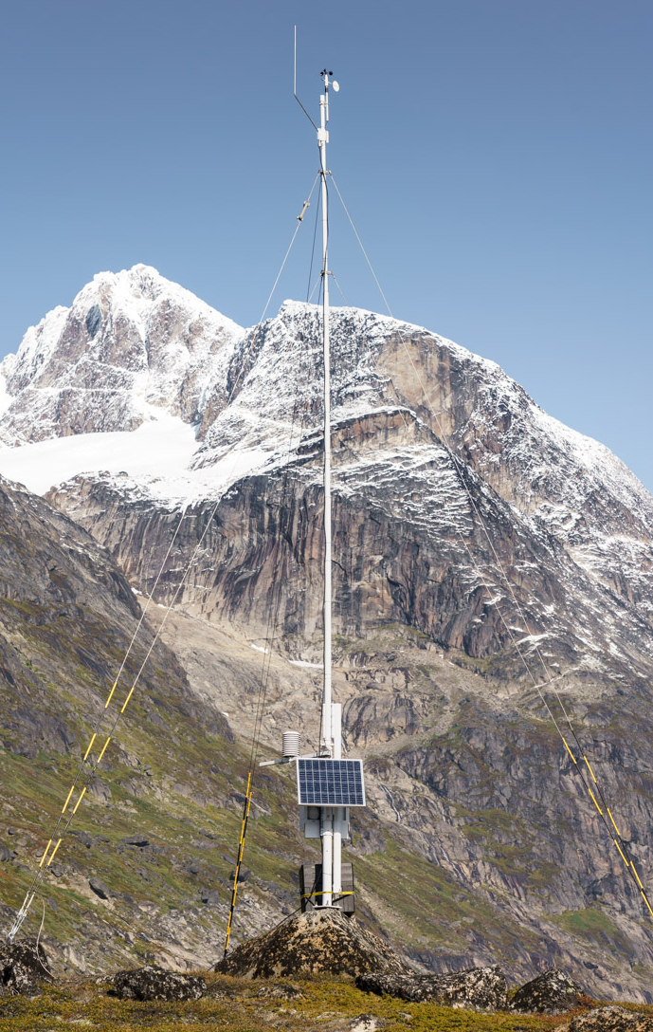
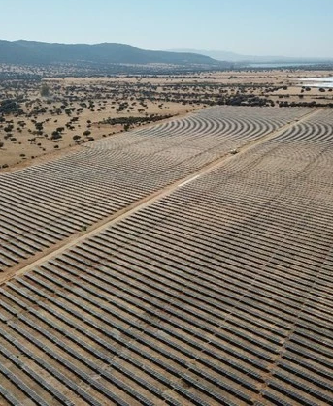
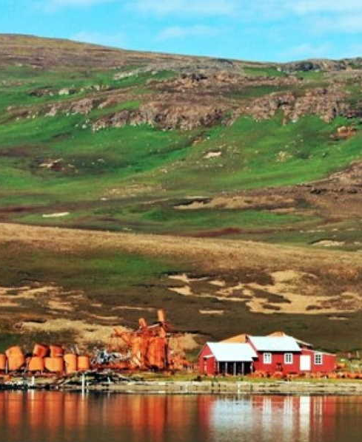
Where can we install e-fuel production hubs?
Let us explore three examples of RREHs, among many others, and their respective advantages.
1. South-east Greenland
2. Extremadura (Spain)
3. Kerguelen Islands (France)
22

Slide 24
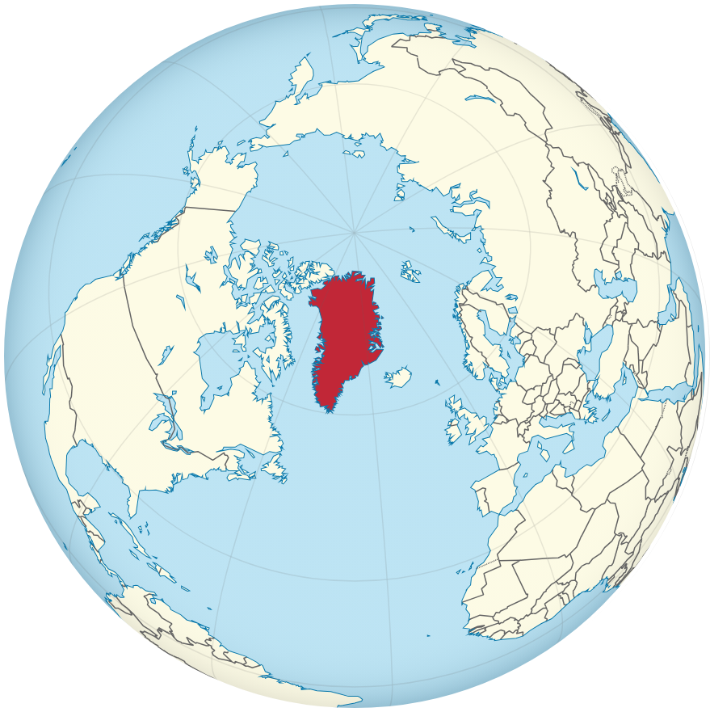
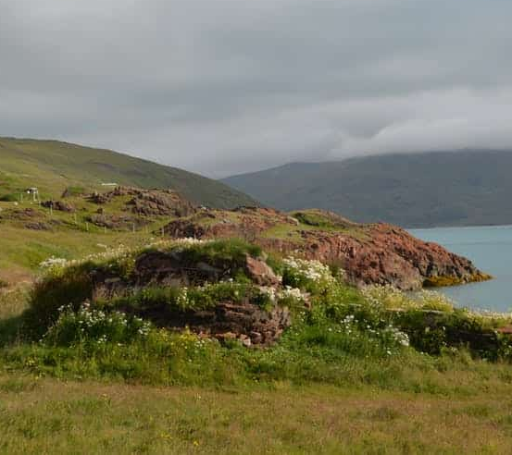
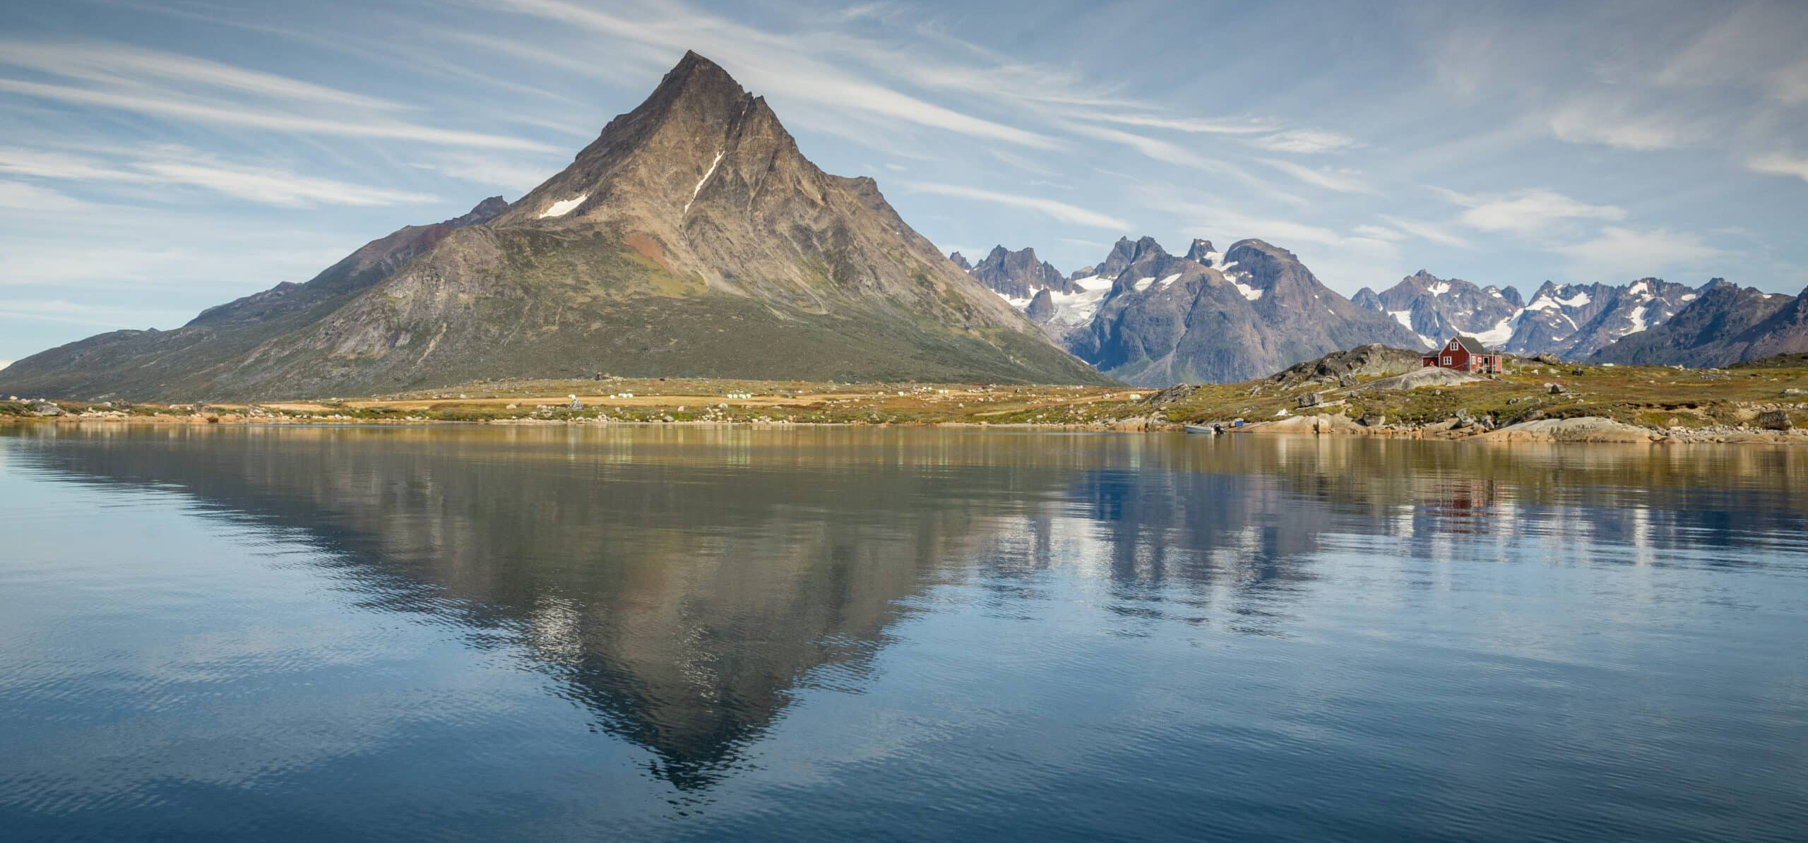
1. South-east Greenland
Vast areas without NIMBY issues, allowing for large-scale renewable energy projects.
Strong katabatic winds at the southern tip, providing steady wind energy potential [16].
Reduced correlation with European wind patterns.
23

Slide 25
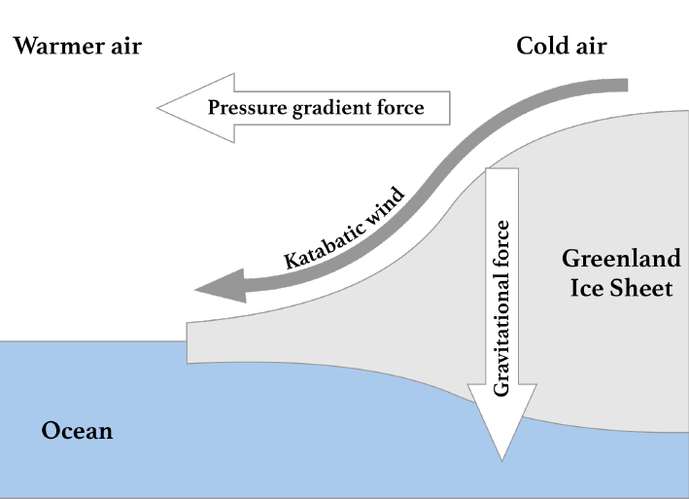
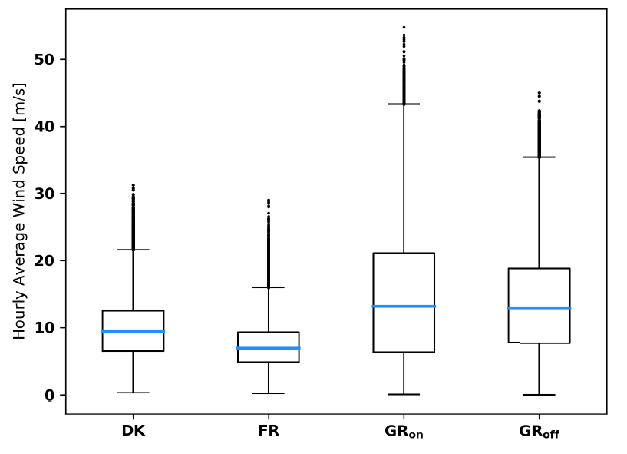
Katabatic winds in South-east Greenland
Katabatic winds are the result of heat transfer processes between the cold ice cap and the warmer air mass above it.
This leads to higher mean wind speeds than in Europe (i.e., Denmark and France) [16].
24

Slide 26
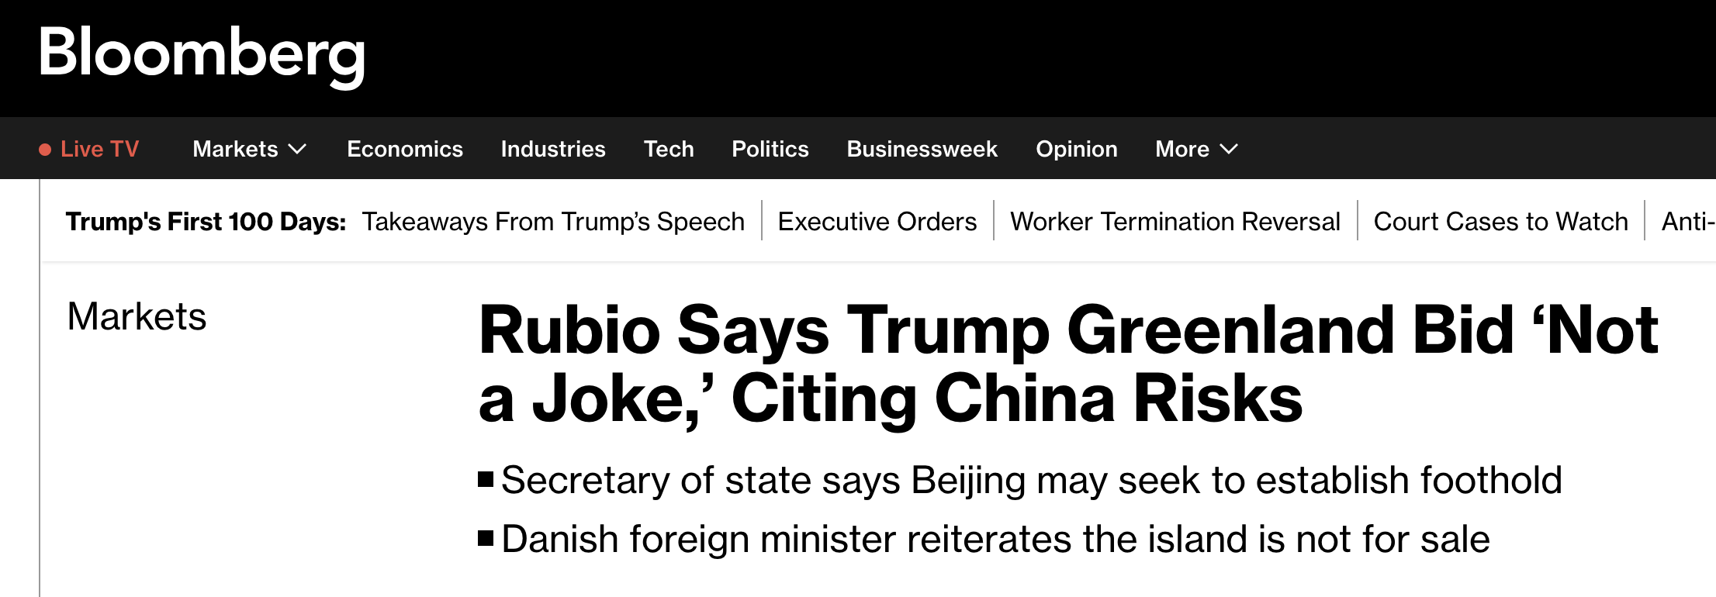

RREH in Greenland and EU Security
Building an RREH in Greenland would strengthen the EU's position in the region and align member states on the need to defend this territory.
January 30, 2025
March 5, 2025
25

Slide 27
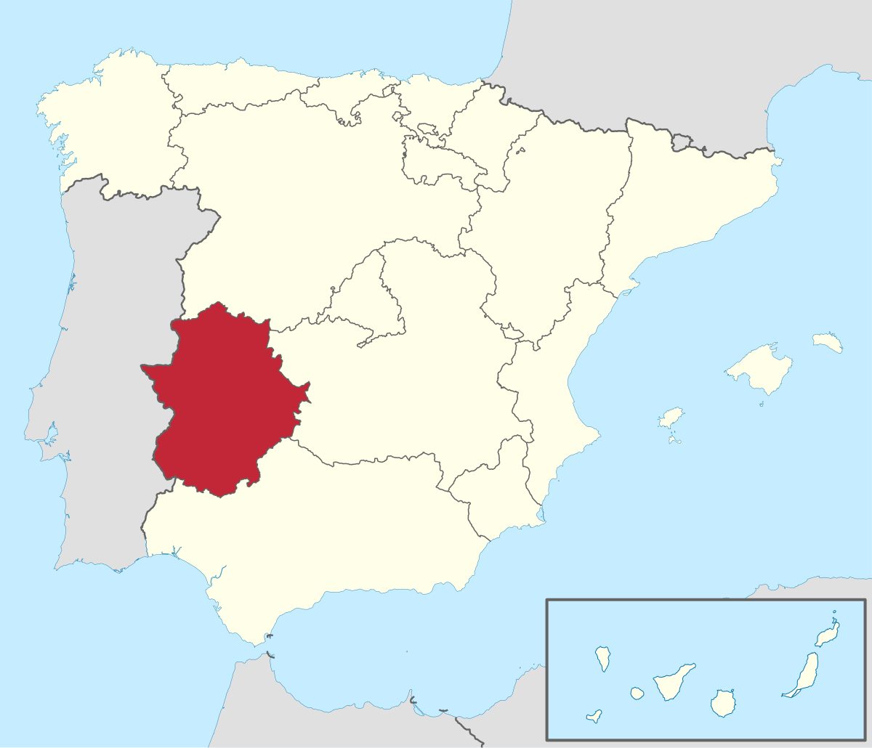
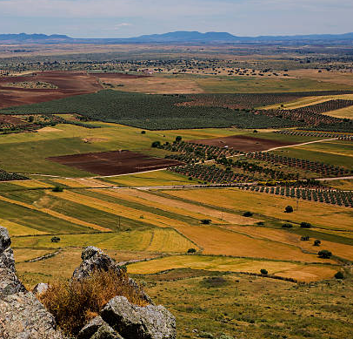
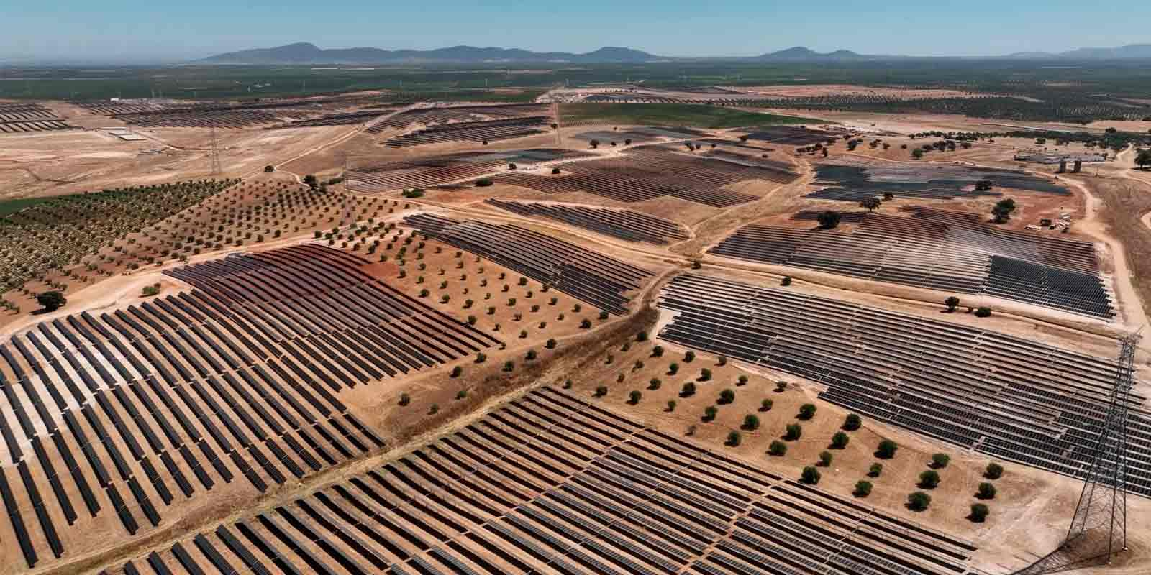
2. Extremadura, a region in Spain
High potential for renewable energy, particularly PV (solar irradiance is 200 W/m² compared to around 110 W/m² in Belgium and Germany).
The region has a low population density, avoiding NIMBY issues.
Easy access to the gas grid for the transport and distribution of e-fuels.
26

Slide 28
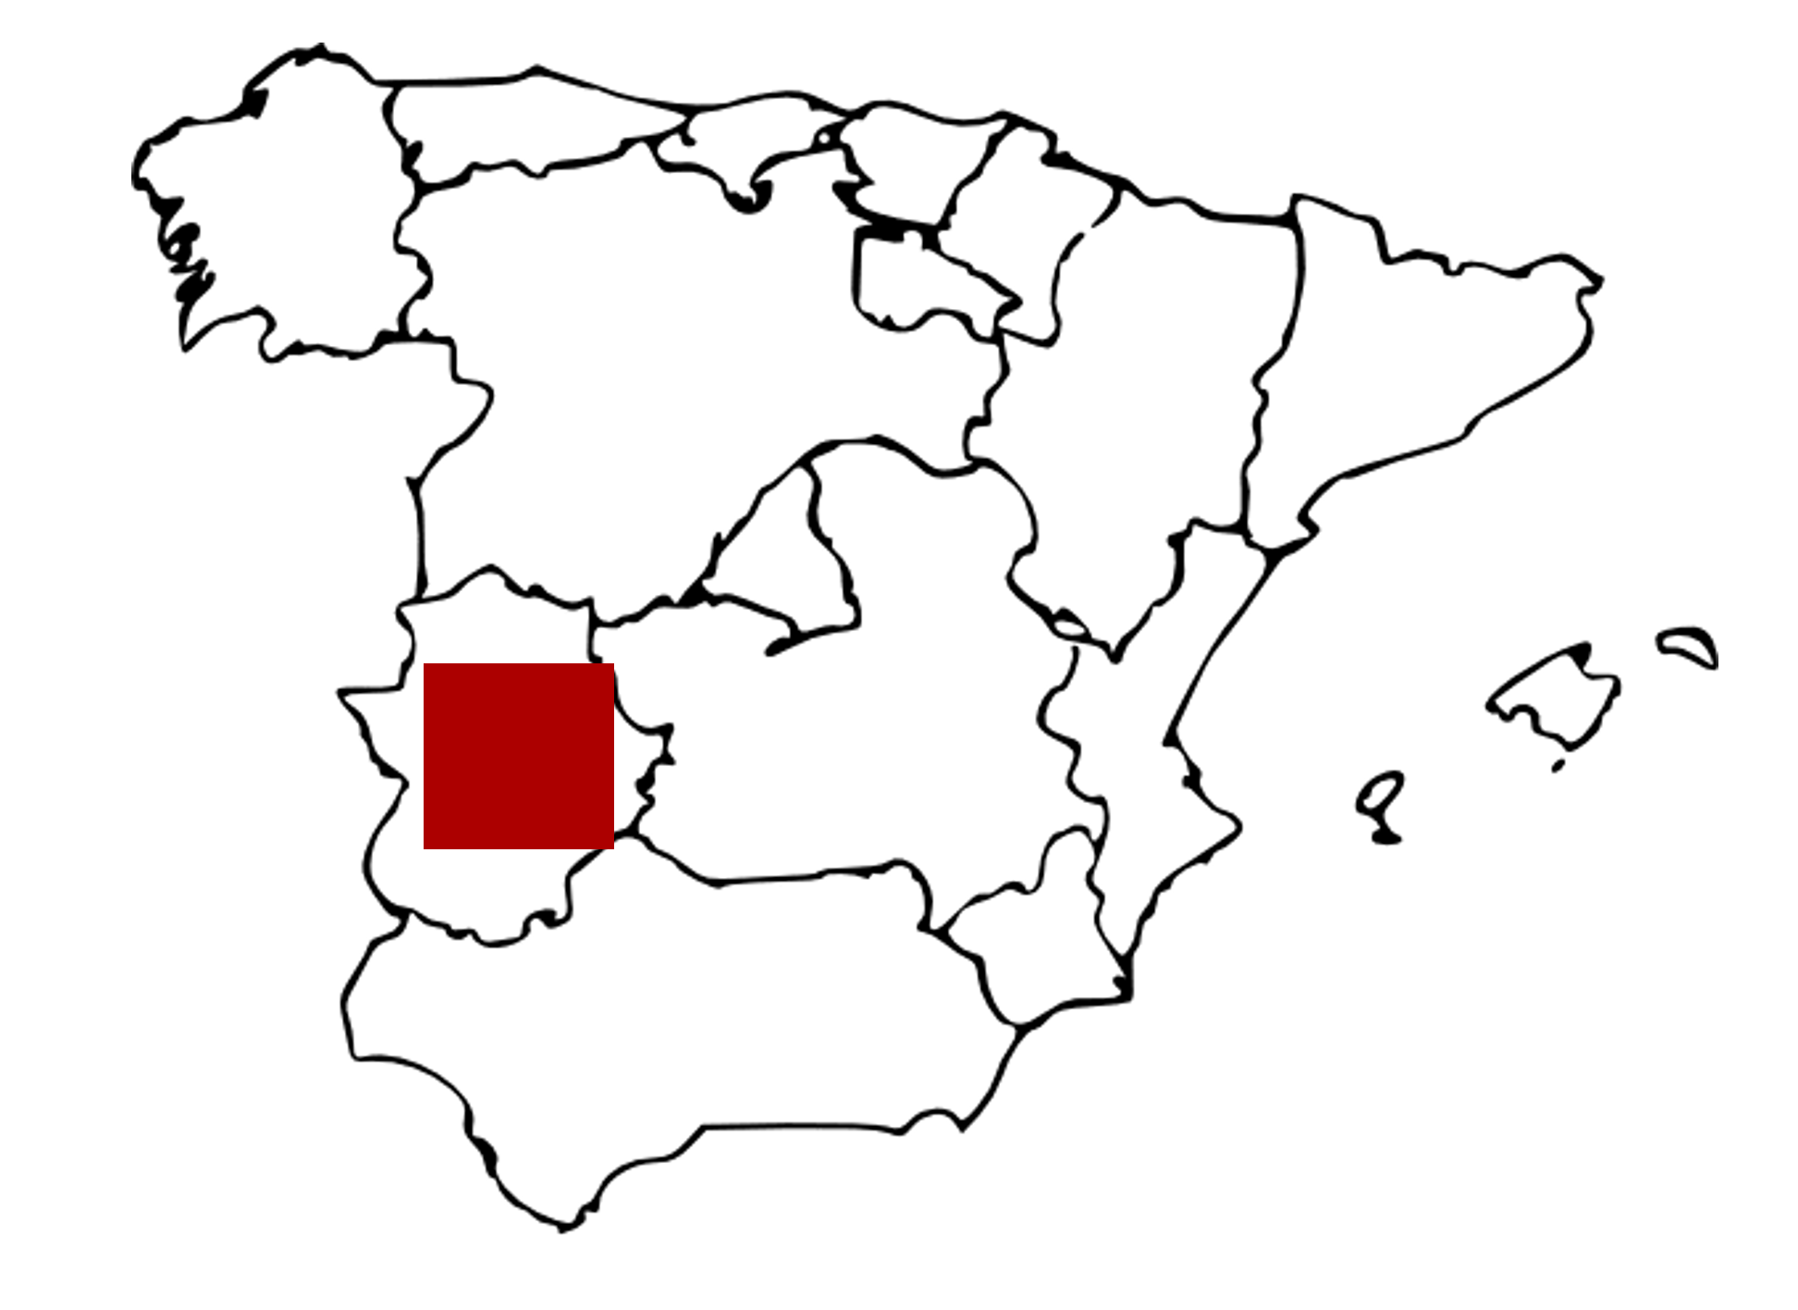
How much land should be covered by PV panels for supplying the entire gas demand of the EU?
The EU’s gas demand is around 330 billion cubic meters per year. Assuming the energy content of natural gas is 10.5 kWh/m³, this corresponds to 3,465 TWh/year.
Supplying the entire gas demand of the EU with solar power and Power-to-Gas technology would require a PV area of approximately 16,000 km², considering a solar irradiance of 200 W/m², a PV efficiency of 25%, and 50% losses in the conversion process.
This corresponds to approximately 40% of the land area of the Extremadura region.
27

Slide 29
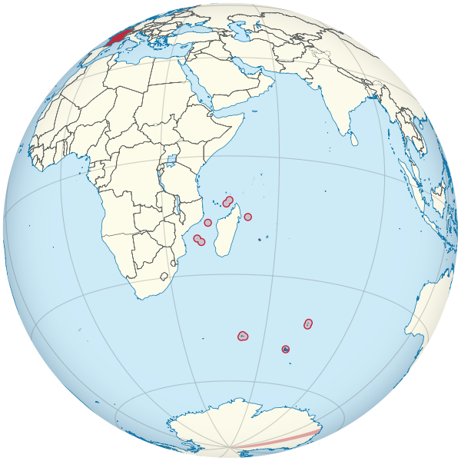
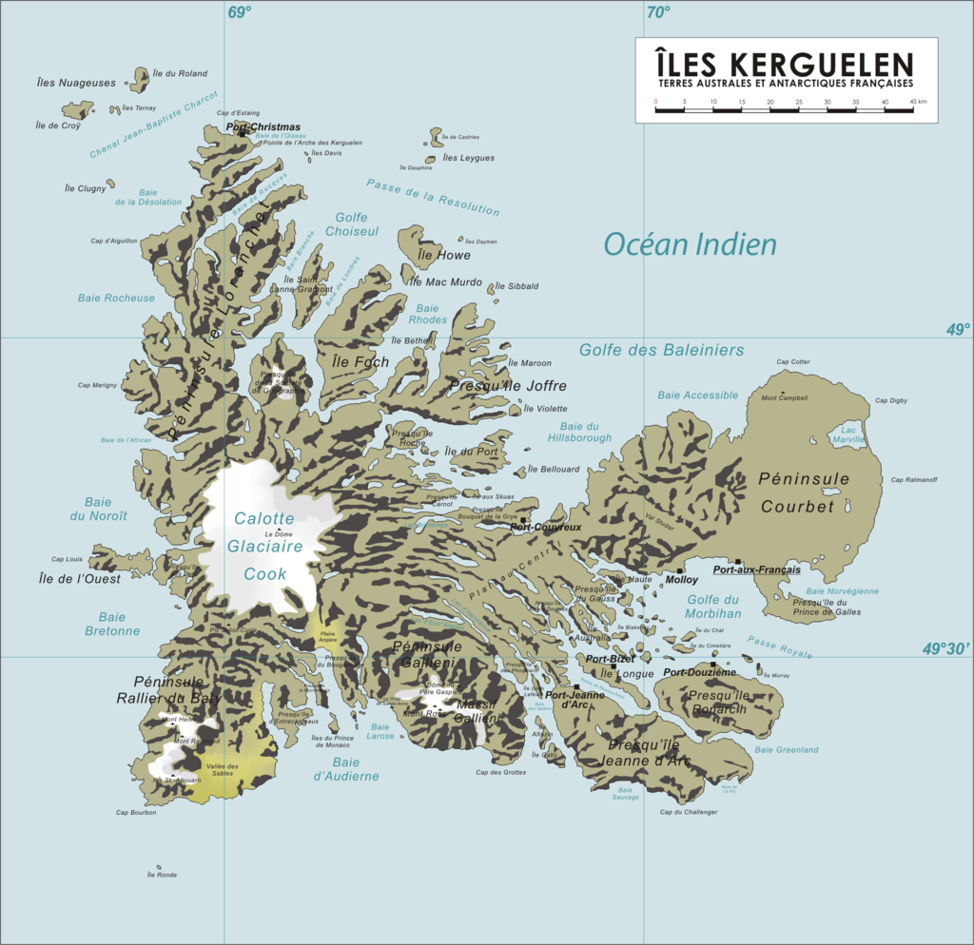
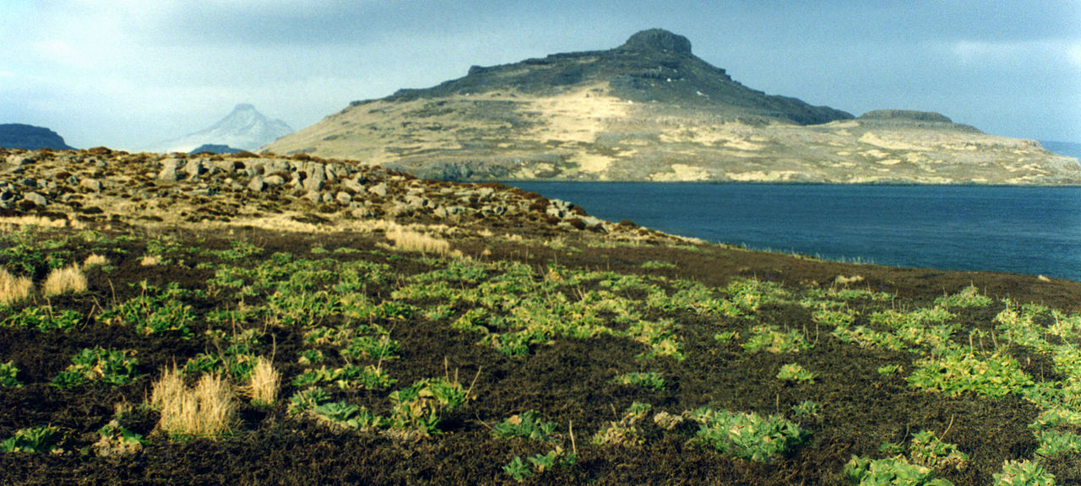
3. Kerguelen Islands
The west coast receives almost continuous wind at an average speed of 35 km/h. Wind speeds of 150 km/h are common and can even reach 200 km/h.
Its status as a French overseas territory offers political stability and access to French and EU financial support.
28

Slide 30
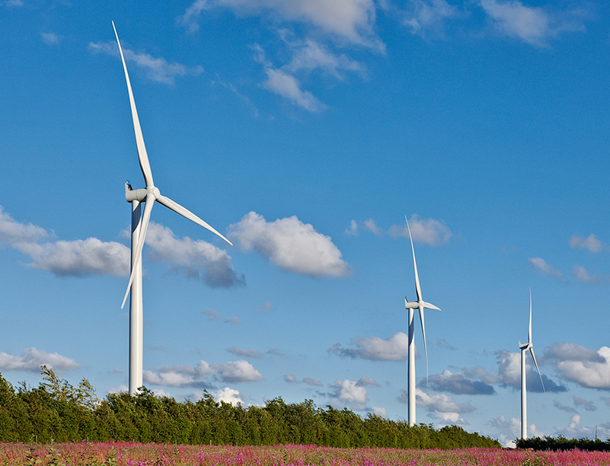
Kerguelen Islands vs. French nuclear power fleet
The average wind speed at a height of 10 m is around 35 km/h (10 m/s) in the Kerguelen Islands, corresponding to around 14 m/s at a height of 100 m, which is a typical value for the height of a wind turbine. Assuming a 40% efficiency in capturing wind energy and an air density of 1.3 kg/m³, the power produced per unit area of a wind farm would be 22.4 W/m² (see Appendix for more details).
If the entire land area of the Kerguelen Islands (7,215 km²) were covered by wind turbines, it would result in an average power production of around 160 GW.
Assuming a 50% loss in transforming this electricity into e-fuels and transporting it back to the EU, the annual production would be 708 TWh, or around double the annual electricity production of the French nuclear power fleet.
Siemens’ turbines in Galway Wind Park, Ireland.
More information on the methodology for performing the calculations can be found in Chapter 05 of the following lecture notes: https://hdl.handle.net/2268/329161
29

Slide 31
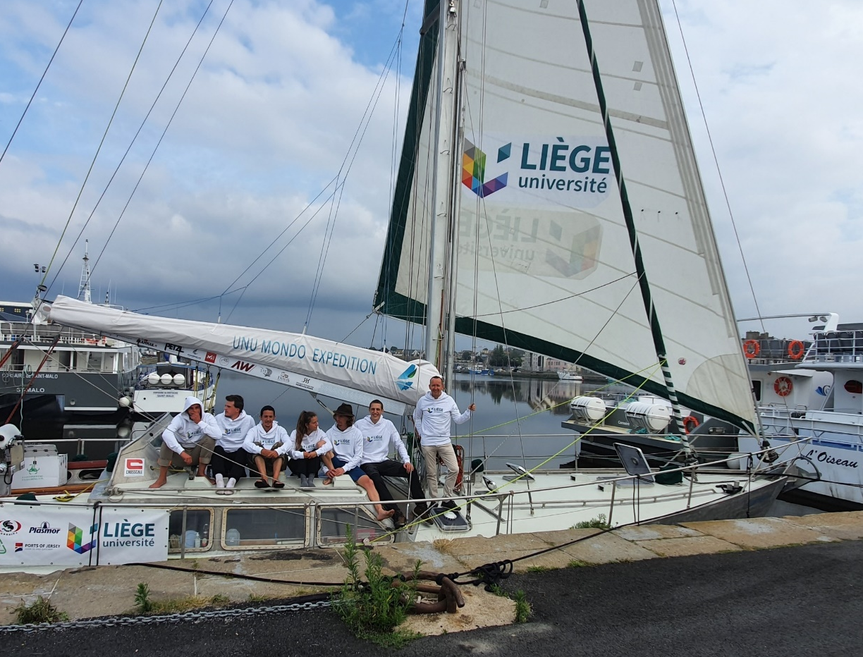
Scientific contribution from our lab
In the Smart Grids Lab of the Montefiore Research Unit of the ULiège, we conduct research on:
Identifying the most promising hubs through techno-economic analyses [2], [5], [6], [7], [8], [9], [11], [15];
Developing a tool, GBOML, to optimally size and operate these hubs [12], [13], [14];
Performing in situ measurements of the winds in Greenland in the context of the Katabata Project [1], [2], [4], [5], [10], [16].
Departure of Saint-Malo (France) to install weather stations in Greenland in 2020. The expedition took place in the context of the Katabata project.
The scientific publications of the lab can be downloaded on Damien Ernst’s website: https://damien-ernst.be
30

Slide 32
References (1/2)
[1] Berger, M., Radu, D., Fonteneau, R., Henry, R., Glavic, M., Fettweis, X., Le Du, M., Panciatici, P., Balea, L., & Ernst, D. (2018). Critical time windows for renewable resource complementarity assessment. Energy, 198, 117308.
[2] Berger, M., Radu, D.-C., Detienne, G., Deschuyteneer, T., Richel, A., & Ernst, D. (2021). Remote renewable hubs for carbon- neutral synthetic fuel production. Frontiers in Energy Research.
[3] Bordoff, J., & O’Sullivan, M. L. (2023, April 10). The age of energy insecurity: How the fight for resources is upending geopolitics. Foreign Affairs.
[4] Chatzivasileiadis, S., Ernst, D., & Andersson, G. (2013). The global grid. Renewable Energy, 57, 372-383.
[5] Dachet, V., Benzerga, A., Coppitters, D., Contino, F., Fonteneau, R., & Ernst, D. (2024). Towards CO2 valorization in a multi remote renewable energy hub framework with uncertainty quantification. Journal of Environmental Management, 363.
[6] Dachet, V., Dubois, A., Miftari, B., Fonteneau, R., & Ernst, D. (2024, December 19). Remote renewable energy hubs: A taxonomy. Energy Reports, 13, 3112-2120. https://doi.org/10.1016/j.egyr.2025.02.040
[7] Dachet, V., Maio, A., Counotte, P., & Ernst, D. (2025). Remote renewable energy hubs in the high seas: A battery-based fully- electric ecosystem. ORBi-University of Liège. https://orbi.uliege.be/handle/2268/327232
[8] Dauchat, L., Dachet, V., Fonteneau, R., & Ernst, D. (2024). Waste heat recovery in remote renewable energy hubs [Paper presentation]. Proceedings of ECOS 2024 - The 37th International Conference on Efficiency, Cost, Optimization, Simulation and Environmental Impact of Energy Systems, Rhodes, Greece. https://hdl.handle.net/2268/313825
[9] Fonder, M., Counotte, P., Dachet, V., de Séjournet, J., & Ernst, D. (2024, March 15). Synthetic methane for closing the carbon loop: Comparative study of three carbon sources for remote carbon-neutral fuel synthetization. Applied Energy, 358. https://doi.org/10.1016/j.apenergy.2023.122606
31

Slide 33
References (2/2)
[10] Lambin, C., Fettweis, X., Kittel, C., Fonder, M., & Ernst, D. (2022). Assessment of future wind speed and wind power changes over South Greenland using the MAR regional climate model. International Journal of Climatology.
[11] Larbanois, A., Dachet, V., Fonteneau, R., & Ernst, D. (2023). E-fuels produced in remote renewable energy hubs: A cross vector analysis. Proceedings of ECOS 2024 - The 37th International Conference on Efficiency, Cost, Optimization, Simulation and Environmental Impact of Energy Systems, Rhodes, Greece.
[12] Miftari, B., Berger, M., Djelassi, H., & Ernst, D. (2022). GBOML: Graph-based optimization modeling language. Journal of Open Source Software, 7(72), 4158.
[13] Miftari, B., Berger, M., Derval, G., Louveaux, Q., & Ernst, D. (2023). GBOML: A structure-exploiting optimization modeling language in Python. Optimization Methods and Software.
[14] Miftari, B., Louveaux, Q., Ernst, D., & Derval, G. (2024). Sensitivity analysis for linear changes of the constraint matrix of a linear program. arXiv preprint arXiv:2410.14443.
[15] Mokeddem, S., Miftari, B., Dachet, V., Derval, G., & Ernst, D. (In press). Distributed e-fuel hubs (DEFH): A case study of a Belgian Fischer-Tropsch liquids hub. (Working paper). ORBi-University of Liège. https://orbi.uliege.be/handle/2268/327044
[16] Radu, D.-C., Berger, M., Fonteneau, R., Hardy, S., Fettweis, X., Le Du, M., Panciatici, P., Balea, L., & Ernst, D. (2019). Complementarity assessment of South Greenland katabatic flows and West Europe wind regimes. Energy, 175, 393-401.
[17] Samus, T., Lang, B., & Rohn, H. (2013). Assessing the natural resource use and the resource efficiency potential of the DESERTEC concept. Solar Energy, 87, 176-183.
32

Slide 34
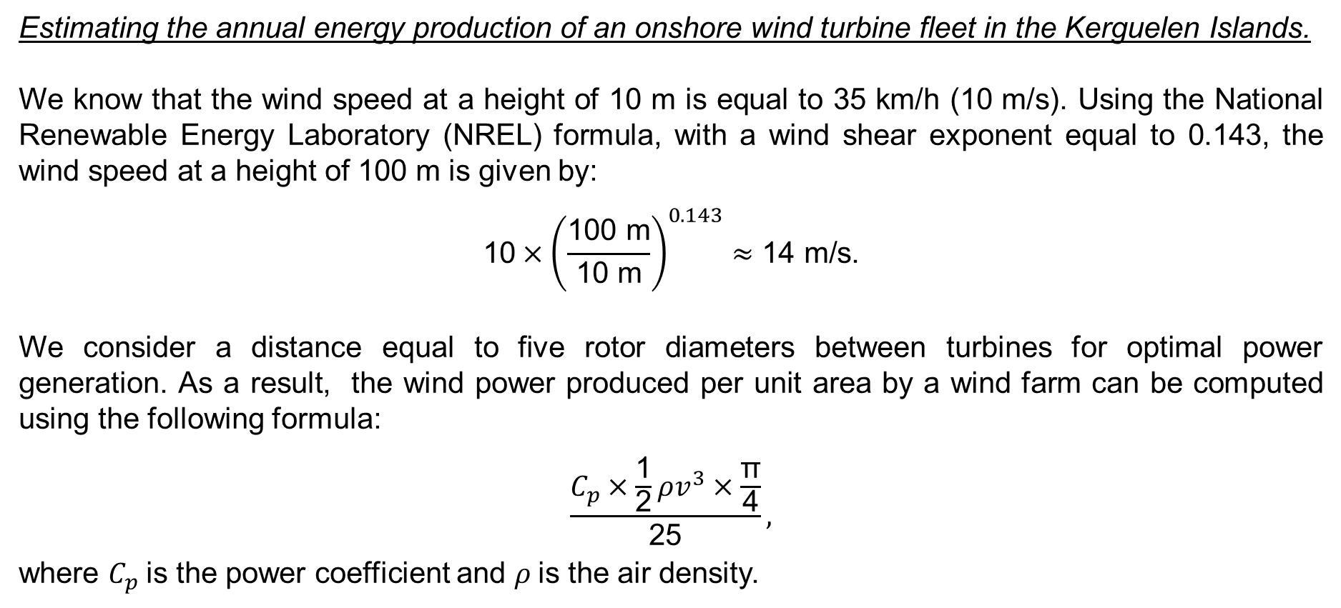
Appendix (1/2)
Estimating the annual energy production of an onshore wind turbine fleet in the Kerguelen Islands.
We know that the wind speed at a height of 10 m is equal to 35 km/h (10 m/s). Using the National Renewable Energy Laboratory (NREL) formula, with a wind shear exponent equal to 0.143, the wind speed at a height of 100 m is given by:
$$\text{10}×{\left(\frac{\text{100 }\text{m}}{\text{10 }\text{m}}\right)}^{0.143}≈\text{14} \text{m}\text{/}\text{s}\text{.}$$
We consider a distance equal to five rotor diameters between turbines for optimal power generation. As a result, the wind power produced per unit area by a wind farm can be computed using the following formula:
$$\frac{C_{p}×\frac{\text{1}}{\text{2}}ρv^{3}×\frac{\text{π}}{\text{4}}}{\text{25}},$$
where $C_{p}$is the power coefficient and $ρ$is the air density.
33

Slide 35
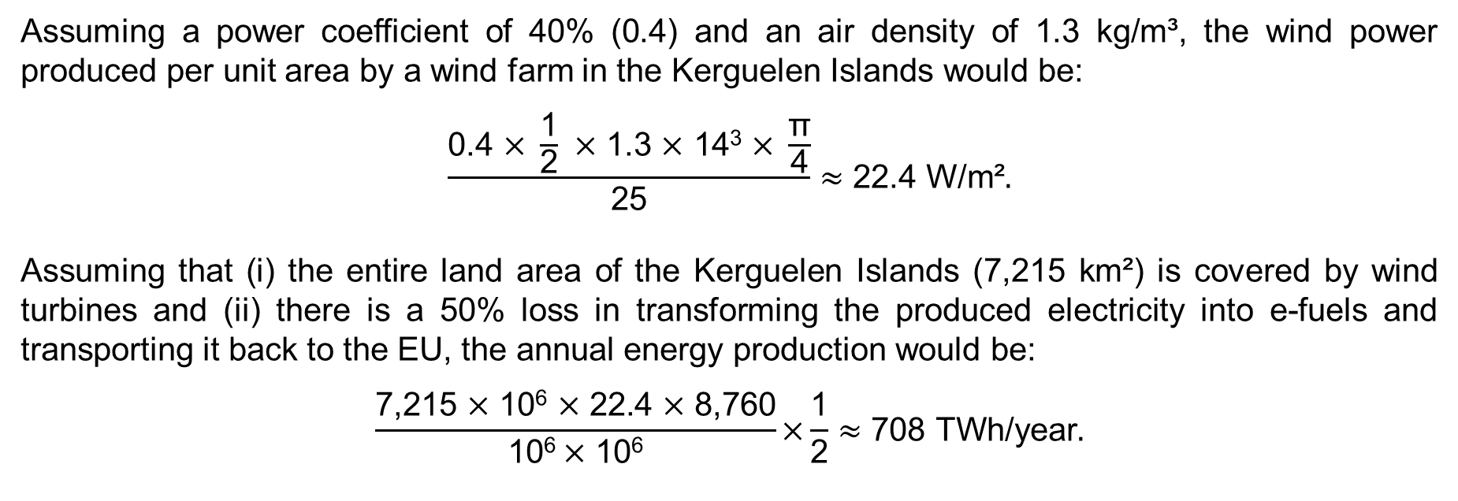
Appendix (2/2)
Assuming a power coefficient of 40% (0.4) and an air density of 1.3 kg/m³, the wind power produced per unit area by a wind farm in the Kerguelen Islands would be:
$$\frac{\text{0}\text{.4 }\text{×} \frac{\text{1}}{\text{2}} \text{×}\text{ 1.3 }\text{×} \text{1}\text{4}\text{3} \text{×} \frac{\text{π}}{\text{4}}}{\text{25}}≈\text{22.}\text{4} \text{W}\text{/}\text{m}\text{²}.$$
Assuming that (i) the entire land area of the Kerguelen Islands (7,215 km²) is covered by wind turbines and (ii) there is a 50% loss in transforming the produced electricity into e-fuels and transporting it back to the EU, the annual energy production would be:
$$\frac{\text{7,215} \text{×} \text{10}\text{6} \text{×} \text{22.4} \text{×}\text{ 8,760}}{\text{1}\text{0}\text{6} \text{×} \text{1}\text{0}\text{6}}\text{×}\frac{\text{1}}{\text{2}}≈\text{708} \text{TWh}\text{/}\text{year}.$$
34

