Slide 1
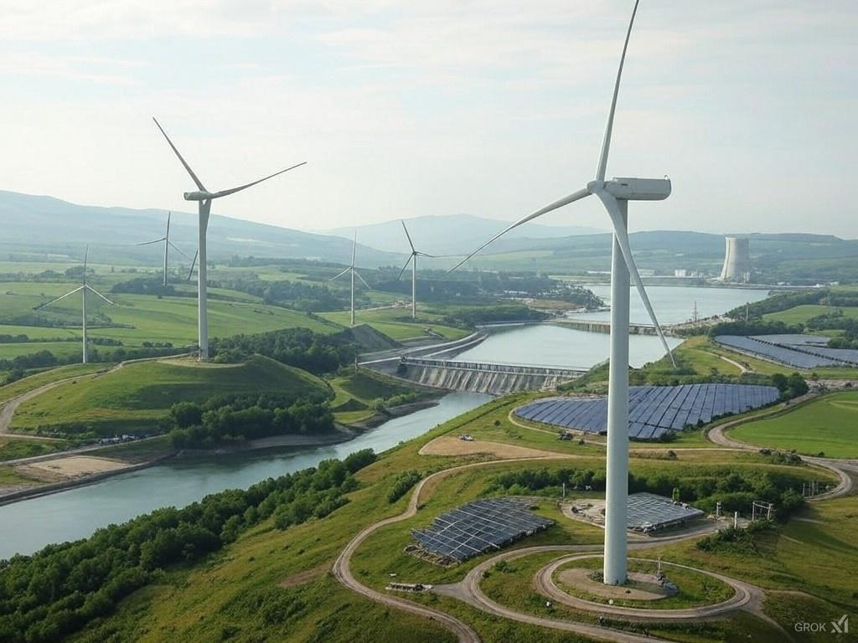
GENV0002-1
Energy and sustainable development
Lecturer: Damien Ernst – University of Liège (dernst@uliege.be)
Chapter 01 – Motivation of the course
Image generated with the AI tool Grok.

Slide 2
Typical quotes about energy
“The energy crisis is imminent; we will face an oil shortage starting in 2025!”
“Nuclear power could address this energy crisis, but we will eventually deplete uranium resources, leading to the same issue.”
“We have inexhaustible access to solar and wind energy; developing renewable technologies is all it will take to save us.”
“Turning off your computer before bed could reduce CO₂ emissions by five million tons every year.”
“Belgium emits approximately 300 kilotons of CO₂ per day, which is equivalent to more than 170,000 round-trip flights between Brussels and New York.”
There is a lack of meaningful facts and figures when dealing with energy policy. Even when numbers are presented, they are often meant to impress rather than to inform.
2

Slide 3
Main objective of the course
The main objective of the course is to acquire the skills to handle numbers that are understandable, comparable, and easy to remember, thereby enhancing the ability to effectively answer questions such as:
“Can Belgium feasibly survive on its own renewable energy sources?”
“By adjusting thermostats one degree closer to the outside temperature, opting for smaller cars, and turning off phone chargers when not in use, can we prevent an energy crisis?”
“Is the Earth's population seven times larger than it should be?”
“What are the energy storage requirements to manage daily fluctuations in the context of a European Union with 100% renewable energy production?”
“Could we harvest energy from areas with high renewable energy potential and transport it to high-consumption areas?”
“Would it be possible to produce all the final energy consumed by humanity using nuclear power alone?”
3

Slide 4
Course program
Plenary lectures on “Energy and sustainable development”
These lectures will be delivered by Prof. Damien Ernst. The teaching material for these lectures has been prepared by the professor and his collaborators. One book that has been particularly influential in the creation of the lecture slides is “Sustainable Energy – Without the Hot Air” by the late Prof. David J.C. MacKay.
Plenary lectures by invited speakers
These sessions will focus on specific topics related to energy.
Group sessions
Each student will participate in one group session.
Detailed information on the website:
https://damien-ernst.be
4

Slide 5
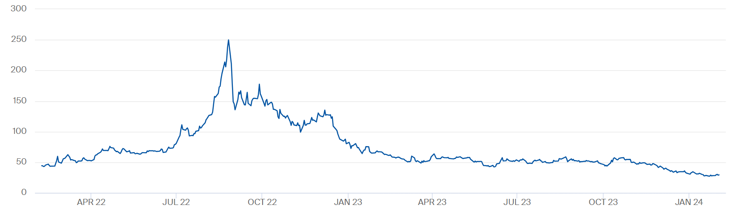
Impact of importing fossil fuels
Fossil fuels are finite resources, and we are likely to exhaust affordable gas and oil supplies within our lifetime. Even if these resources remain accessible globally, heavy reliance on foreign sources introduces significant vulnerabilities, including supply disruptions and geopolitical instability.
For instance, the energy crisis triggered by the war in Ukraine highlighted these risks. Supply disruptions from Russia caused the price of gas on the Dutch TTF to surge to €250/MWh, compared to the typical average of less than €30/MWh over the previous fifteen years.
Dutch TTF natural gas futures pricing (EUR/MWh).¹
¹ Dutch TTF natural gas futures pricing. (2024, February 05). ICE.
5

Slide 6
How fossil fuels contribute to global warming
Burning fossil fuels is a major contributor to climate change due to the release of carbon dioxide (CO₂) emissions. The process leading to climate change can be explained in three steps:
Step 1: Carbon dioxide (CO₂), acting as a greenhouse gas (GHG), enhances the greenhouse effect by trapping heat in the atmosphere;
Step 2: Human activities, particularly the combustion of fossil fuels, increase CO₂ concentrations and emissions;
Step 3: This intensified greenhouse effect leads to climate changes, including a rise in average global temperatures.
6

Slide 7
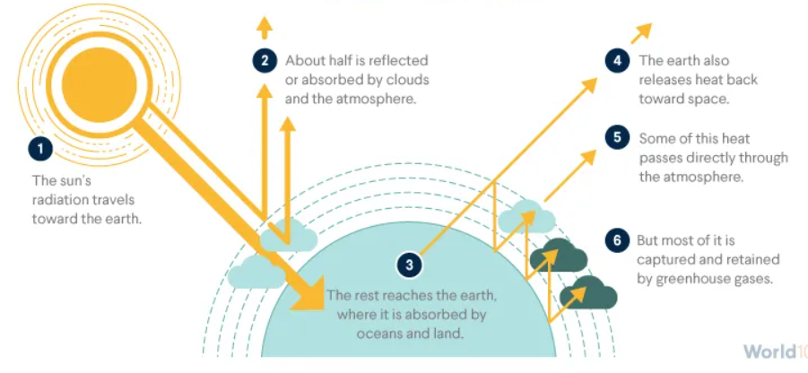
Step 1: CO₂, acting as a GHG, enhances the greenhouse effect by trapping heat in the atmosphere
CO₂ molecules have the ability to absorb and re-emit thermal infrared radiation, which is the heat energy radiated by the Earth's surface. Instead of allowing this heat to escape into space, CO₂ redirects part of it back toward the surface, creating a warming effect.
The greenhouse effect process.¹
¹ The greenhouse effect. (2023, July 25). World101 from the Council on Foreign Relations.
7

Slide 8
The global warming potential of greenhouse gases (1/2)
The global warming potential (GWP) of a gas is a measure of its warming impact relative to CO₂. It considers both the gas's effectiveness in trapping heat and its persistence in the atmosphere, indicating how much of a given gas would be needed to produce the same warming effect as CO₂.
Gas name | Chemical formula | Lifetime (years) | Radiative efficiency (Wm⁻²ppb⁻¹, molar basis) | Global warming potential (GWP) for given time horizon
 |  |  |  | 20-yr. | 100-yr. | 500-yr.
Carbon dioxide | CO₂ | 30 - 95 | 1.37×10⁻⁵ | 1 | 1 | 1
Methane (fossil) | CH₄ | 12 | 5.7×10⁻⁴ | 83 | 30 | 10
Nitrous oxide | N₂O | 109 | 3×10⁻³ | 273 | 273 | 130
CFC-12 | CCl₂F₂ | 100 | 0.32 | 10,800 | 10,200 | 5,200
HCFC-22 | CHClF₂ | 12 | 0.21 | 5,280 | 1,760 | 549
Tetrafluoromethane | CF₄ | 50,000 | 0.09 | 5,301 | 7,380 | 10,587
Sulfur hexafluoride | SF₆ | 3,200 | 0.57 | 17,500 | 23,500 | 32,600
Nitrogen trifluoride | NF₃ | 500 | 0.20 | 12,800 | 16,100 | 20,700
Atmospheric lifetime and global warming potential at different time horizons for various GHGs.¹
¹ Greenhouse gas. (2002, February 1). Wikipedia.
8

Slide 9
The global warming potential of greenhouse gases (2/2)
It is standard practice to express all greenhouse gas emissions in terms of carbon dioxide equivalent (CO₂e). This metric represents the amount of CO₂ that would produce the same warming effect as a given mass of another gas over a specified time frame.
For example, releasing two tons of methane (CH₄) into the atmosphere is equivalent, in terms of warming over a period of 100 years, to emitting 60 tons of CO₂.
Water vapor (H₂O) accounts for approximately 36-72% of the total greenhouse effect, followed by CO₂ at 9-26%, CH₄ at 4-9%, and ozone (O₃) at 3-7%.
Although not classified as a greenhouse gas, carbon monoxide (CO) can have an indirect radiative effect by increasing the concentration of greenhouse gases. CO can react with ozone or water vapor, leading to the formation of additional CO₂.
9

Slide 10
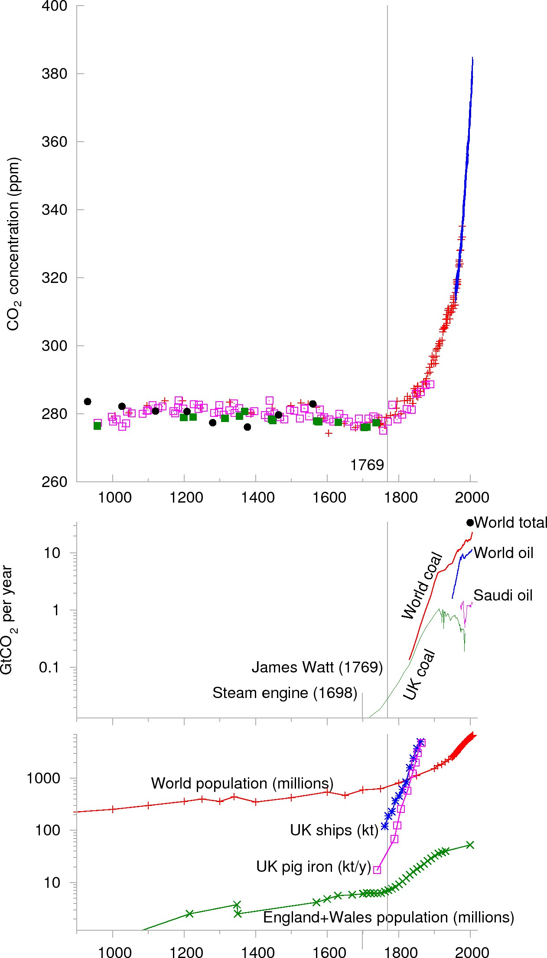
Step 2: Human activities, particularly the combustion of fossil fuels, increase CO₂ concentrations and emissions
Evolution of global CO₂ concentration (ppm) over the last millenium.¹
Evolution of global CO₂ concentration (ppm) over the last century.²
The acronym “ppm” stands for “parts per million”. It indicates the number of CO₂ molecules per million molecules of air.
A rise in the concentration of CO₂ in the atmosphere has been observed since the Industrial Revolution in the 18th century, and this increase continues today. It contributes to an intensified greenhouse effect that results in climate change, such as a rise in average global temperatures and more extreme climate events.
¹ MacKay, D. (2008). Sustainable Energy - Without the Hot Air.
10
² Trends in atmospheric concentrations of CO2 (ppm) between 1800 and 2017. (2019, November 27). European Environment Agency.

Slide 11
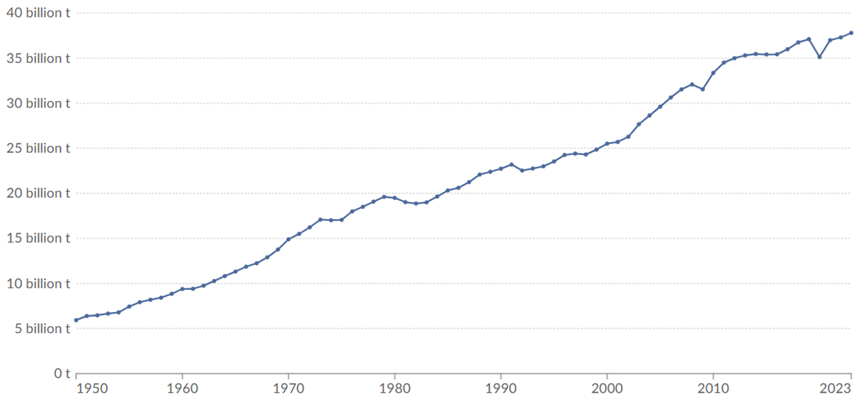
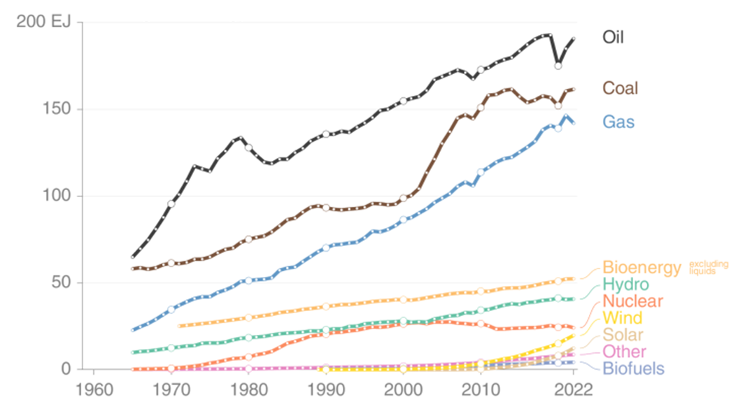
Evolution of global CO₂ emissions (1/2)
Emissions grew slowly until the mid-20th century. In 1950, global CO₂ emissions increased from 6 billion tons (Gt) to 38 Gt in 2023. CO₂ emissions continue to rise due to population growth and the global increase in living standards.
Evolution of global CO₂ emissions from fossil fuels and industry, in billion tons.¹
Annual global energy consumption in EJ (10¹⁸ J).²
¹ Ritchie, H., & Roser, M. (2020, June 10). CO₂ emissions. Our World in Data.
11
² Global fossil CO₂ emissions are projected to rise in 2023. (2023, October 19). CICERO.

Slide 12
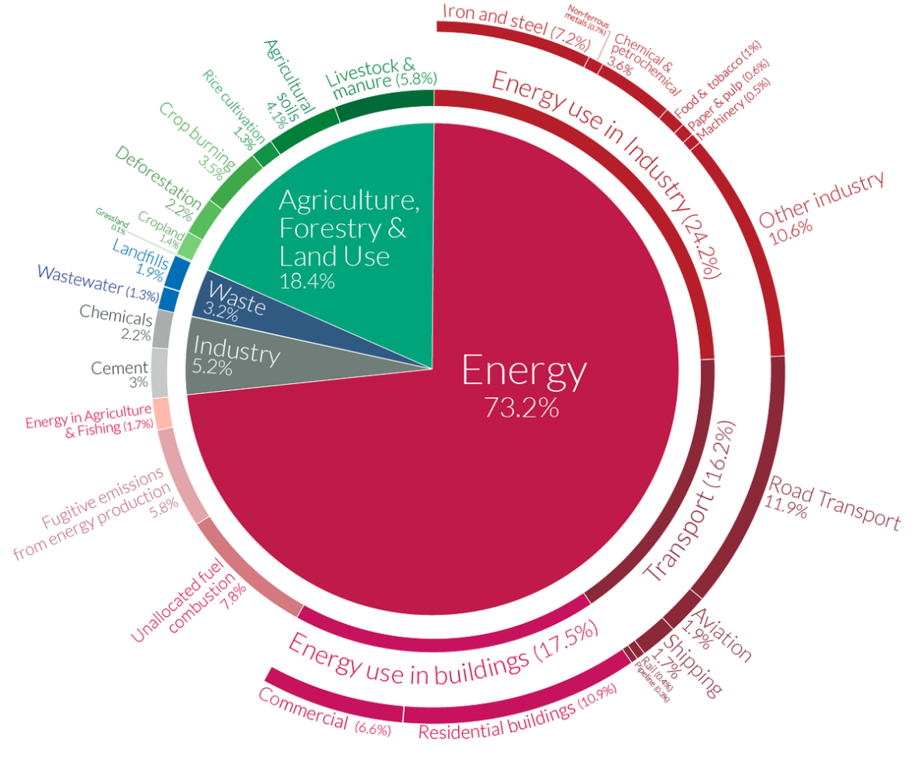
Global distribution of GHG emissions by sector
In 2016, the energy sector, responsible for 73.2% of greenhouse gas emissions, emerged as the largest contributor. This highlights the importance of decarbonising the energy sector.
Global GHG emissions by sector in 2016.¹
12
¹ Ghosh, I. (2020, December 04). A global breakdown of greenhouse gas emissions by sector. Visual Capitalist.

Slide 13
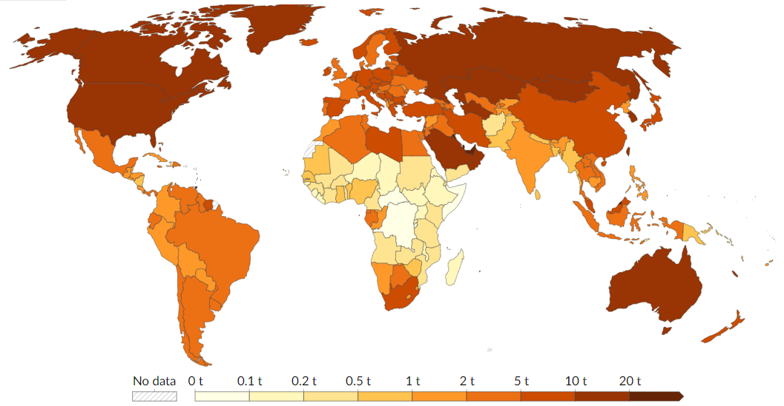
Global distribution of CO₂ emissions by nation
Unsurprisingly, the largest CO₂ emitters are countries with large populations, significant industrial activities, and advanced levels of economic development, such as the USA, China, Russia, Brazil, and India.
CO₂ emissions from fossil fuels and industry in tons per person in the world in 2022.¹
13
¹ Per capita CO₂ emissions. (2023, December 5). Our World in Data.

Slide 14
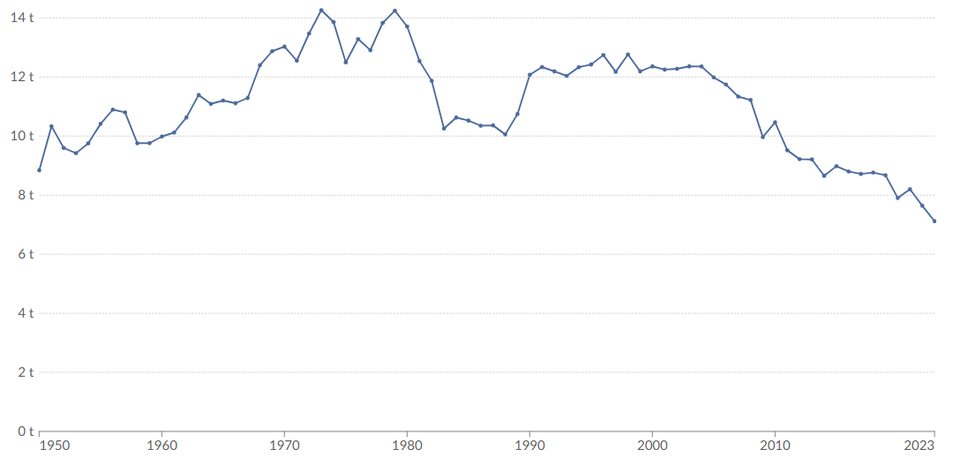
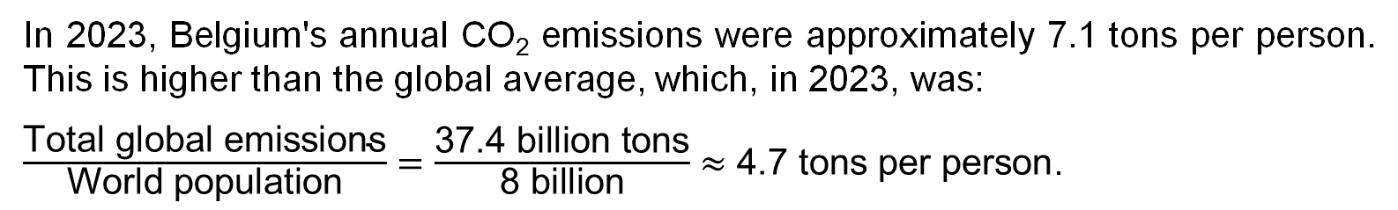
What about CO₂ emissions from Belgium?
In 2023, Belgium's annual CO₂ emissions were approximately 7.1 tons per person. This is higher than the global average, which, in 2023, was:
$\frac{\text{Total} \text{global} \text{emissions}}{\text{World} \text{population}}=\frac{\text{37.4 }\text{billion} \text{tons}}{\text{8 }\text{billion}}≈\text{4.7 }\text{tons} \text{per} \text{person}$.
CO₂ emissions from fossil fuels and industry in tons per person in Belgium, 2023.¹
A progressive decrease in CO₂ emissions from Belgium has been observed since the 2000s, largely driven by the decline of industrial sectors such as steelmaking.
14
¹ Per capita CO₂ emissions. (2023, December 5). Our World in Data.

Slide 15
Arguments of climate change negationists
The graphics are convincing but climate change negationists will say:
“The burning of fossil fuels sends about 38 gigatons of CO₂ per year into the atmosphere, which may sound a lot. Yet the biosphere and the oceans send about 440 gigatons and 330 gigatons of CO₂ in the atmosphere per year, respectively.
The blame cannot be put on human fuel-burning for this increase in CO₂ concentration.”
15

Slide 16
What you should answer them
“The combustion of fossil fuels has disturbed the inherent equilibrium that once existed between the inflow of CO₂ into the atmosphere and the substantial natural outflows from the atmosphere back into the biosphere and the ocean.
It is the disturbance of this balance that leads to the escalation of CO₂ concentrations.”
16

Slide 17
Step 3: This intensified greenhouse effect leads to climate changes, including a rise in average global temperatures
There is considerable uncertainty in this process. Climate science faces significant challenges, particularly in accurately predicting the extent of global warming caused by an increase of CO₂ levels.
While uncertainties remain, climate models consistently agree that doubling the concentration of CO₂ in the atmosphere would have a similar effect to increasing the sun's intensity by 2%, resulting in a temperature rise of approximately 3°C.
As you know, these predictions include the gradual melting of the Greenland ice sheet, rising sea levels, major disruptions to ecosystems, and an increased frequency of extreme weather events such as droughts, extreme precipitation and hurricanes.
17

Slide 18
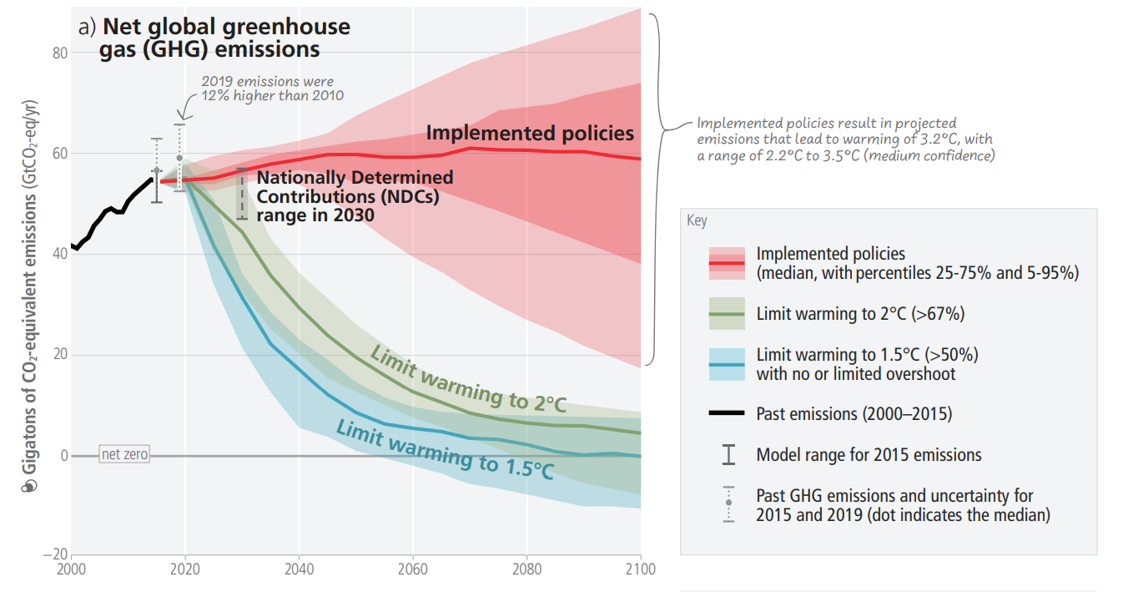
Urgency of meeting the 2°C target
Limiting global warming to 1.5°C or 2°C requires rapid, deep, and, in most cases, immediate reductions in greenhouse gas emissions.
The overall climate scenario is straightforward: to meet the 2°C target, global emissions must be reduced by at least a factor of three by 2050 and reach net zero by 2080. This implies an average annual reduction of around 3%.
Global GHG emissions evolution (GtCO₂e/yr) from IPCC 2023 Report. ¹
¹ AR6 Synthesis Report : Climate Change 2023 — IPCC. (2023). IPCC.
18

Slide 19
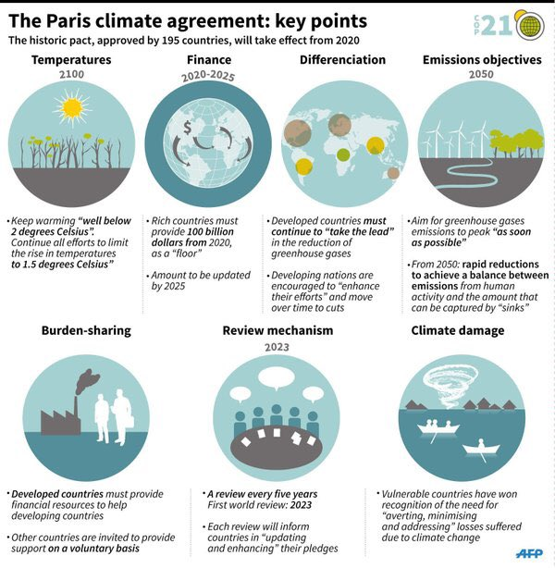
Purpose of the IPCC
The Intergovernmental Panel on Climate Change (IPCC) was established in 1988. The main mission of the IPCC is to assess, in an unbiased and scientific way, the available information on climate change, its potential impacts, and strategies for reducing it.
Their reports are created by scientists from around the world and provide a crucial factual foundation for international negotiations.
The Paris Agreement, signed at the 21st meeting of the Conference of the Parties (COP21) in 2015, is heavily influenced by the IPCC’s reports.
Key points of the Paris climate agreement.¹
¹ 5 Charts that explain the Paris Climate Agreement. (2016, October 16). World Economic Forum.
19

Slide 20
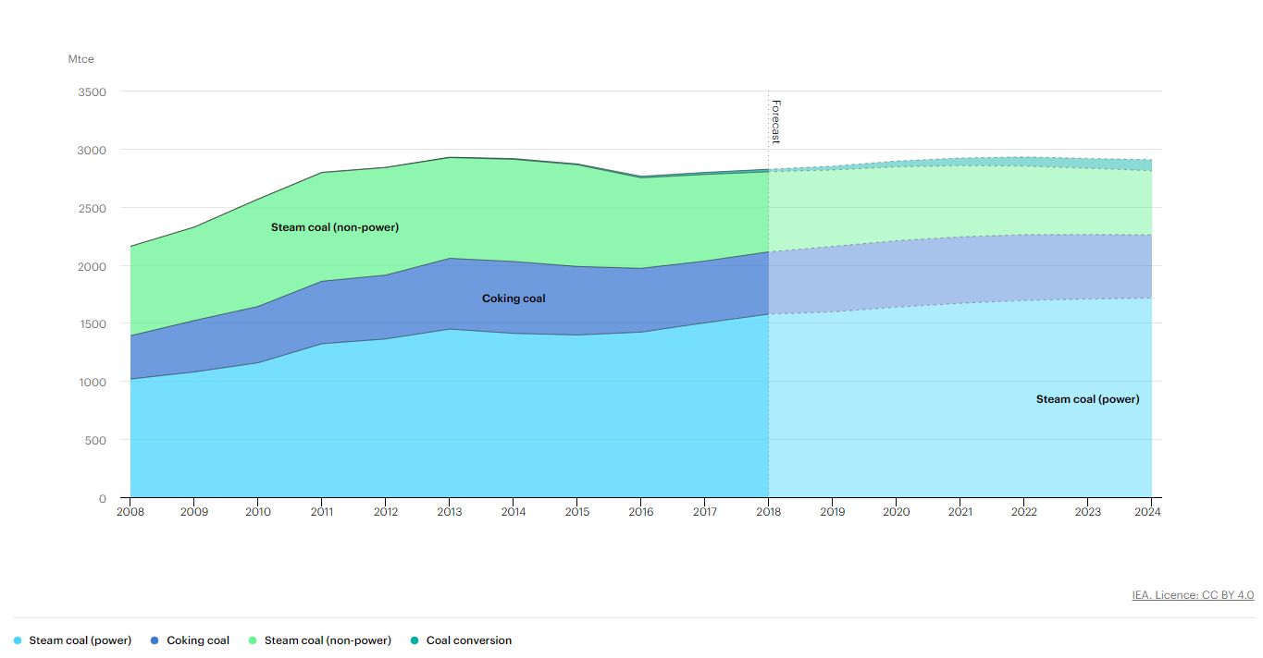
Exercise 1:
In 2018, China's electricity production involved the consumption of 1,576 million tons (Mt) of coal.
Assuming the coal is composed of 100% carbon and complete combustion occurs based on the chemical reaction of carbon, calculate the amount of CO₂ emissions resulting from this activity in China.
The combustion reaction for carbon is C + O₂ → CO₂.
Coal consumption by sector in China, 2008-2024.¹
¹ Coal consumption by sector in China, 2008-2024. (2019). IEA.
20

Slide 21
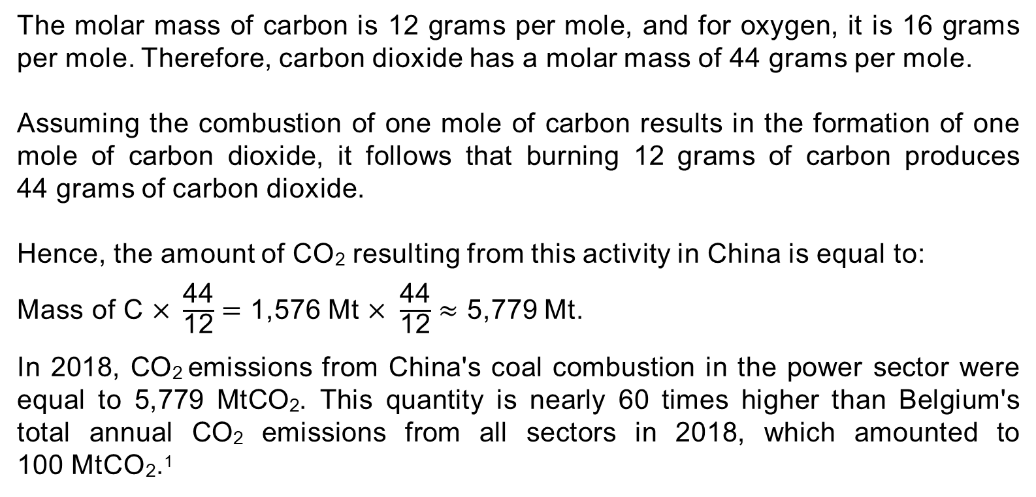
Solution:
The molar mass of carbon is 12 grams per mole, and for oxygen, it is 16 grams per mole. Therefore, carbon dioxide has a molar mass of 44 grams per mole.
Assuming the combustion of one mole of carbon results in the formation of one mole of carbon dioxide, it follows that burning 12 grams of carbon produces 44 grams of carbon dioxide.
Hence, the amount of CO₂ resulting from this activity in China is equal to:
$\text{Mass} \text{of} \text{C} \text{×} \frac{\text{44}}{\text{12}}=$ 1,576 Mt $× \frac{\text{44}}{\text{12}}≈$ 5,779 Mt.
In 2018, CO₂ emissions from China's coal combustion in the power sector were equal to 5,779 MtCO₂. This quantity is nearly 60 times higher than Belgium's total annual CO₂ emissions from all sectors in 2018, which amounted to 100 MtCO₂.¹
21
¹ Ritchie, H., Roser, M., & Rosado, P. (2022, October 27). Energy. Our World in Data.

Slide 22

GENV0002-1
Energy and sustainable development
Lecturer: Damien Ernst – University of Liège (dernst@uliege.be)
Chapter 02 – Units, grades, and performance metrics of energy
Image generated with the AI tool Grok.

Slide 23
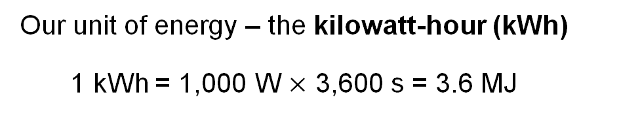

Energy and power units
Energy is the ability or capacity to do work, and it is measured in joules (J).
Power is the rate at which energy is transferred or converted per unit of time. It is measured in joules per second (J/s) or watts (W).
These standard units are not convenient here. Let us use the following ones:
Our unit of energy – the kilowatt-hour (kWh)
1 kWh = 1,000 W $×$ 3,600 s = 3.6 MJ
Our unit of power – the kilowatt-hour per day (kWh/d)
1 kWh/d = $\frac{\text{1,000} \text{×} \text{1 }\text{h}}{\text{24 }\text{h}}$ ≈ 40 W
23

Slide 24
The different grades of energy
Energy is always conserved, which means the concept of “using” energy is a bit misleading. What we actually do when we use energy is transform it from a form with low entropy to one with higher entropy.
Labels for energy units help distinguish between different energy types:
One kWh_{e} represents one kilowatt-hour of electrical energy;
One kWh_{th} represents one kilowatt-hour of thermal energy (higher temperature means lower entropy);
One kWh_{ch} represents one kilowatt-hour of chemical energy.
Not all kWh are equal in terms of energy quality. The distinction between different energy forms depends on factors like entropy and their ability to perform work.
Electrical energy is often considered the highest quality because of its versatility and ease of conversion into useful work. In contrast, thermal and chemical energy may have higher entropy and are less efficiently converted into work without energy loss.
24

Slide 25
Energy conversion and its implications on quality and efficiency
In principle, energy can be converted from one form to another, but this process always involves some losses. For example, when converting the chemical energy from coal into electricity in power stations, the efficiency is typically around 40%. Natural gas power plants are more efficient than coal plants, achieving efficiencies of 50% to 60% using combined cycle systems.
In some energy production and consumption summaries, different energy forms are expressed in the same units, with exchange rates applied to account for differences in quality and efficiency, depending on the context and technologies used.
The idea is that the value or quality of energy can vary depending on its form and use. For instance, 1 kWh_{ch} may be more valuable than 1 kWh_{th} when used to produce liquid fuels.
However, in this class, we use a one-to-one conversion rate to maintain a direct and accurate representation of the energy content and its application, avoiding oversimplifications that come from arbitrary multipliers.
25

Slide 26

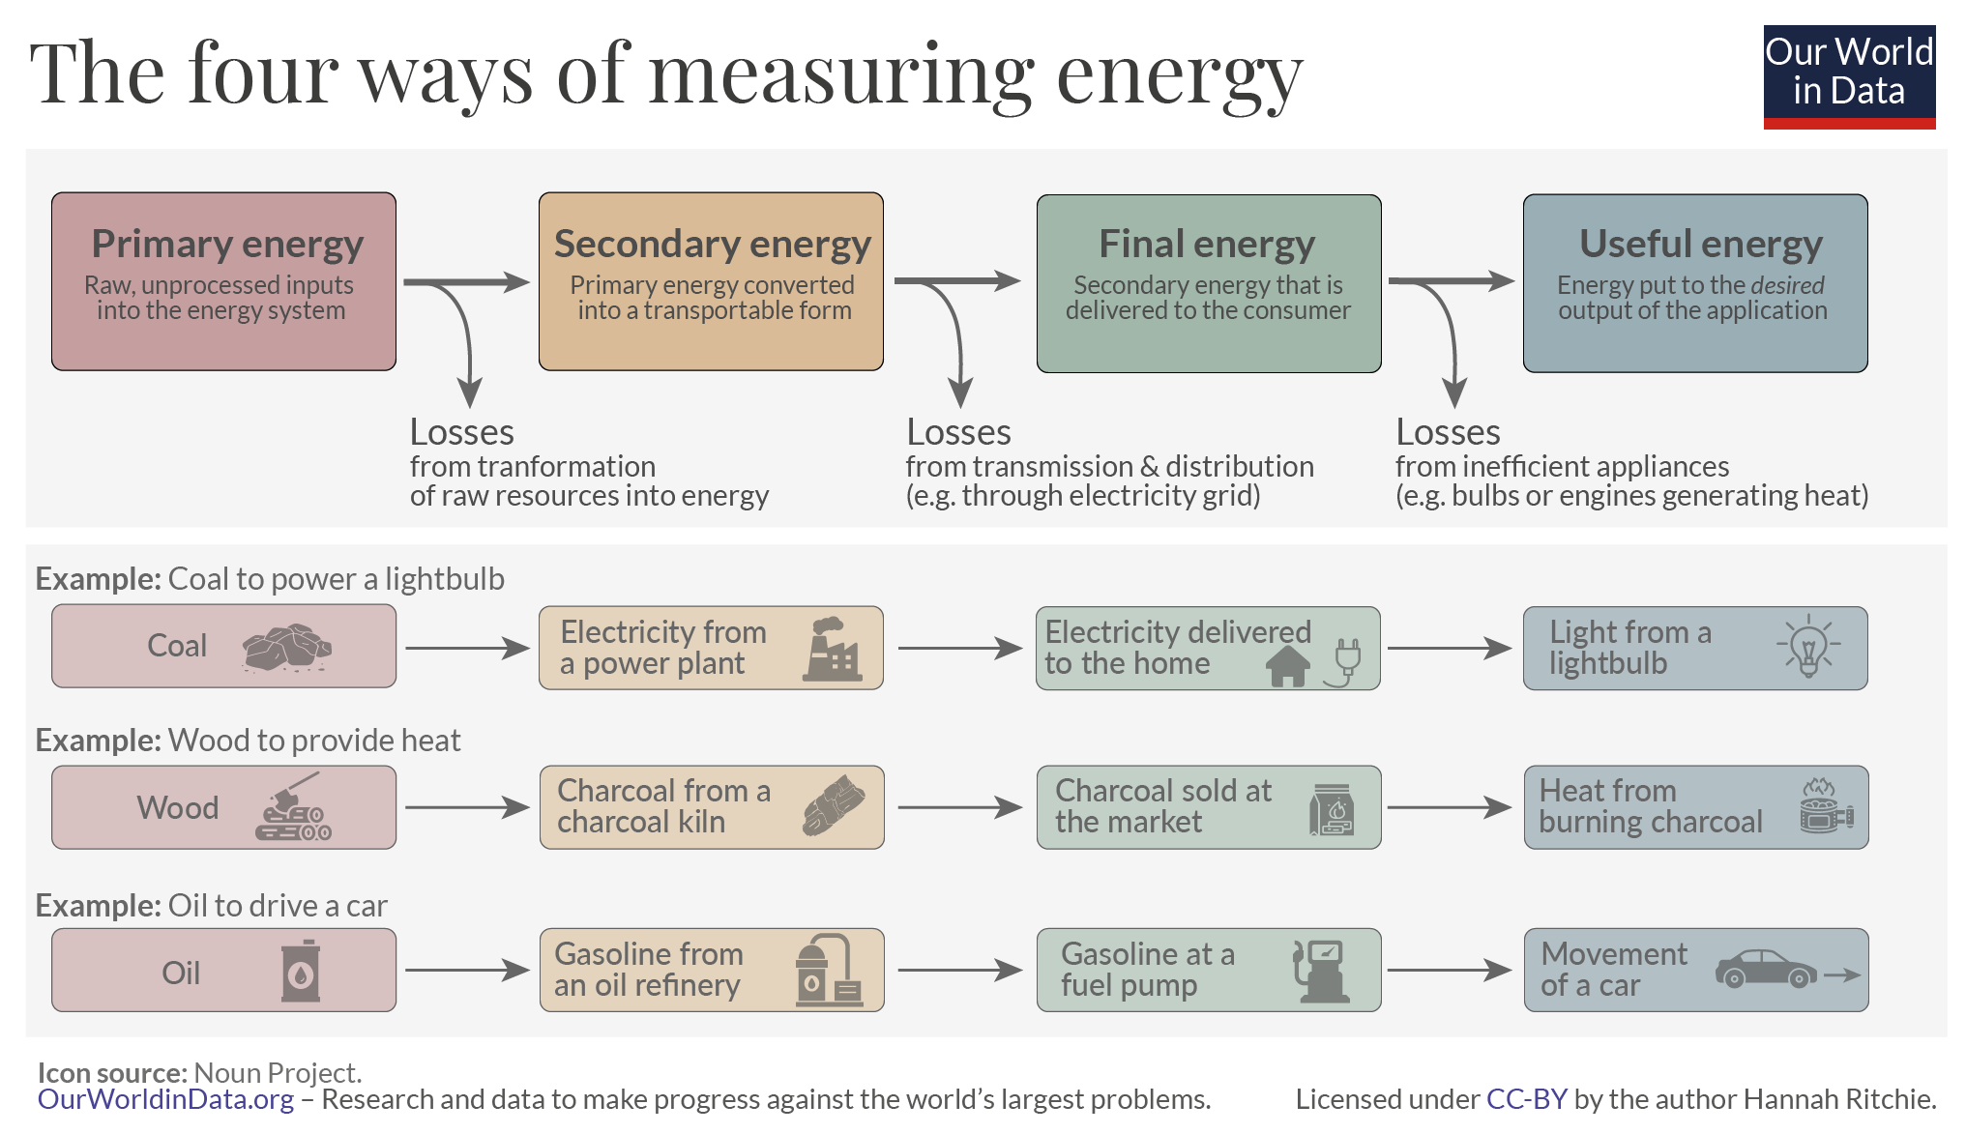
Understanding primary and final energy consumption
Primary energy consumption refers to the energy imported or produced before any processing (such as oil refining and power generation), excluding exports, marine bunkers, and non-energy uses (e.g., oil used as a raw material in the chemical industry).
Final energy consumption refers to the total energy delivered to end-users, including the industrial sector (excluding the energy sector itself), transportation, residential and service buildings, and agriculture.
Four different ways of measuring energy.¹
26
¹ Ritchie, H. (2022, April 4). Primary, secondary, final, and useful energy: Why are there different ways of measuring energy? Our World in Data.

Slide 27
Rated and effective powers
The rated power (installed capacity or nominal power):
This is the maximum power the power plant can produce when running at full capacity under ideal conditions. It's a fixed value given in the plant's technical specifications. For example, a solar farm with a rated power of 10 MW can produce up to 10 MW of electricity when sunlight is optimal, and temperature conditions are ideal.
The effective power:
This refers to the actual power being generated by the plant at any given moment, which can vary depending on factors like weather conditions, maintenance, or the demand for electricity. For instance, on a cloudy afternoon, the effective power might drop to 4 MW because the sunlight is weaker. At night, the effective power would be 0 MW since there is no sunlight.
27

Slide 28
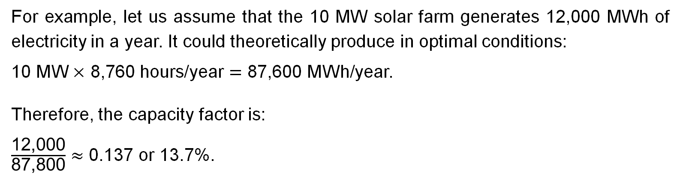
Capacity factor of a power plant
This capacity factor (or load factor) is a measure of how efficiently a power plant is being used over time. It compares the actual energy generated during a period to the maximum energy the plant could have produced if it ran at full capacity the entire time.
$$\text{Capacity} \text{factor}\text{ = }\frac{\text{Actual} \text{energy} \text{production} \text{over} \text{a} \text{given} \text{period} }{\text{T}\text{heoretical} \text{maximum} \text{energy} \text{production} \text{over} \text{that} \text{period}}$$
For example, let us assume that the 10 MW solar farm generates 12,000 MWh of electricity in a year. It could theoretically produce in optimal conditions:
10 MW $×$ 8,760 hours/year $=$ 87,600 MWh/year.
Therefore, the capacity factor is:
$\frac{\text{12,000}}{\text{87,800}}≈$ 0.137 or 13.7%.
28

Slide 29
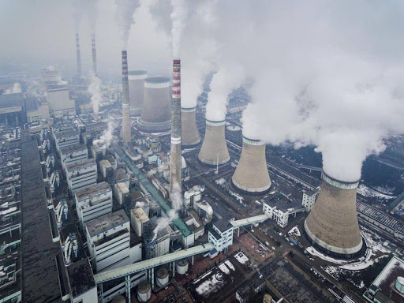
Exercise 1:
The Datang Tuoketuo power station was the largest operational coal power plant in China as of 2021, with an installed capacity of 6.7 GW.
1. What was the mass of coal burned in 2021 with the power station operating continuously at a capacity factor of 56%, assuming one ton of coal produces 1,940 kWh? ¹
2. How much CO₂ will be emitted if burning one ton of coal emits 3.67 tons of CO₂?
29
¹ U.S. Energy Information Administration. (2022). How much coal, natural gas, or petroleum is used to generate a kilowatthour of electricity?

Slide 30
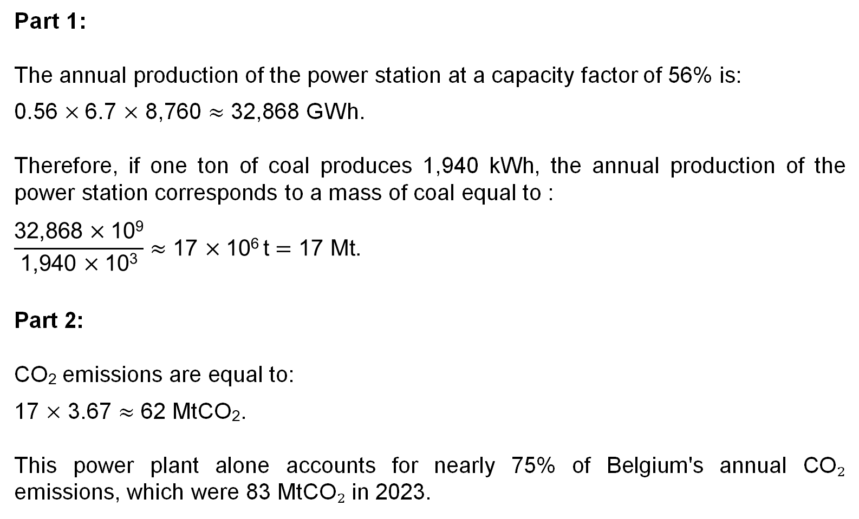
Solution:
Part 1:
The annual production of the power station at a capacity factor of 56% is:
0.56 $×$6.7 $×$ 8,760 $≈$ 32,868 GWh.
Therefore, if one ton of coal produces 1,940 kWh, the annual production of the power station corresponds to a mass of coal equal to :
$$\frac{\text{32,868} \text{× }\text{1}\text{0}\text{9}}{\text{1,940 }\text{× }\text{1}\text{0}\text{3}}≈\text{17 }\text{× }\text{1}\text{0}\text{6 }\text{t}=\text{17 }\text{Mt}\text{.}$$
Part 2:
CO₂ emissions are equal to:
17 $×$ 3.67 $≈$ 62 MtCO₂.
This power plant alone accounts for nearly 75% of Belgium's annual CO₂ emissions, which were 83 MtCO₂ in 2023.
30

Slide 31
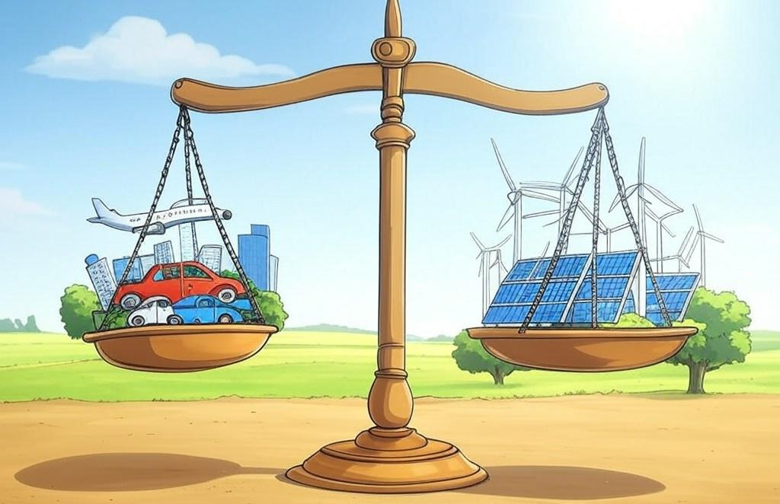
GENV0002-1
Energy and sustainable development
Lecturer: Damien Ernst – University of Liège (dernst@uliege.be)
Chapter 03 – The balance sheet
Image generated with the AI tool Grok.

Slide 32
Is a fossil-free future possible for Belgium? (1/3)
In the next chapters of this course, we will gather information on energy usage in Belgium across various sectors to address the following question:
We will build an energy balance sheet with two sides:
one side detailing the energy consumption (both fossil and renewable) by the population;
the other side showing the potential internal renewable energy production, based on assumptions of efficient exploitation of available surfaces in Belgium.
This balance excludes renewable energy exports and focuses on what could be produced domestically under optimal conditions.
For each energy sector analysed, we will calculate the average consumption or production in kilowatt-hours per person per day (kWh/pers/d). This unit will allow for clear and effective comparisons across the different sectors.
Is it possible for Belgium to live without relying on fossil fuels and by depending only on its internal renewable energy production?
32

Slide 33
Is a fossil-free future possible for Belgium? (2/3)
Each chapter, from chapter 04 to chapter 17, will focus on either an energy consumption sector or a renewable resource. They are presented as follows:
The balance sheet
Chapter 04 – Cars
Chapter 06 – Planes
Chapter 08 – Heating and cooling
Chapter 10 – Lighting
Chapter 12 – Appliances
Chapter 14 – Food and farming
Chapter 16 – Stuff
Chapter 05 – Onshore wind energy
Chapter 07 – Solar energy
Chapter 09 – Hydroelectric energy
Chapter 11 – Offshore wind energy
Chapter 13 – Wave energy
Chapter 15 – Tidal energy
Chapter 17 – Geothermal energy
CONSUMPTION
PRODUCTION
33

Slide 34
Is a fossil-free future possible for Belgium? (3/3)
The balance sheet
As we progress through the chapters, we will accumulate the kilowatt-hours per person per day (kWh/pers/d) values that we have calculated for both sides.
This will result in two columns composed of the summed values, allowing us to compare which of the two is higher.
kWh/pers/d
kWh/pers/d
kWh/pers/d
kWh/pers/d
kWh/pers/d
kWh/pers/d
kWh/pers/d
kWh/pers/d
CONSUMPTION
PRODUCTION
If total energy consumption exceeds potential renewable energy production, then the answer is NO — Belgium could not sustain its energy needs without relying on fossil fuels.
If total energy consumption is lower than potential renewable energy production, then the answer is YES — Belgium could meet its energy needs using only domestic renewable sources.
34

Slide 35
Exercise 1:
ABC Manufacturing wants to compare their renewable energy production with their daily energy consumption.
The company operates its entire fleet of equipment, with a total installed capacity of 100 kW, at full capacity from 9 AM to 6 PM each day. Outside these hours, all equipment remains inactive. Their renewable energy sources include solar panels and a wind turbine, producing an average of 240 kWh and 480 kWh daily, respectively.
Create a balance sheet to compare the daily renewable energy production of the company to its daily energy consumption.
35

Slide 36
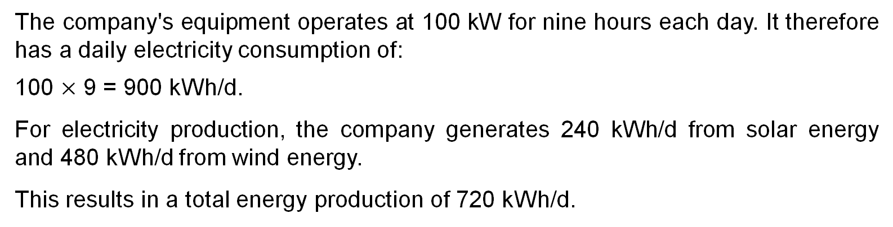
Solution:
The company's equipment operates at 100 kW for nine hours each day. It therefore has a daily electricity consumption of:
100 $×$ 9 = 900 kWh/d.
For electricity production, the company generates 240 kWh/d from solar energy and 480 kWh/d from wind energy.
This results in a total energy production of 720 kWh/d.
Electricity:
900 kWh/d
Solar:
240 kWh/d
Wind:
480 kWh/d
CONSUMPTION
PRODUCTION
36

Slide 37

GENV0002-1
Energy and sustainable development
Lecturer: Damien Ernst – University of Liège (dernst@uliege.be)
Chapter 04 – Cars
Image from Getty Images.

Slide 38
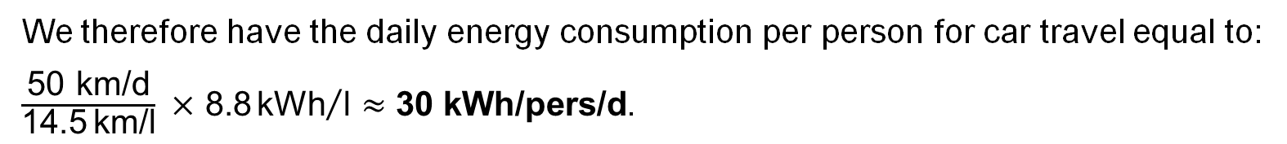
Daily energy consumption per person for car travel
We calculate the daily energy consumption for an internal combustion engine (ICE) car user as follows:
$$\text{energy}\text{/}\text{person}\text{/}\text{day}=\frac{\text{distance} \text{travelled}\text{/}\text{day}}{\text{distance}\text{/}\text{liter} \text{of} \text{fuel}}×\text{energy}\text{/}\text{liter} \text{of} \text{fuel}\text{.}$$
We make the following assumptions:
Daily travel distance = 50 km/d;
Fuel efficiency = 14.5 km/l;
Energy content of gasoline = 8.8 kWh/l.
We therefore have the daily energy consumption per person for car travel equal to:
$\frac{\text{50} \text{km}\text{/}\text{d}}{\text{14.5} \text{km}\text{/}\text{l}} \text{×}\text{ 8.8}{\text{kWh}}/{\text{l}}≈\text{30 }\text{kWh}\text{/}\text{pers}\text{/}\text{d}$.
38

Slide 39
Completion of the current balance sheet
The balance sheet
Car: 30 kWh/pers/d
CONSUMPTION
PRODUCTION
39

Slide 40

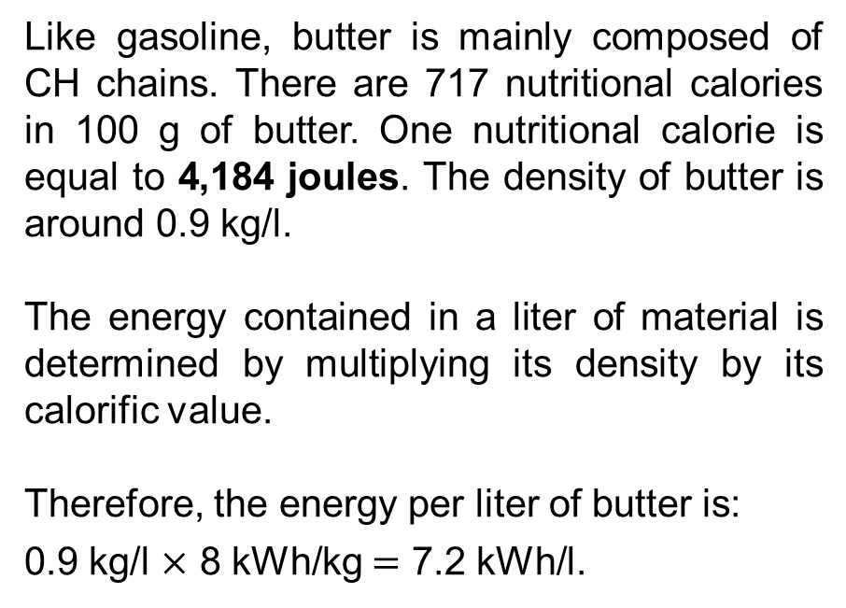
Note on the energy contained in butter
Like gasoline, butter is mainly composed of CH chains. There are 717 nutritional calories in 100 g of butter. One nutritional calorie is equal to 4,184 joules. The density of butter is around 0.9 kg/l.
The energy contained in a liter of material is determined by multiplying its density by its calorific value.
Therefore, the energy per liter of butter is:
0.9 kg/l $×$ 8 kWh/kg $=$ 7.2 kWh/l.
Observe that the energy per liter of butter is in the sat order of magnitude as the energy per liter of gasoline.
40

Slide 41
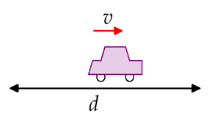

Technical notes on the consumption in ICE cars
The energy used in ICE cars is mainly lost in four ways:
Acceleration and deceleration (through brake usage);
Overcoming air resistance;
Overcoming rolling resistance;
Heat dissipation — approximately 75% of the energy is lost as heat.
We will consider an ICE car with mass $mc$ traveling at speed $v$, and stopping every $d$ meters.
A
B
We will analyse the energy consumption of this car using simple physical models in order to answer questions of this type: (i) How does the energy lost due to air resistance compare to the energy lost through braking? (ii) What is the total energy consumption of the car during its trip from A to B? (iii) What practical measures can be taken to decrease the car’s energy consumption?
We will first neglect the rolling resistance.
41

Slide 42
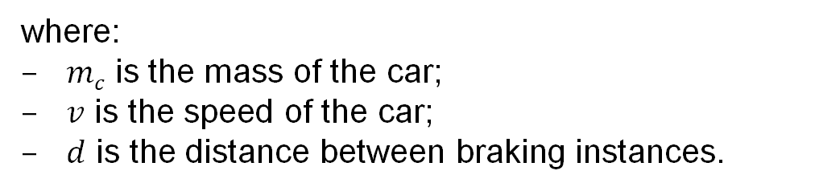
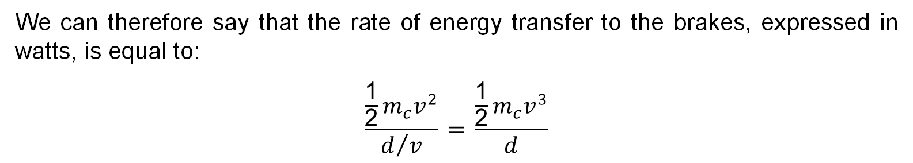
Rate of energy transfer to the brakes
The rate at which energy is transferred to the brakes during deceleration is expressed as:
$$\frac{\text{kinetic} \text{energy}}{\text{duration} \text{between} \text{instances} \text{of} \text{braking}}.$$
We can therefore say that the rate of energy transfer to the brakes, expressed in watts, is equal to:
$$\frac{\frac{\text{1}}{\text{2}}m_{c}v^{2}}{d/v} \text{=} \frac{\frac{\text{1}}{\text{2}}m_{c}v^{3}}{d}$$
where:
$mc$​ is the mass of the car;
$v$ is the speed of the car;
$d$ is the distance between braking instances.
42

Slide 43

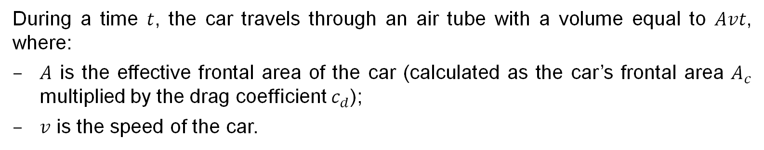
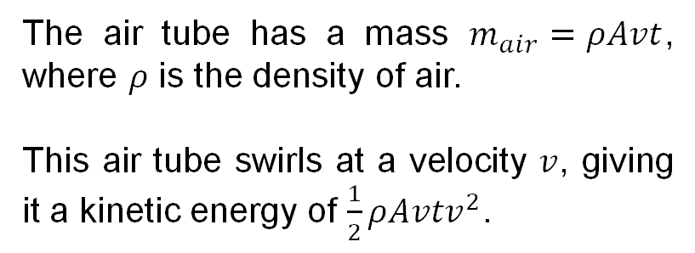
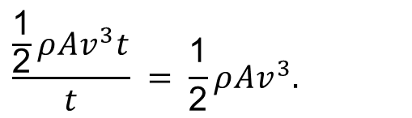
Rate of energy loss to air resistance
During a time $t$, the car travels through an air tube with a volume equal to $Avt$, where:
$A$ is the effective frontal area of the car (calculated as the car’s frontal area $A_{c}$​ multiplied by the drag coefficient $c_{d}$);
$v$ is the speed of the car.
The air tube has a mass $m_{air}=ρAvt$, where $ρ$ is the density of air.
This air tube swirls at a velocity $v$, giving it a kinetic energy of $\frac{1}{2}ρAvtv^{2}$.
We can therefore say that the rate of kinetic energy transferred to the air is equal to:
$$\frac{\frac{\text{1}}{\text{2}}ρAv^{3}t}{t} = \frac{\text{1}}{\text{2}}ρAv^{3}.$$
43

Slide 44
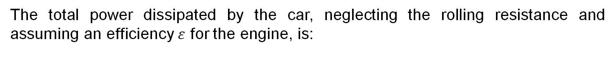
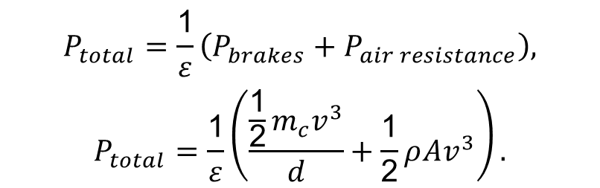
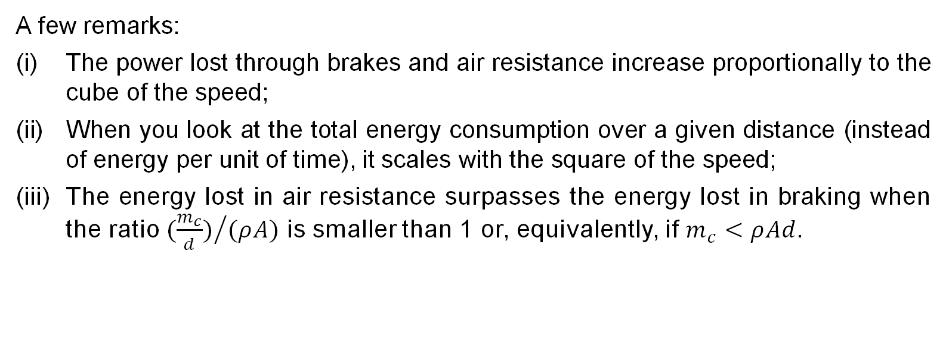
Total power dissipated by the car
The total power dissipated by the car, neglecting the rolling resistance and assuming an efficiency $ε$ for the engine, is:
$$P_{total}=\frac{\text{1}}{ε}\left(P_{brakes}+P_{air resistance}\right),$$
$$P_{total}=\frac{\text{1}}{ε}\left(\frac{\frac{\text{1}}{\text{2}}m_{c}v^{3}}{d}+\frac{\text{1}}{\text{2}}ρAv^{3}\right).$$
A few remarks:
The power lost through brakes and air resistance increase proportionally to the cube of the speed;
When you look at the total energy consumption over a given distance (instead of energy per unit of time), it scales with the square of the speed;
The energy lost in air resistance surpasses the energy lost in braking when the ratio ${(\frac{m_{c}}{d})}/{(ρA)}$ is smaller than 1 or, equivalently, if $m_{c}<ρAd$.
44

Slide 45
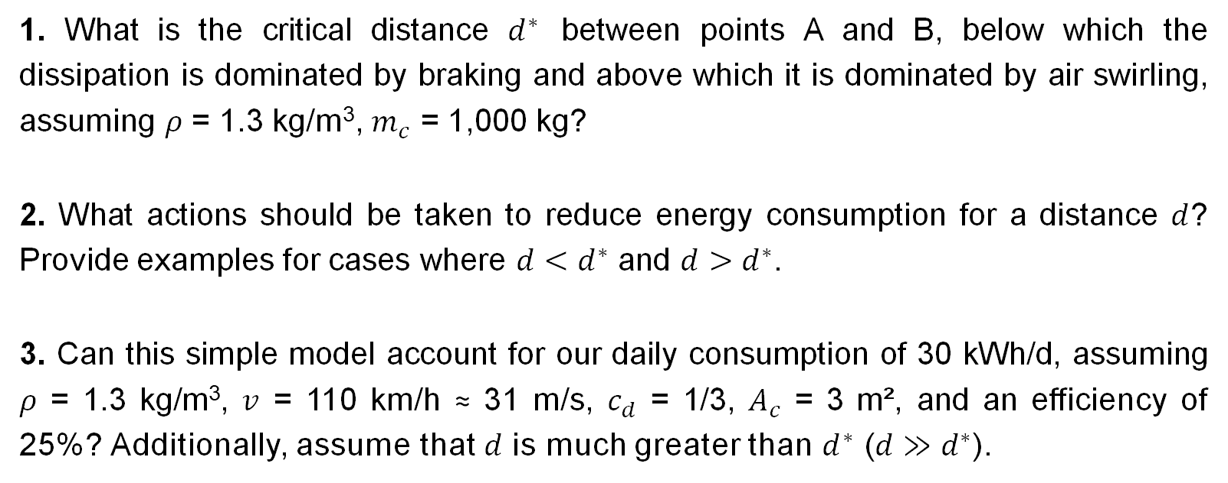
Exercise 1:
1. What is the critical distance $d^{∗}$ between points A and B, below which the dissipation is dominated by braking and above which it is dominated by air swirling, assuming $ρ$ = 1.3 kg/m³, $m_{c}$ = 1,000 kg?
2. What actions should be taken to reduce energy consumption for a distance $d$? Provide examples for cases where $d<d^{∗}$ and $d>d^{∗}$.
3. Can this simple model account for our daily consumption of 30 kWh/d, assuming $ρ$ = 1.3 kg/m³, $v$ = 110 km/h ≈ 31 m/s, $c_{d}$ = 1/3, $A_{c}$ = 3 m², and an efficiency of 25%? Additionally, assume that $d$ is much greater than $d^{∗}$ ($d≫d^{∗}$).
45

Slide 46
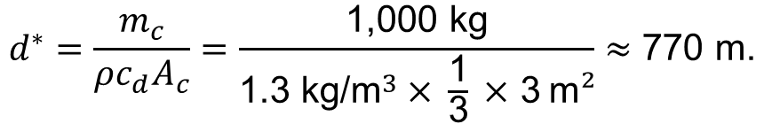
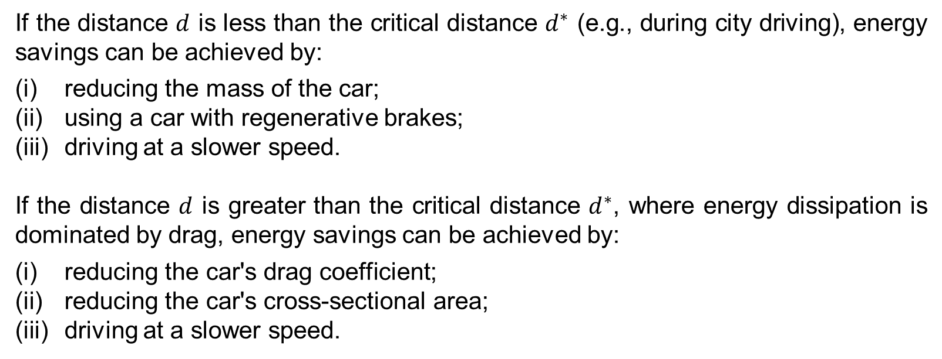
Solution:
Part 1:
The critical distance $d^{∗}$ below which the dissipation is dominated by braking and above which it is dominated by air swirling, is calculated as:
$$d^{∗}=\frac{m_{c}}{ρc_{d}A_{c}}=\frac{\text{1,000 }\text{kg}}{\text{1.3 }\text{kg}\text{/}{\text{m}}^{3} \text{×} \frac{\text{1}}{\text{3}} \text{×}\text{ 3} \text{m}²}≈\text{770 }\text{m}\text{.}$$
Part 2:
If the distance $d$ is less than the critical distance $d^{∗}$ (e.g., during city driving), energy savings can be achieved by:
reducing the mass of the car;
using a car with regenerative brakes;
driving at a slower speed.
If the distance $d$ is greater than the critical distance $d^{∗}$, where energy dissipation is dominated by drag, energy savings can be achieved by:
reducing the car's drag coefficient;
reducing the car's cross-sectional area;
driving at a slower speed.
46

Slide 47
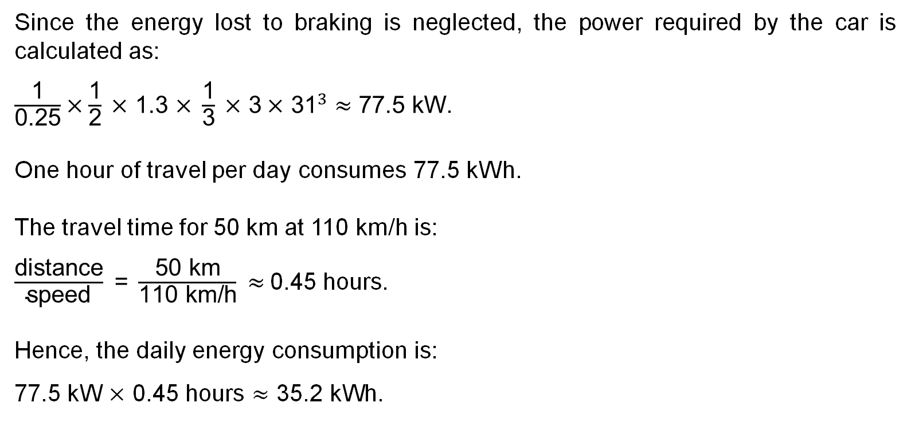
Part 3:
Since the energy lost to braking is neglected, the power required by the car is calculated as:
$\frac{\text{1}}{\text{0.25}}×\frac{\text{1}}{\text{2}} \text{×}\text{ 1.3 }\text{×} \frac{\text{1}}{\text{3}} \text{×}\text{ 3} \text{×} {\text{31}}^{3}≈\text{77.5 }\text{kW}$.
One hour of travel per day consumes 77.5 kWh.
The travel time for 50 km at 110 km/h is:
$\frac{\text{distance}}{\text{speed}}\text{ = }\frac{\text{50 }\text{km}}{\text{110 }\text{km}\text{/}\text{h}}​≈$0.45 hours.
Hence, the daily energy consumption is:
77.5 kW $\text{×}$ 0.45 hours $≈\text{35.2 }\text{kWh}\text{.}$
This simple model can therefore account for our previously computed daily consumption of 30 kWh/d.
47

Slide 48
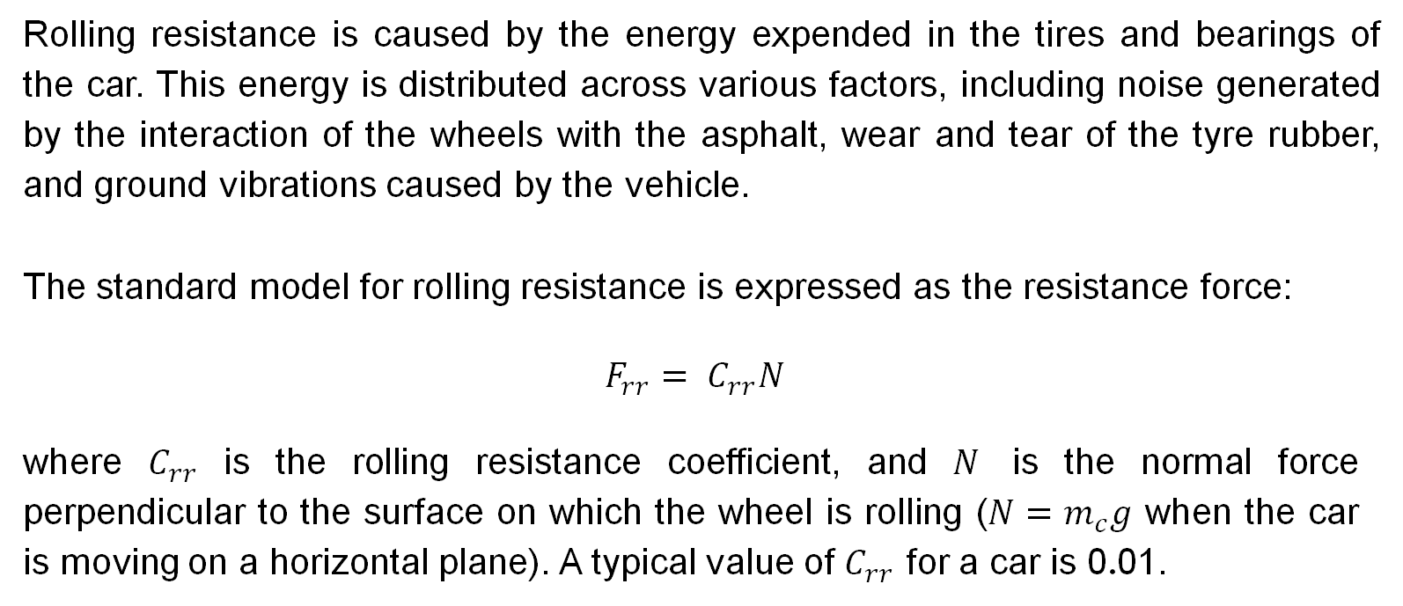
Rolling resistance
Rolling resistance is caused by the energy expended in the tires and bearings of the car. This energy is distributed across various factors, including noise generated by the interaction of the wheels with the asphalt, wear and tear of the tyre rubber, and ground vibrations caused by the vehicle.
The standard model for rolling resistance is expressed as the resistance force:
$$F_{rr}= C_{rr}N$$
where $C_{rr}$ is the rolling resistance coefficient, and $N$ is the normal force perpendicular to the surface on which the wheel is rolling ($N=m_{c}g$ when the car is moving on a horizontal plane). A typical value of $C_{rr}$ for a car is 0.01.
48

Slide 49
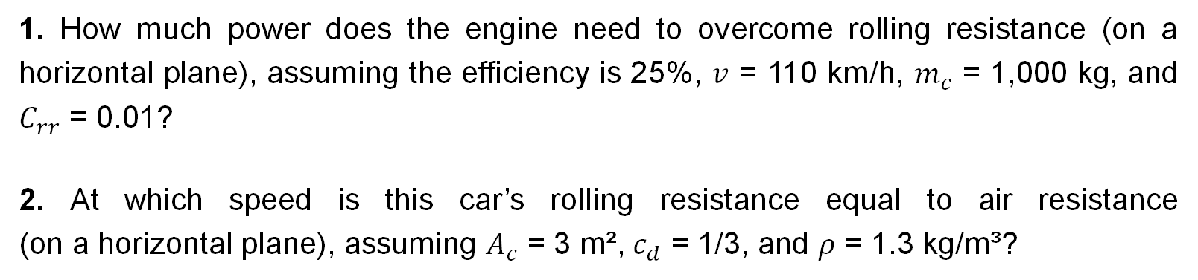
Exercise 2:
1. How much power does the engine need to overcome rolling resistance (on a horizontal plane), assuming the efficiency is 25%, $v$ = 110 km/h, $m_{c}$ = 1,000 kg, and $C_{rr}$ = 0.01?
2. At which speed is this car’s rolling resistance equal to air resistance (on a horizontal plane), assuming $A_{c}$ = 3 m², $c_{d}$ = 1/3, and $ρ$ = 1.3 kg/m³?
49

Slide 50
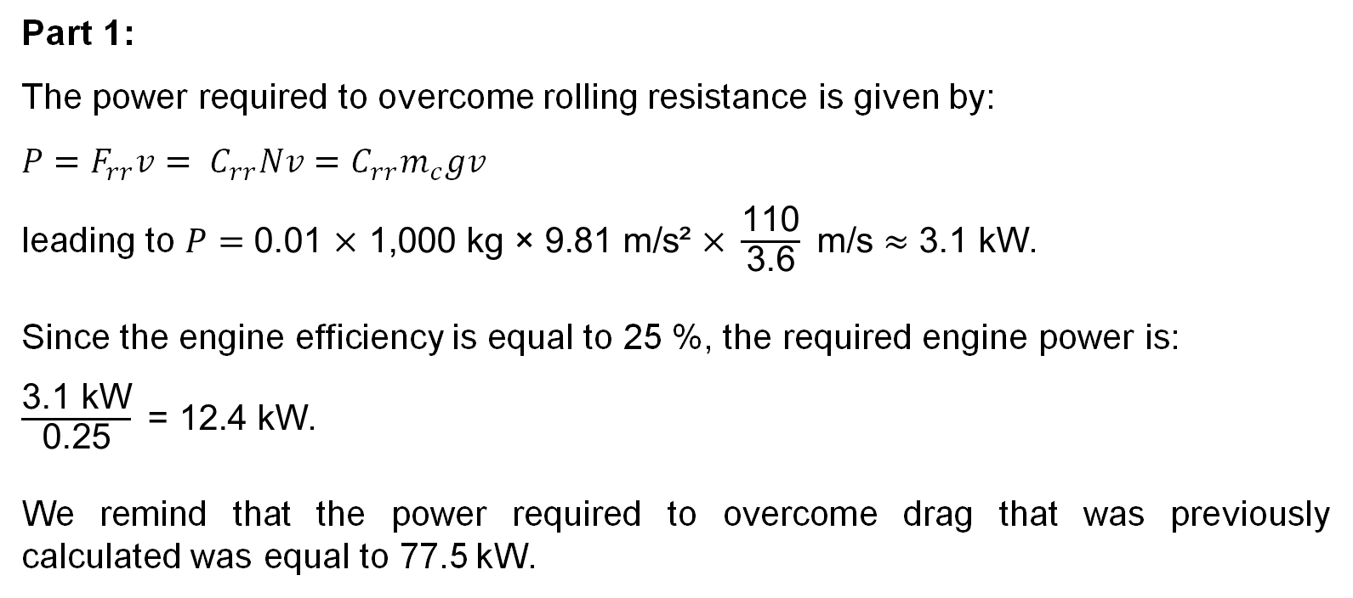
Solution:
Part 1:
The power required to overcome rolling resistance is given by:
$${P=F}_{rr}v= C_{rr}Nv=C_{rr}m_{c}gv$$
leading to $P$ $=$ $\text{0.01 }\text{×} \text{1}\text{,}\text{000 }\text{kg}\text{ × 9.81 }\text{m}\text{/}\text{s}\text{² }\text{×} \frac{\text{110}}{\text{3.6}} \text{m}\text{/}\text{s}≈\text{3.1 }\text{kW}$.
Since the engine efficiency is equal to 25 %, the required engine power is:
$\frac{\text{3.1 }\text{kW}}{\text{0.25}} \text{=}\text{ 12.4 }\text{kW}$.
We remind that the power required to overcome drag that was previously calculated was equal to 77.5 kW.
50

Slide 51
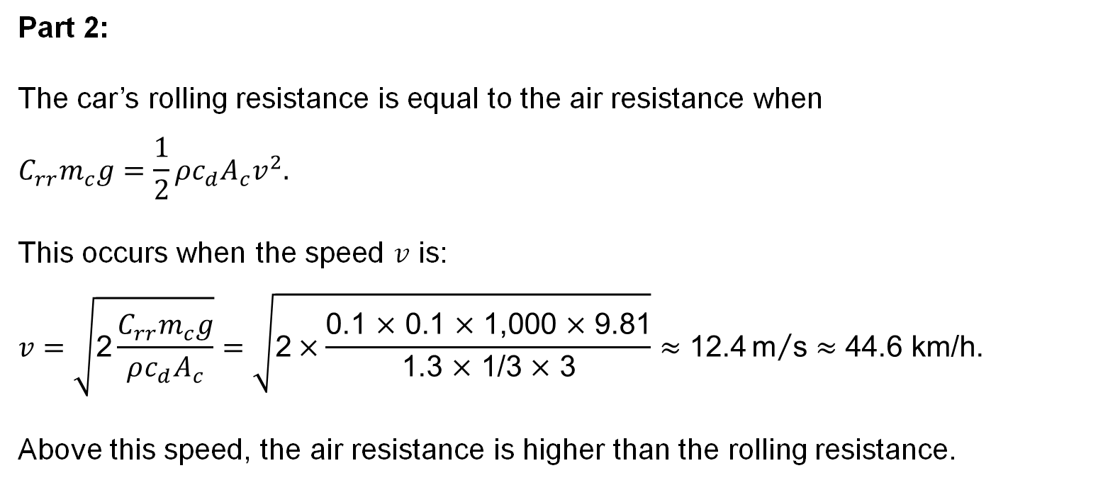
Part 2:
The car’s rolling resistance is equal to the air resistance when
$$C_{rr}m_{c}g=\frac{1}{2}ρc_{d}A_{c}v^{2}.$$
This occurs when the speed $v$ is:
$$v=\sqrt{\text{2}\frac{C_{rr}m_{c}g}{ρc_{d}A_{c}}}=\sqrt{\text{2}×\frac{\text{0}\text{.1 }\text{×} \text{0.1 }\text{×} \text{1,}\text{000} \text{×} \text{9.81}}{\text{1.3 }\text{×} \text{1/}\text{3 }\text{×} \text{3}}}≈\text{12.4}{\text{m}}/{\text{s}}≈\text{44.6 }\text{km}\text{/}\text{h}\text{.}$$
Above this speed, the air resistance is higher than the rolling resistance.
51

Slide 52
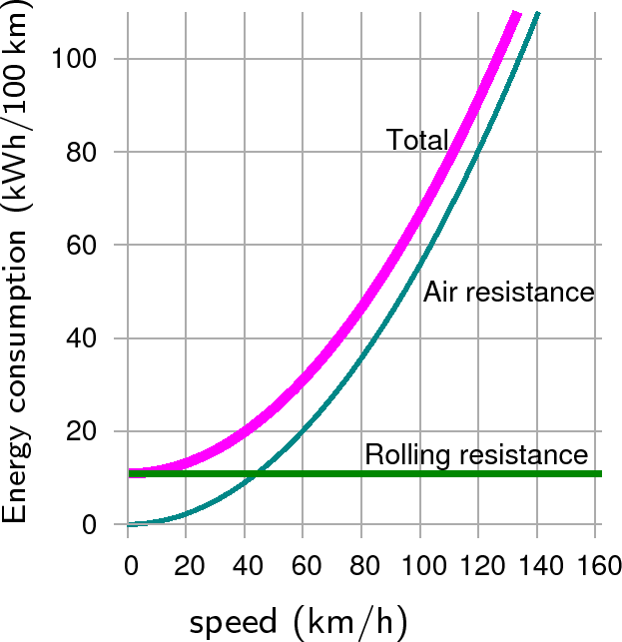
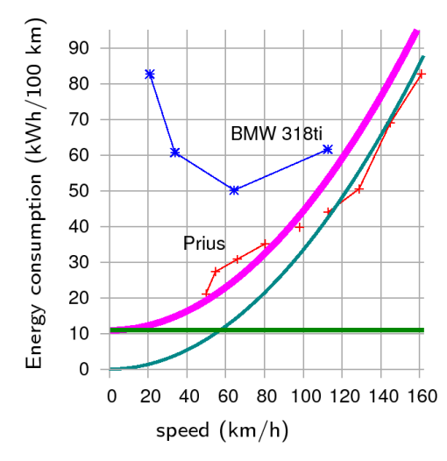
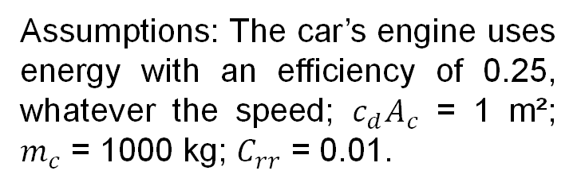
Theoretical vs real car fuel consumption relative to its speed
Simple theory of car fuel consumption (energy per distance) when driving at steady speed.¹
Fuel consumption of existing cars.¹
Assumptions: The car’s engine uses energy with an efficiency of 0.25, whatever the speed; $c_{d}A_{c}$ = 1 m²; $m_{c}$ = 1000 kg; $C_{rr}$ = 0.01.
This shows that more conservative speed limits will not necessarily lead to energy savings.
¹ MacKay, D. (2008). Sustainable Energy - Without the Hot Air.
52

Slide 53
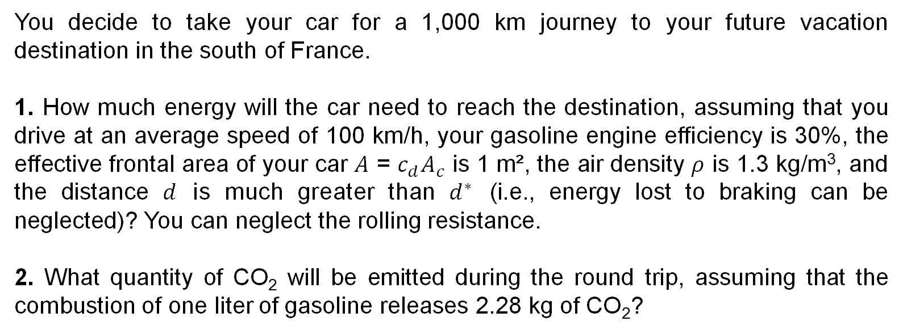
Exercise 3:
You decide to take your car for a 1,000 km journey to your future vacation destination in the south of France.
1. How much energy will the car need to reach the destination, assuming that you drive at an average speed of 100 km/h, your gasoline engine efficiency is 30%, the effective frontal area of your car $A$ = $c_{d}A_{c}$ is 1 m², the air density $ρ$ is 1.3 kg/m³, and the distance $d$ is much greater than $d^{∗}$ (i.e., energy lost to braking can be neglected)? You can neglect the rolling resistance.
2. What quantity of CO₂ will be emitted during the round trip, assuming that the combustion of one liter of gasoline releases 2.28 kg of CO₂?
53

Slide 54
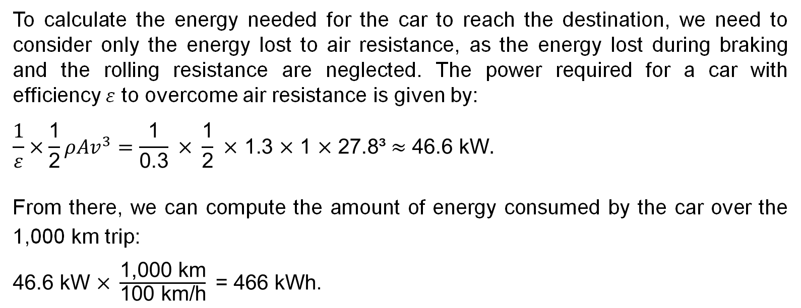

Solution:
Part 1:
To calculate the energy needed for the car to reach the destination, we need to consider only the energy lost to air resistance, as the energy lost during braking and the rolling resistance are neglected. The power required for a car with efficiency $ε$ to overcome air resistance is given by:
$$\frac{1}{ε}×\frac{\text{1}}{\text{2}}ρAv^{3}=\frac{\text{1}}{\text{0.3}} \text{×} \frac{\text{1}}{\text{2}} \text{×}\text{ 1.3 }\text{×}\text{ 1 }\text{×}\text{ 27.8³}≈\text{46.6 }\text{kW}.$$
From there, we can compute the amount of energy consumed by the car over the 1,000 km trip:
$\text{46.6 }\text{kW} \text{×} \frac{\text{1,000 }\text{km}}{\text{100 }\text{km}\text{/}\text{h}}\text{ = 466 }\text{kWh}$.
Part 2:
During the round trip, the car will burn $\frac{\text{2 }\text{×}\text{ 466}}{\text{8.8}}≈$ 106 liters of gasoline.
This leads to 106 $×$ 2.28 $≈$ 242 kg of CO₂ emissions.
54

Slide 55
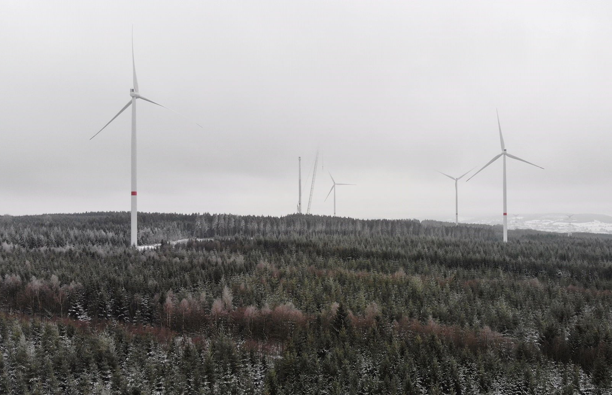
GENV0002-1
Energy and sustainable development
Lecturer: Damien Ernst – University of Liège (dernst@uliege.be)
Chapter 05 – Onshore wind energy
Luminus' first wind farm in a forestry exploitation area (Lierneux, Belgium)

Slide 56

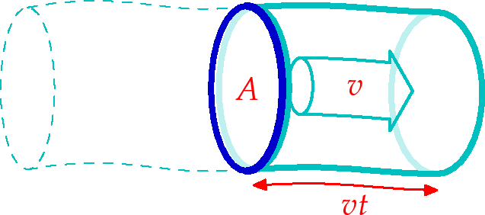
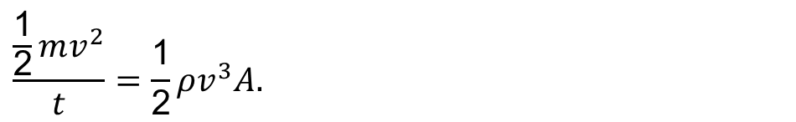
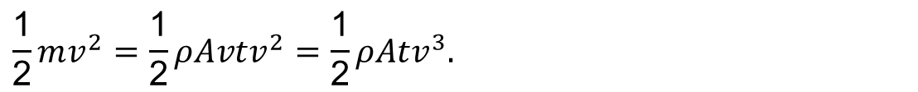
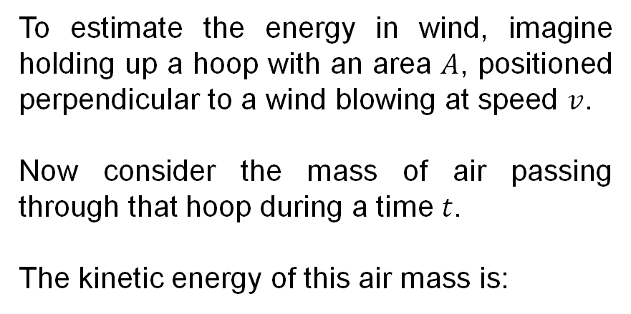
How to determine wind power?
To estimate the energy in wind, imagine holding up a hoop with an area $A$, positioned perpendicular to a wind blowing at speed $v$.
Now consider the mass of air passing through that hoop during a time $t$.
The kinetic energy of this air mass is:
$$\frac{\text{1}}{\text{2}}mv^{2}=\frac{\text{1}}{\text{2}}ρAvtv^{2}=\frac{\text{1}}{\text{2}}ρAtv^{3}.$$
Therefore, the power of the wind over an area $A$, defined as the kinetic energy passing through that area per unit time, is:
$$\frac{\frac{\text{1}}{\text{2}}mv^{2}}{t}=\frac{\text{1}}{\text{2}}ρv^{3}A.$$
56

Slide 57


Power of a wind turbine
As wind approaches a wind turbine, its speed decreases because a portion of its kinetic energy is converted into mechanical energy by the rotor. However, if all the wind’s kinetic energy were extracted, the wind would come to a complete stop upstream, which is physically impossible.
The fraction of the wind's energy that can be captured by a turbine is known as the power coefficient $C_{p}$​. It represents the ability of the wind turbine to convert this kinetic power into usable mechanical power. The maximum theoretical value of $C_{p}$ for an ideal wind turbine is known as the Betz limit, which is 16/27 ≈ 0.59.
In reality, wind turbines cannot achieve this maximum efficiency due to various losses, including friction, turbulence, and other inefficiencies related to the turbine’s design and environmental factors.
$$\text{w}\text{ind} \text{power} \text{produced}=C_{p}×\text{power} \text{of} \text{the} \text{wind} \text{per} \text{unit} \text{area}×\text{area}$$
$$\text{wind} \text{power} \text{produced}=C_{p}×\frac{\text{1}}{\text{2}}×ρ×v^{3}×A$$
57

Slide 58

Estimation of wind speed at a given height
There are two main ways to calculate wind speed at an height $z$. The first one is the National Renewable Energy Laboratory (NREL) formula:
$$v\left(z\right)=v_{10}{\left(\frac{z}{\text{10 }\text{m}}\right)}^{α},$$
where $v_{10}$ is the speed at 10 m, and $α$ is the wind shear exponent, with a typical value of 0.143.
The second one is the Danish Wind Industry Association (DWIA) formula:
$v\left(z\right)=v_{ref}\frac{\text{log}{\text{(}z/{z_{0}\text{)}}}}{\text{log}{\text{(}{z_{ref}}/{z_{0}\text{)}}}},$
where $z_{0}$ is the roughness length, and $v_{ref}$ is the speed at a reference height $z_{ref}$. For agricultural land with houses and hedgerows, a typical value of $z_{0}$​ is 0.1 m.
58

Slide 59


Exercise 1:
Estimate the power produced by an onshore wind turbine in Belgium, assuming that:
The wind turbine is located in Botrange (province of Liège);
The wind speed $v$ is constant throughout the year and equal to 4.67 m/s at an altitude of 10 m; ¹
The wind turbine has a power coefficient $C_{p}$ of 0.4, a rotor diameter $d$ of 100 m, and a rotor height of 100 m;
The air density $ρ$ is 1.3 kg/m³, the wind shear exponent $α$ is 0.143, and the roughness length $z_{0}$is 0.1.
Rotor diameter
Rotor height
¹ The average wind speed at a height of 10 m measured in Botrange in 2023 was 4.67 m/s, see Accurate Botrange wind forecast (2023). World Weather & Climate Information.
59

Slide 60

Solution:
To calculate the power produced by the wind turbine, we first need to adjust the given wind speed $v$. The value provided is related to a height of 10 m, but it is more appropriate to use the wind speed at the rotor height, which in our case is 100 m above the ground.
We can use the NREL and DWIA formulas:
$v\left(\text{100 }\text{m}\right)=\text{4.67}×{\left(\frac{\text{100 }\text{m}}{\text{10 }\text{m}}\right)}^{0.143}≈\text{4.67 }\text{m}\text{/}\text{s}×\text{1.39}≈$ 6.5 m/s
or
$v\left(z\right)=\text{4.67}×\frac{\text{log}{\text{(}{\text{100}}/{\text{0.1)}}}}{\text{log}{\text{(}{\text{10}}/{\text{0.1)}}}}=\text{4.67 }\text{m}\text{/}\text{s}×\text{1.5}≈\text{7 }\text{m}\text{/}\text{s}$.
We will assume the most favourable wind speed of 7 m/s for our exercise.
Hence, the power produced by the wind turbine is equal to:
0.4$×$ $\frac{\text{1}}{\text{2}}$ $×$1.3 kg/${\text{m}}^{3}$ $×$ ${\left(\text{7 }\text{m}\text{/}\text{s}\right)}^{3}×\frac{\text{π}}{\text{4}}{\left(\text{100 }\text{m}\right)}^{2}$ $≈\text{700 }\text{kW}$.
60

Slide 61


Estimation of the power produced of a wind farm per unit area
In a wind farm, the area of land occupied by a group of wind turbines is important. When wind turbines are positioned too closely, those located upwind will create wind shadows for those situated downwind.
To ensure optimal power generation, a common rule of thumb is to space turbines at least 5 rotor diameters apart.
$$\text{Hence}\text{, }\text{the} \text{power} \text{produced} \text{per} \text{unit} \text{area} \text{by} \text{a} \text{wind} \text{farm} \text{is} \text{equal} \text{to}\text{:}$$
$$\frac{C_{p}×\frac{\text{1}}{\text{2}}ρv^{3}×\frac{\text{π}}{\text{4}}d²}{(\text{5}d)²}=\frac{C_{p}×\frac{\text{1}}{\text{2}}ρv^{3}×\frac{\text{π}}{\text{4}}}{\text{25}}.$$
We observe that the power produced per unit area does not depend on rotor diameter. Using the values from our previous exercise, it is equal to:
$$\frac{\text{0.4} × \frac{\text{1}}{\text{2}} × \text{1.3 }\text{kg}\text{/}{\text{m}}^{3} × {\left(\text{7 }\text{m}\text{/}\text{s}\right)}^{3}×\frac{\text{π}}{\text{4}}}{\text{25}}=\text{2.8 }\text{W}\text{/}\text{m}\text{².}$$
61

Slide 62

Why have wind turbines grown larger over time?
Since the answer does not depend on rotor diameter, why have wind turbines been increasing in size over time? There are three main reasons:
Wind speed increases with height, leading to more energy being captured per unit of surface area in a wind farm;
Larger wind turbines have a smaller footprint per MWh produced;
In terms of cost efficiency, improving turbine performance through taller towers and longer blades typically lowers the cost per MW installed.
Evolution of the dimensions of the Enercon turbine model over time.¹
¹ Deboyser, B. (2021, January 20). La turbine Enercon E-160 EP5 élue éolienne de l’année. Révolution Énergétique.
62

Slide 63

How much onshore wind power could plausibly be generated per person in Belgium?
The wind power produced per person is equal to the wind power generated per unit area multiplied by the available area per person.
As of early 2023, the population of Belgium was approximately 11.7 million, with a total land area of 30,688 km². Thus, available the area per person is equal to 2,623 m².
From there we have for the power per person per day:
2.8 W/m² $×$ 2,623 m²/pers = 7.3 kW/pers $≈$ 175 kWh/pers/d.
Let us assume that 5% of Belgium's land area could be covered by wind turbines; it is reduced to 9 kWh/pers/d.
63

Slide 64
Completion of the current balance sheet
The balance sheet
Car: 30 kWh/pers/d
Wind: 9 kWh/pers/d
CONSUMPTION
PRODUCTION
64

Slide 65


Onshore wind farms in Belgium
In 2023, Belgium had 245 onshore wind farms, with a total installed capacity of 3.3 GW.¹ That year, the entire Belgian onshore wind turbine fleet generated around 6.3 TWh of electricity.
This corresponds to: $\frac{\text{6.}\text{3 }\text{×} \text{1}\text{0}\text{12}}{\text{11}\text{.}\text{7} \text{×} \text{1}\text{0}\text{6} \text{×} \text{36}\text{5 }\text{×} \text{1,000}}$ $≈$ 1.5 kWh/pers/d.
The capacity factor is: $\frac{\text{6.}\text{3} \text{×} \text{1}\text{0}\text{12}}{\text{3.3 }\text{×} \text{1}\text{0}\text{9} \text{×} \text{8,760}}$ $≈$ 22%.
Evolution of wind power production in Belgium.²
¹ Grid hosting capacity. (2023). Elia.
65
² Elia. (2024, January 8). Electricity mix 2023 [Press release].

Slide 66

Note on the operating wind speeds for a wind turbine
Variable-speed wind turbines operate across three main regions:
Region 1 refers to the startup phase, when the turbine begins to rotate but has not yet reached an operational speed;
Region 2 is the operational phase in which the turbine aims to capture as much power as possible from the wind;
Region 3 occurs when wind speeds are high enough that the turbine must limit the amount of wind power captured to prevent exceeding safe electrical and mechanical load limits.
Steady-state power curves for wind and example turbine with a 43.3 m rotor diameter.
¹ Johnson, K. et al. (2004). Stability analysis of an adaptive torque controller for variable speed wind turbines. 43rd IEEE Conference On Decision And Control.
66

Slide 67

Note on the land footprint of wind farms
It is important to distinguish between the land area used for wind energy generation by a wind farm and the direct footprint created by the wind turbines themselves. The land occupied by the wind farm can still be used for other purposes, such as agriculture, except for the area directly occupied by the turbines.
Concrete foundations, typically 3 meters deep, occupy between 100 and 300 m², with less than 100 m² of this area not recoverable for cultivable topsoil.
Each turbine requires a gravel-covered maintenance platform ranging from 500 to 1,500 m².
Roads may need to be built or expanded during wind farm construction. In some cases, these roads are not reduced in size afterward, making it easier to maintain and dismantle the wind turbines.
© Philippe Massit/ONCFS
67

Slide 68

Note on the impact of wind turbines on birds
One criticism of wind turbines that continues to draw significant attention is the number of birds killed by spinning blades. Former US President Donald Trump, for instance, accused this technology of “killing all the birds”.
A model by Joel Merriman, a wind specialist at the American Bird Conservancy, estimates that 1.17 million birds are killed each year by wind turbines in the US, which has a wind installed capacity of 144 GW. While this is a significant number, it represents only 0.016% of the estimated 7.2 billion birds living in the US. Moreover, it is substantially less than the 67 to 90 million birds killed by pesticides or the 365 million killed by cats annually in the US.
Estimated number of birds killed by hazards in the US each year (millions).¹
¹ MacKay, D. (2008). Sustainable Energy - Without the Hot Air.
68

Slide 69
Exercise 2:
1. Assume that wind farms in Belgium have an average power produced per unit of land area of 2.8 W/m². Calculate the surface area that would need to be occupied by wind farms to produce an amount of electricity equivalent to Belgium’s annual final electricity consumption, which was 78.4 TWh in 2023.
2. Assuming a load factor of 20%, calculate the installed capacity of onshore wind turbines required to produce these 78.4 TWh.
69

Slide 70


Solution:
Part 1:
The Belgian fleet of wind turbines should have a total effective power of:
$\frac{\text{78.4 }\text{×} \text{1}\text{0}\text{12}}{\text{8,760 }\text{×} \text{1,00}\text{0}}$ = 8,949,771 kW.
The area occupied by these wind turbines would be equal to:
$\frac{\text{8,949,771}}{\text{2,800}}$ $≈$ 3,196 km².
The total land area of Belgium is 30,688 km². This implies that approximately 10% of Belgium's territory would need to be covered with wind turbines to meet the country's electricity demand.
Part 2:
$$\text{The} \text{installed} \text{capacity} \text{would} \text{be} \text{equal} \text{to}\text{:}$$
$\frac{\text{78.4} \text{×} \text{1}\text{0}\text{12}}{\text{0.2 }\text{×} \text{8,760 }\text{×} \text{1,00}\text{0}}$ $≈$ 44,748,858 kW.
This corresponds to over 13 times the installed capacity in Belgium in 2023.
70

Slide 71


World’s most powerful onshore wind turbine in Belgium
The Enercon E-126 is the highest-installed power onshore wind turbine globally, with its most powerful version boasting an installed power of 7.58 MW.
The Estinnes wind farm, located in Hainaut, is the largest onshore wind power facility in Belgium. It consists of 11 Enercon E-126 wind turbines, resulting in a total installed capacity of 81 MW.
Wind turbines at the Estinnes wind farm achieve an average capacity factor of 25.4% annually. Hence, they annually produce:
81 MW $×$ 8,760 h $×$ 0.254 $=$ 180,000 MWh.
Given that the average household consumes approximately 3.5 MWh of electricity annually, this wind farm can meet the electricity needs of 50,000 households each year.
Enercon E-126
Installed power : 7.58 MW
Hub height: 135 m
Rotor diameter: 126 m
71

Slide 72

Next generation of wind turbines
On January 21, 2023, the blades of the future onshore wind turbine SY1310A were completed on the assembly line of the manufacturer SANY in China.
These blades measure 131 meters, resulting in a rotor diameter of over 260 meters, an unprecedented size for onshore wind turbines. Its installed power is expected to reach 15 MW.
SY1310A onshore wind turbine blades was made by SANY Renewable Energy at its factory in Bayannur (China).¹
¹ Woodford, J. (2024, February 7). World’s biggest onshore wind turbine blades unveiled in China. New Scientist.
72

Slide 73

Exercise 2:
As an energy consultant, you have been approached by a Belgian municipality seeking your expertise. The municipality has partnered with the wind farm designer WindFiesta to assess the feasibility of installing a wind farm on one of their plots. The total annual electricity consumption of all households in the municipality amounts to 32 GWh.
WindFiesta offers the Vestas V9 wind turbine model.
Upon reviewing its technical specifications, you note that the turbine has an installed power of 2 MW and a rotor diameter of 90 meters. To maintain the minimum spacing required for optimal turbine efficiency, the proposal suggests installing nine identical wind turbines.
Vestas V90 in Egeln, Germany.
73

Slide 74
The municipality has posed the following questions:
1. Can WindFiesta's proposal meet the municipality’s goal of generating an amount of energy equivalent to the yearly household consumption of 32 GWh, given a capacity factor of 23%?
2. How long would it take for one turbine to generate an amount of energy equivalent to the energy required for producing its concrete foundation? Assume the following:
600 tons of concrete are required for the foundation;
The density of concrete is 2,400 kg/m³;
The energy requirement to produce 1 m³ of concrete is 2,775 MJ.¹
3. The municipality also seeks to evaluate the CO₂e emissions associated with the construction of these wind turbine foundations. Concrete is the third-largest emitter of CO₂e, contributing 4 to 8% of global CO₂e emissions. Assume the following:
Each foundation uses 600 tons of concrete;
The carbon footprint of concrete is 235 kg CO₂e per ton of concrete.
What is the total quantity of CO₂e emitted for the foundations of all the turbines in the wind farm?
¹ Lovins, A. (2011, April 6). Renewable energy’s “footprint” myth. The Electricity Journal 24(6).
74

Slide 75


Solution:
Part 1:
The annual average production of 1 Vestas turbine is equal to:
$\text{0.23} \text{×}$ 2 $\text{×}\text{ 24} \text{×}$ 365$≈$ $\text{4}\text{,030 }\text{MWh}$.
For the nine Vestas turbines, we have:
$\text{9 }\text{×}\text{ 4,030}=$ 36,270 MWh$≈$ 36.3 GWh.
A wind farm consisting of nine Vestas turbines with a 23% capacity factor can therefore meet the municipality's annual electricity consumption of 32 GWh.
75

Slide 76


Part 2:
The energy required for the production of one ton of concrete is equal to:
$\frac{\text{2,775}}{\text{2.4}}=\text{1,156.25}{\text{MJ}}/{\text{t}}$.
The energy required for the entire concrete foundation is:
$\text{1,156.25} \text{×}\text{ 600}=\text{663,750 }\text{×} \text{1}\text{0}\text{6 }\text{J}$.
In one MWh, we have 3.6 $\text{×} \text{1}\text{0}\text{9} \text{J}$. Hence, the energy required expressed in MWh is equal to:
$$\frac{\text{663,750}}{\text{3.6 }\text{×} \text{1}\text{0}\text{9}}≈ \text{184 }\text{MWh}\text{.}$$
Considering a daily average production of 4,030/365 $≈$ $\text{11 }\text{MWh}\text{/}\text{d}$, it would require the wind farm 184/$\text{11}≈$ 16.7 days to produce an amount of energy equal to the energy needed for the production of all the concrete used in the foundations.
Part 3:
The total quantity of CO₂e emitted for the foundations of the nine turbines is:
$\text{235 }\text{×}\text{ 600 }\text{×}\text{ 9}=\text{1,269 }\text{tCO}\text{2}\text{e}$.
76

Slide 77

GENV0002-1
Energy and sustainable development
Lecturer: Damien Ernst – University of Liège (dernst@uliege.be)
Chapter 06 – Planes
A330neo Air Belgium.

Slide 78

Estimating energy consumed per person for a plane trip
The energy consumed per person for a plane trip is calculated as:
$$\text{distance} \text{travelled} \text{×} \text{fuel} \text{consumption}\text{/}\text{p}\text{−}\text{km} \text{×} \text{energy}\text{/}\text{liter}\text{,}$$
where:
The distance travelled refers to the total flight distance in kilometers;
The fuel consumption per passenger-kilometer (p-km) is the amount of fuel required to transport one passenger over one kilometer;
The energy per liter is the calorific value of kerosene, which is used to convert fuel consumption into energy units. Kerosene has a calorific value of 10.3 kWh per liter, higher than the 8.8 kWh per liter for gasoline.
78

Slide 79
Exercise 1:
Estimate the energy consumption per person from air travel in Belgium based on the following assumptions. Each person takes a 4,800 km round trip annually, and the fuel consumption is 3.75 l of kerosene per 100 p-km.¹ The calorific value of kerosene is 10.3 kWh/l.
Provide your answer in kilowatt-hours per person per day.
79
¹ Köse, Y. (2024, November 27). An Empirical Analysis on The Use of Sustainable Fuels in the Aviation Industry. University of Turkish Aeronautical Association.

Slide 80

Solution:
The energy consumed per person for a plane trip of 4,800 km per year is:
$$\text{4,800} \text{×}\frac{\text{3.75}}{\text{100}} \text{×} \text{10.3}=\text{1,854 }\text{kWh}\text{/}\text{pers}\text{.}$$
Therefore, the daily energy consumption per person from air travel corresponds to:
$$\frac{\text{1}\text{,854}}{\text{365}}≈\text{5 }\text{kWh}\text{/}\text{pers}\text{/}\text{d}\text{.}$$
We will assume this value of 5 kWh/pers/d in our balance sheet.
80

Slide 81
Completion of the current balance sheet
The balance sheet
Plane: 5 kWh/pers/d
Car: 30 kWh/pers/d
Wind: 9 kWh/pers/d
CONSUMPTION
PRODUCTION
81

Slide 82

Exercise 2:
Estimate the daily energy consumption per person from plane travel in a Boeing 747-400 under the following conditions.
Imagine each person takes a 4,800 km round trip per year. A Boeing 747-400, with a fuel capacity of 240,000 liters of kerosene, can travel 14,200 km when fully loaded with 416 passengers. However, in practice, the plane typically operates at 80% occupancy, carrying 333 passengers on average.
The calorific value of kerosene is 10.3 kWh per liter, and we assume that fuel consumption is directly proportional to the distance travelled.
For simplicity, ignore the increased consumption during take-off and the impact of weight variations on fuel usage.
Lufthansa Boeing 747-400.
82

Slide 83


Solution:
If the trip length is 14,200 km and the plane operates at full capacity (100%), assuming one round trip per person per year, the daily energy consumption per person would be equal to:
$$\frac{\frac{\text{2 }\text{×}\text{ 240,000 }}{\text{416}} \text{×} \text{10.3}}{\text{365}}≈\text{33 }\text{kWh}\text{/}\text{pers}\text{/}\text{d}\text{.}$$
Now, for a trip length of 2,400 km with the plane 80% full, assuming that fuel consumption is a linear function of the distance travelled, ignoring the impact of weight variation on fuel consumption, the daily energy consumption per person is adjusted as follows:
$$\text{33} \text{×}\frac{\text{2,400}}{\text{14,200}}\text{×}\frac{\text{100}}{\text{80}}≈\text{ 7 }\text{kWh}\text{/}\text{pers}\text{/}\text{d}\text{.}$$
83

Slide 84
Comparison of energy consumption between cars and planes
Modes of transport | Number of passenger(s) | Energy consumption (kWh/100p-km)
Gasoline car Figures based on the assumptions in Chapter 04. | 1 | 60
 | 4 | 15
Boeing 747 Figures based on the data of the previous exercise. | 333 (80% full) | 54
 | 416 (100% full) | 41
Energy consumption of a gasoline car and a Boeing 747 based on the number of passengers.
Under our assumptions, we observe that a plane with an 80% occupancy rate has a similar fuel consumption per passenger-kilometer to a car with only the driver on board.
As the number of passengers in the car increases, the car becomes more fuel-efficient than flying.
84

Slide 85


Gas emissions of modes of transport as observed in real-life
CO₂e emissions per p-km are highest for sea and air travel. However, cars are the largest emitters overall due to their more frequent use compared to air travel.
Carbon footprints of modes of transport measured in grams of CO₂e emitted per passenger-kilometer, as of December 2022.¹
GHG emissions breakdown by mode of transport in the EU in 2019.²
¹ Venditti, B. (2024, April 26). The Carbon Footprint of Major Travel Methods. Visual Capitalist.
85
² European Parliament. (2024, December 6). CO2 emissions from cars: facts and figures.

Slide 86

Notes on air travel consumption and emissions
We would not achieve significant energy savings by traveling on slower planes.
No plane redesign will drastically improve fuel efficiency.
However, energy savings can be achieved by increasing passenger occupancy and improving air traffic management.
Additionally, CO₂ emissions are not the only contributor to the global warming impact of air travel. Airplanes also emit NOₓ, which contributes to global warming.
Moreover, when airplane engines burn kerosene, the water vapour in their exhaust can condense and freeze at high altitudes, creating contrails. These contrails can sometimes persist and develop into artificial cirrus clouds, which contribute to the greenhouse effect.
Aviation’s climate impact.¹
¹ Project Contrails: Preventing Contrails with AI. (s. d.). Google Research.
86

Slide 87

Using artificial intelligence to help airlines prevent contrails
Planes do not always produce contrails; these only form when planes fly through humid atmospheric regions. By avoiding these regions, planes can reduce the creation of warming contrails with minimal impact on fuel consumption.
The challenge lies in predicting where and when these humid regions will occur. By leveraging large volumes of weather data, satellite imagery, and flight records, AI can generate highly accurate forecasts of contrail formation. Pilots and flight dispatchers can then use these predictions to adjust flight altitudes accordingly, thereby reducing the impact on the climate.
AI detecting contrails over the United States, based on satellite imagery.¹
¹ Project Contrails: Preventing Contrails with AI. (s. d.). Google Research.
87

Slide 88






Technical notes on how planes use energy to fly
Energy in planes is used for two main purposes: first, to push air downward to generate lift and keep the plane in the air, and second, to overcome drag in order to maintain forward motion.
In the model we will use for explaining energy consumption in planes, the plane interacts with a stationary air column that has a cross-sectional area $A_{s}$​. After a time $t$, the plane pushes a length of the air column, equal to $v×t$, downward at a speed $u$, where $v$ is the speed of the plane.
$$\vec{v}$$
$A_{s}$
$$\vec{u}$$
Adopted model
A little closer to reality
Adopted model of the plane.¹
¹ MacKay, D. (2008). Sustainable Energy - Without the Hot Air.
88

Slide 89



Analysis of power and energy efficiency in airplane flight (1/4)
To better understand the dynamics of the plane’s flight, we will address the following questions:
1. What is the value of the speed $u$?
2. What is the power $P_{lift}$ required to lift the plane?
3. What is the power $P_{drag}$ needed to overcome the drag force, considering $A_{p}$ as the effective plane's frontal area and $c_{d}$ as its drag coefficient? (following the same model as in Chapter 04)
$A_{p}$
Frontal area of a plane.¹
4. What is the total power required to maintain the plane’s flight?
5. What is the energy consumption per unit of distance travelled?
6. What is the optimal speed for maximising energy efficiency?
¹ Effect of size on drag. (n.d.). Nasa.
89

Slide 90

Analysis of power and energy efficiency in airplane flight (2/4)
1. What is the value of the speed $u$?
We assume that a constant force $F_{t}$ is applied to a tube of length $v×t$ over a time period $t$. As $F_{t}= m_{t}×a$ and $u=a×t$, we can write the following relation:
$$F_{t}=ρvtA_{s}×\frac{u}{t}.$$
We assume the plane is in equilibrium, so the force $F_{t}$ must be equal to the gravitational force acting on the plane. Hence, we can write:
$$u =\frac{mg }{ρvA_{s}}.$$
2. What is the power $P_{lift}$ required to lift the plane?
The power required is:
$$P_{lift}=\frac{\text{kinetic} \text{energy} \text{of} \text{tube}}{\text{time}}=\frac{1}{t}\frac{1}{2}m_{t} u\text{²}=\frac{1}{2t} ρvtA_{s}{\left(\frac{mg}{ρvA_{s}}\right)}^{2}=\frac{1}{2}\frac{m\text{²}g\text{²}}{ρvA_{s}}.$$
90

Slide 91

Analysis of power and energy efficiency in airplane flight (3/4)
3. What is the power $P_{drag}$ needed to overcome the drag force?
The drag force $F_{drag}$​is the force that opposes the plane’s motion through the air and is equal to:
$$\frac{1}{2}c_{d}{ρA}_{p}v\text{².}$$
To calculate the power $P_{drag}$​, we multiply the drag force by the velocity:
$$P_{drag}=\frac{1}{2}c_{d}{ρA}_{p}v\text{³}\text{.}$$
4. What is the total power required to maintain the plane’s flight?
$$P_{total}=P_{lift}+P_{drag}=\frac{(mg)²}{2ρvA_{s}}+\frac{1}{2}c_{d}{ρA}_{p}v^{3}.$$
This expression specifies the total power that the engines need to generate to overcome both the drag force $F_{drag}$ and the lift-related force $F_{lift}$.
91

Slide 92

Analysis of power and energy efficiency in airplane flight (4/4)
5. What is the energy consumption per unit of distance travelled?
Assuming an efficiency $ε$ for the plane's engines, the energy per unit of distance travelled is equal to:
$$\frac{1}{ε}\frac{P_{total}t}{vt}=\frac{1}{ε}\left(\frac{1}{2}c_{d}{ρA}_{p}v^{2}+\frac{(mg)²}{2ρv²A_{s}}\right).$$
6. What is the optimal speed for maximising energy efficiency?
The optimal speed $v_{opt}$ is the speed at which the engine achieves the best balance between overcoming drag and generating lift for minimising the energy consumption per unit of distance travelled. By calculating the value of $v$ which cancels the first derivative of the expression mentioned above, we obtain an optimal speed $v_{opt}$ equal to:
$$\sqrt{\frac{mg}{ρ\sqrt{c_{d}A_{p}A_{s}}}}.$$
92

Slide 93


Correlation between the thrust of a plane and the energy per unit of distance travelled
Thrust is the force generated by the engines which moves a plane through the air. The energy spent per unit of distance travelled is equal to this thrust divided by the efficiency of the engines since Force $×$ Distance = Work.
The minimum energy to be spent per unit of distance travelled is therefore equal to the minimum of the curve “thrust as a function of speed”.
Required thrust for a Boeing 747 as a function of its speed.¹
¹ MacKay, D. (2008). Sustainable Energy - Without the Hot Air.
93

Slide 94
Exercise 3:
1. Determine the optimal cruising speed of an Airbus A320 given the following parameters: the mass of the plane is 75.5 t, the wingspan is 35.8 m, the drag coefficient is 0.03, and the effective frontal area is 70 m².
Assume the air density at cruising altitude is 0.41 kg/m³.
2. How much kerosene would be burned during an intercontinental flight of 10,000 km if the A320 maintains a constant cruising speed equal to the calculated optimal speed?
Assume that the fuel consumption is directly proportional to the distance travelled, the efficiency of the engines is 30%, and the energy contained in one liter of kerosene is 10.3 kWh.
94

Slide 95

Solution:
Part 1:
We assume that the wingspan of the plane represents the diameter of the cross-section of the stationary tube of air. Thus, the area $A_{s}$ is calculated as:
$$A_{s}=\frac{π \text{×} \text{(}\text{wingspan}\text{)²}}{\text{4}}\text{=}\frac{π \text{×}\text{ 35.8}\text{²}}{\text{4}} ≈\text{1,007 }\text{m}\text{².}$$
Applying the given values into the equation for the optimal speed:
$$v_{opt}=\sqrt{\frac{\text{9.81}×\text{75,500}}{\text{0.41}×\sqrt{\text{0.03}×\text{70}×\text{1,007}}}}≈\text{200 }\text{m}\text{/}\text{s}\text{.}$$
95

Slide 96

Part 2:
The energy burned by the plane per unit of distance travelled, considering the efficiency of the engines, is given by this equation:
$$\frac{\text{energy}}{\text{distance}}=\frac{1}{ε}\left(\frac{1}{2}c_{d}{ρA}_{p}{v_{opt}}^{2}+\frac{(mg)²}{2ρ{v_{opt}}^{2}A_{s}}\right)$$
Applying the values, the energy to be spent per unit of distance travelled is equal to:
$\frac{\text{1}}{\text{0.3}}$ $\text{×}$ $\left(\frac{\text{1}}{\text{2}} \text{×}\text{ 0.03 }\text{×}\text{ 0.41 }\text{×}\text{ 70 }\text{×}\text{ 200}\text{²} \text{+}\frac{\left(\text{75,500 }\text{×}\text{ 9.81}\right)\text{²}}{\text{2} \text{×}\text{ 0.41 }\text{×} \text{200}\text{²} \text{×}\text{ 1,007}}\right)≈$ 112,760 N.
This corresponds to an energy expenditure of:
112.76 kN $\text{×}$ 10,000 km $=$ 1,127,600 MJ $≈$ 313,222 kWh.
The energy contained in 1 liter of kerosene is 10.3 kWh. Therefore, the total fuel consumption is:
313,222 / 10.3 $≈$ 30,410 liters.
The A320 would burn approximately 30,410 liters of kerosene during the 10,000 km intercontinental flight.
96

Slide 97

Gross transport cost of aircraft
The gross transport cost is defined as the energy required per unit weight of the entire craft per unit of distance when traveling at optimal speed $v_{opt}$. It is equal to:
$${\frac{\text{1}}{ε}\left(c_{d}\frac{A_{p}}{A_{s}}\right)}^{\frac{1}{2}}g.$$
The gross transport cost is typically measured in kWh/t-km and strongly depends on engine efficiency. For most conventional aircraft, typical values are approximately 0.4 kWh/t-km.
97

Slide 98


Potential improvements in aircraft efficiency
Engine efficiency could be improved through technological advancements, leading to lower fuel consumption. Making planes lighter would also help reduce the net transport cost by lowering the energy required for flight.
Reducing the drag coefficient is another way to improve efficiency. This could be done using laminar flow control, which minimises turbulence over the wings by drawing in small amounts of air through surface perforations.
Experts also suggest that adopting blended-wing body (BWB) designs could further enhance efficiency by improving the plane’s shape.
Conventional and flow control wings.¹
BWB concept from JetZero.²
¹ Krishnan, K., Bertram, O., & Seibel, O. (2017). Review of hybrid laminar flow control systems. Progress In Aerospace Sciences.
98
² Prisco, J. (2023, August 21). JetZero: Is this new plane design the future of aviation? CNN.

Slide 99

Other shapes of planes are also possible
In 2023, NASA awarded Boeing a contract to develop a Transonic Truss-Braced Wing (TTBW) aircraft demonstrator, with testing expected to conclude in the late 2020s.
The TTBW features strut-braced supports, allowing the wing to be thinner and lighter while still maintaining structural integrity.
The upshot? A 7%-10% improvement in fuel efficiency from the wing design alone.
Boeing TTBW concept.
99

Slide 100




Another way of staying up: the airship
The main challenge with planes is that while slowing down reduces air resistance, this benefit is offset by the increased air resistance required to generate more lift to counteract gravity.
An alternative approach could be to achieve buoyancy by using a massive helium-filled balloon. Assuming the balloon is ellipsoidal, its volume is given by:
$V=\frac{2}{3}AL$, where $A$ is the cross-sectional area and $L$ is the length.
The total mass of the balloon is:
$$m_{total}=ρV.$$
If the balloon moves at a speed $v$, the force of air resistance is:
$$F=\frac{1}{2}c_{d}ρAv^{2}.$$
An ellipsoidal airship.
The energy expenditure per unit of distance per unit of mass is then:
$$\frac{F}{ε m_{total}}=\frac{3}{4ε}×c_{d}\frac{v²}{L}.$$
100

Slide 101

Exercise 4:
What is the gross transport cost of an airship 400 m long, flying at a constant speed of 80 km/h (22 m/s), with a rotor efficiency of 25% and a drag coefficient similar to that of an A320, equal to 0.04?
Express the answer in kilowatt-hours per ton-kilometer (kWh/t-km).
AirLander airship prototype.
101

Slide 102

Solution:
We have as energy expenditure per unit distance per unit mass:
$$\frac{F}{ε m_{total}}=\frac{\text{3}}{\text{4} \text{×} \text{0.25}} \text{×}\text{ 0.04 }\text{×}\frac{\text{22}\text{²}}{\text{400}}=\text{ 0.15 }\text{J}\text{/}\text{kg}\text{−}\text{m}\text{.}$$
We can express this value in kWh/t-km:
$\frac{\text{0.15}}{\text{3.6}}≈$0.04 kWh/t-km.
This value is comparable to the energy efficiency of rail transport (0.08 kWh/t-km) and is lower by a factor of 10 compared to conventional aircraft. This suggests that airships could offer a competitive alternative for energy efficient cargo transportation over long distances.
102

Slide 103


Water-skimming wing ships
Ground-effect aircraft fly very close to the Earth’s surface, generating lift by sitting on a cushion of compressed air trapped between its wings and the nearest surface.
Most of the energy expenditure is related to air resistance rather than creating the air cushion. As a result, the freight transport cost could be about half that of a conventional airplane.
Ekranoplan, the Caspian monster.
Boeing Pelican concept.
103

Slide 104

GENV0002-1
Energy and sustainable development
Lecturer: Damien Ernst – University of Liège (dernst@uliege.be)
Chapter 07 – Solar energy
Panda Green Energy Group‘s 100 MWc solar farm - Datong County, China.

Slide 105

Solar irradiance in Belgium
The power of raw sunshine at the equator at midday on a cloudless day is approximately 1,000 W/m². However, adjustments are necessary to estimate the average power per square meter of land area in Belgium. These adjustments include compensation for the angle of the sun relative to the land surface, the fact that the sun is only near its maximum intensity for about 32% of the daylight hours, and that in Belgium, the sun shines on average during 35% of daylight hours.
Taking these factors into account, the average power per square meter of flat ground in Belgium is approximately 117 W/m².
Sunlight hitting the earth at midday on a spring day.¹
Average monthly solar irradiance in Liège, Belgium (1990 - 2020).²
¹ MacKay, D. (2008). Sustainable Energy - Without the Hot Air.
105
² Atlas climatique. (n.d.). KMI.

Slide 106

Solar irradiance in other countries
Average solar irradiance in different cities of the world.¹
¹ MacKay, D. (2008). Sustainable Energy - Without the Hot Air.
106

Slide 107
Turning raw solar power into useful power
Solar energy can be harnessed and transformed in various ways to meet our energy needs. Below are four key methods by which raw solar power is converted into useful forms of energy.
Solar photovoltaic (PV):
Converts sunlight directly into electricity using the photovoltaic effect.
Solar thermal:
Harnesses sunshine to provide direct heating for buildings or water systems.
Solar biomass:
Involves the use of plants, algae, or bacteria, which capture solar energy to produce fuels, electricity, chemicals, or building materials.
Food:
A specific type of solar biomass where plants grow to feed humans or animals (this topic will be explored in Chapter 14).
107

Slide 108

Solar PV – Photovoltaic effect
The photovoltaic effect refers to the ability to convert solar energy into electricity.
A photovoltaic cell, made from semiconductor material, absorbs sunlight, which dislodges electrons and creates an electrical charge. Conductors within the cell collect these electrons. When connected to a load, the flow of electrons generates electricity in the circuit.
Most solar panels are constructed using polycrystalline silicon solar cells, which consist of layers of silicon, phosphorus (N-type dopant), and boron (P-type dopant).
Inside a solar cell.¹
¹ Nicolas. (2022, October 28). Cellules de type N ou type P : comment choisir ? - Eco Green Energy.
108

Slide 109


Solar PV – Physical limit of solar panel efficiency
Regardless of technological advancements, the efficiency of a single-junction solar panel (a panel with one layer of solar cells) cannot exceed a theoretical limit of 33%. Standard solar panel efficiency in 2025 is ranging from 22-25%.
This is known as the Shockley-Queisser limit, which stems from a property of standard photovoltaic materials called the band gap. The band gap determines the specific energy of photons that the material can most efficiently convert. Sunlight contains photons with a wide range of energies; photons with energy below the band gap are not utilized, while those with energy above the band gap can be captured, but any energy exceeding the band gap is lost.
Power density (W/m²)
Power density (W/m²)
Photon energy (eV)
Photon energy (eV)
Power density of the spectrum of midday sunlight.¹
Energy captured by a solar panel with a single band-gap at 1.1 eV (red area). 1 eV=1.6 $×$ 10⁻¹⁹ J.¹
¹ MacKay, D. (2008). Sustainable Energy - Without the Hot Air.
109

Slide 110


Solar PV – Multi-junction cells
A superposition of cells with different properties, utilising different energy bands, allows for more efficient radiation capture. This type of cell is already available on the market, primarily for space applications.
The efficiencies achieved are very promising, exceeding 40% under concentrated sunlight.
Sunlight spectrum
Tunnel junctions
three different cell-types
Structure of a triple-junction cell.¹
¹ Sylvie. (2020, March 10). Types de cellules. Energie Plus.
110

Slide 111

Solar PV – Perovskite cells
A new type of cell, with the general structure ABX₃ in a perovskite structure, is a promising alternative due to its low production cost and high efficiency, with panels surpassing 25% efficiency
In this structure, A is a cation, typically methylammonium (CH₃NH₃⁺), B is a lead cation (Pb₂⁺), and X is a halide anion, typically iodide (I⁻).
Perovskite structure of CH₃NH₃PbI₃.¹
¹ Eames, C. (et al.).(2015). Ionic transport in hybrid lead iodide perovskite solar cells. Nature Communications.
111

Slide 112

Solar PV – Factors that influence efficiency
The operating efficiency of solar panels in real-world conditions is influenced by several factors:
The efficiency of the photovoltaic cells, determined by the cell design;
The overall panel efficiency, which depends on the cell arrangement and panel dimensions;
Solar irradiance and ambient temperature;
Environmental losses, such as shading, dust, and dirt accumulation;
Installation configuration, including orientation (deviation from South) and tilt angle.
Decrease in the efficiency (%) of a PV system in Belgium respect to the optimal configuration.¹
¹ Leloux, J. (2009). Towards the consolidation of a photovoltaic observatory in Wallonia and Brussels (Belgium). 24th European Photovoltaic Solar Energy Conference and Exhibition.
112

Slide 113

Solar PV – Estimating solar power production in Belgium
To estimate the potential solar power generation per person in Belgium, we consider two scenarios: domestic rooftop production and solar farming.
For domestic production, we assume that each individual has 8 m² of PV panels installed on a south-facing roof tilted at 40°, with a panel efficiency of 22%. For solar farming, the available land area per person in Belgium is approximately 2,623 m². The average solar power per unit of flat ground is 117 W/m². We assume that 0.5% of the country could be covered by solar farms.
Therefore, the solar energy produced per person through domestic rooftop production in Belgium is:
$$\frac{\text{0.22 }\text{×}\text{ 117 }\text{×}\text{ 8 }\text{×}\text{ 24}}{\text{1,000}}≈\text{5 }\text{kWh}\text{/}\text{pers}\text{/}\text{d}\text{.}$$
For the solar energy produced per person considering solar farming production in Belgium, we have:
$$\frac{\text{0.2}\text{2} ×\text{ 117 }×\text{ 2,623 }×\text{ 24} × \text{0.}\text{0}\text{5}}{\text{1,000}}≈\text{8 }\text{kWh}\text{/}\text{pers}\text{/}\text{d}\text{.}$$
113

Slide 114


Solar PV – Installed capacity in Belgium
In February 2025, Belgium's total installed photovoltaic capacity reached 10.8 GW, according to Elia, the Belgian Transmission System Operator (TSO)¹. In 2024, solar PV produced 8.4 TWh of electricity, accounting for 11.9% of the country's total electricity generation.
$$\text{This} \text{corresponds} \text{to}\text{: }\frac{\text{8.4 }\text{×} \text{10}\text{12}}{\text{11}\text{.}\text{7} \text{×} \text{10}\text{6} \text{×} \text{36}\text{5 }\text{×} \text{1,000}} \text{≈} \text{2} \text{kWh}\text{/}\text{pers}\text{/}\text{d}\text{.}$$
$$\text{The} \text{capacity} \text{factor} \text{is}\text{: }\frac{\text{8.4} \text{×} \text{10}\text{12}}{\text{10.8 }\text{×} \text{10}\text{9} \text{×} \text{8,760}} \text{≈} \text{9}\text{\%.}$$
Solar production in 2021 per municipality in Wallonia in Belgium (in kWh/pers).²
¹ Elia: le gestionnaire du réseau de transport d’électricité en Belgique. (n.d.). Elia.
114
² Nyssen, E. (2022, April 13). Votre commune est-elle bien équipée en panneaux photovoltaïques?. Le Vif.

Slide 115

Exercise 1:
Kristal Solar PV Park, located in Limburg, is the largest solar farm in Belgium. It is a 99.5 MWc solar PV power project spread over an area of 93 hectares (303,000 panels). The project was developed by ENGIE Fabricom and is currently owned by Limburgse Reconversie Maatschappij. It generates 85 GWh of electricity per year.
1. Calculate the capacity factor and this PV farm.
2. Calculate the efficiency of the PV panels, assuming an average solar irradiance of 110 W/m² and that the PV panels cover half of the surface area of the solar park.
Kristal Solar PV Park (Limburg, Belgium).¹
¹ Benelux`s largest solar park with Sungrow 1500V central inverter solution. (2021, December 14) pv Europe.
115

Slide 116


Solution:
Part 1:
The capacity factor is the ratio of the actual output of the solar farm to its maximum possible output if it were operating at full capacity all the time. This is equal to:
$\frac{\text{85,000} \text{M}\text{Wh}}{\text{99.5 }\text{MW} ×\text{ 8,760 }\text{h}}≈$ 0.098 or 9.8%.
Part 2:
The efficiency of the PV panels is the ratio of the electricity generated to the energy received from the sun. The area covered by PV panels is:
93 ha $×$ 0.5 $=$ 46.5 ha $=$ 465,000 m².
The total solar energy incident on the panels in one year is:
110 W/m² $×$ 465,000 m² $×$ 8,760 h/year $=$ 448,074 MWh/year.
$\text{Hence}\text{, }\text{the} \text{efficiency} \text{of} \text{the} \text{PV} \text{panels} \text{is}\text{:} \frac{\text{85,000}}{\text{423,780} }≈$ 19%.
116

Slide 117
Exercise 2:
It is the year 2030. The price of photovoltaic energy has become very low. The EU-28 has decided to heavily invest in this technology in southern Europe, where solar resources are most abundant, with the goal of covering all its electricity consumption using PV. This electricity consumption is estimated to be around 5,000 TWh.
1. What is the land area required for these solar farms, considering that the efficiency of PV panels is 25% and the average sunlight in southern Europe is approximately 220 W/m²?
2. What would be the total cost of installing these photovoltaic farms, expressed in billions of euros, assuming that the price of photovoltaic panels per installed watt is €0.4 and the capacity factor of PV systems in southern Europe is about 30%?
117

Slide 118


Solution:
Part 1:
For a 1 km² PV farm, the energy produced in one year is calculated as:
$\text{220} \text{W}\text{/}\text{m}\text{² }\text{×} \text{10}\text{6} \text{×} \text{8,760} \text{h} \text{×}\text{ 25\% = }\text{481,800 }\text{×} \text{10}\text{6 }\text{Wh}\text{ = 0.4818 }\text{TWh}$.
The land area required is therefore equal to: $\frac{\text{5,000} \text{TWh}}{\text{0.481}\text{8 }\text{TWh}\text{/}\text{km}\text{²}} ≈$ 10,377 km².
Part 2:
Our PV installation will, on average, produce a power $P$ equal to:
Energy $=$ $P×$ hours per year. Therefore, we have:
$P=\frac{\text{5,000 }\text{TWh}}{\text{8,760 }\text{h}}≈$ 0.57 TW.
Since the capacity factor is 30%, we need to install solar farms having a capacity of:
$\frac{\text{0}\text{.57} \text{TW}}{\text{0.3}}=$1.9 TW.
The cost of installing 1.9 TW of PV at €0.4 per installed watt is equal to:
1.9 $×$10¹² W $×$€0.4/W $=$€760 $× \text{10}\text{9}$ $=$€760 billion.
118

Slide 119

Solar thermal – How solar thermal collectors work
Solar energy is collected using a solar collector, typically installed on a roof. In a flat plate collector, sunlight strikes a metal plate coated with a special layer designed to absorb radiation. Behind this plate, a liquid flows through a tube, absorbing the heat and transporting it to a boiler tank.
The storage tank allows the solar heat to be stored for later use.
E0: solar radiation
E1: solar radiation reflected by the glazing
Q1: lateral and bottom heat losses
Q2: thermal radiation emitted by the collector
Q3: useful heat
The efficiency of a solar collector is the ratio between the useful heat (Q3) transmitted to the fluid and the incident solar radiation (E0).¹
¹ Sylvie. (2020, February 26). Rendement d’une installation solaire thermique. Energie Plus.
119

Slide 120

Solar thermal – Estimating production in Belgium
The efficiency of a solar thermal installation is influenced by a combination of factors, with the performance of the collectors being just one component. Thermal losses can arise during the storage of hot water, the transfer of heat transfer fluids between the collectors and the solar tank, and even from the tank to the various points of use.
Studies show that well-designed installations can capture 35% of the 117 W/m² $×$ 8,760/1,000 $≈$ 1,000 kWh/m² of solar energy reaching the ground annually in Belgium. It is noted that they need to be strategically placed on south-facing roofs, with a tilt angle of around 40°. For each person, we assume that 8 m² of solar thermal panels are installed.
With these conditions, solar thermal panels will capture:
$\text{3}\text{5\%}×\frac{\text{1,000}}{\text{365}} \text{kWh}\text{/}\text{m}\text{²/}\text{d}×\text{8 }\text{m}\text{²}=\text{7.5 }\text{kWh}\text{/}\text{pers}\text{/}\text{d}$.
In practice, we would need to decide whether to use the 8 m² of roof space for thermal or PV panels. For simplicity, we will add the two numbers to the total energy production stack.
120

Slide 121

Note on the debut of photothermal power plants in China
Photothermal energy involves harnessing sunlight to generate high temperatures for thermal energy storage and power production. Photothermal plants use heliostats, which are movable mirrors that concentrate sunlight onto a central heat-absorbing structure. The concentrated heat is stored in a medium, such as high-temperature molten salt, allowing for continuous power generation. This stored energy can be released on demand to provide a stable power supply.
The city of Dunhuang in China is a pioneer in this technology. It hosts the nation’s largest photothermal power plant, with an installed capacity of 100 MW. At its centre stands a heat-absorbing tower of 200 m, surrounded by 12,000 heliostats.
The photothermal power plant in Dunhuang City, China.¹
¹ CGTN. (2023, September 12). Exploring China’s largest photothermal power plant in Dunhuang [Video]. YouTube.
121

Slide 122
Solar biomass – Converting biological systems into energy
The four main routes for obtaining energy from solar-powered biological systems are:
Growing specifically chosen plants and burning them to produce electricity or heat, a process known as coal substitution;
Cultivating plants like sugar cane or corn and converting them into ethanol or biodiesel for use in vehicles or aircraft, or cultivating genetically-engineered bacteria, cyanobacteria, or algae that directly produce hydrogen, ethanol, or butanol. This is referred to as petroleum substitution;
Using by-products from other agricultural activities to create biofuels or to produce electricity;
Growing plants to be directly consumed by energy-requiring humans.
122

Slide 123
Solar biomass – Estimating production in Belgium
For all four processes, the initial point where energy is harnessed is a chemical molecule, such as a carbohydrate, or several molecules. The maximum power obtained from any of these processes can be estimated by considering the amount of power that could pass through this primary stage. We note that many types of losses need to be considered to estimate the real power, such as: (i) losses related to the energy used for producing fertilizers, (ii) losses during farming, and (iii) energy lost in extracting useful energy from the biomass (in the form of electricity if the biomass is burned in power stations, or in the form of chemical energy if the biomass is used for producing biofuels).
We assume that the harvestable power of sunlight in Belgium is 117 W/m², and that the most efficient plants in Europe are about 0.5% efficient at converting solar energy into chemical energy at specific light levels. Additionally, we allocate 50% of the country’s land to bioenergy, which amounts to 1,312 m² of land per person. Furthermore, we assume that the energy processing chain results in 35% losses.
According to these assumptions, the energy captured would be equal to:
$$\frac{\text{0.5\% }×\text{ 117 }\text{W}\text{/}\text{m}\text{² }×\text{ 24 }\text{h} ×\text{ 1,312 }\text{m}\text{²/}\text{pers} ×\text{ 65\%}}{\text{1,000}}≈\text{12 }\text{kWh}\text{/}\text{pers}\text{/}\text{d}\text{.}$$
123

Slide 124
Completion of the current balance sheet
The balance sheet
Solar (biomass): 12 kWh/pers/d
Plane: 5 kWh/pers/d
Solar (thermal): 7.5 kWh/pers/d
Solar farming: 8 kWh/pers/d
Car: 30 kWh/pers/d
Solar (PV): 5 kWh/pers/d
Wind: 9 kWh/pers/d
CONSUMPTION
PRODUCTION
124

Slide 125

Solar biomass – Power density for different plants
In tropical plantations, genetically modified plants can deliver up to 1.5 W/m² with the application of fertilizer and irrigation.
Power production, per unit area, achieved by various plants.¹
¹ MacKay, D. (2008). Sustainable Energy - Without the Hot Air.
125

Slide 126
Exercise 3:
The government aims to meet all of Belgium's electricity needs by burning wood. Belgium's total electricity consumption is 78.4 TWh. A power plant that burns wood has an efficiency of 40%. Additionally, a forest in Belgium converts solar energy into chemical energy at a rate of 0.2 W/m².
What is the amount of land that should be dedicated to growing forests in order to sustainably supply enough wood for the power plants?
126

Slide 127

Solution:
Over the course of a year, each square meter of forest produces 0.0002 kW $×$ 8,760 h = 1.752 kWh of chemical energy.
However, with a conversion efficiency of 40%, only 1.752 kWh $×$ 0.4 $≈$ 0.7 kWh of electrical energy is generated per square meter of forest per year.
To meet Belgium's electricity consumption of 78.4 TWh (or 78.4 $×$10⁹ kWh), the amount of land required for forest growth is therefore equal to:
$\frac{\text{78.4 }\text{×}\text{ 10⁹} \text{kWh}}{\text{0.7} \text{kWh}\text{/}\text{m}\text{²}}≈\text{112} \text{×} \text{10⁹} \text{m}\text{²}=\text{112,000 }\text{km}\text{²}$.
This means that 112,000 km² of land would need to be dedicated to growing forests, which is approximately 3.6 times the size of Belgium.
127

Slide 128


Solar biomass – What about algae?
Algae are plants that are no more efficient at photosynthesis than their terrestrial counterparts. However, when grown in water with enriched CO₂, they can achieve a production rate of up to 4 W/m², requiring 60 g of CO₂ per m² per day.
In 2022, CO₂ emissions from Belgium's electricity and heat producers amounted to 15 million tons ¹. This corresponds to approximately 1.3 tons per person. If all these CO₂ emissions were captured, they could support:
$$\frac{\text{1.3 }\text{×} \text{10}\text{6}}{\text{60 }\text{×}\text{ 365}}≈\text{60 }\text{m}\text{² }\text{of} \text{algae} \text{ponds} \text{per} \text{person}\text{.}$$
These algae ponds would produce:
$\frac{\text{4 }\text{W}\text{/}\text{m}\text{² }\text{×}\text{ 24 }\text{h}}{\text{1,000}} \text{×}\text{ 60 }\text{m}\text{²/}\text{pers}$ $\text{≈} \text{6} \text{kWh}\text{/}\text{pers}\text{/}\text{d}\text{.}$
Qualitas Health algae cultivation site
in Imperial (Texas).²
¹ Belgium - Countries & Regions - IEA. (n.d.). IEA.
128
² Cox, J. (2018, October 26). Growing algae more sustainably for biofuel production. Walter Scott, Jr. College of Engineering.

Slide 129

Solar biomass – And about algae that produces hydrogen?
Hydrogen can be produced directly from the photosynthetic process at its initial stage, whereas carbohydrates require multiple chemical steps for conversion. This direct process could potentially offer a far more efficient method of energy production.
Research studies indicate that genetically modified algae, spread over 11 hectares in the Arizona desert, could produce 300 kg of H₂ per day. Since H₂ contains 39 kWh/kg, such an algae-to-hydrogen facility would deliver an output of approximately 4.4 W/m².
Horizontal and stacked tubular algae reactors (Algae PARC Wageningen University).¹
¹ Płaczek, M., Patyna, A., & Witczak, S. (2017). Technical evaluation of photobioreactors for microalgae cultivation. E3S Web of Conferences.
129

Slide 130
Exercise 4:
Green kerosene, synthesised from algae cultivated in CO₂-enriched water, is regarded by some energy sector stakeholders as a viable alternative to fossil-based kerosene, with the added advantage of being CO₂ neutral. This algae cultivation system converts solar energy into chemical energy stored in the algae, which is then used to produce kerosene.
1. Calculate the total liters of kerosene consumed by a Boeing 747 during a 7,838 km trip from Brussels to New York. The cruising speed of the Boeing 747 is 936 km/h, and its thrust at this speed is 120 kN. Additionally, the engine efficiency is 33%, and the energy content of kerosene is 10.3 kWh per liter. Assuming the plane maintains cruising speed throughout the entire trip, use these values to determine the total fuel consumption for the journey.
2. Determine the total surface area required for algae cultivation to produce enough green kerosene for a Boeing 747 to complete one flight from Brussels to New York per year. The algae cultivation system converts solar energy into chemical energy at an average rate of 4 W/m². However, 50% of this energy is lost during the kerosene production process.
130

Slide 131

Solution:
Part 1:
The energy required by the engines for the flight is calculated as:
$\frac{\text{1}}{\text{0.33}}$ $\text{×}$120,000 N $\text{×}$ 7,838,000 m $≈$ 2.85 $\text{×}$ $\text{10}\text{12}$ J.
This is equivalent to:
$$\frac{\text{2.85 }\text{×} \text{10}\text{12}}{\text{3.6 }\text{×} \text{10}\text{6}}≈\text{ 791,667 }\text{kWh}\text{.}$$
Since one liter of kerosene contains 10.3 kWh of energy, the plane will consume:
$$\frac{\text{761,667}}{\text{10.3}}≈\text{76,860 }\text{li}\text{ter}\text{s} \text{of} \text{kerosene}\text{.}$$
131

Slide 132

Part 2:
Each square meter of algae produces:
4 W $×$ 8760 h $=$ 35,040 Wh of chemical energy annually.
Half of this energy is lost during the conversion to green kerosene, leaving:
35,040 Wh / 2 $=$17,520 Wh or 17.52 kWh per m² annually.
To produce the energy required for the flight, we would therefore need an area of algae production equal to:
$$\frac{\text{791,667}}{\text{17}\text{.}\text{52}}≈\text{45,186 }\text{m}\text{².}$$
132

Slide 133

GENV0002-1
Energy and sustainable development
Lecturer: Damien Ernst – University of Liège (dernst@uliege.be)
Chapter 08 – Heating and cooling
Getty Images.

Slide 134

Calculation for residential power usage - heating (1/2)
Here are a few examples of energy consumption related to residential heating.
Filling a bathtub requires 110 l of water while taking a shower uses 30 l. Water typically enters the house at 10°C, and the desired temperature for both baths and showers is 40°C. The heat capacity of water is 4,184 J/l/°C.
Let us assume one bath every three days and one shower per day. The energy required for the bath per person per day is:
(110$×$(40 − 10) $×$4,184) / 3 $≈$ 4.6 MJ/pers/d, which is 1.3 kWh/pers/d.
For the shower, the energy consumed per person per day is:
30 $×$(40−10) $×$4,184 = 3.8 MJ/pers/d, which is 1 kWh/pers/d.
A kettle, with a power rating of up to 3 kW, consumes around 1 kWh/d when used for 20 min. An electric cooker, where the small ring has a power of about 1 kW and the large ring around 2.3 kW, consumes approximately 1.6 kWh/d when used at full power for half an hour.
134

Slide 135


Calculation for residential power usage - heating (1/2)
A microwave oven, despite having a cooking power of around 900 W, actually consumes 1.4 kW when operating. It consumes around 0.5 kWh/d day when used for 20 min. Finally, a conventional convection oven with a power rating of 3 kW at full capacity consumes approximately 1.5 kWh/d when used for one hour at half power.
A dishwasher consumes approximately 1.5 kWh/d, assuming one run per day. A washing machine uses 80 l of water per load, with an energy consumption of 1 kWh/d when the temperature is set to 40°C. A tumble dryer, with a power rating of 2.5 kW, consumes 2 kWh/d when used for 45 min. A residential iron, with a power of 1 kW, consumes 0.5 kWh/d if used for 30 min.
Hence, residential heating for bath/shower, cooking, and cleaning counts for:
1.3 + 1 + 1 + 1.6 + 0.5 + 1.5 + 1.5 + 1 + 2.5 + 0.5 $≈$ 12 kWh/pers/d.
Finally, a small electric heater has a power of 700 W. Assuming that a person uses two small electric heaters to stay warm for 12 hours a day for six months per year, the energy cost for space heating amounts to 17 kWh/pers/d.
135

Slide 136

Calculation for residential power usage - cooling
Air conditioning is considered a necessity in countries where temperatures exceed 30°C. However, Belgium has little need for it. A window-mounted electric air-conditioning unit consumes approximately 0.6 kW of electricity while providing more than 2 kW of cooling. If used for 12 h per day over 30 days per year, its average consumption amounts to 0.6 kWh/d.
Window-mounted electric air-conditioning unit.
A fridge and freezer have an average power consumption of around 20 W, which corresponds to approximately 0.5 kWh/d.
Hence, the estimated energy cost for cooling is around 1 kWh/pers/d.
We will assume the total of the three values, 12 + 17 + 1 = 30 kWh/pers/d for the balance sheet.
136

Slide 137
Completion of the current balance sheet
The balance sheet
Heating and cooling:
30 kWh/pers/d
Solar (biomass): 12 kWh/pers/d
Plane: 5 kWh/pers/d
Solar (thermal): 7.5 kWh/pers/d
Solar farming: 8 kWh/pers/d
Car: 30 kWh/pers/d
Solar (PV): 5 kWh/pers/d
Onshore wind: 9 kWh/pers/d
CONSUMPTION
PRODUCTION
137

Slide 138


Real statistics related to residential heating in Belgium
According to the Belgian Energy Data Overview from FPS Economy, residential energy consumption at the national level in Belgium amounted to 7.3 Mtoe in 2021.
“Mtoe” stands for “million tons of oil equivalent”, with one Mtoe equivalent to 11.63 TWh. This means that residential energy consumption was approximately 85 TWh.
When looking at the breakdown of energy consumption in households by type of end use, the majority was used for space heating (63 TWh), which is equal to:
$$\frac{\text{63 }\text{×}\text{10}\text{9}}{\text{11.7 }\text{×} \text{10}\text{6} \text{×}\text{ 365}} \text{≈}\text{ 15 }\text{kWh}\text{/}\text{pers}\text{/}\text{d}\text{.}$$
Energy consumption in households per type of end use in 2021.¹
This value is pretty close to our estimate of 17 kWh/pers/d.
¹ FPS Economy. (2023, February 23). Energy Key Data.
138

Slide 139
Technical note on heating buildings
In a perfectly sealed and insulated building, heat would remain indefinitely, eliminating the need for supplementary heating. However, buildings lose heat mainly for two reasons.
The first is conduction, where heat flows through walls, windows, and doors.
The second is ventilation, where warm air escapes through cracks, gaps, and intentional ventilation ducts.
In standard heat loss models, both types of heat flow are directly proportional to the temperature difference between the air inside and the air outside.
139

Slide 140



Conduction loss
The power loss by conduction is determined by the product of three factors. The first factor is the area $A$ of the construction element. The second factor is the U-value, also known as thermal transmittance, which measures the overall rate of heat transfer through the section of a construction element and is expressed in watts per square meter per Kelvin (W/m²/K). The third factor is the temperature difference $∆T$ across the wall.
Power loss $=$ $A$ $U$ $∆T.$
U-values for materials arranged in series, such as a wall and its inner lining, can be combined in a manner similar to how electrical conductance is combined:
$$U_{series}=\frac{\text{1}}{\frac{\text{1}}{U_{1}}+\frac{\text{1}}{U_{2}}}.$$
Impact of an insulating material on the total U-value of a wall.¹
140
¹ Abdul. (2024, January 8). The crucial role of weatherproofing in sustainable design. WFM Media.

Slide 141
Examples of maximum U-values requirements in Belgium
Construction element |  | U_{max} (W/m²/K)
Walls delimiting the protected volume
 | Roofs and ceilings | 0.24
 | Walls | 0.24
 | Floors | 0.24
 | Doors and garage doors | 2.00
 | Windows: - Frame and glazing assembly - Glazing only | 1.50 1.10
Walls between two protected volumes located on adjacent parcels |  | 1.00
Opaque walls inside the protected volume or adjacent to a protected volume on the same parcel |  | 1.00
U_{max} value requirements.¹
The thermal transmittance of construction elements must not exceed their specified maximum value. The lower the U-value, the better the insulation of the element.
¹ Les exigences PEB et d’électromobilité. (n.d.). Site Énergie Du Service Public De Wallonie.
141

Slide 142



Ventilation loss
The power loss by ventilation is typically described as the product of several factors: the heat capacity of air $C$ which is 1.2 kJ/m³/K, the number of air changes per hour $N$, the volume of the space $V$ in m³, and the temperature difference $∆T$ between the inside and outside of the building. It corresponds to:
$$\frac{N}{\text{1 }\text{h}} V C ∆T=\text{1.2 }\text{kJ}\text{/}\text{m}\text{³/}\text{K} \frac{N}{\text{3,600 }\text{s}} V ∆T=\frac{\text{1}}{\text{3}} N V ∆T.$$
Typical values for $N$ are 2 for kitchens, 2 for bathrooms, 1 for lounges, and 0.5 for bedrooms.
The recommended minimum rate of air exchange ranges between 0.5 and 1 to ensure sufficient fresh air for human health, safe combustion of fuels, and the prevention of building damage due to excess moisture.
142

Slide 143




Energy loss and temperature demand
Since energy is power $\text{×}$ time, and considering a positive $∆T$, the energy lost by conduction through an area over a duration $d$ can be expressed as:
$$A U\int_{0}^{d}{∆T\left(t\right)dt},$$
and the energy lost by ventilation as:
$$\frac{\text{1}}{\text{3}} N V\int_{0}^{d}{∆T\left(t\right)dt}.$$
Both these energy losses have the form:
$$"Something"\int_{0}^{d}{∆T\left(t\right)dt .}$$
$"Something"$is referred to as the building's leakiness or heat-loss coefficient.
The term $\int_{0}^{d}{∆T\left(t\right)dt}$ refers to the temperature demand of the building over a specific period such as a year, and represents the heating or cooling demand based on the difference between outdoor temperatures and a standard comfortable indoor temperature. It is often measured in degree-days,
143

Slide 144

Evolution of temperature demand in Belgium
The Heating Degree Days (HDDs) are computed as follows:
(i) First, for each day with an average temperature below 16°C, we calculate the difference between 16°C and the average temperature.
(ii) Next, we sum all these differences to obtain the HDD value.
A similar procedure is followed for calculating the Cooling Degree Days (CDDs).
HDDs are decreasing, while CDDs are increasing in Belgium due to climate change.
This warming trend has been significant since the 1980s, with winter temperatures rising by 0.45°C per decade and a growing frequency of extreme heat events.
HDD and CDD in Belgium, 2000-2020.¹
¹ Belgium Climate Resilience Policy Indicator – Analysis. (2023, May 1). IEA.
144

Slide 145
Exercise 1:
A group of 100 people is locked inside a cube floating in the sky, which does not allow sunlight to pass through. Each side of the cube measures 10 m, resulting in a total surface area of 600 m², including all six sides. The temperature on the outer walls of the cube remains constant at -20°C. The cube is equipped with a ventilation system featuring a perfect heat exchanger that ensures no energy loss occurs through ventilation.
The individuals inside the cube each have an energy expenditure equivalent to their basal metabolic rate, which is 1,510 nutritional Calories (or 1,510 kilocalories) per day. There are 4,184 J in a nutritional Calorie. The thermal transmittance of the cube walls is 2 W/m²/K.
1. Calculate the interior temperature that the cube will naturally converge to as a result of the heat generated by the 100 occupants.
2. Determine the surface of the photovoltaic installation required to produce sufficient electricity to maintain a constant interior temperature of 30°C using electric heaters. Assume the photovoltaic panels operate with an efficiency of 22% and that solar radiation is constant at 110 W/m².
3. Estimate the installed capacity, in kilowatt peaks, for this photovoltaic installation, assuming it operates with a capacity factor of 10%.
145

Slide 146

Solution:
Part 1:
First, we need to determine the thermal power generated by the 100 occupants of the cube. Since each person has an energy expenditure of 1,510 kcal per day, the total energy expenditure of the 100 occupants of the cube is:
1,510 $\text{×}$ 100 = 151,000 kcal/d.
Since there are 4,184 J in one kilocalorie, the total thermal power produced by the 100 occupants of the cube is calculated as:
$$\frac{\text{151,000 }\text{kcal}\text{/}\text{d}}{\text{24 }\text{h} \text{×} \text{3,600 }\text{s}} \text{×}\text{ 4,184 }\text{J}\text{/}\text{kcal}≈\text{7,312 }\text{J}\text{/}\text{s}\text{, }\text{which} \text{corresponds} \text{to}\text{ 7,312 }\text{W}\text{.}$$
This value of 7,312 W represents the power loss of the cube due to heat exchanged through conduction. We can now calculate the temperature differential between the inside and the outside of the cube.
$∆T=\frac{\text{7,312}}{\text{600 }\text{×}\text{ 2}}≈$6 K.
The temperature on the outer walls of the cube is -20°C. Hence, the interior temperature tends toward -20°C + 6°C = -14°C.
146

Slide 147


Part 2:
An interior temperature of 30°C and an exterior temperature of -20°C represent a temperature difference of 50°C. The equation of the heat flux through the walls of the cube can therefore be written:
7,312 + $x$ = 600 $×$ 2 $×$ 50,
where the unknown $x$ represents the effective power required from the photovoltaic installation to maintain an interior temperature of 30°C. The value of $x$ that satisfies this equation is:
$x=$ 600 $×$ 2 $×$ 50 – 7,312 $=$ 52,688 W.
The photovoltaic panels are capable of converting 22% of solar energy (110 W/m²) into electricity. Therefore, the power produced per unit of surface is equal to 110 $×$ 0.22 = 24.2 W/m².
Hence, we need a surface of 52,688 / 24.2 $≈$ 2,177 m² of photovoltaic panels to maintain an interior temperature of 30°C inside the cube.
Part 3:
The effective power is equal to the installed capacity multiplied by the capacity factor. Therefore, the installed capacity of the photovoltaic installation is:
$$\frac{\text{52,688 }\text{W}}{\text{0.10}}=\text{526,880 }\text{Wc}=\text{526.88 }\text{kWc}\text{.}$$
147

Slide 148

GENV0002-1
Energy and sustainable development
Lecturer: Damien Ernst – University of Liège (dernst@uliege.be)
Chapter 09 – Hydroelectric energy
The Three Gorges Dam.

Slide 149

Exploitation of rainfall
A hydroelectric plant converts the gravitational energy of rainfall into electricity. This requires two key elements: altitude and rainfall.
The potential energy available from the volume of rainfall in an area $A$ for hydroelectric generation corresponds to:
$$\int_{A}{\text{rainfall}\left(a\right) ρ_{w} h\left(a\right) g da},$$
where:
rainfall($a$) is the rainfall rate in meters at location $a$;
$h\left(a\right)$is the altitude in meters of location $a$;
$ρ_{w}$ is the density of water (1,000 kg/m³);
$g$ is the strength of gravity (9.81 m/s²).
149

Slide 150

Exercise 1:
1. Estimate the maximum power that can be produced per square meter by an hydroelectrical plant located at the Signal de Botrange which is the highest point in Belgium. It stands at 693 m above sea level. This is a very rainy area for Belgium with an average rainfall of 1,400 mm. The density of water is 1,000 kg/m³.
2. Assume that the whole country has the same potential for hydroelectricity as the Signal of Botrange and estimate the maximum amount of hydroelectricity that can be produced per person per day.
The land area per person in Belgium is 2,623 m².
Average annual precipitation amounts in mm in Belgium (1991-2020).¹
¹ Atlas climatique. (n.d.). KMI.
150

Slide 151

Solution:
Part 1:
To estimate the power produced per unit of surface at Signal de Botrange, we first calculate the potential energy from the volume of rainfall falling on 1 m² of surface, which is equal to:
$\text{1.4 }\text{m} \text{×} \text{1,000 }\text{kg}\text{/}\text{m}\text{³ }\text{×}\text{ 9}\text{.}\text{81}\text{m}\text{/}\text{s}\text{² }\text{×} \text{693} \text{m}\text{ = }\text{9,536,340} \text{J}\text{/}\text{m}\text{²}$.
Then we convert the potential energy into power produced per unit of surface:
$$\frac{\text{9,536,340 }\text{J}\text{/}\text{m}\text{²}}{\text{3,600 }\text{s} \text{×} \text{8,760 }\text{h}}≈\text{0.3 }\text{W}\text{/}\text{m}\text{².}$$
151

Slide 152
Part 2:
The power that can be produced per person per day from hydroelectricity in Belgium, assuming that the whole country has the same potential as the Signal of Botrange, is equal to:
$$\frac{\text{0.3 }\text{W}\text{/}\text{m}\text{² }\text{×}\text{ 2,623 }\text{m}\text{²/}\text{pers} \text{×}\text{ 24 }\text{h}}{\text{1,000}}≈\text{19 }\text{kWh}\text{/}\text{pers}\text{/}\text{d}\text{.}$$
To complete our balance sheet, we consider only 5% of this value, due to the very optimistic assumptions. This results in approximately 1 kWh/pers/d generated by hydroelectricity.
152

Slide 153
Completion of the current balance sheet
The balance sheet
Heating and cooling:
31 kWh/pers/d
Hydroelectricity: 1 kWh/pers/d
Solar (biomass): 12 kWh/pers/d
Plane: 5 kWh/pers/d
Solar (thermal): 7.5 kWh/pers/d
Solar farming: 8 kWh/pers/d
Car: 30 kWh/pers/d
Solar (PV): 5 kWh/pers/d
Onshore wind: 9 kWh/pers/d
CONSUMPTION
PRODUCTION
153

Slide 154

Installed hydroelectricity capacity in Belgium
At the end of 2022, Belgium’s installed hydroelectric capacity was around 124 MW, spread across 176 production sites. The majority (85%) consists of run-of-river plants, with the remaining (15%) coming from dam-based plants.
Run-of-river plants are located along dammed waterways with a relatively low drop height (typically between 3 m and 15 m). In contrast, dam-based plants store large volumes of water in artificial reservoirs.
Hydroelectric power plants in Belgium (March 2015).¹
154
¹ Observatoire l’hydroélectricité - Energie Commune. (2023, November 14). Energie Commune.

Slide 155


Hydroelectricity production in Belgium
Evolution of electricity production (in GWh) from hydroelectric power plants in relation to precipitation (in mm) in Belgium (2012-2022).¹
The average annual production from hydroelectric power plants from 2012 to 2022 was 320 GWh.
$$\text{This} \text{corresponds} \text{to}\text{: }\frac{\text{320 }\text{×} \text{1}\text{0}\text{6} \text{kW}\text{h}}{\text{11.7 }\text{×} \text{10}\text{6} \text{×}\text{ 365}} \text{≈} \text{0.075 }\text{kWh}\text{/}\text{pers}\text{/}\text{d}\text{.}$$
As we can see, our 1 kWh/pers/d estimate for the balance sheet was very optimistic.
155
¹ Observatoire l’hydroélectricité - Energie Commune. (2023, November 14). Energie Commune.

Slide 156

Exercise 2:
The Three Gorges Dam, located on the Yangtze River in China, is the world's largest power station in terms of installed capacity, with a total capacity of 22.5 GW. China has a population of 1.412 billion people.
Assuming the dam operates at a constant capacity factor of 60%, calculate the energy produced per person per day in China.
156

Slide 157


Solution:
The installed capacity of the dam is 22.5 GW. Therefore, the daily electricity produced, assuming a capacity factor of 0.6, is equal to:
The energy produced per person per day is obtained by dividing the daily electricity produced by the total population in China, and is equal to:
22.5 GW $\text{×}$ 24 h $\text{×}$ 0.6 $=$ 324 GWh.
$$\frac{\text{324 }\text{×} \text{10}\text{9}}{\text{1.412 }\text{×} \text{10}\text{9} \text{×}\text{1,000}} \text{≈}\text{ 0.23 }\text{kWh}\text{/}\text{pers}\text{/}\text{d}\text{.}$$
157

Slide 158

GENV0002-1
Energy and sustainable development
Lecturer: Damien Ernst – University of Liège (dernst@uliege.be)
Chapter 10 – Lighting
Getty Images.

Slide 159




Types of electric lamp
Here are the four main types of electric lamp:
(a) The incandescent lamp: A filament wire is heated to a high temperature by an electric current, causing it to glow. A halogen lamp is a type of incandescent lamp that contains a small amount of halogen gas to improve efficiency and lifespan.
(b) The sodium-vapor lamp: A gas-discharge lamp that uses sodium in an excited state to produce light, commonly used for street lighting, emitting a characteristic yellow colour.
(c) The fluorescent lamp: Electricity excites mercury vapor, producing short-wave ultraviolet light, which then causes a phosphor coating to fluoresce, emitting visible light.
(d) The LED lamp: A solid-state lamp that uses light-emitting diodes (LEDs) to produce light efficiently and with a long lifespan.
(a)
(b)
(c)
(d)
159

Slide 160


Luminous efficacy (1/2)
Luminous efficacy, denoted by 𝐾, measures the fraction of electromagnetic power that is useful for lighting. It is the ratio of luminous flux to radiant flux and is expressed in lumens per watt (lm/W). It is defined by the following formula:
$$K=\frac{Φ_{v}}{Φ_{e}}=\frac{\int_{0}^{∞}{K\left(λ\right){ Φ}_{e,λ} dλ}}{\int_{0}^{∞}{Φ_{e,λ}}dλ},$$
where:
$λ$ is the wavelength in nanometers (nm);
$Φ_{v}$ is the luminous flux in lumens (lm);
$Φ_{e}$ is the radiant flux in watts (W);
$Φ_{e,λ}$ is the spectral radiant flux, expressed in watts per meter (W/nm);
𝐾(𝜆) is the spectral luminous efficacy as a function of the wavelength, expressed in lumens per watt (lm/W).
160
Notes:
Efficiency = [same] a light source

Slide 161




Luminous efficacy (2/2)
The function 𝐾(𝜆) reaches its maximum at a wavelength 𝜆 of 555 nm, with a maximum value of 683 lm/W.
$$\frac{\text{K}\text{(}\text{λ}\text{)}}{\text{683}}$$
$λ$ (nm)
Range of wavelengths visible to the human eye.
Therefore, the theoretical limit for the luminous efficacy of a light source is 683 lm/W, which occurs for a monochromatic light source with a wavelength of 555 nm.
161
Notes:
Efficiency = [same] a light source

Slide 162

Luminous efficiency
Luminous efficiency, denoted by $ε$, is the ratio of luminous flux to the power consumption $P_{input}$ of the luminous device, normalised by a factor of 683:
$$ε=\frac{Φ_{v}}{P_{input}×\text{683}}=\frac{\int_{0}^{∞}{K\left(λ\right) Φ_{e,λ} dλ}}{P_{input}×\text{683}}.$$
We can observe that the theoretical maximum luminous efficiency is achieved when all the input power consumed by the luminous device is converted into light at a wavelength of 555 nm.
162
Notes:
Efficiency = [same] a light source ; because the function phi l has no zero value

Slide 163
Examples of efficacy and efficiency of various luminous sources
Luminous source | Lum. efficacy (lm/W) | Lum. efficiency (%)
Candle | 0.3 | 0.04
Tungsten incandescent | 5 – 17.5 | 0.7 – 2.6
Fluorescent – best | 80 – 100 | 12 – 15
Low-pressure sodium lamp | 100 – 200 | 15 – 29
“White” LED – best for now | 110 – 200 | 17 – 29
”White” LED – theorical limit ¹ | 519 | 76
“Red” LED – theorical limit ¹ | 553 | 81
“Blue” LED – theorical limit ¹ | 635 | 93
Ideal monochr. 555 nm source | 683 | 100
Efficacy and efficiency of different luminous devices.²
We note that "Blue" LEDs have a higher theoretical limit than "White" LEDs and "Red" LEDs. In practice, "White" LEDs are even more penalised compared to "Blue" LEDs because they use a phosphor layer to convert blue light into other colours, resulting in energy loss as heat.
¹ Kusuma, P., Pattison, P. M., & Bugbee, B. (2020). From physics to fixtures to food: current and potential LED efficacy. Horticulture Research, 7(1).
163
² Luminous efficacy. (2024, September 13). Wikipedia.
Notes:
Remark= atheoritical limit of … LEDs is [x] %. Because of the integral Klambda

Slide 164

Evolution of the luminous flux per watt consumed
LEDs typically available on the residential market have an efficacy of over 100 lm/W. Since 2010, the average luminous flux of LEDs has improved by around 4 lumens per watt consumed per year.
Luminous flux per watt consumed by technology (from 2010 to 2022).¹
¹ Lighting. (n.d.). IEA.
164

Slide 165

Widespread use of LEDs in the residential sector
Globally, residential LED sales have grown from around 1% of the market in 2010 to about 50% in 2022, with integrated LED luminaires (containing one or more lamps within a unit) making up an increasing share.
Global residential LED sales share (from 2010 to 2022).¹
¹ Lighting. (n.d.). IEA.
165

Slide 166
Exercise 1:
Estimate the energy consumed per person per day for lighting in Belgium considering each home has 10 incandescent bulbs of 100 W used for 5 hours per day, and 10 low-energy bulbs (e.g., LEDs) of 10 W used for 5 hours per day. We assume an average of two people per household and that lighting in workplaces, hospitals, schools, and other buildings requires half the power used for lighting homes.
Provide your answer in kilowatt-hours per person per day.
166

Slide 167

Solution:
The domestic energy consumed per person per day for lighting is equal to:
$$\frac{\text{10 }\text{×} \text{(100 }\text{W}+\text{10 }\text{W}\text{) × 5 }\text{h}}{\text{1,000}}\text{×} \frac{\text{1}}{\text{2}}=\text{2.75 }\text{kWh}\text{/}\text{pers}\text{/}\text{d}\text{.}$$
Now considering the lighting in other buildings uses half the power consumed in households, the total energy consumed per person per day for lighting is equal to:
$$\text{2.75}+\frac{\text{2.75}}{\text{2}}≈\text{4 }\text{kWh}\text{/}\text{pers}\text{/}\text{d}\text{.}$$
We will assume this value of 4 kWh/pers/d in our balance sheet.
167

Slide 168
Completion of the current balance sheet
The balance sheet
Lights: 4 kWh/pers/d
Heating and cooling:
31 kWh/pers/d
Hydroelectricity: 1 kWh/pers/d
Solar (biomass): 12 kWh/pers/d
Plane: 5 kWh/pers/d
Solar (thermal): 7.5 kWh/pers/d
Solar farming: 8 kWh/pers/d
Car: 30 kWh/pers/d
Solar (PV): 5 kWh/pers/d
Onshore wind: 9 kWh/pers/d
CONSUMPTION
PRODUCTION
168

Slide 169

Lighting consumption in Belgian households
Looking back at the energy consumption in households per type of end use which totalled 85 TWh in 2021, we see that 12.3% (10.5 TWh) is for lighting and appliances. (Appliances will be discussed further in Chapter 12.)
$$\text{This} \text{corresponds} \text{to}\text{: }\frac{\text{10.5 }\text{×} \text{1}\text{0}\text{9} \text{kW}\text{h}}{\text{11}\text{.}\text{7} \text{×} \text{10}\text{6} \text{pe}\text{ople}\text{ × 365}} \text{≈} \text{2.5} \text{kWh}\text{/}\text{pers}\text{/}\text{d}\text{.}$$
Energy consumption in households per type of end use in 2021.¹
¹ FPS Economy. (2023, February 23). Energy Key Data.
169

Slide 170

What about street lighting?
In our assumptions, we omitted street lighting. Was that a good decision?
The total consumption of all municipal public lighting in Wallonia, a region in the south of Belgium, amounted to 197 GWh for the year 2021. Wallonia has a population of 3.6 million people.
$\text{This} \text{corresponds} \text{to}\text{: }\frac{\text{197 }\text{×} \text{1}\text{0}\text{6} \text{kW}\text{h}}{\text{3.6 }\text{×} \text{10}\text{6} \text{pe}\text{ople} \text{×} \text{365}} \text{≈} \text{0.15} \text{kWh}\text{/}\text{pers}\text{/}\text{d}$.
It seems that neglecting street lighting was a reasonable assumption.
170

Slide 171

GENV0002-1
Energy and sustainable development
Lecturer: Damien Ernst – University of Liège (dernst@uliege.be)
Chapter 11 – Offshore wind energy
Wind farm in the Belgian part of the North Sea.

Slide 172
Advantages of offshore wind turbines over onshore wind turbines
Offshore wind turbines offer several advantages compared to onshore wind turbines.
Winds at sea are generally stronger and more consistent than on land, allowing offshore turbines to generate electricity more reliably and at higher wind speeds. This results in a more stable and predictable energy output;
The absence of obstacles such as buildings or trees at sea reduces turbulence, improving the efficiency of the turbines;
The vast open space available offshore allows for the installation of larger turbines with longer blades and more powerful generators.
As a result, fewer offshore turbines are needed to produce the same amount of energy as onshore wind farms.
172

Slide 173


Offshore wind capacity in Belgium
There is an installed wind offshore capacity of 2,262 MW in the North Sea that covers a zone of 232 km². It generated nearly 8 TWh of electricity in 2023.
$$\text{This} \text{corresponds} \text{to}\text{: }\frac{\text{8} \text{×} \text{10}\text{9}}{\text{11.7 }\text{×} \text{10}\text{6 }\text{×}\text{ 365}}≈\text{1.9 }\text{k}\text{W}\text{h}\text{/}\text{pers}\text{/}\text{d}\text{.}$$
$$\text{The} \text{capacity} \text{factor} \text{is}\text{: }\frac{\text{8} \text{×} \text{10}\text{3}}{\text{2.262 }\text{×} \text{8,760}}≈\text{40\%.}$$
The capacity factor of offshore wind is about twice that of onshore wind (22%), as calculated in Chapter 05.
The first offshore wind energy zone in Belgium.¹
173
¹ North Sea power hub MOG marks five years of operation with remarkable results. (2024, September 20). Elia.

Slide 174

How much offshore wind power could we generate in Belgium?
Unlike onshore wind power, the available surface area for offshore wind power in Belgium is already known, and the future installed capacity has already been estimated.
A second Belgian offshore wind zone in the North Sea, covering an area of 285 km², is expected to be fully operational by 2030. Named “Princess Elisabeth”, it will feature the world's first artificial energy island and accommodate an installed capacity of 3.5 GW.
Belgian offshore zones.¹
174
¹ North Sea power hub MOG marks five years of operation with remarkable results. (2024, September 20). Elia.

Slide 175


How much offshore wind power could we generate per person?
As mentioned earlier, 2,262 MW of offshore wind capacity have already been installed in Belgium, and an additional 3,500 MW is expected to be installed in the future. We also know that offshore wind turbines in Belgium typically operate with a capacity factor of 40% and that Belgium has a population of approximately 11.7 million people.
Hence, we can calculate the potential for the offshore wind production per person per day:
$$\frac{\left(\text{2,262 + }\text{3,500}\right) \text{×}\text{ 103} \text{×}\text{ 0.4 }\text{×}\text{ 24}}{\text{11.7 }\text{×}\text{ 10}\text{6}} \text{≈}\text{ 4.}\text{5} \text{kWh}\text{/}\text{pers}\text{/}\text{d}\text{.}$$
We will assume this value of 4.5 kWh/pers/d in our balance sheet.
Knowing that the existing 2,262 MW cover an area of 238 km² and that the new wind farms will cover 285 km², the power produced per unit of surface is:
$$\frac{\left(\text{2,262 + }\text{3,500}\right) \text{×}\text{ 10}\text{6}}{\left(\text{238 + 285}\right) \text{×}\text{ 10}\text{6}}\text{×}\text{ 0.4}≈\text{4.4 }\text{W}\text{/}\text{m}\text{².}$$
Note that we had estimated the power produced per unit area of an onshore wind farm to be 2.8 W/m².
175

Slide 176
Completion of the current balance sheet
The balance sheet
Lights: 4 kWh/pers/d
Heating and cooling:
31 kWh/pers/d
Offshore wind: 4.5 kWh/pers/d
Hydroelectricity: 1 kWh/pers/d
Solar (biomass): 12 kWh/pers/d
Plane: 5 kWh/pers/d
Solar (thermal): 7.5 kWh/pers/d
Solar farming: 8 kWh/pers/d
Car: 30 kWh/pers/d
Solar (PV): 5 kWh/pers/d
Onshore wind: 9 kWh/pers/d
CONSUMPTION
PRODUCTION
176

Slide 177


Purposes of the Princess Elisabeth island (1/2)
The future artificial Princess Elisabeth island will combine both direct and alternating currents.
The island’s high-voltage infrastructure will bundle the wind farm export cables from the entire zone, while also serving as a hub for future interconnectors with the UK (Nautilus) and/or Denmark (TritonLink).
Model of the artificial island.¹
Connection of the wind turbines to the island
¹ Elia presents its plans for an energy island, which will be called the Princess Elisabeth Island. (2022, October 20). Elia.
177
² Trappeniers, T., Verwilghen, D., Offshore Tomorrow, Elia, 4COffshore, & Rietjens, D. (2022). Task Force MOG 2.

Slide 178

Purposes of the Princess Elisabeth island (2/2)
These “hybrid” interconnectors (DC and AC links) will not only enable the exchange of electricity between countries but will also be connected to large offshore wind farms in the North Sea, providing significant volumes of renewable energy to Belgium.
Princess Elisabeth island
Onshore substation
Transmission
Major offshore wind power plant and transmission from the Princess Elisabeth offshore substation.¹
178
¹ U.S. Department of Energy, Office of Electricity. (2022). Offshore Wind Energy Strategies. In R. Marlay, A. Moreno, & K. Lefler, U.S. Department of Energy.

Slide 179

Moored floating wind turbines
Most wind turbines today are fixed to the seabed, referred to as bottom-fixed, and are installed in waters less than 60 m deep.
Moored floating wind turbines, on the other hand, can be installed in locations where the sea is up to a few hundred meters deep. These turbines are secured to the seabed using multiple mooring lines and anchors, similar to how floating oil platforms are moored.
Different techniques for mooring offshore wind turbines.
179

Slide 180

First moored floating wind farm in continental Europe
The WindFloat Atlantic project, located 20 km off the coast of Portugal, is the first semi-submersible floating wind farm in continental Europe. It consists of three floating structures, each measuring 30 m.
These structures can support the world's largest commercially available wind turbines, each with an installed capacity of 8.4 MW.
WindFloat Atlantic project’s floating wind farm.¹
¹ Floating offshore wind. (n.d.). Equinor.
180

Slide 181

Research on mobile offshore wind energy systems (MOWES)
Two types of MOWES have been proposed in the literature: unmoored floating offshore wind turbines (UFOWTs) and energy ships (ESs). Both are designed to harness the abundant far-offshore wind resources and function as autonomous Power-to-X plants. They can be used to produce synthetic green fuels like hydrogen or for applications such as direct air carbon capture.
UFOWTs are based on conventional floating wind turbines but use propellers for course-keeping instead of mooring lines, while ESs operate more like sailing ships, generating power through hydro-turbines.
Drawings of a UFOWT model.¹
¹ Raisanen, J. H., Sundman, S., & Raisanen, T. (2022). Unmoored: a free-floating wind turbine invention and autonomous open-ocean wind farm concept. Journal of Physics Conference Series, 2362(1), 012032.
181

Slide 182

GENV0002-1
Energy and sustainable development
Lecturer: Damien Ernst – University of Liège (dernst@uliege.be)
Chapter 12 – Appliances
Collection of popular gadgets in 2016.

Slide 183
Power consumption of appliances (1/2)
How much power do TVs, computers, vacuum cleaners, smartphones, and other appliances consume? There are four different power consumption modes for appliances:
The first mode is when the device is on and active;
The second mode is when the device is on and inactive, meaning it is turned on but not in use;
The third mode is standby, where the device is in standby or sleep mode;
Finally, the fourth mode is when the device is switched off, meaning it is completely powered off but still plugged into the mains.
Power consumed by appliances while they are switched off or in standby mode is also known as vampire power or phantom load.
183

Slide 184
Power consumption of appliances (2/2)
Appliances | Typical (range of) consumption (W) when the device is on and active | Typical (range of) consumption (W) when the device is in standby
42-inch LED TV | 58 - 60 | 0.3
42-inch plasma TV | 450 - 600 | N/A (Not Available)
Projector | 220 - 270 | 1
Computer monitor | 25 - 30 | N/A
Desktop computer | 100 - 450 | N/A
Laptop | 50 - 100 | N/A
PlayStation 5 | 160 - 200 | N/A
Vacuum cleaner | 450 - 900 | 0
Phone charger | 4 - 7 | 0.1 - 0.5 ¹
Wi-Fi router | 4 - 10 | 4
Electric toothbrush charger | 6 | N/A
List of the power consumption of typical household appliances.²
Note that continuous use of 40 W per person is approximately equal to 1 kWh per person per day.
¹ Do phone chargers use electricity when not charging. (2023). Ldnio.
184
² Power consumption of typical household appliances. (n.d.). DaftLogic.

Slide 185
Computation of appliances consumption per person
A reasonable scenario for the daily usage of various appliances by one person is as follows: watching a 42-inch LED TV for 2 hours per day at 60 W, with the TV on standby for the remaining 22 hours at 0.3 W; using a laptop for 2 hours per day at 100 W; operating a desktop computer for 6 hours per day at work at 280 W; playing on a PlayStation 5 for 1 hour per day at 200 W; charging a mobile phone for 2 hours per day at 5 W; and vacuuming for 20 minutes per day at 900 W.
This usage corresponds to an energy consumption per person per day of:
We will assume this value of 2.5 kWh/pers/d in our balance sheet.
$$\frac{\text{(60}\text{×}\text{2) + (0.3}\text{×}\text{22) + (100}\text{×}\text{2) + (}\text{280}\text{×}\text{6}\text{) + (200}\text{×}\text{1) + (}\text{5}\text{×}\text{2) + (900}\text{×}\frac{\text{1}}{\text{3}}\text{​)}}{\text{1,000}}≈\text{2.5} \text{kWh}\text{/}\text{pers}\text{/}\text{d}\text{.}$$
185

Slide 186
Completion of the current balance sheet
The balance sheet
Appliances: 2.5 kWh/pers/d
Lights: 4 kWh/pers/d
Heating and cooling:
31 kWh/pers/d
Offshore wind: 4.5 kWh/pers/d
Hydroelectricity: 1 kWh/pers/d
Solar (biomass): 12 kWh/pers/d
Plane: 5 kWh/pers/d
Solar (thermal): 7.5 kWh/pers/d
Solar farming: 8 kWh/pers/d
Car: 30 kWh/pers/d
Solar (PV): 5 kWh/pers/d
Onshore wind: 9 kWh/pers/d
CONSUMPTION
PRODUCTION
186

Slide 187
Myth conceptions
How should you respond to people who say:
There is no point in my switching off lights, TVs, and phone chargers during the winter. The “wasted” energy they put out heats my home, so it is not wasted.
187

Slide 188
A typical good answer
Case 1: The home is heated by electricity directly converted into heat, such as with ordinary bar fires or blower heaters.
“In this case, you are right — but it might be a good idea to consider changing your heating system.”
Case 2: The home is heated by electricity but uses heat pumps.
“Since heat pumps deliver 3 to 4 units of heat for every unit of electricity, it makes sense to switch off other electric appliances to optimise energy usage.”
Case 3: The home is heated by fossil fuels or biofuels.
“It is probably better to switch off electric appliances in this situation. Indeed, around 90% of the energy in fossil fuels can be turned into heat for the home. In contrast, when fuel is burned in a power station to generate electricity, only about 50% of the energy is converted into electricity, with an additional 8% lost during transmission.”
188

Slide 189

GENV0002-1
Energy and sustainable development
Lecturer: Damien Ernst – University of Liège (dernst@uliege.be)
Chapter 13 – Wave energy
Getty Images.

Slide 190

Understanding wave generation (1/2)
Most of the sunlight that reaches our planet is absorbed by the oceans, warming the water. This warmed water then heats the air above it, leading to the production of water vapor. As the warm air rises, it eventually cools, causing the water vapor to condense and form clouds, ultimately resulting in rainfall.
As the air ascends to its highest point, it is further cooled by the cold of space. This cooled air then sinks back down, creating large convection rolls that circulate the air. From our perspective on the surface, these convection rolls are responsible for generating wind. Wind, therefore, can be considered a form of second-hand solar energy.
When wind blows across open water, it generates waves. Consequently, waves can be viewed as third-hand solar energy.
Sun makes wind and wind makes waves.
190

Slide 191

Understanding wave generation (2/2)
In open water, waves are generated when the wind speed exceeds approximately 0.5 m/s. The longer the wind blows and the larger the expanse of water it travels across, the higher the waves that form. The continuous energy transfer from the wind to the water surface builds up wave height over time.
As the wind continues to interact with the water, the speed of the waves eventually matches the speed of the wind. At this point, the wave system becomes fully developed, meaning no further increase in wave height occurs despite continued wind activity.
Viscosity losses, or the dissipation of wave energy due to friction, are minimal. For instance, a wave with a period 𝑇 of 9 seconds (the time it takes for two successive crests to pass a fixed point) would need to travel around the world three times to lose just 10% of its amplitude.
If waves travel in a particular direction and encounter objects that absorb their energy, the sea beyond the object is calmer. Waves deliver a power per unit length of coastline.
The relationship between the wave speed 𝑣 and the period 𝑇 is derived from the theory of deep-water waves and can be written as:
$$v=\frac{gT}{\text{2}\text{π}}.$$
191

Slide 192


Exercise 1:
You are along the North Sea coast and see a buoy offshore. You would like to know the distance 𝑑 between you and the buoy. There are 4 wave crests between you and the buoy, and the period between two waves is 8 seconds.
What is the distance to the buoy?
$d$?
192

Slide 193

Solution:
The wave speed $v$ is equal to:
$$\frac{\text{9.81 }\text{m}\text{/}\text{s}\text{² }\text{×}\text{ 8 }\text{s}}{\text{2}\text{π}}≈\text{12.5 }\text{m}\text{/}\text{s}\text{.}$$
When observing a series of waves, the distance between each wave crest is called the wavelength 𝜆. The period 𝑇 is the time it takes for a wave to complete one cycle, and the wave speed 𝑣 is the distance travelled by one wave crest in one second. Hence, the relationship between these variables is:
$λ$ $=$ $v T.$
The distance travelled by one wave crest is therefore equal to:
$\text{12.5} \text{m}\text{/}\text{s} \text{×}\text{ 8 }\text{s}=$ 100 m.
Since there are four wave crests between you and the buoy, the total distance separating you from the buoy is 400 m.
193

Slide 194




Defining potential and kinetic energies (1/2)
Energy in waves comes in two forms: potential energy and kinetic energy. Potential energy is associated with moving water from the troughs to the crests, while kinetic energy is linked to the movement of water particles as the wave travels.
.$h/2$
$$h$$
Wave speed, wavelength, and wave height. Small arrows indicate the water's motion, while the larger arrow at the top shows the wave's speed.¹
Based on this figure, the power produced by the waves, considering only the potential energy passing per unit length, is expressed as:
$$P_{potential}≈\frac{m g \frac{h}{\text{2}}}{T},$$
where $m$ is the mass per unit length of the shaded crest and $h$ is the wave height, which is the distance between the trough and the crest of the wave.
¹ MacKay, D. (2008). Sustainable Energy - Without the Hot Air.
194

Slide 195



Defining potential and kinetic energies (2/2)
For simplicity, we approximate the mass per unit length of the shaded crest as:
$$m≈\frac{\text{1}}{\text{2}} ρ \frac{h}{\text{2}} \frac{λ}{\text{2}}.$$
Since $λ=v T$, the power produced by the waves, considering only the potential energy passing per unit length, can also be expressed as:
$$P_{potential}≈\frac{\frac{\text{1}}{\text{2}} ρ A \frac{v T}{\text{2}} g \frac{h}{\text{2}}}{T}≈\frac{\text{1}}{\text{4}} ρ g {\left(\frac{h}{\text{2}}\right)}^{2}v.$$
Waves have kinetic energy equal to their potential energy, as explained in the following link: Power transported by string wave (gsu.edu).
Therefore, the power produced by the waves, considering only the kinetic energy passing per unit length, can be written:
$$P_{kinetic}≈\frac{\text{1}}{\text{4}} ρ g{\left(\frac{h}{\text{2}}\right)}^{2}v.$$
195

Slide 196



Estimating the total power produced by waves
Based on the expressions we have provided, the total power produced by the waves per unit length is:
$${P_{total}=P_{potential}+P}_{kinetic}≈\text{2}×\frac{\text{1}}{\text{4}}ρg{\left(\frac{h}{\text{2}}\right)}^{2}v≈\frac{\text{1}}{\text{2}}ρg{\left(\frac{h}{\text{2}}\right)}^{2}v.$$
However, we have neglected an important factor: the energy in the wave does not travel at the same speed as the wave crests. Instead, it moves at a speed known as the group velocity, which for deep-water waves is half of the wave speed $v$.
This means that the initial equation is wrong, and we need to adjust it by halving the value. The corrected expression for the total power produced by the waves per unit time and per unit length is:
$$P_{total_corrected}=\frac{\text{1}}{\text{4}}ρg{\left(\frac{h}{\text{2}}\right)}^{2}v.$$
196

Slide 197
Exercise 2:
Estimate the power produced by waves per unit length in the North Sea, at 30 km off the Belgian coast.
The wave height is 1 m, with a wave period of 6 seconds. The seawater density is 1,027 kg/m³.¹
¹ Flanders Hydraulics Research, IMDC. (n.d.). THE WAVE CLIMATE IN THE BELGIAN COASTAL ZONE.
197

Slide 198


Solution:
The relationship between the wave speed 𝑣 and the period 𝑇 is derived from the theory of deep-water waves and can be written $v={gT}/{2π}.$ ​The power produced by the waves per unit length can be expressed in terms of the period of the wave, leading to the following expression:
$$P_{total}=\frac{\text{1}}{\text{4}}ρg{\left(\frac{h}{\text{2}}\right)}^{2}\frac{gT}{\text{2}π}=\frac{\text{1}}{\text{8}\text{π}} ρ{ g}^{2}{\left(\frac{h}{\text{2}}\right)}^{2}T.$$
Since $ρ =$1,027 kg/m³, $g$ $=$ 9.81 m/s², $h$ $=$ 1 m, and $T$ $=$ 6 s, the power produced by the waves per unit length at 30 km off the Belgian coast is equal to:
$$\frac{\frac{\text{1}}{\text{8}\text{π}} \text{×}\text{ 1,027 }\text{×}\text{ 9.812 }\text{×}{\left(\frac{\text{1}}{\text{2}}\right)}^{\text{2}}\text{×}\text{ 6}}{\text{1,000}}≈\text{5.9} \text{kW}\text{/}\text{m}\text{.}$$
198

Slide 199

Exercise 3:
Estimate the power produced per person per day by devices capturing the energy of waves along 50% of the Belgian coastline. The coastline stretches for 65 km along the North Sea, where the power produced by the waves per unit length is estimated at 6 kW/m.
Assume that the devices have an energy efficiency of 30% and consider that Belgium's population is 11.7 million people.
199

Slide 200

Solution:
The power produced per person per day from waves is equal to:
$$\frac{\text{6 }\text{kW}\text{/}\text{m} \text{×} \frac{\text{65,000 }\text{m}}{\text{2}} \text{×}\text{ 24 }\text{h} \text{×}\text{ 0.3}}{\text{11.7} \text{×} \text{10}\text{6}}≈\text{0.1 }\text{kWh}\text{/}\text{pers}\text{/}\text{d}\text{.}$$
We will assume this value of 0.1 kWh/pers/d in our balance sheet.
200

Slide 201
Completion of the current balance sheet
The balance sheet
Appliances: 2.5 kWh/pers/d
Lights: 4 kWh/pers/d
Heating and cooling:
31 kWh/pers/d
Waves: 0.1 kWh/pers/d
Offshore wind: 4.5 kWh/pers/d
Hydroelectricity: 1 kWh/pers/d
Solar (biomass): 12 kWh/pers/d
Plane: 5 kWh/pers/d
Solar (thermal): 7.5 kWh/pers/d
Solar farming: 8 kWh/pers/d
Car: 30 kWh/pers/d
Solar (PV): 5 kWh/pers/d
Onshore wind: 9 kWh/pers/d
CONSUMPTION
PRODUCTION
201

Slide 202

Collecting energy in deep water with the Pelamis
The Pelamis is a cylindrical wave energy device consisting of four connected tube segments, each 120 m long and 3.5 m wide. It has an installed capacity of 750 kW and operates best in waters around 50 m deep, typically 5 to 10 km from shore.
Semi-submerged, the Pelamis harnesses wave energy through the motion of its hinged joints. Hydraulic rams convert this motion into high-pressure oil flow, which drives hydraulic motors via smoothing accumulators.
Pelamis structure.¹
¹ Gobato, R., Gobato, A., & Fedrigo, D. F. G. (2015, August 5). Study Pelamis system to capture energy of ocean wave.
202

Slide 203

Pelamis wave farm in Portugal
The Aguçadoura wave farm was the world's first wave farm, located 5 km off the Portuguese coast. It consisted of three Pelamis converters, each generating an average effective power of around 150 kW. Officially inaugurated in 2008, the farm ceased operations just a few months later.
First-generation Pelamis – Aguçadoura, Portugal.
203

Slide 204

First power generation from waves in Brazil
Brazil's first ocean wave power generation was achieved in 2012 with a plant featuring two modules, each consisting of a floater, branch, and pump.
Fixed on the breakwater, the modules connect to a single unit with a turbine, generator, and hyperbaric chamber, producing 50 kW of electricity.
Brazil’s first wave power generator prototype.
These modules convert wave motion into pressurized fluid flow, which can be directly used for reverse osmosis desalination. In this process, seawater is forced through a semi-permeable membrane at high pressure to separate fresh water from salt and impurities. Since the modules already generates pressurized water as part of their energy conversion, this pressure can be harnessed to drive desalination without the need of extra pumps.
204

Slide 205

Another wave energy converter project
The Waveline Magnet, developed by SWEL, consists of multiple floating platforms connected by a spine-like central power system, creating a flexible and modular device that moves with wave motion. These devices can reach up to 600 m in length. SWEL estimates that a single unit can generate up to 100 MW.
Waveline Magnet prototype.
205

Slide 206

GENV0002-1
Energy and sustainable development
Lecturer: Damien Ernst – University of Liège (dernst@uliege.be)
Chapter 14 – Food and farming
Herd of Belgian Blue cattle.

Slide 207



The energy in food converted into thermal energy
In nutrition, a “Calorie” (with a capital C) refers to a kilocalorie (kcal), which is the amount of energy needed to raise the temperature of 1 kg of water by 1 °C. 1 kcal is therefore equivalent to 4,184 J.
This is different from the chemist's calorie (with a lowercase c), which is a smaller unit of energy used in physics and chemistry. One nutritional Calorie (kcal) equals 1,000 chemist's calories (cal).
A person of moderate activity weighing 65 kg consumes food with an energy content of about 2,600 Calories per day. This corresponds to:
$$\frac{\text{2,600 }\text{×}\text{ 4,184}}{\text{3,600 }\text{×}\text{ 1,000}}≈\text{3 }\text{kWh}\text{/}\text{pers}\text{/}\text{d}\text{.}$$
For your information, there are 580 kcal in a Big Mac. Hence, its energy content expressed in kWh is equal to:
$$\frac{\text{580 }\text{×}\text{ 4,184}}{\text{3,600 }\text{×}\text{ 1,000}}≈\text{0.7 }\text{kWh}\text{.}$$
207

Slide 208




How much energy do we actually consume to get 3 kWh/d?
The entire food chain is based on vegetables, with each element in the food chain representing a certain amount of energy contained initially in biomass.
Based on our previous assumption, to feed vegetarians, excluding the energy required for farming, transportation and packaging, around 3 kWh of biomass energy is needed per day.
To consume the total energy requirements in a daily diet of 3 kWh per person, we will analyse the origins of some food, and the amount of energy used in its production.
Let us now look at the energy cost of three types of food: milk, eggs, and meat.
208

Slide 209
Exercise 1:
1. Calculate the energy cost to produce 1 liter of milk in kilowatt-hours per person per day.
Data: The cow weighs 450 kg and has similar energy requirement per kilogram to a 65 kg human that burns 3 kWh per day. The cow produces 16 liters of milk per day and we assume that all the energy the cow needs is only for producing milk.
2. Determine the ratio between the energy contained in one liter of milk and the energy required to produce that liter of milk.
Data: There are 670 Calories in one liter of milk.
209

Slide 210

Solution:
Part 1:
We know that a 450 kg cow and a human of 65 kg human consume per kg the same amount of energy. We also know that a 65 kg human consumes 3 kWh of energy per day. Hence, the daily energy requirement of a 450 kg cow is:
$$\frac{\text{450}}{\text{65}}\text{×}\text{ 3 }\text{≈} \text{20.}\text{8} \text{kWh}\text{.}$$
Since one cow produces 16 liters of milk per day, the energy cost to produce 1 liter of milk is equivalent to utilising 1/16th of the cow’s input energy. Therefore, the energy cost to produce 1 liter of milk per person per day is:
$\text{20.}\text{8 / 16}=\text{1.3} \text{kWh}\text{/}\text{pers}\text{/}\text{d}\text{.}$
210

Slide 211

Part 2:
One liter of milk has 670 Calories, which corresponds to:
$$\frac{\text{670 }\text{×}\text{ 4,184}}{\text{3,600 }\text{×}\text{ 1,000}}\text{≈}\text{ 0.}\text{7}\text{8 }\text{kWh}\text{.}$$
The ratio between the energy contained in a liter of milk and the energy required to produce this liter of milk is:
$$\frac{\text{0.78}}{\text{1.3}}\text{= 0.6}\text{.}$$
In other words, from an energy point of view, milk production is 60% efficient.
211

Slide 212

Exercise 2:
1. Calculate the energy cost to produce one egg in kilowatt-hours per person per day.
Data: The layer hen consumes 110 g of chicken feed per day, with an energy content of around 3.3 kWh/kg.
2. Determine the ratio between the energy contained in one egg and the energy required to produce this egg.
Data: There are 80 Calories in one egg.
212

Slide 213

Solution:
Part 1:
The energy consumption of one layer hen is $\text{0.110 }\text{×}\text{ 3.3 = 0.363}$ kWh/d.
If it lays 290 eggs per year, the energy cost for eating one egg per day is:
$$\text{0.363 }\text{×} \frac{\text{365}}{\text{290}} \text{≈}\text{ 0.46} \text{kWh}\text{/}\text{pers}\text{/}\text{d}\text{.}$$
Part 2:
One egg has 80 Calories, which corresponds to:
$$\frac{\text{80 }\text{×}\text{ 4,184}}{\text{3,600 }\text{×}\text{ 1,000}} \text{≈} \text{0.09 }\text{kWh}\text{.}$$
The ratio between the energy contained in one egg and the energy required to produce this egg is:
$$\frac{\text{0.09}}{\text{0.46}}≈\text{0.2}\text{.}$$
In other words, from an energy point of view, egg production is around 20% efficient.
213

Slide 214

Exercise 3:
1. Calculate the energy cost to produce 240 g of beef meat in kilowatt-hours per person per day.
Data: The weight of a cow at birth is equal to 0 kg and grows linearly with time to reach 450 kg on the 1,000th day, the day of its slaughter. The cow has a similar energy requirement per kilogram as a 65 kg human, estimated at 3 kWh/d. Additionally, the cow is 66% meat.
2. Determine the ratio between the energy contained in one kilogram of beef and the energy required to produce that kilogram of beef.
Data: There are 2,500 Calories per kilogram of beef.
214

Slide 215

Solution:
Part 1:
A consumption of 0.240 kg of beef per day represents:
$\frac{\text{0.240}}{\text{0.66}}$ $≈$ 0.364 kg of cow per day.
Assuming that the weight of a cow at birth is equal to 0 kg and grows linearly with time to reach 450 kg on the 1,000th day, the average weight of the cow over 1,000 days is:
$\frac{\text{450}}{\text{2}}$ = 225 kg.
To be able to slaughter a 450 kg cow every day, we therefore need to feed:
225 $×$ 1,000 = 225,000 kg of cow.
Since a 65 kg human has a daily energy requirement of 3 kWh and a cow's daily energy requirement per kilogram is assumed to be similar to that of a 65 kg human, the total daily energy required to feed a 225,000 kg of cows is:
$\frac{\text{225},\text{000}}{\text{65}}×$3 $≈$ 10,385 kWh of plants.
215

Slide 216

Follow-up on Part 1:
However, with these 10,385 kWh of plants, we get 450 kg of cow per day, not 0.364 kg as required. Therefore, to get 0.364 kg of cow per day, the energy cost is:
$$x=\frac{\text{10,385}}{\text{450}}× \text{0.364}≈\text{8.}\text{4} \text{kWh}\text{.}$$
By the way, notice that the answer is independent of the weight of the cow after 1,000 days, which allows us to write that $x$ is also equal to:
$$\frac{\text{0.364}}{\text{2}}\text{×}\text{ 1,000 }\text{÷}\text{ 65 }\text{×} \text{3}\text{.}$$
This is a small trick to solve the problem faster.
216

Slide 217

Part 2:
One kilogram of beef has 2,500 Calories, so 240 grams contain:
2,500 $\text{×}\text{ 0.240 = 600 }\text{kcal}\text{.}$
600 Calories correspond to:
$$\frac{\text{600 }\text{×}\text{ 4,184}}{\text{3,600 }\text{×}\text{ 1,000}} \text{≈} \text{0.}\text{70} \text{kWh}\text{.}$$
The ratio between the energy contained in 240 g of beef meat and the energy required to produce it is:
$$\frac{\text{0.7}}{\text{8}\text{.4}} \text{≈} \text{0.0}\text{8.}$$
In other words, from an energy point of view, beef meat production is around 8% efficient.
This answer is a strong argument for vegetarians, but do not jump to conclusions too quickly. For instance, in some places, there are no better ways to capture the power of sunlight than with sheep.
217

Slide 218

Energy for producing food per person per day
We assume a daily diet of 3 kWh per person, consisting of one liter of milk, two eggs, 240 g of beef, with the remainder of the energy intake coming from vegetables.
Since the energy contained in the milk, eggs, and beef in this diet is equal to:
0.78 + (2 $×$ 0.09) + 0.70 $≈$ 1.7 kWh/pers/d,
we have that energy intake from vegetables is therefore equal to:
3 $−$ 1.7 = 1.3 kWh/pers/d.
Using the values from the previous exercises, the total energy cost of producing all the food per person per day is equal to:
1.3 + (2 $×$ 0.46) + 8.4 + 1.3 $≈$ 12 kWh/pers/d.
Additionally, we can add the energy required for fertilizers (2 kWh/pers/d) and the energy used by farm vehicles, machinery, heating (greenhouses), lighting, ventilation, and refrigeration (1 kWh/pers/d).
This brings the total energy cost of producing food to approximately 15 kWh/pers/d.
218

Slide 219
Completion of the current balance sheet
The balance sheet
Food: 15 kWh/pers/d
Appliances: 2.5 kWh/pers/d
Lights: 4 kWh/pers/d
Heating and cooling:
31 kWh/pers/d
Waves: 0.1 kWh/pers/d
Offshore wind: 4.5 kWh/pers/d
Hydroelectricity: 1 kWh/pers/d
Solar (biomass): 12 kWh/pers/d
Plane: 5 kWh/pers/d
Solar (thermal): 7.5 kWh/pers/d
Solar farming: 8 kWh/pers/d
Car: 30 kWh/pers/d
Solar (PV): 5 kWh/pers/d
Onshore wind: 9 kWh/pers/d
CONSUMPTION
PRODUCTION
219

Slide 220

Exercise 4:
Calculate the percentage of Wallonia's land area required to feed its inhabitants, assuming that 50% of the population is vegetarian and the other 50% consumes only beef. Wallonia has an area of 16,569 km² and a population of 3.7 million people.
We assume each person requires 2,600 Calories per day. The weight of a cow at birth is equal to 0 kg and grows linearly with time to reach 450 kg on the 1,000th day, the day of its slaughter. The cow has a similar energy requirement per kilogram as a 65 kg human, estimated at 3 kWh/d. Additionally, the cow is 66% meat and there are 2,500 Calories per kilogram of beef.
Moreover, plants used as vegetables store solar energy at a rate of 0.2 W/m².
Location of Wallonia in Belgium.
220

Slide 221

Solution:
A person needs 2,600 $\text{×}$ 4,184 = 10,878,400 J/d and 1 m² of land area produces 0.2 $\text{×}$ 3,600 $\text{×}$ 24 = 17,280 J in the form of biomass per day. Therefore, the surface area needed for 1 vegetarian is equal to:
$$\frac{\text{10,878,400}}{\text{17,}\text{280}}≈\text{630} \text{m}\text{².}$$
To feed the ${\text{3.7}}/{\text{2}}$ = 1.85 million vegetarians in Wallonia, we need a surface equal to:
$$\frac{\text{630 }\text{×}\text{ 1.85 }\text{×}\text{10}\text{6}}{\text{10}\text{6}}≈\text{1,166 }\text{km}\text{².}$$
221

Slide 222

A carnivorous person needs to eat 2,600 / 2,500 $≈$ 1 kg of meat per day, which is equivalent to 1 / 0.66 $≈$ 1.5 kg of beef.
Assuming the weight of a cow at birth is equal to 0 kg and that its weight growths linearly with time, it means that for ensuring the 1.5 kg of beef per day, we need to “feed” everyday:
$\frac{\text{1.5 }\text{×}\text{ 1,000}}{\text{2}}=$ 750 kg of cows.
Since cows are vegetarian and have per kg the same energy requirements as humans, the surface of cultivable land required for feeding the carnivorous population of Wallonia is equal to:
$$\frac{\text{750}}{\text{65}}\text{×} \text{1,166}≈\text{13}\text{,}\text{454} \text{km}\text{².}$$
The land required for feeding the Walloon population is therefore equal to $\text{1,166}$ + $\text{13}\text{,}\text{454}$ = 14,620 km², which corresponds to 88% of Wallonia's land area.
222

Slide 223
Why carnivorous animals are not part of regular diets anywhere in the world?
The animals we commonly consume are mostly raised through farming, and it is easier and more cost-effective to raise herbivores (such as cows and sheep) or omnivores (such as chickens and pigs) than carnivores.
The energy flow in a food chain may explain this. Indeed, energy is lost at each level of a food chain. When an animal consumes food, only a portion of the energy contained in that food is retained for growth. The rest is lost as heat or used in other metabolic processes (for movements, etc.). Because carnivores are higher up in the food chain, more energy is lost at each step, making them an inefficient solution to obtain food for humans, from an energy point of view.
223

Slide 224

GHG emissions from our food
GHG emissions across the supply chain of different types of food.¹
Methane emissions from cows, along with land conversion for grazing and growing animal feed, result in cattle having a very high carbon footprint.
Similarly, methane production from cows leads to significantly higher emissions for dairy milk compared to plant-based alternatives.
¹ Food: greenhouse gas emissions across the supply chain. (n.d.). Our World in Data.
224

Slide 225

GENV0002-1
Energy and sustainable development
Lecturer: Damien Ernst – University of Liège (dernst@uliege.be)
Chapter 15 – Tidal energy
Low and high tide at the Bay of Fundy – Maine, USA.

Slide 226


Explanation of tides with a simplified model
The gravitational pull of the Moon on Earth, combined with their orbit around the Sun, causes tides.
Colin MacLaurin (1698-1746), a Scottish mathematician, demonstrated that a smooth sphere covered by a sufficiently deep ocean under the tidal force of a single deforming body becomes a prolate spheroid.
We make three assumptions:
The rotation of the moon around the Earth and the effect of the sun can be neglected;
The Earth can be represented by MacLaurin’s sphere;
A quasi-static model for ocean dynamics is appropriate.
Concentric Maclaurin spheroid.¹
Gravitational pull of the moon.
¹ Wahl, S. M., Hubbard, W. B., & Militzer, B. (2016). The Concentric Maclaurin Spheroid method with tides and a rotational enhancement of Saturn’s tidal response. Icarus.
226

Slide 227

Comments on our first assumption
The rotation of the moon around the Earth affects the tidal period. Since the moon orbits the Earth once every 28 days, the tidal period is not exactly 12 hours but rather 12 hours and 25.2 minutes. The sun also influences the tides, although its effect is smaller than that of the moon because it is much farther from the Earth.
During the full moon and new moon phases, the gravitational effects of the sun and the moon combine, creating larger tides known as spring tides. These occur when the sun, moon, and Earth are aligned, leading to the highest high tides and the lowest low tides.
In contrast, during the half-moon phases, when the sun and moon form a right angle relative to the Earth, the gravitational forces partially cancel each other out, resulting in smaller tides known as neap tides. During neap tides, the difference between high and low tide is the smallest.
Spring-neap tidal variation in a lunar cycle.
227

Slide 228

Comments on our second and third assumptions
The Earth cannot be accurately represented by a MacLaurin’s sphere because continents obstruct the movement of tidal waves, leading to more complex tidal behaviour. In the Atlantic Ocean, tidal crests and troughs are formed but cannot travel around the Earth freely. Instead, they move around the ocean's perimeter in an anticlockwise direction, taking approximately 25 hours to complete a cycle.
The quasi-static model also has limitations. It does not consider the dynamics of tidal wave propagation or the Coriolis force, which plays a significant role in tidal behaviour. For example, the Coriolis force helps explain why tides are larger on the French side of the English Channel.
Coriolis effect.
228

Slide 229


Converting tidal energy with tidal stream generators
There are three main methods for harvesting tidal energy: tidal stream generators, tidal barrages, and tidal lagoons.
Tidal stream generators operate similarly to traditional wind turbines, relying on the kinetic energy of moving water to produce power. The power produced per unit of sea-floor area is:
$$P=\frac{\text{1}}{\text{2}} \text{A} \text{ρ} \text{U}\text{³,}$$
where 𝜌 is the density of water and 𝑈 is the speed of tidal currents.
Underwater turbines.
Tidal stream generators are one of the most common methods for harnessing tidal energy and come in various design archetypes, including axial turbines, oscillating hydrofoils, crossflow turbines, and tidal kite systems.
229

Slide 230
Example of locations in the British Isles for tidal stream generators
The map shows regions around the British Isles where peak tidal flows exceed 1 m/s. Red areas indicate water depths greater than 100 m.
If tidal farms were installed in these regions, an estimated 9 kWh/pers/d could be generated in the British Isles.¹
The British Isles.
¹ MacKay, D. (2008). Sustainable Energy - Without the Hot Air.
230

Slide 231

Converting tidal energy into electricity with tidal barrages
A tidal barrage is a structure similar to a dam built across an estuary or bay. It traps water in a pool as the tide rises and releases it as the tide falls, driving turbines to produce electricity through a hydraulic generator.
The flow is controlled through sluice gates to optimise energy production during both outgoing and incoming tides.
Diagram of a modern tidal barrage.¹
¹ Selin, & Eckley, N. (2008). Tidal power | Description, Renewable Energy, Electricity Generation, Types, & Facts. Encyclopedia Britannica.
231

Slide 232

Pool model to estimate the amount of energy a tidal barrage can deliver (1/3)
We will focus on the estimation of the energy produced per unit of surface area of a tidepool that is filled at high tide and emptied at low tide, producing electricity from both flow directions.
Tidepool filled at high tide, in cross section.¹
In the model that we will use for our estimations, the tidepool is assumed to reach the low or high-water level almost instantaneously, which neglects energy losses from friction, turbulence, and drag over long flow periods.
¹ CK-12 Foundation. (2014).
232

Slide 233



Pool model to estimate the amount of energy a tidal barrage can deliver (2/3)
We will use the term “range” to refer to the difference in height between low- and high-water levels. We assume that the low-water level is at a height of 0. We define $h$ as half of the range, $ε$ as the efficiency of the turbines, and $ρ$ as the density of water.
Let us analyse the potential energy generated during each stage separately.
At the start of the outgoing tide, the pool is at height $\text{2}h$, and the sea is at height 0. The total range during the outflow is 2$h$. The mass of water per unit of surface area is therefore equal to $\text{2}ρh.$
When the water flows out to sea, it releases potential energy. The amount of potential energy per unit of surface area converted by turbines is 2$ρhghε$.
Tidepool filled at high tide, in cross section.¹
¹ CK-12 Foundation. (2014).
233

Slide 234

Pool model to estimate the amount of energy a tidal barrage can deliver (3/3)
During the incoming tide, the pool is at height 0, and the sea is at height $\text{2}h$. The process is similar to the outgoing tide and the amount of potential energy per unit of surface area converted by turbines is also 2$ρhghε$.
If we consider two outgoing tides and two incoming tides each day, the total potential energy per unit of surface area that can be converted into electricity by turbines from a tidepool per day is:
4 $×$ 2$ρhghε$ $=$ 8$ρh^{2}gε.$
234

Slide 235


Can we estimate the power produced by a tidal barrage in the North Sea? (1/2)
The North Sea has a surface area of 750,000 km². A superb and ambitious project would be to transform the North Sea into a tidepool. Let us estimate the energy per Belgian per day that could be produced by a tidal barrage around the North Sea.
We assume the tidepool is filled rapidly at high tide and emptied rapidly at low tide, considering the implications as mentioned earlier.
The total range of the barrage is 2$h$ $=$ 4 m, and the turbines have an efficiency $ε$of 90%. We consider the density of saline water $ρ$ to be 1,027 kg/m³.
235

Slide 236

Can we estimate the power produced by a tidal barrage in the North Sea? (2/2)
Based on these assumptions, the power produced per unit of surface area by this tidal barrage would be equal to:
$$\frac{\text{8 }\text{×}\text{ 1,027 }\text{×}\text{ 2}\text{²} \text{×}\text{ 9.81 }\text{×}\text{ 0.9}}{\text{3,600 }\text{×}\text{ 24}}≈\text{3.4 }\text{W}\text{/}\text{m}\text{²}\text{.}$$
Since the area of the North Sea is 750,000 km², the power produced per Belgian per day by transforming it into a tidepool would be equal to:
$$\frac{\text{3.4 }\text{×}\text{ 750,000 }\text{×} \text{10}\text{6} \text{×}\text{ 24}}{\text{1,000 }\text{×} \text{11.7 }\text{×} \text{10}\text{6}} \text{≈} \text{5,231 }\text{kWh}\text{/}\text{pers}\text{/}\text{d}\text{.}$$
However, this value seems compromised because the assumptions we made are not valid for this North Sea pool for several reasons including:
A range of 4 m is what is observed in estuaries but not everywhere in the North Sea;
The size of the North Sea is not negligible with respect to the length of the tidal waves. As a consequence, we can certainly not assume that the pool can reach low or hight-water levels almost instantly.
236

Slide 237


Exercise 1:
The Severn Barrage is a proposed power station to be built in the UK, stretching from Cardiff to Weston. Calculate how much electricity could be produced per person per day for the UK during spring tides on one hand, and neap tides on the other. Consider a daily energy generation of 8$ρh^{2}gε$ per unit of surface area of the tidepool, as estimated by our pool model.
The range at Cardiff is 11.3 m during spring tides and 5.8 m during neap tides. The size of the tidepool would be 500 km².
We assume that turbines have an efficiency of 90%, and the density of saline water is 1,027 kg/m³. The population of the UK is 67 million.
Proposed Cardiff–Weston Severn barrage scheme.¹
¹ Hammond, G.et al. (2017). A technology assessment of the proposed Cardiff–Weston tidal barrage, UK. Proceedings of the Institution of Civil Engineers.
237

Slide 238



Solution:
Considering a daily energy generation of 8$ρh^{2}gε$, the power produced per unit of surface area by the Severn Barrage during spring tides is equal to:
$$\frac{\text{8 }\text{×}\text{ 1,027 }\text{×}\text{ (11.3 / 2)}\text{²} \text{×}\text{ 9.81 }\text{×}\text{ 0.9}}{\text{3,600 }\text{×}\text{ 24}}≈\text{26.8} \text{W}\text{/}\text{m}\text{².}$$
During neap tides, it is equal to:
$$\frac{\text{8 }\text{×}\text{ 1,027 }\text{×}\text{ (5.8 / 2)}\text{²} \text{×}\text{ 9.81 }\text{×}\text{ 0.9}}{\text{3,600 }\text{×}\text{ 24}}≈\text{7} \text{W}\text{/}\text{m}\text{².}$$
Since the area of the tidepool is 500 km², the power produced per person in the UK per day during spring tides is equal to:
During neap tides, it is equal to:
These estimates assume that the water is let in as a single pulse at the peak of spring tide and let out as a single pulse at neap tide. In practice, inflow and outflow are spread over several hours, which reduces the power delivered.
$$\frac{\text{26.8 }\text{×}\text{ 500} \text{×}\text{ 10}\text{6 }\text{×}\text{ 24}}{\text{1,000 }\text{×}\text{ 67} \text{×}\text{ 10}\text{6}}≈\text{4.8 }\text{kWh}\text{/}\text{pers}\text{/}\text{d}\text{.}$$
$$\frac{\text{7 }\text{×}\text{ 500} \text{×}\text{ 10}\text{6 }\text{×}\text{ 24}}{\text{1,000 }\text{×}\text{ 67} \text{×}\text{ 10}\text{6}}≈\text{1.3 }\text{kWh}\text{/}\text{pers}\text{/}\text{d}\text{.}$$
238

Slide 239

Tidal barrage with pumping
The pumping method artificially increases the tidal range in a tidepool to enhance the power output. At high tide, water is pumped into the tidepool until a height of $\text{2}h+b$ is reached. The energy cost of pumping extra water at high tide is repaid with interest when the same water is released at low tide.
Let us assume that the hydraulic generator has an efficiency $ε_{g}$ and that the pump has an efficiency of $ε_{p}$. The energy cost per surface of tidepool of pumping water to boost the range by $b$ m is:
$$\frac{b^{2} ρ g}{\text{2} ε_{p}}.$$
The additional energy generated at low tide is:
$ε_{g}\left(\text{2}h+\frac{b}{2}\right)bρg$.
By defining the combined efficiency $ε=ε_{g}ε_{p}$, the optimal extra height is:
$$b=\text{2}h\frac{ε}{\text{1 − }ε}.$$
For example, if the tidal range is $\text{2}h$ = 4 m and the combined efficiency is 75%, pumping adds 12 m to the range.
239

Slide 240

Tidal lagoon as an alternative to tidal barrage
A tidal lagoon is an enclosed area built along the coast or offshore, surrounded by a retaining wall. It creates an artificial pool where water is stored as the tide rises. The water is then released through turbines to generate electricity. Great locations for lagoons are places with shallow water and a large tidal range.
The Tidal Lagoon Swansea Bay was a proposed tidal lagoon power plant that was to be constructed in the UK.
Options to enable the proposal to go ahead are still being explored.
Tidal lagoon proposal in Swansea Bay.¹
¹ Webster, R. (2017, January 16). A rough guide to tidal lagoons. Carbon Brief.
240

Slide 241


What about a circular-shaped tidal lagoon in the sea?
Illustration of a circular-shaped tidal lagoon.
If the tidal lagoon were built in the North Sea, a circular shape would be preferable because it would maximise the ratio of the lagoon's surface area to its perimeter.
This, in principle, minimises the engineering cost per W/m² produced.
241

Slide 242

Tidal power potential in the Belgian part of the North sea (1/3)
Averaged available tidal current power in W/m² at specific points in the Belwind Zone.¹
We observe that the available power per unit of surface area ranges from 90 to 110 W/m² at most locations within the Belwind Zone, which was part of the initial phase of offshore wind development in Belgium.
¹ Mathys, P. et al. (2012). Belgian ocean energy assessment « BOREAS ».SSD.
242

Slide 243

Tidal power potential in the Belgian part of the North sea (2/3)
The average extractable tidal current power is considerably lower than the available tidal current power. In the Belwind zone, the extractable power decreases to 7-12 W/m², approximately a factor of 10 lower than the available power.
However, there is one significant exception: the harbour of Zeebrugge.
The large disturbance in current flow caused by the harbour results in high peak velocities around the break-waters, where up to 110 W/m² can be extracted from the available 330 W/m² at the optimal location.
Averaged available tidal current power in W/m² at specific points in locations around the harbour of Zeebrugge.¹
¹ Mathys, P. et al. (2012). Belgian ocean energy assessment « BOREAS ».SSD.
243

Slide 244

Tidal power potential in the Belgian part of the North sea (3/3)
We assume a constant tidal power production of 12 W/m² in the Belwind Zone, which covers an area of 238 km², and a constant tidal power production of 110 W/m² in the harbour of Zeebrugge, covering an offshore area of 12 km². The tidal power that could theoretically be produced in these two areas per person per day in Belgium is then equal to:
$$\frac{\text{12} \text{×} \text{238} \text{×} \text{10}\text{6}\text{ + }\text{110 }\text{×} \text{12} \text{×} \text{10}\text{6}}{\text{10}\text{3} \text{×} \text{11.7 }\text{×} \text{10}\text{6}}\text{×} \text{24}≈\text{8.5 }\text{kWh}\text{/}\text{pers}\text{/}\text{d}\text{.}$$
We will assume one fifth of this value of 8.5 kWh/pers/d in our balance sheet, which is 1.7 kWh/pers/d.
244

Slide 245
Completion of the current balance sheet
The balance sheet
Food: 15 kWh/pers/d
Appliances: 2.5 kWh/pers/d
Lights: 4 kWh/pers/d
Tide: 1.7 kWh/pers/d
Heating and cooling:
31 kWh/pers/d
Waves: 0.1 kWh/pers/d
Offshore wind: 4.5 kWh/pers/d
Hydroelectricity: 1 kWh/pers/d
Solar (biomass): 12 kWh/pers/d
Plane: 5 kWh/pers/d
Solar (thermal): 7.5 kWh/pers/d
Solar farming: 8 kWh/pers/d
Car: 30 kWh/pers/d
Solar (PV): 5 kWh/pers/d
Onshore wind: 9 kWh/pers/d
CONSUMPTION
PRODUCTION
245

Slide 246
Advantages of tidal power
There are several reasons to be excited about tidal power, especially in regions where it is more suitable:
Tidal power is highly predictable, unlike solar or wind power;
Tidal power is more consistent than solar or wind energy;
Tidal power is relatively inexpensive;
Since humans live on land rather than in or under the sea, they are less likely to object to the presence of lagoons or tidal farms.
246

Slide 247
How should you respond to people who say this?
Extracting power from the tides slows down the Earth’s rotation so it cannot be called renewable and it may even lead to a disaster in the long-run (if the earth stops spinning).
247

Slide 248
What you should say
The dissipation of energy by tidal friction already averages about 3.64 TW. This corresponds to roughly 31,886 TWh per year.
Many tidal energy extraction systems would just be extracting energy that would have been lost through friction anyway in friction. Even if we doubled or tripled the power extracted from the earth-moon system, tidal energy would still last hundreds of millions of years.¹
Note that around 400 million years ago, there were 420 days in a year.²
¹ Munk, W., Wunsch, C. (1998). Abyssal recipes II: energetics of tidal and wind mixing. Deep-Sea Research Part I. 45 (12): 1977–2010.
248
² Jerry, Z. L. (2023). Tidal Energy Is Not Renewable. Stanford University.

Slide 249

GENV0002-1
Energy and sustainable development
Lecturer: Damien Ernst – University of Liège (dernst@uliege.be)
Chapter 16 – Stuff
Art by Christopher Dombres.

Slide 250
Raw materials to produce stuff
In this chapter, the term “stuff” refers to everything we use in our daily lives, whether we own it or not. This includes personal goods, which are items we individually possess and use at home. It also covers public goods or goods used by companies, which refer to objects and infrastructure utilised in workplaces or society at large.
All stuff we use comes from raw materials. The smartphone in your hand, the clothes you wear, and the car you drive all come from natural resources that have been extracted and transformed to meet our needs.
These raw materials include:
minerals like sand, clay, iron, copper, cobalt and lithium;
fossil fuels such as oil, coal, and natural gas;
organic resources like cotton, corn, and wood.
250

Slide 251
Phases of the lifecycle of stuff (1/2)
There are four main phases in the lifecycle of stuff, each associated with energy consumption.
Phase R – Raw materials:
The first phase begins with the extraction and processing of raw materials. This includes:
mining minerals like iron for steel and lithium for batteries;
drilling for oil and gas, which are refined into gasoline, plastics, etc.;
harvesting crops such as cotton for clothing and corn for biofuels;
cutting and processing wood to create lumber for construction, furniture, etc.
Raw materials must then go through processes such as melting, purifying, refining, and transporting before they become basic components (steel, plastic, paper, ceramic, glass, fibbers, etc.).
Phase P – Production:
In the second phase, basic components are further transformed into finished products ready for distribution and use. This phase requires energy for molding, shaping, refining, assembling, and powering machinery and lighting.
251

Slide 252


Phases of the lifecycle of stuff (2/2)
Phase U – Use:
The third phase refers to the energy consumed during a product's usage phase throughout its lifespan; it includes the energy required when the finished product is in operation and actively used by consumers. This is what we analysed in previous chapters, covering the energy consumption of cars, planes, heating and cooling systems, lighting devices, and appliances.
Phase E – End-of-life:
The fourth and final phase of the lifecycle of stuff covers the energy required for disposal, recycling, and pollution cleanup.
Phase R: Raw material extraction and processing
Phase P: Manufacturing, transportation and installation
Phase U: Operation and maintenance
Phase E: Landfill and Recycling
Phases of the lifecycle of a wind turbine.
252

Slide 253

Embodied energy of stuff
We will estimate the total embodied energy of various stuff to create a daily per-person assessment. Embodied energy refers to the primary energy consumed to produce an item before it is used (during phases R and P).*
It should not be confused with energy content, which measures the energy that can be released from the product itself during combustion or conversion.
Example of aggregated embodied energy in polyethylene terephthalate (PET) bottles, considering only phases R and P.
* In some works that we will refer to later, the embodied energy assessment of stuff also includes the energy consumed in phases U and E.
253

Slide 254




Estimating embodied energy of various stuff (1/7)
Drink containers:
Considering only the energy consumed during phases R and P, the embodied energy of a PET bottle and an aluminium can is 84 MJ/kg and 200 MJ/kg, respectively.¹ We assume that a person consumes one 400 ml PET bottle (25 g), and one 330 ml aluminium can (20 g) each day. Hence, the embodied energy of drink containers per person per day is equal to:
$$\frac{\text{84}}{\text{3.6}}\text{×}\text{ 0.025 + }\frac{\text{200}}{\text{3.6}}\text{×}\text{ 0.020 }\text{≈}\text{ 1.7 }\text{kWh}\text{/}\text{pers}\text{/}\text{d}\text{.}$$
Potable water:
The average energy use for a potable water system is 0.026 kWh/m³ for extraction, 0.066 kWh/m³ for treatment and 0.303 kWh/m³ for storage and transfer.² We assume that these three values define the embodied energy of potable water in phases R and P. If one person uses 100 liters daily, the embodied energy of potable water per person per day is:
$$\frac{\text{0.026 + 0.066 + 0.303}}{\text{10}} \text{≈}\text{ 0.04 }\text{kWh}\text{/}\text{pers}\text{/}\text{d}\text{.}$$
¹ The IMPEE project: Improving Engineering Education. (n.d.). University of Cambridge.
254
² Shannak, S., (2018), Energy and Economic Implications of Water Transfer, Open Water.

Slide 255




Estimating embodied energy of various stuff (2/7)
Food packaging:
Three packaging options are considered:
tin steel can (TS);
glass (GL);
polypropylene (PP).
TS
GL
PP
For a 200 g portion of food, considering TS as the primary packaging and including the secondary cardboard packaging, phases R and P require 4.182 MJ. When GL is used as the primary packaging, the requirement is 3.930 MJ. With PP as the primary packaging, this value decreases to 2.769 MJ.¹
We assume that a person consumes 1.2 kg of food per day, with 200 g packaged in TS, 200 g in GL, and 800 g in PP. This results in a total embodied energy per person per day equal to:
$$\frac{\text{4.182}}{\text{3.6}}+\frac{\text{3.390}}{\text{3.6}}+\frac{\text{2.769}×\text{4}}{\text{3.6}}\text{≈}\text{ 5.2 }\text{kWh}\text{/}\text{pers}\text{/}\text{d}\text{.}$$
¹ Ingarao, G., Licata, S., Sciortino, M., Planeta, D., Di Lorenzo, R., & Fratini, L. (2016). Life cycle energy and CO2 emissions analysis of food packaging: an insight into the methodology from an Italian perspective. International Journal of Sustainable Engineering, 10(1), 31–43.
255

Slide 256

Estimating embodied energy of various stuff (3/7)
Printed papers:
It was shown in a study that a student must purchase in average one 250-sheet scholarly book per class, resulting in a total of 40 books over four years. Considering all phases of the book’s lifecycle (R, P, U, and E), including processing paper and ink derived from harvested wood and petroleum stocks, respectively, printing, assembly, binding, distribution, storage, and eventual disposal or reselling, the total embodied energy amounts to 3,794 MJ.¹
We assume that energy consumption from phases U and E is negligible for printed papers, so we consider as first approximation that phases R and P consume 3,794 MJ of energy.
An average office worker consumes 10,000 sheets of paper per year², which is equivalent to 40 scholarly books of 250 sheets each. Assuming that personal paper consumption per individual is in average half that of an office worker, the total embodied energy of printed paper per person per day is:
$$\frac{\text{3,794}}{\text{3.6}×\text{365}}\text{×}\frac{\text{1}}{\text{2}}\text{ ≈}\text{ 1.4 }\text{kMWh}\text{/}\text{pers}\text{/}\text{d}\text{.}$$
¹ Kozak, G. (2003). Printed Scholarly Books and e-book Reading Devices: A Comparative Life cycle assessment of two book options (By University of Michigan & Center for Sustainable Systems; No. CSS03-04).
² Tolga. (2021, May 27). Paper consumption in offices - PaperTR. PaperTR.
256

Slide 257



Estimating embodied energy of various stuff (4/7)
Textiles:
To estimate the embodied energy of textiles during phases R and P, we consider the total energy required to produce the fibre and weave it into cloth.
The embodied energy for phases R, P, and U of cotton and polyester is 147 MJ/kg and 217 MJ/kg, respectively.¹ We assume that half of this total embodied energy comes from washing and drying during the usage phase.
cotton
polyester
If each person consumes an average of 15 kg of textiles per year—10 kg of cotton and 5 kg of polyester—the total embodied energy of textiles during phases R and P per person per day is equal to:
$$\frac{\frac{\text{147}}{\text{3}\text{.}\text{6} \text{×}\text{ 2}}\text{×}\text{ 10 +}\frac{\text{217}}{\text{3}\text{.}\text{6} \text{×}\text{ 2}}\text{×}\text{ 5}}{\text{365}} \text{≈} \text{1 }\text{kWh}\text{/}\text{pers}\text{/}\text{d}\text{.}$$
¹ What is the energy profile of the textile industry? (2011, October 31). OEcotextiles.
257

Slide 258

Estimating embodied energy of various stuff (5/7)
Mobile devices:
Considering only the energy consumed during phases R and P, the embodied energy of a modern laptop and a typical smartphone is 4.5 GJ and 1 GJ, respectively. The expected replacement times are 3 years for the laptop and 2 years for the smartphone.¹
We assume that everyone owns both a laptop and a smartphone. Therefore, the embodied energy of mobile devices per person per day is calculated as:
$$\frac{\text{4.5}×\text{1}\text{0}\text{3}}{\text{3.6}×\text{365 }\text{×}\text{ 3}}+\frac{\text{1}×\text{1}\text{0}\text{3}}{\text{3.6}×\text{365 }\text{×}\text{ 2}}\text{≈}\text{ 1.5 }\text{kWh}\text{/}\text{pers}\text{/}\text{d}\text{.}$$
¹ Raghavan, B., Ma, J., ICSI, & UC Berkeley. (2011). The energy and emergy of the internet. In Hotnets ’11 (pp. 1–2). ACM.
258

Slide 259

Estimating embodied energy of various stuff (6/7)
Furniture, appliance and tool items:
A study showed that a six-room house contains an average of 74 items of furniture, appliances, and tools (FATs), with a total embodied energy of 287 GJ.¹
Furthermore, house size can be measured by the average number of rooms per person. In Belgium, this was 2.1 rooms per person in 2021.²
Based on this information, and assuming (i) that the number of FATs increases proportionally with the number of rooms and (ii) an average lifespan of 10 years for all FATs, the embodied energy per person per day is equal to:
$$\frac{\text{287}×\text{1}\text{0}\text{3}}{\text{3.6}×\text{365 }\text{×}\text{ 10}}\text{×}\frac{\text{2.1}}{\text{6}}\text{≈}\text{ 7.6 }\text{kWh}\text{/}\text{pers}\text{/}\text{d}\text{.}$$
¹ Khajehzadeh, I., & Vale, B. (2017). How house size impacts on the number of furniture, appliance and tool items (FATs) in a house: An embodied energy study of New Zealand houses. Energy Procedia, 142, 3170–3175.
² Housing in Europe - Size of housing. (2021). Eurostat.
259

Slide 260


Estimating embodied energy of various stuff (7/7)
Vehicles:
The energy required for vehicle production is 41.8 MJ per kilogram of vehicle weight, covering phases R and P (resource extraction, material production, vehicle part manufacturing, and assembly).¹ We assume a 2-ton car with a lifespan of 10 years, shared by two people. Based on this, the embodied energy of vehicles per person per day is:
$$\frac{\text{41.8}×\text{2,000}}{\text{3.6}×\text{365 }\text{×}\text{ 10}}\text{×}\frac{\text{1}}{\text{2}}≈\text{3.2} \text{kWh}\text{/}\text{pers}\text{/}\text{d}\text{.}$$
Houses:
A 2011 study estimated that the total energy required for extracting raw materials, manufacturing and transporting products and components, and constructing a conventional residential building ranges from 1.7 to 7.3 GJ/m².² On average, households have approximately 50 m² of living space per person. Assuming an average embodied energy of 4.5 GJ/m² and a building lifespan of 100 years, the embodied energy of houses per person per day is calculated as:
$$\frac{\text{4.}\text{5 }\text{×} \text{10}\text{3} \text{×}\text{ 50}}{\text{3.6 }\text{×}\text{ 365 }\text{×}\text{ 100}}≈\text{1.7} \text{kWh}\text{/}\text{pers}\text{/}\text{d}\text{.}$$
¹ Sato, F. E. K., & Naabaa, T. (2020). Energy Consumption Analysis for Vehicle Production through a Material Flow Approach. Energies, 13(9), 2396.
260
² Azari, R., & Abbasabadi, N. (2018). Embodied energy of buildings: A review of data, methods, challenges, and research trends. Energy and Buildings.

Slide 261


Estimating embodied energy of transporting stuff
In Chapter 06, we discussed that freight transport is measured in ton-kilometers.
In 2023, 276 million tons of goods were transported by road using vehicles registered in Belgium, corresponding to 32,234 million ton-kilometers (t-km).¹ Assuming that half of these goods are destined for the Belgian population, the per-person freight transport is calculated as:
$$\frac{\text{32,234 }\text{×} \text{10}\text{6}}{\text{11.7 }\text{×} \text{10}\text{6}}\text{×}\frac{\text{1}}{\text{2}}≈\text{1,378 }\text{t}\text{−}\text{km}\text{/}\text{pers}\text{.}$$
We assume that the energy required for road transportation is 1 kWh/t-km. Hence, the energy cost of transporting stuff per person per day is equal to:
$$\frac{\text{1,378}}{\text{365}} \text{≈}\text{ 3.8 }\text{kWh}\text{/}\text{pers}\text{/}\text{d}\text{.}$$
Average energy consumption for different forms of freight-transport.²
¹ Road freight transport Statbel. (2024, October 29). Statbel.
261
² MacKay, D. (2008). Sustainable Energy - Without the Hot Air.

Slide 262

Estimating total embodied energy of stuff per person per day
Previously, we computed the daily per-person embodied energy of several personal goods, which are items we individually own and use at home. These include drink containers, food packaging, printed paper, textiles, mobile devices, FATs, vehicles, and houses. We will assume that the embodied energy of personal goods is equal to the sum of the embodied energy of the various goods considered in this chapter.
However, many goods are not owned by households. They are owned by companies or the public sector (factories, hospitals, universities, roads, etc.). We will assume that the embodied energy per person per day of those goods is equal to the embodied energy per person per day of personal goods.
Therefore, the total embodied energy of stuff per person per day, by also considering a value of $\text{3.8 }\text{kWh}\text{/}\text{pers}\text{/}\text{d}$ for the transport of stuff, is calculated as:
$$\left(\text{1.7 + 5.2 + 1.4 + 1 + 1.5 + 7.6 + 3.2 + 1.7}\right) \text{×}\text{ 2 + 3.8 = 50.4 }\text{kWh}\text{/}\text{pers}\text{/}\text{d}\text{.}$$
262

Slide 263


Completion of the current balance sheet
The balance sheet
Stuff: 50.4 kWh/pers/d
CONSUMPTION
PRODUCTION
263

Slide 264
Exercise 1:
Estimate the energy consumption per person per day of a smartphone during the phase U of its lifecycle and compare it to the embodied energy from phases R and P. The total energy required for phases R and P of a typical smartphone is approximately 1 GJ.
During phase U, energy consumption comes from charging the battery. We consider a battery with a capacity of 3,000 mAh operating at 5 V.
We assume that:
the electrical energy going inside the smartphone everyday is equal to its battery capacity;
the smartphone has a lifespan of 2 years.
264

Slide 265

Solution:
The energy consumed per person per day for phases R and P of the smartphone assuming a lifespan of two years is equal to:
$$\frac{\text{1}×\text{1}\text{0}\text{3}}{\text{3.6}×\text{365 }\text{×}\text{ 2}}\text{≈}\text{ 0.38 }\text{kWh}\text{/}\text{pers}\text{/}\text{d}\text{.}$$
By using the relation $\text{Current} ×\text{Voltage} ×\text{Time}\text{ = }\text{Energy}$, each person will be responsible for a daily electrical energy consumption related to its smartphone equal to:
3 A $×$ 5 V $×$ 1 h = 15 Wh/pers/d, or 0.015 kWh/pers/d.
Hence, the energy consumption during the usage phase (phase U) of the smartphone accounts for only $\frac{\text{0.015}}{\text{0.38}}$ = 3.95% of the energy required for raw material extraction and production (phases R and P).
265

Slide 266

GENV0002-1
Energy and sustainable development
Lecturer: Damien Ernst – University of Liège (dernst@uliege.be)
Chapter 17 – Geothermal energy
Nesjavellir geothermal plant, Iceland.

Slide 267
Sources of the geothermal energy
Geothermal energy comes from three main sources:
Some minerals deep underground contain radioactive elements like uranium, thorium, and potassium. These elements slowly break down over time, releasing heat in the process;
When Earth first formed, it was extremely hot. While the surface has cooled over billions of years, some of that original heat remains trapped deep inside. Over time, it gradually moves upward toward the surface;
Moreover, the Moon and the Sun pull on the Earth with their gravity, causing the planet’s surface to stretch and bend slightly. This movement creates friction inside the Earth, generating additional heat, though on a smaller scale.
267

Slide 268

Exercise 1:
The Nesjavellir geothermal plant in Iceland produces 1,100 liters of water at 85°C per second, while regular water is otherwise pumped at 10°C. The heat capacity of water is 4,184 J/l/°C.
A part of this hot water is used for electricity generation. The plant has an installed capacity of 120 MW_{e} and a capacity factor of 90%.
Calculate (i) the total thermal energy and (ii) the total electricity produced by the Nesjavellir geothermal plant in kilowatt-hours per person per day. We consider a population of 390,000 people in Iceland.
Nesjavellir geothermal plant.
268

Slide 269



Solution:
1. The plant produces 1,100 liters of water per second at 85°C, while the initial temperature is 10°C. The thermal power of the geothermal plant is calculated as:
Hence, the total thermal energy produced per person per day is:
2. With a 90% capacity factor, the effective electrical power of the geothermal plant is:
Therefore, the total electricity produced per person per day is:
$$\frac{\text{1,100 }\text{×} \text{4,184 }\text{×} \text{(8}\text{5}\text{ − 10)}}{\text{10}\text{6}} ≈\text{345 }\text{MWth}\text{.}$$
$$\frac{\text{345} \text{×} \text{10}\text{3} \text{×}\text{ 24}}{\text{390,000}}≈\text{21.2 }\text{kWh}\text{/}\text{pers}\text{/}\text{d}\text{.}$$
120 $\text{×}$ 0.9 $=$ 108 MW_{e}.
$$\frac{\text{108 }\text{×} \text{10}\text{3} \text{×}\text{ 24 }}{\text{390,000}}≈\text{6.6 }\text{kWh}\text{/}\text{pers}\text{/}\text{d}\text{.}$$
269

Slide 270

Challenge of sustainable geothermal power
There are two types of geothermal power: the power available at ordinary locations on the Earth’s crust and the power available in special hot spots like Iceland. The greater total resource likely comes from ordinary locations, as they are far more abundant.
The main challenge lies in making geothermal power sustainable.
The rate at which heat can be sustainably extracted from the Earth's red-hot interior is limited by the speed at which heat travels through solid rock. If too many extraction points are concentrated in the same area, the surrounding rock may gradually become colder, reducing the efficiency of heat extraction.
Heat transfer from the Earth’s core to the crust.¹
¹ Brian. (2024, April 24). Measures of temperature in the bowels of the Earth. Geological Digressions.
270

Slide 271



Limits to sustainable geothermal energy extraction
A condition for sustainable geothermal power is extracting energy at a rate equal to or less than the natural rate at which heat is already flowing out of the Earth. The rate of energy extraction depends on the depth. The heat flow from the Earth's core through the mantle is about 10 mW/m², while at the surface, the heat flow is around 50 mW/m². This means that the maximum rate of energy we can extract per unit area is 50 mW/m².
However, there is an additional challenge: close to the surface, the temperature is too low to produce heat that can be effectively used for practical purposes, such as heating buildings or generating electricity. This limitation aligns with Carnot's rule, which specifies that the maximum efficiency of any heat engine is:
$$η_{max}=\text{1}−\frac{T_{cold}}{T_{hot}},$$
where $T_{cold}$ is the absolute temperature of the cold reservoir and $T_{hot}$ is the absolute temperature of the hot reservoir.
Temperature profile in a typical location.
271

Slide 272
Conceptualisation of geothermal energy in Belgium
At the unveiling of the first deep geothermal project in Mons (city of Wallonia, a region of Belgium), a minister of energy used the phrase:
What are your thoughts on this?
Hot water, Walloon oil?
272

Slide 273
Elements of the answer
He draws a parallel between geothermal energy and oil, emphasizing that geothermal energy could benefit Wallonia in a way that is similar to how oil has enriched Saudi Arabia.
Unlike Iceland, Wallonia is not ideally suited for geothermal power. If geothermal energy were to be widely used in Wallonia, it would likely be sustainable only for a limited period, essentially resembling the extraction of finite geothermal resources.
His comparison of geothermal power to oil is relevant because, if exploited intensively, Wallonia's geothermal resources would not last any longer than oil reserves.
273

Slide 274

Estimating geothermal power produced per person per day
To come up with an estimate for geothermal power in Belgium, we assume that only half of the maximum power per square meter can be harnessed, which is 25 mW/m², and half of the land area of Belgium (30,688 km²) is utilised for geothermal power.
Based on these assumptions, the sustainable geothermal power produced per person per day in Belgium would be limited to:
$$\frac{\text{0.025 }\text{×} \frac{\text{30,688 }\text{×} \text{10}\text{6}}{\text{2}} \text{×}\text{ 24}}{\text{10}\text{3} \text{×}\text{ 11.7 }\text{×} \text{10}\text{6}}\text{≈} \text{1} \text{kWh}\text{/}\text{pers}\text{/}\text{d}\text{.}$$
274

Slide 275
Completion of the current balance sheet
The balance sheet
Stuff: 50.4 kWh/pers/d
Geothermal: 1 kWh/pers/d
CONSUMPTION
PRODUCTION
275

Slide 276

How is geothermal energy harnessed?
In areas with shallow and accessible hot water reservoirs, open-loop systems are used by drilling wells into these reservoirs to extract the hot water or steam.
In regions where geothermal reservoirs are deeper and the heat is more intense, closed-loop systems are used. In these systems, water or a heat transfer fluid circulates through a network of pipes installed underground, absorbing heat from the ground and bringing it back to the surface. This process is similar to placing a large hot water tank deep underground.
Procedure for exploiting geothermal deposits at various depths.
276

Slide 277


Current geothermal capacity in Belgium
Since the end of 2018, the first Belgian deep geothermal plant producing heat and electricity has been operational at the Mol site in Flanders (a region of Belgium). With continuous production, the three wells have a thermal potential of approximately 9.2 MW_{th} and generate the equivalent of 40 GWh annually at a constant flow rate.
The capacity factor for thermal energy production is calculated as:
$$\frac{\text{40} \text{×} \text{10}\text{3}}{\text{9.2 }\text{×} \text{8}\text{,}\text{760}}≈\text{0.5}\text{.}$$
Balmatt energy plant in Mol, Flanders.
277

Slide 278

A new era for geothermal energy
In September 2023, FervoEnergy announced plans to open the world’s largest geothermal power plant in Beaver County, Utah, USA, within two years. The plant is expected to have an installed capacity of 90 MW_{e} by 2026, with plans for expansion to 400 MW_{e} by 2028.
Development of the 400 MW_{e} Cape Station geothermal project in Beaver County, Utah, USA.
278

Slide 279

Most recent technological advancements
Drillers are pursuing deep geothermal energy for electricity generation by using techniques such as horizontal drilling and pumping water underground through fractures in rock.
Once the water reaches the underground heat sources, it rises back to the surface, transferring its heat to another liquid with a lower boiling point, which then creates steam. This steam drives turbines to generate electricity.
This technology used in deep geothermal energy is similar to that employed for extracting shale oil and gas by relying on fracking.
Fervo’s process in Utah using horizontal drilling to turn heat from deep underground into electricity.¹
¹ Ramkumar, A. and Morenne, B. (2024, February 29). Frackers are now drilling for clean power. Wall Street Journal.
279

Slide 280

GENV0002-1
Energy and sustainable development
Lecturer: Damien Ernst – University of Liège (dernst@uliege.be)
Chapter 18 – Final balance sheet and overview of strategies to close the gap
Image created with draw.io.

Slide 281

Overview of the complete balance sheet
88.1 kWh/pers/d
137.9 kWh/pers/d
49.8 kWh/pers/d
The total energy consumption per person per day in Belgium exceeds the potential internal renewable energy production, even under optimistic assumptions.
What can Belgium do to close the gap?
281

Slide 282

What can Belgium do to close the gap?
Can we meet our needs if everyone contributes a little, such as by unplugging phone chargers when not in use?
Considering that a phone charger consumes 0.1 W in standby (value taken from Chapter 12), with 10 million chargers, this amounts to 1 MW. In kilowatt-hours per person per day, this consumption is equal to:
It seems that unplugging phone chargers contributes very little to closing the gap. Solving our energy crisis will require big changes rather than small ones.
Big changes consist of strategies aimed at both reducing energy consumption per person per day and increasing the energy supply.
$$\frac{\text{1 }\text{×}\text{ 10}\text{6} \text{×}\text{ 24}}{\text{1,000 }\text{×}\text{ 11.7} \text{×} \text{10}\text{6}} \text{≈ 0.002 }\text{kWh}\text{/}\text{pers}\text{/}\text{d}\text{.}$$
282

Slide 283
Strategies for energy demand reduction
Large reductions in demand could be achieved in three ways:
Reducing our population;
Changing our lifestyle;
Maintaining our lifestyle through efficiency and technology.
In this course on sustainable development taught for engineers, we will naturally prioritise the third approach. We will discuss how to reduce energy consumption and decarbonise two major loads from the balance sheet: transport (Chapter 19) and heating (Chapter 20).
We focus on these two sectors because they occupy a significant share of the balance sheet, and solutions, some already under study or directly implemented, are available.
283

Slide 284
Strategies for energy supply increase
Before discussing strategies to increase the energy supply in our balance sheet, in Chapter 21 we will first examine how to ensure that the power generated by internal renewable sources matches the power consumed at any given time. This involves being able to manage the fluctuations of supply and demand.
Next, we will explore the possibility of importing renewable energy from remote sources by studying Remote Renewable Energy Hubs (RREH) in Chapter 22.
Finally, in Chapter 23 we will consider an energy source that we have not yet discussed: nuclear power. In particular, we will examine whether it would be possible to meet all of humanity’s final energy consumption using fission nuclear power alone—or perhaps also nuclear fusion in the future—and the challenges associated to it.
284

Slide 285

GENV0002-1
Energy and sustainable development
Lecturer: Damien Ernst – University of Liège (dernst@uliege.be)
Chapter 19 – Reducing energy consumption and decarbonising the transport sector
Image generated with Canva.

Slide 286
Reminder of transportation metrics
There are two categories of transport: passenger transport and freight transport.
Passenger transport is measured in passenger-kilometers (p-km). For example, if a car travels 100 km with one occupant, it covers 100 p-km. If the same car travels 100 km with four passengers, it covers 400 p-km.
Freight transport, on the other hand, is measured in ton-kilometers (t-km). For instance, if a truck transports 5 tons of cargo over 100 km, it covers 500 t-km.
Energy consumption for passenger transport is typically measured in kilowatt-hours per 100 passenger-kilometers (kWh/100p-km), while for freight transport, it is measured in kilowatt-hours per ton-kilometer (kWh/t-km).
286

Slide 287
Some values already mentioned in class
In Chapter 04 (Cars), we calculated an energy consumption of 30 kWh/pers/d for cars, with a daily travel distance of 50 km. Considering a car with one occupant, this translates to 60 kWh/100p-km.
In Chapter 06 (Planes), we found that the typical energytrains consumption per unit weight per unit of distance for planes is approximately 0.4 kWh/t-km. For helium-filled balloons, the energy consumption per unit weight per unit of distance is around 0.04 kWh/t-km, which is similar to the value observed for trains (0.08 kWh/t-km).
In Chapter 16 (Stuff), it was shown that the energy consumption per unit weight per unit of distance for road transportation and container ships is around 1 kWh/t-km and 0.015 kWh/t-km, respectively.
287

Slide 288
Energy allocation in surface transport and key concepts for reducing consumption
In short-distance travel with frequent starts and stops, most of the energy is used for accelerating the vehicle and its contents. Key strategies for reducing consumption in this type of transportation include:
reducing weight;
increasing the distance between stops;
decreasing speed;
minimising travel;
utilising regenerative braking.
In long-distance travel at a constant speed, most of the energy is used to overcome air resistance. Key strategies for reducing consumption include:
decreasing speed;
minimising travel;
reducing the vehicle's frontal area or using elongated vehicles that can carry more passengers.
There are also inefficiencies in the energy conversion chain. Therefore, another strategy for reducing consumption is to improve the efficiency of the energy conversion process.
288

Slide 289





Exploring sustainable transportation
This chapter will be structured around the following themes:
Computation of the energy consumption of bikes and strategies to encourage their use;
Assessment of whether public transport is really more energy efficient than individual car driving;
Legislative opportunities and technological developments to reduce the energy consumption of cars;
Methods for reducing the dependence on fossil fuels in the aviation sector;
Decarbonising the freight sector and enhancing its energy efficiency.
289

Slide 290
I. Computation of the energy consumption of bikes and strategies to encourage their use

Slide 291

Exercise 1:
1. Calculate the energy consumption in kilowatt-hours per 100 passenger-kilometers of a bicycle traveling at a constant speed of 21 km/h without stop.
2. Calculate the energy consumption kilowatt-hours per 100 passenger-kilometers of a bicycle traveling at 21 km/h with stops every 200 meters.
3. Compare and comment on the energy consumption of the bicycle from the two preceding cases with that of a car (with a single occupant) traveling (i) at the same speed and (ii) at 110 km/h.
In all cases, rolling resistance is neglected.
Remember from Chapter 04 (Cars) that, under certain assumptions similar to those made here, the energy per meter travelled for surface transport is:
$$\frac{1}{ε_{veh}}×\left(\frac{1}{2}m_{veh}\frac{v^{2}}{d}+\frac{1}{2}ρA_{veh}c_{d}^{veh}v^{2}\right).$$
Data:
Typical values for bicycle: frontal area $A_{bike}$ = 0.75 m², drag coefficient $c_{d}^{bike}$ = 1, total mass $m_{bike}$ (bike + rider) = 80 kg;
Typical values for car: mass $m_{car}$ = 1,000 kg, frontal area $A_{car}$ = 3 m², drag coefficient $c_{d}^{car}$ = 1/3;
Efficiency of human muscle and engine efficiency are both 25%;
Density of air $ρ$ = 1.3 kg/m³.
291

Slide 292


Solution:
Part 1:
The energy consumption in kilowatt-hours per 100 passenger-kilometers of a bicycle at 21 km/h without stop is:
Part 2:
The energy consumption in kilowatt-hours per 100 passenger-kilometers of a bicycle at 21 km/h with stops every 200 meters is:
$$\frac{\frac{\text{1}}{\text{0.25}}\text{×}\left(\frac{\text{1}}{\text{2}} \text{×}\text{ 1.3 }\text{×}\text{ 0.75 }\text{×}\text{ 1 }\text{×}{\left(\frac{\text{21}}{\text{3.6}}\right)}^{\text{2}}\right)\text{×} \text{10}5}{\text{3.6 }\text{×} \text{10}\text{6}}≈\text{1.}\text{84} \text{kWh}\text{/100}\text{p}\text{−}\text{km}\text{.}$$
$$\text{1.84}+\frac{\frac{\text{1}}{\text{0.25}}\text{×}\left(\frac{\text{1}}{\text{2}} \text{×}\text{ 80 }\text{×} {\left(\frac{\text{21}}{\text{3.6}}\right)}^{\text{2}}\text{÷}\text{ 200}\right)\text{×} \text{10}5}{\text{3.6 }\text{×} \text{10}\text{6}}≈\text{2.60} \text{kWh}\text{/100}\text{p}\text{−}\text{km}\text{.}$$
292

Slide 293


Part 3:
A car traveling at a constant speed of 21 km/h without stops consumes:
At low speed and without stops, a bicycle does not consume significantly less energy than a car. In fact, if the car were filled with multiple occupants, it might even perform better in terms of kWh/100p-km.
A car traveling at 21 km/h with stops every 200 m consumes:
However, when frequent stops are involved, bicycles become much more energy efficient due to their lightweight nature.
$$\frac{\frac{\text{1}}{\text{0.25}}\text{×}\left(\frac{\text{1}}{\text{2}} \text{×}\text{ 1.3 }\text{×} \text{3 }\text{×} \frac{\text{1}}{\text{3}}\text{×}{\left(\frac{\text{21}}{\text{3.6}}\right)}^{\text{2}}\right)\text{×} \text{10}5}{\text{3.6 }\text{×} \text{10}\text{6}}≈\text{2.46} \text{kWh}\text{/100}\text{p}\text{−}\text{km}\text{.}$$
$$\text{2.46}+\frac{\frac{\text{1}}{\text{0.25}}\text{×}\left(\frac{\text{1}}{\text{2}} \text{×}\text{ 1,000 }\text{×} {\left(\frac{\text{21}}{\text{3.6}}\right)}^{\text{2}}\text{÷}\text{ 200}\right)\text{×} \text{10}5}{\text{3.6 }\text{×} \text{10}\text{6}}≈\text{11.91} \text{kWh}\text{/100}\text{p}\text{−}\text{km}\text{.}$$
293

Slide 294


A car traveling at a constant speed of 110 km/h without stops consumes:
A car traveling at 110 km/h with stops every 200 m consumes:
Regarding high speeds, cars exhibit significant energy consumption. It is important to note that while cars consume more energy at high speeds, we cannot directly compare this to bikes as, on level ground, bikes are incapable of reaching such velocities.
However, one should notice that bikes operate without relying on fossil fuels, even if food can also have a significant carbon footprint.
$$\frac{\frac{\text{1}}{\text{0.25}}\text{×}\left(\frac{\text{1}}{\text{2}} \text{×}\text{ 1.3 }\text{×}\text{ 3 }\text{×} \frac{\text{1}}{\text{3}}\text{×}{\left(\frac{\text{110}}{\text{3.6}}\right)}^{\text{2}}\right)\text{×} \text{10}\text{5}}{\text{3.6 }\text{×} \text{10}\text{6}}≈\text{67.43} \text{kWh}\text{/100}\text{p}\text{−}\text{km}\text{.}$$
$$\text{67.43}+\frac{\frac{\text{1}}{\text{0.25}}\text{×}\left(\frac{\text{1}}{\text{2}} \text{×}\text{ 1,000 }\text{×} {\left(\frac{\text{110}}{\text{3.6}}\right)}^{\text{2}}\text{÷}\text{ 200}\right)\text{×} \text{10}\text{5}}{\text{3.6 }\text{×} \text{10}\text{6}}≈\text{326.77} \text{kWh}\text{/100}\text{p}\text{−}\text{km}\text{.}$$
294

Slide 295

Energy consumption of extreme eco cars
Extreme eco-cars have smaller frontal areas and drag coefficients compared to bikes. They also do not have a significantly higher weight.
As a result, when looking at energy consumption in kilowatt-hours per 100 passenger-kilometers, eco-cars are more efficient than bikes.
Nova prototype, Shell Eco Marathon Europe 2022.
295

Slide 296



Strategies to encourage the use of bikes
Bikes are an energy efficient mode of transportation, so it makes sense to develop strategies to encourage their use. These strategies could include:
Providing excellent cycling facilities;
Introducing appropriate laws, such as lower speed limits for vehicles and safety regulations for cyclists;
Setting up bike networks similar to the Blue Bike system in Belgium;
Making electric bikes more accessible and promoting their use. In fact, an electric bike uses less than 0.7 kWh/100km.
Blue Bike service.
Electric bicycle battery.
296

Slide 297

Example of bad policy-making
In 1993, the city of Guangzhou (China) attempted to ban bicycles from the city centre, citing that they were causing traffic chaos.
297

Slide 298
II. Assessment of whether public transport is really more energy efficient than individual car driving

Slide 299



Public transport vs. car driving
Do you think public transport is really more energy efficient
than driving a car individually?
299

Slide 300
Elements of the answer
NO, because:
Buses, trains, and trolleys are significantly heavier than individual cars, resulting in higher energy requirements for acceleration;
They have larger frontal areas and may possess worse drag coefficients;
People often have to travel longer distances with public transport than they would with their car.
YES, because:
Buses, trains, and trolleys have the capacity to carry many passengers. Therefore, even if their energy consumption in kWh per kilometer is higher than that of cars, they can result in much lower energy costs when measured in kWh per 100 passenger-kilometers;
They are less susceptible to congestion, where significant energy is expended in acceleration and deceleration;
Trains and trolleys utilise electricity. As the conversion rate from electricity to mechanical power is much higher than that from fossil fuels, trains and trolleys have an advantage in efficiency.
300

Slide 301

Some numbers for public transport (bus)
A high-quality study conducted in China measured the impact of passenger load on real-world fuel consumption in a diesel bus.¹
At 10 m/s (36 km/h) with 40 passengers (assuming 50 kg per person), fuel consumption is 5 g/p-km, which, with a diesel energy density of 12.5 kWh/kg, equals 6.25 kWh/100p-km.
With only 10 passengers at the same speed, consumption increases to 15 g/p-km, or 18.75 kWh/100p-km.
Fuel consumption per passenger (g/p-km) at varying speeds and loads.¹
Considering these values and assuming a car consumes 60 kWh/100p-km with one passenger and 15 kWh/100p-km with four, what are your observations on bus energy efficiency?
¹ Jia, W., Chen, X., & Shan, X. (2018). Modeling urban bus fuel consumption in Shanghai, China, based on localized MOVES. Transportation Research Record Journal of the Transportation Research Board, 2672(25), 150–162.
301

Slide 302
Elements of the answer
When well-occupied (>40 passengers), an urban bus consumes 6.25 kWh/100p-km, about 10-times less than a car with a single occupant (60 kWh/100p-km);
However, with less than 10 passengers, the urban bus consumption rises to 18.75 kWh/100p-km, making a car with four passengers (15 kWh/100p-km) more energy efficient;
Urban bus efficiency for short trips may be lower than these values suggest, as passengers might travel longer distances by bus than they would by car to reach their destination.
302

Slide 303
III. Legislative opportunities and technological developments to reduce the energy consumption of cars

Slide 304

Cars
Public transport and bicycles are effective solutions for achieving more energy efficient transportation. However, they have several limitations:
a lack of flexibility desired by users;
potentially slow speeds;
physical demands on users.
Therefore, it is reasonable to assume that people’s attachment to their cars will persist.
Our discussion on cars will focus on:
Legislative opportunities to promote the use of more energy efficient cars and reduce energy consumption (from the perspective of lawmakers);
Technological developments that improve cars.
304

Slide 305

Legislative opportunities for cars
Lawmakers must navigate a trade-off between enforcing fuel-saving measures for cars and maintaining voter support. Here are four key strategies, each with varying levels of effectiveness and popularity:
Increasing taxes on cars: Encourages biking and public transport but is highly unpopular;
Speed limits on cars: Since fuel consumption increases quadratically with speed, lower limits effectively reduce energy use at no cost and with moderate public acceptance;
Congestion management strategies: Dynamic speed limits can ease traffic with little opposition, while congestion charges are more effective but unpopular;¹
Incentives for fuel-efficient cars: Financial incentives for fuel-efficient vehicles are well-received, while taxing older polluting cars is unpopular for users of these vehicles but welcomed by others for environmental benefits.
¹ Soriguera, F., Torné, J. M., & Rosas, D. (2012). Assessment of dynamic speed limit management on metropolitan freeways. Journal of Intelligent Transportation Systems, 17(1), 78–90.
305

Slide 306


Example of legislative measures to reduce car traffic in Paris
Examples of policies that have helped Paris evolve from one of the most polluted, traffic-congested cities to a leader in sustainability:
2007: Launch of the Vélib' bike-sharing service, a revolutionary initiative at the time.
2015: A €150 million investment in new cycling infrastructure.
Following years: The controversial conversion of Rue de Rivoli, one of the city's busiest roads, into a bike highway.
Urban redesign: Replacement of much of the city's car parking with bike parking and pedestrian areas.
2024: A vote to triple parking fees for SUVs.
Evolution of the Rue de Rivoli.
Car ownership has dropped from 60% to 35% over the last two decades in Paris. These measures have contributed to a 20% reduction in carbon emissions over the same period.
306

Slide 307
Technologies enhancing cars
In the constantly evolving landscape of automotive technologies, various approaches are being explored to reduce its environmental footprint while enhancing energy efficiency. Among these advancements, five key technologies stand out:
Regenerative braking: Enables vehicles to recover energy during braking, reducing fuel consumption, particularly in urban areas;
Hybrid electric vehicles: Combine an internal combustion engine with an electric motor to lower emissions and improve energy efficiency;
Electric vehicles: Powered by rechargeable batteries, they provide a zero-emission alternative to conventional vehicles and are developing rapidly;
Compressed air vehicles: Still in their infancy, these vehicles use compressed air for clean and cost-effective mobility, though their adoption remains limited;
Hydrogen-powered vehicles: Utilise fuel cells to generate electricity for propulsion, producing only water as a by-product and offering a clean mobility solution.
307

Slide 308


a. Regenerative braking
Regenerative braking captures energy as the vehicle slows down. There are three main types of regenerative braking:
Hydraulic motors: Driven by the wheels, these can compress air, which is then stored in a small canister.
Electric generators: Coupled to the wheels, these generators charge an electric battery or supercapacitor. Electric regenerative braking can recover up to 50% of the car’s energy during a braking event, potentially reducing the energy cost of city driving by approximately 20%.
Regenerative braking system.¹
Flywheels: Energy can be stored in a flywheel. Regenerative systems using flywheels can recover at least 70% of the braking energy. They also provide a solution for handling high power with smaller systems. For example, a 65 kg flywheel can store up to 60 kW of power, while electric batteries capable of delivering that much power would weigh around 450 kg.
¹ Wen, M. T. X., & Tien, D. T. K. (2018). Analysis of a hybrid mechanical regenerative braking system. MATEC Web of Conferences, 152, 02011.
308

Slide 309

b. Hybrid electric vehicles (HEVs)
A hybrid electric vehicle (HEV) is a vehicle that uses two or more distinct power sources to propel the vehicle, such as optimizing fuel usage by generating its own electricity. HEVs are equipped with regenerative braking, which can lead to a reduction of around 30% in fossil fuel consumption. It is important to note that there are also plug-in hybrid electric vehicles (PHEVs).
For example, the 2024 Toyota Prius consumes 4 liters of gasoline per 100 km. The energy contained in one liter of gasoline is 8.8 kWh/l, which equals approximately 35 kWh/100km.
We observed that a bus with 10 passengers consumes 18.75 kWh/100p-km. Therefore, it becomes more energy efficient to travel with two people in a Prius than in a lightly occupied urban bus.
2024 Toyota Prius.
309

Slide 310



c. Electric vehicles (EVs)
An electric vehicle (EV) is powered by an electric motor that uses electrical energy stored in batteries or another energy storage device. Electric motors provide EVs with instant torque, resulting in strong and smooth acceleration.
EVs are highly energy efficient. Here are three examples:
Smart Fortwo: 10 kWh/100km in urban areas and 15 kWh/100km on highways;
BMW i4: 16.5 kWh/100km in urban areas and 22 kWh/100km on highways;
Tesla Model 3: 11 kWh/100km in urban areas and 15 kWh/100km on highways.¹
Smart Fortwo.
BMW i4.
Tesla Model 3.
¹ https://ev-database.org/
310

Slide 311

c. The barriers to the deployment of EVs (1/2)
In 2023, one in five new car sales globally were EVs. The two main factors that still hinder the faster deployment of EVs are vehicle prices and range anxiety.
The issue of vehicle prices is being addressed by an increasing number of affordable models entering the market. For example, in 2015, an EV with a range of 300 km cost at least around US$30,000.
Today, more capable models are available at lower prices, such as the new EV from BYD with a 500 km range, launched in China in early 2024, priced at US$15,000.
BYD’s Qin Plus EV.
311

Slide 312
c. The barriers to the deployment of EVs (2/2)
Do you think the public is justified in worrying about the range of EVs?
Here are some values to guide your answer:
Some EVs have longer ranges than certain gasoline cars (e.g., Tesla Model 3 with a range of 630 km). However, the majority of EVs have a range of 200-450 km, which is shorter than the majority of gasoline cars, typically around 560 km.
A typical EV (with a 60 kWh battery) takes approximately 8 hours to charge from empty to full using a 7 kW charging point. The larger the car’s battery and the slower the charging point, the longer it takes to charge from empty to full.
312

Slide 313

c. Elements of the answer (1/2)
You would argue that the public should not be overly concerned about EV range for the following reasons:
Current EVs have a range of 200 to 450 km, which is well beyond the average daily distance travelled by most car users. This range could still be extended by incorporating more or better batteries.
However, it is important to note that an EV's energy consumption increases with its weight due to rolling resistance and the energy required for acceleration.
Today, the energy density of commercial lithium-ion batteries is around 250 Wh/kg.
However, some cutting-edge battery developers, such as CATL and Amprius, have already reached the 500 Wh/kg threshold, which may lead to cars having a range of more than 1,000 km in the future.
CATL battery-powered car at the Munich Motor Show.
313

Slide 314
c. Elements of the answer (2/2)
Fast-charging DC stations with a charging power of up to 350 kW can also be installed, enabling charging in under five minutes for a range of more than 150 km (assuming a consumption of 18 kWh/100 km).
However, to fully benefit from this, batteries with a high C-rating are required. The C-rating of a battery indicates how quickly it can be charged relative to its total capacity. More specifically, the charging time of a battery is equal to 60 minutes divided by its C-rating value.
For example, CATL is set to launch fast-charging EV batteries in 2024 featuring a 6C charging rate. This means the battery can be fully charged in just 10 minutes, much faster than standard EV batteries.
We will further discuss the concept of C-rating in Chapter 21.
¹ EVBox Troniq High Power: la borne de recharge rapide de 400 kW EVBox. (n.d.). EVBox.
314

Slide 315
c. Others concerns about EVs (1/2)
“I live in a cold place. How can I recharge an EV when I need power-hungry heating?”
The efficiency of an internal combustion engine is about 25%, whereas the electric motor in an EV operates at 90–95% efficiency, consuming an average of 10 kW. Some of the energy lost during operation is dissipated as heat, which can be redirected to warm the vehicle's cabin, reducing the need for additional power-hungry heating systems.
“Are lithium-ion batteries safe in an accident?”
Typical EV batteries are made of lithium-ion cells. The risk of fire from thermal runaway in a lithium-ion EV battery cannot be completely eliminated, but statistics show that conventional gasoline-powered vehicles catch fire more often than fully electric ones.
Moreover, advancements in battery technology are leading to safer alternatives, such as solid-state sodium batteries, which offer improved thermal stability.
315

Slide 316

c. Others concerns about EVs (2/2)
“Is there enough lithium to produce batteries for a massive fleet of EVs?”
Global lithium reserves are estimated at 90 million tons in ore deposits. Since lithium-ion batteries contain only about 3% lithium, and a typical lithium-ion EV battery weighs 200 kg*, there is enough lithium from these reserves to produce:
Additionally, solid-state sodium batteries are emerging as a promising alternative to lithium-ion batteries. Sodium is more abundant and cost-effective than lithium.
In November 2024, CATL announced its second-generation sodium-ion battery, set to be commercialized in 2025. This battery offers impressive safety, excellent low-temperature resistance, and aims for an energy density of over 200 Wh/kg.
$$\frac{\text{90 }\text{×} \text{10}\text{6} \text{×}\text{10}\text{3}}{\text{200 }\text{×}\text{ 0.03}} \text{= 15 }\text{billion} \text{EV} \text{batteries}\text{.}$$
*If we assume the energy density of commercial lithium-ion EV batteries is around 270 Wh/kg, a battery weighing 200 kg has a capacity of 0.270 × 200 = 54 kWh.
316

Slide 317
c. Recycling of EV batteries (1/2)
Many EV batteries may be reused rather than immediately recycled. Even if there are no longer efficient for long-distance driving, they can still have sufficient storage capacity for alternative applications. One common reuse is providing backup power to the grid.
If a battery is no longer viable for any application, it must be recycled. However, recycling presents challenges, starting with disassembly. EV batteries are not standardized, meaning that packs from, for example, Tesla, BMW, and Nissan come in distinct sizes and designs, with different cell structures and connections.
Once a battery is dismantled, metals such as lithium, nickel, cobalt, and manganese can be recovered using two traditional methods:
The pyrometallurgical recycling that involves heating the materials in a high-temperature furnace to extract metals. However, it requires significant energy consumption;
The hydrometallurgical process that involves dissolving battery components in chemical solutions to extract metals. While this method can lead to higher recycling rates, it requires additional pre-treatment steps to break down the components beforehand.¹
¹ EV battery recycling: A comprehensive look at direct, pyro, hydro, and other processes. (2024). Meticulous Research.
317

Slide 318
c. Recycling of EV batteries (2/2)
Researchers are continuously developing new recycling methods to improve efficiency and sustainability. We can cite two promising approaches, among many other:
The direct recycling that involves shredding the battery to separate its components without altering the chemical structure of active materials. It is a cost-effective process that preserves the cathode material, allowing it to be reused with minimal treatment. By avoiding chemical breakdown, direct recycling reduces waste and energy consumption.¹
Chinese researchers have recently proposed a new hydrometallurgical method that addresses the overuse of strong acids and bases in conventional hydrometallurgical processes. This method exploits the glycine ligand complexation reaction that allows metals to be efficiently leached in a neutral environment. It has the potential to recover 99.99% of lithium.²
¹ EV battery recycling: A comprehensive look at direct, pyro, hydro, and other processes. (2024). Meticulous Research.
² Xu, Z., et al. (2025). A green and efficient recycling strategy for spent Lithium‐Ion batteries in neutral solution environment. Angewandte Chemie International Edition.
318

Slide 319

d. Compressed air vehicles (CAVs)
A compressed air vehicle (CAV) is powered by motors that run on compressed air. The system works by storing air at high pressure in a tank and then releasing it in a controlled manner to drive the motor. This process is similar to how a steam engine operates, where the expansion of steam generates mechanical power. In a CAV, the expanding compressed air provides the force needed to move the vehicle.
There are two main challenges with CAVs:
The low energy density of compressed air results in poor engine performance, with a maximum of about 100 Wh/kg (three times lower than that of lithium-ion batteries). As a result, their driving range is limited to just a few tens of kilometers.
The process of compressing air generates heat, which leads to energy loss. This makes CAVs less energy efficient compared to electric vehicles.
AirPod, the compressed air-powered vehicle by MDI.
Despite these challenges, CAVs offer some advantages over EVs, including lower manufacturing costs, the use of fewer harmful chemicals, and significantly faster refuelling times.
319
Notes:
https://www.sciencedirect.com/science/article/pii/S2211467X2030136X#bib45

Slide 320

e. Hydrogen vehicles
A hydrogen vehicle uses a fuel cell stack that converts compressed hydrogen gas stored onboard into electricity through a chemical reaction with oxygen from the air. The only emission from the process is water vapor.
The conversion efficiency of hydrogen into electricity in these engines can exceed 60%, which is notably high compared to conventional internal combustion engines. Note that although the energy density of hydrogen is 40 kWh/kg, it is only 4.8 kWh/l (at 700 bars) due to its low volumetric density.
Automotive fuel call system design.
320

Slide 321

e. Energy efficiency of hydrogen vehicles
The energy stored in the hydrogen, which is used in the fuel cell to generate electricity, comes from the electrical energy initially used during the electrolysis process to produce this hydrogen.
Let us consider 1 kWh (1000 Wh) of electricity produced by a renewable source such as a wind turbine. To power a hydrogen vehicle, this energy must first be converted into hydrogen by passing it through water using the electrolysis process (75% efficient). The hydrogen produced then needs to be compressed, chilled, and transported to the hydrogen station (90% efficient). Once inside the vehicle, the hydrogen is converted into electricity through the fuel cell (60% efficient). Finally, the motor transforms electricity into mechanical energy (95% efficient).
1,000 Wh
750 Wh
675 Wh
400 Wh
385 Wh
Taken together, only 38.5% of the original electricity (385 Wh out of 1 kWh) is used.
321

Slide 322


Exercise 2:
The Hyundai NEXO SUV has an estimated range of 750 km, according to the manufacturer. The tank capacity is 6.33 kg, and the consumption is stated as 0.84 kg/100km.
1. What is the final energy consumption in kWh/100km for this hydrogen car?
2. What is the amount of renewable electrical energy used in the process of electrolysis of water to enable the car to travel 100 km?
Data:
The energy density of hydrogen is 40 kWh/kg;
The efficiency of the electrolysis process is 75%;
10% of the energy is lost during the compression and distribution stages;
The efficiency of the fuel cell is 60%.
Hyundai NEXO.
322

Slide 323



Solution:
Part 1:
The energy density of hydrogen is 40 kWh/kg, and the hydrogen consumption is 0.84 kg/100km. Therefore, the final energy consumption in kWh/100km for the Hyundai NEXO SUV is:
Part 2:
The fuel cell conversion has already been factored into the hydrogen consumption. When we also account for energy losses caused by compression and distribution, we obtain:
Since the electrolysis process has an efficiency of 75%, the electrical energy consumption is:
$\text{0.84 }\text{×}\text{ 40 = 33.6 }\text{kWh}$/100km.
$\text{33.6 }\text{×} \frac{\text{1}}{\text{0.90}} \text{≈ 3}\text{7.3} \text{kWh}$/100km.
$\text{3}\text{7.3 }\text{×} \frac{\text{1}}{\text{0.75}}\text{ ≈ 49.7 }\text{kWh}$/100km.
323

Slide 324
IV. Methods for reducing the dependence on fossil fuels in the aviation sector

Slide 325

Airplanes
We have seen that significant improvements in fuel efficiency are possible for cars. But what about airplanes?
For example, the A350-900, introduced in 2013 as a highly fuel-efficient airplane, consumes 2.87 liters of kerosene per 100 passenger-kilometers, compared to 3.84 liters for the Boeing 747. This results in a 25% improvement in fuel efficiency.
henry_jeffrey_aviation
A350-900.
However, this rate of progress is constrained by a physical limit. Regardless of the airplane's size, any plane must expend about 0.4 kWh/t-km of energy. This indicates that it is very unlikely we will see a significant decrease in the energy consumption of the air travel industry.
325

Slide 326
Airplanes
So, what about reducing the dependence on fossil fuels in the aviation sector? There are three main strategies being explored to achieve this goal:
Carbon-neutral kerosene-powered airplanes: These use bio-based or synthetic fuels that emit only as much CO₂ as was absorbed during their production;
Hydrogen-powered airplanes: These rely on hydrogen combustion or fuel cells to generate thrust, producing only water as a byproduct;
Electric airplanes: These use battery-powered electric motors, eliminating direct emissions but face limitations in energy storage and range.
326

Slide 327

a. Production of bio-based fuels
In Chapter 07 (Solar energy), we explored one method of producing biofuels for planes through the cultivation of plants rich in oils or sugars.
The CO₂ emitted when burning these biofuels is offset by the CO₂ absorbed by the plants during their growth.
Algae are among the most efficient biomass producers, capable of generating up to 4 W/m² in water with a high concentration of CO₂ in it. However, this remains low compared to the estimated photovoltaic production in Belgium, which reaches 25 W/m².
Biofuels produced by the UOP Ecofining process is blended seamlessly with petroleum-based jet fuel at commercial scale.
327

Slide 328
Exercise 3:
In 2022, the United States had the highest demand for jet fuel in the world, reaching 1.6 million barrels per day. To replace all fossil kerosene with biofuel, you propose installing algae cultivation in the state of Texas.
We assume that:
The energy content per barrel is 1.6 MWh;
The solar-to-chemical energy potential is 4 W/m²;
The algae-to-kerosene conversion has an efficiency of 50%.
Estimate the surface area required for algae cultivation in Texas to fully replace the 2022 U.S. fossil kerosene consumption with biofuel.
328

Slide 329




Solution:
The U.S. aviation industry consumes 1.6 million barrels of oil per day, with each barrel containing 1.6 MWh of energy. The annual energy consumption is:
Algae cultivation has a solar-to-chemical energy potential of 4 W/m². Over a year, the energy production per 1 km² of algae is:
With an algae-to-kerosene conversion efficiency of 50%, the energy available in kerosene per 1 km² of algae is:
$\text{1.6 }\text{×} \text{10}\text{6} \text{×}\text{ 1.6 }\text{×}\text{ 365}≈\text{9.34 }\text{×} \text{10}\text{8}$ MWh/year.
$\text{4} \text{×} \text{10}\text{6} \text{×}\text{ 365 }\text{×}\text{ 24}≈\text{3.5 }\text{×} \text{10}\text{4} \text{MWh}$/year.
$\frac{\text{3.5 }\text{×} \text{10}\text{4}}{\text{2}} \text{= 1.75 }\text{×} \text{10}\text{4}$ MWh/year/km².
To replace the total U.S. jet fuel consumption, the required cultivation area is:
This is equivalent to 7.7% of the size of the state of Texas (695,662 km²).
$$\frac{\text{9.34 }\text{×} \text{10}\text{8}}{\text{1.75 }\text{×} \text{10}\text{4}}≈\text{5.34 }\text{×} \text{10}\text{4} \text{= 53,400 }\text{km}\text{².}$$
329

Slide 330

a. Production of carbon-neutral kerosene (1/2)
The Fischer-Tropsch synthesis is a chemical process that converts a mixture of carbon dioxide (CO₂) and hydrogen (H₂) into carbon-neutral kerosene.
Steps of the process:
Hydrogen production: Generate H₂ from water through electrolysis using renewable electricity;
Carbon capture: Extract CO₂ directly from the air through direct air capture (DAC);
Fischer-Tropsch reaction: Convert H₂ and CO₂ into carbon-neutral kerosene through the Fischer-Tropsch process.
These reactions will be detailed in Chapter 22 (Remote Renewable Energy Hubs).
330

Slide 331

a. Production of carbon-neutral kerosene (2/2)
Production of carbon-neutral kerosene from water and air powered by renewable electricity, through the splitting of CO2, formation of syngas and Fischer-Tropsch synthesis.
331

Slide 332

a. Electrolysis and Fischer-Tropsch synthesis are well established processes that have been mastered over decades
Industrial-scale water electrolysis has been in use since 1900.
During World War II, Nazi Germany relied heavily on the Fischer-Tropsch process to produce synthetic fuels from coal, compensating for its limited access to crude oil.
In 1944, half of the fuel used by the Wehrmacht was produced from coal using the Fischer-Tropsch reaction.
332

Slide 333

a. Direct Air Capture (DAC)
DAC is a much more recent technology. While the basic chemistry behind CO₂ capture has been known for decades, large-scale DAC systems have only started to emerge in recent years.
The largest direct air capture and storage plant, Mammoth, began operations in Iceland in 2024. Developed by Climeworks, it is designed to capture up to 36,000 tons of CO₂ per year.
Mammoth DAC plant in Hellisheiði, Iceland.
333

Slide 334
Exercise 4:
This time, you propose an alternative to algae-based biofuel production: synthesising carbon-neutral kerosene via the Fischer-Tropsch process. To fully replace fossil-derived kerosene in the U.S., you suggest installing PV systems to generate the necessary electricity for this synthesis.
We assume that:
The energy content per barrel of kerosene is 1.6 MWh;
PV panels in Texas produce 50 W/m²;
The efficiency of electricity-to-kerosene conversion is 50%.
Estimate the total surface area of PV panels required in Texas to fully replace the 1.6 million barrels per day of fossil kerosene consumed in the U.S. in 2022 with carbon-neutral kerosene.
334

Slide 335




Solution:
The U.S. aviation industry consumes 1.6 million barrels of oil per day, with each barrel containing 1.6 MWh of energy. The annual energy consumption is:
PV panels in Texas produce 50 W/m². Over a year, the energy production per 1 km² of PV panels is:
With an electricity-to-kerosene conversion efficiency of 50%, the energy available in kerosene per 1 km² of PV panels is:
$\text{1.6 }\text{×} \text{10}\text{6} \text{×}\text{ 1.6 }\text{×}\text{ 365}≈\text{9.34 }\text{×} \text{10}\text{8}$ MWh/year.
$\text{50 }\text{×} \text{10}\text{6} \text{×}\text{ 365 }\text{×}\text{ 24 = 4.38 }\text{×} \text{10}\text{5 }\text{MWh}$/year.
$\frac{\text{4.38 }\text{×} \text{10}\text{5}}{\text{2}}\text{= 2.19 }\text{×} \text{10}\text{5}$ MWh/year/km².
To replace the total U.S. jet fuel consumption, the required PV panels area is:
This is equivalent to only 0.6 % of the size of the state of Texas (695,662 km²).
$$\frac{\text{9.34 }\text{×} \text{10}\text{8}}{\text{2.19 }\text{×} \text{10}\text{5}}≈\text{4.26 }\text{×} \text{10}3=\text{4,260 }\text{km}\text{².}$$
335

Slide 336


b. Hydrogen-powered airplanes
As with cars, the use of hydrogen to power aircraft is being explored. For instance, Airbus aims to develop the world's first commercial hydrogen-powered aircraft by 2035.
For a New York to Brussels flight (7,838 km) aboard a Boeing 747, the required kerosene consumption is 76,860 liters. If the same chemical energy were stored using hydrogen, significantly larger tanks would be required due to hydrogen’s low volumetric energy density. In this case, the necessary hydrogen volume would be 282,735 liters of liquid hydrogen, which corresponds approximately to 283 m³.
Airbus ZEROe hydrogen tanks design.
Consumption of jet fuel (kerosene vs. hydrogen) for a trip from NY to Brussels.
336

Slide 337

c. Electric airplanes
In this configuration, a battery powers an electro-mechanical motor. The main challenge is the energy density of commercial batteries, which is approximately 270 Wh/kg—far lower than kerosene’s 12 kWh/kg. As a result, the range of electric airplanes is currently limited to 500–1,000 km.
However, higher-energy-density batteries are in development. Emerging battery chemistries could reach up to 1,000 Wh/kg, potentially enabling electric airplanes with ranges of 3,000 km in the near future.
E22 Spark electric aircraft revealed by Infinitus Aero in 2023.
337

Slide 338

c. Toward faster electric airplanes
The limited range of electric airplanes may be addressed through advancements in battery technology, but electromechanical motors may result in electric airplanes that travel too slowly (the fastest currently reaches 670 km/h).
However, new technological developments, such as electric plasma motors, could enable much faster electric airplanes in the future.
VASIMR laboratory experiment.
338

Slide 339
V. Decarbonising the freight sector and enhancing its energy efficiency

Slide 340

Improving freight (1/2)
Surface freight transport: To reduce energy consumption, alternatives include using trains instead of trucks, adopting carbon-neutral fuels, or utilising electric trucks. In April 2024, Kempower, a Finnish EV charging manufacturer, launched its Megawatt Charging System for electric trucks over 1 MW.
Sea freight transport: This mode is energy efficient, consuming about 0.015 kWh/t-km. Transitioning sea freight away from fossil fuels is possible by adopting carbon-neutral fuels, hydrogen-powered ships, battery-powered vessels, or even nuclear-powered ships.
NS Savannah, the first nuclear-powered ship for freight transport,
was launched in 1962.
340

Slide 341

Improving freight (2/2)
Air freight transport: The same solutions apply as for airplanes, but the transition can also include shifting to surface transport, sea transport, freight movement by airships, or a combination of these three methods.
Lockheed Martin’s P-791, a fully functional cargo airship demonstrator – 2006.
341

Slide 342

GENV0002-1
Energy and sustainable development
Lecturer: Damien Ernst – University of Liège (dernst@uliege.be)
Chapter 20 – Reducing energy consumption and decarbonising the heating sector
Micro-Combined Heat and Power (CHP) system.

Slide 343
Exploring sustainable heating
Based on what we saw in Chapter 08 (Heating and cooling), the power required to heat a building can be expressed as:
$$\text{Power} \text{consumption}\text{ = }\frac{\text{average} \text{temperature} \text{difference} \text{×} \text{leakiness} \text{of} \text{the} \text{building}}{\text{heating} \text{system} \text{efficiency}}.$$
Therefore, we will discuss three approaches to reducing heating power consumption:
Lowering the average temperature difference;
Reducing the leakiness of the building;
Increasing the efficiency of the heating system.
343

Slide 344
I. Lowering the average temperature difference

Slide 345

Impact of lowering indoor setpoints on heating demand
Lowering the average temperature difference can be achieved by adjusting thermostats. For instance, reducing the thermostat setting by just 1°C can decrease heating energy consumption by approximately 7%.¹
This is directly linked to the concept of Heating Degree Days (HDDs), which we discussed in Chapter 08. HDDs define a building's heating demand based on outdoor temperatures and the indoor setpoint temperature. Lowering the indoor setpoint reduces the total HDD calculated for the building and, consequently, its heating demand.
It is important to note that heating demand can also be (partially) offset by incidental heat gains, such as those from solar radiation, appliance usage, and body heat from occupants. These factors contribute to indoor warmth and reduce the need for active heating.
These incidental gains can help maintain a comfortable indoor temperature with reduced heating input.
« Incidental » heat gains.
¹ Playing my part. (2022). European Comission.
345

Slide 346
II. Reducing the leakiness of the building

Slide 347

Minimising heat loss through effective insulation
Proper insulation is one of the most effective ways to minimise heat loss through walls, floors, and roofs. The effectiveness of insulation is measured by its R-value, which indicates the material’s thermal resistance.
A higher R-value means better insulation performance, as it resists heat transfer more effectively. The R-value is the inverse of the U-value, which measures the rate of heat transfer through a material.
Various insulation materials, such as fiberglass, cellulose, and foam, offer different R-values and are selected based on climate conditions and building requirements.
Insulation R-values.
347

Slide 348

Ventilation systems (1/2)
Effective ventilation enhances energy efficiency. There are three main methods to ventilate a building: natural ventilation, single-flow ventilation and double-flow ventilation.
348

Slide 349

Ventilation systems (2/2)
Natural ventilation: This is the simplest form of ventilation, occurring when doors and windows are open to allow fresh air to circulate. However, it significantly reduces energy efficiency, as most heat escapes.
Single-flow ventilation: The majority of Belgian buildings use a single-flow mechanical ventilation system to meet thermal regulations. These buildings are generally well-sealed, making forced ventilation necessary. This system operates with a single fan to ensure continuous airflow.
Double-flow ventilation: This system preconditions incoming fresh air using an air-to-air heat exchanger, which can recover over 80% of the heat from extracted stale air. The heat-recovery process helps maintain energy efficiency while providing ventilation. Two fans are required for operation, and this system is commonly used in passive houses.
349

Slide 350

Energy efficiency of ventilation
At the same ventilation rates and motor efficiency, double-flow ventilation requires twice as much electrical energy as single-flow ventilation.
However, it recovers a significant portion of the heat from the discharged stale air. This is the case in passive houses, where energy efficiency is prioritised.
Passive house.
350

Slide 351
Rebound effect
Energy efficiency improvements can sometimes lead to disappointing gains in energy consumption. This phenomenon is known as the rebound effect. It occurs when energy savings achieved through more efficient technologies lead to behavioral changes that partially or even fully offset those gains.
For example, if a building is better insulated and equipped with a more efficient ventilation system, its occupants might choose to raise the indoor temperature or heat rooms that were previously kept cooler. In extreme cases, where increased consumption completely negates efficiency gains, this is referred to as total rebound or the Jevons paradox.¹
The rebound effect is not limited to home heating but also occurs in transportation, industry, and other areas of energy use.
¹ Özsoy, T. (2024). The “energy rebound effect” within the framework of environmental sustainability. Wiley Interdisciplinary Reviews Energy and Environment, 13(2).
351

Slide 352
III. Increasing the efficiency of the heating system

Slide 353
Increasing the efficiency of the heating system
Electric heating systems are typically highly efficient, with an energy efficiency close to 100%, meaning nearly all the electricity consumed is converted into heat.
In contrast, fossil fuel boiler systems that burn natural gas, oil, or propane use combustion to heat water or produce steam, which is then circulated through a building to provide warmth. The efficiency of these systems typically ranges from 80% to 95%.
We will now:
Explore the performance of these two traditional methods for generating a combination of electricity and heat from gas;
Examine two alternative technologies for improving building heating efficiency: combined heat and power (CHP) systems and heat pumps;
Compare these technologies;
Discuss the limitations associated with the large-scale adoption of heat pumps.
353

Slide 354
Comparing the performance of boilers and gas turbines for combined heat and power generation (1/2)
We will focus on two systems for producing heat and electricity: fossil fuel boilers and gas turbines.
A boiler is a device that burns fuel (like gas, oil, or propane) to heat water or to produce steam. This hot water or steam is then circulated through a building to provide warmth. Boilers are typically 80% to 95% efficient; the most efficient boiler systems are condensing boilers.
They are called condensing boilers because they capture and condense the water vapor from combustion back into liquid water, which is drained from the system. These boilers achieve high efficiency by using waste heat from the flue gases to preheat the cold water before it enters the boiler.
Note that electric heating systems tend to be even more efficient, with nearly 100% of the electricity used being converted into heat.
Traditional gas turbines are Open Cycle Gas Turbines (OCGT). They work by compressing air, mixing it with fuel, and burning it. The hot gases from this combustion expand and spin a turbine, which is connected to a generator that produces electricity. These systems are usually about 35% efficient.
A Combined Cycle Gas Turbine (CCGT) captures the hot exhaust gases from the gas turbine to produce steam, which drives a secondary steam turbine. The most efficient CCGT systems can achieve an efficiency of around 64%.
354

Slide 355
Comparing the performance of boilers and gas turbines for combined heat and power generation (2/2)
Condensing boiler
Standard boiler
Old CCGT
Best CCGT
China's Pingshan Phase II
record coal plant (49.4%)
Siemens record
gas turbine (64.2%)
Old coal plant
OCGT
CCGT
Each point on the two dashed lines shows the percentage of electricity and heat that can be generated from a given amount of fossil fuel energy, depending on the combination of power plants and boilers used.
355

Slide 356

Performance of Combined Heat and Power systems (1/2)
Unlike traditional systems, which focus on either heat or electricity, Combined Heat and Power (CHP) systems are designed to produce both electricity and useful heat simultaneously from a single energy source.
In a conventional large centralised power station, much of the energy is lost as waste heat through chimneys and cooling towers. This inefficiency happens because heat engines always need to release excess heat into a colder environment. However, with CHP systems, instead of letting this waste heat escape, it can be redirected to provide heating for buildings or industrial processes, which makes the system much more efficient overall.
Performance of a conventional plant vs. a CHP plant.
356

Slide 357


NEW
Performance of Combined Heat and Power systems (2/2)
Here are some examples of CHP plants around the world:
Co-op City CHP plant in New York, USA:
  Heat efficiency 40%, electrical efficiency 33%;
Battersea power station in London, UK:
  Heat efficiency 45%, electrical efficiency 28%;
Helen Oy CHP plants in Helsinki, Finland:
  Heat efficiency 50%, electrical efficiency 40%;
Avedøre power station in Copenhagen, Denmark:
  Heat efficiency 44%, electrical efficiency 43%;
Vattenfall CHP plants in Berlin, Germany:
  Heat efficiency 47%, electrical efficiency 45%.
Vatenfall Rostock plant
(15 MW_{e}/27MW_{th}).
Today, the focus of CHP technology has shifted towards micro-CHP systems, which are designed for individual buildings or small groups of buildings. These systems provide both heat and electricity to the buildings, making energy production more decentralised, while also exporting any surplus electricity to the grid.
357

Slide 358
Performances of CHP systems vs. traditional methods
What relevant comments can be made about CHP systems?
Condensing boiler
Standard boiler
Best CCGT
Old CCGT
Helen Oy
Vattenfall
Co-op City
Avedøre
Battersea
China's Pingshan Phase II
record coal plant (49.4%)
Siemens record
CCGT (64.2%)
Old coal plant
OCGT
CCGT
358

Slide 359
Elements of the answer
The heat generated by CHP systems is not a free by-product of a standard gas-fired power station. In fact, the electrical efficiency of CHP systems is significantly lower than that of electricity-only gas power stations.
The combined electrical and heat efficiencies of CHP systems can be lower than those of an energy system that uses the "right mix" of condensing boilers and gas-fired power stations, even if it is not always the case.
CHP systems also come with certain constraints:
  They are less flexible in balancing electricity and heat production, which can lead to inefficiencies, such as excess heat generation at times;
  Additionally, CHP systems can only deliver heat to locations within a relatively small neighbourhood, whereas power plants can supply electricity to all customers connected to the grid.
359

Slide 360

Performance of heat pumps (1/2)
A heat pump transfers heat from a lower-temperature heat source to a higher-temperature heat sink. It operates by using a refrigerant or working fluid to absorb heat from the heat source (such as air, water, or the ground). Through a cycle of compression and expansion, the temperature of the absorbed heat is raised to a level suitable for heating purposes.
The heat is then released into the higher-temperature space, such as a building or water heater. A heat pump moves heat from where it is not needed to where it is needed, providing either heating or cooling effects depending on the direction of heat transfer.
Air and ground-source heat pumps.
360

Slide 361




Performance of heat pumps (2/2)
The efficiency of a heat pump, also known as the coefficient of performance (COP), is the ratio of the heat pumped to the energy input required (work done by the compressor). If we are pumping heat from a lower-temperature source at temperature $T_{C}$​ into a higher-temperature space at temperature $T_{H}$​, both temperatures expressed in Kelvin (relative to absolute zero), the ideal efficiency of a heat pump (Carnot COP) is expressed by:
$$\text{Carnot} \text{COP}=\frac{Q_{H}}{W}=\frac{Q_{H}}{Q_{H} − Q_{C}}=\frac{T_{H}}{T_{H} −{ T}_{C}}.$$
Let us consider a ground-source heat pump with a ground temperature of 6°C and a desired indoor temperature of 21°C. The ideal efficiency, in this case, would be:
$\frac{\text{273.15 + 21}}{\text{21 − 6}} \text{=}$ 19.61.
The average COP for installed heat pumps typically ranges between 3 and 4.
361

Slide 362
Performance of heat pumps vs. other technologies
What relevant comments can be made about heat pumps?
Heat pump COP-4 / Best CCGT
Heat pump COP-3 / Old CCGT
362

Slide 363
Elements of the answer
Heat pumps with a COP of 3 powered by modern CCGTs are always more efficient than CHP systems;
If the goal is to heat multiple buildings using natural gas, condensing boilers, which are 95% efficient, can be used. Alternatively, natural gas can be used in a modern CCGT to generate electricity, which then powers heat pumps in the buildings. This second approach can achieve an overall efficiency of between 192% with a COP of 3 and 256% with a COP of 4;
However, CHP systems can still be a good choice when high-grade heat is needed (e.g., at 200°C), as heat pumps become less efficient at higher temperature differences;
Additionally, electricity network losses, typically between 5% and 10%, may reduce the advantage of heat pumps over CHP systems, especially if the electricity is generated by older CCGT units.
363
Notes:
New -> Modern

Slide 364

Limitations linked to the large-scale adoption of heat pumps
Due to the ground's relatively stable temperature of around 11°C throughout the year, ground-source heat pumps can offer better performance, especially in winter when air temperatures can be more than 10°C colder than the ground.
However, the ground is not an unlimited heat reservoir. If heat is extracted too quickly, especially in winter in neighbourhoods where many heat pumps are used, the ground temperature can drop significantly, potentially reducing the heat pump’s COP. One solution to maintain good performance in winter is to operate the heat pumps in reverse mode during the summer to complement the natural heat regeneration process that occurs in the warm season.
364

Slide 365

GENV0002-1
Energy and sustainable development
Lecturer: Damien Ernst – University of Liège (dernst@uliege.be)
Chapter 21 – Management of energy fluctuations
Frequency control in power system.

Slide 366
Overall problem of supply and demand fluctuations
Energy supply and demand are constantly shifting. Renewable energy sources generate electricity at varying levels throughout the day, week, month, and seasons. At the same time, demand for electricity fluctuates as well, increasing during peak hours when people use appliances and heating or cooling systems and decreasing at night or during periods of reduced activity.
These variations create challenges in balancing supply and demand, especially when energy production is low during high-demand periods, such as cold, windless winter evenings.
In this chapter, we will explore solutions to the following question:
How can we ensure that we can balance supply and demand for electricity in an electrical network powered by renewables?
366

Slide 367

Solutions to balance supply and demand
Four solutions can help address this challenge:
Storing energy: Excess energy produced during times of high generation can be stored and released when needed.
Regulating power generation: Power plants can be adjusted to better match demand, either by curtailing excess production or ramping up dispatchable sources like hydro or bioenergy.
Managing energy demand: Demand-side management encourages consumers to shift their electricity usage to times when energy supply is higher, reducing strain on the grid.
Global Grid integration: Expanding transmission networks and interconnecting grids across regions can help balance supply and demand by transporting electricity from areas with surplus production to those with consumption needs.
367

Slide 368
I. Storing energy

Slide 369

Round-trip efficiency of energy storage systems
Energy storage involves absorbing electricity (charging), storing it in some form, and later delivering it back to the grid (discharging). The ratio of energy output during discharging to energy input during charging represents the round-trip efficiency of the process.
$$\text{Round}\text{−}\text{trip} \text{efficiency}\text{ = }\frac{\text{Electrical} \text{energy} \text{output} \text{during} \text{discharge}}{\text{Electrical} \text{energy} \text{input} \text{during} \text{charge}} \text{×}\text{ 100.}$$
A higher round-trip efficiency means less energy is lost during a charge and discharge, improving the overall performance of the storage system.
Note that round-trip efficiency is not a static value; it can decrease over time because of factors like self-discharge in storage units, aging of components, and variations in operating conditions.
100 Wh
80 Wh
Charge losses
Discharge losses
Round-trip efficiency of a battery.
369

Slide 370

Cycles of energy storage systems
Round-trip efficiency can decrease over time as the number of cycles increases. A cycle is one full use of a storage system. One cycle happens when the storage system is discharged and then recharged.
During the discharging phase of a cycle, the storage system releases energy until it reaches a specified limit. The percentage of the battery that has been discharged relative to the overall capacity of the battery is known as the Depth of Discharge (DoD).
In the charging phase of a cycle, the system absorbs energy until it reaches its maximum State of Charge (SoC).
SoC of the battery
DoD of the battery
Note that charging a battery to 100% and discharging it to 0% places stress on the battery, reducing its lifespan. To extend battery life, many systems limit the cycle range, for example, between 10% and 90% of total capacity, ensuring a safety margin.
370
Notes:
https://www.huntkeyenergystorage.com/battery-life-cycle/

Slide 371




Evaluating energy storage needs for a 100% renewable EU grid
We will explore four energy storage technologies:
Compressed air energy storage (CAES);
Pumped-hydro energy storage (PHES);
Fuels;
Batteries.
CAES.
After this section on storing energy, we will:
Provide an overview of each technology;
Estimate the storage capacity needed to balance daily and seasonal variations in photovoltaic energy generation within an EU scenario targeting 100% renewable energy;
Assess which storage technologies are best suited to meet these requirements.
PHES.
fuels.
batteries.
371

Slide 372


a. Overview of compressed air energy storage (CAES)
Compressed air energy storage (CAES) is a method of storing energy for later use by compressing air. It helps stabilise power grids by using excess electricity to compress air into storage tanks or underground reservoirs at high pressures. The stored energy can later be recovered by expanding the high-pressure air (approximately 200 bar) through a turbine to generate electricity.
The round-trip efficiency of CAES typically ranges from 60% to 65% on the first day of storage.
CAES round-trip efficiency in function of storage duration.
Working of compressed air storage.
372
Notes:
https://thundersaidenergy.com/downloads/compressed-air-energy-storage-costs-and-economics/#:~:text=The%20round%20trip%20efficiency%20of,our%20power%20plant%20loss%20attributions).

Slide 373
Exercise 1:
A power plant has an output of 100 MW and operates continuously for 24 hours, generating a total of 2,400 MWh of energy per day.
CAES uses compressed air at 200 bars, which has a potential energy of 106 MJ per cubic meter.
Estimate the volume of compressed air (in cubic meters) that would be needed to store the energy produced by this power plant in one day.
373

Slide 374



Solution:
When air is compressed to 200 bars, its volumetric energy density is 106 MJ/m³, or:
The volume of the reservoir needed to store a total of 2,400 MWh of energy in one day is equal to:
This volume of the reservoir is equivalent to a cube with a side length of:
$\frac{\text{106 }\text{×} \text{10}\text{6}}{\text{3.6 }\text{×} \text{10}\text{6}} \text{≈} \text{29.5}$ kWh.
$\frac{\text{2.4 }\text{×} \text{10}\text{6}}{\text{29.5}} \text{≈}$81,356 m³.
${\text{81,356}}^{1/3}$ $\text{≈}$ 43.3 m.
374

Slide 375

a. Overview of pumped-hydro energy storage
A pumped-hydro energy storage (PHES) system stores energy in the form of potential energy of water, by pumping water from a lower to a higher reservoir. Later, the water is released through a turbine to generate electricity when needed.
The round-trip efficiency of this process is relatively high, typically around 75 - 80%.
Additionally, there is no self-discharge. Once stored, the water remains available for use. Evaporation losses are minimal compared to the total volume of the reservoir, ensuring long-term energy storage with little loss.
Working of a pumped storage hydro power plant.
375
Notes:
https://prepp.in/news/e-492-pumped-storage-hydro-psh-power-plant-environment-notes

Slide 376

a. PHES capacity in the world
According to the International Energy Agency (IEA), global electrical storage capacity in 2023 was estimated at 272 GW, with 67% of it coming from PHES units.
In 2013, PHES accounted for 99% of storage capacity. The shift is due to the rapid growth of battery storage in recent years.
Global installed electrical storage capacity in 2023.
376

Slide 377


a. PHES capacity in Belgium
The Coo power station in Belgium can store approximately 6 GWh of electrical energy, with a turbine capacity of 1,160 MW, comparable to the output of a PWR nuclear reactor.
Expanding this type of storage is relatively limited in the country due to land constraints, surface area requirements, and NIMBY opposition. Additionally, sufficient elevation is needed for effective water flow.
Reservoirs of the Coo power plant.
In theory, smaller-scale installations could serve as system services for medium-voltage networks. For example, Switzerland is developing a village-scale hydroelectric storage system capable of storing 250 kWh.¹
The potential energy $mgh$ indicates that, for the same stored energy, one can either increase the water mass or the height of the drop. However, to minimise reservoir size, pipe diameter, and turbine dimensions, it is preferable to increase the height rather than the volume of stored water.
¹ CMS. (2018, April 24). Energy storage regulation in Switzerland.
377

Slide 378
Exercise 2:
1. Calculate the energy in kilowatt-hours that can be stored in a pumped storage station, assuming the following conditions:
The upper reservoir covers an area of 1 km², and its depth is 50 m;
The altitude difference between the bottom of the upper reservoir and the lower reservoir is 400 m, with the height of the lower reservoir remaining constant;
The system operates with a round-trip efficiency of 1;
The density of water is 1,000 kg/m³.
2. Estimate the “energy density” of water in watt-hours per kilogram using this pumped storage station.
378

Slide 379




Solution:
Part 1:
To calculate the energy stored in the pumped storage station, we will estimate the potential energy of the water in the upper reservoir using the formula $mgh$.
The mass $m$ is the mass of water in the upper reservoir and is calculated as:
The height $h$ represents the height of the centre of mass of the upper reservoir with respect to the lower reservoir. This height is equal to:
Therefore, the potential energy that can be stored in the pumped storage station is equal to:
1,000 $\text{×}$ 50 $\text{×}$ $\text{10}\text{6}$ = 5 $\text{×}$ 10¹⁰ kg.
400 + $\frac{\text{50}}{\text{2}}$ = 425 m.
$\frac{\text{5 }\text{×} \text{10}\text{10 }\text{×}\text{ 9.81 }\text{×} \text{4}\text{25}}{\text{3.6 }\text{×}\text{10}\text{6}}≈ \text{5.8 }\text{×} \text{10}\text{7 }$kWh.
379

Slide 380


Part 2:
The “energy density” of water is simply expressed by $gh$. Using the data of this specific pumped storage station, it is equal to:
$$\frac{ \text{9.81 }\text{×} \text{4}\text{25}}{\text{3.6 }\text{×}\text{10}3}≈\text{1.2 }\text{Wh}\text{/}\text{kg}\text{.}$$
380

Slide 381
a. Overview of fuels
This type of storage refers to the conversion of a low-energy material, such as water or biomass, into a high-energy-density fuel, such as hydrogen (H₂), synthetic fuels, or hydrocarbons using electricity. The high-energy-density fuel can be stored and later used to generate electricity when needed.
For example, electrolysis splits water into H₂ and oxygen, transforming water, a low-energy material, into hydrogen, a high-energy-density fuel.
The fuel can be burned in a conventional combustion engine or power plant to produce electricity. Alternatively, it can be used in a fuel cell, which directly converts the fuel’s chemical energy into electricity through an electrochemical reaction with oxygen.
Commercial electrolysers have typically an efficiency of 70%. This efficiency should improve to around 80% in the years to come. Fuel cells that convert hydrogen back into electricity operate at an efficiency in excess of 60%.
381

Slide 382
a. High-energy-density fuels
Fuels like hydrogen can store a large amount of energy relative to their mass and volume. This high-energy density makes them particularly valuable in heavy industries such as steel production, chemical manufacturing, and maritime shipping, where efficient energy storage and transportation are essential.
Storage technologies |  | Typical (range of) energy density (kWh/kg) | Typical (range of) volumetric energy density (kWh/m³)
CAES | Air (200 bars) | 0.11 | 29.5
PHES | Pumped station (Ex. 2) | 0.0012 | 1.2
Fuels | Hydrogen (350 bars) | 39.4 | 394*
 | Natural gas | 13.5 – 15.1 | 10.8 – 11.3
 | Methane | 15.4 | 11
Batteries | Lithium-Ion battery | 0.16 – 0.30 | 352 - 660
 | Sodium-Ion battery | 0.14 - 0.16 | 252 - 288
*Hydrogen compressed at 350 bar has a density of only 0.010 kg/L (or 10 kg/m³). Therefore, its volumetric energy density at 350 bar is: 39.4 × 10 = 394 kWh/m³. The value of 394 kWh/kg relates to the higher heating value of hydrogen. Its lower heating value is around 33 kWh/kg.
382

Slide 383

a. Overview of batteries
The first battery cells were developed by Volta in the early 19th century. Battery cells generate electricity through a redox reaction, a chemical process in which electrons are exchanged.
Batteries consist of three distinct components:
An anode: The negative electrode, typically a metal, that donates electrons to the electrical circuit during the discharge of the battery.
A cathode: The positive electrode, usually a metal oxide, that receives electrons from the circuit during the discharge of the battery.
An electrolyte: The medium in which electrochemical reactions occur, facilitating ion transfer between the electrodes. It can be an aqueous solution, an acid, or a base. The chemical energy stored in atomic bonds is converted into electricity when the electrolyte chemically interacts with the electrodes.
Discharging and charging
of a battery.
383

Slide 384

a. Description of the structure of batteries (1/2)
Diagram of the battery cell, module, and pack.
A battery cell is the smallest electrochemical unit in a battery system. It stores and releases electrical energy through chemical reactions. Each cell typically operates at a voltage of around 3.6 to 3.7 volts.
Battery cells are manufactured in various formats, including cylindrical, prismatic, and pouch shapes, depending on the application.
384

Slide 385
a. Description of the structure of batteries (2/2)
A battery module is an intermediate unit composed of multiple cells connected in series or parallel. This configuration increases the overall voltage and/or capacity compared to a single cell.
Modules are housed in protective enclosures and often include basic sensors. They are easier to manage, monitor, or replace than individual cells, making them practical for maintenance and system design.
A battery pack consists of multiple modules assembled into a complete energy storage system. It integrates a Battery Management System (BMS), along with cooling and safety mechanisms to ensure stable operation.
Battery packs are commonly used in electric vehicles, renewable energy storage, and backup power applications. They are engineered to deliver the final required performance in terms of voltage, capacity, and durability for the end-use system.
385

Slide 386
a. C-rating of batteries
Ah (ampere-hours) measures the charge capacity of a battery, which is the amount of current a battery can supply over a period of time at a specific voltage.
The C-rating of a battery indicates how quickly it can be safely charged (or discharged) relative to its total capacity.
More specifically, the minimum charging/discharging time of a battery is equal to one hour divided by its C-rating value. A higher C-rating means the battery can deliver or absorb more current in a shorter time.
For example, if you have a 20 Ah battery with a C-rating of 1C, it means the battery can deliver 20 A over 1 h.
If the C-rating were 2C, the minimum time it could take to discharge 20 Ah is 30 minutes.
If the C-rating were 0.5C, this time would be equal to 2 h.
386

Slide 387

Exercise 3:
You have a 0.5C-rated 300 ampere-hours battery pack with a voltage of 715 volts.
Determine how much energy in kilowatt-hours can be stored in the battery pack in one hour.
387

Slide 388

Solution:
By using the relation $\text{Current} ×\text{Voltage} ×\text{Time}\text{ = }\text{Energy}$, the energy that can be stored in the battery pack is equal to:
300 A $×$ 715 V $×$ 1 h = 214.5 kWh.
The C-rating of 0.5 of the battery pack indicates that half of its capacity can be charged in one hour.
Therefore, $\frac{\text{214.5}}{\text{2}}\text{ = 107.25 }\text{kWh}$ can be charged in this battery in one hour.
388

Slide 389
a. Energy density of different battery technologies
The energy density of a battery cell refers to the amount of energy it can store in relation to its weight. It is usually measured in Wh/kg. A higher energy density means the cell can store more energy for the same weight, making it more efficient and lighter for use.
The choice of materials in the electrodes and the overall design of the battery have a big impact on energy density.
Technology | Estimated time to market | Typical (range of) energy density (Wh/kg) | Company developing the technology
Lithium-ion with Nickel Manganese Cobalt | Commonly used today | 230 | Tesla
Lithium Iron Phosphate | Already used, still in development | 170 | BYD, Ford, GM, Rivian
Lithium Manganese Iron Phosphate | 2024 | 240 | Gotion High Tech, CATL
Sodium-ion | 2024-2025 | 160-200 | CATL, BYD, Nothvolt
Li-ion with silicium anode | 2025-2028 | 300 | Group14, Enevate, Amprius
Li-Sulfur with metallic lithium anode | 2027-2030 | 450-690 | Zeta Energy, Lyten, Theion
Next-generation battery technologies and their performances.¹
389
¹ Sabrina.Ramessur. (2024, December 9). Next-Generation battery Technologies. Blog De L’ISIGE - MINES Paris.

Slide 390

a. Cost of Lithium-ion battery cells and packs
Lithium-ion battery cell and pack costs have never been so low. Like PV panels, their prices have dropped significantly over the past decade.
Average price trend for lithium-ion battery cells and packs, 2013-2024.¹
390
¹ BloombergNEF. (2024, December 10). Lithium-Ion Battery Pack Prices See Largest Drop Since 2017, Falling to $ 115 per Kilowatt-Hour.

Slide 391

a. Cost of Nickel Manganese Cobalt (NMC) and Lithium Iron Phosphate (LFP) battery modules
In 2024, global lithium-ion battery module costs ranged from $93/kWh to $106/kWh, depending on the chemistry (LFP vs. NMC). However, prices were significantly lower for Chinese modules, which were less than $60/kWh.
Breakdown of lithium-ion battery costs.¹
¹ Thunder Said Energy. (2024, September 26). Lithium ion battery costs: materials and manufacturing?
391
Notes:
https://thundersaidenergy.com/downloads/lithium-ion-batteries-for-electric-vehicles-what-costs/

Slide 392

a. Cost of sodium-ion battery cells
Sodium-ion battery technology is experiencing significant advances in energy density, comparable to those seen in LIBs two decades ago, if not greater. SIBs tend also to offer high round-trip efficiency than LIBs with a LFP chemistry.
In 2024, the average global cost of sodium-ion cells is $87/kWh. Sodium-ion batteries are expected to become much cheaper over time, mostly because they are only composed of abundant and inexpensive materials such as sodium, iron, carbon, and nitrogen.
They are projected to reach approximately $10/kWh by 2028.¹
Sodium-ion battery cell over the last decade.
As battery production scales, the battery cell costs are coming down.²
¹ Gordon, O. (2024, July 1). Exclusive: sodium batteries to disrupt energy storage market. Energy Monitor.
392
² Sparks, P. (2024, December 18). The Sodium ion Batteries: A Complementary Technology to Lithium ion Batteries. MMTA.

Slide 393
Exercise 4:
In Lazard's 2023 analysis, the cost of solar electricity production in very sunny places was reported at €21.70/MWh.¹ However, this value did not account for the cost of energy storage, which is necessary for ensuring electricity availability when solar generation is insufficient.
The goal of this exercise is to determine the cost per MWh of electricity consumed when storage is integrated using lithium-ion battery systems.
Data:
50% of the solar energy is used directly, while 50% is stored in batteries;
The charging efficiency is 97%;
The discharging efficiency is 97%;
The cost of lithium-ion battery systems is €100/kWh;
The batteries have a ten-year lifetime with one full cycle per day and 100% depth of discharge.
¹ Lazard. (2023, April). LCOE+, Lazard’s levelised cost of energy analysis.
393

Slide 394



Solution:
First, let us compute how much energy can be consumed from 1 MWh produced by PV panels. Since 50% of the energy is used directly and 50% is stored, we must account for storage efficiency losses to know exactly the amount of energy that can be consumed. With a charging efficiency of 0.97 and a discharging efficiency of 0.97, the total energy available to the consumer is:
$$\text{0.5 + 0.5 }\text{×}\text{ (0.97 }\text{×}\text{ 0.97) ≈ 0.97 }\text{MWh}\text{.}$$
The total cost of this 0.97 MWh of energy is the sum of two components: the €21.70/MWh paid for the PV energy and the cost of storage.
We indeed need to invest into a battery that has a capacity of 0.97 $×$ 0.5 = 0.485 MWh. This battery costs 0.485 $×$100 $×$100 = €4,850. This results in a cost per cycle of:
Hence, when storage is integrated using lithium-ion battery modules, the cost of electricity consumed is:
$$\frac{\text{4,850}}{\text{10 }\text{×}\text{ 365}}\text{≈}\text{ €1.33.}$$
$$\frac{\text{(21.70 + 1.33)}}{\text{0.97}}\text{≈}\text{ €23.74/}\text{MWh}\text{.}$$
394

Slide 395

Exercise 5:
Calculate the weight of lithium-ion batteries required to store enough electricity to cover the daily primary energy needs of one million Belgians.
Data:
The daily energy consumption per Belgian, as determined through the balance sheet process, is 137.9 kWh/pers/d;
The energy density of lithium-ion batteries is 250 Wh/kg;
Lithium-ion batteries have a discharging efficiency of 95%.
2. Compare the weight of those lithium-ion batteries with the weight of the Charles de Gaulle aircraft carrier, which is 42,000 tons.
3. Estimate the cost of those lithium-ion batteries assuming that you will pay €7,000 per 100-kWh of battery.
Charles de Gaulle aircraft carrier.
395

Slide 396



Solution:
Part 1:
The daily primary energy consumption of one million Belgians is equal to 137.9 $\text{×}$ 10⁶ kWh. The weight of li-ion batteries required to store this quantity of energy, assuming an energy density of 250 Wh/kg and a discharging efficiency of 95%, is equal to:
$$\frac{\text{137.9} \text{×} \text{10}\text{6}}{\text{0.250 }\text{×}\text{ 0.95}} \text{≈}\text{ 5.8 }\text{×} \text{10}\text{8 }\text{kg}\text{.}$$
Part 2:
The weight of the Charles de Gaulle aircraft carrier is 42,000 tons. Therefore, those li-ion batteries correspond to the weight of $\frac{\text{5.8 }\text{×} \text{10}\text{8}}{\text{42,000 }\text{×} \text{10}\text{3}} \text{≈}$13.8 aircraft carriers.
Part 3:
We know that we will pay €7,000 per 100 kWh of battery power. Therefore, the cost of the entire storage system would be equal to:
$$\frac{\text{137.9} \text{×} \text{10}\text{6 }\text{×}\text{ 7,000}}{\text{100}} \text{≈} \text{€}\text{9.7 }\text{billion}\text{.}$$
396

Slide 397
b. Computation assumptions for storage to balance daily and seasonal fluctuations in an EU scenario targeting 100% renewable energy
Let us estimate the storage capacity needed to balance daily and seasonal variations in photovoltaic (PV) energy generation within an EU scenario targeting 100% renewable energy.
We start by calculating the storage requirements to balance daily fluctuations. Here are the assumptions made for the computation:
The EU aims to ensure an uninterrupted energy supply at all times;
Electricity demand and production from other renewable sources, besides PV, remain constant;
PV installations generate a constant power output from 7 AM to 7 PM, with no generation outside these hours;
PV installations produce 50 kWh/pers/d;
Daily energy consumption matches daily energy production;
The EU population is 450 million;
Storage is assumed to have a 100% round-trip efficiency.
397

Slide 398

b. Computation of storage needs for daily fluctuations
For the twelve hours during which PV sources generate energy, 50 / 2 = 25 kWh per person need to be stored. We know that the population of the EU is 450 million. Hence, we have a total energy storage requirement of:
$\text{25 }\text{×}\text{ 450 }\text{×} \text{10}\text{6} \text{≈} \text{1.13 }\text{×} \text{10}\text{10}$ kWh of energy.
Note that storing this energy would require:
$\frac{\text{1.13 }\text{×} \text{10}\text{10}}{\text{5.9 }\text{×}\text{10}\text{7}} \text{≈}\text{ 192}$ pumped storage stations (from Exercise 2);
Lithium-ion batteries that would weigh the same as
$\frac{\text{1.13 }\text{×} \text{10}\text{10}}{\text{0.250 }\text{×}\text{ 42,000 }\text{×}\text{ 1,000}} \text{≈}\text{ 1,076}$ Charles de Gaulle aircraft carriers, under the assumption that they have an energy density of 250 Wh/kg;
A cube of length ${\left(\frac{\text{1.13 }\text{×}\text{10}\text{10}}{\text{390}}\right)}^{1/3}\text{≈} \text{307}$ m filled with H₂ compressed at 350 bars.
398

Slide 399
b. Computation assumptions for storage to balance seasonal fluctuations in an EU scenario targeting 100% renewable energy
Now we calculate the storage requirements to balance seasonal fluctuations. Here are the assumptions made for the computation:
The EU aims to ensure an uninterrupted energy supply at all times;
Electricity demand and production from other renewable sources, besides PV, remain constant;
PV installations generate 80 kWh/pers/d for half the year during the sunny period, from the beginning of May to the end of October. They generate 20 kWh/pers/d for the rest of the year;
Annual energy consumption matches annual production;
The EU population is 450 million;
Storage is assumed to have a 100% round-trip efficiency.
399

Slide 400


b. Computation of storage needs for seasonal fluctuations
To match annual energy consumption with production, (80-20) / 2 = 30 kWh/pers/d must be stored during the sunny period (May–October) to cover the rest of the year. We know that the population of the EU is 450 million. Hence, we have a total energy storage requirement of:
Note that storing this energy would require:
$\text{30 }\text{×} \frac{\text{365}}{\text{2}} \text{×}\text{ 450 }\text{×}\text{10}\text{6 }\text{≈}\text{ 2.46 }\text{×} \text{10}\text{12}$kWh of energy.
$\frac{\text{2.46 }\text{×} \text{10}\text{12}}{\text{5.9 }\text{×} \text{10}\text{7}}\text{ ≈}\text{ 41,695}$ pumped storage stations (from Exercise 2);
Lithium-ion batteries that would weigh the same as
$\frac{\text{2.46 }\text{×} \text{10}\text{12}}{\text{0.250 }\text{×}\text{ 42,000 }\text{×}\text{ 1,000}} \text{≈}\text{ 234,286}$ Charles de Gaulle aircraft carriers;
A cube of side length ${\left(\frac{\text{2.46 }\text{×} \text{10}\text{12}}{\text{390}}\right)}^{1/3}\text{≈}\text{ 1,848}$ m filled with H₂ compressed at 350 bars.
This is how big the cube filled with H₂ compressed at 350 bars may be.
400

Slide 401

c. Which storage technologies are best suited to balance fluctuations in an EU scenario targeting 100% renewable energy?
Four criteria can be used to select the most suitable storage technology for investment:
Investment costs: For most storage systems, except batteries, investment costs are divided into two components:
  Reservoir cost: The cost of storing the energy storage vector, which increases with capacity;
  Conversion system cost: The cost of converting electricity into the energy storage vector and back, which increases with the power exchange rate with the grid.
Lifetime: The number of cycles the storage system can complete before requiring refurbishment.
Environmental impact: The ecological footprint associated with the storage technology.
Efficiency and operating costs: The overall efficiency of the system and its associated operating costs.
401

Slide 402

c. Investment in compressed air energy storage (CAES)
Investment costs: It is very difficult to know what the investment costs are. We may guess that the cost of compressors and generators is at least €1,000/kW or €1 per W. Using this number, the investment cost for CAES capacity needed to balance daily fluctuations in PV energy generation within an EU scenario targeting 100% renewable energy would be equal to:
Huge costs are expected for the reservoirs but no clear data are available.
Lifetime: At least 10,000 cycles.
Environmental impact: It is low because the reservoirs would be underground. May be much higher if gas were to be burned to warm up the air during the decompression phase. This is a strategy that is sometimes used in CAES systems.
Efficiency and operating costs: Efficiency can be as high as 60-65% if the energy stored is recovered after a short period of time.
$\frac{\text{1.13 }\text{×} \text{10}\text{10} \text{×}\text{ 3,600 }\text{×}\text{ 1,000}}{\text{12} \text{×} \text{3,600}}≈$ €940 billion.
402

Slide 403

c. Investment in pumped-hydro energy storage (PHES)
Investment costs: In classic hydro projects, they range between €2,000 and €4,000/kW. Let us consider a cost of €2,000/kW. Hence, the investment costs to balance daily fluctuations in PV energy generation within an EU scenario targeting 100% renewable energy would be equal to:
Much larger reservoirs may be needed than in classic hydro projects and this may significantly increase the costs, especially if people have to be displaced to build the reservoirs.
Lifetime: At least 50,000 cycles.
Environmental impact: This may be huge. Reservoirs would have to cover hundreds of km² just to cope with daily fluctuations and perhaps thousands of km² or more to cope with seasonal fluctuations.
Efficiency and operating costs: Efficiency is high (80%) and operating costs are low.
$\frac{\text{1.13 }\text{×} \text{10}\text{10} \text{×}\text{ 3,600 }\text{×}\text{ 2,000}}{\text{12 }\text{×}\text{ 3,600}}≈$ €1,880 billion.
403

Slide 404
c. Investment in fuels
Investment costs: We can assume a price of €400/kW installed for electrolysers. We note that we cannot exclude a significant price drop for electrolysers in the future. To balance the daily fluctuations in PV energy in our 100% renewable energy scenario, the cost of the electrolysers would therefore be:
Investments in other devices such as for example storage tanks, compressors, fuel cells may also be needed. For more information on this subject, the reader is referred to Chapter 22.
Lifetime: Based on the performance of existing fuel cells, the number of cycles may be fewer than 10,000.
Environmental impact: They may be low, as hydrogen and other fuels have a high volumetric energy density.
Efficiency and operating costs: The efficiency is currently quite low (50%) but may significantly improve with advancements in technology.
$\frac{\text{1.13 }\text{×} \text{10}\text{10} \text{×}\text{ 3,600 }\text{×}\text{ 400}}{\text{12 }\text{×}\text{ 3,600}}≈$€377 billion.
404

Slide 405


c. Investment in batteries
Investment costs: Technology is rapidly evolving to build low-cost lithium-ion and sodium-ion batteries. Let us consider lithium-ion battery systems at €100/kWh. Hence, storing $\text{1.13 }\text{×} \text{10}\text{10}$kWh for managing daily fluctuations would lead to a cost of €1,130 billion. The investment cost for battery storage capacity needed to balance seasonal fluctuations in PV energy generation within an EU scenario targeting 100% renewable energy would be equal to:
Lifetime: ±10,000 cycles.
Environmental impact: They may be low if batteries are properly recycled.
Efficiency and operating costs: The efficiency is very high (>92%).
$\text{2.46 }\text{×} \text{10}\text{12 }\text{×}\text{ 100 =}$ €246,000 billion.
405

Slide 406
c. What would you do to store electricity?
You are tasked by your government to develop its energy policy in terms of storage.
What would be the main guidelines of your policy?
406

Slide 407
c. Elements of the answer
Developing pumped hydro-energy storage sites where feasible in an environmentally friendly manner, given the high efficiency and low cost of this technology;
Investing in batteries to store energy and balance daily fluctuations between production and consumption. However, this technology may be too expensive for addressing long-term imbalances;
Avoiding investment in compressed air energy storage due to its low efficiency and the difficulties to find suitable places for installing CAES systems.
Investing in technologies that convert electricity into fuels, with the fuel used for applications where it is especially useful (e.g., aviation, heavy industries) rather than being converted back into electricity for the grid. The fuel would be created when supply of energy is high and used all year long. This would offer a way to compensate for long-term imbalances between production and consumption.
407

Slide 408
II. Regulating power generation

Slide 409
Controlling the power generated (1/2)
There are three possibilities to adjust power generation to better match demand:
Exploit the storage capabilities of renewable energy (RE) sources
Many RE sources have – or can be designed to have – storage capabilities. These storage capabilities can be used to adjust their power production to match demand.
Plant type | Energy storage vector
Hydro | Water in a reservoir
Tidal | Water in a reservoir
Geothermal | Heat in the ground
Thermal solar | Heat in pressurised steam, concrete, molten salts
Wind | Blades that store kinetic energy
Biofuel | Fuel
409

Slide 410
Controlling the power generated (2/2)
Downward modulation by curtailing RE:
When electricity production exceeds demand, renewable energy sources, such as wind farms or PV installations could be curtailed, partially or totally.
Upward modulation when RE sources are not fully utilised:
We could invest in renewable energy sources so as to ensure that there is, for a significant amount of the time, a surplus of capacity. In such a context, when the demand for electricity increases, renewable energy sources could potentially be modulated upwards
410

Slide 411
III. Managing energy demand

Slide 412
Managing energy demand effectively
Demand-side management adjusts energy consumption patterns by shifting usage from periods of electricity scarcity to times when there is a surplus.
Examples of electrical loads that can be shifted include washing machines, electric vehicles, and heating/cooling systems.
Demand-side management is an old concept in power systems for maintaining the balance between electricity production and consumption. It has traditionally been applied to industrial loads. Now, with smart meters and time-based electricity pricing, households are also more and more encouraged to adapt their consumption to the level of renewable energy production.¹
412
¹ Ernst, D. (2024). Energy market and regulation. (ULiège - University of Liège [Faculty of Applied Sciences], Liège, Belgium).

Slide 413

Smart house for demand side management
In the near future, consumers may have the ability to communicate their energy preferences to the power grid and automatically adjust their electricity consumption based on personal needs and available load flexibility.
The concept of a smart house relies on information technology for shifting/managing domestic loads in real-time.
413

Slide 414


Demand-side management using electrical vehicles
In a future powered entirely by renewable energy, surface transport will be electrified. There are currently more than 290 million vehicles on European roads. We assume that:
All vehicles will be electrified;
Each vehicle's battery will have an average capacity of 100 kWh.
The total storage capacity of these vehicles would be equal to:
This represents approximately $\frac{\text{2.9 }\text{×} \text{10}\text{10}}{\text{1.13 }\text{×} \text{10}\text{10}} \text{≈}\text{ 2.5}\text{−}\text{times}$ the amount of energy required to manage daily electricity fluctuations in our example of an EU running on 100% renewable energy.
Developing demand-side management strategies to utilise this storage capacity would be highly beneficial. If renewable energy generation exceeds demand, electric vehicles connected to the grid could store the surplus energy. Conversely, when generation falls short, they could feed power back into the grid.
100 $\text{×}$ 290⁶ = 2.9 × 10¹⁰ kWh.
414

Slide 415

Demand-side management using long-term thermal storage
Typical demand-side management strategies can help address short-term imbalances between electricity generation and consumption. However, for long-term imbalances, such as seasonal variations, long-term thermal storage would be a valuable solution.
With long-term thermal storage, heat pumps in buildings would operate in reverse during the summer, transferring heat to the ground. This stored heat would then be used in winter to warm buildings, reducing their electricity consumption during the colder months.
Heat and cold storage with heat pump.
415

Slide 416
IV. Global Grid integration

Slide 417

Definition of the Global Grid
A Global Grid is an electrical network that spans the entire planet, connecting the world's electricity consumers and producers. Its backbone would be composed of very long High-Voltage Direct Current (HVDC) links.¹
It could drive renewable electricity costs significantly downward, potentially putting fossil fuels out of business, mainly for two main reasons: (i) it can naturally smooth out fluctuations in renewable energy generation as well of the load and (ii) it can facilitate the harvesting of renewable energy where it is particularly abundant.
A mapped prototype of the Global Energy Interconnection (GEI) Backbone Grid.²
¹ Chatzivasileiadis, S., Ernst, D., & Andersson, G. (September 2013). The global grid. Renewable Energy, 57, 372-383.
417
² Harvard-China project. (2018, June 15). Does the path to a low-carbon future run through a Global Grid? Medium.

Slide 418
Natural smoothing of renewable energy generation fluctuations in a Global Grid setting (1/2)
Here are three examples that illustrate why a Global Grid may naturally smooth out renewable energy generation fluctuations:
Solar energy is only produced during daylight hours, but sunrise and sunset times vary by longitude. In a Global Grid setting, electricity generated by PV installations in one time zone can be transmitted to another time zone where it is nighttime, helping to reduce daily fluctuations;
When it is winter in the Northern Hemisphere, it is summer in the Southern Hemisphere. Thanks to electrical connections between the Northern and the Southern hemispheres, one could naturally smooth out the seasonal fluctuations of renewable energy generation and, in particular, of solar energy.
418

Slide 419

Natural smoothing of renewable energy generation fluctuations in a Global Grid setting (2/2)
The larger the area on which wind power is collected, the more stable the wind power production is. This phenomenon is already observed at a country level and would be exploited at its maximum potential in a Global Grid setting.
Frequency of relative power changes in one-hour intervals from (i) a single offshore wind farm in the Danish North Sea, (ii) all expected Danish offshore wind farms in 2030 (3.8 GW) and (iii) all expected wind farms (onshore & offshore) in Denmark in 2030 (8.1 GW).¹
¹ Ernst, D. (2013). Solving the fluctuation problems in a land with 100% of renewable energy. ULiège.
419

Slide 420

Exercise 6:
Remember that, to manage the daily fluctuations in our EU scenario targeting 100% renewable energy, we needed to store $\text{1.13 }\text{×} \text{10}\text{10}$ kWh of energy within 12 hours. Estimate the cost of the transmission infrastructure required to send this energy to the American continent over 12 hours and then return it over the next 12 hours.
Data:
The cost is €1.2 billion per 1,000 km for a submarine cable with a 5,000 MW capacity;
5,500 km of cable is needed to connect the European grid to the North American grid;
Transmission losses are negligible.
420

Slide 421

Solution:
To transmit 1.13 × 10¹⁰ kWh over 12 hours, we need to have a power equal to:
1.13 $\text{×}$ 10¹⁰ / 12 $\text{≈}$9.42 $\text{×}$ 10⁸ kW.
Since the transmission capacity of the cable is 5,000 MW, the number of cables required is:
$$\frac{\text{9.42} \text{×} \text{10⁸ }\text{kW}}{\text{5,000 }\text{×} \text{1,000}} \text{≈} \text{189 }\text{cables}\text{.}$$
The cost of the submarine cable is €1.2 billion per 1,000 km. The required cable length is 5,500 km. Hence, the cost per cable is:
1.2 $\text{×}$ $\frac{\text{5,500}}{\text{1,000}}$ = €6.6 billion,
which leads to a total cost of:
€6.6 billion $\text{×}$ 189 cables $\text{≈}$ €1.25 trillion.
Note that, since the cost of the transmission infrastructure depends on the maximum instantaneous imbalance rather than the integral of the energy imbalances, the Global Grid solution could be more cost-efficient for addressing seasonal fluctuations.
421

Slide 422
Governments, energy policy and fluctuations
Many possibilities exist for solving supply and demand fluctuation problems in a region with 100% renewable energy. The real challenge is deciding where and in which type of technology to invest for generation, storage, and demand-side management to ensure a reliable energy supply at the lowest cost.
In many countries, governments will not directly invest in generation, storage, and demand-side management schemes but will establish incentive mechanisms, regulations, and market structures that define the rules for the different stakeholders of an energy system.
A key question for governments is how to define these rules to ensure that stakeholders (consumers, prosumers, producers, etc.) act in a way that drives the energy system towards near-optimal performance at minimal cost.
422

Slide 423

GENV0002-1
Energy and sustainable development
Lecturer: Damien Ernst – University of Liège (dernst@uliege.be)
Chapter 22 – Remote hubs
Namibian desert.

Slide 424

The Global Grid: What the Economist says about it
An article on the Global Grid was published in the prestigious British magazine The Economist in January 2025¹, 12 years after the original Global Grid paper.²
A few quotes from this article:
“Connecting up grids brings a host of benefits. Countries need fewer largely redundant power plants that are used only when demand peaks or when other generation goes offline. The top-up to supply can come down a cable instead. This makes it cheaper to generate electricity at both ends of the wire.”
“Diversifying sources of supply multiplies the economic benefits while reducing dependence on each supplier, and hence their leverage.”
“[…] international cables help protect against the unpredictable.”
¹ The Economist. (2025, January 23). To make electricity cheaper and greener, connect the world’s grids.
² Chatzivasileiadis, S., Ernst, D., & Andersson, G. (September 2013). The global grid. Renewable Energy, 57, 372-383.
424

Slide 425


Technological feasibility arguments for the Global Grid
Global cable networks have existed for a long time;
Many undersea high-voltage direct current (HVDC) cables are already in operation. In 2024, the longest of these is the 765-km Viking Link, which connects the United Kingdom and Denmark.
Additionally, undersea cables have been successfully installed at depths of up to 1,500 m;
Since 2020, China's Changji-Guquan DC ​link can transmit 12 GW over 3,000 km.​
There are no technological issues with building very long DC lines or cables on land or undersea.​
Telegraph network in 1901.
European Supergrid.¹
¹ Westphal, K. &. P. M. &. P. J. M. (2022). Geopolitics of electricity : Grids, space and (political) power.
425

Slide 426


Why choose DC technology over AC for interconnection?
It is much easier to connect non-synchronous power systems with DC technology, as it acts as a firewall between the AC zones, decoupling their dynamics;
For the same voltage level, DC links incur fewer losses than AC ones;
There is better control over the power transferred in HVDC lines, which eases the operation of the power system and may encourage merchant investment.​
Synchronous areas in the European power system.
426

Slide 427
The main forces behind the creation of the Global Grid are the quest for cheap renewable energy and the natural smoothing of fluctuations
The pursuit of RE began in Europe in the early 2000s primarily to reduce reliance on fossil fuels due to climate change concerns and to address safety issues related to nuclear power. Initially, this pursuit was fuelled by subsidies.
Over time, the costs of renewable energies, particularly wind and solar power, have significantly decreased. Now, a second phase is emerging as RE costs continue to decline. RE sources, especially in favourable locations, are increasingly putting fossil fuels and nuclear energy out of business.
Consequently, a key motivation behind the Global Grid initiative is to harness renewable energy from remote generous renewable sources to distribute it to consumers worldwide.
The other key motivation behind the building of a Global Grid is that it would allow for natural smoothing of fluctuations of the load and the renewable generation (see end of Chapter 21).
427

Slide 428



Best RE production areas vs. large energy consumption areas
We note that areas with high PV power potential and high wind power density tend to be distant from regions with high population density, which is correlated with high energy demand.
High photovoltaic (PV) power potential.
High wind power density.
High population density.
428

Slide 429
Remote Renewable Energy Hubs (RREHs): another concept for exploiting remote renewable energy sources
Based on the idea of harnessing abundant, cheap, and high-quality RE sources, let us introduce the concept of Remote Renewable Energy Hubs (RREHs) through the following three definitions:
Definition 1: An energy hub integrates the input and output of commodities, conversion, and storage, enabling coupling between different energy systems. It can also include production/consumption units and transportation infrastructure, allowing the exchange of multiple commodities, including e-fuels. These are synthetic natural gas or liquid fuels produced using electricity.
Definition 2: A renewable energy hub is an energy hub that relies on renewable energy sources for energy production.
Definition 3: A Remote Renewable Energy Hub (RREH) is a renewable energy hub located in a remote area.*
We note that the e-fuels produced in RREHs do not necessarily require huge investment in transport infrastructure to be sent to load centres as they can be transported, for example, by boats or existing pipelines.
* These definitions are taken from the following reference: Dachet, V., Dubois, A., Miftari, B., Fonteneau, R., & Ernst, D. (19 December 2024). Remote Renewable Energy Hubs: a Taxonomy. Energy Reports, 13, 3112-2120. We note that the nomenclature used afterwards to define these hubs is taken from the same paper.
429

Slide 430



Characteristics of an RREH
Any RREH $r$ can be characterised by:
$L_{r}$, a set of locations;
$G_{r}=(T_{r}, H_{r})$, a graph of technologies that integrates various technologies (wind turbines, solar panels, methanation, Fischer-Tropsch, Haber-Bosch, direct air capture (DAC), etc.) in the set of nodes $T_{r}$, and various exchanges of commodities in the set of hyperedges $H_{r}.$
These key elements enable the processing and production of commodities that fall into four categories:
Imports $I_{r}$: carbon dioxide, seawater, etc.;
Exports $E_{r}$: methane, methanol, ammonia, hydrogen, electricity, etc.;
By-products $B_{r}$ : heat, oxygen, water, etc.;
Locally exploited opportunities $O_{r}$: potable water, fertiliser, electricity, heat, etc.
Schematic view of an RREH with the different sets which define it.
430

Slide 431

Example 1: RREH in the Namibian desert for CO2-neutral fuel production
Artist’s representation of an infrastructure where solar energy and direct air capture of CO₂ are used to produce CH₄. The synthetic gas is then liquefied and shipped to consumption centres.
The Namibian desert is an excellent choice for an RREH due to vast renewable energy resources, low population density and political stability.
431

Slide 432


Example 1: Graph of technologies of an RREH in the Namibian desert for CO₂-neutral methane production
Namibia coast
Coastland
Namibia desert
Inland
Belgium
Destination
Imports:
seawater
Exports:
liquefied CH₄
By-products:
heat and oxygen
Locally exploited opportunities:
$$∅$$
Commodity exchanges in the technological graph, from electricity generation in Namibia to the distribution of methane gas at the load centre in Belgium.
432

Slide 433

Example 2: Variation of Example 1 for ammonia production
Imports:
seawater
Exports:
liquefied NH₃
By-products:
heat and oxygen
Locally exploited opportunities:
$$∅$$
433

Slide 434


Example 3: Variation of Example 1 for methanol production
Imports:
seawater
Exports:
CH₃OH
By-products:
heat and oxygen
Locally exploited opportunities:
$$∅$$
434

Slide 435

Example 4: Variation of Example 1 for hydrogen production
Imports:
seawater
Exports:
liquefied H₂
By-products:
heat and oxygen
Locally exploited opportunities:
$$∅$$
435

Slide 436

Why produce e-fuel in an RREH? (1/2)
An RREH transforming renewable electricity into e-fuels offer several advantages:
These e-fuels can be used in industries that require high-temperature processes (e.g., the steel industry);
The existing infrastructure for transporting and storing fossil fuels can be reused. For example, the huge gas network in Europe could be reused without adaptation if the e-fuel produced is CH₄, as it is the same molecule as natural gas;
RREHs can be rapidly constructed in parallel at multiple locations worldwide using standardised technology;
European gas system capacity.¹
¹ ENTSOG, GIE, SYSCAP. (2025, January 1). System capacity map 2025.
436

Slide 437

Why produce e-fuel in an RREH? (2/2)
E-fuels can help decarbonise maritime and aviation transport;
E-fuels can provide a solution for seasonal energy storage;
The Haber-Bosch process can be used to synthesize e-NH₃ that can be used as a basis for nitrogen fertilisers.
German Hapag-Lloyd AG ship
437

Slide 438

Exploiting local opportunities in sunny areas
RREHs are likely to be developed in sunny areas where access to fresh water is often limited.
They could be used to produce fresh water, nitrogen fertilisers, and electricity to support local agriculture and help often impoverished communities to thrive.
Irrigation system in the Wadi Rum desert, Jordan.
438

Slide 439

Valorising the by-products
The hubs previously examined for producing e-fuels generate by-products, specifically heat and O₂.
We note that it could be beneficial to use heat within the technologies of the remote hubs examined, since the performance of processes like methanation, electrolysis, or desalination could be improved by an additional heat input.
Furthermore, heat from a renewable energy hub in cold places, like windy Greenland for example, could be used for heating buildings. Oxygen can also be sold to generate additional revenue streams and improve the economic sustainability of these hubs.
Artist’s representation of a remote energy hub in Greenland.
439

Slide 440
Processes and technologies of an RREH
In the following, we will review the physical and chemical transformations occurring in RREHs. These reactions cover Power-to-Gas (converting electrical energy into chemical energy in the form of gases) and Power-to-Liquid (converting electrical energy into chemical energy in the form of liquids) technologies as well as carbon capture ones.
Power-to-Gas:
  Water electrolysis;
  Methane synthesis (methanation).
Power-to-Liquids:
  Fischer-Tropsch synthesis;
  Methanol synthesis;
  Ammonia synthesis.
Carbon capture:
  Direct Air Capture (DAC);
  Post-Combustion Carbon Capture (PCCC).
440

Slide 441
a) Power-to-Gas – Water electrolysis
Water electrolysis is the splitting of water into oxygen and hydrogen through the application of an electric current.
_{e}-
^{2 H}2^{O}(l)
^{O}2(g) ^{+ 2H}2(g)
There are three main technologies:
Alkaline Electrolysis (AEL), which is mature and relatively inexpensive, suitable for large-scale applications requiring a cost-effective solution;
Proton Exchange Membrane Electrolysis (PEMEL), which is commercialised but expensive, is effective for applications requiring compactness and rapid dynamic response, despite the higher cost.
Solid Oxide Electrolysis (SOEL), still under development and very expensive, promising high energy efficiency but constrained by significant initial costs and specific large-scale applications.
441

Slide 442

a) Power-to-Gas – Methane synthesis (methanation)
Methane can be synthesised using the Sabatier reaction, which converts carbon dioxide (CO₂) and hydrogen (H₂) into methane (CH₄) and water (H₂O).
^{CO}2(g) ^{+ 4H}2(g)
^{CH}4(g)
+ 2H₂O_{(g)}
The Sabatier reaction is a highly exothermic reaction. It is typically catalysed by metals such as nickel at high temperatures to facilitate the reaction.
This reaction is named after Paul Sabatier, a French chemist who won the 1912 Nobel Prize in Chemistry for his work on hydrogenation reactions
Paul Sabatier, Nobel Prize, (1854-1941).
442

Slide 443
b) Power-to-Liquid – Fischer-Tropsch synthesis
The Fischer-Tropsch (FT) reaction converts carbon monoxide and hydrogen into liquid hydrocarbons.
(2n+1)H_{2(g)} + nCO_{(g)}
^{C}n^{H}2n+2(l)
+ nH₂O
The CO in the FT reaction can be produced by the Reverse Water Gas Shift (RWGS) reaction:
H_{2(g)} + CO_{2(g)}
^{CO}
+ H₂O
The Fischer-Tropsch reaction involves a complex chain growth mechanism where CO and H₂ molecules adsorb onto the catalyst surface and undergo a series of chemical transformations. These include insertion into hydrocarbon chains and subsequent hydrogenation steps.
As chain growth proceeds, longer hydrocarbon chains are formed, varying from methane (CH₄) to heavier liquid hydrocarbons like those found in diesel-range molecules. For instance, kerosene typically comprises hydrocarbons with carbon chains ranging from approximately 10 to 16 atoms.
443
Notes:
The synthesis gas (syngas) is originally prepared through the reforming of natural gas, coal, or biomass. To produce carbon monoxide sustainably, carbon capture technologies would be required.
The syngas mixture is then introduced into a reactor containing a suitable catalyst, often based on iron or cobalt.

Slide 444
b) Power-to-Liquid – Methanol synthesis
The methanol synthesis reaction involves carbon (di)oxide and hydrogen to produce methanol (CH₃OH) and water. While it is related to the Sabatier reaction in terms of utilising CO/CO₂ and H₂, the methanol synthesis reaction has distinct conditions and catalyst requirements.
+
CH₃OH_{(g)}
^{CO}2(g) ^{+ 3H}2(g)
CH₃OH_{(g)}
^{2H}2(g)
^{CO}(g)
^{+ H}2^{O}(g)
The catalyst typically includes metals such as copper or zinc oxide. The methanol obtained can be liquefied to serve as fuel for trucks or boats.
The methanol synthesis reaction typically operates at temperatures ranging from 200 to 300°C and pressures of 50 to 100 bar.
444

Slide 445
b) Power-to-Liquid – Ammonia synthesis
The synthesis of ammonia (NH₃) from nitrogen (N₂) and H₂ occurs via the Haber-Bosch process. N₂ is obtained from the air, which is composed of approximately 78% nitrogen.
^{3H}2(g) ^{+ N}2(g)
^{2 NH}3(g)
The reaction requires high temperatures raging from 400°C to 500°C and pressures around 150-250 bar. Ammonia is one of the most cost-effective e-fuels to produce and transport from a remote hub.
This is one of the most important industrial chemical processes due to its role in producing fertilisers which are crucial for enhancing agricultural productivity around the world.
445

Slide 446

c) Carbon capture – Direct Air Capture (DAC)
There are technologies available for capturing CO₂ directly from the atmosphere, but they are primarily developed by a limited number of companies, notably Carbon Engineering and Climeworks.
DAC widespread adoption is still limited:
The technology is still expensive because it has not yet benefited from economies of scale;
Additionally, DAC technologies require substantial energy consumption.
Carbon Engineering’s Squamish pilot plant and Climeworks’ Orca plant. When CO₂ is delivered at 15 MPa, the design requires either 8.81 GJ of natural gas, or 5.25 GJ of gas and 366 kWh of electricity, per ton of CO₂ captured.¹
¹ Keith, D. W., Holmes, G., St Angelo, D., & Heidel, K. (2018). A Process for Capturing CO2 from the Atmosphere. Joule, 2(8), 1573‑1594.
446

Slide 447

c) Carbon capture – Post-Combustion Carbon Capture (PCCC)
Post-combustion carbon capture units filter flue gases produced by the combustion of fuels to extract carbon dioxide and possibly other compounds, such as nitrogen oxides.
This process consumes energy/electricity and reduces the efficiency of power plants equipped with such capture units by 5-10%. Additionally, capture units incur extra investment and operating costs, often comparable to those of the electric generator itself.
Linde-BASF 1 MWe pilot PCCC plant in Wilsonville, USA.
447

Slide 448
c) DAC and PCCC for sourcing CO₂ in the RREH
Not all the CO₂ utilised for methanation in RREHs needs to come from DAC. There is also the option to import CO₂ from PCCC facilities.
PCCC may lower the cost of e-fuel production in RREHs because it is easier to capture CO₂ from exhaust fumes with a higher CO₂ concentration (around 7,000 ppm) compared to the CO₂ concentration in the air (around 425 ppm).
Example of RREH located in Algeria importing part of the CO₂ from Belgium. This CO₂ was captured via PCCC on emitting industries.¹
¹ Dachet, V., Benzerga, A., Coppitters, D., Contino, F., Fonteneau, R., & Ernst, D. (2024). Towards CO2 valorization in a multi remote renewable energy hub framework with uncertainty quantification. Journal of Environmental Management, 363, 121262.
448

Slide 449



Where can we install RREHs for e-fuel production in Europe?
Let us explore three areas for installing RREHs in Europe, among many others, and their respective advantages: South-East Greenland, Extremadura (Spain), and the Kerguelen Islands (France).
Extremadura (Spain)
Kerguelen Islands (France)
South-east Greenland.
449

Slide 450



RREH in South-east Greenland
Vast areas without NIMBY issues, allowing for large-scale renewable energy projects;
Strong katabatic winds at the southern tip, providing steady wind energy potential;¹
Reduced correlation with European wind patterns.
¹ Radu, D.-C., Berger, M., Fonteneau, R., Hardy, S., Fettweis, X., Le Du, M., Panciatici, P., Balea, L., & Ernst, D. (2019). Complementarity assessment of South Greenland katabatic flows and West Europe wind regimes. Energy, 175, 393-401.
450

Slide 451


Katabatic winds in South-east Greenland
Katabatic winds are the result of heat transfer processes between the cold ice cap and the warmer air mass above it.
This leads to higher mean wind speeds than in Europe (i.e., Denmark and France).
451

Slide 452



RREH in Extremadura, a region in Spain
High potential for renewable energy, particularly PV (solar irradiance is 200 W/m² compared to around 110 W/m² in Belgium and Germany);
The region has a low population density, avoiding NIMBY issues;
Easy access to the gas grid for the transport and distribution of e-fuels.
452

Slide 453
Exercise 1:
1. Calculate the land area in Extremadura that should be covered by PV panels to supply the entire gas demand of the EU. This is done by converting renewable energy into synthetic gases.
We assume that:
The gas demand of the EU is 330 billion cubic meters per year;
The energy content of natural gas is 11 kWh/m³;
The solar irradiance is 200 W/m²;
The PV are 25%-efficient;
There are 50% losses in the conversion process.
2. Estimate the percentage of the Extremadura region that would be covered by this PV installation.
The Extremadura has a total area of approximatively 40,000 km².
453

Slide 454



Solution:
Part 1:
The EU’s gas demand corresponds to:
$\text{330 }\text{×} \text{10}\text{9 }\text{×} \text{1}\text{1} \text{=} \text{3,}\text{630} \text{×} \text{10}\text{9}$ kWh/year = $\text{3,}\text{630}$ TWh/year.
Supplying the entire gas demand of the EU with solar power and Power-to-Gas technology would require a PV area equal to:
$$\frac{\text{3,}\text{630 }\text{×} \text{10}\text{6}}{\text{200 }\text{×}\text{ 0.25 }\text{×}\text{ 0.5 }\text{×}\text{ 8,760}}≈\text{16,}\text{675} \text{km}\text{².}$$
Part 2:
This corresponds to approximately $\frac{\text{16,}\text{675}}{\text{40,000}}=$ 42% of the land area of the Extremadura region.
454

Slide 455



RREH in the Kerguelen Islands
The west coast receives almost continuous wind at an average speed of 35 km/h at a height of 10 m. Wind speeds of 150 km/h are common and can even reach 200 km/h;
Its status as a French overseas territory offers political stability and access to French and EU financial support.
455

Slide 456

Exercise 2:
1. Calculate the annual wind energy production that could be generated in the Kerguelen Islands if they were fully covered with wind turbines.*
Data:
The entire land area of the Kerguelen Islands is 7,215 km²;
Wind turbines are spaced at a distance equal to five rotor diameters between turbines for optimal power generation;
The wind speed at a height of 10 m is around 10 m/s in the Kerguelen Islands;
Consider that the wind harnessed by the wind turbines has a speed equal to the wind speed observed at 100 m;
Assume that the wind speed evolves with the height according to the National Renewable Energy Laboratory (NREL) formula, with a wind shear exponent equal to 0.143;
The$\text{power} \text{coefficient}$is 40%;
The air density is 1.3 kg/m³.
* The methodology for carrying out the computation can be found in Chapter 05.
456
Notes:
High

Slide 457
2. Compare the result with the annual electricity production of the French nuclear power fleet.
Data:
There are 50% losses in transforming the electricity into e-fuels and transporting it back to the EU;
The French nuclear power fleet has 61 GW of installed capacity and a load factor of 80%.
457

Slide 458


Solution:
Part 1:
We know that the wind speed at a height of 10 m is equal to 10 m/s. Using the National Renewable Energy Laboratory (NREL) formula, with a wind shear exponent equal to 0.143, the wind speed at a height of 100 m is given by:
We consider a distance equal to five rotor diameters between turbines for optimal power generation. Therefore, the wind power produced per unit area by a wind farm can be computed as follows:
$$\text{10}×{\left(\frac{\text{100}}{\text{10}}\right)}^{0.143}≈\text{14 }\text{m}\text{/}\text{s}\text{.}$$
$$\frac{\text{0.4 }\text{×} \frac{\text{1}}{\text{2}} \text{×}\text{ 1.3 }\text{×} \text{1}\text{4}3 \text{×} \frac{\text{π}}{\text{4}}}{\text{25}}≈\text{22.4 }\text{W}\text{/}\text{m}\text{²}.$$
458

Slide 459


Assuming that (i) the entire land area of the Kerguelen Islands (7,215 km²) is covered by wind turbines and (ii) there is a 50% loss in transforming the produced electricity into e-fuels and transporting it back to the EU, the annual energy production of the wind farms is equal to:
$$\frac{\text{7,215 }\text{×} \text{10}6 \text{×} \text{22.4 }\text{×}\text{ 8,760}}{\text{10}12}\text{×}\frac{\text{1}}{\text{2}}≈\text{708 }\text{TWh}\text{/}\text{year}.$$
Part 2
The annual energy production of the French nuclear power fleet would be equal to:
$$\frac{\text{61} \text{×}\text{ 0.8 }\text{×}\text{ 8,760}}{\text{10}3}≈\text{427} \text{TWh}\text{/}\text{year}.$$
The ratio between the annual energy production of e-fuels in the Kerguelen islands and the annual electricity production of the French Nuclear power fleet would be:
$$\frac{\text{708}}{\text{427}} ×\text{100}≈\text{166}\text{\%}.$$
459

Slide 460
Geopolitical opportunities of RREHs
The Global Grid and the proliferation of RREHs will create a complex web of interdependencies between states. The abundant availability of wind and solar energy resources within these hubs mitigates the risk of their exploitation as political energy weapons, unlike gas and oil reserves that are often concentrated in specific countries.
This shift towards remote RE sources promotes stability and equitable energy distribution on an international scale.
RREHs would provide the European Union with the opportunity to assert its leadership in technological innovation (such as the hydrogen industry and transportation) and to lead in managing the deployment of these production centres on the international stage.
By building and consolidating long-term relationships for establishing RREHs, the EU would also position itself as a normative power, able to promote democratic regimes by favouring collaborations with partners who uphold human rights, democracy, freedom, equality, and the rule of law.
460

Slide 461

Risk of resources monopoly
While renewable energies are abundant worldwide and allow for the emergence of numerous energy supply partners, some actors may concentrate certain technological or mining resources.
Therefore, European institutions must remain vigilant regarding the origin of the resources needed for the construction of RREHs. Notably, China’s share of global photovoltaic panel production increased to 74.7% in 2021, compared to only 2.6% for the EU (IEA, 2022).
It remains therefore important to design supply chains that are diversified to avoid excessive dependence on a few countries that produce these technologies.
Solar panels shipment volume in MW, in 2018.
461

Slide 462

Ethical considerations in developing RREHs
When developing RREHs, it is crucial to carefully consider the local environment.
Establishing RREHs in the Global South should not be seen as a colonialist or exploitative venture as long as three key principles are respected: ensuring a fair sharing of benefits, promoting economic development through the infrastructure created to develop the RREH, and exploiting the inherent local opportunities while respecting local contextual factors.
Kirkuk oil field (Iraq) in 1932. The oil extracted from this field at the time mainly benefited the United Kingdom. This is an example of energy colonialism that should not be reproduced with RREH.
462

Slide 463

Scientific contribution from our lab
The Smart Grids Lab of the Montefiore Research Unit of the ULiège has conducted pioneering research on the concept of RREH. In particular, we have conducted research on:
identifying the most promising hubs through techno-economic analyses [2], [4], [5], [6], [7], [8], [10], [14];
developing a tool, GBOML, to optimally size and operate these hubs [11], [12], [13];
performing in situ measurements of the winds in Greenland in the context of the Katabata Project [1], [2], [3], [4], [9], [15].
Departure of Saint-Malo (France) to install weather stations in Greenland in 2020. The expedition took place in the context of the Katabata project.
463

Slide 464
References (1/2)
[1] Berger, M., Radu, D., Fonteneau, R., Henry, R., Glavic, M., Fettweis, X., Le Du, M., Panciatici, P., Balea, L., & Ernst, D. (2018). Critical time windows for renewable resource complementarity assessment. Energy, 198, 117308. https://hdl.handle.net/2268/230029
[2] Berger, M., Radu, D.-C., Detienne, G., Deschuyteneer, T., Richel, A., & Ernst, D. (2021). Remote renewable hubs for carbon-neutral synthetic fuel production. Frontiers in Energy Research. https://hdl.handle.net/2268/250796
[3] Chatzivasileiadis, S., Ernst, D., & Andersson, G. (2013). The global grid. Renewable Energy, 57, 372-383. https://hdl.handle.net/2268/211405
[4] Dachet, V., Benzerga, A., Coppitters, D., Contino, F., Fonteneau, R., & Ernst, D. (2024). Towards CO2 valorization in a multi remote renewable energy hub framework with uncertainty quantification. Journal of Environmental Management, 363. https://hdl.handle.net/2268/309679
[5] Dachet, V., Dubois, A., Miftari, B., Fonteneau, R., & Ernst, D. (2024, December 19). Remote renewable energy hubs: A taxonomy. Energy Reports, 13, 3112-2120. https://hdl.handle.net/2268/309761
[6] Dachet, V., Maio, A., Counotte, P., & Ernst, D. (2025). Remote renewable energy hubs in the high seas: A battery-based fully- electric ecosystem. ORBi-University of Liège. https://hdl.handle.net/2268/327232
[7] Dauchat, L., Dachet, V., Fonteneau, R., & Ernst, D. (2024). Waste heat recovery in remote renewable energy hubs [Paper presentation]. Proceedings of ECOS 2024 - The 37th International Conference on Efficiency, Cost, Optimization, Simulation and Environmental Impact of Energy Systems, Rhodes, Greece. https://hdl.handle.net/2268/313825
[8] Fonder, M., Counotte, P., Dachet, V., de Séjournet, J., & Ernst, D. (2024, March 15). Synthetic methane for closing the carbon loop: Comparative study of three carbon sources for remote carbon-neutral fuel synthetization. Applied Energy, 358. https://hdl.handle.net/2268/307481
464

Slide 465
References (2/2)
[9] Lambin, C., Fettweis, X., Kittel, C., Fonder, M., & Ernst, D. (2022). Assessment of future wind speed and wind power changes over South Greenland using the MAR regional climate model. International Journal of Climatology. https://hdl.handle.net/2268/288534
[10] Larbanois, A., Dachet, V., Fonteneau, R., & Ernst, D. (2023). E-fuels produced in remote renewable energy hubs: A cross vector analysis. Proceedings of ECOS 2024 - The 37th International Conference on Efficiency, Cost, Optimization, Simulation and Environmental Impact of Energy Systems, Rhodes, Greece. https://hdl.handle.net/2268/310172
[11] Miftari, B., Berger, M., Djelassi, H., & Ernst, D. (2022). GBOML: Graph-based optimization modeling language. Journal of Open Source Software, 7(72), 4158.
[12] Miftari, B., Berger, M., Derval, G., Louveaux, Q., & Ernst, D. (2023). GBOML: A structure-exploiting optimization modeling language in Python. Optimization Methods and Software. https://hdl.handle.net/2268/296930
[13] Miftari, B., Louveaux, Q., Ernst, D., & Derval, G. (2024). Sensitivity analysis for linear changes of the constraint matrix of a linear program. arXiv preprint arXiv:2410.14443. https://hdl.handle.net/2268/323606
[14] Mokeddem, S., Miftari, B., Dachet, V., Derval, G., & Ernst, D. (In press). Distributed e-fuel hubs (DEFH): A case study of a Belgian Fischer-Tropsch liquids hub. (Working paper). ORBi-University of Liège. https://hdl.handle.net/2268/327044
[15] Radu, D.-C., Berger, M., Fonteneau, R., Hardy, S., Fettweis, X., Le Du, M., Panciatici, P., Balea, L., & Ernst, D. (2019). Complementarity assessment of South Greenland katabatic flows and West Europe wind regimes. Energy, 175, 393-401. https://hdl.handle.net/2268/291606
465

Slide 466

GENV0002-1
Energy and sustainable development
Lecturer: Damien Ernst – University of Liège (dernst@uliege.be)
Chapter 23 – Nuclear energy
The material of this chapter is largely inspired from: Ernst, D. (2019). Nuclear: the dreaming reality. Ernst, D. (2019). https://hdl.handle.net/2268/240858

Slide 467



Explanation of nuclear fission
Nuclear reactors operate on the principle of nuclear fission.
A neutron must be introduced into a heavy fissile atomic nucleus such as uranium-235 (235U) or plutonium-239 that splits into two smaller fragments.
These nuclear fragments are in highly excited states and emit neutrons that can induce additional fissions, producing more neutrons and continuing the process.
This continuous, self-sustaining series of fissions is known as a fission chain reaction. A large amount of energy is released during this process, which serves as the basis for nuclear power systems.
In about 10⁻¹² second, the fission fragments lose their kinetic energy and come to rest, emitting a number of gamma rays; they are then called fission products.¹
¹ Spinrad, I, B., Marcum, & Wade. (2025, February 13). Nuclear reactor | Definition, History, & Components. Encyclopedia Britannica.
467

Slide 468

Nuclear fission in a nuclear reactor: A historical overview
The fission of heavy nuclei by neutron absorption was discovered in 1938, which set researchers on the path to the chain reaction, leading to the development of the atomic bomb and the production of energy in nuclear power plants.
The most common type of nuclear reactor worldwide is the Pressurised Water Reactor (PWR), which uses pressurised water for both moderating and cooling functions. They were originally developed in the United States in the 1950s.
Shippingport atomic power station (December 2, 1957). The world’s first nuclear power plant dedicated to peaceful purposes.¹
In nuclear engineering, a neutron moderator is a medium that reduces the speed of fast neutrons, ideally without capturing any, leaving them as thermal neutrons with only minimal (thermal) kinetic energy. These thermal neutrons are immensely more susceptible than fast neutrons to propagate a nuclear chain reaction of 235U or some other fissile isotopes by colliding with their atomic nucleus.
¹ Virginia Nuclear Energy Consortium. (2015, August 13). December 2, 1957 – Shippingport Atomic Power Station becomes the world’s first atomic electric power plant devoted exclusively to peacetime uses.
468

Slide 469

How it works in a PWR nuclear plant?
Extracting heat: In the reactor, the fission of uranium or plutonium nuclei produces a large amount of energy in the form of heat that increases the temperature of the water in the primary circuit. The water is kept under pressure to prevent it from boiling (155 bar – 345°C).
ii
i
iii
The three independent water circuits of a PWR plant.
Producing steam: The primary circuit transfers heat to the water in the secondary circuit within a steam generator, converting it into steam (70 bar – 220°C). The pressure of this steam drives a turbine, which in turn powers an electricity generator.
Condensing steam and removing heat: After exiting the turbine, the steam is cooled and condensed back into water by a condenser, where cold water from the sea or a river circulates. When near a river, the water in this third circuit can be cooled by air circulating in a cooling tower.
469

Slide 470

More advanced representation of the process in a PWR plant
Operation of a PWR plant.
470

Slide 471
Is 100% nuclear feasible?
In this chapter, we will explore solutions to the following question through ten sections, each covering a different topic related to nuclear energy.
Would it be possible to produce all the final energy consumed by humanity using nuclear power alone?
Assessment of the total nuclear capacity requirement
Overview of heat dissipation in the production process
Resource sufficiency – how many years can we last?
Safety imperatives in the nuclear industry
Location for our proposed nuclear fleet
Estimation of the levelised cost of electricity from nuclear power
Strategies for reducing the cost of nuclear energy
Consumption and extraction of raw materials
Nuclear waste management
Nuclear fusion
471

Slide 472
I. Assessment of the total nuclear capacity requirement

Slide 473

The Evolutionary Pressurised Reactor (EPR)
Let us consider the Evolutionary Power Reactor (EPR)* as the PWR nuclear power plant to meet global final energy consumption. It was designed in the 1990s by a French-German joint venture.
As of 2023, three EPRs have become operational: two in Taishan, China, which began operation in 2018 and 2019, respectively, and one in Olkiluoto, Finland, which started in 2021. The Flamanville-3 EPR received its first nuclear fuel load on May 8, 2024.
Installed capacity: 1,650 MW_{e,} 4,500 MW_{th}
Capacity factor: 90%
Fuel: 25 tons of enriched uranium per year.
This requires 150 tons of natural uranium annually. Using mixed oxide (MOX) fuel reduces uranium consumption by 25% through recycling.
EPR of the Olkiluoto nuclear power plant (Finland).
* It was initially known as the European Pressurised Reactor.
473

Slide 474
Exercise 1:
How many operational EPR nuclear power plants would be needed to generate the same amount of electricity as the global final energy consumption for 2019, which was 116,000 TWh?
The EPR has a capacity of 1,650 MW and a capacity factor of 90%.
474

Slide 475

Solution:
The EPR has a capacity of 1,650 MW, or 0.00165 TW. The annual energy production of one EPR plant is equal to:
The number of EPRs needed to generate electricity equivalent to the global final energy consumption (based on 2019 levels) is:
$$\text{0.00165 }\text{×}\text{ 0.90 }\text{×}\text{ 365 }\text{×}\text{ 24 }\text{≈}\text{ 13 }\text{TWh}\text{.}$$
116,000 / 13 $\text{≈}$ 8,923.
So, going forward, we will consider that a fleet of 9,000 operational EPR nuclear power plants would be needed to produce enough electricity to supply global final energy consumption. It will be referred to as our proposed nuclear fleet in the following.
475

Slide 476

Installed capacity of nuclear power in the world
In August 2023, 442 nuclear reactors were in operation, including only three EPRs. The number of nuclear reactors would need to be expanded by a factor of around 20 to reach our goal.
Publication by the IEA on the global status and development of nuclear power programmes (August 23, 2023).
476

Slide 477
II. Overview of heat dissipation in the production process

Slide 478




Thermal dissipation in EPR through cooling water
When an EPR is in operation, it must dissipate (4500-1650) = 2,850 MW_{th}. Vaporising water at 20°C requires 0.685 kWh/kg. The density of water is 1,000 kg/m³. Therefore, the volume of water that needs to be vaporised per second to dissipate this heat is equal to:
$$\frac{\text{2,850 }\text{×} \text{10}\text{6}}{\text{0.685 }\text{×} \text{10}\text{3 }\text{×}\text{ 3,600 }\text{×}\text{ 1,000}}\text{≈}\text{ 1.156 }\text{m}\text{³/}\text{s}$$
For our proposed nuclear fleet operating at a 90% capacity factor, the required water volume for vaporisation would be 1.156 $×$ 9,000 $×$ 0.9 $\text{≈}$ 9,364 m³/s.
Congo river: 41,000 m³/s
Mississipi: 16,790 m³/s
Danube: 6,500 m³/s
Comparison with some well-known water sources flows.
478

Slide 479

Thermal dissipation in EPR through heat exchanger
Power plants can cool down with a fully closed-circuit of water.
For instance, in the Twinerg CCGT power plant in Luxemburg, which is now closed, the surplus heat intended for district heating was released into the atmosphere using a heat exchanger (located on the left side in the picture below).
The 375 MW Twinerg gas power plant (2002-2016) located in Luxemburg.
479

Slide 480
III. Resource sufficiency – how many years can we last?

Slide 481


Is there enough uranium for our proposed nuclear fleet?
Resources are generally categorised based on whether they are measured or inferred and the price levels at which they are economical to produce.
We will work with the estimation of the available minable resources reported in 2019 by the IAEA and NEA¹, which is the following:
Identified uranium resources: 8Mt (at a price < $260/kgU);
Evaluated terrestrial ultimate resources: 72Mt (at a price < $260/kgU).
We consider that one EPR requires 150 tons of natural uranium per year. Therefore, these resources would supply our proposed nuclear fleet for:
This is not that much because there is only 0.7% of 235U in uranium ore and 99.3% of 238U which is not fissile.
$$\frac{\text{72 }\text{×} \text{10}\text{6}}{\text{9,000 }\text{×}\text{ 150 }} \text{≈ }\text{53 }\text{years}.$$
Fission of an atom generates an average of around 200 MeV of energy. Of this, 186 MeV is released directly, while 14 MeV is produced later due to the degradation of fission products.
¹ Uranium 2018: Resources, Production and Demand. (2019, December 20). Nuclear Energy Agency (NEA).
481

Slide 482


But wait, there is plenty of uranium in the ocean
The ocean contains an estimated 4.5 Gt of uranium, with a concentration of 0.003 g per ton of seawater.
If we assume that 10% of this uranium can be recovered, it results in 450 million tons of uranium. This quantity of uranium could supply fuel for our proposed nuclear fleet for:
$$\frac{\text{450 }\text{×} \text{10}\text{6}}{\text{9,000 }\text{×}\text{ 150}} \text{≈ }\text{333 }\text{years}.$$
Scientists have demonstrated a new bio-inspired material for an eco-friendly and cost-effective approach to recovering uranium from seawater.¹
¹ Huff, A. C. (2019, May 16). Bio-inspired material targets oceans’ uranium stores for sustainable nuclear energy. Phys.org.
482

Slide 483

Exercise 2:
In a Japanese experiment from the late 1990s, researchers collected 1 kg of uranium in 240 days. This equals 1.5 kg per year, using a device with a surface area of 64 m².
To meet the annual global energy demand of 116,000 TWh with our proposed nuclear fleet of 9,000 EPRs, calculate the surface area needed for this device.
Assume each EPR requires 150 tons of natural uranium annually.
Moored floating body used off the coast of Japan.
483

Slide 484



Solution:
Each EPR requires 150 tons of uranium annually. Hence, the quantity of uranium needed every year for the 9,000 EPRs is equal to:
The device used in the Japanese experiment collects 1.5 kg of uranium per year for every 64 m². Hence, the quantity of uranium that could be per km² per year is:
From there, the surface area required to collect 1,350,000 tons of uranium per year in the sea is equal to:
9,000 $\text{×}$ 150 = 1,350,000 tons.
$$\frac{\text{1.5} \text{×} \text{1}\text{0}\text{6}}{\text{64}} \text{≈}\text{ 23,438 }\text{kg}\text{/}\text{km}\text{².}$$
$$\frac{\text{1,350,000} \text{×} \text{1}\text{0}\text{3}}{\text{23,438}} \text{≈}\text{ 57,600 }\text{km}\text{².}$$
484

Slide 485

And there are fast-breeder reactors
Fast-breeder reactors can extract almost all the energy from uranium. They use fast neutrons, which are more efficient at causing fission in certain isotopes, like 238U.
These reactors reduce fuel requirements by at least a factor of 50 compared to PWRs.
In this case, land reserves of uranium could supply fuel for our proposed nuclear fleet for:
Adding 10% of seawater reserves increases this to:
53 $\text{×}$ 50 = 2,650 years.
$$\left(\text{53 + 333}\right)\text{×}\text{ 50 = 19,300 }\text{years}\text{.}$$
485

Slide 486


Fast-breeder sodium-cooled reactors (1/3)
There are several commercially functioning fast-neutron reactors in operation as for example, the BN-600 (560 MW) and the BN-800 (880 MW).
BN-800 Beloïarsk reactor in Russia.
486

Slide 487

Fast-breeder sodium-cooled reactors (2/3)
The SNR-300 was a fast-breeder, sodium-cooled nuclear reactor built near the town of Kalkar, Germany. The reactor was completed in 1985 but was never brought online.
The SNR-300 was designed to output 327 MW. Part of this project was financed by Belgium.
The site is now home to the Wunderland Kalkar theme park.
SNR-300 reactor in Germany.
487

Slide 488

Fast-breeder sodium-cooled reactors (3/3)
Superphénix was a French fast-breeder sodium-cooled reactor that operated from 1986 to 1997. It had a capacity of 1,240 MW_{e}.
From the very beginning, Superphénix faced a lot of technical challenges, including sodium leaks. These issues, combined with strong political opposition, led to repeated shutdowns. As a result, the reactor produced very little electricity relative to its high construction and operating costs.
Superphénix plant located in the Rhône-Alpes region, France.
488

Slide 489
IV. Safety imperatives in the nuclear industry

Slide 490


Safety issues of nuclear power
The two most significant nuclear accidents in history:
Chernobyl (April 1986).
Fukushima (March 2011).
490

Slide 491


Life goes on at Chernobyl (1/2)
Chernobyl, today.
Los Angeles, today.
491

Slide 492

Life goes on at Chernobyl (2/2)
After the 1986 Chernobyl accident, 116,000 people were permanently evacuated from a 4,200 km² exclusion zone. Scientists have debated what happened to the wildlife left behind.
Some studies suggested that radiation severely impacted animal populations, even at low doses. However, long-term data show no clear negative effects on mammal numbers. In fact, populations of elk, roe deer, red deer, and bear are similar to those in nearby nature reserves, and wolves are over seven-times more abundant.¹
Helicopter surveys also revealed that elk, roe deer, and wild boar populations grew steadily in the decade following the accident.
40 years after Chernobyl disaster, wildlife is flourishing in the “(not that) radioactive wasteland”.
These findings suggest that, despite radiation contamination, Chernobyl has become a thriving refuge for wildlife.
¹ T.G. Deryabina, et al. (2015, October 05). Long-term census data reveal abundant wildlife populations at Chernobyl. Current Biology.
492

Slide 493


Generation III reactors are safer
The Gen III reactors such as the EPR, AP1000, and APR1400 have enhanced safety features and improvements in design.
Gen III reactors are equipped with passive safety systems that rely on natural forces like gravity, convection, and compressed gases, rather than active systems that require power to operate. This reduces the risk of failure during emergencies, such as loss of power.
Main EPR safety features.
AP1000 passive design.
493

Slide 494

Generation IV reactors are even safer: MYRRHA project
The MYRRHA project (Multi-purpose hYbrid Research Reactor for High-tech Applications) is a research reactor project managed by the Belgian Nuclear Research Centre (SCK CEN).
MYRRHA is a reactor driven by a proton accelerator, meaning it uses a particle accelerator to generate neutrons and sustain the chain reaction.
This project has several key objectives:
3-D rendering of the MYRRHA facility (Belgium).
Changing the atomic structure of long-lived radioactive isotopes into shorter-lived or stable ones;
Producing isotopes used in medicine for the diagnosis and treatment of certain diseases, particularly cancer;
Testing materials and fuels under reactor conditions, contributing to research on Generation IV reactors.
494

Slide 495

Features of the MYRRHA reactor
There are three interesting features of the MYRRHA reactor:
When the proton accelerator stops, the reaction stops immediately;
This Accelerator-Driven System (ADS) reactor makes it easier to safely burn large quantities of minor actinides, whose fission produces few delayed neutrons;
Interior of the reactor vessel of the MYRRHA project..
The lead-bismuth coolant has several unique properties:
  It is opaque to gamma radiation but transparent to neutron flux;
  It melts easily at a low temperature (150°C) but boils only at an extremely high temperature (1,740 °C);
  It has a high heat capacity;
  It can naturally circulate through the reactor core without the need for pumps, whether during normal operation or for residual decay heat removal;
  It will solidify once the decay heat from a used reactor drops to a low level.
495

Slide 496
V. Location for our proposed nuclear fleet

Slide 497

Where to put our proposed nuclear fleet?
Although the safety of EPRs is high, zero risk does not exist. Moreover, nuclear opponents will always be alarmist about a failure that could endanger the population.
One could simply install these plants in areas where no one lives.
Proposal for nuclear production zones along with the distance of UHV lines for transporting electricity to consumption areas.
497

Slide 498



A deeper look into Northern Russia for our nuclear fleet
Northern Russia has approximately 12,000 km of coastline.
Around 2,400 EPRs (600$×$4) could be built in groups of four EPRs spaced 20 km apart. In case of an INES 7* type incident, only four generators would be in an exclusion zone.
The Chernobyl accident occurred in 1986 with Reactor 4. Reactor 2 was closed in 1991, Reactor 1 in 1996, and Reactor 3 in 2000. Hence, even though the reactors were all grouped together, it is very unlikely that a major incident on one would endanger the integrity of the others.
Proposal for the configuration of the installation of EPR plants on the Russian coast.
* This is the highest level of severity on the International Nuclear and Radiological Event Scale (INES).
498

Slide 499


Powering long-distance energy transport
To transport energy from nuclear power plants to consumption areas, it is important to develop Ultra High Voltage (UHV) lines for long-distance electricity transmission, which results in less loss.
Since 2020, the Changji-Guquan UHVDC link can transmit 12 GW over 3,000 km at 1.1 million volts from Xinjiang in the Northwest to Anhui in eastern China.
This plays a key role in China in developing remote renewable energy plants and coal power plants where primary energy resources are available.
Construction of the Changji-Guquan UHVDC power line (2019).
Changji-Guquan UHVDC power line on the map.
499

Slide 500
VI. Estimation of the levelised cost of electricity from nuclear power

Slide 501

Definition of the levelised cost of electricity (LCOE)
The Levelised Cost of Electricity (LCOE) is a metric used to assess the cost of generating electricity over a power plant’s operational lifetime. It is used to compare the per-unit costs of different technologies.
The LCOE is calculated as:
$$\text{LCOE}\text{ = }\frac{\text{CAPEX}\text{ + }\text{FOM}\text{ + }\text{VOM}}{\text{capacity} \text{×} \text{capacity} \text{factor} \text{×} \text{lifetime}},$$
where:
the capital expenditure (CAPEX) is the initial investment required to build the power plant;
the fixed operation & maintenance costs (FOM) are the costs that remain constant regardless of electricity generation, such as infrastructure maintenance;
the variable operation & maintenance costs (VOM) are the costs that vary with electricity production, including maintenance dependent on usage and fuel expenses.
The denominator represents the total energy output expected over the plant’s lifetime, factoring in its capacity, capacity factor, and lifetime.
501

Slide 502


Computation of the LCOE of two nuclear plants
Let us calculate the LCOE of two nuclear plants – two APR-1400s at Shin Kori, in South Korea, and one EPR at Flamanville, in France – using data from the 2020 report “Projected Costs of Generating Electricity”.¹ For this analysis, we assume a weighted average cost of capital (WACC) of 0%, meaning the company can access capital at no cost.
We assume a capacity factor of 0.9 and a lifetime of 60 years. We will consider two scenarios: one with no investment in long DC links and one with investments in long DC links.
Finally, we will compare these results with the LCOE of renewable energy sources.
APR-1400 units 3 and 4 at Shin Kori (2 $×$ 1,340 MW_{e}).
EPR unit 3 at Flamanville (1,650 MW_{e}).
¹ IEA & NEA. (2020, December 09.) Project Costs of Generating Electricity, 2020 Edition.
502

Slide 503
LCOE of nuclear power with no investment in long DC links
Here are the data from the 2020 report “Projected Costs of Generating Electricity”:
The CAPEX is $2,410/kW for the APR 1400 units 3 and 4 at Shin Kori and $8,620/kW for the EPR unit 3 at Flamanville;
Annual FOM costs are $80/kW;
VOM costs are directly given in $/MWh: $39.81/MWh for the APR 1400 reactors at Shin Kori and $24.45/MWh for the EPR reactor at Flamanville. Note that Flamanville 3 was not yet operational in 2020, meaning the reported VOM value may change (increase) once the reactor is in service.
Based on these values, the LCOE for APR 1400 units 3 and 4 at Shin Kori is:
Using the same computation, similar computation, the LCOE for the EPR unit 3 at Flamanville is:
$$\frac{\text{(}\text{2,410} \text{+ (80 }\text{×}\text{ 60)) }\text{×}\text{ 1,000}}{\text{1 }\text{×} \text{0.9 }\text{×}\text{ 60 }\text{×} \text{8,760}}\text{+ }\text{39.81} \text{≈} \text{\$55.05/}\text{MWh} \text{≈} \text{€}\text{50.88}\text{/}\text{MWh}\text{.}\text{∗}$$
$$\frac{\text{(8}\text{,}\text{620 }\text{+ (80 }\text{×}\text{ 60)) }\text{×}\text{ 1,000}}{\text{1 }\text{×} \text{0.9 }\text{×}\text{ 60 }\text{×} \text{8,760}}\text{+ }\text{24.45} \text{≈} \text{\$5}\text{2}\text{.}\text{82}\text{/}\text{MWh} \text{≈} \text{€}\text{48.82}\text{/}\text{MWh}\text{.}\text{∗}$$
* USD/EUR exchange rate on 28 March 2025.
503

Slide 504

LCOE of nuclear power with investment in long DC links (1/2)
We consider a UHVDC line operating at 1000 kV of length 4,000 km. Data related to such a line, borrowed from the 2019 report “Global Electricity Network - Feasibility Study”,¹ are reported on the table below.
 | UHVDC line (1000 kV) | AC/DC converter
Cost | M€0.22/km/GW | M€90/GW
Losses | 3%/1,000 km | 1%
Lifetime | 50 years | 25 years
Hence, the infrastructure costs used at full capacity add per MWh sent through the line a cost of:
$$\frac{\left(\frac{\text{0,22 }\text{×}\text{ 4,000}}{\text{50}} \text{+ }\frac{\text{2 }\text{×}\text{ 90}}{\text{25}}\right)\text{×}\text{ 106}}{\text{1,000} \text{×} \text{8,760}} \text{≈ }\text{€2.83/}\text{MWh}\text{.}$$
¹ Yu, J., et al. (2019). Global electricity network - Feasibility study.
504

Slide 505



LCOE of nuclear power with investment in long DC links (2/2)
We only consider the losses in energy transport through the HVDC lines, excluding any losses from AC/DC conversion. The cost for nuclear with investment in long DC links is calculated as:
$$\frac{\text{LCOE} \text{with} \text{no} \text{investment} \text{in} \text{long} \text{DC} \text{links}}{\text{1 − }\text{losses}} \text{+} \text{DC} \text{links} \text{infrastructure} \text{costs}\text{.}$$
The LCOE for APR 1400 units 3 and 4 at Shin Kori with investment in a DC link of 4000 km is:
$$\frac{\text{5}\text{0.88}}{\text{1 − (}\frac{\text{0.03}}{\text{1,000}} \text{×}\text{ 4000)}} \text{+} \text{2.83} \text{≈}\text{ €60.65/}\text{MWh}\text{.}$$
The LCOE for EPR unit 3 at Flamanville with investment in a DC link of 4000 km is:
$$\frac{\text{48.82}}{\text{1 − (}\frac{\text{0.03}}{\text{1,000}} \text{×}\text{ 4000)}} \text{+} \text{2.83} \text{≈}\text{ €58.31/}\text{MWh}\text{.}$$
The LCOE of nuclear power, with investment in long DC links (such as those transporting electricity from nuclear plants in Northern Russia to demand centers in Europe), is about 20% higher than without such investment.
505

Slide 506

Comparing the LCOE of nuclear power and renewables
The LCOE values for renewable electricity, as reported in Lazard's 2023 analysis¹, are the following:
LCOE of photovoltaic: between €21.70 and €86/MWh;
LCOE of onshore wind: between €21.70 and €67/MWh;
LCOE of offshore wind: between €65 and €126/MWh.
When half of the generated solar electricity needs to be stored during the day, the LCOE of photovoltaic energy, when priced at €21.70/MWh, increases to €$\text{23.74}$/MWh (see Exercise 4, Chapter 21).
What comments can you make putting these costs in perspective with the costs of nuclear power?
¹ Lazard. (2023, April). LCOE+, Lazard’s levelised cost of energy analysis.
506

Slide 507
Elements of the answer
In terms of €/MWh produced, renewable energy is cheaper than nuclear power in the best locations.
In Lazard’s 2023 analysis, non-zero WACCs are assumed for renewable energy. Taking a non-zero WACC for nuclear may still significantly increase its costs.
Renewable energy may be significantly cheaper than nuclear power in an optimised Global Grid setting that naturally solves the fluctuation problems and allows for the harvesting of renewable energy where there is a lot of wind and sun.
In a non-Global Grid setting, nuclear power can compete with renewables in many countries not that blessed by renewable energy resources such as Belgium.
In many countries near the equator, where you have a lot of sun, plenty of space for installing PV panels and no seasonal fluctuations, a PV system + battery would be hard to beat in financial terms by a nuclear system for ensuring a constant power supply.
507

Slide 508
VII. Strategies for reducing the cost of nuclear energy

Slide 509


Building more nuclear plants to move down the learning curve
The learning rate for PV is around 25%, meaning that for each doubling of capacity, the price of PV modules has decreased by 25%.
Achieving similar cost reductions for nuclear power may be more challenging. Initially positive, nuclear learning rates have turned negative due to additional environmental requirements and rising labour costs.
For example, in the US, pre-reversal learning rates were around 24%. However, after reaching 32 GW of cumulative global capacity in 1967, they declined to -102%.
Learning effects in the PV panel industry.
Overnight construction cost plotted against cumulative global capacity (GW) of some nuclear power reactors.
² Lang, P. (2017). Nuclear Power Learning and Deployment Rates ; Disruption and Global Benefits Forgone. Energies, 10(12), 2169.
509

Slide 510

Innovating in fission technologies – Pebble bed reactor (1/2)
The pebble bed reactor is a good example of innovation. It operates at higher temperatures since it is cooled by gas, resulting in greater efficiency.
It is intrinsically safe due to several factors:
As the temperature increases, the uranium fuel absorbs more neutrons, reducing the number available to sustain the chain reaction. This lowers the reactor's power output and helps prevent overheating;
Heat-driven gas convection ensures passive cooling;
The pebbles consist of TRISO particles, which can withstand extreme temperatures well beyond the limits of current nuclear fuels;
Fuel replacement occurs continuously.
Schematic of a pebble bed reactor.
510

Slide 511

Innovating in fission technologies – Pebble bed reactor (2/2)
The world’s first modular High-Temperature Gas-Cooled Reactor, Pebble Bed Module (HTR-PM), began commercial operation in China in December 2023.
The HTR-PM consists of two small reactors (250 MW_{th} each) powering a single 210 MW_{e} steam turbine. It uses helium as a coolant and graphite as a moderator.
The world's first HTR-PM starts commercial operation in China.
511

Slide 512

Innovating in fission technologies – Molten salt reactor
Molten salt reactors have burner capabilities that allow for the reduction of spent fuel inventory through the use of fast neutrons. They are inherently safe due to several factors:
They operate at low pressures, minimising the risk of explosions;
An increase in temperature reduces the reactor's reactivity, helping to control the reaction;
The coolant has a high boiling point, reducing the risk of coolant evaporation and reactor core exposure;
Fission byproducts are chemically bonded to the coolant, preventing their release;
In the event of a power failure, the reactor can be naturally cooled by air circulation, eliminating the need for active cooling systems.
Schematic of a molten salt reactor.
512

Slide 513

Innovating in fission technologies – The small modular reactor
Small modular reactors (SMRs) are advanced nuclear reactors that have a power capacity of up to 300 MW_{e} per unit, which is about one-third of the generating capacity of traditional nuclear power reactors. Their smaller size allows for easier construction and more flexible deployment, with many components manufactured in factories for faster, more cost-effective assembly.
Third-Generation SMRs are based on pressurised water reactor (PWR) technology but in a more compact design compared to conventional large-scale plants (around 1,000 MW_{e}).
Fourth-Generation SMRs are still in the research and industrial prototype phase, but some are already being deployed and operated. Some use fast neutrons, allowing them to generate 50- to 100-times more electricity from the same amount of uranium as conventional reactors.
SMRs can also be installed on ships to supply electricity in remote locations.
The Russian floating power plant Akademik Lomonosov that has two 35 MW SMRs.
513

Slide 514

Valorising heat
About 60% of the energy generated by nuclear reactors is lost as heat. Valorising this heat could greatly improve the economics of nuclear power.
The utilisation of heat from large reactors can be complex because transporting heat over long distances presents a technical challenge.
But it is feasible.
For example, since 2023, the Haiyang nuclear power plant, which houses two AP1000 reactors, has been supplying heat to approximately 400,000 people. The heat is distributed through a 23 km pipeline.
Haiyang nuclear power plant (China).¹
¹ Nuclear Engineering International. (2024, February 23). China’s nuclear energy heating project begins operation.
514

Slide 515

Valorising heat from small modular reactor
Valorising the heat of SMRs could be easier due to their smaller size. For instance, SMRs can be installed in residential districts for heating and in industrial zones where chemical and manufacturing companies are concentrated, as these sectors require significant amounts of high-temperature heat.
Steady Energy in Finland plans to build a nuclear power plant to heat a residential district using its 50 MW_{th} LDR-50 SMR.
The LDR-50 reactor, which does not require electricity or mechanical parts for cooling, could heat a small town and even be used for desalination or industrial steam production.
We note that the high-temperature heat that could be produced by SMRs could also support hydrogen production through for example high-temperature electrolysis.
Schematic of the LDR-50 reactor design.
515

Slide 516

Using heat from a nuclear reaction for CO₂ capture
As discussed in Chapter 22 (Remote hubs), Direct Air Capture technology enables the capture of CO₂ directly from the atmosphere, which can then be used in the production of e-fuels. The process requires approximately 1.4 MWh of heat (at temperatures exceeding 600°C for the calciner, currently provided by burning natural gas) and 0.4 MWh of electricity per ton of CO₂ captured and compressed to 150 bars.
The heat produced by nuclear reactors could be utilised to power this process.
Diagram illustrating the direct air capture.
516

Slide 517
VIII. Consumption and extraction of raw materials

Slide 518

Increasing of the global consumption of raw material
Critical minerals (lithium, cobalt, nickel, graphite, etc.) are essential raw materials for the global economy. Renewable energy sources and electric vehicles (EVs) are more mineral- and material-intensive, often exceeding the requirements of the fossil fuel alternatives they replace. For example, EVs require six-times more critical minerals than fossil fuel vehicles.
The International Energy Agency (IEA) has highlighted that the demand for minerals needed for low-carbon energy generation, particularly for solar panels, wind turbines, and EVs, will triple by 2040.
Nuclear energy offers advantages in terms of energy density, leading to a lower demand for critical minerals per unit of energy produced.
Critical minerals required per unit of electricity produced.
518

Slide 519
Exercise 3:
Compare the raw material consumption required to meet a global final energy consumption of 116,000 TWh under three different scenarios:
100% Nuclear;
100% Solar Photovoltaic (PV);
100% Wind.
The table below lists the material consumption in tons per MW for each technology used in these scenarios.
Consumption of materials in ton/MW | Nuclear plant | PV panels | Wind turbines
Steel | 44 | 355 | 138
Concrete | 307 | 92 | 440
Copper | 1 | 5 | 4
Aluminium | 0.1 | 34.1 | 2.8
For your calculations, use the following assumptions:
The capacity factor of nuclear plant, PV panels, and wind turbines is 90%, 20%, and 30%, respectively;
The lifetime of nuclear plant, PV panels, and wind turbines is 60 years, 30 years, and 25 years, respectively.
519

Slide 520

Solution:
Let us compute for each scenario, the capacity of we need to build every year:
100% Nuclear: $\frac{\text{116,000}}{\text{60 }\text{×}\text{ 0.9 }\text{×}\text{ 8,760}} ≈$ 0.25 TW/year;
100% PV: $\frac{\text{116,000}}{\text{30 }\text{×}\text{ 0.2 }\text{×}\text{ 8,760}}≈$ 2.21 TW/year;
100% Wind: $\frac{\text{116,000}}{\text{25 }\text{×}\text{ 0.3 }\text{×}\text{ 8,760}}≈$ 1.47 TW/year.
We know the material consumption in tons per MW for each technology. Hence, we can easily compute the quantities of raw materials required per year for each scenario. The results are presented in the table below and in the graphs on the next slide.
kt/year | 100% Nuclear | 100% PV | 100% Wind
Steel | 11,000 | 784,550 | 202,860
Concrete | 76,750 | 203,320 | 646,800
Copper | 250 | 11,050 | 5,880
Aluminium | 25 | 75,361 | 4,116
520

Slide 521
Steel
(global consumption in 2019:
1,870 millions of tons)
Concrete
(global consumption in 2019:
4,080 millions of tons
Copper
(global consumption in 2019:
23.6 millions of tons)
Aluminium
(global consumption in 2019:
88 millions of tons)
521

Slide 522


Extraction of raw materials
The Chuquicamata copper mine in Chile produced 321 kilotons of copper in 2019.
Based on the results of Exercise 3, 78% of this production would need to be allocated for a 100% nuclear scenario.
For the 100% PV and 100% wind scenarios, the required copper production would be equivalent to the output of 34 and 18 Chuquicamata mines, respectively.
Chuquicamata copper mine (Chile).
Would raw material extraction still pose an environmental challenge if the mining industry achieves carbon neutrality?
At the end of 2023, the first hydrogen-powered mining truck was introduced at the Mogalakwena mine in South Africa. Additionally, there are plenty of opportunities to produce carbon-neutral e-fuels, as discussed in Chapter 22 (Remote Hubs).
Hydrogen-powered mining truck.
522

Slide 523
IX. Nuclear waste management

Slide 524
Exercise 4:
Calculate the volume of the average production of uranium waste per person over their lifetime, assuming that the entire global energy demand is met by 9,000 EPR reactors, with each reactor generating 25 tons of uranium waster per year.
Assume a world population of 8 billion and an average human lifetime of 80 years in your calculations. The density of uranium is approximated to be 18,950 kg/m³.
524

Slide 525

Solution:
The average amount of uranium waste attributable to one person over their lifetime is equal to:
$$\frac{\text{9,000} \text{×}\frac{\text{25}}{\text{8} \text{×} \text{10}9}\text{×} \text{80}}{\text{1,000}} \text{= 2.25 }\text{kg}\text{.}$$
These 2.25 kg of uranium occupy a volume equal to 2.25 / 18,950 ≈ 119 cm³, or 119 ml. This corresponds to approximately one third of the capacity of a Coca-Cola can.
525

Slide 526

Standard approach to handle nuclear waste
For low-level (LLW) and short-lived intermediate-level (ILW) radioactive waste, disposal options include near-surface burial or underground caverns at depths of tens of meters.
In contrast, long-lived ILW and high-level waste (HLW), including used fuel, require deep geological disposal, with repositories at 250–1,000 m or boreholes at 2,000–5,000 m.
The volume of HLW could be significantly reduced through reprocessing and fast-neutron reactors, but this remains controversial due to concerns about contamination increasing radioactive material.
Inputs and outputs of a nuclear power plant.
526

Slide 527



Examples of nuclear low-level radioactive waste storage
Low-level waste storage pit at the Nevada National Security Site (USA).
Nuclear Regulatory Commission (NRC) picture of a low-level waste facility.
Concept of the future surface disposal facility in Dessel (Belgium) for LLW and ILW storage.
527

Slide 528



KBS-3 project in Sweden for nuclear high-level radioactive waste management
The KBS-3 disposal concept from Sweden for HLW storage.
Deposition holes for KBS-3 disposal.
Underground complex for the KBS-3 project. The start of construction was announced on January 15, 2025.
528

Slide 529



Onkalo project in Finland for nuclear high-level radioactive waste management
Actual waste disposal operations in Onkalo (Finland) are set to begin in 2026.
Deep geological disposal in Onkalo, Finland.
529

Slide 530

Why should we store nuclear waste on Earth?
The space industry has been transforming since SpaceX entered the scene, ushering in an era of more affordable space travel driven by private entrepreneurs. Increased rocket reliability will further reduce costs.
Traveling to the Moon may soon become as routine as crossing the Atlantic a century ago.
The cost of launching things into space (per kilogram) to low earth orbit (altitude < 100 km).
530

Slide 531

Exercise 5:
Evaluate whether it makes sense from an energy perspective to send the long-life radioactive waste from 9,000 EPRs to the Moon using a rocket with the same energy consumption per flight as the Saturn V rocket.
Use the following assumptions:
Each EPR introduces 25 tons of enriched uranium into the fuel cycle annually, which we consider as the only nuclear waste;
Each EPR generates 13 TWh of energy per year;
The Saturn V rocket can transport 40 tons of waste to the Moon, consuming 4,000 MWh of fuel per launch.
Saturn V flight launch.
531

Slide 532

Solution:
The total amount of enriched uranium waste from our proposed nuclear fleet is:
$\text{25 }\text{×}\text{ 9,000 = 225,000}$ t/year.
To send the total amount of waste to the moon, it will require:
$$\frac{\text{225,000}}{\text{40}} \text{×}\text{ 4,000 = 22.5 }\text{× }\text{1}\text{0}\text{6 }\text{MWh}\text{ = 22.5 }\text{TWh}\text{.}$$
This 22.5 TWh is slightly less than the annual energy production of two EPRs. From a purely energy standpoint, sending waste to the Moon is feasible.
532

Slide 533
X. Nuclear fusion

Slide 534

Running out of renewable energy
Over the past 30 years, global energy consumption has grown by an average of 2% per year.
Renewable energy faces challenges such as land competition, societal acceptance and resource quality. For wind energy, the theoretical maximum potential ranges from 157,000 TWh to 594,000 TWh, though some estimates suggest the practical potential could be as low as 9,000 TWh.¹
Solar energy has vast potential, especially if solar photovoltaics can be widely deployed, including on oceans.
A floating solar test system installed
by Ocean Sun off the coast of Norway (2021).
¹ Y. Deng, et al. (2015, March). Quantifying a realistic, worldwide wind and solar electricity supply. Global Environmental Change.
534

Slide 535


Solar potential of Africa versus our future energy needs
We have approximately 60 $\text{×}\text{ 106}$ TWh of solar energy reaching Africa every year.
We assume that the (i) total feasible renewable energy potential is equivalent to the energy generated by covering a quarter of Africa with 22%-efficient PV panels, and (ii) this quarter of Africa receives 15 $\text{×}\text{ 106}$ TWh/year of solar energy annually. Therefore, it results in a total renewable energy potential of 3,300,000 TWh.
The global energy consumption in 2019 was 116,000 TWh and we consider a 2% annual growth in energy consumption. Hence, the full potential of Africa will be exploited after $x$ years, where $x$ is defined by:
$\text{T}\text{otal} \text{solar} \text{energy} \text{potential}\text{ = }{\text{(1 + }\text{growth} \text{rate}\text{)}}^{x}$ $\text{×}$ global consumption in 2019.
This leads to $x$ equal to:
$$\frac{\text{3.3 }\text{×}\text{ 10}18}{\text{0.116 }\text{×}\text{ 10}18} \text{=}{\text{ (1 + 0.02)}}^{x} \text{→} x\text{ = }\frac{\text{ln}\left(\frac{\text{3.3 }\text{×} \text{10}18}{\text{0.116 }\text{×} \text{10}18}\right)}{\text{ln}\left(\text{1+}\text{1.02}\right)} \text{≈ 169} \text{years}\text{.}$$
If they were to generate this amount of energy annually, fast-neutron reactors would deplete land uranium reserves and 10% of seawater reserves in:
$$\frac{\text{19,300}}{\frac{\text{3.3 }\text{×} \text{10}18}{\text{0.116 }\text{×} \text{10}18}}≈\text{6}\text{78 }\text{years}\text{.}$$
535

Slide 536
And what about nuclear fusion?
Nuclear fusion occurs when two light atomic nuclei, typically deuterium and tritium (isotopes of hydrogen), combine to form a heavier nucleus, such as helium. This reaction releases a huge amount of energy and is the same process that powers the sun and stars.
The fusion of 1 kg of deuterium releases 0.022 TWh of energy. Earth's oceans contain about 45 teratons of deuterium (around 31 grams per ton of seawater against 0.003 gram for uranium).
If 10% of the deuterium in the ocean were used in a fusion reactor with 30% efficiency, it could generate:
This would be enough to sustain a global energy demand of 3,300,000 TWh, the solar potential of Africa, for about 9 million years.
Advantages of nuclear fusion:
Inherently safe technology;
Minimal environmental impact (no greenhouse gas emissions);
No risk of nuclear proliferation;
No long-life high-level waste.
$$\text{4.5 }\text{×} \text{10}\text{15 }\text{×}\text{ 0.022 }\text{×}\text{ 0.3 }\text{≈}\text{ 3 }\text{×} \text{10}\text{13 }\text{TWh}\text{.}$$
536

Slide 537


Harnessing the power of the stars on Earth with the Tokamak
Controlled nuclear fusion takes place in a device called a Tokamak, first conceptualised in 1950.
A Tokamak uses strong magnetic fields to trap a superheated plasma, creating the conditions needed for atomic nuclei to fuse. The plasma is shaped like a toroid (donut form), and the magnetic fields keep it from touching the reactor walls, preventing it from cooling down.
To reach the extreme temperatures required for fusion, methods like particle beam injection and radiofrequency waves heat the plasma to millions of degrees Celsius. The magnetic fields also help stabilise the plasma, ensuring that fusion reactions can be sustained.
Magnet system of a Tokamak fusion device.
Internal structure of a Tokamak.
537

Slide 538


ITER, a large-scale project
The ITER programme is one of the world’s most ambitious energy projects. It involves 33 countries, including the 27 European Union members, as well as China, India, Japan, Korea, Russia, and the United States, working together to build the largest Tokamak ever designed, located in France.
ITER's goal is to produce 500 MW of fusion power with an input of 50 MW. As an experimental device, ITER will not operate continuously, and the energy produced will not be converted into electricity.
Member countries of the ITER project.
Location of the ITER construction site.
538

Slide 539


Tokamak from the ITER Project is not a dream anymore
Fusion reaction: Deuterium-tritium;
Goal: Demonstrate the technologies needed for a fusion reactor;
Power input: 50 MW → Power output: 500 MW;
Plasma temperature: 150 million °C;
Magnet temperature: -269 °C;
First plasma: 2036;
Full deuterium-tritium fusion operation: 2039;
International collaboration: EU, USA, Russia, Korea, Japan, China, India.
April 2014:
October 2024:
539

Slide 540

Updates on the ITER Project
In mid-2024, ITER announced further delays and budget increases. The timeline for achieving first plasma has been pushed to 2036, with full-energy deuterium-tritium fusion operations expected by 2039. Additionally, the project faces an estimated €5 billion cost overrun.
Despite these setbacks, progress continues. In March 2025, Microsoft partnered with ITER to integrate artificial intelligence technologies aimed at enhancing the modelling, prediction, and control of fusion reactions.
Cross-sectional image of the ITER Tokamak.
540

Slide 541




ITER Tokamak building
Tokamak pit, May, 2020.
Tokamak pit, September, 2020.
Tokamak Complex, December, 2022.
Tokamak Complex, April, 2024.
541

Slide 542





Competitors/other ways to obtain fusion
Stellarator, f.i. Wendelstein 7X (Germany).
Magnetised target fusion (General Fusion, Canada).
Laser National Ignition Facility (Lawrence Livermore National lab, USA).
Z Machine (Sandia lab, USA).
Experimental Advanced
Superconducting Tokamak (EAST)
(Hefei Institutes of Physical Science, China).
542

Slide 543

What will come after ITER?
By 2050, DEMO, the successor to ITER, will be an “industrial demonstration” reactor operating continuously (steady-state). It will produce approximately 500 MW_{e} and 1,200 MW_{th}.
This should be the last step before the commercialisation of fusion reactors.
Illustration of the size difference between DEMO and a human being.
A final word: By the time human civilisation reaches a level of energy consumption equivalent to the renewable energy potential of the Earth, it may have also reached a level of technological development that allows technical solutions other than fusion to generate additional energy.
543

Slide 544

Kardachev type I-II civilization.*
*The Kardashev scale is a method for measuring a civilisation's level of technological advancement based on the amount of energy it can harness and use. A Type I civilisation can access all the energy available on its planet and store it for consumption; a Type II civilisation can directly consume a star's energy, most likely through a Dyson sphere; a Type III civilisation can capture all the energy emitted by its galaxy, including energy from stars, black holes, and other objects within it.
544

