Slide 1

Linguistic Diversity in Rhegium
during the Principate
Evidence from Funerary Inscriptions
Language and Cultural Interactions in the Roman World
The Impact of Inscriptions
March 6-7, 2025 — Groningen
Hugo Simons — Assistant-PhD candidate, University of Liège
hugo.simons@uliege.be

Slide 2
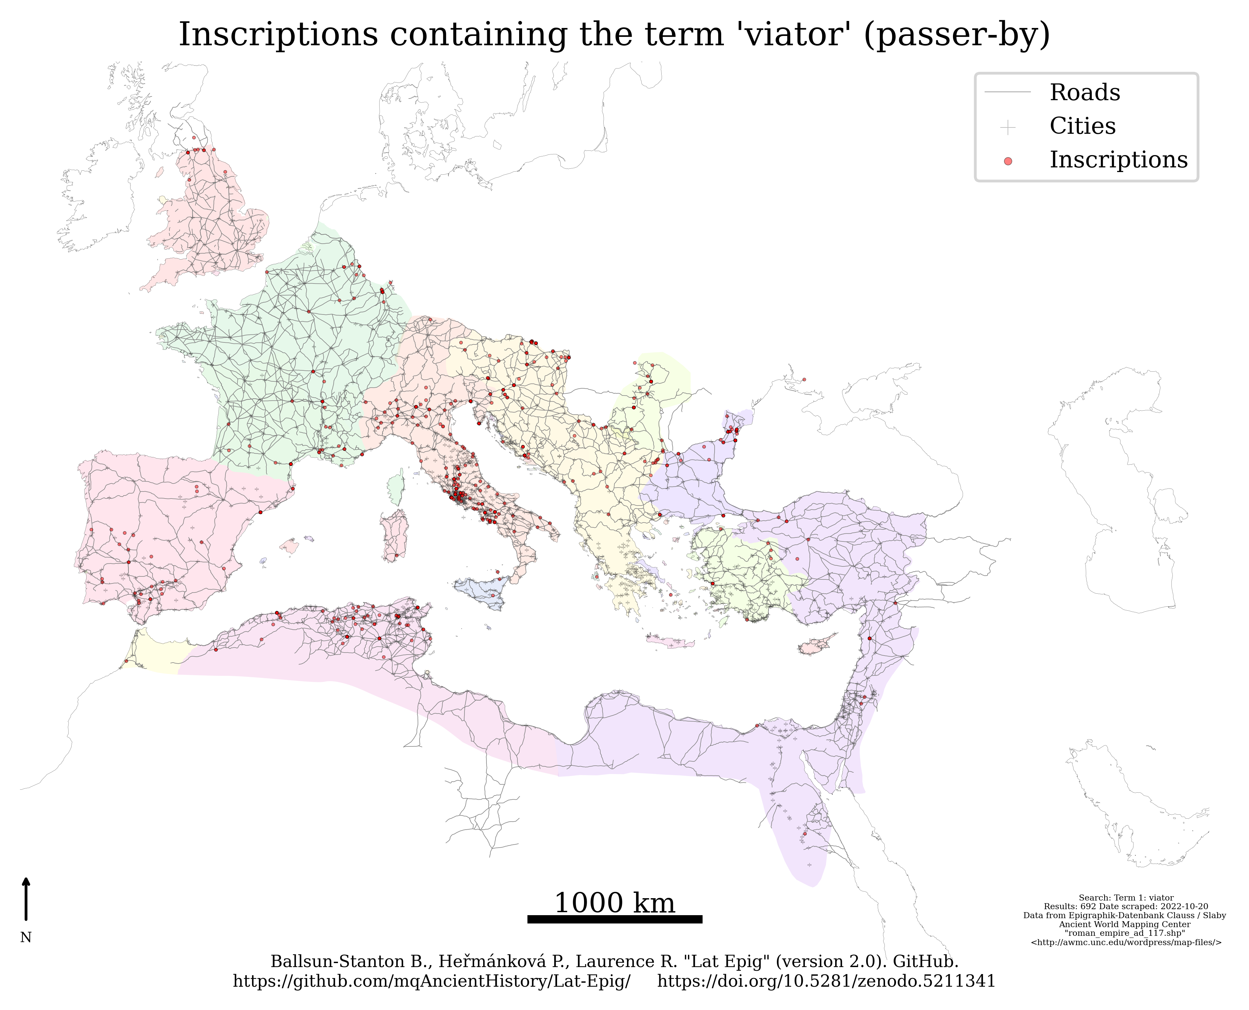
preliminary remarks

Slide 3
Distribution of inscription (language and type) from the 1st century BC to the late end of the 3rd century AD

Slide 4

Distribution of dated tituli sepulcrales between the 1st century BC and the end of the 3rd century AD
Undated funerary inscriptions from Rhegium
CIL X, 8 | D(is) M(anibus) | C(aio?) C(- - -) Nou|an(o?) E(- - -) N[- - -] | O(- - -) T(- - -) F(- - -) LṾ[- - -]||cica co(n)|iu<g>i be[ne] | [merenti(?)] | [- - -].
CIL X, 9 | D(is) M(anibus) | Epagatus uix(it) | a(n)nis LXX Limen | conservo pie|tatis fecit.
CIL X, 10 | D(is) M(anibus) | Sex(tus) Fabius Cels[us uix(it)] | [a]nnis XXVIIII mens(ibus) Ṿ | die{m} I parentes et || fratres piissimo fecer^{unt}.
CIL X, 14 | [- - -]ianus | [- - -]oraie | [- - -] pater | [- - -]re || [- - -]p.
CIL X, 8339b | Neri[- - -] | uixit annis | LXXX m(ensibus) IIII fe|cit Asyll[- - -] || [pa]tri dulcissim[o].
CIL X, 8339c | D(is) M(anibus) | Chresimion | uix(it) ann(os) III | mens(es) III dies || III parentes | filio piissimo.
Ephemeris Epigraphica VIII, 249 | Hyginu[s] | [si]ḅi et | [- - -].
Ephemeris Epigraphica VIII, 837 | Clodi Prisci | [- - -]ỌC[- - -].
Suppl. It. 5, Regium Iulium 32 | - - - - - - | [- - - filiae piis- vel amantis- vel caris-]|simạ[e, quae uixit ann(is)] | XXV, m[ens(ibus) - - -], || mater (hereda) [fecit].

Slide 5
J.N. Adams’ typology of bilingual texts, revised by A. Mullen (2013), p. 84
Adams | 1 Bilingual texts | 2 Texts implicitly reflecting bilingual situations | 3 Mixed-language texts | 4 Transliterated
 | Two separate parts in different languages and ‘a content which is usually, at least in part, common to both’ | ‘An “implicitly bilingual” text is on the face of it in a single language, but there is reason to think that another language played a part in its formation’ | Texts showing any form of code-switching or code-mixing | Composed in language A, but the script is that of language B
Revised | 1 Bi- (/ tri-) version bi- (/ tri-) lingual texts | 2 Texts displaying bilingual phenomena | 3 Mixed-language texts | 4 Transliterated texts
 | As above (plus specification of number of versions and languages) | Composed in language A, but showing interference/code-switching/ borrowing from language B | 3a Written in genetically mixed languages or 3b codes that are so mixed that it is impossible to identify the dominant language | As above. Can involve texts displaying bilingual phenomena or bi-version bilingual texts

Slide 6
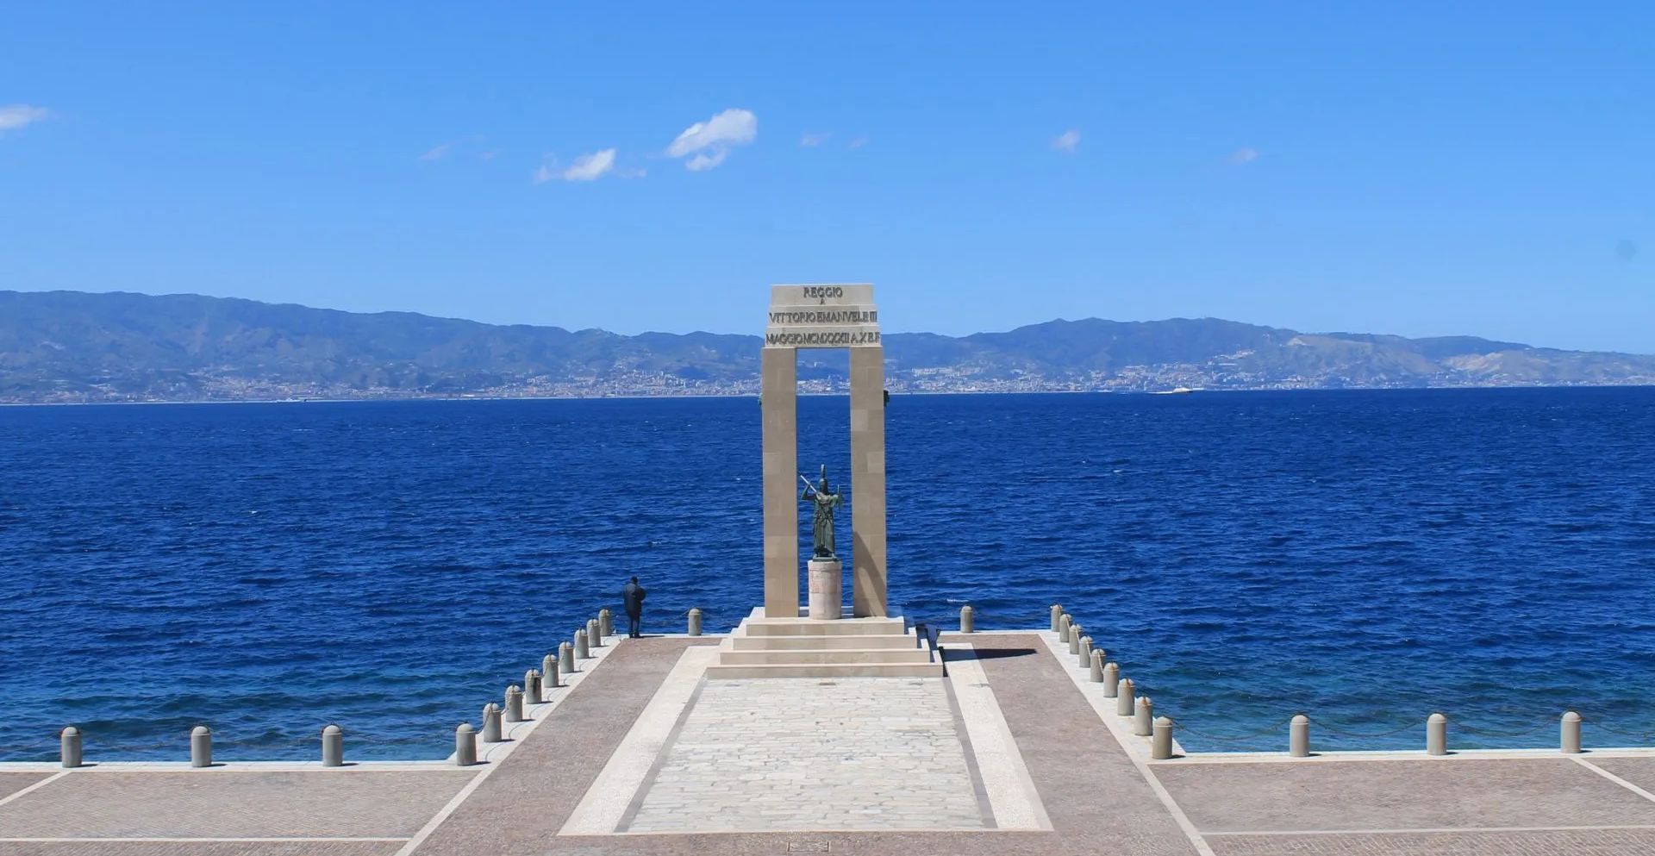
Ancient Reggio Calabria
in context

Slide 7
Strabo’s testimony
Strabo, VI.1.6: Πομπήιον δ᾿ ἐκβαλὼν τῆς Σικελίας 〈ὁ〉 Σεβαστὸς Καῖσαρ, ὁρῶν λειπανδροῦσαν τὴν πόλιν, συνοίκους ἔδωκεν αὐτῇ τῶν ἐκ τοῦ στόλου τινάς, καὶ νῦν ἱκανῶς εὐανδρεῖ.
Augustus Caesar, after ejecting Pompeius from Sicily, seeing that the city was in want of population, gave it some men from his expeditionary forces as new settlers, and it is now fairly populous.
(Trad. H.L. Jones, 1924, LCL.)

Slide 8
Distribution of Rhegium’s dated inscriptions between the 6th century BC and the end of the 5th century AD
“However, […] when explaining the development of the epigraphic culture in Rome, Italy, and the coastal regions of the western Mediterranean (the ‘core area’) […] during the first to third centuries ce, a key factor emerges: the precocity and intensity of the integration of different communities in the Roman civic body
—that is, Roman citizenship” (Beltrán 2023, p. 41).

Slide 9
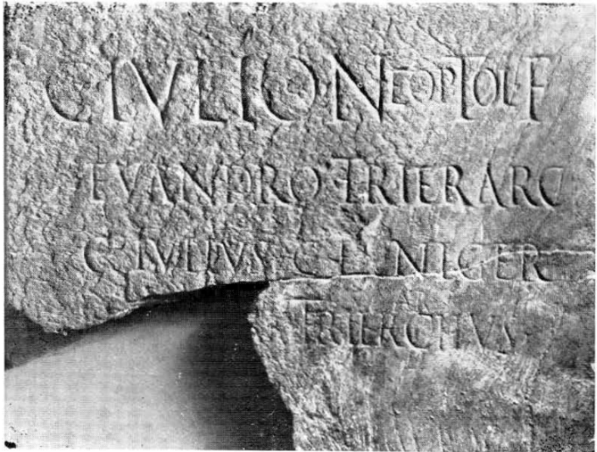
Strabo’s testimony
Strabo, VI.1.6: Πομπήιον δ᾿ ἐκβαλὼν τῆς Σικελίας 〈ὁ〉 Σεβαστὸς Καῖσαρ, ὁρῶν λειπανδροῦσαν τὴν πόλιν, συνοίκους ἔδωκεν αὐτῇ τῶν ἐκ τοῦ στόλου τινάς, καὶ νῦν ἱκανῶς εὐανδρεῖ.
“Augustus Caesar, after ejecting Pompeius from Sicily, seeing that the city was in want of population, gave it some men from his expeditionary forces as new settlers, and it is now fairly populous.”
(Trad. H.L. Jones, 1924, LCL.)
© Buonocore 1989
27 BC to 14 AD.
C(aio) Iulio Neoptol(emi) f(ilio)
Euandro trierarc(ho)
C(aius) Iulius C(ai) f(ilius) Niger
trier`ar´chus.
Suppl. It. 5, Regium Iulium 17.

Slide 10
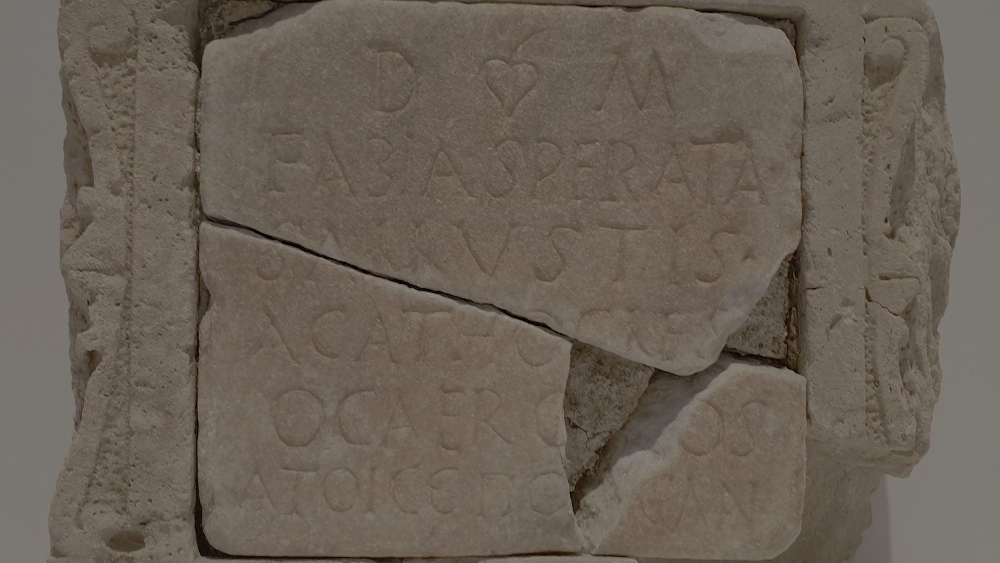
Greek and Roman
cultural spheres
in contact
© Museo Archeologico Nazionale Reggio Calabria 2021

Slide 11
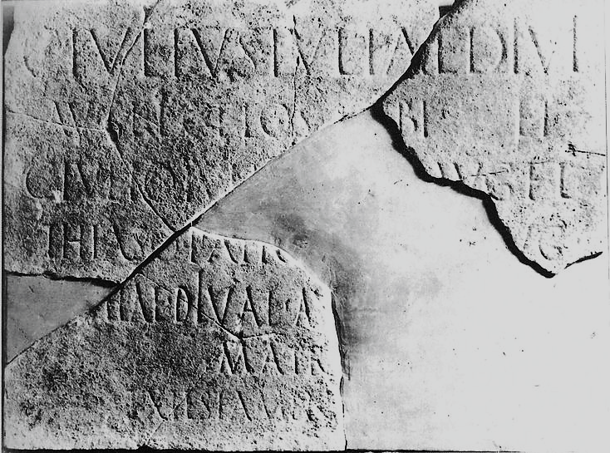
Greek and Roman cultural spheres in contact: naming practices
Mixed names: “use of names from different linguistic groups within one formula” (Mullen 2013, p. 136).
Latin inscriptions
© Buonocore 1989
© Buonocore 1989
42 to 70 AD.
C̣. Iulius Iuliae diui
Aug(usti) f(iliae) l. Gelos [si]bi et
C̣. Iulio Iuḷị[ae diui] Aug(usti) f(iliae) l.
Thiaso paṭṛ[i seuir(o) A]ug(ustali),
5 [et I]ụliae diuai (!) Aụ[g(ustae) l. - - -]
matr[i],
ex testamen[to f(ieri) i(ussit)].
Suppl. It. 5, Regium Iulium 16.
27 BC to 14 AD.
C(aio) Iulio Neoptol(emi) f(ilio)
Euandro trierarc(ho)
C(aius) Iulius C(ai) f(ilius) Niger
trier`ar´chus.
Suppl. It. 5, Regium Iulium 17.

Slide 12
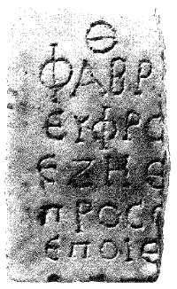
Greek and Roman cultural spheres in contact: naming practices
Mixed names: “use of names from different linguistic groups within one formula” (Mullen 2013, p. 136).
Greek inscriptions
© D’Amore 2007
© Cook 1971
2nd – 3rd c. AD.
Θ(εοῖς) [Κ(αταχθονίοις)]
Φαβρ[ικία]
Εὐφρο[σύνη]
ἔζη(σεν) ἔ[τη - - -]
5 Προσ+[- - - - - - -]
ἐποίε[ι].
IG Reggio Calabria 41.
1st c. AD.
[Πρύτ]ανις ἐκ τοῦ ἰδίου καὶ ἄρχων πεντα-
ετηρικὸς Σέξ(τος) Νουμώνιος Σέξ(του) υ(ἱὸς) Ματοῦρος·
συνπρυτάνεις Κ(όιντος) Ὀρθώριος Κ(οίντου) υ(ἱὸς) Βάλβιλλος, Μ(ᾶρκος) Πετρώ-
νιος Μ(άρκου) υ(ἱὸς) Ποῦλχερ, Μ(ᾶρκος) Κορνήλιος Μ(άρκου) υ(ἱὸς) Μαρτιᾶλις·
5 ἱεροσκόποι Μάνιος Κορνήλιος Οὐῆρος, Γ(άιος) Ἀντώνιος
Θύτης· ἱεροσαλπιστὴς Γ(άιος) Ἰούλιος Ῥηγῖνος· ἱεροκῆ(ρυξ)
Γ(άιος) Καλπούρνιος Οὐῆρος· ἱεροπαρέκτης Κ(όιντος) Καικίλιος
Ῥηγῖνος· ταμίας Μελίφθονγος Ματούρου· σπονδαύλης
Νατᾶλις. Καπναύγης Ἑλίκων Ματοῦρου. Μάγιρος Ζώσιμος. ❦
IG Reggio Calabria 8.

Slide 13
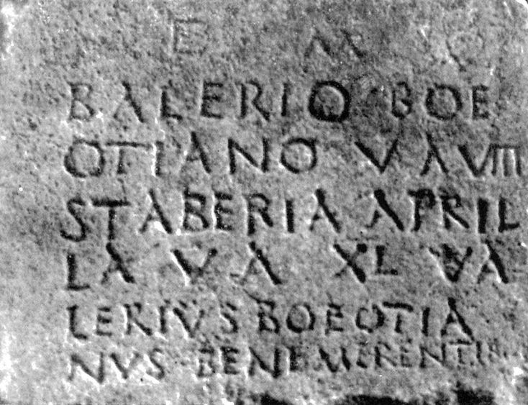
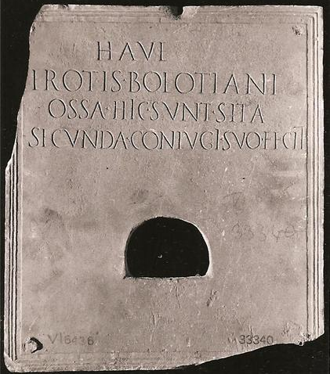

Greek and Roman cultural spheres in contact: naming practices
Hybrid names: less common than mixed names, the use of elements from more than one language within a single name (Mullen 2013, p. 136).
© Buonocore 1989
© Museo Nazionale Romano 2012
2nd – 3rd c. AD.
D(is) M(anibus) ❦
Balerio (!) Boe-
otiano u(ixit) a(nnos) $\overline{VIII}$
Staberia April-
5 la u(ixit) a(nnos) $\overline{XL}$ Va-
lerius Boeotia-
nus bene merentib(us).
Suppl. It. 5, Regium Iulium 27.

Slide 14
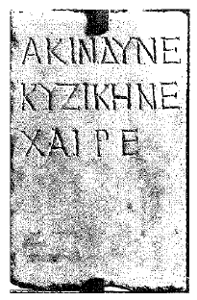
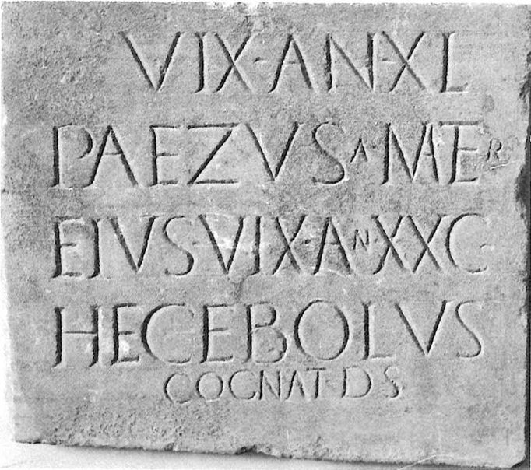
Greek and Roman cultural spheres in contact: naming practices
© D’Amore 2007
The epitaph of Akindynos stresses the role of Rhegium as a stopover before Pozzuoli:
Suetonius, Diuus Titus 5:
Quare festinans in Italiam, cum Regium, dein Puteolos oneraria naue appulisset, Romam inde contendit expeditissimus.
“Because of this he hastened to Italy, and putting in at Regium and then at Puteoli in a transport ship, he went with all speed from there to Rome.”
(Trad. J.C. Rolfe, 1914, LCL.)
© Buonocore 1989
Early imperial period.
- - - - - -
uix(it) an(nis) XL,
Paezusa mater
eius uix(it) an(nis) XXC,
Hecebolus
5 cognat(us) d(e) s(uo).
Suppl. It. 5, Regium Iulium 23.
2nd – 3rd c. AD.
Ἀκίνδυνε
Κυζικηνέ,
χαῖρε.
IG Reggio Calabria 37.

Slide 15
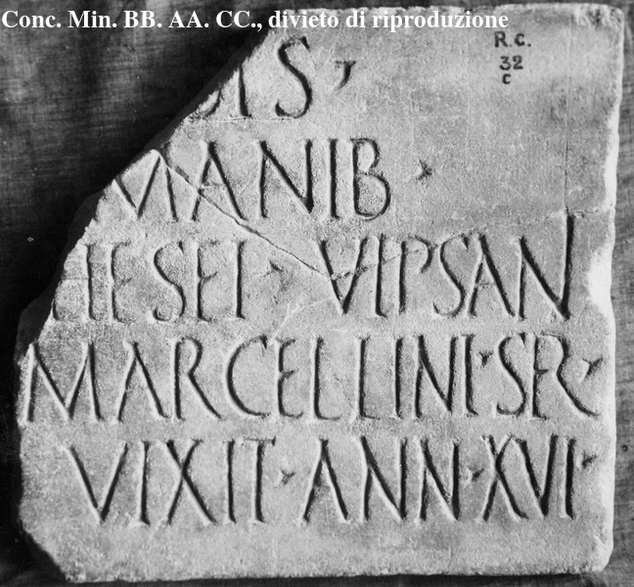
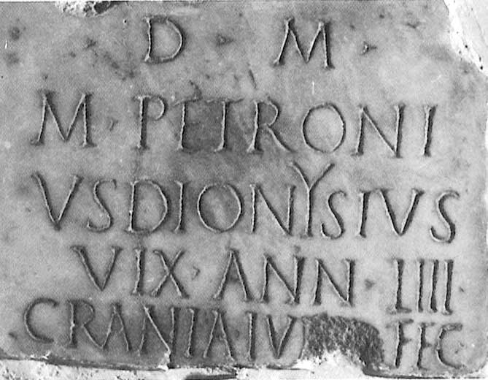

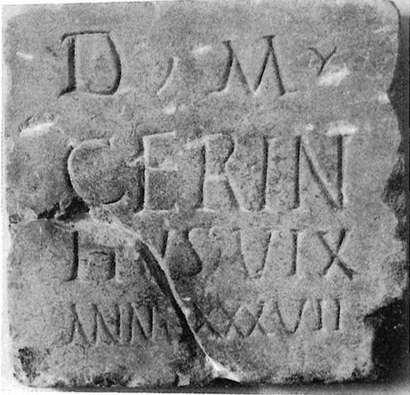
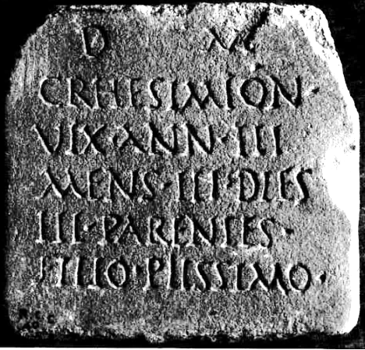
Greek and Roman cultural spheres in contact: formulaic material
“Dis Manibus” formula: 15 inscriptions out of 31 display the dedication to the Manes (Dis Manibus or Θεοῖς Καταχθονίοις).
Latin “DM” or “Dis Manib”
Greek “ΘΚ”
© Museo Archeologico Nazionale Reggio Calabria
© Buonocore 1989
© D’Amore 2007
© D’Amore 2004
2nd half of the 1st c. AD. (CIL X, 12.)
2nd c. AD. (Suppl. It. 5, Regium Iulium 25.)
© Buonocore 1989
© Museo Archeologico Nazionale Reggio Calabria
2nd – 3rd c. AD. (IG Reggio Calabria 41.)
2nd – 3rd c. AD. (IG Reggio Calabria 36.)
Cf. Lucia D’Amore, “Epigramma greco inedito nel Museo Archeologico Nazionale di Reggio Calabria”, ZPE 148 (2004), p. 81-84.
2nd c. AD. (Suppl. It. 5, Regium Iulium 21.)
Imperial period. (CIL X, 8339c.)

Slide 16
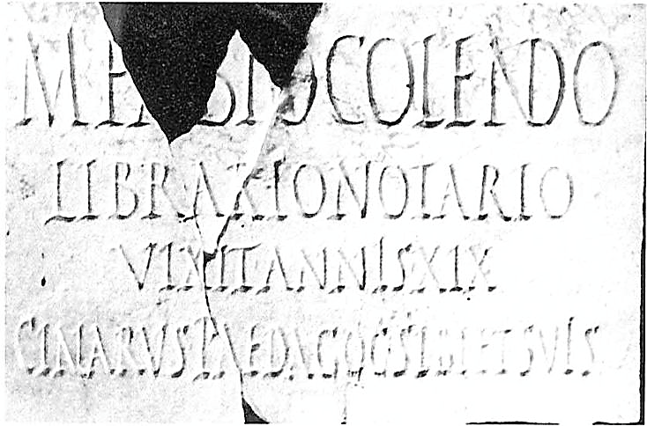
Greek and Roman cultural spheres in contact: formulaic material
“Dis Manibus” formula: 15 inscriptions out of 31 display the dedication to the Manes (Dis Manibus or Θεοῖς Καταχθονίοις).
Age of the deceased: - “uixit annos”.
- Greek translation “ἔζησεν ἔτη”.
- In 4 out of the 7 Greek inscriptions.
The name of the deceased is more often in the nominative case when “uixit annos” is used.
3 exceptions :
© Buonocore 1989
© Buonocore 1989
© Museo Archeologico Nazionale Reggio Calabria
2nd – 3rd c. AD. (Suppl. It. 5, Regium Iulium 27.)
End of the 2nd c. AD. (Suppl. It. 5, Regium Iulium 18.)
2nd half of the 1st c. AD. (CIL X, 12.)

Slide 17
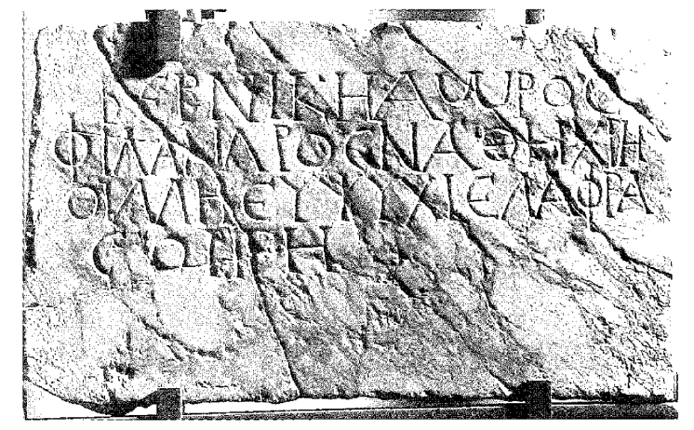
Greek and Roman cultural spheres in contact: formulaic material
l. 1: - The name Bernikē pinpoints to an origin in the Hellenized East.
- The lady died “untimely” (ἄωρος).
l. 2-3: - Epithets common in epitaphs when qualifying a woman.
- Multiple errors suggesting a limited familiarity with Greek.
l. 3: - “εὐψύχι” for “εὐψύχει”, a consolatory formula especially popular in Roman Egypt (Leiwo 1994, p. 108).
l. 3-4: - “ἐλαφρά σοι γῆ” : a translation of the Latin formula “(sit) tibi terra leuis”.
© D’Amore 2007
2nd – 3rd c. AD.
ΒΕΡΝΙΚΗ ΑꞶΡΟϹ Βερνίκη ἄωρος
ΦΙΛΑΝΛΡΟϹ ΝΑΘΗ ΧΡΗ φίλαν〈δ〉ρος 〈ἀγ〉αθὴ χρη-
ΟΙΜΗ ΕΥΨΥΧΙ ΕΛΑΦΡΑ 〈σ〉ίμη εὐψύχι ἐλαφρά
ϹΟΙ ΓΗ σοι γῆ.
IG Reggio Calabria 39.

Slide 18
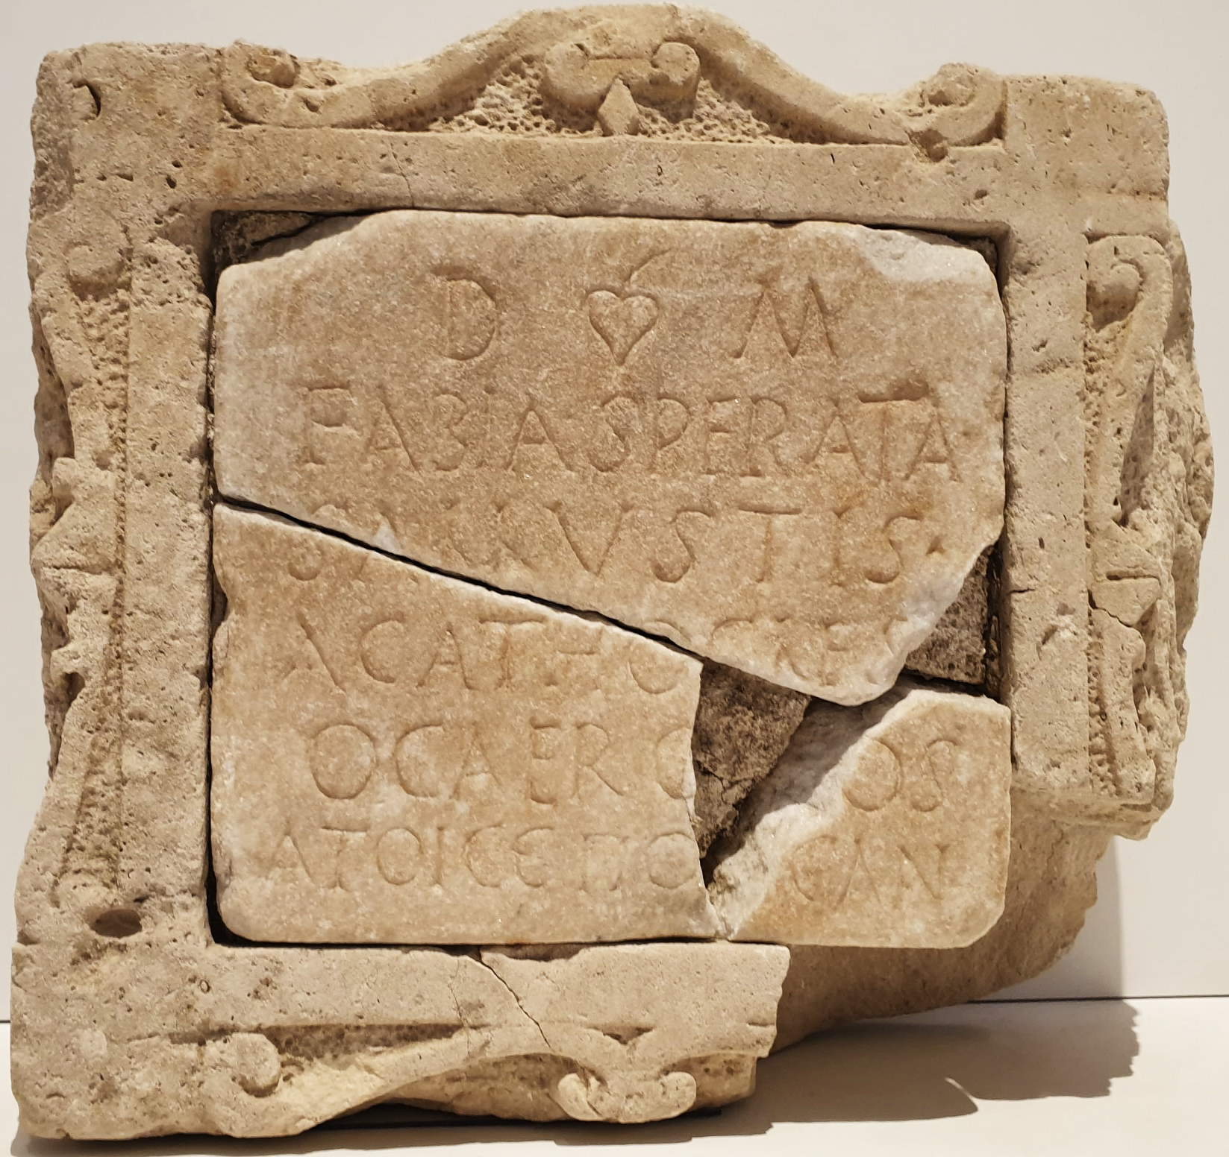
The case of Fabia Sperata and Sallustis Acathocles
© Museo Archeologico Nazionale Reggio Calabria 2021
2nd – 3rd c. AD.
D(is) ❦ M(anibus)
Fabia Sperata
Sallustis
Acathocles
5 o cae Ro[di]os
ἁτοῖς ἐπό[η]σαν.
IG Reggio Calabria 38.

Slide 19
The case of Fabia Sperata and Sallustis Acathocles
© Museo Archeologico Nazionale Reggio Calabria 2021
2nd – 3rd c. AD.
D(is) ❦ M(anibus)
Fabia Sperata
Sallustis
Acathocles
5 o cae Ro[di]os
ἁτοῖς ἐπό[η]σαν.
IG Reggio Calabria 38.
© Buonocore 1989
2nd c. AD. (Suppl. It. 5, Regium Iulium 25.)

Slide 20
The case of Fabia Sperata and Sallustis Acathocles
© Museo Archeologico Nazionale Reggio Calabria 2021
2nd – 3rd c. AD.
D(is) ❦ M(anibus)
Fabia Sperata
Sallustis
Acathocles
5 o cae Ro[di]os < ὁ καὶ Ῥόδιος
ἁτοῖς ἐπό[η]σαν.
IG Reggio Calabria 38.
Imperial period.
D(is) M(anibus)
Epagatus uix(it) < Ἐπάγαθος
a(n)nis LXX Limen
conseruo pie-
5 tatis fecit.
CIL X, 9.

Slide 21
Conclusion
© Museo Archeologico Nazionale Reggio Calabria 2021

Slide 22
Conclusion
Latin is the most represented language of the tituli sepulcrales, but:
  A possible survival bias.
  Maintenance of Greek through time (function: stressing an identity?).
  Names evoking the Greek East or, at least, Hellenized individuals.
Funerary formulae are…
  Testimonies of contact between languages. Ex. :
    Θεοῖς Καταχθονίοις < Dis Manibus.
    ἔζησεν ἔτη < uixit annos.
    ἐλαφρά σοι γῆ < (sit) tibi terra leuis.
  Testimonies of a relative fluidity in blending Greek and Latin elements. Ex. :
    Epitaph of Βερνίκη (IG Reggio Calabria 39).
    Epitaph of Fabia Sperata and Sallustis Acathocles (IG Reggio Calabria 38).
Naming practices…
  Provide example of foreigners, far from their home, and displaying their Eastern origins.
  Stress the role of Rhegium as a stopover for the travellers moving from East to West.

Slide 23
Selected bibliography
Adams J.N., Bilingualism and the Latin Language, Cambridge, 2003.
Adams J.N., “Romanitas’ and the Latin Language”, CQ 53-1 (2003), p. 184-205.
Beltrán Fr., “Latinization, Citizenship, and the Epigraphic Habit”, in Mullen A. (ed.), Social Factors in the Latinization of the Roman West, Oxford, 2023, p. 24-50.
Biville Fr., “Situations et documents bilingues dans le monde gréco-romain”, in Biville Fr. et alii (ed.), Bilinguisme gréco-latin et épigraphie, Lyon, 2008, p. 35-53.
Consani C., “The Greek of Italy between archaism, internal evolution and contact phenomena”, Graeco-Latina Brunensia 2 (2016), p. 99-115.
Cordano F., “Epigrafia greca nell’Italia romana”, in Urso G. (ed.), Patria diversis gentibus una ? Unità politica e identità etniche nell’Italia antica, Pisa, 2008, p. 63-72.
D’Amore L., “Aspetti linguistici e onomastici nella documentazione epigrafica di Rhegion dall’arcaismo all’età bizantina”, Linguarum Varietas 7 (2018), p. 75-94.
Kaimio J., The Romans and the Greek Language, Helsinki, 1979.
Kajanto I., Supernomina. A study in Latin epigraphy, Helsinki, 1966.
Leiwo M., Neapolitana: A Study of Population and Language in Graeco-Roman Naples, Helsinki, 1994.
Leiwo M., “From Contact to Mixture: Bilingual Inscriptions from Italy”, in Adams J.N. et alii (ed.), Bilingualism in Ancient Society, 2002, p. 168-194.
Mosino F., “Il più antico testo grecanico della Calabria (CIL X, 11)”, Klearchos 22 (1980), p. 111-115.
Mosino F., “Profilo culturale di Reggio greca e romana”, in Gentili B., Pinzone A. (ed.), Messina e Reggio nell’antichità: storia, società, cultura, Messina, 2002, p. 311-320.
Mullen A., Southern Gaul and the Mediterranean: Multilingualism and Multiple Identities in the Iron Age and Roman Periods, Cambridge, 2013.
Poccetti P., “Impoliteness among slaves: An epigraphic evidence for insults from a Graeco-Roman bilingual context of Southern Italy”, Veleia 39 (2022), p. 157-172.

