Slide 1

Validation of Calcein Violet as a marker of Apis mellifera semen viability in flow cytometry : preliminary results.
APIMONDIA 2023 – SANTIAGO CHILE
S EGYPTIEN, F. BRUTINEL, B. DEWALS, S. DELEUZE
Fundamental and Applied Resarch for Animal Health Research Unit University of Liège, Belgium

Slide 2
Context
Improving cryopreservation
Evaluation after insemination
  Time consuming
  Planning
  Environmental influence: season length, queen loss
In vitro evaluation
  Immediate answer
  Repeatability
  No season limitation for evaluation: winter ok

Slide 3
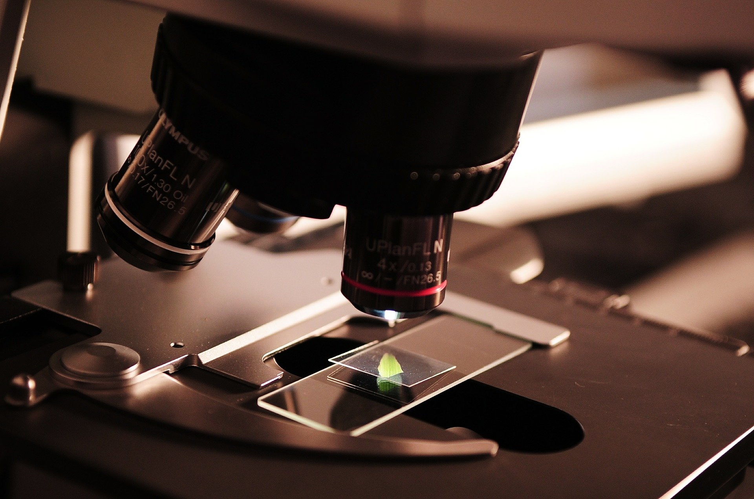
In vitro semen evaluation
Mammals:
  Parameters
  Modern techniques : fluorochrome dyes
  Multi-parameter analysis
Drone semen analysis: not much described
  Review Sperm Quality Assessment in Honey Bee Drones. Biology 2020,9,174
  Motility
  Viability :
    SYBR14 + PI fluorochromes
    Calcein Violet
Egyptien S., et al. Animals 2023, 13, 1874. https://doi.org/10.3390/ani13111874

Slide 4
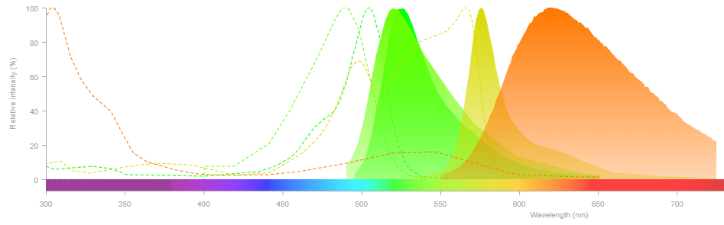
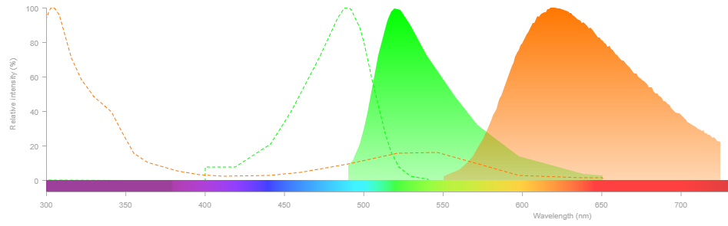
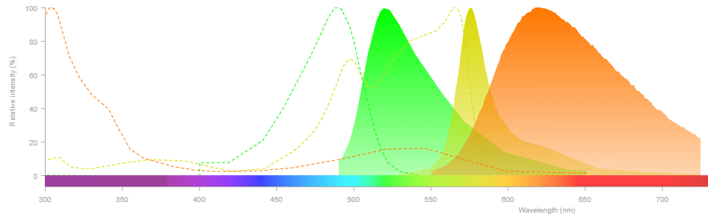
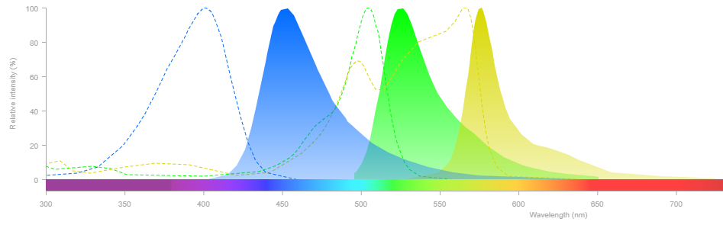
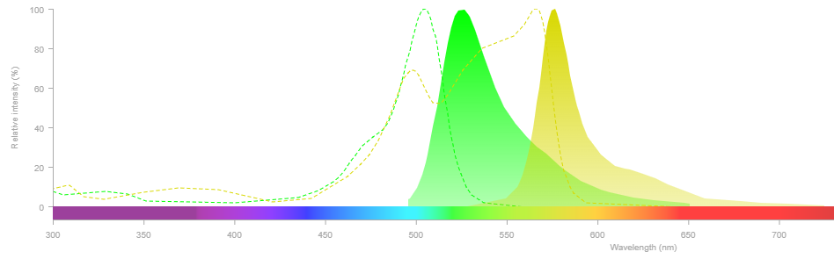

Multiple parameter sperm analysis
Small sample volume ➔ 1 sample - several parameters!
Several parameters robustness of analysis
!! Spectral overlapping !!
Acrosomal Status + ROS
Viability + Acrosomal Status + ROS
Viability + Acrosamal Status
Viability + Acrosomal Status + ROS
Viability
DCF
DCF
DCF
SYBR
PI
CaV
SYBR
PE
PI
PE
SYBR
PE
PI
PE

Slide 5
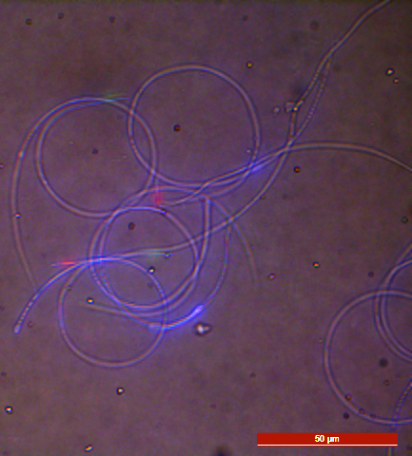

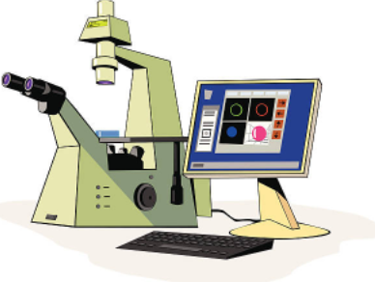

MATERIAL AND METHODS
1. Validation of CaV using Serial staining combinations and dead controls in Epifluorescence
Live drone sperm is marked by calcein violet
Epifluorescence mandatory for validation but:
  Large sample
  Manual, 100 events
  Motility limitation
CaV -
PI +
CaV +

Slide 6

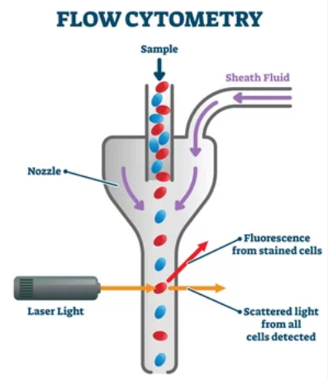
Multiple parameter sperm analysis
Analysis thousands of events in a few seconds
Several lasers ➔ several fluorochromes

Slide 7


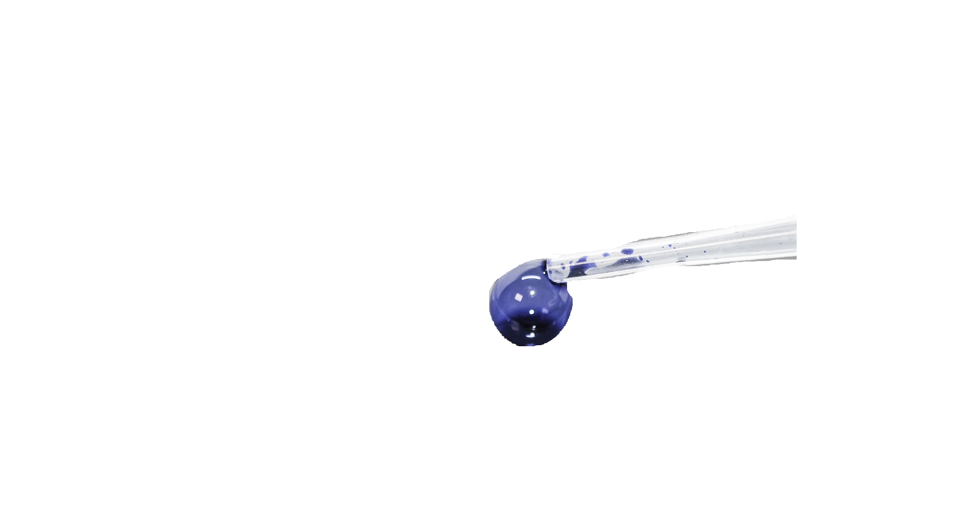
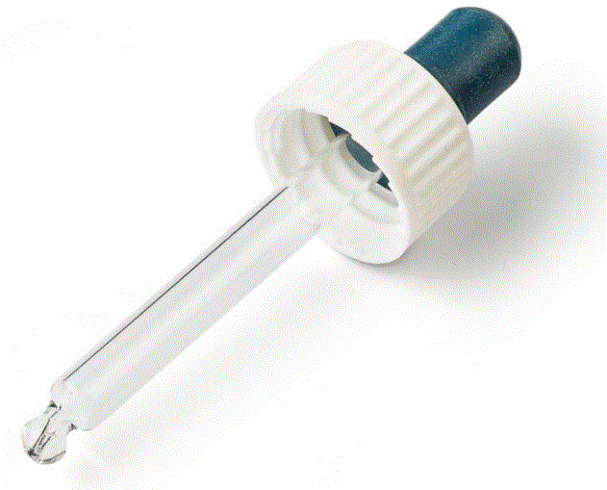
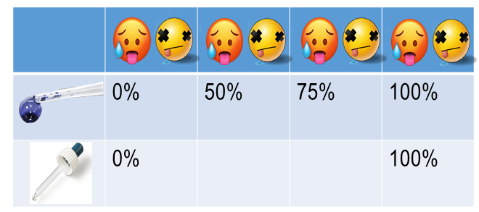
MATERIAL AND METHODS
2. Validation of CaV in Flow cytometry using dead controls
Controled percentage of dead spermatozoa in sample
Dead controls: semen heat treated for 20min at 60°C
Samples = (fresh semen + variable % of dead cells) stained or unstained

Slide 8

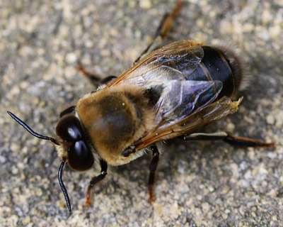
Material and MethodS
1 ) >50x
2) Semen dilution : 5 x10⁶/mL
3) Incubation
4) Flow cytometry
1.4 µM
>10min no washing

Slide 9
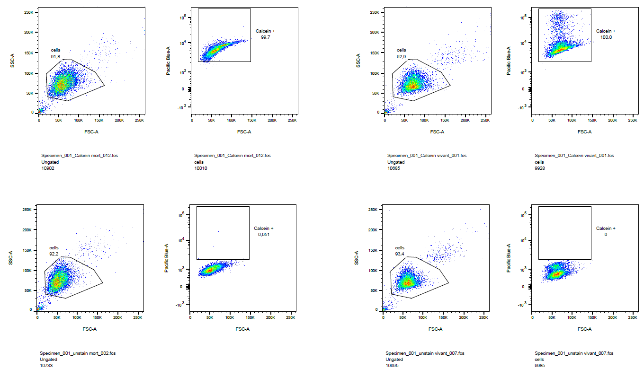

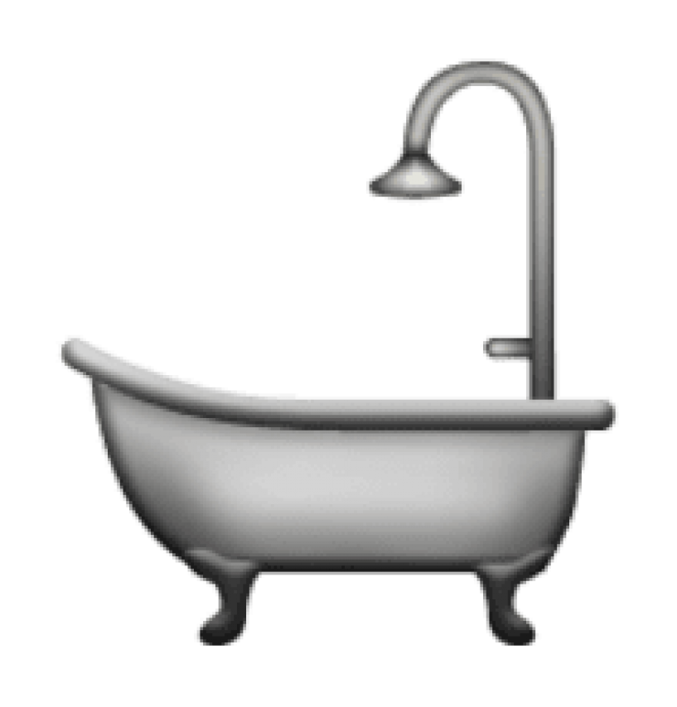
Preliminary results
100%
0%
Heat treated semen : CaV 100% +
Non treated semen: CaV 100% +
Cell wash!

Slide 10
Material and MethodS
1 ) >50x
2) Semen dilution : 5 x10⁶/mL
3) Incubation
4) Flow cytometry
1.4 µM - 10min
Washing
Resuspend in bee semen diluent

Slide 11
PreliMinary Results
0%
100%
50%
75%
65%
10%
50%
24%
2%
8%

Slide 12
discussion
2 to 8% autofluorescence (in heat treated or non treated samples)
Correction of raw data eg: 65% of positive cells in non treated samples ➔ 63% of live sperm
10% - 8% = 2% of live sperm in killed sample : Preserved mb integrity
Observed in 75% : 17.5% ⬄ 24% measured – 6.5% of autofluorescence
Expected in 75% : 17.25 %
Observed in 50% : 45 % ⬄ 50% measured – 5% of autofluorescence
Expected in 50% : 32.5 %
Statistical analysis not possible, only one sample

Slide 13

cONCLUSION
Fine tuning needed to validate the use of CaV in flow cytometry
  Automated modern technique
  Small sample volume / large number events analysis (+-30 000 cells evaluated/analysis)
Promising preliminary results
Need to validate new fluorochromes evaluating more drone semen parameters

Slide 14
cONCLUSION
Drone semen evaluation perfect solution

