Slide 1

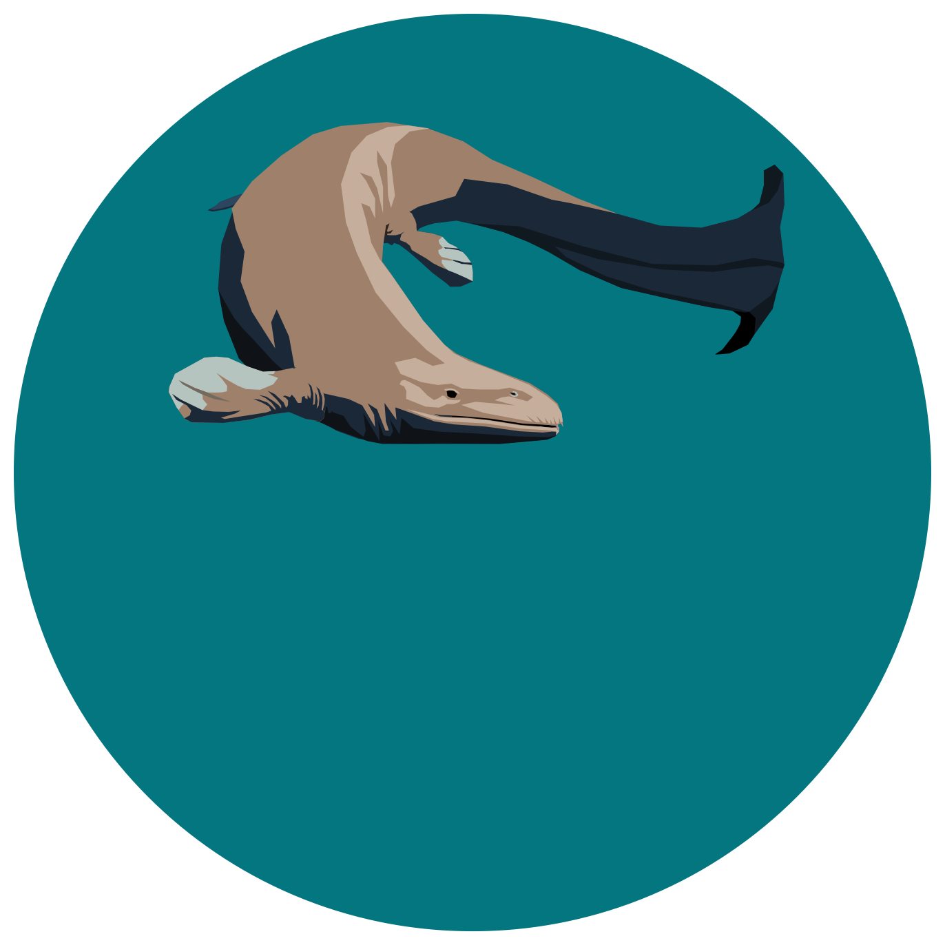




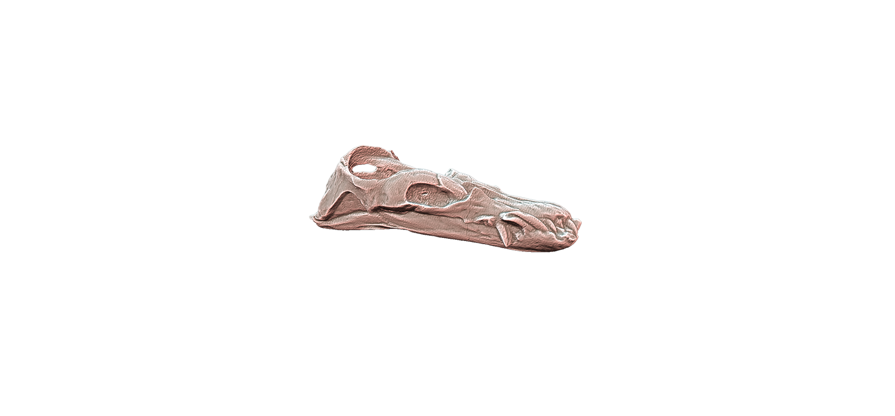
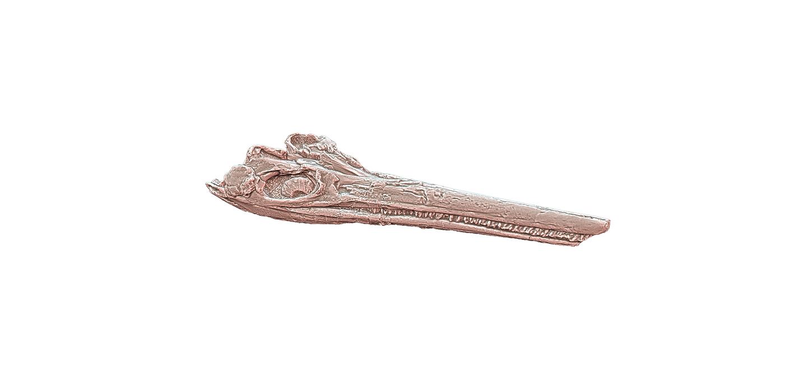




EVOLUTION &
DIVERSITY
DYNAMICS LAB
SECAD
2024
June 25 – 28th
Liège, Belgium
Contrasting macroevolutionary patterns in raptorial tetrapods across the Triassic–Jurassic transition
Antoine Laboury, Thomas L. Stubbs, Torsten M. Scheyer, Andrzej S. Wolniewicz, Jun Liu, Marc E.H. Jones, Valentin Fischer
@LabouryA
A.Laboury@uliege.be
Notes:
Dear aquatic tetrapod lovers, during the next 15 minutes, let’s go back to the very end of the Triassic to investigate how the events of that time have impacted the morphological diversification of the main raptorial predators, the ichthyosaurians and eosauropterygians.

Slide 2

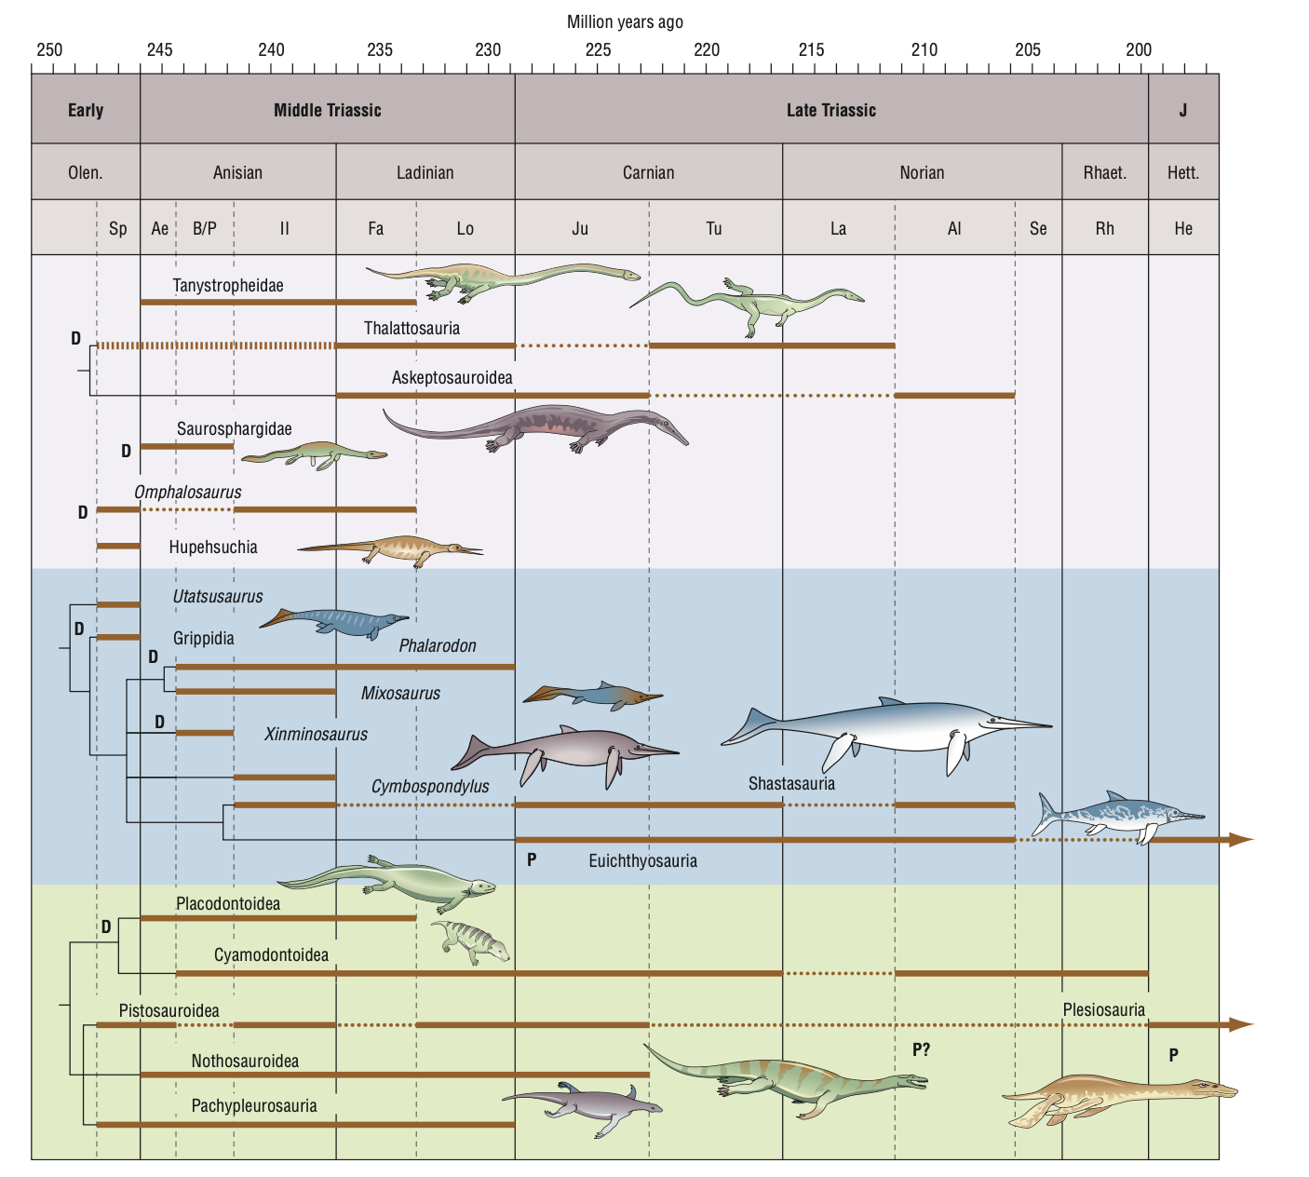
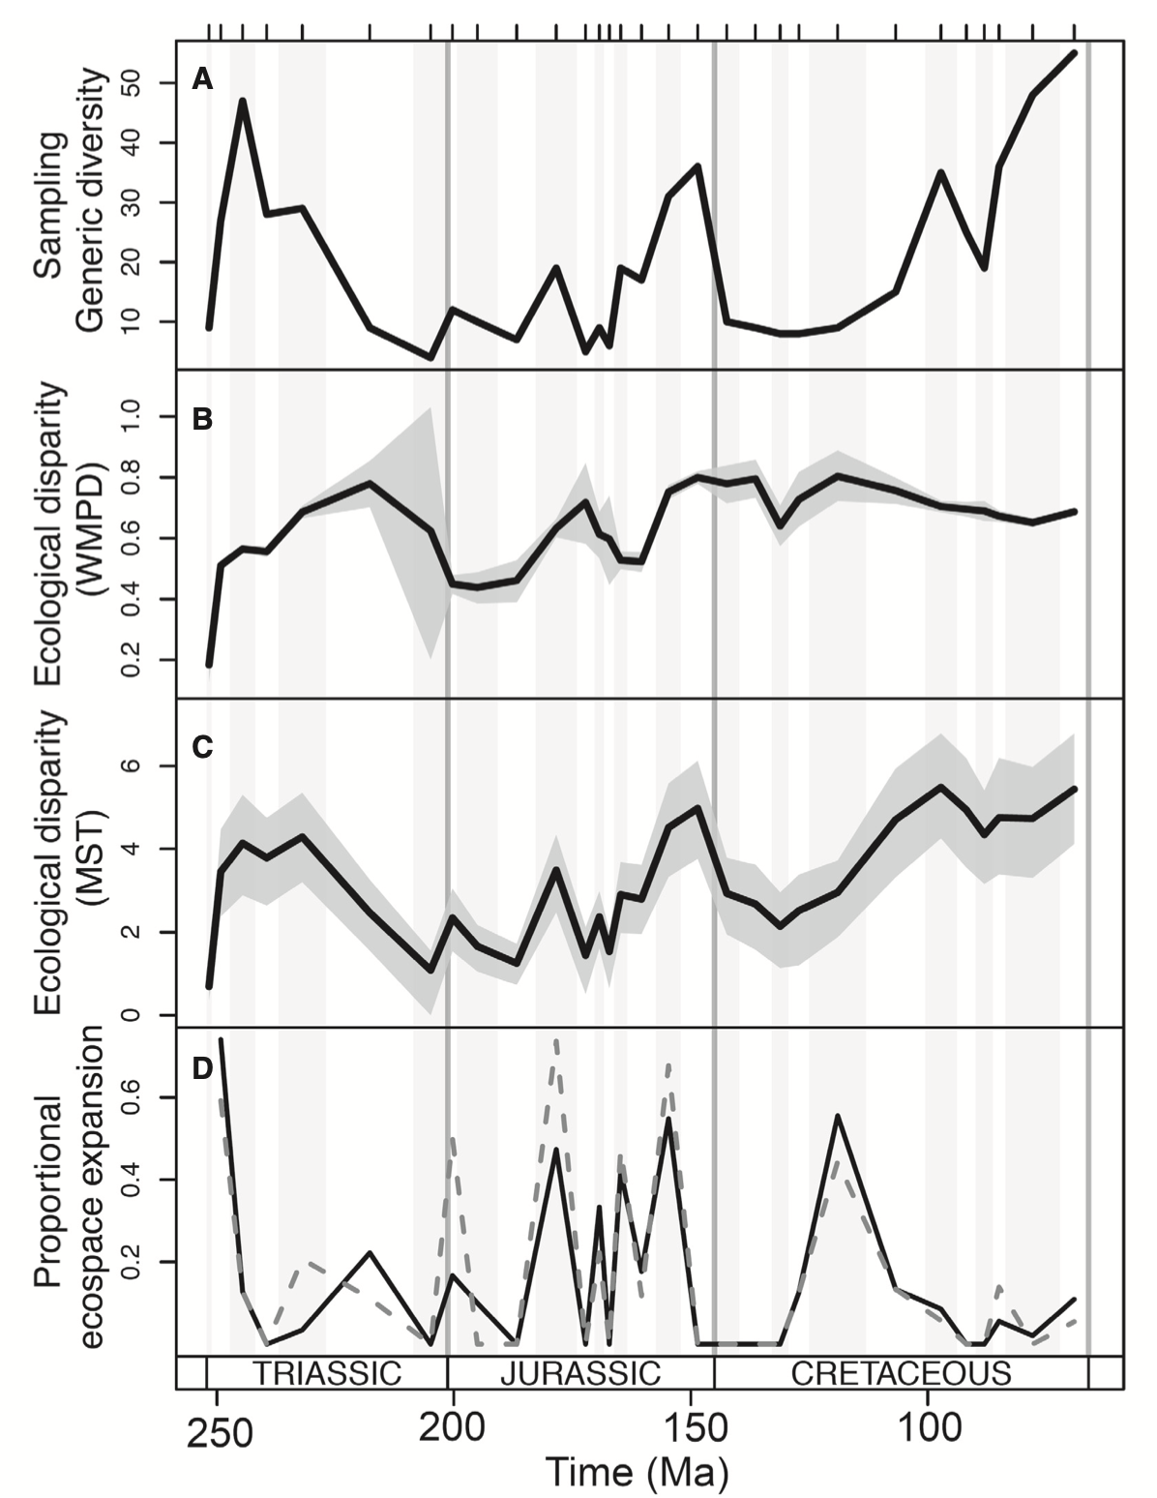
The Middle Triassic records the maximum of disparity
Benson (2013)
Reeves et al. (2021)
Notes:
Only a few millions years after the most catastrophic mass extinction at the end of the Permian, several independent lineages of reptiles rapidly invaded the marine realm.
These animals experienced a remarkable morphological diversification (one of the greatest of the whole Mesozoic) which peaked during the Middle Triassic as they explored empty or new ecological niches in shallow-water mainly in the Tethys ocean.

Slide 3
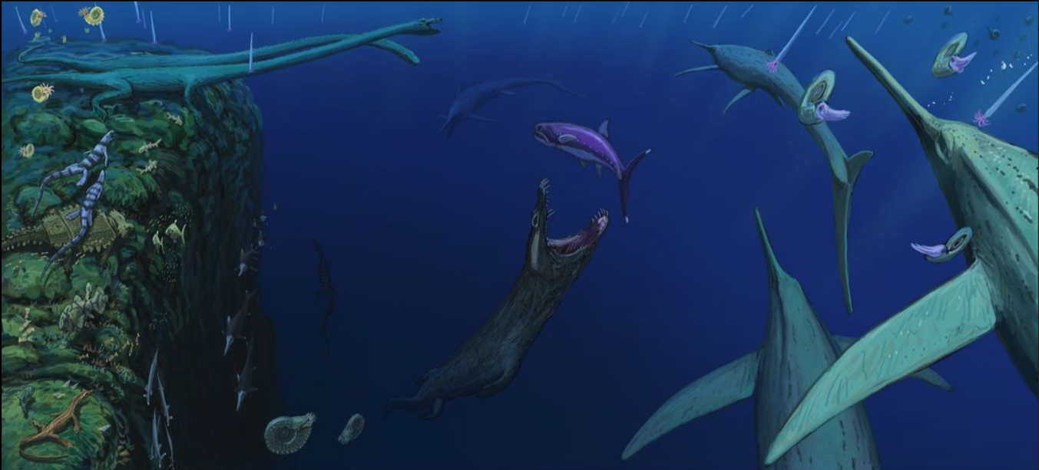
Typical marine ecosystem of the Middle Triassic
@ Joshua Knüppe
Notes:
Here’s an example of what could have been typical coastal environments during Middle Triassic. These ecosystems were populated by a large variety of marine tetrapods/reptiles

Slide 4
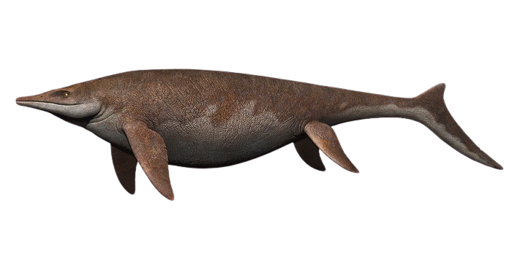
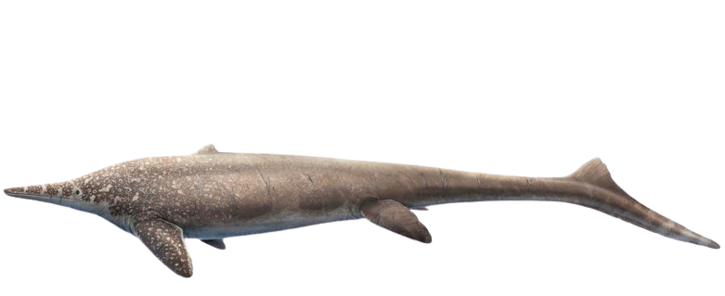
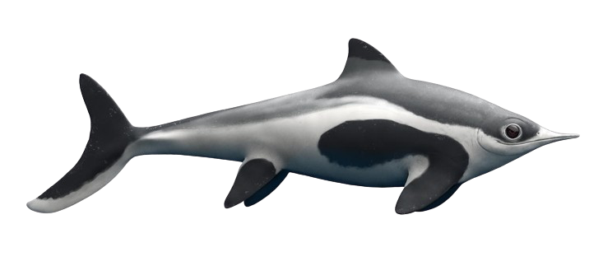
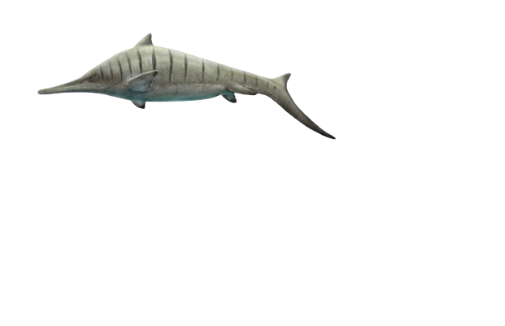
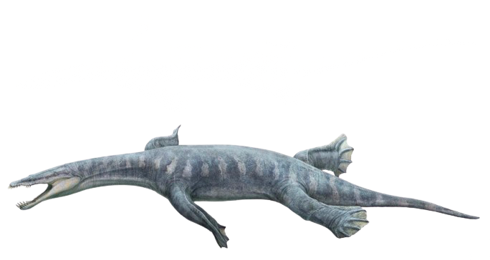
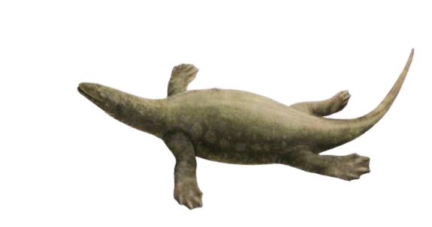
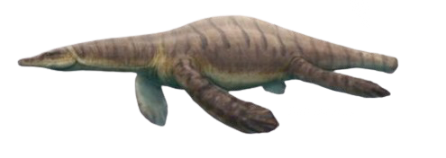
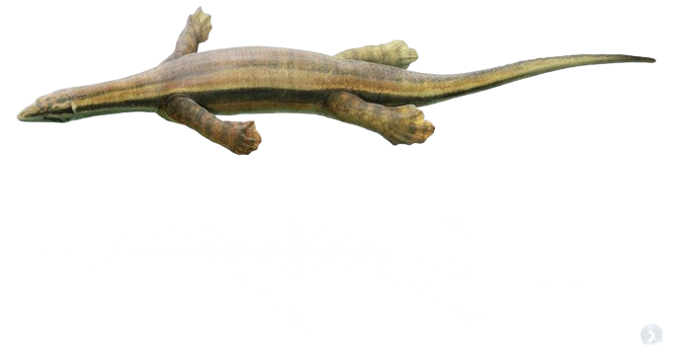
Triassic ichthyosaurians and eosauropterygians displayed a wide range of morphologies
@ Gabriele Ugueto; Andrey Atuchin
Notes:
In the seas of mostly Middle but also in the Late Triassic, ichthyosaurians and eosauropterygians became extremely diverse by evolving into very distinct body plans thus by adopting various body-size ranges, diets and swimming modes. And this, reflects the occupation of a wide spectrum of ecological niches.

Slide 5
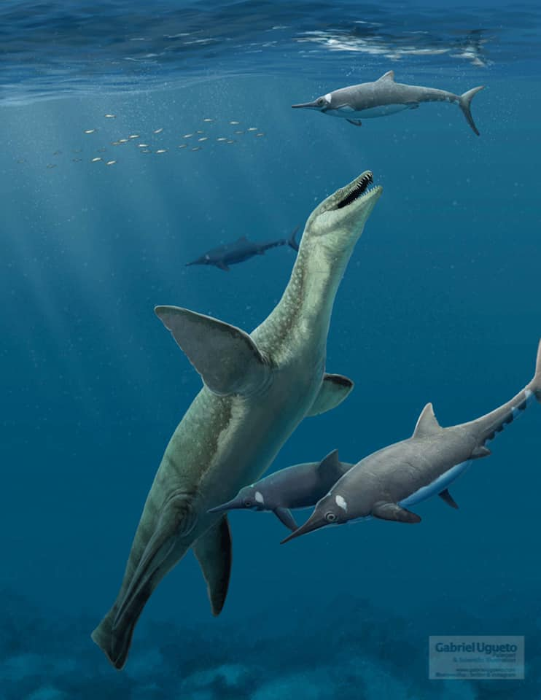
Only ichthyosaurians and eosauropterygians crossed the T/J limit
Benson (2013)
Notes:
A previously mentioned, among the whole Triassic aquatic tetrapod lineages, only these animals have crossed the Triassic – Jurassic transition and therefore survived to the end-Triassic events. However fully pelagic primitive parvipelvian ichthyosaurians and plesiosaurians of the Early Jurassic are commonly found to be significantly less disparate than their Triassic predecessors.

Slide 6
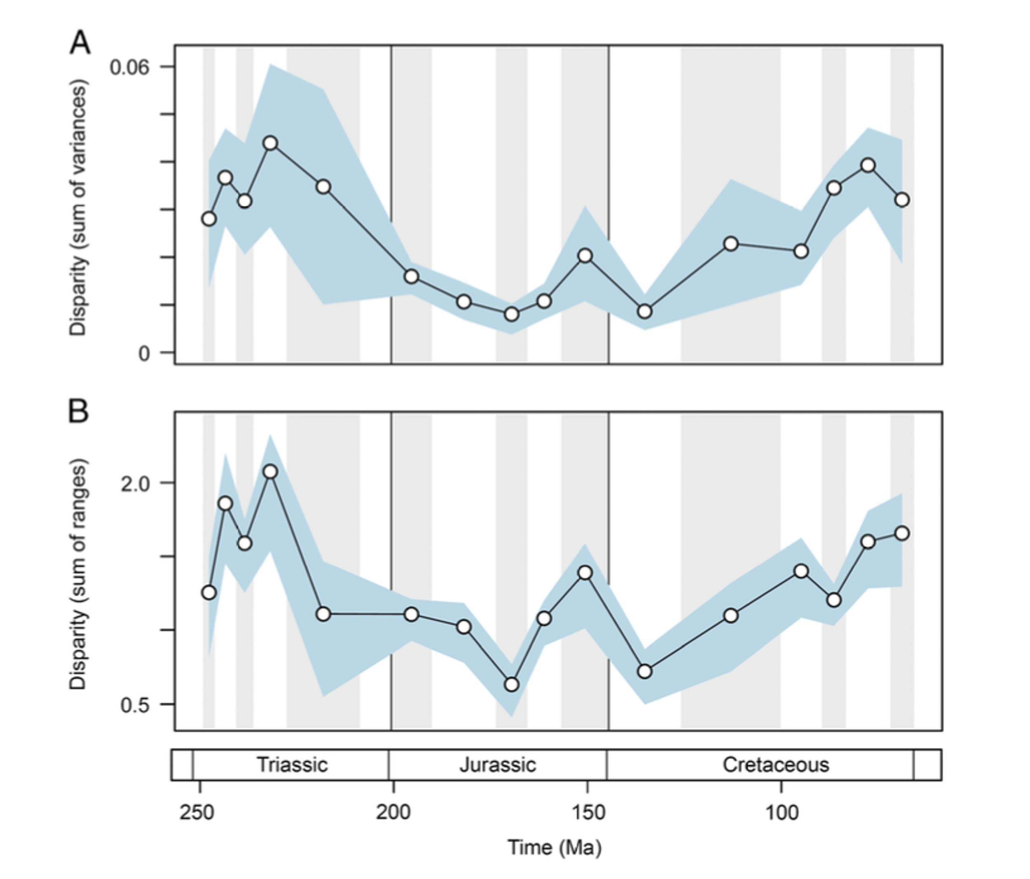
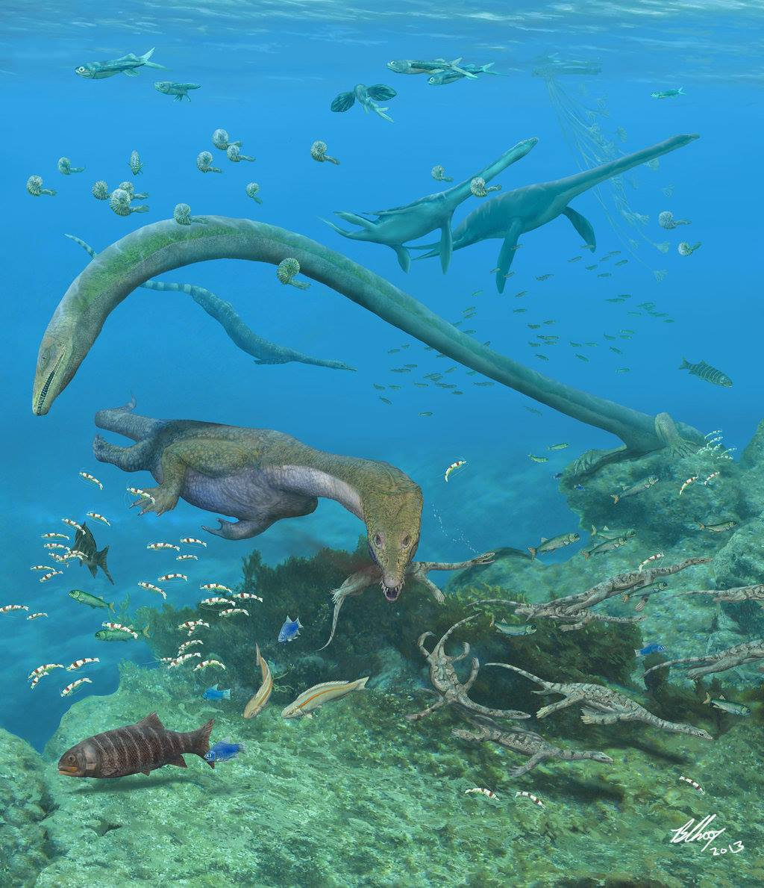

Something might happened during the Late Triassic…
Loss of coastal species during regression events
Modified from Stubbs et al. (2016)
@Brian Choo from Benton et al. (2013)
Notes:
Therefore, something have happened during the Late Triassic. Several quantitative analyses have reported huge drop in disparity during that period.
Typical Triassic coastal dwellers disappeared by the end of the Triassic and that these extinctions seems to be most likely correlated with sea regressions that led to the loss of typical shallow environments.

Slide 7
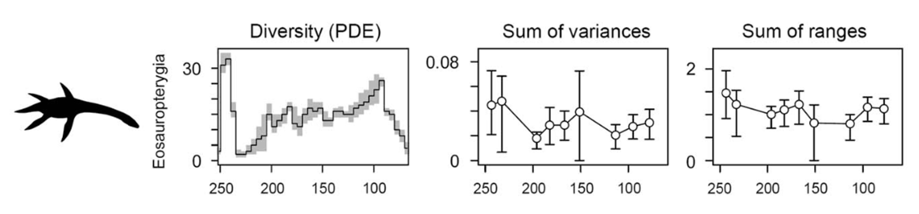
Macroevolutionary bottleneck caused by end—Triassic event?
Modified from Stubbs et al. (2016)
Notes:
It is during these events that the diversity and disparity of eosauropterygians dramatically dropped as emblematic lineages such as pachypleurosauroids, nothosauroids and primitive pistosauroids went extinct, leading to the loss of niches that were never later re-occupied by plesiosaurians.

Slide 8
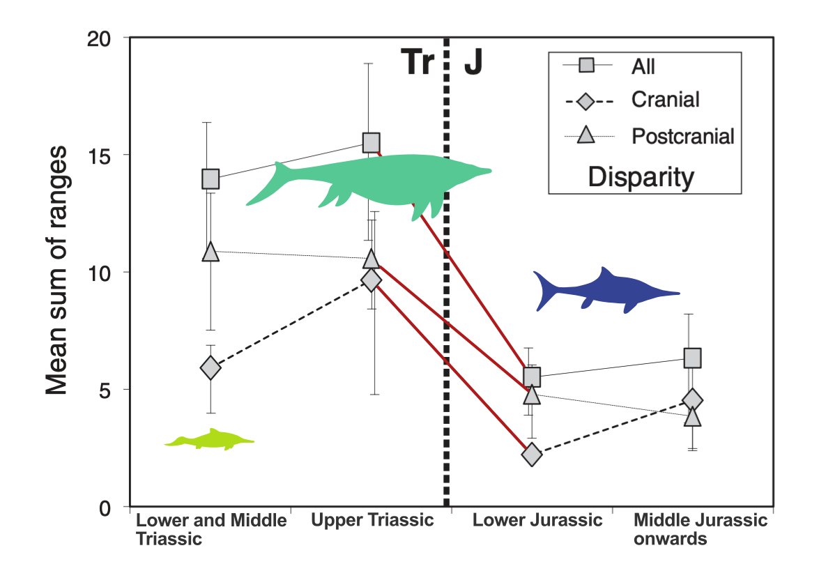
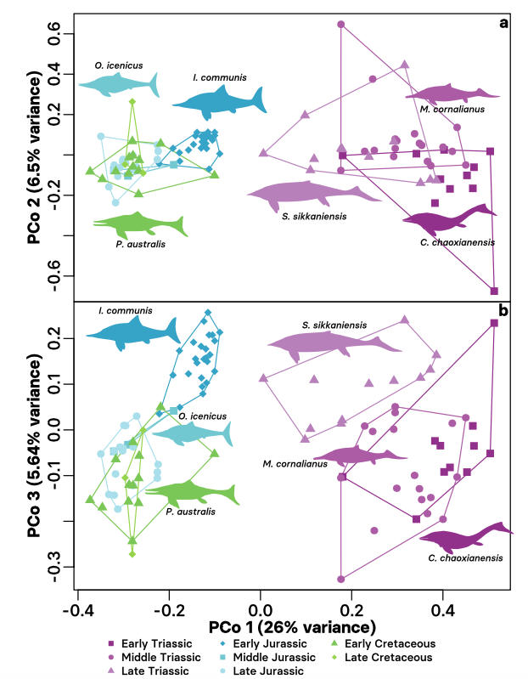
Macroevolutionary bottleneck caused by end—Triassic event?
Massive reduction of disparity and morphospace occupation for ichthyosaurians recorded through the T/J transition
Moon & Stubbs. (2020)
Modified from Thorne et al. (2020)
Notes:
Concerning ichthyosaurians, it has been also commonly admitted by recent analyses that these animals also suffered from a similar macroevolutionary bottleneck at or close to the Triassic – Jurassic transition which dramatically impacted their disparity and caused a complete change in their morphospace occupation.
However, most studies that suggested the existence of a bottleneck solely relied on phylogenetic data or investigated overall marine reptile diversification dynamics on a broad scale by using large time intervals, general ecospace characters, without focussing on that specific time period.
Moreover, some of these studies did not really consider the high scarcity of the fossil record of the latest substages of the Triassic which can lead to an oversimplification of more complex events.

Slide 9
The main questions of this study are...
How does the ecomorphospace occupation of eosauropterygians and ichthyosaurians evolve from the Middle Triassic to the Early Jurassic ?
How did end-Triassic events impact their morphology and disparity ?
Notes:
This is why, the influence end-Triassic events and their impact on the morphological diversification of main raptorial predators should be further investigated and clarified.
To tackle this issue and shed light on this crucial period in the evolution of ichthyosaurians and eosauropterygians, our study is aiming to better understand how the ecomorphospace occupation of these clades evolves from the Middle Triassic to the Early Jurassic
And also how these events impacted the global morphology disparity and morphology.

Slide 10
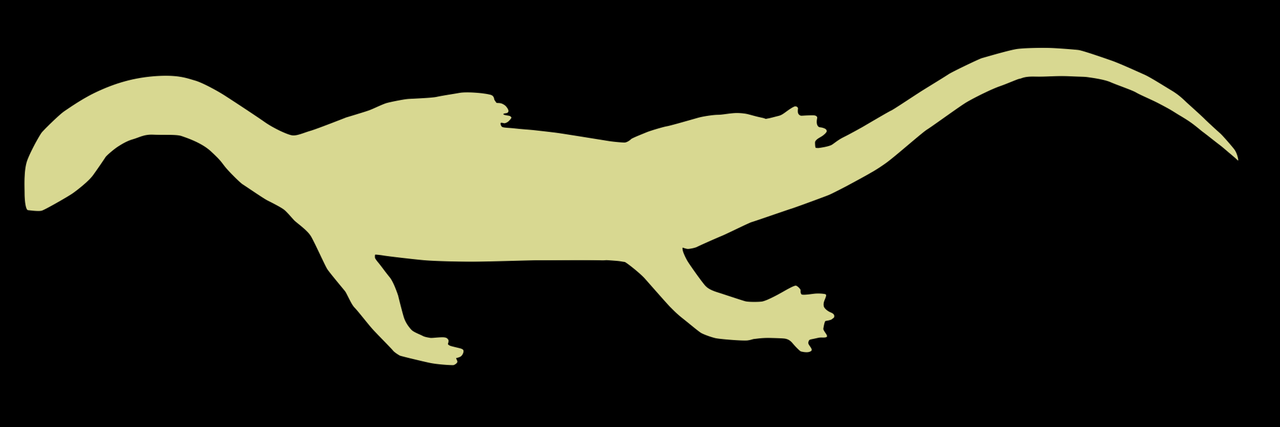
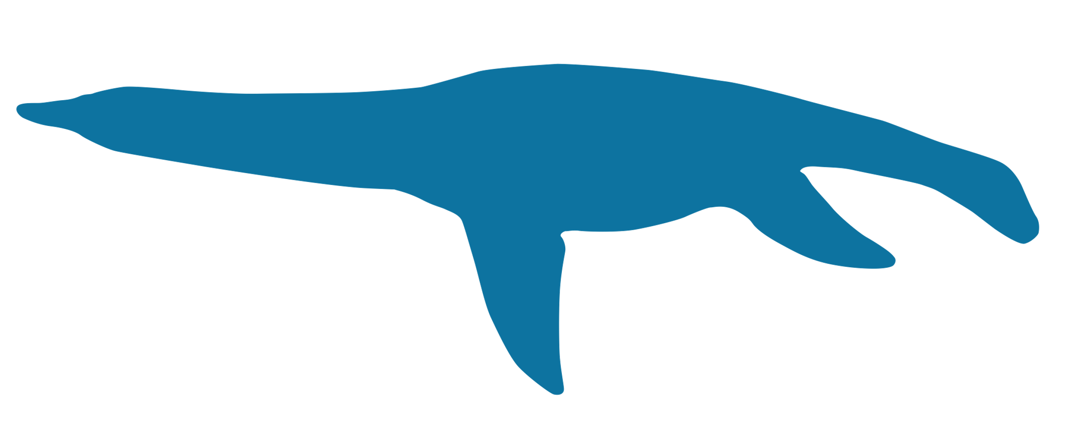
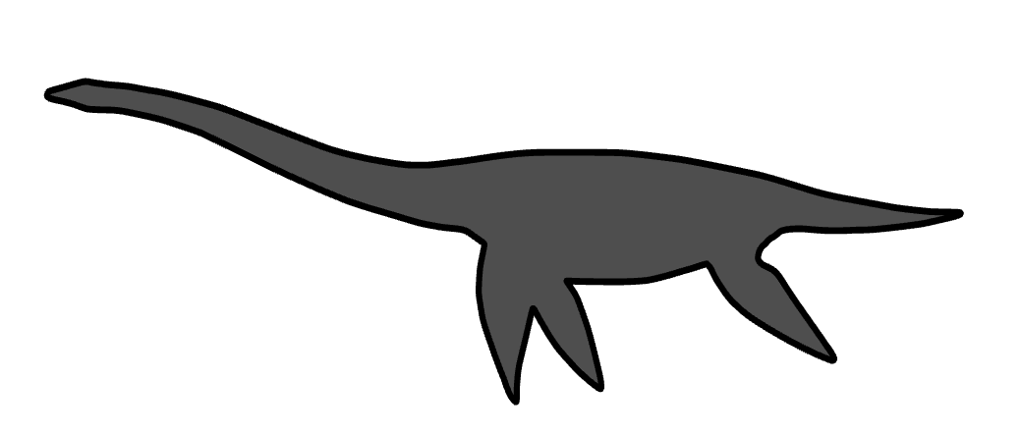
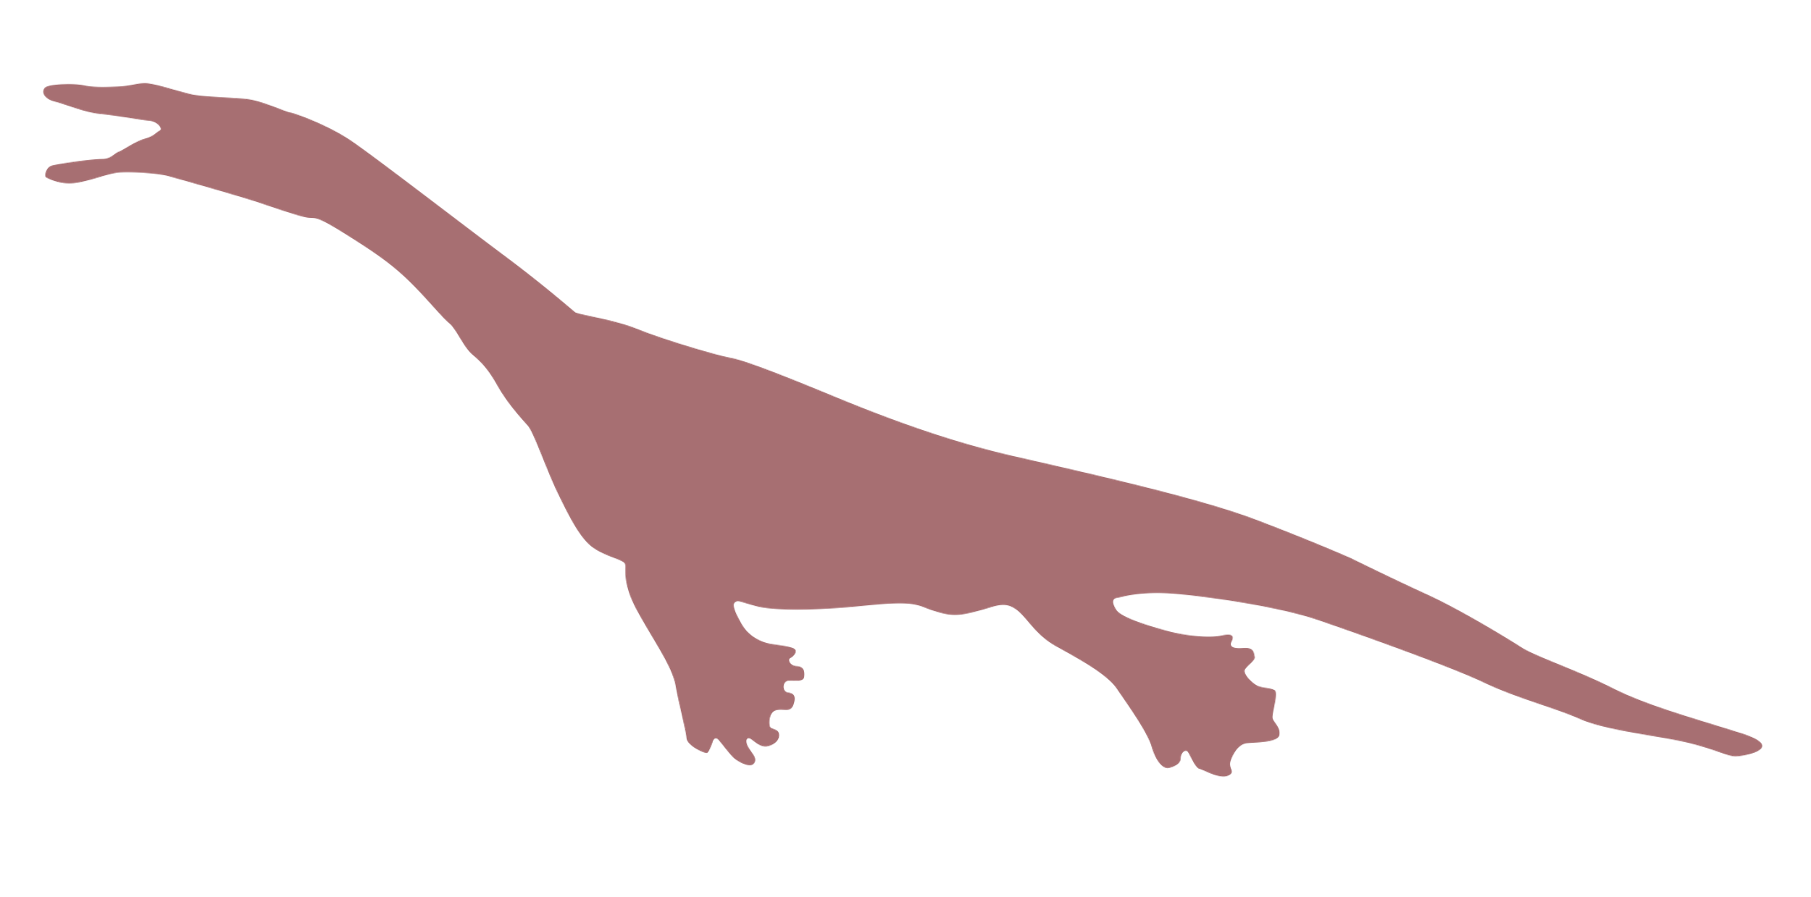
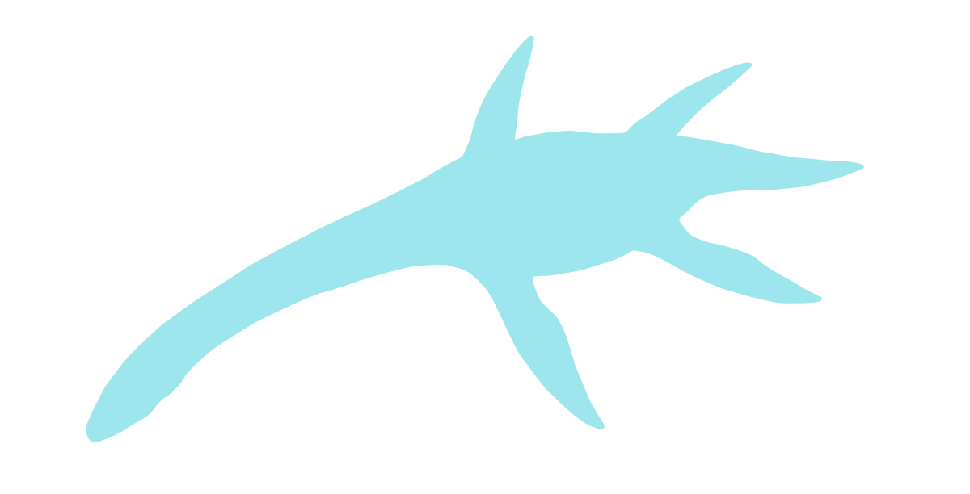
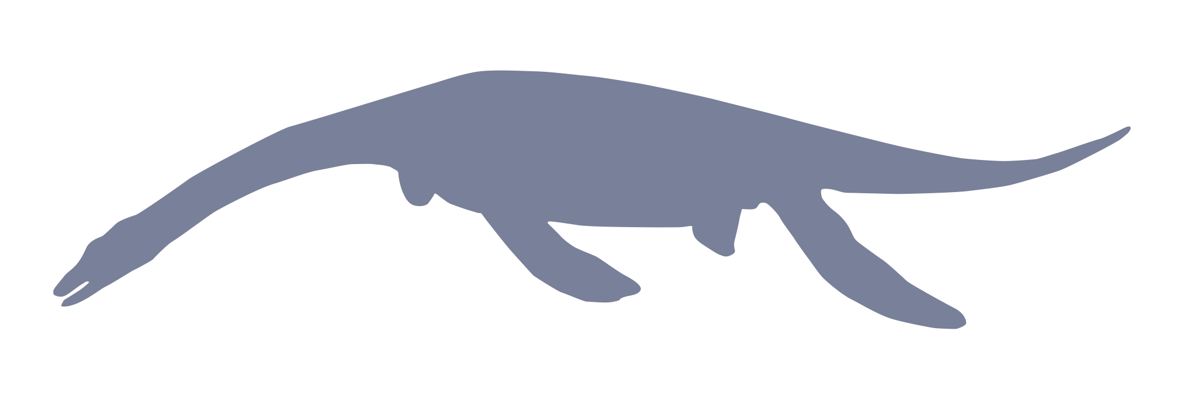
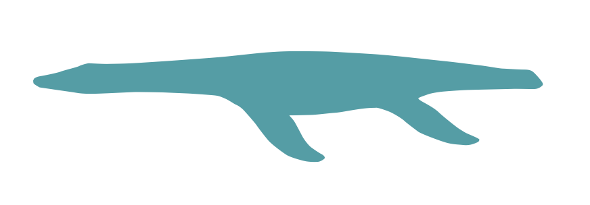



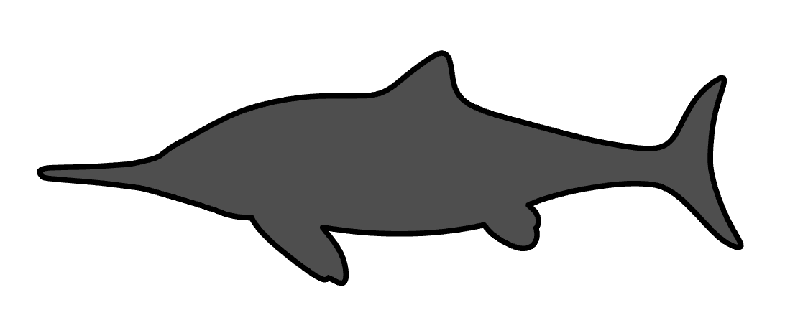
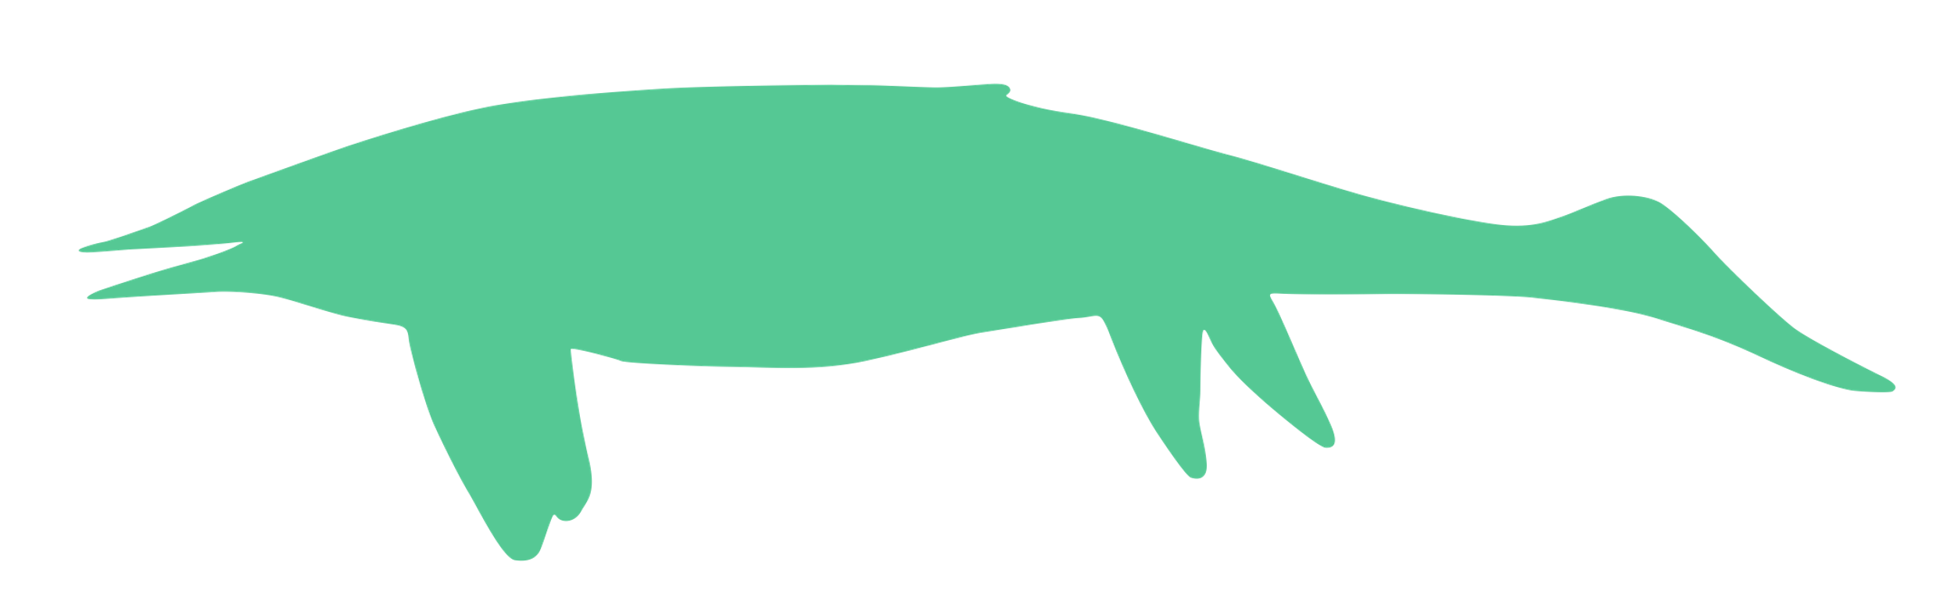
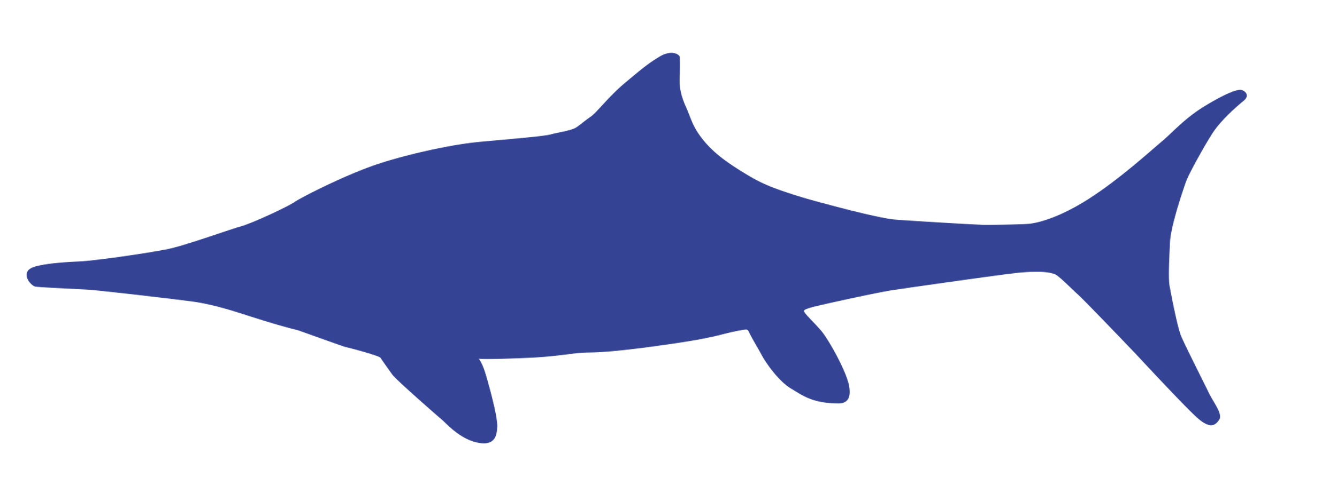
Our sample of ichthyosaurians and eosauropterygians
51 taxa
17 pachypleurosauroids
3 pliosauroids
16 nothosauroids
5 plesiosauroids
3 pistosauroids
7 rhomaleosaurids
32 taxa
6 early ichthyosaurians
10 early parvipelvians
6 non-parvipelvian
merriamosaurians
10 thunnosaurians
Notes:
Our analyses comprise taxon sampling spanning from the Middle Triassic to the Early Jurassic. We try to have the largest spectrum of well preserved and complete specimen as we currently can. This implies however the removal of important but partially known Late Triassic taxa to avoid distortion in PCoA analyses.

Slide 11
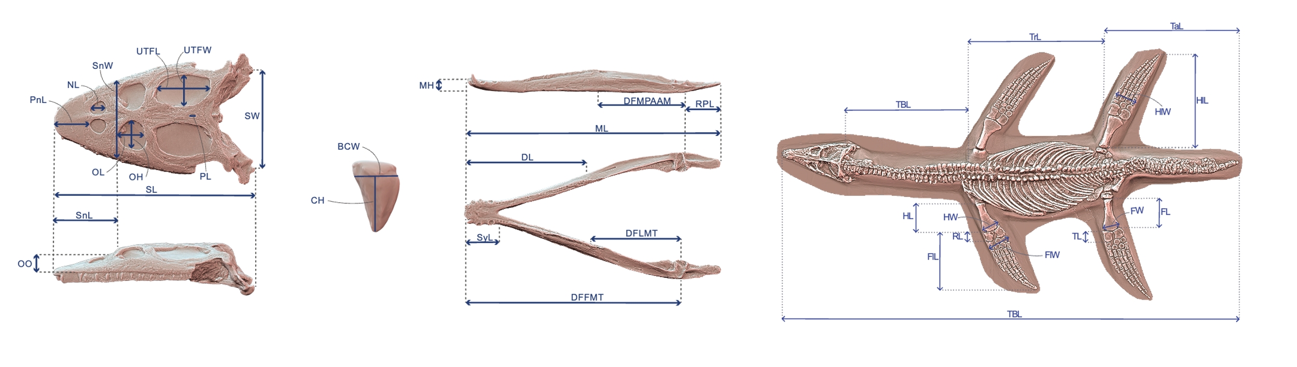
Linear data to create functionally – informative traits
Combination of dimensionless quantitative morphological ratios on craniodental and postcranial regions having clear biomechanical and/or architectural implications
Notes:
Reconstructing the evolution of disparity and ecomorphospace occupation requires an extensive morphological dataset for both clades. We gathered numerous linear data which serve to create morphofunctionally informative dimensionless ratios on the craniodental and the postcranial regions, associated with discrete traits characterizing the morphology of the mandible and teeth.
All these data will serve to compute Principal Coordinate Analyses and ecomorphological disparity evolution

Slide 12

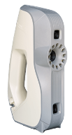
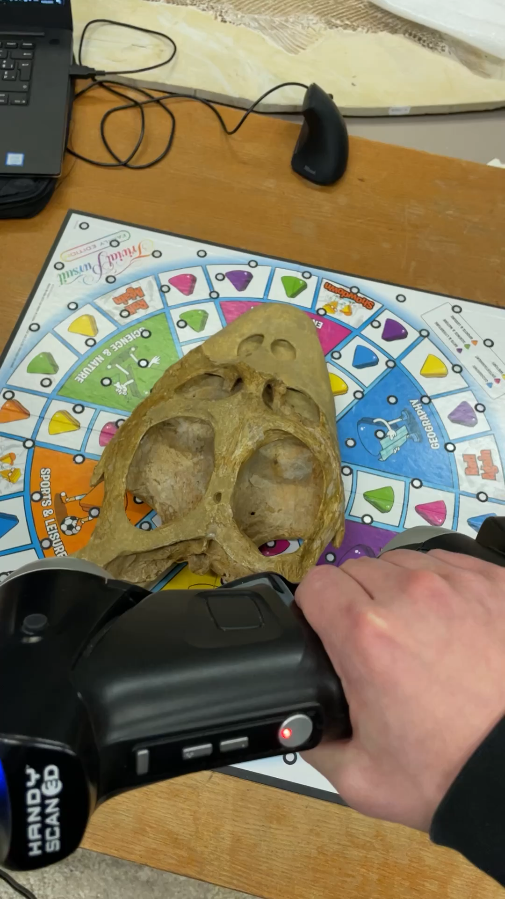
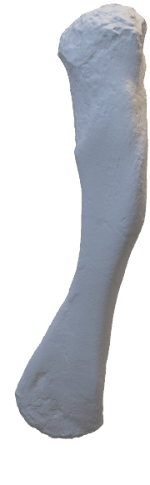
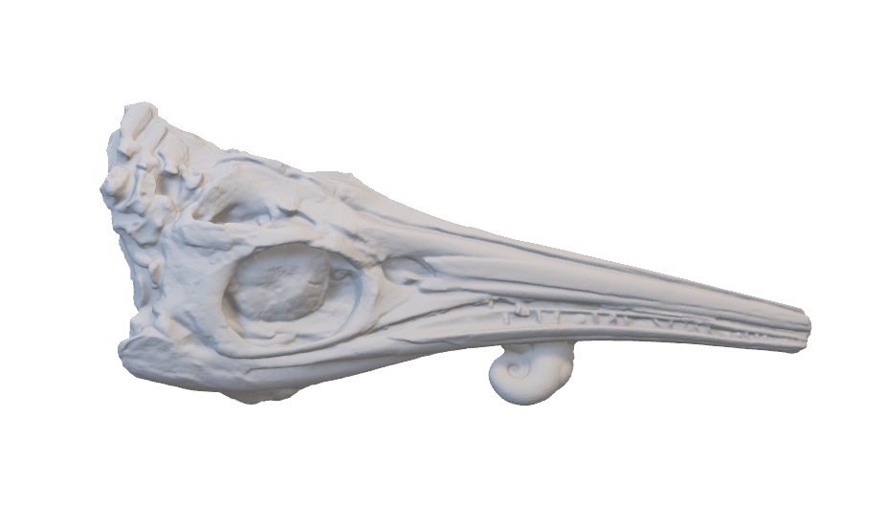
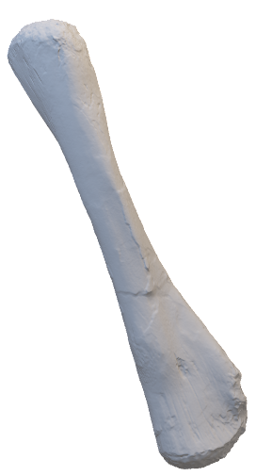
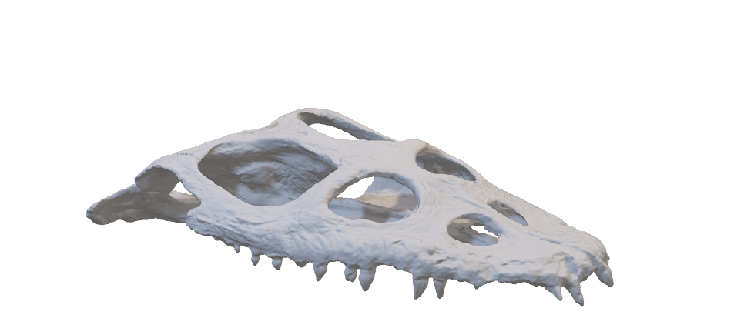
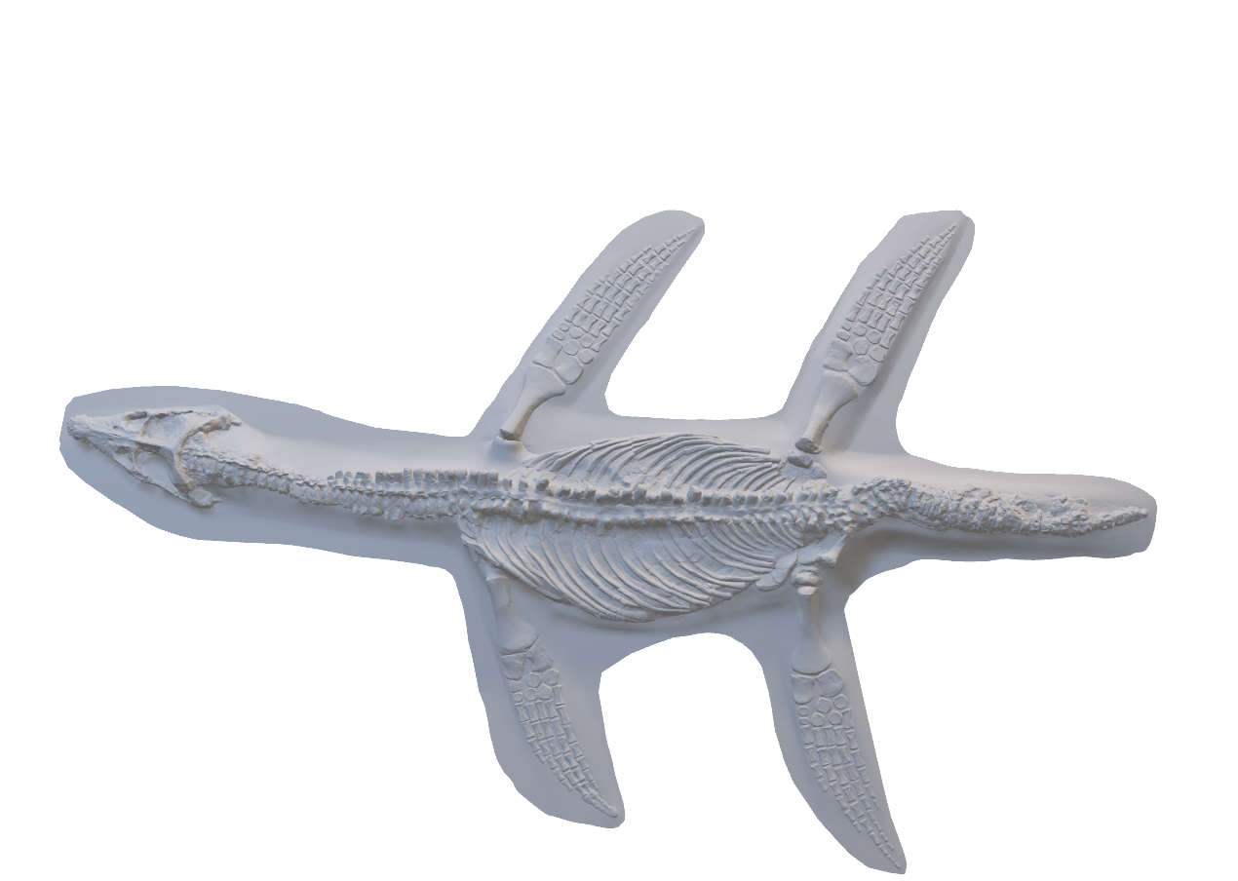
Data gathered in numerous ways
Measurements on 3D digitalized specimens
Nothosaurus giganteus (SMNS 1589b)
Rhomaleosaurus cramptoni (NHMUK PV R 34)
Simosaurus gaillardoti (SMNS 14733)
Simosaurus gaillardoti (GPIT-PV-60638)
Stenopterygius quadriscissus (MNHNL TU904)
Notes:
How were these data collected?
We spent time to create 3D models by using both white light and laser scanners of some key specimens and we took on them digital measurements.

Slide 13
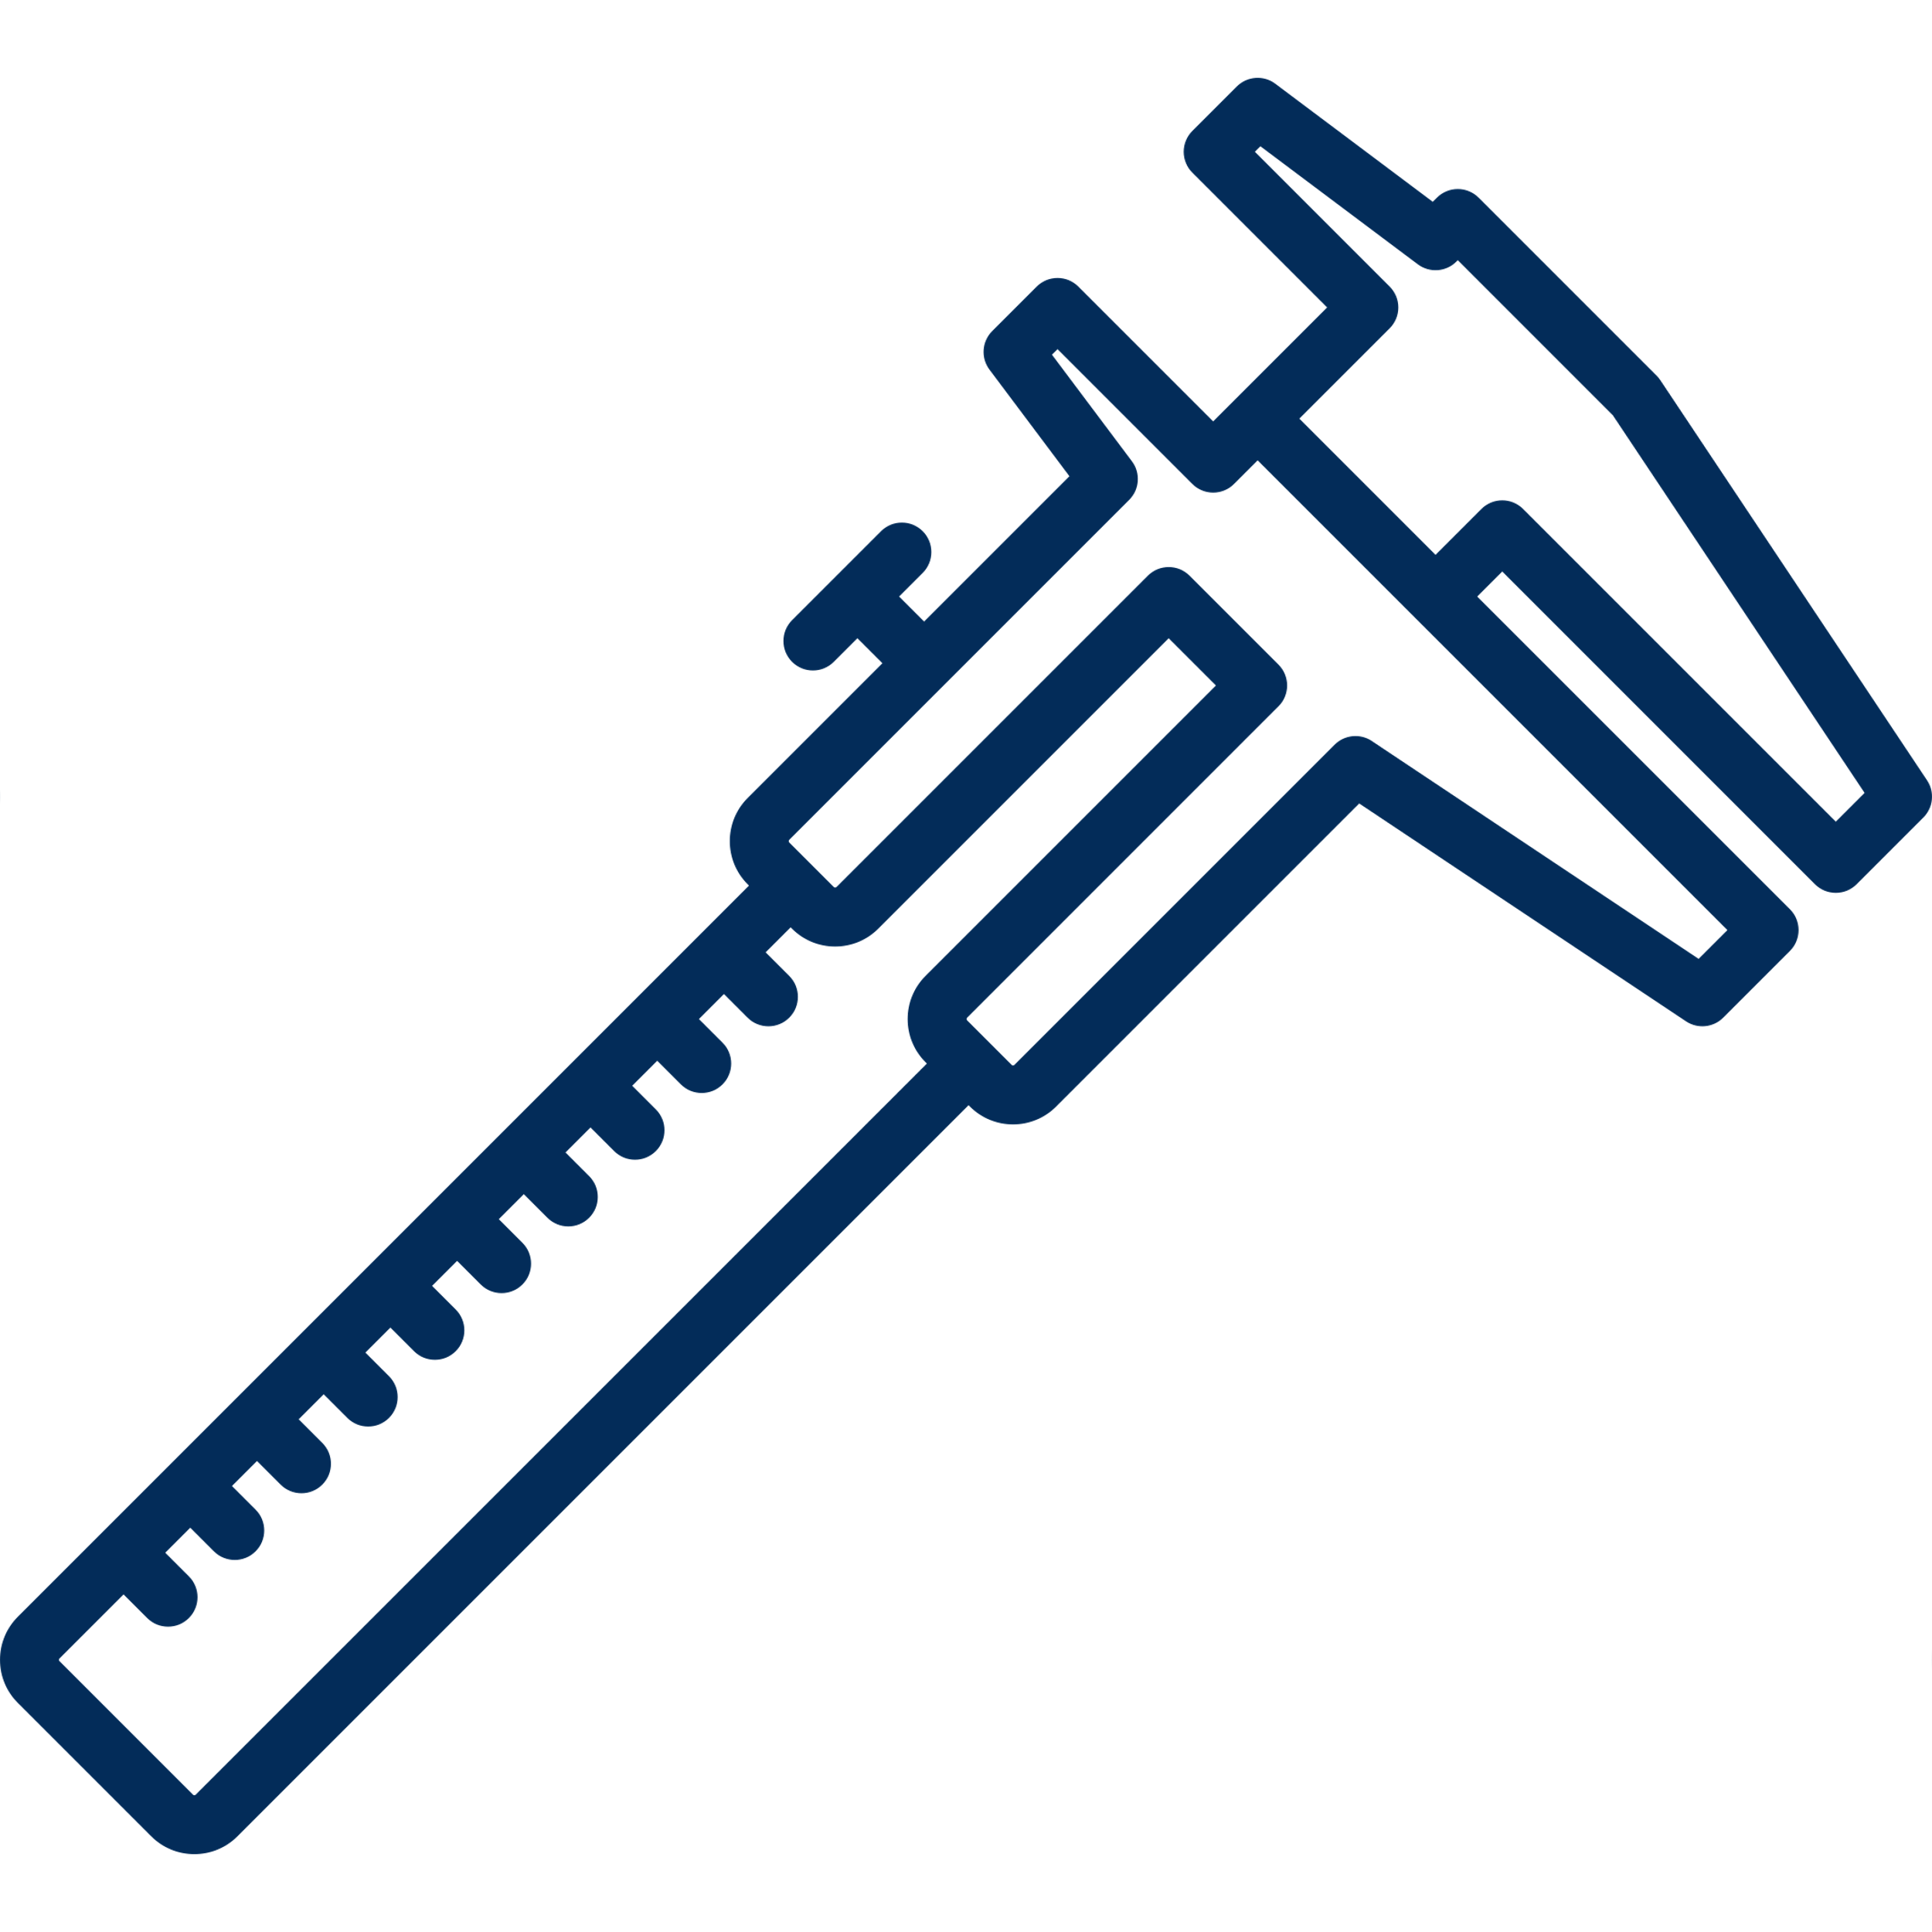
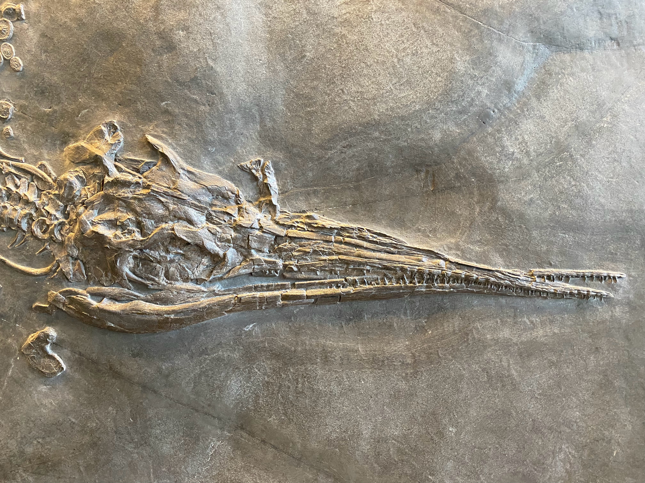

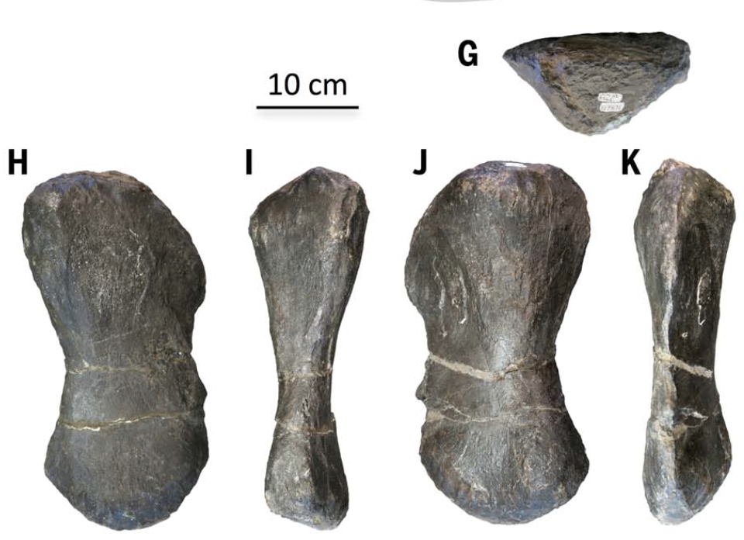
Data gathered in numerous ways
First-hand measurements
Specimens figured in the literature
Cymbospondylus youngorum (LACM DI 157871 )
Modified from Sander et al. (2021)
Besanosaurus leptorhynchus (PIMUZ T 4376)
Notes:
However, a huge part of our measurements were taken directly on specimens stored in various institutions but also on first-hand photographs. When no other alternative were available, we populated our datasets by using measurements or figured specimens published in the literature.

Slide 14
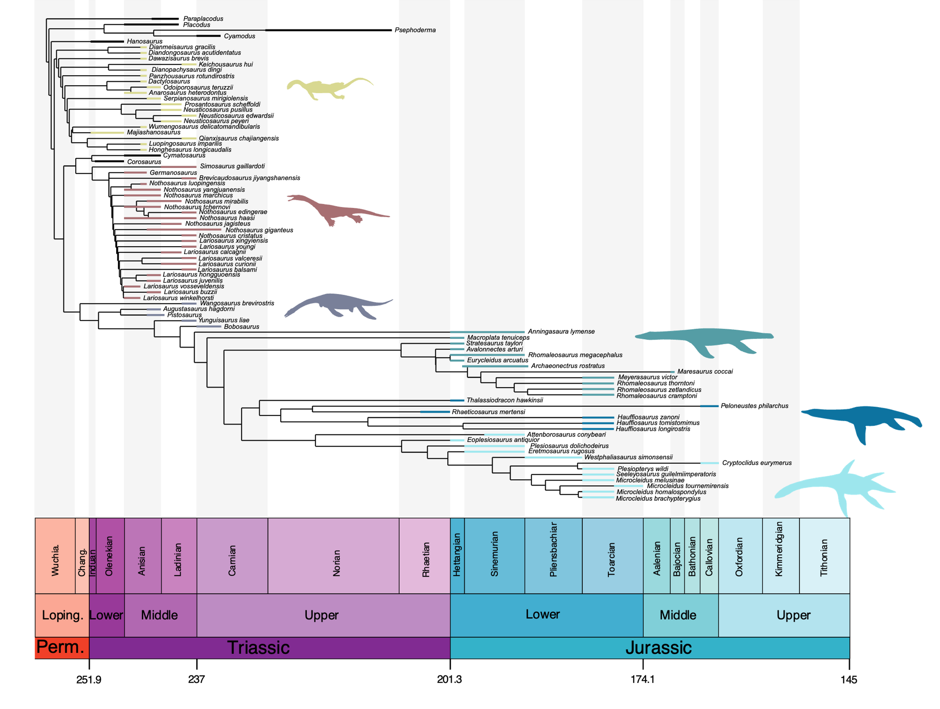
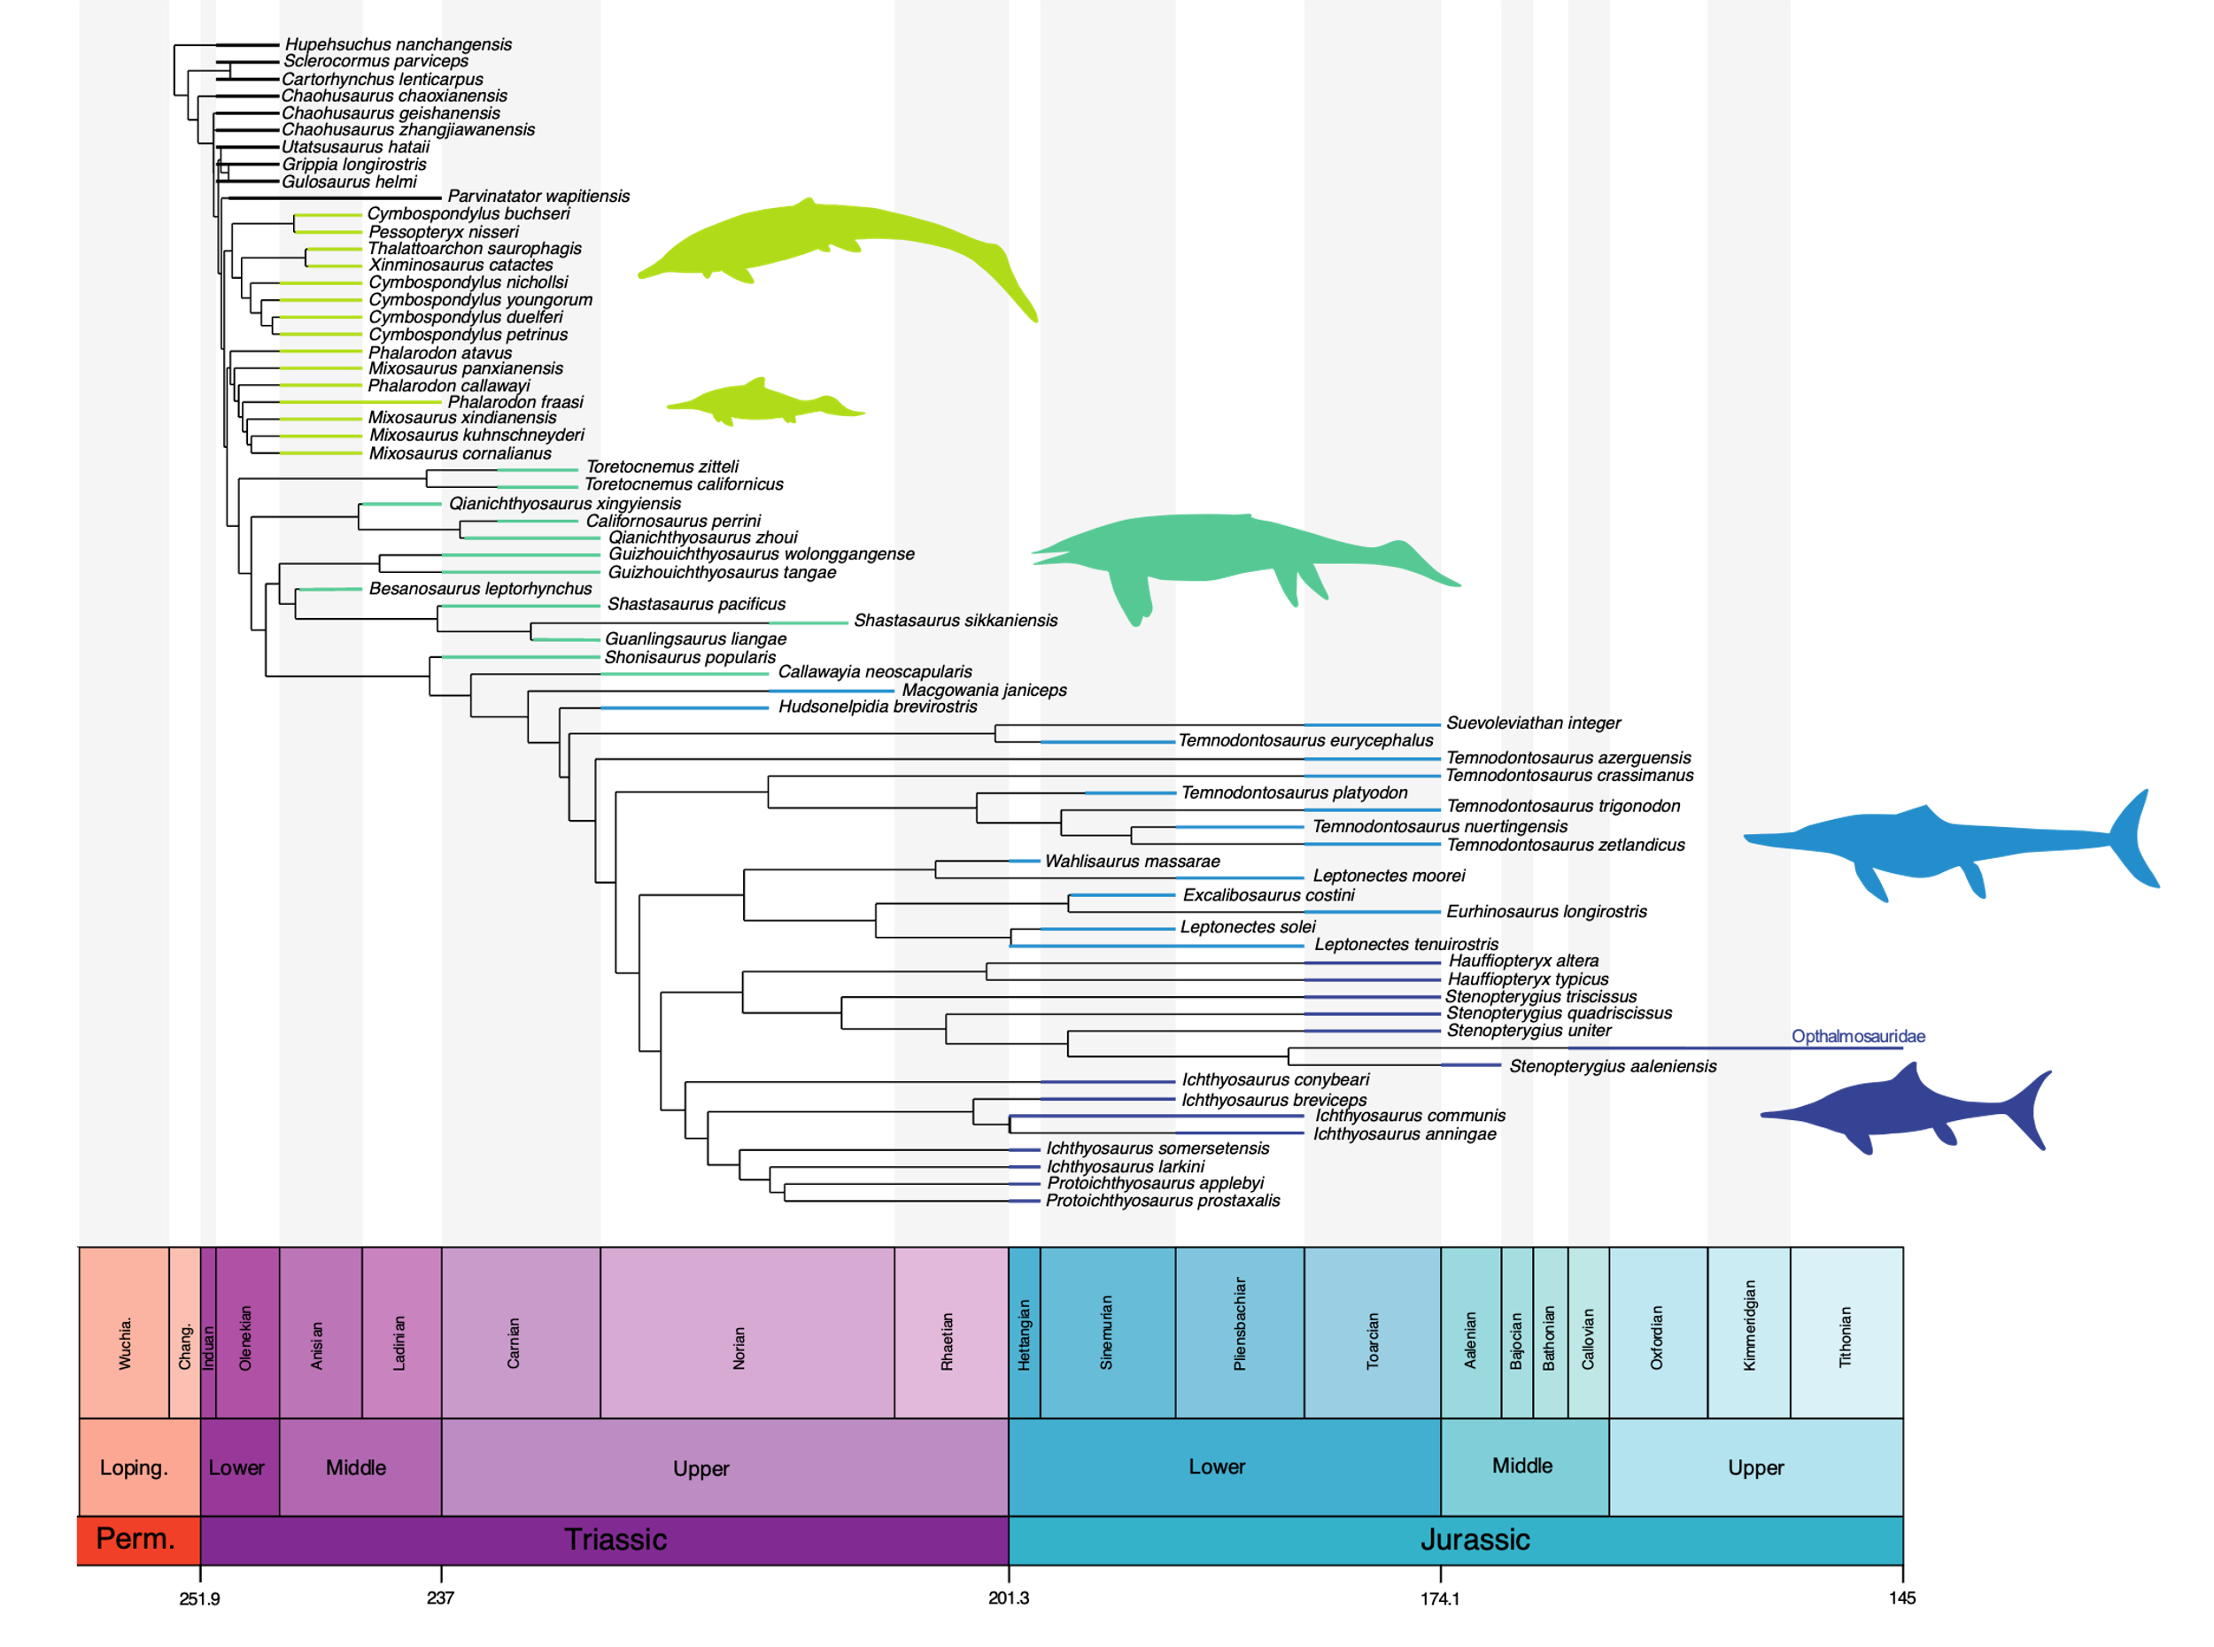
Phylogenetic framework
All cladistic datasets analysed in Maximum Parsimony within an implied weighting framework (K=12)
Trees timescaled with the MBL and the Hedman algorithms
Composite tree arising from the topologies of Hu et al. (2024) and Wintrich et al. (2017)
Tree topology based on Laboury et al. (2022)
Notes:
Some of our analyses requires a phylogenetic framework to visualize evolutionary trajectories.
For ichthyosaurians, we used the character- taxon matrix that I published two years ago considering the extensive taxonomic sampling of Middle Triassic–Lower Jurassic taxa.
No cladistic dataset thorougly yet investigate relationships of Triassic and post-Triassic sauropterygians. For this reason we created a composite phylogenetic tree by combining topologies generated by using datasets of Hu et al. (2024) for Triassic taxa and the one published by Wintrich et al. (2017).

Slide 15

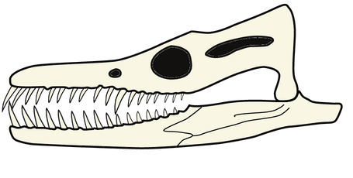
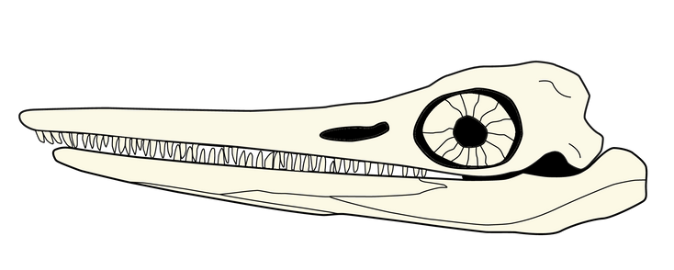
CRANIODENTAL ECOMORPHOSPACE OCCUPATION
Notes:
Ah, time is flying. So, because the results are intriguing than for the postcranial body region, I will dedicate this part of the talk only on the results of the craniodental ecomorphospace occupation of both ichthyosaurians and eosauropterygians.

Slide 16
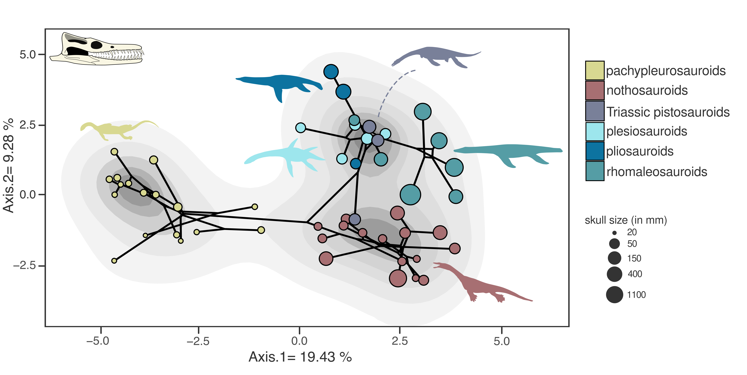
Eosauropterygian clades occupy well distinct zones
Pvalue = 0.005
Laboury et al. in review (Evolution)
Notes:
Firstly, when we look at the phylomorphospace of eosauropterygians, we can clearly see that each group occupies distinct regions of the ecomorphospace which therefore is predominantly shaped by a strong phylogenetic signal. This would suggest that each would have occupied distinct ecological niches. Interestingly, a significant number of early plesiosaurians are nested within Triassic pistosauroids meaning that the ‘typical’ craniodental plesiosaurian architecture would have appeared before the T/J transition, actually, 40 millions years before.

Slide 17
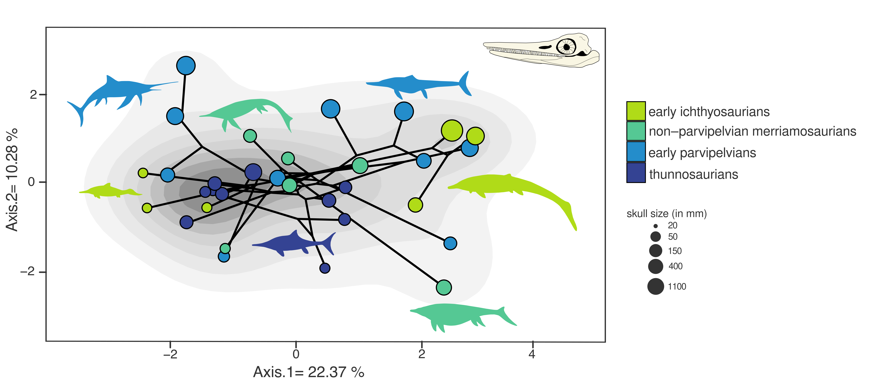
Wide overlap of craniodental phenotypes for ichthyosaurians
Pvalue = 0.181
Laboury et al. in review (Evolution)
Notes:
Now, if look at the phylomorphospace occupation of ichthyosaurians, a such pattern suggesting a distinction of groups is not recovered. Indeed, no clear discrimination between these latter is observed and species of the different groups seems to be widely spread in the ecomorphospace.
But after the T/J, some species seem to explore new regions as the hyperlongirostrine leptonectids.

Slide 18
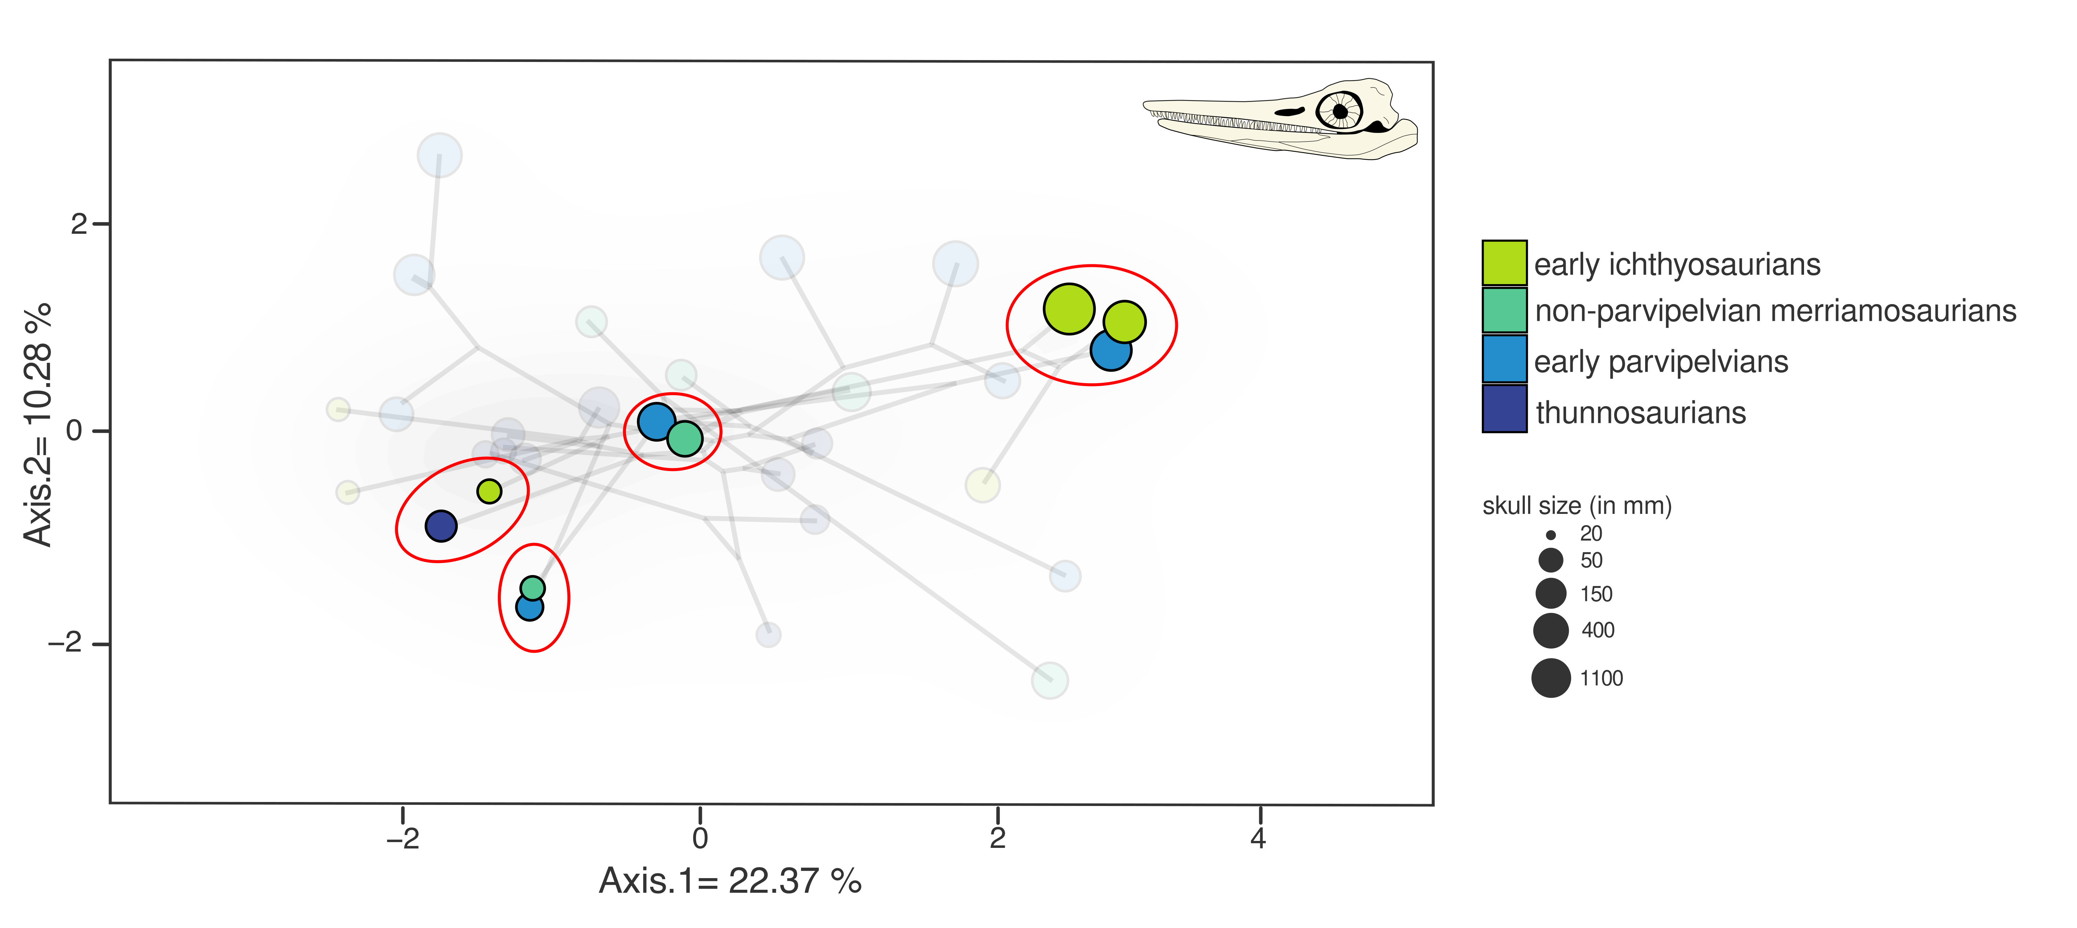
Wide overlap of craniodental phenotypes for ichthyosaurians
Laboury et al. in review (Evolution)
Notes:
Futhermore, some phylogenetically and temporally distant taxa occupy very close positions in the ecomorphospace highlighting a recurrence of craniodental morphotypes on either side of the T/J transition.

Slide 19
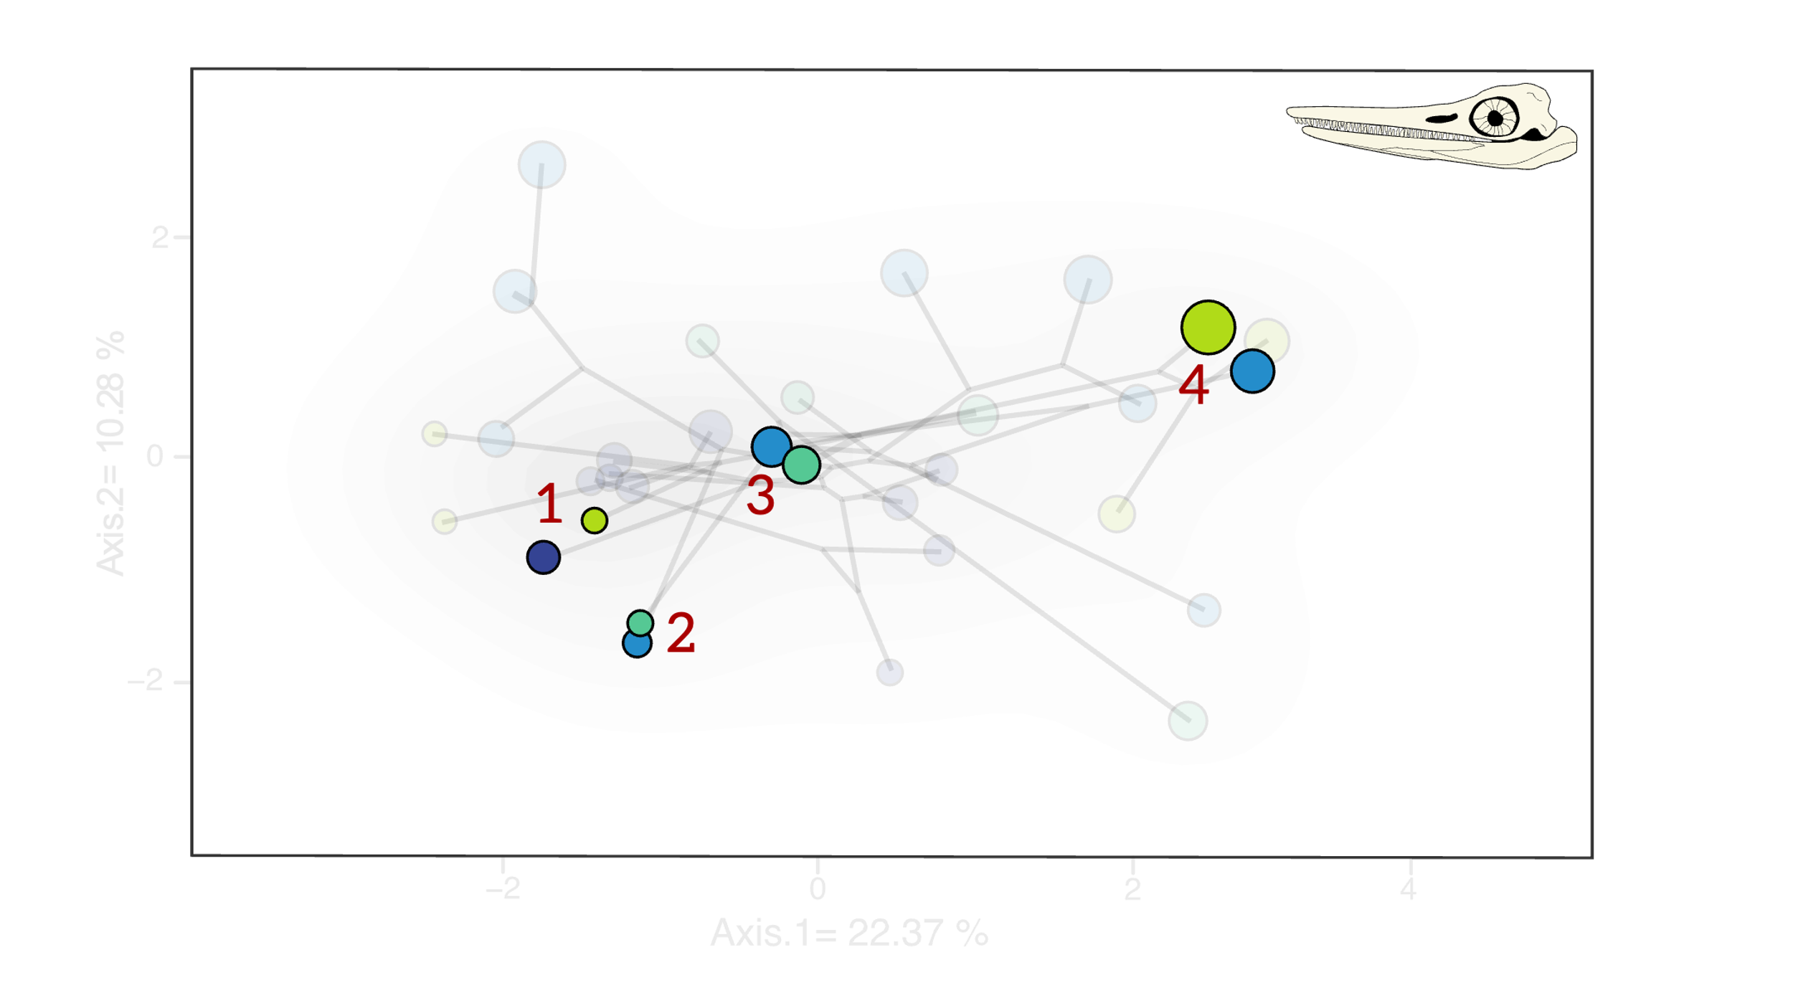
Partial convergences between Triassic and Early Jurassic taxa
Number | Taxa | Ct 1 | Pvalue | ang.state.time | Pvalue
1 | Mixosaurus cornalianus — Hauffiopteryx typicus | 0.1717 | 0.0000 | 0.1748 | 0.0710
2 | Qianichthyosaurus zhoui — Leptonectes moorei | 0.4631 | 0.0100 | 0.0330 | 0.0095
3 | Guizhouichthyosaurus wolonggangense — Suevoleviathan integer | 0.5790 | 0.0400 | 0.8378 | 0.2985
4 | Cymbospondylus youngorum — Temnodontosaurus eurycephalus | 0.7976 | 0.0030 | 0.1471 | 0.0615
Laboury et al. in review (Evolution)
Notes:
For this reason, we computed convergence tests by using the Ct metrics and the method developed by Castiglione et al. (2019). Convergence is partially found as the Castiglione method did not recover significant results. However, Ct results tend to inferred the fact that some Early Jurassic taxa could have produce phenotypes superficially similar to that of Triassic species.

Slide 20
FIRST CONCLUSIONS
Contrasting evolutionary pattern in the craniodental diversification of both marine reptile clades
Clear influence of a strong phylogenetic heritage for eosauropterygians implying well distinct morphologies
No clear evolutionary trajectory for ichthyosaurians. Re-emergence of phenotypes already present in the Triassic and exploration of new regions of the ecomorphospace
Notes:
Okay, let’s make a short summary of the conclusions that can be drawn from these ecomorphospace analyses. The main message is that we can observe a contrasting evolutionary pattern in the craniodental diversification of of clade.
Indeed, the ecomorphospace occupation of eosauropterygians is mostly influenced by a strong phylogenetic heritage, implying distinct morphologies for each clade and therefore distinct ecological niches.
On the other side, ichthyosaurian lacks a similar trend but their craniodental evolution seems to be characterize by the re-emergence of superficially similar phenotypes already present in the Triassic, as well as the exploration of new regions of the ecomorphospace.

Slide 21
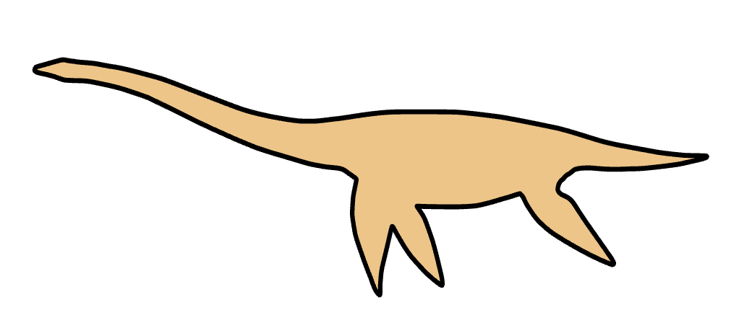

EVOLUTION OF DISPARITY AND BODY SHAPE THROUGH TIME
Notes:
Now let’s have a look on how end-Triassic events impacted the evolution of overall disparity and specific morphological features such as fin shape and body size.

Slide 22

No dramatic drop of ecomorphological disparity for ichthyosaurians
A drop in craniodental morphofunctional disparity is expected between Late Triassic and earliest Jurassic eosauropterygians
Craniodental morphofunctional disparity nearly similar between Late Triassic and earliest Jurassic ichthyosaurians
Laboury et al. in review (Evolution)
Notes:
Based on our PCoA results, we computed the total amount of disparity based on all PCoA axes for different time bins that either belong to the Triassic or the Early Jurassic. Both clades experienced their highest ecomorphological disparity during the Middle Triassic. Even if

Slide 23

Disparity sampling with phylogenetic information
Laboury et al. in review (Evolution)
Notes:
In order to increase the resolution of the evolution of disparity, we used our phylogenetic information for ichthyosaurians and phylo-ecomorphospace for eosauropterygians (as we have a composite phylogenetic tree) to compute the overall disparity through time.

Slide 24
Disparity sampling with phylogenetic information
No significant drop in disparity at or close to the T/J transition but at rather at the early Late Triassic for both eosauropterygians and ichthyosaurians.
Laboury et al. in review (Evolution)
Notes:
And for both clade, we can observe a significant drop in disparity not at or close the T/J transition but during the first half of the Late Triassic when sea levels rapidly fluctuated. This is what has been previously highlighted by other research for eosauropterygians but not for ichthyosaurians. From the Norian or the Rhaetian (depending on the clade), the disparity seems to gradually increase, probably with the emergence of pelagic plesiosaurians and parvipelvians which contradicts the hypothesis of a macroevolutionary bottleneck at the very end of the Triassic. It would rather suggest that the events of that time would not have a substantial impact on their evolution.
Please notice that the dramatic disparity drop for eosauropterygians and the low values during the second half of the Late Triassic are likely to be exaggerated by the poor fossil record.

Slide 25

Clear change in limb morphology during the Late Triassic
Laboury et al. in review (Evolution)
Notes:
We computed phenograms tracing the evolution of brachial and crural indexes (respectively relative radius and tibia length compared to the length of the humerus and femur) which can be used as proxies of adaptation to oceanic environments. For both eosauropterygians and ichthyosaurians, a clear separation is visible between typical Triassic groups which are characterized by high values, reflecting a less degree of adaptation open ocean and plesiosaurians and parvipelvians which are considered as pelagic taxa.
And this clear change seems to have happened during the first half of the Late Triassic when the latter clades might have appeared and when the environments changed.

Slide 26

Did end-Triassic events impact body size ?
Laboury et al. in review (Evolution)
Notes:
Finally, and I promise, it’s the last graph, we also gathered a set of dorsal vertebra height which can be used to estimate the body size of aquatic tetrapod (Please do not hesitate to have further have a look on the poster of Valentin) to visualize of this trait might have evolved between the Late Triassic and the Early Jurassic. This would give us more information on how very end Triassic events might impacted size of these animals.
With the available material up to date, dimensions of dorsal vertebrae of eosauropt is likely to appear stable on either side of the T/J transition. In contrary to ichthyosaurians, this transition is marked by a significant reduction in body size range which can be explained by the loss of gigantic shastasaurids at the end of the Rhaetian that were still present in the very Late Triassic.

Slide 27
SECOND CONCLUSIONS
No catastrophic macroevolutionary bottleneck evidenced at the very end of the Triassic.
Support of extinction events during the early Late Triassic which decimated coastal dwellers (Benson & Butler, 2011; Kelley et al., 2012)
Suggestion of a two—phase extinction event for non parvipelvian ichthyosaurians
Phase 1 in the Carnian/early Norian with the loss of majority of shallow water taxa
Phase 2 at the end of the Rhaetian with the loss of nearly all gigantic shastasaurids
BUT scarcity of the sampling in the Late Triassic fossil record → Oversimplification?
Notes:
What can we conclude from this section and these analyses about the impact of the end Triassic events on the evolution of the main marine tetrapod groups?
First of all, our analyses support for both groups major extinction events during the early Late Triassic (Carnian – first half of the Norian) which decimated coastal dwellers when sea regressions reshaped marine ecosystems. This scenario was already introduced a decade ago and our results also point in this direction.
For non-parvipelvian ichthyosaurians, we would like to propose a two-phase extinction scenario rather than a unique macroevolutionary bottleneck at T/J transition. The first phase saw the extinction of the majority of taxa still adapted to shallow water environments. Only gigantic shastasaurids and the small efficient cruiser parvipelvians survived to these extinction caused by eustastic sea-levels changes. However, the final demise of shastasaurids at the end of the Rhaetian and the subsequent turnover that led the dominance to pelagic parvipelvians represent the second phase. Indeed, considering the disparity and diversity of the Early Jurassic species, it seems that the very end of the Triassic did not have a substantial impact on their evolution.
However, it is very important the keep in mind that the fossil sampling in the latest Triassic is very scarce. Therefore, we did what we could with the available information. But our hypothesis and suggestion could therefore be the simplification of a more complex scenario.

Slide 28
TAKE–HOME MESSAGES
Contrasting evolutionary patterns in the craniodental diversification of ichthyosaurians and eosauropterygians
Important extinction events during the early Late Triassic rather than a macroevolutionary bottleneck at the T/J transition
Notes:
Just briefly, if you want to remember key elements of this talk, please keep in mind these two points:
Ichthyosaurians and eosauropterygians are characterized by different evolutionary patterns in their craniodental evolution across the Middle Triassic – Early Jurassic time interval.
We do not spot a dramatic macroevolutionary bottleneck at the T/J transition but rather we detected important extinction events at the early Late Triassic which decimated coastal taxa and highly impacted the disparity and evolution of the main raptorial predators of that time.

Slide 29

MANY THANKS TO
SECAD
2024
June 25 – 28th
Liège, Belgium
funding organisms:
the team and helpers:
Thomas L. Stubbs, Andzrej Wolniewicz, Jun Liu, Torsten M. Scheyer, Marc E.H. Jones, Valentin Fischer, Jamie MacLaren, Rebecca Bennion, Nicole Klein, Narimane Chatar, Daniel Macphail
the institutions:
Sedgwick Museum of Earth Sciences (CAMSM), Field Museum National History (FMNH), Geological Museum, Peking University (GMPKU), Paleontology Collection in Tübingen (GPIT), Urwelt-Museum Hauff in Holzmaden (HAUFF), Institute of Paleontology and Paleoanthropology, Chinese Academy of Sciences (IVPP), Lyme Regis Philpot Museum (LYMPH), National Museum of Natural History of Luxembourg (MNHNL), National Museum of Natural History Leiden (MNHNL), Royal Ontario Museum (ROM), Royal Tyrell Museum of Palaeontology (RTMP), Paläontologisches Institut der Universität Zürich (PIMUZ), Staatliches Museum für Naturkunde Stuttgart (SMNS), Wuhan Centre of China Geological Survey (WCCGS)
Notes:
I would like to end by thanking organisms that have funded this research, all members of the teams and people who helped me and also all the institutions (and curators) for having access to their material.

Slide 30
SUPPLEMENTS
Notes:
I would like to end by thanking organisms that have funded this research, all members of the teams and people who helped me and also all the institutions (and curators) for having access to their material.

Slide 31

Eosauropterygian postcranial phylo-ecomorphospace occupation
Laboury et al. in review (Evolution)
Notes:
Firstly, when we look at the phylomorphospace of eosauropterygians, we can clearly see that each group occupies distinct regions of the ecomorphospace which therefore is predominantly shaped by a strong phylogenetic signal. This would suggest that each would have occupied distinct ecological niches. Interestingly, a significant number of early plesiosaurians are nested within Triassic pistosauroids meaning that the ‘typical’ craniodental plesiosaurian architecture would have appeared before the T/J transition, actually, 40 millions years before.

Slide 32

Ichthyosaurian postcranial phylo-ecomorphospace occupation
Laboury et al. in review (Evolution)
Notes:
Firstly, when we look at the phylomorphospace of eosauropterygians, we can clearly see that each group occupies distinct regions of the ecomorphospace which therefore is predominantly shaped by a strong phylogenetic signal. This would suggest that each would have occupied distinct ecological niches. Interestingly, a significant number of early plesiosaurians are nested within Triassic pistosauroids meaning that the ‘typical’ craniodental plesiosaurian architecture would have appeared before the T/J transition, actually, 40 millions years before.

Slide 33

Eosauropterygian craniodental tanglegram
Laboury et al. in review (Evolution)
Notes:
Firstly, when we look at the phylomorphospace of eosauropterygians, we can clearly see that each group occupies distinct regions of the ecomorphospace which therefore is predominantly shaped by a strong phylogenetic signal. This would suggest that each would have occupied distinct ecological niches. Interestingly, a significant number of early plesiosaurians are nested within Triassic pistosauroids meaning that the ‘typical’ craniodental plesiosaurian architecture would have appeared before the T/J transition, actually, 40 millions years before.

Slide 34

Ichthyosaurian craniodental tanglegram
Laboury et al. in review (Evolution)
Notes:
Firstly, when we look at the phylomorphospace of eosauropterygians, we can clearly see that each group occupies distinct regions of the ecomorphospace which therefore is predominantly shaped by a strong phylogenetic signal. This would suggest that each would have occupied distinct ecological niches. Interestingly, a significant number of early plesiosaurians are nested within Triassic pistosauroids meaning that the ‘typical’ craniodental plesiosaurian architecture would have appeared before the T/J transition, actually, 40 millions years before.

Slide 35
L
Evolution of ecomorphological disparity
A drop in craniodental morphofunctional disparity is expected between Late Triassic and earliest Jurassic eosauropterygians
Craniodental morphofunctional disparity nearly similar between Late Triassic and earliest Jurassic ichthyosaurians
Laboury et al. in review (Evolution)
Notes:
Firstly, when we look at the phylomorphospace of eosauropterygians, we can clearly see that each group occupies distinct regions of the ecomorphospace which therefore is predominantly shaped by a strong phylogenetic signal. This would suggest that each would have occupied distinct ecological niches. Interestingly, a significant number of early plesiosaurians are nested within Triassic pistosauroids meaning that the ‘typical’ craniodental plesiosaurian architecture would have appeared before the T/J transition, actually, 40 millions years before.

