Slide 1
Recycling in the built environment: challenges and techniques for engineers
L. Courard, Université de Liège
Universitatea Politehnica Timişoara,
Seminar for master students
February 26, 2025
Luc.Courard@uliege.be

Slide 2

      26.000 students
      2.500 foreign students (1200 from E.U.)
      78 nationalities and 5 continents
      2.500 graduated per year
      350 doctors Honoris Causa
      11 faculties
      450 professors
      1800 researchers
http//www.uliege.be

Slide 3
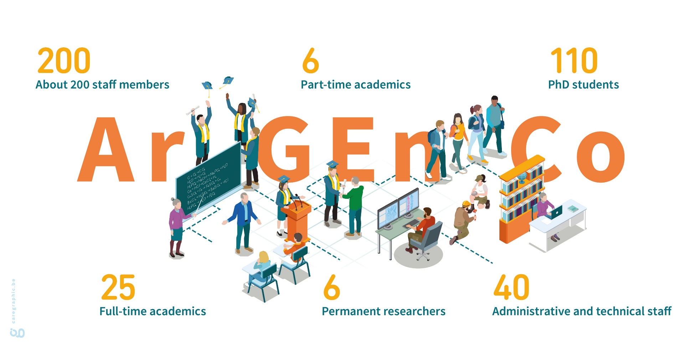

Slide 4

Master Programs
3 civil engineer master degrees
Geology and Mining Engineering
Civil Engineering
Architectural Engineering
2 specialized master’s degrees
Urban and regional planning
Transportation management
Continuing education programs
Auscultation et réparation des ouvrages en béton
BIM
MOCC ConstruiREcycler
Accredited at European level EUR-ACE Label & CTI

Slide 5
Societal context

Slide 6
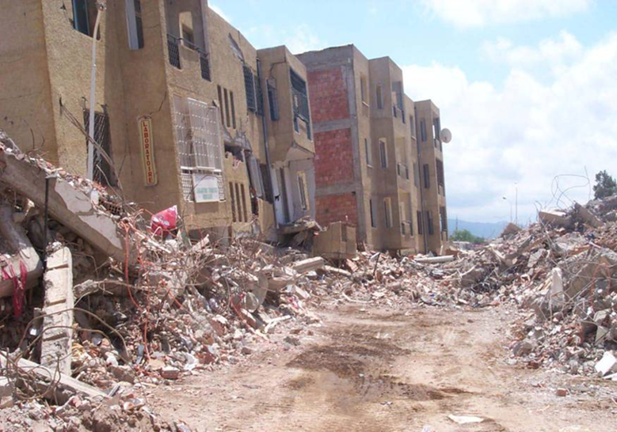
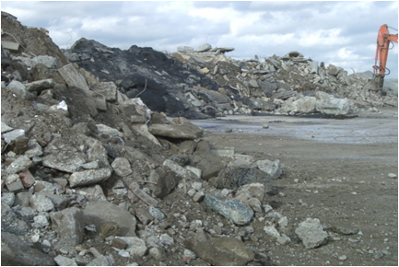
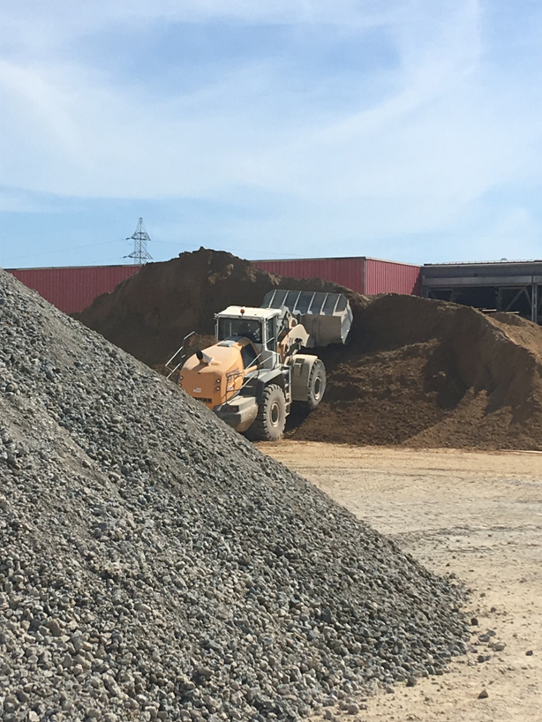
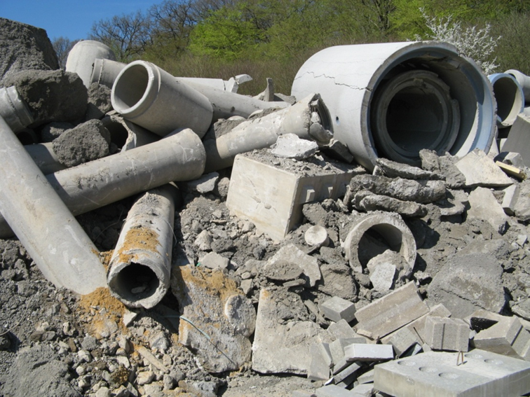
Global context
What to do?

Slide 7
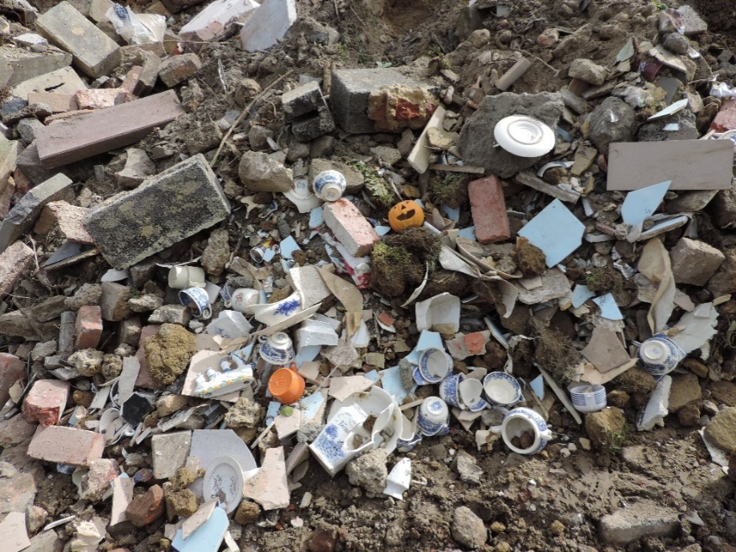
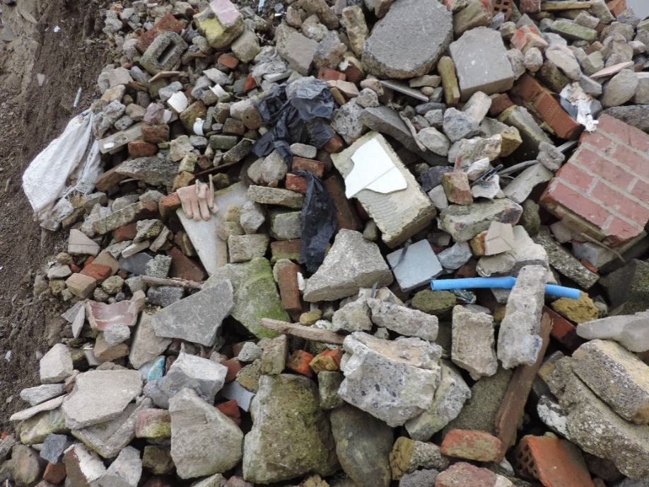
Global context
Transforming wastes …

Slide 8
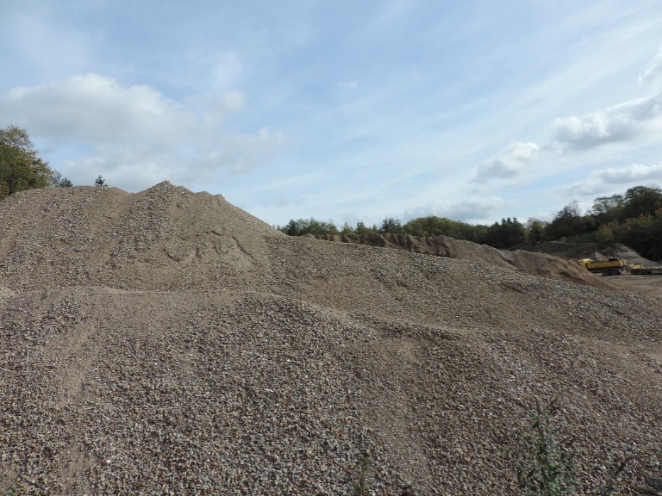
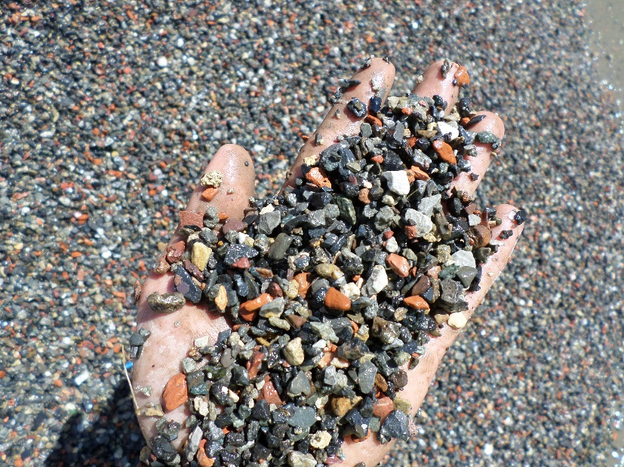
Global context
… into secondary ressources

Slide 9
Global context
3R: Reduce, Reuse and Recycle
Meeting Sustainable Development Goals: recovery targets to 70% of construction and demolition wastes (CD&W) by 2020 in European Union (Directive 2008/98/EC)
Reducing use of natural aggregates (preservation of natural resources)

Slide 10
Global context
3R: Reduce, Reuse and Recycle
  Mean recycling of C&DW in EU27 is 87% (7% backfilling and 80% recycling) + 7% landfilling and 6% energy recovery
  25 (out of 27) member states comply with the target!
  In 7 (out of 25 states complying), compliance is only with backfilling
Using CD&W as sub-base and base material in road construction (“less noble”) → upcycling (“upscaling”)
Use of recycled aggregates in concrete – opportunities for upscaling in Europe. J. N. Pacheco, J. de Brito, M. L. Tornaghi, 2023 (JRC Science for policy report (ISSN 1831-9424)

Slide 11
Conditions for recycling: requirements, barriers, applications

Slide 12
Conditions for recycling
Possible applications
  (Back)Filling materials: low requirements, consumed in large quantities, for embankments but transportable over short distances due to costs;
  Aggregates: high quality requirements to lead to finished products of quality identical to that of traditional materials;
  Binders: very precise specifications, properties must remain constant over time;
  Activators: small quantities, which can cause problems of collection, storage, distribution and regularity.

Slide 13
Conditions for recycling
Possible restrictions
  Transport
    Transport price = f(quantity, distance)
    Independent of the quality
    Interesting recycling if
      Landfill far away
      High dumping charge
      Expensive raw materials and difficult supply
  Standards
    a material has not specification because it is new and not used
    a material is little used because it is uncovered by specifications

Slide 14
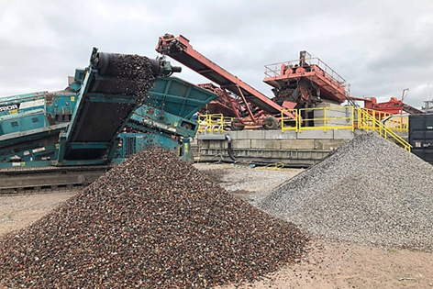
Conditions for recycling
Possible restrictions
  Technique
    Constant properties over time- Material quality
  Logistic et economic
    Constant production over time
  Environmental impact
    LCA

Slide 15
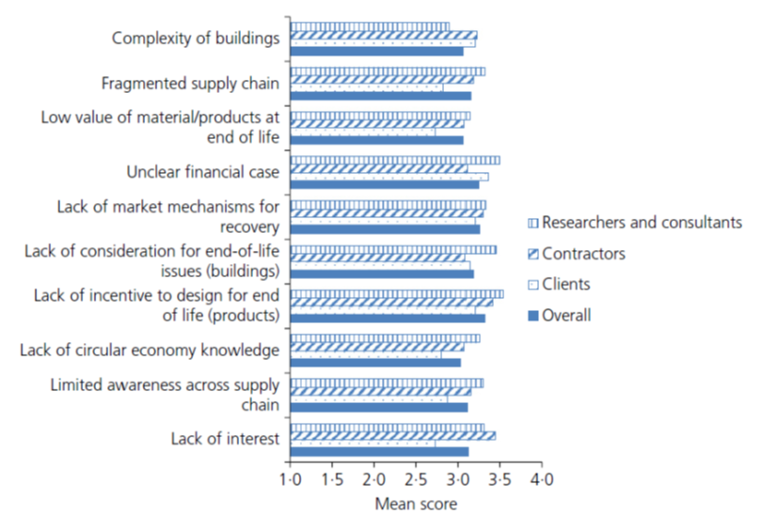
Barriers and challenges
Most significant challenges for implementing circular economy in industrywide (survey-2017)
Tebbat Adams, K., Thorpe T., Osmani M., Thornback J., “Circular economy in construction: current awareness, challenges and enablers”. Waste and resources management 170 (1) (2017) 15-24

Slide 16
Recommendations (JRC-2023)
Public authorities need to understand the full picture
Reliable statistics for monitoring of C&DW recovery performances (national and regional levels)
Ensure broad geographical coverage of C&DW recycling facilities – capacitate concrete producers for RA use
Create a demand, ensure a market
Legislation to enforce policy, inspection to enforce legislation
Use of recycled aggregates in concrete – opportunities for upscaling in Europe. J. N. Pacheco, J. de Brito, M. L. Tornaghi, 2023 (JRC Science for policy report (ISSN 1831-9424))

Slide 17
Recommendations (JRC-2023))
Provide guidelines and standards and train the supply chain
Accelerate innovation through knowledge transfer and synergies
Research and innovation in improved methods for reuse and recycling
Large scale, nation-wide holistic industry-oriented program
Increase public outreach and clear communication – circular models require public trust and transport
Do not underestimate the importance of local authorities
Use of recycled aggregates in concrete – opportunities for upscaling in Europe. J. N. Pacheco, J. de Brito, M. L. Tornaghi, 2023 (JRC Science for policy report (ISSN 1831-9424))

Slide 18
Recommendations: examples and applications

Slide 19
Recommendations
Public authorities need to understand the full picture
  Enhance public procurement through the introduction of mandatory percentages of recycled aggregates in large civil engineering projects
  Prohibit landfilling
Reliable statistics for monitoring of C&DW recovery performances (national and regional levels)

Slide 20
Reliable statistics
We produce wastes
  Between 3.4 to 4 billions tons/year or from 80 to 126 tons/second!
  Each day, human activity is contributing for more than 10 billions kg wastes
  Annual production of recycled aggregates accounted for 278 million tons in 2019
  Construction area is producing more or less than 40% of CO₂
UEPG, 2021. European Aggregates Association – Annual Review 2020-2021, Brussels, 30 p.

Slide 21
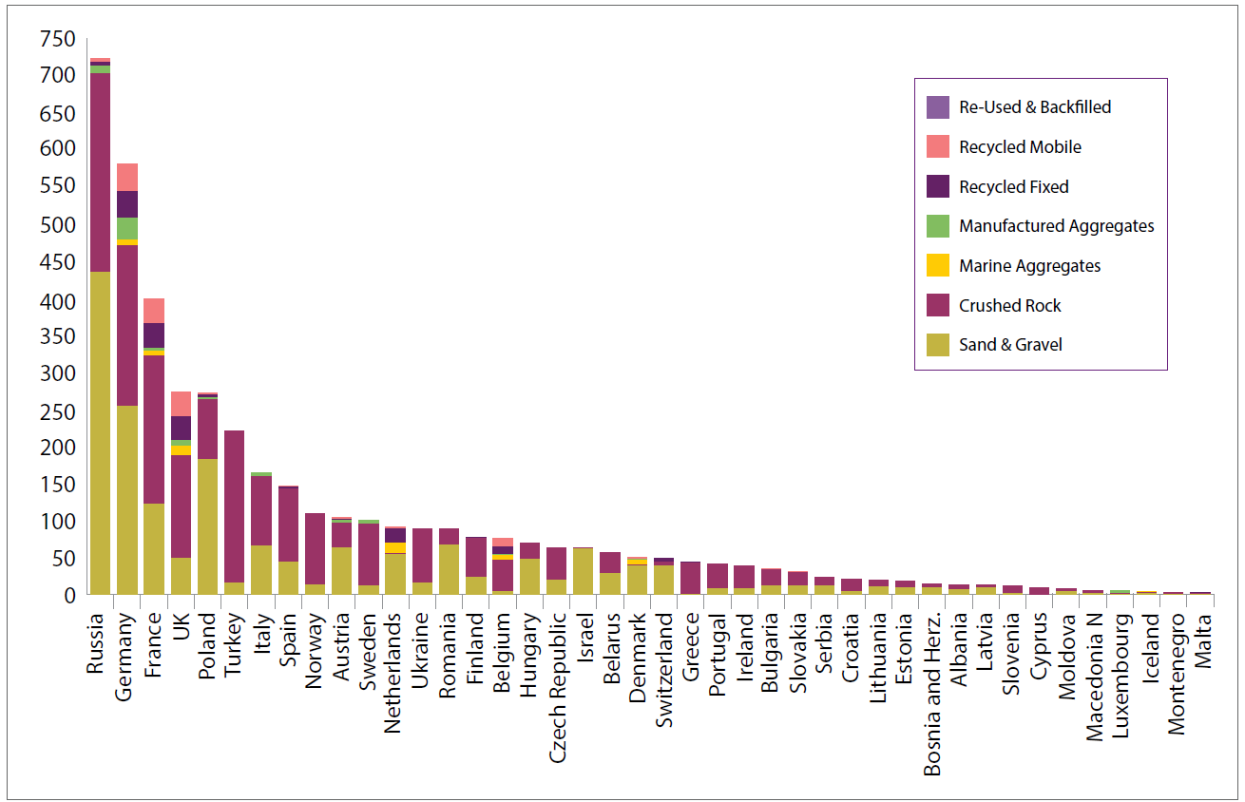
Reliable statistics
2020 aggregates production in Europe in millions of tonnes by country and type
UEPG, 2021. European Aggregates Association – Annual Review 2020-2021, Brussels, 30 p.

Slide 22
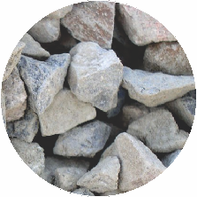
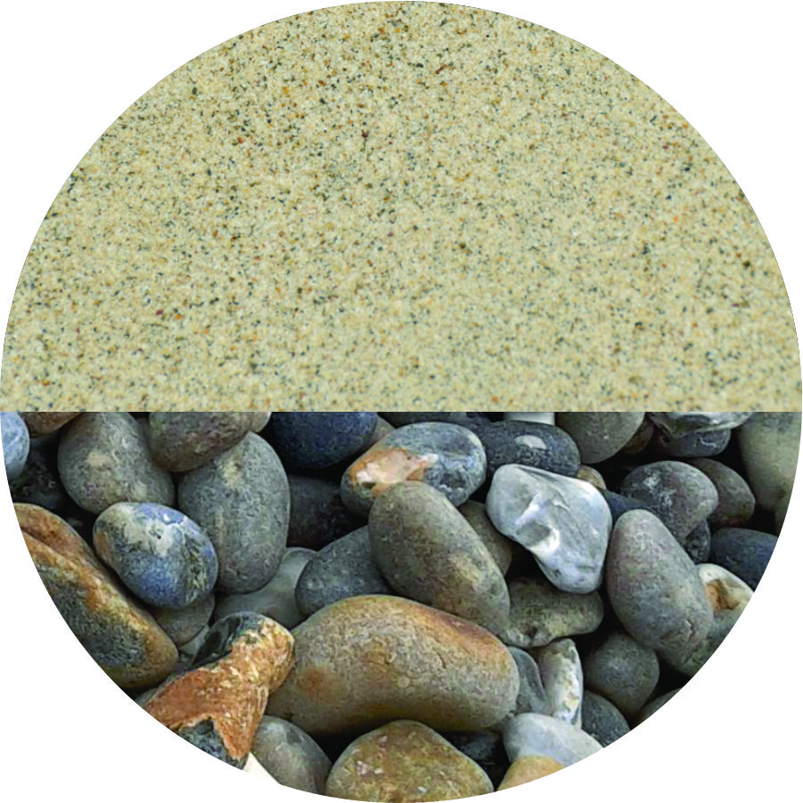
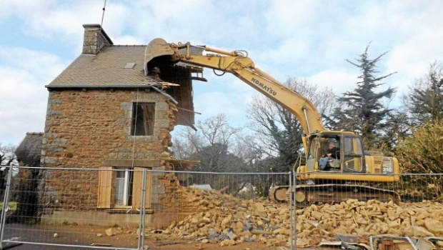
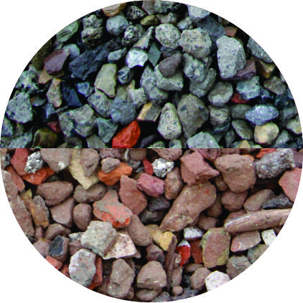
Reliable statistics
3 billion tons produced in EU27+UK+EFTA in 2019 (UEPG 2021)
Virgin Aggregates
Recycled Aggregates
46.9% crushed rock
39.7% sand & gravel
Construction & demolition wastes (CDW)
9.3% recycled (278 million tonnes)
Concrete
Mixed
INTERREG NEW CirMAP - Valorisation of Recycled fine aggregates through 3D printing of customized shapes (WP1T1)

Slide 23
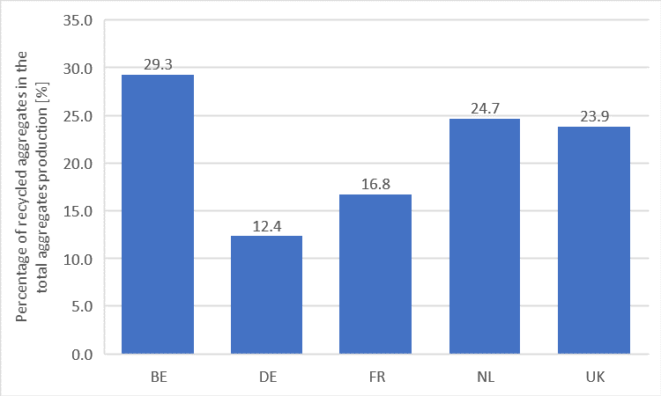
Reliable statistics
NWE countries (BE, DE, FR, NL, UK) are responsible for:
  47% of the virgin aggregates production (1417 Mtons)
  89% of the recycled aggregates production (248.4 Mtons)
Recycled aggregates/natural aggregates
INTERREG NEW CirMAP - Valorisation of Recycled fine aggregates through 3D printing of customized shapes (WP1T1)

Slide 24
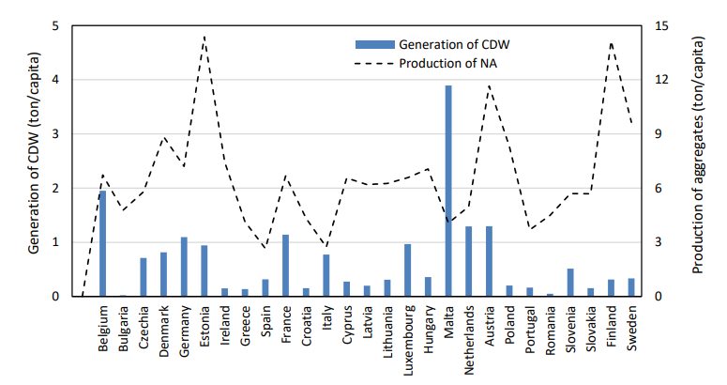
Reliable statistics
Generation of C&DW and production of NA per capita
Use of recycled aggregates in concrete – opportunities for upscaling in Europe. J. N. Pacheco, J. de Brito, M. L. Tornaghi, 2023 (JRC Science for policy report (ISSN 1831-9424)

Slide 25
Reliable statistics
Non metallic material extraction has increased nearly 5 times over the 50 last years
It represents now almost half of the total material extraction (42,8 BT)
Build stocks have grown 23-fold in the 21th century
In 2018, 43,6 BT materials were added while 12BT was depleted from stock
Net addition: 32,8 BT (two-third of net stock addition in Growing Countries)

Slide 26
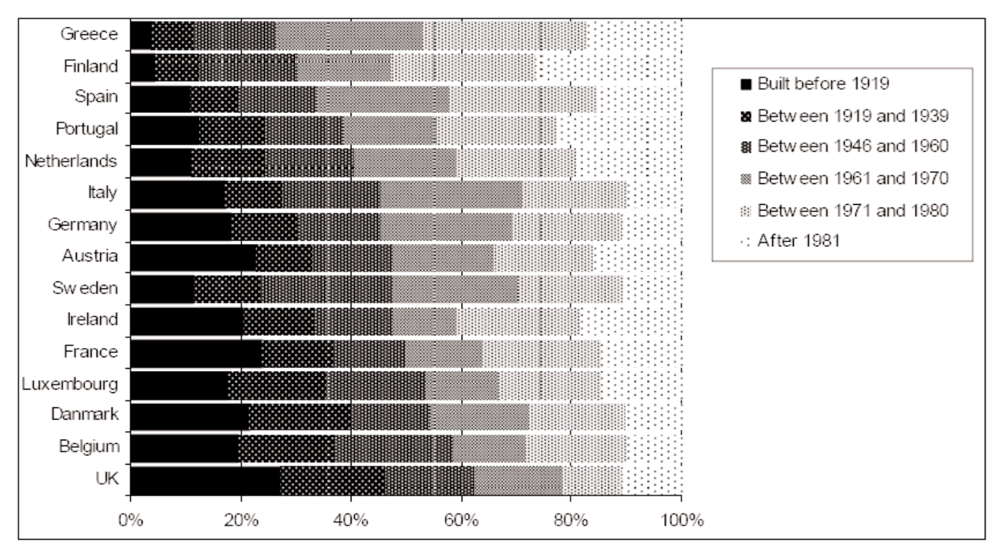
Reliable statistics
Distribution of building age in different European countries (BE: 70% older than 1970)
Scientific Support Plan for a Sustainable Development Policy (SPSD II), (2006), Socio-technical factors influencing residential energy consumption (SEREC), Belgian Science Policy, Brussels

Slide 27
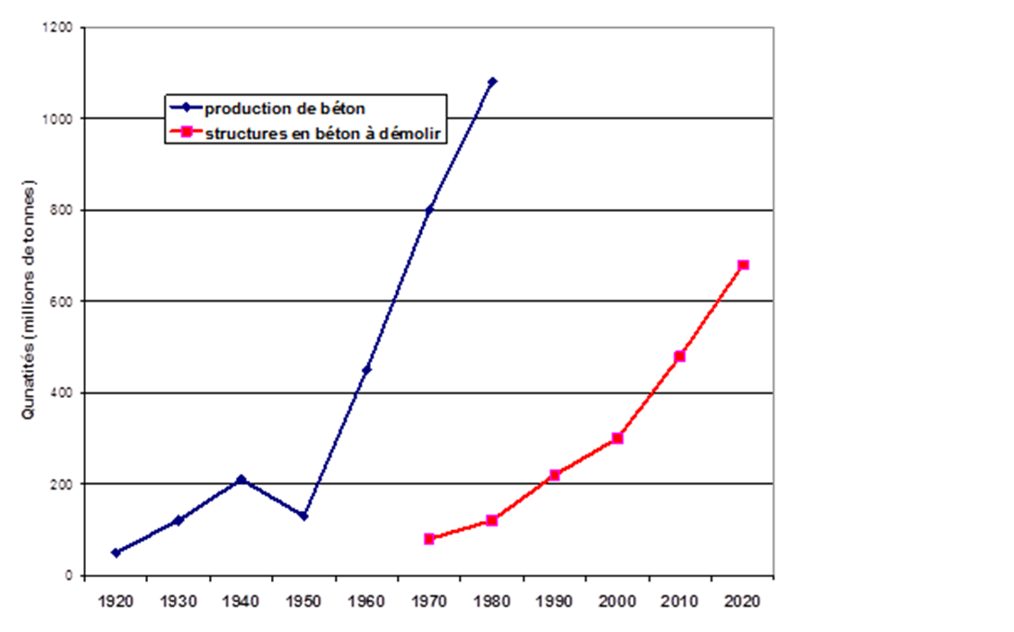
Geographical coverage
Ensure broad geographical coverage of C&DW recycling facilities – capacitate concrete producers for RA use

Slide 28
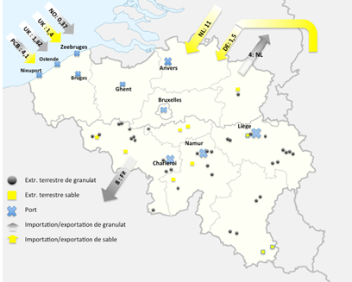
Geographical coverage
Market versus extraction site
  Example Antwerp: large city – no raw natural materials
Provinces and Brussels | Consumption (Million tonnes) | Mean distance from quarry (km)
Antwerp | 13.78 | 102
Flemish Brabant | 8.51 | 70
Walloon Brabant | 9.16 | 42
Brussels | 11.32 | 56
West Flanders | 6.62 | 39
East Flanders | 27.64 | 70
Hainaut | 3.00 | 40
Limburg | 10.35 | 64
Liege | 8.43 | 43
Luxembourg | 0.59 | 38
Namur | 2.13 | 45

Slide 29
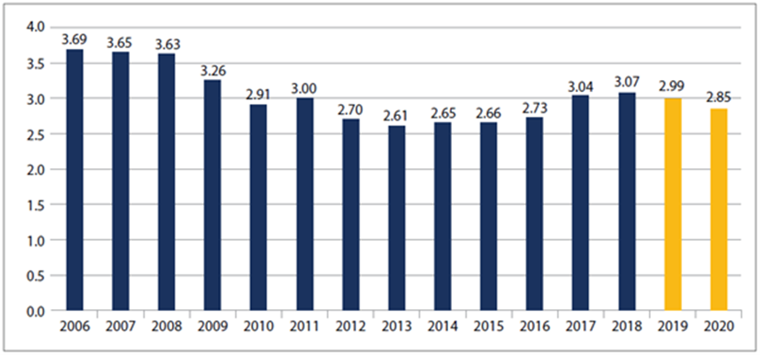
Market
Create a demand, ensure a market
  Trend in total EU27 + UK + EFTA Tonnages (in billions of tonnes) for the production of aggregates (UEPG 2021) - 26,000 quarries and pits, operated by 15,000 companies

Slide 30
Legislation
Legislation to enforce policy, inspection to enforce legislation
  End (out)-of-waste status
    Certification CE2+
    Technical sheet
    Declaration of performance
  → recycled aggregate = aggregate

Slide 31
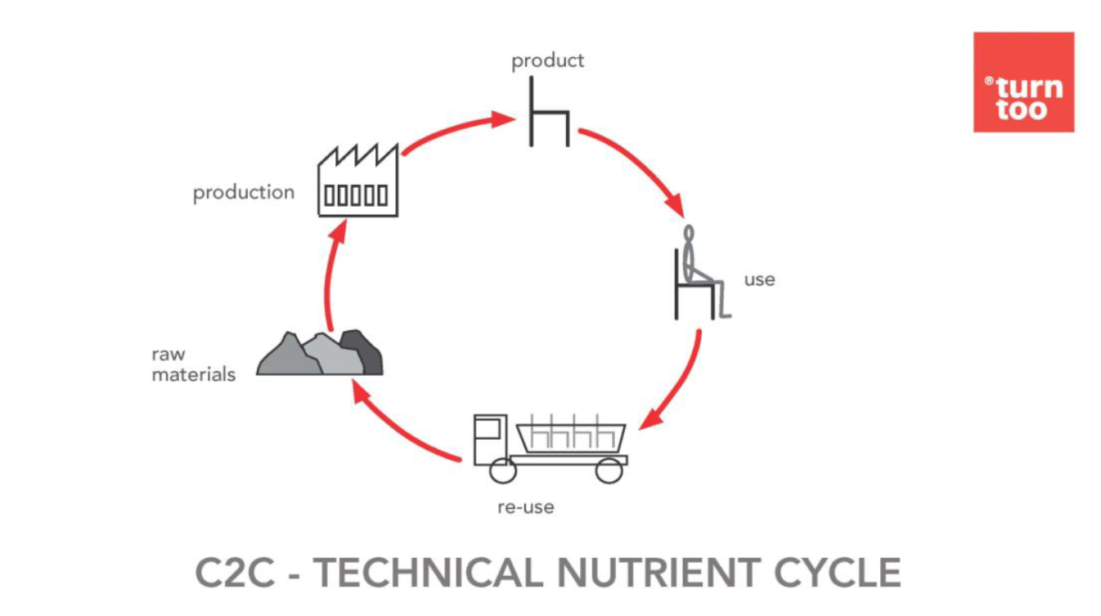
Guidelines and standards
Provide guidelines and standards and train the supply chain (do not mix organic and inorganic materials)
S. BECKERS (d’après M. BRAUNGART –EPEA, Cradle to Cradle)

Slide 32
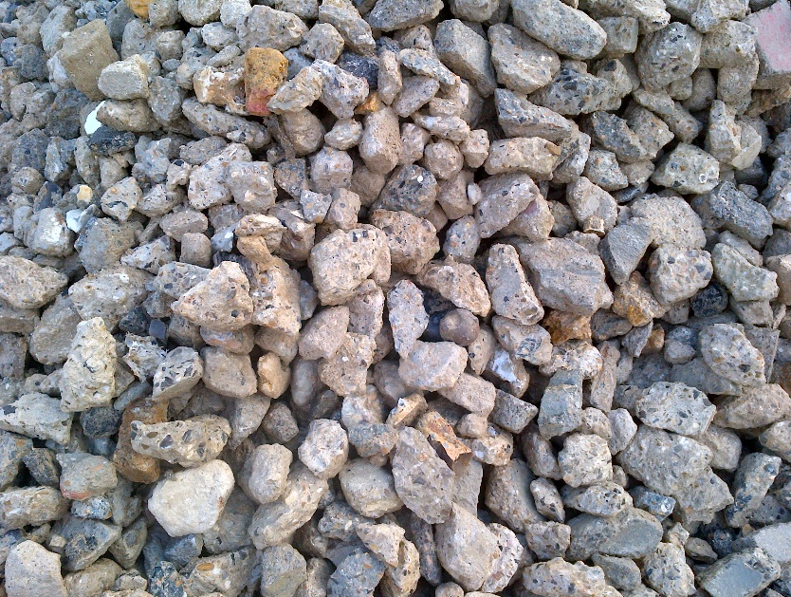
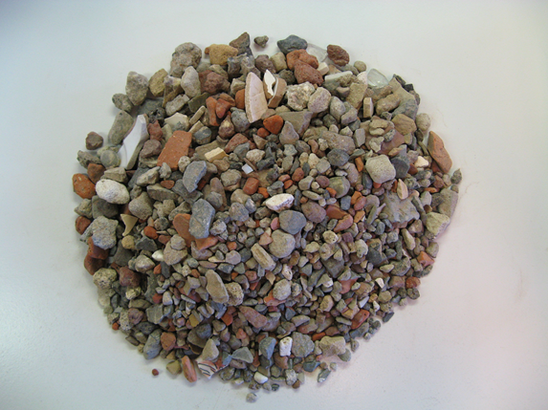
Guidelines and standards
Standards NBN EN 206 and NBN B 15-001
  Annex E (NBN EN 206) gives recommendations for using recycled aggregates
  Two types of aggregates are defined (d > 4mm) :
Type A : concrete aggregates | Type B : mix aggregates

Slide 33

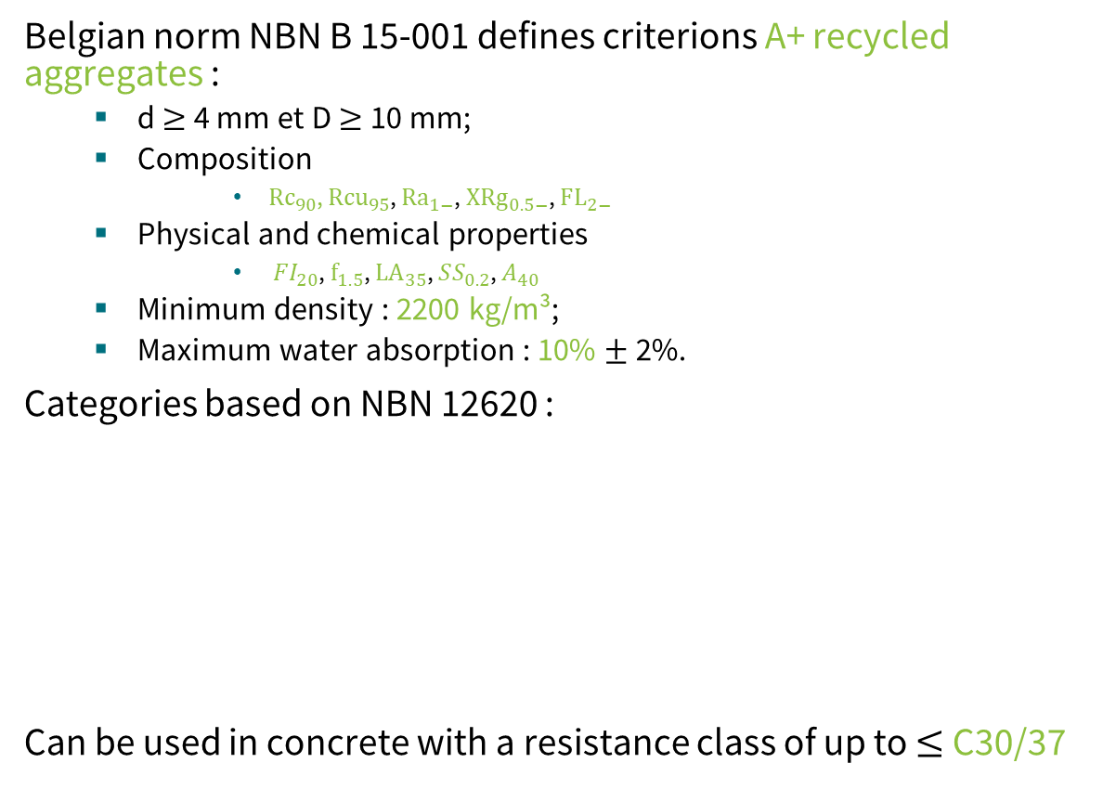
Guidelines and standards
Belgian norm NBN B 15-001 defines criterions A+ recycled aggregates :
  d $≥$ 4 mm et D $≥$ 10 mm;
  Composition
      ${Rc}_{90}$, ${Rcu}_{95}$, ${Ra}_{1−}$, $X{Rg}_{0.5−}$, $FL_{2−}$
  Physical and chemical properties
      ${FI}_{20}$, $f_{1.5}$, ${LA}_{35}$, $SS_{0.2}$, $A_{40}$
  Minimum density : 2200 kg/m³;
  Maximum water absorption : 10% $±$ 2%.
Categories based on NBN 12620 :
Can be used in concrete with a resistance class of up to $≤$ C30/37
Rc : concrete Ru : natural stone Ra : bitumineous material XRg : glass FL : floating materials | FI : flakiness index f : fine content LA : Los Angeles coefficient SS : soluble sulfate A : setting time modification

Slide 34
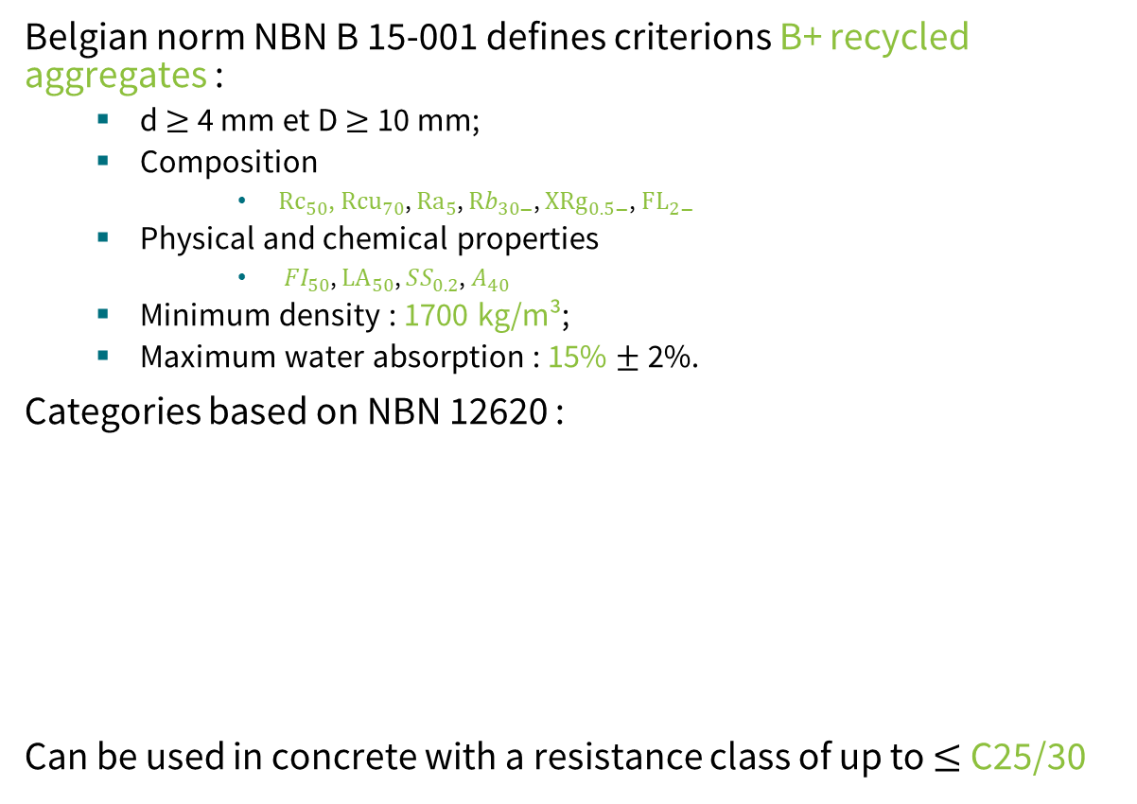
Guidelines and standards
Belgian norm NBN B 15-001 defines criterions B+ recycled aggregates :
  d $≥$ 4 mm et D $≥$ 10 mm;
  Composition
      ${Rc}_{50}$, ${Rcu}_{70}$, ${Ra}_{5}$, ${Rb}_{30−}$, $X{Rg}_{0.5−}$, $FL_{2−}$
  Physical and chemical properties
      ${FI}_{50}$, ${LA}_{50}$, $SS_{0.2}$, $A_{40}$
  Minimum density : 1700 kg/m³;
  Maximum water absorption : 15% $±$ 2%.
Categories based on NBN 12620 :
Can be used in concrete with a resistance class of up to $≤$ C25/30
Rc : concrete Ru : natural stone Ra : bitumineous material XRg : glass FL : floating materials | FI : flakiness index f : fine content LA : Los Angeles coefficient SS : soluble sulphate A : setting time modification

Slide 35

Knowledge transfer
Accelerate innovation through knowledge transfer and synergies

Slide 36
Knowledge transfer
MOOC ConstruiREcycler
  MOOC (Massive Open Online Course)
  Objective: study opportunities for the valorization of secondary resources for buildings and civil engineering
Organization: 4 weeks
  Introduction
  Aggregates
  Binders
  Insulating products

Slide 37
Industry-oriented projects
Large scale, nation-wide holistic industry-oriented program
  PNR Recybeton (France): https://www.pnrecybeton.fr/rapports/rapports-recybeton/
  INTERREG SeRaMCo (BE, FR, GE, LU, NL): https://vb.nweurope.eu/projects/project-search/seramco-secondary-raw-materials-for-concrete-precast-products

Slide 38
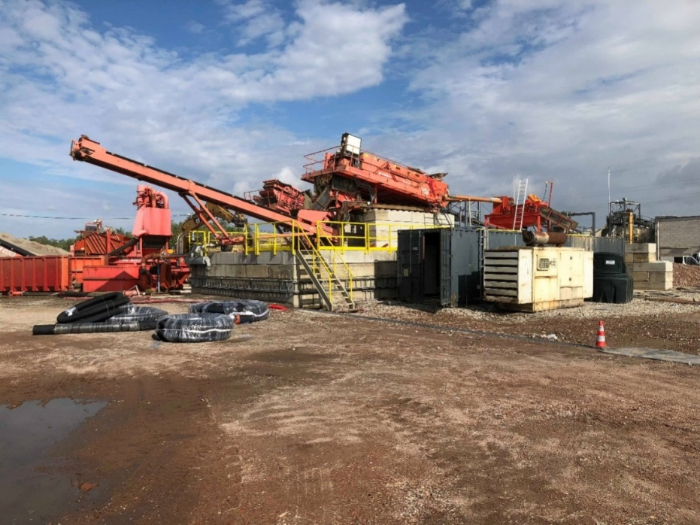
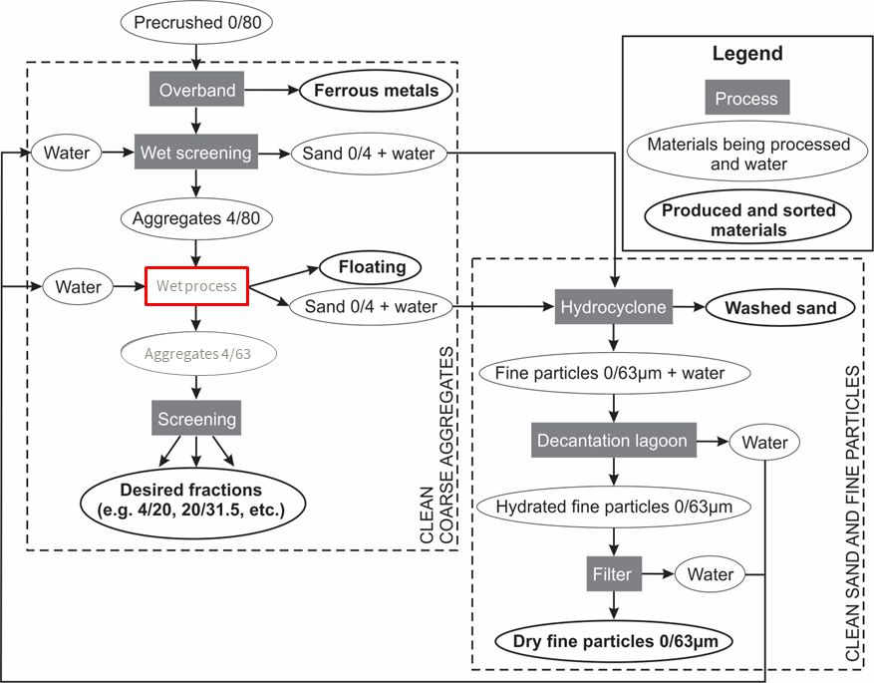
Industry-oriented projects
SeRaMCo recycling plant (Tradecowall)

Slide 39
Research and innovation
Research and innovation in improved methods for reuse and recycling
  Preparation of recycled concrete aggregates: materials processing
  Recycling production waste for concrete blocks
  RA for prefab elements
  Valorization of fine bricks
  Use of recycled sand for 3D printing
  CO₂ capture for increasing RCA properties

Slide 40
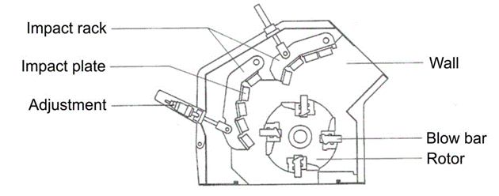
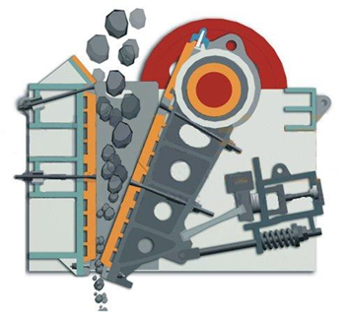
Material processing
Impact crusher
  allows producing very fine fractions
  induces the biggest wear
  limited by the primary size of waste to be treated
Jaw crusher
  to treat bulky waste like concrete slabs
  does not allow to produce very fine particles
  generally requires a secondary crushing
Effects of crushing method on the properties of produced recycled concrete aggregates. J. Hubert, Z. Zhao, F. Michel, L. Courard. Buildings 2023, 13, 2217 (https://doi.org//10.3390/buildings13092217)

Slide 41
Material processing
Experimental mixes
Name | Reference | CEM III | Sandstone | Low cement | Low W/C
Aggregates nature | Limestone | Limestone | Sandstone | Limestone | Limestone
Aggregates 2/7 mm (kg/m³) | 368.8 | 368.8 | 368.8 | 405.1 | 367.1
Aggregates 7/14 mm (kg/m³) | 345 | 345 | 345 | 379 | 343.4
Aggregates 14/20 mm (kg/m³) | 433.5 | 433.5 | 433.5 | 476.2 | 431.5
Sand 0/4 mm (kg/m³) | 604.9 | 604.9 | 604.9 | 664.4 | 602.1
Cement type | CEM I 52.5 | CEM III 52.5 | CEM I 52.5 | CEM I 52.5 | CEM I 52.5
Cement quantity (kg/m³) | 400 | 400 | 400 | 320 | 452
Cement paste volume (dm³/m³) | 351 | 358 | 351 | 282 | 351
Efficient water (kg) | 224.2 | 224.2 | 224.2 | 180.6 | 207.1
W/C ratio | 0.56 | 0.56 | 0.56 | 0.56 | 0.46
Superplasticizer (g/kg cement) | 0 | 0 | 0 | 6.8 | 3.3

Slide 42
Material processing
The flakiness index decreases with increasing granular fraction
The jaw crusher produces flakier aggregates
No influence of the concrete composition

Slide 43
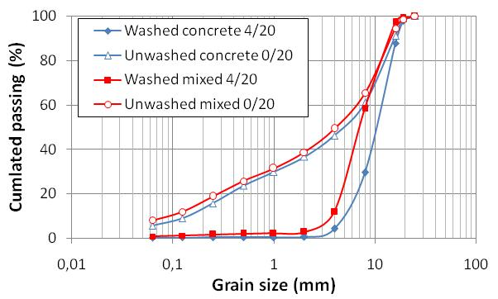
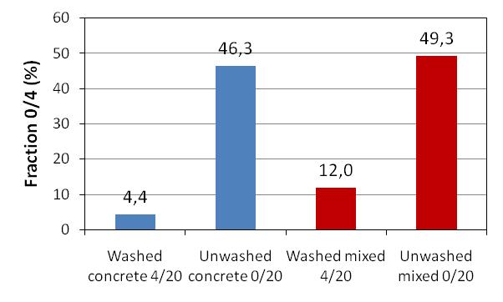
Materials processing: washing
0/4 fraction comprises nearly 50% of the unwashed aggregates composition
0/4 fraction a bit higher in mixed aggregates
Washing significantly reduces the sand fraction of the aggregates
Unwashed
Washed

Slide 44
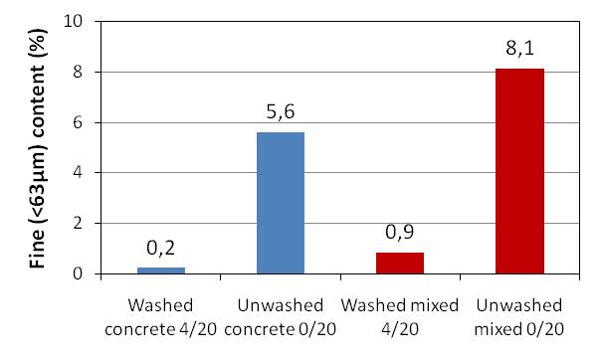
Materials processing: washing
Fine content (< 63µm) higher in mixed aggregates and significantly reduced by washing
Fine fraction higher in mixed aggregates
Washed aggregates respect regulations in all considered countries
Max. allowed

Slide 45
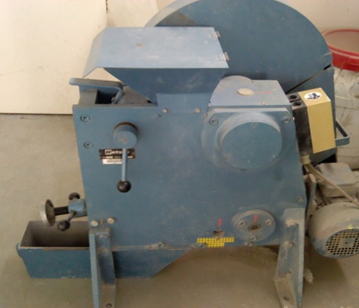
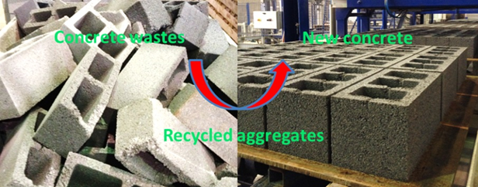
Production wastes
RCA manufactured in laboratory
  Old concrete from block wastes (C8/10 concrete)
  Crushing (jaw crusher in laboratory, opening ≈10mm)
  Separation of RCA by sieving (0/20mm)
    Four granular classes: 0/2 - 2/6.3 - 6.3/14 - 14/20
Use of RCA from precast blocks for the production of new concrete building blocks: an industrial scale study. Z. Zhao, L. Courard, S. Groslambert, Th. Jehin, A. Léonard, J. Xiao. Resources, Conservation & Recycling 157 (2020) 1-13 (https://authors.elsevier.com/a/1ahbs3HVLKiAuJ)( http://hdl.handle.net/2268/246444)

Slide 46
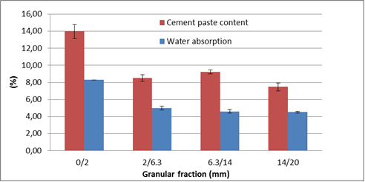
Production wastes
Water absorption W_{A} (EN 1097-6)
  Cement Paste Content and W_{A} of 0/2mm fraction larger than three coarse fractions

Slide 47
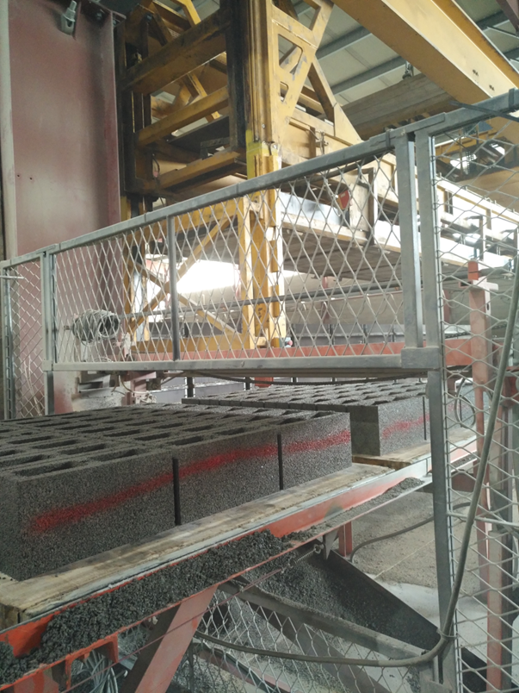
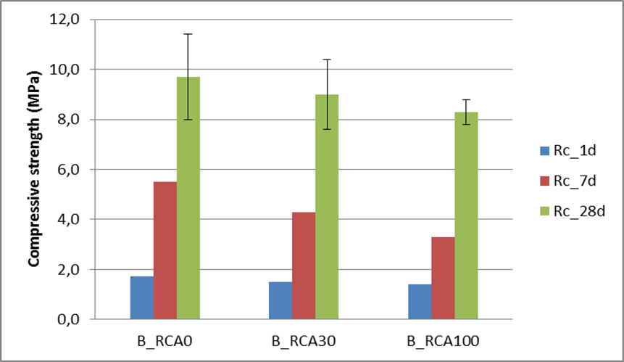
Production wastes
Compressive strength
  Compressive strengths of concretes with RCA are slightly lower than those of concrete with natural aggregate
  Compressive strength of concrete made with 100% RCA at 28 days is 8 MPa (14.4% decrease)

Slide 48
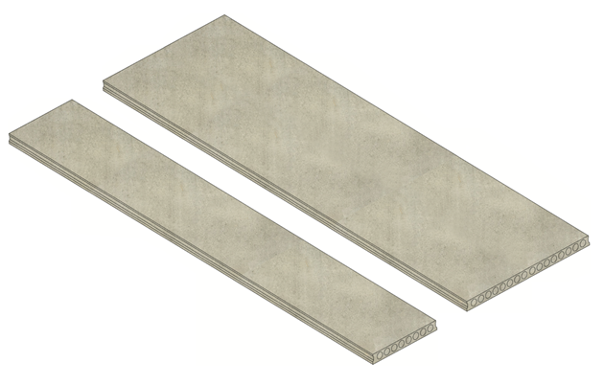
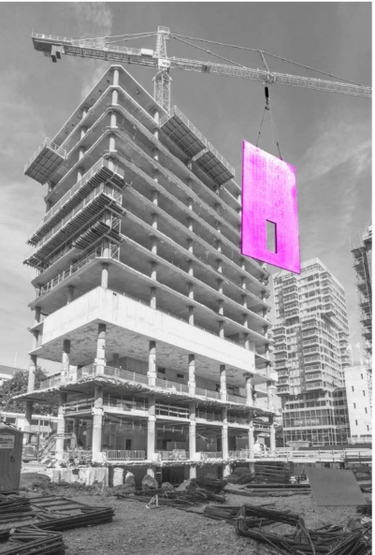
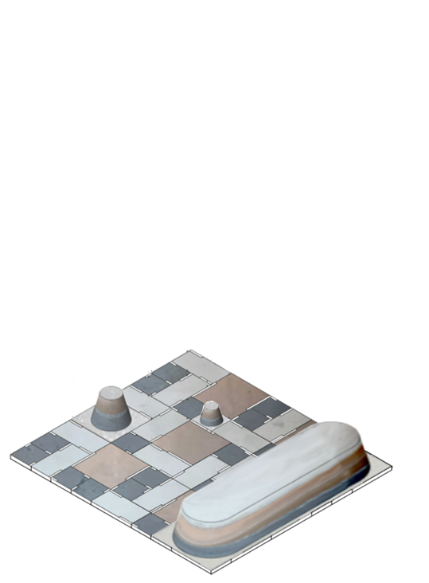
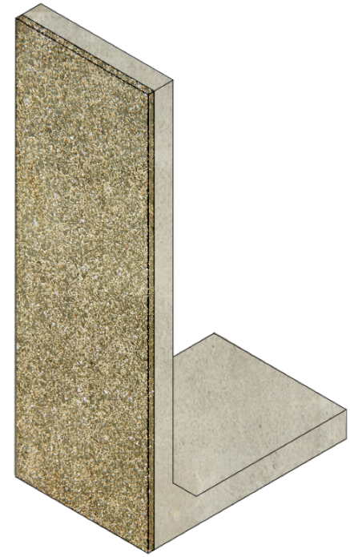
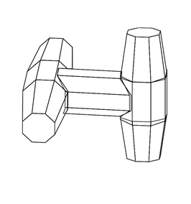
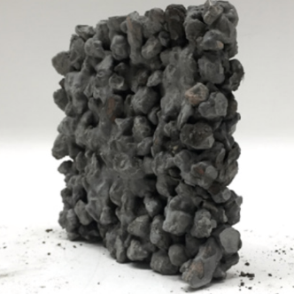
Prefab products
      Hollow Core Floor Slab
      Urban SeRaMCo Elements
      Sound Absorbing L-Wall
      Façade Cladding
      Salty Concrete
      Rammed Concrete
      Energy Sound Barrier
      Foam Concrete Insulated Wall
      Cooling Wall
      Energy Bench

Slide 49
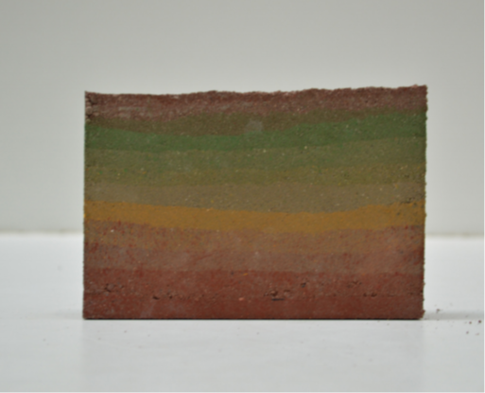
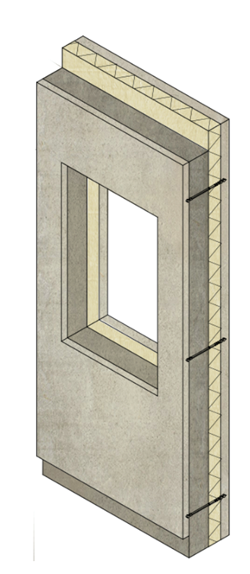
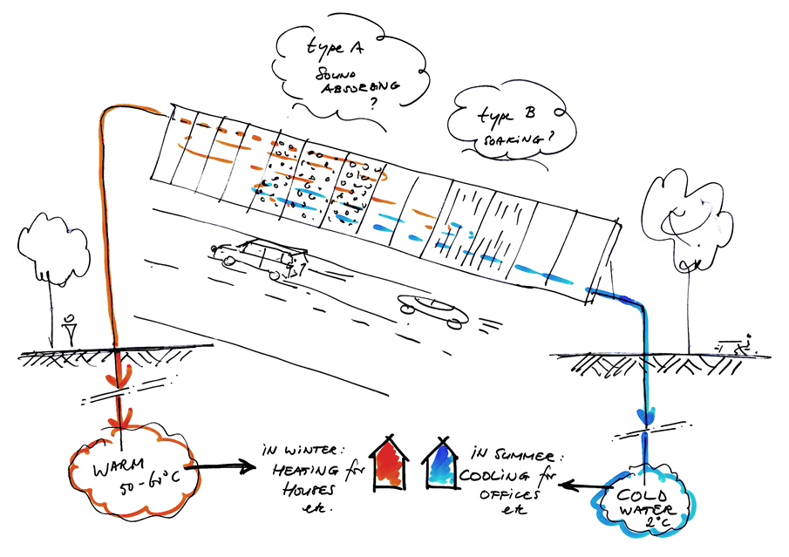
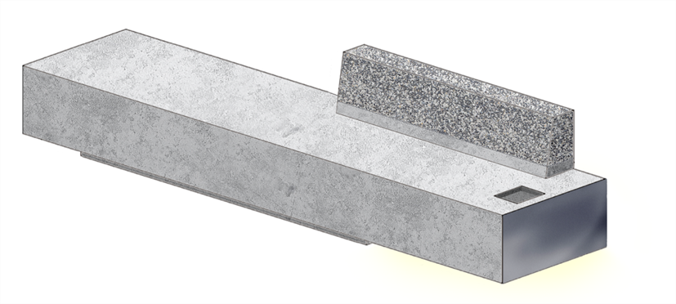
Prefab products
      Hollow Core Floor Slab
      Urban SeRaMCo Elements
      Sound Absorbing L-Wall
      Façade Cladding
      Salty Concrete
      Rammed Concrete
      Energy Sound Barrier
      Foam Concrete Insulated Wall
      Cooling Wall
      Energy Bench

Slide 50


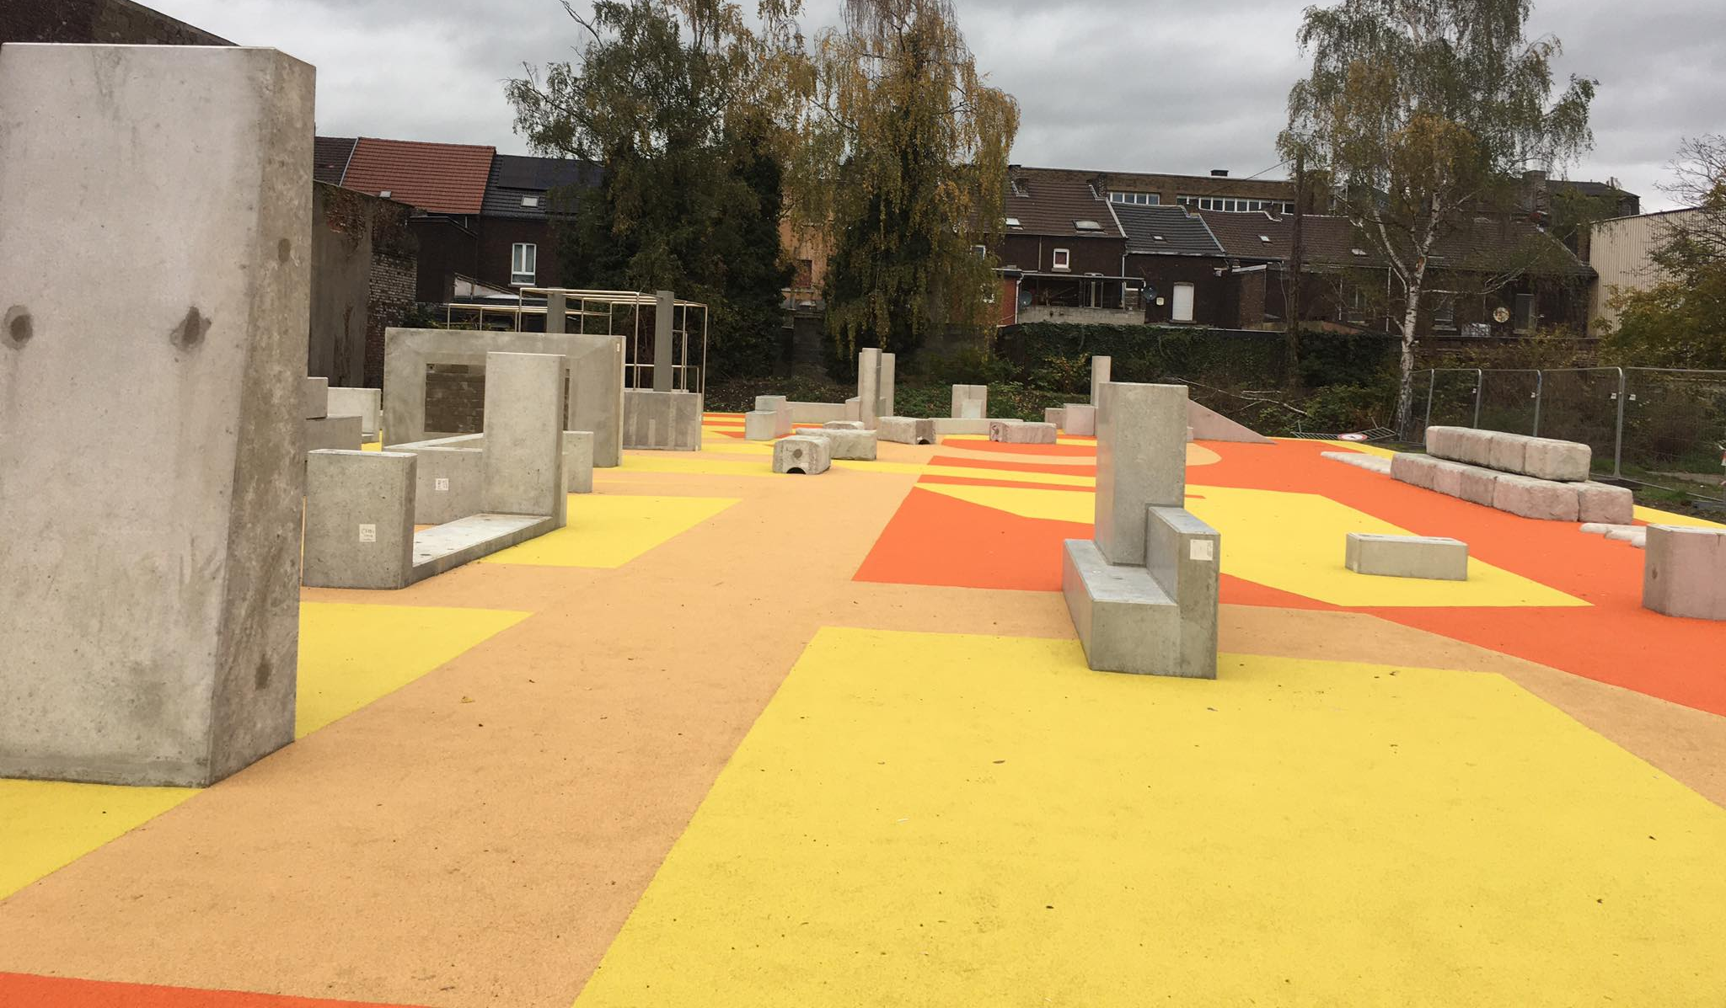

Prefab products: Parkour Park
      Cement produced with recycled fines
      Recycled concrete aggregates
      Natural sand
𝑅𝑐 : 50-55 MPa
W/C <= 0.45
Ciment >= 340 kg/m³
Absorption d’eau <= 6.5%

Slide 51

Fine bricks
Flow of brick waste: 1-2% of C&DW in BE/North of France
Valorization
  Reuse of bricks
  Aggregates: landfilling/recycling for backfilling
  Brick fine particles
Recycled brick fines for new alkali activated binder. A. Grellier, D. Bulteel, L. Courard. 17th International Congress on Polymers in Concrete ICPIC 2023, Sept. 17-20th, Warsaw.

Slide 52
Fine bricks
Brick fine particles
  3 types of granulometry
    B1: d₅₀ = 3.3 µm (with supplementary cyclogrinding)
    B2: d₅₀ = 20 µm
    B3: d₅₀ = 190 µm
Mineralogy

Slide 53
Fine bricks
Alcali Activated Material production
Brick fine particles
B2
GGBFS
Alcali-Activating Solution
Soda (NaOH)
Sodium Silicates (Na₂SiO₃)
(SiO₂/Na₂O: 1.45)
Substitution
10, 20, 30 and 50 %
Characterization at
7 and 90 days

Slide 54

Fine bricks
Poral distribution
  Finer porosity with time for all the mixes
  Finer porosity with BLM 50% than BL 50%

Slide 55

Fine bricks
Mechanical strength
  BL: slower kinetics – Rc ↓ when [brick fines] ↑
  BLM: quicklier kinetics - Rc ≥ GGBFS from 90 days
  Brick fines can act as a precursor

Slide 56


Carbonation of RCA affected by AAR
Expansion (%)
  Laboratory manufactured RCA from boosted concrete stored at 38°C (+ carbonation 20%)
Effect of carbonation on recycled concrete aggregates affected by alkali-silica reaction. S. Grigoletto, J. Hubert, J. Duchesne, B. Bissonnette, F. Michel, L. Courard. 17th International Conference on Alkali Aggregate Reaction in Concrete ICCAR 2024, 18-24 mai 2024, Ottawa (Canada)

Slide 57





Recycled sand for 3D printing
Design opportunities
3D printing:
Binder
Environmental impact
Granular skeleton (100% recycled sand)
Siam Research and Innovation Company - Triple S (2017)
Notes:
Et c’est vraiment dans cette démarche que s’incrit le projet SeRaMCo qui a pour but de …

Slide 58


Mortar characterization
Casted samples (4x4x16 cm prismatic samples are casted)
Printed samples (4x4x16 cm prismatic samples are extracted from S shaped printed éléments)
Three points bending and compressive strength :
Influence of the type of sand (natural crushed limestone sand vs concrete RFA)
Compressive strength
Water curing (20°C and 95±5% relative humidity)

Slide 59
Mortar characterization
Capillary absorption tests NBN EN13057
Influence of the printing process (casted samples vs printed samples)
Water absorption [kg/m²] and absorption coefficient [mm/h^{0,5}]
Porosity
Influence of the printing process (casted samples vs printed samples)]

Slide 60

Conclusions
Urban furniture
Bernard Serin park in Seraing

Slide 61

Final recommendations
Challenges: supply chain, circular economy, acceptability

Slide 62



Acknowledgment
VALDEM INTERREG FWVL
  Integrated solutions for valorizing waste flows from building demolition: : a cricular economy over borders
CiRMAP INTERREG NWE project
  Circular economy via customisable furniture with Recycled MAterials for public Places - https://www.uee.uliege.be/cms/c_4843025/fr/cirmap
SeRaMCo INTERREG NWE project
  Secondary Raw Materials for Concrete Precast Products (introducing new products, applying the circular economy) - http://www.nweurope.eu/seramco

Slide 63

Acknowledgment
Wallonia Brussels International
  WalRoCarb – Carbonatation accélérée de bétons produits avec matériaux recyclés et cendres de biomasse (Accelerated Carbonation of Concrete produced with Recycled Materials and Biomass Ash)

