Slide 1

Mind blanking as default manifestation of contentless thinking
Mini-Symposium
'Non-ordinary states of consciousness’
October 15 2024
Paris
Athena Demertzi, PhD
Director, Physiology of Cognition Lab
GIGA Institute
CRC-Human Imaging Unit
University of Liège
BELGIUM

Slide 2
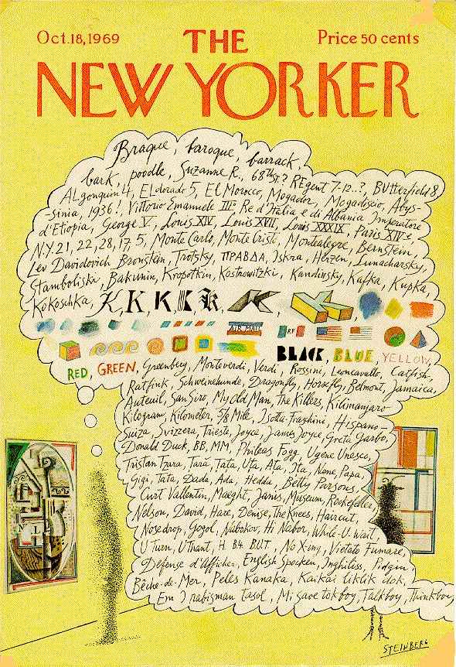
The resting brain
The resting mind
Demertzi, Kucyi, Ponce-Alvarez, Keliris, Whitfield-Gabrieli, Deco. Netw Neurosci 2022
Demertzi & Whitfield-Gabrieli: Neurology of Consciousness 2nd ed. 2015
Demertzi et al, Front Hum Neurosci 2013 Fox et al, PNAS 2005
Notes:
Saul Steinberg's marvelous New Yorker cover from October 8, 1969 (see Figure 1), provides the best picture of human consciousness I have encountered. Not just words, but colors and shapes succeed each other in delicious association. Even the genius of Steinberg can't quite render aromas, tickles and sounds on the cover of a magazine, but at least he suggests the likelihood of their inclusion. And the whole rendering is made possible by his exploitation of a familiar cartoonists' convention, the thought balloon or thought bubble. Calling this a convention underplays its naturalness; I doubt that children ever need to have the convention explained to them--it's quite wonderfully obvious what it depicts, metaphorically: the stream of consciouscontents in the mind of the man looking at the painting in the museum. This powerful and natural metaphor provides a nice setting of the problem of consciousness: If this picture gives us the metaphorical truth, what is the literal truth? How can an account of what happens in the man's brain ever do justice to the familiar--indeed intimate--facts we recognize in this metaphorical rendering?
W. James (1980): five characters in thought
Every thought tends to be part of a personal consciousness
Within each personal consciousness, thought is always changing
Within each personal consciousness, thought is sensibly continuous
It always appears to deal with objects independent of itself
It is interested in some parts of these objects to the exclusion of others, and welcomes or rejects or chooses from among them, all the while it thinks

Slide 3
Mental states
Christoff et al, Nat Rev Neurosci 2016
Notes:
Mental states =

Slide 4
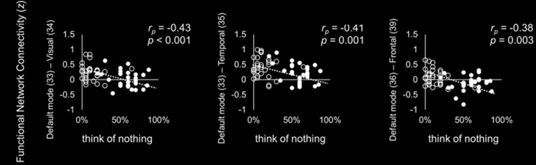
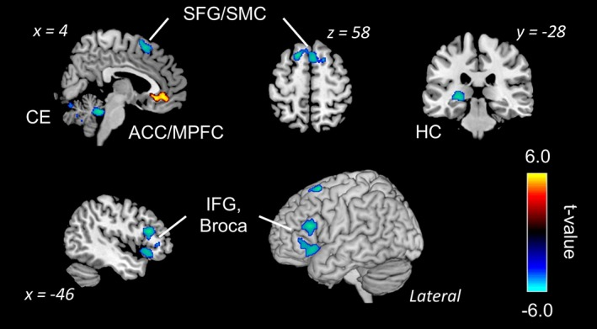
Voluntary Mind Blanking?
”Keep awake, fixate on the cross, and think of nothing as best you can. When you realise that you are thinking about something, disengage your attention and again try to think of nothing”.
Kawagoe et al , Eur J Neurosci 2018
“When you realize that you are thinking about something, disengage your attention and again try to think of nothing during the scans”
Kawagoe et al, Hum. Brain Mapp 2019
Notes:
Decreased activation:
Broca's area → reduced “inner speech”
Hippocampus → less impressionable “content”
Increased activation:
ACC → stream of consciousness continuity is retained
Decreased connectivity:
DMN - sensory cortices → less available content from sensory avenues to drive internally, self-oriented thought

Slide 5
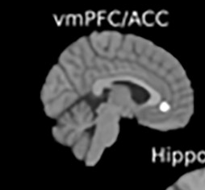
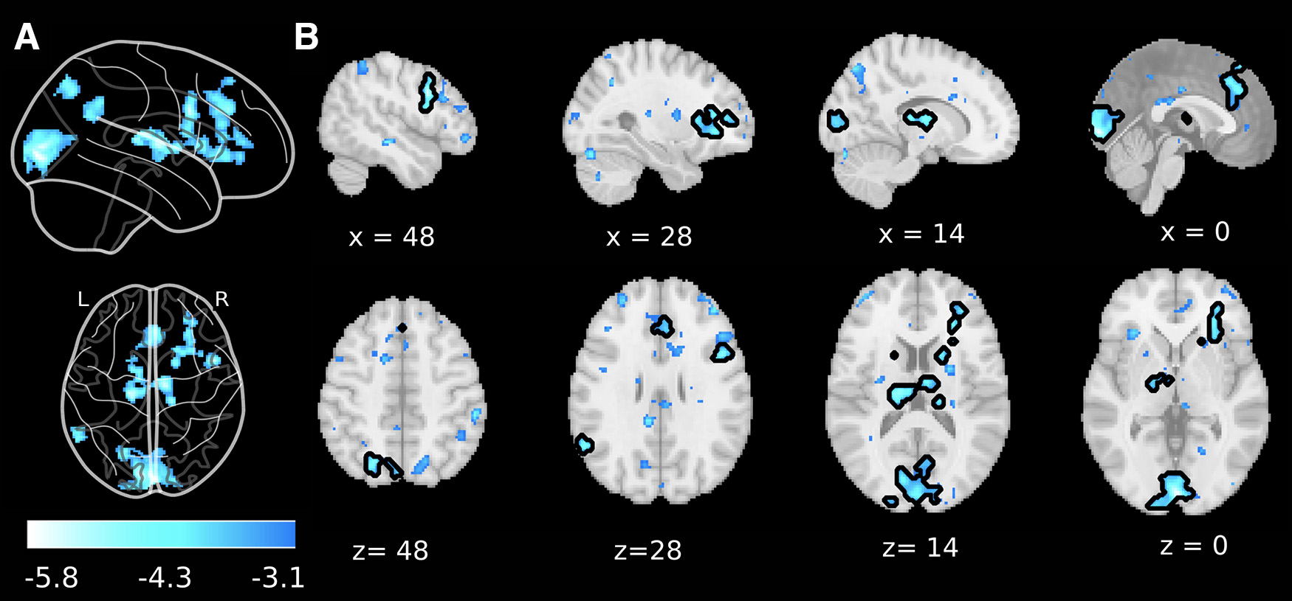
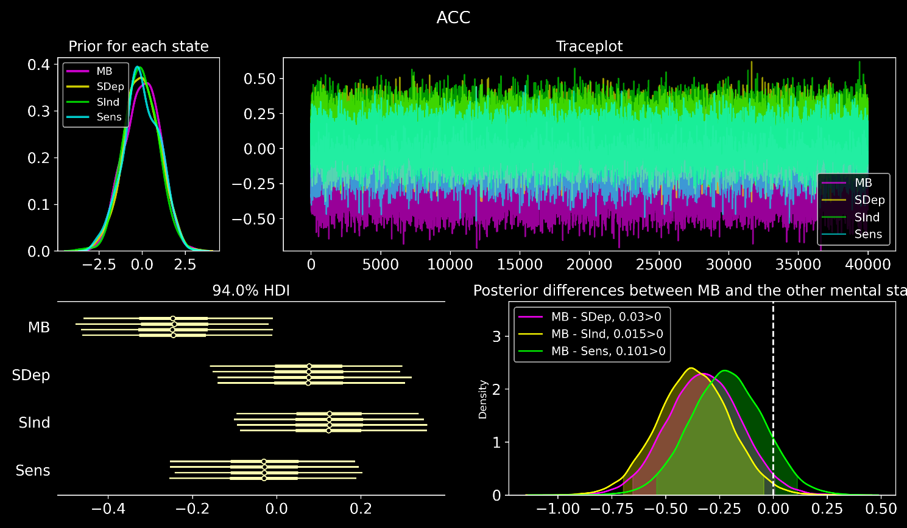
Non-induced Mind Blanking
fMRI univariate analysis of MB reports reveals whole-brain deactivations
Bayesian linear model of the beta parameters in
the ACC cluster (Kawagoe 2019)
Prior expectations Traceplot of model fit (MCMC-NUTS)
Posterior values
The vmPFC/ACC contains
significant evidence for MB deactivations
voxel-level p_{uncorrected} <0.001
cluster level p_{FDR} <0.05
Posterior distribution contrasts
Frontal deactivations differentiated
between MB and SInd
Boulakis, Mortaheb, Van Calster, Majerus, Demertzi. JNeurosci 2023
Notes:
We sampled 5000 samples from the posterior, with 2000 samples as burn-in.
- Forest plot of each of the four sampled chains of the posterior distribution indicate that vmPFC/ACC contains significant evidence for MB deactivations, as the b values did not contain 0 in the
94% highest density interval (HDI). The HDI is the interval which contains the required mass such that all points within the interval have a higher probability density than points outside the interval.
- Posterior differences between MB and the other mental states. We observed that the contrast MB-SInd did not contain 0 in the 94% HDI* (shaded yellow area), providing evidence that frontal deactivations differentiated between MB and SInd.
*The HDI can be used in the context of uncertainty characterisation of posterior distributions as Credible Interval (CI).
https://www.linkedin.com/advice/0/how-do-you-visualize-bayesian-models-skills-statistics#:~:text=Trace%20plots%20show%20how%20the,sampling%20from%20the%20posterior%20distribution.

Slide 6
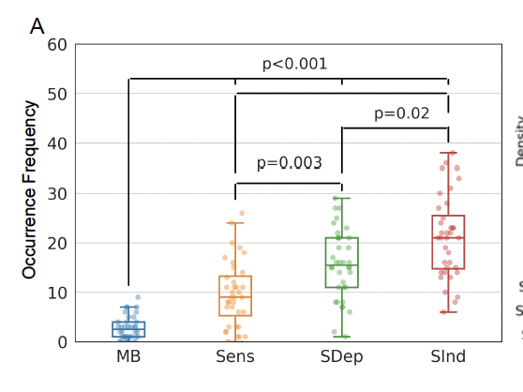
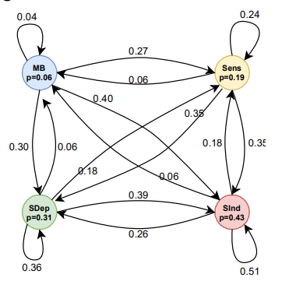
Mind Blanking reports happen spontaneously
Less frequent Equally probable across time Transient relay
MB Senses Stimulus Stimulus
Dependent Independent
n subjects= 36
n probes = 50
duration = 48-58min
Mortaheb, Van Calster, Raimondo, Klados, Boulakis, Georgoulaa, Majerus, Van De Ville*, Demertzi*. PNAS 2022
Van Calster, D’Argembeau, Salmon, Peters, Majerus, J Cogn Neurosci 2017

Slide 7
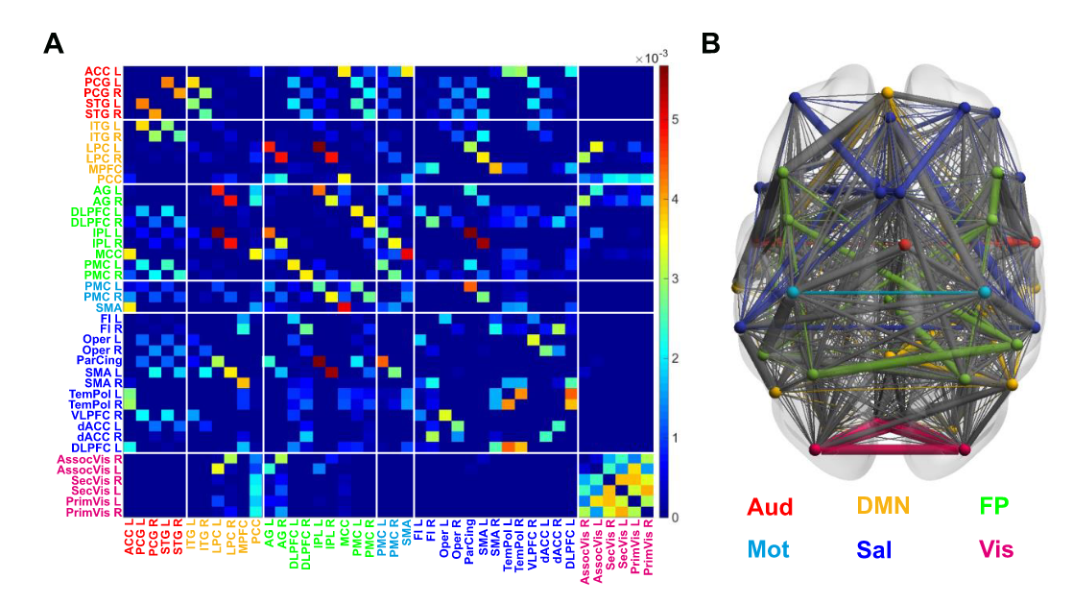
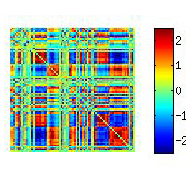
The brain as a network
100 billion neurons, ~100 trillion synaptic connections
The Connectome
Fornito, Zalesky, Bullmore. Ch 1: An Introduction to Brain Networks. Fundamentals of Brain Network Analysis, Academic Press 2016
Sporns, Tononi, & Koetter. PLoS Comput Biol 2005
Image from: Demertzi & Tagliazucchi, Dehaene, Deco, Barttfeld, Raimondo […] Sitt. Science Advances 2019
Notes:
This approach emphasises the fundamental roles of the interactions between regions, thereby finding solid grounding in the complex systems approach to the brain – and providing plentiful insights about brain function and dysfunction

Slide 8
“Simple” connectivity in unconscious states
Demertzi & Tagliazucchi, Dehaene, Deco, Barttfeld, Raimondo, Martial, Fernández-Espejo, Rohaut, Voss, Schiff, Owen, Laureys, Naccache, Sitt. Science Advances 2019

Slide 9
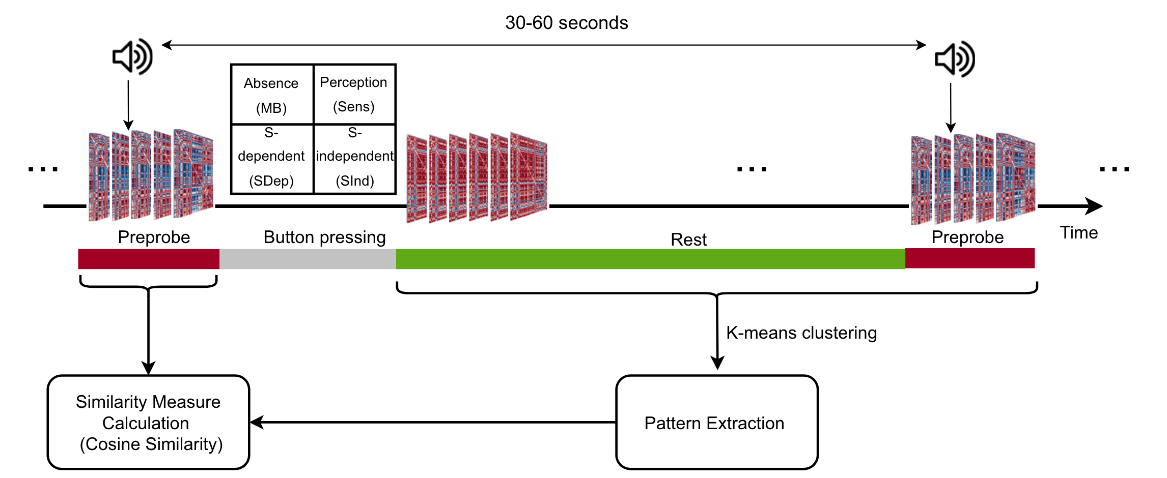
Experience Sampling and analysis
(48-58min)
n subjects= 36
n probes = 50
duration = 48-58min
Mortaheb, Van Calster, Raimondo, Klados, Boulakis, Georgoulaa, Majerus, Van De Ville*, Demertzi*. PNAS 2022
Van Calster, D’Argembeau, Salmon, Peters, Majerus, J Cogn Neurosci 2017

Slide 10
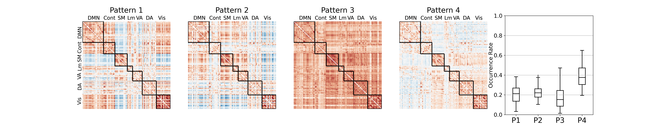
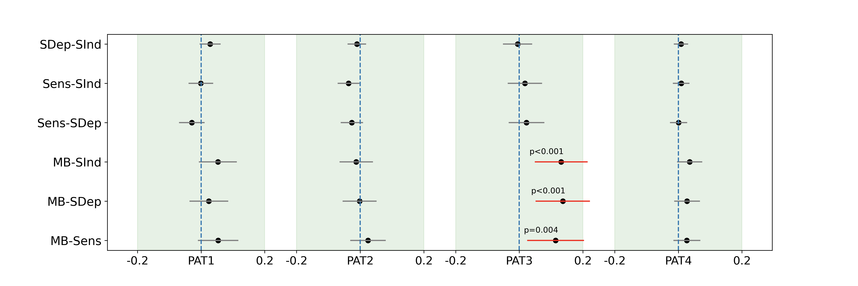
MB is linked to a hyper-connected state
Sparsely reported Reduced perceptions Equiprobable
Mortaheb, Van Calster, Raimondo, Klados, Boulakis, Georgoulaa, Majerus, Van De Ville*, Demertzi*. PNAS 2022
Notes:
Cosine similarity determines how similar two matrices/vectors are irrespective of their norm. It can be considered as the normalized version of the Euclidean distance (i.e., projecting the vectors onto the unit sphere and calculating Euclidean distance, which is then effectively the cosine of the angle between those vectors). Subsequently, for each mental state the distribution of distances to all four centroids was created.
A generalized linear mixed effect model with gamma distribution and log link function was applied to test the relationship between the distances to each pattern and the mental states.
Tukey post hoc test was applied to compare

Slide 11
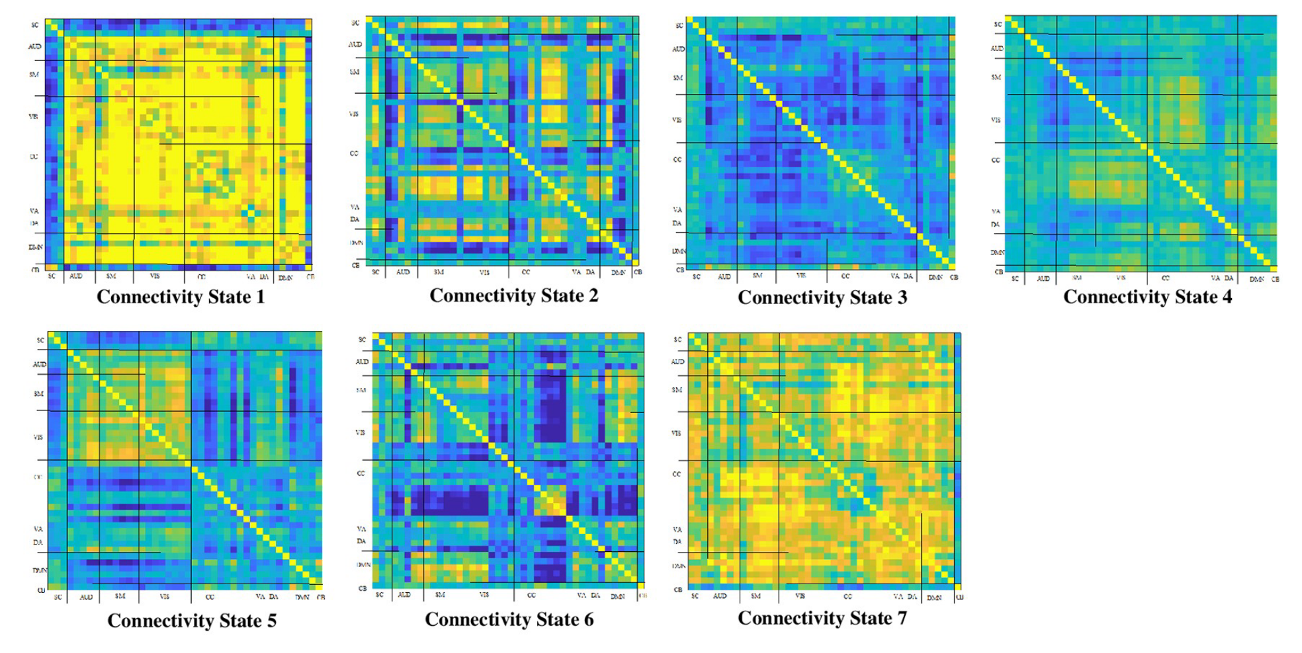
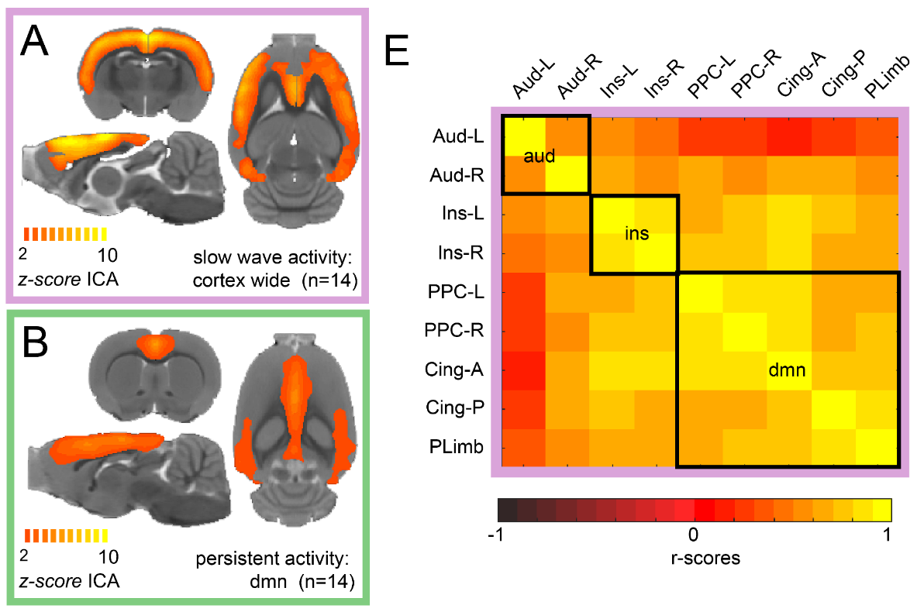
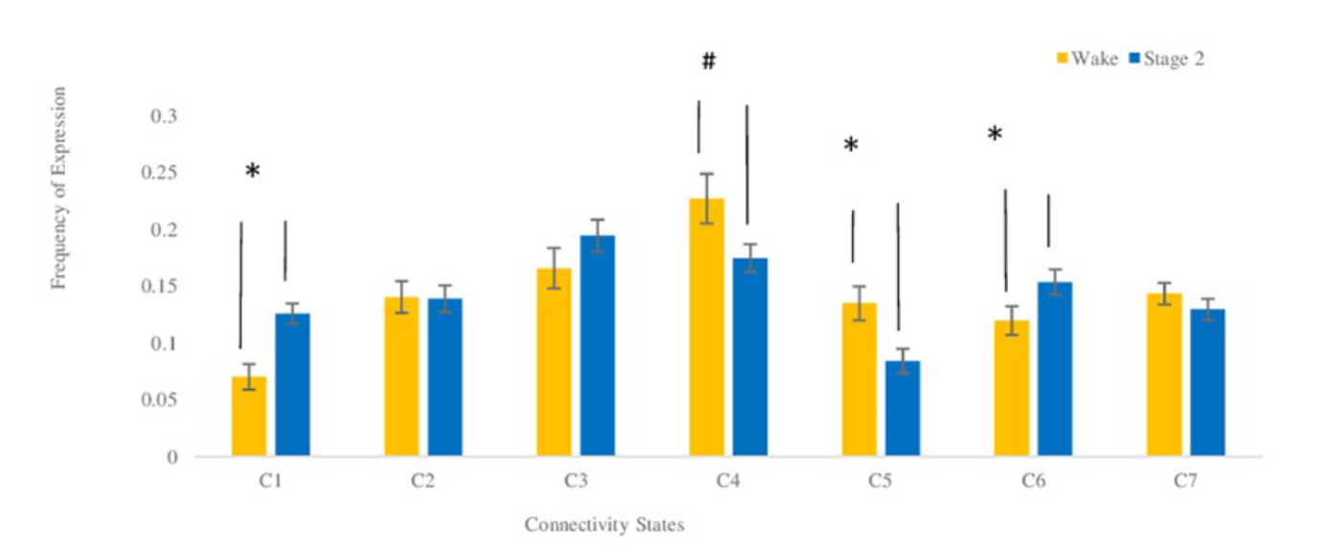
Higher connectivity in unconscious states
NREM sleep
Humans
Isoflurane anesthesia
Rats
Wake
Stage 2
Frequency
El-Baba et al, PLOS One 2019
Aedo-Jury et al, eLife 2019

Slide 12
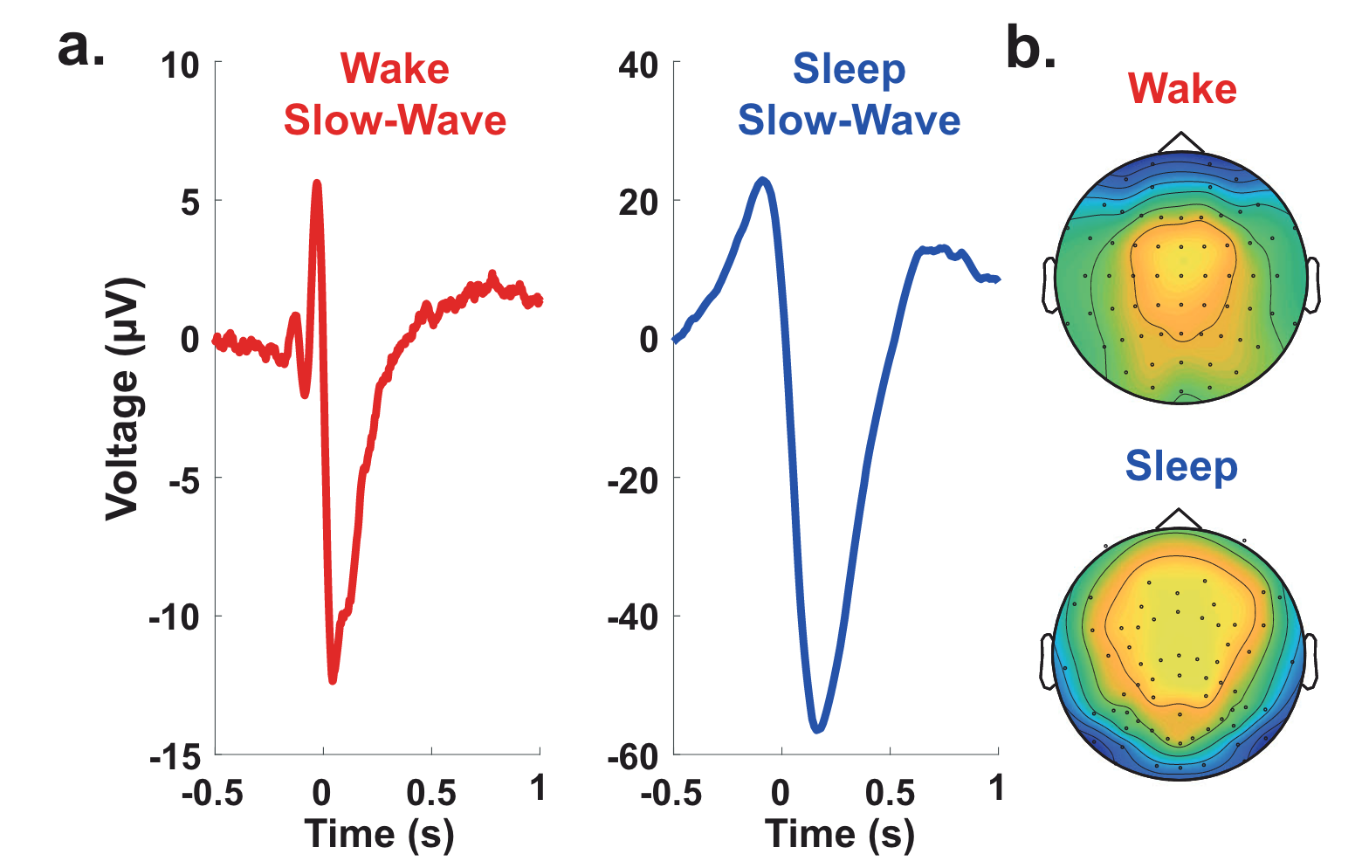
Slow wave activity in wakefulness: “local sleeps”
Properties of slow waves
Predictive of mental states
Andrillon et al, Nat Communications 2021
Notes:
Slow waves in the back of the brain were associated with misses (Fig. 5c), which is consistent with the involvement of parietal cortices in sensorimotor integration
MB > MW: reduction of slow-wave amplitude over frontal electrodes but an increase in their upward slope over parietal electrodes were predictive of MB: a perturbation of frontal cortices leads to unconstrained thoughts (MW) rather than the loss of awareness, but that awareness decreases when posterior regions momentarily go offline, a pattern similar to the neural correlates of dreaming during sleep or spontaneous thoughts during wakeful rest57,75.
Slow wave parameters such as
Amplitude
slope and
number of negative peaks
are thought to depend on the number of recruited neurons and the speed of synchronization across neuronal populations (Esser et al., 2007; Riedner et al., 2007; Vyazovskiy et al., 2007). In particular, steep, high-amplitude slow waves with few negative peaks are generated when an efficient neuronal synchronization allows for a fast recruitment of a large number of neurons at the cortical level.
https://www.ncbi.nlm.nih.gov/pmc/articles/PMC3900623/#:~:text=Slow%20wave%20activity%20(SWA%2C%200.5,slope%20of%20sleep%20slow%20waves.:
It has been proposed that the slope of slow waves, measured in the EEG, may represent a marker of this neuronal synchronization.^{16–18} Thus, the faster neuronal populations of a network are able to synchronize their activity, the steeper the slopes of the slow waves are. Consequently, the slope of slow waves at the beginning of the night when sleep pressure is high is much steeper compared to the slope of slow waves with the same amplitude towards the end of the sleep period when sleep pressure has dissipated.¹⁷

Slide 13
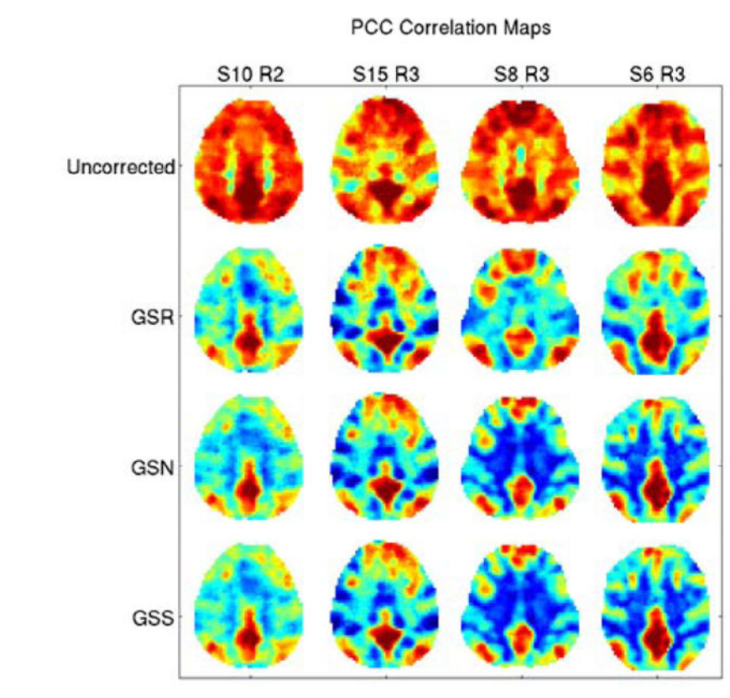
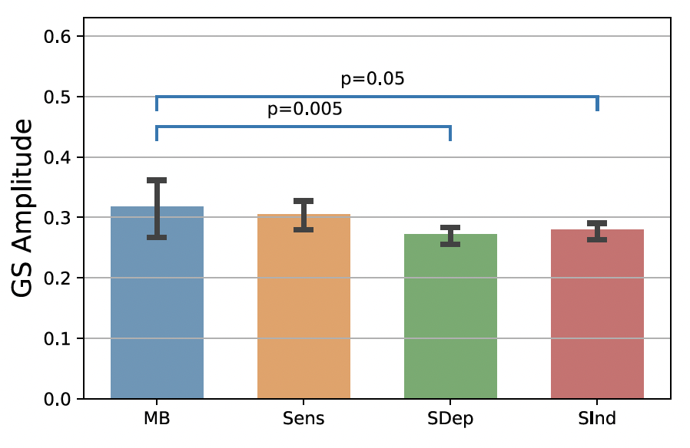
Higher connectivity and BOLD
The Global Signal
Higher Global Signal Amplitude around MB reports
Liu et al, NeuroImage 2017
Mortaheb et al, PNAS 2022
Notes:
‘‘Global flow’’ in PET (Friston et al., 1990), which is the average measured blood flow for the entire volume.
In fMRI there is at least a superficial analogue which we will refer to as the ‘‘global signal’’ and which we define as the average brain voxel time series (the global signal is thus a time signal)
The global signal for each subject was calculated after applying the atlas and time series extraction, by averaging time series of all the ROIs
The global signal amplitude was defined as the sum of the absolute value of the GS time points related to the functional repertoire of each mental state (extracted at the ROI level, after preprocessing)

Slide 14
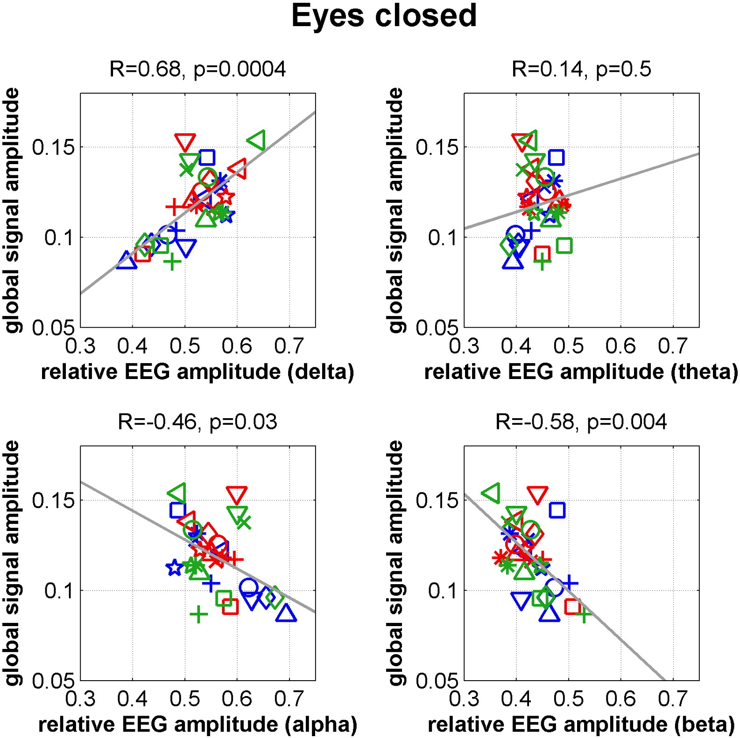
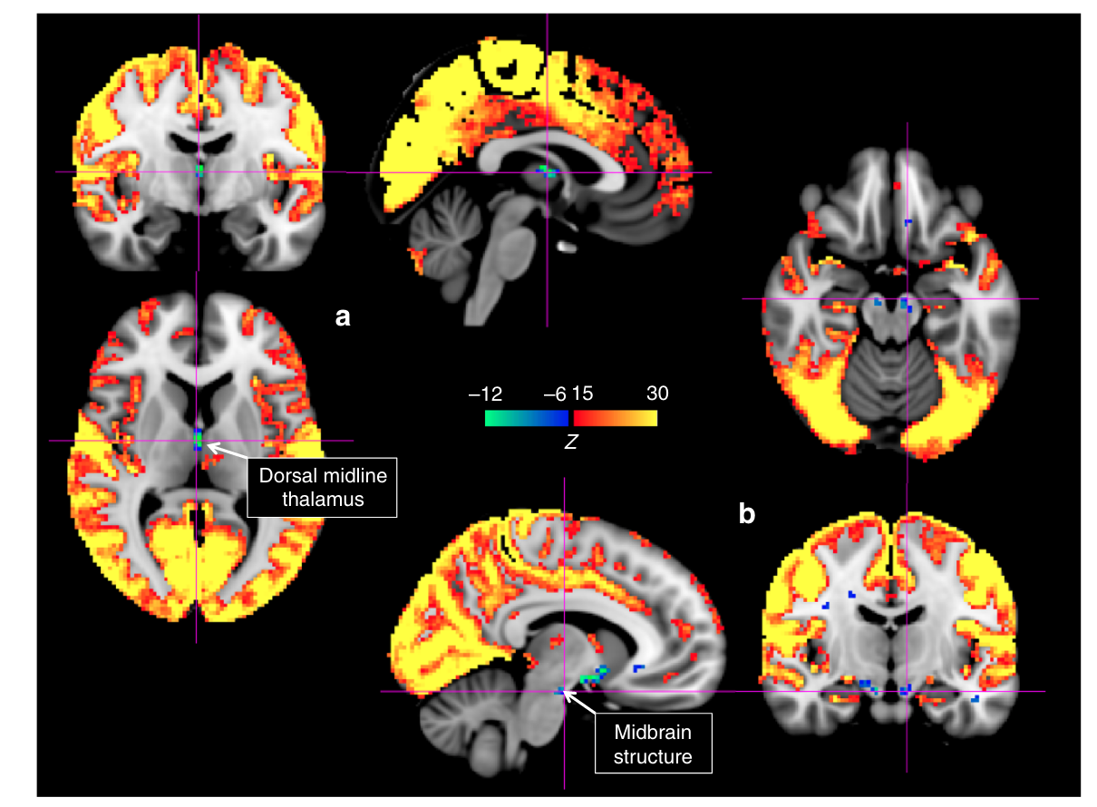
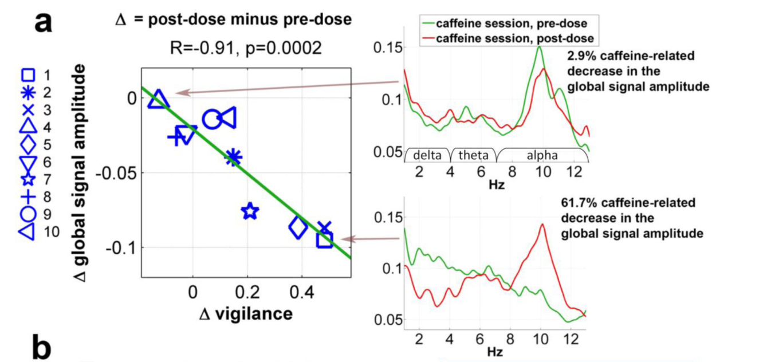
Global Signal amplitude reflects levels of vigilance
GS amplitude is linked to low arousal
GS amplitude linked to signal decreases in subcortical structures of arousal
GS amplitude decreases with caffeine intake
Wong et al, Neuroimage 2013
Liu et al, Nat Communications 2018
Notes:
Liu 2018:momentary increases in the global signal are accompanied by signal decreases in subcortical regions with established involvement in promoting arousal and wakefulness.

Slide 15
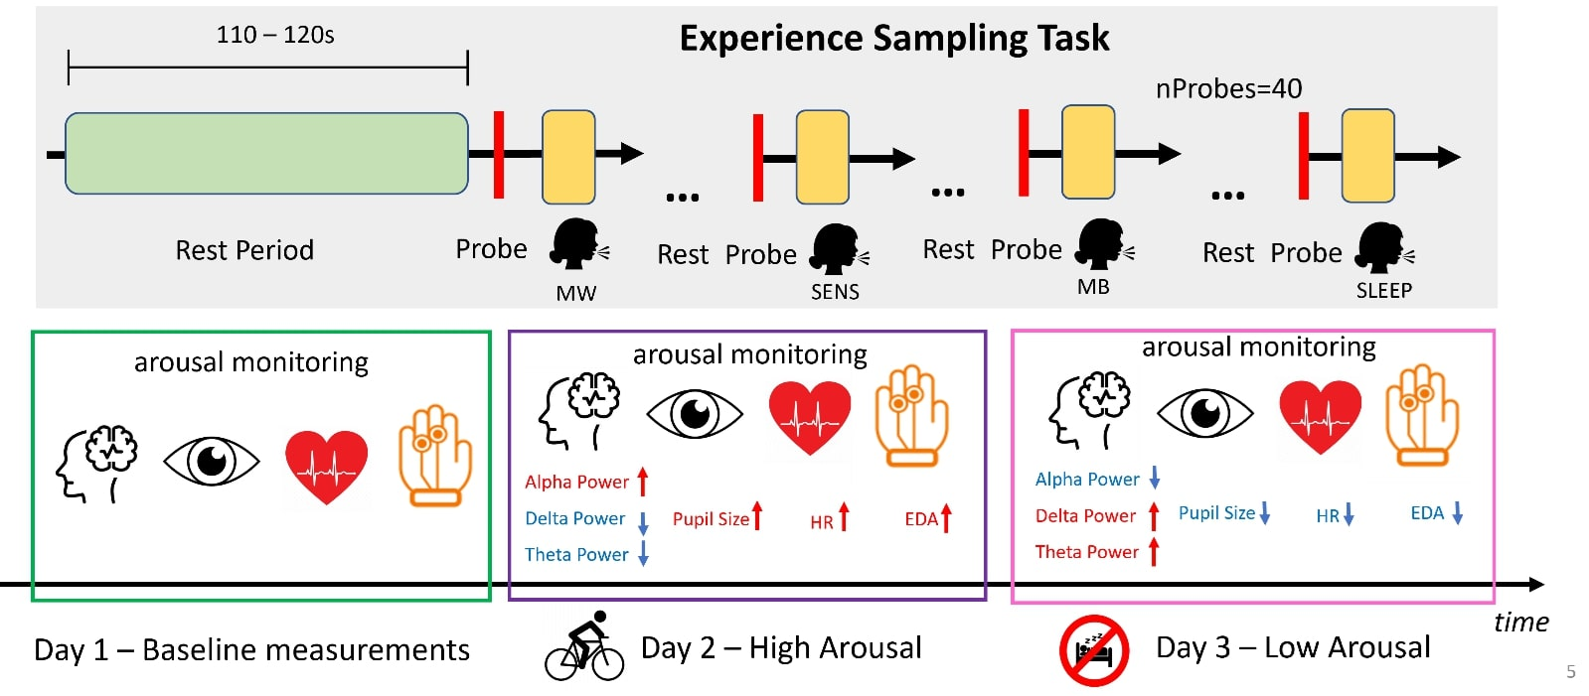
Do arousal variations mediate MB?
Boulakis, Simos, Zoi, Mortaheb, Schmidt, Raimondo, Demertzi. Registered Report Stage2 (results), biorχiv 2024
Notes:
N = 26
Power = .95
3 sessions
Baseline
Post-Exercise
Sleep Deprivation
40 resting blocks (110-120sec) -> probe
Monitored and matched sleep schedule

Slide 16
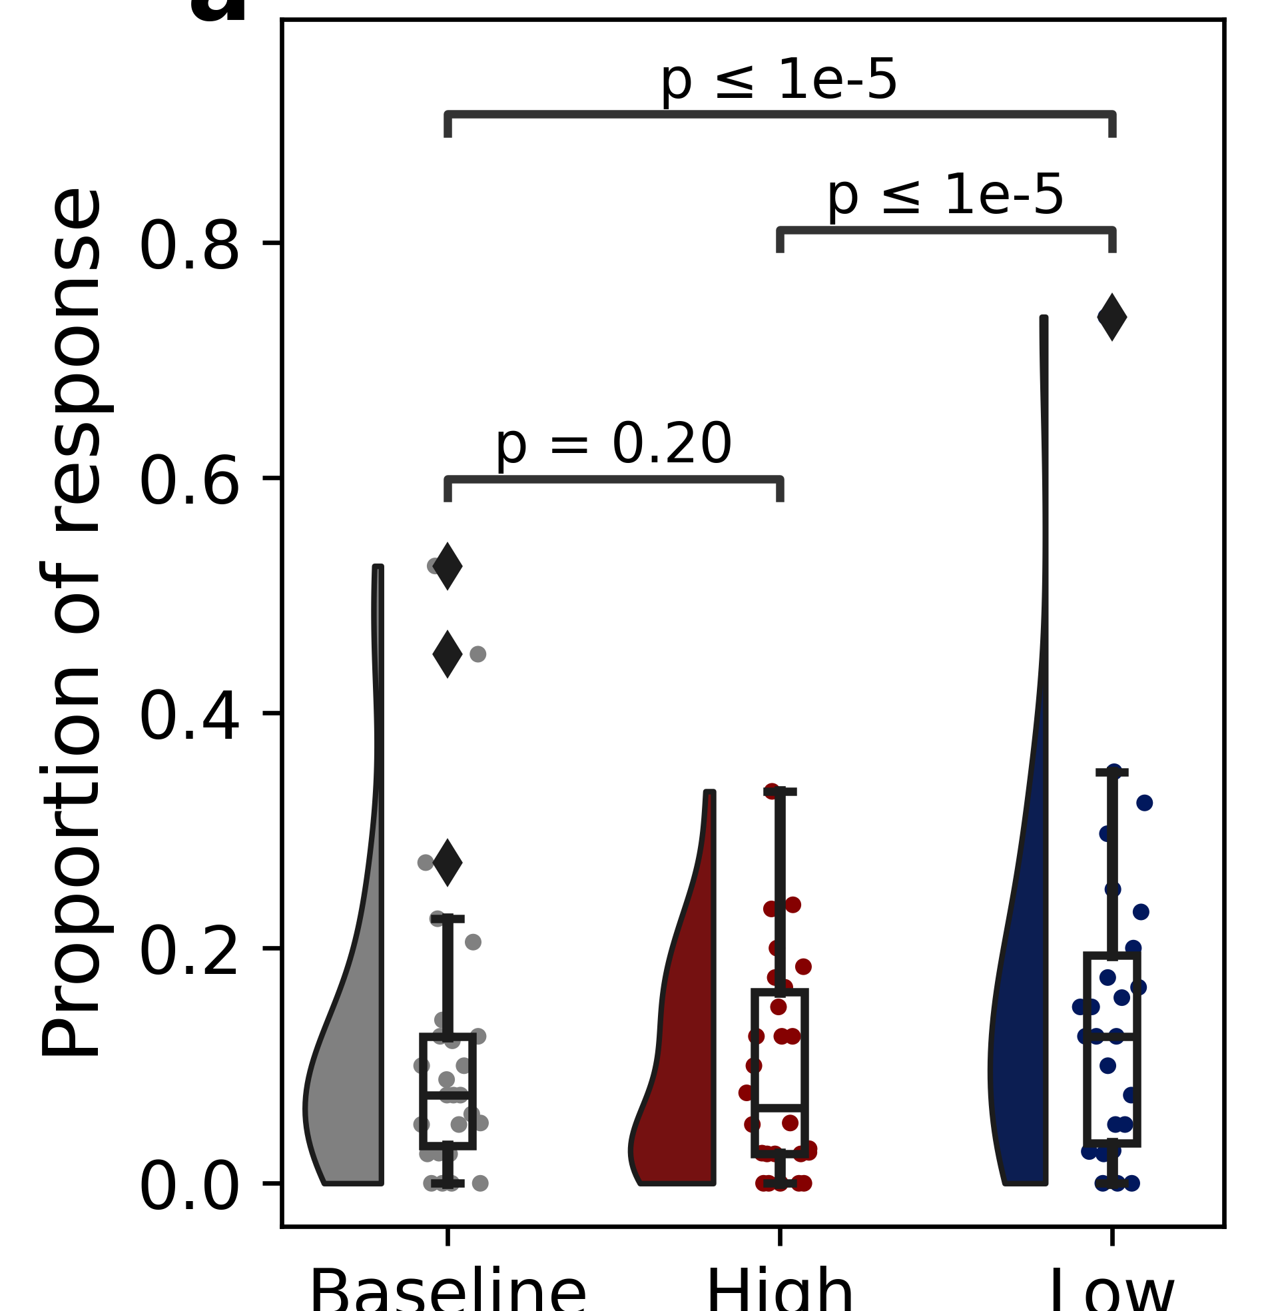
Altered arousal increases MB reports
Transition Probabilities
Sleep depriv – Exercise
-.2
MW
-.23
.01
.07
.09
SENS
MB
.1
Baseline Excercise Sleep depriv
.06
.05
.07
but MB was more frequent in
first half of post-exercise vs. second half (divergence = 4.08, p = 3.2e-02)
Notes:
Transition probabilities revealed that, after sleep deprivation, MW was more likely to be followed by MB and less likely to be followed by more mind-wandering reports.

Slide 17
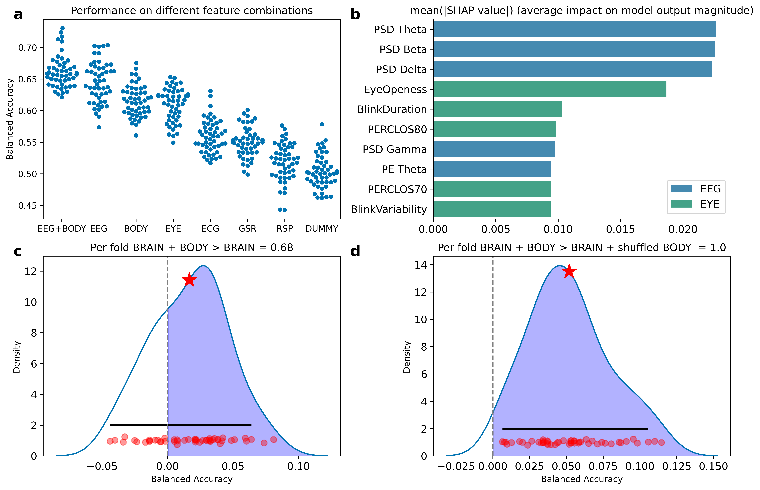
MB has an embodied profile
MB vs. other states
Boulakis, Simos, Zoi, Mortaheb, Schmidt, Raimondo, Demertzi. Registered Report Stage2 (results), biorχiv 2024
Notes:
A balanced random forest classifier trained on a combination of BRAIN and BODY features outperformed classifiers trained solely on BRAIN or BODY features when evaluated with balanced accuracy. Individual points
indicate performance on the folds of the repeated cross-validation.
b) Subset of the 10 features with the highest mean of the 628 absolute SHAP values obtained from the balanced random forest classifier.

Slide 18
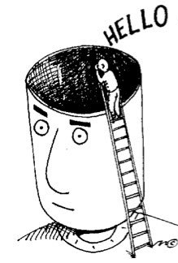
Summary
Mind Blanking reports:
are uniform time in typical waking
are more frequent after sleep deprivation
are more frequent after immediate physical exercise
are ”spontaneous” (but also induced, forgotten, undetected)
can challenge theories of consciousness
(Andrillon, Lutz, Windt, Demertzi (in prep).
MB is a default mental state during
ongoing thinking
Notes:
A balanced random forest classifier trained on a combination of BRAIN and BODY features 626 outperformed classifiers trained solely on BRAIN or BODY features when evaluated with balanced accuracy. Individual points 627 indicate performance on the folds of the repeated cross-validation.
b) Subset of the 10 features with the highest mean of the 628 absolute SHAP values obtained from the balanced random forest classifier.

Slide 19








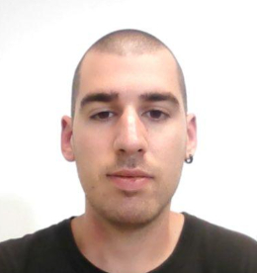





Physiology of Cognition Lab
Publications
Athena Demertzi, PI
Matthieu Koroma, PhD
Paris
Boulakis
Larry D
Fort
Agustina Aragón Daud
Nikos J
Simos
Venia Giamala
Varya Strizhneva
CRC HUMAN IMAGING UNIT
INTERNATIONAL COLLABORATORS
Sepehr Mortaheb
Christina SCHMIDT
Christine BASTIN
Christophe PHILLIPS
Gilles VANDEWALLE
Fabienne COLLETTE
Federico RAIMONDO (FZ Jülich)
Thomas ANDRILLON
Jenny WINDT
Antoine LUTZ
Nao TSUCHIYA
Aniko KUSZTOR
Kristian SANDBERG
Timo Torsen Schmidt
Marzia DE LUCIA
Andria PELENTRITOU
Christine BLUME
Jan REMAEKERS
Natasha MASON
Pablo MALLARONI
Notes:
Conclusions: I showed how states of unconsciousness raise ethical debates, mostly about whether C . exists. I provided data which point towards the one or the other direction. In the end, it seems there is an Open dialogue in the science of about what C it is. In that respect, Consciousness is a construct of consensus and we'd better be off to define 4 quantify it as accurately as possible. This is why I think

Slide 20

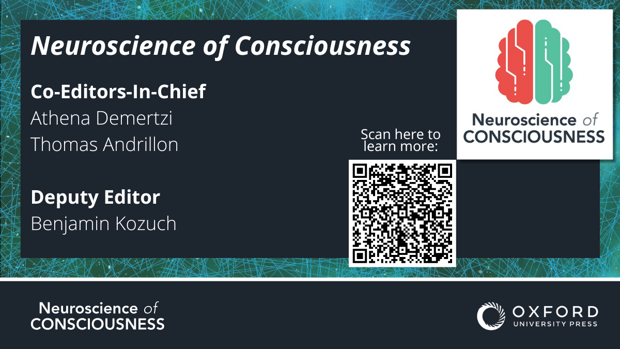
Attend!
Submit!

Slide 21
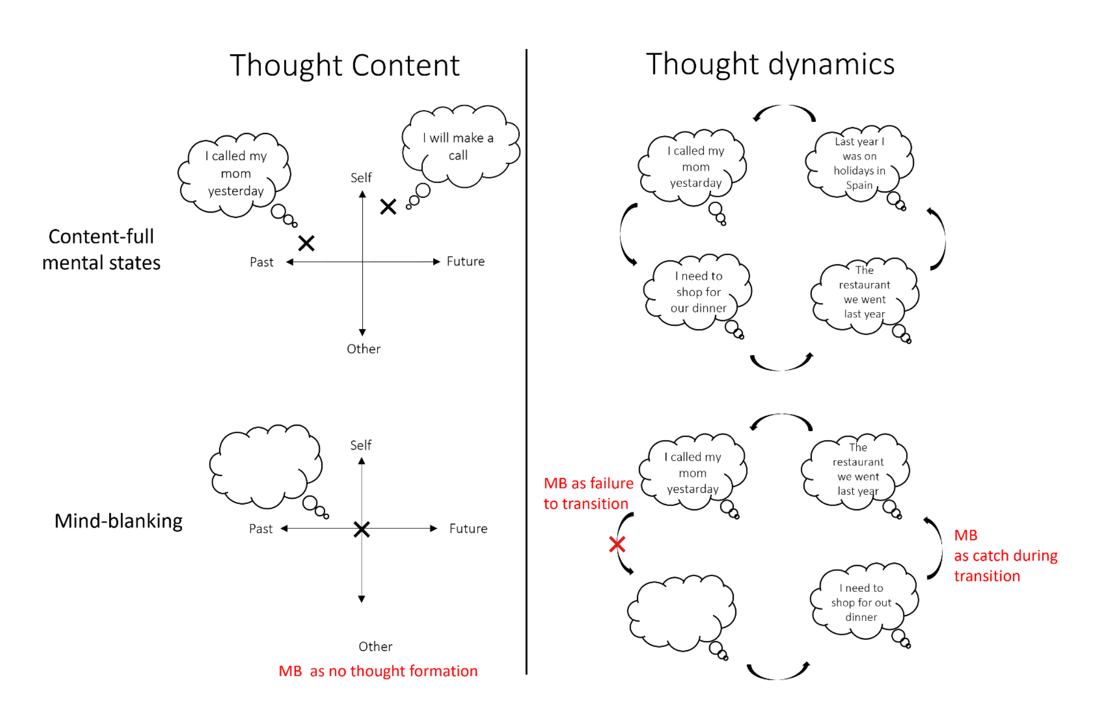
Relating MB to aspects of ongoing thinking
Boulakis & Demertzi. What’s the blank about? Relating mind-blanking to aspects of ongoing thinking. psyArXiv 2024

Slide 22
Simple connectivity in “unconsciousness”
Demertzi & Tagliazucchi, Dehaene, Deco, Barttfeld, Raimondo, Martial, Fernández-Espejo, Rohaut, Voss, Schiff, Owen, Laureys, Naccache, Sitt. Science Advances 2019

Slide 23
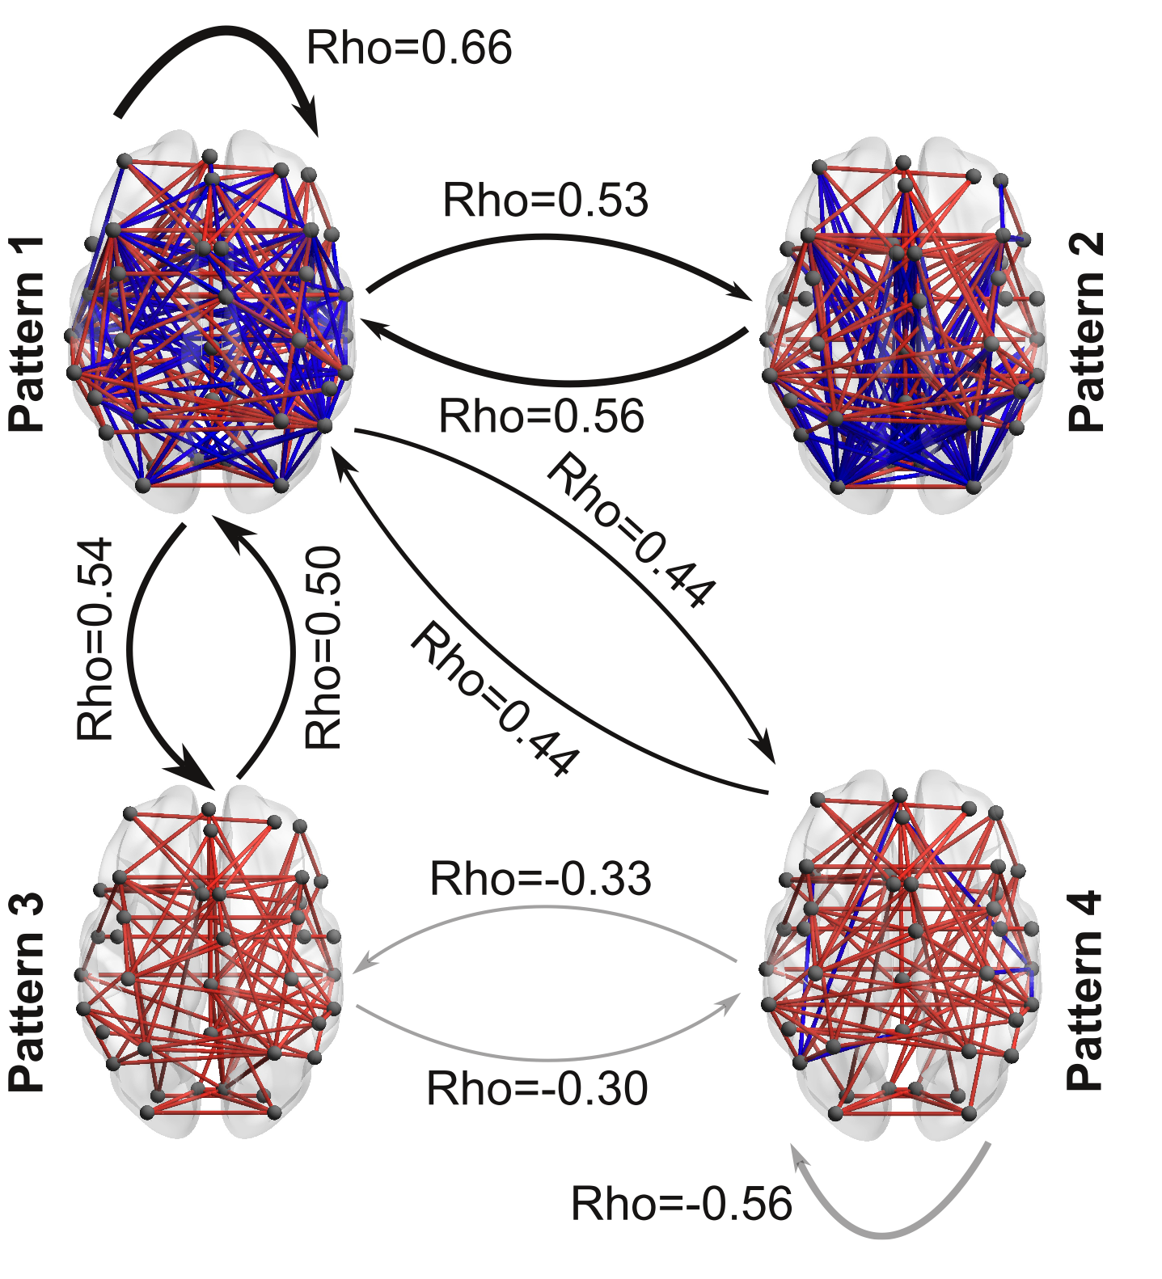
Higher dynamism in conscious states
Healthy > MCS > UWS
UWS > MCS > Healthy
Demertzi & Tagliazucchi, Dehaene, Deco, Barttfeld, Raimondo, Martial, Fernández-Espejo, Rohaut, Voss, Schiff, Owen, Laureys, Naccache, Sitt. Science Advances 2019
Notes:
﻿Black arrows indicate a higher probability to transit between the coordination patterns in healthy controls (HC) as opposed to patients in MCS and patients in UWS (HC > MCS > UWS). Gray arrows indicate the opposite trend (HC < MCS < UWS)
﻿To further describe the dynamic nature of the pattern exploration, we obtained, for each participant, a matrix containing information about the probabilities that any given pattern to transition into another. This matrix contains, in its ith row, the normalized (i.e., sum equal to one) frequency distribution of observing a volume labeled as the ith pattern transitioning into the pattern corresponding to the jth column. The average contiguous amount of time spent in each pattern for each clinical group was corrected for random durations by subtracting the average duration of surrogate shuffled pattern series.
The sequence predictability for each individual was quantified using the entropy rate (Markov entropy) for the corresponding probabilities and the transition probability matrices. The entropy rate for the sequence of brain patterns of each participant was computed as follows:
Astochastic or random process is a mathematical object usually defined as a family of random variables. Many stochastic processes can be represented by time series. However, a stochastic process is by nature continuous while a time series is a set of observations indexed by integers.

Slide 24
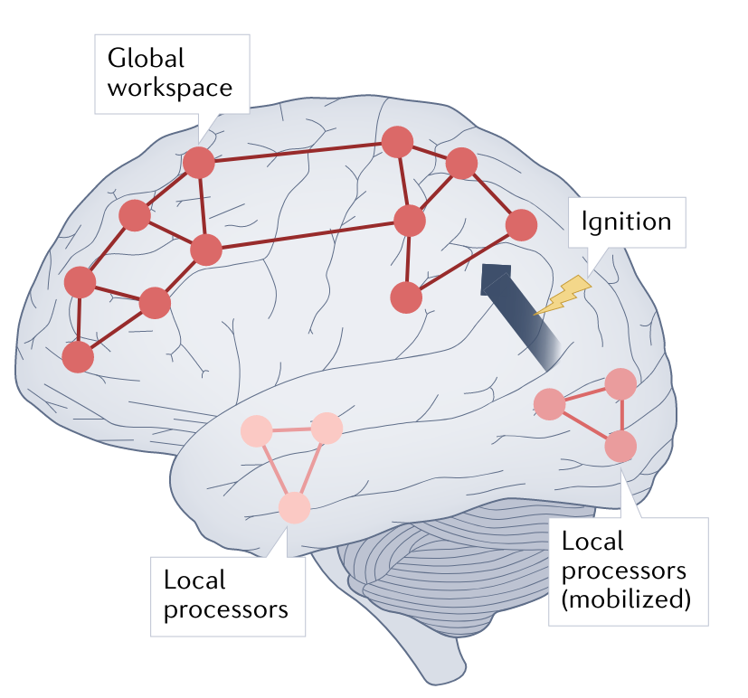
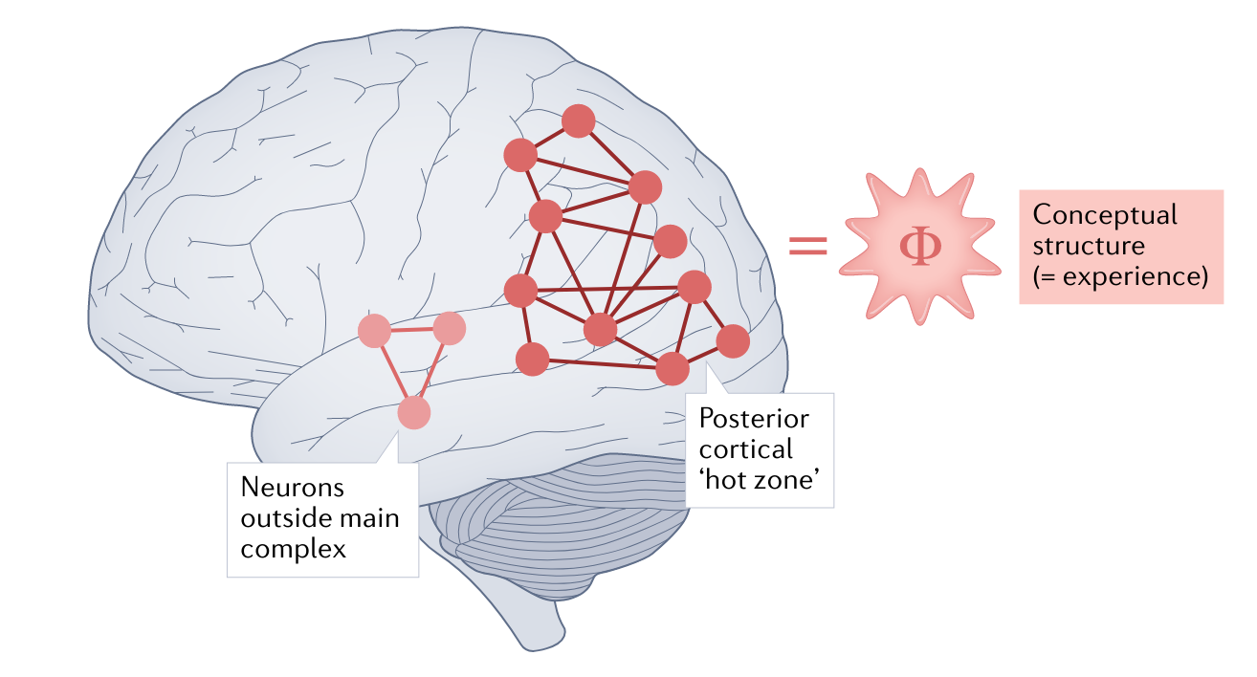
Non-reportable Awareness? Challenges for Theories of Consciousness
Global Neuronal Workspace Theory
Integrated information theory
Seth & Bayne Nat Rev Neurosci 2022
Notes:
Is it possible to decode the experience of MB from brain body interaction? What would such a brain-body profile look like?
Is the experience of MB phenomenologically akin to other cases of inability to report our mental life, like blindsight? What can we draw from there?

Slide 25
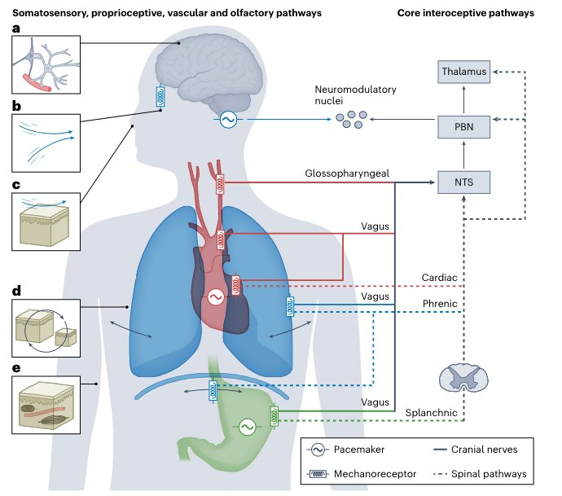
The embodied
perspective
Engelen, Solcà, Tallon-Baudry. Nature Neurosci 2023​
Varela F. Nat Rev Neurosci. 2001​

Slide 26
The mind is embodied and embedded
Seth & Friston. Phil Trans R Soc London B 2016
Notes:
Neuronal activity encodes expectations about the causes of sensory input with the aim to minimize surprise of sensory data

Slide 27

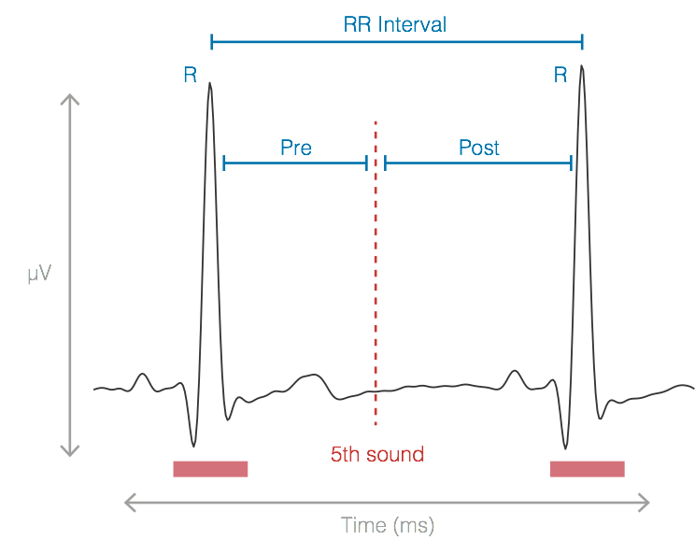
Cardiac reactions to oddballs in MCS
Auditory oddball paradigm
Electrocardiographic markers carry
independent information from EEG
Cardiac cycle-phase acceleration
only in MCS
Bekinschtein et al., PNAS, 2009
Post interval
Raimondo, Rohaut, Demertzi, Valente, Engemann, Salti, Fernandez Slezak, Naccache, Sitt. Annals of Neurology 2017
Bekinschtein et al., PNAS, 2009
Notes:
After the deviant, the foillowing heartbeat is faster in the MCS

Slide 28
Cardiac reactions to oddballs in sleep
Cardiac deceleration for global deviants only in REM
Koroma, Boulakis, Raimondo, Blume, Strauss, Demertzi. In prep
EEG: Strauss, Sitt, King, Elbaz, Azizi, Buiatti, Naccache, van Wassenhove, Dehaene, S, PNAS 2015
EEG: Blume, Niedernhuber, Spitschan, Slawik, Meyer, Bekinschtein, & Cajochen. Sleep 2022

Slide 29

Cardiac responses to word-induced relaxation during sleep
Cardiac decelaration after
relaxing words
Cardiac modulation = SR - RS
S
relax
R
R
relax
vs
xaler
materials
vs
slairetam
Time (ms)
n=50
RS
SR
night
night
Koroma, Beck, Schmidt, Rasch, Demertzi, A. J Sleep Res 2024
Notes:
Cardiac modulation index: the difference between the word's onset (S) and the heartbeat (R) coming after (SR) versus before (RS) the word's presentation. Positive index values indicate cardiac activity deceleration; negative index values indicate cardiac acceleration.

Slide 30
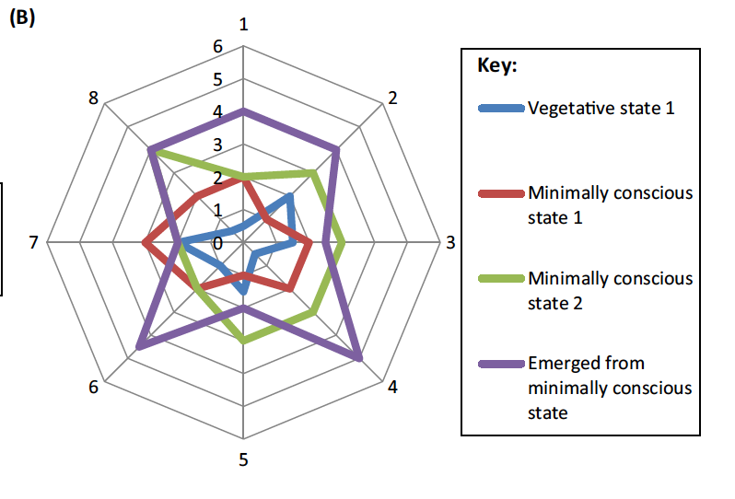
Consciousness is multidimensional
Inter-state dynamism
(metastability)
Cross-modal interactions
(multi-sensory integration)
“Rich” inter-regional
communication
(arousal)
Functional Anticorrelations
(neural inhibition)
Embodied responsiveness
(active inference)
Bayne, Hohwy, Owen Trends Cogn Sci 2016
Notes:
Metastability refers to the human brain’s ability to integrate several functional parts and to produce neural oscillations in a cooperative and coordinated manner. phase synchronization forms the basis of metastable behavior in neural networks.

