Slide 1


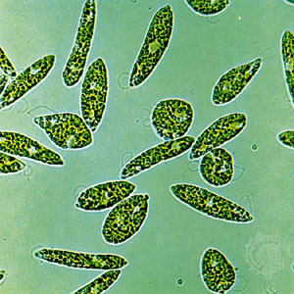
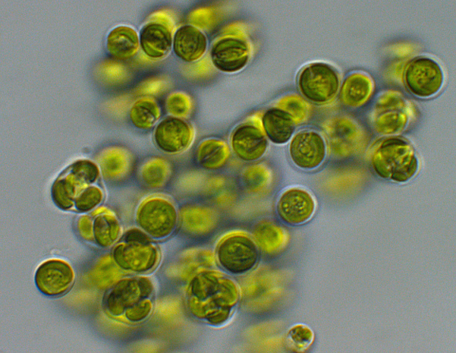
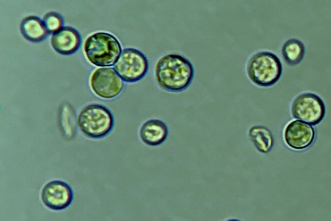
Optimization of the growth of microalgae in the presence of organic carbon sources by genetic and physiological approaches
ADV_BIO Project
Département des Sciences de la Vie
Laboratory of genetics and physiology of microalgae
Euglena gracilis
Promoter : Claire REMACLE
Co-promoter : Pierre CARDOL
Chlorella protothecoides
Pablo Perez Saura – May 2023
3rd Thesis committee
Galdieria sulphuraria

Slide 2



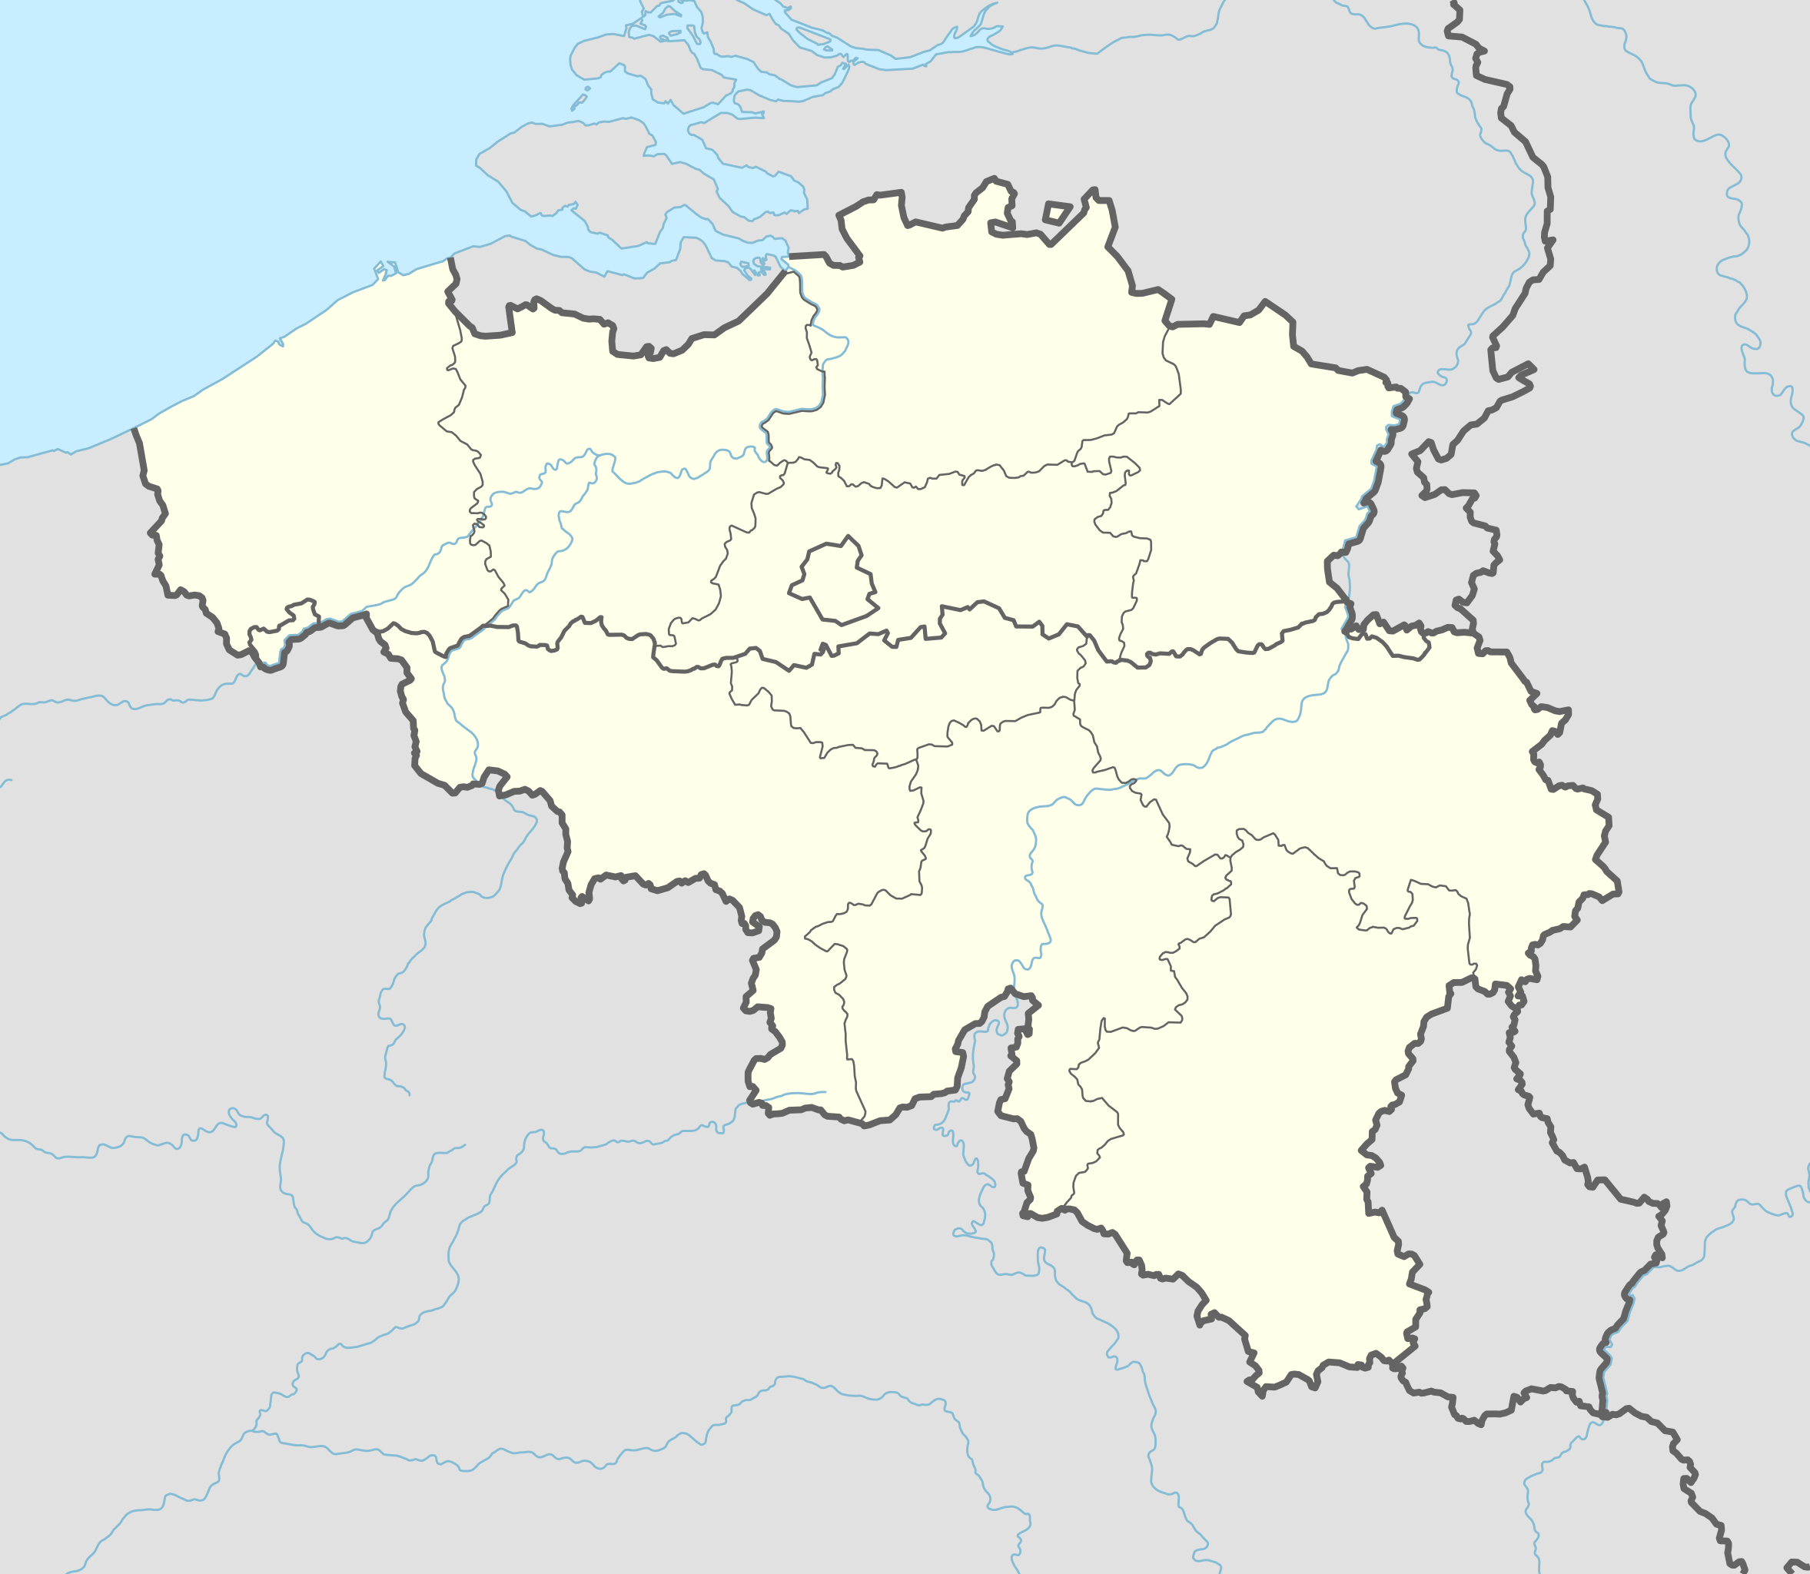


ADV_BIO – Presentation of the project
« Technological innovation in the production of advanced biofuels applicable to the Belgian territory for road and air transport and technical, economic and environmental feasibility analysis »

Slide 3

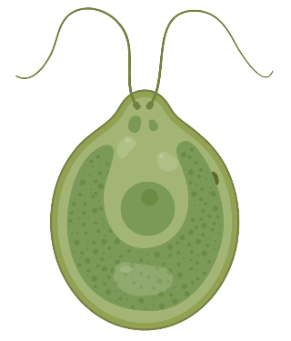



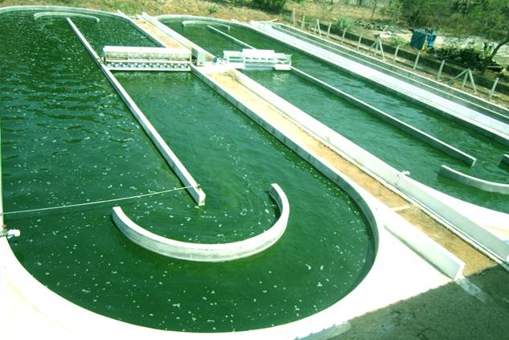





ADV_BIO – Presentation of the project
Feedstock
Open pond culture of microalgae
Heterotrophy

Slide 4
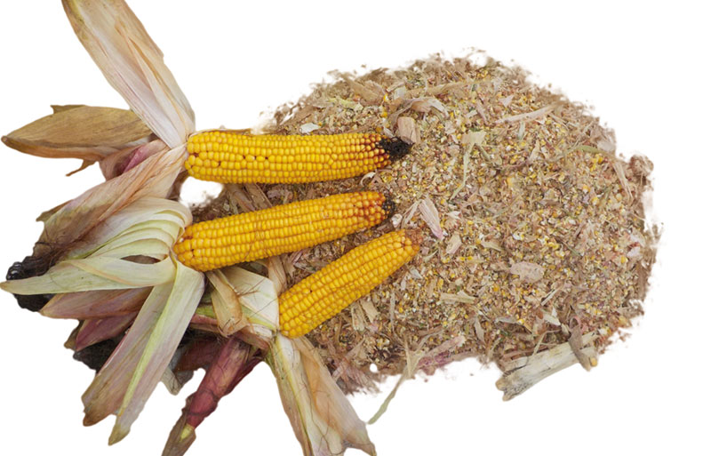
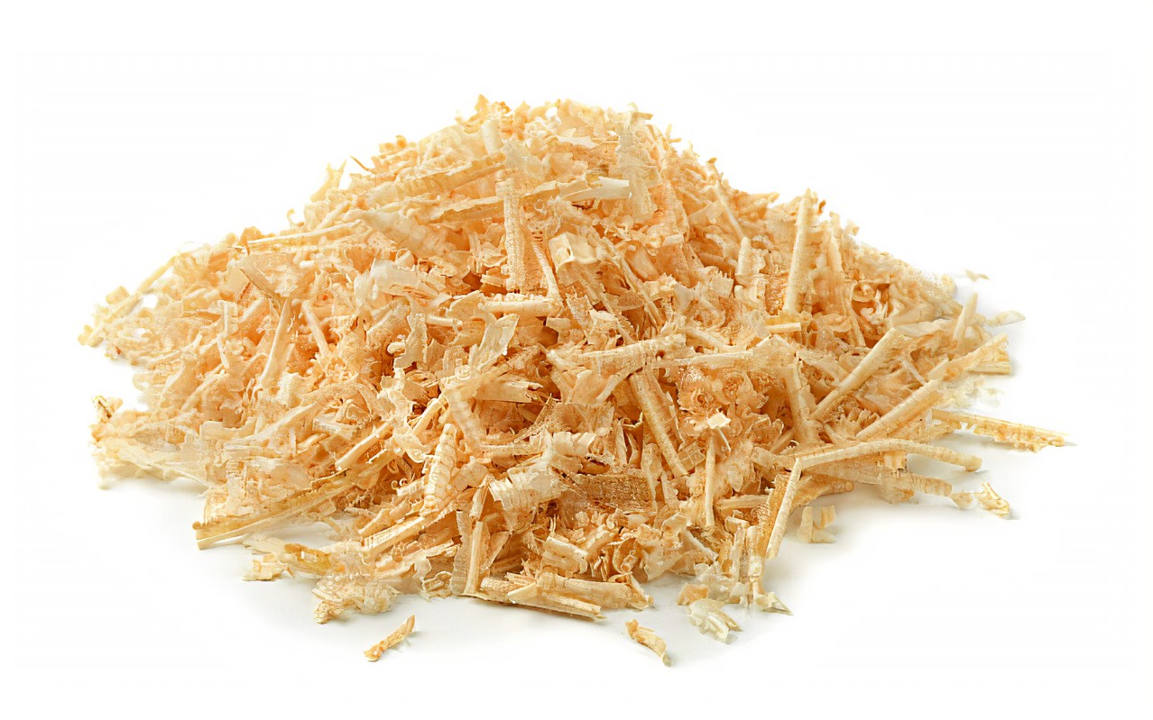
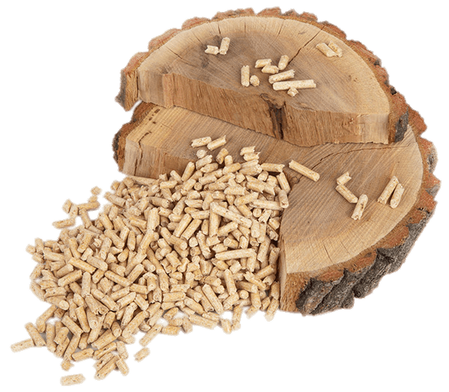
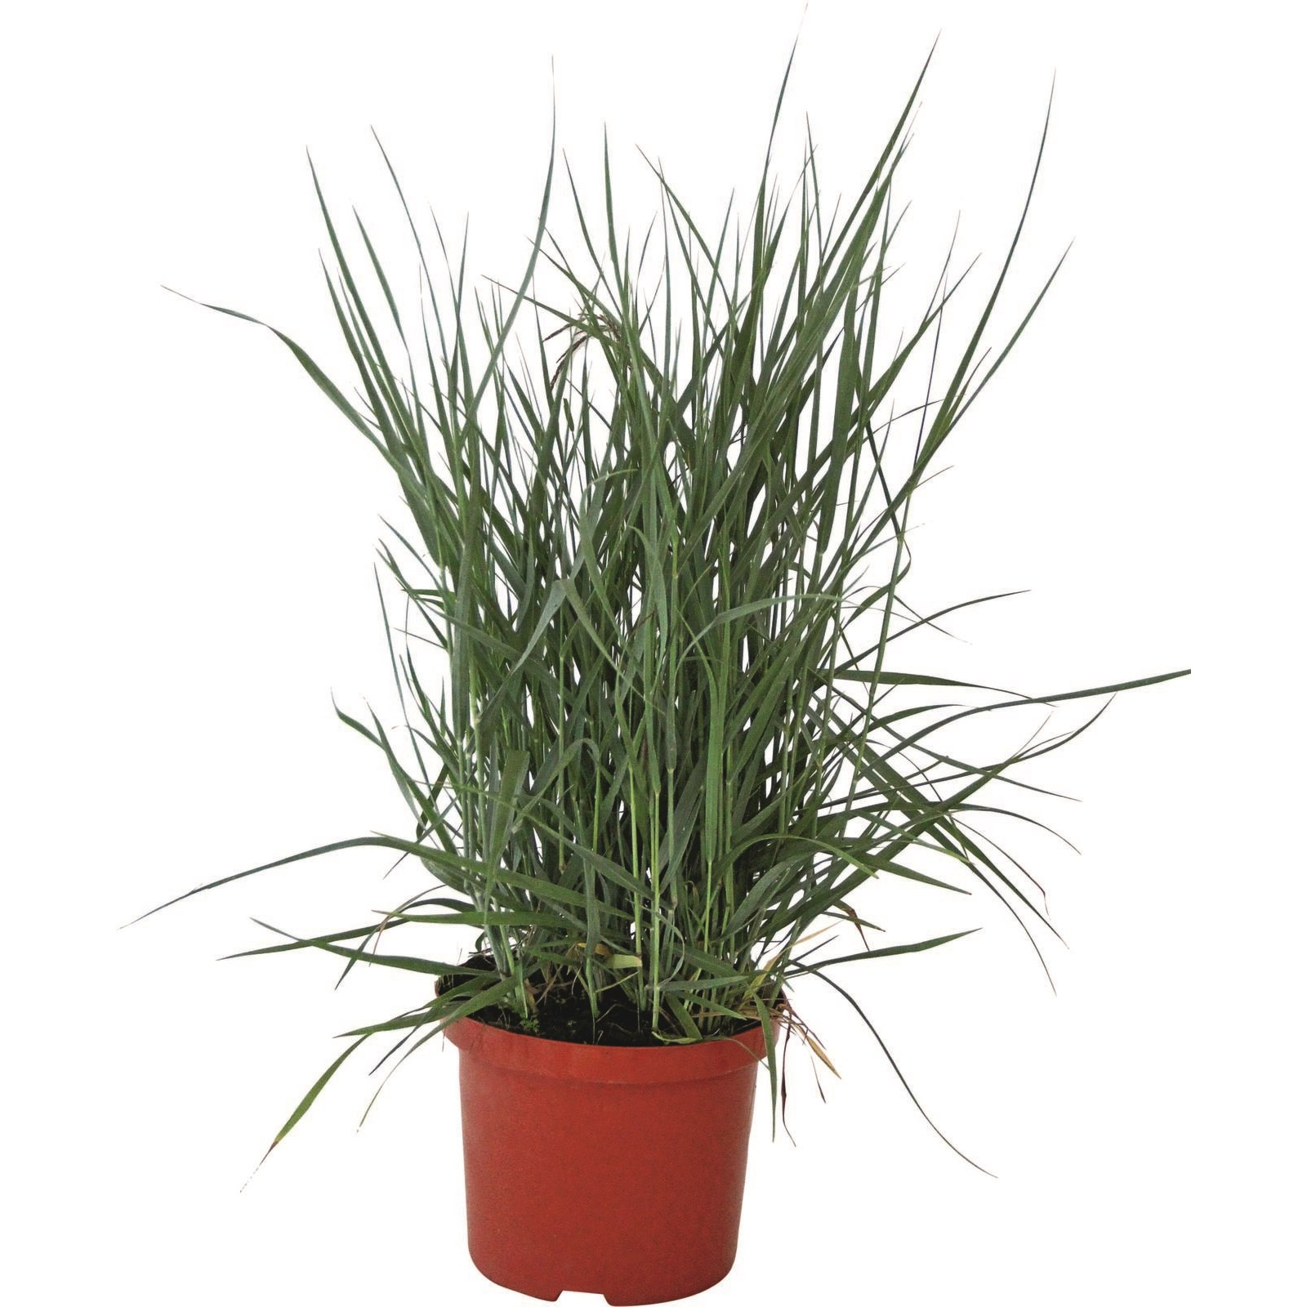
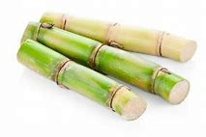
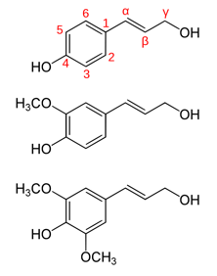
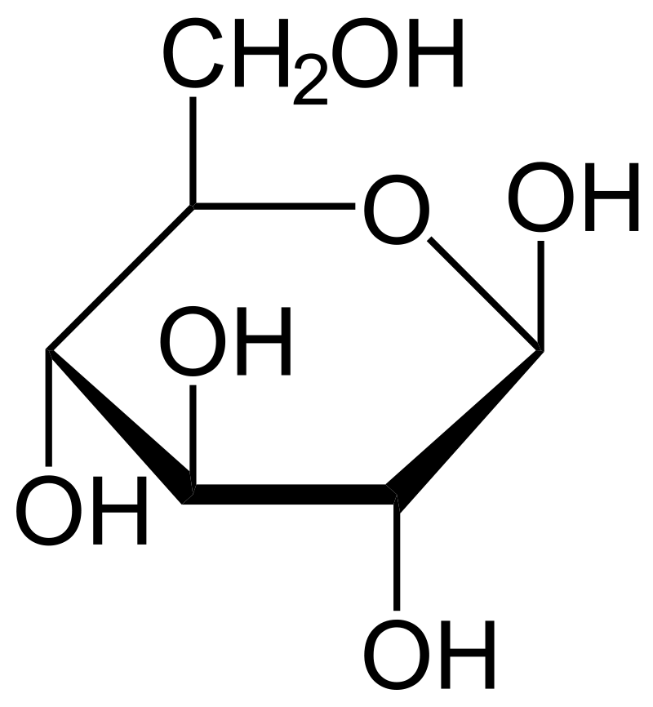
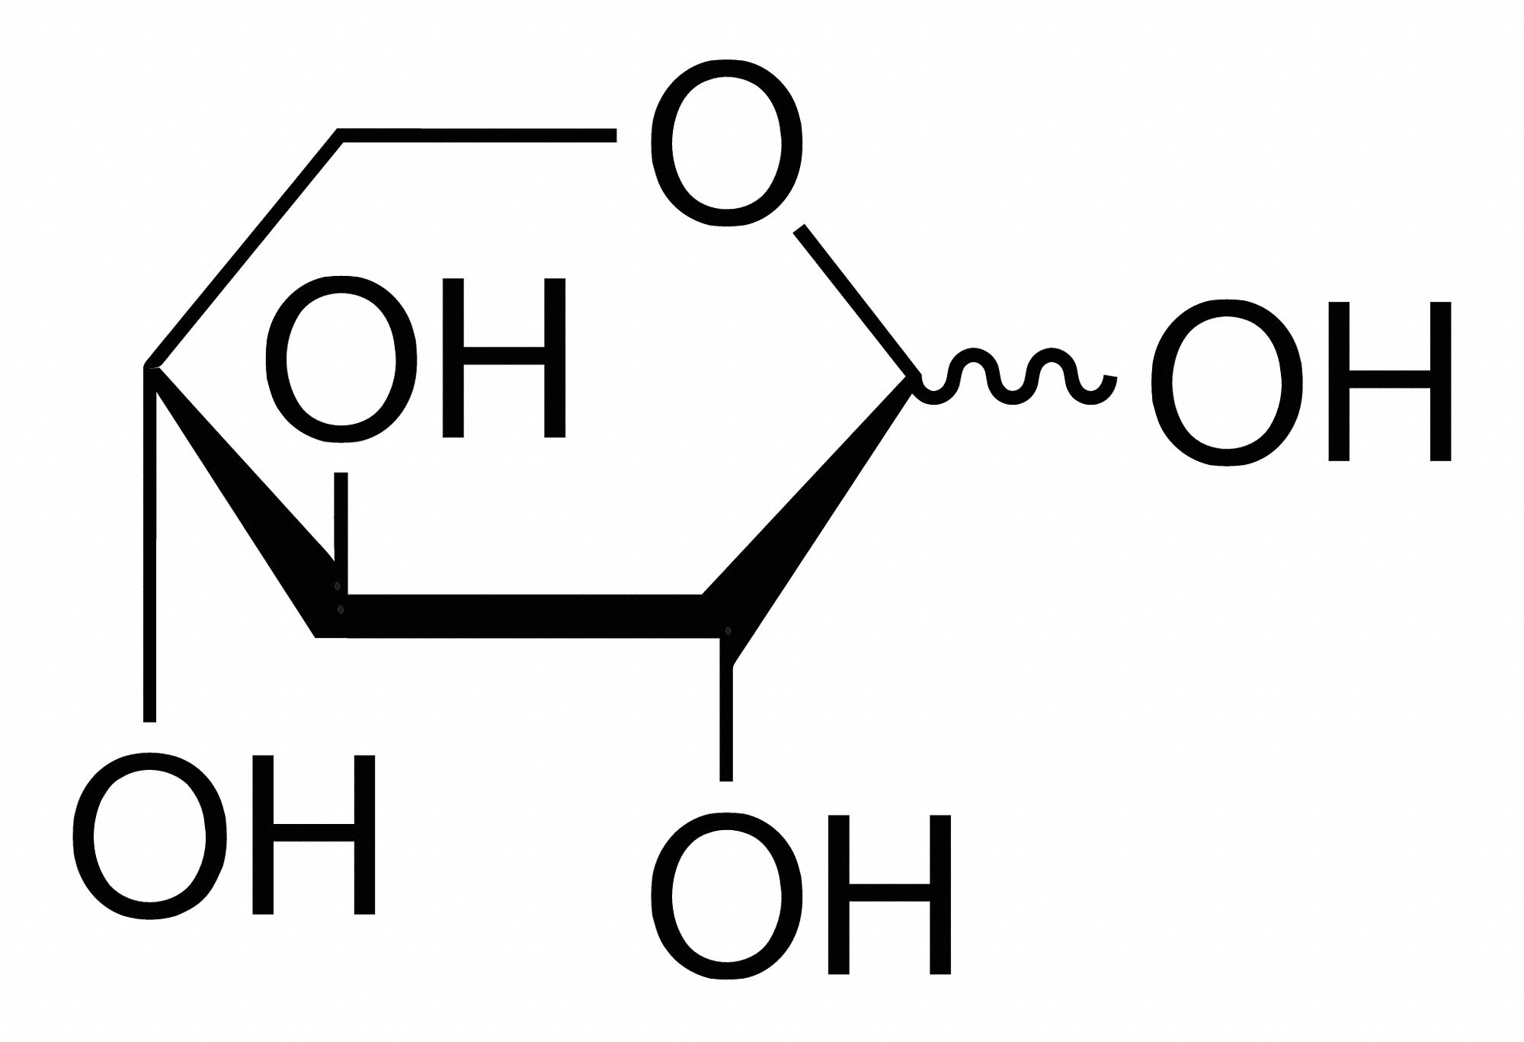
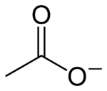
Hemicellulosic-rich biomass valorization
Lignocellulosic matter
Cellulose
40-50% DW
Lignin
0-30% DW
Hemicellulose
20-50% DW
Glucose
Xylose
Acetate
Phenolic compounds
*Data from Jahirul et al., 2012
Notes:
Basé sur la littérature, on sait que les 3 sucres principalement retrouvés dans la composition de l’hémicellulose sont le glucose, le xylose et l’acétate, avec en moindre mesure le rhamnose, l’arabinose, le mannose et le galacose.

Slide 5
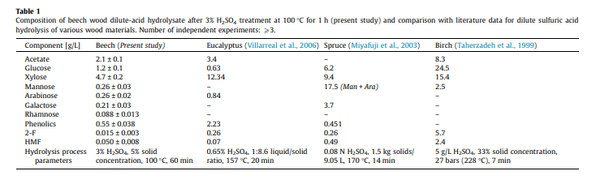
Hemicellulosic-rich biomass valorization
Lignocellulosic matter
Lignin 0-30%
Cellulose 40-50% DW
Glucose
Hemicelllulose 20-50% DW
Xylose
Acetate
Data from Jahirul et al., 2012 and Miyazek et al., 2017

Slide 6
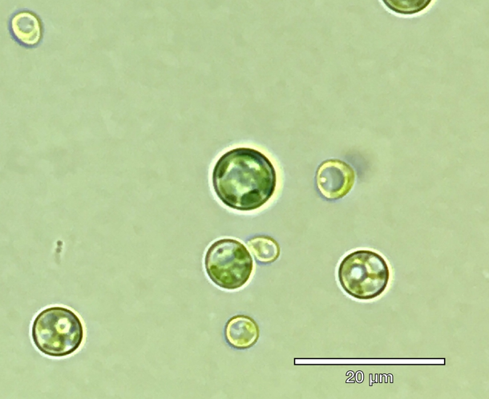
ADV_BIO – What microalgae are studied ?
Euglena gracilis
Wallless
Up to 60% m/m of paramylon in aerobic conditions
Converted into wax esters in anaerobic conditions
Galdieria sulphuraria
An extremophilic red microalga
Optimum T° = 42°C
Optimum pH = 2
Able to use up to 50 different carbon sources
Auxenochlorella protothecoides
High lipid content (±50% of the DW)
High level of saturated fatty acids (up to 90% of the total)
High oxidative stability for biodiesel

Slide 7
Fixed culture conditions depending on the strains
Are our strains able to grow in the presence of the hemicellulosic carbon sources ?
Variable carbon source content
All strains are grown in the dark under constant agitation
Carbon source | Carbon atoms (mM) | Concentration (g.L⁻¹) | Concentration (mM)
Glucose | 150 | 4,5 | 25
Xylose | 150 | 4,5 | 30
Acetate | 150 | 6,15 | 75
Mix of glucose – xylose – acetate | 50-50-50 | 1,5 – 1,5 – 2,05 | 8,33 – 10 – 25
Strain | Medium | T° | Starting pH
G. sulphuraria | Allen | 42°C | 2
E. gracilis | TMP* | 25°C | 7
A. protothecoides | TMP | 25°C | 7
or
or
or
* Some E. gracilis essential vitamins were added to the medium after autoclaving (B1, B8, B12)

Slide 8
Growth parameters and nutrient consumption
Glucose
Xylose
DW - Galdieria
DW - Euglena
[Carbon] - Galdieria
[Carbon] - Chlorella
[Carbon] - Euglena
DW - Chlorella
Glucose
E. gracilis did not show any growth in the presence of glucose
Xylose
Only G. sulphuraria was able to grow in the presence of xylose
Acetate
G. sulhpuraria’s growth is inhibited by the presence of acetate
Mix
- A. protothecoides and E. gracilis exhibited growth in the presence of all the three carbon sources
Acetate
Mix
D

Slide 9
Growth parameters and nutrient consumption
DW - Galdieria
DW - Euglena
[Carbon] - Galdieria
[Carbon] - Chlorella
[Carbon] - Euglena
DW - Chlorella
Glucose
Xylose
Acetate
E. gracilis did not show any growth in the presence of glucose
Only G. sulphuraria was able to grow in the presence of xylose
G. sulhpuraria’s growth is inhibited by the presence of acetate

Slide 10
Growth parameters and nutrient consumption
Mix
E. gracilis
A. protothecoides
DW - Euglena
DW - Chlorella
[Glucose]
[Xylose]
[Acetate]
As shown before, E. gracilis was not able to assimilate glucose or xylose
A. protothecoides could assimilate glucose and acetate at the same time, but also xylose with a delayed response

Slide 11
Fatty acid content

Slide 12
Fatty acid distribution

Slide 13
Total protein and storage carbohydrate content

Slide 14
Summary of the results

Slide 15
Growth parameters and nutrient consumption
Glucose
DW - Galdieria
DW - Euglena
[Carbon] - Galdieria
[Carbon] - Chlorella
Galdieria
Auxenohlorella
[Carbon] - Euglena
DW - Chlorella

Slide 16
A
B
Galdieria
Euglena
Auxenohlorella

Slide 17
C
D
E
F
Galdieria
Euglena
Auxenohlorella

Slide 18
A
B

Slide 20
Growth parameters and nutrient consumption
Euglena gracilis
Carbon source | Doubling time (Day) | Max biomass (g.L⁻¹) | Max productivity (gDW.L⁻¹.d⁻¹) | Sugar to biomass conversion (gDW.gsugar⁻¹)
Glucose | / | / | / | /
Xylose | / | / | / | /
Acetate | 0.72 ± 0.05 | 1.08 ± 0.04 | 0.47 ± 0.10 | 0.21 ± 0.02
Mix | 0.67 ± 0.01 | 0.70 ± 0.01 | 0.33 ± 0.02 | 0.14 ± 0.01
E. gracilis is only able to assimilate acetate in the tested conditions
The presence of other carbon sources than acetate in the medium does not affect its growth capability
Its carbon source conversion into biomass is low
Notes:
Pour chaque algue expliquer à l’oral que la source de carbon est en théorie le nutriment limitant, mais que le dosage ne fonctionne par sur milieu TMP

Slide 21
Growth parameters and nutrient consumption
Galdieria sulphuraria
Carbon source | Doubling time (Day) | Max biomass (g.L⁻¹) | Max productivity (gDW.L⁻¹.d⁻¹) | Sugar to biomass conversion (gDW.gsugar⁻¹)
Glucose | 0.63 ± 0.02 | 2.37 ± 0.34 | 1.62 ± 0.22 | 0.54 ± 0.08
Xylose | 0.72 ± 0.02 | 2.27 ± 013 | 1.31 ± 0.08 | 0.52 ± 0.01
Acetate | / | / | / | /
Mix | / | / | / | /
G. sulphuraria has the same ability to grow on glucose or xylose
The presence of acetate in the medium at a concentration of 25 mM inhibits its growth due to the low pH
It has a high sugar-to-biomass conversion ratio leading to high biomass productivity
Notes:
Expliquer pourquoi un bas pH inhibe a une influence sur l’acétate et sur la croissance.

Slide 22
Growth parameters and nutrient consumption
Chlorella protothecoides
Carbon source | Doubling time (Day) | Max biomass (g.L⁻¹) | Max productivity (gDW.L⁻¹.d⁻¹) | Sugar to biomass conversion (gDW.gsugar⁻¹)
Glucose | 0.37 ± 0.02 | 0.82 ± 0.02 | 0.59 ± 0.08 | 0.17 ± 0.01
Xylose | / | / | / | /
Acetate | 0.44 ± 0.01 | 1.12 ± 0.02 | 0.39 ± 0.01 | 0.17 ± 0.01
Mix | 0.34 ± 0.01 | 1.17 ± 0.14 | 0.46 ± 0.14 | 0.23 ± 0.04
A. protothecoides is not able to grow in the presence of xylose alone, but its presence does not affect its growth parameters
Xylose can be assimilated when another carbon source is present in the medium
Its biomass productivity is better in the presence of glucose alone than acetate alone. Nevertheless, glucose assimilation is quickly lowering the pH, leading to a cessation of growth (data not shown)
Notes:
Malheureusement je n’ai pas les courbes de diminution du pH pour C. proto.. Mais je sais que la croissance s’arrête quand le pH atteint 3.5.

Slide 23
Biomass content
Fatty acids
E. gracilis
G. sulphuraria
A. protothecoides
FA content
FA distribution
Notes:
Décrire les graphiques, expliquer que C. proto est vraiment intéressante car elle produit bcp d’acides gras. Mais que finalement leur distribution en SFA, MUFA et PUFA est assez homogène. G. sulphuraria en revanche montre en phase expo une distrubution en SFA importante, intéressant pour les biocarburants. De plus, son haut taux de conversion des sucres en biomasse lui apporte de bonnes productivités et donc de bon rendements de production d’acides gras saturés.

Slide 24
Biomass content
Storage carbohydrates and proteins
E. gracilis
G. sulphuraria
A. protothecoides
Carbohydrates
Proteins
Notes:
Pas de données pour l’amidon avec E. gracilis (paramylon)

Slide 25
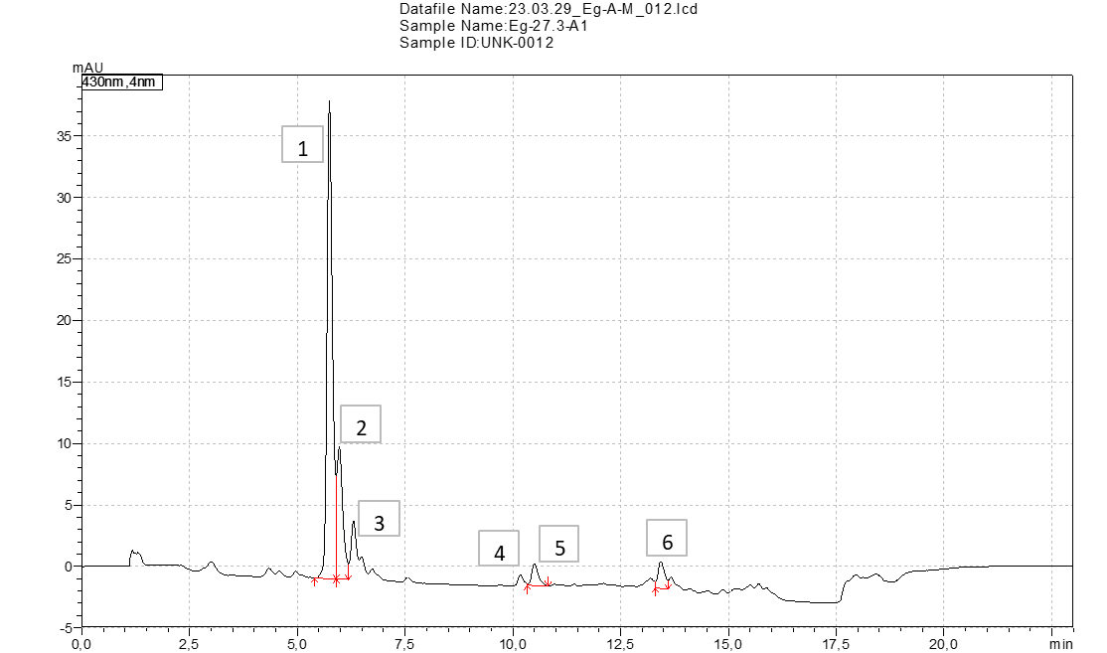
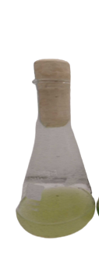
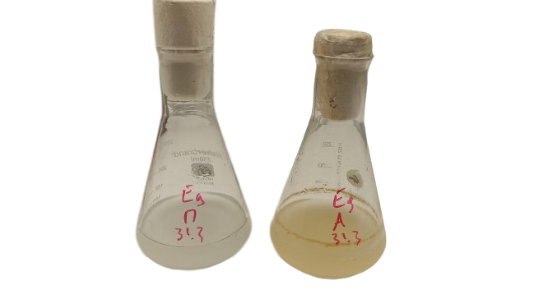
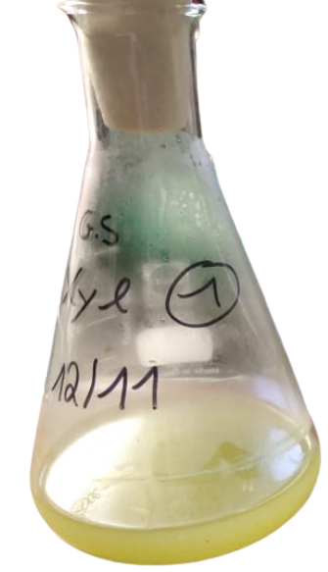
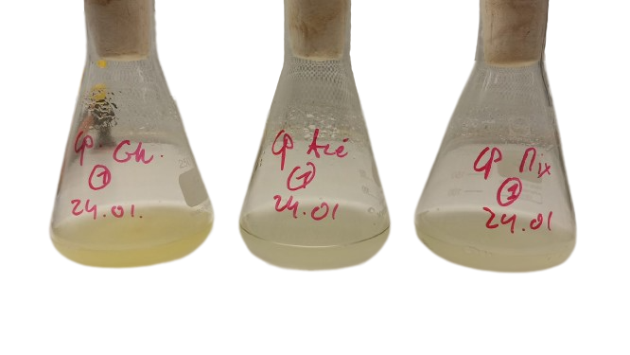
Biomass content
Pigments
E. gracilis
G. sulphuraria
A. protothecoides
Mix
Acetate
Glucose
Xylose
Glucose
Acetate
Mix
Peak 1
Peak 2
Peak 3
Notes:
Pas de pigments pour Gs en présence de glucose, mais au vue de la tête de la culture on dirait qu’il y a encore moins de pigments qu’en présence de glucose.. Aucun pigment connu détecté chez E. gracilis ni en phase expo ni en phase stationnaire. Les pics on des formes de caroténoïdes secondaires. Ce caroténoïde secondaire correspondant au pic 1 est présent en plus grand quantité dans le milieu avec acétate, et visuellement on remarque une coloration orangée en fin de phase stationnaire. On remarque que le contenu en pigments est encore plus faire chez C. proto que chez Galdieria. L’hétérotrophie semble bcp affecter son contenu pigmentaire. Remarque : des cultures en phase stationnaire de C. proto avaient été replacées à la lumière et jamais elle n’ont retrouvé leur coloration. Expliquer les photos, que globalement toutes perdent généreusement leurs pigments, et que la coloration verte disparaît presque intégralement quelle que soit la condition étudiée.

Slide 26
Summary of the results
Strain​ | Substrate​ | Doubling Time (Days) | Max DW ​ (g.L⁻¹)​ | Max productivity (gDW.L⁻¹.d⁻¹) | Sugar to biomass conversion (gDW.gsugar⁻¹) | Max [Fatty acids] (mg.gDW⁻¹)​ | % SFA​ | % MUFA​ | % PUFA​ | Max [Carbohydrates] (mg.gDW⁻¹)​
G. sulphuraria​ | Glucose​ | 0.63 ± 0.02 | 2.37 ± 0.34 | 1.62 ± 0.22 | 0.54 ± 0.08 | 143,0 ± 35,0​ | 57,4 ± 0,5​ | 8,1 ± 0,7​ | 34,4 ± 0,5​ | 264,4 ± 2,7​
 | Xylose​ | 0.72 ± 0.02 | 2.27 ± 013 | 1.31 ± 0.08 | 0.52 ± 0.01 | 64,9 ± 0,5​ | 62,9 ± 0.7​ | 16,9 ± 0,6​ | 20,2 ± 0,1​ | 203,3 ± ​0,1
 | Acétate​ | / | / | / | /​ | /​ | /​ | /​ | /​ | /​
 | Mix​ | / | /​ | / | /​ | /​ | /​ | /​ | /​ | /​
C. protothecoides​ | Glucose​ | 0.37 ± 0.02 | 0.82 ± 0.02 | 0.59 ± 0.08 | 0.17 ± 0.01 | 218,3 ± 18,9​ | 33,3 ± 4,5 | 31,2 ± 1,1 | 35,6 ±​ 3,4 | 75,1 ± 17
 | Xylose​ | / | / | / | / | /​ | /​ | /​ | /​ | /​
 | Acétate​ | 0.44 ± 0.01 | 1.12 ± 0.02 | 0.39 ± 0.01 | 0.17 ± 0.01 | 318,2 ​± 2,6 | 30,5 ± 0,4 | 39,6 ± 0,4 | 29,9 ±​ 0,3 | 23,8 ± 5,2
 | Glu-xyl-ace | 0.34 ± 0.01 | 1.17 ± 0.14 | 0.46 ± 0.14 | 0.23 ± 0.04 | 216,2 ± 32,0​ | 26,4 ± 0,2 | 39,1 ± 0,9 | 34,5 ±​ 0,8 | 22,3 ± 2,4​
E. gracilis​ | Glucose​ | / | / | / | /​ | /​ | /​ | /​ | /​ | /​
 | Xylose​ | / | / | / | /​ | /​ | /​ | /​ | /​ | /​
 | Acétate​ | 0.72 ± 0.05 | 1.08 ± 0.04 | 0.47 ± 0.10 | 0.21 ± 0.02 | 68,2 ± 4,6​ | 67,2 ± 1,1​ | 8,8 ± 0,6​ | 27,8 ± 1,3​ | ND​
 | Glu-xyl-acé​ | 0.67 ± 0.01 | 0.70 ± 0.01 | 0.33 ± 0.02 | 0.14 ± 0.01 | 54,4 ± 6,4 | 75,4 ± 4,7 | 6,7 ± 0,6 | 76,5 ± 4,2 | ND​
/ : No growth
ND : No data

Slide 27
Conclusions
Chlorella protothecoides is the only strain studied capable of growing efficiently in the presence of a mix of the three carbon sources found in hemicellulosic material.
It seems to be able to assimilate xylose if other carbon sources are present.
It has a very low carbohydrate and pigment content in heterotrophy but high levels of proteins and fatty acids.
Galdieria sulphuraria growth is inhibited by the presence of acetate in the medium.
It is the only strain studied able to grow in the presence of xylose as unique carbon source.
It shows low fatty acid content but high sugar to biomass conversion and biomass productivity.
The fatty acids produced in exponential phase are mainly SFA.
Euglena gracilis can only assimilate acetate as a carbon source found in hemicellulose hydrolysate in heterotrophy.
Fatty acid levels are low and carbohydrate content must be determined.

Slide 28
What about growing the strains in the presence of hemicellulose hydrolysate ?

Slide 29
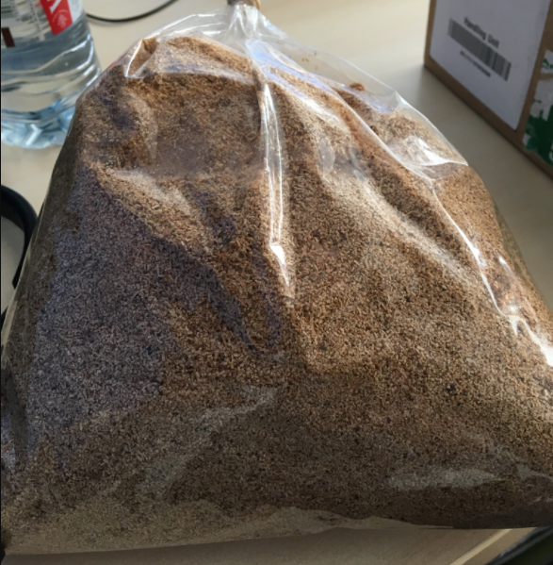
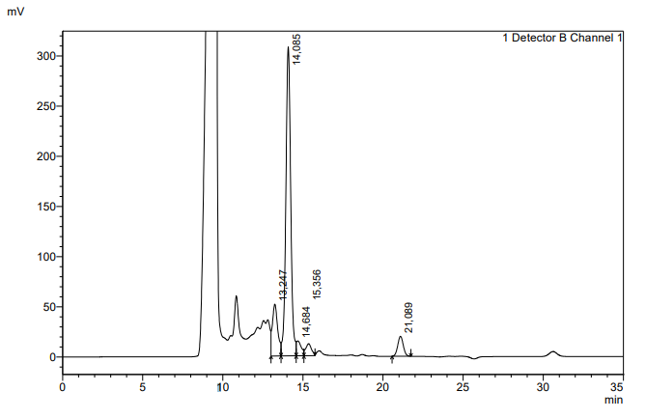
Lignocellulosic matter hydrolysis
H₂SO₄ 3%
Hemicellulose hydrolysate
Autoclave
(121°C ; 20min)
Solid fraction
Sawdust
provided by Iris Cornet lab
Filtration, pH neutralisation and sterilization
Hemicellulose hydrolysate containing glucose, xylose, mannose, arabinose, galactose and rhamnose
Composition analysis by HPLC
Compound | [](g.L⁻¹) | %
Glucose | 1,7 | 12,2
Xyl-Man-Gal | 10,1 | 71,2
Rhamnose | 0,5 | 3,5
Arabinose | 0,4 | 3,1
Acetate | 1,4 | 10,1
Total | 14,1 | 100,0
Feed algae
Galdieria sulphuraria
Glucose
Xylose
Mannose
Galactose
Rhamnose
Arabinose
Acetate
Chlorella protothecoides
Euglena gracilis

Slide 30
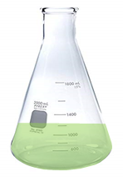

How to valorize all the carbon sources found in the hydrolysate ?
Chlorella protothecoides is able to assimilate acetate and glucose, and produces interesting amounts of lipids.
Galdieria sulphuraria growth is inhibited by the presence of acetate in the medium. Nevertheless, it is a good candidate for xylose valorization.
Galdieria
TMP
pH7
25°C
Xyl/Ace/Glu
Oligos, NaCl
H₂SO₄ pH2
42°C
Xyl
+
+
Chlorella
Chlorella biomass
Galdieria
First attempt conducted with the M1 intern. 1/10 of the medium was replaced by the neutralised hemicellulose hydrolysate.
Notes:
Je sais qu’il y a beaucoup de texte mais je vais l’expliquer à l’oral ça ira vite, et malheureusement Mathias ne m’a toujours pas envoyé ses résultats.

Slide 31
How to valorize all the carbon sources found in the hydrolysate ?
C. protothecoides was able to grow and remove the acetate from the medium.
G. sulphuraria could grow in the acidified medium after C. protothecoides removal, consuming the remaining xylose from the medium.
What is next?
Analysis of the biomass composition of each algal fraction
Increasing the hydrolysate concentration
Scale-up of the process using the bioreactor (fed batch or continuous)
Another publication?

