Slide 1


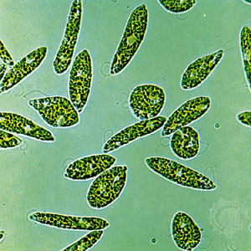
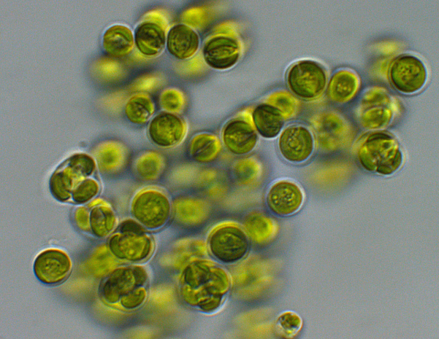
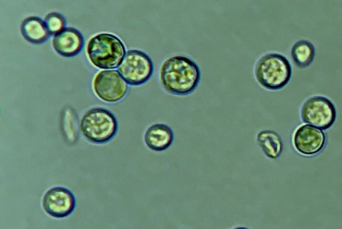
Optimization of the growth of microalgae in the presence of organic carbon sources by genetic and physiological approaches
ADV_BIO Project
Département des Sciences de la Vie
Laboratory of genetics and physiology of microalgae
Euglena gracilis
Promoter : Claire REMACLE
Co-promoter : Pierre CARDOL
Chlorella protothecoides
Pablo Perez – May 2022
Annual Meeting ADV-BIO
Galdieria sulphuraria

Slide 2
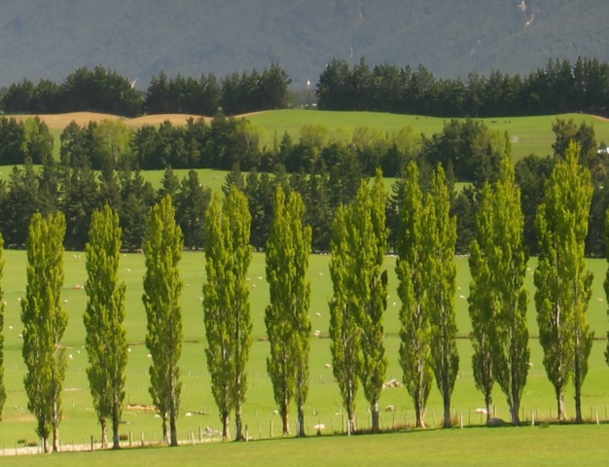
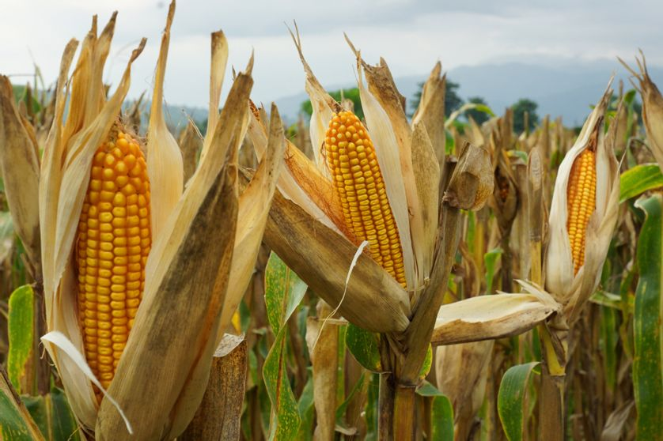
Objective of WorkPackage 1 : microalgae based biomass
Lignocellulosic matter
Including wood and agricultural waste.
Microalgae
WP1
WP4
Optimization of the growth conditions in the dark, « physiological » improvements, establishment of production systems
Feedstock for microalgal growth
Production of new biomasses optimized for biofuel applications.
Chemical conversion at low T°
Hydro-thermal conversion at high T°
WP2
WP3
Poplar
Corn (straw)
Chemo-thermal conversion at high T°
Kerosene
Transesterification
Diesel
WP5
Technical and economic comparative analysis and environmental impact study
Gasoline
Biodiesel
Bioethanol
Low T° conversion
WP7
WP6
Notes:
.

Slide 3

Why to study microalgae to produce biofuel?
No need of arable lands to grow
Can be cultivated in seawater or wastewater
High biomass productivity
VS
High photosynthetic efficiency
High lipid content
No lignin within their cell wall

Slide 4

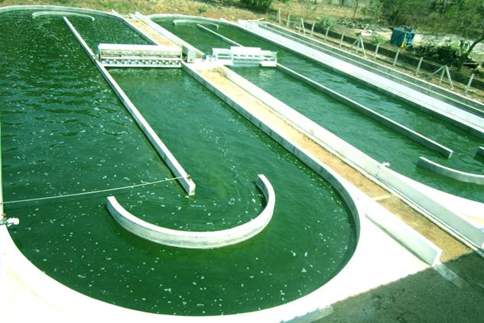


Objectives of the WorkPackage 1
Heterotrophy
Open pond culture of microalgae
« Optimization of the growth of microalgae in the dark in the presence of organic carbon sources by genetic and physiological approaches »

Slide 5
Objectives of the WorkPackage 1
WP1 : Optimization of the growth of microalgae in the dark in the presence of organic carbon sources by genetic and physiological approaches
  Selection of 3 different algal strains able to grow in heterotrophy
  Composition of growth media containing different substrates such as hemicellulose hydrolysates
  Analyses of algal growth parameters and biomass content
  Physiological approaches to induce biomass and lipids production
  Scale-up for biomass production increase
  ROS resistant cell lines investigation
  Optimization of low light mixotrophic cell lines

Slide 6
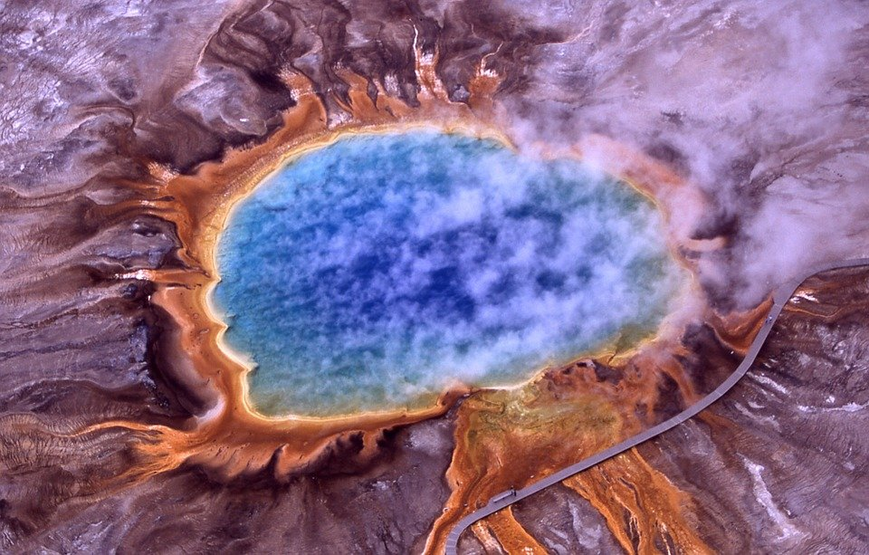
Which microalgae are studied for the project and why ?
Euglena gracilis
Wallless
Up to 60% m/m of paramylon in aerobic conditions
Converted into wax esters in anaerobic conditions
Galdieria sulphuraria
An extremophilic red microalga
Optimum T° = 42°C
Optimum pH = 2
Able to use up to 50 different carbon sources
Chlorella protothecoides
High lipid content (±50% of the DW)
High level of saturated fatty acids (up to 90% of the total)
High oxidative stability for biodiesel
Sulphurous acidic hot spring in Yellowstone National Park

Slide 7


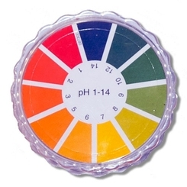

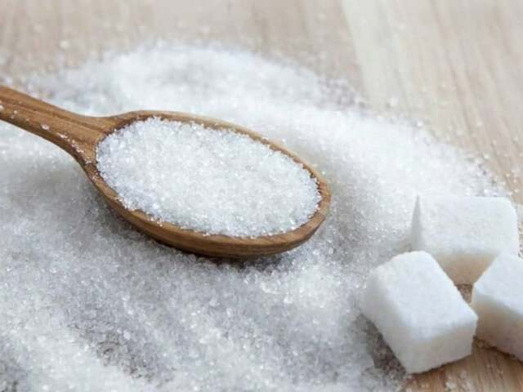
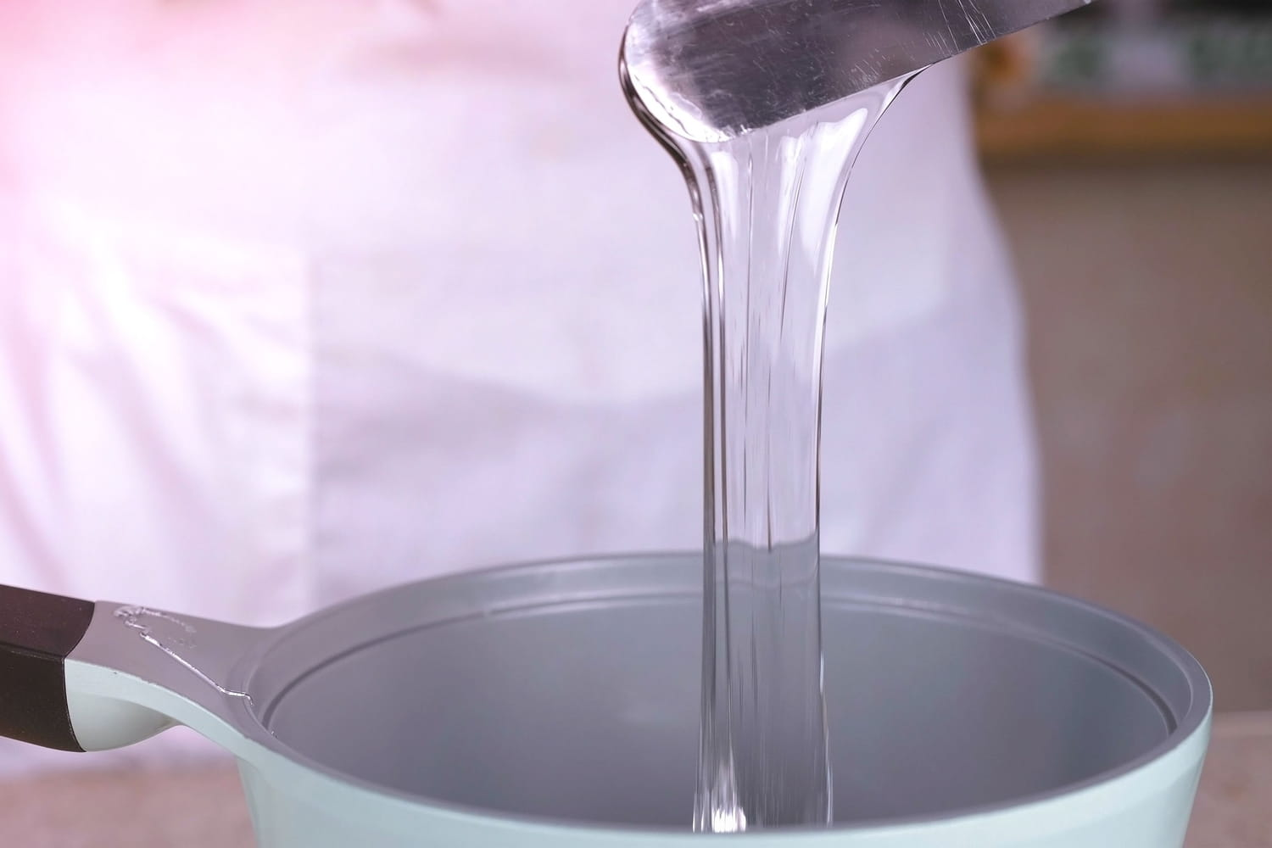
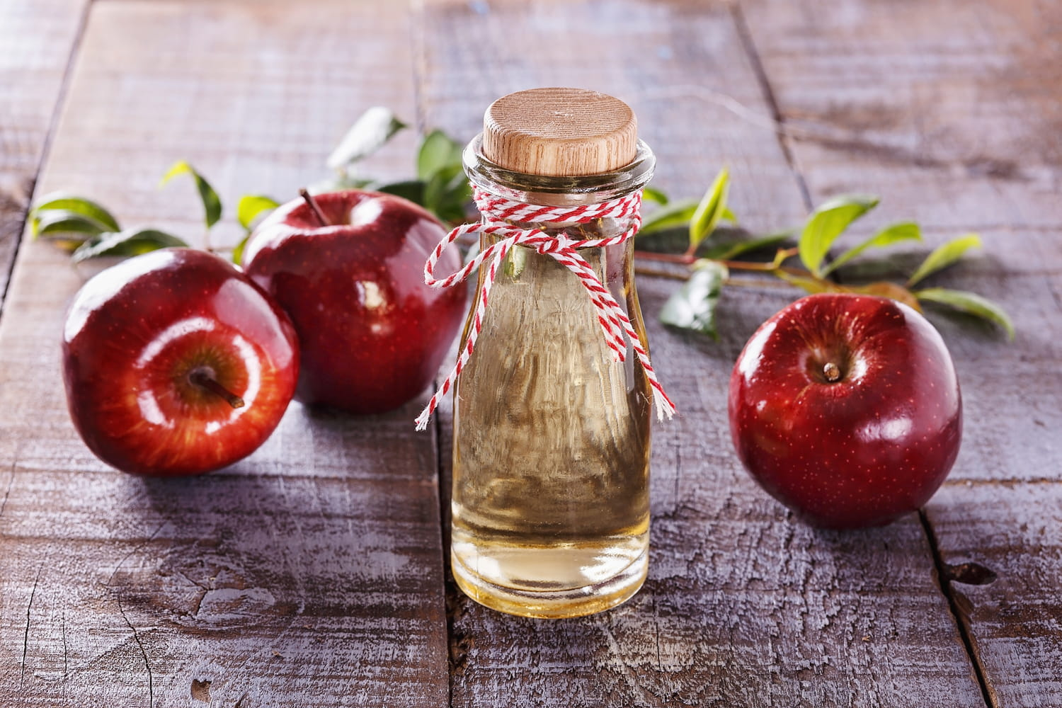




Physiological approaches to enhance lipid productivity
Stresses to enhance lipid production
Temperature
pH
Salinity
Nutrient starvation
Different organic carbon sources as nutrient
Sugars
Polyols
Organic acids
Notes:
Montrer différents sucre avec lesquels ça pousse et dire que je compare les sucres et les souches et voilà.

Slide 8
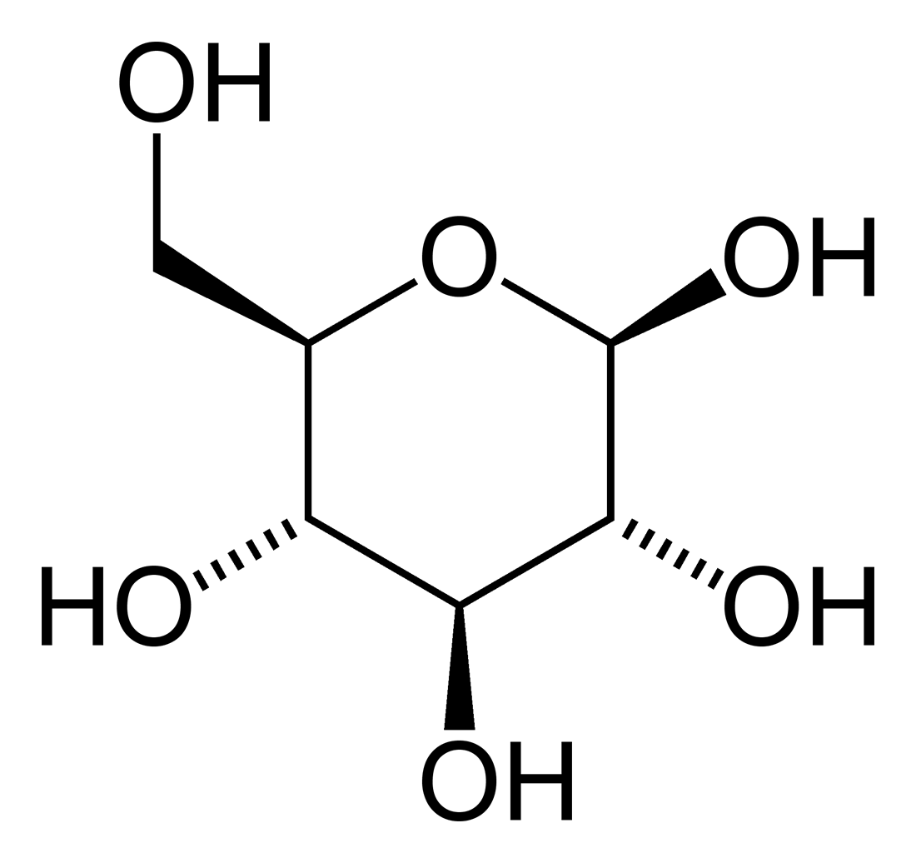
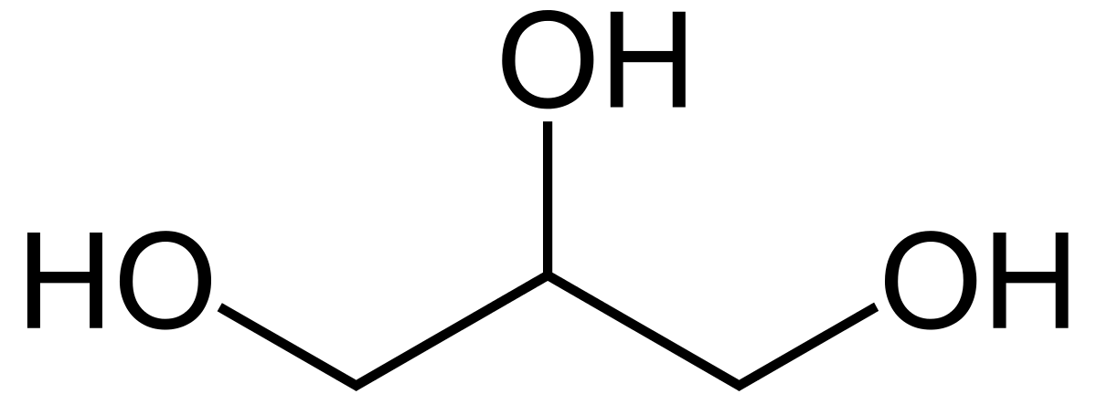
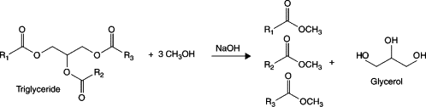
Why to grow G. sulphuraria with glucose or glycerol ?
Glucose
Glycerol
Widely found in nature (e.g. in starch, cellulose,…)
One of the most common carbon source used for microalgal heterotrophic growth
Chlorophyll a biosynthesis inhibition reported in litterature
By-product of the transesterification process
For 10Kg of biodiesel produced, approx 1Kg of glycerol is created
MM = 92,094 g.mol⁻¹
MM = 180,156 g.mol⁻¹
Adapted from Mota, 2012
+Water 10% w/w
+Methanol <1% w/w
+NaCl 10% w/w
Glucose | Glycerol
25mM | 50mM
4,50 | 4,60

Slide 9
Growth parameters and fatty acid content
Harvesting points
Carbon source | Doubling time (Day) | Max biomass (g.gDW⁻¹) | Max productivity (gDW.L⁻¹.d⁻¹) | Sugar to biomass conversion (gDW.gsugar⁻¹) | Max FA production (mg.L⁻¹)
Glucose | 0.63 ± 0.02 | 2.37 ± 0.34 | 1.62 ± 0.22 | 0.56 ± 0.08 | 175.25 ± 5.47
Glycerol | 0.64 ± 0.02 | 2.67 ± 0.48 | 1.50 ± 0.10 | 0.57 ± 0.05 | 195.48 ± 15.36

Slide 10
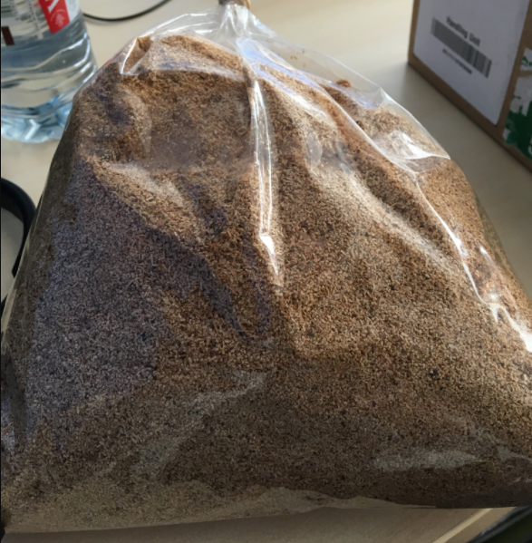
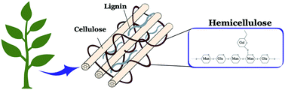
Galdieria sulphuraria grown on hemicellulose sugars
Make bonds between cellulosic fibres
Represent 30 to 45% of the total plant biomass on earth
Sawdust
Naidjokona et al., 2020
H₂SO₄ 0.1M
142°C
12min
Hemicellulose hydrolysate
Solid fraction
Filtration
Hemicellulose hydrolysate containing glucose, xylose, mannose, arabinose, galactose and rhamnose
Hemicellulose composition based on Miazek et al., 2017

Slide 11
Conclusions
Perspectives
G. sulphuraria has the same ability to grow heterotrophically under glucose or glycerol as carbon source
No significant differences were found in biomass composition according to the carbon source
G. sulphuraria is a promising candidate to convert hemicellulose into valuable bio-compounds
Grow G. galdieria in the presence of « real » hemicellulose hydrolysate
Enhance lipid production by inducing nutrient starvation such as nitrogen
Scale-up of the culture with the incoming 5L bioreactor
Grow other heterotrophic friendly microalgal species in the presence of hemicellulose hydrolysate
Chlorella protothecoides
Euglena gracilis

