Slide 1
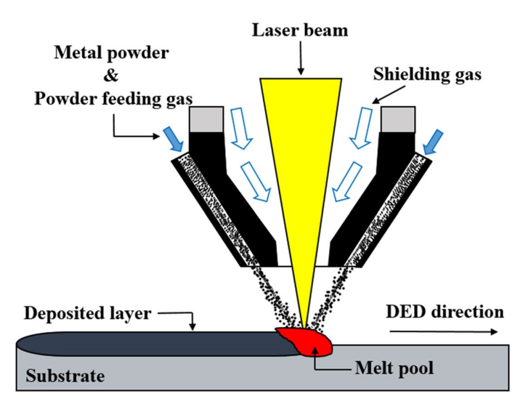
Abdul Herrim SEIDOU
Materials Engineer / PhD Candidate
Metallic Materials Science Unit (MMS)
University of Liège, Belgium
ahb.seidou@uliege.be
Evaluation of Corrosion Resistance of 316L stainless steel with or without SiC additions produced via Directed Energy Deposition
Direct Energy Deposition (DED)
Materials tested
Corrosion tests performed in 0.5M NaCl (aq) solution at room temperature
316L stainless steel (wrought)
316L stainless steel DED
316L + 10 vol.% SiC DED
316L + 20 vol.% SiC DED
Open Circuit
Polarization (OCP) ~ 15h
For system stabilization
Electrochemical Impedance Spectroscopy (EIS)
Bode and Nyquist plots for general corrosion evaluation
Advantages of DED:
Potentiodynamic Polarization (PDP)
PDP curve for pitting corrosion
High build rates
Can be used for repair
Multi-material range
Reduced material waste

Slide 2
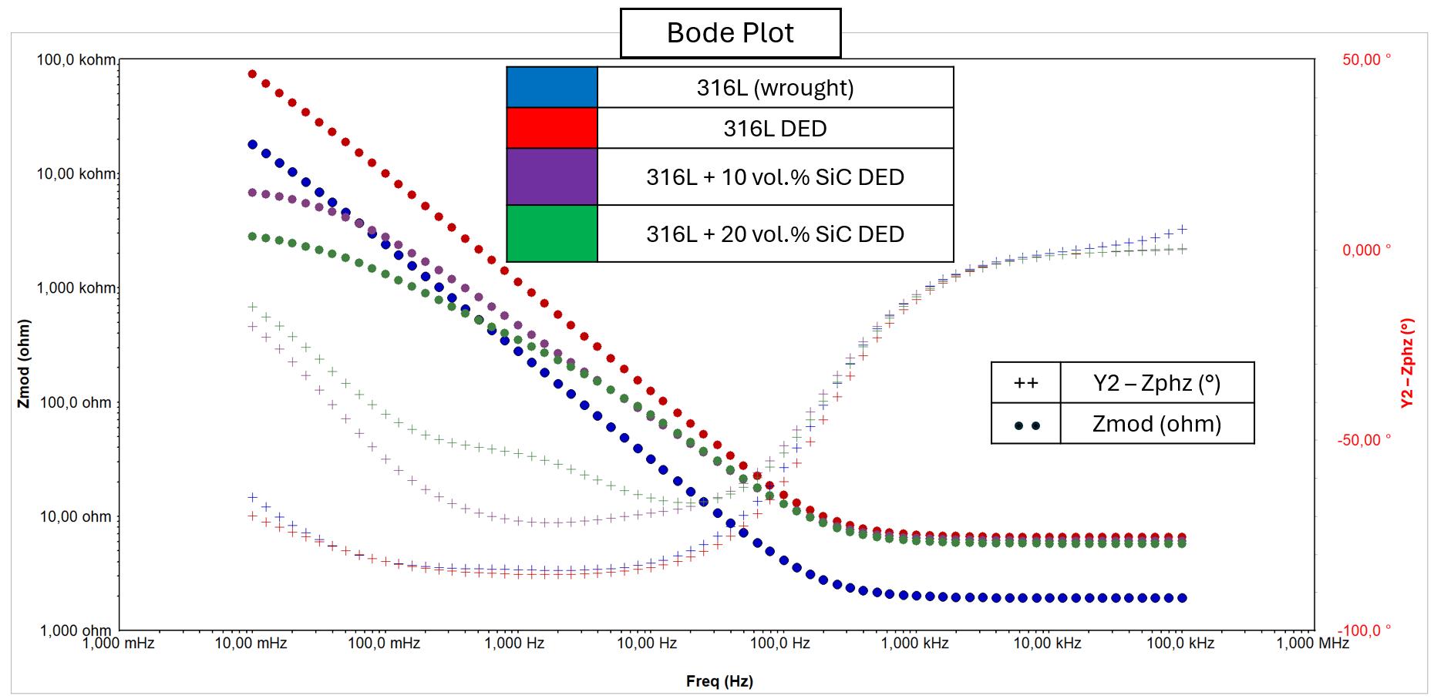
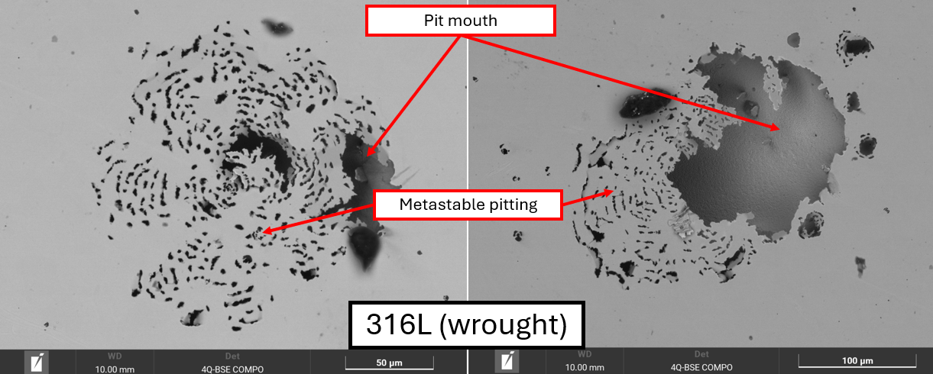
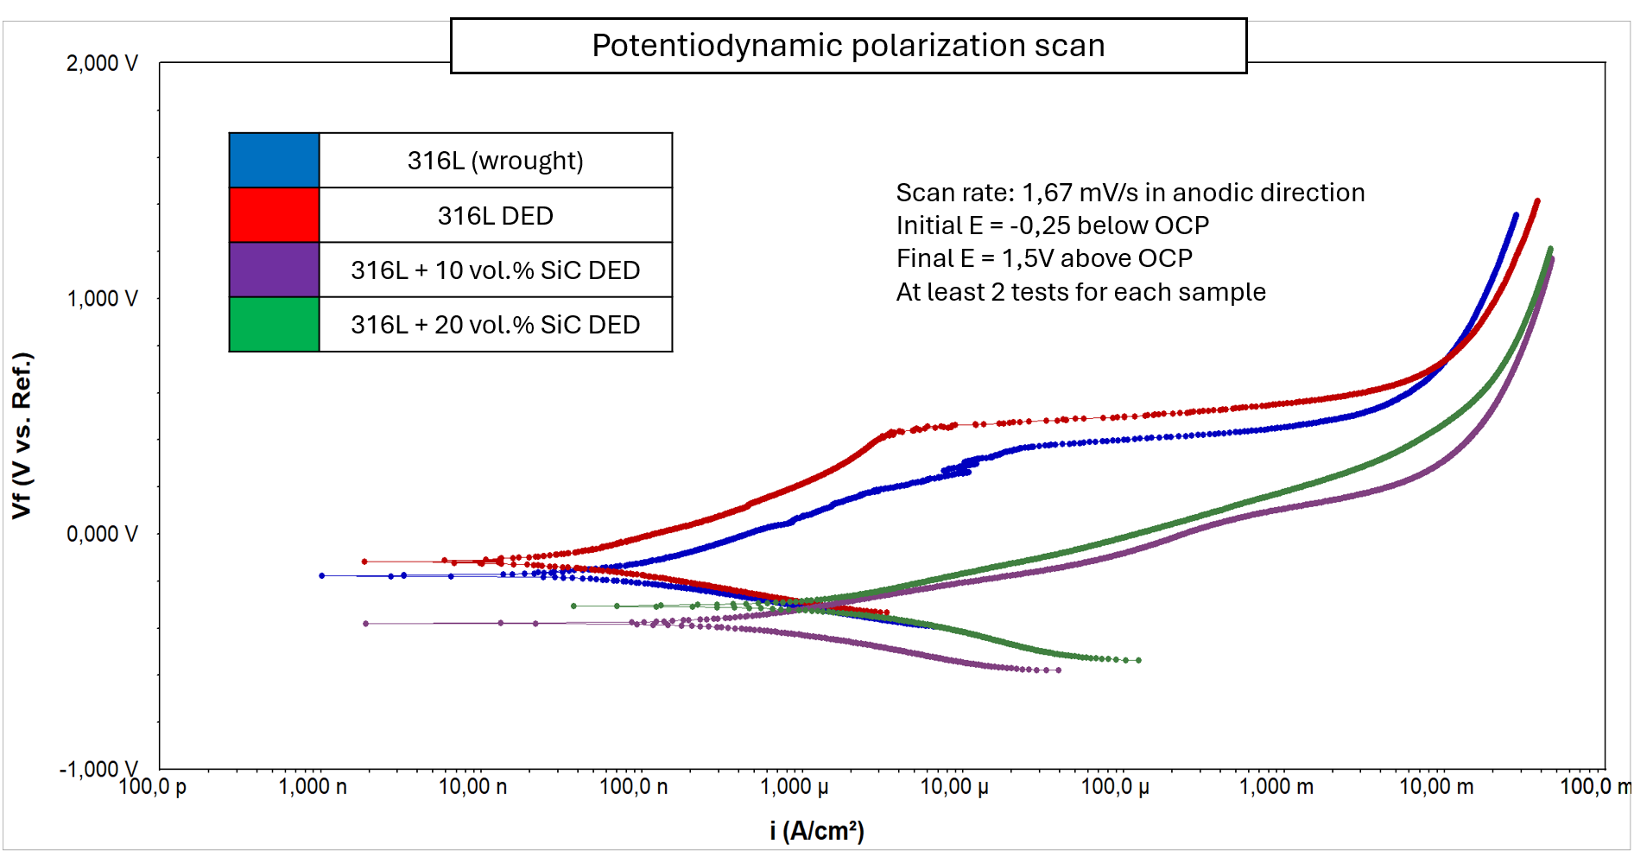
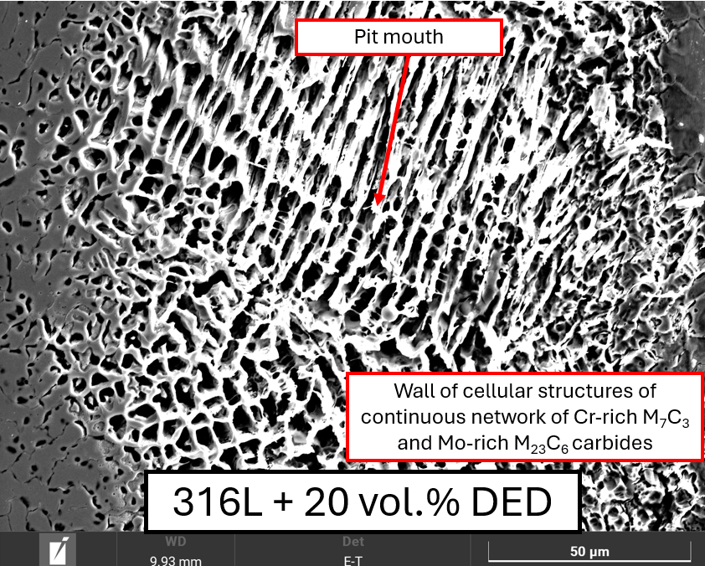
Abdul Herrim SEIDOU
Materials Engineer / PhD Candidate
Metallic Materials Science Unit (MMS)
University of Liège, Belgium
ahb.seidou@uliege.be
SEM micrographs after potentiodynamic polarization
EIS for general corrosion
Potentiodynamic polarization for passivation and pitting corrosion

