Slide 1
Combined PV-EV-HP Hosting Capacity Analysis of a Belgian Low-Voltage Distribution Network
Authors:
Amina Benzerga, Maurizio Vassallo, Simon Gérard, Julien Vandeburie, Damien Ernst

Slide 2
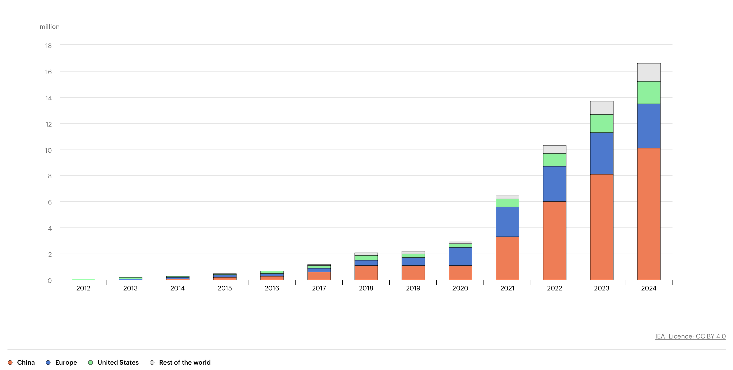
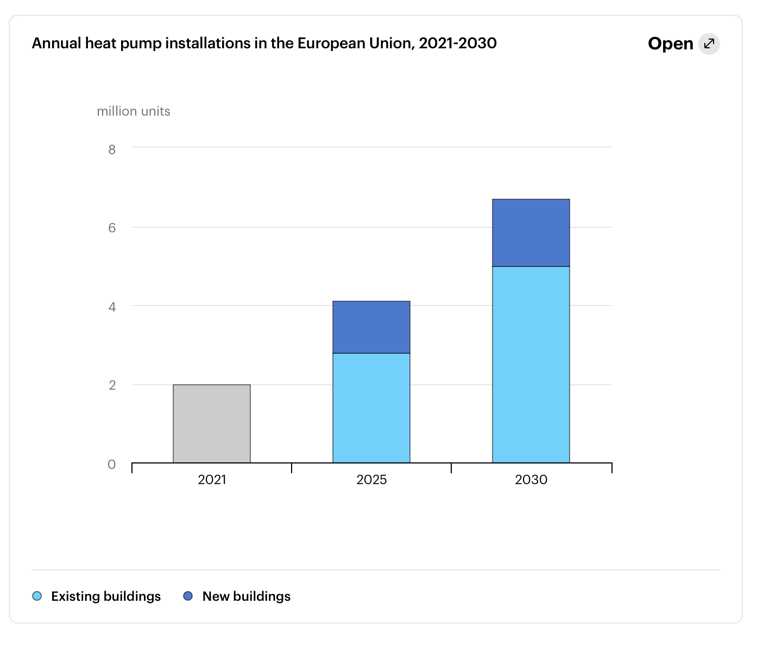
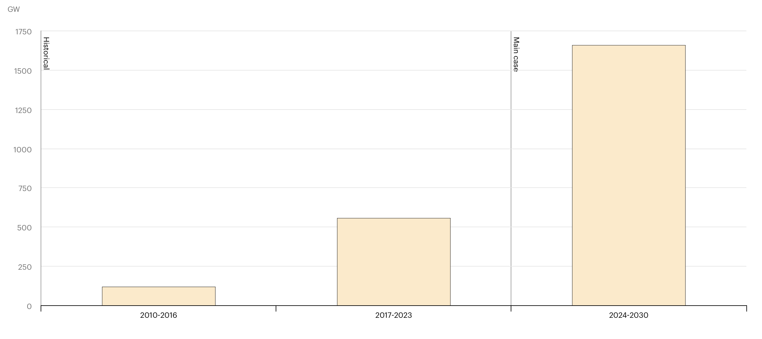
Introduction
Electric car sales
(https://www.iea.org/reports/global-ev-outlook-2024/trends-in-electric-cars)
PV- distributed capacity growth
(https://www.iea.org/reports/renewables-2024/electricity)
(https://www.iea.org/search?q=heat%20pump%20installation)

Slide 3
Problem statement
The aim:
Determine the combined PV-EV-HP hosting capacity (HC) of a given network.
Definition:
The HC is the amount of new resources that can be hosted by a network before facing any issues, i.e., compromising its operational limits or violating safety constraints.
A scenario: a combination of installed technologies across the network. This is a potential evolution of the network.
A penetration: that gauges the amount of new installations in the network for each technology in a given scenario. The penetration is chosen as the % of customers with new technologies compared to the total number of customers.
Note that the HC problem is defined using the generic formalism [1].

Slide 4
Problem statement
A binary function detects if any issue occurred in a given scenario. Two types of issues are considered: voltage level (over and under voltage) and overloading of the lines.
The hosting capacity is chosen as the feasible penetrations, defined in [1], which are penetrations that are associated with scenarios with no issues.
Notes:
This means that you do not stop the simulations if a penetration is not feasible.

Slide 5
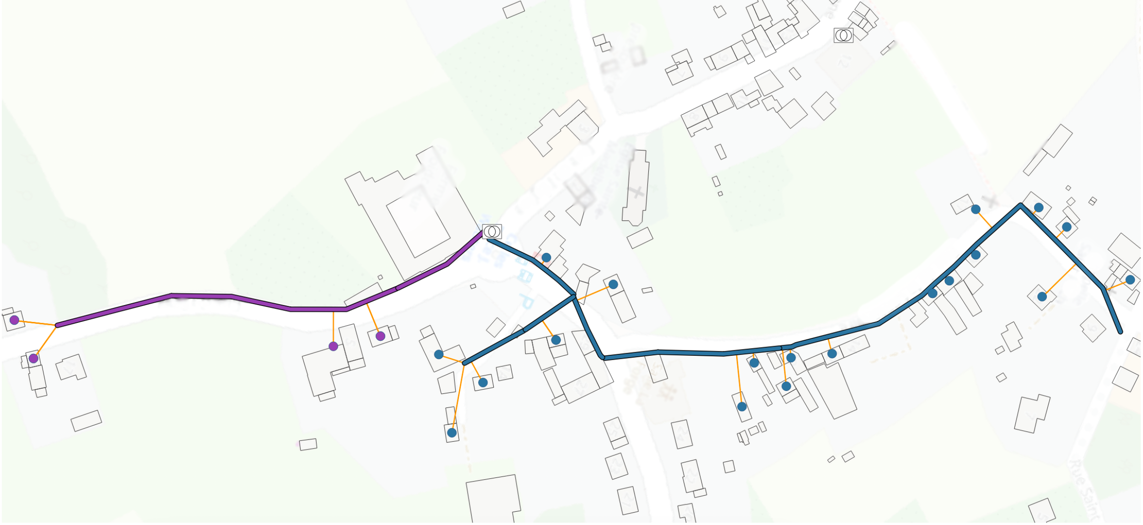
Case study – Belgian network
The network was reconstructed using topological path identification[2].
23 customers
2 feeders
1 transformer (MV/LV substation)
42 lines
15 customers with Smart Meters
Timeseries:
Load and PV: from SM
EV and HP: SIRIUS [3]
15min granularity

Slide 6
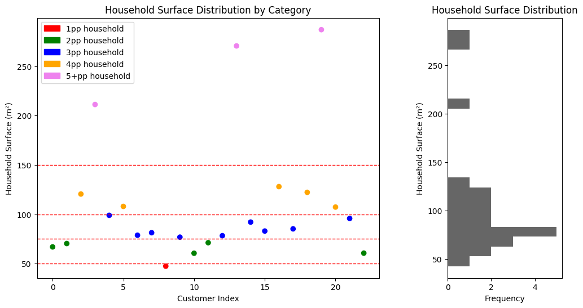
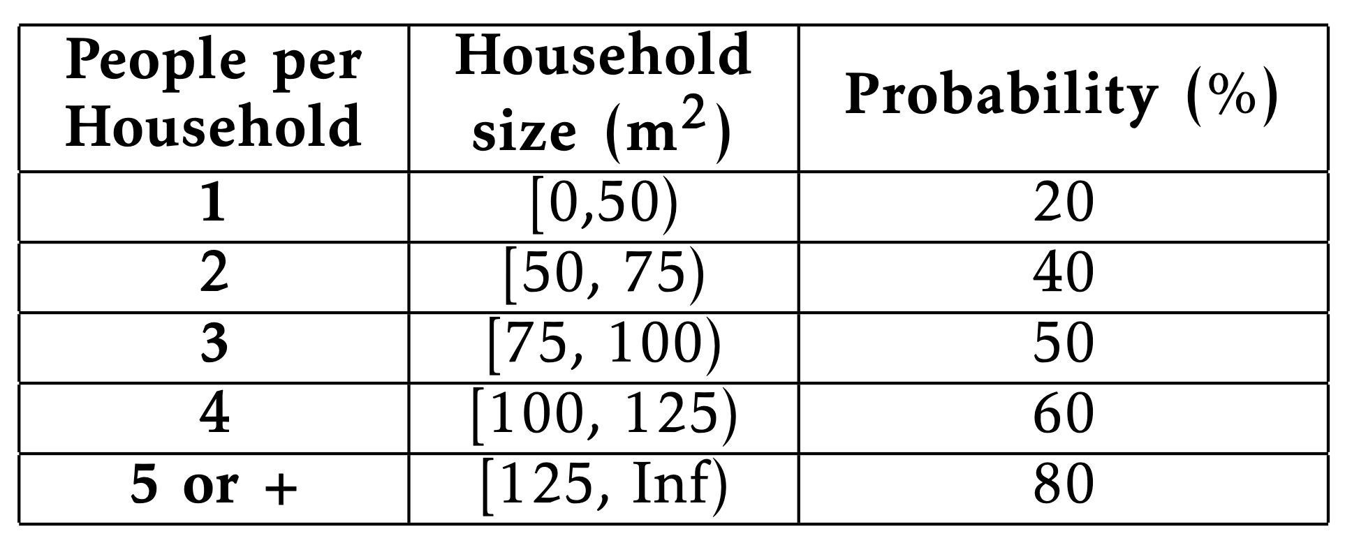
Case study – considered scenarios
Technologies size:
Probability of installing a technology:
Use a probability to install a new technology for each customer and technology type.
Table I: Probability of installing a new technology per people in the household and household size.

Slide 7
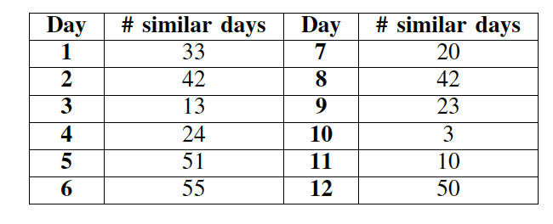
Case study – scenarios reduction
Representative days:
Reduce the number of time steps considered
Table II: Number of days in a year of 366 days that are similar to the considered representative days.

Slide 8
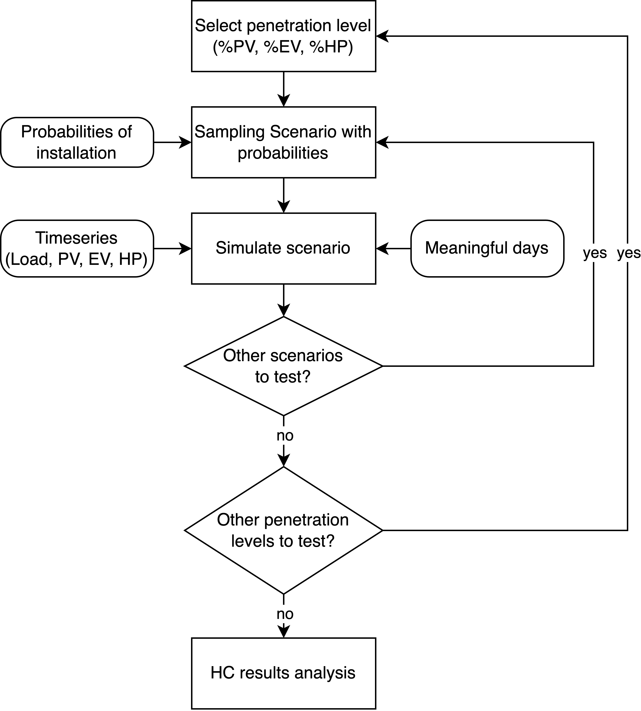
Implementation
Penetration levels: [25%, 50%, 75%, 100%]
100 scenarios for penetration level

Slide 9
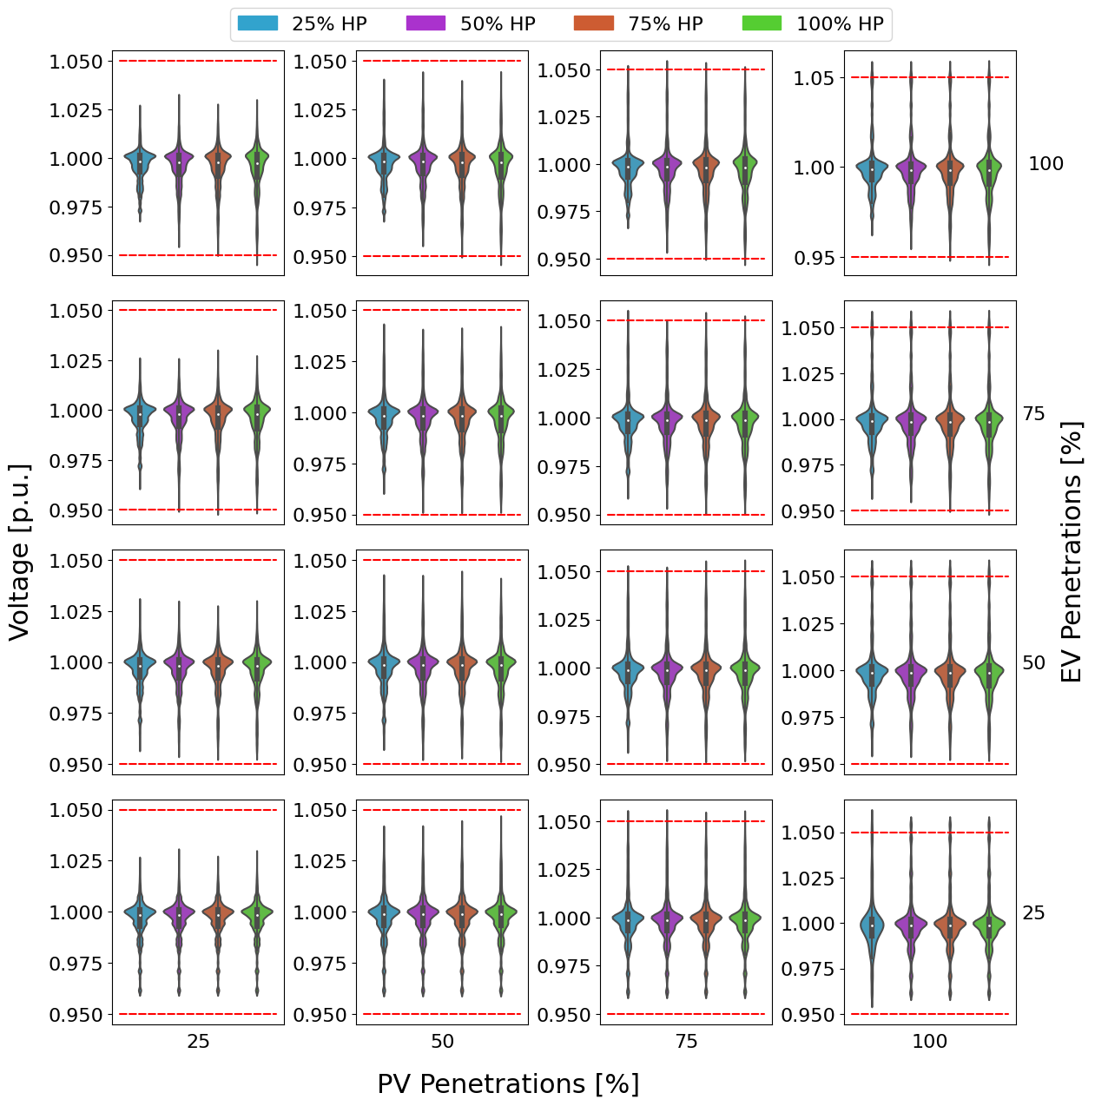
Results - Voltage
Acceptable for a penetration around 50% for all technologies
under-voltage is encountered rapidly for both EV and HP penetrations higher than 50%.
Over-voltage is not faced before 75% of PV penetration.

Slide 10
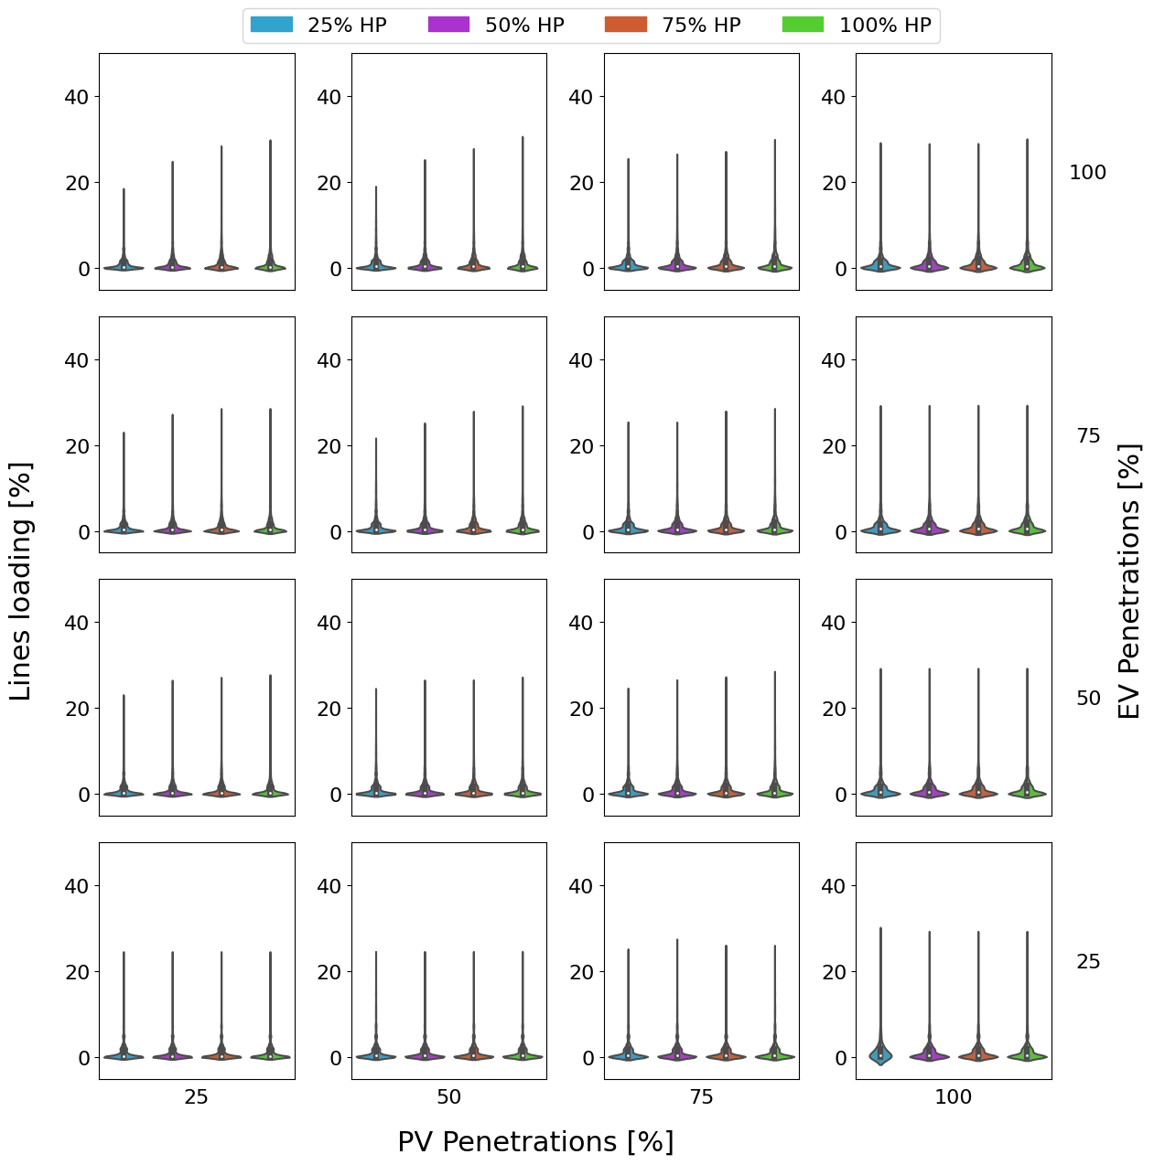
Results – congestion
Even with high penetration rates for all three technologies, the lines of the case study network are not overloaded.

Slide 11
Conclusion and future work
This research used the formalisation of HC [1] for combined PV, EV and HP.
The analysis is conducted using a reconstruction of a Belgian network using topological path identification [2].
The empirical data are given by a Belgian DSO and representative days are taken from Sirius [3].
The analysis showed that over a penetration of 50% for each technologies, issues, more precisely over- and under-voltage, are encountered while no overloading of the lines.
Elaborate the selection of the representative days for instance considering weather conditions, energy consumption patterns,…
Broaden the research and data available on the probabilities for customers to add new technologies.
Tests robustness of the results with for instance different sizes of installations

Slide 12
References
[1] A. Benzerga, A. Bahmanyar, G. Derval, and D. Ernst, “A unified definition of hosting capacity, applications and review,” 2024.
[2] M. Vassallo, A. Bahmanyar, L. Duchesne, A. Leerschool, S. Gerard, T. Wehenkel, and D. Ernst, “A systematic procedure for topological path identification with raw data transformation in electrical distribution networks,” in 7th International Conference on Energy, Electrical and Power Engineering (CEEPE 2024), CEEPE, Yangzhou, China, 2024.
[3] J. Vandeburie, T. Wehenkel, and S. Gerard, “Predicting local effects of energy transition through development of a network observation tool,” in 27th International Conference on Electricity Distribution (CIRED 2023), IET, 2023, pp. 3625–3628.

