Slide 1
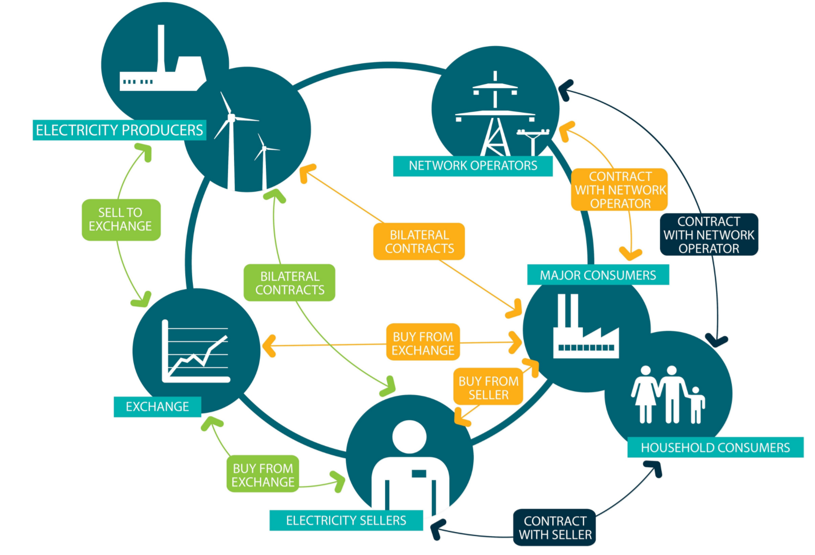
ELEC0018-1
Energy market and regulation
Lecturer: Damien Ernst – University of Liège (dernst@uliege.be)
Picture from Elering

Slide 2
ELEC0018-1
Energy market and regulation
Lecturer: Damien Ernst – University of Liège (dernst@uliege.be)
  Chapter 00 – Organisation of the course

Slide 3
Goals of the course
Gain a comprehensive understanding of how electricity, gas and oil prices, as well as carbon allowance prices, are determined, including the key factors that influence price fluctuations over time.
Explore the structure of electricity, gas, oil and carbon markets, including key players (e.g., producers, suppliers, retailers, regulators, consumers), and how these markets have evolved. Be able to critically assess the pros and cons of these schemes.
Analyse the impact of current political decisions and policies such as renewable energy incentives, carbon pricing, and energy regulations on the future cost and accessibility of electricity.
Develop an understanding of the economic relationships between electricity and other energy carriers such as gas, oil and renewables, and how shifts in one energy sector can influence pricing and availability in others.
Equip yourself with the knowledge to predict future trends in the energy sector, taking into account both market and policy changes.

Slide 4
Course guidelines and evaluation criteria
Attendance in the course is mandatory.
The course will include:
  Plenary lectures given by Damien Ernst and invited guests,
  Plenary lectures given by prestigious invited speakers, whose teaching material is available on the class website: https://damien-ernst.be/teaching/elec0018-1-energy-markets/,
  Weekly reading assignments of scientific papers,
  Evaluations based on the readings,
  Group presentations of the readings.
Grading will be based on the following:
  Evaluation of the reading assignments (25%),
  Group presentation of the reading (25%),
  Oral exam (50%).
For the second session, grades will be based on a new scientific paper presentation (50%) and an oral exam (50%).

Slide 5
Content of the course
The course is divided into chapters as follows:
Chapter 00 – Organisation of the course
Chapter 01 – Motivation of the course
Chapter 02 – Overview of electricity markets
Chapter 03 – From monopolies to liberalisation in electricity markets
Chapter 04 – Participants in the electricity markets
Chapter 05 – Chronology of electricity markets and the forward/futures markets
Chapter 06 – The day-ahead market and its optimization problem
Chapter 07 – The day-ahead market and the problem with transmission networks
Chapter 08 – Balancing and securing the electricity power system
Chapter 09 – The impact of transmission networks on electricity trading
Chapter 10 – Energy sharing
Chapter 11 – Overview of gas markets
Chapter 12 – Overview of oil markets
Chapter 13 – Overview of carbon markets
Chapter 14 – Geopolitics and perspectives

Slide 6
Communications and questions
For questions about the organisation or content of the class:
Preferred option: Discuss with the instructors after class.
Email: Contact via email at matthias.pirlet@uliege.be.

Slide 7
References (1/3)
The materials (books, lectures, journals, reports) used to develop Chapters 1 to 14, excluding Chapter 11 presented by a guest speaker, are listed below in order from the most recent to the oldest. The sources for the figures and data used in the course are provided in footnotes on the corresponding slides.
Peeters, C. & Elia. (2023). Elia publishes its adequacy & flexibility study for Belgium for the period 2024-2034. [Press-release]. https://www.elia.be/-/media/project/elia/shared/documents/pressreleases/2023/20230629_pressrelease_adeqflex_en.pdf
ACER. (2022). ACER’s final assessment of the EU wholesale electricity market design. https://www.acer.europa.eu/sites/default/files/documents/Publications/Final_Assessment_EU_Wholesale_Electricity_Market_Design.pdf
Dumas, J. (2021). Energy Markets Retailers. [Course presentation]. University of Liege. https://github.com/jonathandumas/ELEC0018-1-energy-markets-retailers
Thiesen, H., & Jauch, C. (2021). Application of a new dispatch methodology to identify the influence of inertia supplying wind turbines on Day-Ahead Market sales volumes. Energies.
https://www.mdpi.com/1996-1073/14/5/1255

Slide 8
References (2/3)
Meeus, L. (2020). The evolution of electricity markets in Europe. Edward Elgar Publishing.
Bryant, G. (2019). Carbon Markets in a Climate-Changing capitalism. Cambridge University Press.
Pinson, P. (2019). Renewables in Electricity Markets. [Course presentation]. Imperial College London. http://pierrepinson.com/index.php/teaching/
Kirschen, D., Strbac, G. (2018). Fundamentals of Power System Economics. (2nd ed.). Wiley.
Cornélusse, B. (2017) How the European day-ahead electricity market works. [Course presentation]. University of Liege.
https://bcornelusse.github.io/material/CoursEM20170331.pdf
Hansen, J.-P., Percebois, J. (2017). Transition(s) électrique(s). Éditions Odile Jacob.
Biggar, D., Hesamzadeh, M., (2014). The Economics of Electricity Markets. Wiley.
Morales, J., Conejo, A., Madsen, H., Pinson, P., Zugn, M. (2014). Integrating Renewables in Electricity Markets. Springer.

Slide 9
References (3/3)
Lahaie, S. (2009). How to take the dual of a linear program. http://slahaie.net/docs/lpdual.pdf
European Wind Energy Association, Morthorst, P.-E., Awerbuch, S., Krohn, S., Awerbuch, S., Morthorst, P. E., Soren Krohn Consulting, Science and Technology Policy Research, University of Sussex, & Risoe National Laboratory. (2009). The economics of wind energy. Krohn, S. Ed.
https://www.ewea.org/fileadmin/files/library/publications/reports/Economics_of_Wind_Energy.pdf

Slide 10
ELEC0018-1
Energy market and regulation
Lecturer: Damien Ernst – University of Liège (dernst@uliege.be)
Chapter 01 – Motivation of the course

Slide 11
Introduction to energy markets
Energy plays a key role in economic activities, making both the availability and cost of energy sources critical factors for economic development and social well-being. Consequently, governments have established policy objectives to improve the availability, affordability, and sustainability of energy.
The term ‘energy markets’ refers to a complex system in which producers, transport and distribution operators, traders, and consumers interact to achieve their respective objectives. These markets include electricity, gas, oil, coal, and other energy-related commodities, such CO₂ emission allowances.
The electricity, gas, oil, and carbon markets are interlinked. Oil and gas are key fuels for electricity generation in many regions, meaning their prices directly influence electricity costs. Additionally, rising CO₂ prices increase the cost of electricity produced from fossil fuels, which can drive greater demand for cleaner energy alternatives.
For these reasons, this course will examine all these markets, with an emphasis on electricity markets.

Slide 12
Why study electricity markets?

Slide 13
Reasons to study electricity markets
There are three main reasons to study electricity markets:
Reason 1:
Electricity will become more and more prominent in our societies.
Reason 2:
The electricity markets have entered a phase where common approaches are challenged.
Reason 3:
More and more opportunities to become an active user in electricity markets even if you are a small consumer.

Slide 14
Electricity will become more and more prominent in our societies
Future electricity consumption in Belgium is expected to increase due to rising demand from industries, electrification of transport, and heating systems.
However, consumption trends could vary with advancements in grid flexibility, policy shifts, and energy-saving efforts aimed at balancing this growth. The role of renewables and electrification in sectors like transport will also significantly influence future demand.
TWh
Uses and losses
Heat pumps
Electric Vehicles
Electrification of industry, data centres, and electrolysers
Decarbonized electricity production (nuclear, wind, solar)
Example of projected electricity consumption scenario by Elia (2023). There is a significant gap between decarbonized electricity production and the ever-increasing electricity consumption.¹
¹https://www.elia.be/-/media/project/elia/shared/documents/press-releases/2023/20230629_pressrelease_adeqflex_en.pdf

Slide 15
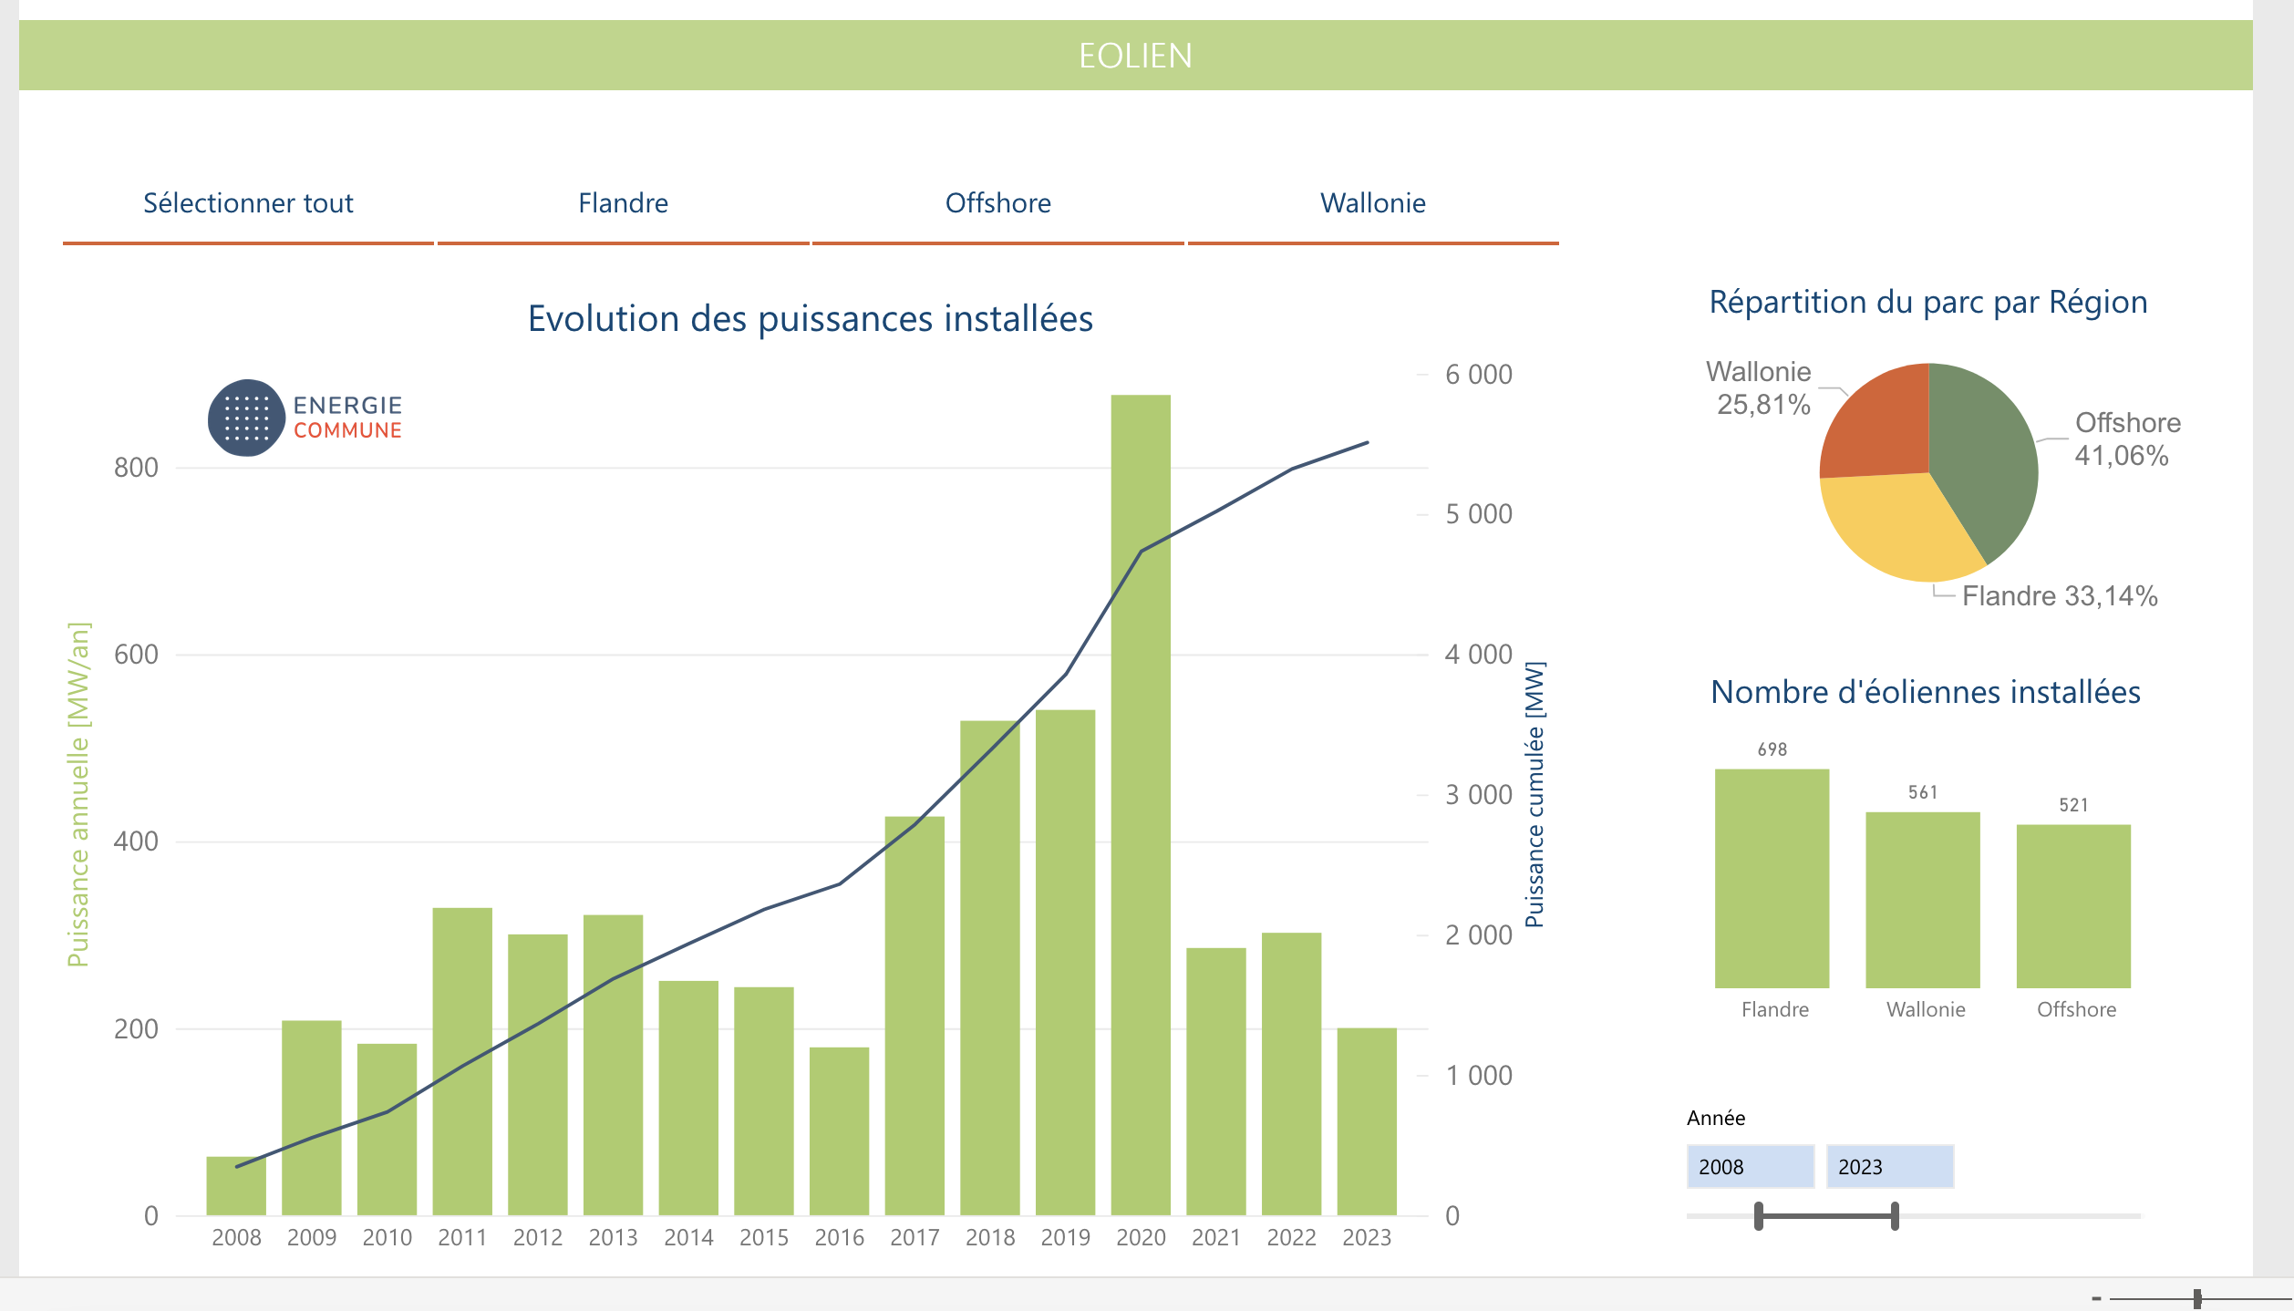
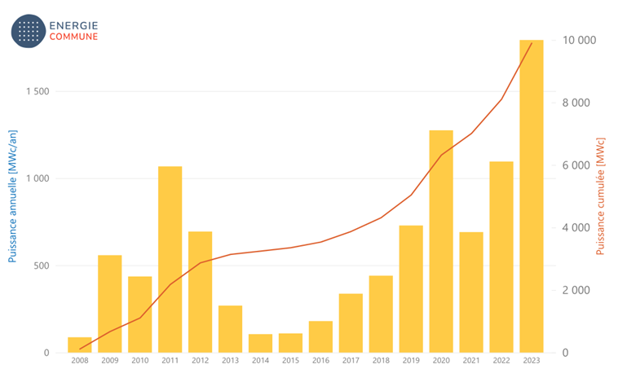
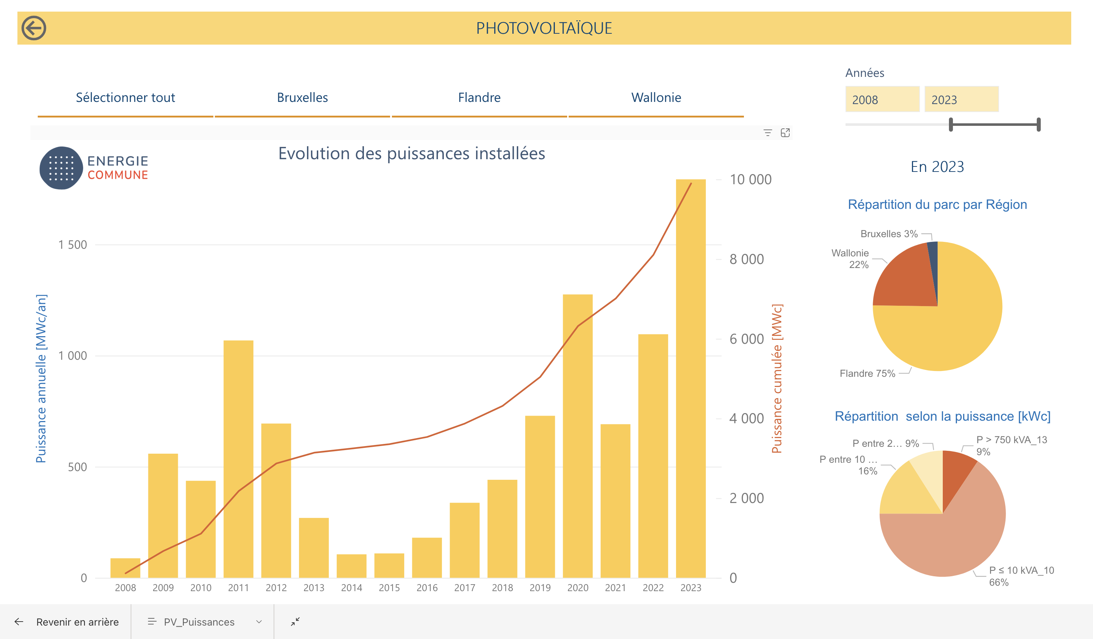
The electricity markets have entered a phase where common approaches are challenged.
Installed wind power capacities
Installed solar power capacities
Status in 2023
Distribution of the fleet by Region
Number of installed wind turbines
Distribution of the fleet by Region
Distribution by Rated Power (kWc)
Evolution of installed wind and solar energy capacities in Belgium + 2023 figures.¹
The rise of renewable energy is good news for CO₂ emissions, but the rise of renewables has brought new challenges.
¹https://www.renouvelle.be/

Slide 16
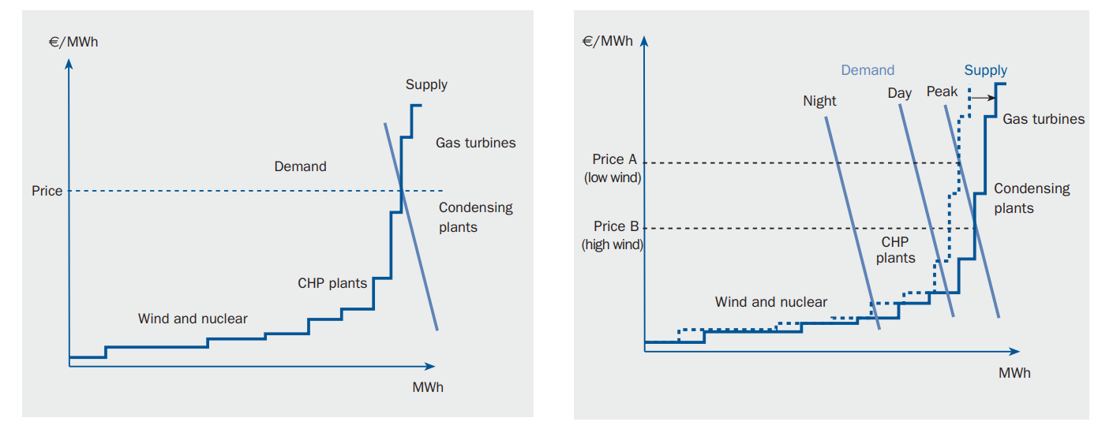
First challenge: the need for capacity markets
The first challenge is the need to introduce capacity markets. As renewables drive prices down, it becomes harder to secure funding for capital expenditures (CAPEX). Electricity prices can even drop to very low levels or become negative. If we only compensate for energy volumes, no investments would be profitable anymore in this context.
(a)
(b)
(a) Supply and demand curve for the NordPool Power Exchange and
(b) how wind power influences the power spot price at different times of day.
¹https://www.ewea.org/fileadmin/files/library/publications/reports/Economics_of_Wind_Energy.pdf

Slide 17
Second challenge: difficulties to balance the system (1/2)
The second challenge is that the deployment of renewable assets creates additional difficulties for Balance Responsible Parties (BRPs) in maintaining the balance between production and consumption. This requires further development of flexibility markets.
Electricity supply, especially from renewable energy sources, is also difficult to predict due to weather conditions:
PV with partially cloudy weather: It is hard to predict when clouds will cover a photovoltaic (PV) installation.
Thunderstorms: Predicting the exact moment when wind farms will reach their cut-off speed is challenging.
Saharan dust events (observed in Europe): Their impact on PV production is particularly difficult to forecast.
Additionally, congestion can occur in major power lines within a region, potentially leading to generation curtailment.

Slide 18
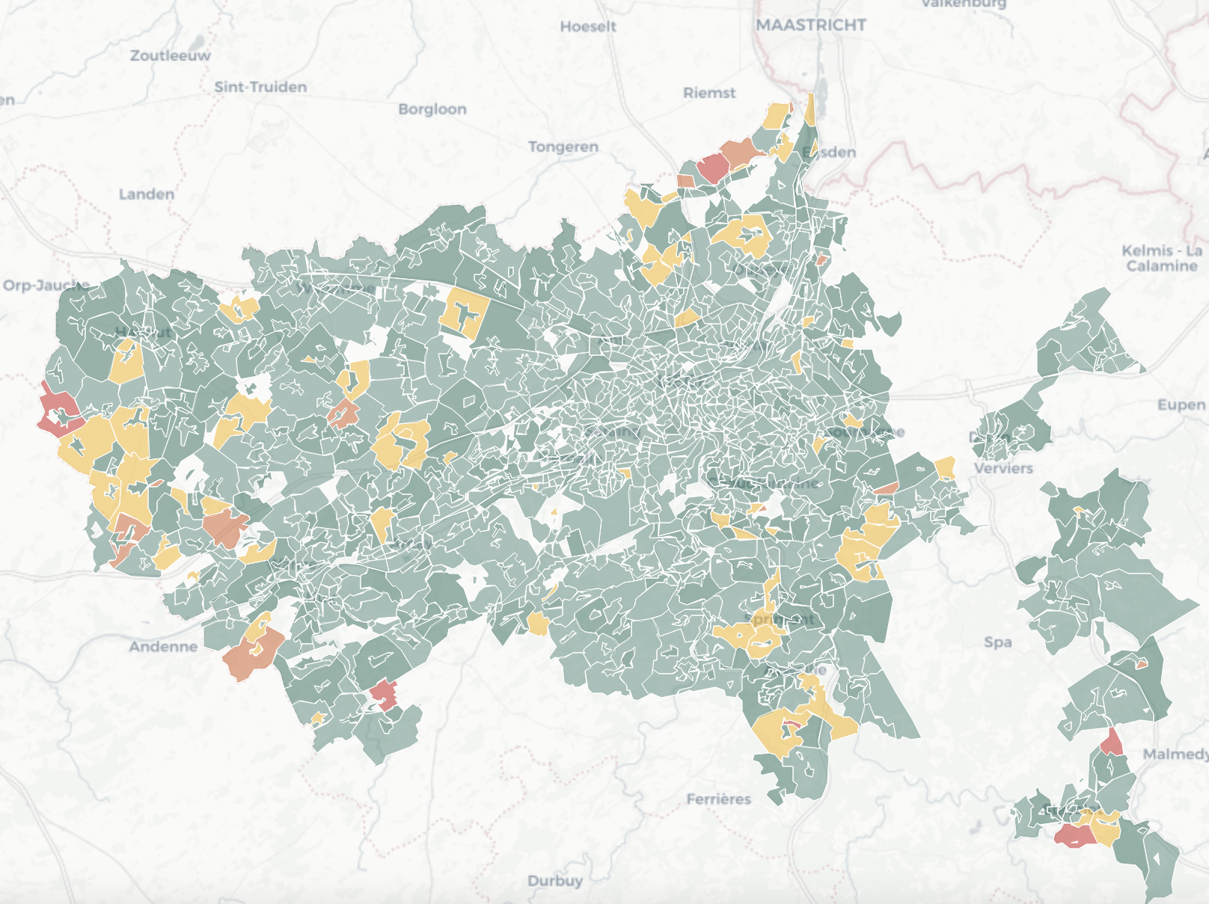
Third challenge: network issues
The third challenge is that renewables can lead to congestion and voltage issues on transmission and distribution networks. For instance, photovoltaic (PV) generation can cause overvoltage. When overvoltage is detected, PV production may be curtailed to protect the network.
Such issues on the distribution network call the need for new markets or revised market rules specifically designed to address these problems. One example is the development of local flexibility markets.
Legend:
Less than 1% annual losses
Between 1% and 5% annual losses
Between 5% and 10% annual losses
Between 10% and 15% annual losses
More than 15% annual losses
Inverter decoupling in the province of Liège, Belgium.

Slide 19
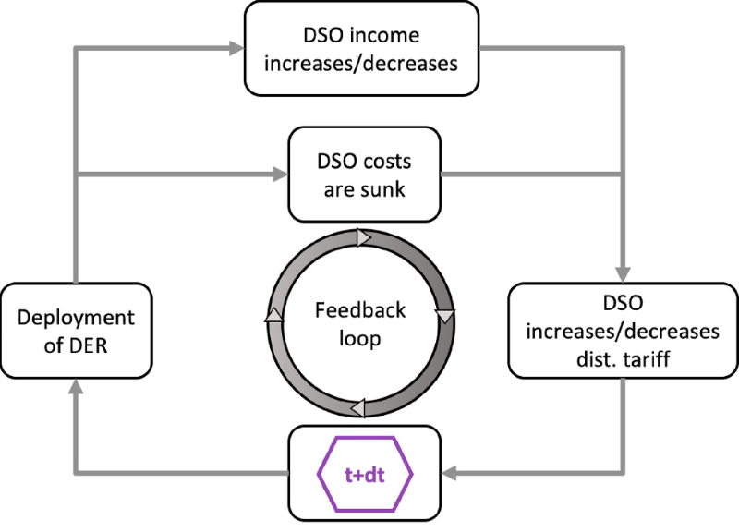
Fourth challenge: ‘death spiral’ of utilities
The utility grid death spiral refers to a vicious cycle where more consumers adopt distributed energy resources (such as rooftop solar panels), leading to a decline in utility revenues.
As more people generate their own electricity, utilities raise prices to cover the fixed costs of maintaining the grid, which in turn causes even more consumers to leave the grid or reduce their reliance on it.
In Wallonia, a region of Belgium, the introduction of the prosumer tariff is linked to this concern, as well as the need to fairly distribute grid maintenance costs.
Multi-agent interaction model with the feedback loop created by the deployment of residential PV panels and by the DSO's remuneration mechanism.¹
¹https://doi.org/10.1016/j.enpol.2020.112065

Slide 20
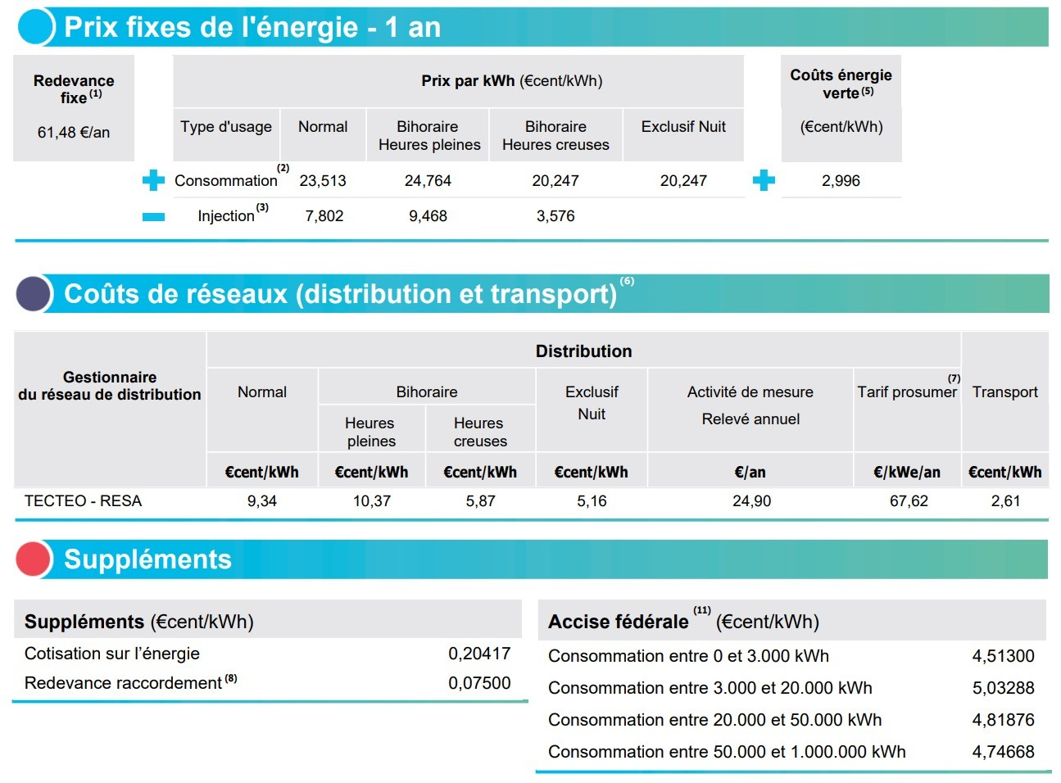
Reason 3: From passive consumer to active participant
To enable a small consumer to actively participate in electricity markets, the first step is transitioning away from fixed electricity pricing.
Data for May 2023 for a residential customer located in the Walloon Region, Belgium, and connected to the RESA network.

Slide 21
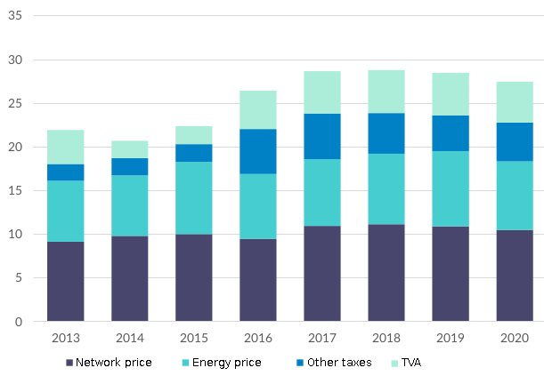
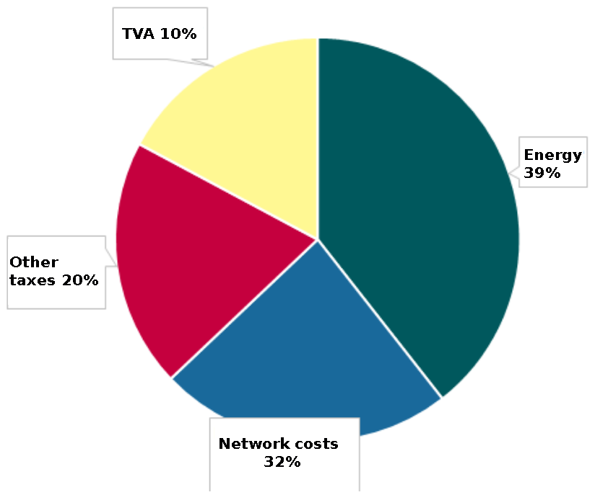
There are few opportunities to reduce your electricity bill
In 2023, the average residential electricity price in Belgium was approximately €0.382/kWh. The average energy consumption per household ranged from 2.5 to 5 MWh per year, resulting in an annual electricity cost of roughly €950 to €1,910.
In this case, it is important to note that less than 50% of this price is attributed to the energy itself, and only this portion is influenced by electricity market fluctuations.
Electricity market in 2020: Evolution in eurocents/kWh for consumption band DC (2,500–5,000 kWh/year).¹
Breakdown of electricity prices in Wallonia, Belgium, October 2021.²
¹https://economie.fgov.be/fr/publications/energy-key-data-fevrier-2022
²https://www.creg.be/fr/consommateurs/prix-et-tarifs/comment-est-compose-le-prix-de-lenergie

Slide 22
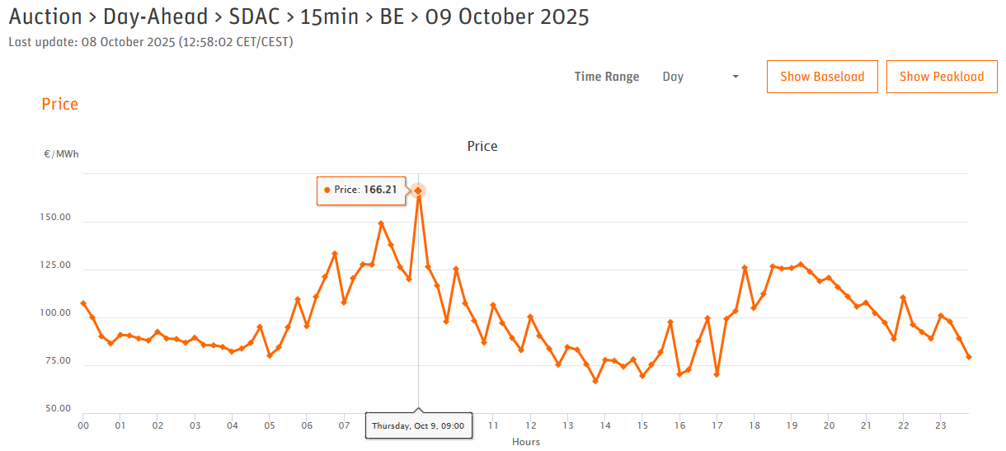
Now, there are contracts where the price paid for energy varies every 15 minutes (contracts indexed to the day-ahead price)
EPEX Spot day-ahead auction status in Belgium on October 09, 2025.¹
¹https://www.epexspot.com/en/market-data

Slide 23
And you can start benefiting of short supply chains for energy
Consumers are increasingly concerned about the origin of the electricity they consume, seeking transparency regarding its sources and environmental impact.
Additionally, the electricity sector is influenced by the ‘short supply chain’ trend, where consumers prefer locally produced electricity from renewable sources. More than just a trend, this short supply chain approach offers several benefits:
it may reduce transmission and distribution losses in some cases,
it prevents local overvoltage,
it enhances supply security,
it supports the local economy.
This has led to the development of energy communities and specific types of Power Purchase Agreements (PPA).

Slide 24
Your time to work!
Try to answer the following question:
You have 30 minutes to answer this question.
Find at least 3 sources: news articles, videos, scientific articles, etc.
Identify which reasons are highlighted in those articles
Identify the main actors of the electricity sector
Note all the terms that you do not understand
After 30 minutes, we will put our findings in common.
Why has the electricity bill of consumers risen
so dramatically since 2021?

Slide 25
Why study gas markets?

Slide 26
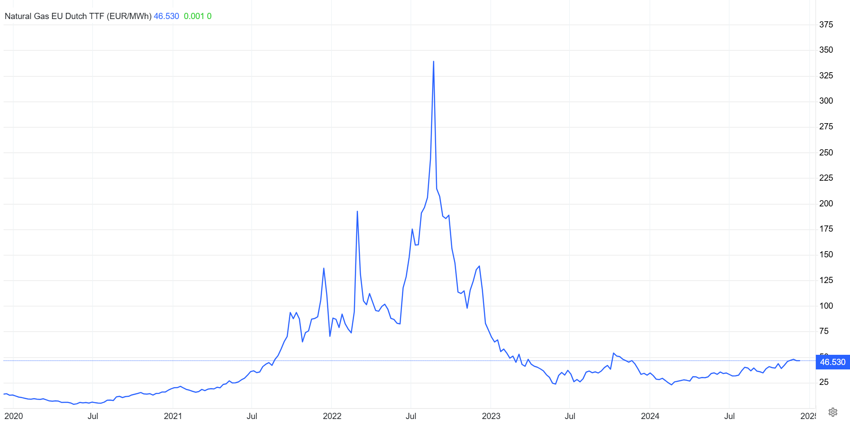
A historic peak in natural gas prices in 2022 (1/2)
Natural Gas EU Dutch TTF Pricing in €/MWh.¹
¹ https://tradingeconomics.com/commodity/eu-natural-gas

Slide 27
A historic peak in natural gas prices in 2022 (2/2)
The most evident answer to the previous question concerns the surge in natural gas prices in Europe, which significantly impacted gas and electricity bills in several European countries and caused an unprecedented energy crisis.
European natural gas prices reached unprecedented highs, exceeding €300/MWh in August 2022 on the Natural Gas EU Dutch TTF. The TTF is the main benchmark for natural gas prices in Europe.
A benchmark is a reference point. In the context of markets, it represents a commonly accepted price, or index.

Slide 28
Gas-fired power plants often act as ‘price setters’
Gas-fired power plants account for approximately 200 GW of installed capacity in Europe, representing around 25% of European electricity production. In comparison, 20% of electricity comes from coal, 13% from nuclear energy, and 18% from renewables.
In European electricity markets, particularly in Germany, gas-fired power plants often act as ‘price setters’, determining the marginal price. This occurs when demand exceeds the supply that lower-cost energy sources, such as solar or wind, can provide. In such cases, gas-fired plants step in to meet the demand, setting the electricity price because their marginal production cost is the highest among the technologies used to balance the grid.
The marginal cost of gas-fired power plants depends on several factors, including:
The price of natural gas, the primary fuel these plants use.
The cost of CO₂ emissions, as these plants are required to purchase carbon allowances to cover their greenhouse gas emissions under systems like the EU ETS (this will be detailed in Chapter 13, which focuses on carbon markets).
*Marginal cost refers to the additional cost of producing one more unit of electricity.

Slide 29
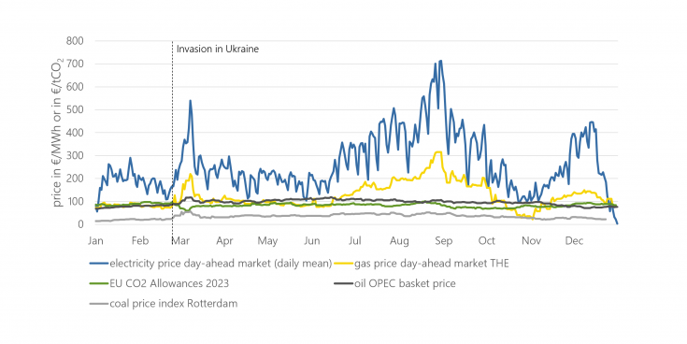
Example of the price increase in Germany
Before 2022, about 40% of the natural gas used in Europe comes from Russia.
In 2021, gas prices began to rise due to reduced Russian gas supplies.
The situation worsened in 2022 following Russia's invasion of Ukraine, leading to further supply restrictions. By March 2022, gas prices peaked at €220/MWh in Germany, nearly ten times the average price of €24/MWh in 2019–2021.
The Nord Stream pipelines sabotage in September 2022 resulted in another price spike, with gas prices reaching €316/MWh on the day-ahead market.
As shown in the following figure, the fluctuations in electricity prices on the day-ahead market closely follow the trends in gas prices.
Electricity, fuel and CO₂ prices in Germany in 2022.¹
¹https://www.ffe.de/en/publications/german-electricity-prices-on-the-epex-spot-exchange-in-2022/

Slide 30
Why study oil markets?

Slide 31
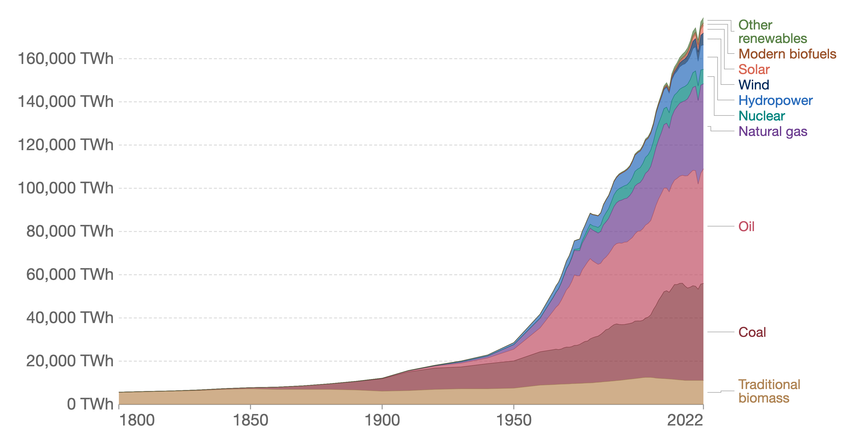
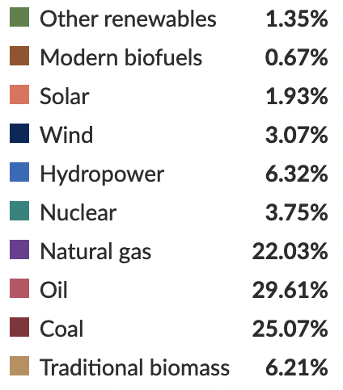
Oil in global energy consumption
In 2022, oil represented approximately 30% of global primary energy consumption, amounting to 52,970 TWh out of a total of 178,899 TWh.
Global primary energy consumption by source.¹
Oil markets are highly complex. governments and producer alliances sometimes intervene to stabilize prices or prevent major market imbalances, as demonstrated during the 2020 oil crisis.
¹ https://ourworldindata.org/grapher/global-primary-energy

Slide 32
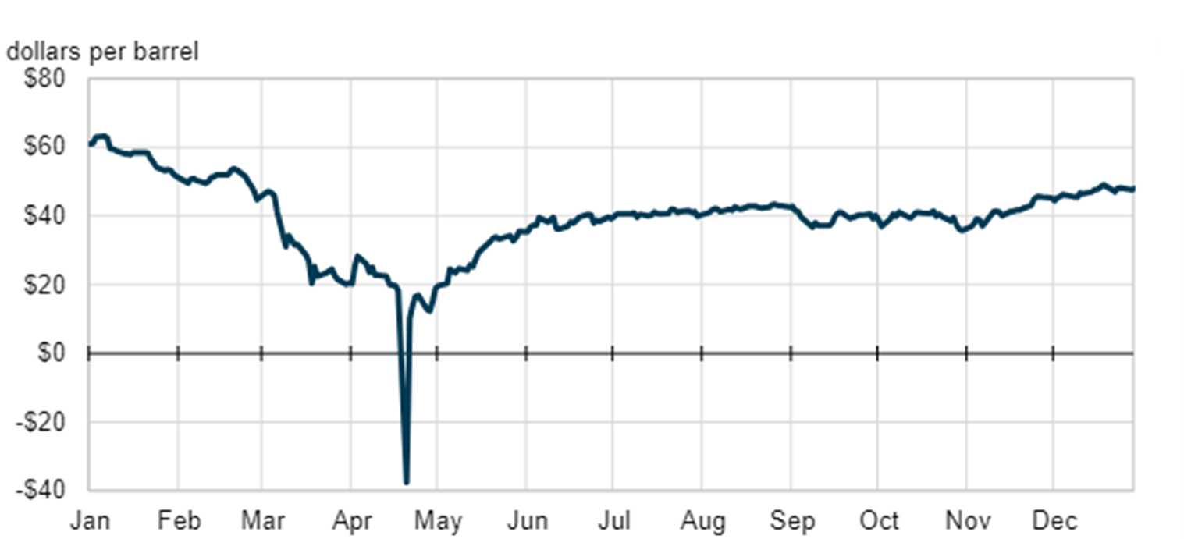
The 2020 oil price crash (1/2)
Daily West Texas Intermediate crude oil futures price in 2020.¹
¹ https://www.eia.gov/todayinenergy/detail.php?id=46336

Slide 33
The 2020 oil price crash (2/2)
The 2020 oil price crash was triggered by a combination of an unforeseen collapse in demand due to the COVID-19 pandemic and a supply shock caused by a price war between Russia and Saudi Arabia. Storage facilities, especially in Cushing, Oklahoma, the main delivery point for West Texas Intermediate (WTI) future contracts, were approaching full capacity. This oversupply forced producers to pay buyers to take crude oil off their hands. For the first time, U.S. oil futures prices turned negative.
On April 20, 2020, WTI futures fell to -$37.63/barrel. The international benchmark, Brent crude, also dropped sharply, hitting $9.12/barrel, a stark contrast to prices exceeding $70 earlier in the year.
The barrel is a unit representing 42 gallons (about 159 liters) in oil trading.
To stabilize the market, an agreement was reached to reduce output by 9.7 million barrels per day, marking the largest coordinated cut in history.

Slide 34
Why study carbon markets?

Slide 35
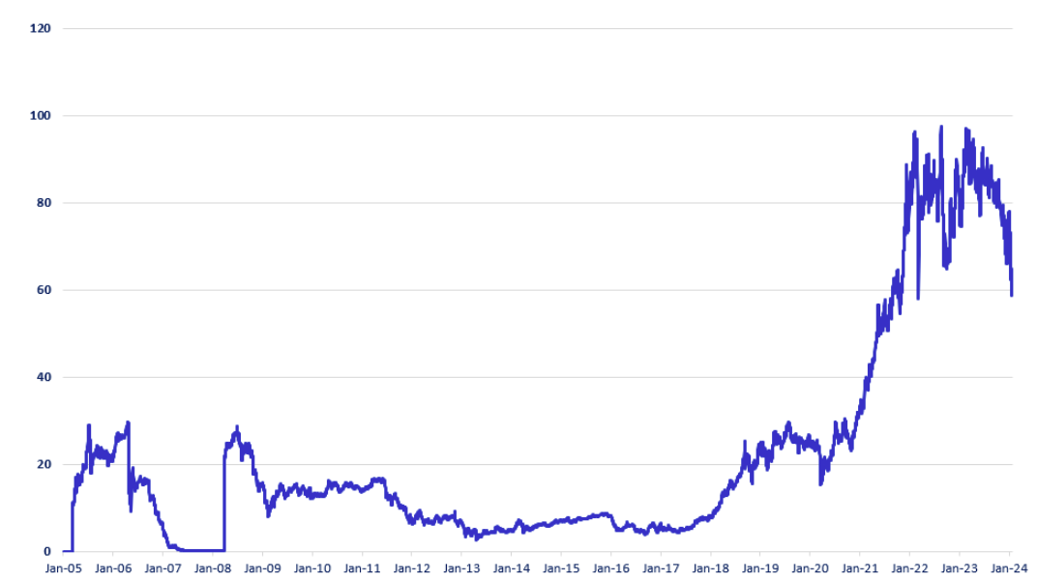
The trading of carbon allowances (1/3)
Historical price evolution in EUR of European Union Allowances.¹
¹ https://www.homaio.com/post/what-drives-the-eu-ets-carbon-allowance-price

Slide 36
The trading of carbon allowances (2/3)
Carbon dioxide (CO₂), the primary greenhouse gas driving climate change, is now monitored and traded as a commodity in systems known as carbon markets. These markets place a monetary value on CO₂ emissions, effectively incorporating their environmental and social impacts into economic decision-making.
The cap-and-trade system is a widely used market-based mechanism to reduce CO₂ emissions. Under this system, countries or companies are allocated a cap, or maximum limit, on their emissions. This cap represents the allowable amount of CO₂ they can emit, measured in tons of CO₂ equivalent.
Entities that emit less than their cap generate surplus allowances—essentially unused emission rights. These allowances can be traded or sold to other entities that exceed their emission limits, creating a financial incentive to reduce emissions and allowing the market to determine the most cost-effective reduction measures.

Slide 37
The trading of carbon allowances (3/3)
Power plants burning fossil fuels (coal, natural gas, oil) must purchase carbon allowances for each ton of CO₂ they emit. The price of these allowances directly adds to the cost of electricity generation. Higher carbon prices make fossil-fuel-based electricity more expensive (this is basically their primary goal: encouraging a shift to cleaner energy sources).
However, in practice, gas-fired power plants often set prices on the day-ahead market, especially during times of high demand or low renewable output. As a consequence, the Emissions Trading System (ETS) upward impacts almost directly electricity markets.

Slide 38
ELEC0018-1
Energy market and regulation
Lecturer: Damien Ernst – University of Liège (dernst@uliege.be)
Chapter 02 – Overview of electricity markets

Slide 39
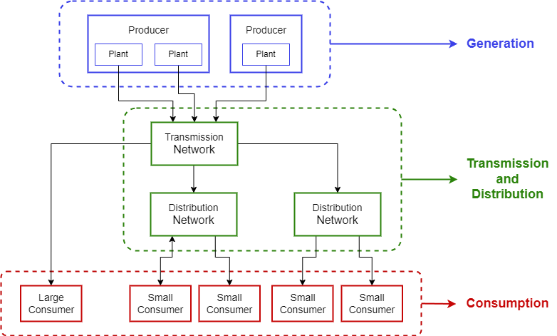
The flow of energy – How electricity reaches consumers (1/2)
The three main components of the electricity grid are:
Generation
Transmission and Distribution
Consumption.

Slide 40
The flow of energy – How electricity reaches consumers (2/2)

Slide 41
Electricity industry – Presentation of the entities
Transmission System Operator (TSO): Operates the high-voltage electricity transmission network. Its role is to ensure the stability and security of the electricity supply.
Distribution System Operator (DSO): Responsible for managing the medium and low-voltage distribution network, delivering electricity to end users.
Producer/Generator: Produces electrical energy and generates sales in the wholesale market.
Retailer: Purchases electricity in the wholesale market for their customers (end consumers).
Supplier: Both procures electricity from the wholesale market and sells it to end consumers.
Consumer: Most consumers purchase electricity via retailers; only large industrial consumers directly access wholesale markets.
Market regulator: Defines market rules and monitors potential abuse of market power.
Market operator: Operates the energy markets (matching, clearing, settlements).

Slide 42







Electricity industry – Main actors in Belgium
Transmission System Operator (TSO):
Elia.
Distribution System Operator (DSO):
ORES, RESA, Sibelga, Fluvius, etc.
Independent System Operator (ISO):
In Europe, the TSO performs functions similar to an ISO.
Producer/Generator:
Engie Electrabel, EDF Luminus, Lampiris, Eneco, etc.
Retailer:
Engie Electrabel, EDF Luminus, Lampiris, Eneco, Mega, etc.
Market regulator:
CREG, CWaPE, BRUGEL, VREG.
Market operator:
EPEX SPOT, EEX, ICE Endex, etc.

Slide 43
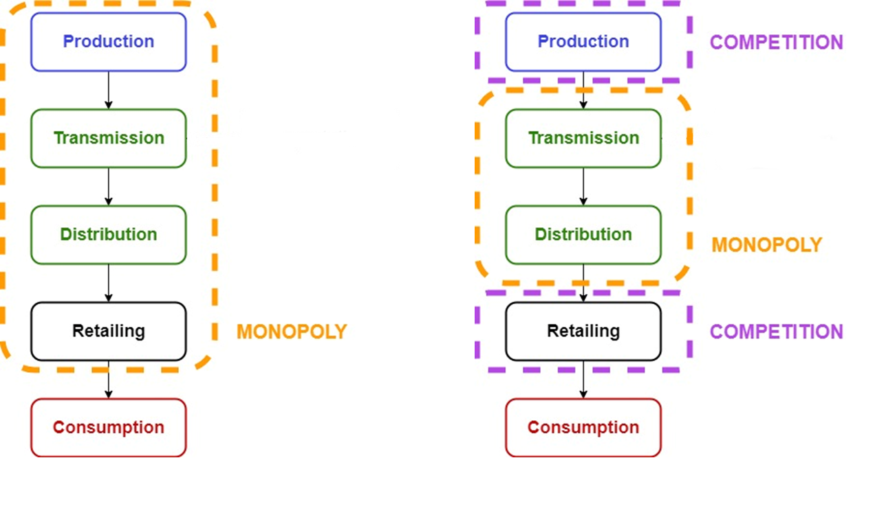
Electricity industry – From monopoly to liberalisation
Historically, the electricity industry was organised as a monopoly in Belgium. Nowadays, it is significantly liberalised:
Before the liberalisation:
After the liberalisation:

Slide 44
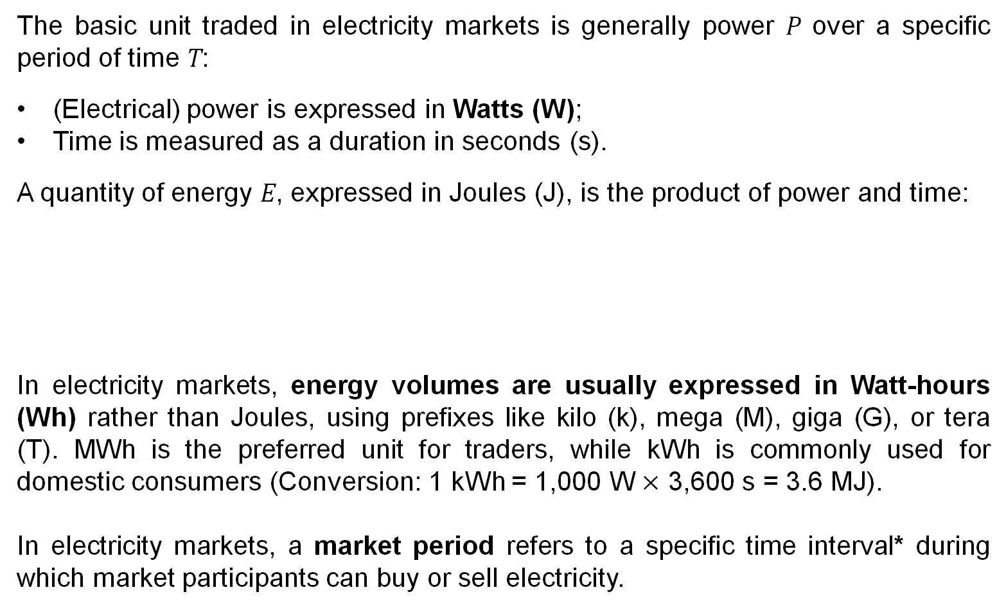
Electricity Markets – What is traded
The basic unit traded in electricity markets is generally power P over a specific period of time T:
(Electrical) power is expressed in Watts (W);
Time is measured as a duration in seconds (s).
A quantity of energy E, expressed in Joules (J), is the product of power and time:
In electricity markets, energy volumes are usually expressed in Watt-hours (Wh) rather than Joules, using prefixes like kilo (k), mega (M), giga (G), or tera (T). MWh is the preferred unit for traders, while kWh is commonly used for domestic consumers (Conversion: 1 kWh = 1,000 W $×$ 3,600 s = 3.6 MJ).
In electricity markets, a market period refers to a specific time interval* during which market participants can buy or sell electricity.
E [J] = P [W] * T [s]
*Typically 15 minutes in the EU, but it may be different in other countries (five-minute intervals in the intraday market in the US).

Slide 45
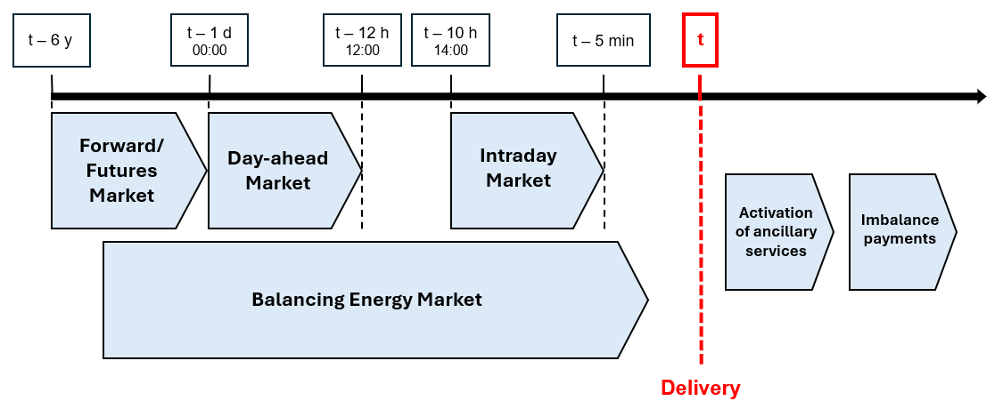
Electricity Markets – Overview
x

Slide 46
Presentation of the forward and futures markets
Each participant on these markets can submit an order, which is an instruction to buy (bid) or sell (ask) a certain volume of electricity at a specific price. The order can be matched with a corresponding order from another participant through a long-term bilateral contract.
A bilateral contract is an agreement directly negotiated between two parties, typically between a producer, such as a power plant, and a consumer, which could be a large industrial user, a supplier, or a retailer.
A variety of products are available in long-term contracts, including calendar (yearly), quarterly, or monthly base-load products. The trading horizon spans from several years until the beginning (or a few days before the beginning) of the market period covered by the contract.

Slide 47
Difference between the forward and futures markets
Contracts in the futures market are standardised in terms of size, maturity, and specifications (e.g., the volume of electricity, the delivery point). They are traded on organised exchanges like EEX (European Energy Exchange) and ICE Endex.
In contrast, contracts in the forward market are negotiated directly between the parties without the involvement of an exchange. They are customised to meet the specific needs of the parties involved.
Both contracts provide market participants with the ability to lock in a fixed price for a future electricity transaction, protecting them against unpredictable price fluctuations in the spot or intraday markets (price hedging). This helps mitigate the risks associated with the uncertainty of electricity prices.

Slide 48
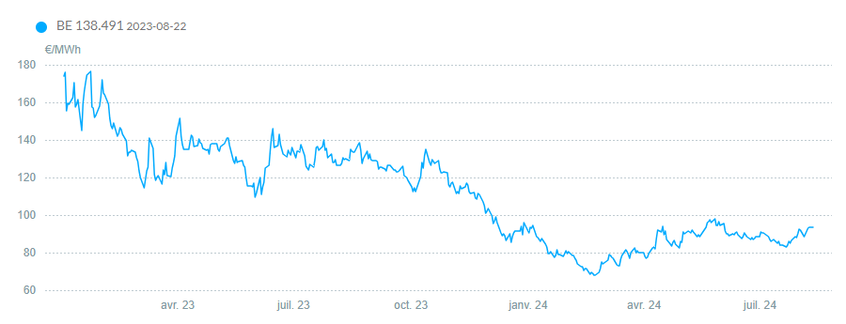
An example of a product in the forward and futures markets
Let us take the Calendar (CAL) product as an example. This is a yearly baseload product which involves the delivery of constant electric power for the entire year, maintaining the same volume for every market period of the year.
Trading for this product starts three years ahead of the delivery year and ends a few days before the first day of the delivery year.
Historic representation of electricity forward price baseload CAL +1 (08/13/24).
CAL + 1 refers to the delivery of electricity for the entire calendar year following the current one.

Slide 49
Presentation of the day-ahead market
Also known as the electricity spot market, the day-ahead market is the central platform of trading for matching electricity supply and demand on a daily basis. This market operates once a day, covering all 15-minute times slots of the following day through a blind auction. The switch from an hourly to ¼ hourly time resolution dates back to October 1st, 2025.
The day-ahead market operates as a pool where all bids and offers are considered simultaneously and kept confidential.
A single market-clearing price is determined for each 15-minute period in each market zone (a geographical area where electricity prices are uniformly set based on local supply and demand, as well as factors like supply and demand in neighbouring countries and import/export capacities) by the market-clearing algorithm.
The market operator is EPEX SPOT (originally Belpex).

Slide 50
Timeline of the day-ahead market
A
00:00
C
12:00
E
12:50
F
00:00
B
D
Opening of the day-ahead market for all time periods of the following day.
Market participants submit their bids and asks to the order book (simple orders, block orders, exclusive orders, curtailable orders, …).
Closing of the day-ahead market for all time periods of the following day.
Execution of the market-clearing algorithm.
Notification of the market participants and system operators about the market-clearing outcomes.
Beginning of the delivery of electricity for the entire day.

Slide 51
Types of order
Order type | Time period | Execution condition | Key feature
Simple orders | Single period | Fully executed if market clears at specified price | Independent bids for specific periods
Block orders | Multiple consecutive periods | All or nothing for the entire block of periods | Linked execution across multiple hours
Exclusive orders | Multiple block orders | Only one order from a set can be executed | Provides different block order scenarios
Curtailable orders | Single or multiple periods | Partially executed based on market operator's discretion | Allows for flexibility in execution
…

Slide 52
The day-ahead market-clearing algorithm (with no congestion)
For each time period of the following day, the clearing algorithm follows these steps:
1) Aggregation of supply: All the asks submitted to the order book are aggregated to form the supply curve, organised from lower to higher costs.
2) Aggregation of demand: All the bids submitted to the order book are aggregated to form the demand curve, organised from higher to lower willingness to pay.
Price
(€/MWh)
Intersection of the supply (blue) and demand (orange) graph before application (BA) of the algorithm.¹
3) Determination of equilibrium: The equilibrium point, where the quantity of electricity supplied matches the quantity demanded, is identified at the intersection of the supply and demand curves.
4) Dispatch of orders and price setting: All asks and bids to the left of the equilibrium point are dispatched, meaning these orders are fulfilled. The unique price paid for all energy exchanges, known as the market-clearing price, is set at the price at the equilibrium point. This price applies uniformly to all transactions for that time period in the market zone.
¹ https://doi.org/10.3390/en14051255

Slide 53
Managing deviations in the day-ahead market
The problem is that the clearing of the day-ahead market occurs well before the actual supply and consumption operations, between 12 and 36 hours in advance. However, actual generation or consumption may deviate from the originally contracted schedule due to factors like changing weather or technical issues.
Market participants have three options:
Compensate with other generation or consumption assets within their portfolio
Adjust their positions through the intraday market
Do nothing and face exposure to the balancing market

Slide 54
Presentation of the intraday market
The intraday market allows participants to make last-minute adjustments and balance their positions closer to real time.
This market supports continuous trading, meaning a trade is executed as soon as two matching orders are found, with different constraints depending on the order types. trading is now largely based on a 15-minute time resolution, although hourly and half-hourly products may still exist.
The market operator is EPEX SPOT (originally Belpex).

Slide 55
Timeline of the intraday market
A C
12:00 B 12:50
D
15:00
F
Delivery - 5min Delivery
E
Closing of the day-ahead market for all time periods of the following day.
Market-clearing algorithm execution.
Notification of the market participants and system operators about the market-clearing outcomes.
Opening of the intraday market for the delivery on the following day.
Continuous trading on the intraday market.
Closing of the intraday market for the delivery period considered.

Slide 56
A fictitious example in the intraday market (1/3)
Context: There is a last-minute update in the wind forecast, and the predicted wind power generation in a supplier's portfolio is suddenly reduced by 50 MWh for the market period 10:00-10:15. The wind power generator intends to adjust its position on the intraday market.
Question: What actions could this supplier take to avoid any imbalance?
ID | Side | Quantity (MWh) | Price (€/MWh)
G1 | Ask | 100 | 35
G2 | Ask | 80 | 40
G3 | Ask | 50 | 50
G4 | Ask | 20 | 65
C1 | Bid | 10 | 55
C2 | Bid | 20 | 60
C3 | Bid | 35 | 65
C4 | Bid | 110 | 70

Slide 57
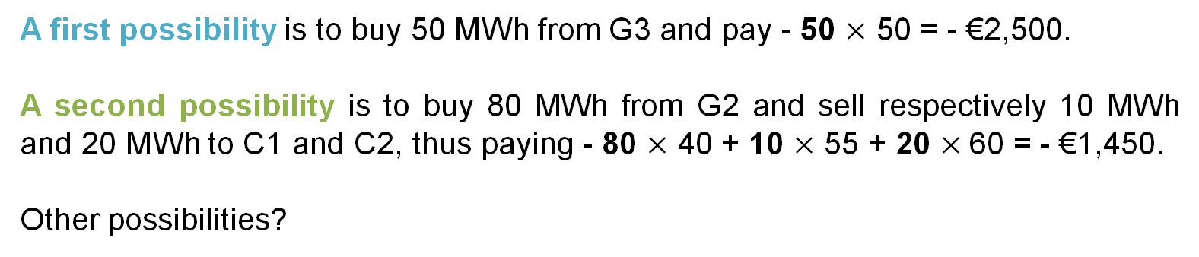
A fictitious example in the intraday market (2/3)
A first possibility is to buy 50 MWh from G3 and pay - 50 $\text{×}$ 50 = - €2,500.
A second possibility is to buy 80 MWh from G2 and sell respectively 10 MWh and 20 MWh to C1 and C2, thus paying - 80 $\text{×}$ 40 + 10 $\text{×}$ 55 + 20 $\text{×}$60 = - €1,450.
Other possibilities?
ID | Side | Quantity (MWh) | Price (€/MWh)
G1 | Ask | 100 | 35
G2 | Ask | 80 | 40
G3 | Ask | 50 | 50
G4 | Ask | 20 | 65
C1 | Bid | 10 | 55
C2 | Bid | 20 | 60
C3 | Bid | 35 | 65
C4 | Bid | 110 | 70

Slide 58
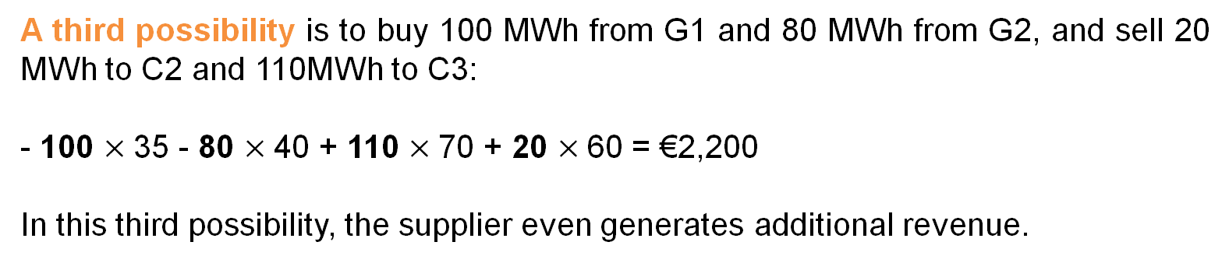
A fictitious example in the intraday market (3/3)
A third possibility is to buy 100 MWh from G1 and 80 MWh from G2, and sell 20 MWh to C2 and 110MWh to C3:
- 100 $\text{×}$35 - 80 $\text{×}$40 + 110 $\text{×}$70 + 20 $\text{×}$60 = €2,200
In this third possibility, the supplier even generates additional revenue.
ID | Side | Quantity (MWh) | Price (€/MWh)
G1 | Ask | 100 | 35
G2 | Ask | 80 | 40
G3 | Ask | 50 | 50
G4 | Ask | 20 | 65
C1 | Bid | 10 | 55
C2 | Bid | 20 | 60
C3 | Bid | 35 | 65
C4 | Bid | 110 | 70

Slide 59
Imbalance of the power system
There are several reasons why the power system may become imbalanced:
Demand forecasting challenges: Predicting electricity demand is difficult, and actual consumption may differ significantly from the forecast made during day-ahead market clearing.
Supply forecasting challenges: Predicting electricity supply is particularly challenging for renewable energy sources, which depend on weather conditions. Examples include:
  Photovoltaic (PV) power with cloudy weather: The timing and impact of clouds over a PV installation can be difficult to predict.
  Wind power during thunderstorms: It is hard to forecast when wind speeds will reach the cut-off point, causing wind farms to shut down.
  Dust storms: The effect of dust on PV production is challenging to forecast accurately.*
Technical issues: Technical problems can affect both electricity generation and the transmission and distribution infrastructure.
Transmission congestion: Congestion on major power lines within a zone can occur, sometimes leading to generation curtailment to avoid overloading the system.
*See, for instance, https://www.sciencedirect.com/science/article/pii/S2213138824000031

Slide 60
Presentation of the balancing market
The balancing stage, which occurs close to real time (after delivery), is crucial for enabling the TSO to maintain a balanced power grid (generation ≈ consumption) at any time.
The complete balancing stage includes:
The balancing market, where the TSO acquires regulating power from voluntary producers and consumers before the time of delivery;
Imbalance payments, where market participants cover the costs associated with their contributions to keeping the power system balanced.
The market operator is Elia, in Belgium.
The (negative) flow of money to producers and consumers from the futures, forward, day-ahead, or intraday markets is always based on the volumes committed to in these markets, not the actual volumes delivered.

Slide 61
Imbalances on the balancing market
There exist three possible situations for the power grid balance:
1. Positive imbalance:
Generation > Consumption (downward regulation required)
2. Negative imbalance:
Generation < Consumption (upward regulation required)
3. No imbalance:
Generation ≈ Consumption (no regulation required)
The same reasoning is also valid for a producer/consumer considered individually (contracted production/consumption vs actual production/consumption).
Positive imbalance
Negative imbalance
No imbalance
Generation
Generation
Generation
Consumption
Consumption
Consumption

Slide 62
Price signals in the balance markets (1/2)
The imbalance market operates with imbalance prices. This pricing incentivises producers and consumers to be as accurate as possible in their scheduling to avoid costly imbalances.
These prices are designed to reflect the costs the TSO incurs to maintain grid stability, such as:
Upward reserves: In cases of a shortfall (generation < consumption), the TSO purchases additional electricity from producers or storage systems capable of quickly increasing production.
Downward reserves: In cases of oversupply (generation > consumption), the TSO either asks producers to reduce production or pays flexible consumers to increase their demand.

Slide 63
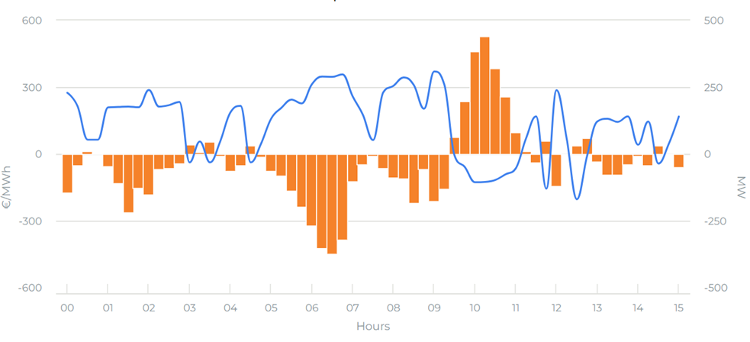

Price signals in the balance markets (2/2)
Imbalance prices on 17/09/2024.
Market participants (producers or major consumers) who deviate from their schedules must pay or receive compensation based on these imbalance prices.

Slide 64
Exercise 1:
A wind producer has sold 25 MWh of electricity at a price of €45/MWh on the day-ahead market for the period 10:00-10:15. Due to inaccurate wind forecasts at the time of market clearing (day-ahead market), the actual production deviates from the original schedule. The imbalance price for this market period* is set at €50/MWh.
1. What is the revenue of this producer if its actual production is 20 MWh?
2. What is the revenue of this producer if its forecast is correct?
3. What is the revenue of this producer if its actual production is 30 MWh?
*On the day-ahead market, a period is 15 minutes. In some EU markets, electricity delivery is expected to be balanced over intervals of 15 minutes. This introduces what is called a quarter-hourly (15-minute) granularity in terms of production and consumption obligations.

Slide 65
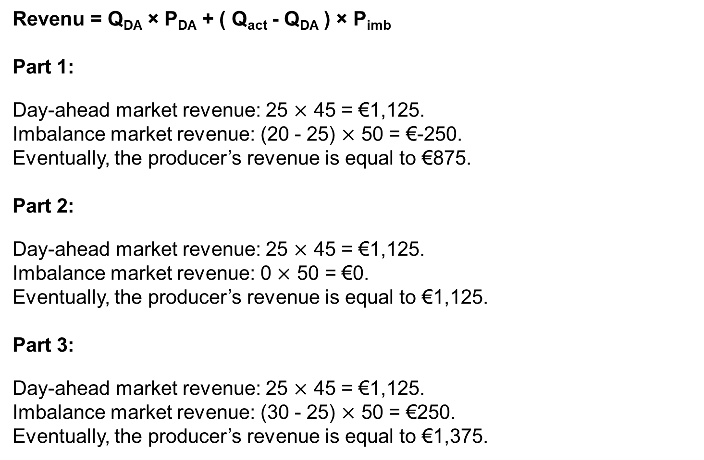
Solution:
Revenu = Q_{DA} × P_{DA} + ( Q_{act} - Q_{DA} ) × P_{imb}
Part 1:
Day-ahead market revenue: 25 $\text{×}$ 45 = €1,125.
Imbalance market revenue: (20 - 25) $\text{×}$ 50 = €-250.
Eventually, the producer’s revenue is equal to €875.
Part 2:
Day-ahead market revenue: 25 $\text{×}$ 45 = €1,125.
Imbalance market revenue: 0 $\text{×}$ 50 = €0.
Eventually, the producer’s revenue is equal to €1,125.
Part 3:
Day-ahead market revenue: 25 $\text{×}$ 45 = €1,125.
Imbalance market revenue: (30 - 25) $\text{×}$ 50 = €250.
Eventually, the producer’s revenue is equal to €1,375.

Slide 66
The balancing market – Two-price imbalance settlement
In the third part of the previous exercise, the producer's positive imbalance (excess production) partially offsets the negative imbalance of the entire power system, resulting in a revenue surplus. This can encourage speculative behaviour in the imbalance market, which is undesirable as it could lead to significant instabilities in the power system.
To address this, a two-price imbalance settlement is used instead of a one-price imbalance settlement:
Actors contributing to the power system imbalance are penalised based on the imbalance price;
Actors unintentionally offsetting the power system imbalance do not receive additional rewards beyond the day-ahead market clearing price.
Considering a two-price imbalance settlement policy in the third part, the producer’s revenue would be:
Day-ahead market revenue: 25 x 45 = €1,125.
Imbalance market revenue: 5 x 45 = €225.
Eventually, the producer’s revenue is equal to €1,350.

Slide 67
Presentation of the ancillary services market
The ancillary services market provide essential support services that maintain grid stability, reliability, and efficiency. It operates alongside primary electricity markets like the day-ahead and intraday markets.
The ancillary services market relies on a combination of market-based mechanisms and regulatory requirements. TSOs and DSOs procure ancillary services from market participants, including power plants, demand response providers, and other entities capable of delivering these services.
There are multiple types of ancillary services, including:
Frequency control: Primary, secondary, and tertiary reserves
Voltage control: Primary, secondary, and tertiary controls
System restart: Black start capability
The market operator is also Elia, in Belgium.

Slide 68
Ancillary services classification
Ancillary services classification related to system operation
Frequency control
Voltage control
System restart
Automatic Generation Control (AGC)
Primary regulation
Secondary regulation
High-frequency response
Spinning reserve
Non-spinning reserve
Emergency control actions
Primary control
Secondary control
Tertiary control

Slide 69
ELEC0018-1
Energy market and regulation
Lecturer: Damien Ernst – University of Liège (dernst@uliege.be)
Chapter 03 – From monopolies to liberalisation
in electricity markets

Slide 70
The amazing evolution of the structure of the electricity markets
Some facts:
For several decades, the amount of energy delivered by the electricity network has doubled about every 8 years.
In most parts of the world, the average consumer is deprived of electricity for less than two minutes per year.
How did the structure of the electricity markets
we know today develop?
Let us look at the history of the energy (electricity) industry, from monopoly to the emergence of liberalisation.

Slide 71
Responding crisis and war with market transformation
Context in the U.S.:
In 1929, the Great Depression hit the United States.
Capitalism and the market economy – dominant at this time – were pointed to as one of the main culprits of this crisis.
Franklin D. Roosevelt, who was elected in 1933, spoke about ‘a cynical and egoistic market economy’.
He implemented a series of measures to decrease the power of private entities and increase the power of the state.
Context in Europe:
In the 1950s, Europeans had emerged from two wars (1914-1918 & 1939-1945) and an economic crisis (1920s).
There was a similar anti-capitalist sentiment.
Strong labour unions and governments pushed for nationalization.

Slide 72
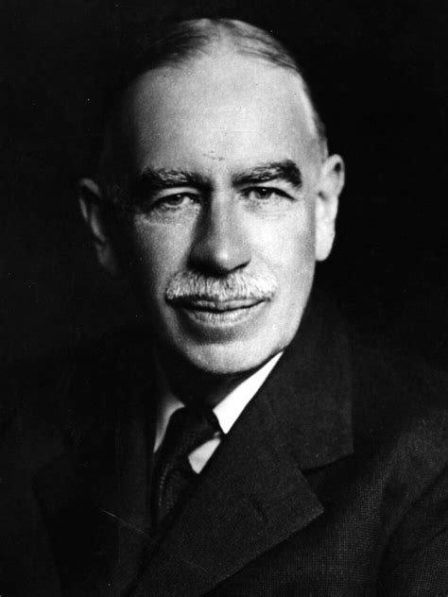
Keynesian economics: shaping markets through public policy
Supported by the theories of a renowned economist of the time, John Maynard Keynes (1883-1946):
did not believe that a constant equilibrium exists between demand and supply;
saw the economy as being in constant imbalance rather than a succession of balanced states;
promoted a political economy where demand is supported by large infrastructure projects (as done in the US), or public spending (e.g., social security implemented in Europe).
‘The ideas of economists and political philosophers, both when they are right and when they are wrong are more powerful than is commonly understood. Indeed, the world is ruled by little else.
Practical men, who believe themselves to be quite exempt from any intellectual influences, are usually slaves of some defunct economist.’
John Maynard Keynes

Slide 73
Economies of scale in electricity production
These political and economic views were to be applied to the electricity sector.
They were also supported by technological advances.
Evolution of production unit size:
Start of the century: ~25 MW
From 1945 to 1965: an increase from 50 MW to 300 MW
1970s: nuclear power plants of ~1000 MW
It became possible to build bigger, better, and less expensive units.
The unit cost of production was divided by 4 or 5 between 1950 and 1980.
However, the total cost of one unit increased as the units became larger.

Slide 74
Consolidation and monopoly
Until the 1980s, electricity consumers had no choice in selecting their supplier, as electricity providers operated as regional monopolies. These suppliers were vertically integrated, meaning a single company controlled production, transmission, and distribution within a specific area.
Consumers were bound to their local supplier and subject to a uniform, imposed price for electricity, with no competitive alternatives available.
MONOPOLY
By the end of the 1980s, most developed economies had fully embraced this monopolistic model in the electricity sector. Consolidation efforts had further reduced the number of suppliers, exemplified by Belgium, where over a dozen companies in 1950 merged into only a few by 1990.

Slide 75
Advantages of monopoly structures in electricity markets
Monopoly structures supported large-scale and coordinated electrification projects, driving economic development and enhancing living standards. These achievements may not have been feasible in a fragmented, competitive market during the early stages of electricity distribution.
Centralized control allowed for consistent growth of electricity networks, meeting the needs of a rapidly modernizing society. Over several decades, electricity demand doubled approximately every eight years, showcasing the scalability of this approach.
Monopoly structures ensured continuity of service, with reliability metrics showing significant improvements. For example, by 2004, the average consumer experienced less than two minutes of power outages annually.

Slide 76
Drawbacks of monopoly structures in electricity markets
Economic inefficiency
Monopolies were not inherently cost-effective, often lacking incentives to optimize operations and reduce costs.
Inefficiency in operations
The absence of competitive pressure discouraged efficient practices, leading to operational complacency.
Unnecessary investments
Monopolistic structures sometimes led to overinvestment in infrastructure or projects that did not align with actual demand.
Government influence
Public entities operating within monopolistic frameworks were prone to excessive government interference, which could detract from operational independence.
Higher costs for consumers
The lack of competition often resulted in higher electricity prices compared to what could be achieved in a competitive market.

Slide 77
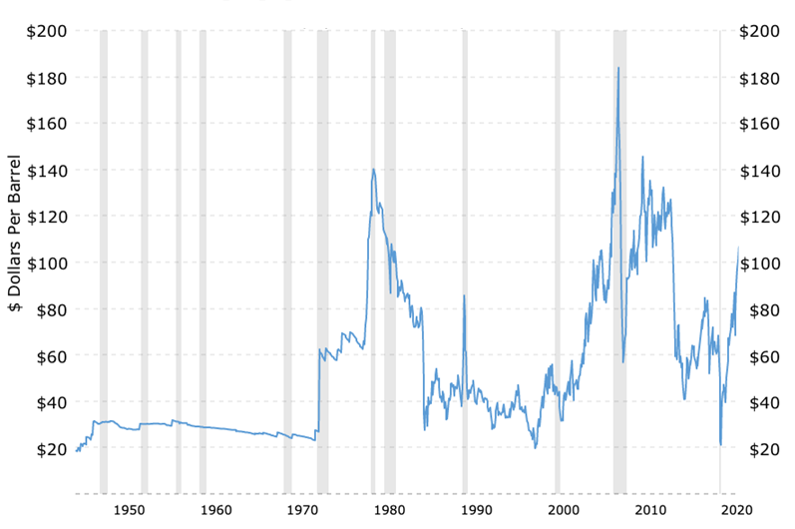
The rise of liberalisation (1/3)
In 1973, the first oil crisis led to oil prices quadrupling, followed by a doubling in 1979. Electricity prices, which had been declining for decades, suddenly surged.
This resulted in a loss of public trust in institutions across Europe due to the perceived poor handling of the crisis.
West Texas Intermediate oil price (adjusted for inflation) history 1946–2022.¹
The crisis led to the election of Margaret Thatcher, who initiated a significant wave of privatisations. In response, Europe advocated for the creation of the ‘Single Market’ and promoted competition as a strategy to revitalise the continent.
¹https://www.macrotrends.net/1369/crude-oil-price-history-chart

Slide 78
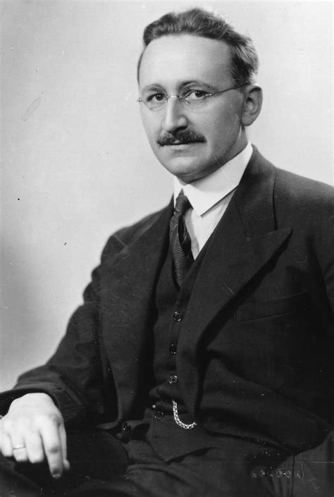
The rise of liberalisation (2/3)
The new UK prime minister was inspired and supported by Friedrich Hayek (1899–1992).
He proposed an alternative way of managing the economy through liberalism, a view shared by people like Milton Friedman and the Chicago Boys (Chile).
He believed that the state should not intervene in economic life and saw the market as a tool to oppose governmental planning or control.
His influence has been rising since the 1930s.

Slide 79
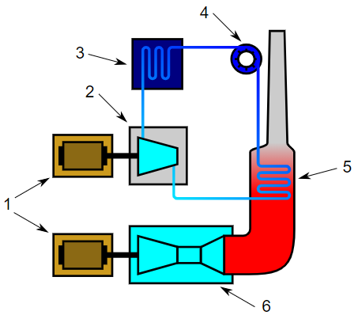
The rise of liberalisation (3/3)
As for the wave of nationalization, liberalisation was supported by technological changes. In the 1980s, a new production technology emerged: the combined cycle gas turbine (CCGT).
These units could use both gas and steam to run turbines that produced electricity, achieving efficiencies comparable to those of large production units, but at much smaller sizes (300 MW, or even 50 MW).
Their size made them easy to deploy, removing barriers to entry that protected monopolies while diminishing some of their added value.
Legend:
1-Electric generators, 2-Steam turbine, 3-Condenser, 4-Pump,
5-Boiler/heat exchanger, 6-Gas turbine
Working principle of a combined cycle power plant.¹
A few years later, they were joined by new renewable energy sources that also enjoyed the same modularity.
¹https://wiki.openstreetmap.org/wiki/Tag:plant:type%3Dcombined_cycle

Slide 80
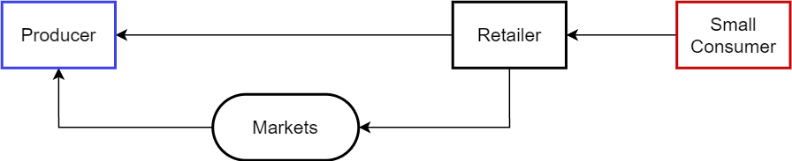
The liberalisation of the electricity sector in 6 steps (1/2)
Step 1: Open production to competition
Step 2: Introduce a new actor, the retailer (or provider):
Serve as an intermediary between producers and small consumers
Protect small consumers from price fluctuations
Step 3: Retailers buy electricity from producers:
Bilateral contracts
Centralized market operated by a market operator
Flow of money in liberalised electricity markets.

Slide 81
The liberalisation of the electricity sector in 6 steps (2/2)
Step 4: Electricity transport is a natural monopoly
At the national level:
Transmission network operated by a Transmission System Operator (TSO) or several TSOs, each having the monopoly on its own geographic territory
At the regional level:
Distribution network operated by the Distribution System Operators (DSOs)
Step 5: Introduce the ISO (Independent System Operator)
Responsible for maintaining the security of power system operation
Can be managed by the TSO (as it is the case in Belgium)
Step 6: Introduce the regulator:
Determines or approves the electricity market rules
Investigates the suspected cases of abuse (market power)
Sets or controls the prices of products and services in the case of monopolies (e.g. distribution network fees)

Slide 82
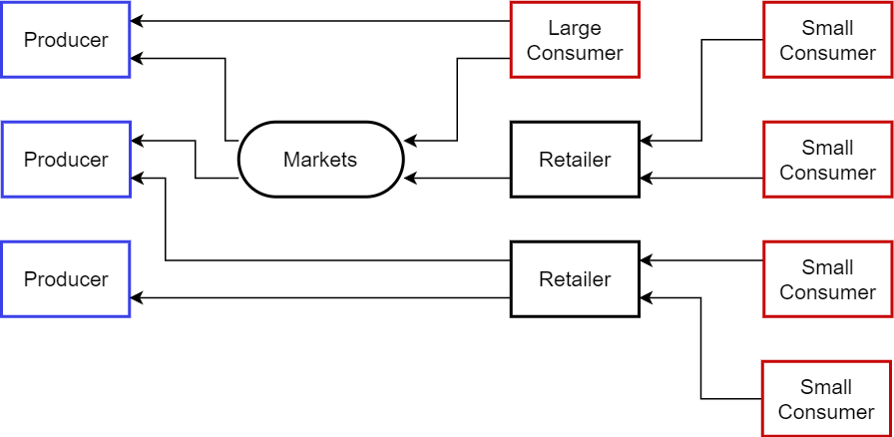
Flow of money (1/2)
Retailers can buy directly from producers, from the market, or a mix of both.
Flow of money in liberalised electricity markets.

Slide 83
Flow of money (2/2)
Note that this is still a very simplified view of money flows. Among other things, this does not show:
Payment of taxes and network fees, which are included in the price paid by small consumers to retailers, who then pay those taxes and fees.
Buying from producers/selling by retailers. Sometimes, as we will see later, producers (or retailers) can be incentivized to buy (or sell) energy instead of selling (or buying) it.
Balancing fees.
Payments for capacity mechanisms.
Guarantees of origin.

Slide 84
Open questions about liberalisation
Challenges following the end of the monopoly utility model:
Previously, the operation and development of the power system were managed by a single organisation, which was one of the key advantages of the monopoly model. However, with liberalisation, this centralised control has been replaced by multiple entities.
This raises several important questions:
Can these entities be coordinated to achieve least-cost operations (e.g., joint maintenance of the transmission system and operational lines, coordination of long-term development in generation and transmission)?
Will free markets ensure that generation will always meet demand?
How can future investments be optimised?

Slide 85
Remarks about liberalisation
Most economic laws supporting the push for liberalisation assume a market with perfect competition. However, this is far from the case in electricity markets.
Typically, in France, EDF – the former national monopoly – still owns most of the production assets.
To ensure fair competition, Europe has imposed corrective mechanisms such as ARENH (Accès Régulé à l’Électricité Nucléaire Historique), which requires EDF to sell part of its production to its competitors at a regulated price.

Slide 86
ELEC0018-1
Energy market and regulation
Lecturer: Damien Ernst – University of Liège (dernst@uliege.be)
Chapter 04 – Participants in the electricity markets

Slide 87
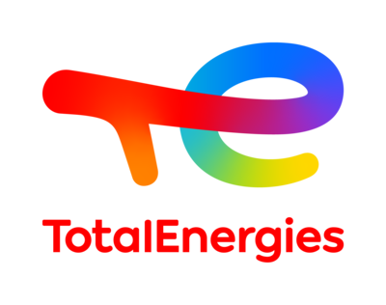
Recap of actors in Belgium (1/6)
Generating Companies/Producers:
Own one or more power plants
Sell the electrical energy produced by these plants
May also compete to sell ancillary services
Generation Companies with assets in Belgium:
Engie Electrabel
EDF Luminus
Eneco
TotalEnergies
...

Slide 88
Recap of actors in Belgium (2/6)
Retailer:
Sells electricity to small consumers through the retail market
Buys electricity from producers on the wholesale market (or directly from producers)
A generation company can also operate as a retailer.
Market share of retailers in Wallonia (Belgium).¹
¹ https://www.creg.be/fr/consommateurs/le-marche-de-lenergie/parts-de-marche-des-fournisseurs-denergie

Slide 89


Recap of actors in Belgium (3/6)
The TSO manages the transmission network and the ISO maintains the security of the network. In Belgium, TSO = ISO → Elia.
At the European level:
ENTSO-E – European network of transmission system operators for electricity.

Slide 90
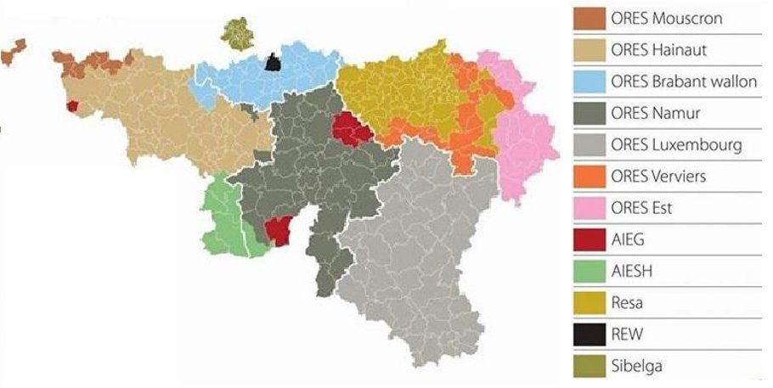
Recap of actors in Belgium (4/6)
Several DSOs for the three Belgian regions:
Wallonia: Ores, Resa, Régie de Wavre, AIESH, AIEG;
Brussels-Capital region: Sibelga;
Flanders: Fluvius.
Distribution of DSOs across Belgian territory.

Slide 91




Recap of actors in Belgium (5/6)
1 country, 4 regulators:
National: CREG – Commission de Régulation de l’Electricité et du Gaz;
Wallonia: CWAPE – Commission Wallonne Pour l’Energie;
Brussels-Capital: BRUGEL – Brussels Gaz and Electricity;
Flanders: VREG – Vlaamse Regulator van de Elektriciteits- en Gasmarkt.

Slide 92



Recap of actors in Belgium (6/6)
Market Operator:
Matches generating bids (from sellers) with consumption offers (from buyers);
Manages the settlement of accepted bids and offers.
The market operator varies depending on the type of market.
Moreover, most European markets have been integrated.
Typical market operators include EPEX SPOT, EEX, and ICE Endex.

Slide 93
A simplified view of the producer (1/2)
Now, let us take a closer look at two specific actors: the producer (generator) and the retailer (provider). Let us start with the producer.
The goal of the producer is to maximize profit, which is calculated as revenue minus costs. Revenue is simply the quantity of energy sold multiplied by the price at which it is sold.
Costs are generally divided into two categories:
Long-term costs: investments and maintenance costs.
Short-term costs: operational and fuel costs, etc.
Another important cost is the marginal cost of production, which is the cost of producing the last unit of energy.

Slide 94
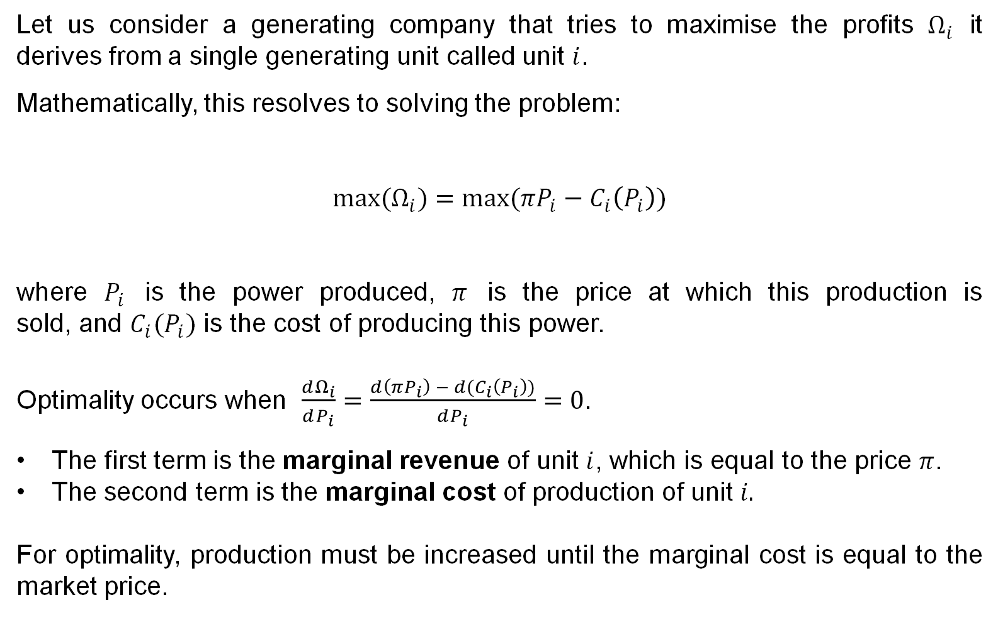
A simplified view of the producer (2/2)
Let us consider a generating company that tries to maximise the profits $Ω_{i}$ it derives from a single generating unit called unit $i$.
Mathematically, this resolves to solving the problem:
$$max(Ω_{i})=max⁡(πP_{i}−C_{i}\left(P_{i}\right))$$
where $P_{i}$ is the power produced, $π$ is the price at which this production is sold, and $C_{i}(P_{i})$ is the cost of producing this power.
Optimality occurs when $\frac{dΩ_{i}}{dP_{i}}=\frac{d\left(πP_{i}\right) − d(C_{i}\left(P_{i}\right))}{dP_{i}}=0$.
The first term is the marginal revenue of unit $i$, which is equal to the price $π$.
The second term is the marginal cost of production of unit $i.$
For optimality, production must be increased until the marginal cost is equal to the market price.

Slide 95
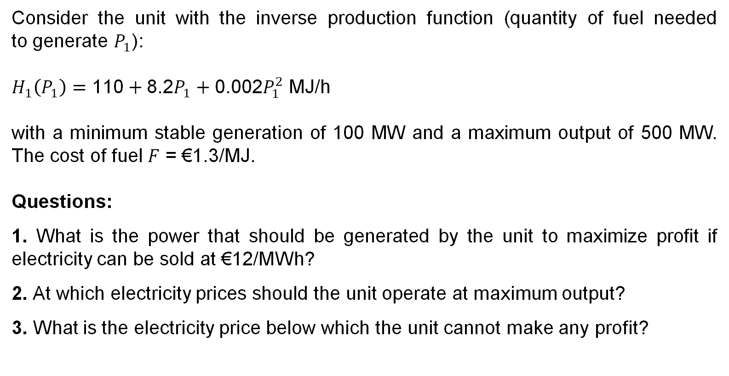
Exercise 1:
Consider the unit with the inverse production function (quantity of fuel needed to generate $P_{1}$):
$H_{1}\left(P_{1}\right)=\text{110}+\text{8.2}P_{1}+\text{0.002}P_{1}^{2}$ MJ/h
with a minimum stable generation of 100 MW and a maximum output of 500 MW. The cost of fuel $F$ = €1.3/MJ.
Questions:
1. What is the power that should be generated by the unit to maximize profit if electricity can be sold at €12/MWh?
2. At which electricity prices should the unit operate at maximum output?
3. What is the electricity price below which the unit cannot make any profit?

Slide 96
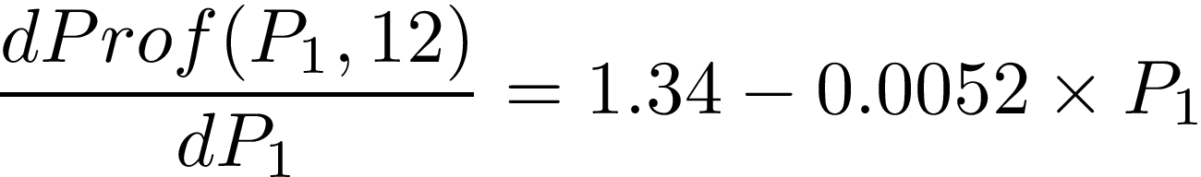
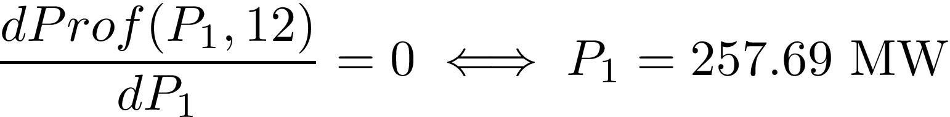
Solution:
Part 1:
Define the profit function:
Freeze the price to €12/MWh, and compute the derivative of the profit function with respect to the power:

Slide 97
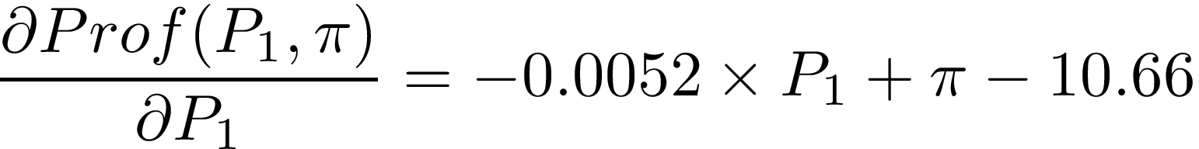
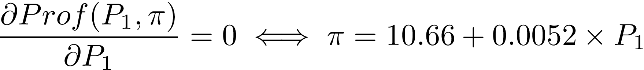

Part 2:
The partial derivative of the profit function with respect to the power variable allows to determine a relationship between any power and its associated optimal price :
We then compute the optimal price associated with a power of 500MW:

Slide 98
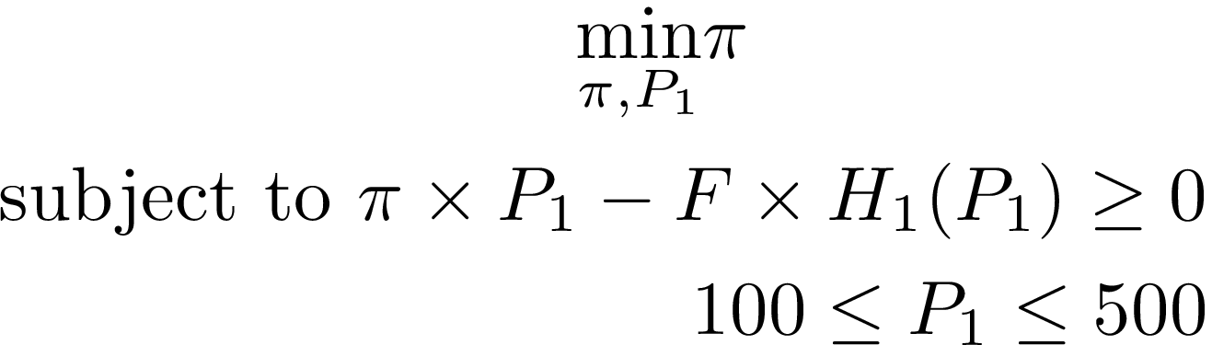
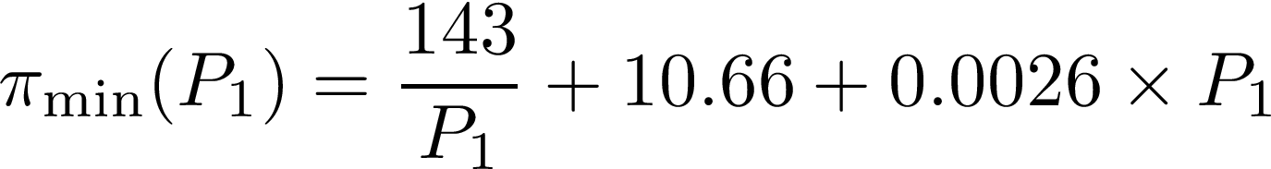
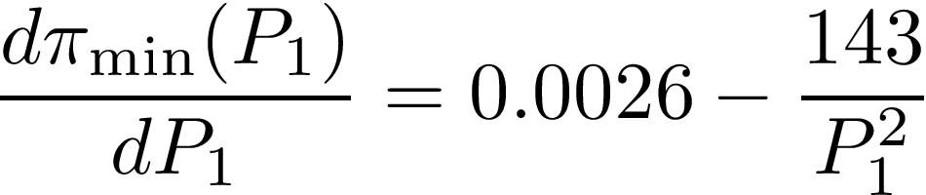
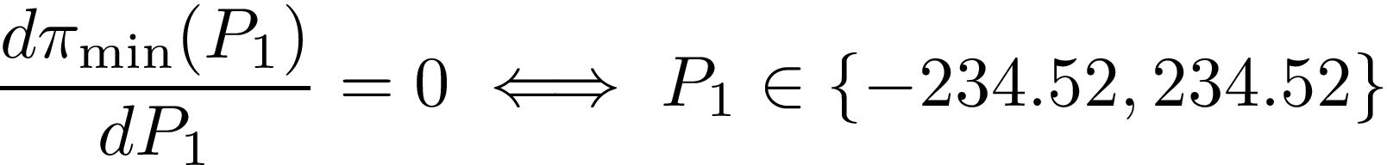
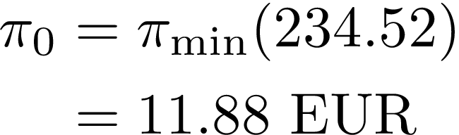
Part 3:
First approach: solve the following optimization problem:
Alternative approach: getting a zero profit provides a mathematical relationship that returns, for any power, the minimum price:
By minimizing the previous mapping through differentiation, we can compute a power for which the associated minimal price is the smallest among all minimum prices:
We finally get the electricity price by computing the minimum price associated with the power :

Slide 99
A more realistic scheduling
The production profile needs to be optimized over several market periods rather than just one due to the following factors:
Start-up costs: These are the costs associated with starting units. Diesel generators and open cycle gas turbines have low start-up costs, while large thermal units require a significant amount of heat energy before the steam reaches the temperature and pressure sufficient to sustain the generation of electric power, resulting in high start-up costs.
Dynamic constraints: Limits are placed on the variation of production of a generator to avoid mechanical stress (mainly on the prime mover) and the problems related to temperature gradients.
Environmental constraints: For example, the rate at which certain pollutants are released into the atmosphere is limited (or restricted over a year), and there are constraints on the use of water for hydro plants.

Slide 100
How can we measure the cost to produce electricity?
The Levelized Cost of Electricity (LCOE), or Levelized Energy Cost (LEC), is often used as a measure to define the cost of electrical energy.
It represents the net present value of the unit cost of electricity.
LCOE is commonly considered as a proxy for the average price that the generating asset must receive in the market to break even over its lifetime.
It provides a first-order economic assessment of the cost competitiveness of an electricity-generating system, incorporating all costs over its lifetime: initial investment, operations and maintenance, cost of fuel, and cost of capital.

Slide 101
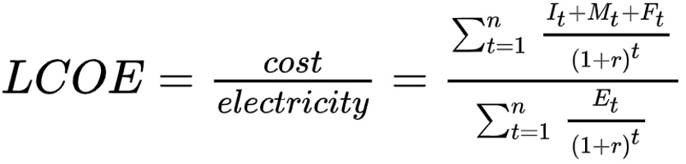

LCOE – Mathematical formulation
Mathematically, LCOE is computed as:
where:
= Investment expenditures in the year t;
= Operations and maintenance expenditures in the year t;
= Fuel expenditures in the year t;
= Electricity generation in the year t;
= Discount rate;
= Life of the system

Slide 102
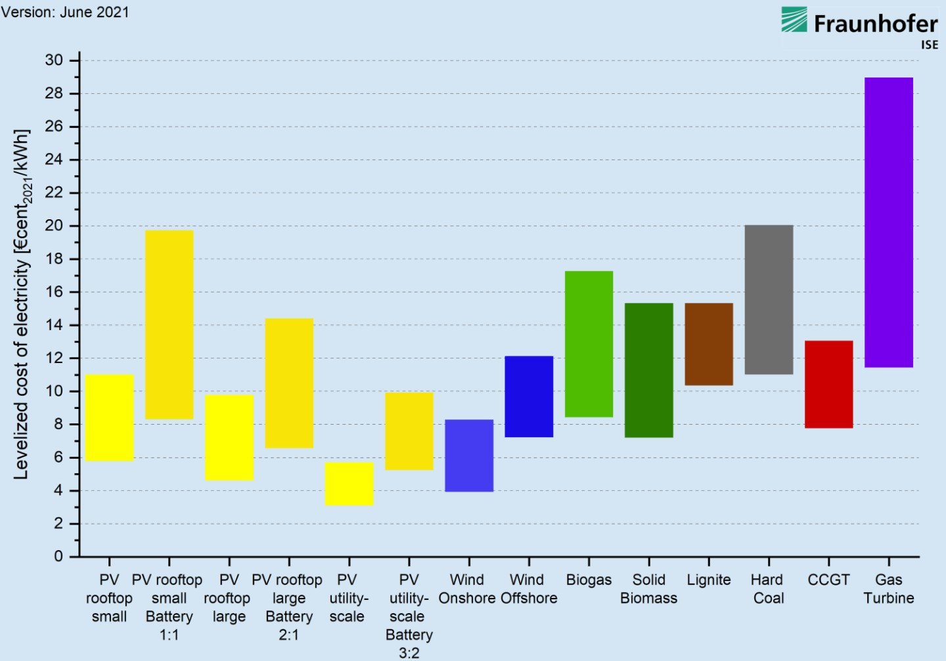
LCOE – Example
LCOE of renewable energy technologies and conventional power plants at locations in Germany in 2021.¹
¹ https://www.ise.fraunhofer.de/en/press-media/press-releases/2021/levelized-cost-of-electricity-renewables-clearly-superior-to-conventional-power-plants-due-to-rising-co2-prices.html

Slide 103
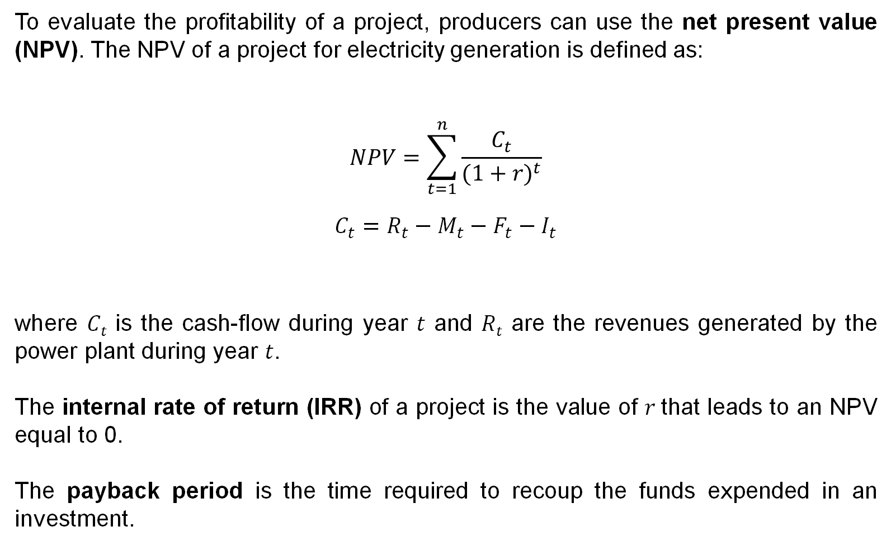
The net present value
To evaluate the profitability of a project, producers can use the net present value (NPV). The NPV of a project for electricity generation is defined as:
$$NPV=\sum_{t=1}^{n}{\frac{C_{t}}{{(1+r)}^{t}}}$$
$$C_{t}=R_{t}−M_{t}−F_{t}−I_{t}$$
where 𝐶_{𝑡} is the cash-flow during year 𝑡 and 𝑅_{𝑡} are the revenues generated by the power plant during year 𝑡.
The internal rate of return (IRR) of a project is the value of $r$that leads to an NPV equal to 0.
The payback period is the time required to recoup the funds expended in an investment.

Slide 104
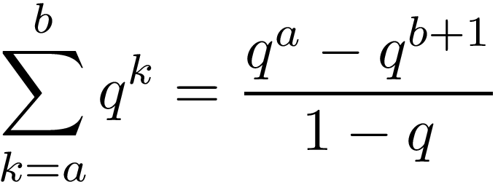


Exercise 2:
Mister X has installed at home 4 kWp of PV panels at a price of €6,000. His panels have a lifetime of 20 years. This installation generates 3,500 kWh of electricity per year.
1. Compute the LCOE given a discount rate of 0% and 5%.
2. Assume a retail price for electricity of €c23/kWh, compute the payback period of the installation.
3. Given the same retail price for electricity, compute the internal rate of return of the project.
Reminder: where and .

Slide 105
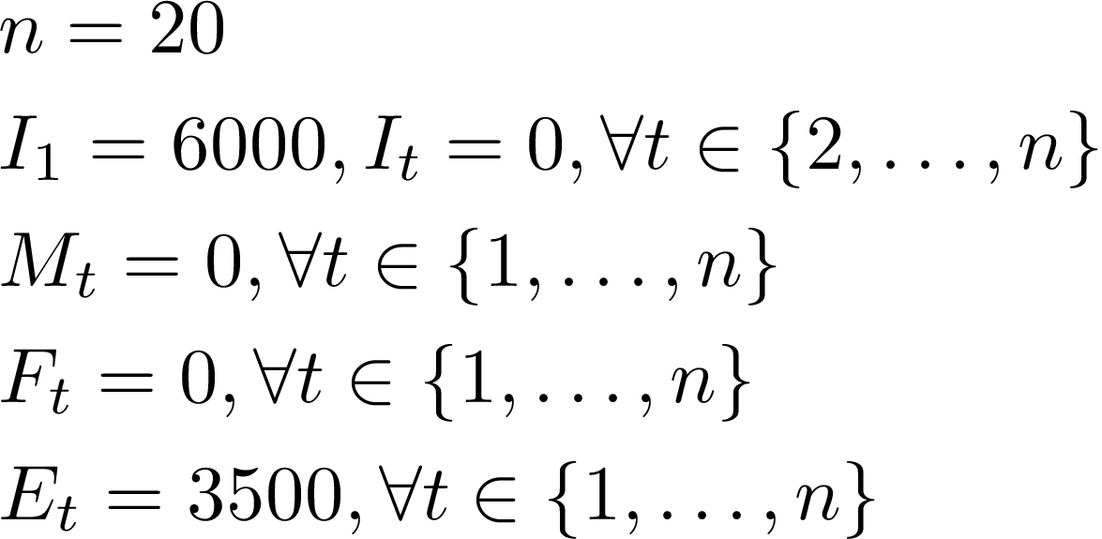


Solution:
Part 1:
Apply the LCOE formula, taking into account the following assumptions:
LCOE values for discount factors of 0% and 5% are €c9/kWh and €c14/kWh, respectively.
Consider the simple payback time. Each year, an economy of 3,500 $×$ 0.23 euros is made. Thus, payback time is :
Part 2:

Slide 106



Part 3:
IRR can be obtained by studying the NPV as a function of the discount rate:
The internal interest rate can be found by searching numerically for a zero
of the NPV function, for instance using
Newton-Raphson scheme:

Slide 107
Fixed price contracts from retailers
The role of retailers is to buy electricity from producers and sell it to consumers. Retailers may offer their customers various types of contracts, which generally fall into two categories: fixed price contracts or variable price contracts, depending on the customers risk aversion.
In the so-called fixed price contract, you pay a monthly fee equal to:
A + B x Consumption
with A is expressed in EUR, B in EUR/kWh and where Consumption is the monthly consumption in kWh. The terms A and B do not change over the duration of the contract.

Slide 108
Variable price contracts from retailers
For a typical variable energy price contract, you pay per month a fee equal to:
A + (Index x B + C) x Consumption
where A is expressed in EUR, C in EUR/kWh and B is dimensionless. These three terms remain constant over the duration of the contract. Index is expressed in EUR/kWh and varies from month to month. It is related to the average of the prices observed on the spot market.
In Belgium, 60% of contracts were fixed price contracts before the 2022 energy crisis. Now retailers prefer very much to offer variable price contracts.

Slide 109
Challenges in energy retailing and pricing
To buy energy at a variable price on the wholesale market and sell it at another price, sometimes a fixed one, at the retail level.
The quantity-weighted average price at which a retailer purchases energy should be lower than the rate it charges its customers.
Retailers must accurately forecast the consumption of their customers to reduce their exposure to spot market prices (accuracy is usually good when serving a large group of customers).
Retailers may offer more competitive tariffs to customers who record the energy consumed during each time period.

Slide 110
ELEC0018-1
Energy market and regulation
Lecturer: Damien Ernst – University of Liège (dernst@uliege.be)
Chapter 05 – Chronology of electricity markets and the forward/futures markets

Slide 111
Explanation of the terminology
The first option to build an offer is to buy directly from the producer. They can also buy electricity through a market.
But what are exactly electricity markets?
According to Investopedia, a market is a place where two parties can gather to facilitate the exchange of goods and services. The parties involved are usually buyers and sellers. The market may be physical like a retail outlet, where people meet face-to-face, or virtual like an online market, where there is no direct physical contact between buyers and sellers.
What is an electricity market?
product → electricity (both energy and power)
buyers → retailers & sellers → producers
mostly virtual
Why an ‘s’ in markets?
Electricity has some special properties → several ways to exchange it.

Slide 112
Chronology of markets
x

Slide 113
Bilateral contracts
There are two main categories of markets, bilateral markets and electricity pools.
In bilateral trading, energy is exchanged directly between two parties: a buyer and a seller. Several forms of bilateral trading exist, depending on the volume of energy involved and the time available for delivery:
Customized long-term contracts:
These contracts are negotiated privately and typically involve large volumes of energy. Due to the scale of the transaction, they tend to incur higher transaction costs.
Over-the-counter (OTC) trading:
This form involves smaller amounts of energy and typically uses a standard delivery profile that specifies energy amounts for different times of the day or week. OTC trading generally has lower transaction costs and is often used for adjusting or refining positions.

Slide 114
Electronic trading
Electronic trading: Offers to buy energy or bids to sell energy are traded. Bids and offers are visible to everyone but remain anonymous.
When a party enters a new bid, the system checks if it matches an existing offer (i.e., an offer with a price greater than or equal to the bid). If a match is found, a deal is struck. Otherwise, the bid is added to the list of bids. A similar procedure applies to offers.
Remarks: Electronic trading is fast and cost-effective, often used to refine positions in the minutes before the market closes.

Slide 115
Electricity pools
Electricity naturally pools as it flows from generators to loads, leading to the concept that trading could be centralized through electricity pools.
In this system, there are no repeated interactions between buyers and sellers to achieve market equilibrium. Instead, a pool provides a systematic mechanism for determining this equilibrium.
The trading process in a pool is centralized, simplifying the matching of supply and demand at an aggregated level, and ensuring that prices reflect the overall balance between generation and consumption.

Slide 116
Electricity pools – how they work
Producers submit bids for the period under consideration.
Bids represent the amount of electrical energy at a certain price. These bids are ranked in order of increasing price, and a supply curve for the market is created.
Consumers submit offers (the amount of energy they are willing to buy at a certain price), forming a demand curve.
⇒ These two curves define the merit order.
The intersection of the demand and supply curves represents the market equilibrium price (also called the System Marginal Price, SMP).
Bids below the market equilibrium price and offers above it are accepted.
More information on this subject will be covered in the Chapter 06.

Slide 117

Let us focus on the first market
The forward market is the most prominent electricity market when it comes to the number of transactions (88% of transactions), followed by spot markets covering day-ahead (11%) and intraday (1%) timeframes.

Slide 118

Forward/future market – Reminder
A variety of products are available, including yearly, quarterly, or monthly base-load products. These products provide a fixed amount of energy for the given period.
The trading horizon ranges from several years up to a few days before the product’s first delivery day.
Market operators include EEX and ICE Endex.
Relative shares of trading volume per year in the future of Germany (2019-2021)¹.
¹ https://www.acer.europa.eu/sites/default/files/documents/Publications/Progress_report_European_wholesale_electricity_21.pdf

Slide 119
Hedging (1/3)
The forward/futures market brings together producers and consumers interested in trading through forward/futures contracts to reduce exposure to the volatility of the spot market, a practice known as hedging.
The forward/futures price should reflect the consensus expectation of the spot price.
Examples of hedging:
A generator is interested in hedging its revenues from producing electricity. It sells 100 MWh of electricity every hour of a year at €50/MWh in a forward market:
(+): it hedges against the risk of prices (and revenues) dropping below €50/MWh (e.g.: €30/MWh).
(-): it gives up potential additional revenues if prices increase to €100/MWh.
An electricity-intensive consumer will also wish to hedge its costs. If the consumer buys that annual 100 MWh contract for €50/MWh:
(+): it avoids the risks of losing money if prices increase above €50/MWh (e.g.: €100/MWh).
(-): it gives up on the potential lower cost (e.g.: €30/MWh).

Slide 120

Hedging (2/3)
Using proper hedging strategies allows to reduce the cost of energy. The following graph illustrates that hedging the procurement smoothens the impact of high prices.
Unit procurement costs in €/MWh of a retailer using different hedging strategies in the German electricity market in 2021.¹
¹ https://www.acer.europa.eu/sites/default/files/documents/Publications/Final_Assessment_EU_Wholesale_Electricity_Market_Design.pdf

Slide 121
Hedging (3/3)
The previous figure shows different procurement strategies a retailer could have adopted in the German electricity market in 2021. These strategies range from fully sourcing electricity in day-ahead markets to using various shares of month- or year-ahead contracts. The example demonstrates that hedging procurement smooths the impact of high prices, which began in September 2021. The longer the hedge, the more gradual the price increase experienced by the retailer and its customers.
Price volatility does not necessarily increase the average cost paid by consumers over time. Likewise, long-term procurement does not completely shield consumers from rising prices but spreads the impact over a longer period, reducing the immediate shock of price spikes.

Slide 122
Forward contracting
Forward contracts are over-the-counter (OTC) bilateral agreements that allow for customizable terms based on the specific needs of the parties involved.
These terms include:
The quantity and quality of the product to be delivered;
The delivery date;
The payment date following delivery;
The penalties for either party failing to meet their commitments;
The price to be paid.
Forward contracting facilitates planning by minimizing the risk of unexpected price fluctuations. It enables businesses to set prices with confidence in their cost structure and allows consumers to better manage their budgets.
Since these are bilateral contracts, there is a counterparty risk (i.e., the risk that one party will default on its obligations). There is no third-party institution that guarantees the transaction between the two parties.

Slide 123
Futures contracting
Futures contracts are traded on regulated markets, such as the EEX. Because of this, futures contracts tend to be more liquid than OTC forward contracts. This increased liquidity means that there are many market participants, making it easier to buy and sell these contracts; traders can easily enter and exit positions without causing significant price fluctuations.
In the context of futures contracts, a clearinghouse acts as an intermediary. It ensures that transactions are executed properly, thereby reducing counterparty risk for participants. If one party defaults, the clearinghouse takes on the obligations, protecting the other participants.

Slide 124
Forward vs Futures – summary of differences
Aspect | Forward Market | Futures Market
Trading platform | OTC (private negotiation) | Organized exchange (standardised)
Regulation | Less regulated (higher counterparty risk) | Highly regulated (lower counterparty risk)
Customisation | Fully customisable | Standardised contracts
Settlement | Mainly physical (can be financial) | Mainly financial (can be physical)
Liquidity | Lower liquidity | Higher liquidity
Price transparency | Less transparent | Highly transparent
Counterparty risk | Higher (no clearinghouse) | Lower (clearinghouse guarantees)

Slide 125

What is a good strategic practice for a supplier to effectively use forward markets for hedging? (1/3)
A supplier cannot only purchase standardized products to cover a long period. In this context, how can it effectively hedge itself?

Slide 126

What is a good strategic practice for a supplier to effectively use forward markets for hedging? (2/3)

Slide 127

What is a good strategic practice for a supplier to effectively use forward markets for hedging? (3/3)

Slide 128
Options (1/2)
Futures and forward contracts are firm contracts, meaning delivery is unconditional. If the seller is unable to deliver the agreed quantity, or the buyer cannot take full delivery, they must buy or sell it via another market (e.g., day-ahead).
Options are contracts with conditional delivery; they are only exercised if the holder chooses to do so.
Call option: gives the holder the right to buy a specified amount of a commodity at a price called the exercise price.
Put option: gives the holder the right to sell a specified amount of a commodity at the exercise price.

Slide 129

Options (2/2)
Contracts for difference (or swaps) work as follows:
The two parties agree on a strike price and an amount of the commodity for a given period of time. The contract is settled by paying the difference between the strike price and the spot market price for that period, multiplied by the agreed amount, to the buyer or seller.
For instance, if the spot price is €100/MWh, the swap price is €75/MWh, and the amount is 20 MWh, the buyer pays €$\text{25}×$ 20 to the seller at the agreed date and time. If the spot price falls below €75/MWh, the seller owes money to the buyer.
Contracts for difference are often grouped across several time periods. For example, peak swaps cover multiple peak load hours. More complex forms of swaps exist, such as caps, floors, and collars (see [Biggar]).

Slide 130
Power Purchase Agreement
A Power Purchase Agreement (PPA) is a long-term (10-20 years) contractual agreement between an energy buyer and seller.
The buyer agrees to purchase a portion of the production from a generation asset at a fixed price per MWh for the duration of the contract.
PPAs can provide a reliable source of financing for project developers while offering protection to investors.
Although this type of contract can be used for any generation asset, renewable project developers have increasingly turned to PPAs for financing as government subsidies for renewable energy projects have decreased.

Slide 131
Collateral
Collateral refers to money set aside as a guarantee by the buyer and seller of long-term products. This guarantee covers the risk of default by one of the counterparties.
Hedging through trading in forward and futures markets requires collateral.
When prices spike and volatility increases, collateral requirements also rise significantly, increasing the financial guarantees that market participants need to hedge for future years.
An increase in collateral requirements – also called margin call - often leads to increased debt, which may put some market participants at risk of bankruptcy.

Slide 132

Collateral – example (1/2)
1. Initial Contract:
Party A buys a calendar product for 2,000 MWh to be delivered in Year Y+2 at
€100/MWh. The total contract value is: 2,000 $×$100 = €200,000.
2. Market price drop in year Y+1:
During year Y+1, the market price for the same product drops to €80/MWh.
If Party A defaults (e.g., becomes bankrupt or decides not to honor the contract to buy electricity from a cheaper source), they will fail to fulfill their obligation to purchase at the agreed-upon price of €100/MWh.

Slide 133

Collateral – example (2/2)
3. Seller's risk:
The seller is now in a position where they would have to sell the 2,000 MWh in the open market at the lower market price of €80/MWh instead of the agreed price of €100/MWh.
This results in a €20/MWh loss for the seller. For 2000 MWh, this amounts to a total potential loss of 2,000 MWh $×$ €20/MWh = €40,000.
4. Margin Call:
To protect the seller from this potential loss, a margin call of €20/MWh is applied to the 2,000 MWh that Party A has contracted to buy.
This means that Party A (buyer) is required to deposit the potential loss of €40,000 as collateral to cover the risk of default.

Slide 134
ELEC0018-1
Energy market and regulation
Lecturer: Damien Ernst – University of Liège (dernst@uliege.be)
Chapter 06 – The day-ahead market and its optimization problem

Slide 135

Chronology of markets

Slide 136
Elements of context of the day-ahead market
One day before delivery time, the day-ahead market, also referred to as the electricity spot market, allows participants to adjust their position for the 24 hours of the following day.
Hourly products allow participants to buy or sell electricity for each hour of the next day.
The market operator is EPEX SPOT.
Producers aim to:
  sell energy if they expect to make a profit (referred to as being ‘in the market’) or,
  purchase energy to meet their delivery obligations if it is cheaper than producing it themselves. (referred to as being ‘out of the market’)
Retailers buy energy for their consumers and adjust their positions based on their expectations of a surplus or shortage, depending on their forward contracts.

Slide 137
Timeline of the day-ahead market
A
00:00
C
12:00
E
12:50
F
00:00
B
D
Opening of the day-ahead market for all time periods of the following day.
Market participants submit their bids and offers to the order book.
Closing of the day-ahead market for all time periods of the following day.
Execution of the market clearing algorithm.
Notification of the market participants and system operators about the market clearing outcomes.
Beginning of the delivery of electricity for the entire day.

Slide 138
Exercise 1:
According to the buying and selling instructions given in the table:
ID | Side | Quantity (MWh) | Price (€/MWh)
G1 | Sell | 50 | 20
G2 | Sell | 100 | 10
G3 | Sell | 20 | 30
G4 | Sell | 200 | 5
G5 | Sell | 10 | 0
C1 | Buy | 50 | 1
C2 | Buy | 100 | 15
C3 | Buy | 200 | 20
C4 | Buy | 50 | 30
1. What minimum price should a consumer pay for buying 20 MWh? What is the cost of the last unit of energy?
2. What maximum revenue will a producer receive for selling 20 MWh? What is the revenue of the last unit of energy?

Slide 139

Solution:
Part 1:
What minimum price should a consumer pay for buying 20 MWh?
10 MWh $×$ €0/MWh + 10 MWh $\text{×}$ €5/MWh = €50
What is the cost of the last unit of energy?
€5 – the marginal cost for a consumer
ID | Side | Quantity (MWh) | Price (€/MWh)
G1 | Sell | 50 | 20
G2 | Sell | 100 | 10
G3 | Sell | 20 | 30
G4 | Sell | 200 | 5
G5 | Sell | 10 | 0
C1 | Buy | 50 | 1
C2 | Buy | 100 | 15
C3 | Buy | 200 | 20
C4 | Buy | 50 | 30

Slide 140

Part 2:
What maximum revenue should a producer receive for selling 20 MWh?
20 MWh $×$ €30/MWh = €600
What is the revenue of the last unit of energy?
€30 – the marginal revenue for the producer
ID | Side | Quantity (MWh) | Price (€/MWh)
G1 | Sell | 50 | 20
G2 | Sell | 100 | 10
G3 | Sell | 20 | 30
G4 | Sell | 200 | 5
G5 | Sell | 10 | 0
C1 | Buy | 50 | 1
C2 | Buy | 100 | 15
C3 | Buy | 200 | 20
C4 | Buy | 50 | 30

Slide 141

Key terms in electricity markets – Pool market
Participants in the pool market can submit requests to buy or sell energy, which are referred to as ‘orders’, ‘offers’, or ‘bids’.
The expression ‘pool market’ refers to a centralized marketplace where electricity is traded between sellers (producers/generators) and buyers (i.e., retailers, suppliers, large consumers).
Sellers and buyers do not interact outside of the pool market, even if they belong to the same firm. All bidding decisions must be based only on public information.

Slide 142
Key terms in electricity markets – Orders
An order is a general term that applies to both the buying and selling of quantities or volumes of electrical power at a specified price for a given period. Orders are anonymous in the pool market.
An ask order represents the price a seller is willing to accept; this is an offer.
A buy order represents the price a buyer is willing to pay.
Producers submit ask orders to supply a specific amount of electrical power at a designated time for the relevant period. Retailers submit orders specifying the quantity they need and the price they are willing to pay.
Note: In the context of electricity markets, the term ‘bidding’ is often used to encompass both the process by which producers and retailers submit offers to supply or purchase electricity. Therefore, the term ‘bid’ can refer to both an ask order and a buy order.

Slide 143
Key terms in electricity markets – Marginal cost
The marginal cost is the change in total production cost that results from producing one additional unit. In the context of electricity generation, this means the cost for a producer to generate an additional MWh.
In the electricity market, producers typically submit their marginal costs as bid prices; they aim to sell their electricity at a price that covers the cost of producing that last unit. It also reflects their incentive to avoid underestimating or overestimating their costs. If a producer submits a bid price that is too low, they may not cover their costs. Conversely, a price that is too high could make them uncompetitive compared to other producers.

Slide 144
Key terms in electricity markets – Merit order
In the day-ahead market, producers submit their offers for each time period of the upcoming day. The merit order organizes these offers based on their marginal costs, ranking them from lowest to highest. This systematic arrangement determines which producers will supply electricity to meet demand.
To address this demand, the market operator (EPEX SPOT) looks at the total electricity requirement for each time period of the day and starts accepting offers according to the merit order. The least expensive production units are activated first, meaning that offers from producers with the lowest marginal costs are accepted until the total demand is satisfied. The last accepted offer that meets the total demand sets the clearing price for that time period.

Slide 145
Key terms in electricity markets – Social welfare
Social Welfare is a measure of the overall economic efficiency of the electricity market, representing the combined benefit to both consumers and producers. Social welfare is maximized when the margin between the value consumers get from using electricity and the cost of producing it is as large as possible. This happens when:
Consumers benefit by paying a price (clearing price) lower than what they are willing to pay, generating the consumer surplus.
Producers benefit by receiving a price (clearing price) higher than their marginal cost of production, generating the producer surplus.
The clearing price is a key factor in determining social welfare. If it is too low, producers may not cover their costs, leading to inefficient production or supply shortages. If it is too high, consumers may pay more than necessary, reducing consumer surplus. The optimal clearing price, therefore, is one that reflects the true marginal cost of production while satisfying demand.

Slide 146
Exercise 2:
Let us revisit the buying and selling instructions from Exercise 1.
ID | Side | Quantity (MWh) | Price (€/MWh)
G1 | Sell | 50 | 20
G2 | Sell | 100 | 10
G3 | Sell | 20 | 30
G4 | Sell | 200 | 5
G5 | Sell | 10 | 0
C1 | Buy | 50 | 1
C2 | Buy | 100 | 15
C3 | Buy | 200 | 20
C4 | Buy | 50 | 30
1. What is the marginal cost for x MWh?
2. What is the marginal revenue for x MWh?

Slide 147

Solution:
Part 1:
ID | Side | Quantity (MWh) | Price (€/MWh)
G5 | Sell | 10 | 0
G4 | Sell | 200 | 5
G2 | Sell | 100 | 10
G1 | Sell | 50 | 20
G3 | Sell | 20 | 30

Slide 148

Part 2:
ID | Side | Quantity (MWh) | Price (€/MWh)
C4 | Buy | 50 | 30
C3 | Buy | 200 | 20
C2 | Buy | 100 | 15
C1 | Buy | 50 | 1

Slide 149

Key terms illustrated through supply and demand curves (1/2)
The merit order refers to the arrangement of bids/offers in order of cost-efficiency.
The marginal cost represents the cumulative supply curve, while the marginal revenue reflects the cumulative demand.
The clearing price is the equilibrium price 𝒑_{𝒆𝒒}​ where supply and demand intersect.
The consumer surplus is the benefit for consumers when the price they are willing to pay is higher than the clearing price.
The producer surplus is the benefit for producers when their marginal cost of production is lower than the clearing price.

Slide 150

Key terms illustrated through supply and demand curves (2/2)
The social welfare is the area between the supply and demand curves, corresponding to the total of consumer and producer surpluses. It can be seen as the benefit of clearing the market at the equilibrium price

Slide 151
The settlement of the market clearing
What is the final cost of electricity?
There are two payment mechanisms:
Pay-as-clear (or uniform pricing): a single price is set as the clearing price.
Pay-as-bid: each participant receives the amount they bid.
In the EPEX market, the pay-as-clear mechanism is used, with pricing based on the equilibrium price. Under the pay-as-clear system, agents are incentivized to bid at their marginal cost.
Question:
In the previous exercise, which payment mechanism has been implemented?

Slide 152
Pay-as-bid vs Pay-as-clear
In a pay-as-clear market, all participants receive the same clearing price for their electricity, which is determined by the marginal cost of the last unit needed to meet demand. This mechanism encourages producers to bid at their true cost of production (marginal cost), as they know they will be paid the market-clearing price regardless of their bid.
In a pay-as-bid market, participants are paid the price they bid. This encourages producers to strategically inflate their bids to match what they anticipate the clearing price will be, rather than bidding based on their actual costs. As a result, the system could become inefficient, with less accepted demand, unreliable price discovery, and higher overall market prices due to ‘gaming’ behavior.
In conclusion, a pay-as-bid market would introduce additional complexity in forecasting and potentially lead to inefficiencies, as some producers might misestimate the price. This could result in financial losses, price spikes, and a reduction in accepted demand.

Slide 153
Pay-as-bid vs Pay-as-clear – Example (1/3)
Let us assume there are four producers—A, B, C, and D—bidding to supply electricity to meet a total demand of 100 MWh.
Producer A bids 30 MWh at €50/MWh;
Producer B bids 20 MWh at €60/MWh;
Producer C bids 70 MWh at €80/MWh;
Producer D bids 40 MWh at €100/MWh.
We will examine the profit differences between both payment mechanisms: pay-as-clear and pay-as-bid.

Slide 154

Pay-as-bid vs Pay-as-clear – Example (2/3)
In a pay-as-clear market, the price paid to all producers is determined by the highest accepted bid. Since producer C's bid of €80/MWh is the highest bid needed to meet demand, producers A, B, and C receive €80/MWh for their electricity.
Producer A bids €50/MWh, produces 30 MWh, and is paid €80/MWh. Its profit is therefore (€80/MWh – €50/MWh) $×$ 30 MWh = €900.
Producer B bids €60/MWh, produces 20 MWh, and is paid €80/MWh. Its profit is therefore (€80/MWh – €60/MWh) $×$20 MWh = €400.
Producer C bids €80/MWh, produces 50 MWh, and is paid €80/MWh. Its profit is therefore (€80/MWh – €80/MWh) $×$50 MWh = €0. Producer C breaks even, but all producers are incentivized to bid their true costs, as the clearing price is set by the marginal producer (C).

Slide 155
Pay-as-bid vs Pay-as-clear – Example (3/3)
In a pay-as-bid market, each producer is paid based on the price they offer, rather than a uniform clearing price. If they bid at their marginal cost:
Producer A is paid €50/MWh for its 30 MWh.
Producer B is paid €60/MWh for its 20 MWh.
Producer C is paid €80/MWh for its 50 MWh.
In this case, none of the producers makes a profit, as they receive exactly their marginal cost. Observing this, in future auctions, producers A and B might bid higher—possibly closer to producer C’s price (€80/MWh)—to increase their profit.
This kind of strategic offering could lead to inefficiencies, as producers focus on predicting the market price rather than offering based on their true costs.

Slide 156


Example – EPEX auction
Aggregated supply and demand curves including all orders submitted between 07:00 and 07:15 on March 25th, 2026, to the NEMOs participating in the SDAC auction for the considered bidding zone. The displayed price corresponds to the EPEX SPOT market clearing price.
Displayed prices correspond to the EPEX SPOT market clearing prices of the respective SDAC auction.

Slide 157

Overview of the optimization problem of the day-ahead market
Objective:
Maximize social welfare.
Assumptions:
A set of bids is provided for a specific time period of the day.
A bid can be partially cleared, meaning a portion of the quantity can be purchased.
Pay-as-clear mechanism is used at the equilibrium price $p_{eq}$​.
Main constraint:
Demand and supply must be balanced at each time period.

Slide 158

Parameters and variables of the optimization problem
Buy orders submit by the retailers (Demand):
Set of orders $L_{D}=\left\{D_{i} | i=1,⋯,N_{D}\right\}$;
Maximum quantity for order $D_{i}$: $P_{i}^{D}$;
Willingness to pay for order $D_{i}$: $λ_{i}^{D}$.
Ask orders submit by the producers (Generation):
Set of orders $L_{G}=\{G_{j}|j=1,⋯,N_{G}\}$;
Maximum generation capacity for order $G_{j}$: $P_{j}^{G};$
Price for order $G_{j}$: $λ_{j}^{G}.$
Decision variables:
Consumption schedule $y^{D}=\left[y_{1}^{D}, …,y_{N_{D}}^{D}\right], 0 ≤y_{i}^{D}≤$ $P_{i}^{D}$,
Generation schedule $y^{G}=\left[y_{1}^{G}, …,y_{N_{G}}^{G}\right], 0 ≤y_{j}^{G}≤$ $P_{j}^{G}$.

Slide 159


Optimizing the social welfare
The objective is to find the schedules $y^{D}$ and $y^{G}$ that maximize social welfare, which corresponds to the area between the cleared supply and demand bids.
$$\max_{y^{D},y^{G}}{\sum_{i=1}^{N_{D}}{{λ_{i}^{D}y}_{i}^{D}} − \sum_{j=1}^{N_{G}}{{λ_{j}^{G}y}_{j}^{G}}}$$
Demand (consumption) and supply (generation) must be equal:
$$\sum_{i=1}^{N_{D}}{y_{i}^{D}}−\sum_{j=1}^{N_{G}}{y_{j}^{G}}=0$$
Generation / Demand constraints:
$$0{≤y}_{i}^{D}≤P_{i}^{D}, ∀ i=1,⋯,N_{D}$$
$$0{≤y}_{j}^{G}≤P_{j}^{G}, ∀ j=1,⋯,N_{G}$$
In the following, we consider the equivalent minimization problem obtained by minimizing the negative of the objective function while keeping all constraints unchanged.

Slide 160



A simple 2S-2C example of social welfare optimization
Let us consider two producers and two retailers.
$\max_{y_{1}^{G},y_{2}^{G},y_{1}^{D},y_{2}^{D}}{ }{λ_{1}^{D}y}_{1}^{D}+{λ_{2}^{D}y}_{2}^{D}$ $−$ ${λ_{1}^{G}y}_{1}^{G}−{λ_{2}^{G}y}_{2}^{G}$
Demand (consumption) and supply (generation) must be equal:
$y_{1}^{G}+y_{2}^{G}−y_{1}^{D}−y_{2}^{D}=0$
Generation / consumption constraints:
$0{≤y}_{1}^{G}≤P_{1}^{G}, 0{≤y}_{2}^{G}≤P_{2}^{G},$
$0{≤y}_{1}^{D}≤P_{1}^{D}, 0{≤y}_{2}^{D}≤P_{2}^{D}$.
The equivalent minimization objective is:
$\min_{y_{1}^{G},y_{2}^{G},y_{1}^{D},y_{2}^{D}}{ }{− ( λ_{1}^{D}y}_{1}^{D}+ {λ_{2}^{D}y}_{2}^{D}$ $−$ ${λ_{1}^{G}y}_{1}^{G}−{λ_{2}^{G}y}_{2}^{G} )$

Slide 161

Optimizing social welfare involves solving a linear program
Linear Programming (LP) is usually expressed in a standardised form called the ‘compact form’:
$$\min_{y}{{ c}^{T}y}$$
subject to
$$A_{eq} y=b_{eq}$$
$$A y≤b$$
$$y≥0$$
The compact form allows to easily encode the problem in a classical solver. Solving this problem, called the primal, provides the demand and generation schedules.

Slide 162







In the case of the 2P-2R example, this leads to…
$$\min_{y}{{ c}^{T}y}$$
subject to
$$A_{eq} y=b_{eq}$$
$$A y≤b$$
$$y≥0$$
where:

Slide 163


The dual LP to get the clearing price
If we want to obtain the clearing price, we need to solve the dual of the previous LP, which is also a LP:
$$\max_{y,ν}{{ −b}^{T}ν}$$
subject to
$$A_{eq}^{T}λ −A^{T}ν≤c$$
$$ν≥0$$
$λ$ and $ν$ are dual variables, also known as Lagrange multipliers, associated with the equalities and inequalities from the primal problem;
$λ$ corresponds to the (unique) equality constraint which links generation and demand. Solving for $λ$ provides the clearing price $λ$* (the equilibrium price $p_{eq}$);
$ν$ is associated with the inequality constraint. Solving for $ν$ provides the consumer surplus and producer surplus;
In practice, there is no need to formulate the dual problem, as most solvers directly provide the solution when solving the primal problem.

Slide 164





In the case of the 2P-2R example, this leads to…
$$\max_{y,ν}{{ −b}^{T}ν}$$
subject to
$$A_{eq}^{T}λ −A^{T}ν≤c$$
$$ν≥0$$
where:
And, more concretely,
subject to:

Slide 165

A closer look at the constraints
subject to:
Controlling the gap between equilibrium price and pre-specified suppliers and consumer prices.

Slide 166


Overview of the inelastic demand
What if there is a demand $D$that must be delivered regardless of the price?
The social welfare is infinite, as the consumer is willing to pay an infinite price in the worst-case scenario. It is infinite only because the net consumer surplus is infinite.
In this context, maximising social welfare corresponds to maximising the net producer surplus. Equivalently, the optimal dispatch is the one that maximises the area under the cleared generation bids. This area is referred to as the opportunity cost.
$$\min_{\left\{y_{j}^{G}\right\}}{\sum_{j=1}^{N_{G}}{{p_{j}^{G}y}_{j}^{G}}}$$
subject to
$$\sum_{j=1}^{N_{G}}{y_{j}^{G}}=D$$
$$0 ≤y_{j}^{G}≤P_{j}^{G}, ∀j=1,⋯,N_{G}$$

Slide 167


The inelastic demand in practice
In practice, it might happen that the total supply does not cover the demand. In this case, the previous optimization problem has no solution.
To address this, we can add to the objective function the cost $p_{shed}$ for the portion of the demand $ΔD$ that is not supplied. This price corresponds to the Value Of Lost Load (VOLL).
$$\min_{\left\{y_{j}^{G}\right\},ΔD}{\sum_{j=1}^{N_{G}}{{p_{j}^{G}y}_{j}^{G}}}+p_{shed}ΔD$$
subject to
$$\sum_{j=1}^{N_{G}}{y_{j}^{G}}+ΔD=D$$
$$0 ≤ΔD≤D$$
$$0 ≤y_{j}^{G}≤P_{j}^{G}, ∀j=1,⋯,N_{G}$$

Slide 168
Overview of the shifting demand
Shifting demand: Rather than reducing their demand, consumers may choose to delay their demand until prices are lower. This concept has existed for a long time, exemplified by night and day tariffs.
There are many opportunities for shifting demand that can still be exploited, even for small customers (e.g., turning off the fridge for half an hour or delaying laundry).
Investments in systems to take advantage of these demand-shifting opportunities are crucial in a landscape where more and more electricity is generated from renewables.
Investments: Recording consumers' consumption for every market period (which is essential to avoid purchasing electricity based on a fixed tariff), installing automatic devices in homes to shift loads, etc.

Slide 169
Negative prices may happen (1/2)
A negative clearing price in the day-ahead market is the consequence of an oversupply of electricity. Typically, this oversupply is the consequence of the association of a low demand and inflexible and/or abundant generation.
Some producers may submit offers at negative prices: nuclear, run-of-the-river hydro, trash burning, and other generators that have to run. Submitting these orders at negative prices is a strategy to be sure that these units are included in the production schedule, no matter the price.
Other negative offers might come from renewable generators who receive production subsidies and can thus remain profitable even if the price is negative.
In addition, negative prices can occur in regions where there is limited transmission capacity to export surplus electricity. In such cases, the local electricity supply exceeds local demand, causing prices to fall to negative levels in that region, even though other areas might need the electricity.

Slide 170

Negative prices may happen (2/2)
Theorical merit order without (left) and with RES (right).¹
Practical merit order without (left) and with RES (right);
RES_{(X)} expected renewable generation production of distributed nature; F flexible; NF non-flexible.¹
¹ https://doi.org/10.1016/j.tej.2015.04.001

Slide 171
ELEC0018-1
Energy market and regulation
Lecturer: Damien Ernst – University of Liège (dernst@uliege.be)
Chapter 07 – The day-ahead market and
the problem with transmission networks

Slide 172

The optimization problem – Reminder (1/2)
Buy orders submit by the retailers (Demand):
Set of orders $L_{D}=\left\{D_{i} | i=1,⋯,N_{D}\right\}$;
Maximum quantity for order $D_{i}$: $P_{i}^{D}$;
Willingness to pay for order $D_{i}$: $λ_{i}^{D}$.
Ask orders submit by the producers (Generation):
Set of orders $L_{G}=\{G_{j}|j=1,⋯,N_{G}\}$;
Maximum generation capacity for order $G_{j}$: $P_{j}^{G};$
Price for order $G_{j}$: $λ_{j}^{G}.$
Decision variables:
Consumption schedule $y^{D}=\left[y_{1}^{D}, …,y_{N_{D}}^{D}\right], 0 ≤y_{i}^{D}≤$ $P_{i}^{D}$,
Generation schedule $y^{G}=\left[y_{1}^{G}, …,y_{N_{G}}^{G}\right], 0 ≤y_{j}^{G}≤$ $P_{j}^{G}$.

Slide 173


The optimization problem – Reminder (2/2)
The goal is to find an optimal dispatch (or schedule) for the market participants in order to maximize social welfare.
This can be achieved by solving the so-called primal optimization problem, which is formulated by writing the social welfare objective, the supply-demand balance equality constraint, and the inequality constraints related to generation and consumption.
By solving the dual problem, we can also determine the clearing price, also known as the equilibrium price or system price.

Slide 174


The problem with transmission networks (1/2)
Many European countries can participate in bidding in a day-ahead electricity market. Bidding zones are specific geographic areas where market participants can submit their bids and offers for electricity. Each bidding zone (or bidding area) has its own Power eXchange (PX) which collects participants orders.
A bidding zone can contain multiple nodes, each representing a specific location in the electricity grid where electricity is generated, consumed, or transferred.
These nodes are interconnected through transmission lines, which allow for the transfer of energy between them. The price within a bidding zone is uniform, meaning that all nodes within that zone receive the same price for electricity.
However, there is a limit to the amount of power that can be transmitted due to capacity constraints on these lines.
EPEX auction status (October 3, 2024).
How can this constraint be considered in the day-ahead auction?

Slide 175



The problem with transmission networks 2/2
The objective remains identical: maximizing the total social welfare across the different nodes. The energy exchanged between two nodes is constrained by the maximum capacity of the transmission line(s) connecting them.
500
0
-500
-1 000
-1 500
Day-ahead import
Intraday import
Intraday export

Slide 176
History, vocabulary and acronyms – the EU context (1/3)
Before the introduction of Market Coupling, cross-border capacity and electricity had to be purchased separately: a trading member had to reserve cross-border capacity before using this capacity to transport the purchased electricity.
Market Coupling utilizes implicit auctions, where market participants bid for the electricity on the Power Exchange without individually receiving cross-border capacity allocations.
Power Exchanges then take into account available cross-border capacities in the price calculation process to minimize the price differences across market areas.
The mechanism for coupling markets is called “Single Day-Ahead Coupling” (SDAC). Its goal is to create a single pan-European cross-zonal day-ahead electricity market.
In practice, the SDAC mechanism allows cross-border transmission capacities to be allocated in “the most efficient way” by coupling wholesale electricity markets using a common algorithm: EUPHEMIA (the acronym comes from Pan-European Hybrid Electricity Market Integration Algorithm).

Slide 177
History, vocabulary and acronyms – the EU context (2/3)
2006: Tri-lateral Market Coupling between the French, Belgian and Dutch day-ahead markets.
2010: Market coupling in Central West Europe (CWE) – Benelux, France and Germany.
2014: Price coupling in North-Western Europe (NEW) using the Price Coupling of Regions (PCR) solution. At the same time, a similar solution is implemented in South-Western Europe (SWE). Full coupling of both NEW and SWE is achieved through Multi-Regional Coupling (MRC). This includes Belgium, Denmark, Estonia, Finland, France, Germany+Austria, Great Britain (GB), Latvia, Lithuania, Luxembourg, the Netherlands, Norway, Poland, Sweden, Portugal and Spain.
Later in 2014: 4M MC coupling between the Czech Republic, Hungary, Romania and Slovakia using the PCR solution.
2015: Italy and Slovenia coupled with MRC.
2016: Bulgaria and Croatia join MRC (in isolated mode).
2018: Croatia and the island of Ireland coupled with MRC; Germany and Austria split into two bidding zones.
2020: Greece coupled with MRC through SDAC.
2021: EU-GB interconnectors and GB bidding zones exit SDAC; Bulgaria coupled with SDAC; 4M MC and MRC coupling; inclusion of Bulgaria-Romania border in SDAC coupling.
2022: Croatian-Hungarian border included in SDAC coupling.
2025 (October): Day-ahead market goes ¼ hourly.

Slide 178

History, vocabulary and acronyms – the EU context (3/3)
SDAC represents the current and most extensive phase of European market coupling for day-ahead electricity markets.
PCR was a precursor initiative aimed at developing the price coupling mechanism across regional markets, which eventually evolved into SDAC.
MRC was a regional coupling effort focused on establishing a common price reference in specific regions, paving the way for the broader coupling mechanism seen in SDAC.

Slide 179
Involved parties
Transmission System Operators (TSOs):
50Hertz Transmission, ADMIE, Amprion, APG, AST, ČEPS, Creos, EirGrid, Elering, ELES, ELIA, Energinet, ESO, Fingrid, HOPS, Litgrid, MAVIR, PSE, REE, REN, RTE, SEPS, SONI, Statnett, Svenska Kraftnät, TenneT DE, TenneT NL, Terna, Transelectrica, and TransnetBW.
Nominated Electricity Market Operators (NEMOs):
BSP, CROPEX, SEMOpx (EirGrid and SONI), EPEX, EXAA, GME, HEnEx, HUPX, IBEX, Nord Pool, OMIE, OKTE, OPCOM, OTE, and TGE.

Slide 180




Day-ahead SDAC prices on 25 March 2026 across different bidding zones
Belgium
Nederland
France
German-Luxemburg
Source: https://www.epexspot.com/en/market-data

Slide 181

Parameters and variables of the optimization problem considering nodes
Each order is now associated with a node $n=1,⋯,N$.
Buy orders submit by the retailers (Demand):
Node for order $D_{i}^{n}$: $n$.
Set of orders $L_{D}$ for $N_{D}$ demand bids $=\left\{D_{i}^{n} | i=1,⋯,N_{D};n=1,⋯,N\right\}$;
Set of indices of demand bids in node $n$: $I_{n}=\{i|D_{i}^{n^{′}}∈L_{D}; n′=n\}$;
Maximum quantity for order $D_{i}^{n}$: $P_{i}^{D}$;
Willingness to pay for order $D_{i}^{n}$: $λ_{i}^{D}$;
Ask orders submit by the producers (Generation):
Node for order $G_{j}^{n}$: $n$.
Set of orders $L_{G}$ for $N_{G}$ generation bids $=\left\{G_{j}^{n} | j=1,⋯,N_{G};n=1,⋯,N\right\}$;
Set of indices of generation bids in node $n$: $J_{n}=\{j|G_{j}^{n^{′}}∈L_{G}; n′=n\}$;
Maximum quantity for order $G_{j}^{n}$: $P_{j}^{G}$;
Willingness to pay for order $G_{j}^{n}$: $λ_{j}^{G}$;
Decision variables:
Consumption schedule $y^{D}=\left[y_{1}^{D}, …,y_{N_{D}}^{D}\right], 0 ≤y_{i}^{D}≤$ $P_{i}^{D}$,
Generation schedule $y^{G}=\left[y_{1}^{G}, …,y_{N_{G}}^{G}\right], 0 ≤y_{j}^{G}≤$ $P_{j}^{G}$.

Slide 182


Constraints of the optimization problem considering nodes
Let us introduce:
The maximum capacity $C_{n,n^{′}}$ of the interconnections
between two nodes $n$ and $n′$;
The power exchanged $q_{n,n^{′}}$ between two nodes $n$ and $n′$.
The exchanged power $q_{n,n^{′}}$ between two nodes is bounded by the maximum capacity of the line. However, power can flow in both directions:
$$−C_{n,n^{′}}≤q_{n,n^{′}}≤C_{n,n^{′}}, ∀n,n′=1,⋯,N$$
The power flowing from node $n$ to node $n′$ is the opposite of the power flowing from node $n′$ to node $n$:
$$q_{n,n^{′}}={−q}_{n^{′},n }, ∀n,n′=1,⋯,N$$

Slide 183



Formulation of the optimization problem considering nodes
The objective is still to maximise social welfare:
$$\max_{y^{D},y^{G}}{\sum_{i=1}^{N_{D}}{{λ_{i}^{D}y}_{i}^{D}} − \sum_{j=1}^{N_{G}}{{λ_{j}^{G}y}_{j}^{G}}}$$
Each bid can still be partially accepted but is bounded by the quantity offered at that price:
$$0{≤y}_{i}^{D}≤P_{i}^{D}, ∀ i=1,⋯,N_{D}$$
$$0{≤y}_{j}^{G}≤P_{j}^{G}, ∀ j=1,⋯,N_{G}$$
At each node, the difference between consumption and production equals the total power exchanged by that node with the other nodes:
$$\sum_{i∈I_{n}}{y_{i}^{D}} −\sum_{j∈J_{n}}{y_{j}^{G}}=\sum_{n^{′}=1}^{N}{q_{n^{′},n }}$$

Slide 184

Solution of the optimization problem considering nodes
The solution to the problem is the optimal dispatch subject to the transmission constraints:
$$\max_{\left\{y_{i}^{D}\right\},\left\{y_{j}^{G}\right\}}{\sum_{i=1}^{N_{D}}{{p_{i}^{D}y}_{i}^{D}}−\sum_{j=1}^{N_{G}}{{p_{j}^{G}y}_{j}^{G}}}$$
subject to
$$\sum_{i∈I_{n}}{y_{i}^{D}} −\sum_{j∈J_{n}}{y_{j}^{G}}=\sum_{n^{′}=1}^{N}{q_{n^{′},n }}, ∀n=1,⋯,N$$
$$0 ≤y_{i}^{D}≤P_{i}^{D}, ∀i=1,⋯,N_{D}$$
$$0 ≤y_{j}^{G}≤P_{j}^{G}, ∀j=1,⋯,N_{G}$$
$$−C_{n,n^{′}}≤q_{n,n^{′}}≤C_{n,n^{′}}, ∀n,n′=1,⋯,N$$
$$q_{n,n^{′}}={−q}_{n^{′},n }, ∀n,n′=1,⋯,N$$

Slide 185

Discussion about the optimal dispatch
The power transmitted on a line $q_{n,n^{′}}$ can be expressed as a function of the susceptance of the line, $B_{n,n^{′}}$, and of the phase difference between the voltages at the nodes, $δ_{n,n^{′}}$:
$$q_{n,n^{′}}=B_{n,n^{′}}δ_{n,n^{′}}$$
In a two-node system, power flows from the node with the lower price (if cleared independently) to the node with the higher price.
However, this does not hold true not when there are more than two nodes, as the power flow becomes more complex due to interactions between multiple nodes.

Slide 186

Exercise 1:
Simplify the previous model to a two-node system.
Consider a transmission line with capacity $C$.
Let $q$ be the power exchanged between the two nodes.
500
0
-500
-1 000
-1 500
Day-ahead import
Intraday import
Intraday export

Slide 187

Solution:
$$\max_{\left\{y_{i}^{D}\right\},\left\{y_{j}^{G}\right\}}{\sum_{i=1}^{N_{D}}{{p_{i}^{D}y}_{i}^{D}}−\sum_{j=1}^{N_{G}}{{p_{j}^{G}y}_{j}^{G}}}$$
subject to
$$\sum_{i∈I_{1}}{y_{i}^{D}} −\sum_{j∈J_{1}}{y_{j}^{G}}=q$$
$$\sum_{i∈I_{2}}{y_{i}^{D}} −\sum_{j∈J_{2}}{y_{j}^{G}}=−q$$
$$0 ≤y_{i}^{D}≤P_{i}^{D}, ∀i=1,⋯,N_{D}$$
$$0 ≤y_{j}^{G}≤P_{j}^{G}, ∀j=1,⋯,N_{G}$$
$$−C≤q≤C$$

Slide 188
Exercise 2:
ID | Side | Node | Quantity (MWh) | Price (€/MWh)
G1 | Sell | 1 | 50 | 20
G2 | Sell | 1 | 100 | 10
G3 | Sell | 1 | 20 | 30
G4 | Sell | 1 | 200 | 5
G5 | Sell | 1 | 10 | 0
G6 | Sell | 2 | 100 | 30
G7 | Sell | 2 | 50 | 10
G8 | Sell | 2 | 100 | 5
C1 | Buy | 1 | 50 | 1
C2 | Buy | 1 | 100 | 15
C3 | Buy | 1 | 200 | 20
C4 | Buy | 1 | 50 | 30
C5 | Buy | 2 | 100 | 5
C6 | Buy | 2 | 120 | 20
1. Build the merit orders for both nodes, first assuming they are not interconnected.
2. Now, assuming a transfer of 10 MWh from node 1 to node 2 is possible, is it profitable to trade between the two nodes based on their independent merit orders?

Slide 189



Solution:
Part 1:
Want to draw the graph by yourself? Check that link (Google Colab).

Slide 190
Part 2:
The 30 MWh available at the second node are less expensive than the clearing price at the first node. Therefore, it will be profitable to transfer an additional 10 MWh from node two to node one. In this example, the equilibrium prices remain unchanged, but the merit order at node one shifts by 10 MWh.

Slide 191

Part 2: alternative approach
Let us write down the optimization problem.
To do so, we will not use the “compact form” as described in the previous lesson, but we will directly write down the equations using the GBOML language.
Let us explore the code together.

Slide 192
Settlement of the clearing price
The merit price at which electricity is bought and sold at a specific node in the network is the nodal price. When transmission lines are congested, they cannot carry all the electricity that producers want to send to the market. This limitation means that some nodes may experience different prices due to their capacity to receive electricity.
In Europe, the market is divided into bidding zones that aggregate multiple nodes. Each zone has a uniform zonal price, meaning that all nodes within that zone share the same price for electricity transactions. Each participant pays or is paid at its zonal price.
Since the zonal price does not reflect all individual nodal prices, it might miss some local congestion issues. For example, if one node in a zone is congested while another is not, both nodes will still have the same zonal price. Consequently, the zonal price fails to accurately represent the true supply and demand conditions at each node.
This situation may result in a congestion surplus, which is the difference between the payments made by the loads and the revenues received by the producer.

Slide 193

Bidding zones in Europe
Bidding zone configuration from ENTSO-E technical report 2021.¹
¹ https://eepublicdownloads.azureedge.net/clean-documents/mc-documents/211209_ENTSO-E%20Bidding%20Zone%20Configuration%20Technical%20Report%202021.pdf

Slide 194
In reality, things are even more complex
Extending the market clearing process to include block orders is not straightforward. Some orders may also be partially cleared (prices may even depend on quantities);
The social welfare must take into accound potential costs associated with transmission contraints;
In practice, the social welfare objective is not linear, but quadratic;
There are also integer decision variables;
There are some operational constraints, in particular ramping constraints, so all 24-hourly products must be considered together;
…
The EUPHEMIA solution to perform Market Coupling approximates the overal problem with a Mixed Integer Quadratic Program (MIQP). The output solution needs to be checked afterwards for its compliance with the original problem.

Slide 195
ELEC0018-1
Energy market and regulation
Lecturer: Damien Ernst – University of Liège (dernst@uliege.be)
Chapter 08 – Balancing and securing the electricity power system

Slide 196
Overview of electricity markets – Reminder
x

Slide 197
From transactions to potential imbalances
Forward/futures, day-ahead, and intraday markets are financial markets:
These are only transactions; no one is ‘forced’ to generate or consume;
After market clearing, which determines the prices and volumes for each market time unit, market participants are informed of the outcomes;
In the European setup, participants then proceed with self-dispatch, meaning they decide independently how to generate or consume electricity based on the agreed-upon volumes and prices.
However, imbalances can still occur when the amount a party has contracted to buy or sell differs from what it actually needs or can produce.

Slide 198
Balancing and securing the power system
To ensure that the power system operates smoothly, managed markets play a crucial role in balancing supply and demand.
They refer to any controlled or regulated market mechanism, typically under the oversight of the Independent System Operator (ISO), that ensures the safe, secure, and efficient operation of the power system.
The managed market framework takes priority over the open energy market.
Beyond real-time balancing, there are additional considerations to ensure that electricity demand is always met. These include:
I. managing network security problems,
II. ensuring the availability of ancillary services,
III. maintaining future system security.
We will examine each of these three aspects in detail in their respective parts.

Slide 199
Part I:
Network security problems

Slide 200
What kind of security problems are we speaking of?
Needs are classified according to three different issues:
Balancing issues: This category includes the challenges associated with maintaining a balance in the electrical grid, such as the real-time adjustments needed to ensure that the supply of electricity matches the demand, preventing frequency deviations.
Network issues: This refers to challenges related to the physical infrastructure of the electrical grid, such as the transmission and distribution network. This involves issues related to network capacity and voltage control.
System restoration: This involves the procedures and actions taken to restore the electrical grid to normal operation after a significant disruption, such as a blackout or a natural disaster. This includes bringing substations, power lines, and generation sources back online in a coordinated manner.
Note: This classification is not perfect, as there are interactions, for example, between balancing and network issues.

Slide 201
Addressing these issues with ancillary services
Ancillary services are support services that help maintain the reliability and stability of the power system. These services can include frequency control, voltage control and system restart; they are essential for addressing each of these issues.
They are typically provided by both producers (such as power plants and other sources of electricity) and loads (consumers). For example, in the context of frequency control:
Producers can offer services such as reserve capacity or regulation by adjusting their output as needed.
Certain loads may have demand response capabilities, allowing them to reduce their consumption during peak periods.
We will examine the three types of issues one by one, looking at how they manifest and how to address them.

Slide 202
1) Balancing issues – Understanding frequency stability
Assumption:
All loads and generators are connected to the same bus bar.
If there is too much generation, excess energy is stored by the generators in the form of kinetic energy, which leads to an increase in frequency.
If there is too little generation, generators release kinetic energy, resulting in a decrease in frequency.
Systems with low inertia are more vulnerable to large frequency deviations because they lack the rotational momentum to stabilize frequency changes. Large frequency deviations can activate the overspeed or underspeed protection systems of generators. This can further destabilize the system by causing shutdowns or reduced generation capacity, leading to a chain reaction of instability that can result in a system collapse.
This chain reaction occurs when imbalances in generation and demand trigger successive negative effects on the stability of the system.
The general philosophy for handling balancing issues is to always try to keep the frequency as close as possible to its nominal value.

Slide 203

1) Balancing issues – An example of imbalances (1/6)
Load over 5 periods.​

Slide 204

1) Balancing issues – An example of imbalances (2/6)
Energy traded based on forecast.​

Slide 205

1) Balancing issues – An example of imbalances (3/6)
Energy produced versus energy traded.​

Slide 206

1) Balancing issues – An example of imbalances (4/6)
Imbalances.​

Slide 207

1) Balancing issues – An example of imbalances (5/6)
Components of the imbalances.​

Slide 208


1) Balancing issues – An example of imbalances (6/6)
Differences between load and energy traded:
Trades do not account for rapid load fluctuations;
The market assumes load is constant throughout the trading period;
Forecasting errors lead to discrepancies.
Differences between the energy traded and the energy produced:
Minor control errors can occur;
Finite ramp rates at the start and end of trading periods cause imbalances;
Unit outages create significant imbalances.
Load and generation fluctuations.
Resulting imbalances.
Notes:
En haut excess of power
En bas not enough power

Slide 209
1) Balancing issues – Types of imbalances
Imbalances between load and generation have three different components with distinct time signatures:
Rapid random fluctuations: Sudden and unpredictable changes in load or generation that occur on a short timescale, making them hard to predict (e.g., the start or stop of equipment).
Slower cyclical fluctuations: More predictable changes that occur over a longer period, such as daily or seasonal variations in consumption (e.g., higher demand in the evening or during winter).
Occasional large deficits: Rare but significant imbalances that can result from the failure of large power plants.

Slide 210
1) Balancing issues – Tailored ancillary services
The ISO can treat the previous components separately and tailor the different ancillary services needed to cope with each specific component of the total imbalance.
Regulation service: It is designed to handle rapid fluctuations in load and small unintended changes in generation. It helps the system frequency remain closer to its nominal value and is provided by units that can rapidly increase or decrease their output.
Load-following service: It addresses slower fluctuations, particularly those that are predictable but not considered by the market, such as intra-period changes.
Reserve services: They are designed to help with large and unpredictable power deficits. However, obtaining reserve services is a preventive security action, ensuring that reserve capacity is available to take proactive measures.

Slide 211

1) Balancing issues – An example of response sequence
A 1,220 MW generation loss occurs in Great Britain, which has a total installed capacity of 65 GW;
Sequence of events:
The primary response, fully activated within 10 seconds and sustained for an additional 20 seconds, successfully stops the frequency drop;
Following this, the secondary response kicks in, becoming fully available 30 seconds after the incident and lasting for another 30 minutes to bring the system closer to its nominal frequency;
Finally, gas turbines come online, producing the last increase in frequency to stabilize the system.

Slide 212
2) Network issues – Avoiding system destabilization
As load and generation vary, the flows through the network and the voltages at different points fluctuate. The operator is responsible for maintaining a safe balance by adjusting the flows and keeping the system stable.
Every component of the power system (such as transformers, cables, and generators) has a maximum capacity it can handle safely. To prevent damage or failure, the ISO must ensure that none of the equipment is overloaded.
An N-1 contingency analysis must also be carried out to ensure that the system remains stable even if one key component fails.
Destabilization can take various forms, such as:
cascading failures, where one failure triggers others like a domino effect;
voltage collapse, where node voltages drop significantly, potentially leading to a blackout;
loss of synchronism, resulting in discrepancies in voltage, phase, current, or frequency;
large undamped oscillations that may trigger protection relays.

Slide 213

2) Network issues – N-1 security criterion
A system has two generators, A and B, each with a capacity of 100 MW, connected to a load.
However, the maximum load that can be handled securely is not 200 MW, but 100 MW! This is because the operational limit is determined by the N-1 security criterion, which requires that the system must remain stable even if one generator fails.
Therefore, the maximum secure load of the system is the minimum load that can be supported under these conditions.

Slide 214
2) Network issues – The operating cost of reliability
Electricity buyers and sellers need a reliable power network. Reliability has a value: improving reliability should be measured in terms of reduction in the expected cost of outages, which is not trivial.
Alternative:
For estimating the cost of an outage, one can rely on the estimation of a quantity called the Value of Lost Load (VoLL) which is defined as the amount of money that an average customer would be willing to pay for not being deprived of a MWh of electrical energy without sufficient advance notice.
Country / Region | VoLL ($/MWh)
UK | 22,000
EU | 12,290 – 29,050
US | 7,500
New Zealand | 41,269
Australia | 45,708
Ireland | 9,538
Northeast USA | 9,283 – 13,925
Sources: Fundamentals of Power System Economics – D.K. & G.S., London Economics & Brattle Group.

Slide 215
2) Network issues – Actions for reliability
However, reliability also has a cost. The operating cost of reliability emanate from two types of activities that the system operator engages in:
Preventive measures: Designed to put the system in a state where the occurrence of a credible disturbance does not cause instability.
Corrective measures: Taken after a disturbance to "save" the system from further instability.
In the previous illustration of two generators, each with a capacity of 100 MW, connected to a load, both preventive and corrective actions are employed.
Preventively, the maximum load that can be served is limited. However, in the event of a generator outage, corrective adjustments may be made to the generating power of the remaining generator.

Slide 216
2) Network issues – Preventive actions
When the state of the system indicates that a credible contingency could trigger instability, operators must take preventive actions.
Low or negligible cost preventive actions include:
  Transformers have multiple taps that allow to change voltage levels;
  Changing the configuration of the network, including opening or closing specific transmission lines, transformers, or other components;
  Generators can have their voltage set points adjusted;
  Phase-shifting transformers allow control over power flow by adjusting the phase angle of voltage.
High-cost preventive actions arise as system loading increases.
At a certain point, security can only be ensured by imposing limitations on generation patterns, which come with significant costs.
Extensive computations are required to select the most effective actions, especially when complex instability phenomena are considered.

Slide 217
2) Network issues – Reactive power support services
In a power system, managing voltage levels is crucial for ensuring the reliable operation of the grid. Several reactive resources and voltage control devices (such as capacitors, reactors, and tap-changing transformers) can be controlled directly by the ISO to help maintain voltage stability. Generating units provide reactive power support which is the most effective means of controlling voltage.
Therefore, a voltage control service needs to be defined to specify the conditions under which the system operator can utilize the reactive power resources provided by generating companies. Defining the conditions can be challenging; it requires consideration of both normal grid operation and unexpected events, such as equipment failures or outages.

Slide 218
2) Network issues – Services from producers
System operators may also need to obtain additional network services from producers, such as:
Inter-trip schemes: These automatically disconnect some generation and/or load in the event of a fault to maintain system stability. These schemes have no effect on the current state of the power system, but in the event of a fault, the automatically disconnect some generation and/or lad to maintain stability.
Power system stabilizers: These devices adjust the output of generators to dampen oscillations that may develop in the network. They can also increase the amount of power that can be transmitted through a line.

Slide 219
3) System restoration
Disturbances may spiral out of control, leading to a complete collapse of the power system. The system operator is responsible for restoring the system as quickly as possible. However, restarting large thermal plants requires a significant amount of power, which may not be available if the entire system has collapsed.
Some generators, such as hydro plants and diesel generators, can restart autonomously. The system operator must ensure that sufficient restoration resources are available. This ancillary service is commonly referred to as black-start capability.

Slide 220
Part II:
Ancillary services

Slide 221
Overview of ancillary services
Power system operators require various resources to maintain the security and reliability of the electrical grid, and some of these resources must be obtained from other industry participants in the form of ancillary services.
These include:
Black start capability: The ability to restart a grid following a complete blackout, ensuring that it can be brought back online in a controlled and systematic manner.
Frequency response: Designed to maintain system frequency within a very narrow and stable range, these services involve automatic and very fast responses to changes in power supply and demand. Frequency response helps prevent frequency deviations that could lead to instability.
Fast reserve: Provides additional energy or capacity on short notice when needed. These resources can be rapidly deployed to address unexpected imbalances between power supply and demand.
Reactive power support: Another critical ancillary service to control voltage levels. Devices such as capacitors, reactors, and generators can provide reactive power as needed.
etc.

Slide 222
Ancillary services classification
Ancillary services classification related to system operation
Frequency control
Voltage control
System restart
Automatic Generation Control (AGC);
Primary regulation;
Secondary regulation;
High frequency response;
Spinning reserve;
Non-spinning reserve;
Emergency control actions.
Primary control;
Secondary control;
Tertiary control.
We will focus more on frequency control, as it is the key mechanism that maintains the balance of the system.

Slide 223
Types of reserves used in power grid frequency control
Primary:
Generators are equipped with automatic voltage control systems that continuously adjust their output to maintain the grid frequency around the nominal frequency (e.g., 50 Hz in Europe). This control mechanism helps prevent frequency deviations at the source and ensures that the generator's output remains within an acceptable range.
Secondary:
This level of control coordinates the settings and operation of various devices and equipment to provide automatic and rapid responses to frequency deviations. It plays a key role in restoring the frequency of the grid to its nominal value after significant disturbances.
Tertiary:
Tertiary control strategies are typically used in situations where automatic reserves are insufficient to stabilize the grid frequency. They may involve additional resources that can be brought online under the control of grid operators.

Slide 224
Naming conventions in power grid frequency control
Europe:
Equivalents in USA:
Fast
Primary reserve (R1)
Frequency Containment Reserve (FCR)
Regulation
Secondary Reserve (R2)
Automatic Frequency Restoration Process (aFRR)
Spinning
Reserve
Non-spinning Reserve
Tertiary Reserve (R3)
Frequency restoration via manual activation (mFRR)
Replacement Reserve
Slow

Slide 225

Activation timeline of frequency control reserves
FCR: stabilizing the frequency.
Automatically fully available within 10 seconds and sustainable for an additional 20 seconds.
aFRR: return the power grid to its target frequency.
Automatically fully available within 30 seconds of an incident and sustainable for an additional 30 minutes.
mFRR: providing backup for the secondary reserve.
Manually activated.

Slide 226
Obtaining ancillary services (1/2)
Let us examine two mechanisms for obtaining ancillary services
1) Compulsory provision of ancillary services:
In this approach, the regulator or system operator mandates some participants, such as producers or grid operators, to provide specific ancillary services as a condition of participating in the power market. These requirements are typically outlined in regulations, contracts, or service agreements.
This method is often suitable for critical services necessary for grid stability and reliability, particularly those with strong public interest. Services like black start capability, frequency response, and fast reserve typically fall under compulsory provision.
The compulsory provision ensures that essential services are always available, even in the absence of market incentives. This approach helps avoid situations where a lack of these services could compromise the security of the power system.

Slide 227
Obtaining ancillary services (2/2)
2) Market-based mechanism for ancillary services:
Ancillary services are procured through competitive markets where market participants, including generators and demand response providers, offer their services in response to market signals such as prices or requests for proposals. These markets are designed to promote efficient resource allocation and price discovery.
Market-based mechanisms are well-suited for services that can be provided by various sources and are not immediately critical to grid stability. Examples include regulation services, load-following, and some reserve services.
This approach encourages competition, innovation, and cost-effectiveness in delivering ancillary services. They allow participants to respond flexibly to changing grid conditions and price signals, potentially resulting in more efficient service delivery.
The choice between compulsory provision and market-based mechanisms is influenced by the type of ancillary service, the nature of the power system, and historical circumstances.

Slide 228

Compulsory provision of ancillary services
As a condition for connection, a category of industry participants can be required to provide a specific type of ancillary service.
For example, generating units may be required to be equipped with a 4% droop coefficient (σ) to ensure that all units contribute equally to frequency regulation. The droop coefficient defines the relationship between a generator's output and the grid frequency. A 4% droop coefficient means that the generator will adjust its output by 4% for every 1 Hz change in grid frequency.
Generating units may also be required to operate with a power factor ranging from 0.85 leading to 0.9 lagging and be equipped with voltage regulators. The power factor measures the ratio of active power to apparent power in an alternating current circuit. A power factor range of 0.85 leading to 0.9 lagging indicates that the generators must provide a mix of reactive power (leading or lagging) to help control and stabilize voltage levels.

Slide 229
The disadvantages of compulsory provision
Unnecessary investments: Not all generating units need to participate in frequency control, and not all units require power system stabilizers.
Limited room for innovation: This approach does not allow for technological advancements or commercial innovation.
Unpopularity: Providers may feel compelled to supply services for which they are not compensated (e.g., producing reactive reserves increases losses and limits the maximum amount of active power that can be produced).
Inability to provide services: Some participants may be unable to provide required services (e.g., nuclear units cannot rapidly adjust their power output). Therefore, compulsion may not be suitable for certain services.
Inefficient resource use: Efficient units should not be forced to operate at partial load to provide reserves.

Slide 230
Market-based mechanism for ancillary services
Instead of making the provision compulsory, the ISO can organize markets where it will buy ancillary services from other market participants.
Long-term contracts are preferred for services in which the amount needed does not change (or changes very little) over time, such as black-start capability, inter-trip schemes, power-system stabilizers, and frequency regulation.
Spot markets are needed for services where the needs vary substantially over the course of the day and offers change due to interactions with the energy market. The last part of the necessary reserve is often provided through short-term market mechanisms.
In Europe, these markets are structured around two types of actors:
Balance Responsible Parties (BRPs): These are market participants responsible for ensuring that their own energy consumption and/or production matches their contracted positions. BRPs may be producers, suppliers, large consumers, or traders.
Balance System Providers (BSPs): They provide balancing services to the grid operator. They may include producers, demand response providers, or other entities capable of supplying ancillary services to maintain grid balance.

Slide 231
The Balance Responsible Party (BRP)
A BRP is a market participant, or its designated representative, responsible for managing its imbalances. BRPs are required to take all reasonable measures to maintain balance. This may involve adjusting generation, trading in the electricity market, or implementing demand response measures to align supply and demand.
Each BRP is responsible for a portfolio of access points and must take all necessary actions to maintain balance between injections, offtakes, and commercial power trades within their portfolio.
A list of Belgian BRPs is available at
https://opendata.elia.be/explore/dataset/ods196/information/
Source: https://www.elia.be/en/electricity-market-and-system/role-of-brp

Slide 232
Day balance schedule by BRPs in Belgium
The day before the operating period, BRPs must submit a daily balance schedule to Elia for their portfolio. This schedule includes:
The expected injections (electricity generation) and offtakes (electricity consumption) at each access point.
Commercial power trades, such as purchases and sales, with other BRPs or those related to cross-border transactions (imports and exports). These transactions can be day-ahead or intraday, depending on market conditions.
In Belgium, the daily balance schedule must be balanced on a quarter-hourly basis, meaning the sum of injections and purchases must equal the sum of offtakes and sales for every 15-minute interval.

Slide 233
Imbalance tariffs by BRPs in Belgium
Elia uses ex-post measurement data from the access points and the commercial trade schedules to verify whether a BRP has maintained balance.
If a BRP incurs an imbalance on a quarter-hourly basis, they are subject to imbalance tariffs which are financial penalties. The imbalance tariffs incentivize the BRP to keep their portfolio balanced or, under certain conditions, to assist Elia in maintaining grid security and reliability.
To correct the imbalances created by BRPs, the ISO organizes balancing markets. These markets offer flexibility in the form of ancillary services provided by Balance Service Providers (BSPs).

Slide 234
Note about demand-side provision of ancillary services
Historically, generating units provided all ancillary services. In a competitive environment, the demand side should also be able to offer these services.
In principle, all balancing issues could be addressed by the demand side. Additionally, the demand side could help tackle other instability issues, such as voltage instability, loss of synchronism, and damping of oscillations.
Demand response programs enable consumers to reduce or shift their electricity consumption during peak periods, which can help alleviate supply-demand imbalances and manage frequency fluctuations.
This presents huge opportunities for new businesses, but things may quickly evolve (e.g., cheap batteries appearing on the market).

Slide 235
Buying ancillary services
The ISO is responsible for purchasing ancillary services on behalf of the users of the system through a market mechanism. He pays the providers of these services and recovers costs from the users. It is essential for the ISO to buy the optimal amount of services and pay the appropriate price for them.
Depending on the type of reserve, the ISO may pay for capacity and/or energy. For example, primary reserves are considered “energy-neutral services”, meaning that the BSPs are only compensated for the capacity they provide.
Fair cost allocation is essential in this context. Users need to pay a fair share of the costs associated with procuring ancillary services. The allocation methods aim to distribute these costs equitably among the various users based on their usage and the benefits they receive from reliable grid operations.

Slide 236
Quantifying the needs of ancillary services
Marginal cost of security: This refers to the cost associated with increasing the reliability and stability of the electricity system. It can be defined using probabilistic models that estimate the amount of load that cannot be served during one year for a given level of security.
Marginal value of security: This represents the additional value that increased security provides to customers, which can be more challenging to compute.
Cost/benefit analysis: This is used to determine the point at which the level of needs for ancillary services is economically optimized. It identifies the point where the marginal cost of providing additional security equals the marginal value of that security.

Slide 237
Allocating the cost of ancillary services
Not all consumers value system security equally. For example, the cost of service interruption is greater for a semiconductor factory than for a residential customer. Therefore, customers should be able to pay for a desirable level of reliability. However, selling customized reliability is often too difficult to achieve in practice.
The requirement for load-following and regulation services depends on the type of customers. Typically, industrial customers need more regulation, so costs should be allocated according to the type of load to avoid creating a situation where a cluster of customers subsidizes others.
In practice, since all users receive the same level of security, the cost of ancillary services is shared among all users based on some measure of their use of the system, typically the energy consumed or produced.

Slide 238
Part III:
Future system security

Slide 239
Preparing for the future
Ancillary services are useful for ensuring the security of the system in the short to mid-term. However, they do not guarantee that sufficient capacity will be available in the future.
This requires the right investments in the following areas:
Transportation;
Generation;
Storage (if applicable);
Demand-side management (to alleviate investments in the other categories).

Slide 240

Investments in the network
As explained in previous lessons, investments in the network are financed through taxes and/or congestion surplus (which are extra revenues generated by Transmission System Operators (TSOs) when there is congestion on electricity transmission lines between two different zones or markets that have distinct electricity prices).
Investment decisions are made by regional monopolies or governmental agencies (which can sometimes be the same entity).
In Europe, decisions regarding transmission investments are made at the European level through a cost-benefit analysis outlined in the Ten-Year Network Development Plans (TYNDP) compiled by ENTSO-E.
See the latest report here:
https://tyndp.entsoe.eu/

Slide 241
Investments in electricity generation
Energy markets should be designed to ensure that sufficient investments are made in capacity to cover future demand. Additionally, these investments often need to align with the current political agenda. For example:
Willingness for energy independence in Europe in the 1970s led to significant nuclear investments.
The current energy transition is driving major investments in new renewable sources.
There are diverging objectives between what the market wants (efficiency, competition, and cost-effectiveness) and what politics desires (environmental sustainability, energy security, and social equity).
These two objectives may not always align, creating a need for regulation. Yet, regulation might interfere with the proper functioning of the market and require complementary mechanisms.

Slide 242
Three regulation mechanisms that affect investment and network security
Price caps: Maximum price that can be charged for electricity. While they protect consumers from price spikes, they can deter investment in new generation capacity, particularly during periods of high demand.
Renewable sources support: Policies and incentives to support renewable energy development can influence investment decisions. These may include feed-in tariffs, tax credits, and renewable portfolio standards.
Capacity Mechanisms (CMs): Payments to producers to ensure they maintain and invest in capacity. CM design can be complex and may require careful balancing with market dynamics.

Slide 243
1) Price caps – The missing money problem (1/2)
Assuming there is enough capacity to meet demand even at peak times, the clearing market price rises to reflect the marginal cost of the most expensive unit dispatched. When the margin between available capacity and peak demand tightens, electricity prices rise to the point of reflecting a scarcity premium.
For socio-political and technical reasons, prices may be capped. In this case, supply will meet demand, but the capped price might allow to cover the fixed costs of the “marginaly producing power plant”, which in turn may deprive the market of the necessary investment in new or replacement capacity.
In consequence, the energy-only market may not provide a price signal which would guarantee an adequate level of generation in the middle / long term.
This is the ‘missing money’ problem.

Slide 244


1) Price caps – The missing money problem (2/2)
The ‘missing money’ refers to the portion of the costs associated with generation capacity that is not covered by the revenues earned in the market.
As a result, many capacity holders lack a positive business case to enable current and new capacities to be available on the market.
Capacity Mechanisms (CMs) provide additional remuneration to compensate for the missing money to market participants for them to remain in the market and stabilize the system.
CRM General Info Session 2024 – Elia.

Slide 245

1) Price caps – Beware of their deadweight loss
In addition, enforcing a maximum price or price cap results in a deadweight loss, meaning a reduction in social welfare.
In this case, social welfare decreases from ABCDEF to ABCD when a price cap is set at 𝜋₂.

Slide 246
2) Renewable sources support – Types of contract (1/2)
Support scheme | Description
Feed-In Tariffs (FIT) | Fixed payment per MWh for renewable electricity over a long-term contract
Feed-In Premium (FIP) | Premium payment added to the market price
Renewable Portfolio Standards (RPS) / Quotas | Obligation for utilities to source a percentage of their electricity from renewables
Contract for Difference (CfD) | Two-way contract ensuring stable prices for renewable electricity (strike price)
Green Certificates / Renewable Energy Certificates (RECs) | Tradable certificates representing 1 MWh of renewable energy
Auction Systems (Competitive Tenders) | Governments or regulators solicit bids from developers
Tax Incentives and Grants | Direct tax credits or subsidies for renewable energy investments

Slide 247

2) Renewable sources support – Types of contract (2/2)
‘Traditional’ Feed-In Tariff (FIT):
‘Modern’ FIT
Contract for Difference (CfD):
Feed-In Premium (FIP):
Example of some price-based contracts.

Slide 248
2) Renewable sources support – impacts from supports
One of the most notable impacts of renewable energy on market prices is the price suppression effect. In electricity markets, generation resources are dispatched based on their marginal cost, known as the merit order. As more wind energy enters the market, it lowers the overall clearing price in the day-ahead market because higher-cost resources are displaced.
This effect is more pronounced when wind output is high, and it can lead to very low or even negative prices during periods of high wind generation combined with low demand.
Negative prices are highly accentuated by support mechanisms (FiT, FiP, CfD, etc) since those mechanisms provide to the renewable energy sources the same financial stream of revenues provided that they are dispachted.

Slide 249
2) Renewable sources support – What about negative bid and how to deal with it?
In some cases, electricity prices can drop into negative territory due to an oversupply, where generators are willing to pay to avoid shutting down their operations. Under a FIP system, wind parks can still make a profit even with negative prices.
For example, if a wind park receives a premium of €10/MWh and the market price falls to -€9.9/MWh, the producer still earns the €10/MWh premium, resulting in a net price of €0.1/MWh (10 - 9.9). Therefore, the wind park doesn’t lose money and may still bid in negative territory to ensure they are dispatched.
To address negative prices, one option is to stipulate that if clearing prices go negative, market participants lose their support (whether under CfD or FIP). In this case, the optimal strategy would be to bid at €0/MWh.
The impact depends on the number of renewable producers: (i) If there are only a few, prices may remain stable; (ii) If there are many, clearing prices will decrease as the number of renewable producers grows, but they will not turn negative.

Slide 250
3) Capacity Mechanisms (CMs) – Presentation
Current market mechanisms that remunerate electricity may not provide sufficient support for investments in controllable generation units, such as CCGTs, if energy prices do not remain high enough for a sufficient period.
Capacity Mechanisms (CMs) that make separate capacity revenues available to generators and/or demand response would be needed to ensure generation adequacy. Several Member States have already opted for the introduction of one or more capacity mechanisms to address perceived residual market failures.

Slide 251

3) Capacity Mechanisms (CMs) in Europe
CMs in Europe in 2017.

Slide 252
3) Capacity Mechanisms (CMs) – The ‘EU taxonomy’ (1/3)
Targeted mechanisms
Market-wide mechanisms
Volume-based
Price-based
Volume-based
Price-based
Tenders
for new capacity
Strategic
reserve
Targeted
capacity payment
Central
buyer
De-central
obligation
Market-wide
capacity payment
2
4
5
1
3
6

Slide 253
3) Capacity Mechanisms (CMs) – The ‘EU taxonomy’ (2/3)
Targeted mechanisms are those where the required amount of capacity and the amount expected to be brought forward by the market are identified centrally. The CM then supports only the additional capacity (or ‘top-up’) needed beyond what the market would otherwise provide.
1) Tender for new capacity: Typically, the beneficiary of such a tender receives financial support for constructing a power plant to bring forward the identified top-up capacity. Once the plant is operational, in some models, the top-up capacity operates in the market as usual (without guaranteed electricity sales). It is also possible for the plant to be supported through a power purchase agreement.
2) Strategic reserve: In a strategic reserve mechanism, the top-up capacity is contracted and held in reserve outside the market. It only operates when specific conditions are met (e.g., when no more capacity is available, or electricity prices reach a certain level). Strategic reserves typically aim to keep existing capacity available for the system.
3) Targeted capacity payment: In this model, a central body sets the price of capacity, which is paid to a subset of capacity providers operating in the market. For example, it may apply only to a specific technology or to providers meeting certain criteria.

Slide 254
3) Capacity Mechanisms (CMs) – The ‘EU taxonomy’ (3/3)
In a market-wide mechanism, all capacity required to ensure security of supply receives payment, including both existing and new capacity providers. This effectively makes 'capacity' a separate product from 'electricity.’
4) Central buyer: Here, the total required capacity is set centrally and procured through a central bidding process, where potential capacity providers compete, allowing the market to determine the price.
5) Decentralized obligation: In this model, electricity suppliers or retailers are required to contract with capacity providers to secure the total capacity needed to meet their consumers' demand. Unlike the central buyer model, there is no central bidding process, though market forces still establish the price for the required capacity volume.
6) Market-wide capacity payment: In this case, the price of capacity is set centrally, based on estimates of the level of payment needed to bring forward sufficient total capacity, and it is paid to all capacity providers in the market.

Slide 255
3) Capacity Mechanisms (CMs) – Opinions on these CMs
Tenders for new capacity: May not sufficiently support emerging technologies like distributed generation and storage. Could become necessary in the event of a nuclear phase-out.
Strategic reserve: Suitable as a temporary measure, but why exclude strategic reserve generators from the market unless there's an adequacy issue?
Targeted capacity payment: Simple to implement but lacks competition and innovation. It is beneficial that the units remain in the market.
Central buyer: Likely to result in payments to generators that would continue operating without these subsidies. Could lead to market power issues. However, it is a good option for promoting large-scale investments in generation, fostering innovation and competition.
Decentralized obligation: Shares the same drawbacks as the central buyer model but may encourage more competition and innovation. However, it could create transparency issues.
Market-wide capacity payment: Does not promote innovation or competition and will likely result in payments to already bankable generators.

Slide 256

The CRMs in Belgium
In Belgium, it is the central buyer mechanism that is under application.
The TSO, Elia, plays the role of the central buyer. Elia (i) organizes the capacity auctions, (ii) ensures the procurement of sufficient capacity to meet the demand, and (iii) manages the contracts and financial settlements.
Regarding the auction process, capacity providers are supposed to bid at a certain price. Elia evaluates the bids (reliability, price, amount of capacity) and contract with the providers proposing the lowest prices.

Slide 257
ELEC0018-1
Energy market and regulation
Lecturer: Damien Ernst – University of Liège (dernst@uliege.be)
Chapter 09 – The impact of transmission networks on electricity trading

Slide 258
The impact of transmission networks on electricity trading
Transmission constraints and losses can cause significant distortions in the electricity market. In this lesson, we will explore the impact of the transmission network on electricity trading and discuss techniques to mitigate these limitations.
The structure of the lesson is as follows:
Role of TSOs, ENTSO-E, and RSCs;
Transmission rights;
Losses.

Slide 259
I. Role of TSOs, ENTSO-E, and RSCs

Slide 260
Roles of Transmission System Operators (TSOs)
TSOs are responsible for the security of supply within a specific geographical zone, known as a control area, which can range from a country to smaller regions. To ensure that electricity demand is reliably met, they must:
Develop Ten-Year Network Development Plans (TYNDP) to outline how the grid will evolve to meet future demand and incorporate changes such as new generation sources or transmission lines.
Evaluate whether the system will have sufficient capacity to cover demand at all times through “System Adequacy Assessments”, which are conducted 5 to 10 years in advance.
Continuously perform calculations and simulations to assess grid conditions, adapting their assumptions based on new developments in their own network or those of neighboring regions.
Act within minutes/seconds to mitigate any risks and maintain grid stability.
If, despite these precautions, an incident occurs, the source of the problem can be easily traced, allowing for swift fixes and compensation for any affected grid users.

Slide 261
Roles of ENTSO-E
The multilateral agreement and system operation guidelines assign the European Network of Transmission System Operators for Electricity (ENTSO-E) the responsibility of supporting TSOs and their regional strategies.
“ENTSO-E and its members, as the European TSO community, fulfil a common mission: Ensuring the security of the interconnected power system in all time frames at pan-European level and the optimal functioning and development of the European interconnected electricity markets, while enabling the integration of electricity generated from renewable energy sources and of emerging technologies.”¹
ENTSO-E fulfills this role by:
Providing IT tools and systems, such as the common grid model, which help TSOs enhance their operational planning at both regional and pan-European levels.
Facilitating communication about the roles of Regional Security Coordinators (RSCs) and TSOs.
¹ https://www.entsoe.eu/about/inside-entsoe/objectives/

Slide 262
Roles of Regional Security Coordinators (RSCs)
RSCs were established to enhance coordination and information sharing across the grid. They operate independently from national governments and TSO-specific interests.
RSCs engage from one year ahead to one hour before dispatch, running calculations and making recommendations to TSOs.
They are required to deliver five core services:
Security analysis,
Capacity calculation,
Outage coordination (coordinating planned maintenance outages, which was previously limited to neighboring countries),
Adequacy forecasting,
Common grid model (CGM) development.

Slide 263

Current RSCs in Europe

Slide 264

The common grid model (CGM)
Each TSO publishes its Individual Grid Model (IGM), a dynamic representation of its electricity grid.
RSC engineers receive these IGMs from various TSOs and merge them to create a Common Grid Model (CGM), representing the European electricity grid. This service can be provided a year, a week, a day in advance, or even multiple times per day.
With the CGM, all TSOs have the same detailed overview of high-voltage line flows, enabling them to analyze system behavior and ensure grid security.
The CGM serves as the foundation for most RSC processes.

Slide 265
II. Transmission rights

Slide 266

A simple problem
Problem:
G1 wants to sell 300 MW to L1;
G2 wants to sell 200 MW to L2.
Is it always possible?

Slide 267
Transactions curtailment
G1 wants to sell 300 MW to L1;
G2 wants to sell 200 MW to L2.
If the transmission lines between Bus A and Bus B can always transfer 500 MW, even under contingency conditions, this is acceptable.
If the transmission capacity is less than 500 MW, it is not possible; some transactions will need to be curtailed.

Slide 268
How to curtail transactions?
Determining whether a set of transactions would make the operation of the system insecure is relatively easy, though it can be computationally demanding. However, determining which transactions should be curtailed is more complex.
Administrative procedures can be established to prioritize the transactions to be cut back, based on factors such as the nature of the transaction, their order of registration, or historical data.
However, these administrative curtailments are inefficient and should be avoided, as they do not take into account the relative economic benefits of various transactions, which may be unknown to the TSO in a decentralized trading system.

Slide 269
Physical transmission rights
Advocates for decentralized trading believe that buyers and sellers are best positioned to decide whether they wish to use the network.
When signing a contract, buyers and sellers should be offered the option to purchase the right to use the transmission system for their transaction.
Physical Transmission Rights (PTR) entitling its holder to physically transfer a certain volume of electricity between two bidding zones within a given period of time. The transfer takes place in a specific direction via a nomination to the TSOs.
PTRs are purchased at auctions, allowing parties to determine whether these additional costs are justifiable.

Slide 270
Example of costs for physical transmission rights
Suppose that:
G1 and L1 (300 MW) have agreed on a price of €30/MWh;
G2 and L2 (200 MW) have agreed on a price of €32/MWh;
At the same time, G3 offers energy at €35/MWh.
Therefore:
L2 should not pay more than €3/MWh for the transmission rights;
L1 could pay up to €5/MWh before preferring to purchase energy from G3.

Slide 271

Problem with transmission rights
Problem 1: In Europe, the situation is more complex due to the presence of multiple lines. The path that power takes through a network is not determined by the wishes of market participants but by physical laws.
Problem 2: Even if it were determined by the wishes of market participants, issues would still arise, as power can be traded from A to B and from B to A, creating counter-flows.
Problem 3: There is a risk of market power: physical transmission rights can enhance the ability of certain participants to exert market power.
Overview border-crossing power exchanges.

Slide 272
Risk of market power
Example: The most expensive generator (G3) may seek to secure the transmission rights between A and B to fend off competition from generators connected to A. If G3 buys the transmission rights, it effectively blocks G1 and G2 from selling to Bus B.
To avoid this problem, a UIOSI (Use-It-or-Sell-It) principle has been attached to physical transmission rights.

Slide 273
Transmission rights in practice
Historically, the right to trade across borders was granted to utilities, which were often state-owned and vertically integrated.
In 1996, a directive was established that specified TSOs must provide non-discriminatory access to their networks.
However, this is not entirely the case, as some long-term contracts remain in place.
In a market-based environment, there are two main methods for selling transmission rights:
Explicit Auction
Implicit Auction (also known as market coupling – cf dedicated lessons)

Slide 274
Explicit auction – Periods before day-ahead
An explicit auction involves TSOs auctioning transmission rights to the highest bidders, separately from the trading of energy.
In practice, these auctions are conducted through the Joint Allocation Office (JAO), a consortium of 20 TSOs from 17 countries that employs harmonized auction rules and timings.
In most of Europe, access to forward electricity markets across borders is based on transmission rights, and cross-border long-term transmission rights can only be allocated through explicit auctions.
Auctions are organized for at least monthly and yearly transmission rights.

Slide 275
Explicit auction – Limitation and discussion
Market participants face challenges due to the separation of transmission rights from energy trading. To bid for these rights, traders must accurately predict hourly price differences between zones, which is a challenging task.
Accurately predicting these differences requires a comprehensive understanding of various market dynamics, including generation patterns, demand fluctuations, congestion, and network constraints.
Additionally, there is ongoing discussion about the procedures to follow if a TSO needs to curtail long-term transmission rights due to network issues.
The key question is how the TSO will compensate the market players who have purchased these rights.

Slide 276
Day-ahead and implicit auction (1/2)
In an implicit auction, transmission rights are integrated directly into the energy trading process. In Europe, the day-ahead market has been interconnected across countries, forming the Single Day-Ahead Coupling (SDAC).
Here the clearing process done through EUPHEMIA:
Bid matching:
Bids from each national market are collected. For each market, electricity supply and demand bids are matched based on the local price. If a region has surplus generation (more offers to sell than demand), it would tend to have a lower price. Regions with higher demand relative to supply would have a higher price.
Transmission capacity allocation:
The algorithm checks for price differences between regions. If two neighboring markets have different prices and there is available transmission capacity between them, electricity is scheduled to flow from the lower-priced region to the higher-priced region. The flow continues until one of three things happens:
Prices converge between the two regions;
All available transmission capacity is used (i.e., congestion occurs);
All supply and demand bids are matched.

Slide 277
Day-ahead and implicit auction (2/2)
Price formation:
The clearing price in each zone is determined based on the marginal cost of the last accepted electricity offer in that market. In uncongested regions, prices will converge to a single market clearing price. In congested regions (where the transmission line is fully used), prices may remain different, reflecting the supply and demand balance within each region.
Congestion management:
When congestion occurs (i.e., a transmission line is fully utilized and can't accommodate further flows), prices in the exporting region (low-price region) and importing region (high-price region) remain different. This price difference is known as the congestion rent, which reflects the economic value of the limited transmission capacity.
Results:
Results include the market clearing price for each region, cross-border electricity flow indicating the scheduled electricity transfers between zones, and congestion rents, if applicable, for overloaded transmission lines.

Slide 278
Types of transmission rights
Physical Transmission Rights (PTR):
Type of right that entitles the holder to physically transfer a certain volume of electricity within a specified period of time between two bidding zones in a specific direction.
If the trader decides not to utilize the right, the UIOSI (Use-It-or-Sell-It) principle applies. The trader is compensated for the value of the right in a day-ahead auction, with the price difference across the border serving as the implicit price for the transmission right.
Financial Transmission Rights (FTR):
Type of right that entitles the holder to receive financial remuneration (or obligate the holder to provide financial remuneration) based on the day-ahead allocation results between two bidding zones during a specified period of time in a specific direction.

Slide 279
After day-ahead
Currently, intraday transmission rights are offered free of charge.
They operate on a first-come, first-served basis, with rights allocated to the first participants matched on the continuous trading platform until no more rights are available or until the border is closed (i.e., one hour before delivery).
This system is not market-based; therefore, no transmission rights are specifically reserved for the intraday stage. Only the rights that have not been utilized in the day-ahead stage are allocated for intraday trading.
Currently, most transactions occur through continuous trading due to the small volumes sold. However, ACER (the European Union Agency for the Cooperation of Energy Regulators) is advocating for auctions that would allow for the sale of transmission rights similar to the day-ahead process.

Slide 280
III. Losses

Slide 281
Losses in transmission networks
Losses occur in electricity networks. Since one or more generators must produce this lost energy and these generators expect to be compensated for all the energy they generate, a mechanism must be established to account for losses and their associated costs in electricity networks.
There are three types of losses:
Fixed losses: They are caused by hysteresis and eddy current losses in the iron core of transformers, as well as the corona effect in transmission lines. Fixed losses are proportional to the square of the voltage and are independent of power flows; as a first approximation, they can be considered constant.
Non-technical losses: This refers to energy that is stolen from the network.
Variable losses: Also known as transport-related losses or copper losses, they are proportional to the resistance of the branch and the square of the current flowing through it. Variable losses are usually much higher than other types of losses.
In Western European countries, 1% to 3% of the energy produced is lost in the transmission network, and 4% to 9% is lost in the distribution system.

Slide 282
Handling losses under bilateral trading
Because losses are not a linear function of the flows in the transmission system, the losses incurred by a transaction do not only depend on the amount of power traded and the locations of the two parties involved. These losses also depend on all the other transactions occurring within the network.
Allocating these losses or their costs among all market participants is a challenge that does not have an easy solution. A fair mechanism would ensure that participants who contribute more to the losses bear a larger share of the costs compared to others.

Slide 283
ELEC0018-1
Energy market and regulation
Lecturer: Damien Ernst – University of Liège (dernst@uliege.be)
Chapter 10 – Energy sharing

Slide 284
Introduction to the chapter
The European Union has introduced policies through directives to promote renewable energy, aiming to address challenges such as reducing CO2 emissions, enhancing energy independence, and combating energy poverty. These policies have also opened up new opportunities, including increased citizen involvement in energy production.
One notable development is the concept of energy sharing, a collective approach to energy management. In Wallonia, a region of Belgium, two main energy-sharing solutions are available.
The first involves peer-to-peer electricity exchange facilitated by a retailer’s platform, where participants must all be customers of the same retailer.
The second leverages the legal framework for energy communities, allowing members to trade energy among themselves while keeping their individual contracts with their respective electricity retailers.
Notes:
2 paragraphe: enlever in Belgium.
The lesson will be separated in three parts

Slide 285
Outline of the chapter
To properly understand energy sharing, this chapter will be organized into the following parts:
Understanding a residential electricity bill and the impact of self-production
Analysis of peer-to-peer electricity exchange through a retailer’s platform
Examination of the legal framework for energy communities and their various models

Slide 286
PART I:
Understanding a residential electricity bill and the impact of self-production

Slide 287
The electricity bill of a Belgian consumer
The surge in PV installations, particularly among private individuals, has transformed them into “prosumers”, who both produce and consume electricity. Before exploring the impact of individual renewable energy production on their electricity bills, let us first examine what it involves.
The electricity bill for an individual comprises four components:
1. Cost of energy: The cost of the electricity actually consumed, determined by the tariff of the chosen supplier. This cost varies according to contracts, applied tariffs (fixed or variable), and level of consumption.
2. Renewable energy (RE) contribution: The costs of policies designed to encourage the development of renewable energy, such as feed-in tariffs.
3. Grid fees: Transmission costs billed by the TSO for the transport of high-voltage electricity and distribution costs billed by the DSO for the distribution of electricity to the individual’s home.
4. Taxes and levies: Levies, contributions, federal and regional taxes.

Slide 288
Composition of an electricity tariff sheet
Data for May 2023 for a residential customer located in the Walloon Region, Belgium, and connected to the RESA network.
The peak/off-peak hours billing system charges different rates for electricity based on the time of day. Full hours, during high demand periods, have higher rates, while off-peak hours, during low demand periods, have reduced rates.

Slide 289
Example of an electricity bill
Let us consider Mr. Dupont, a private individual with an annual consumption of 4,000 kWh. He does not own any photovoltaic (PV) panels. In May 2023, his total consumption was 1/12th of his annual consumption, with 68% of it occurring during peak hours and the remaining 32% during off-peak hours. Below is a breakdown of his bill for May 2023, based on the figures from the previous tariff sheet:
Billing Data | Nature | Number of units (kWh) | Unit price (€c/kWh) | Amounts (EUR) | VAT
Peak hour consumption | Cost of energy | 213.66 | 24.764 | 52.91 | 21%
Off-peak hour consumption | Cost of energy | 100.54 | 20.247 | 20.36 | 21%
RE contribution | RE contribution | 314.2 | 2.996 | 9.41 | 21%
Peak hour distribution | Grid fees | 213.656 | 10.37 | 22.16 | 21%
Off-peak hour distribution | Grid fees | 100.544 | 5.87 | 5.90 | 21%
Transmission costs | Grid fees | 314.2 | 2.61 | 8.20 | 21%
Special excise duty | Taxes and levies | 314.20 | 5.033 | 15.81 | 21%
Network access rights | Taxes and levies | 314.20 | 0.279* | 0.88 | Exemption under Art.28, 5° of the VAT Code
Total invoice amount | - | - | - | 135.63 | -
*Cotisation sur l’énergie + Redevance raccordement.

Slide 290


PV production allows self-consumption
As soon as Mr. Dupont becomes the owner of a PV system, he becomes a prosumer. He can cover all or part of his electricity needs with the electricity he produces himself.
This self-consumed electricity does not flow into the grid; it is entirely free behind the meter!
Electricity consumption and production of an individual over a sunny day (May 2023).

Slide 291
Feeding electricity back into the grid
When PV production is less than consumption, Mr. Dupont buys additional electricity required from a retailer, paying for the energy, grid fees, and taxes.
When production exceeds consumption, Mr. Dupont sells the surplus on the wholesale market. Typically, for procumers energy is bought at about five-times the price at which it is sold.*
€c43.44/kWh
Purchase and sale from a retailer during a peak hour (including VAT).
*The backward spinning meter case is not considered in the calculation.

Slide 292

Selling back to the grid is not very profitable
The injection price is low because PV systems produce most electricity during the daytime when there is often an oversupply, driving market prices down. Suppliers also need to maintain profit margins, further reducing the amount paid for injected electricity.
However, selling may be more profitable during periods of high energy demand, when prices are higher, and when electricity is not needed on-site.

Slide 293
The problem with existing contracts
Retailers act as intermediaries between the electricity markets and end consumers.
Most retail electricity contracts fall into two categories: fixed-price* or variable-price contracts. In the case of variable-price contracts, the price per kWh is typically updated monthly based on a weighted average of spot market prices.
Only a few retail contracts use dynamic pricing, where the cost of electricity is calculated by multiplying the amount of energy consumed during each market period by the spot price for that period.
Currently, by offering similar (“unsophisticated”) contracts, retailers mainly compete on price alone. This situation often leads to market consolidation, which reduces competition, limits choice in electricity contracts, and can result in high prices.
Retailers are interested in contracts that enable them to participate more actively in the energy markets.
*Even fixed-price contracts are fixed only for a limited time period.

Slide 294
PART II:
Analysis of peer-to-peer electricity exchange through a retailer’s platform

Slide 295
The solution provided by digital platforms
Digital retailer platforms enable prosumers to access a variety of electricity supply products and customise them according to their preferences. For example, when a prosumer generates electricity through solar panels, they may not be able to immediately use all the energy for self-consumption. The excess energy is then fed back into the grid.
Instead of selling this surplus electricity to their retailer at a low fixed price determined when signing the contract, the prosumer can sell it through their retailer on the spot market, potentially making a larger profit. Alternatively, they can share it with another consumer through a peer-to-peer (P2P) energy-sharing arrangement. P2P energy-sharing does not require the two parties to be in close proximity; however they must be customers of the same retailer and be connected to the same network.
A P2P product allows consumers to hedge against rising energy prices, actively participate in the energy transition, and ensure the origin of their electricity.

Slide 296

An example of a P2P energy sharing
Mr. Mars and Mrs. Venus are customers of the same retailer, each with a fixed-price electricity contract. On a sunny day, solar panels of Mr. Mars generate 3 kWh of electricity over an hour. His household uses only 2 kWh, so he must feed the remaining 1 kWh into the grid.
Meanwhile, Mrs. Venus wants to use her washing machine, which consumes 1 kWh. Through the retailer’s sharing platform, they arrange for Mrs. Venus to use the 1 kWh of surplus electricity from Mr. Mars at a reduced price.

Slide 297

Illustration of a P2P energy share
It is important to note that the shared electricity is not physically delivered directly from the prosumer to the consumer. Instead, the electricity purchased through a P2P energy sharing arrangement comes from the public grid, with applicable fees applied.
The ‘cost of energy’ applied to the volume of electricity, however, is based on a sharing agreement established between the parties involved.

Slide 298
PART III:
Analysis of the framework of energy communities and their different models

Slide 299
Energy sharing in energy communities
The P2P energy-sharing model is based on a platform that is specific to a single retailer. It is also possible to utilise the legal framework for energy communities. Members of an energy community can trade energy among themselves while maintaining their contracts with their respective electricity retailers.
Within this community, members can exchange electricity during each market period, based on their consumption and their production. These exchanges are reflected in adjusted meter readings for each participant, showing the amount of energy traded between members.
These adjusted meter readings are then sent to the retailers. This leads to changes in the electricity bill sent by the retailer to each member, as the electricity exchanges within the community are taken into account in the final invoicing.
We will take a closer look at the different models of energy communities, with a specific focus on the Renewable Energy Community (REC).

Slide 300
The roles of the members of an energy community
An energy community is composed of the following members:
The producer: This is the owner of the production unit that generates the energy shared with the other members. It could be an individual who owns a PV system on their roof or someone who invests in a wind turbine.
The consumer: This is the end user who consumes the energy produced as part of the sharing arrangement. A participant in the energy community can be both a producer and a consumer (prosumer).
The energy-sharing representative: This is the intermediary between the DSO and the participants in the sharing arrangement. They handle all administrative aspects (setup, billing, etc.) and can also be a producer or consumer within the energy sharing system. The energy-sharing representative also transmit the repartition keys to the DSO.
The DSO (Distribution System Operator): This is the entity responsible for collecting consumption data from the grid, which is then transmitted to the supplier and the energy-sharing representative for billing purposes.

Slide 301
Respective characteristics of RECs and CECs
A Renewable Energy Community (REC) is a group of actors (individuals, businesses, local authorities) whose main commercial or professional activity is not participating in one or more energy communities.
They come together to develop, produce, consume, and sell renewable energy. They own production installations such as solar panels, wind turbines, or biomass systems located nearby, which they manage to achieve their goal of harnessing renewable energy for economic and environmental benefits.
These production installations can be placed on buildings or freely within the local perimeter. Participation is limited by geographical and/or technical criteria within a proximity area.
In the case of a Citizen Energy Community (CEC), there are no restrictions on potential participants. Additionally, energy production from non-renewable sources is permitted, but it is restricted to the electricity sector. The community's scope is also not limited and can be broader compared to the sharing within an REC.

Slide 302
Common characteristics of RECs and CECs (1/2)
The community must have a legal personality distinct from its participants. It can own assets, enter contracts, and participate in the electricity market on its own behalf, rather than as an extension of its participants.
The community is based on free and voluntary participation and is autonomous. The community must operate independently, with decision-making power vested within the community itself, without undue influence from external entities.
The community can engage in the following activities in the electricity market:
Electricity production
Electricity supply
Self-consumption of electricity produced on its own premises
Sharing among its participants
Aggregation practices
Participation in flexibility services
Electricity storage
Providing charging solutions for electric vehicles
Provision of energy efficiency or other energy-related services
Sale of electricity

Slide 303
Common characteristics of RECs and CECs (2/2)
The community must specify in its statutes the environmental, social, or economic objectives it pursues. The main goals may focus on sustainability, social equity, economic benefits, or energy access.
The statutes must establish clear rules to ensure the community is controlled effectively by its members and operates independently. This includes mechanisms to prevent external influence from overriding the community's objectives, preserving its autonomy and integrity.
The community must formally notify the CWaPE about its formation. Additionally, it must receive approval for its electricity-sharing activities, ensuring compliance with regulations and a secure framework for the exchange of electricity.
Details and distinctions between RECs and CECs can be discerned in the legal texts.

Slide 304
Renewable Energy Community (REC) in legislation
Article 22 of Directive 2018/2001:
1. Member States shall ensure that final customers, in particular household customers, are entitled to participate in a renewable energy community while maintaining their rights or obligations as final customers, and without being subject to unjustified or discriminatory conditions or procedures that would prevent their participation in a renewable energy community, provided that for private undertakings, their participation does not constitute their primary commercial or professional activity.
2. Member States shall ensure that renewable energy communities are entitled to:
(a) produce, consume, store and sell renewable energy, including through renewables power purchase agreements;
(b) share, within the renewable energy community, renewable energy that is produced by the production units owned by that renewable energy community, subject to the other requirements laid down in this Article and to maintaining the rights and obligations of the renewable energy community members as customers;
(c) access all suitable energy markets both directly or through aggregation in a non- discriminatory manner.
3. Member States shall carry out an assessment of the existing barriers and potential for the development of renewable energy communities in their territories.
4. Member States shall provide an enabling framework to promote and facilitate the development of renewable energy communities. That framework shall ensure, inter alia, that:
(a) unjustified regulatory and administrative barriers to renewable energy communities are removed;
(b) renewable energy communities that supply energy or provide aggregation or other commercial energy services are subject to the provisions relevant for such activities; 21.12.2018 EN Official Journal of the European Union L 328/121
(c) the relevant distribution system operator cooperates with renewable energy communities to facilitate energy transfers within renewable energy communities;

Slide 305
(d) renewable energy communities are subject to fair, proportionate and transparent procedures, including registration and licensing procedures, and cost-reflective network charges, as well as relevant charges, levies and taxes, ensuring that they contribute, in an adequate, fair and balanced way, to the overall cost sharing of the system in line with a transparent cost-benefit analysis of distributed energy sources developed by the national competent authorities;
(e) renewable energy communities are not subject to discriminatory treatment with regard to their activities, rights and obligations as final customers, producers, suppliers, distribution system operators, or as other market participants;
(f) the participation in the renewable energy communities is accessible to all consumers, including those in low-income or vulnerable households;
(g) tools to facilitate access to finance and information are available;
(h) regulatory and capacity-building support is provided to public authorities in enabling and setting up renewable energy communities, and in helping authorities to participate directly;
(i) rules to secure the equal and non-discriminatory treatment of consumers that participate in the renewable energy community are in place.
5. The main elements of the enabling framework referred to in Paragraph 4, and of its implementation, shall be part of the updates of the Member States' integrated national energy and climate plans and progress reports pursuant to Regulation (EU) 2018/1999.
6. Member States may provide for renewable energy communities to be open to cross-border participation.
7. Without prejudice to Articles 107 and 108 TFEU, Member States shall take into account specificities of renewable energy communities when designing support schemes in order to allow them to compete for support on an equal footing with other market participants.

Slide 306
Citizen Energy Community (CEC) in legislation
Article 16 of Directive 2019/944:
1. Member States shall provide an enabling regulatory framework for citizen energy communities ensuring that:
(a) participation in a citizen energy community is open and voluntary;
(b) members or shareholders of a citizen energy community are entitled to leave the community, in which case Article 12 applies;
(c) members or shareholders of a citizen energy community do not lose their rights and obligations as household customers or active customers;
(d) subject to fair compensation as assessed by the regulatory authority, relevant distribution system operators cooperate with citizen energy communities to facilitate electricity transfers within citizen energy communities;
(e) citizen energy communities are subject to non-discriminatory, fair, proportionate and transparent procedures and charges, including with respect to registration and licensing, and to transparent, non-discriminatory and cost-reflective network charges in accordance with Article 18 of Regulation (EU) 2019/943, ensuring that they contribute in an adequate and balanced way to the overall cost sharing of the system. 14.6.2019 EN Official Journal of the European Union L 158/151
2. Member States may provide in the enabling regulatory framework that citizen energy communities: (a) are open to cross-border participation;
(b) are entitled to own, establish, purchase or lease distribution networks and to autonomously manage them subject to conditions set out in paragraph 4 of this Article;
(c) are subject to the exemptions provided for in Article 38(2).
3. Member States shall ensure that citizen energy communities:
(a) are able to access all electricity markets, either directly or through aggregation, in a non- discriminatory manner;

Slide 307
(b) are treated in a non-discriminatory and proportionate manner with regard to their activities, rights and obligations as final customers, producers, suppliers, distribution system operators or market participants engaged in aggregation;
(c) are financially responsible for the imbalances they cause in the electricity system; to that extent they shall be balance responsible parties or shall delegate their balancing responsibility in accordance with Article 5 of Regulation (EU) 2019/943;
(d) with regard to consumption of self-generated electricity, citizen energy communities are treated like active customers in accordance with Point (e) of Article 15(2);
(e) are entitled to arrange within the citizen energy community the sharing of electricity that is produced by the production units owned by the community, subject to other requirements laid down in this Article and subject to the community members retaining their rights and obligations as final customers. For the purposes of Point (e) of the first subparagraph, where electricity is shared, this shall be without prejudice to applicable network charges, tariffs and levies, in accordance with a transparent cost-benefit analysis of distributed energy resources developed by the competent national authority.
4. Member States may decide to grant citizen energy communities the right to manage distribution networks in their area of operation and establish the relevant procedures, without prejudice to Chapter IV or to other rules and regulations applying to distribution system operators. If such a right is granted, Member States shall ensure that citizen energy communities:
(a) are entitled to conclude an agreement on the operation of their network with the relevant distribution system operator or transmission system operator to which their network is connected;
(b) are subject to appropriate network charges at the connection points between their network and the distribution network outside the citizen energy community and that such network charges account separately for the electricity fed into the distribution network and the electricity consumed from the distribution network outside the citizen energy community in accordance with Article 59(7);
(c) do not discriminate or harm customers who remain connected to the distribution system.

Slide 308
Community-based energy-sharing between prosumers not living in the same building: the case of Brussels
The surplus electricity that is not used by the prosumer can be sold at a higher rate than the market purchase price, but the goal is to create a ‘win-win’ situation for both the producer and the consumer involved in the transaction.
The ‘cost of energy’ component is negotiated to ensure it is attractive to the buyer and beneficial to the seller. However, grid fees will still apply. The distribution costs, on the other hand, may become more favourable depending on the participants' locations within the electrical grid.
Participants are supplied by:
Type A: electricity produced in the building where they reside; Type B: the same low-voltage transformer station; Type C: the same Elia substation; Type D: different Elia substations.
Energy Sharing | Type A | Type B | Type C | Type D
100% | €66.40 | €100.14 | €125.95 | €136.96
50% | €101.69 | €118.56 | €131.46 | €136.97
35% | €112.25 | €124.06 | €133.09 | €136.97
Standard distribution tariff | €126.81
Simulation of the distribution tariff in the Sibelga network (Brussels, Belgium) for a consumption of 1,000 kWh for the 2023 tariff year for a customer with a capacity of less than 56 kVA. Type A is the most advantageous.

Slide 309



Community-based energy sharing in a condominium
A condominium is a type of property where multiple individuals (owners) hold separate units within a single building. Owners may choose to live in their units themselves (owner-occupants) or rent them out to tenants. All unit owners collectively form the condominium association, which is responsible for managing the shared spaces and resources of the building, including any PV system on the roof.
Usually, the PV installation is owned by this association and is connected behind the association’s main meter, which measures the consumption of common areas within the building. This setup allows the energy generated to offset energy needs in common areas of the building, reducing overall energy costs for shared spaces.
Condominium
However, a challenge with PV systems in condominiums is that they are typically connected behind this single main meter. Community-based energy sharing solutions help address this issue by allowing for separate accounting and billing of energy consumed from the grid versus energy consumed from the PV system, ensuring fair distribution of energy savings among the owners.

Slide 310
Energy sharing within a condominium in legislation
Article 21.4 of Directive 2018/2001:
“Member States shall ensure that renewables self-consumers located in the same building, including multi-apartment blocks, are entitled to:
(a) to generate renewable energy, including for their own consumption, store and sell their excess production of renewable electricity, including through renewables power purchase agreements, electricity suppliers and peer-to-peer trading arrangements, without being subject: (i) in relation to the electricity that they consume from or feed into the grid, to discriminatory or disproportionate procedures and charges, and to network charges that are not cost-reflective;
(ii) in relation to their self-generated electricity from renewable sources remaining within their premises, to discriminatory or disproportionate procedures, and to any charges or fees;
(b) to install and operate electricity storage systems combined with installations generating renewable electricity for self-consumption without liability for any double charge, including network charges, for stored electricity remaining within their premises;
(c) to maintain their rights and obligations as final consumers;
(d) to receive remuneration, including, where applicable, through support schemes, for the self-generated renewable electricity that they feed into the grid, which reflects the market value of that electricity and which may take into account its long-term value to the grid, the environment and society;
They are permitted to arrange sharing of renewable energy that is produced on their site or sites between themselves, without prejudice to the network charges and other relevant charges, fees, levies and taxes applicable to each renewables self-consumer. Member States may differentiate between individual renewables self-consumers and jointly acting renewables self-consumers. Any such differentiation shall be proportionate and duly justified.”
310

Slide 311





The repartition key for energy sharing in an energy community
The distribution of the injected energy is calculated for each market period. The distribution is determined according to repartition keys, which are mathematical rules for distributing the volumes among the occupants.
A repartition key $k=[k1, …,k_{n}]$ is simply the vector representing how the volume of energy allocated to sharing is distributed among the n participants.
$k_{i}=$ percentage of the energy attributed to member $i$
$$\sum_{i}{k_{i}}=1$$
$$k_{i}≥0$$
$k_{i}$values may vary over time.
311

Slide 312
Types of repartition keys
In Wallonia, the repartition keys must be sent to the DSO, such as ORES or RESA. These keys provide the necessary data for the DSO to adjust the energy allocation across different users or areas accurately. Using these repartition keys, the DSO modifies the raw meter readings, adjusting them to reflect the redistributed energy volumes. These corrected meter readings are then sent to the market, where they serve as the basis for billing and are subsequently forwarded to retailers. This process ensures that all involved parties receive accurate billing data that reflects the adjusted energy distribution.
The key must be approved by the CWaPE. Three standard repartition keys are always accepted:
1. The equal static repartition key
2. The specific static repartition key
3. The dynamic repartition key proportional to consumption
The choice of keys is important to accurately reflect the intent of the energy community: it is fundamentally about determining to what extent each occupant has the right to consume the energy produced by the PV installation.
312

Slide 313
Equal static repartition key
 | Before sharing | Sharing | After sharing
 | Consumptions | Allocated volumes | Shared volumes consumed | Allocated consumptions | Surplus
Shared volume | - | 1,000 | - | - | -
Participant 1 | 160 | 250 – 25% | 160 | 0 | 90
Participant 2 | 300 | 250 – 25% | 250 | 50 | 0
Participant 3 | 350 | 250 – 25% | 250 | 100 | 0
Participant 4 | 120 | 250 – 25% | 120 | 0 | 130
Total | 930 | 1,000 | 780 | 150 | 220
Energy actually shared: 78% Self-consumption: 84%
Energy volumes are shared in a fixed and equal manner among participants up to cover their entire consumption. Any remaining energy is retained by the energy community.
It will be easy to add or remove a participant from the energy-sharing arrangement, with distribution percentages automatically adjusted.

Slide 314
Specific static repartition key
 | Before sharing | Sharing | After sharing
 | Consumptions | Allocated volumes | Shared volumes consumed | Allocated consumptions | Surplus
Shared volume | - | 1,000 | - | - | -
Participant 1 | 160 | 400 – 40% | 160 | 0 | 240
Participant 2 | 300 | 200 – 20% | 200 | 100 | 0
Participant 3 | 350 | 200 – 20% | 200 | 150 | 0
Participant 4 | 120 | 200 – 20% | 120 | 0 | 80
Total | 930 | 1,000 | 680 | 250 | 220
(Source: CWaPE)
Energy actually shared: 68% Self-consumption: 73%
The difference with an equal static key is that energy volumes are allocated among participants based on predefined percentages outlined in an agreement. These percentages can, for example, reflect the individual investment share in the production units.
This key allows for setting priorities in the distribution of energy volumes.
However, with a static key (whether equal or specific), it is possible to end up with a surplus even if the total consumption of the building is sufficient to cover the production.

Slide 315


Dynamic repartition key proportional to consumption
 | Before sharing | Sharing | After sharing
 | Consumptions | Allocated volumes | Shared volumes consumed | Allocated consumptions | Surplus
Shared volume | - | 1,000 | - | - | -
Participant 1 | 160 | 172 – 17.2% | 160 | 0 | 12
Participant 2 | 300 | 323 – 32.3% | 300 | 0 | 23
Participant 3 | 350 | 376 – 37.6% | 350 | 0 | 26
Participant 4 | 120 | 129 – 12.9% | 120 | 0 | 9
Total | 930 | 1,000 | 930 | 0 | 70
Energy actually shared: 93% Self-consumption: 100%
Energy volumes are dynamically allocated among participants based on their energy consumption, as much as possible according to demand:
$v_{i}$ is the volume allocated to participant $i$
$c_{i}$ is the energy consumption of participant $i$
$n$ is the number of participants
$V$ is the total volume to be shared among participants

Slide 316
Fairness aspect for the choice of the repartition key
The choice of the repartition key is crucial for the energy community and must be thoroughly discussed in advance.
The fairness of the dynamic key can be questioned. While the distribution may be optimal from an external perspective (e.g., environmental and community benefits), it might not seem fair from an internal perspective. For example, one might ask: “Why does my neighbour, who consumes more electricity and who is less attentive, end up saving more?”
The CWaPE specifies that up to three repartition keys can be used simultaneously, but no more. The first key is applied, followed by a second key for the remaining unallocated energy, and finally, a third key if needed. For example, one might first use a fixed repartition key and then apply a dynamic key to allocate the remaining unused energy.
Another important factor is the pricing of the shared energy.

Slide 317
Pricing aspect for the choice of the repartition key
Let us go back to the energy-sharing model within a condominium. The excess electricity produced by the PV system on the building's roof, which is not consumed by the owners, is sold to the tenants who participate in the energy community. The revenue from selling the excess electricity goes to the owners.
The main factors for setting the price of the shared electricity are:
the price of energy on the external market
the investment made and the desired profitability
For energy-sharing to be effective, it is essential that both parties (owners and tenants) benefit.
If the price is set too low, tenants will make greater savings, but this may discourage the owners, possibly putting the project at risk.
On the other hand, if the price is too high, the owners will increase their revenue from energy sales, but this may discourage tenants, leading to reduced energy consumption.
This creates a kind of balance between the interests of owners and tenants.

Slide 318
Charges on shared energy in an energy community
Renewable energy contributions and taxes are applied uniformly to both shared and retailer-supplied energy, meaning that shared energy does not reduce these costs, except in the case of energy-sharing within a condominium, where specific grid fee reductions apply.
According to the tariff methodology for DSOs in the Walloon Region, applicable for the 2025-2029 regulatory period and adopted by CWaPE on May 31, 2023, grid fees are reduced by 80% for shared energy in the case of energy-sharing within a condominium.
To simplify administration, all charges, including those for shared energy are invoiced through the retailer who provides a single invoice that includes both grid-supplied and shared energy costs.

Slide 319
Example: Benefits from energy sharing within a condominium
Mr. Dupont decides to move to a condominium in the city, becoming a tenant. The condominium is equipped with PV panels, and an energy-sharing arrangement is in place. Mr. Dupont wants to participate in it.
Let us compare the price of electricity purchased from the retailer to the price of electricity purchased under the energy-sharing arrangement, considering one peak hour.
Data:
Mr. Dupont's consumption remains exactly the same
The costs applied to the different components of Mr. Dupont's bill are based on the same tariff sheet (see page 49)
The excess production from the PV system is sold at a price of €c15/kWh

Slide 320

Example: Benefits from energy sharing within a condominium
Grid fees are reduced by 80% for shared energy in the case of energy-sharing within a condominium. Mr. Dupont's grid fees are calculated as:
10.37 $\text{×}$ 20% ≈ €c2.07/kWh.
Mr. Dupont's benefit is the savings he makes when purchasing shared energy:
43.44 – (15 + 3 + 2.07 + 5.31) = €c18.06/kWh.
€c18.06/kWh

Slide 321
Exercise 2:
1. Let us use the Athena residence in Ougrée, Belgium, as a basis for the assumptions in this exercise. What are the annual benefits from energy sharing for (a) the condominium and (b) each occupant (tenant or owner)?
Data:
A condominium with 76 units, each with an annual consumption of 1,600 kWh
It is assumed that each occupant (owner or tenant) has the same consumption profile
The equal static allocation key is applied
There is a PV system with a capacity of 60 kWp and a capacity factor of 13% owned by the condominium association
One-third of the PV production is used by the shared spaces of the condominium. The remaining part is sold in its entirety within the energy sharing agreement at €0.15/kWh instead of being sold to the retailer at €0.078/kWh
The price of electricity purchased from the retailer is €0.4344/kWh

Slide 322

Exercise 2:
2. What would happen if some participants were removed from the energy-sharing arrangement of the condominium?
"Athena" Residence.

Slide 323


Solution:
Part 1:
a) A PV installation of 60 kWp with a capacity factor of 13% has an annual production of: 60 $\text{×}$ 0.13 $\text{×}$ 8,760 = 68,328 kWh.
One-third of the PV production is used for the shared space of the condominium, and the remaining is sold in its entirety within the energy-sharing agreement at €0.15/kWh instead of €0.078/kWh. This results in an annual benefit for the condominium of:
68,328 $\text{×}$ 2/3 $\text{×}$ (0.15 – 0.078) = €3,279.74.
b) Each occupant receives 68,328 $\text{×}$ (2/3) / 76 ≈ 599.37 kWh at a rate of €25.38/kWh instead of €43.44/kWh, resulting in a benefit of:
599.37 $\text{×}$ (0.4344 – 0.2538) = €108.25/year.
Any owner occupant will benefit from both gains, i.e., 1/76th of the condominium benefit + €108.25, which results in 3,279.74 / 76 + 108.25 = €151.40/year

Slide 324
Part 2:
The benefits of sharing the production from the PV system are distributed among all participants. Therefore, excluding some tenants from the sharing arrangement can increase the gains for the owner-occupants and the remaining tenants. This raises an equity issue, as it would mean depriving some tenants of the benefits of sharing in order to boost the gains of those who remain in the arrangement.
Moreover, removing too many participants would decrease self-consumption, thereby reducing the volume of shared energy and, consequently, the benefits for the remaining participants.

Slide 325
Summary of the different cases of energy sharing
Parameters | Community-based energy-sharing in a same building | Renewable Energy Communities (REC) | Citizen Energy Communities (CEC)
Reference | Article 21.4 of Directive 2018/2001 | Article 22 of Directive 2018/2001 | Article 16 of Directive 2019/944
Production | From renewable energy sources located in or on the building | From renewable energy sources | Only electricity, from renewable or non-renewable sources
Perimeter | Within the same building | Close to the production facilities | Not limited
Legal entity obligation | No | Yes | Yes
Participants & control | Group of active clients acting collectively within or on the same building | Shareholders or members of the community, including individuals, local authorities or small and medium-size businesses | No restrictions on participants; effective control by members or shareholders who are individuals, local authorities or small businesses
Activities | Only energy-sharing | See page 63 | See page 63

Slide 326
ELEC0018-1
Energy market and regulation
Lecturer: Damien Ernst – University of Liège (dernst@uliege.be)
Chapter 11 – Overview of gas markets

Slide 327
Gas infrastructure and markets
This chapter on gas markets is presented by a guest speaker from Fluxys, a leading Belgian company specializing in natural gas transmission, storage, and liquefied natural gas (LNG) terminalling.
Fluxys’ extensive experience and active role in European gas infrastructure make them highly qualified to deliver this presentation. The material for this chapter is available on the course webpage:
https://damien-ernst.be/teaching/elec0018-1-energy-markets/

Slide 328
ELEC0018-1
Energy market and regulation
Lecturer: Damien Ernst – University of Liège (dernst@uliege.be)
Chapter 12 – Overview of oil markets

Slide 329
Outline of the chapter
The purpose of this lesson is to explore the significance of oil in the global economy and the intricate systems that govern its production and distribution, with a main focus on the U.S. whose (international) policy has influenced the sector very much.
The lesson is structured into the following six sections:
The oil supply chain
Specifics of the oil industry
Key milestones in the industry
Determinants of oil prices
Oil contracts and types of hedging
Focus on U.S. oil markets
Notes:
What is the supply chain of oil;
What is the history of oil (in short);
What determines the price of petrol;
What is a reserve;
How to protect yourself from oil prices volatility.

Slide 330
I. The oil supply chain

Slide 331

The oil supply chain structure (1/2)
Upstream: Identification, exploration, construction and production;
Midstream: transportation, storage for the wholesale marketing of crude oil;
Downstream: refining, marketing and distribution of products derived from crude oil.
The oil supply chain.¹
¹ https://www.energyinfrastructure.org/-/media/energyinfrastructure/images/about-us-ei/supply-chain-and-production/oil-supply-chain-vs-2.pdf
Notes:
WHY NOT demander à l’assemblée comment prédire les prix du pétrole?

Slide 332

The oil supply chain structure (2/2)
The oil supply chain legend.

Slide 333
II. Specifics of the oil industry

Slide 334
A global industry
The ease of transporting and storing oil, which has contributed to the development of a global oil market. This contrasts with the high cost of transporting coal.
Penetration of oil in the global energy balance can be attributed to several key factors among them:
High energy density (41.868 MJ/kg compared to 26–33 MJ/kg of coal);
Liquid form;
Exceptional versatility in usage;
Aggressive commercial strategies by multinational companies in the sector;
Cost-effective production.

Slide 335
Highly capitalistic industry
Initially competitive, the oil industry evolved into an oligopolistic structure in the late 19th century, largely reshaped by Rockefeller’s strategic approach.
By securing preferential rates with railroads and acquiring competing refineries, Rockefeller gained control over transportation and refining, reducing costs and driving competitors out. His company, Standard Oil, came to dominate the market, setting new standards for industrial organization and practices. Rockefeller chose the "Standard Oil" name as a symbol of the reliable "standards" of quality and service that he envisioned for the nascent oil industry.¹
Significant capital investments are required across the supply chain, from exploration and transportation to refining, with exploration posing substantial risks, as one in four drills is unproductive.
¹Grayson, Leslie E. (1987). Who and How in Planning for Large Companies: Generalizations from the Experiences of Oil Companies. Springer. p. 213. ISBN 9781349084128. Retrieved June 27, 2017.
Notes:
Rocke-feller trasnport + rafineries + Standard pour les industriels

Slide 336

But what is oil?
Petroleum, also known as crude oil or simply oil, is a naturally occurring yellowish-black liquid mixture composed mainly of hydrocarbons, found in geological formations.
A sample of petroleum.

Slide 337

Hydrocarbons
A hydrocarbon (HC) is an organic compound composed exclusively of carbon (C) and hydrogen (H) atoms. Its general formula is $C_{n}H_{m}$.
Hydrocarbons are often divided into two categories:
Saturated: $C_{n}H_{2n+2}$;
Unsaturated: $C_{n}H_{2n}$.
Hydrocarbons also include acyclic hydrocarbons (without a cyclic structure) and cyclic hydrocarbons—often referred to as 'aromatics’, which have a cyclic structure.

Slide 338

Varieties of oil (1/2)
Crude oil is not a homogeneous product, and its production cost varies by location and over time. There are various types of crude oil, and quality depends on two main factors:
Density: Measured relative to the density of water, which has an API (American Petroleum Institute) gravity of 10 degrees. A higher API gravity (>10°) indicates that the oil is lighter than water.
The API gravity is calculated as follows:
$$\text{API}\text{ = }\frac{\text{141.5}}{\text{d}} \text{− 131.5}$$
where $d=ρ_{crude oil}/ρ_{H_{2}O}$ is the specific gravity of the crude oil (dimensionless), $ρ_{crude oil}$ and $ρ_{H_{2}O}$ are the densities of crude oil and water.
2. Impurity content, particularly sulfur content.

Slide 339


Varieties of oil (2/2)
Petroleum gas (LPG): Propane ($\text{C}\text{3}\text{H}\text{8}$) and Butane ($\text{C}\text{₄}\text{H}\text{₁₀}$);
Gasoline (mainly $\text{C}\text{7}\text{H}\text{16}$);
Kerosene (C₁₀H₂₂ to C₁₄H₃₀);
Diesel (mainly $\text{C}\text{16}\text{H}\text{34}$).
https://thepetrosolutions.com/types-configurations-petroleum-oil-refineries/

Slide 340
Hydrocarbon cracking (1/2)
Hydrocarbon cracking is the process of breaking long hydrocarbon chains into shorter ones, yielding products that are easier to refine and use. The process requires high temperatures.
Hydrocarbon cracking includes four main types:
Thermal cracking: This is a process that uses high temperatures, often above 450°C, and sometimes high pressures to break down large, heavy hydrocarbons into smaller, more useful molecules. Thermal cracking is one of the earliest forms of cracking and typically produces a mix of lighter hydrocarbons, including alkenes.
Steam cracking: Steam cracker units are facilities where feedstocks such as naphtha, liquefied petroleum gas (LPG), ethane, propane, or butane are thermally cracked with steam in a series of pyrolysis furnaces to produce lighter hydrocarbons;

Slide 341

Hydrocarbon cracking (2/2)
Fluid catalytic cracking (FCC): This type of cracking uses a catalyst in a fluidized state to break down heavy hydrocarbons at lower temperatures than thermal cracking. The FCC process, typically occurring at temperatures around 500°C, produces gasoline, olefins, and other valuable products.
Hydrocracking: This process produces high-quality gasoline, jet fuel, and diesel, and it also removes sulfur and nitrogen impurities from the feedstock, making it particularly useful in producing cleaner fuels.
Heptane: C₇H₁₆
Pentane: C₅H₁₂
Ethene: C₂H₄
Example of catalytic cracking.¹
¹ https://www.youtube.com/watch?v=zr8l7KVXy1g

Slide 342

Differential rent of oil
Chemically, the classification of crude oils is based on API gravity that we remind:
$$\text{API}\text{ = }\frac{\text{141.5}}{\text{d}} \text{− 131.5}$$
Extra heavy oil: API gravity below 10.0° (i.e. $ρ_{crude oil}$> 1000 kg/m³), consisting of the longest chains.
Heavy crude oil: API gravity below 22.3° (i.e. $ρ_{crude oil}$from 920 to 1000 kg/m³), with longer chains;
Medium oil: API gravity between 22.3° and 31.1° (i.e. $ρ_{crude oil}$from 870 to 920 kg/m³), with moderately long hydrocarbon chains;
Light crude oil: API gravity higher than 31.1° (i.e. $ρ_{crude oil}$< 870 kg/m³), containing shorter hydrocarbon chains;
The lighter and shorter the hydrocarbon chains, the more valuable the product tends to be. Light crude products like gasoline and diesel sell better than heavy crude products like fuel oil and bitumen, creating a market value difference known as the differential rent.

Slide 343
Disparities – Technical production costs
The disparities in production costs are influenced by various factors, including geological conditions, proximity to consumption areas, and political stability.
Offshore oil production can be significantly more expensive than onshore operations. For example, costs in the Middle East range from $2 to $5 per barrel* for onshore production, while offshore production in the Gulf of Guinea can reach $40 to $50 per barrel. The complexities of offshore production are exemplified by the challengers of exploiting the Kashagan Offshore challenges and the Deepwater Horizon disaster.
Nevertheless, the development of offshore oil production has been particularly prominent in regions like the North Sea, where advancements in technology and infrastructure have made it feasible despite the higher costs.
*One barrel of oil equals 159 liters, and one ton of oil is approximately 7.3 barrels.
Notes:
Kashagan Offshore galère
Deep water horizon
This has led to the development of offshore oil production in regions like the North Sea, for example.
Example: Onshore in the Middle East (2 to 5 dollars per barrel) Offshore in the Gulf of Guinea (40 to 50 dollars per barrel)
One barrel = 159 liters. One ton = 7.3 barrels.

Slide 344

The Deepwater Horizon disaster
The Deepwater Horizon disaster was a catastrophic offshore oil spill that occurred on April 20, 2010, in the Gulf of Mexico. The disaster began with an explosion on the Deepwater Horizon drilling rig, which was operated by BP. The explosion and subsequent fire resulted in the sinking of the Deepwater Horizon and the deaths of 11 workers, and 17 others were injured.
This led to a blowout at the Macondo well, resulting in the release of millions of barrels of oil into the ocean over a period of nearly 87 days. It is one of the largest environmental disasters in history.

Slide 345
Disparities – Porter’s Five Forces framework
In the long term, the oil industry must contend with the following factors:
Competition among existing players (Insiders);
Threat of new entrants (Outsiders);
Threat of substitutes;
Power of customers, which was particularly evident during the COVID-19 crisis and is influenced by the relatively low lifting costs of oil;
Bargaining power of suppliers, as illustrated by the influence of OPEC+.
This model is known as Porter’s Five Forces framework¹, developed by Harvard University professor Michael Porter.
Additionally, the industry is affected by various regulations.
¹Michael E. Porter, "How Competitive Forces Shape Strategy", Harvard Business Review, May 1979 (Vol. 57, No. 2), pp. 137–145.

Slide 346
Disparities – Notion of reserve (1/2)
Once discovered, natural ‘resources’ are defined as ‘reserves’ if they are determined to be economically recoverable. The possible expansion of the ‘reserves’ category is shown on the figure to represent the dynamic nature of mineral resource extraction; economic and technological developments may allow for previously unknown or economically unviable resources to be extracted.

Slide 347
Disparities – Notion of reserve (2/2)
Twenty percent of the barrels come from the 20 largest wells located in the Persian Gulf, Mexico, Venezuela, Brazil, Algeria, Russia, Azerbaijan, and Kazakhstan.
The concept of reserves is considered "relative" because it depends on multiple factors that can change over time (e.g., technology, economics, regulations, discovery of new reserves, production rates)
Thus, the R/P ratio and reserve estimates fluctuate over time, reflecting the relative and dynamic nature of what we consider "reserves" based on current technology, economics, and policies. This explains why the R/P ratio increased from 44 years in 2009 to 55 years in 2012; it reflects updated estimates due to these changing factors.

Slide 348
Reserves of National Oil Companies (NOCs) in the end of 2023
Reserves in billions of barrels for major NOCs:
Venezuela: 303;
Saudi Arabia: 267;
IR Iran: 209;
Iraq National Oil Company: 145;
United Arab Emirates: 113;
Kuwait: 102;
Libya: 48;
Nigeria: 38;
Algeria: 12;
Gabon: 2.
Source: https://publications.opec.org/asb/chapter/show/123/2113
Notes:
HOW TO INCORPORATE THIS SLIDE CORRECTLY

Slide 349
Exercise
Knowing that:
Saudi Aramco has proven reserves of around 295 billion of barrels;
The daily worldwide oil consumption is around 100 million barrels.
For how many years could Aramco serve the worldwide oil consumption?

Slide 350
Solution
$\frac{\text{295 × }{\text{10}}^{\text{9}} \text{barrels}}{\text{100 × }{\text{10}}^{\text{6}}\text{barrels}\text{/}\text{day}}\text{=} \text{2.95 × }{\text{10}}^{\text{3}} \text{days} \text{≈} \text{8.08 }\text{years}$
Saudi Aramco could supply approximatively 8 years of worlwide oil consumption.

Slide 351
Unconventional oil (1/3)
Unconventional oil refers to crude oil extracted from sources that require advanced technologies for production. As example of those sources we have: oil sands, shale oil, or deepwater reserves. On the contrary, conventional oil is obtained from easily accessible reservoirs.
From a chemical perspective, there is no difference between these types. The differentiation between conventional and unconventional resources mainly comes from the reservoir's geological characteristics and the fluid properties (permeability and viscosity).

Slide 352

Unconventional oil (2/3)
These advanced technologies include:
Hydraulic fracturing (fracking): injecting high-pressure water, sand, and chemicals into a well to fracture the rock and release the oil or gas.
Steam injection: injecting steam into a well to heat the oil and reduce its viscosity, making it easier to extract.
Mining: bitumen is mined and then processed to extract the oil.

Slide 353

Unconventional oil (3/3)
The emergence of unconventional oil in the 2000s was driven by high oil prices in 2008, which made unconventional oil production profitable. This development has an impact on the reserves-to-production (R/P) ratio.
Monthly U.S. field production of crude oil (January 1920-August 2018). ¹
¹https://commons.wikimedia.org/w/index.php?curid=74033050

Slide 354
III. Key milestones in the industry

Slide 355

From 1859 to 1870
The oil industry was primarily American, characterized by chaotic competition and strong price volatility due to daily fluctuations in discoveries.
Edwin L. Drake, to the right, and the Drake Well in the background, in Titusville, Pennsylvania, where the first commercial well was drilled in 1859 to find oil.

Slide 356

From 1870 to 1911
While the oil industry remained predominantly American, a shift toward monopolization occurred under the influence of D. Rockefeller, the founder of Standard Oil.
Standard Oil achieved monopoly status by employing at least two key strategies:
Strategic Focus on Transportation and Refining: Rather than concentrating on the uncertain process of oil exploration and production (where only 1 in 4 wells was productive), Standard Oil prioritized transportation and refining. These essential, lower-risk segments of the oil industry provided a more stable foundation for growth and control.
Standard Oil company logo.
Aggressive Pricing to Eliminate Competition: Once large enough to influence market prices, Standard Oil sold its oil at significantly reduced prices, undercutting competitors until they could no longer sustain operations. This aggressive pricing strategy allowed Standard Oil to drive rivals out of business and consolidate its market dominance.
Notes:
ADD PHOTO CALIFORNIE

Slide 357

1911: Standard Oil company decomposition
The Sherman Act, passed in 1890 by the U.S. Congress, ultimately led to the breakup of Standard Oil, resulting in the formation of 33 independent companies following a Supreme Court decision in 1911.
Standard Oil company decomposition. ¹
¹https://www.mazdaofnorthmiami.com/history-of-miami-henry-flagler-3-of-5-2/

Slide 358
From 1911 to 1928 – Decreasing marginal costs
The global oil market became internationalized and more competitive, this time among multinational corporations. This era witnessed the rise of major companies such as Standard Oil of New Jersey, Royal Dutch Shell, Anglo-Persian Oil Company (now British Petroleum), Gulf Oil, Socony Mobil Oil, Standard Oil of California (SoCal, now Chevron), and Texaco.
Marginal cost refers to the expenses incurred to manufacture one additional unit
of a good. As a manufacturing process becomes more efficient or as economies of
scale are realized, the marginal cost often declines over time. However, there
comes a point when it may become increasingly more expensive to produce one
additional unit.
In the context of the oil industry, as companies improve their extraction and production processes or achieve economies of scale (where the cost per unit decreases as production increases), it often happens that the marginal cost of accessing crude oil declines over time.
The decline in the long-term marginal cost of accessing crude oil encouraged companies to cooperate and avoid destructive competition.

Slide 359
From 1911 to 1928 – Cartelization
This cooperation can manifest as the formation of cartels, where a group of producers agree to limit production to maintain higher prices and secure their profitability. Cartels can help stabilize an industry by reducing competition, but they can also lead to anti-competitive practices.
The risk of cartelization is particularly pronounced when industry insiders (established companies with lower marginal costs) seek to prevent new entrants from competing. These new entrants may have access to more cost-effective extraction methods or technologies, which could disrupt the market by driving prices down.
To protect their interests, insiders may collude to limit competition and maintain their market position, working against the principles of free market competition.

Slide 360
From 1928 to 1960
The highly internationalized global oil industry became dominated by the ‘Seven Sisters’ cartel, which comprised:
Anglo-Iranian Oil Company (now BP),
Gulf Oil (later part of Chevron),
Royal Dutch Shell,
Standard Oil Company of California (SoCal, now Chevron),
Standard Oil Company of New Jersey (Esso, later Exxon, and since 1999 part of ExxonMobil),
Standard Oil Company of New York (Socony, later Mobil, and since 1999 part of ExxonMobil),
Texaco (merged with Chevron in 2001).
Three of the seven multinational corporations agreed on production levels and prices, and the remaining four followed suit. The cartel controlled over 90% of international trade and more than 75% of refining and distribution.
The agreement established the “Gulf Plus System” to set a price for a barrel of oil anywhere in the world.

Slide 361

Gulf Plus System from 1928 to 1943
Single quotation, single base point: $P_{j}=P_{1}+a D_{ij}$
$P_{j}$ is the price at destination $j$;
The base point $i$ is the Gulf of Mexico (east coast of the USA);
The price $P_{1}$ is the Platt’s cotation of crude oil (a Cleveland trading newspaper that published the daily price of crude oil);
The $D_{ij}$ is the distance between the base point $i$ and the destination $j$;
$a$ is the cost per unit of distance to transport a barrel of oil.
Question: If you were a major oil company, how could you trick this system to maximize your revenues?

Slide 362
Gulf Plus System from 1928 to 1943
The Gulf Plus System, which used a single base point and single pricing quotation, led to "ghost freight" charges. These charges occurred when crude oil was sourced from the Middle East rather than from the USA.
Despite the actual shipping origin, freight costs were calculated as if the oil were shipped from the USA, resulting in inflated and sometimes misleading freight charges.

Slide 363

Gulf Plus System from 1943 to 1947
Single quotation, double base point:
$P_{j}=P_{1}+a D_{ij}$ if point $j$ is closer to the Gulf of Mexico than the Persian Gulf,
$P_{j}=P_{1}+a D_{kj}$ if point $j$ is closer to the Persian Gulf than the Gulf of Mexico.
$P_{j}$ is the price at destination $j$;
First base point $i$ is the Gulf of Mexico;
Second base point $k$ is the Persian Gulf;
$P_{1}$ is the Platt’s cotation of crude oil.
The neutral point is located in Malta. Anything west of Malta should originate from the USA, while anything to the east should come from the Middle East.

Slide 364


Gulf Plus System from 1947 to 1959
Double quotation, double base point:
$P_{j}=P_{1}+a D_{ij}$ if point $j$ is closer to the Gulf of Mexico,
$P_{j}=P_{2}+a D_{kj}$ if point $j$ is closer to the Persian Gulf.
$P_{j}$ is the price at destination $j$;
First base point $i$ is the Gulf of Mexico;
Second base point $k$ is the Persian Gulf;
$P_{1}$ is the Platt’s cotation of crude oil at the Gulf of Mexico;
$P_{2}$ is the Platt’s cotation of crude oil at the Persian Gulf.
Question: What could happen if $P_{2}$ becomes lower and lower than $P_{1}$?

Slide 365
Gulf Plus System from 1947 to 1959
In the context of oil pricing, if the price of oil in the Middle East (𝑃₂) was lower than the price in the United States (𝑃₁), the “neutral point” — the geographical location where it became equally economical to ship oil from either the Middle East or the U.S. — shifted westward.
By the early 1950s, this neutral point had moved all the way to the east coast of the United States. This shift meant that, for much of the U.S., importing oil from the Middle East became more cost-effective than relying on domestic supplies, influencing the U.S. market's reliance on Middle Eastern oil and impacting global trade dynamics.

Slide 366
In 1960
The Organization of the Petroleum Exporting Countries (OPEC) was created by five producer countries: Saudi Arabia, Kuwait, Iran, Iraq, and Venezuela. It was later joined by Qatar, Indonesia, Libya, Abu Dhabi, Algeria, Nigeria, Ecuador, and Gabon.
OPEC members in 2020. ¹
¹https://commons.wikimedia.org/w/index.php?curid=4428362

Slide 367
From 1960 to 1971
OPEC restructured global oil production in favor of oil-producing states. Its coordination allowed for nationalization and favorable pricing without Western interference. Before OPEC, states faced penalties for altering oil production governance. These penalties included military coercion (e.g., in 1953, the US and UK sponsored a coup against Mohammad Mosaddegh after he nationalized Iran's oil production) and economic sanctions (e.g., the Seven Sisters slowed down oil production in one non-compliant state while ramping up production elsewhere).
Alongside OPEC, competition emerged from so-called ‘independents’, predominantly Anglo-Saxon multinationals such as Amoco, Arco, Conoco, Getty Oil, Occidental, and Sinclair. Additionally, public companies from importing countries, like Compagnie Française des Pétroles (Total) in France and Eni in Italy, also contributed to this competitive landscape.
However, demand has been increasing while the supply side struggles to meet this rising demand, giving rise to concerns about potential shortages reminiscent of the 1970s and fueling discussions on resource depletion.

Slide 368
1971: End of Bretton Woods system
The Bretton Woods system, established in 1944, was a monetary order that aimed to promote international economic stability after World War II. Under this system, countries agreed to peg their currencies to the U.S. dollar, which was itself convertible to gold at a fixed rate of $35 per ounce.*
Countries participating in the Bretton Woods system were required to maintain fixed exchange rates between their currencies and the U.S. dollar. This led to some problems:
After World War II, the U.S. economy grew rapidly, leading to an increase in the supply of U.S. dollars. Many of these dollars circulated outside the United States as a result of foreign aid, military spending, and international trade;
As more U.S. dollars accumulated in foreign markets, countries began to hold large reserves. If a country held more dollars than it could convert to gold (due to the U.S. holding a limited amount of gold), this created potential instability.​
To finance its spending, the U.S. government printed more dollars, leading to inflationary pressures. If more dollars were in circulation without a corresponding increase in gold reserves, it could devalue the dollar.
*1 ounce ~ 28.35g

Slide 369
From 1971 to 1973
In 1971, President Nixon ended the Bretton Woods system by suspending the direct convertibility of U.S. dollars to gold. This move was prompted by a significant decline in U.S. gold reserves, rising inflation, and growing doubts about the dollar's stability. The value of the dollar declined relative to gold, and the dollar was no longer guaranteed by a fixed gold value.
As the dollar's value fluctuated due to its separation from gold, oil-producing nations faced a decline in their revenue. To counteract this, OPEC announced in September 1971 that they would adopt a gold-based pricing system for oil. However, this system did not remain in place for long.
The OPEC gold pricing system swiftly evolved into the petrodollar system, where oil-exporting countries earned U.S. dollars through the sale of their oil. By 1973, during the oil crisis, OPEC member countries began pricing oil exclusively in U.S. dollars, which established a new standard for global oil transactions. This shift was driven by a desire to stabilize oil revenues following the collapse of the Bretton Woods system.

Slide 370

From 1973 to 1981
The seventies have seen two oil crises: The detonating events were the Yom Kippur War (1973-1974), a conflict between Israel and a coalition of Arab states led by Egypt and Syria, and the Iran-Iraq War (1979-1981), where both countries relied on oil revenues to fund their military efforts.
Iran-Iraq War
Kippur War
1973–1974: During the First Oil shock, prices quadrupled to around $12/barrel during, driven by an OPEC embargo.
Mid-1970s: Prices stabilized at a high level but remained around $12-15/barrel.
1979–1980: Prices doubled to nearly $39/barrel due to the Second Oil Shock.
During this period, new oil fields were brought into production, particularly in the North Sea.
https://commons.wikimedia.org/w/index.php?curid=4040114

Slide 371
IV. Determinants of oil prices

Slide 372
Economic and geopolitical factors influencing oil prices
Depletion of reserves;
Demand;
Production;
Speculation and the value of the U.S. dollar;
Exporters' absorption capacity and economic tensions.

Slide 373
1) Depletion of reserves
The depletion of oil reserves leads to diminishing supply, which can increase extraction costs and drive prices higher due to scarcity concerns. The existence of a scarcity rent is a significant determinant of international oil prices, as market prices typically exceed the marginal cost of production.
Various economic theories help explain these dynamics:
Hotelling's Theory: Harold Hotelling's theory asserts that the price of non-renewable resources should rise over time at the rate of interest, reflecting their diminishing availability.
Pakravan's Theory: F. Pakravan suggests that oil-producing nations should carefully balance output to manage prices effectively. By controlling production levels, OPEC can stabilize prices and ensure long-term sustainability, even as reserves deplete.
Pindyck's Theory: Robert Pindyck examines how price volatility and uncertainty impact investment decisions in the oil industry, suggesting that fluctuations can lead to underinvestment.

Slide 374


The peak oil Theory
Developed by King Hubbert, the theory posits that all production from a reservoir follows a Hubbert curve. The peak is reached when the quantities extracted equal those remaining to be extracted. A key challenge is the need to estimate proven reserves (P), which depend on crude oil prices and the intensity of technological progress: P = $f$(crude oil price, technological progress intensity).
The estimation of proven reserves is often "strategic" and can frequently be overestimated or underestimated in various cases (e.g., OPEC, Russia, etc.).
Hubbert's upper-bound prediction for US crude oil production (Hubbert curve) in 1956 versus actual production through 2016.
Source: https://en.wikipedia.org/wiki/Hubbert_peak_theory

Slide 375

2) Demand
Demand growth in Asia (China and India).
Fossil fuel consumption in selected countries from 1965 to 2022.

Slide 376
3) Production (1/2)
Several key factors on the production side contribute to fluctuations in global oil prices. These determinants shape both the supply dynamics and the market power of major producers:
Structure of Production: The organization and ownership of oil production facilities significantly influence pricing. Market power concentration, especially in a few influential companies or countries, can amplify the impact of production decisions on global oil prices.
Production Volumes: Increases in oil production volumes typically exert downward pressure on prices by boosting supply. However, sustained increases depend on the capacity of major producers and geopolitical stability in oil-rich regions, which affects the elasticity of oil supply.
Export Market Share: Exporting countries’ share of the global oil market has been a crucial price determinant, particularly through the influence of OPEC. For example, during the first oil crisis, OPEC accounted for approximately 86% of global oil exports, granting it significant leverage in controlling oil prices. This share decreased to around 53% by 2008, reflecting shifts in production and export capacity among both OPEC and non-OPEC countries.

Slide 377
3) Production (2/2)
Industry Consolidation: The transformation of the dominant oil companies, known historically as the "Seven Sisters," into the "Five Majors" (ExxonMobil, Chevron, BP, Shell, and Total) has reshaped the competitive landscape. The consolidation of these firms has strengthened their role in stabilizing or influencing oil prices through coordinated investment and production strategies.
Capacity Utilization Rates: The degree to which oil producers utilize their available capacity directly affects prices. Higher utilization rates signal strong demand or supply constraints, often resulting in price increases. Conversely, low utilization rates may reflect weaker demand or an oversupply, putting downward pressure on prices.
Cost of Accessing Crude Oil: Production costs, which include the expenses associated with locating, extracting, and transporting crude oil, vary widely depending on geographic and technological factors. Higher access costs, often found in offshore or unconventional oil sources, tend to drive up prices, especially when cheaper sources become less available.

Slide 378
4) Speculation and value of the U.S. dollar
Petrodollars are the U.S. dollars earned by oil-producing countries from their oil exports. This concept emerged in the 1970s when rising U.S. imports of increasingly expensive crude oil significantly increased the dollar reserves of foreign producers.
Petrodollar recycling refers to the reinvestment of these dollar-denominated oil revenues into global financial markets. The U.S. dollar had already established itself as the world’s leading currency before the rise of petrodollars, and it has maintained this position despite the growth of U.S. energy production and expanding trade deficits.
The relationship between the U.S. dollar’s exchange rate and oil prices is intricate; shifts in the dollar can impact oil prices, while U.S. monetary policy adjusts in response to these exchange rate movements. This interdependence helps explain how U.S. economic cycles are closely tied to fluctuations in oil prices.
Source: https://www.investopedia.com/articles/forex/072915/how-petrodollars-affect-us-dollar.asp

Slide 379
5) Exporters' absorption capacity and economic tensions
When oil prices increase, production initially rises but eventually stabilizes and declines past a certain price point, suggesting a limit to the investment capacities to absorb the revenues generated.
Oil-exporting states often establish sovereign wealth funds to invest in sectors that can replace oil revenues over time.
Additionally, factors such as political tensions (e.g., the Gulf War) and natural disasters can impact oil prices.

Slide 380

Oil price – WTI vs. Brent
Nowadays, two benchmark references for determining the price of oil:
Price on the New York Mercantile Exchange (NYMEX): West Texas Intermediate (WTI). WTI crude has an API gravity of 39.6°, making it very ‘light’.
Price on the Intercontinental Exchange (ICE): North Sea Brent Crude. Brent has an API gravity of 38°—still quite light, though not as light as WTI.
Spot price of West Texas Intermediate in relation to the price of Brent crude.¹
Question: What are nowadays the arguments for potential increases or decreases in oil prices?
¹ https://commons.wikimedia.org/w/index.php?curid=50518908

Slide 381
Answers to the question
Arguments in favor of future price increases:
Sustained strong demand in Asia and emerging countries with growing populations;
Rising costs of oil access due to stricter environmental regulations and higher insurance costs;
Lack of investment in upstream capacity;
Producers' preference for high prices;
Diplomatic and military tensions leading to speculation.
Arguments in favor of future price decreases:
Energy efficiency and substitution policies (e.g., coal, gas, renewables, and nuclear) in importing countries;
High potential of unconventional oil;
Growing role of new oil-exporting countries in Africa and Asia, reducing supply disruption risks;
Technological advancements, particularly in offshore drilling and shale oil, leading to reduced crude oil production costs;
Electrification of the heating and transport sectors.

Slide 382





Some press papers
Sources: Bloomberg; Reuters; The Economist.

Slide 383
V. Oil contracts and types of hedging

Slide 384
Oil contracts
In the oil industry, there are three main types of contracts that enable an oil company to exploit a resource within a country:
  Concession contracts;
  Production-sharing contracts;
  Service contracts.

Slide 385
Concession contracts
Under a concession contract, a producing state grants a concessionary oil company (typically private) the right to explore for oil and develop any discoveries made, under clearly defined terms.
In return, the producing state may receive various forms of revenue, depending on the terms of the concession contract:
  Bonuses: Payments made upfront, often through auctions.
  Surface Royalties: Payments proportional to the area of land exploited.
  Production Royalties: Payments proportional to the volume of oil produced.
  Corporate Income Tax: Tax paid by the concessionaire on their income.
What is a Royalty?
A royalty is a "royal right" (originally referring to minerals) granted by the sovereign to an individual or corporation. In the oil industry, royalties are payments made by the producer of minerals, oil, or natural gas to the owner of the land or mineral rights.
Typically, a concession is granted for a limited duration, ranging from 10 to 20 years.

Slide 386

Production sharing contracts
A producer state authorizes a foreign company to explore for and extract oil in partnership with its national company (usually state-owned).
The producing state retains ownership of the discovered oil, while the foreign company is entitled to recover its incurred costs ("cost oil") and receive a share of the oil ("profit oil").
Historically, this share was split with 65% for the state and 35% for the company; today, the split has shifted to 85% for the state and 15% for the company. This system was introduced by Indonesia in 1966 and later by Peru in 1971.
An alternative model, known as the ‘buy-back’ system, also exists. In this model, cost oil remains to cover exploration and production expenses, but profit oil is replaced by a fixed fee, independent of the oil price or production volume. This system was first negotiated in 1995 between Iran and the American company Conoco.

Slide 387
Services contracts
In technical assistance contracts, the foreign company provides its expertise in exchange for financial remuneration, regardless of the research outcomes or associated risks.
The company has no ownership of any crude oil discovered.
However, certain clauses incentivize discoveries, such as a preferential price on a portion of the production or a bonus proportional to the discovery.
Question: What is the prefered contract of oil companies?

Slide 388
Answers to the question
To Maximize Revenue:
Concession contracts involve higher risk due to exploration but offer high returns in the event of a discovery.
To Minimize Risk:
Technical assistance contracts eliminate exploration risk, but they also result in lower revenue since the company does not own any of the oil.

Slide 389
Types of hedging
When the price was effectively "regulated" by the Seven Sisters cartel or by OPEC, hedging was of little interest.
Since 1980, spot prices have fluctuated daily based on supply and demand dynamics.
Following the oil crisis, volatility in the spot market increased due to agents acting in contradictory ways, leading to the emergence of derivatives markets, including:
Forward and futures contracts;
Options;
Swaps.

Slide 390
1) Forwards and futures contracts
As in the electricity market, forwards and futures are contracts in which two parties agree to buy and sell an asset at a specified price by a certain date.
Forward | Future
Private and customizable agreement that settles at the end of the agreement. | Standardized terms.
Traded over the counter (OTC). | Traded on an exchange, where prices are settled on a daily basis until the end of the contract.
No oversight. | Regulated by the Commodity Futures Trading Commission (CFTC).
Counterparty risk. | Almost no chance for default.
Source: https://www.investopedia.com/ask/answers/06/forwardsandfutures.asp

Slide 391


2) Options
An option is a type of futures contract without a firm commitment, where obligations are asymmetrical (seller’s obligations ≠ buyer’s obligations). The buyer pays a premium and has the right to buy or sell the underlying asset at a predetermined price (the "strike price"). The issuer of the option faces higher risk, while the buyer’s risk is limited to the premium paid.
An American option can be exercised at any time up to maturity, while a European option can only be exercised at maturity.
An option is defined by four components: its nature (Call, the right to buy, or Put, the right to sell), the strike price, the specified date, and the premium.
Earnings
Earnings
Price of the underlying
Price of the underlying
(a) Earnings profile for a call buyer with premium p and strike price K; (b) Earnings profile for a put buyer with premium p and strike price K.

Slide 392
3) Swaps
Swaps are financial contracts where two parties agree to exchange specific financial assets, obligations, or cash flows to manage exposure to certain market risks, such as price fluctuations. In the oil industry, swaps are commonly used to hedge against price volatility, enabling companies to stabilize revenues and costs.
It is a tailor-made contract, functioning because each party anticipates opposite market movements. In a forward or futures contract, the buyer anticipates that the asset's price will increase, so he aims to lock in a lower price now. Meanwhile, the seller believes the price will either stay the same or decrease, so he is willing to secure today’s higher price.

Slide 393
3) Example of a Swap in the Oil Industry
Consider a situation where an airline company (Party A) wants to protect itself from rising oil prices, while an oil producer (Party B) wants to safeguard against a drop in oil prices. They could enter into an oil price swap:
Terms: Party A agrees to pay Party B a fixed price per barrel for oil it consumes (e.g., $80 per barrel), while Party B agrees to pay Party A Warnings floating price based on the market rate of oil at that time.
How It Works: Each month, if the market price of oil is higher than $80, Party B pays the difference to Party A, compensating Party A for the higher fuel cost. Conversely, if the market price is below $80, Party A pays the difference to Party B, ensuring Party B has a stable income.
This arrangement provides price certainty: the airline is protected from high fuel costs, and the oil producer benefits from a steady income even if market prices fall.

Slide 394
VI. Focus on U.S. oil markets

Slide 395

The oil market chain in the U.S.
Source: Oil Price Information Service (OPIS) (2023). Fuel Buying 101.

Slide 396
The NYMEX or futures market (1/2)
The New York Mercantile Exchange (NYMEX), also known as ‘Merc’, ‘the futures market’ or simply ‘the print’ is a mostly electronic platform where buyers and sellers can trade fuel commodities (on paper) for delivery dates ranging from a month up to 18 months in the future, giving it the name ‘futures market’.
This market is often called a ‘paper’ market because few physical barrels ever change hands; instead, trading volume consists mainly of contracts exchanged among participants.
The Commodity Futures Trading Commission (CFTC) regulates NYMEX, ensuring accountability for every 1,000-barrel contract traded.

Slide 397
The NYMEX or futures market (2/2)
Two other key features of NYMEX:
Trades are anonymous;
The exchange guarantees counterparty performance, minimizing risks of defaults like the Enron collapse in 2001.
NYMEX prices tend to respond to significant factors, including currency market shifts, geopolitical events, OPEC decisions, supply reports (like weekly U.S. inventory and production figures), refinery incidents, and weather events.

Slide 398

The spot fuel market (1/3)
Spot purchases refer to fuel that is physically traded either through pipelines or on water (via barges or cargo). The term ‘spot’ indicates that the negotiation occurs for immediate delivery. Unlike the NYMEX, the physical product changes hands directly, as Refiner X sells diesel to End-User Y for a tank at Location Z.
Spot deals are always conducted in bulk, with a minimum of 5,000 barrels and typically ranging up to 50,000 barrels.
There are seven major U.S. spot markets located in specific refinery hubs, so it is essential to identify the one that corresponds to your local wholesale market.
Note: One barrel of oil equals 159 liters, and one ton of oil is approximately 7.3 barrels.

Slide 399
The spot fuel market (2/3)
Who buys and sells?
Refiners produce fuel and may need to buy more if they do not have enough or sell excess fuel if they have too much.
Traders are speculators who bet on market movements, taking large physical positions based on their predictions.
Brokers facilitate transactions by matching buyers with sellers and collecting a commission; they never handle the fuel themselves.
End-users include fleets, truck stops, or jobbers looking to supplement their rack purchases with spot purchases. However, end-users must be able to trade sufficient volume on the pipeline and have enough storage to accommodate a spot-sized fuel shipment.
The spot market generally reacts to what the NYMEX does, but it also responds to its own set of forces, including weather events, refinery outages, and infrastructure disruptions.
Notes:
Jobbers == Wholesaler

Slide 400

The spot fuel market (3/3) – The spot basis
The spot basis refers to the relationship between the paper market and the spot market, specifically between a commodity on the NYMEX and its corresponding commodity in the physical bulk market. This relationship can sometimes be positive, sometimes negative, and occasionally "flat" compared to futures prices.
If the current-month, often called the spot-month, RBOB gasoline blendstock is trading on the NYMEX at $1.65/gallon*, a Gulf Coast refiner may indicate that they are selling spot for 15 cents under that price. Traders are typically busy and may not specify ‘15 cents under NYMEX RBOB’, but that is the implied meaning. The minus 15 cents represents what you are negotiating against the NYMEX price, and this amount is also referred to as a ‘differential’.
The differentials fluctuate based on market conditions both in the U.S. and globally.
*One gallon is approximately equal to 3.78 litres.

Slide 401

The wholesale rack market (1/4)
A rack is a fuel distribution point, usually located along a pipeline, where fuel is supplied. It is called a “rack” because trucks pull up to an actual loading rack to receive fuel from their suppliers. There are approximately 400 racks in the United States, with 220 situated on pipelines and the remainder not.
Unlike spot transactions, which typically involve high volumes, rack transactions usually consist of ‘truck and trailer’ quantities (approximately 8,000 gallons).
Who pulls fuel from a rack?
Jobbers: Distributors who resell fuel, treating it as a revenue center;
Retailers: Businesses that sell fuel to consumers;
End Users: Organizations or individuals who directly use the fuel.

Slide 402

The wholesale rack market (2/4)
An example of spot-to-rack pricing: Atlanta is served by the Gulf Coast spot market.
Assumptions:
The cost to ship diesel from the Gulf Coast to Atlanta is approximately $0.0375/gallon.
Extra fees amount to $0.0125/gallon (e.g. terminal fees, security fees, …).
Today’s average spot price for Gulf Coast ultra-low-sulfur diesel is $2.58/gallon (calculated as NYMEX price +/- differential).
Question: What is the total cost to the refiner in this example?
A spot price increase or decrease day-to-day changes that equation AND impacts the refiner price at the rack.

Slide 403
The wholesale rack market (3/4)
The refiner’s total cost to get the diesel from their refinery to the Atlanta rack is $2.63/gallon ($2.58 + $0.0375 + $0.0125).
Now, let us say that a day later, the cost at the Gulf Coast rises from $2.58/gallon to $2.63/gallon; a 5-cent per gallon increase.
Using the same calculations as above, the ‘spot replacement’ cost jumped from $2.63/gallon yesterday to $2.68 today. You can bet that refiners, who monitor the spot market throughout the day, will not ‘eat’ those 5 cents per gallon.
They will raise their rack prices by some or all of that amount to account for the change in their market cost.
This increase is expected to take effect around 6 p.m. local time at the corresponding rack.

Slide 404
The wholesale rack market (4/4)
The only charges included in a rack price are those incurred in transporting the fuel from the refinery to the distribution rack. Rack prices do not include taxes or freight charges for carrying the fuel from the rack to the retail station.
The products sold at the rack include most grades of gasoline, distillates, biodiesel, renewable diesel, pure ethanol, and, in some cases, jet fuel. Propane is sold at racks that are separate from those for refined products, but it can also be found at racks that sell refined products.

Slide 405
The retail market (1/2)
The retail portion of the fuel chain is the most visible to the public and likely the most complex to navigate. In the previous section, we discussed wholesale racks, where fuel resellers, retailers, and end users pick up fuel in ‘truck and trailer’ quantities at one of roughly 400 terminals in the U.S.
Aside from some ancillary shipping-related charges, there is no tax included in a rack price. Up until this point, we have not considered the cost of getting the fuel from the rack to the station, but that changes once we reach the retail price level.

Slide 406
The retail market (2/2)
A station seeks to set a price that reflects the perceived value of the brand in the market, balancing customer expectations with competitive pricing. This is a complex process aimed at attracting customers, maximizing fuel volume sold, and optimizing profit margins.
Elasticity of demand plays a crucial role here, as some stations experience high elasticity (meaning that lowering their price leads to an increase in volume sold), while others have low elasticity, where lowering prices does not significantly boost sales and instead just reduces profits. It is a very complicated scenario.

Slide 407
Conclusion
Oil supply chain: upstream, midstream, and downstream segments;
Industry diversity: disparities in oil types, technical costs, and reserves availability;
History: dating back to the first oil well in 1860;
Price determinants: reserve depletion, supply, demand, speculation, and economic tensions;
Oil contracts: concession agreements, production sharing agreements, service contracts, hedging types (Forwards/Futures, Options, Swaps);
Oil markets: Futures, Spot, Rack, Retail.

Slide 408
ELEC0018-1
Energy market and regulation
Lecturer: Damien Ernst – University of Liège (dernst@uliege.be)
Chapter 13 – Overview of carbon markets

Slide 409

Climate change as an externality and taxes for tackling it
Arthur Cecil Pigou (1877 – 1959) was an English economist who conceptualized pollution as an externality, which is unaccounted-for cost or benefit of an activity that affect social welfare.
He identified negative externalities as social costs not accounted for in economic transactions, where private benefits could exceed social costs, leading to inefficient resource allocation.
Pigou proposed that these externalities could be addressed through so-called Pigouvian taxes, imposed by the state to internalize these costs and optimize economic welfare. Environmental economists adapted it to address issues like climate change, viewed as a market failure caused by unpriced social costs of carbon emissions.

Slide 410

Internalize climate change with market-based mechanisms
In his 1960 paper, ‘The Problem of Social Cost’, Ronald Harry Coase (1910 – 2013), another English economist, critiques Pigou’s approach and offers a new perspective.
When property rights are well-defined and transaction costs are low, private parties can negotiate solutions to externalities without the need for government intervention. Property rights refer to the arrangements that define the ownership, use, and transfer of resources and assets.
Coase emphasized that externalities involve reciprocal relationship. For example, a factory emitting pollution imposes costs on nearby residents, but restricting the factory's operations could impose costs on the factory owners. Resolving the issue involves balancing these reciprocal effects.
According to Coase, government intervention might be unnecessary in many cases if private negotiations are feasible. However, when transaction costs are high, government regulation or corrective policies (like taxes or subsidies) might still be needed.

Slide 411
Pricing pollution with carbon markets
Since carbon dioxide is the main greenhouse gas driving climate change, this lesson will focus on its trading, often referred to simply as ‘carbon markets’. Carbon markets are a practical application of the Coase theorem, which emphasizes market-based solutions to address externalities like climate change.
The Coase theorem suggests that when property rights are clearly defined – in this case, the right to emit CO₂ – and transaction costs are low, market mechanisms can enable efficient solutions. Building on this idea, carbon markets assign a monetary value to carbon emissions, internalizing their environmental and social costs.
By setting a price on emissions and allowing their trading, carbon markets incentivize economic actors to adopt cleaner solutions where it is most cost-effective. This approach ensures that pollution is accounted for in economic decision-making while minimizing the overall costs of the ecological transition.

Slide 412
Overview of policy instruments to reduce CO₂ emissions (1/2)
There are several ways for public authorities to internalize the external costs of carbon emissions and reduce CO₂ emissions.
Here are four main policy approaches:
Baseline-and-credit systems;
Command-and-control regulation;
Carbon tax;
Carbon market: cap-and-trade mechanism.
In this chapter, we will focus on the last two mechanisms, which rely on market-based incentives.

Slide 413
Overview of policy instruments to reduce CO₂ emissions (2/2)
Baseline-and-credit systems
A reference level (baseline) of emissions is defined for a given sector. Actors emitting more than the baseline must buy allowances from actors emitting less.
Command-and-control regulation
This approach relies on regulatory measures such as standard settings, permissions, limits on emissions, or prohibitions. It does not rely on price signals but on legal obligations imposed by public authorities.
Carbon tax
A carbon tax sets a price per unit of emissions (€/tCO₂). Economic actors then decide how much to emit depending on their abatement costs. The market determines the optimal level of emissions reduction.
Carbon market (cap-and-trade mechanism)
A maximum total level of emissions (cap) is fixed. Emission allowances are allocated or auctioned and can be traded between market participants. The market determines the carbon price consistent with the emissions cap.

Slide 414
Carbon tax vs. carbon market (cap-and-trade)
Carbon tax and cap-and-trade systems are both market-based instruments designed to internalize the external costs of carbon emissions.
Both mechanisms (i) encourage emissions reductions where they are least costly, (ii) provide incentives to develop low-carbon technologies, (iii) generate public revenues, and (iv) allow flexibility in how emissions reductions are achieved.
However, they differ in how price and quantity are determined.
Carbon tax (price instrument): The regulator fixes the carbon price. The market determines the resulting quantity of emissions reductions.
Advantages: a stable and predictable carbon price, facilitating investment decisions without uncertainty about future regulatory costs.
Cap-and-trade (quantity instrument): The regulator fixes the total quantity of emissions allowed. The market determines the carbon price.
Advantages: it ensures that emissions remain below a predefined target, while the carbon price adjusts automatically to economic conditions such as inflation.

Slide 415
Outline of the chapter
In this lesson, we will explore the origins of carbon markets, the organisations that established them, and examine the functioning of market-based mechanisms, with a focus on allowance auctions and trading.
This will allow us to understand the price of carbon and its evolution over the past 20 years in Europe.
The lesson is divided into four parts:
The Kyoto Protocol
The European Emissions Trading System (EU ETS)
The auctioning and trading of EU Allowances (EUAs)
The history of EUA pricing and its impact on fossil fuel power plants

Slide 416
I. The Kyoto Protocol

Slide 417

The sulphur dioxide market as a pioneer
The origins of carbon markets can be traced back to the 1970s in the United States, with the introduction of emissions trading for sulphur dioxide (SO₂) by the U.S. Environmental Protection Agency.
In 1990, the U.S. introduced the first nationwide SO₂ trading scheme. Its goal was to reduce acid rain by cutting SO₂ emissions from fossil fuel power plants by 50% compared to 1980 levels. The scheme’s innovation was allowing power plants to trade emissions allowances, thereby determining how reductions would be achieved through market forces rather than direct government mandates.
The success of the SO₂ trading program in reducing emissions at a lower cost than direct regulation made it a compelling case for the use of market-based mechanisms, such as carbon trading.
From 1994 to 2004, SO₂ emissions in U.S. decreased by 11.7 million tons/year (a 79% decline).¹
¹ https://doi.org/10.1016/j.tej.2016.12.00

Slide 418

The negotiation of the Kyoto Protocol
In 1997, the Third Conference of the Parties (COP 3) to the United Nations Framework Convention on Climate Change (UNFCCC) was held in Kyoto, Japan. During this conference, the Kyoto Protocol was negotiated, marking the first legally binding agreement to set GHG emission reduction targets for developed countries and economies in transition.
In the treaty, the U.S. successfully advocated for the inclusion of market-based mechanisms to help meet emissions reduction targets.
Front page of The Japan Times on December 12, 1997,
the day after the signing of the Kyoto Protocol.¹
¹ https://www.japantimes.co.jp/news/2022/12/04/national/history/japan-times-1997-160-nations-adopt-kyoto-protocol/

Slide 419
Understanding the Kyoto Protocol
In the Kyoto Protocol, countries are grouped based on their responsibilities for climate action:
Industrialised countries: Advanced economies that were historically responsible for the majority of GHG emissions, including the U.S., Canada, Japan, and the EU member states. They are committed to reducing their GHG emissions. For instance, the EU set a target of an 8% reduction in emissions by 2012 compared to 1990 levels.
Economies in transition: Emerging economies that were previously part of the Soviet Union or Eastern Bloc, such as Russia, Ukraine, and other former Soviet republics. These countries are subject to the same emissions reduction targets as industrialized nations but were allowed more flexibility. For example, Russia was allowed to maintain emissions at 1990 levels.
Developing nations: These include countries with lower historical contributions to GHG emissions, such as India, Brazil, and Kenya. They are not required to reduce emissions but are encouraged to pursue sustainable development.

Slide 420
The market-based mechanisms of the Kyoto Protocol
The Kyoto Protocol established three market-based mechanisms that aim to drive market-based emission reduction in industrialised countries and economies in transition:
Clean Development Mechanism (CDM)
1
Based on offset project development
Baseline-and-credit
Joint Implementation (JI)
2
Emission Trading
Allocation and trading of allowance globally
Cap-and-trade
3
Market-based mechanisms of the Kyoto Protocol.

Slide 421
The Kyoto Protocol – The baseline-and-credit model (1/3)
Both CDM and JI use the baseline-and-credit model, which compares emissions from a project to a reference level known as the baseline.
The baseline scenario, also called business-as-usual emissions, represents the amount of emissions that would occur under normal circumstances, without any intervention or additional efforts to reduce emissions. This baseline determines the actual reduction in emissions achieved by a project.
A project refers to specific activities or interventions designed to reduce emissions compared to this baseline. For example, a project in a developing country might involve building a wind farm, replacing a coal-fired plant. This switch directly reduces CO₂ emissions compared to the baseline scenario, where the coal plant would have been operating.
The project generates carbon credits by demonstrating that emissions are lower than they would have been under the baseline scenario. Each carbon credit is equivalent to one ton of CO₂ equivalent that has been effectively prevented from entering the atmosphere. These carbon credits are tangible, tradable units that can be sold to other countries or companies needing to meet their own emissions reduction targets.

Slide 422


The Kyoto Protocol – The baseline-and-credit model (2/3)
The CDM enables countries with emission reduction commitments to implement projects in developing nations. These projects earn Certified Emission Reduction (CER) credits.
Examples include renewable energy initiatives like wind farms, rural electrification projects using solar panels, or energy efficiency measures such as the adoption of efficient cookstoves.
CERs by country of origin – October 2012.¹
CERs monthly spot prices in 2012.¹
¹ https://en.wikipedia.org/wiki/Certified_emission_reduction

Slide 423
The Kyoto Protocol – The baseline-and-credit model (3/3)
JI, in contrast, focuses on projects implemented between developed countries with emission reduction obligations under the Kyoto Protocol. It generates Emission Reduction Units (ERUs) through initiatives in host countries that also have emissions caps.
JI has been particularly impactful in Eastern Europe (and post-Soviet states), where countries with surplus emissions capacity from industrial declines in the 1990s hosted projects that attracted investment and improved technology.
The main difference between CDM and JI lies in their focus and their effect on development. CDM targets developing countries, promoting sustainable development alongside emissions reductions. JI, on the other hand, operates within the boundaries of capped systems in developed countries, ensuring a ‘zero-sum’ transfer of allowances within these limits, which made the mechanism more reliable compared to the CDM. However, JI had a smaller global reach than CDM.

Slide 424

Concerns regarding CDM and JI project-based mechanisms
Critics argue that the CDM and JI diverts attention away from reducing emissions domestically, as it allows countries to meet their targets by investing in projects abroad. Moreover, the quality of some CDM projects, like large hydroelectric dams, caused significant environmental disruption and social displacement.
For example, the Allain Duhangan Hydroelectric Project (192 MW) in India, registered under the CDM in 2005, faced significant criticism.
It diverted crucial water resources, damaged local ecosystems, and disrupted livelihoods without providing adequate compensation or consultation to affected communities.
View of the plant.¹
¹ https://ejatlas.org/conflict/allain-duhangan-hydropower-project-india

Slide 425
The Kyoto Protocol – The cap-and-trade model (1/2)
The third market mechanism of the Kyoto Protocol is the emissions trading, which operates under a cap-and-trade model.
In this system, countries or companies are assigned a cap or limit on their emissions. This cap represents the right to emit a certain amount of CO₂ (or other GHGs).
If entities emit below their assigned cap, they create surplus allowances (unused rights to emit) which can be measured in tons of CO₂ equivalent. These surplus allowances can be sold to other entities that exceed their emission caps.
If an entity exceeds its cap, it must either reduce emissions to meet the limit or buy allowances from others who have surplus. This creates an incentive to lower emissions, as it can be more cost-effective to reduce emissions than to purchase allowances.

Slide 426

The Kyoto Protocol – The cap-and-trade model (2/2)
Allowances trading system.¹
The cap-and-trade system ensures the same net effect on the atmosphere by maintaining a fixed overall limit on emissions, as long as each traded allowance represents a one-ton reduction in emissions below the cap and is retired after use.
Allowances trading provides companies with flexibility. For instance, they can purchase allowances during periods of higher emissions, or sell surplus allowances during periods of lower emissions, without exceeding the overall cap.
The allocation of allowances, their purchase during auctions, and their trading will be discussed in detail later in the lesson.
¹ https://www.hellocarbo.com/blog/communaute/prix-du-carbone/

Slide 427
II. The European Emissions Trading System (EU ETS)

Slide 428
The rise of Emissions Trading Schemes (ETS)
Despite the initial push for market-based solutions, the U.S. Senate never ratified the Kyoto Protocol. In 2001, President George W. Bush officially withdrew U.S. support for the agreement.
However, this setback did not prevent many countries and regions from implementing or planning their own Emissions Trading Schemes (ETS), recognizing them as effective tools for mitigating climate change outside the international framework.

Slide 429
The chronology of the European ETS
In 2005, the Kyoto Protocol came into force, coinciding with the launch of the European Emissions Trading System (EU ETS), the first regional ETS in the world. Based on the cap-and-trade principle, it initially targeted the energy sector and heavy industries.
In 2008, the EU ETS incorporated Kyoto mechanisms, allowing European companies to use credits from CDM and JI projects.
From 2012 onward, the scope of the EU ETS expanded to cover additional sectors, such as industry, agriculture, aviation and even maritime transport in 2024. Other reforms included the introduction of an EU-wide emissions cap.
2005 - 2007
2008 - 2012
2013 - 2020
2021
Phase I
Phase II
Phase III
Phase IV
Pilot phase:
Learning by doing.
Stabilization:
1st commitment period under the Kyoto Protocol.
European harmonization and consolidation.
Structural reform and further development.
Overview of EU ETS phases.

Slide 430
The development of ETS around the world (1/2)
During the 2010s, ETS proliferated globally:
New Zealand (2008): Launched its ETS, covering multiple sectors, including agriculture;
United States: Several states introduced regional systems, such as the Regional Greenhouse Gas Initiative (RGGI) (2009) in the northeast;
Tokyo (2010) and South Korea (2015): Implemented ETS at the local and national levels, respectively;
China: Began pilot ETS projects in various provinces starting in 2013, laying the groundwork for its national system, which officially launched in 2021.
Beyond ETS and carbon taxes, innovative carbon pricing mechanisms have been developed:
Canada: A baseline-and-credit system was introduced in British Columbia;
Australia: The Safeguard Mechanism operates as a baseline-and-offset system.
*Excess emissions are compensated through external projects.

Slide 431


The development of ETS around the world (2/2)
As of recent years, over 20% of GHG emissions are covered by carbon pricing, according to the World Bank.
Compliance carbon pricing tools around the world, 2024.¹
¹ https://carbonpricingdashboard.worldbank.org/compliance/instrument-detail

Slide 432

Concerns regarding the EU ETS (1/2)
Phase I of the EU ETS (2005–2007) is often criticized as a key example of the emissions trading system's initial design flaws. Nearly all allowances (over 95%) were allocated for free to emitters in 2007, based on historical emissions (grandfathering).
This approach aimed to facilitate the integration of industries into the system but often overestimated actual emissions, resulting in a significant surplus of allowances.
Historic of EU carbon allowance price (EUR).¹
¹https://tradingeconomics.com/commodity/carbon

Slide 433
Concerns regarding the EU ETS (2/2)
Additionally, allowances from Phase I could not be carried over to Phase II (2008–2012). This lack of flexibility led to a rush to sell surplus allowances as the phase ended, further driving down prices.
Moreover, the economic slowdown in the late 2000s caused emissions to be lower than expected, exacerbating the surplus and reducing demand for allowances.
The primary goal of emissions trading systems like the EU ETS is to internalize the cost of GHG by creating a financial incentive for industries to reduce their emissions. The price of allowances shows the cost of emitting carbon. When the price is low, companies have little to no financial motivation to invest in cleaner technologies or improve energy efficiency.

Slide 434
Why was overallocation allowed?
The EU ETS was a new and complex mechanism, and policymakers prioritized gaining industry acceptance over creating a strict cap. Allowing overallocation and free allowances was seen as a way to prevent resistance from key sectors.
Member states were also involved in determining their national allocation plans, leading to lobbying and lenient caps to favour domestic industries.
At the time, there was limited reliable data on actual emissions, leading to overestimation when setting caps.
The issues in Phase I led to important changes in later phases:
Phase II: Introduced stricter caps, more accurate allocation, and integration with CDM and JI mechanisms.
Phase III: Shifted to auctioning allowances instead of giving them for free, applied a single EU-wide cap, and created tools like the Market Stability Reserve (MSR) to handle surplus allowances.

Slide 435
The Market Stability Reserve (MSR)
The MSR began operating in January 2019 in response to the oversupply of allowances in the EU ETS. It has been designed to automatically adjust the supply of allowances based on certain levels of surplus and/or carbon prices. It is essentially a tool to help balance the market by withdrawing allowances from circulation when there are too many available, and reintroducing them when there are too few, helping to stabilize the market without directly manipulating carbon prices.
In 2018, the revision of the EU ETS included a significant increase in the MSR intake rate, which refers to the percentage of surplus allowances that are automatically placed in the MSR. This intake rate was doubled from 12% to 24% until 2023. Additionally, the minimum number of allowances placed into the MSR was raised from 100 million to 200 million.
Since its implementation, the MSR has not substantially raised carbon prices, with average spot prices only slightly increasing. However, it is important to note that carbon prices could have fallen significantly without the MSR, as it has helped prevent a further oversupply of allowances from depressing the market. The long-term effectiveness of the MSR remains to be seen, as it will depend on how effectively it can respond to future market imbalances.

Slide 436
The risk of carbon leakage
Carbon leakage happens when companies move their production to countries with weaker climate policies to avoid the costs of emission regulations, like those under the EU ETS.
The main reason for carbon leakage is cost. If climate policies in one region, such as the EU, make production more expensive, companies in industries that use a lot of energy or produce high emissions might relocate to countries with fewer environmental rules.
High-risk sectors for carbon leakage account for over 45% of the EU’s emissions in industries covered by the Emissions Trading System (ETS). These sectors include cement, aluminium, iron and steel, fertilizers, electricity and hydrogen.
To stop carbon leakage and protect the competitiveness of its industries, the EU has established the Carbon Border Adjustment Mechanism (CBAM).

Slide 437

The Carbon Border Adjustment Mechanism (CBAM)
The CBAM is the world's first system designed to put a fair price on the carbon emitted during the production of carbon-intensive goods imported into the EU.
Starting in 2026, EU importers of goods in CBAM sectors will need to:
Register in the CBAM system;
Declare the emissions produced during the manufacturing of imported goods;
Annually, importers must purchase and submit certificates equivalent to the emissions generated during production. These certificates will be priced based on the weekly primary ETS market price.
CBAM: Checklist for EU importers.¹
Free allowances currently provided to ETS sectors under the EU system will be gradually phased out for CBAM sectors to ensure fair competition.
¹ https://taxation-customs.ec.europa.eu/carbon-border-adjustment-mechanism_en

Slide 438
III. The auctioning and trading of EU Allowances (EUAs)

Slide 439
EU Allowances (EAUs) – Allocation and auctioning (1/2)
European Union Allowances (EUAs) represent the right to emit GHG. Some companies in sectors like industry and heating, which are regulated by the EU ETS, receive free allowances from the European Commission. However, this free allocation has been gradually reduced in Phase IV of the EU ETS (2021-2030). Since Phase II, electricity generators no longer receive free allowances, except in certain Member States needing to modernize their power sector.*
Since 2013, auctioning has been the main method for regulated companies to purchase EUAs under the EU ETS.
*A reserve of allowances is established for new entrants and for the expansion of existing installations.

Slide 440
EU Allowances (EAUs) – Allocation and auctioning (2/2)
For the 2021-2030 period, up to 57% of EUAs will be auctioned. The remaining allowances will be allocated for free to prevent carbon leakage.
Of the EUAs to be auctioned:
90% is distributed among all Member States based on their historical emissions at the start of the system. This ensures that countries with higher historical emissions are allocated more allowances to auction.
10% is reserved for 16 Member States to support solidarity. These 16 countries are generally those with lower-income economies or a higher need for financial assistance to transition to low-carbon economies. These Member States include countries like Bulgaria, Croatia, Estonia, Latvia, Lithuania, Hungary, Poland, Romania, Slovakia, Slovenia, and others.

Slide 441


EEX as the common auction platform (1/2)
The Auctioning Regulation outlines the rules governing the timing, administration, and other aspects of the auctioning process under the EU ETS. These rules ensure consistency and transparency in the allocation of allowances.
The European Energy Exchange (EEX), based in Leipzig, Germany, serves as the common auction platform. It works alongside its clearing system, European Commodity Clearing AG (ECC). The EEX is responsible for conducting the auctions, while the ECC ensures the financial settlement and clearing of transactions.
In simpler terms, the EEX handles the bidding process, while the ECC handles the financial transactions and ensures that the buying and selling of allowances are executed smoothly.

Slide 442
EEX as the common auction platform (2/2)
On November 4, 2020, the European Commission signed a five-year contract with EEX and ECC. This contract can be extended for up to seven years, as agreed upon in the joint procurement agreement between the Commission and Member States.
EUAs are auctioned by 28 countries, including 25 EU Member States as well as Iceland, Liechtenstein, and Norway. These countries participate in a common auction platform, which was selected through a joint procurement procedure.
To clarify, each participating country receives a certain amount of EUAs and is responsible for auctioning them. The agents answering to the auction are typically entities designated by each country (such as a national auction body or another authorized representative). These agents manage the auction process for their respective country's allowances, while the EEX platform facilitates the broader auctioning process across all participating countries.

Slide 443
Why a common exchange trading platform?
A common exchange trading platform offers key advantages:
It enhances transparency by providing recognized reference prices and publishing market data, including prices and volumes.
It pools liquidity by attracting a large number of trading participants to a single, unified system.
It enhances stability and security through the high degree of automation in standardized trading and settlement processes.
It eliminates counterparty risks since clearing and settlement are managed by the clearing house, ECC.
It ensures equal treatment and non-discrimination by adhering to strict regulatory standards and maintaining anonymity for participants.

Slide 444

EEX auctions for the EU ETS
EEX: Over 2,800 successful auctions for the EU ETS to date.¹
¹https://www.eex.com/fileadmin/EEX/Downloads/Markets/Environmentals/20240905_EU_ETS_-_Participation_in_the_auctions_and_outlook_secondary_market.pdf

Slide 445
The participation to the auctions market
Eligibility to participate in EUAs auctions is governed by the Auctioning Regulation. The following categories of participants are permitted:
Compliance buyers: These include operators of stationary installations (e.g., power plants and industrial facilities), aircraft operators, and shipping companies;
Business groupings of compliance buyers: Groups representing multiple compliance buyers can pool resources and bid collectively;
Investment firms and credit institutions: These entities may act as intermediaries or trade allowances for financial purposes;
Other intermediaries: Specifically authorized entities, approved by the participant's home Member State (e.g. Vertis, STX Group, South Pole).
Participants must meet certain admission requirements under EU and EEX regulations, including:
Establishment in the EU: This requirement applies to all participants except compliance buyers, who may be located outside the EU;
Nominated registry account: Participants must hold an account in the Union Registry, which tracks the ownership and transfer of allowances;
Nominated bank account: Participants need a designated bank account.

Slide 446
The calendar of the auctions market
The auction calendar is determined by EEX in compliance with the requirements of the Auctioning Regulation. It specifies the timing, frequency, and distribution of auction volumes.
The calendar includes the dates and volumes of EUAs (and aviation allowances) to be auctioned. These volumes are calculated annually based on the provisions of the ETS Directive and may be further adjusted by the Market Stability Reserve.
Allocations for special mechanisms, such as the Innovation Fund and the Modernization Fund, are also incorporated into the calendar.
To ensure accessibility and transparency, the auction calendar and daily auction results, including prices and volumes, are published on the EEX website.

Slide 447
Overview of the auction process
The auction process can be structured into four chronological stages. Let us examine each one.
9:00-11:00 am
1
Bidding window
~11:01 am
2
Auction clearing
price determination
+
Publication
of results
Auction day +
1 ECC business day
3
Payment
+
Delivery (internal)
Upon request
4
Delivery (external)

Slide 448
Stages of the auction process (1/3)
9:00-11:00 am
Bidding Window
  Products available:
    T3PA*: Spot EUAs for Phases 3 and 4 of the EU ETS. A lot refers to the unit size for bidding, and each lot contains 500 EUAs. A EUA represents the right to emit one ton of CO₂ equivalent, so each lot corresponds to 500 tons of CO₂ emissions. In the auction, you can bid in multiples of 500;
    EAA3*: Spot EU Aviation Allowances (EUAAs) for Phases 3 and 4 of the EU ETS. Like EUAs, EUAAs have a lot size of 500 allowances, each representing one ton of CO₂ equivalent emissions.
  Bidding rules:
    Participants could submit, modify, or withdraw bids during the bidding window;
    Bids could be placed directly through the Auction System, indirectly via the EEX Helpdesk, or through an intermediary;
    Bids are submitted anonymously, meaning participants cannot identify who has placed a bid, but they can still view the bids in the system.
*T3PA and EAA3 stand for ‘Trading phase 3 Primary Auction’ and ‘European Aviation Auction phase 3’, respectively.

Slide 449
Stages of the auction process (2/3)
~11:01 am
Auction clearing price determination:
  Bids are ranked in descending order based on the bid price.
  In cases of tied bids, an algorithm is used for random selection to determine the order;
  Bid volumes are accumulated, starting from the highest bid;
  The clearing price is set at the point where the total bid volumes meet or exceed the number of allowances available for auction. This price applies to all successful bidders.
Publication of results:
  The main auction results are published both in the Auction System and on the auction platform's website.

Slide 450
Stages of the auction process (3/3)
Auction day + 1 ECC business day
Payment:
  Funds are transferred from the Clearing Member of a Trading Member to the ECC.
  The ECC then transfers the payment to the Auctioneer.
Delivery (internal):
  Allowances are transferred within the ECC Union Registry Account from the Auctioneer (seller) to the Trading Member (or an intermediary) who successfully secured allowances in the emissions auction (buyer).
Upon request
Delivery (external):
  Allowances are transferred from the ECC Union Registry Account to the Union Registry Account of the Trading Member.

Slide 451
An example of the auction clearing price (1/2)
Here is a list of different bidders (A to F), showing their bid prices and the corresponding volumes of EUAs:
Bidder | Price | Volume
A | €62 | 500,000
B | €66 | 600,000
C | €64 | 300,000
D | €65 | 800,000
E | €65 | 500,000
F | €75 | 10,000
Total: |  | 2,710,000
How to conduct an auction for 1 million EUAs?

Slide 452
An example of the auction clearing price (2/2)
When arranged in descending order based on the bid price, the list is as follows:
Bidder | Price | Volume
F | €75 | 10,000
B | €66 | 600,000
D | €65 | 800,000
E | €65 | 500,000
C | €64 | 300,000
A | €62 | 500,000
Total: |  | 2,710,000
Allocation
10,000
600,000
390,000
0
0
0
1,000,000
In this example, Bid volumes are accumulated, starting from the highest bid, until the total bid volumes meet or exceed the number of allowances available for auction. The clearing price is then set at this point, and this price applies to all successful bidders. Bidders D and E are sorted randomly using an algorithm.
Bidder D determines the clearing price as the last successful bidder, with the allowances allocated at an auction clearing price of €65 per allowance.

Slide 453
Trading in allowances: the secondary market
When EU countries and companies release EUAs into circulation through auctions, these allowances can be freely traded. Any individual or company with an account in the EU registry can participate in buying and selling EUAs, regardless of whether they are covered by the EU ETS.
Trading on the carbon market can occur either directly between a buyer and seller or through stock exchanges and intermediaries. While all EUAs have the same characteristics and are interchangeable, the trading products differ based on delivery time and payment terms. These products include spot allowances, futures contracts, and options.

Slide 454
The secondary market – Available markets
Spot market: EUAs are bought and sold for immediate settlement. In practice, that means the transaction must be completed within three days.
Futures market: Buyers and sellers agree on a price and delivery date in the future, with payment typically made on the delivery date. The most commonly traded futures are December contracts, as these align with the annual compliance cycle of the EU ETS. Companies use these contracts to cover their emission obligations for the upcoming year, and they are settled and delivered around mid-December each year.
In futures trading, traders can also avoid receiving the actual allowances by closing their position before the delivery date. To do this, they make a second trade that cancels the first one. The difference in price between the two trades is paid in cash, instead of delivering the allowances.
Options market: Participants trade the right, but not the obligation, to buy or sell EUAs at a predetermined price before the expiration date.
  A call option gives the buyer the right to purchase allowances, providing an opportunity to profit if prices rise.
  A put option gives the buyer the right to sell allowances, offering protection if prices drop.

Slide 455
Auctions market and secondary market – Differences
 | Auctions market | Secondary market
Authorized | Operators of stationary installations, aircraft operators and the maritime industry, as well as investment firms, credit institutions and business groupings (under special conditions) | Every entity meeting the EEX membership preconditions
Registry account | Union registry account | Union registry account, but only required in case of physical delivery
Procurement | EUA auctions (max. 1/day), buy side only | Continuous exchange trading, buy and sell
Minimum lot size | 500 EUAs | 1,000 EUAs
Trading window | Almost every exchange trading day 9:00 – 11:00 CET | Every exchange trading day 8:00 – 18:00 CET
Markets | Spot | Spot, Futures, Options
Capital cost | Payment after the auction | Derivatives: payment can be made after the contract expires, often near the compliance deadline

Slide 456
IV. The history of EUA pricing and its impact on fossil fuel power plants

Slide 457
What are the drivers of EUA prices in history? (1/2)
Let us revisit the EUA trading price curve we saw earlier and briefly explain the variations in EUA prices from 2005 to the present.
We can distinguish two distinct periods:
Early phases (2005–2020): oversupply and consistently low prices
Post-2020: steady rise in EUA prices
Historic of EU carbon allowance price (EUR).¹
¹https://tradingeconomics.com/commodity/carbon

Slide 458
What are the drivers of EUA prices in history? (2/2)
Early Phases (2005–2020):
The financial crisis (2007–2008) reduced industrial activity, energy consumption, and emissions. This drop in EUA demand pushed prices near zero during this period.
In the initial three phases, the EU ETS focused on regulatory setup. Over-allocation of allowances led to a significant surplus, causing prices to remain below €30.
Post-2020:
EUA prices rose steadily following several revisions:
  Under the revised MiFID II regulation in 2018, EUAs were classified as financial instruments, attracting participation from hedge funds and investment funds.
  Introduced in 2019, the Market Stability Reserve (MSR) allowed regulators to withdraw excess allowances from the market, tightening supply and helping prices recover.
Between 2021 and 2023, EUA prices stabilized around €80/tCO₂, driven by increasing demand and reduced supply.

Slide 459
The impact of rising EUAs prices on high-carbon technologies
Could the post-2020 price increase make fossil fuel power plants without carbon capture and storage (CCS) economically unviable?
Let us refer to Dominique Finon’s March 2017 note¹ to address this question.
The goal of Finon’s analysis is to determine the carbon prices that would make low-carbon technologies (LCTs) competitive with high-carbon technologies (HCTs). The LCTs studied in his note include coal-fired power plants with CCS and nuclear power plants, compared to HCTs such as natural gas combined-cycle gas turbines (CCGT) and coal-fired power plants, assuming a capital cost of 8% for the high-carbon technologies.
Explanation of the calculation:
The carbon value of a low-emitting plant (such as a coal plant with CCS or a nuclear plant) is based on the emissions avoided when this plant replaces a higher-emitting alternative, like a coal or gas plant.
At first, there is no price on carbon, and the low-carbon plant tends to have higher building costs compared to the one that emits more.
¹https://static1.squarespace.com/static/54ff9c5ce4b0a53decccfb4c/t/592b93d720099e2f4b12042f/1496028121500/Finon+Note+carbon+price+and+LCT+competitive.pdf

Slide 460
Case studies of the Finon’s analysis
The following scenarios explore the effects of capital cost variations on equilibrium carbon prices and the competitiveness of LCTs relative to HCTs:
Case 1 – Common capital cost (8%):
Both LCTs and HCTs operate with the same capital cost of 8%.
Case 2 – Government-guaranteed LCTs (5% capital cost):
A government guarantee lowers the capital cost for LCTs to 5%, while emitting technologies retain a capital cost of 8%.
Case 3 – Increased risk for LCTs (12.5% capital cost):
LCTs face higher perceived risks, raising their capital costs to 12.5%. HCTs maintain an 8% capital cost.

Slide 461
Results of the Finon’s analysis
Ref. fossil tech. | Case 1 |  | Case 2 |  | Case 3
- | Coal with CCS | Nuclear | Coal with CCS | Nuclear | Coal with CCS | Nuclear
Gas CCGT 8% capital cost | 85 €/tCO₂ | 60 €/tCO₂ | 50 €/tCO₂ | 20 €/tCO₂ | 120 €/tCO₂ | 132 €/tCO₂
Coal plant 8% capital cost | 35 €/tCO₂ | 30 €/tCO₂ | 20 €/tCO₂ | 12.5 €/tCO₂ | 54 €/tCO₂ | 60 €/tCO₂
Based on this analysis, we can determine CO₂ price thresholds that make HCTs economically unviable compared to LCTs. For example, a coal power plant with an 8% capital cost becomes uncompetitive compared to a coal power plant with CCS (also at 8% capital cost) if the CO₂ price reaches or exceeds €35/ton.
Similarly, a gas-fired CCGT plant with an 8% capital cost would no longer be economically viable compared to a coal power plant with CCS if the CO₂ price exceeds €85/ton. When compared to nuclear power with similar capital costs, a gas-fired CCGT plant becomes unviable at a CO₂ price of €60/ton.

Slide 462
Key takeaways of the Finon’s analysis
Capital cost sensitivity:
LCTs are very sensitive to capital costs because they usually require more investment to build compared to HTCs.
Impact of de-risking:
Government support, such as guarantees or financial safety measures (like long-term contracts or loan guarantees), can lower the carbon prices needed to make LCTs competitive.
Risk aversion:
If investors see LCTs as risky, it raises capital costs, making them less competitive and requiring higher carbon prices to balance the costs.
Subsidies as an alternative:
Instead of using de-risking measures, targeted subsidies can directly reduce investment costs and help make LCTs more competitive.

Slide 463
The Clean Spark Spread and Clean Dark Spread metrics (1/2)
The Clean Dark Spread (CDS) and Clean Spark Spread (CSS) are financial metrics used to assess the profitability of electricity generation from coal-fired and gas-fired power plants, respectively. Both metrics share the same formula but apply to different fuels:
where:
‘Electricity price’ is the market price at which electricity is sold;
‘Fuel cost’ is the cost of the fuel used for electricity generation (coal for CDS and natural gas for CSS);
‘Carbon cost’ is the cost of emissions, calculated as the carbon price per ton of CO2 emitted.
Spread (CDS or CSS) = Electricity price − (Fuel cost + Carbon cost)

Slide 464
The Clean Spark Spread and Clean Dark Spread metrics (2/2)
For example, let us assume a carbon price of €60/tCO₂ and a carbon intensity of 350 kgCO₂/MWh for a Gas CCGT. In this case, the carbon cost would be calculated as:
Carbon cost = 0.35 tCO₂/MWh × €60/tCO₂,
thus adding €21/MWh to the cost of electricity produced.
This increase makes electricity generation from gas plants less competitive compared to low-carbon technologies.

Slide 465

An example: Analysing the price increase from 2019 to 2021 using the CSS and CDS metrics (1/2)
Evolution of the CSS (50% efficiency) and the CDS (42% efficiency) for year-ahead futures contracts (Cal +1) in Europe.¹
¹ https://www.creg.be/sites/default/files/assets/Publications/Studies/F2289FR.pdf

Slide 466
An example: Analysing the price increase from 2019 to 2021 using the CSS and CDS metrics (2/2)
The surge in carbon prices in Europe, which exceeded €60/tCO₂ in the first half of 2021, significantly impacted energy markets:
Higher carbon prices made coal less competitive than gas for electricity generation. Since coal emits more CO₂ per MWh, it faced higher carbon costs under the EU ETS.
During the first two quarters of 2021, the CSS was higher than the CDS for year-ahead futures contracts (delivery in 2022). This meant it was cheaper to produce electricity using natural gas than coal during this period.
As natural gas prices continued to rise, coal regained its competitiveness for electricity generation. By the third quarter of 2021, the CDS surpassed the CSS for futures contracts, including deliveries for winter 2021-2022 and annual contracts for 2022.

Slide 467
References

Slide 468
Bryant, G. (2019). Carbon markets in a climate-changing capitalism. Cambridge University Press.
Finon, D. (2017). The carbon prices making low carbon plants competitive. CIRED.
eex group. (2024). Participation in the auctions and outlook secondary market. Insight EU Monitoring.
Federal Ministry for Economic Affairs and Climate Action. (n.d.). Carbon markets. Accessed December 16, 2024.
Directorate-General for Climate Action. (n.d.). EU Emissions Trading System (EU ETS). European Commission. Accessed December 16, 2024.
Environmental Protection Agency. (n.d.). Licensing & Permitting: Climate change. EPA. Accessed December 16, 2024.
Emissionshändler. (n.d.). Primary and secondary market. Emissionshändle. Accessed December 16, 2024.
DNV. (n.d.). EU ETS – Emissions Trading System. DNV. Accessed December 16, 2024.

Slide 469
ELEC0018-1
Energy market and regulation
Lecturer: Damien Ernst – University of Liège (dernst@uliege.be)
Chapter 14 – Geopolitics and perspectives

Slide 470
Organization of this lesson
In this lesson, we will interweave factual descriptions of landmark events in the field of energy with discussions about the possible outcomes and the effects these events may have on international politics and the power struggles between nations.
Five landmark events will be discussed in five sections:
I. The rise of oil production in the Americas;
II. The rise of the liquefied natural gas industry and the end of the golden age of gas pipelines;
III. Prices of photovoltaic panels and batteries slashed by the Chinese manufacturing sector;
IV. Development of remote renewable energy hubs for the production of carbon-neutral energy-rich molecules;
V. Military strikes on energy infrastructures.

Slide 471
I. The rise of oil production in the Americas

Slide 472


Increase in oil production
Oil production is increasing in North America, Central America, and South America. The Americas are becoming net oil exporters!
How U.S. crude oil production increased over three presidencies.
Guyana monthly gross oil production (Dec. 2019 – Dec. 2025).

Slide 473

Consequences of increased oil production (1/2)
The U.S. will likely intervene much less in the Middle East, as it will no longer depend on this region for its oil supply. It is important to note that events occurring in this area will still affect the prices that U.S. consumers pay for petroleum-based products, but they will have a minimal impact on the U.S. trade balance.
The power of OPEC+ to manipulate market prices through production cuts will significantly weaken. With the increase in oil production in the Americas, these countries are losing market share and their ability to maintain high oil prices, which could result in significant financial difficulties for them.
Total oil production from OPEC+.
Note: OPEC+ expands beyond the original OPEC members to include other major oil-producing countries, notably Russia, Mexico, and others.

Slide 474


Consequences of increased oil production (2/2)

Slide 475
II. The rise of the liquefied natural gas industry and the end of the golden age of gas pipelines

Slide 476


Liquefied natural gas (LNG) carrier
LNG carrier and the interior of one of its tanks.

Slide 477

Liquefied natural gas (LNG) rise driven by several factors
New and cost-effective gas extraction technologies (e.g., fracking) are enabling previously untapped regions to develop a large surplus of gas that can only be exported via LNG terminals.
Since the energy crisis of 2022, when Russia partially interrupted gas supplies to Europe, countries are increasingly reluctant to rely on a single supplier country for significant volumes of their gas. They have more confidence in the LNG market, where it is easier to switch suppliers.
Monthly U.S. natural gas net trad (Jan. 2014 – Dec. 2022).
Source: U.S. Energy Information Administration, Short-Term Energy Outlook (STEO)

Slide 478


Power of Siberia 2 pipeline will probably never be built…

Slide 479
Consequences of the rise of the LNG industry
The concept of a nation having significant influence over other nations due to its gas wealth is likely to diminish.
LNG prices are expected to fall significantly. With the emergence of new players in the LNG market, gas prices are likely to converge towards the marginal production cost of the most expensive producer, which could result in gas-rich countries becoming less wealthy.
In terms of pricing, LNG will always be significantly more expensive than coal, which costs around 15 €/MWh. Currently, only gas transported by pipeline can compete with coal, despite coal's high CO₂ emissions. It is very likely that Asian countries will never switch from coal to gas for their electricity supply, even though coal-fired power plants emit much more CO₂ (900 kgCO₂/MWh of electricity produced compared to 400 kg for gas-fired power plants).
This situation could lead to significant tensions between Asia and Europe regarding climate change negotiations.

Slide 480
III. Prices of photovoltaic panels and batteries slashed by the Chinese manufacturing sector

Slide 481


Drop in the price of photovoltaic (PV) panels and batteries
PV panels now cost around €0.1/Wp. In China, factories are already able to produce battery packs at around €50/kWh.

Slide 482

Price for PV + battery electricity at the equator (in €/MWh)
Let us estimate the cost of electricity produced by a 1 MWp PV installation combined with batteries to smooth out fluctuations in energy production.
Assuming a load factor of 25% for the PV panels and that they produce the same quantity of electricity every day (a reasonable assumption at the equator), we also assume that the batteries are sized to store half of the daily amount of electricity generated.
Since the 1 MWp PV installation would produce 1 × 0.25 × 24 = 6 MWh per day, this would require investing in a 3 MWh battery pack.
The CAPEX cost for the PV installation and battery pack would be:
(0.1 × 1,000,000) + (3 × 1,000 × 50) = €250,000.
Neglecting losses in the batteries, the PVs and battery pack would generate over their lifetime of 20 years:
1 × 8,760 × 20 × 0.25 = 43,800 MWh.
This would lead to an average CAPEX cost per MWh produced of:
$\frac{\text{250,000}}{\text{43,800}}≈$ €5.7/MWh.

Slide 483

Prices for forward electricity products in Belgium (in €/MWh)
Quotation from September 11th, 2024, end of day.
Observation: It would not be excessive to describe electricity priced at €5.70/MWh as ‘free electricity’. This illustrates just how cheap PV panels and batteries have become!

Slide 484

Will solar PV become the world’s cheapest electricity source?
Will solar PV soon be the cheapest source of electricity in most places around the world? A recent research paper published in Nature Communications suggests yes. Most surprisingly, this conclusion includes both short- and long-term storage costs for renewable energy sources.
Reference to the paper: Nijsse, F.J.M.M., Mercure, JF., Ameli, N. et al. The momentum of the solar energy transition.
Nature Communications, 14, 6542 (2023). https://doi.org/10.1038/s41467-023-41971-7

Slide 485
Consequences of the affordability of PVs and batteries
Countries and companies investing in gas as a flexible bridge to renewable energy may be misguided, as batteries will primarily handle renewable energy fluctuations.
African nations, long held back by limited affordable electricity, could see phenomenal growth as PV and battery installations capitalize on abundant sunshine.
Energy-intensive industries may relocate to equatorial regions with cheap, stable electricity. This could pose challenges for countries like Germany, which have energy-intensive industries and will not benefit in the same way from cheap photovoltaic power.
Note: While PV energy is becoming incredibly cheap, we should not underestimate the ability of the fossil fuel industry to compete on price, even in Africa. Indeed, even if gas is sold at around €35/MWh on the Dutch TTF (the reference price for the EU market), U.S. gas producers are doing just fine with a gas price below €10/MWh at the Henry Hub. Furthermore, it is reported that Qatar can produce LNG at a cost of less than €2/MWh.

Slide 486

Consequences of the affordability of PVs and batteries
Countries lacking abundant solar energy could address this issue by initiating the development of a Global Grid to globalize electricity as a commodity, ensuring more uniform pricing worldwide.
A Global Grid would also naturally mitigate renewable energy fluctuations, significantly lowering renewable electricity costs.
A mapped prototype of the Global Grid proposed by GEIDCO.
More on the Global Grid: Chatzivasileiadis, S., Ernst, D., & Andersson, G. (2013). The global grid. Renewable Energy, 57, 372-383. https://hdl.handle.net/2268/144423

Slide 487


Consequences of the affordability of PVs and batteries
The drop in battery prices is making electric vehicles (EVs) significantly cheaper per kilometer than internal combustion engine (ICE) cars. Increased battery energy density now allows for affordable EVs with ranges exceeding 1,000 km.
Additionally, the arrival of 4C batteries enables very fast recharging (60 min / 4 = 15 min) at fast-charging stations. These factors suggest that the ICE market may collapse within the coming decades, or even just years.

Slide 488

Consequences of the affordability of PVs and batteries
This is troubling news for OPEC+. The organization is already losing market share (see section I) and now faces a gradual loss of its road transport business, which accounts for around half of oil demand.
Given this, many OPEC+ countries risk losing their influence if they do not reform. To remain relevant on the global stage, they must reinvent themselves as dynamic eco-nomies, independent of oil industry subsidies.
Significant challenges lie ahead for countries like Iran, Russia, and Saudi Arabia.
Distribution of oil demand in the OECD in 2022, by sector.

Slide 489

Consequences of the affordability of PVs and batteries
If policies remain unchanged, China is set to become the global manufacturing hub for photovoltaic panels, batteries, and electric vehicles.
This shift is likely to fuel tensions with other countries that want to protect their industries (especially automotive) from being overwhelmed by China in a global cleantech market.
Imposing tariffs on Chinese products until domestic industries can catch up could be an effective solution, particularly for the EU, which seeks to avoid replacing its dependence on fossil fuel imports with a reliance on cleantech imports.
The Chinese carmaker BYD sells about twice as many electric vehicles as all German carmakers combined.

Slide 490

Consequences of the affordability of PVs and batteries
China’s cleantech industry benefits from its control over critical minerals essential to the energy transition. A realist approach suggests that the EU will never become a cleantech superpower without securing its own supply of these vital resources.
To address this, the EU has two main strategies:
developing mines within EU territory;
pursuing deep-sea mining in EU exclusive economic zones or international waters.

Slide 491

Development of mines in the EU territory
The EU possesses substantial mineral resources that have been overlooked due to stringent environmental regulations limiting mining activities.
With advancements in clean mining technologies, the EU could develop mines with far lower environmental impact compared to those in less-regulated regions.
Additionally, mining robots could help minimize exposure to unsafe working conditions, further supporting responsible resource extraction.

Slide 492


Deep sea mining
Polymetallic nodules, found at depths of 4–6 km in major oceans and even in shallow waters like the Baltic Sea, are a vital resource for clean technology industries. Exploiting these nodules should be a European priority, as their environmental impact is significantly lower than traditional land-based mining.
The European company DEME, based in Belgium, is a global leader in deep-sea mining and has developed advanced machines capable of efficiently harvesting these nodules.

Slide 493
IV. Development of remote renewable energy hubs for the production of carbon-neutral energy-rich molecules

Slide 494

The Remote Renewable Energy Hub (RREH)
A Remote Renewable Energy Hub (RREH) is an energy center situated far from major demand areas, designed to harvest abundant, high-quality renewable energy.
An example of an RREH is where solar and wind energy is collected in the Algerian desert, transmitted to the coast via an HVDC link, converted into carbon-neutral CH₄, and then shipped to the EU.

Slide 495
Why RREH is the new hot thing in the energy sector?
Renewable energy production near load centers is often constrained by space and lower-quality primary energy sources. RREHs create new opportunities to decarbonize economies at a low cost.
These hubs can produce decarbonized fuels like H₂ or NH₃, as well as non-decarbonised but CO₂-neutral fuels through technologies like direct air capture (DAC), electrolysis, and Fischer-Tropsch synthesis. This approach offers vast potential to decarbonize hard-to-abate sectors, such as aviation.
RREHs can also be rapidly deployed in parallel worldwide, leveraging consistent technology and providing benefits to local communities.
More on those RREH in: Dachet, V., Lokotar, I., & Ernst, D. (2024). Remote renewable energy hubs:
A leadership opportunity that Europe must seize. Confrontations Europe. https://hdl.handle.net/2268/318392

Slide 496

An example of a RREH for CH₄ production

Slide 497

Fertilizer production with RREHs
Many RREH projects are emerging focused on NH₃ synthesis, as it is the most cost-effective energy-dense molecule to produce in these hubs. NH₃ plays a crucial role in food production, as it is widely used for nitrogen fertilizers.
Currently, NH₃ is predominantly synthesized from CH₄.

Slide 498
Consequences of the emerging of RREHs
RREHs will compete directly with the fossil fuel industry, particularly in supplying decarbonized kerosene for aviation and NH₃ for fertilizers.
This poses significant challenges for oil- and gas-rich nations, as RREHs leverage the rapidly decreasing costs of clean technologies. With the ability to be constructed quickly and simultaneously across regions, RREHs could displace large segments of the fossil fuel sector.
The rise of RREHs could rapidly diminish the wealth of fossil-fuel-dependent countries, potentially altering global power dynamics faster than expected.

Slide 499
V. Military strikes on energy infrastructures

Slide 500


Recent events (1/4)
09/28/2022: Attack on NS1 and NS2 (Baltic Sea).

Slide 501

Recent events (2/4)
06/01/2024: Electricity in the Belgorod region of Russia was cut off after a drone attack and explosions at substations in Stary Oskol.

Slide 502

Recent events (3/4)
09/01/2024: Drone attack on the 2520 MW Konakova power station (North of Moscow) and on the gas distribution network to which it was connected.

Slide 503

Recent events (4/4)

Slide 504
Consequences of military strikes on energy infrastructures
Countries are recognizing that even with substantial wealth and military power, cheap drones and technologies can inflict severe damage and cause critical losses to energy infrastructure.
This emerging threat has the potential to shift global power dynamics, as demonstrated by drones' impact on the Ukrainian battlefield.
Consequently, these risks are expected to drive the adoption of distributed energy systems, which are inherently more resilient against attacks.
Additionally, this will likely lead to the creation of new mechanisms for managing electricity networks to enhance their resilience against strategic disruptions.

