Slide 1
Detection and structuration of building and vegetation changes using LiDAR point clouds.
Abderrazzaq Kharroubi 1, Zouhair Ballouch 1,2, Imane Jeddoub 1, Rafika Hajji 2, Roland Billen 1
1, GeoScITY, UR SPHERES, University of Liège, 4000 Liège, Belgium; (akharroubi, zouhair.ballouch, i.jeddoub, rbillen)@uliege.be
2, College of Geomatic Sciences and Surveying Engineering, Hassan II Institute of Agronomy and Veterinary Medicine, Rabat 10101, Morocco; r.hajji@iav.ac.ma
12-13 December 2024
Low-Cost 3D workshop
Brescia, Italy

Slide 2
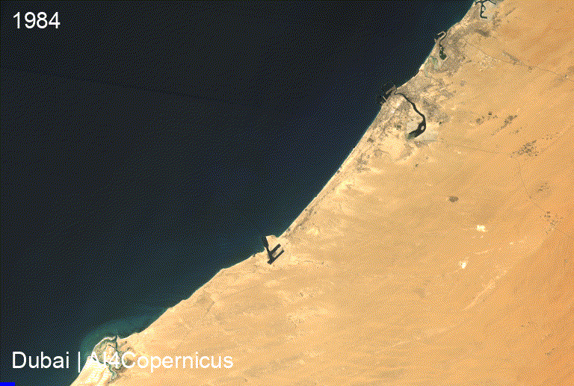
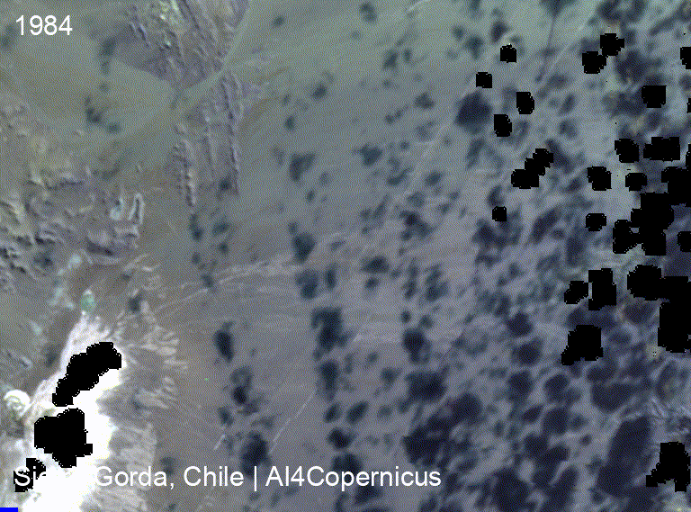
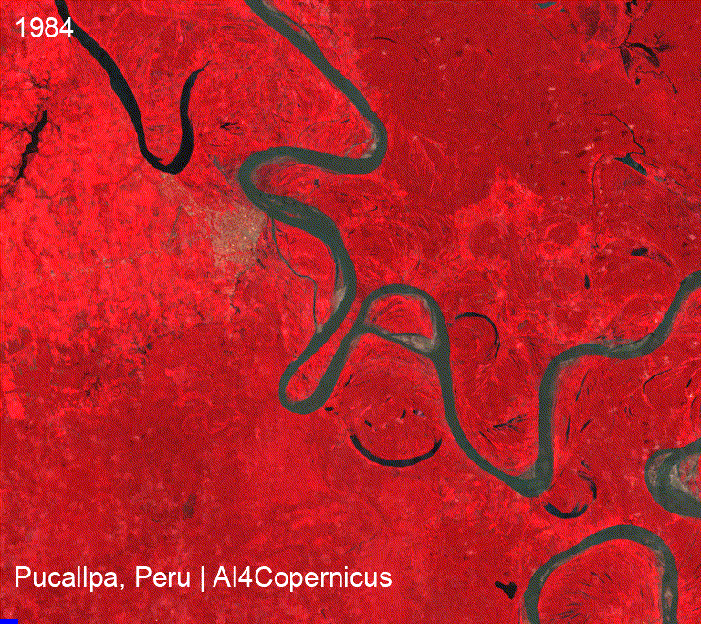
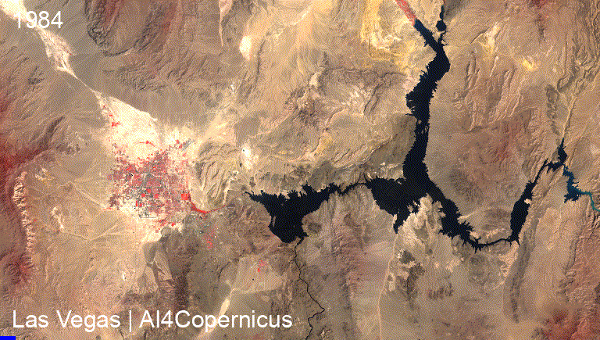
Introduction
Optical satellite images
InSAR (Interferometric SAR)
RADAR
LiDAR
Change detection is of general interest for monitoring dynamic process using remote sensing.
Created with: https://streamlit.geemap.org/

Slide 3
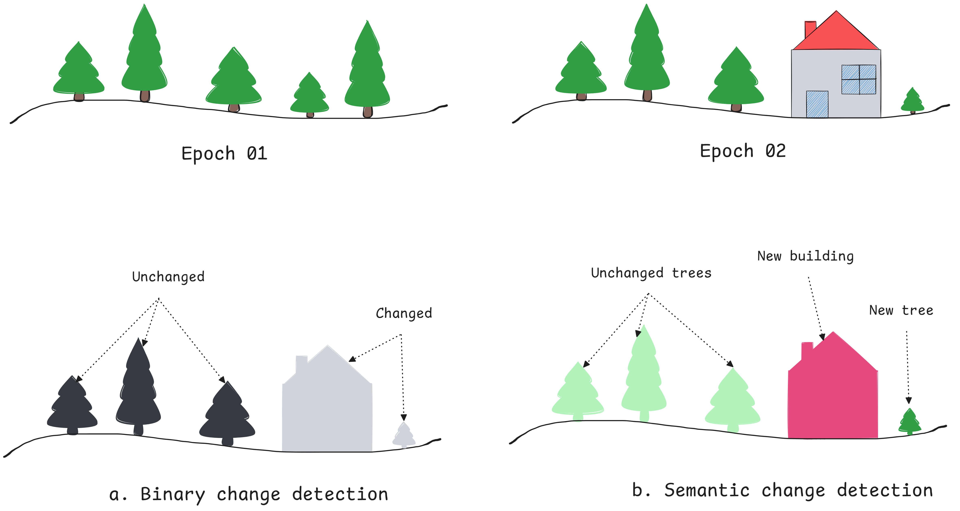
Problem Statement
Challenges in Change Detection:
Irregular, unstructured nature of point clouds.
Integrating buildings and vegetation changes.
Managing different acquisition densities and accuracies across epochs.
Gaps in Current Approaches:
Reliance on labeled data.
Limited integration of semantic and geometric changes.
Lack of structuration into standardized formats like CityJSON.

Slide 4
Objective
Develop a workflow for detecting and structuring building and vegetation changes using LiDAR point clouds.

Slide 5
Methodology overview
CityJSON is a JSON-based encoding for storing 3D city models, also called digital maquettes or digital twins

Slide 6
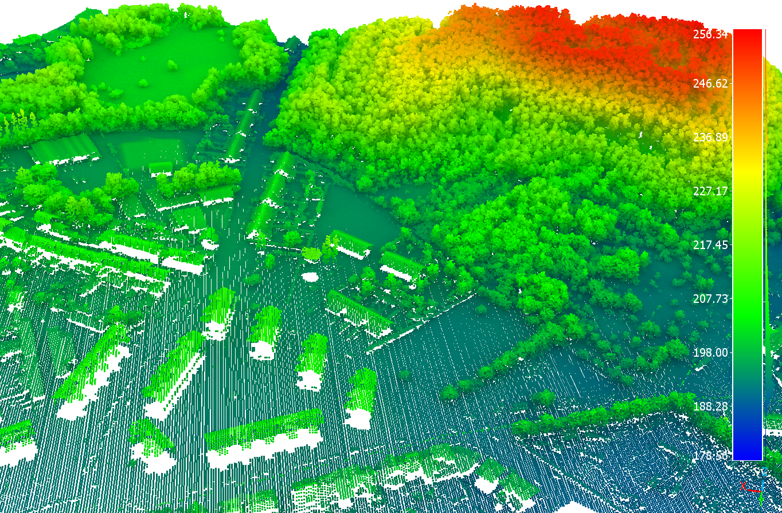
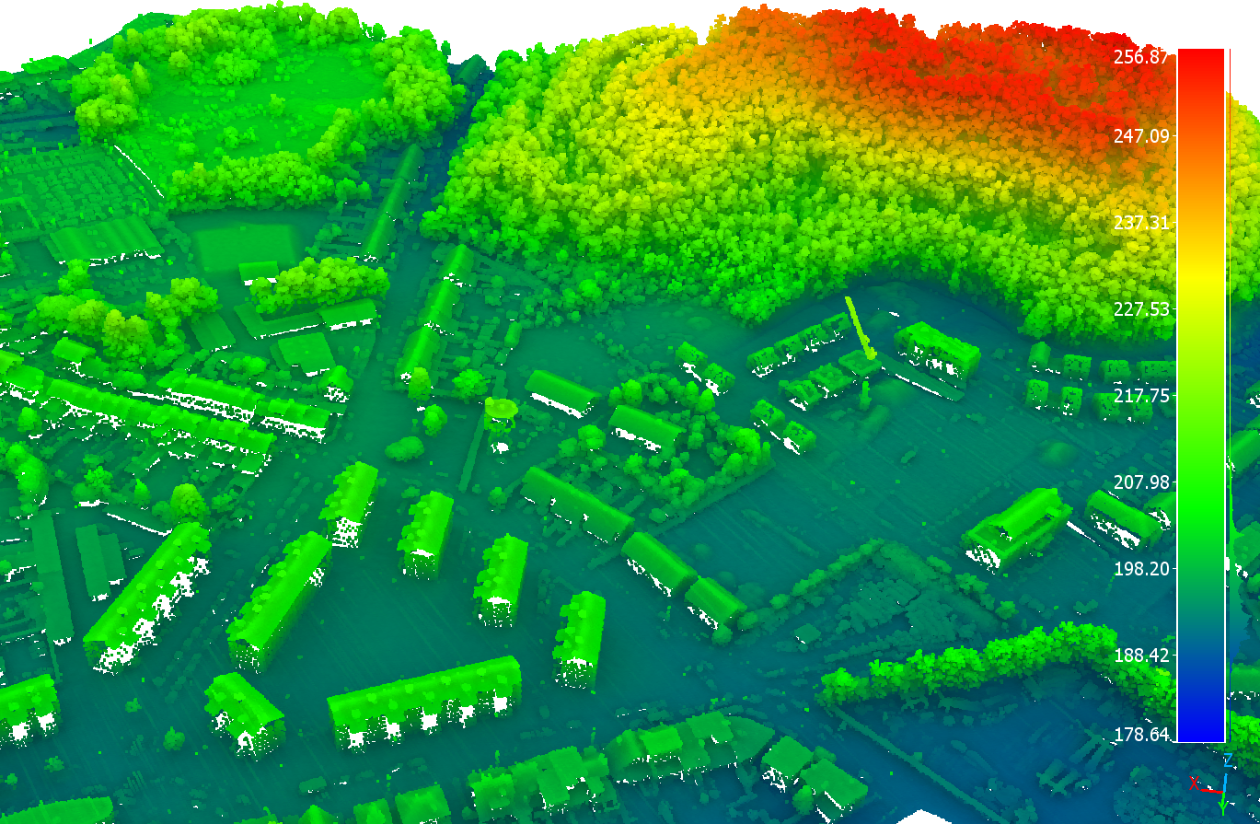
Study area and data
2014
Study Area:
City of Liège, Belgium. Diverse urban landscape: buildings, vegetation, and infrastructure.
LiDAR Data:
Epoch 1 (2014):
Altitude: 1015–1550 m, Density: 0.8 points/m²
Epoch 2 (2022):
Altitude: 2400 m, Density: 6.8 points/m²
Additional Data: Vector footprints from the PICC (Projet Informatique de Cartographie Continue).
2022

Slide 7
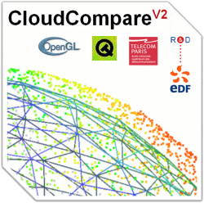
Tools and scripts

Slide 8
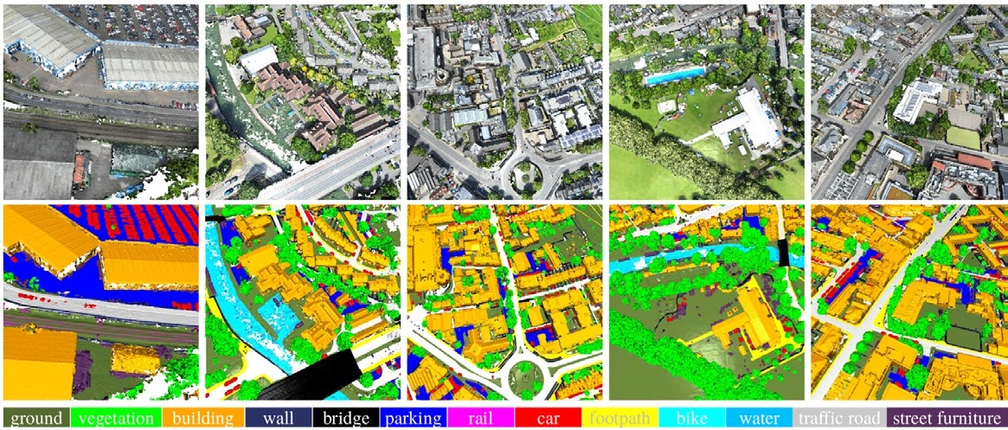
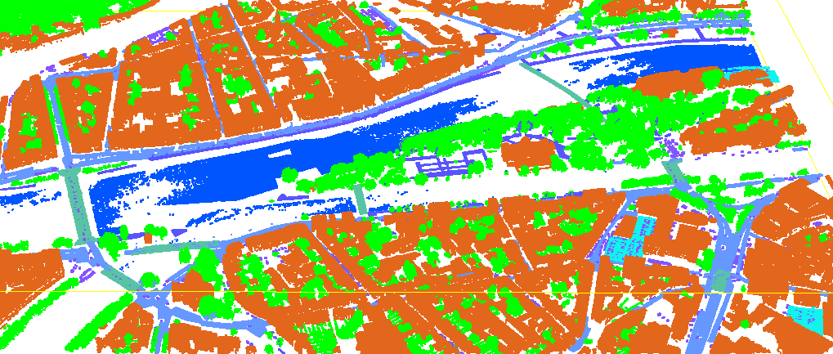
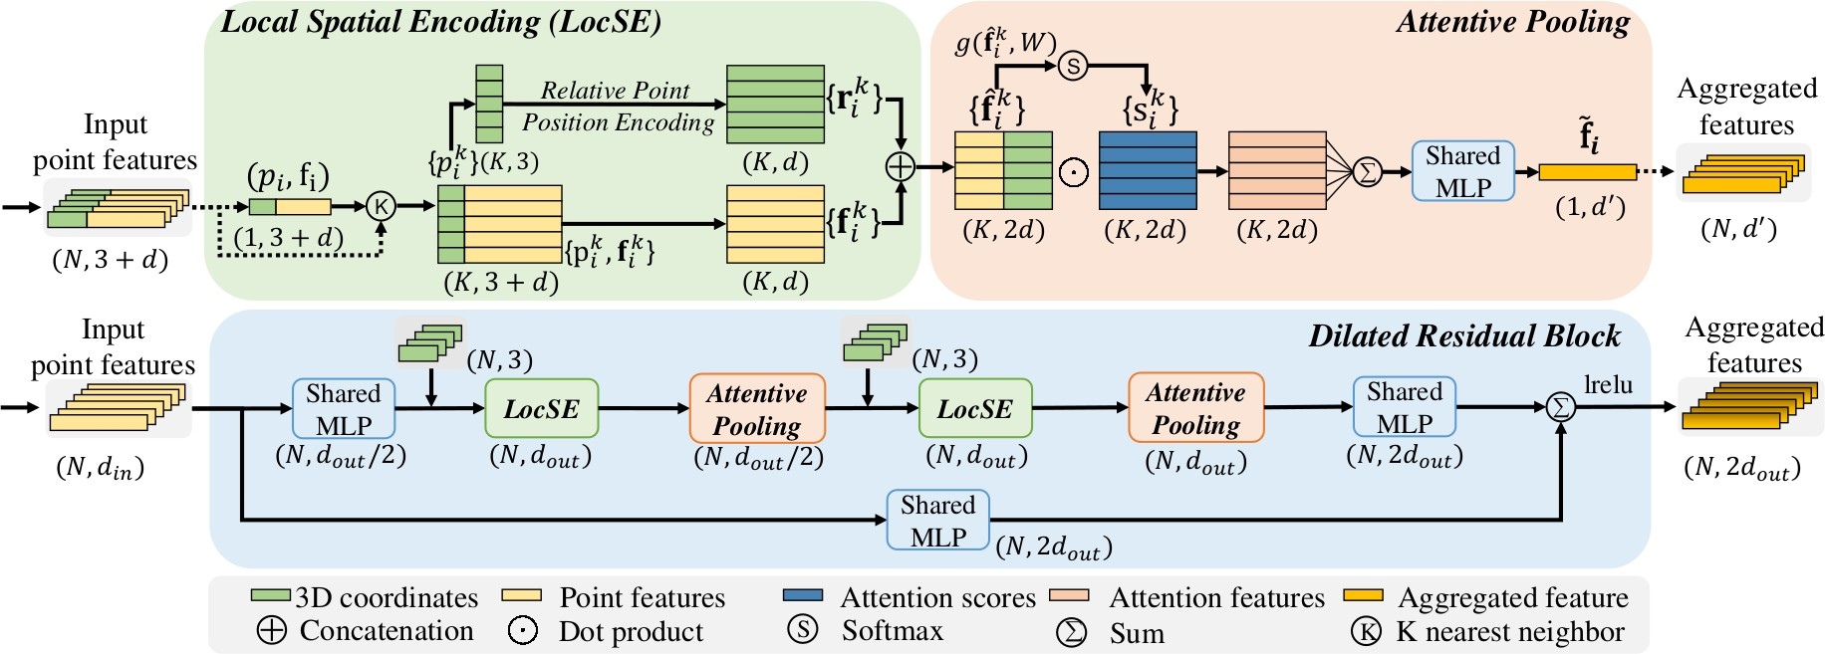
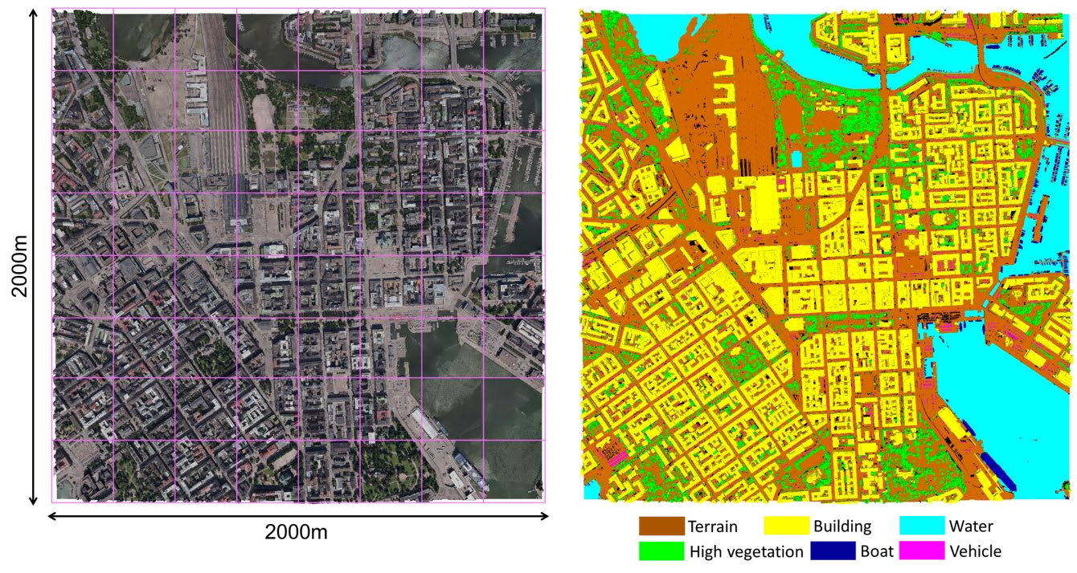
Semantic and instance segmentation
RandLA-Net for 3D semantic segmentation
Training set 1
Training set 2
SensatUrban dataset
Liège dataset
Training set 3
(source: Hu et al., 2020)
SUM: A Benchmark Dataset of Semantic Urban Meshes
Deep learning model

Slide 9
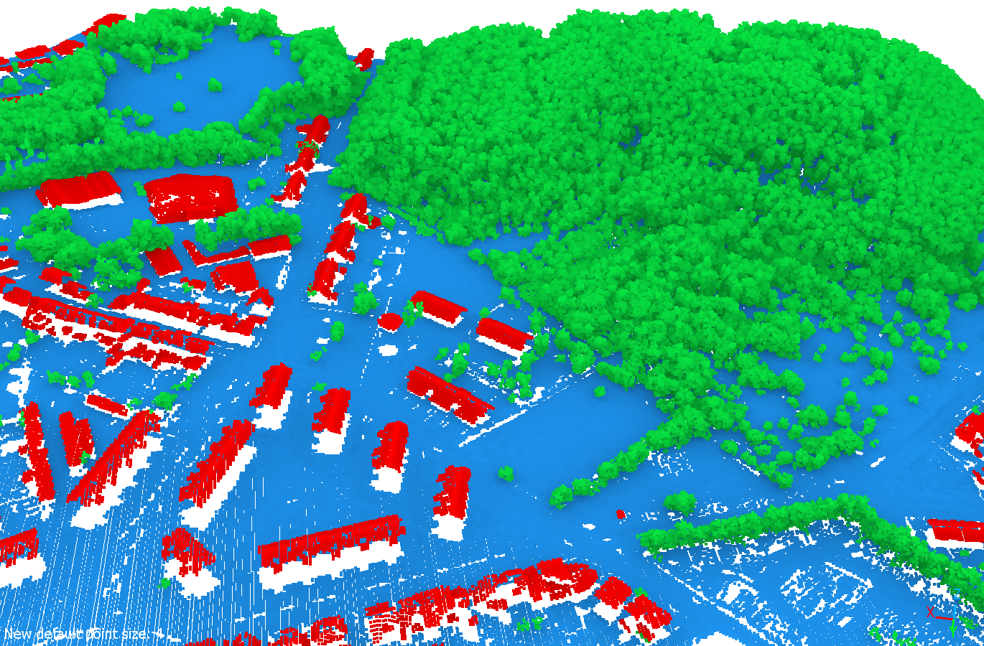
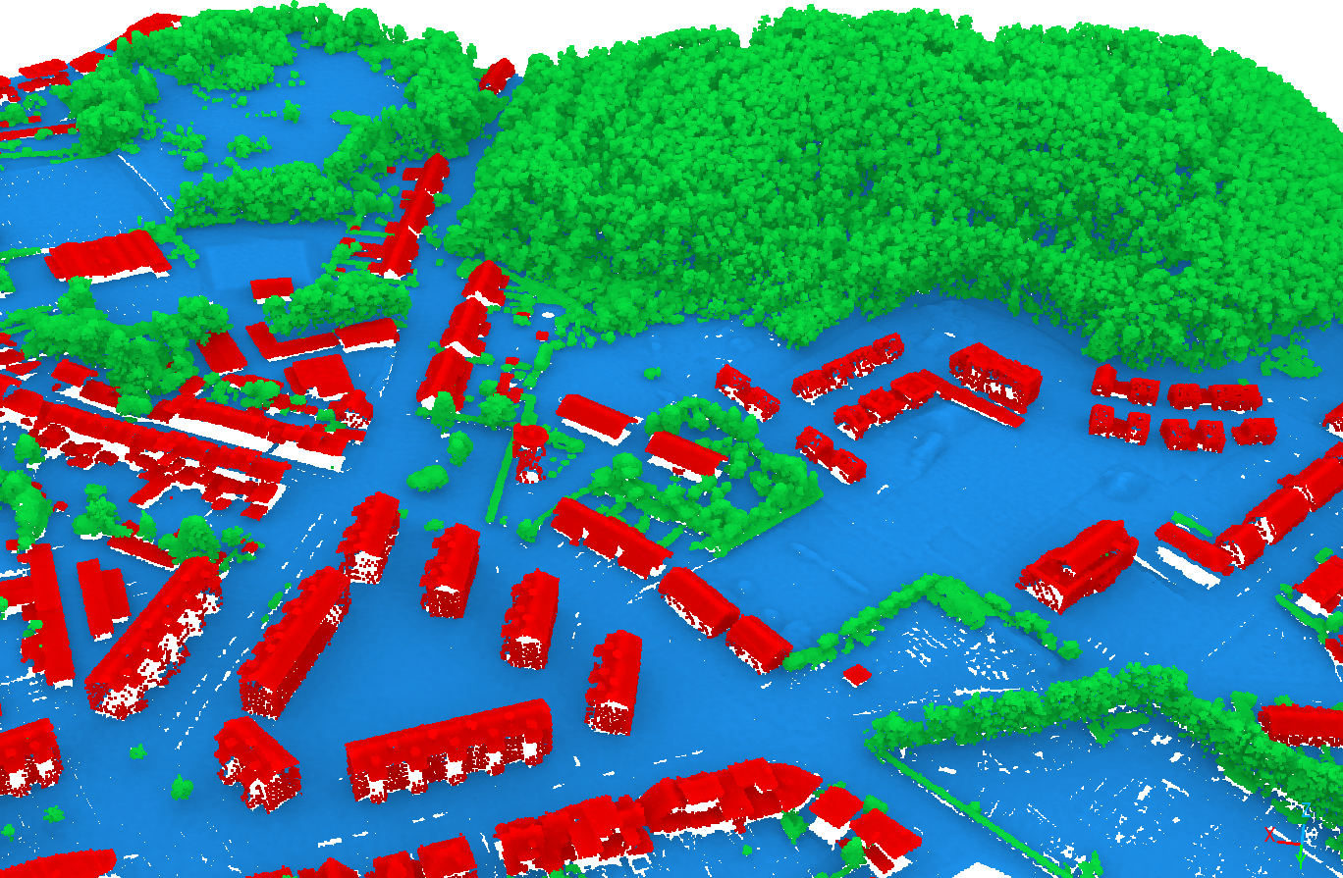
Semantic and instance segmentation
RandLA-Net for 3D semantic segmentation
2014
2022
Ballouch, Z., Jeddoub, I., Hajji, R., Kasprzyk, J.-P., and Billen, R.: Towards a Digital Twin of Liege: The Core 3D Model based on Semantic Segmentation and Automated Modeling of LiDAR Point Clouds, 2024.

Slide 10
Semantic and instance segmentation
Adaptation of TreeISO for aerial data hierarchal grouping
Final segments
Final trees segmentation, merged based on the gaps and overlapping ratio
Intermediate segments
Show the 2nd-stage segmentation from 2D cut-pursuit, merge previous clusters horizontally
Initial segments
Show the initial segmentation from 3D cut-pursuit
Raw Point cloud
Ground points must be removed prior to tree isolation
TreeISO paper: Xi, Z.; Hopkinson, C. 3D Graph-Based Individual-Tree Isolation (Treeiso) from Terrestrial Laser Scanning Point Clouds. Remote Sens. 2022, 14, 6116. https://doi.org/10.3390/rs14236116

Slide 11
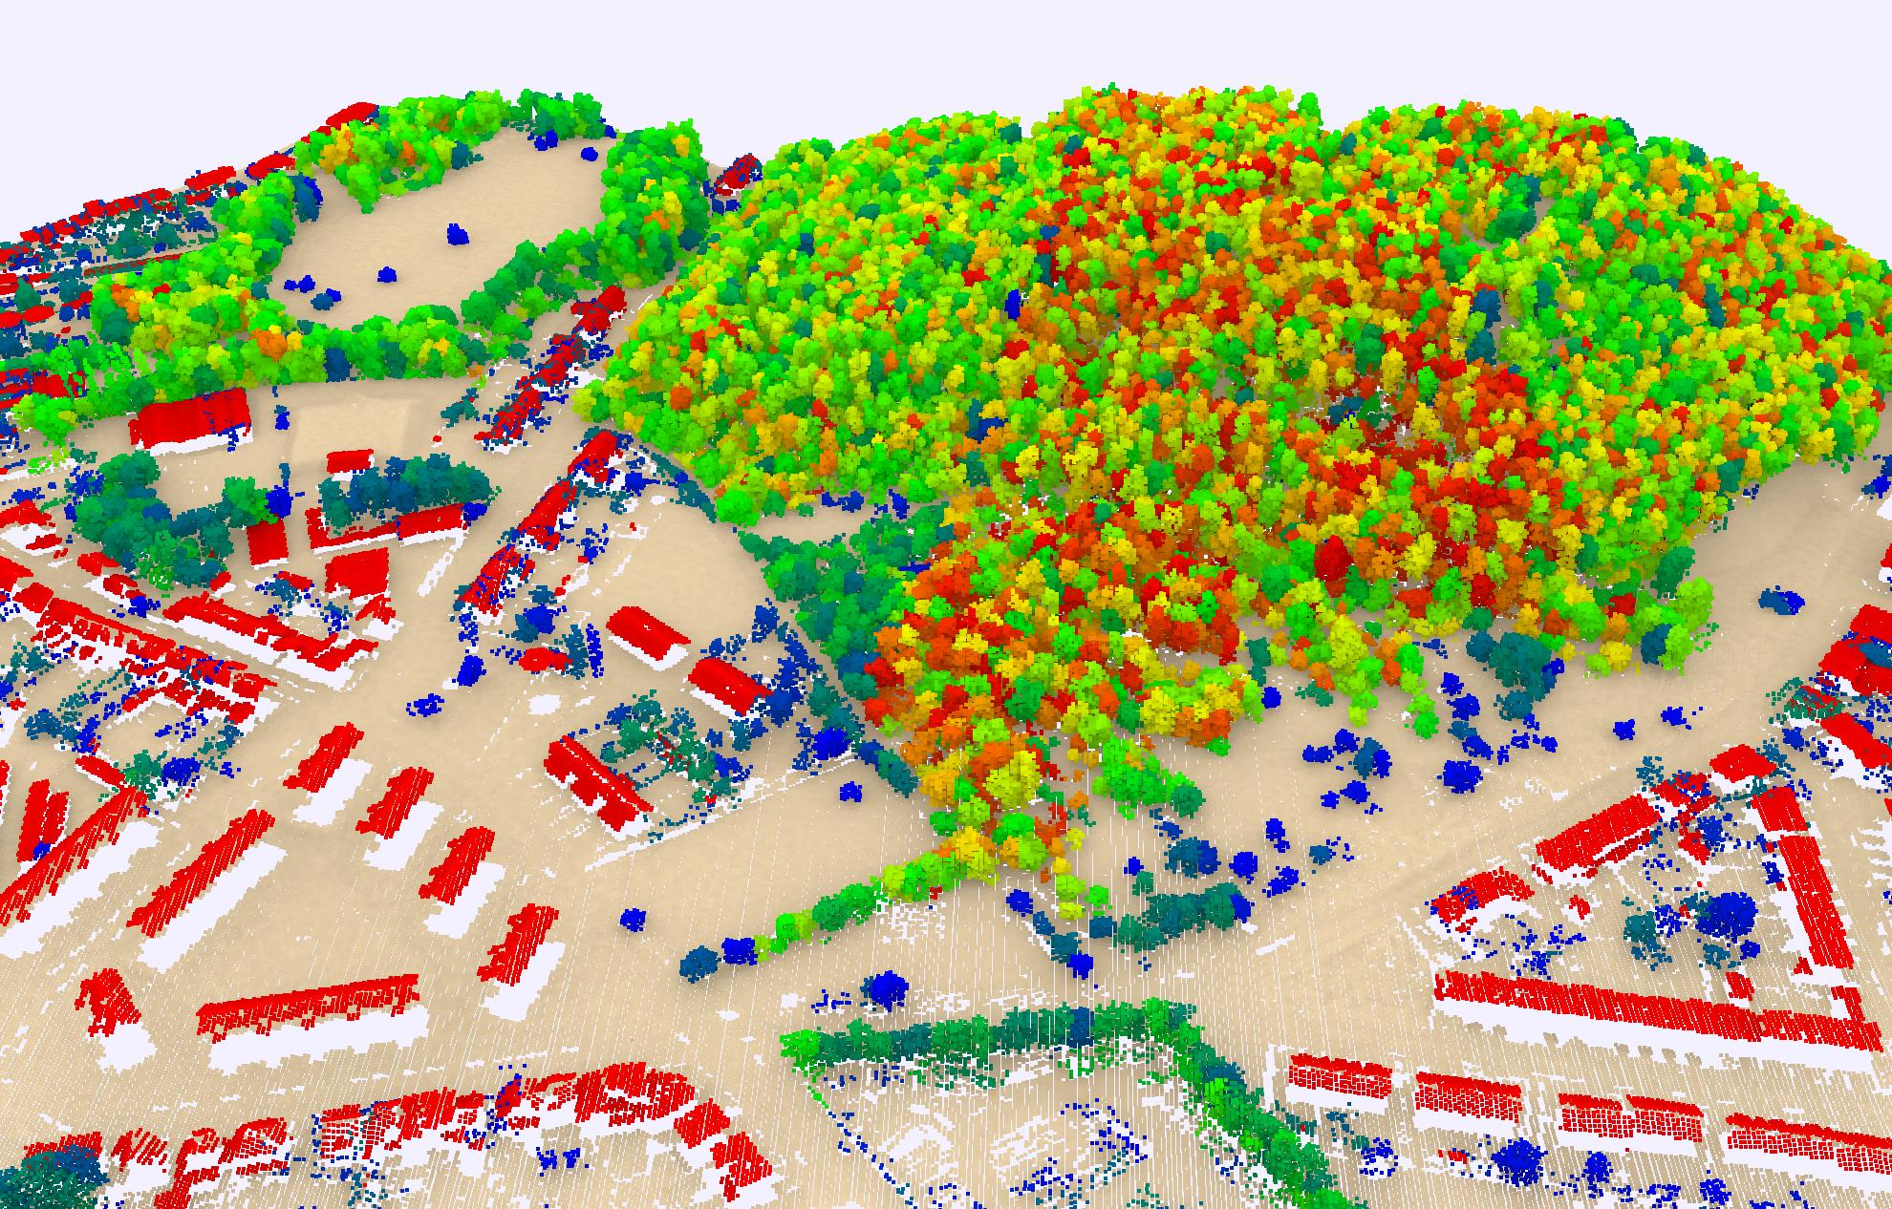
Semantic and instance segmentation
PICC for building individualization and TreeISO for trees
PS: After clustering the trees, a filtering step was applied to exclude objects with tops lower than 3 meters, as fences and small objects were misclassified as vegetation.

Slide 12
Change detection approach
Change Classes:
New (appearance).
Lost (disappearance).
Modified.
Unchanged.
Point-Level Change Detection:
M3C2 distances projected on a horizontal plane to handle façade effects.
Clustering:
Connected component analysis to filter noise and small artifacts.

Slide 13
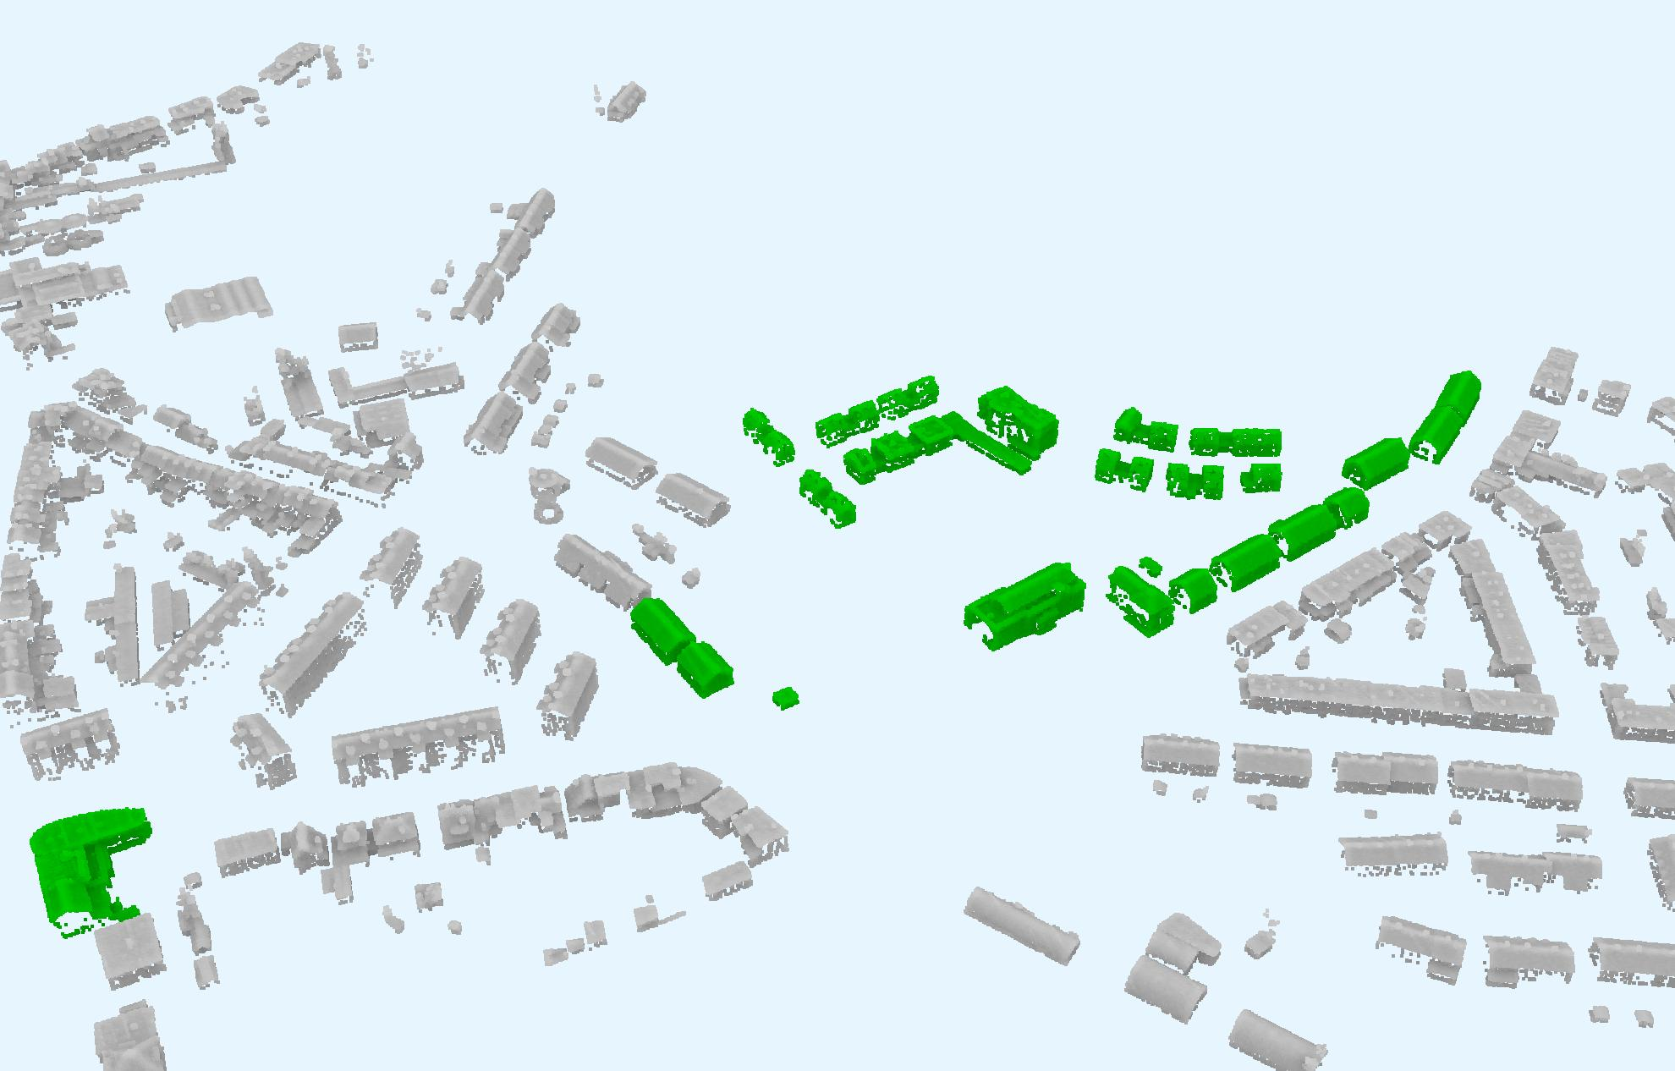
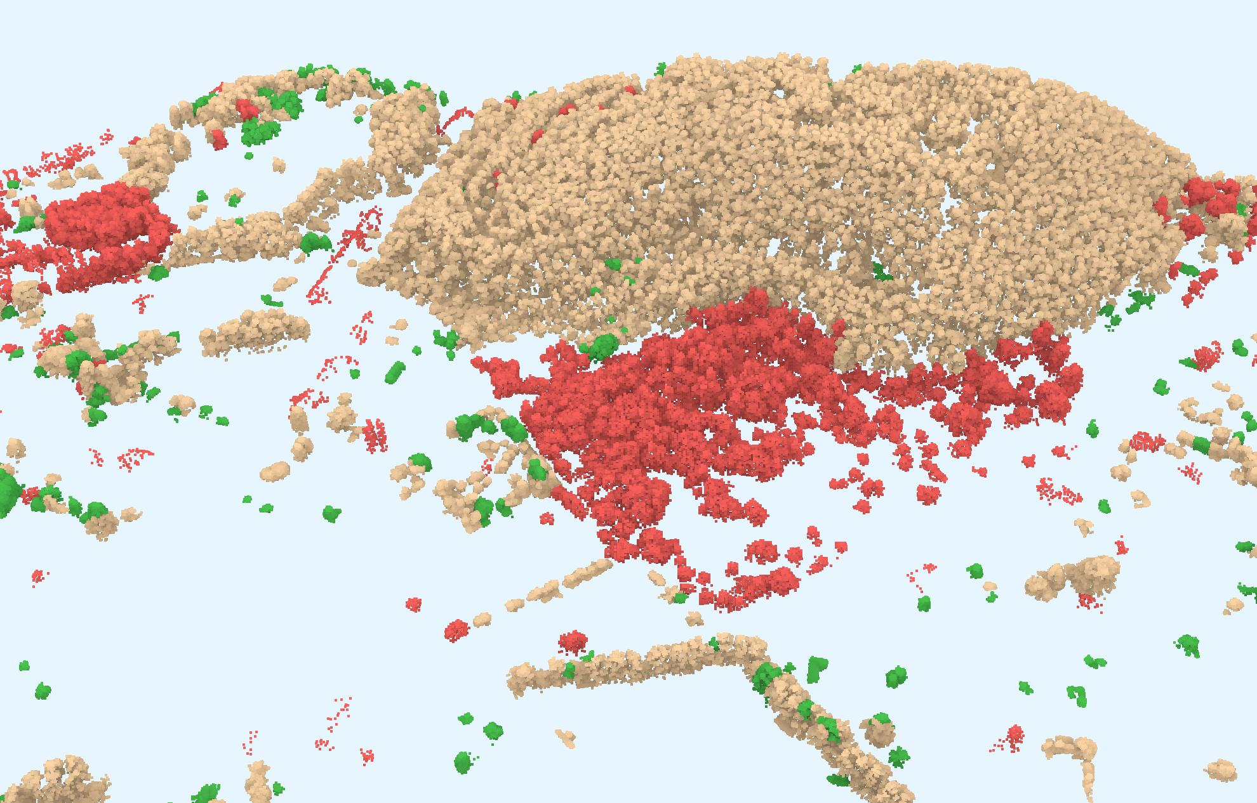
Change Metrics
The new building visualized in green, and unchanged in gray
Building Metrics:
Volume change.
Height variation.
Bounding box dimensions.
Tree Metrics:
Canopy height.
Growth and pruning detection.
Classification:
Rule-based thresholds.
Optional machine learning classification (e.g., Random Forest) if training data is available.
New vegetation visualized in green, removed in red and modified in brown

Slide 14
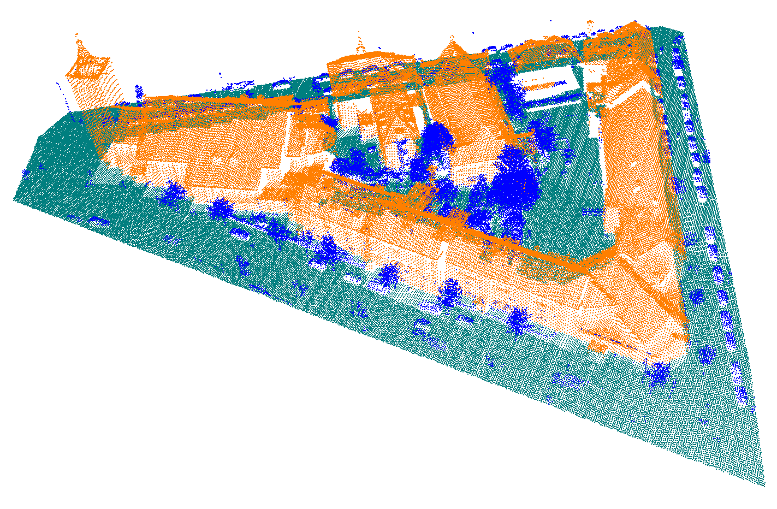
Building modeling LOD2.2 using Geoflow
2D building polygons
LOD2.2 CityJSON model
Files are on average 7X more compact than their CityGML-XML equivalent
LiDAR point cloud

Slide 15
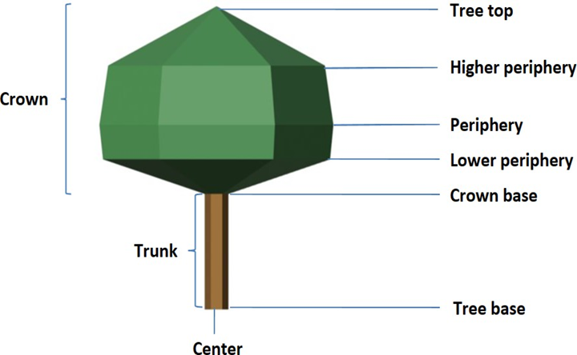
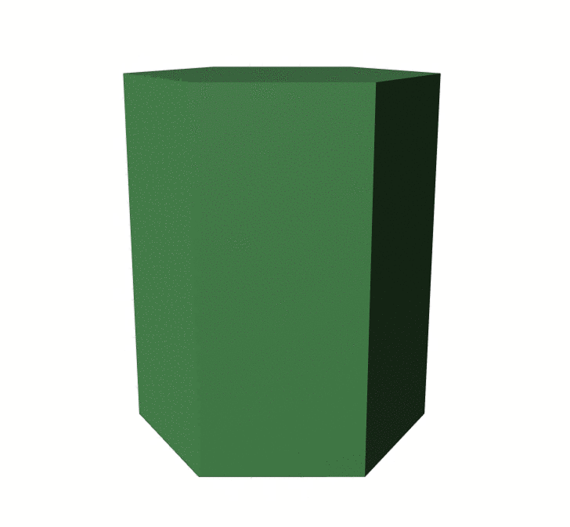
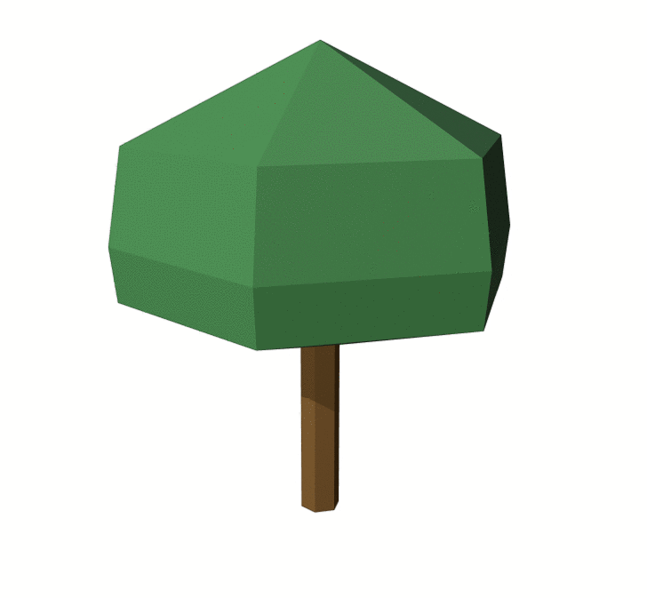
Tree modeling using Tree Reconstruction
LOD0 LOD1 LOD2
Detail levels
Tree construction parameters
Source: de Groot, Rob. (2020).

Slide 16
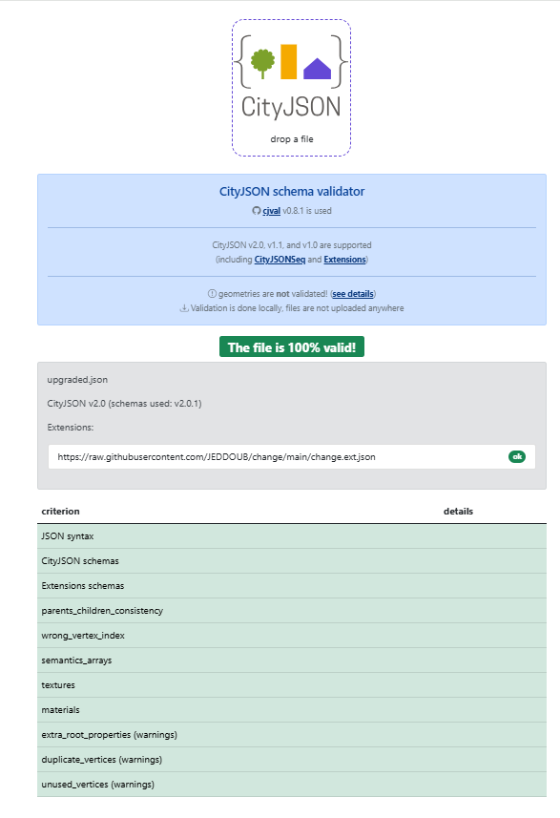
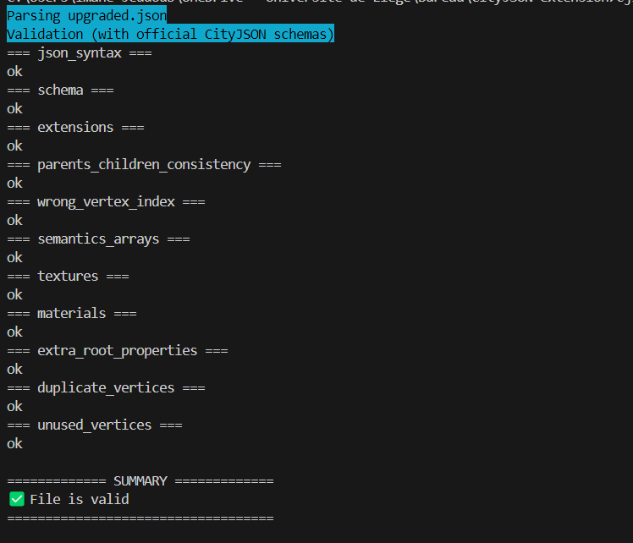
New CityJSON extension for change

Slide 17
Model validation
Input mode
Valid ?
Geometric validation of the 3D primitives according to the international standard ISO 19107 (Val3dity)
Schema validation to verify if the model complies with the CityJSON specifications (cjval)

Slide 18
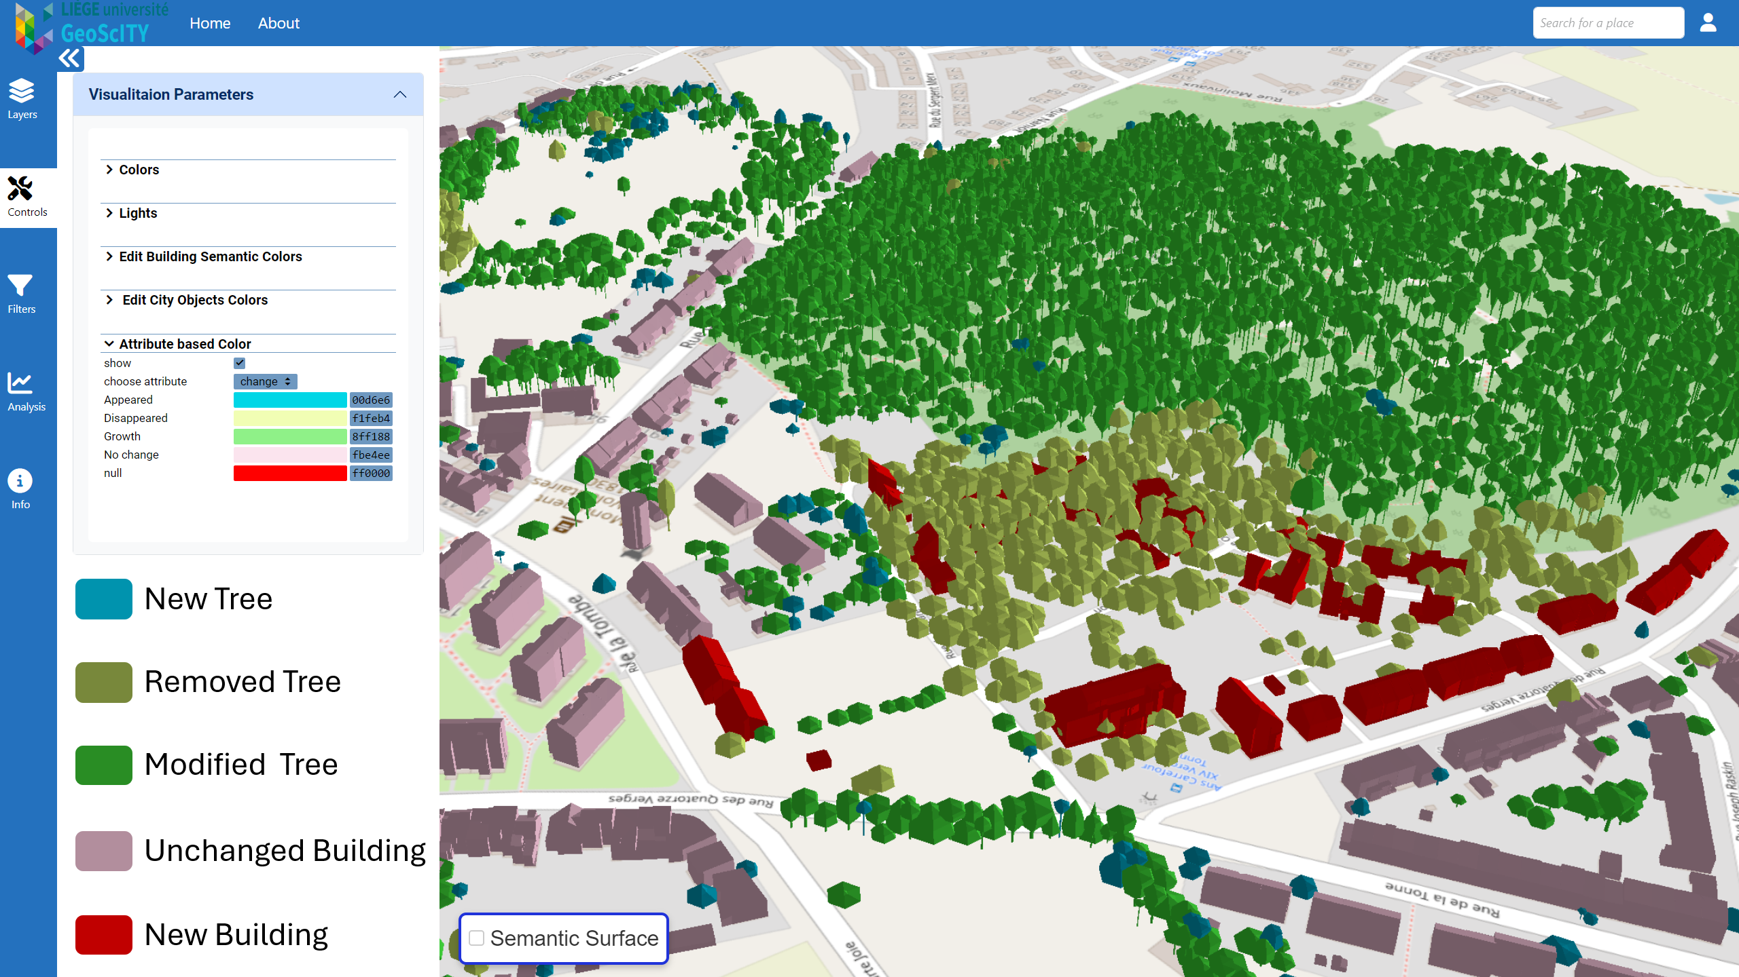
Final CityJSON model
Purpose: Standardized representation for integration into urban models.
Attributes Added:
Change class (e.g., new, lost).
Geometric metrics (e.g., height, volume).
Semantic labels (e.g., building, tree).
Check the Demo session: CITY2TWIN: An Open Urban Digital Twin Platform from Data Integration to Visualization and Analysis

Slide 19
Challenges and Future directions
Challenges:
Instance Segmentation Errors: Mis-segmentation can lead to false detections in subsequent analysis steps.
Over/under-segmentation in Vegetation: Dense vegetation areas may result in fragmented and inaccurate segmentation.
Static Detection Thresholds: Fixed thresholds fail to adapt to changing urban and environmental conditions.
Future Works:
Object-Level Classification: Employ machine learning classifiers on existing and new object-level metrics to refine change detection and characterization.
Generative AI for Analysis: Use 3D foundation models for interactive querying and enhanced descriptions of detected changes.
Uncertainty Integration: Incorporate uncertainty evaluation metrics to quantify reliability and improve confidence in change detection outputs.

Slide 20
Do not hesitate to contact
Geomatics Unit | geomatics.ulg.ac.be
Allée du Six Août 19 (B5A) | 4000 Liège
This research was funded by the National Belgian Funds for Scientific Research FNRS-FRS, through an Aspirant FRNS grant for Abderrazzaq KHARROUBI (Oct. 2021).
Eng. Abderrazzaq Kharroubi
akharroubi@uliege.be

Slide 21
Detection and structuration of building and vegetation changes using LiDAR point clouds.
Abderrazzaq Kharroubi 1, Zouhair Ballouch 1,2, Imane Jeddoub 1, Rafika Hajji 2, Roland Billen 1
1, GeoScITY, UR SPHERES, University of Liège, 4000 Liège, Belgium; (akharroubi, zouhair.ballouch, i.jeddoub, rbillen)@uliege.be
2, College of Geomatic Sciences and Surveying Engineering, Hassan II Institute of Agronomy and Veterinary Medicine, Rabat 10101, Morocco; r.hajji@iav.ac.ma
12-13 December 2024
Low-Cost 3D workshop
Brescia, Italy

