Slide 1
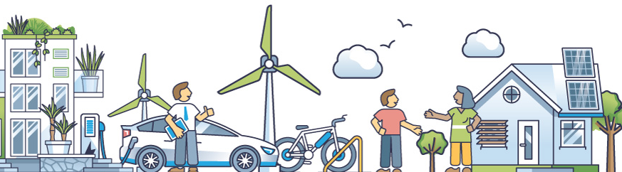
ENVT0905-1
Energy Communities
Lecturer: Damien Ernst – University of Liège (dernst@uliege.be)
Understanding Energy Sharing

Slide 2
Introduction to the lesson
The European Union has introduced policies through directives to promote renewable energy. These aim to address challenges like reducing CO₂ emissions, decreasing energy dependence, and alleviating energy poverty.
In Belgium, various incentives, especially for photovoltaic systems, have been implemented. These encourage investment in renewable energy, leading to its widespread adoption in the residential sector. It has created new opportunities, including increased citizen participation in energy production.
This has also led to the concept of energy sharing which is a collective approach to energy management. In Wallonia, a region of Belgium, two main energy-sharing solutions exist. One involves peer-to-peer electricity exchange through a retailer’s platform, where participants must be customers of the same retailer. The other uses the legal framework of energy communities, whose members can trade energy among themselves while maintaining their contracts with their respective electricity retailers.
2
Notes:
2 paragraphe: enlever in Belgium.
The lesson will be separated in three parts

Slide 3
Lesson outline
To properly understand energy sharing, the lesson will be organized into the following parts:
Overview of the energy sector and key EU energy policies;
Introduction to the mechanisms of electricity markets;
Incentives for renewable energy development in Belgium (Wallonia);
Breakdown of a residential electricity bill and the impact of self-production;
Analysis of peer-to-peer electricity exchange through a retailer’s platform;
Analysis of the framework of energy communities and their different models.
3

Slide 4
PART I:
Overview of the energy sector and key EU energy policies

Slide 5
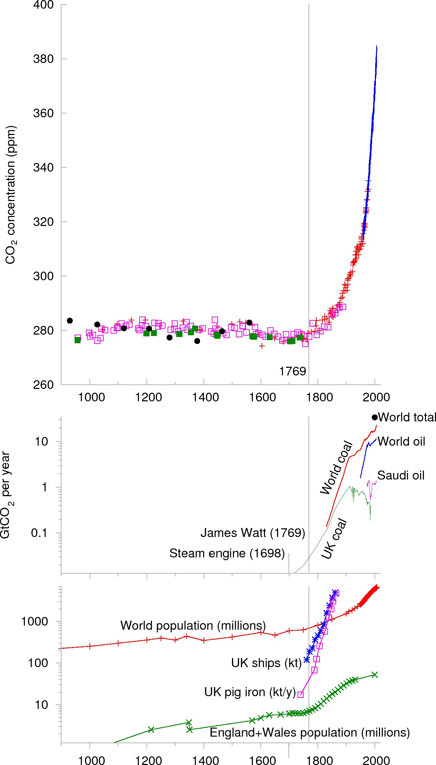
Challenges of the energy transition: reducing CO₂ emmisions
Evolution of global CO₂ concentration (ppm) over the last millennium.
Evolution of global CO₂ concentration (ppm) over the last century.
The acronym “ppm” stands for “parts per million”. It indicates the number of CO₂ molecules per million molecules of air.
A rise in the concentration of CO₂ in the atmosphere has been observed since the Industrial Revolution in the 18th century, and this increase continues today. It contributes to an intensified greenhouse effect that results in climate change, such as a rise in average global temperatures and more extreme climate events.
5

Slide 6
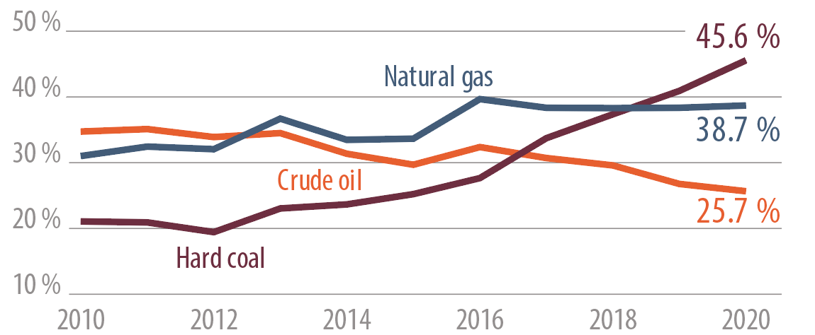
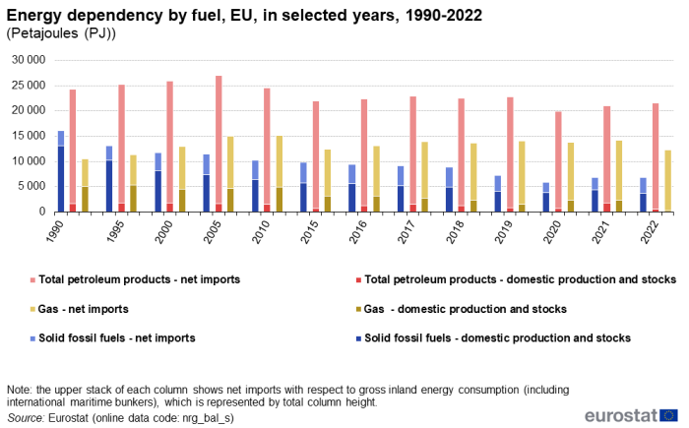
Challenges of the energy transition: decreasing dependency
Europe’s dependency on fossil fuel imports, particularly from politically unstable regions, exposes the EU to the risk of supply disruptions. Utilising local renewable energy sources can enhance energy security.
EU energy import dependency from Russia – Share of total imports.
Energy dependency by fuel in Petajoules (PJ),in the EU, for selected years between 1990 and 2022.
1 PJ = 10¹⁵ J, which is equivalent to 277.8 GWh. The light-colored segments are net imports relative to gross inland energy consumption (total column height).
6

Slide 7
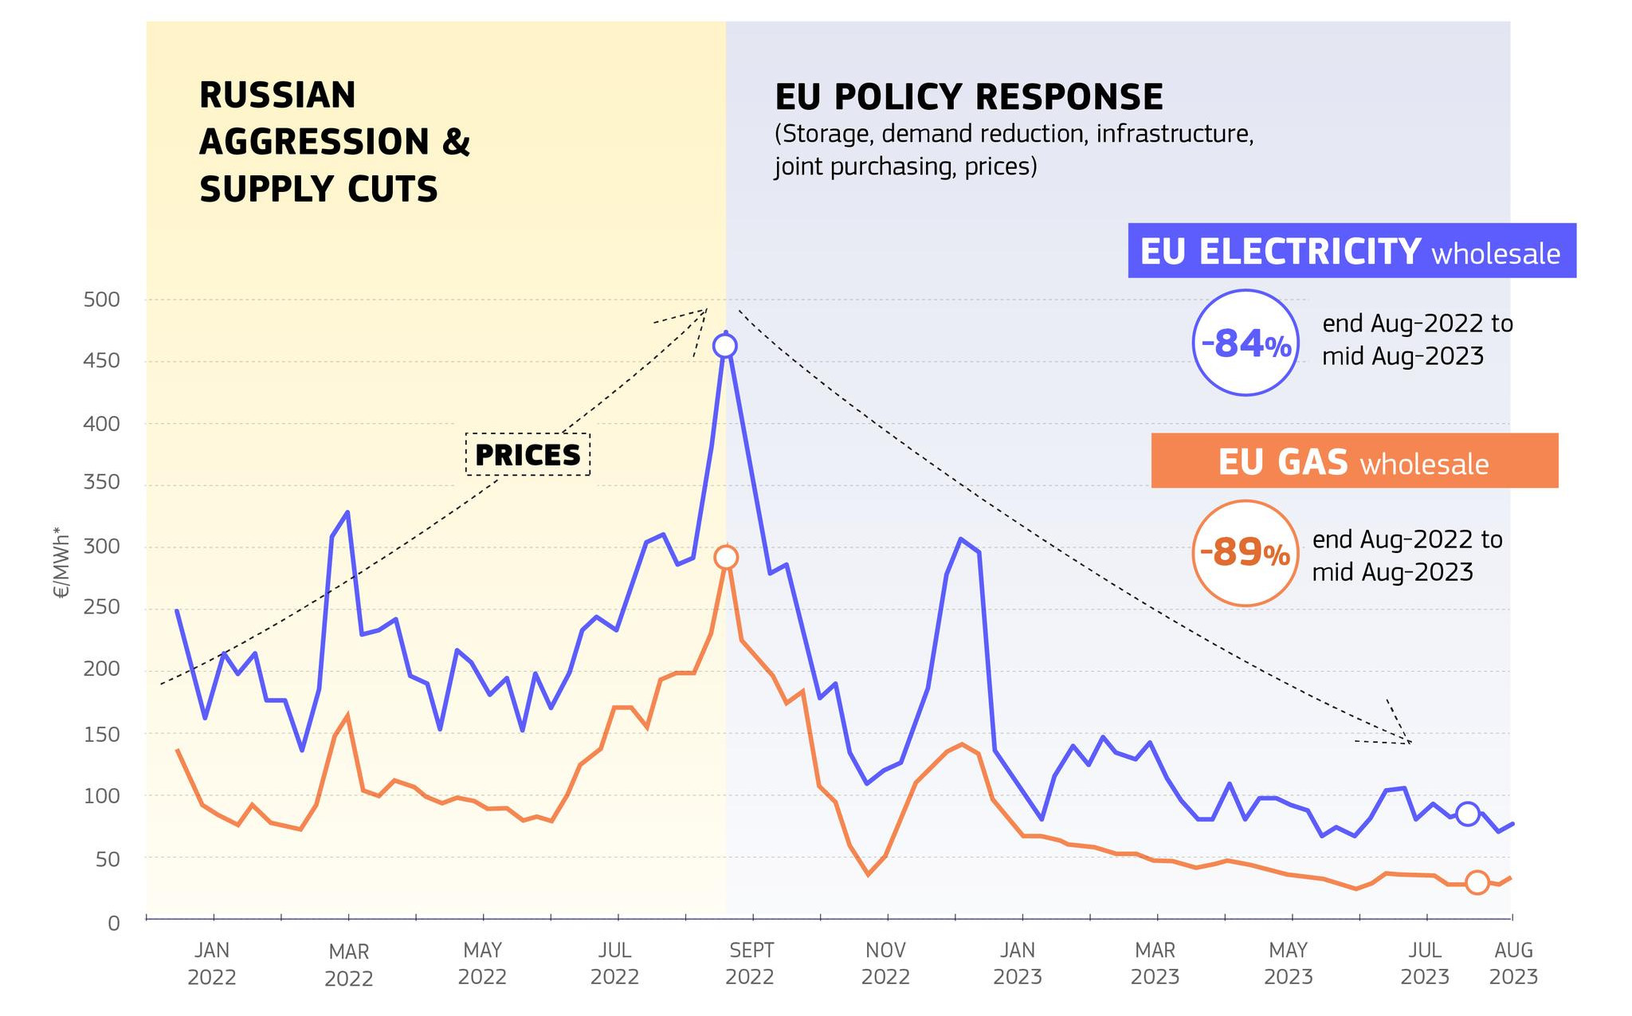
Challenges of the energy transition: alleviating energy poverty
Energy poverty occurs when a household is forced to limit its energy use to the extent that it harms the health and wellbeing of its members. This issue arises from three factors: a significant portion of household income being spent on energy, low household income, and the poor energy efficiency of buildings.
The COVID-19 crisis, followed by the surge in energy prices and the Russian invasion of Ukraine in February 2022, has aggravated an already difficult situation for many EU citizens.
Evolution of gas and electricity prices in Europe.
7

Slide 8
Catalysing the growth of renewable energy in Europe
Key European directives for deploying renewable energy:
Directive 2009/28/EC sets targets for the share of renewable energy in the EU's total energy consumption, aiming for 20% by 2020. Additional goals were included in the 2020 Climate and Energy Package, which aimed to reduce greenhouse gas emissions by 20% and improve energy efficiency by 20%.
Directive 2018/2001 replaced and enhanced Directive 2009/28/EC, setting a new binding target of 32% renewable energy in total consumption by 2030.
The European Green Deal (2019), although not a directive or regulation itself, includes strategies and legislative initiatives aimed at achieving climate neutrality by 2050. The EU has committed to reducing its emissions by 55% by 2030 compared to 1990 levels.
To achieve these targets, various programmes are available. For example, InvestEU aims to mobilise private investments in sustainable and innovative projects across Europe.
The aspects of these and other directives related to energy communities will be addressed later in Part VI.
8

Slide 9
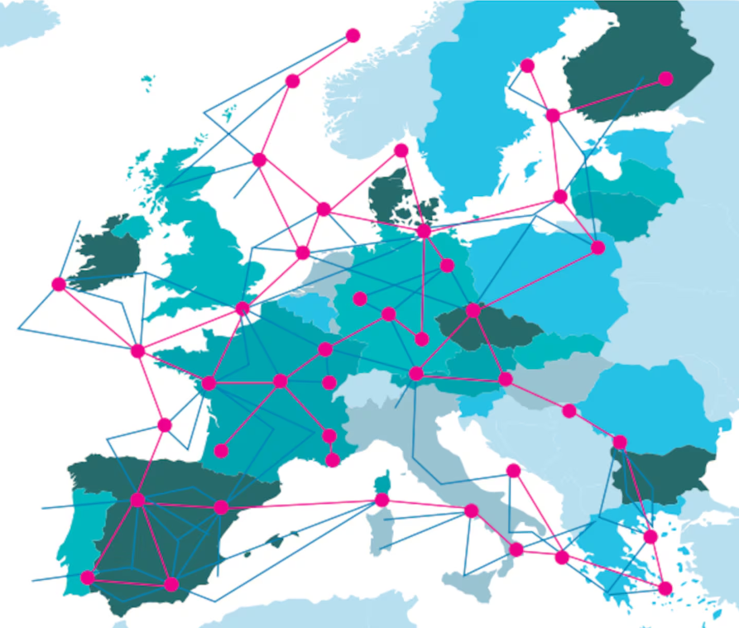
The European electrical systems coupling with the Supergrid
The Supergrid is a Direct Current (DC) network that overlays existing Alternating Current (AC) networks. Extensive DC links connect power grids and energy markets from local, regional, national, and continental power systems.
These long DC links can help smooth out fluctuations in renewable energy production levels and enable the utilisation of renewable resources in remote areas with abundant sun and wind.
European Supergrid.
This system will make the trading and exchange of power across multiple countries and regions easier, with the goal of distributing electricity more efficiently throughout Europe. It aims to reduce CO₂ emissions, decrease energy dependency, and alleviate energy poverty.
To better understand this approach, the next section will introduce the mechanisms of electricity markets.
9

Slide 10
PART II:
Introduction to the mechanisms of electricity markets

Slide 11
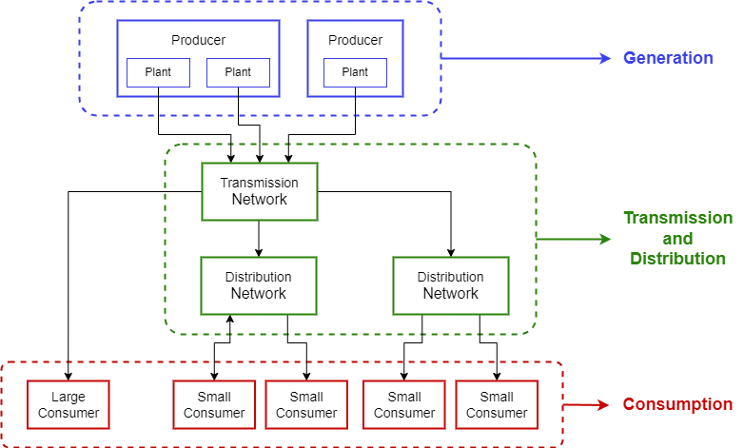
The flow of energy – How electricity reaches consumers (1/2)
The three main components of the electricity grid are:
Generation
Transmission and Distribution
Consumption.
11

Slide 12
The flow of energy – How electricity reaches consumers (2/2)
12

Slide 13
Electricity industry – Presentation of the entities
Transmission System Operator (TSO): Operates the high-voltage electricity transmission network. Its role is to ensure the stability and security of the electricity supply.
Distribution System Operator (DSO): Responsible for managing the medium and low-voltage distribution network, delivering electricity to end users.
Producer/Generator: Produces electrical energy and generates sales in the wholesale market.
Retailer: Purchases electricity in the wholesale market for their customers (end consumers).
Supplier: Both procures electricity from the wholesale market and sells it to end consumers.
Consumer: Purchases electricity in the wholesale or retail markets.
Market regulator: Defines market rules and monitors potential abuse of market power.
Market operator: Operates the energy markets (matching, clearing, settlements).
13

Slide 14







Electricity industry – Main actors in Belgium
Transmission System Operator (TSO):
Elia.
Distribution System Operator (DSO):
ORES, RESA, Sibelga, Fluvius, etc.
Independent System Operator (ISO):
Elia.
Producer/Generator:
Engie Electrabel, EDF Luminus, Lampiris, Eneco, etc.
Retailer:
Engie Electrabel, EDF Luminus, Lampiris, Eneco, Mega, etc.
Market regulator:
CREG, CWaPE, BRUGEL, VREG.
Market operator:
EPEX SPOT, EEX, ICE Endex, etc.
14

Slide 15
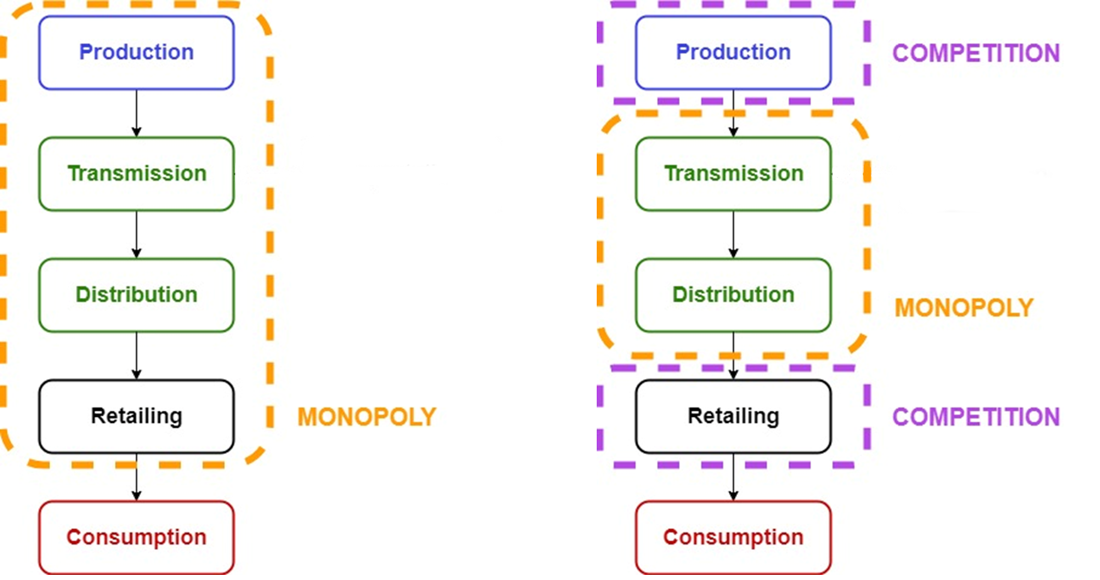
Electricity industry – From monopoly to liberalisation
Historically, the electricity industry was organised as a monopoly in Belgium. Nowadays, it is significantly liberalised:
Before the liberalisation:
After the liberalisation:
15

Slide 16
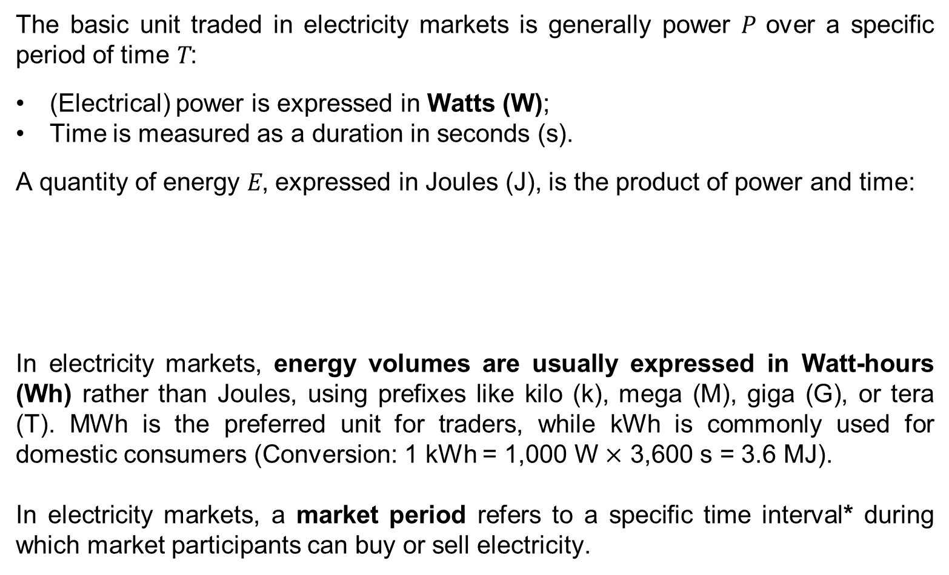
Electricity Markets – What is traded
The basic unit traded in electricity markets is generally power P over a specific period of time T:
(Electrical) power is expressed in Watts (W);
Time is measured as a duration in seconds (s).
A quantity of energy E, expressed in Joules (J), is the product of power and time:
In electricity markets, energy volumes are usually expressed in Watt-hours (Wh) rather than Joules, using prefixes like kilo (k), mega (M), giga (G), or tera (T). MWh is the preferred unit for traders, while kWh is commonly used for domestic consumers (Conversion: 1 kWh = 1,000 W $×$ 3,600 s = 3.6 MJ).
In electricity markets, a market period refers to a specific time interval* during which market participants can buy or sell electricity.
E [J] = P [W] * T [s]
*Typically 15 minutes in the EU, but it may be different in other countries (five-minute intervals in the intraday market in the US).
16

Slide 17
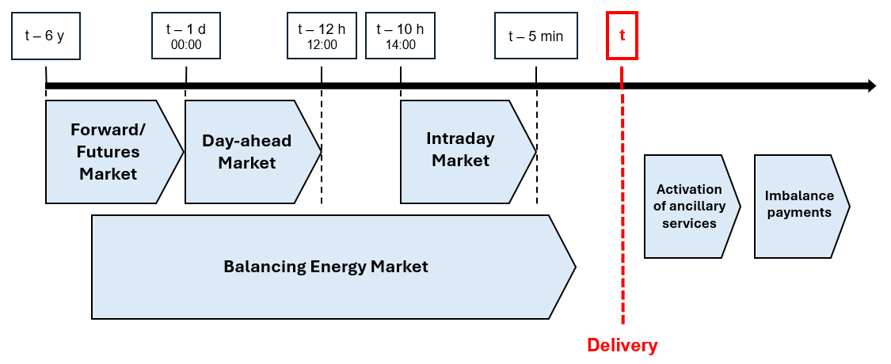
Electricity Markets – Overview
x
17

Slide 18
Presentation of the forward and futures markets
Each participant on these markets can submit an order, which is an instruction to buy or sell a certain volume of electricity at a specific price. The order can be matched with a corresponding order from another participant through a long-term bilateral contract.
A bilateral contract is an agreement directly negotiated between two parties, typically between a producer, such as a power plant, and a consumer, which could be a large industrial user, a supplier, or a retailer.
A variety of products are available in long-term contracts, including calendar (yearly), quarterly, or monthly base-load products. The trading horizon spans from several years until the beginning (or a few days before the beginning) of the market period covered by the contract.
18

Slide 19
Difference between the forward and futures markets
Contracts in the futures market are standardised in terms of size, maturity, and specifications (e.g., the volume of electricity, the delivery point). They are traded on organised exchanges like EEX (European Energy Exchange) and ICE Endex.
In contrast, contracts in the forward market are negotiated directly between the parties without the involvement of an exchange. They are customised to meet the specific needs of the parties involved.
Both contracts provide market participants with the ability to lock in a fixed price for a future electricity transaction, protecting them against unpredictable price fluctuations in the spot or intraday markets (price hedging). This helps mitigate the risks associated with the uncertainty of electricity prices.
19

Slide 20
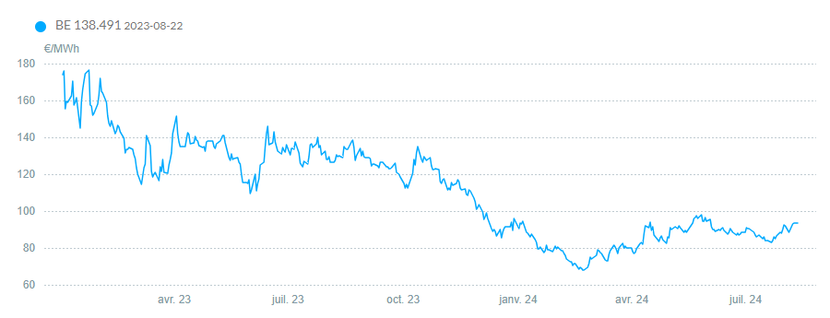
An example of a product in the forward and futures markets
Let us take the Calendar (CAL) product as an example. This is a yearly baseload product which involves the delivery of constant electric power for the entire year, maintaining the same volume for every market period of the year.
Trading for this product starts three years ahead of the delivery year and ends a few days before the first day of the delivery year.
Historic representation of electricity forward price baseload CAL +1 (08/13/24).
CAL + 1 refers to the delivery of electricity for the entire calendar year following the current one.
20

Slide 21
Presentation of the day-ahead market
Also known as the electricity spot market, the day-ahead market is the central platform of trading for matching electricity supply and demand on a daily basis. This market operates once a day, covering all hours of the following day through a blind auction with hourly resolutions. In the future, the day-ahead markets are likely to evolve to a quarter-hourly resolution.
The day-ahead market operates as a pool where all bids and offers are considered simultaneously and kept confidential.
A single market-clearing price is determined for each hour in each market zone (a geographical area where electricity prices are uniformly set based on local supply and demand, as well as factors like supply and demand in neighbouring countries and import/export capacities) by the market-clearing algorithm.
The market operator is EPEX SPOT (originally Belpex).
21

Slide 22
Timeline of the day-ahead market
A
00:00
C
12:00
E
12:50
F
00:00
B
D
Opening of the day-ahead market for all hours of the following day.
Market participants submit their bids and asks to the order book (simple orders, block orders, exclusive orders, curtailable orders, …).
Closing of the day-ahead market for all hours of the following day.
Execution of the market-clearing algorithm.
Notification of the market participants and system operators about the market-clearing outcomes.
Beginning of the delivery of electricity for the entire day.
22

Slide 23
Types of order
Order type | Time period | Execution condition | Key feature
Simple orders | Single period | Fully executed if market clears at specified price | Independent bids for specific periods
Block orders | Multiple consecutive periods | All or nothing for the entire block of periods | Linked execution across multiple hours
Exclusive orders | Multiple block orders | Only one order from a set can be executed | Provides different block order scenarios
Curtailable orders | Single or multiple periods | Partially executed based on market operator's discretion | Allows for flexibility in execution
…
23

Slide 24
The day-ahead market-clearing algorithm (with no congestion)
For each hour of the following day, the clearing algorithm follows these steps:
1) Aggregation of supply: All the asks submitted to the order book are aggregated to form the supply curve, organised from lower to higher costs.
2) Aggregation of demand: All the bids submitted to the order book are aggregated to form the demand curve, organised from higher to lower willingness to pay.
Price
(€/MWh)
Intersection of the supply (blue) and demand (orange) graph before application (BA) of the algorithm.
3) Determination of equilibrium: The equilibrium point, where the quantity of electricity supplied matches the quantity demanded, is identified at the intersection of the supply and demand curves.
4) Dispatch of orders and price setting: All asks and bids to the left of the equilibrium point are dispatched, meaning these orders are fulfilled. The unique price paid for all energy exchanges, known as the market-clearing price, is set at the price at the equilibrium point. This price applies uniformly to all transactions for that hour in the market zone.
24

Slide 25
Managing deviations in the day-ahead market
The problem is that the clearing of the day-ahead market occurs well before the actual supply and consumption operations, between 12 and 36 hours in advance. However, actual generation or consumption may deviate from the originally contracted schedule due to factors like changing weather or technical issues.
Market participants have three options:
Compensate with other generation or consumption assets within their portfolio
Adjust their positions through the intraday market
Do nothing and face exposure to the balancing market
25

Slide 26
Presentation of the intraday market
The intraday market allows participants to make last-minute adjustments and balance their positions closer to real time.
This market supports continuous trading, meaning a trade is executed as soon as two matching orders are found, with different constraints depending on the order types. Hourly, half-hourly, and quarter-hourly contracts are available.
The market operator is EPEX SPOT (originally Belpex).
26

Slide 27
Timeline of the intraday market
A C
12:00 B 12:50
D
15:00
F
Delivery - 5min Delivery
E
Closing of the day-ahead market for all hours of the following day.
Market-clearing algorithm execution.
Notification of the market participants and system operators about the market-clearing outcomes.
Opening of the intraday market for the delivery on the following day.
Continuous trading on the intraday market.
Closing of the intraday market for the delivery period considered.
27

Slide 28
A fictitious example in the intraday market (1/3)
Context: There is a last-minute update in the wind forecast, and the predicted wind power generation in a supplier's portfolio is suddenly reduced by 50 MWh for the market period 10:00-11:00. The wind power generator intends to adjust its position on the intraday market.
Question: What actions could this supplier take to avoid any imbalance?
ID | Side | Quantity (MWh) | Price (€/MWh)
G1 | Ask | 100 | 35
G2 | Ask | 80 | 40
G3 | Ask | 50 | 50
G4 | Ask | 20 | 65
C1 | Bid | 10 | 55
C2 | Bid | 20 | 60
C3 | Bid | 35 | 65
C4 | Bid | 110 | 70
28

Slide 29
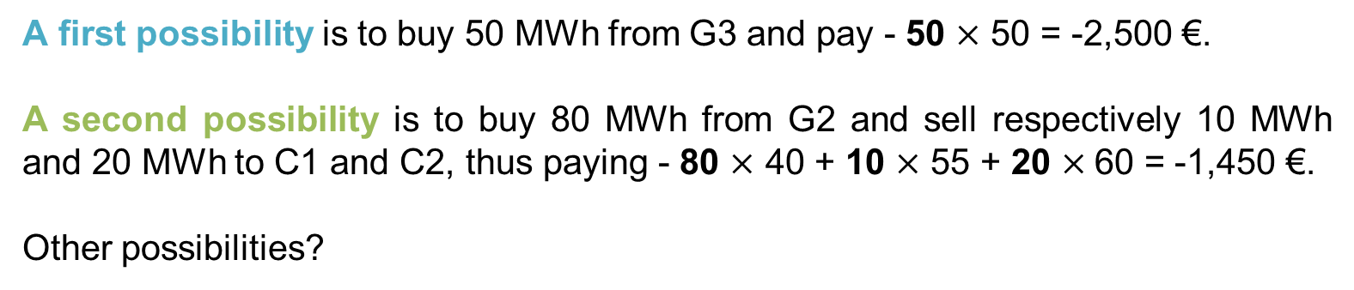
A fictitious example in the intraday market (2/3)
A first possibility is to buy 50 MWh from G3 and pay - 50 $\text{×}$ 50 = -2,500 €.
A second possibility is to buy 80 MWh from G2 and sell respectively 10 MWh and 20 MWh to C1 and C2, thus paying - 80 $\text{×}$ 40 + 10 $\text{×}$ 55 + 20 $\text{×}$60 = -1,450 €.
Other possibilities?
ID | Side | Quantity (MWh) | Price (€/MWh)
G1 | Ask | 100 | 35
G2 | Ask | 80 | 40
G3 | Ask | 50 | 50
G4 | Ask | 20 | 65
C1 | Bid | 10 | 55
C2 | Bid | 20 | 60
C3 | Bid | 35 | 65
C4 | Bid | 110 | 70
29

Slide 30
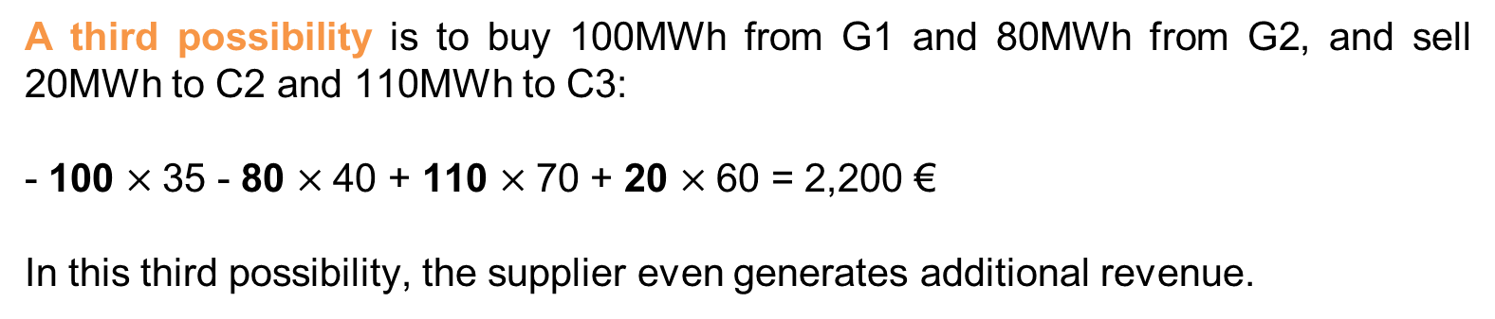
A fictitious example in the intraday market (3/3)
A third possibility is to buy 100MWh from G1 and 80MWh from G2, and sell 20MWh to C2 and 110MWh to C3:
- 100 $\text{×}$35 - 80 $\text{×}$40 + 110 $\text{×}$70 + 20 $\text{×}$60 = 2,200 €
In this third possibility, the supplier even generates additional revenue.
ID | Side | Quantity (MWh) | Price (€/MWh)
G1 | Ask | 100 | 35
G2 | Ask | 80 | 40
G3 | Ask | 50 | 50
G4 | Ask | 20 | 65
C1 | Bid | 10 | 55
C2 | Bid | 20 | 60
C3 | Bid | 35 | 65
C4 | Bid | 110 | 70
30

Slide 31
Imbalance of the power system
There are several reasons why the power system may become imbalanced:
Demand forecasting challenges: Predicting electricity demand is difficult, and actual consumption may differ significantly from the forecast made during day-ahead market clearing.
Supply forecasting challenges: Predicting electricity supply is particularly challenging for renewable energy sources, which depend on weather conditions. Examples include:
  Photovoltaic (PV) power with cloudy weather: The timing and impact of clouds over a PV installation can be difficult to predict.
  Wind power during thunderstorms: It is hard to forecast when wind speeds will reach the cut-off point, causing wind farms to shut down.
  Dust storms: The effect of dust on PV production is challenging to forecast accurately.¹
Technical issues: Technical problems can affect both electricity generation and the transmission and distribution infrastructure.
Transmission congestion: Congestion on major power lines within a zone can occur, sometimes leading to generation curtailment to avoid overloading the system.
¹See, for instance, https://www.sciencedirect.com/science/article/pii/S2213138824000031
31

Slide 32
Presentation of the balancing market
The balancing stage, which occurs close to real time (after delivery), is crucial for enabling the TSO to maintain a balanced power grid (generation ≈ consumption) at any time.
The complete balancing stage includes:
The balancing market, where the TSO acquires regulating power from voluntary producers and consumers before the time of delivery;
Imbalance payments, where market participants cover the costs associated with their contributions to keeping the power system balanced.
The market operator is Elia, in Belgium.
The (negative) flow of money to producers and consumers from the futures, forward, day-ahead, or intraday markets is always based on the volumes committed to in these markets, not the actual volumes delivered.
32

Slide 33
Imbalances on the balancing market
There exist three possible situations for the power grid balance:
1. Positive imbalance:
Generation > Consumption (downward regulation required)
2. Negative imbalance:
Generation < Consumption (upward regulation required)
3. No imbalance:
Generation ≈ Consumption (no regulation required)
The same reasoning is also valid for a producer/consumer considered individually (contracted production/consumption vs actual production/consumption).
Positive imbalance
Negative imbalance
No imbalance
Generation
Generation
Generation
Consumption
Consumption
Consumption
33

Slide 34
Price signals in the balance markets (1/2)
The imbalance market operates with imbalance prices. This pricing incentivises producers and consumers to be as accurate as possible in their scheduling to avoid costly imbalances.
These prices are designed to reflect the costs the TSO incurs to maintain grid stability, such as:
Upward reserves: In cases of a shortfall (generation < consumption), the TSO purchases additional electricity from producers or storage systems capable of quickly increasing production.
Downward reserves: In cases of oversupply (generation > consumption), the TSO either asks producers to reduce production or pays flexible consumers to increase their demand.
34

Slide 35
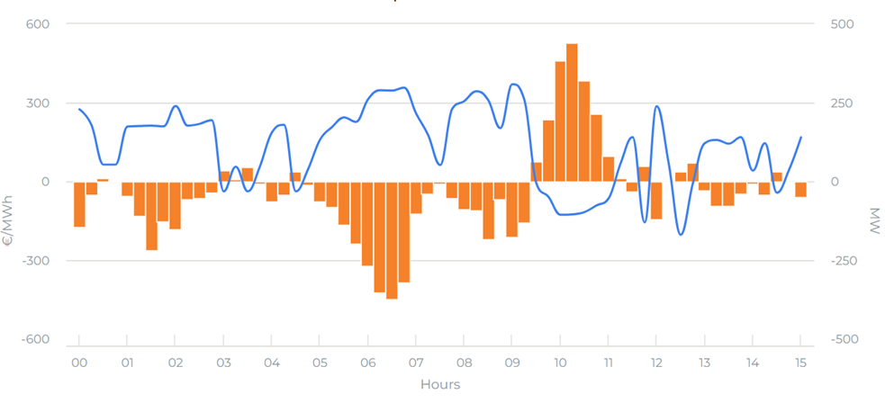

Price signals in the balance markets (2/2)
Imbalance prices on 17/09/2024.
Market participants (producers or major consumers) who deviate from their schedules must pay or receive compensation based on these imbalance prices.
35

Slide 36
Exercise 1:
A wind producer has sold 100 MWh of electricity at a price of 45 €/MWh on the day-ahead market for the period 10:00-11:00. Due to inaccurate wind forecasts at the time of market clearing (day-ahead market), the actual production deviates from the original schedule. The imbalance price for this market period* is set at 50 €/MWh.
1. What is the revenue of this producer if its actual production is 80 MWh?
2. What is the revenue of this producer if its forecast is correct?
3. What is the revenue of this producer if its actual production is 120 MWh?
*On the day-ahead market, a period is 1 hour. In some EU markets, electricity delivery is expected to be balanced over intervals of 15 minutes. This introduces what is called a quarter-hourly (15-minute) granularity in terms of production and consumption obligations.
36

Slide 37
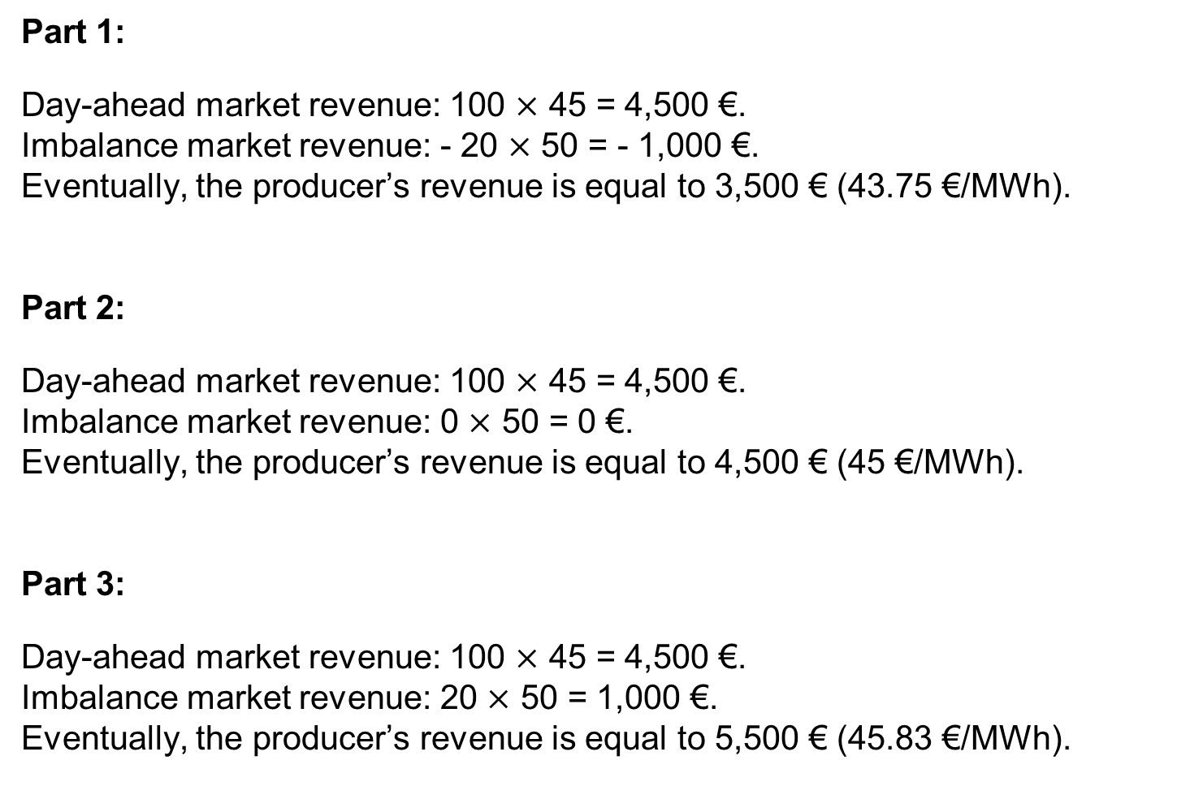
Solution:
Part 1:
Day-ahead market revenue: 100 $\text{×}$ 45 = 4,500 €.
Imbalance market revenue: - 20 $\text{×}$ 50 = - 1,000 €.
Eventually, the producer’s revenue is equal to 3,500 € (43.75 €/MWh).
Part 2:
Day-ahead market revenue: 100 $\text{×}$ 45 = 4,500 €.
Imbalance market revenue: 0 $\text{×}$ 50 = 0 €.
Eventually, the producer’s revenue is equal to 4,500 € (45 €/MWh).
Part 3:
Day-ahead market revenue: 100 $\text{×}$ 45 = 4,500 €.
Imbalance market revenue: 20 $\text{×}$ 50 = 1,000 €.
Eventually, the producer’s revenue is equal to 5,500 € (45.83 €/MWh).
37

Slide 38
The balancing market – Two-price imbalance settlement
In the third part of the previous exercise, the producer's positive imbalance (excess production) partially offsets the negative imbalance of the entire power system, resulting in a revenue surplus. This can encourage speculative behaviour in the imbalance market, which is undesirable as it could lead to significant instabilities in the power system.
To address this, a two-price imbalance settlement is used instead of a one-price imbalance settlement:
Actors contributing to the power system imbalance are penalised based on the imbalance price;
Actors unintentionally offsetting the power system imbalance do not receive additional rewards beyond the day-ahead market clearing price.
Considering a two-price imbalance settlement policy in the third part, the producer’s revenue would be:
Day-ahead market revenue: 100 x 45 = 4,500 €.
Imbalance market revenue: 20 x 45 = 900 €.
Eventually, the producer’s revenue is equal to 5,400 € (45 €/MWh).
38

Slide 39
Presentation of the ancillary services market
The ancillary services market provide essential support services that maintain grid stability, reliability, and efficiency. It operates alongside primary electricity markets like the day-ahead and intraday markets.
The ancillary services market relies on a combination of market-based mechanisms and regulatory requirements. TSOs and DSOs procure ancillary services from market participants, including power plants, demand response providers, and other entities capable of delivering these services.
There are multiple types of ancillary services, including:
Frequency control: Primary, secondary, and tertiary reserves
Voltage control: Primary, secondary, and tertiary controls
System restart: Black start capability
The market operator is also Elia, in Belgium.
39

Slide 40
Ancillary services classification
Ancillary services classification related to system operation
Frequency control
Voltage control
System restart
Automatic Generation Control (AGC)
Primary regulation
Secondary regulation
High-frequency response
Spinning reserve
Non-spinning reserve
Emergency control actions
Primary control
Secondary control
Tertiary control
40

Slide 41
PART III:
Incentives in Belgium (Wallonia) for renewable energy development

Slide 42
Incentives in Belgium: The reverse spinning meter
Electric meters measure the amount of electricity consumed in kWh and display a total that increases as you use more electricity.
When they produce more electricity than they consume, homeowners with PV systems could observe on their old unidirectional meters that it recorded the surplus energy sent to the grid as “negative consumption”. In other words, when the PV system generated more electricity than was consumed, the meter's total decreased instead of increasing, creating the appearance of it “turning backward”.
This phenomenon, which has been resolved with the introduction of bidirectional meters, is still referred to as a “reverse spinning meter” when discussing excess electricity produced by PV systems that is not immediately used and thus fed into the grid. This allowed homeowners to receive a deduction for the electricity taken from the grid similar to how a virtual battery operates.
As of January 1, 2024, the concept of the “reverse spinning meter” has been discontinued in Wallonia for new PV systems.
42

Slide 43
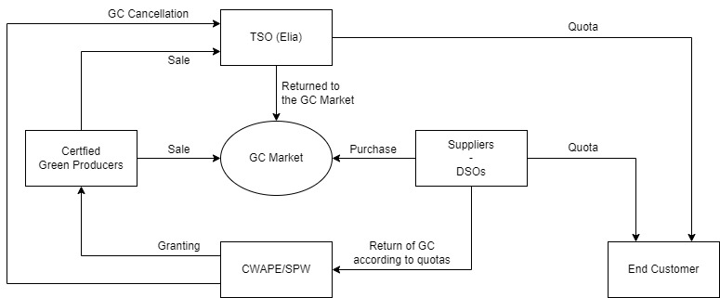
Incentives in Belgium: The Green Certificate mechanism (1/3)
How did the GC mechanism initially worked in Wallonia? (2003 – 2014)
Energy producers using renewable sources or cogeneration (solar, biogas, biomass, wind, hydro) with installations over 10 kW received one GC for every 1 MWh produced, representing an estimated 456 kg of CO₂ avoided. Initially, the GC system was managed by CWaPE.
Since they were required to submit a quarterly quota of GCs based on their electricity sales, suppliers purchased them at a guaranteed minimum price of 65 €. The quota started at 3% in 2003, increasing by 1% yearly to reach 12% in 2012. Non-compliance resulted in a 100 € penalty per missing GC.
The Green Certificate mechanism.
43

Slide 44
Incentives in Belgium: The Green Certificate mechanism (2/3)
How does the GC mechanism work today in Wallonia?
Now overseen by the Walloon Public Service (SPW), the Green Certificate system has evolved to ensure a fair return on investment for renewable energy projects.
The mechanism remains active for green electricity production sites under the following conditions:
For photovoltaic systems with a capacity exceeding 10 kW: all new production units with a compliance inspection (RGIE* date) carried out after 1 January 2015.
For other renewable energy sectors (biogas, solid and liquid biomass, fossil cogeneration, wind, and hydroelectricity): all new production units except those with a final permit (free of appeals) before 1 July 2014 or those with a compliance inspection (RGIE date) carried out before 1 July 2014.
*It stands for Règlement Général sur les Installations Électriques. This is the General Regulation for Electrical Installations in Belgium.
44

Slide 45
Incentives in Belgium: The Green Certificate mechanism (3/3)
The number of GCs awarded to production units is calculated as follows:
  GC = t_{GC} × E_{np}
  t_{GC} = min (cap, k_{CO2} × k_{ECO})
Where:
E_{np}​ = Net electricity produced (MWh), limited to the first 20 MW tranche for biomass, cogeneration, and hydropower sources;
cap = A maximum limit of 2.5 GC/MWh;
k_{CO2} = CO₂ savings rate, capped at 2 for installations under 5 MW and at 1 for installations over 5 MW (unless otherwise allowed by decree), applied each year based on the actual performance of the installation;
k_{ECO}​ = Economic coefficient applied annually for a given energy source throughout the issuance period.
45

Slide 46
Economic Bubble of Green Certificates in Belgium
In 2007, the Minister of Energy, André Antoine, decided to multiply the number of GCs granted to the photovoltaic sector by seven since it was struggling to take off. Additionally, a cash bonus of 3,500 € for each new installation, the ability for the meter to run backwards, and a federal tax deduction were introduced. As a result, PV panels began to adorn roofs all over Wallonia.
In 2009, Jean-Marc Nollet took over the responsibility. He abolished the cash bonus because the price of panels had significantly decreased, making the bonus costly for the Walloon budget. The regulator (CWAPE) pointed out that the support remained too substantial. However, it took a year for the decision on a gradual reduction of support to be implemented, starting from December 1, 2011. This decision triggered an economic bubble. The reform of the GC system was announced three months before its implementation. Households that could afford it understood they needed to hurry to invest. As a result, in just one month (November 2011), 29,000 installations were ordered. Some would achieve an extraordinary return of 30% per year, funded by all consumers.
This Green Certificate bubble caused a financial abyss that still has repercussions today; it is estimated that more than a billion euros still need to be absorbed. However, it did result in a boom in photovoltaic installations among individuals.
46

Slide 47
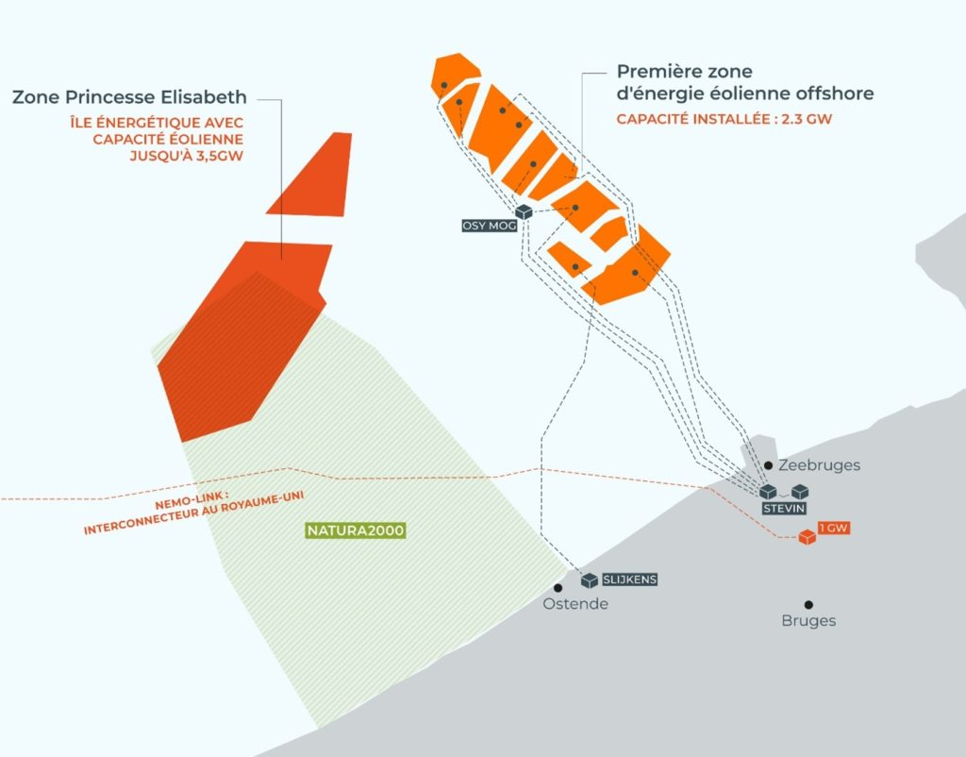
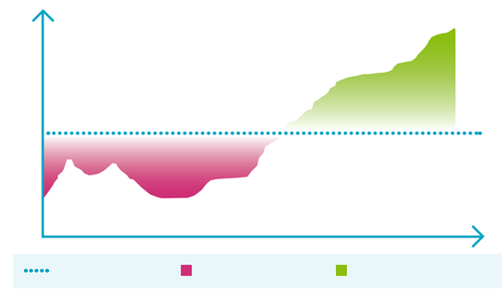
Incentives in Belgium: the contract for difference
Since 2018, the introduction of a competitive bidding process for the Princess Elisabeth zone has been in preparation, with the Contract for Difference (CfD) considered as a new support mechanism for offshore wind.
In a CfD, a fixed price is agreed with the wind farm for the purchase of the electricity produced during the contract period. If the market price is lower, the government pays the difference (acting as a subsidy). What happens when the market price is higher depends on the contract terms.
In June 2021, CREG published a study recommending a two-sided CfD. In this model, the wind farm is subsidised when electricity prices are below the fixed price (strike price) but must pay back when electricity prices exceed this fixed price.
Market price
Time
Fixed price (strike price)
Premium for the developer
Return for the community
Princess Elisabeth zone.
Two-sided contract for difference.
47

Slide 48
PART IV:
Understanding a residential electricity bill and the impact of self-production

Slide 49
The electricity bill of a Belgian consumer
The surge in PV installations, particularly among private individuals, has transformed them into “prosumers”, who both produce and consume electricity. Before exploring the impact of individual renewable energy production on their electricity bills, let us first examine what it involves.
The electricity bill for an individual comprises four components:
1. Cost of energy: The cost of the electricity actually consumed, determined by the tariff of the chosen supplier. This cost varies according to contracts, applied tariffs (fixed or variable), and level of consumption.
2. Renewable energy (RE) contribution: The costs of policies designed to encourage the development of renewable energy, such as feed-in tariffs.
3. Grid fees: Transmission costs billed by the TSO for the transport of high-voltage electricity and distribution costs billed by the DSO for the distribution of electricity to the individual’s home.
4. Taxes and levies: Levies, contributions, federal and regional taxes.
49

Slide 50
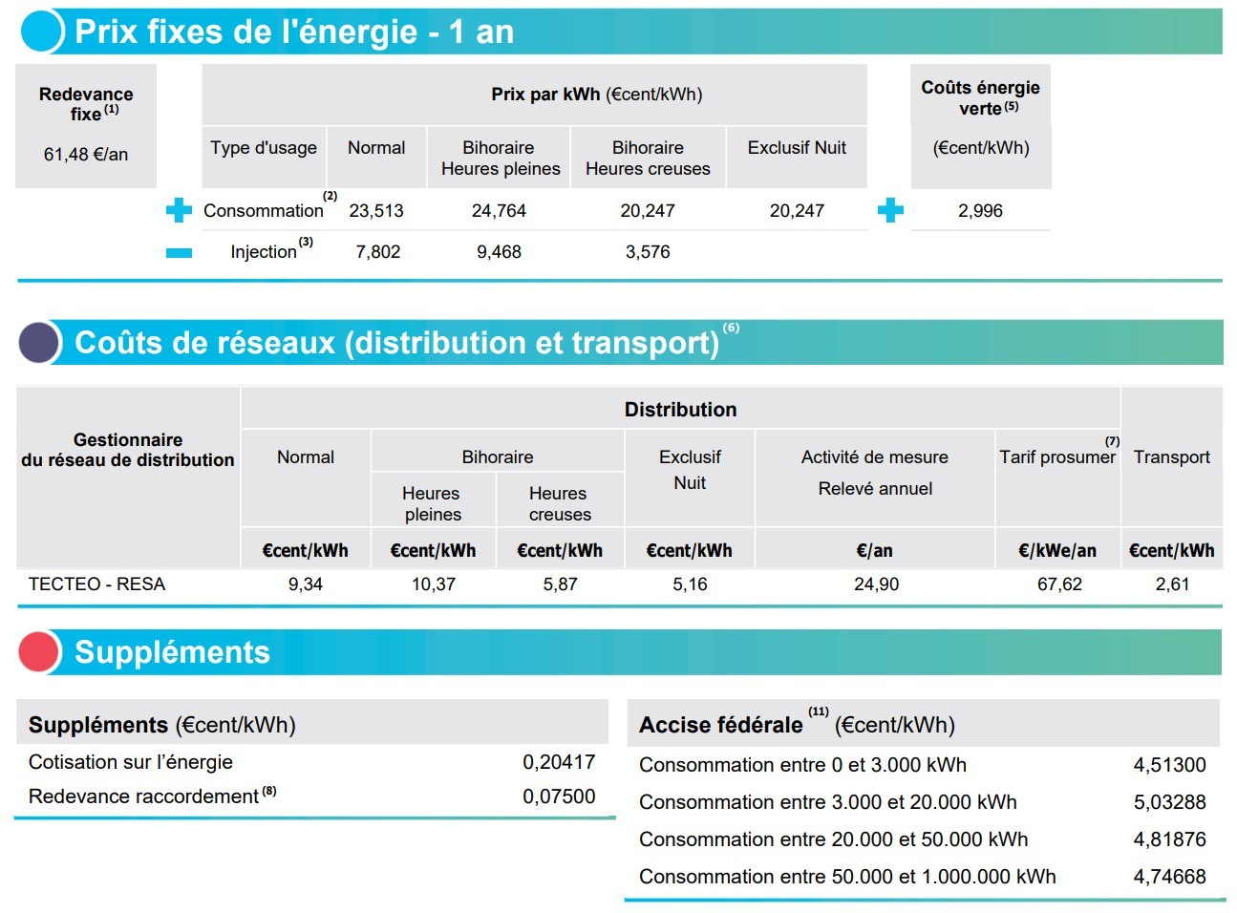
Composition of an electricity tariff sheet
Data for May 2023 for a residential customer located in the Walloon Region, Belgium, and connected to the RESA network.
The peak/off-peak hours billing system charges different rates for electricity based on the time of day. Full hours, during high demand periods, have higher rates, while off-peak hours, during low demand periods, have reduced rates.
50

Slide 51
Example of an electricity bill
Let us consider Mr. Dupont, a private individual with an annual consumption of 4,000 kWh. He does not own any photovoltaic (PV) panels. In May 2023, his total consumption was 1/12th of his annual consumption, with 68% of it occurring during peak hours and the remaining 32% during off-peak hours. Below is a breakdown of his bill for May 2023, based on the figures from the previous tariff sheet:
Billing Data | Nature | Number of units (kWh) | Unit price (€c/kWh) | Amounts (EUR) | VAT
Peak hour consumption | Cost of energy | 213.66 | 24.764 | 52.91 | 21%
Off-peak hour consumption | Cost of energy | 100.54 | 20.247 | 20.36 | 21%
RE contribution | RE contribution | 314.2 | 2.996 | 9.41 | 21%
Peak hour distribution | Grid fees | 213.656 | 10.37 | 22.16 | 21%
Off-peak hour distribution | Grid fees | 100.544 | 5.87 | 5.90 | 21%
Transmission costs | Grid fees | 314.2 | 2.61 | 8.20 | 21%
Special excise duty | Taxes and levies | 314.20 | 5.033 | 15.81 | 21%
Network access rights | Taxes and levies | 314.20 | 0.279* | 0.88 | Exemption under Art.28, 5° of the VAT Code
Total invoice amount | - | - | - | 135.63 | -
51
*Cotisation sur l’énergie + Redevance raccordement.

Slide 52
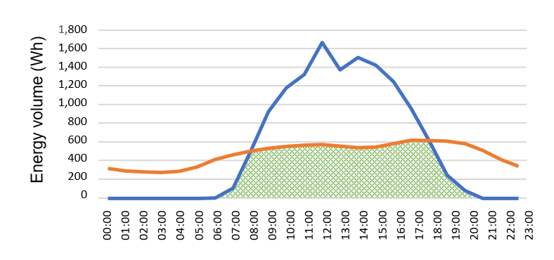
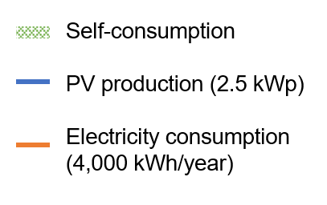
PV production allows self-consumption
As soon as Mr. Dupont becomes the owner of a PV system, he becomes a prosumer. He can cover all or part of his electricity needs with the electricity he produces himself.
This self-consumed electricity does not flow into the grid; it is entirely free behind the meter!
Electricity consumption and production of an individual over a sunny day (May 2023).
52

Slide 53
Feeding electricity back into the grid
When PV production is less than consumption, Mr. Dupont buys additional electricity required from a retailer, paying for the energy, grid fees, and taxes.
When production exceeds consumption, Mr. Dupont sells the surplus on the wholesale market. Typically, for procumers energy is bought at about five-times the price at which it is sold.*
43.44 €c/kWh
Purchase and sale from a retailer during a peak hour (including VAT).
*The backward spinning meter case is not considered in the calculation.
53

Slide 54
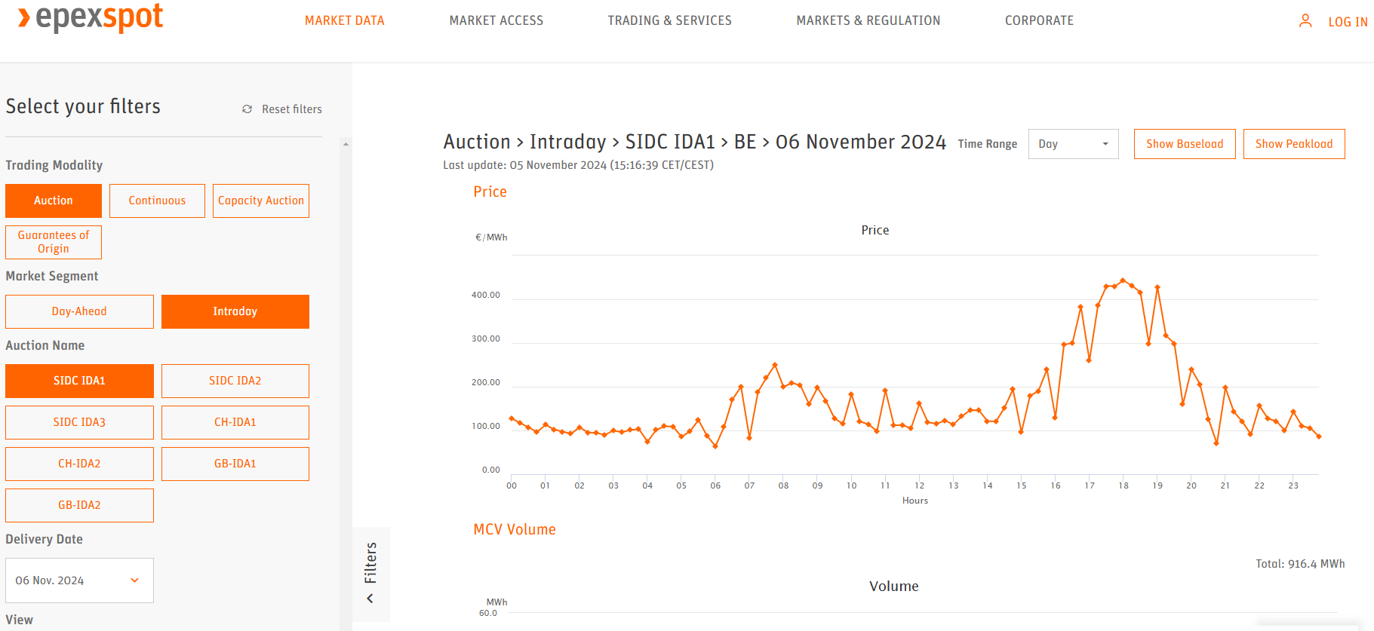
Selling back to the grid is not very profitable
The injection price is low because PV systems produce most electricity during the daytime when there is often an oversupply, driving market prices down. Suppliers also need to maintain profit margins, further reducing the amount paid for injected electricity.
However, selling may be more profitable during periods of high energy demand, when prices are higher, and when electricity is not needed on-site.
54

Slide 55
The problem with existing contracts
Retailers act as intermediaries between the electricity markets and end consumers.
Most retail electricity contracts fall into two categories: fixed-price* or variable-price contracts. In the case of variable-price contracts, the price per kWh is typically updated monthly based on a weighted average of spot market prices.
Only a few retail contracts use dynamic pricing, where the cost of electricity is calculated by multiplying the amount of energy consumed during each market period by the spot price for that period.
Currently, by offering similar (“unsophisticated”) contracts, retailers mainly compete on price alone. This situation often leads to market consolidation, which reduces competition, limits choice in electricity contracts, and can result in high prices.
Retailers are interested in contracts that enable them to participate more actively in the energy markets.
*Even fixed-price contracts are fixed only for a limited time period.
55

Slide 56
PART V:
Analysis of peer-to-peer electricity exchange through a retailer’s platform

Slide 57
The solution provided by digital platforms
Digital retailer platforms enable prosumers to access a variety of electricity supply products and customise them according to their preferences. For example, when a prosumer generates electricity through solar panels, they may not be able to immediately use all the energy for self-consumption. The excess energy is then fed back into the grid.
Instead of selling this surplus electricity to their retailer at a low fixed price determined when signing the contract, the prosumer can sell it through their retailer on the spot market, potentially making a larger profit. Alternatively, they can share it with another consumer through a peer-to-peer (P2P) energy-sharing arrangement. P2P energy-sharing does not require the two parties to be in close proximity; however they must be customers of the same retailer and be connected to the same network.
A P2P product allows consumers to hedge against rising energy prices, actively participate in the energy transition, and ensure the origin of their electricity.
57

Slide 58
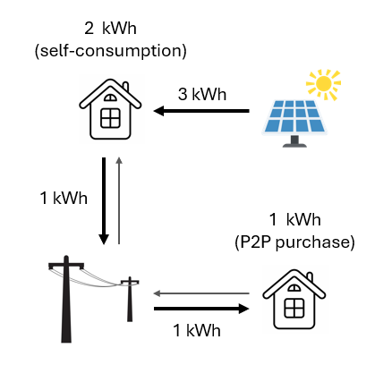
An example of a P2P energy sharing
Mr. Mars and Mrs. Venus are customers of the same retailer, each with a fixed-price electricity contract. On a sunny day, solar panels of Mr. Mars generate 3 kWh of electricity over an hour. His household uses only 2 kWh, so he must feed the remaining 1 kWh into the grid.
Meanwhile, Mrs. Venus wants to use her washing machine, which consumes 1 kWh. Through the retailer’s sharing platform, they arrange for Mrs. Venus to use the 1 kWh of surplus electricity from Mr. Mars at a reduced price.
58

Slide 59
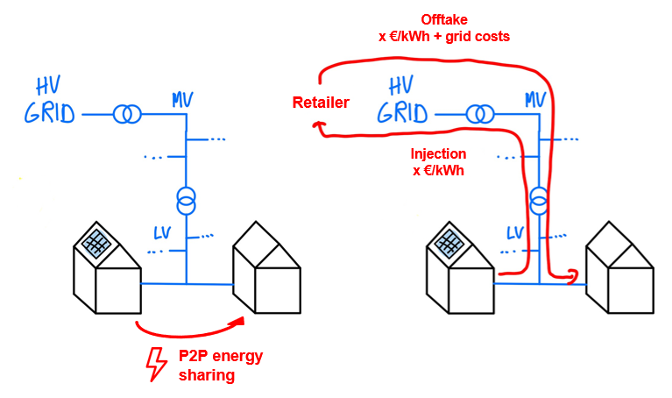
Illustration of a P2P energy share
It is important to note that the shared electricity is not physically delivered directly from the prosumer to the consumer. Instead, the electricity purchased through a P2P energy sharing arrangement comes from the public grid, with applicable fees applied.
The “cost of energy” applied to the volume of electricity, however, is based on a sharing agreement established between the parties involved.
59

Slide 60
PART VI:
Analysis of the framework of energy communities and their different models

Slide 61
Energy sharing in energy communities
The P2P energy-sharing model is based on a platform that is specific to a single retailer. It is also possible to utilise the legal framework for energy communities. Members of an energy community can trade energy among themselves while maintaining their contracts with their respective electricity retailers.
Within this community, members can exchange electricity during each market period, based on their consumption and their production. These exchanges are reflected in adjusted meter readings for each participant, showing the amount of energy traded between members.
These adjusted meter readings are then sent to the retailers. This leads to changes in the electricity bill sent by the retailer to each member, as the electricity exchanges within the community are taken into account in the final invoicing.
We will take a closer look at the different models of energy communities, with a specific focus on the Renewable Energy Community (REC).
61

Slide 62
The roles of the members of an energy community
An energy community is composed of the following members:
The producer: This is the owner of the production unit that generates the energy shared with the other members. It could be an individual who owns a PV system on their roof or someone who invests in a wind turbine.
The consumer: This is the end user who consumes the energy produced as part of the sharing arrangement. A participant in the energy community can be both a producer and a consumer (prosumer).
The energy-sharing representative: This is the intermediary between the DSO and the participants in the sharing arrangement. They handle all administrative aspects (setup, billing, etc.) and can also be a producer or consumer within the energy sharing system. The energy-sharing representative also transmit the repartition keys to the DSO.
The DSO (Distribution System Operator): This is the entity responsible for collecting consumption data from the grid, which is then transmitted to the supplier and the energy-sharing representative for billing purposes.
62

Slide 63
Respective characteristics of RECs and CECs
A Renewable Energy Community (REC) is a group of actors (individuals, businesses, local authorities) whose main commercial or professional activity is not participating in one or more energy communities.
They come together to develop, produce, consume, and sell renewable energy. They own production installations such as solar panels, wind turbines, or biomass systems located nearby, which they manage to achieve their goal of harnessing renewable energy for economic and environmental benefits.
These production installations can be placed on buildings or freely within the local perimeter. Participation is limited by geographical and/or technical criteria within a proximity area.
In the case of a Citizen Energy Community (CEC), there are no restrictions on potential participants. Additionally, energy production from non-renewable sources is permitted, but it is restricted to the electricity sector. The community's scope is also not limited and can be broader compared to the sharing within an REC.
63

Slide 64
Common characteristics of RECs and CECs (1/2)
The community must have a legal personality distinct from its participants. It can own assets, enter contracts, and participate in the electricity market on its own behalf, rather than as an extension of its participants.
The community is based on free and voluntary participation and is autonomous. The community must operate independently, with decision-making power vested within the community itself, without undue influence from external entities.
The community can engage in the following activities in the electricity market:
Electricity production
Electricity supply
Self-consumption of electricity produced on its own premises
Sharing among its participants
Aggregation practices
Participation in flexibility services
Electricity storage
Providing charging solutions for electric vehicles
Provision of energy efficiency or other energy-related services
Sale of electricity
64

Slide 65
Common characteristics of RECs and CECs (2/2)
The community must specify in its statutes the environmental, social, or economic objectives it pursues. The main goals may focus on sustainability, social equity, economic benefits, or energy access.
The statutes must establish clear rules to ensure the community is controlled effectively by its members and operates independently. This includes mechanisms to prevent external influence from overriding the community's objectives, preserving its autonomy and integrity.
The community must formally notify the CWaPE about its formation. Additionally, it must receive approval for its electricity-sharing activities, ensuring compliance with regulations and a secure framework for the exchange of electricity.
Details and distinctions between RECs and CECs can be discerned in the legal texts.
65

Slide 66
Renewable Energy Community (REC) in legislation
Article 22 of Directive 2018/2001:
1. Member States shall ensure that final customers, in particular household customers, are entitled to participate in a renewable energy community while maintaining their rights or obligations as final customers, and without being subject to unjustified or discriminatory conditions or procedures that would prevent their participation in a renewable energy community, provided that for private undertakings, their participation does not constitute their primary commercial or professional activity.
2. Member States shall ensure that renewable energy communities are entitled to:
(a) produce, consume, store and sell renewable energy, including through renewables power purchase agreements;
(b) share, within the renewable energy community, renewable energy that is produced by the production units owned by that renewable energy community, subject to the other requirements laid down in this Article and to maintaining the rights and obligations of the renewable energy community members as customers;
(c) access all suitable energy markets both directly or through aggregation in a non- discriminatory manner.
3. Member States shall carry out an assessment of the existing barriers and potential for the development of renewable energy communities in their territories.
4. Member States shall provide an enabling framework to promote and facilitate the development of renewable energy communities. That framework shall ensure, inter alia, that:
(a) unjustified regulatory and administrative barriers to renewable energy communities are removed;
(b) renewable energy communities that supply energy or provide aggregation or other commercial energy services are subject to the provisions relevant for such activities; 21.12.2018 EN Official Journal of the European Union L 328/121
(c) the relevant distribution system operator cooperates with renewable energy communities to facilitate energy transfers within renewable energy communities;
66

Slide 67
(d) renewable energy communities are subject to fair, proportionate and transparent procedures, including registration and licensing procedures, and cost-reflective network charges, as well as relevant charges, levies and taxes, ensuring that they contribute, in an adequate, fair and balanced way, to the overall cost sharing of the system in line with a transparent cost-benefit analysis of distributed energy sources developed by the national competent authorities;
(e) renewable energy communities are not subject to discriminatory treatment with regard to their activities, rights and obligations as final customers, producers, suppliers, distribution system operators, or as other market participants;
(f) the participation in the renewable energy communities is accessible to all consumers, including those in low-income or vulnerable households;
(g) tools to facilitate access to finance and information are available;
(h) regulatory and capacity-building support is provided to public authorities in enabling and setting up renewable energy communities, and in helping authorities to participate directly;
(i) rules to secure the equal and non-discriminatory treatment of consumers that participate in the renewable energy community are in place.
5. The main elements of the enabling framework referred to in Paragraph 4, and of its implementation, shall be part of the updates of the Member States' integrated national energy and climate plans and progress reports pursuant to Regulation (EU) 2018/1999.
6. Member States may provide for renewable energy communities to be open to cross-border participation.
7. Without prejudice to Articles 107 and 108 TFEU, Member States shall take into account specificities of renewable energy communities when designing support schemes in order to allow them to compete for support on an equal footing with other market participants.
67

Slide 68
Citizen Energy Community (CEC) in legislation
Article 16 of Directive 2019/944:
1. Member States shall provide an enabling regulatory framework for citizen energy communities ensuring that:
(a) participation in a citizen energy community is open and voluntary;
(b) members or shareholders of a citizen energy community are entitled to leave the community, in which case Article 12 applies;
(c) members or shareholders of a citizen energy community do not lose their rights and obligations as household customers or active customers;
(d) subject to fair compensation as assessed by the regulatory authority, relevant distribution system operators cooperate with citizen energy communities to facilitate electricity transfers within citizen energy communities;
(e) citizen energy communities are subject to non-discriminatory, fair, proportionate and transparent procedures and charges, including with respect to registration and licensing, and to transparent, non-discriminatory and cost-reflective network charges in accordance with Article 18 of Regulation (EU) 2019/943, ensuring that they contribute in an adequate and balanced way to the overall cost sharing of the system. 14.6.2019 EN Official Journal of the European Union L 158/151
2. Member States may provide in the enabling regulatory framework that citizen energy communities: (a) are open to cross-border participation;
(b) are entitled to own, establish, purchase or lease distribution networks and to autonomously manage them subject to conditions set out in paragraph 4 of this Article;
(c) are subject to the exemptions provided for in Article 38(2).
3. Member States shall ensure that citizen energy communities:
(a) are able to access all electricity markets, either directly or through aggregation, in a non- discriminatory manner;
68

Slide 69
(b) are treated in a non-discriminatory and proportionate manner with regard to their activities, rights and obligations as final customers, producers, suppliers, distribution system operators or market participants engaged in aggregation;
(c) are financially responsible for the imbalances they cause in the electricity system; to that extent they shall be balance responsible parties or shall delegate their balancing responsibility in accordance with Article 5 of Regulation (EU) 2019/943;
(d) with regard to consumption of self-generated electricity, citizen energy communities are treated like active customers in accordance with Point (e) of Article 15(2);
(e) are entitled to arrange within the citizen energy community the sharing of electricity that is produced by the production units owned by the community, subject to other requirements laid down in this Article and subject to the community members retaining their rights and obligations as final customers. For the purposes of Point (e) of the first subparagraph, where electricity is shared, this shall be without prejudice to applicable network charges, tariffs and levies, in accordance with a transparent cost-benefit analysis of distributed energy resources developed by the competent national authority.
4. Member States may decide to grant citizen energy communities the right to manage distribution networks in their area of operation and establish the relevant procedures, without prejudice to Chapter IV or to other rules and regulations applying to distribution system operators. If such a right is granted, Member States shall ensure that citizen energy communities:
(a) are entitled to conclude an agreement on the operation of their network with the relevant distribution system operator or transmission system operator to which their network is connected;
(b) are subject to appropriate network charges at the connection points between their network and the distribution network outside the citizen energy community and that such network charges account separately for the electricity fed into the distribution network and the electricity consumed from the distribution network outside the citizen energy community in accordance with Article 59(7);
(c) do not discriminate or harm customers who remain connected to the distribution system.
69

Slide 70
Community-based energy-sharing between prosumers not living in the same building: the case of Brussels
The surplus electricity that is not used by the prosumer can be sold at a higher rate than the market purchase price, but the goal is to create a "win-win" situation for both the producer and the consumer involved in the transaction.
The “cost of energy” component is negotiated to ensure it is attractive to the buyer and beneficial to the seller. However, grid fees will still apply. The distribution costs, on the other hand, may become more favourable depending on the participants' locations within the electrical grid.
Participants are supplied by:
Type A: electricity produced in the building where they reside; Type B: the same low-voltage transformer station; Type C: the same Elia substation; Type D: different Elia substations.
Energy Sharing | Type A | Type B | Type C | Type D
100% | 66.40 € | 100.14 € | 125.95 € | 136.96 €
50% | 101.69 € | 118.56 € | 131.46 € | 136.97 €
35% | 112.25 € | 124.06 € | 133.09 € | 136.97 €
Standard distribution tariff | 126.81 €
Simulation of the distribution tariff in the Sibelga network (Brussels, Belgium) for a consumption of 1,000 kWh for the 2023 tariff year for a customer with a capacity of less than 56 kVA. Type A is the most advantageous.
70

Slide 71


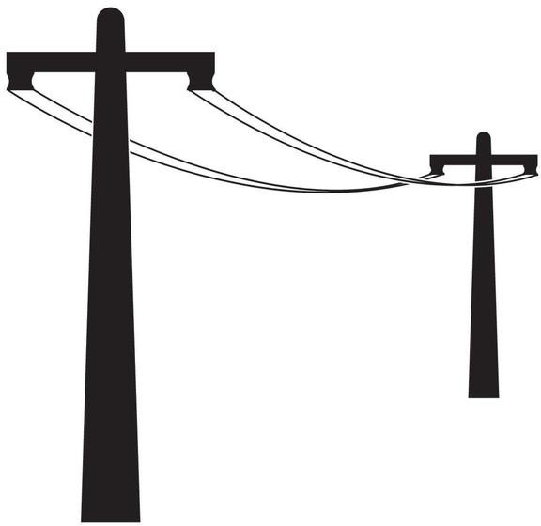
Community-based energy sharing in a condominium
A condominium is a type of property where multiple individuals (owners) hold separate units within a single building. Owners may choose to live in their units themselves (owner-occupants) or rent them out to tenants. All unit owners collectively form the condominium association, which is responsible for managing the shared spaces and resources of the building, including any PV system on the roof.
Usually, the PV installation is owned by this association and is connected behind the association’s main meter, which measures the consumption of common areas within the building. This setup allows the energy generated to offset energy needs in common areas of the building, reducing overall energy costs for shared spaces.
Condominium
However, a challenge with PV systems in condominiums is that they are typically connected behind this single main meter. Community-based energy sharing solutions help address this issue by allowing for separate accounting and billing of energy consumed from the grid versus energy consumed from the PV system, ensuring fair distribution of energy savings among the owners.
71

Slide 72
Energy sharing within a condominium in legislation
Article 21.4 of Directive 2018/2001:
“Member States shall ensure that renewables self-consumers located in the same building, including multi-apartment blocks, are entitled to:
(a) to generate renewable energy, including for their own consumption, store and sell their excess production of renewable electricity, including through renewables power purchase agreements, electricity suppliers and peer-to-peer trading arrangements, without being subject: (i) in relation to the electricity that they consume from or feed into the grid, to discriminatory or disproportionate procedures and charges, and to network charges that are not cost-reflective;
(ii) in relation to their self-generated electricity from renewable sources remaining within their premises, to discriminatory or disproportionate procedures, and to any charges or fees;
(b) to install and operate electricity storage systems combined with installations generating renewable electricity for self-consumption without liability for any double charge, including network charges, for stored electricity remaining within their premises;
(c) to maintain their rights and obligations as final consumers;
(d) to receive remuneration, including, where applicable, through support schemes, for the self-generated renewable electricity that they feed into the grid, which reflects the market value of that electricity and which may take into account its long-term value to the grid, the environment and society;
They are permitted to arrange sharing of renewable energy that is produced on their site or sites between themselves, without prejudice to the network charges and other relevant charges, fees, levies and taxes applicable to each renewables self-consumer. Member States may differentiate between individual renewables self-consumers and jointly acting renewables self-consumers. Any such differentiation shall be proportionate and duly justified.”
72

Slide 73

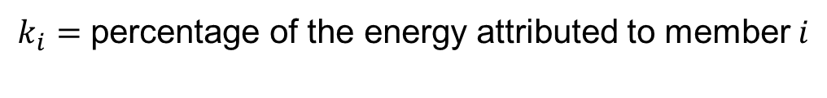

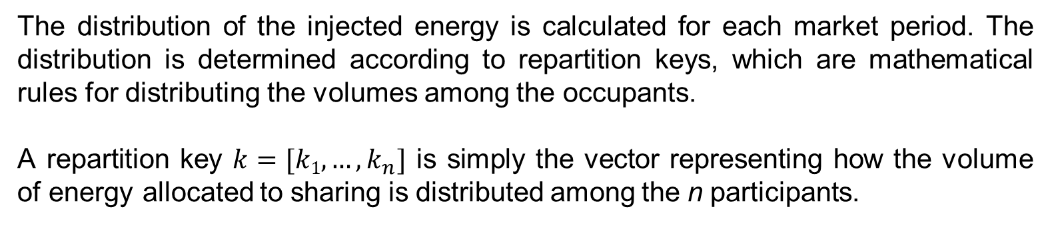

The repartition key for energy sharing in an energy community
The distribution of the injected energy is calculated for each market period. The distribution is determined according to repartition keys, which are mathematical rules for distributing the volumes among the occupants.
A repartition key $k=[k1, …,k_{n}]$ is simply the vector representing how the volume of energy allocated to sharing is distributed among the n participants.
$k_{i}=$ percentage of the energy attributed to member $i$
$$\sum_{i}{k_{i}}=1$$
$$k_{i}≥0$$
$k_{i}$values may vary over time.
73

Slide 74
Types of repartition keys
In Wallonia, the repartition keys must be sent to the DSO, such as ORES or RESA. These keys provide the necessary data for the DSO to adjust the energy allocation across different users or areas accurately. Using these repartition keys, the DSO modifies the raw meter readings, adjusting them to reflect the redistributed energy volumes. These corrected meter readings are then sent to the market, where they serve as the basis for billing and are subsequently forwarded to retailers. This process ensures that all involved parties receive accurate billing data that reflects the adjusted energy distribution.
The key must be approved by the CWaPE. Three standard repartition keys are always accepted:
1. The equal static repartition key
2. The specific static repartition key
3. The dynamic repartition key proportional to consumption
The choice of keys is important to accurately reflect the intent of the energy community: it is fundamentally about determining to what extent each occupant has the right to consume the energy produced by the PV installation.
74

Slide 75
Equal static repartition key
 | Before sharing | Sharing | After sharing
 | Consumptions | Allocated volumes | Shared volumes consumed | Allocated consumptions | Surplus
Shared volume | - | 1,000 | - | - | -
Participant 1 | 160 | 250 – 25% | 160 | 0 | 90
Participant 2 | 300 | 250 – 25% | 250 | 50 | 0
Participant 3 | 350 | 250 – 25% | 250 | 100 | 0
Participant 4 | 120 | 250 – 25% | 120 | 0 | 130
Total | 930 | 1,000 | 780 | 150 | 220
Energy actually shared: 78% Self-consumption: 84%
Energy volumes are shared in a fixed and equal manner among participants up to cover their entire consumption. Any remaining energy is retained by the energy community.
It will be easy to add or remove a participant from the energy-sharing arrangement, with distribution percentages automatically adjusted.
75

Slide 76
Specific static repartition key
 | Before sharing | Sharing | After sharing
 | Consumptions | Allocated volumes | Shared volumes consumed | Allocated consumptions | Surplus
Shared volume | - | 1,000 | - | - | -
Participant 1 | 160 | 400 – 40% | 160 | 0 | 240
Participant 2 | 300 | 200 – 20% | 200 | 100 | 0
Participant 3 | 350 | 200 – 20% | 200 | 150 | 0
Participant 4 | 120 | 200 – 20% | 120 | 0 | 80
Total | 930 | 1,000 | 680 | 250 | 220
(Source: CWaPE)
Energy actually shared: 68% Self-consumption: 73%
The difference with an equal static key is that energy volumes are allocated among participants based on predefined percentages outlined in an agreement. These percentages can, for example, reflect the individual investment share in the production units.
This key allows for setting priorities in the distribution of energy volumes.
However, with a static key (whether equal or specific), it is possible to end up with a surplus even if the total consumption of the building is sufficient to cover the production.
76

Slide 77
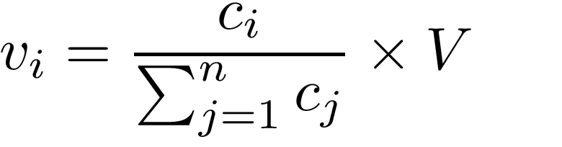
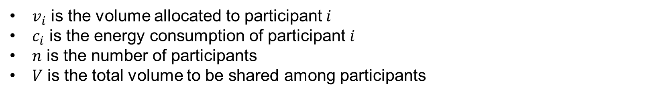
Dynamic repartition key proportional to consumption
 | Before sharing | Sharing | After sharing
 | Consumptions | Allocated volumes | Shared volumes consumed | Allocated consumptions | Surplus
Shared volume | - | 1,000 | - | - | -
Participant 1 | 160 | 172 – 17.2% | 160 | 0 | 12
Participant 2 | 300 | 323 – 32.3% | 300 | 0 | 23
Participant 3 | 350 | 376 – 37.6% | 350 | 0 | 26
Participant 4 | 120 | 129 – 12.9% | 120 | 0 | 9
Total | 930 | 1,000 | 930 | 0 | 70
Energy actually shared: 93% Self-consumption: 100%
Energy volumes are dynamically allocated among participants based on their energy consumption, as much as possible according to demand:
$v_{i}$ is the volume allocated to participant $i$
$c_{i}$ is the energy consumption of participant $i$
$n$ is the number of participants
$V$ is the total volume to be shared among participants
77

Slide 78
Fairness aspect for the choice of the repartition key
The choice of the repartition key is crucial for the energy community and must be thoroughly discussed in advance.
The fairness of the dynamic key can be questioned. While the distribution may be optimal from an external perspective (e.g., environmental and community benefits), it might not seem fair from an internal perspective. For example, one might ask: “Why does my neighbour, who consumes more electricity and who is less attentive, end up saving more?”
The CWaPE specifies that up to three repartition keys can be used simultaneously, but no more. The first key is applied, followed by a second key for the remaining unallocated energy, and finally, a third key if needed. For example, one might first use a fixed repartition key and then apply a dynamic key to allocate the remaining unused energy.
Another important factor is the pricing of the shared energy.
78

Slide 79
Pricing aspect for the choice of the repartition key
Let us go back to the energy-sharing model within a condominium. The excess electricity produced by the PV system on the building's roof, which is not consumed by the owners, is sold to the tenants who participate in the energy community. The revenue from selling the excess electricity goes to the owners.
The main factors for setting the price of the shared electricity are:
the price of energy on the external market
the investment made and the desired profitability
For energy-sharing to be effective, it is essential that both parties (owners and tenants) benefit.
If the price is set too low, tenants will make greater savings, but this may discourage the owners, possibly putting the project at risk.
On the other hand, if the price is too high, the owners will increase their revenue from energy sales, but this may discourage tenants, leading to reduced energy consumption.
This creates a kind of balance between the interests of owners and tenants.
79

Slide 80
Charges on shared energy in an energy community
Renewable energy contributions and taxes are applied uniformly to both shared and retailer-supplied energy, meaning that shared energy does not reduce these costs, except in the case of energy-sharing within a condominium, where specific grid fee reductions apply.
According to the tariff methodology for DSOs in the Walloon Region, applicable for the 2025-2029 regulatory period and adopted by CWaPE on May 31, 2023, grid fees are reduced by 80% for shared energy in the case of energy-sharing within a condominium.
To simplify administration, all charges, including those for shared energy are invoiced through the retailer who provides a single invoice that includes both grid-supplied and shared energy costs.
80

Slide 81
Example: Benefits from energy sharing within a condominium
Mr. Dupont decides to move to a condominium in the city, becoming a tenant. The condominium is equipped with PV panels, and an energy-sharing arrangement is in place. Mr. Dupont wants to participate in it.
Let us compare the price of electricity purchased from the retailer to the price of electricity purchased under the energy-sharing arrangement, considering one peak hour.
Data:
Mr. Dupont's consumption remains exactly the same
The costs applied to the different components of Mr. Dupont's bill are based on the same tariff sheet (see page 49)
The excess production from the PV system is sold at a price of 15 €c/kWh
81

Slide 82
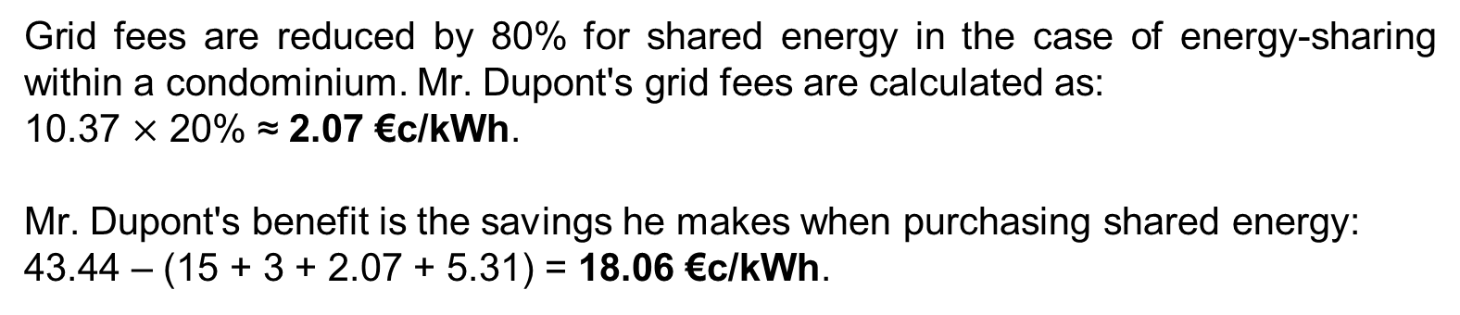
Example: Benefits from energy sharing within a condominium
Grid fees are reduced by 80% for shared energy in the case of energy-sharing within a condominium. Mr. Dupont's grid fees are calculated as:
10.37 $\text{×}$ 20% ≈ 2.07 €c/kWh.
Mr. Dupont's benefit is the savings he makes when purchasing shared energy:
43.44 – (15 + 3 + 2.07 + 5.31) = 18.06 €c/kWh.
18.06 €c/kWh
82

Slide 83
Exercise 2:
1. Let us use the Athena residence in Ougrée, Belgium, as a basis for the assumptions in this exercise. What are the annual benefits from energy sharing for (a) the condominium and (b) each occupant (tenant or owner)?
Data:
A condominium with 76 units, each with an annual consumption of 1,600 kWh
It is assumed that each occupant (owner or tenant) has the same consumption profile
The equal static allocation key is applied
There is a PV system with a capacity of 60 kWp and a capacity factor of 13% owned by the condominium association
One-third of the PV production is used by the shared spaces of the condominium. The remaining part is sold in its entirety within the energy sharing agreement at 0.15 €/kWh instead of being sold to the retailer at 0.078 €/kWh
The price of electricity purchased from the retailer is 0.4344 €/kWh
83

Slide 84
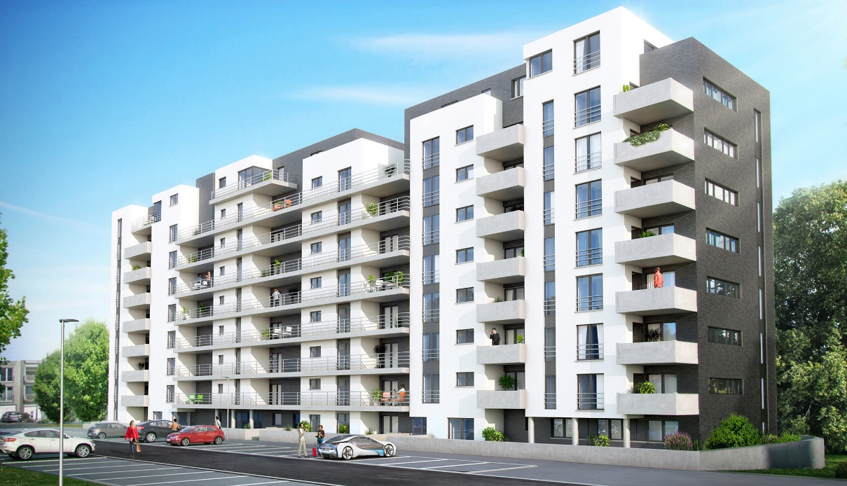
Exercise 2:
2. What would happen if some participants were removed from the energy-sharing arrangement of the condominium?
"Athena" Residence.
84

Slide 85
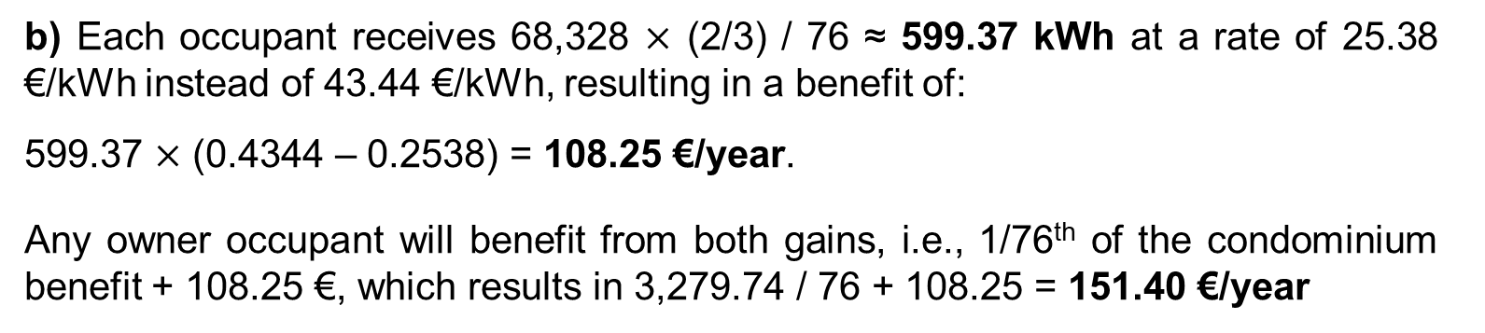
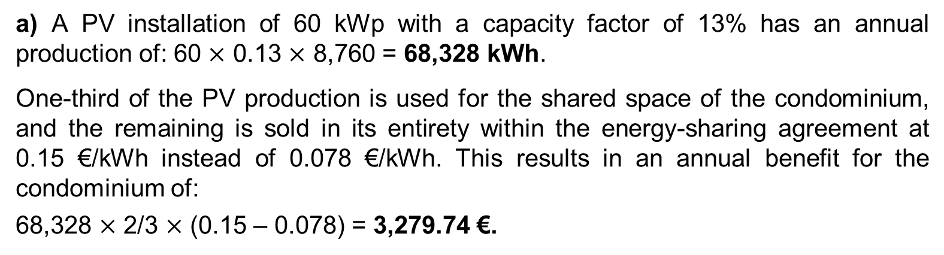
Solution:
Part 1:
a) A PV installation of 60 kWp with a capacity factor of 13% has an annual production of: 60 $\text{×}$ 0.13 $\text{×}$ 8,760 = 68,328 kWh.
One-third of the PV production is used for the shared space of the condominium, and the remaining is sold in its entirety within the energy-sharing agreement at 0.15 €/kWh instead of 0.078 €/kWh. This results in an annual benefit for the condominium of:
68,328 $\text{×}$ 2/3 $\text{×}$ (0.15 – 0.078) = 3,279.74 €.
b) Each occupant receives 68,328 $\text{×}$ (2/3) / 76 ≈ 599.37 kWh at a rate of 25.38 €/kWh instead of 43.44 €/kWh, resulting in a benefit of:
599.37 $\text{×}$ (0.4344 – 0.2538) = 108.25 €/year.
Any owner occupant will benefit from both gains, i.e., 1/76th of the condominium benefit + 108.25 €, which results in 3,279.74 / 76 + 108.25 = 151.40 €/year
85

Slide 86
Part 2:
The benefits of sharing the production from the PV system are distributed among all participants. Therefore, excluding some tenants from the sharing arrangement can increase the gains for the owner-occupants and the remaining tenants. This raises an equity issue, as it would mean depriving some tenants of the benefits of sharing in order to boost the gains of those who remain in the arrangement.
Moreover, removing too many participants would decrease self-consumption, thereby reducing the volume of shared energy and, consequently, the benefits for the remaining participants.
86

Slide 87
Summary of the different cases of energy sharing
Parameters | Community-based energy-sharing in a same building | Renewable Energy Communities (REC) | Citizen Energy Communities (CEC)
Reference | Article 21.4 of Directive 2018/2001 | Article 22 of Directive 2018/2001 | Article 16 of Directive 2019/944
Production | From renewable energy sources located in or on the building | From renewable energy sources | Only electricity, from renewable or non-renewable sources
Perimeter | Within the same building | Close to the production facilities | Not limited
Legal entity obligation | No | Yes | Yes
Participants & control | Group of active clients acting collectively within or on the same building | Shareholders or members of the community, including individuals, local authorities or small and medium-size businesses | No restrictions on participants; effective control by members or shareholders who are individuals, local authorities or small businesses
Activities | Only energy-sharing | See page 63 | See page 63
87

