Slide 1




Uncovering the molecular and cellular mechanisms of reliable neuromodulation in heterogeneous neurons
February 13th 2025
Notes:
This thesis is about neurons but we need first to understand what they are

Slide 2

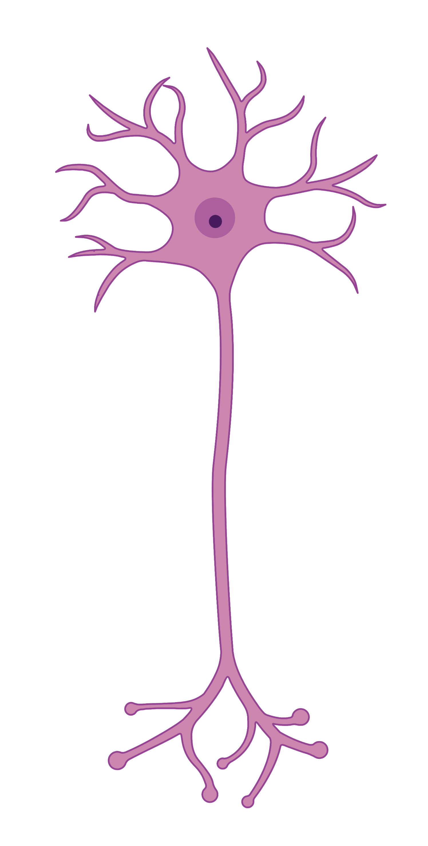

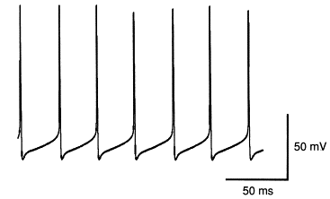
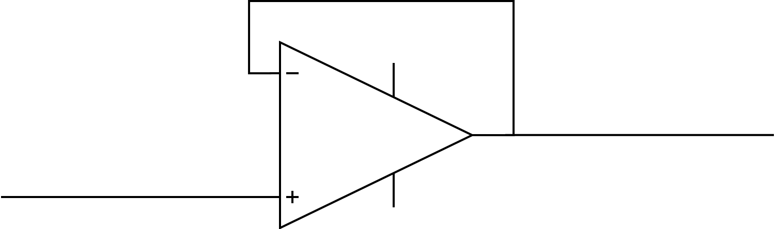
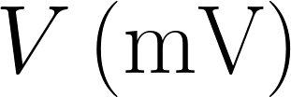

Neurons use spikes to communicate
Jefferys et al., 1996
1
Notes:
Neurons are the cells processing the information and responsible for cognition. It uses electrical signal to communicate. Information is transmitted during a spike. Don’t need to describe the spike.

Slide 3
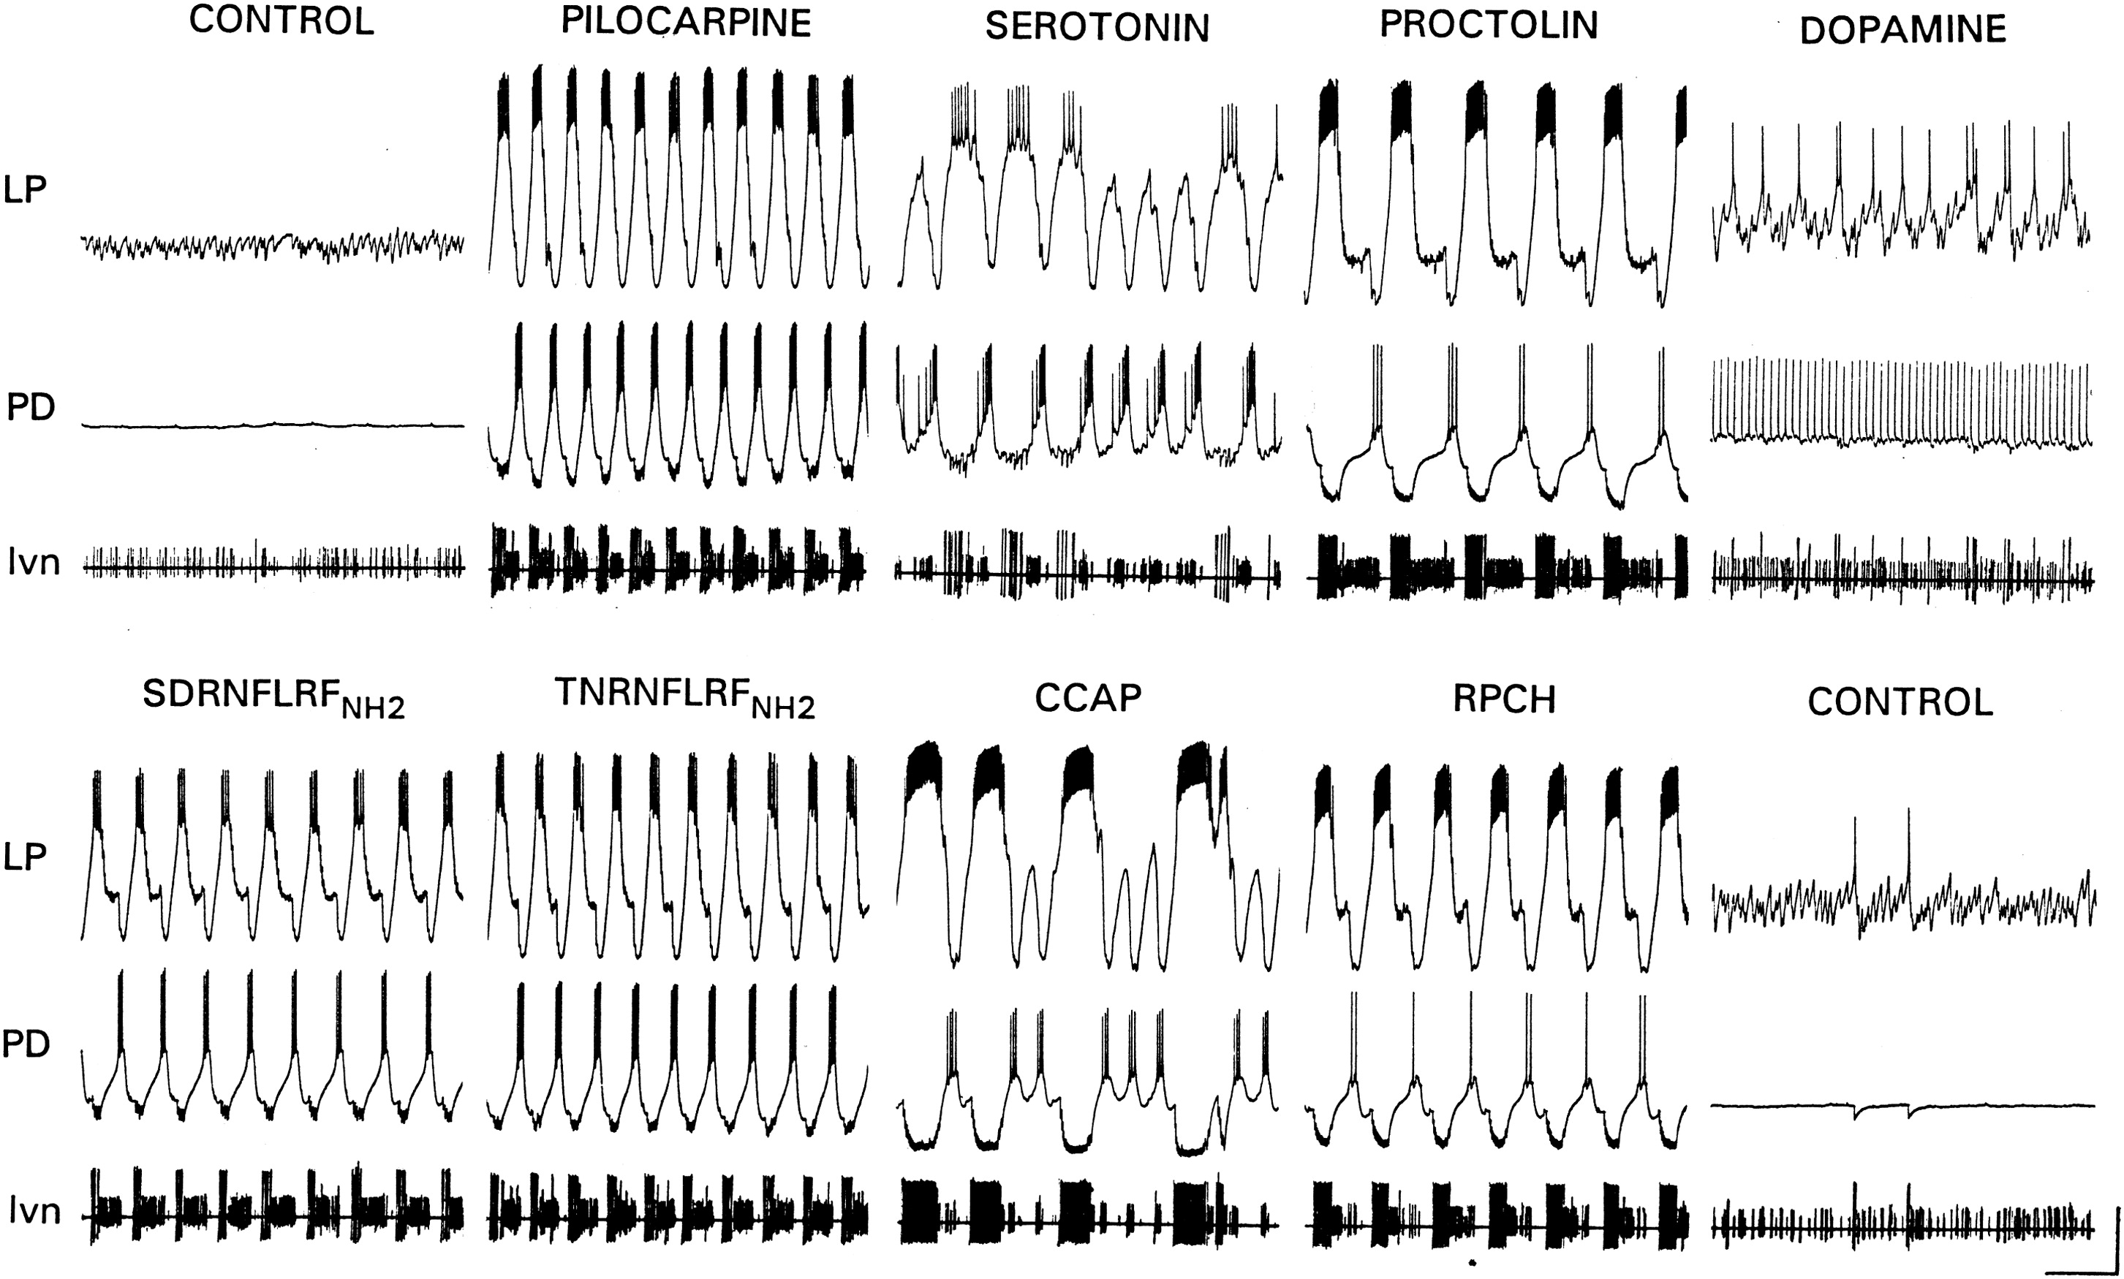
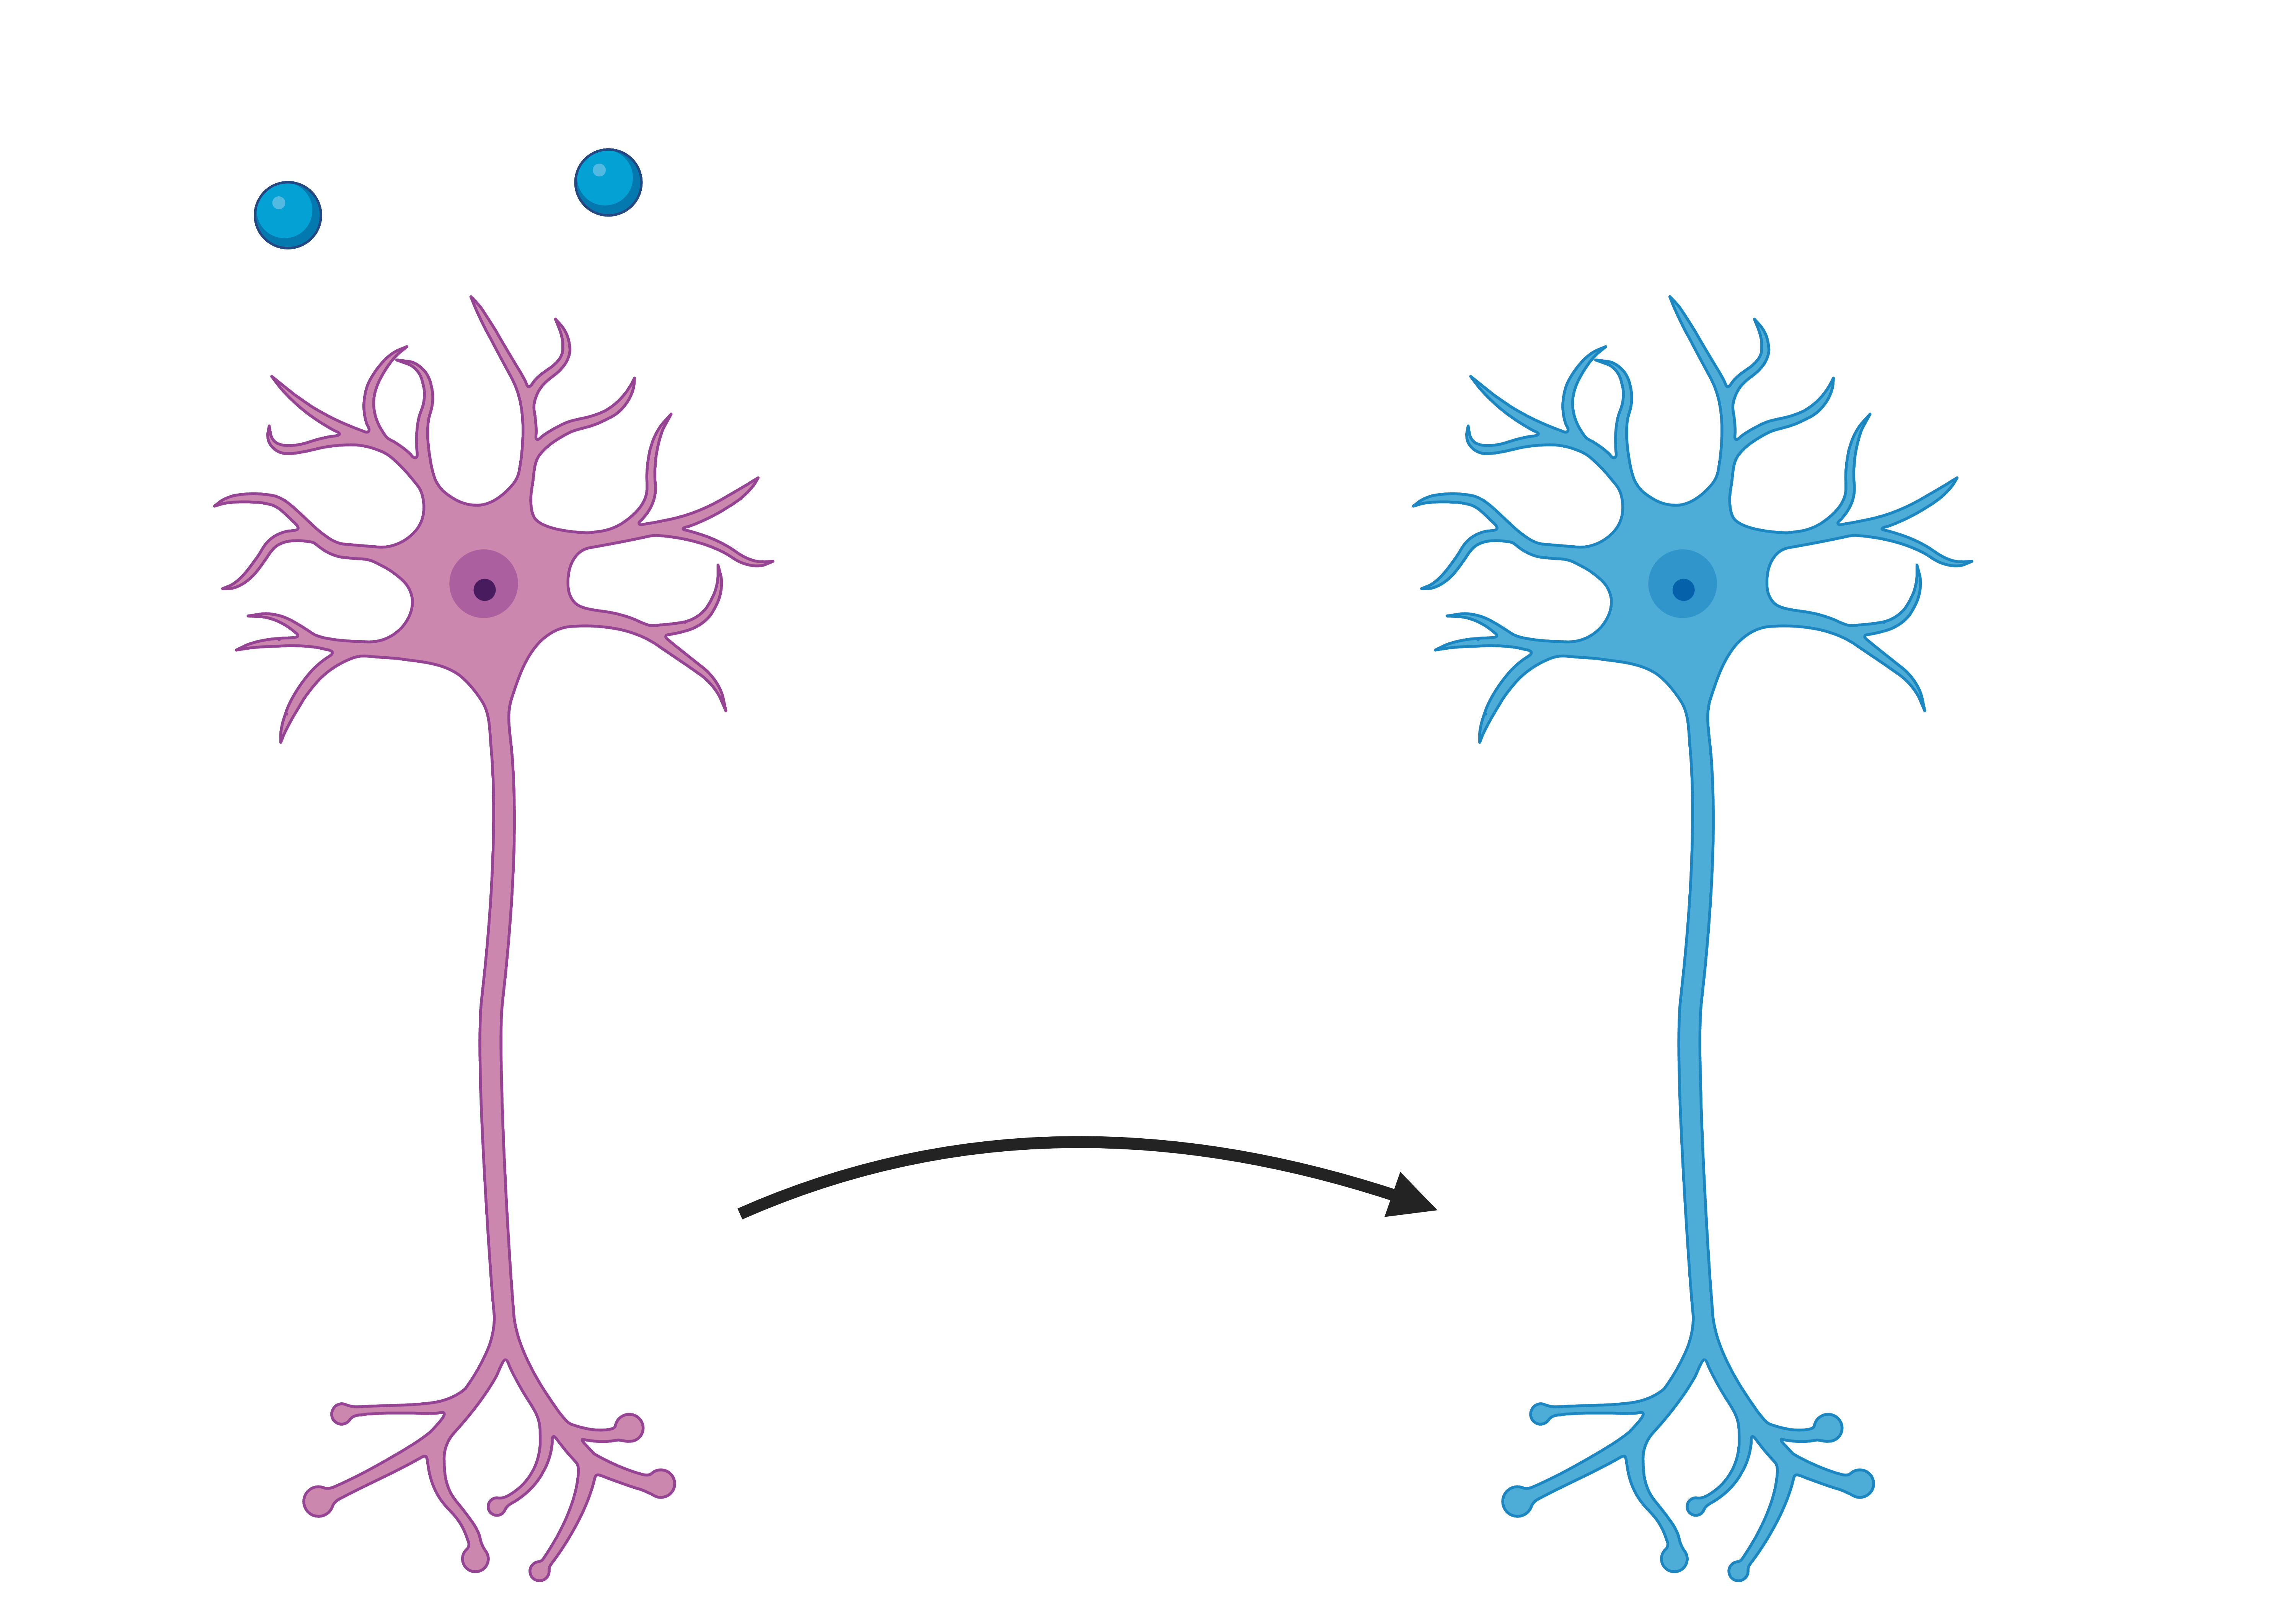
Neuronal activity is highly modulated
Control activity
Pilocarpine
Dopamine
Neuromodulation
Crustacean Cardioactive Peptide
Marder, 2012
2
Notes:
This activity is very plastic and neuromodulated. Don’t cite neuromodulators. There are many neuromodulators, here is an example of 3. Why is that useful ? On the left, motor circuit OFF, on the right, sometimes ON.

Slide 4
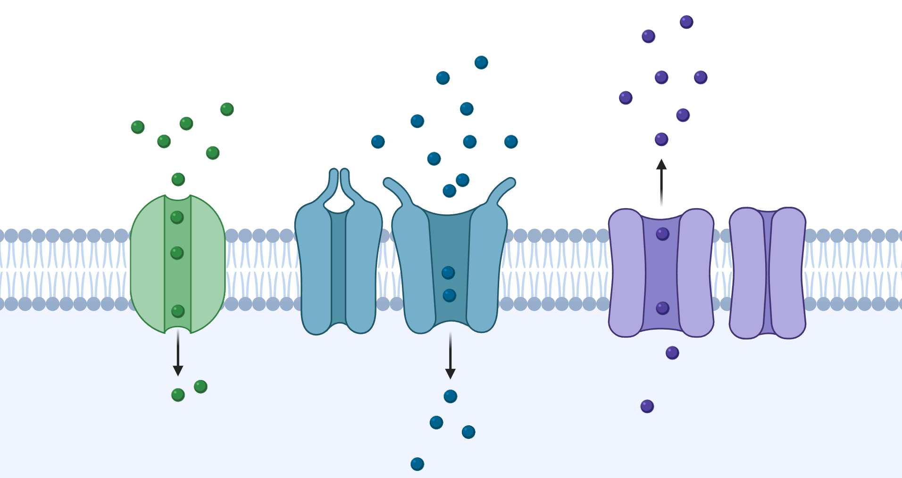
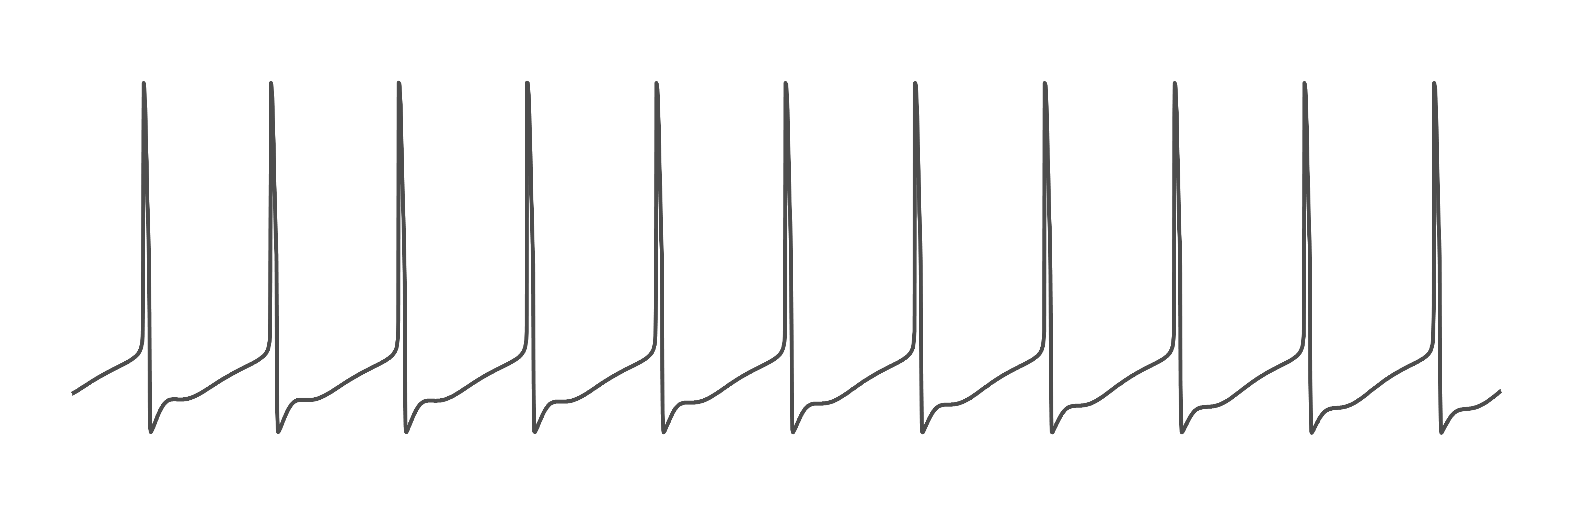
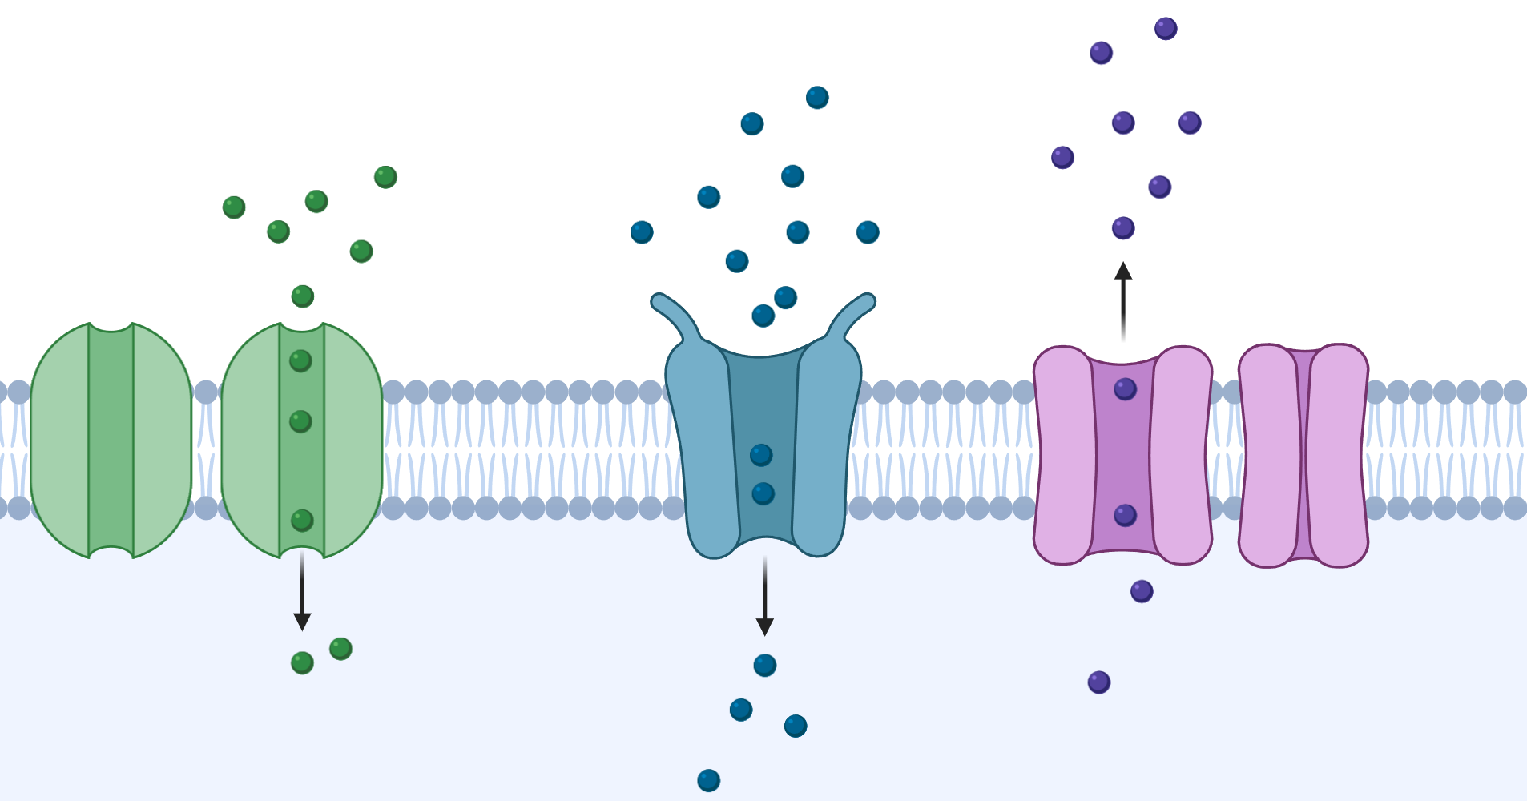
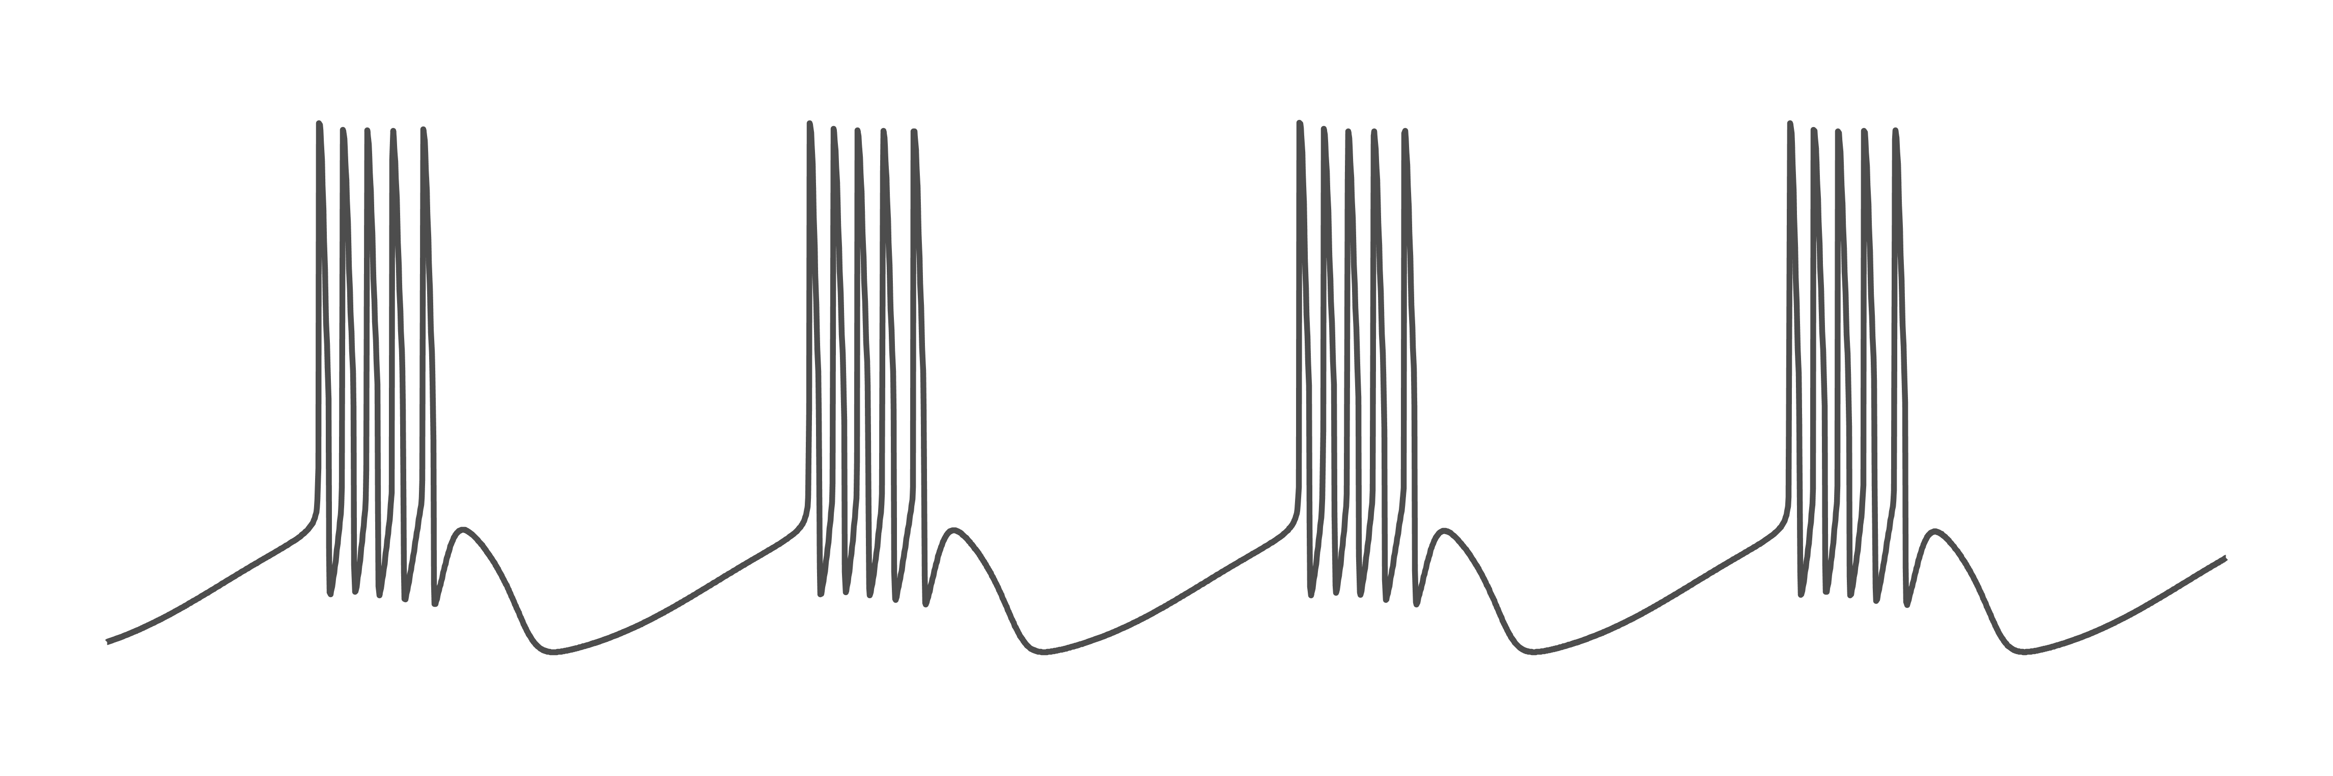



Ion channels determine spiking activity
$$Na^{+}$$
$$Ca^{++}$$
$$K^{+}$$
3
Notes:
How does that work ? Ion channels are responsible of this electrical signal. No change in ion. Change type of channel by changing the kinetics of the channel. They are voltage gated, and produce a current, which affects the voltage and so on. Only change in type and density.

Slide 5
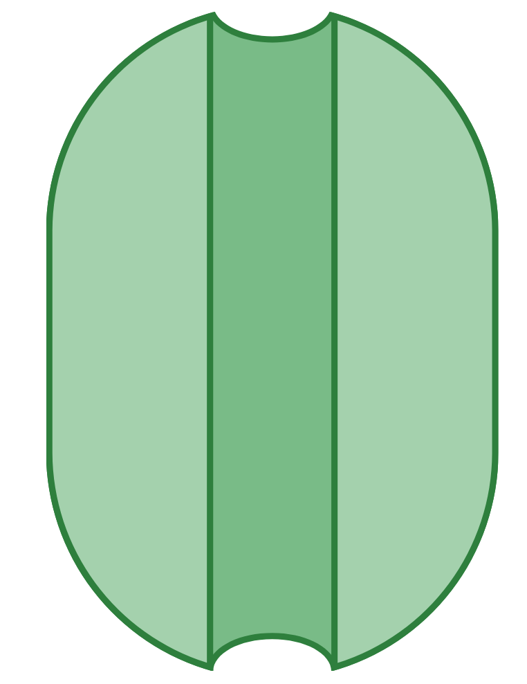
Voltage gated ion channels are involved in a feedback loop
Voltage
Channel current
Voltage gated ion channel
Voltage activity
4
Notes:
Voltage gated ion channel opening depends on the membrane voltage. However, once they change their permeability, they will produce a channel current, that, in turn, affect the membrane voltage, and so on. So, we already see that this is involved in a complex feedback loop.

Slide 6
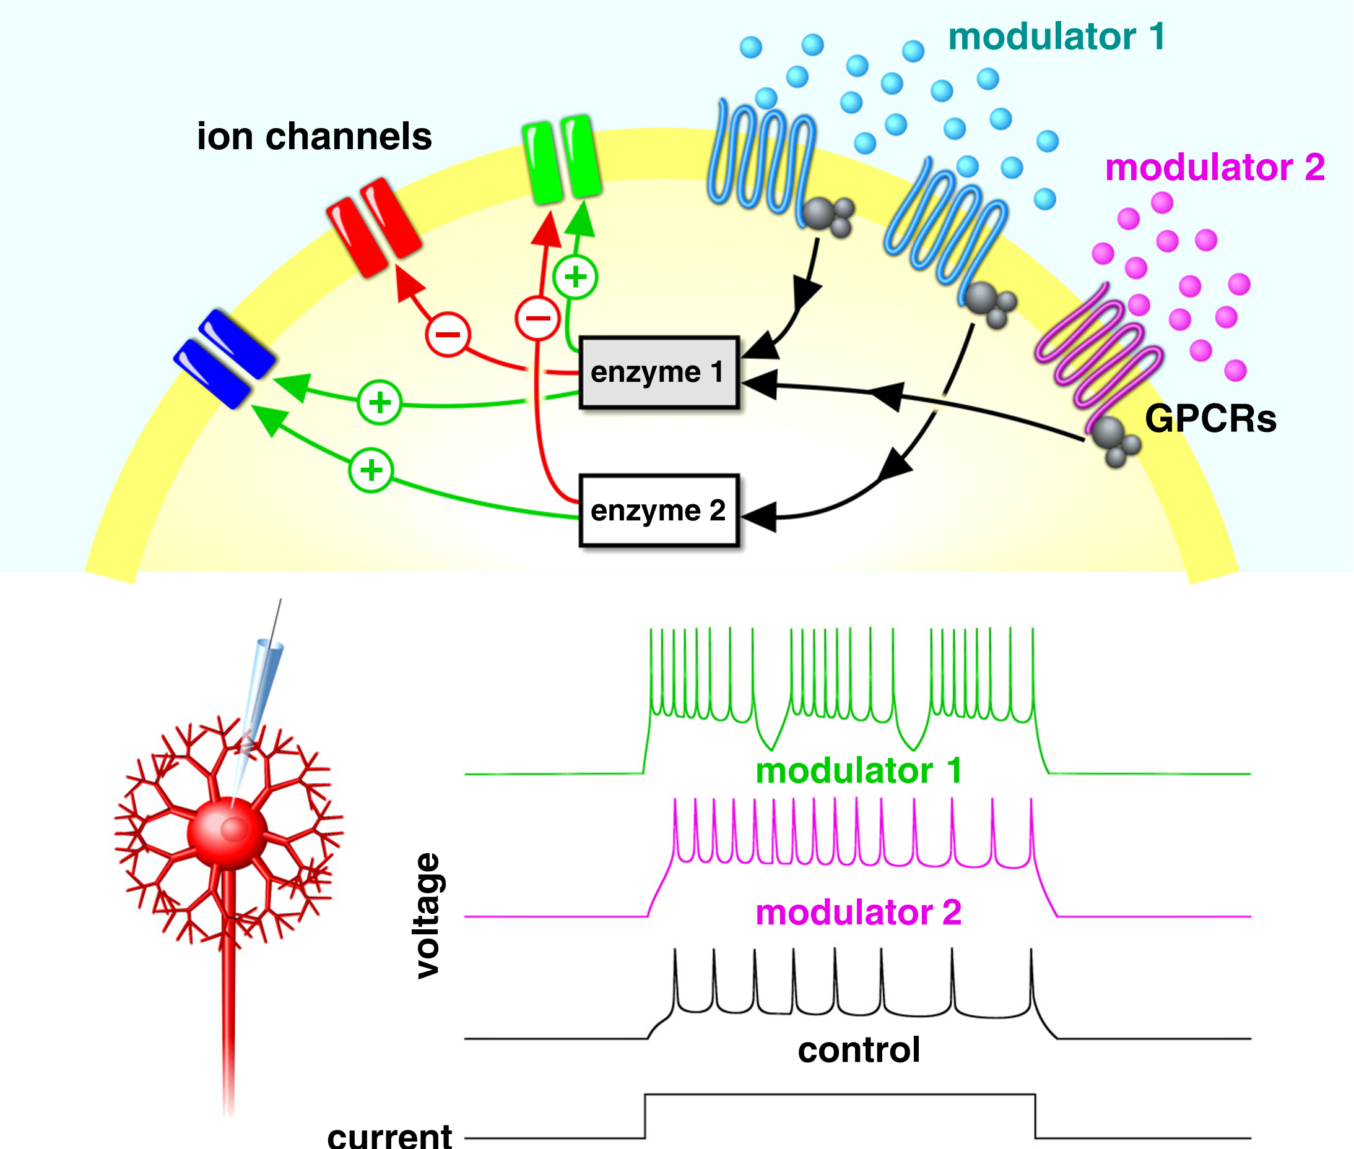
Neuromodulation affects ion channels
molecular cascade 1
molecular cascade 2
Nadim and Bucher, 2014
5
Notes:
We don’t know everything, and it has never been modeled.

Slide 7
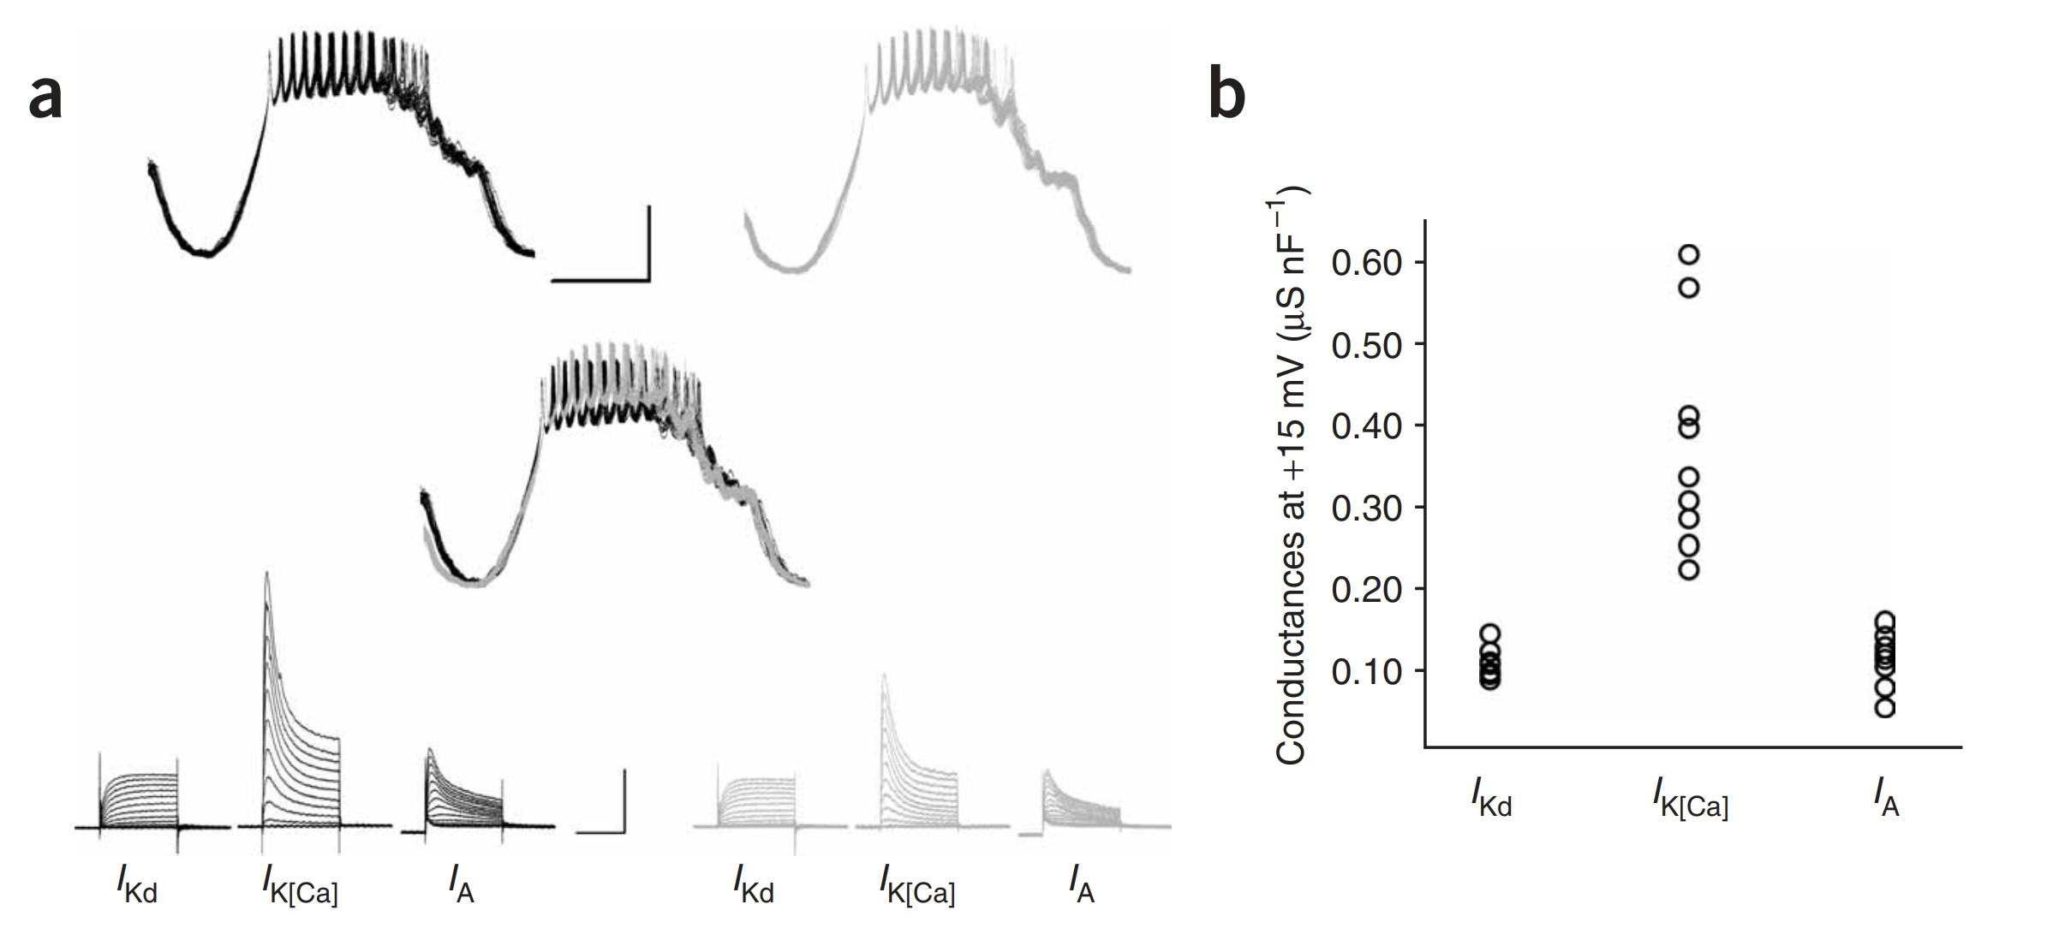
Degeneracy consists in similar activities emerging from different channel densities
Up to several folds !
Schulz et al., 2006
6
Notes:
Not use exact

Slide 8
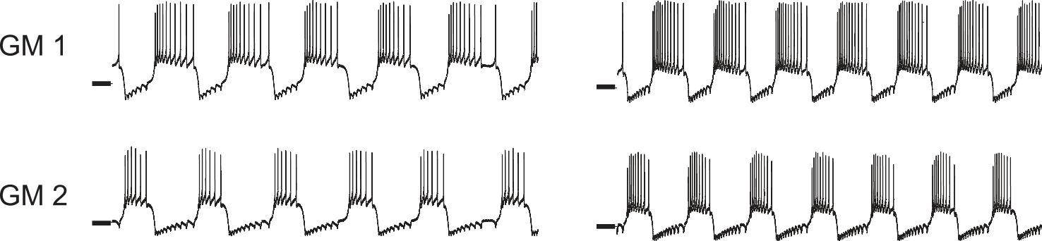
Neuromodulation is reliable in physiology
Control activity
Serotonin
Degenerate
Grashow et al., 2009
7
Notes:
Nmod in physiological degenerate population is robust. Never same, use similar.

Slide 9
Research question
How can neuromodulation be reliable in a degenerate population ?
8
Notes:
There are many answers but no real agreement on that question.

Slide 10
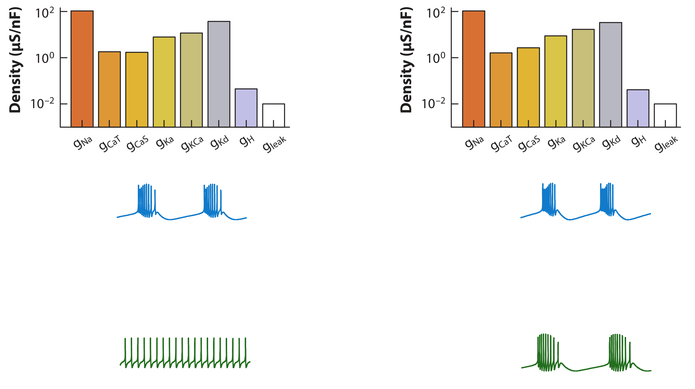
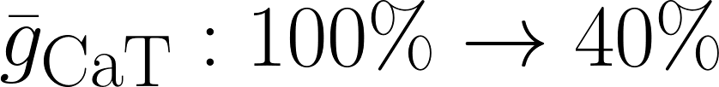
State independent neuromodulation is unreliable
Control activity
Modulated
Marder et al., 2014
9
Notes:
The only attempts of fixed neuromodulation is unreliable

Slide 11
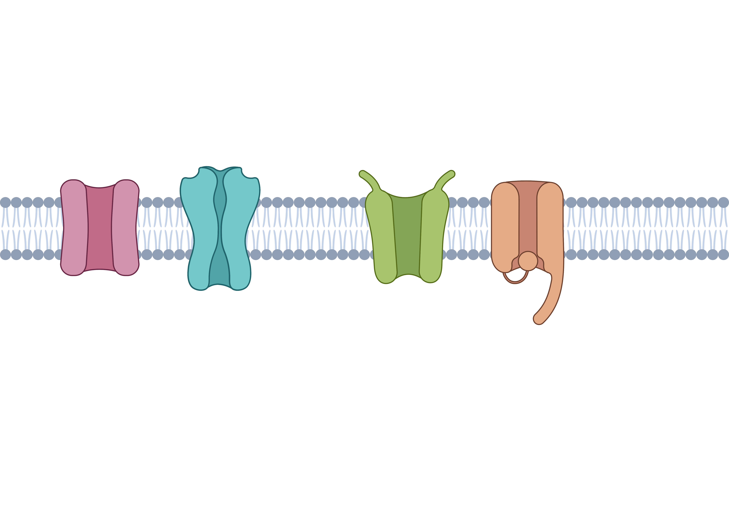
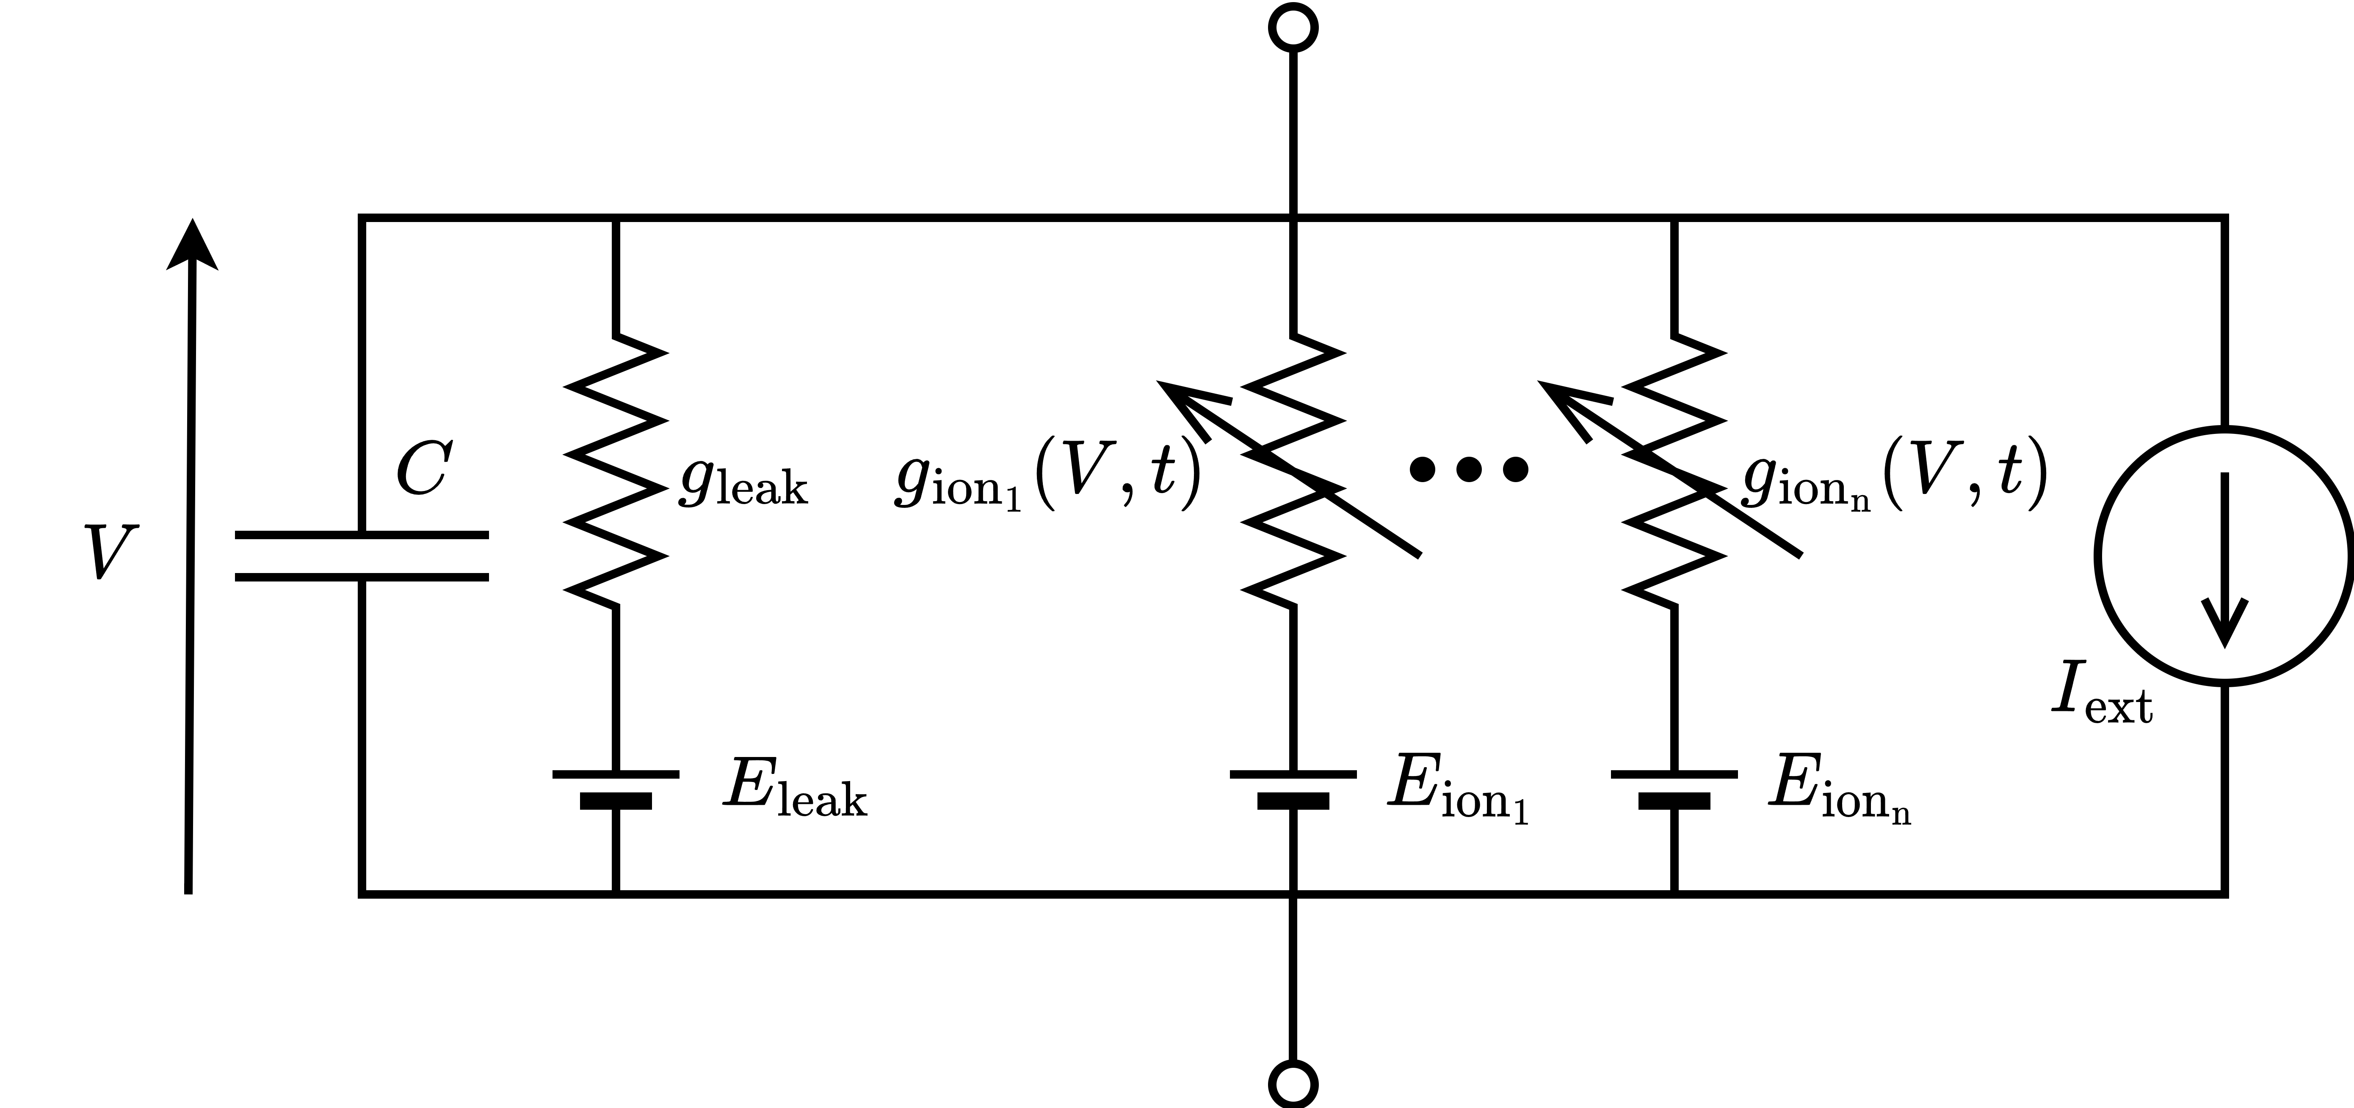
Conductance based models are composed of ion channels
10
Notes:
We chose to study the effect of nmod on g_bar, which is dominant

Slide 12
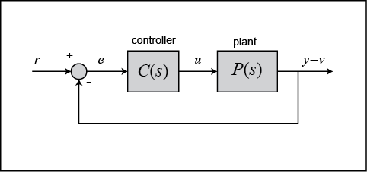

What are feedback control systems?
Throttle
Target speed
Actual speed
Car body
11

Slide 13
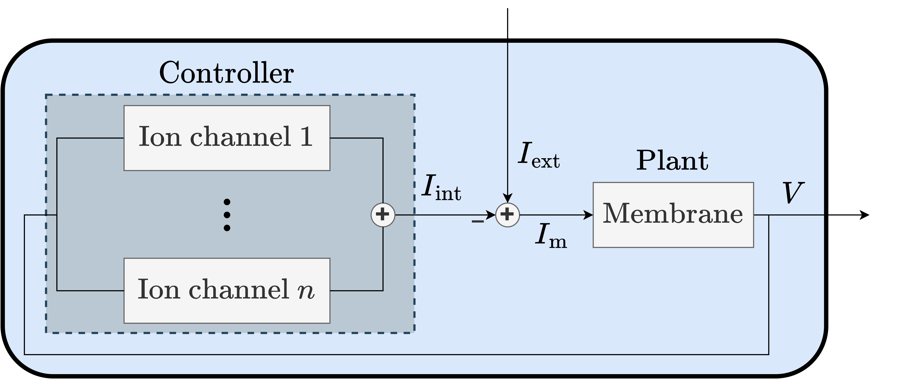

Neurons as feedback models
12

Slide 14





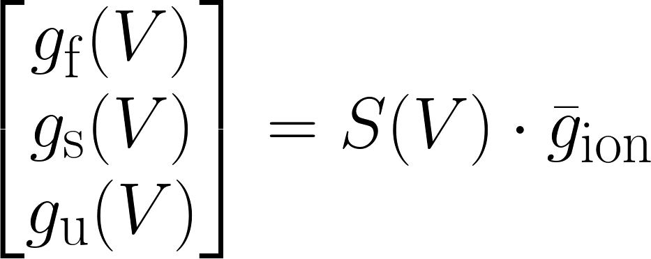
The control action of ion channels can be aggregated in 3 feedback gains
Drion et al., 2015
13
Notes:
Value of neuronal feedback gain determine the activity (not completely attention). Same values, same activity. Give an example (sodium for fast, and so on).

Slide 15
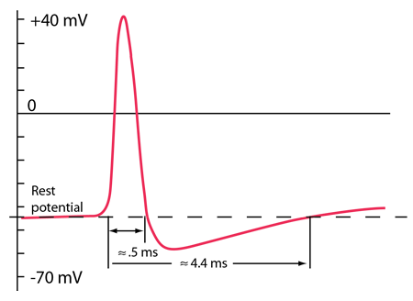
The control action of ion channels can be aggregated in 3 feedback gains
+
-
13
Notes:
To give you more intuition about what they are coding for…

Slide 16
The control action of ion channels can be aggregated in 3 feedback gains
+
Slow -
-
+
Slow +
13

Slide 17
I. Is there any structure in neuronal degeneracy ?
How can neuromodulation be reliable in a degenerate population ?
II. Is it possible to build a reliable neuromodulation controller ?
III. Is it compatible with homeostatic plasticity ?
14
Notes:
There are many answers but no real agreement on that question. Giving the outline may help.

Slide 18
I. Is there any structure in neuronal degeneracy ?
How can neuromodulation be reliable in a degenerate population ?
II. Is it possible to build a reliable neuromodulation controller ?
III. Is it compatible with homeostatic plasticity ?
Fyon, A., Franci, A., Sacré, P., & Drion, G. (2024). Dimensionality reduction of neuronal degeneracy reveals two interfering physiological mechanisms. PNAS nexus, 3(10), pgae415.
14
Notes:
There are many answers but no real agreement on that question. Giving the outline may help.

Slide 19

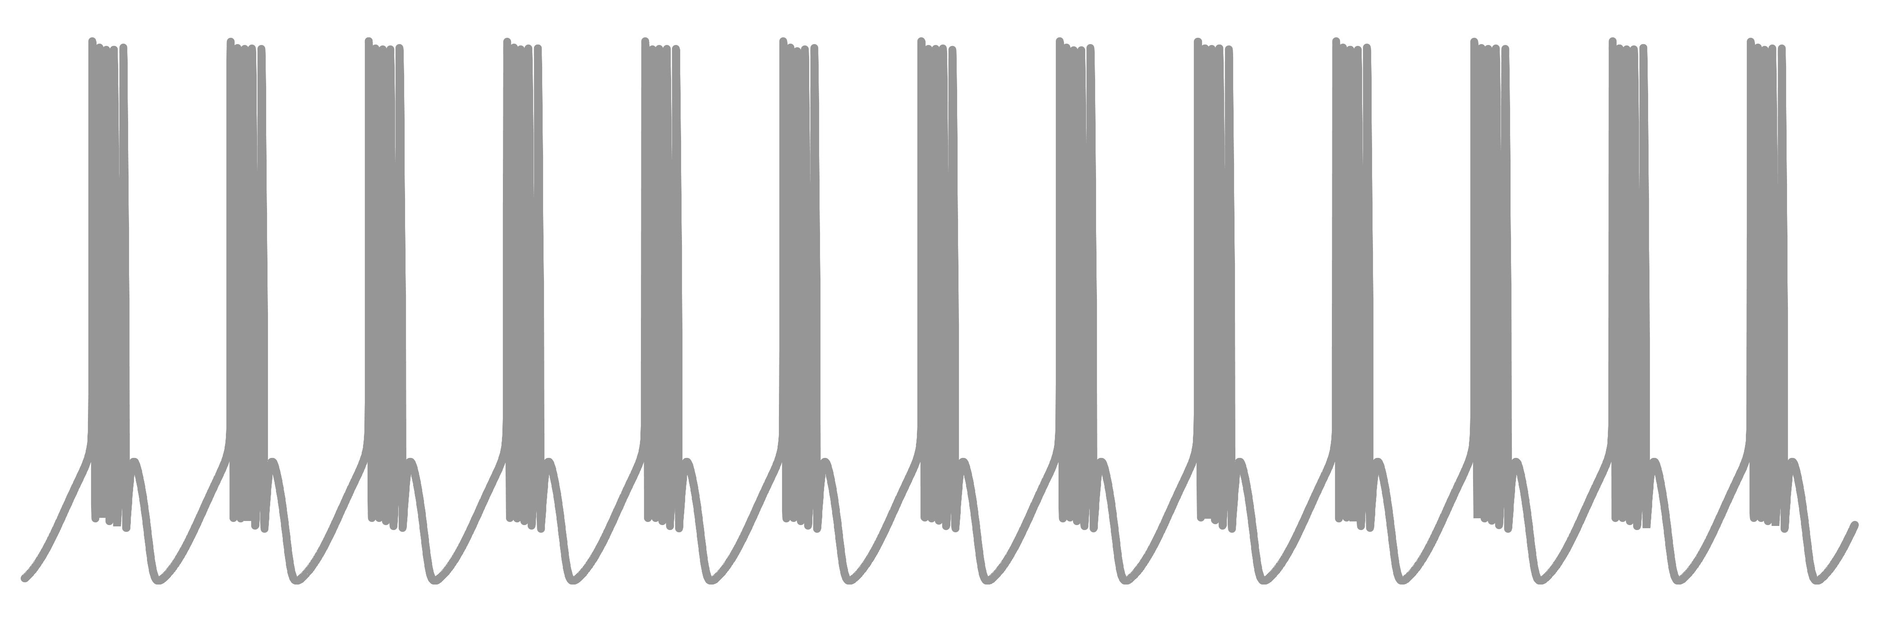


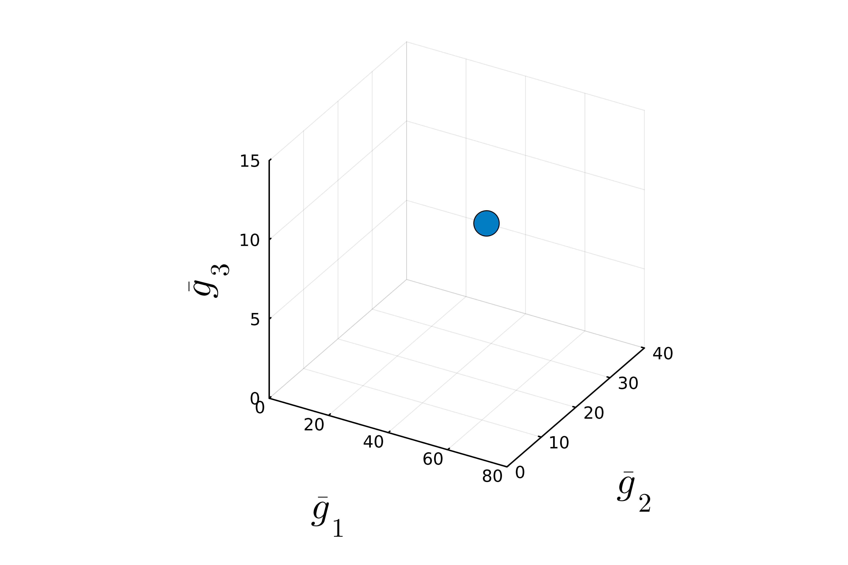
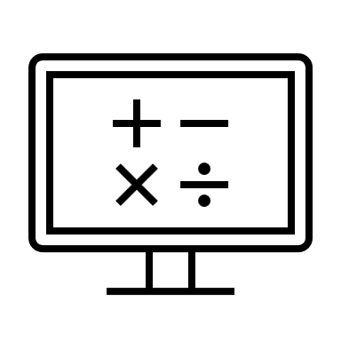

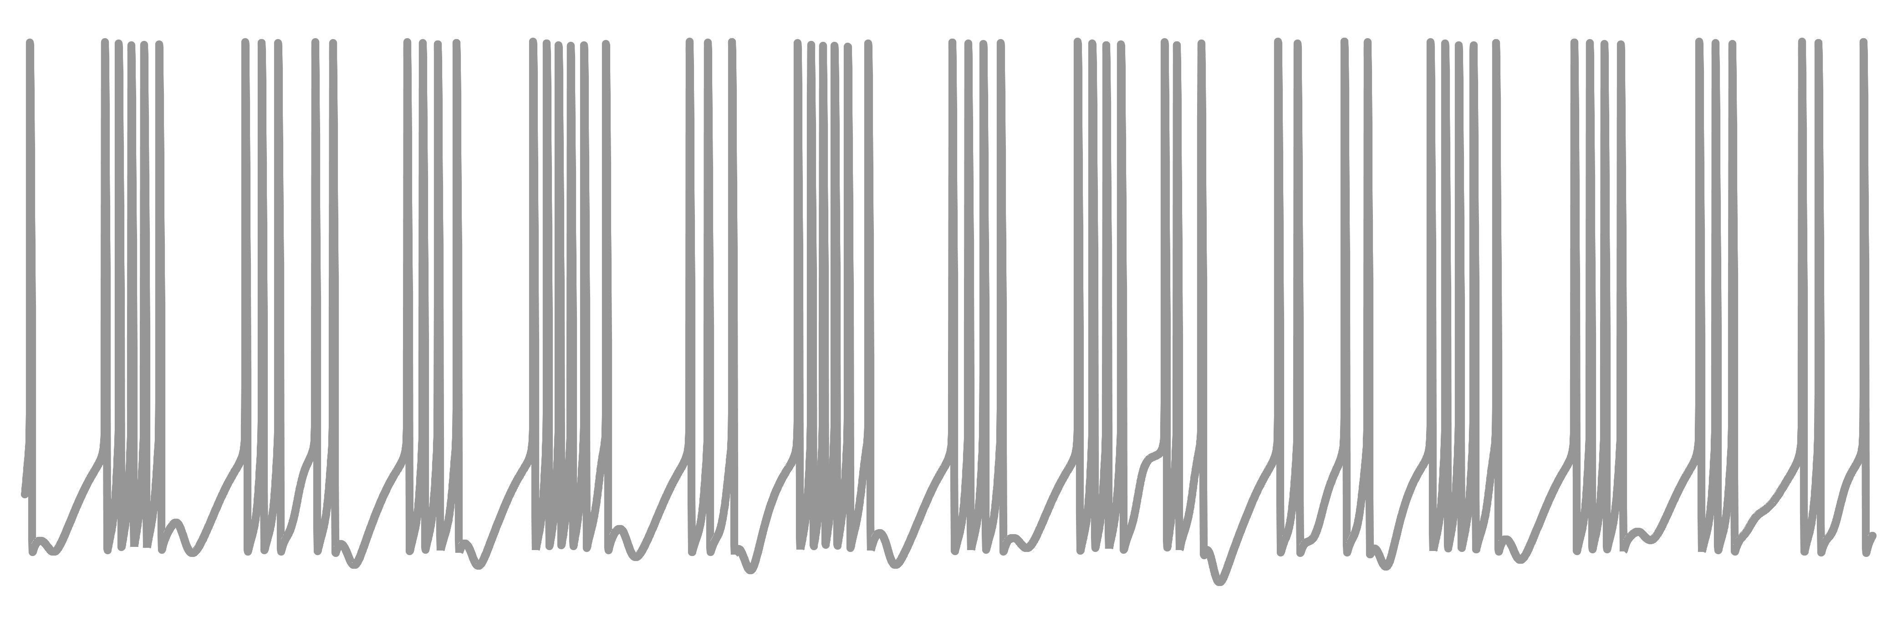

A naïve method to build degenerate populations
. . .
15
Notes:
Explain how to build a degenerate population. We POST-PROCESSED, not CONTROLLED

Slide 20
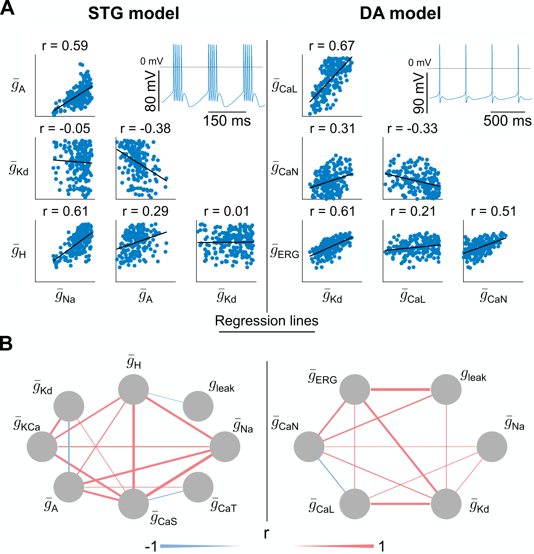
Neuronal degeneracy is associated with variable pairwise correlations in channel conductances
Liu et al., 1998
Qian et al., 2014
16
Notes:
Study degeneracy as in experimental neuroscience, by studying correlations between conductances. We can observe that we reproduce results from experiments. Neuron is a point, so cloud are population. Correlation is used as a measure of degeneracy. Indeed, if channel are correlated, they have the same function and are degenerate.

Slide 21
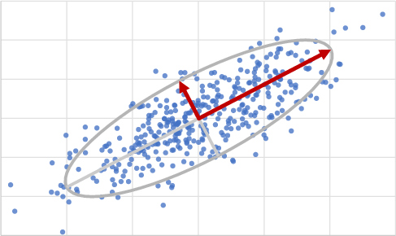
A few PCs capture neuronal degeneracy
PC1
PC2
17
Notes:
Explain PCA, then explain that a few PCs, a few direction, explain most of the variance of the overall population

Slide 22
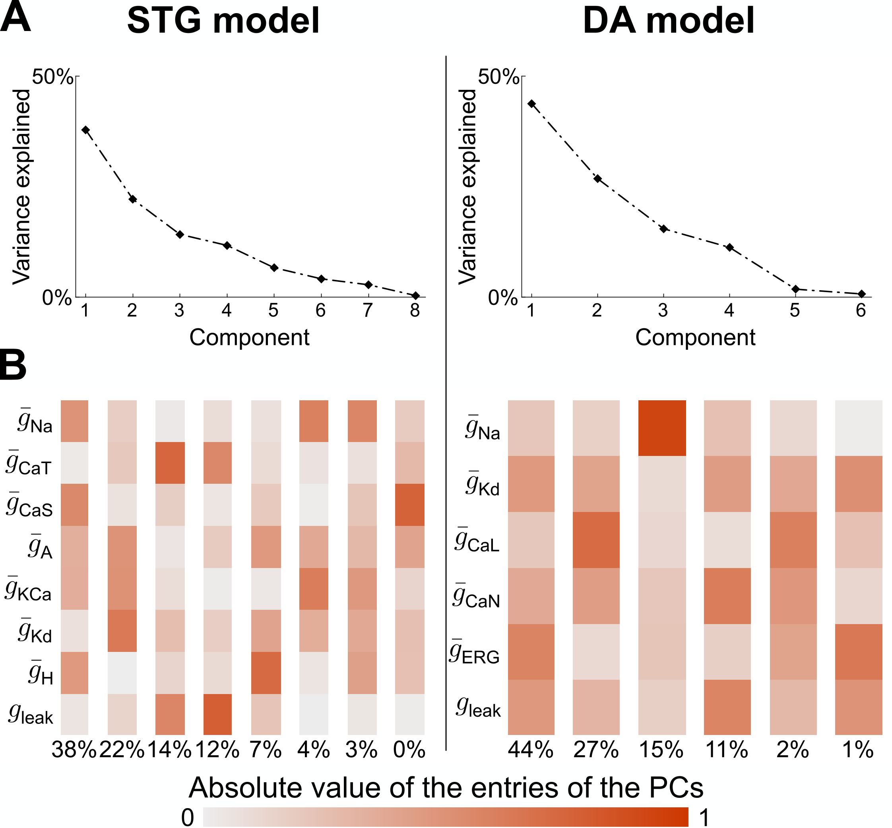
A few PCs capture neuronal degeneracy
PC2
PC1
> 90% of the variance
17
Notes:
Explain PCA, then explain that a few PCs, a few direction, explain most of the variance of the overall population

Slide 23
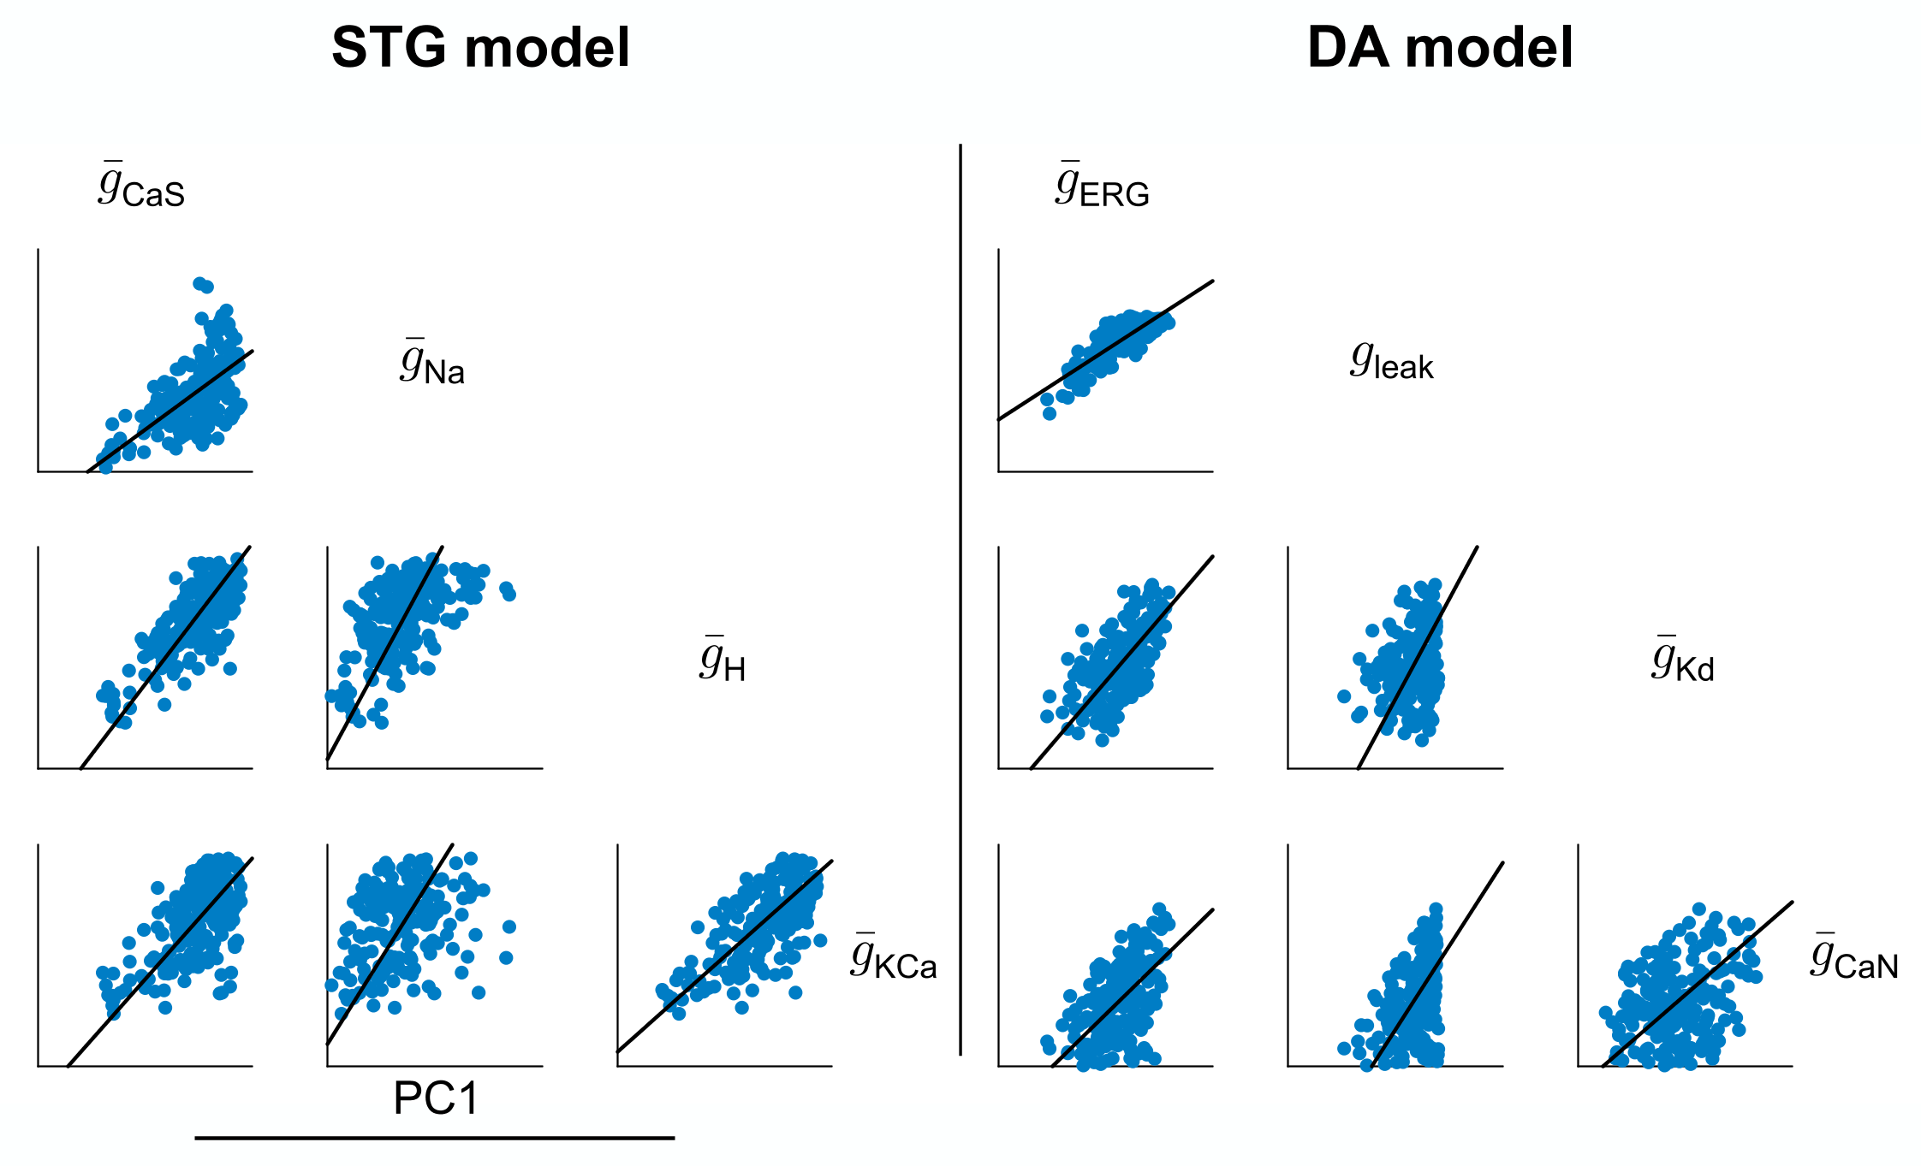
Dominant PC captures homogeneous scaling of maximal conductances
18
Notes:
H.S. do not change neuronal feedback gain, so do not change activity. 2D alignment is different from high dimensional alignment

Slide 24
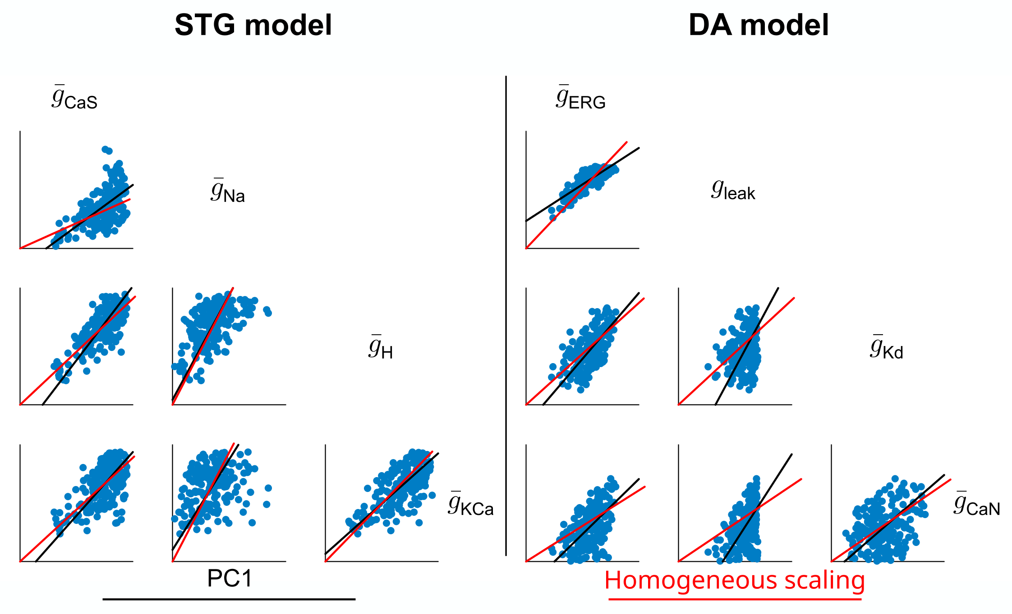
Dominant PC captures homogeneous scaling of maximal conductances
80% of
alignment
90% of
alignment
18
Notes:
H.S. do not change neuronal feedback gain, so do not change activity. 2D alignment is different from high dimensional alignment

Slide 25
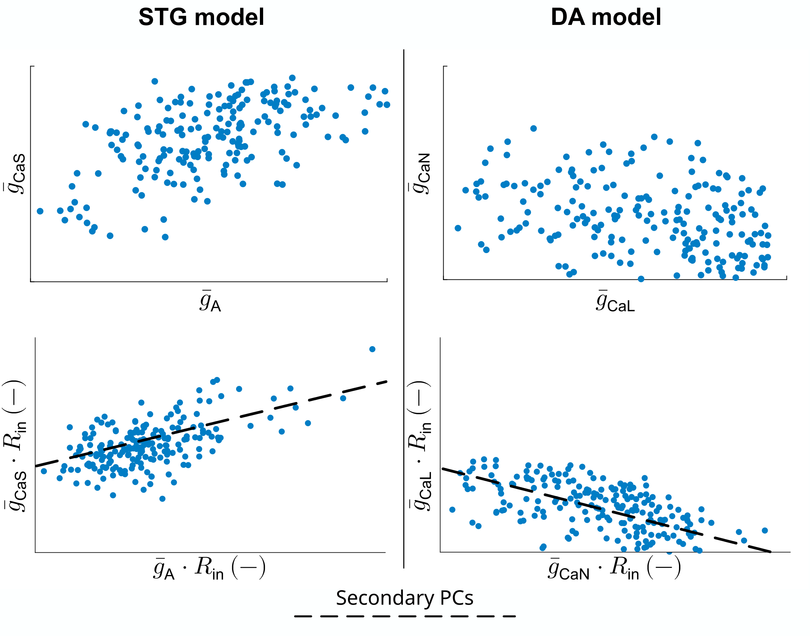
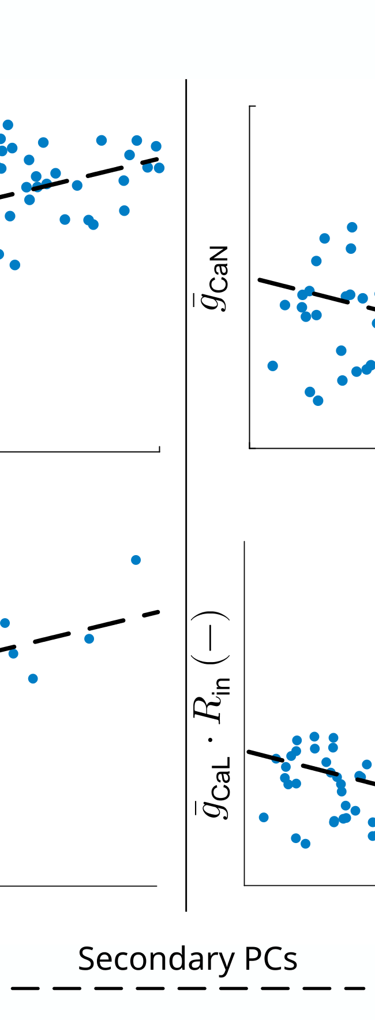
Secondary PCs capture variable conductance ratios
19
Notes:
New correlation

Slide 26
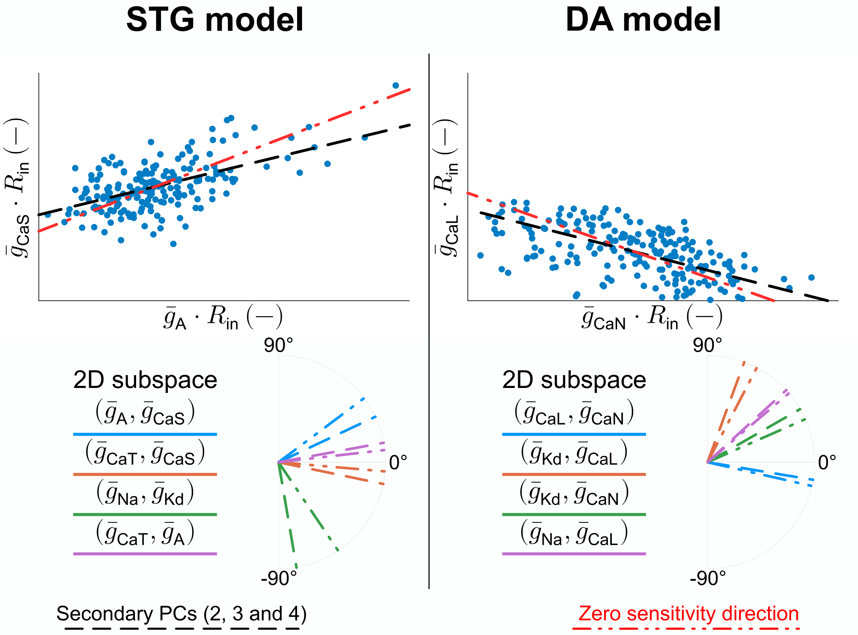
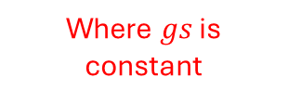
Secondary PCs capture variable conductance ratios
Fast
Neuron
Ultraslow
Slow
Where $gs$ is constant
19
Notes:
New correlation

Slide 27
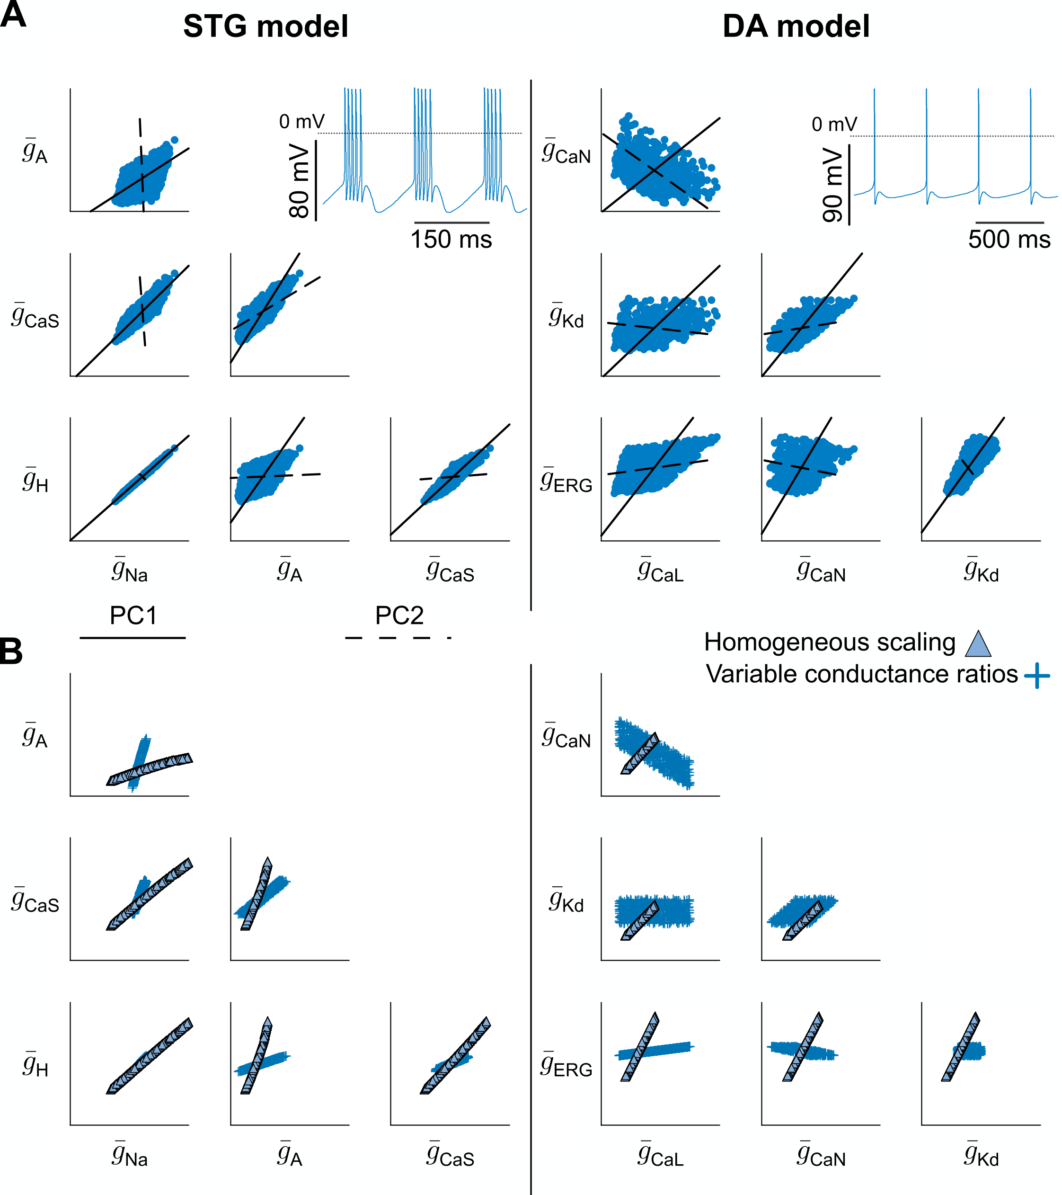
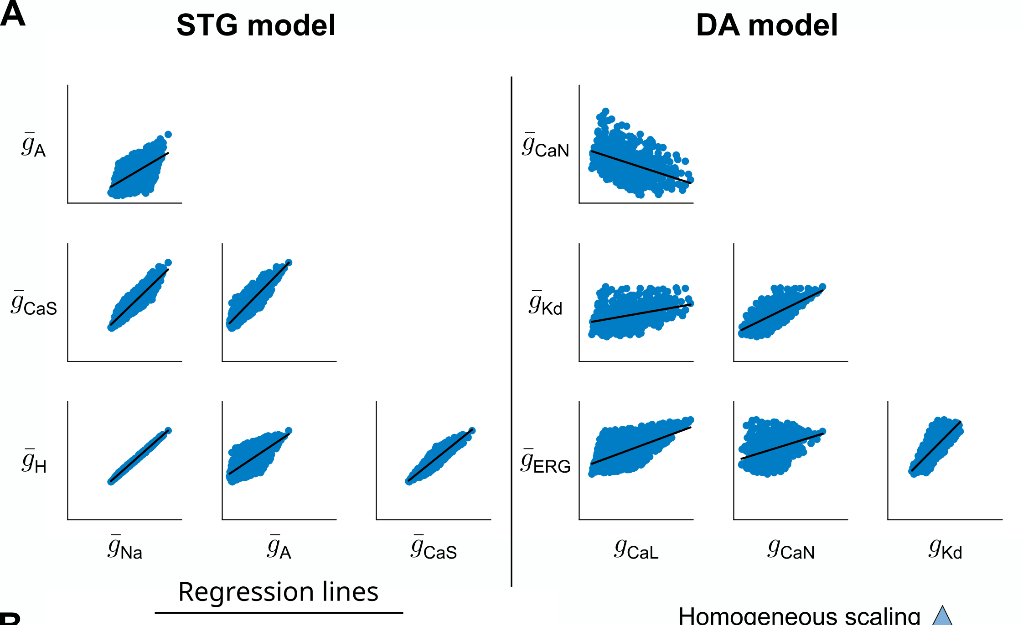
An alternative approach to build degenerate parameter sets
Homogeneous scaling
Variable conductance ratios
20
Notes:
It is now sufficient to use only these two mechanisms to produce new degenerate population that can produce positive or negative correlations as before, and that PCs of this new population align with these mechanisms.

Slide 28
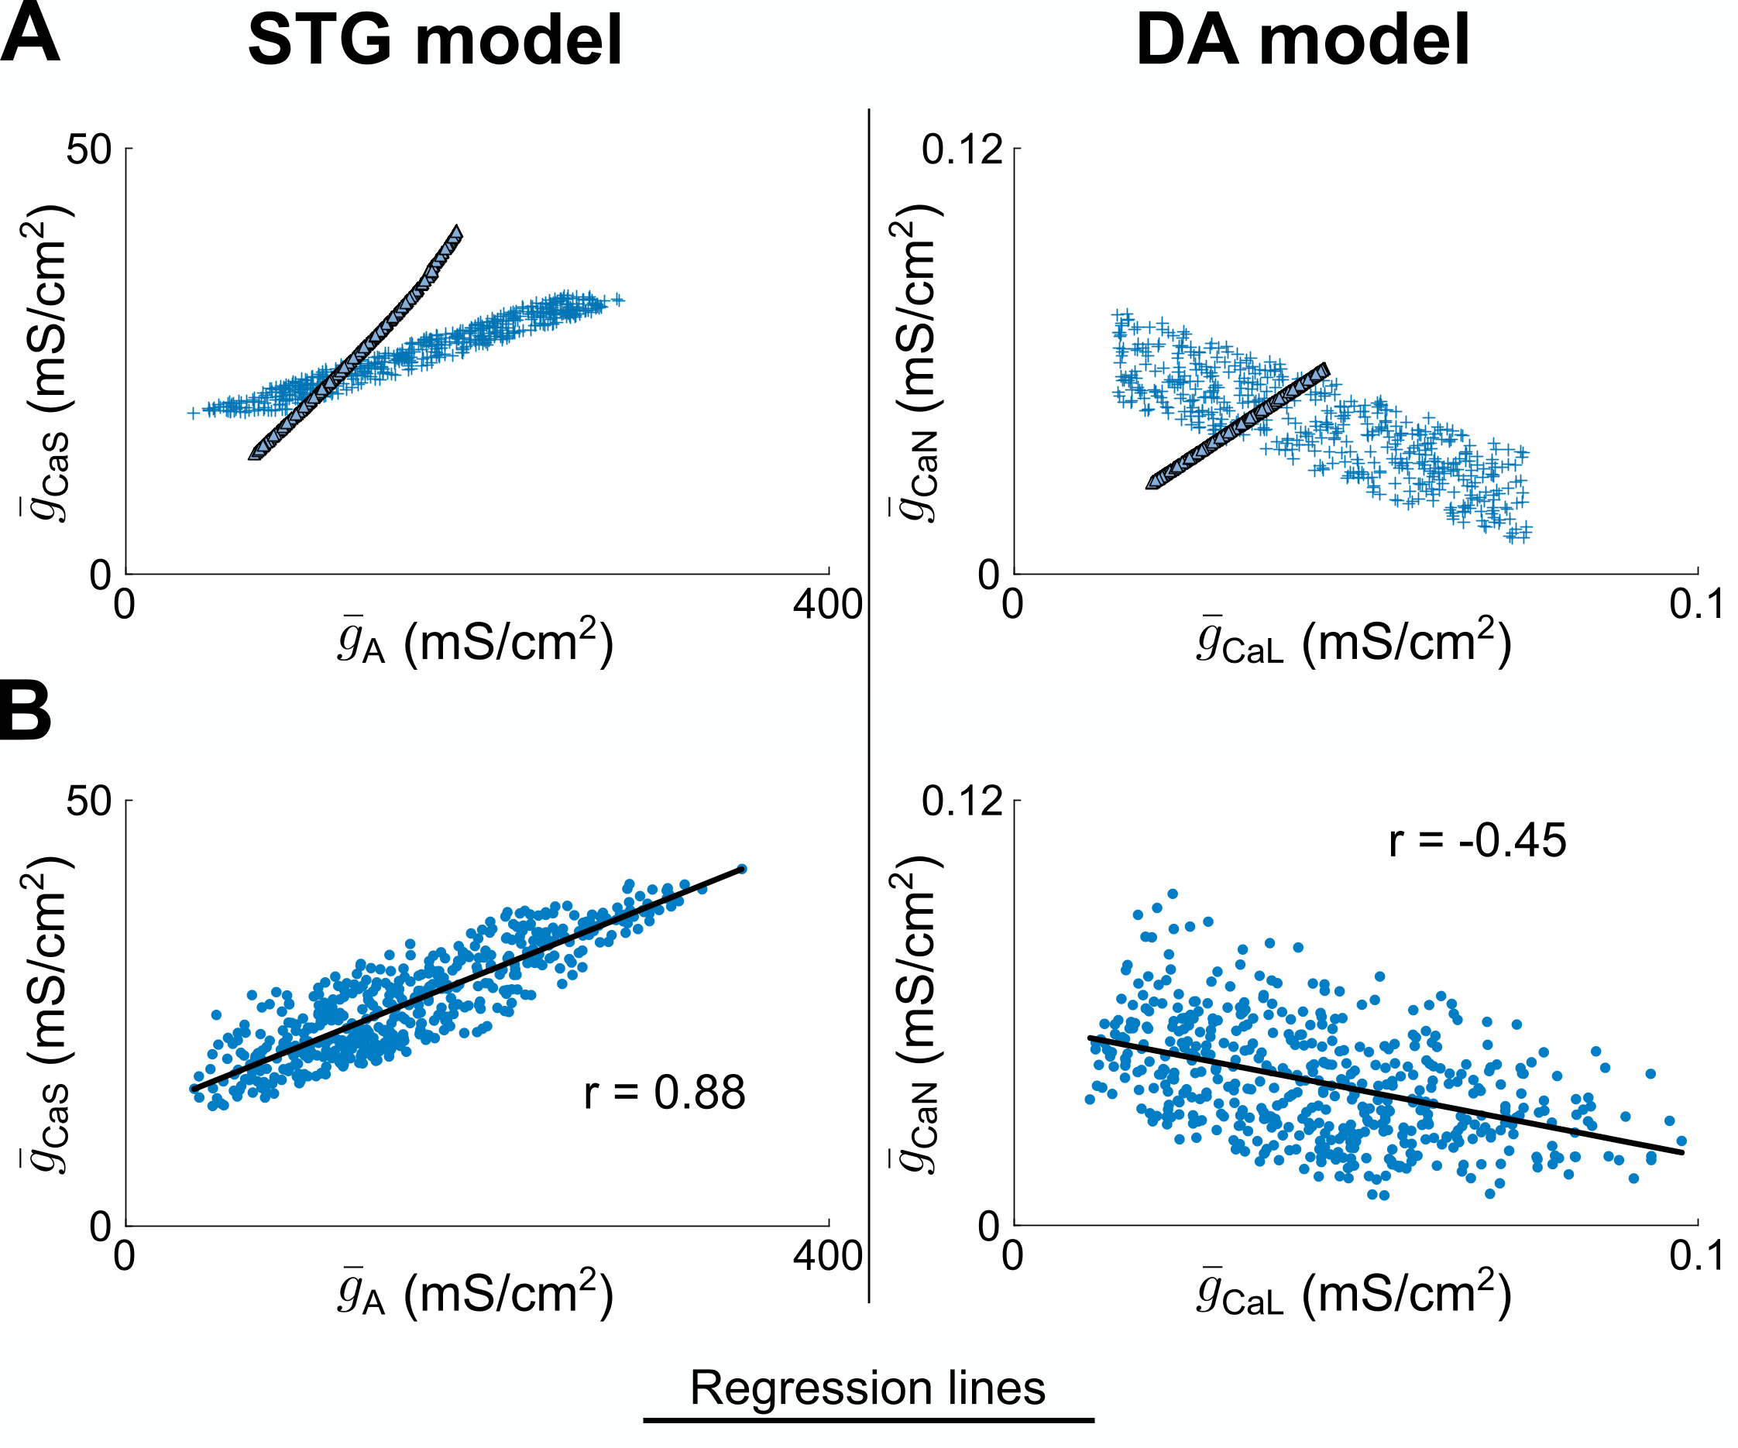
Variability from both homogeneous scaling and variable conductance ratios tunes correlation
21
Notes:
This separation explains correlations. If correlated, we could think that channels have a common mechanisms and vice versa. But both have the same mechanism but with different alignment and apparent correlation. Once this is understood, how can we modulate the activity.

Slide 29
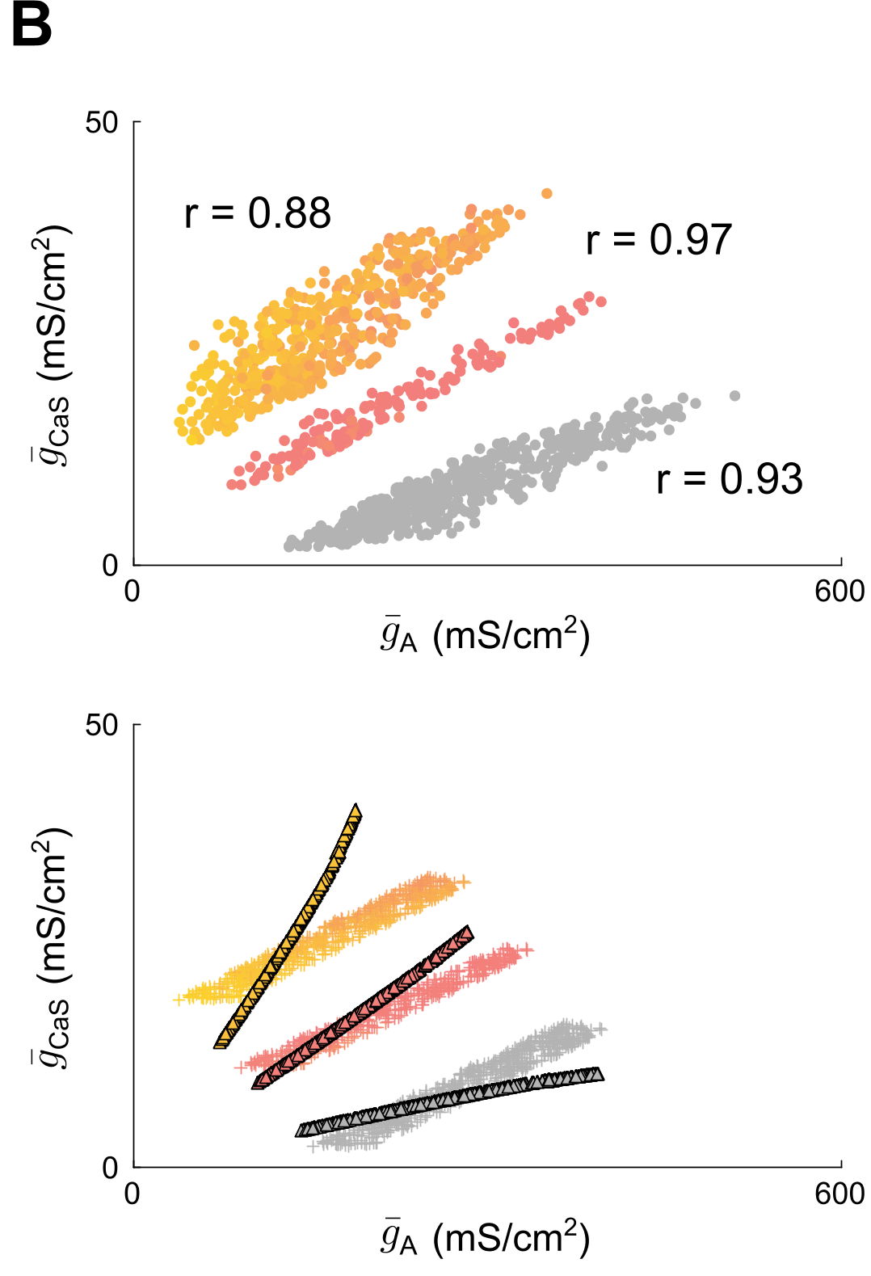
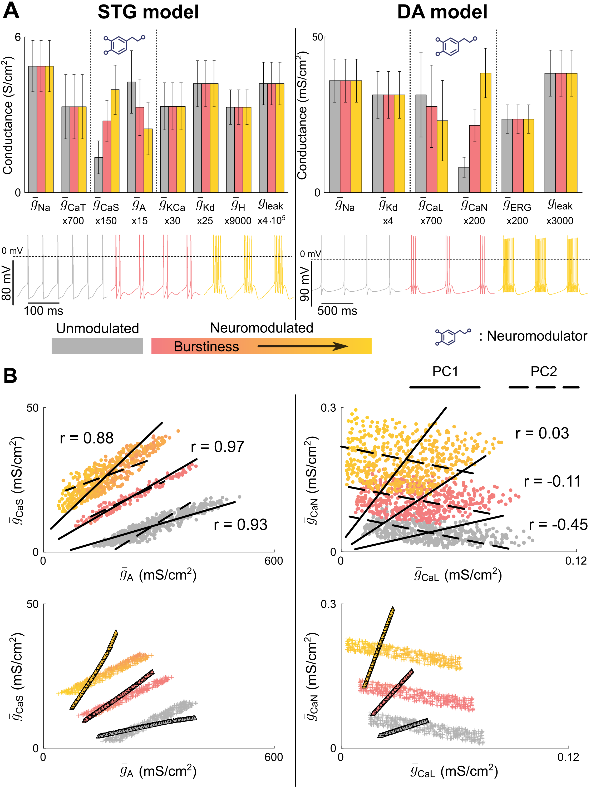
Variability in pairwise correlations is neuromodulation-dependent
Fast
Neuron
Ultraslow
Slow
-
+
++
22
Notes:
See the example of the STG population. We can use the generation algorithm to produce 3 distinct population that have different spiking activity by tuning the values of the neuronal feedback gains. We do so by changing only two conductances. It is completely NON PHYSIO. No direct rule for neuromodulation (additive and multiplicative). Since the multiplicative effect is larger on neurons away from the origin, no state independent rule of nmod.

Slide 30
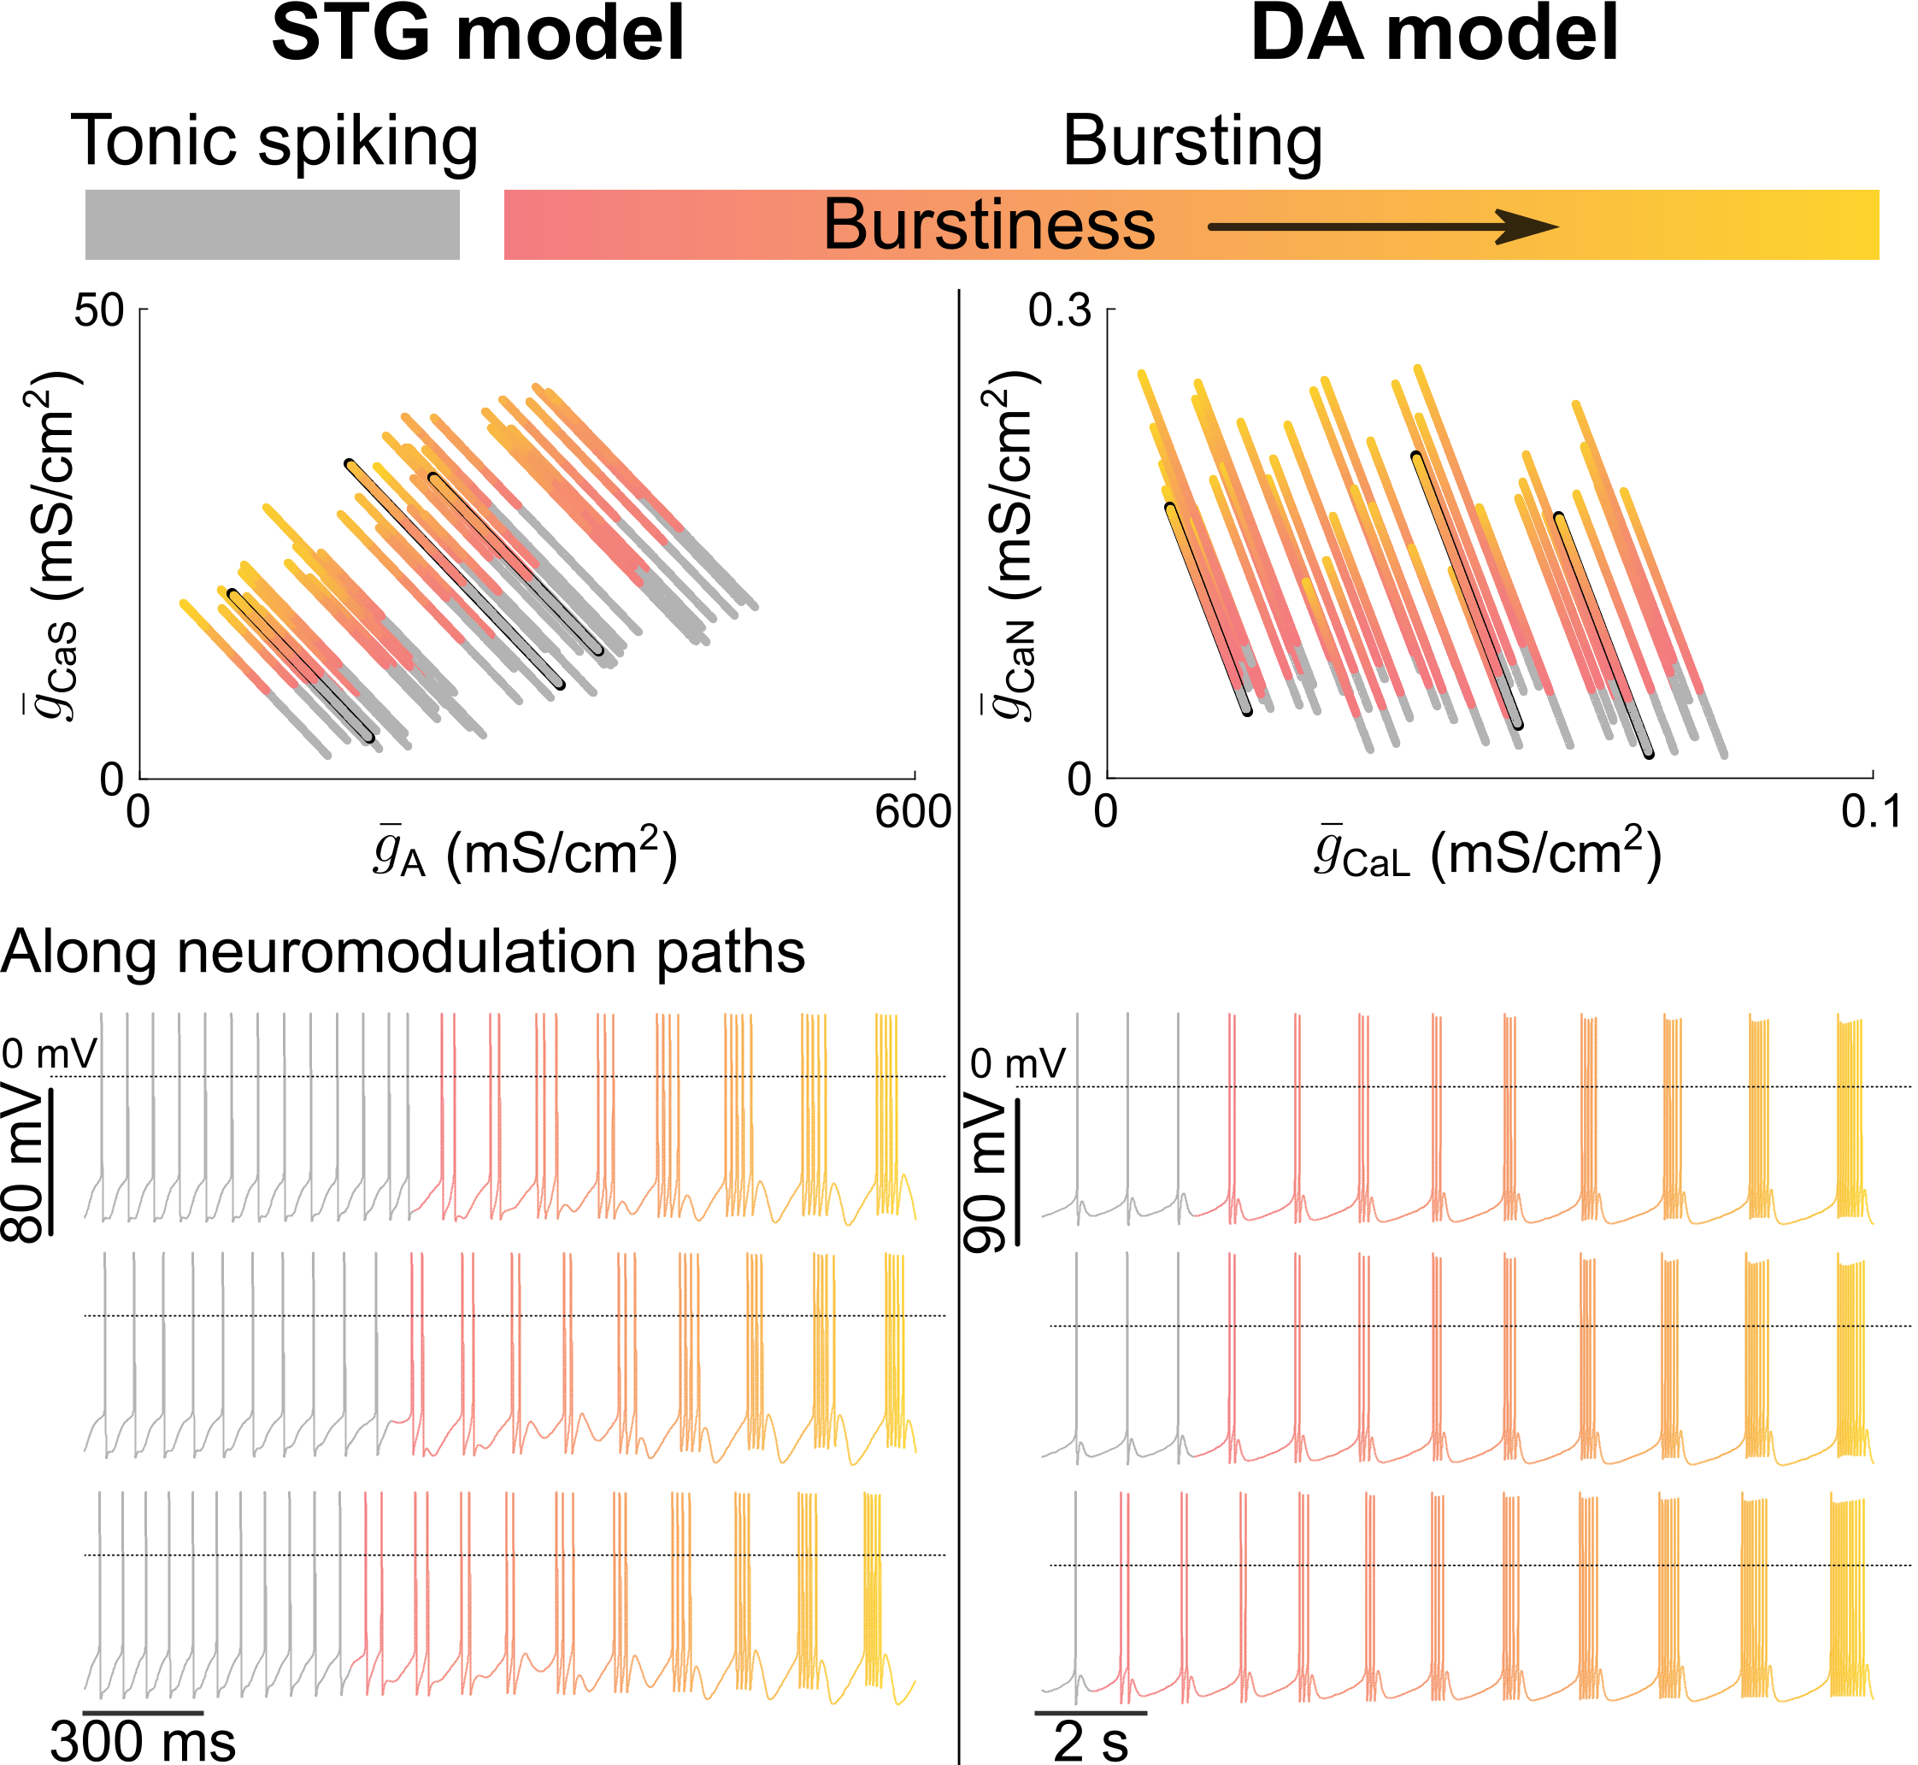
A simple indirect rule for robust neuromodulation
23
Notes:
We can observe neuromodulation paths are linear in a direction that is neuron type dependent, that can be encoded into genes. However, the length of the path, the step, are not encoded, it is neuron dependent. This means that neuromodulation controls each neuron along that direction to control where the neuron has to land.

Slide 31
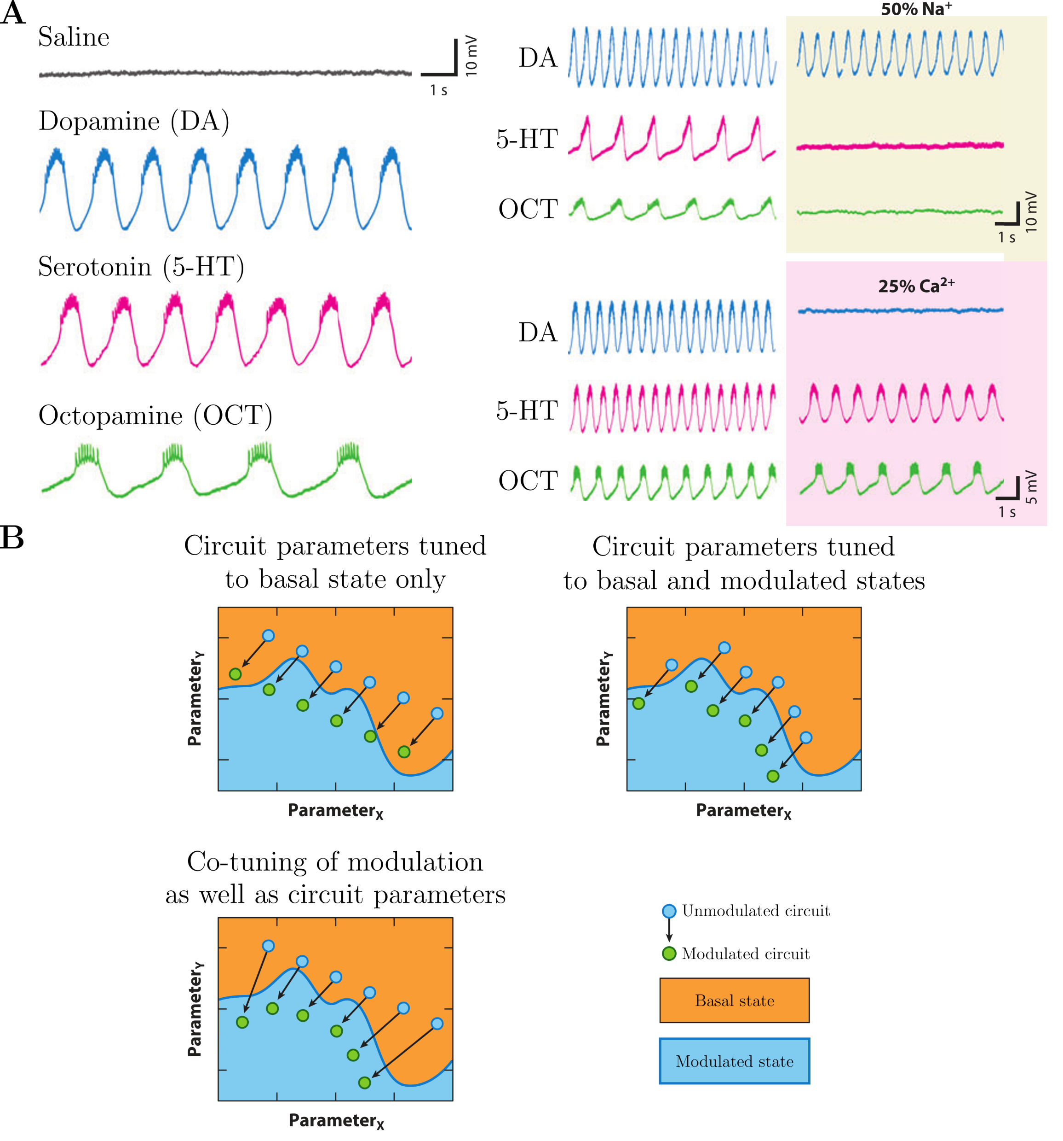
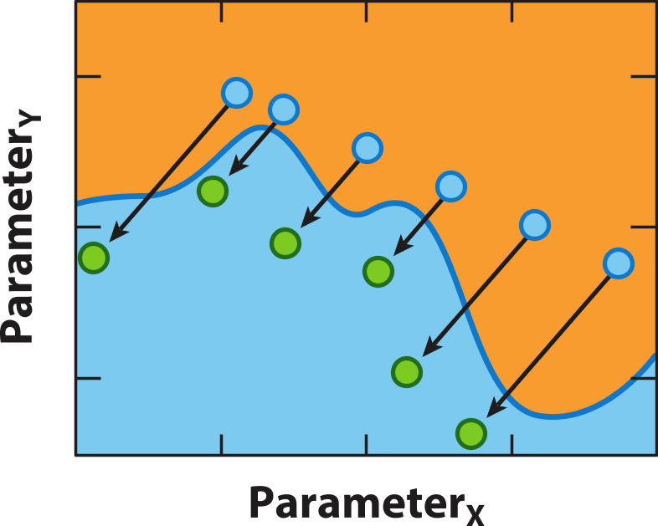
A simple indirect rule for robust neuromodulation
Our rule
Marder et al., 2014
23
Notes:
We can observe neuromodulation paths are linear in a direction that is neuron type dependent, that can be encoded into genes. However, the length of the path, the step, are not encoded, it is neuron dependent. This means that neuromodulation controls each neuron along that direction to control where the neuron has to land.

Slide 32
I. Is there any structure in neuronal degeneracy ?
How can neuromodulation be reliable in a degenerate population ?
II. Is it possible to build a reliable neuromodulation controller ?
III. Is it compatible with homeostatic plasticity ?
Fyon, A., Sacré, P., Franci, A., & Drion, G. (2023). Reliable neuromodulation from adaptive control of ion channel expression. IFAC-PapersOnLine, 56(2), 458-463.
24
Notes:
There are many answers but no real agreement on that question.

Slide 33
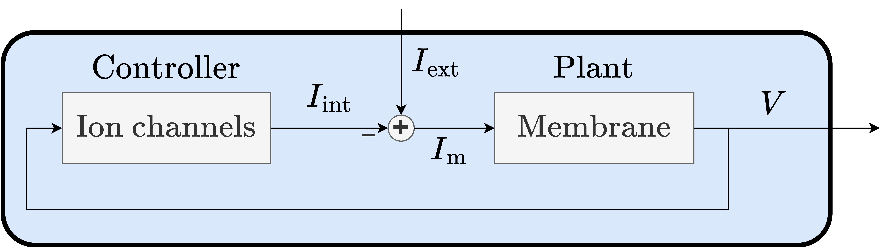
Neuromodulation can be seen as an adaptive control problem
25

Slide 34
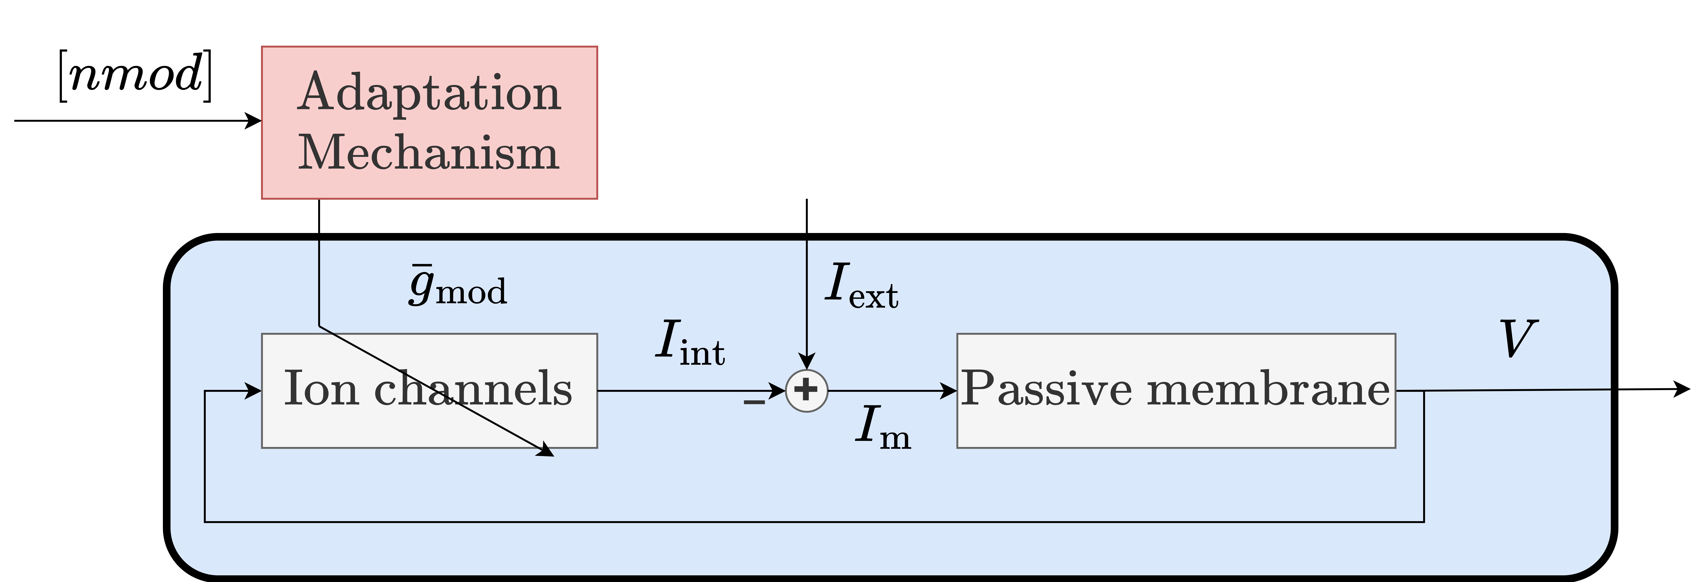
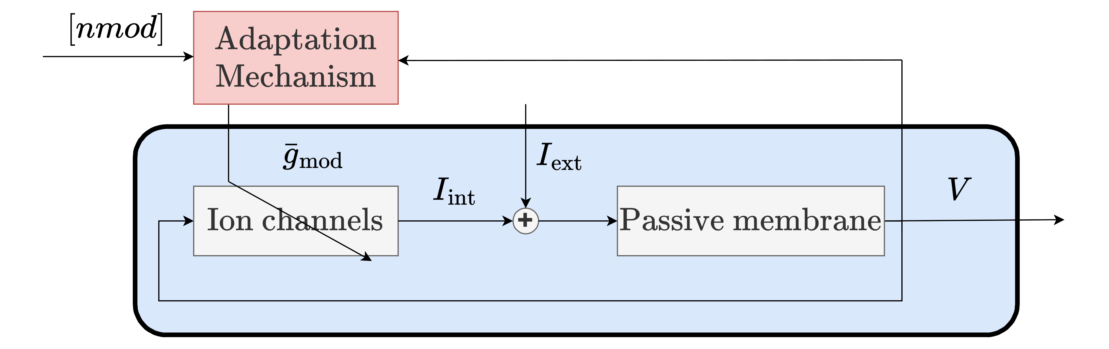
Neuromodulation can be seen as an adaptive control problem
Actual activity
Target activity
25
Notes:
If mismatch, then the controller make adjustment. It is a feedback adaptation on a feedback circuit, in order to produce neuron-dependent changes.

Slide 35
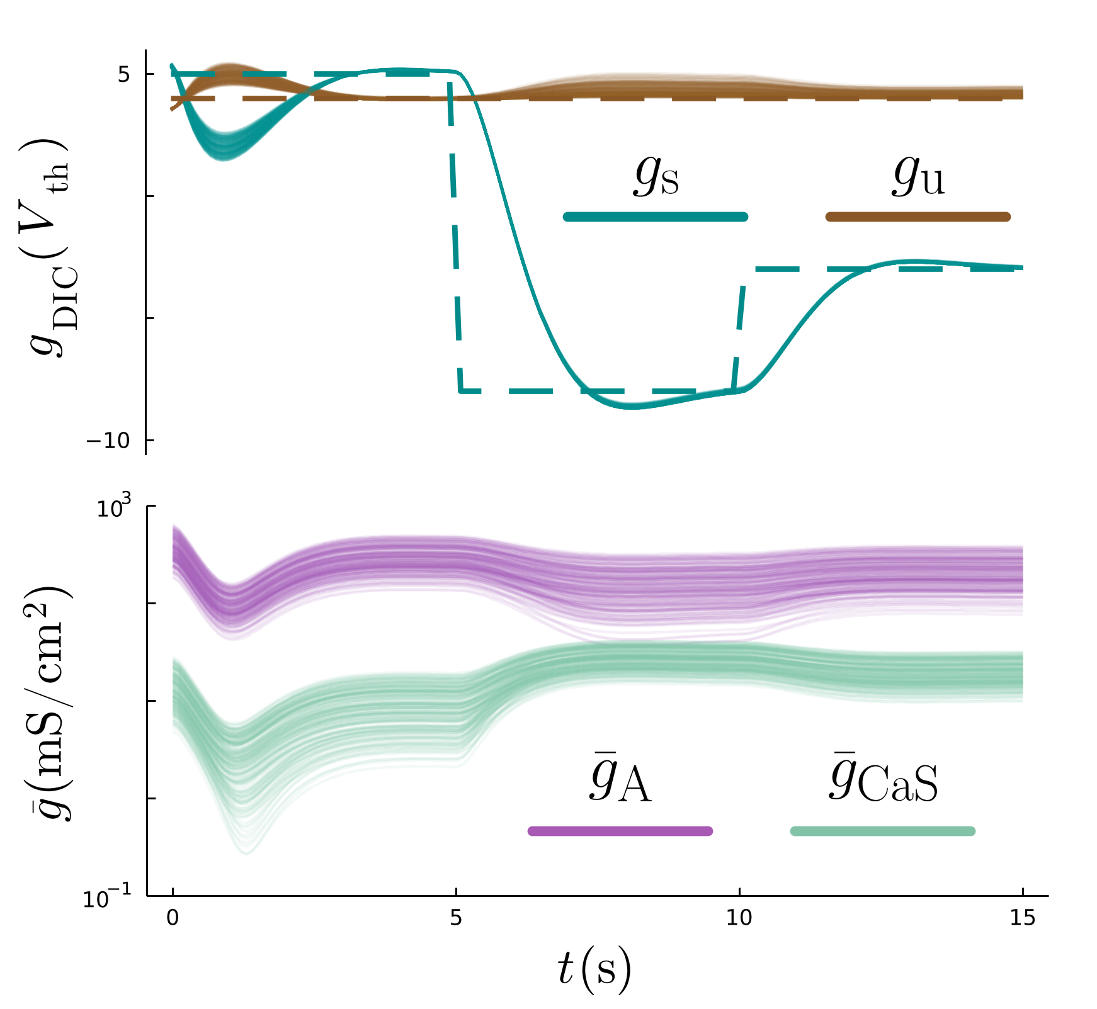
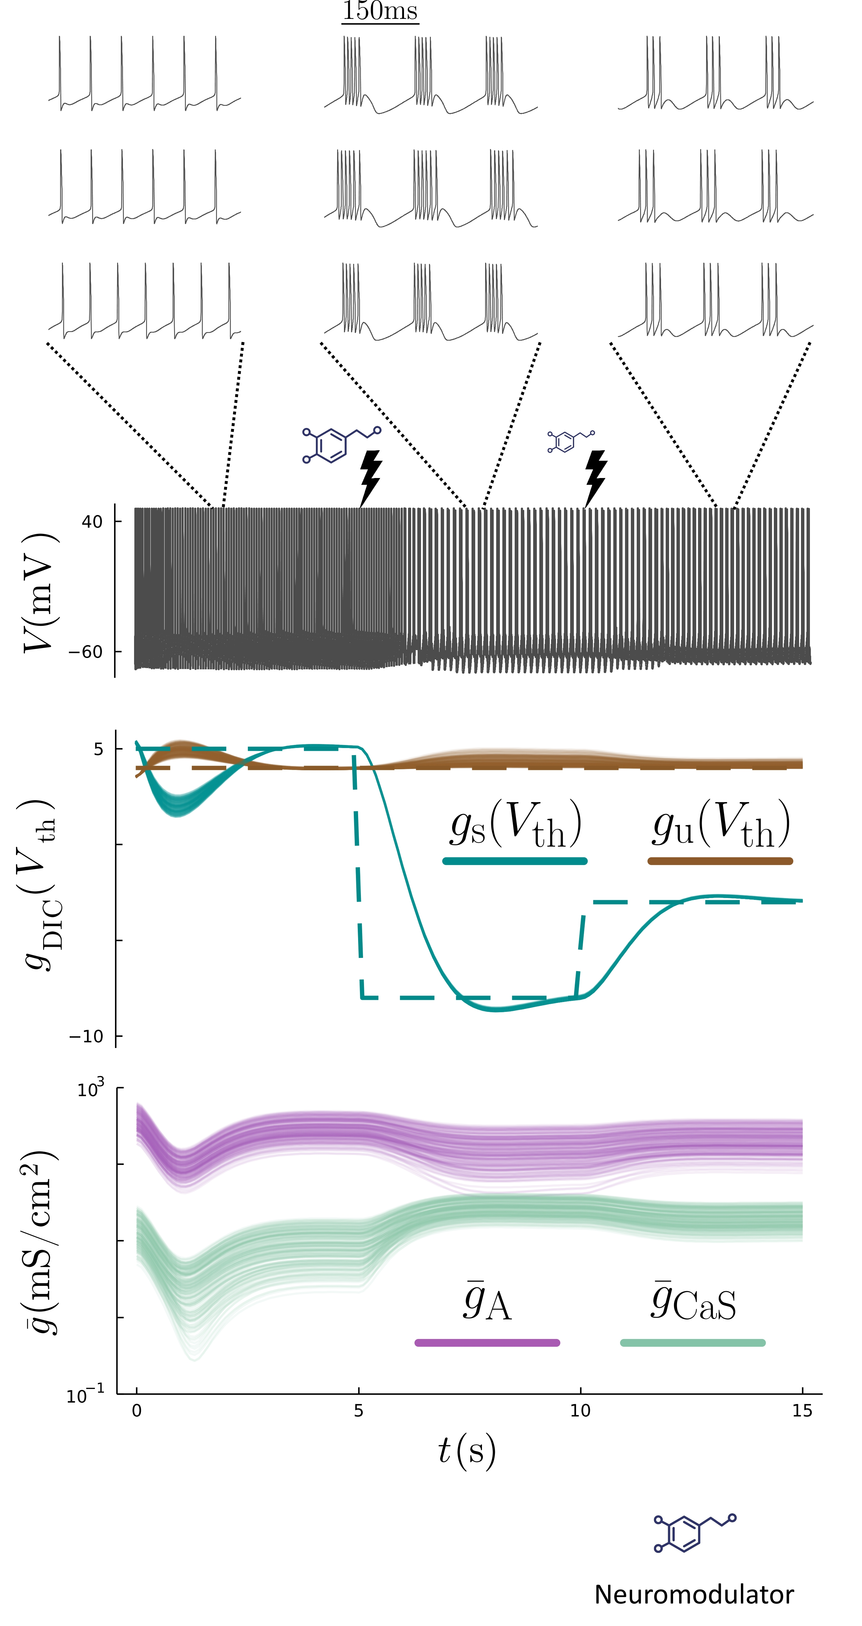
The adaptive controller tunes ion channels in a neuron dependent way
N = 200
26
Notes:
Note that the g bar are logarithmic

Slide 36
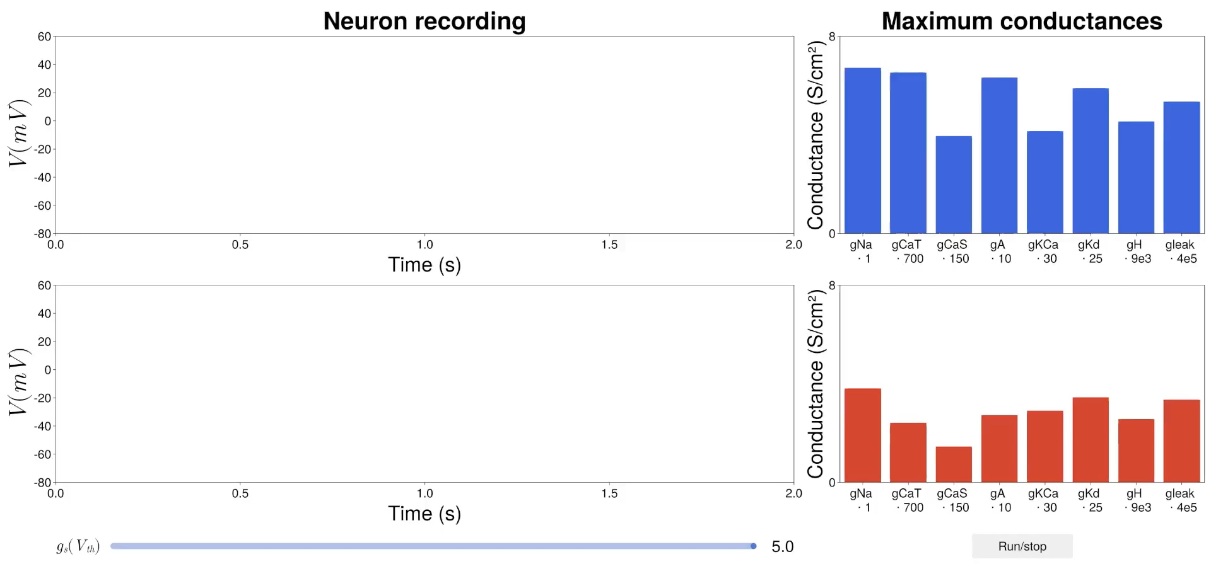
Two degenerate neurons are modulated in a similar way
27

Slide 37
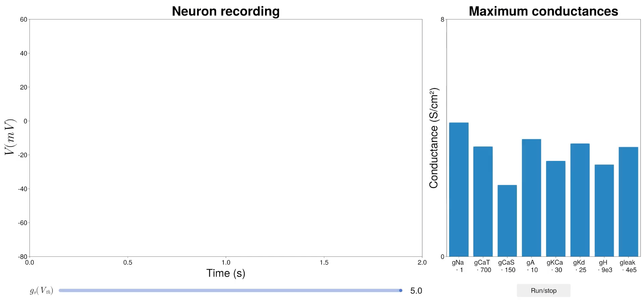
Random noise on conductances is compensated
27
Notes:
Speak about turnover.

Slide 38
Neuromodulation as an adaptive controller is robust to degeneracy
Target activity
Actual activity
28
Notes:
If mismatch, then the controller make adjustment. It is a feedback adaptation on a feedback circuit, in order to produce neuron-dependent changes.

Slide 39
I. Is there any structure in neuronal degeneracy ?
How can neuromodulation be reliable in a degenerate population ?
II. Is it possible to build a reliable neuromodulation controller ?
III. Is it compatible with homeostatic plasticity ?
Fyon, A., & Drion, G. (2024). Neuromodulation and homeostasis: complementary mechanisms for robust neural function. arXiv preprint arXiv:2412.04172.
29
Notes:
I would like to check something…. But function robustness and maintaining over time is important, that is fulfilled by homeostatic plasticity

Slide 40




Controlled neuromodulation leads to high Ca
Apoptosis, toxicity, …
Unmodulated
Modulated
Unmodulated
Modulated
30
Notes:
Function is great but robustness of function over time is important as well.

Slide 41




A model of homeostatic control
O’Leary et al., 2014
31
Notes:
Sensor of mean intracellular calcium to up or downregulate. Ratios of conductances are genetically encoded. Physiological origin of homogeneous scaling.

Slide 42

Homeostasis can lead to pathological excitability in the presence of sharp neuromodulation
32
Notes:
Naïve way of nmod

Slide 43
Homeostasis can lead to pathological excitability in the presence of sharp neuromodulation
32

Slide 44
Homeostasis can lead to pathological excitability in the presence of sharp neuromodulation
32

Slide 45

Why do sharp neuromodulation and homeostasis do not lead to robust neural function?
33

Slide 46

Controlled neuromodulation and homeostasis naturally lead to robust neuronal function
Interaction
N = 200
34
Notes:
Speak about both controllers timescales

Slide 47
Why do controlled neuromodulation and homeostasis lead to robust neural function?
35

Slide 48

Why do controlled neuromodulation and homeostasis lead to robust neural function?
36

Slide 49
Take-home messages
I. Neuronal degeneracy is structured
How can neuromodulation be reliable in a degenerate population ?
II. This structure can be used to build a reliable adaptive controller of neuromodulation
III. Controlled neuromodulation is necessary for homeostasis to produce robust neural function
37
Notes:
There are many answers but no real agreement on that question.

Slide 50

Perspectives
Using dynamic clamp to experimentally validate the controller
Integrate the controller in neuromorphic systems
Sharp et al., 1993
Mendolia, 2024
38
Notes:
Experimental validation of the neuromodulation controller using dynamic clamp on isolated neurons
Development of a degenerate population of neuron models using our generation method based on experimentally recorded spike times (ongoing work by master’s student Julien Brandoit)
Neuromorphic engineering validation of the neuromodulation controller

Slide 51

Perspectives
Development of a method to build a degenerate population based on recorded spike times (ongoing work with Julien Brandoit, master student)
Population generation method of this thesis
39
Notes:
Very large degenerate population (not complete)

Slide 52


Perspectives
Application of the neuromodulation controller on small rhythmic network to produce robust gait control
Gallop
Trot
40
Notes:
Experimental validation of the neuromodulation controller using dynamic clamp on isolated neurons
Development of a degenerate population of neuron models using our generation method based on experimentally recorded spike times (ongoing work by master’s student Julien Brandoit)
Neuromorphic engineering validation of the neuromodulation controller

Slide 53



I.
II.
III.

Slide 54
Supplemental material

Slide 55


STG

Slide 56


STG

Slide 57

DA

Slide 58

DA

Slide 59

James et al., 2017

Slide 60

Barnett and Larkman, 2007

Slide 61

Marder and Weimann, 1992 & Hooper and Marder 1984

Slide 62

Schulz et al., 2006

Slide 63

Mukunda and Narayanan, 2017 & Prinz et al., 2004

Slide 64

Marder et al., 2014

Slide 65
Marder et al., 2014

Slide 66

O’leary et al., 2014

Slide 67

Goaillard and Marder, 2021

Slide 68

Goaillard and Marder, 2021

Slide 69

Goaillard and Marder, 2021

Slide 70

Goaillard and Marder, 2021

Slide 71

Kodama et al., 2020 & Goaillard and Marder, 2021

Slide 72

Nelson and Rinzel, 1995 & Hunter et al., 2002

Slide 73

Yi et al., 2017

Slide 74

Johnson and Chartier, 2017 & Jacquier et al., 2023

Slide 75

Gangopadhyay et al., 2018 & Alonso and Marder, 2019

Slide 76

Drion et al., 2015 & Zang and Marder, 2023

Slide 77

O’Leary et al., 2014

Slide 78

O’Leary et al., 2014

Slide 79

Tatsuki et al., 2016

Slide 80

Drion et al., 2015

Slide 81

Drion et al., 2015

Slide 82

Drion et al., 2015

Slide 83

Drion et al., 2015

Slide 84



Tonic firing
Bursting
Global slow negative feedback
Global slow negative feedback
Local slow positive feedback

Slide 85

Fernandez Lorden et al., 2023 & Schmetterling et al., 2024 & Mendolia et al., 2023

Slide 86
Liu et al., 1998
Qian et al., 2014

Slide 87


Slide 88

1
2
3

Slide 90


Slide 91


Slide 92

Aström and Murray, 2021

Slide 93

Wilkerson, 2016 & Aström and Murray, 2021

Slide 94

Chaffre et al., 2022

Slide 95





Reference for

Slide 97


Slide 98


Slide 99


Slide 100

O’Leary et al., 2014
Notes:
Different ratios encoded lead to different firing excitabilities. Population built with this model align on homogeneous scaling where the slope depends on the encoded ratio.

Slide 102
Interaction

Slide 103


Slide 104


Slide 105


Part IV: Application of neuromodulation in small rhythmic networks
4. Application to network
Gallop
Trot
Barron-Zambrano et al., 2010
Notes:
How can I make neuromodulation of the single cell be applied to small network for behavior. In the literature, different connectome

Slide 106

Gait control using neuromodulation
4. Application to network
Gallop
Trot

Slide 107
Gait control using neuromodulation
4. Application to network
Gallop
Trot

Slide 108
Gait control using neuromodulation
4. Application to network
Gallop
Trot

Slide 109
Gait control using neuromodulation
4. Application to network
Gallop
Trot

Slide 110
Gait control using neuromodulation
4. Application to network
Gallop
Trot

Slide 111






Neuromodulated gait control is robust against neuronal degeneracy
4. Application to network

Slide 112


Neuromodulated gait control is robust against neuronal degeneracy
4. Application to network

Slide 113





Neuromodulatory input
Neuromodulated network
OFF
ON
Dutta et al., 2019
Motor neurons

Slide 114

Barron-Zambrano et al., 2010

Slide 115


Slide 116

Bucher et al., 2015

Slide 117

Bucher et al., 2015

Slide 118

Bucher et al., 2015

Slide 119

Bucher et al., 2015

Slide 120

Danion and Latash, 2010

Slide 121

Brandoit, 2025

Slide 122

Brandoit, 2025

Slide 123

Brandoit, 2025

Slide 124

Brandoit, 2025

Slide 125

Brandoit, 2025

Slide 126


Slide 127


Slide 128


Slide 129


Slide 130


Slide 131


Slide 132


Slide 133


