Slide 1


Working memory represents phonological and semantic information differently
Benjamin Kowialiewski

Slide 2
Immediate serial recall (“simple span”)

Slide 3
lion

Slide 4
sky

Slide 5
desk

Slide 6
minute

Slide 7
wave

Slide 8
coriander

Slide 9
Serial recall
?

Slide 10
Serial recall
Encoding
lion
sky
desk
minute
wave
coriander
Saint-Aubin & Poirier (1999), International Journal of Psychology

Slide 11
Serial recall
Encoding
lion
sky
desk
minute
wave
coriander
Recall
lion
/
minute
desk
pave
coriander
Saint-Aubin & Poirier (1999), International Journal of Psychology

Slide 12
Serial recall
Encoding
lion
sky
desk
minute
wave
coriander
Recall
lion
/
minute
desk
pave
coriander
Item recall
1
0
1
1
0
1
Saint-Aubin & Poirier (1999), International Journal of Psychology

Slide 13
Serial recall
Encoding
lion
sky
desk
minute
wave
coriander
Recall
lion
/
minute
desk
pave
coriander
Item recall
1
0
1
1
0
1
Order recall
1
NA
0
0
NA
1
Saint-Aubin & Poirier (1999), International Journal of Psychology

Slide 14
Phonological similarity
 | Item 1 | Item 2 | Item 3 | Item 4 | Item 5 | Item 6
Rhyming | bat | rat | fat | cat | mat | pat
Non-Rhyming | car | mug | pile | fur | pave | jaw
Gupta et al. (2005), Memory & Cognition

Slide 15
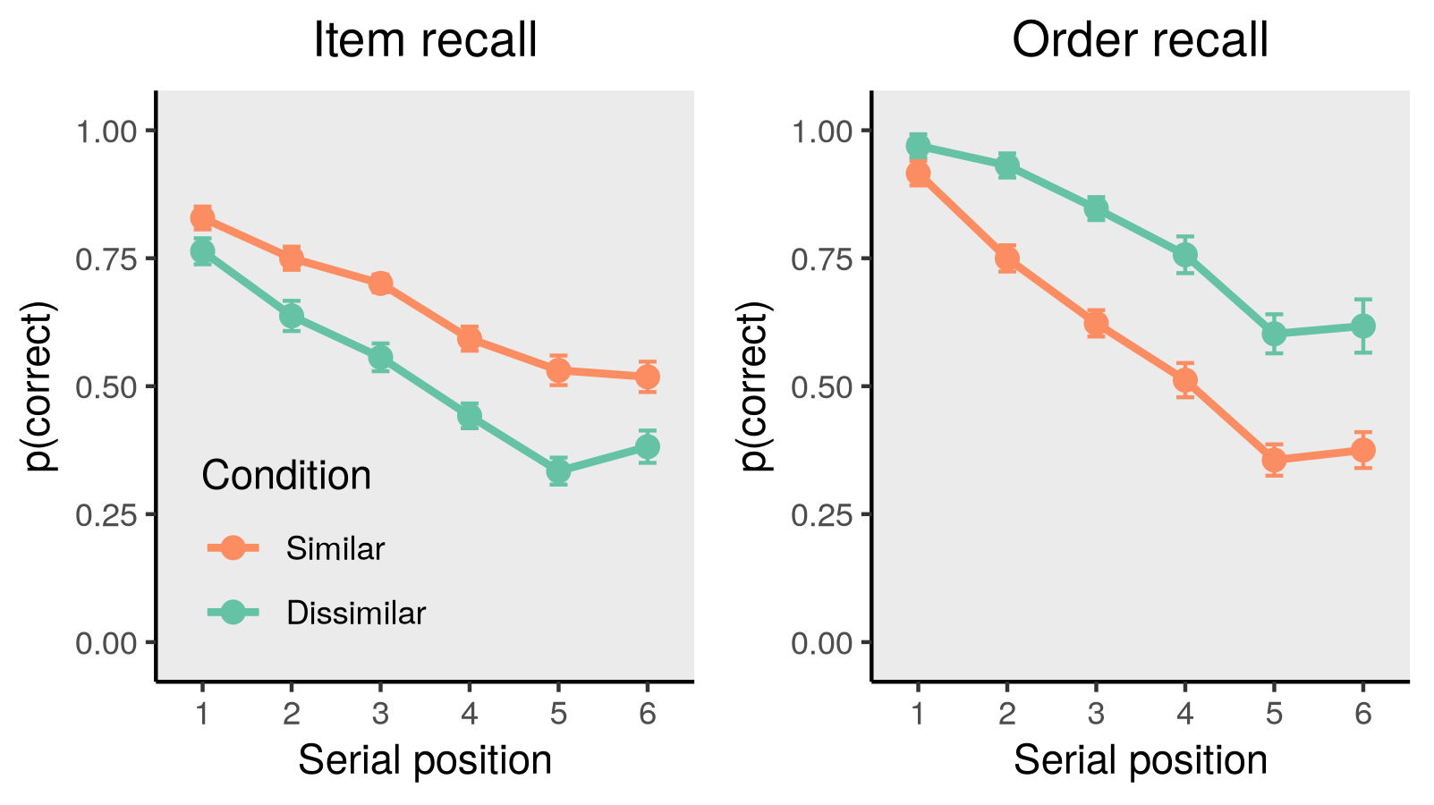
Phonological similarity

Slide 16
Why is the phonological similarity effect so important?

Slide 17
lion
sky
desk
Schweickert (1993) Memory & Cognition

Slide 18
lion
sky
desk
Schweickert (1993) Memory & Cognition

Slide 19
lion
sky
desk
Schweickert (1993) Memory & Cognition

Slide 20
lion
sky
desk
lion
sky
desk
Schweickert (1993) Memory & Cognition

Slide 21
Activation
lion
sky
desk
lion
sky
desk
Schweickert (1993) Memory & Cognition

Slide 22
Activation
lion
sky
desk
lion
sky
desk
Omission threshold
Schweickert (1993) Memory & Cognition

Slide 23
Activation
lion
sky
desk
lion
sky
desk
Omission threshold
cat
bat
fat
Schweickert (1993) Memory & Cognition

Slide 24
Activation
lion
sky
desk
lion
sky
desk
Omission threshold
cat
bat
fat
Schweickert (1993) Memory & Cognition

Slide 25
Activation
lion
sky
desk
lion
sky
desk
Omission threshold
cat
bat
fat
Schweickert (1993) Memory & Cognition

Slide 26
Activation
lion
sky
desk
lion
sky
desk
Omission threshold
cat
bat
fat
cat
bat
fat
Schweickert (1993) Memory & Cognition

Slide 27
Activation
lion
sky
desk
lion
sky
desk
Omission threshold
Activation
cat
bat
fat
cat
bat
fat
Schweickert (1993) Memory & Cognition

Slide 28
Activation
lion
sky
desk
lion
sky
desk
Omission threshold
Activation
cat
bat
fat
cat
bat
fat
Schweickert (1993) Memory & Cognition

Slide 29
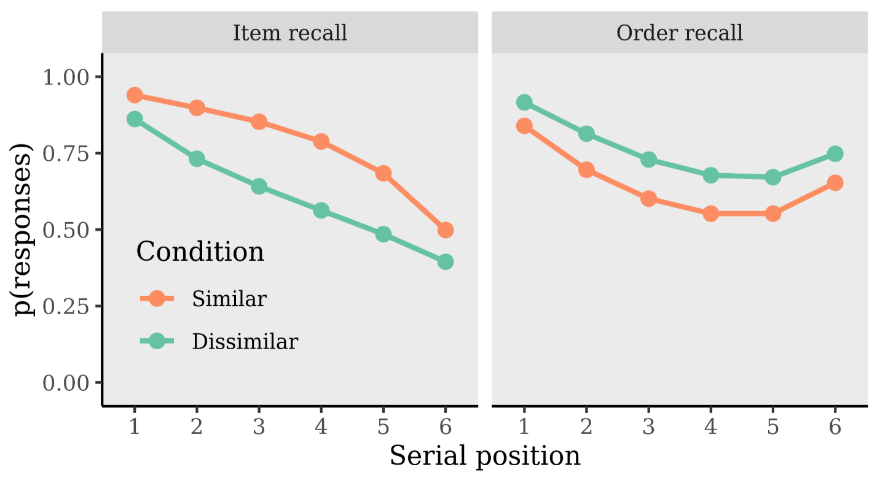
Kowialiewski & Oberauer (under review)

Slide 30
Why is the phonological similarity effect so important?

Slide 31
Why is the phonological similarity effect so important?
Because it shows that working memory represents information in a phonological format.

Slide 32
Hypothesis:
If people encode words' semantics into working memory, they should confuse more often semantically similar than dissimilar items.

Slide 33
Semantic similarity

Slide 34
Semantic similarity
 | Item 1 | Item 2 | Item 3 | Item 4 | Item 5 | Item 6
Similar | leopard | puma | cheetah | tiger | lion | jaguar
Dissimilar | sword | coffee | chair | flower | mirror | shark
Poirier & Saint-Aubin (1995), QJEP

Slide 35
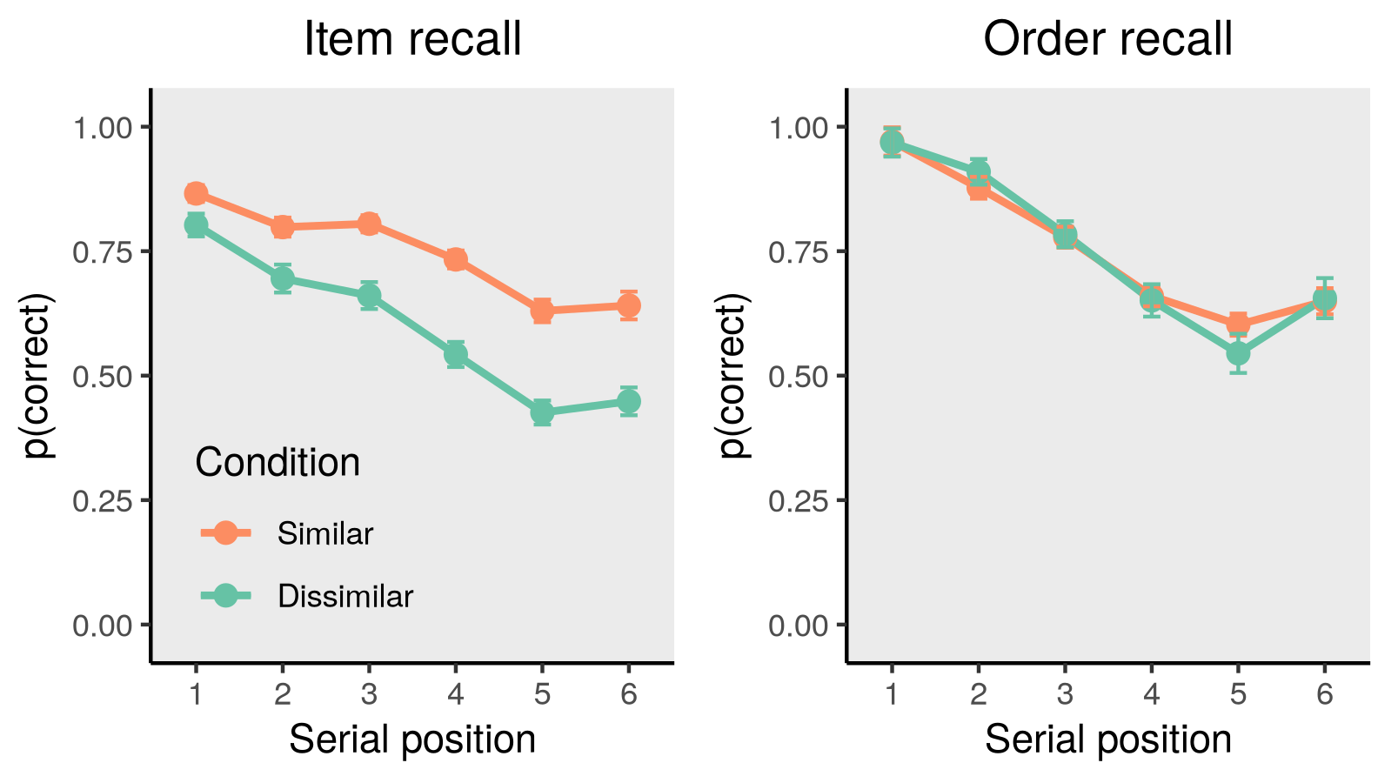
Semantic similarity
Kowialiewski, Krasnoff, Mizrak & Oberauer (2023) Cognition

Slide 36
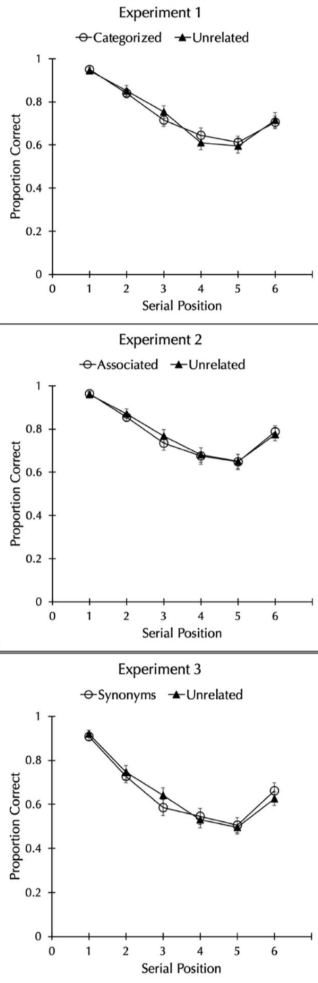
Neath et al. (2022) Experimental Psychology

Slide 37
The working memory system behaves as if it had no information about items’ semantics.

Slide 38

Solution:
Working memory encodes only features that are shared by several items
Kowialiewski & Oberauer (under review)

Slide 39
Dissimilar
Kowialiewski & Oberauer (under review)

Slide 40
Dissimilar
Kowialiewski & Oberauer (under review)

Slide 41
Dissimilar
Similar
Kowialiewski & Oberauer (under review)

Slide 42
Dissimilar
Similar
Kowialiewski & Oberauer (under review)

Slide 43
Activation
lion
sky
desk
lion
sky
desk
Omission threshold
Kowialiewski & Oberauer (under review)

Slide 44
Activation
lion
sky
desk
lion
sky
desk
Omission threshold
Activation
leopard - animal
tiger - animal
lion - animal
leopard - animal
tiger - animal
lion - animal
Kowialiewski & Oberauer (under review)

Slide 45
Activation
lion
sky
desk
lion
sky
desk
Omission threshold
Activation
leopard - animal
tiger - animal
lion - animal
leopard - animal
tiger - animal
lion - animal
Kowialiewski & Oberauer (under review)

Slide 46
Activation
lion
sky
desk
lion
sky
desk
Omission threshold
Activation
leopard - animal
tiger - animal
lion - animal
leopard - animal
tiger - animal
lion - animal
Kowialiewski & Oberauer (under review)

Slide 47
Activation
lion
sky
desk
lion
sky
desk
Omission threshold
Activation
leopard - animal
tiger - animal
lion - animal
leopard - animal
tiger - animal
lion - animal
Kowialiewski & Oberauer (under review)

Slide 48
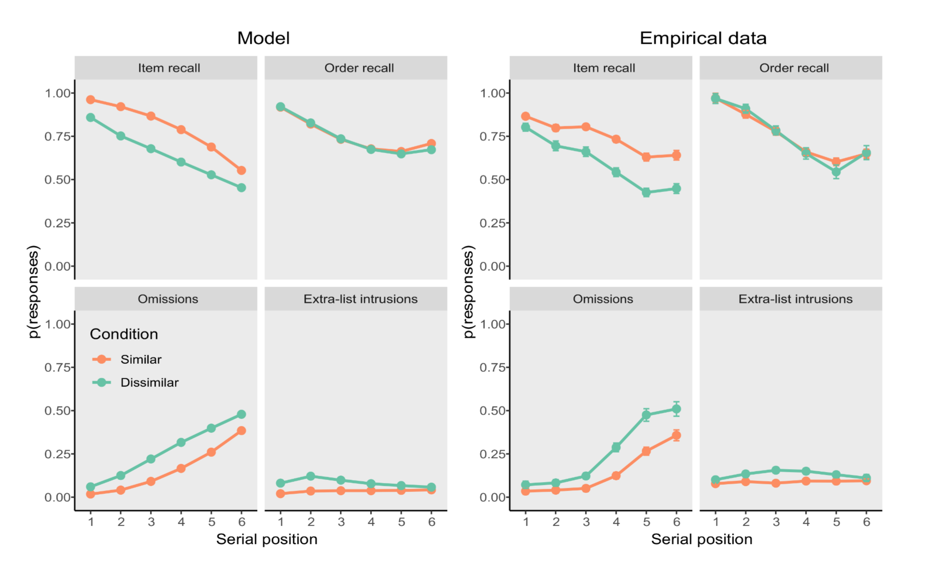
Kowialiewski & Oberauer (under review)

Slide 49
Activation
lion
sky
desk
lion
sky
desk
Omission threshold
Activation
leopard - animal
tiger - animal
lion - animal
leopard - animal
tiger - animal
lion - animal
Kowialiewski & Oberauer (under review)

Slide 50
Kowialiewski & Oberauer (under review)

Slide 51
Kowialiewski & Oberauer (under review)

Slide 52
Phonological similarity increases confusion errors.
Semantic similarity does not.
This calls for different ways of representing semantic information into working memory.
Solution: working memory encodes only shared features.

Slide 53
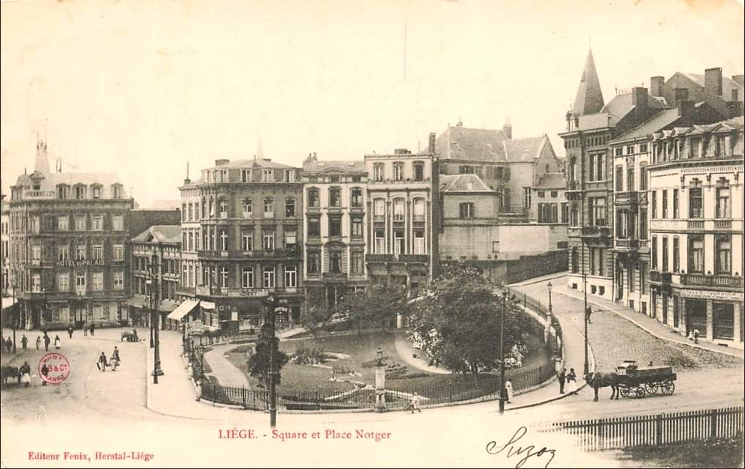
Danke schön
Merci
Dank u wel

Slide 54
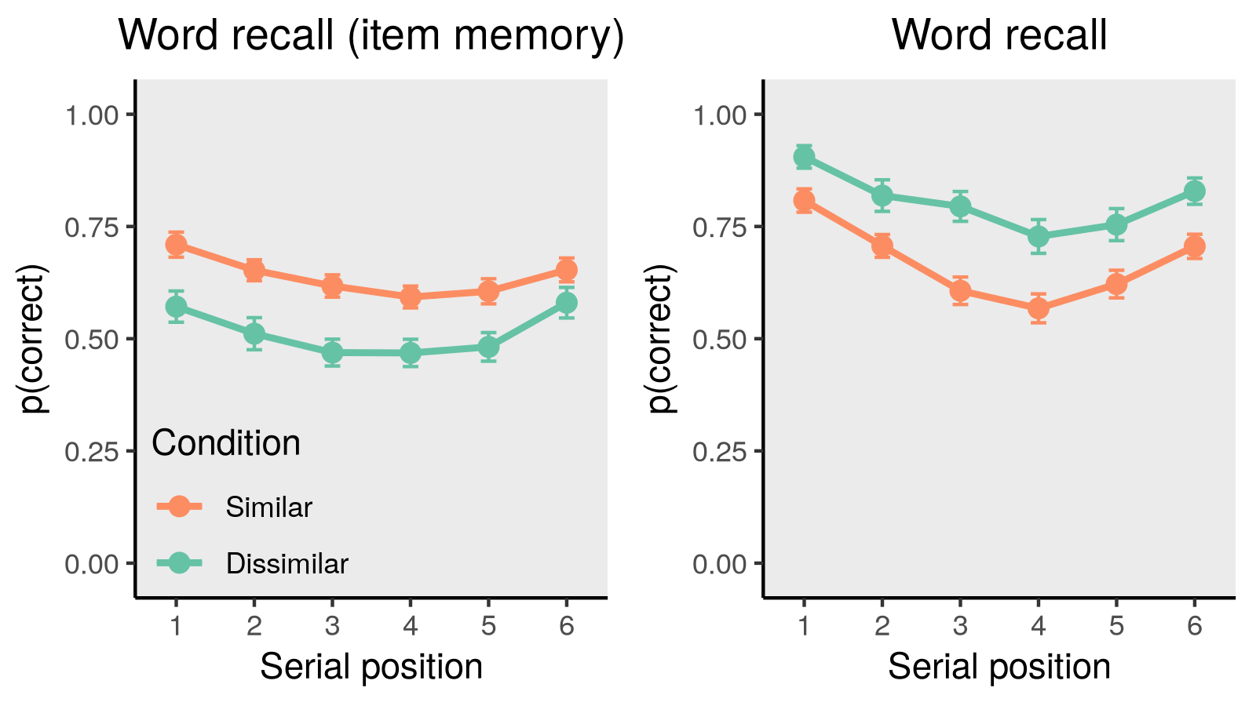
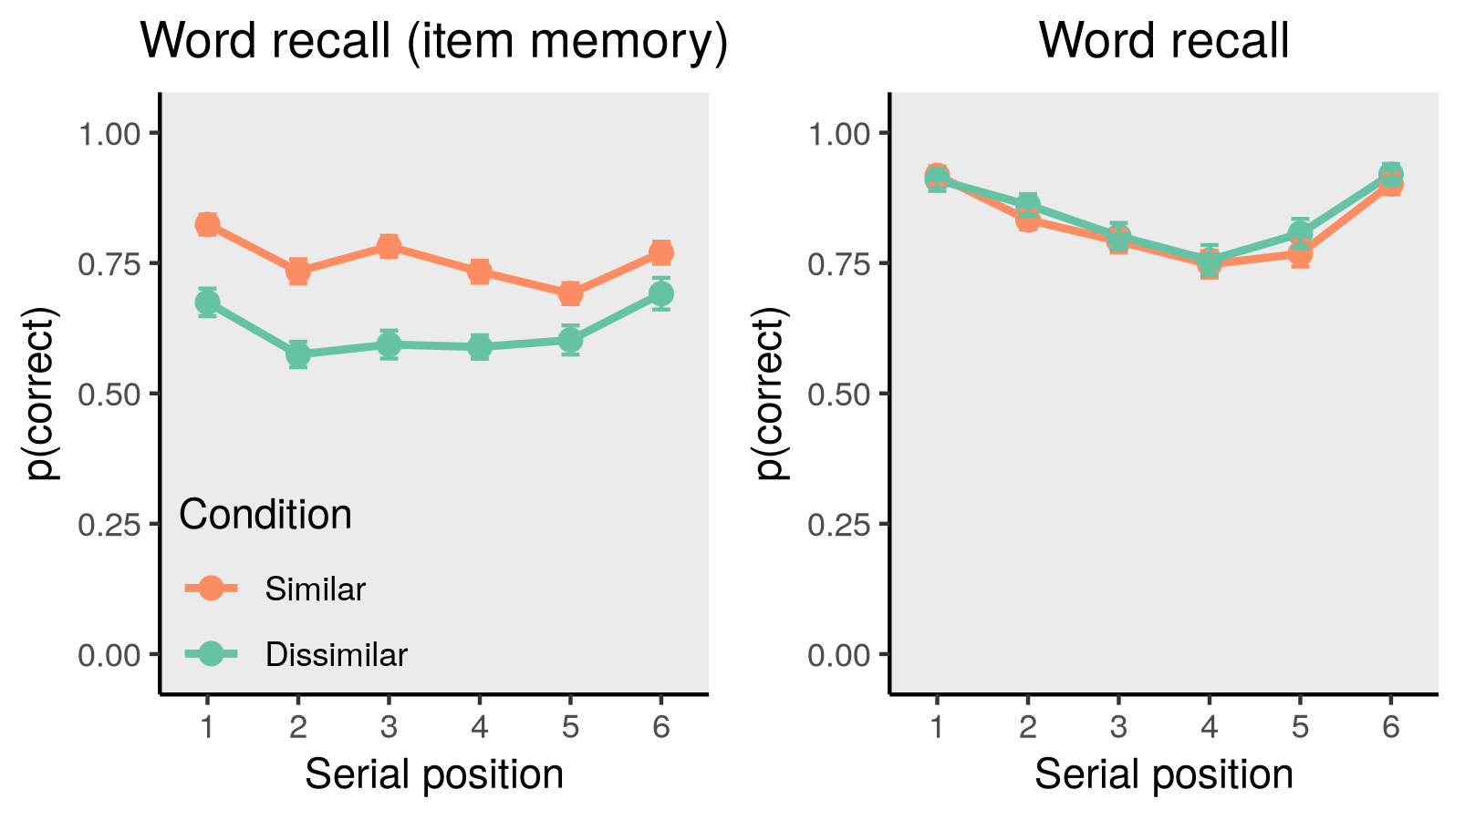
Phonological domain
Semantic domain
Kowialiewski, Krasnoff, Mizrak & Oberauer (2023) Cognition

Slide 55
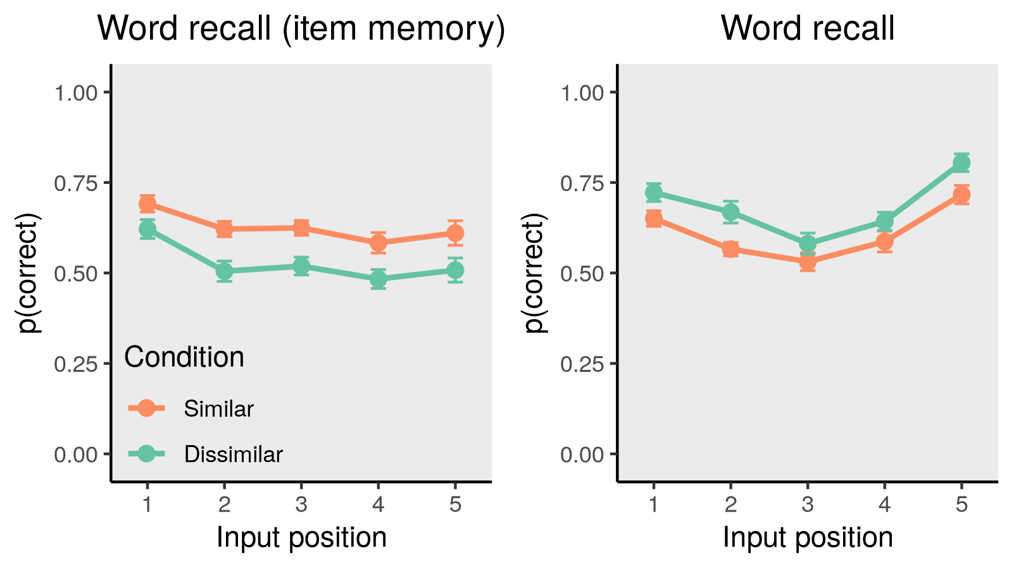
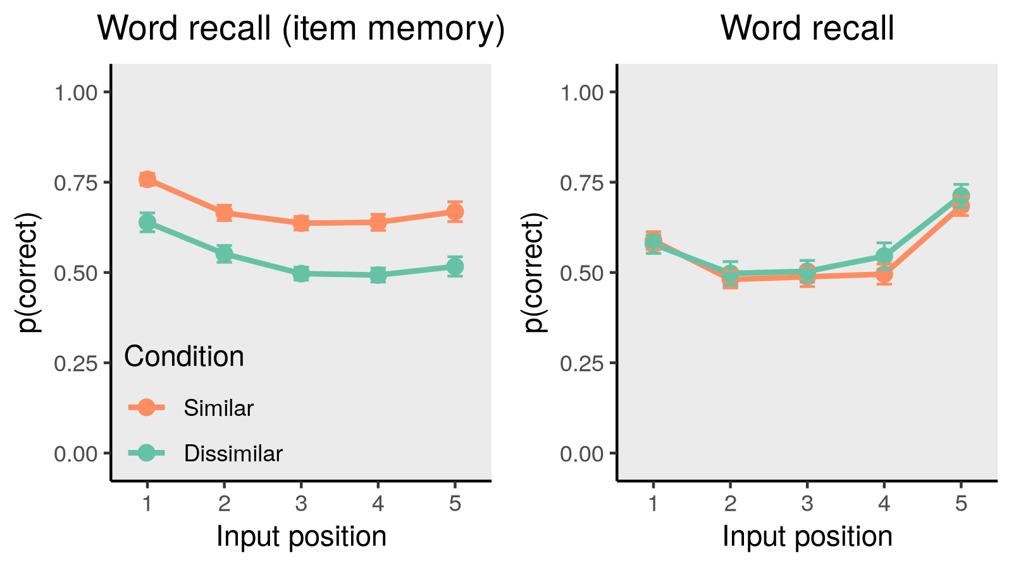
Phonological dimension
Semantic dimension
Kowialiewski, Krasnoff, Mizrak & Oberauer (2023) Cognition

