Slide 1
A typological study of applicative uses of spatial markers: A pilot study
PhD candidate: Timofey Mukhin
Supervisors: An Van linden & Dana Louagie
Linguists’ Day, Linguistic Society of Belgium
University of Mons, 11 October 2024

Slide 2
Outline
Introduction
Sample & data collection
Analysis & results
Conclusion

Slide 3
1. Introduction

Slide 4
What are applicatives?
(1) San Lucas Quiaviní Zapotec (Zapotecan; Munro 2000: 285–286 cited in Zúñiga & Creissels 2024: 4)
a. B-ìi’lly Gye’eihlly cëhnn Jwaany.
pfv-sing M. with J.
b. B-ìi’lly-nèe Gye’eihlly [Jwaany].
pfv-sing-appl M. J.
‘Mike sang with John.’
Applicatives: morphological verb markers that increase the valency of verbs (= the number of arguments), by allowing “the coding of a thematically peripheral argument or adjunct as a core-object argument” (Peterson 2007: 1).
Broader definition from Zúñiga & Creissels (2024: 4): introduced argument (applied phrase) need not be a core argument
Base Construction = BC
Applicative Construction = AC

Slide 5
Previously established sources
Traditionally two independent (direct) sources for applicatives: adpositions and verbs (Peterson 2007:125)
New sources:
+ nouns (as direct source) (Nordlinger 2019: 423; Arkadiev 2021: 50)
+ classifiers (Rose 2019)
+ spatial verb morphology (Van linden 2022; Payne 2021)

Slide 6
Spatial verb morphology
Harakmbut (isolate, SA; Van linden 2022: 130, 142, 148)
(2) ken-taʔ ãrĩ-tẽ kuru-te on-niŋ-on-tuk-po…
dist-loc filler-loc patio-loc 3pl.ind-ben.appl-spat:on-plant-dep
‘Then, eh, they planted her on the patio for him [i.e. the jaguar]…’
(3) o-wedn-ato ãnĩ [bisikleta] o-n-kot
3sg.ind-lie-am:move&do filler bicycle 3sg.ind-spat:on-fall
‘He falls (literally: ‘moves and lies down’), eh, he falls onto his bike.’
(4) men-pa an-on-ka-tuy, tia
which-manner 3pl.dub-spat:on-do-rem.pst.indir.evd aunt
‘How did they do it to him, auntie?’
spatial marker
spatial, applicative
non-spatial, applicative
→ single grammaticalization path

Slide 7
Research questions
RQ1: How widespread is the applicative use of spatial markers in the world’s languages? Any areal/genetic patterns?
RQ2: What are the characteristics of spatial markers with applicative uses or applicative markers of spatial origin?
Some parameters of variation:
functional type of spatial markers (SMs)
syntactic effect of the applicative marker
semantic role of the applied phrase

Slide 8
2. Sample & data collection

Slide 9
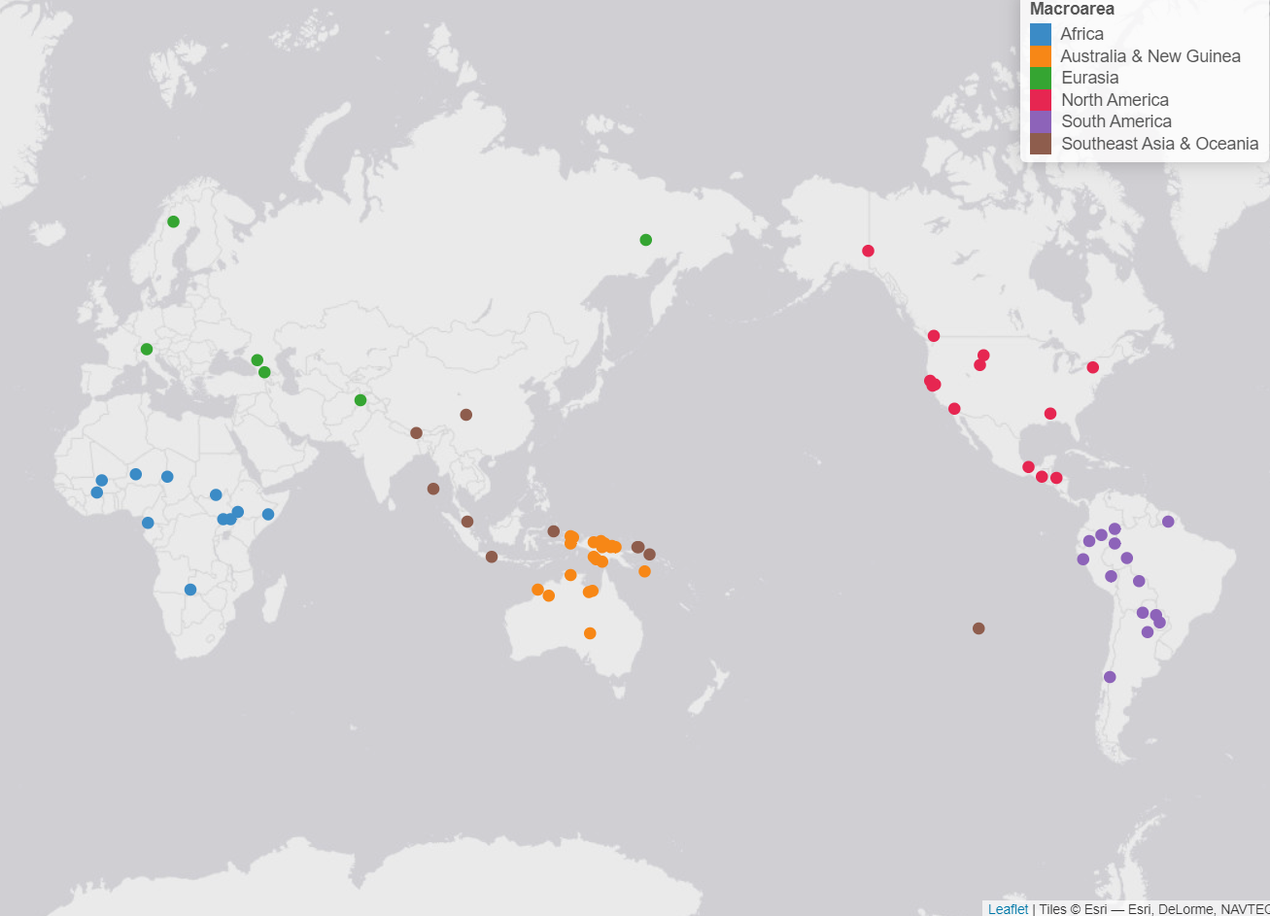
Sample and data collection
75 languages
(ultimate goal: 240)
Genus-Macroarea method (Miestamo 2005):
unrelated at level of genus
from 6 macroareas in proportion to their genealogical diversity
+ from most recent sources
Figure 1. 75-language sample

Slide 10
3. Analysis & results

Slide 11
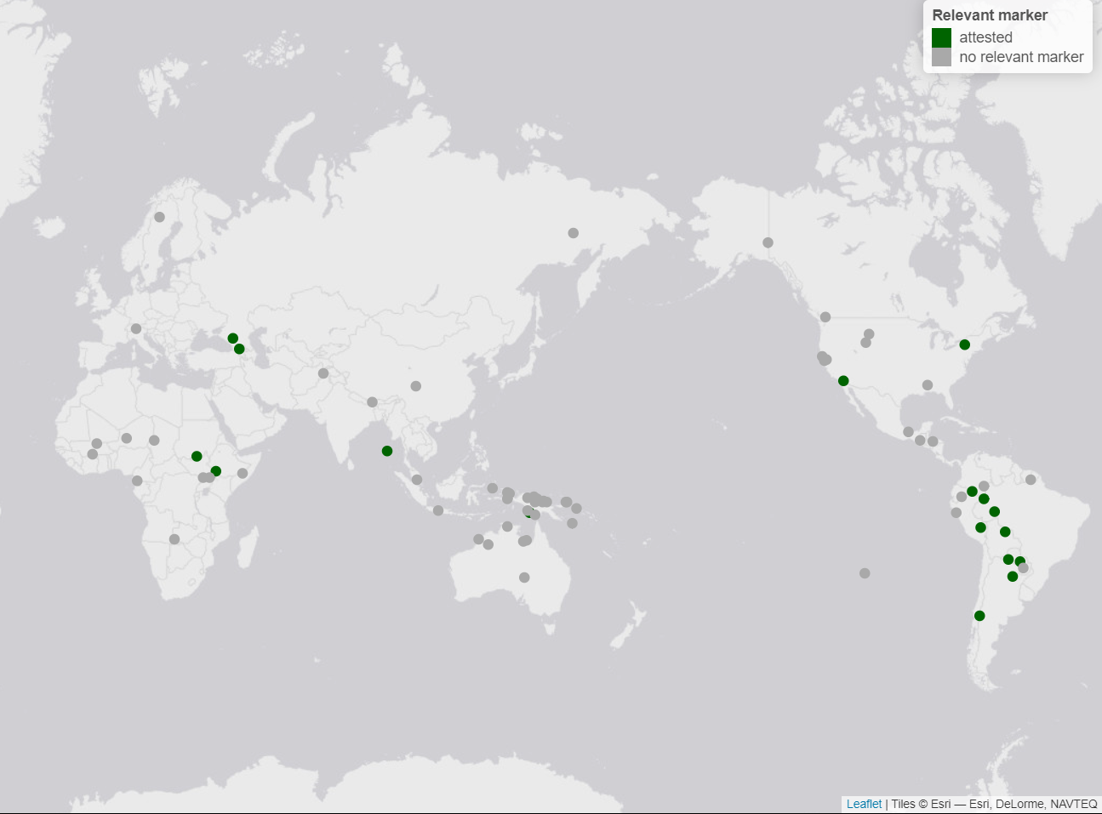
RQ1
23% (n=17) languages of the sample
25 markers so far
Figure 2. Spatial markers with applicative uses

Slide 12
Parameters of variation (RQ2)
functional type of spatial markers (SMs)
syntactic effect of the applicative marker
semantic role of the applied phrase
General problem with (i): so far, no comprehensive typological studies of spatial verb morphology which provide an overview of all possible types of SMs (Plungian 2002: 3; Forker 2019: 92; Ross 2021: 32)
Bottom-up approach: data from grammars → language reports → typology of the parameters of variation

Slide 13
RQ2: (i) type of spatial marker
Classification in this study based on two parameters:
1. Type of spatial meaning coded (Guillaume & Koch 2021: 3; Ross 2021: 35; Ganenkov 2009: 127; Kibrik 1970)
Direction (e.g. ventive go → come)
Localization (e.g. super sleep on X)
Associated Motion (e.g. subsequent ventive sleep and then come)
2. Semantic type of verb with which SM is attested
Motion verb (e.g. walk)
Non-motion verb (e.g. sleep)
→ Two major classes of SMs:
Dedicated = one meaning regardless of the verb type
Mixed = various types of meanings with different types of verb

Slide 14
RQ2: (i) type of spatial marker
(5) Abaza (Northwest Caucasian, E) (Arkadiev 2021: 40), (O’Herin 2002: 64)
a. non-motion verb: localization SUPER (contactless)
a-č’ḳʷən a-ʒəχ’ d-a-qa-ĉ-ṭ
def-youth def-spring 3sg.h.abs-3sg.n.io-loc-sleep(aor)-decl
‘The guy fell asleep over the spring of water.’
b. motion verb: direction upwards
a-mara (j-)ʕa-qa-l-əj-d
def-sun (3sg.n.abs-)cisl-loc-go.in-prs-decl
‘The sun rises’.
→ qa- = DIR/LOC

Slide 15
Results RQ2: (i) type of spatial marker
Table 1. Types of SMs attested with applicative uses
 | AM | DIR/AM | DIR | DIR/LOC |  | total
attested types of SMs | 16% (4) | 16% (4) | 28% (7) | 40% (10) |  | 25
 | Direction(+Motion) |  |  |  | Localization
DIR/LOC → SUPER (n=7) or IN (n=3)
AM, DIR/AM, DIR → no preferences

Slide 16
RQ2: (ii) syntactic effect of applicative
1. Syntactic Status of the applied phrase (AppP) in the AC:
P-applicative — AppP = direct object
D-applicative — AppP = dative/indirect object
X-applicative — AppP = oblique
2. Status of the semantic equivalent (BaseP) of the AppP in the BC:
Optional applicative — BaseP present in the BC
Obligatory applicative — BaseP obligatorily absent from the BC
3. Sensitivity to syntactic valency (relevant for P-applicatives):
Transitivizing applicative — increases number of core syntactic arguments in BC
Redirecting applicative — introduction of AppP + demotion of non-Actor argument (up to omission)

Slide 17
RQ2: (ii) syntactic effect of applicative
Georgian (Kartvelian, E; Hewitt 1995: 184)
(6) locative optional D-applicative
a. k'ac-ma k'onvert’-ze misamart-I da-(Ø-)c'er-a
man-erg envelope-on address-nom prev-(it-)write-he(aor)
b. k'ac-ma [k'onvert’-s] misamart-I da-(Ø-Ø-)a-c'er-a
man-erg envelope-dat address-nom prev-(it-it-)appl-write-he(aor)
‘The man wrote the address on the envelope.’
Murui (Witotoan, SA; Wojtylak 2020: 344)
(7) source obligatory X-applicative
[Alexis jo-fo-mona] Fransiska=dɨ-no-moloc gui-zaɨbi-t-epred
Alexis house-clf-abl Francisca=at-clf-loc eat-ventv-lk-3
‘From the house of Alexis (she) came to eat at Francisca’s.’
BC
AC

Slide 18
RQ2: (ii) syntactic effect of applicative
Agar Dinka (Nilotic, not in the sample; Andersen 1992-1994: 10 cited in Payne 2021: 719)
(8) P-applicative (redirecting)
a. ḏɔ̤ɔk à-bòk dít
boy decl-throw bird
‘The boy is throwing at the bird.’
b. ḏɔ̤ɔk à-bóok [doòot]
boy decl-throw:itv stone
‘The boy is throwing a stone thither.’
Direct object = Goal in BC (8a) → Direct object = Theme in AC (8b)
BC
AC

Slide 19
Results RQ2: (ii) syntactic effect of applicative
Table 2. Syntactic effect of SM with applicative uses
 | Obligatory | Optional | Total
P-applicative | 60% (15) | 16% (4) | 76% (19)
D-applicative | 0 | 12% (3) | 12% (3)
X-applicative | 12% (3) | 0 | 12% (3)
total | 72% (18) | 28% (7) | 100% (25)
Not attested in the pilot sample:
Obligatory D-applicative
Optional X-applicative: also not attested cross-linguistically (Zúñiga & Creissels 2024: 21)
Redirecting applicative

Slide 20
RQ2: (iii) semantic role of AppP
Table 3. Attested semantic roles of AppP
Functions of applicative markers:
Adding a “spatial” applied phrase
Adding a “non-spatial” applied phrase
role type | semantic role | example
Spatial | Source | ‘walk from X’
 | Goal | ‘walk to X’
 | Location | ‘walk in X’
Non-spatial | Recipient | ‘send to X’
 | Beneficiary | ‘fish for X’
 | Maleficiary | ‘cast a spell on X’
 | Instrument | ‘walk using X’
 | Comitative | ‘walk with X’
 | Experiencer | ‘smth happened to X’
 | Reason | ‘kill because of X’
 | Stimulus | ‘dream of X’
 | Subject matter | ‘lie about X’
 | Standard of comparison | ‘be taller than X’

Slide 21
RQ2: (iii) semantic role of AppP: spatial
spatial marker
spatial, applicative
non-spatial, applicative
Murui (Witotoan, SA; Wojtylak 2020: 532, 375, 434, 344)
(9) ventive/reversive directional
bi-e nokae da-ma faɨri-yaɨ-kai-d-epred joraida ie dane abɨdo
this.cts-clf canoe one-clf float-?-incp-lk-3 lake conn once again
rii-zaɨbi-d-epred
arrive-ventv-lk-3
‘This canoe floated away (lit. alone) at the lake, and, once again, it came back.’
(10=7) source obligatory X-applicative/prior subject ventive AM (motion-cum-purpose)
[Alexis jo-fo-mona] Fransiska=dɨ-no-moloc gui-zaɨbi-t-epred
Alexis house-clf-abl Francisca=at-clf-loc eat-ventv-lk-3
‘From the house of Alexis (she) came to eat at Francisca’s.’

Slide 22
RQ2: (iii) semantic role of AppP: refuting hypothesis
spatial marker
spatial, applicative
non-spatial, applicative
Tikuna (Tikuna, SA; Bertet 2020 : 218, 583)
(11) SUPER(/DIST) locational
ye̊-má níì=ĩ̊ rǜ yĕʼ-àkǜ=ã̄ʼa
dist-anaph 3m=be and dist.ploc-approx=quot
tà=chó-pétǖ-ʼü̃́ ĩʼ̆pémá-gù=ãʼ̄a…
3.sbj=be.there.pl-across-sub edge.of.the.jungle-ploc=quot
‘So, they would spend their time over there, at the edge of the jungle…’
(12) experiencer obligatory P-applicative
[mārǖ mù-ʼè yá=dùü̃̄-ʼè-ʼü̃̄] ná=ǘ-pétǜ i=̀ñå-à caso
prf be.several-rel lk=be.a.human-rel-acc 3m=be.there.sg-across lk=prox-exo case
‘[...] this thing has happened to several people.’

Slide 23
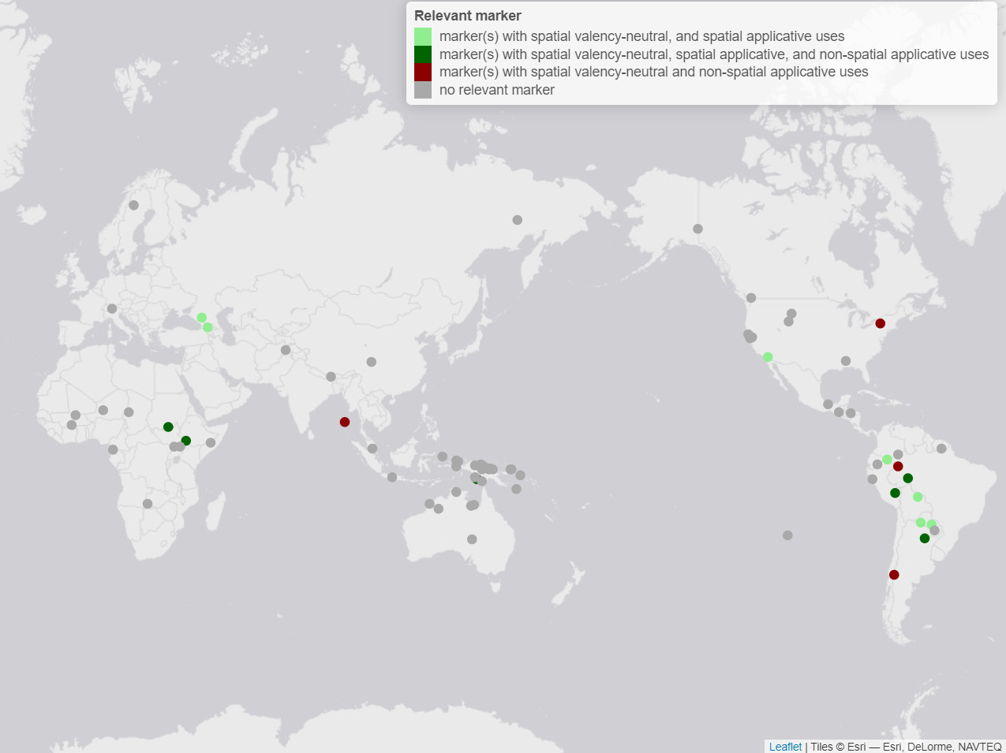
Results RQ2: (iii) semantic role of AppP
Figure 3. Types of semantic role(s) of Applied phrase

Slide 24
Results RQ2: type of spatial marker & semantic role
Skewed distribution of non-spatial semantic roles over types of SMs:
Beneficiary, Standard of Comparison, Subject Matter: only attested with AM, DIR or DIR/AM markers (never with Localization markers)
Maleficiary, Reason, Comitative, Experiencer: only attested with Localization markers (DIR/LOC)
Recipient, Stimulus, Instrument: no bias
Table 4. Semantic roles attested for different types of SMs
Table 5. Non-spatial roles of AppP per SM type (SM might add ≥ 1 semantic role)
 | ben | soc | subjm | rec | stim | inst | exp | com | reas | mal
No Localization (n=10) | 2 | 2 | 1 | 2 | 2 | 1
Localization (n=15) |  |  |  | 1 | 2 | 1 | 1 | 2 | 4 | 4

Slide 25
4. Conclusion

Slide 26
RQ1: How widespread is the applicative use of spatial markers in the world’s languages? Any areal/genetic patterns?
Relevant markers:
23% languages of the sample (17 out of 75 languages), 25 markers attested so far
Attested in all macroareas
>50% (n=14) of the cases in South America

Slide 27
RQ2: What are the characteristics of spatial markers with applicative uses or applicative markers of spatial origin?
(i) type of spatial marker
Most frequent: DIR/LOC (40%: n=10)
If Localization: either SUPER or IN
(ii) syntactic effect of applicative
X-applicatives typically obligatory (n=3);
D-applicatives typically optional (n=3);
P-applicatives more often obligatory (n=15) than optional (n=4)
(iii) semantic role of AppP
Skewed distribution of non-spatial semantic roles over types of SMs

Slide 28
Further research questions
RQ3: What do our findings tell us about the correlations established in the literature?
E.g., Peterson’s hierarchy (2007: 229) of the semantic roles of applied phrases:
BEN > INST, COM > LOC, CIRCUM
RQ4: What are the diachronic implications of our findings?

Slide 29
References (1)
Andersen, T. 1992‒1994. Morphological stratification in Dinka: On the alternations of voice quality, vowel length and tone in the morphology of transitive verbal roots in a monosyllabic language. Studies in African Linguistics 23(1), 1‒63.
Arkadiev, P. 2021. Between noun incorporation and lexical affixation in Northwest Caucasian (with focus on Abaza). Paper presented at Stockholm University, 9 Dec 2021, online.
Belkadi, A. 2016. Associated Motion Constructions in African Languages. Africana Linguistica 22, 43–70.
Bertet, D. 2020. Aspects of Tikuna grammar (San Martin de Amacayacu variety, Colombia) : phonology, nominal phrase, predicative phrase.
Broadwell, G. A. 2006. A Choctaw Reference Grammar. (Studies in the anthropology of North American Indians.) Lincoln: University of Nebraska Press.
Dixon, R. M. W. 2004, The Jarawara Language of Southern Amazonia, Oxford University Press.
Forker, D. 2019. Elevation as a category of grammar: Sanzhi Dargwa and beyond. Linguistic Typology 23(1). 59–106. https://doi.org/10.1515/lingty-2019-0001
Ganenkov, Dmitry. 2009. Towards a typology of attachment markers: Evidence from East Caucasian languages. In Patience Epps & Alexandre Arkhipov (eds.), New challenges in typology: Transcending the borders and refining the distinctions, 127–148. Berlin: Mouton de Gruyter.
Guillaume, A. & Koch, H. (eds.). 2021. Associated Motion, Berlin: De Gruyter.
Guérois, R., Gibson, H. & Persohn, B. 2021. Associated motion in Bantu languages. In Guillaume, A. & Koch, H. (eds.), Associated motion, 569-610. Berlin: De Gruyter.

Slide 30
References (2)
Kibrik, A.E. 1970 K tipologii prostranstvennykh znachenii (na materiale padezhnykh sistem dagestanskikh yazykov) [Towards a typology of locative meanings (based on case systems of Daghestanian languages)], Yazyk i chelovek, 110–156.
Hewitt, B. G. 1995. Georgian: A Structural Reference Grammar. Amsterdam: John Benjamins.
Miestamo, M. 2005. Standard negation, Berlin: Mouton de Gruyter.
Miestamo, M., Bakker, D. & Arppe, A. 2016. Sampling for variety. Linguistic Typology, 20(2), 233–296. https://doi.org/10.1515/lingty-2016-0006
Moroz G. 2017. lingtypology: easy mapping for Linguistic Typology. https://CRAN.Rproject.org/package=lingtypology.
Munro, P. 2000. The leaky grammar of the Chickasaw applicatives. In Okrent, A. & Boyle, J. (eds.), The proceedings from the main session of the Chicago Linguistic Society’s thirty-sixth meeting, 285–310. Chicago: Chicago Linguistic Society.
Nordlinger, Rachel. 2019. From body part to applicative: Encoding ‘source’ in Murrinhpatha. Linguistic Typology 23(3). 401–433.
O’Herin, B. 2002. Case and Agreement in Abaza. Arlington: SIL International & University of Texas Press.
Payne, D.L. 2021. The extension of associated motion to direction, aspect and argument structure in Nilotic languages. In Guillaume, A. & Koch, H. (eds.), Associated motion, 695-746. Berlin: De Gruyter.
Peterson D.A. 2007. Applicative constructions. Oxford: Oxford University Press.

Slide 31
References (3)
Plungian, V. A. 2002. O specifike vyraženija imennyx prostranstvennyx xarakteristik v glagole: Kategorija glagol’noj orientacii [On the specifics of the expression of nominal spatial properties on the verb: The category of verbal orientation]. In Plungian, V. A. (ed.), Issledovanija po teorii grammatiki. Vyp. 2: Grammatikalizacija prostranstvennyx značenij v jazykax mira, 57–98. Moscow: Russkie Slovari.
Rose, Françoise. 2019. From classifiers to applicatives in Mojeño Trinitario: A new source for applicative markers. Linguistic Typology 23 (3). 435–466.
Ross, D. 2021. A crosslinguistic survey of Associated Motion and Directionals. In Guillaume, A. & Koch, H. (eds.), Associated Motion, 31–86. Berlin: de Gruyter Mouton.
Van linden, A. 2022. Spatial prefixes as applicatives in Harakmbut. In S. Pacchiarotti & F. Zúñiga (eds.), Applicative morphology: Neglected syntactic and non-syntactic, 129-159. Berlin: De Gruyter.
Wojtylak, K. I. 2020. A Grammar of Murui (Bue): A Witotoan language of Northwest Amazonia. Leiden: Brill.
Zuniga, F. & Denis C. 2024. Applicative Constructions in the World’s Languages, Berlin, Boston: Mouton de Gruyter.

Slide 32
Thank you!
Timofey Mukhin <tmukhin@uliege.be>
An Van linden <an.vanlinden@uliege.be>
Dana Louagie <dana.louagie@uliege.be>

