Slide 1
Innovative Applications of Essential Oils in Agronomy and Food Preservation
By invitation of Prof. Zhiguo LI
Marie-Laure Fauconnier-Manon Genva and Clément Burgeon
29/11/2024
Notes:
PAGE D'INTRODUCTION 1 / page permettant l'insertion du titre de la présentation ainsi que d'autres infos (date, lieu, orateur, sous-titre,…)
Si vous souhaitez modifier la photo de fond :
Allez dans le menu « Affichage » > « Masques » > « Masque des diapositives »
Supprimez l’image du drapeau déjà présente
Allez dans « Insertion » > « Photo » et chargez votre image (en veillant à la bonne qualité de celle-ci)
Placez celle-ci en « Arrière-plan » via le menu « Réorganiser »

Slide 2
Conference outline
What is an essentiel oil?
Traditionnal uses of essential oils and market
New applications of essential oils in agronomy
Case study of essential oil injection into apple tree trunks for insect protection
New applications of essential oil in food conservation
Advantages and inconvenients
Perspectives
Notes:
PAGE DE CONTENU 1 / Possibilité d'insérer du texte, des images, de la vidéo, des graphiques …

Slide 3
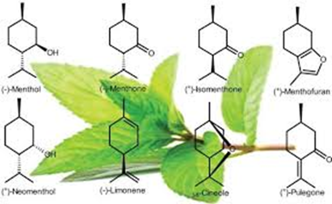
What is an essential oil?
Definition of Eos
Essential oils are complex mixtures of volatile compounds produced by living organisms and isolated by physical means only (pressing and distillation) from a whole plant or a plant part of known taxonomic origin.
A plant extract obtained by solvent extraction (like vanilla) or by supercritical CO₂ is NOT an essential oil !
Essential oils are NOT oils (like peanut oils)
Does all the plants are essential oils bearing plants?
Yes theoretically
No in fact
- typical and unique blend of volatiles (rose, lavender)
- secretion and accumulation in specialized anatomical structures (e.g. trichomes)

Slide 4
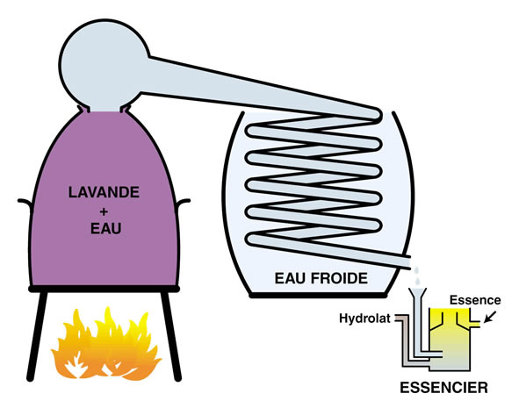
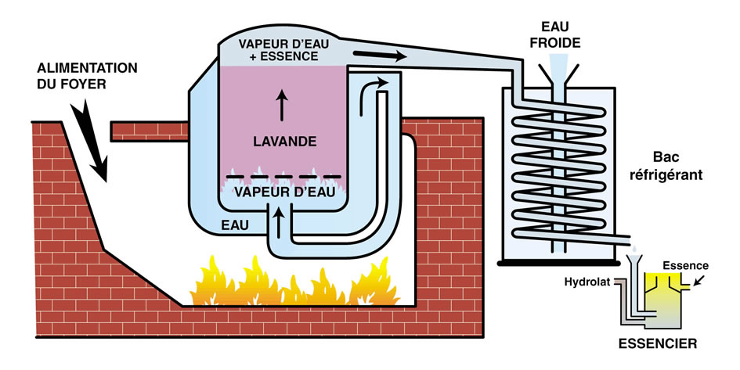
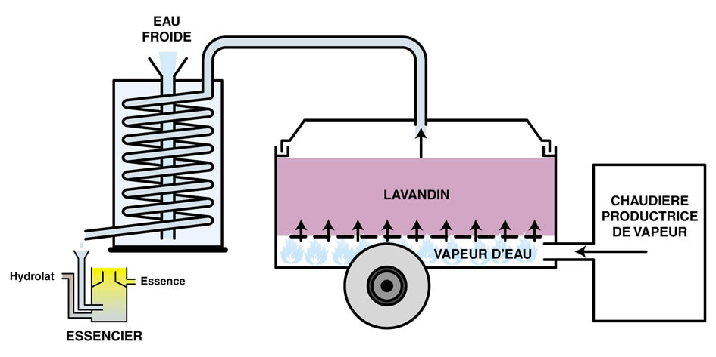
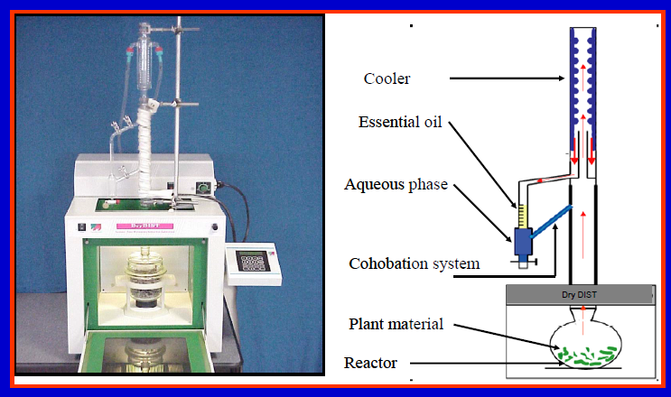
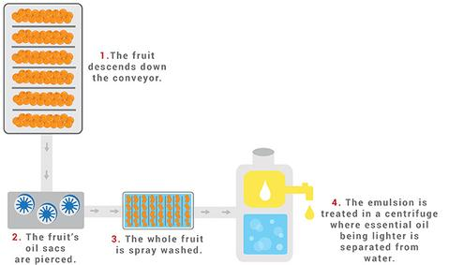
Extraction techniques
Hydrodistillation:
very simple
not expensive
direct contact with plant material
Steam distillation:
more complex
more expensive
no direct contact with plant material
In field steam distillation:
of practical use
direct distillation after harvest
limited volume
Pressing:
used for citrus Eos
Eos contain non volatile compounds
not expensive
Microwave assisted techniques

Slide 5
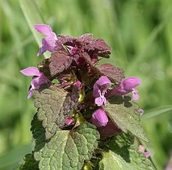
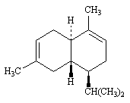
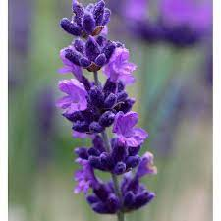
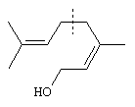
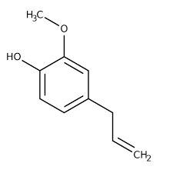
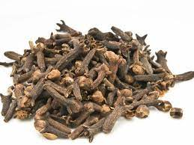
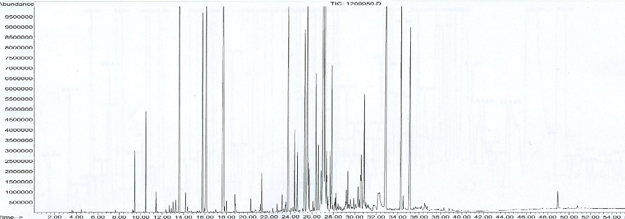
What is an essential oil?
Composition:
Mainly three pathways
- Mevalonate ➔ sesquiterpenes
- Methyl-erythritol ➔ mono and diterpenes
- Shikimic ➔ phenylpropenes
But also :
- Acid
- Alcohol
- Ketones
- Esters
- S and N containing compounds
➔ very complex composition e.g. ylang ylang EO : > 450 compounds

Slide 6
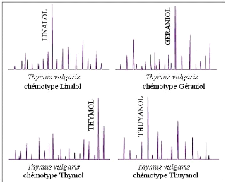
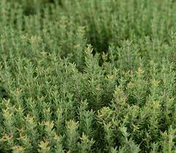
What is an essential oil?
Composition:
Depends on the organ (cinnamon leaves: eugenol, cinnamon bark: cinnamaldehyde, cinnammon roots: camphor)
Depends on the season
Depends on the climate-soil-distillation (terroir effect)
Presence of pathogens
Chemotypes
Thyme: 7 chemotypes
Linalol
Géraniol
Thymol
Thujanol
Carvacrol
α-terpinéol
Hydrate de sabinène

Slide 7
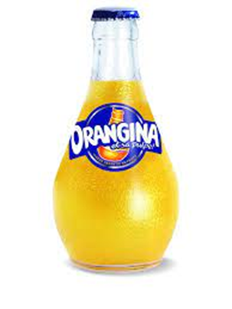
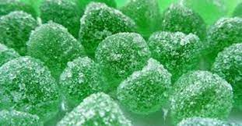
Traditionnal uses of essential oils
Conventional uses of EOs :
Food
Beverage
Cosmetics/perfume
Aromatherapy

Slide 8
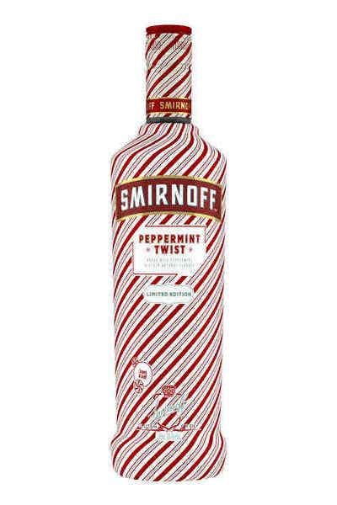
Traditionnal uses of essential oils in food and beverages
Food product | Flavor dosage (%) | EO content in flavor (%)
1. Alcoholic beverage | 0,05-0,15 | 3-100
2. Soft drinks | 0,10-0,15 | 2-5
3. Sweets (confectionery, chocolate) | 0,15-0,25 | 1-100
4. Bakery (cake, biscuits, …) | 0,10-0,25 | 1-50
5. Ice creams | 0,10-0,30 | 2-100
6. Dairy products, desserts | 0,05-0,25 | 1-50
7. Meat and fish products | 0,10-0,25 | 10-20
8. Sauces, ketchup, condiments | 0,10-0,50 | 2-10
9. Food concentrates | 0,10-0,50 | 1-25
10. Snacks | 0,10-0,15 | 2-20
Flavor:
Solution in ethanol
Emulsion (gum arabic)
Maltodextrin

Slide 9
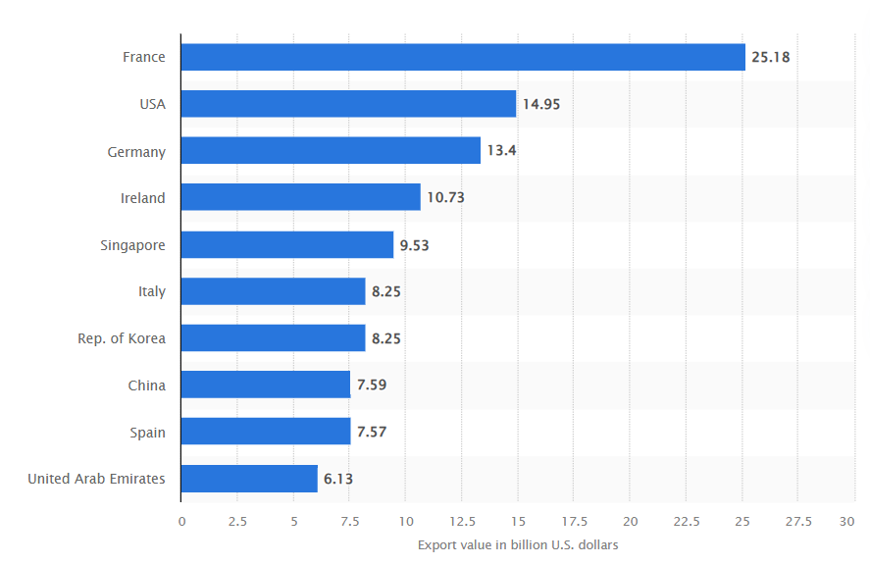
Export value of essential oils and resinoids worldwide in 2023
China is a key actor in EO market

Slide 10
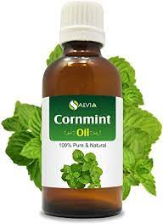
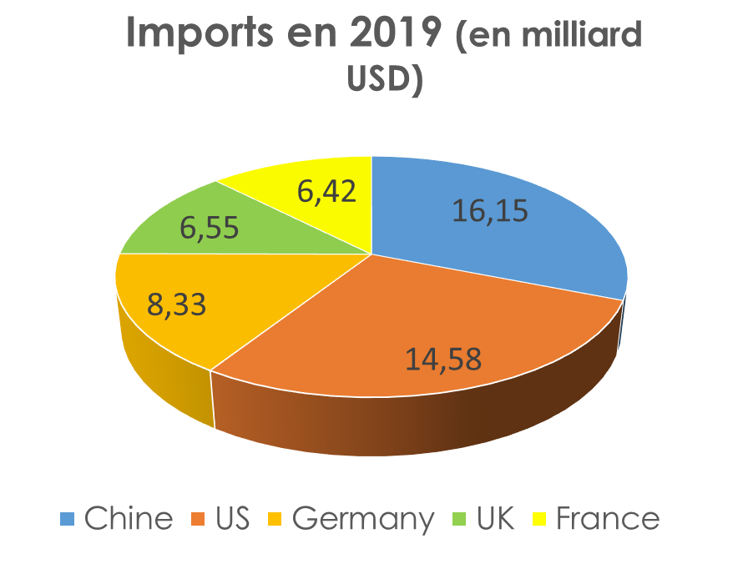
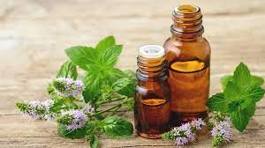
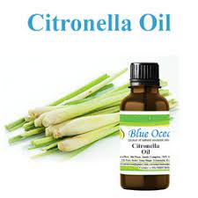
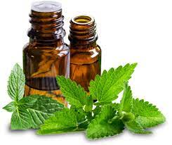
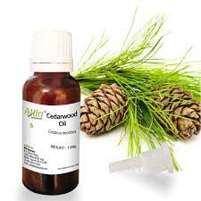
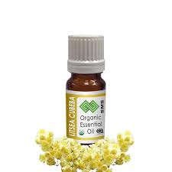
China top essential oil production and EO import
Cornmint
Peppermint
Eucalyptus
Citronella
Spearmint
Cedarwood
Litsea cubeba
China is a key actor in EO market
3000 Eos described but 300 on the market

Slide 11
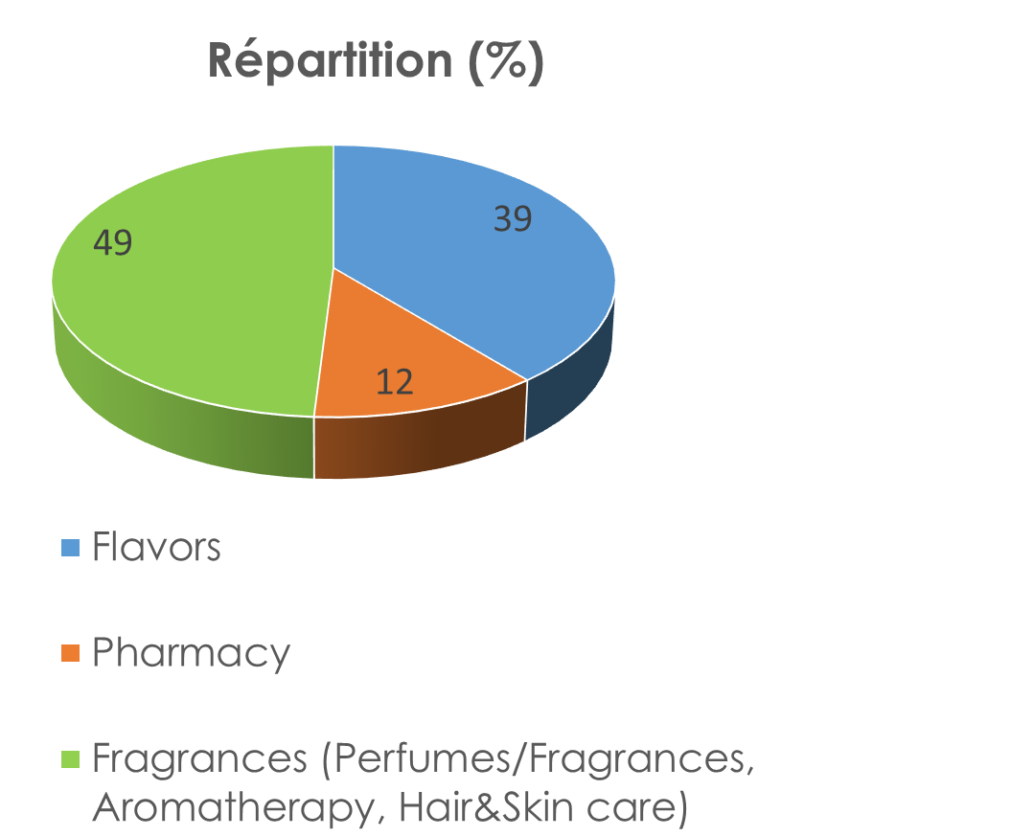
Eos traditional uses and new application sectors
Cosmetics & Perfumes
Aromatherapy
Aroma
Pharmacy
Household products
Additives and food pacakging
Biocides (agronomy/ veterinary/food)
Insecticide
Fongicide
Bactericide
Virucide
Nematicide
Acaricide
Anti-sprouting
Builiding block for chemical synthesis
New applications

Slide 12
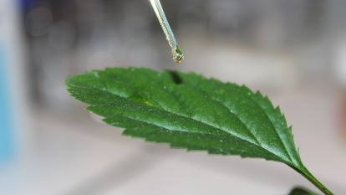
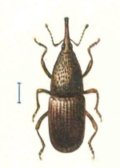
New applications of essential oils in agronomy
More recently numerous applications in agronomy (biocide)
Insecticide (GS 182 000)
Herbicide (GS 123 000)
Bactericide-fungicide (GS 127.000)
Acaricide-nematicide (GS 40.000)
But also anti-sprouting agent, virucide, soil microbiote quality improvement, post-harvest desease, self-life increase …

Slide 13
New applications of essential oils in agronomy
Eos as insecticide:
Eos used alone or mixture of it (synergy, additive effect)
Deterrent, antifeedant, repellent, acute toxicity (ingestion, inhalation, topical application)
➔ Pest of stored food, pest of crops, pest of forests, household pest

Slide 14
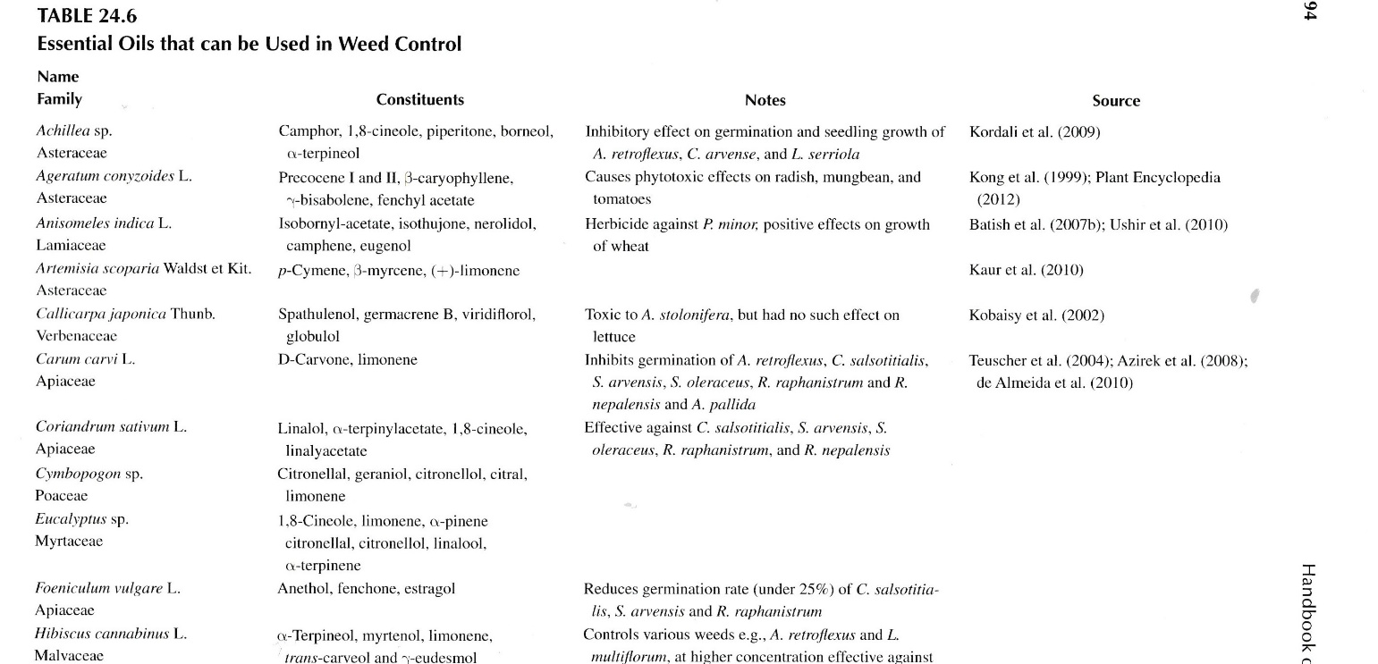
New applications of essential oils in agronomy
Eos as herbicide: weed control in the context of glyphosate replacement
- Many Eos have herbicidal activity (total or selective and/or antigerminative)

Slide 15
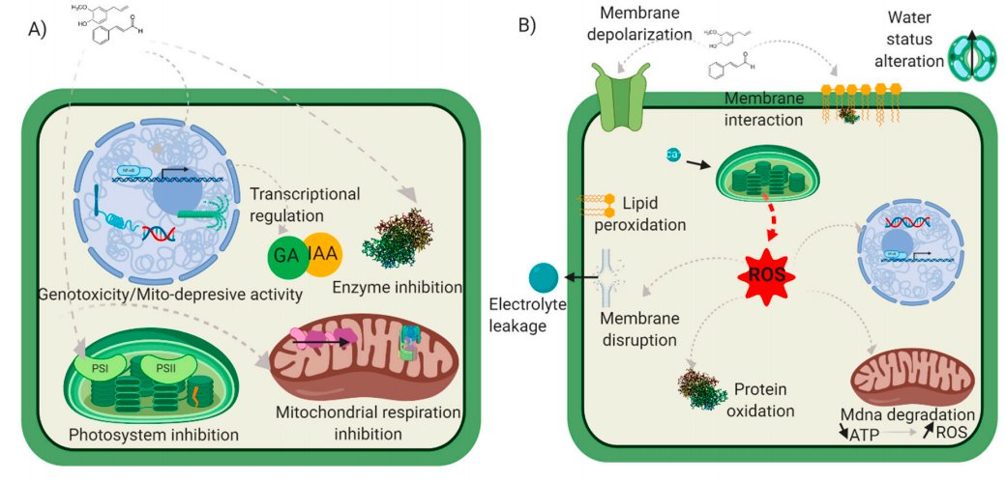
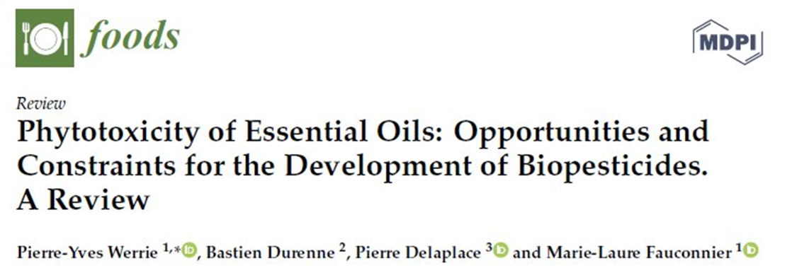
New applications of essential oils in agronomy
Eos as herbicide: weed control in the context of glyphosate replacement
Low persistance, multiple action modes (less resistance)

Slide 16
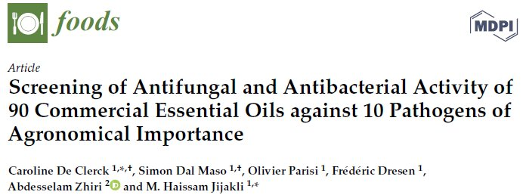
New applications of essential oils in agronomy
Eos as bactericide/fungicide
Bactericide: activity against Gram + and Gram -, various mode of action
Fungicide but also fungistatic

Slide 17
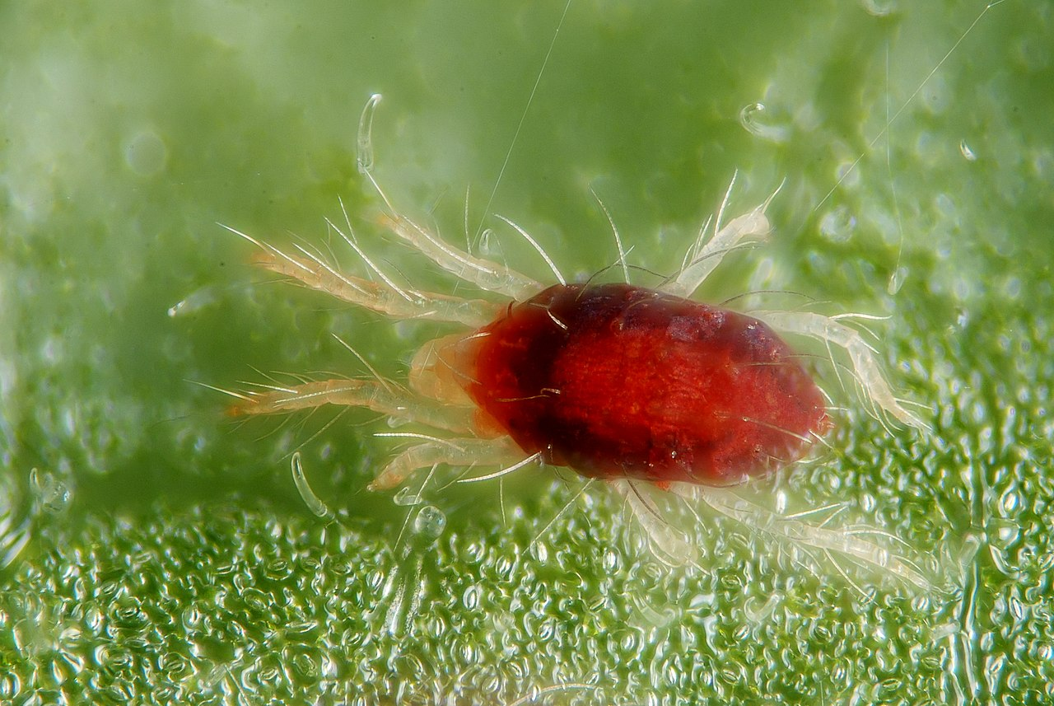
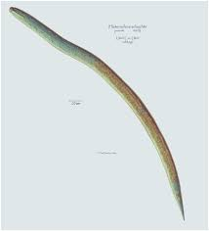
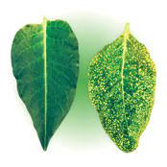
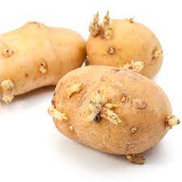
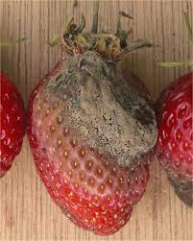
New applications of essential oils in agronomy
Acaricide: Good results of Deverra scoparia EO on Tetranychus urticae (red spider mite). Repellent, direct mortality, reduced fecundity
Nematicide : effect of limonene containg Eos and many others on nematodes
Virucide: tobacco Mosaic virus (lemongrass EO)
Anti-sprouting agent (potatoes, carvone rich EOs)
Soil microbiote improvement: biodegradation but nutriment source for soil µoorganisms
Post-harvest desease: bacteria, fungi

Slide 18
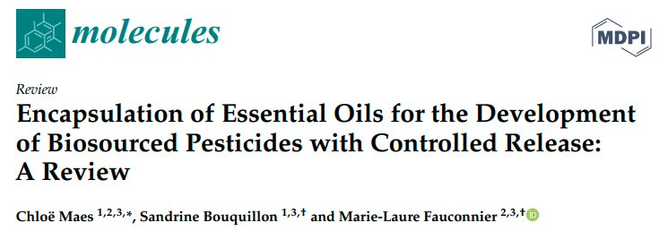
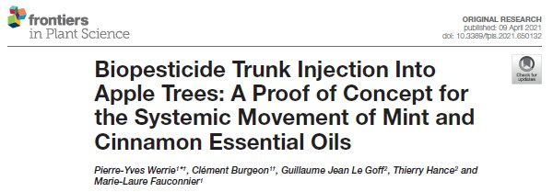
New applications of essential oils in agronomy
Advantages and constraints
Advantages:
reduced side effects (human, not target organisms,
environment)
low persistance
multiple action mode (less ressistance)
Good acceptability by consumers
Constraints :
Flavour
variability (composition)➔ standardization
phytotoxicity
volatility (encapsulation + new mode of injection)
Cost (only for high value crops?)
Sustainability of resource
Regulatory aspects (US versus EU)

Slide 19
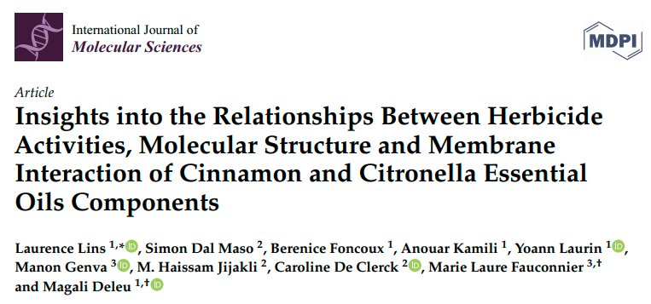
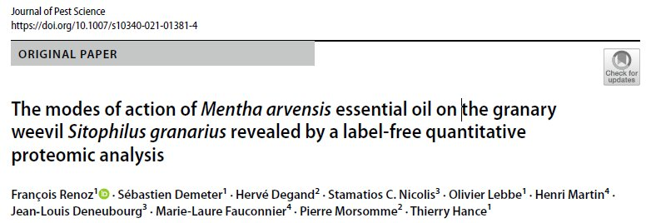
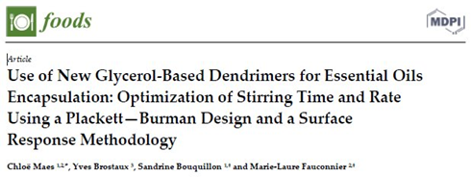
New applications of essential oils in agronomy
Challenges: what’s next
Test in vitro ➔ in vivo
Controlled conditions versus field conditions
Comprehesion of mode of action
(structure-activity relationship)
Innovative formulation
Exploring new EOs

Slide 20
Development of a new tool for pest management in fruit arboriculture using essential oils applied by trunk injection in apple trees
Pierre-Yves WERRIE, Clément BURGEON, Marie-Laure FAUCONNIER
Notes:
P-Y Werrie
LCMN gbx Belgium
Phd thesis dev….

Slide 21
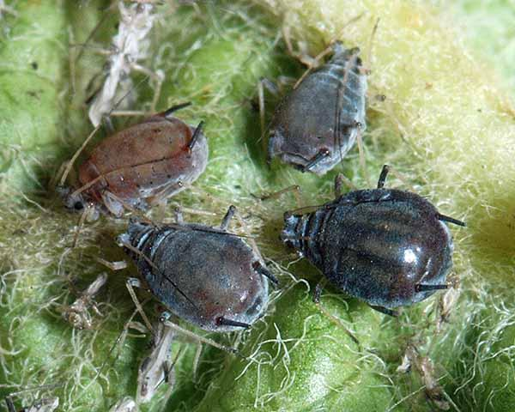
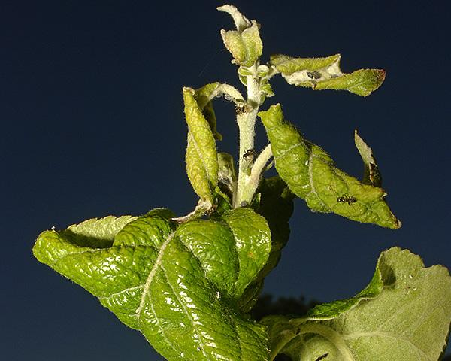
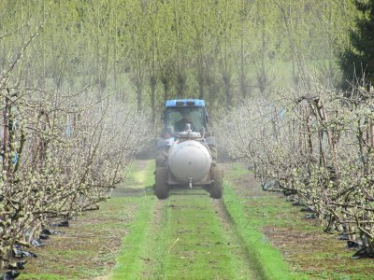
Context : Current pest management strategies of Dysaphis plantaginea in orchards
Sap sucking insects
Leave deformation /fruits loss
Honeydew (fungi development)
Main pest (20% yield loss)
Chemicals control (synthetic pesticides)
Environmental risks
Pesticide-resistant populations
Public demand for environmentally friendly products
Notes:
Apple production is among the first fruit production worldwide
as any other plant, apple trees are subject to abiotic and biotic stresses that cause important economic losses.
Especially from this little aphid called
Current pest management
those strategies lead environmental risks

Slide 22
Context : The case for essential oils in insect pest management
Neurotoxic mode of action (GABA, AChE)
Low toxicity on mammalian species
Compatible with integrated pest management (IPM)
Rapid degradation and volatilization
Low specificity
Cost
Alternative plant delivering system- Trunk injection
Target sap sucking pest
Lower application rate
Reduced environment load
Notes:
investigated for its insect pest management properties
which is why we have developed in this project and alternative plant delivering system compared to classical pulverization
the trunk injection, using the natural xylem flow within the trees to translocate the injected compound to target the SAP sucking insects, lower the application rate and reduce environment load.

Slide 23
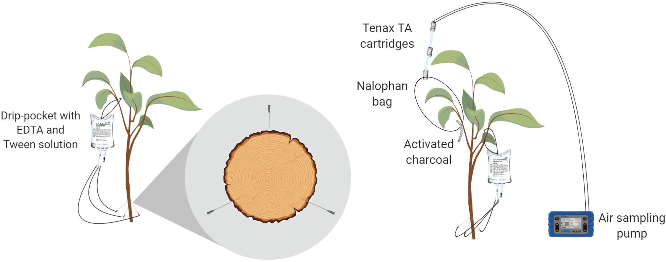
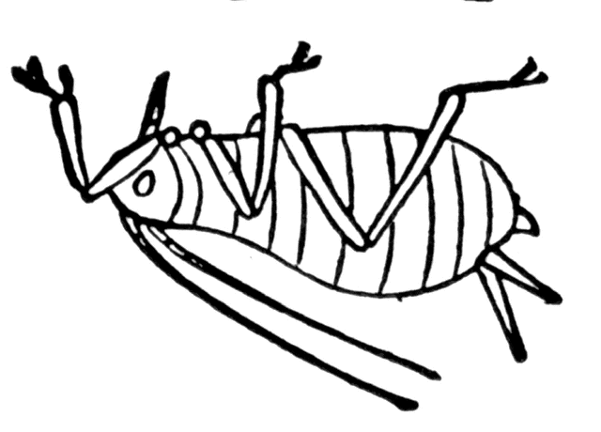
Research objectives
Demonstrate the systemicity of EO injection
Characterize the biochemical and physiological impact of EO applications on apple tree (phytotoxicity)
Investigate the insecticidal properties on D. plantaginea
Notes:
The research objectives were divided in 3 parts
The first part was to demonstrate the systemicity of essential oil injection
the second part was to better characterize the biochemical and physiological impact of essential oil application on apple tree especially its potential phytotoxicity
the third part investigate the insecticidal properties on d plantaginea

Slide 24
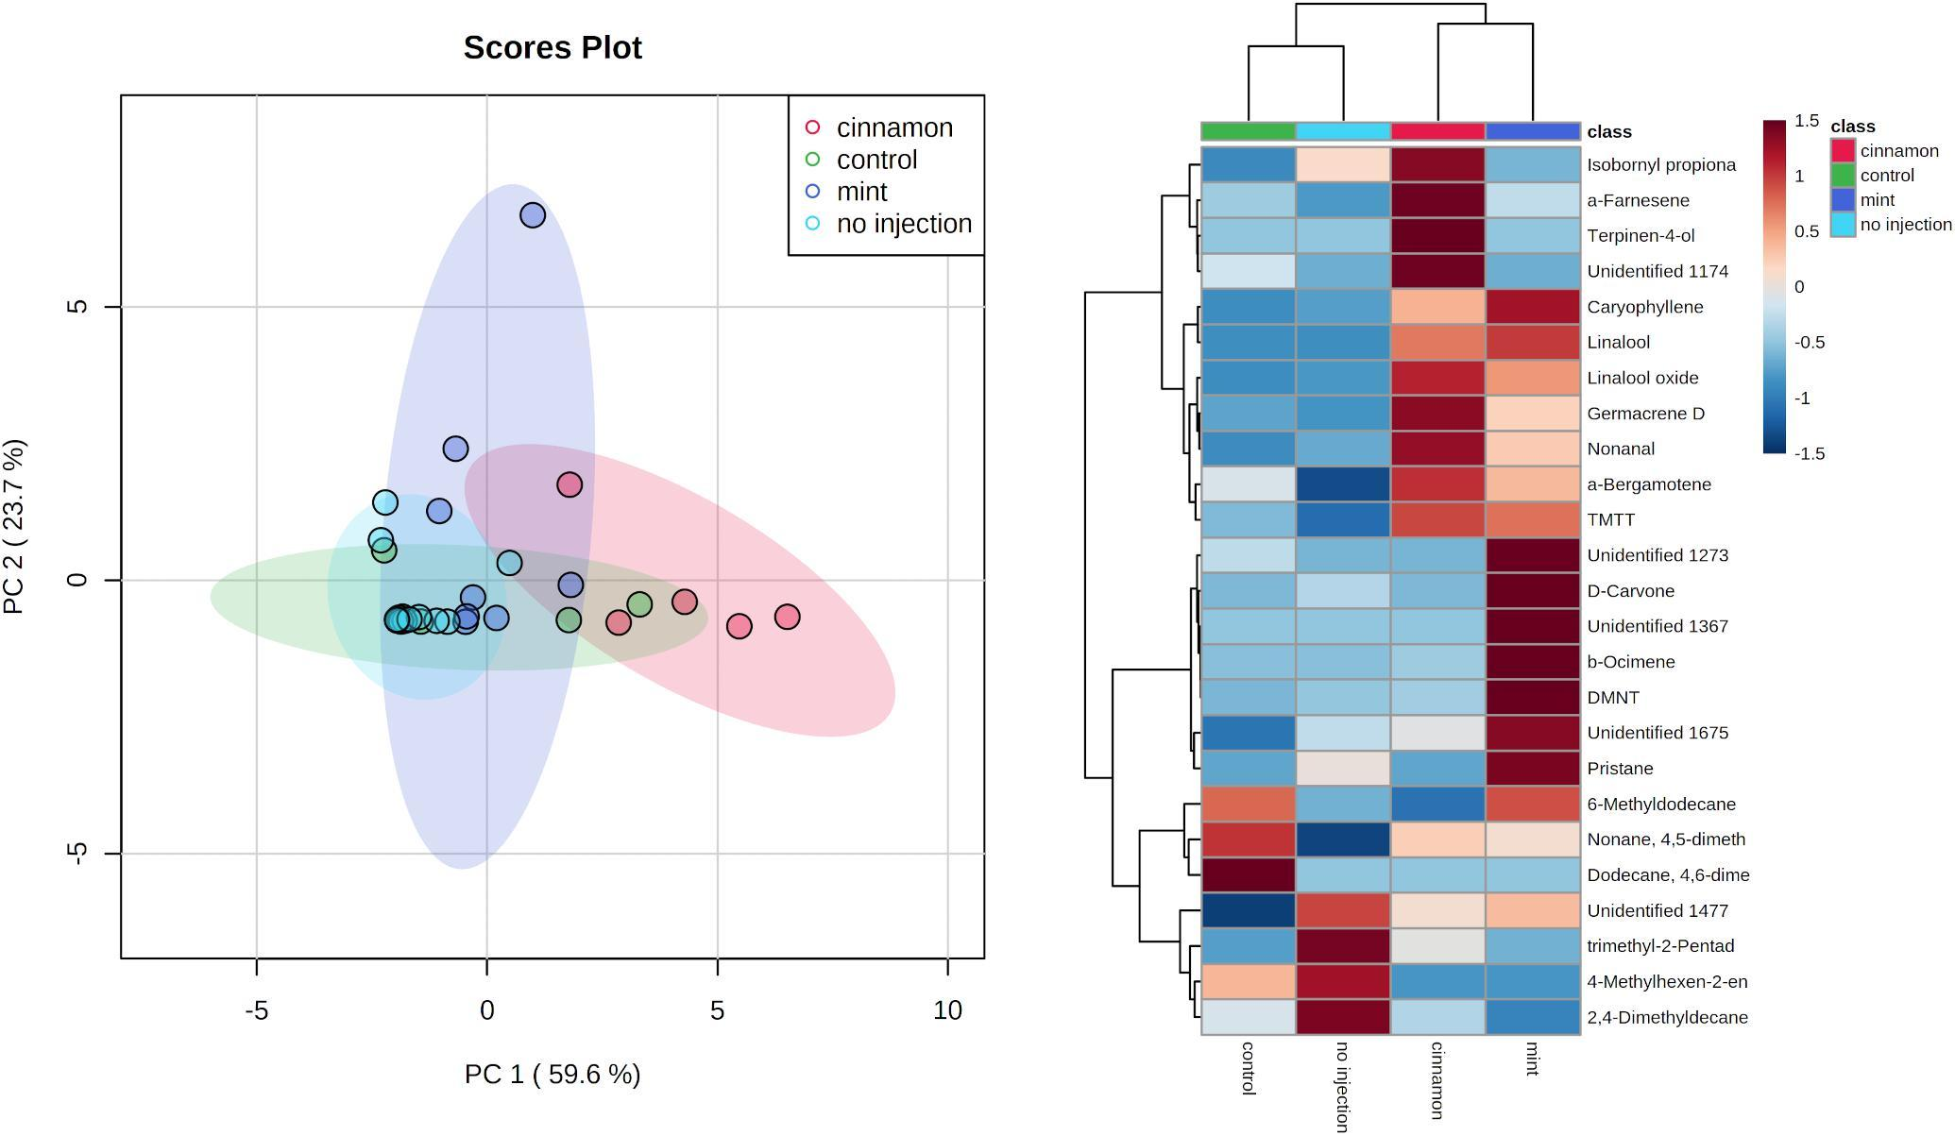
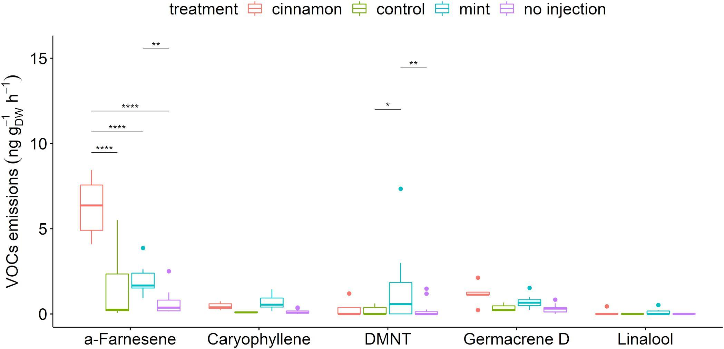
Systemicity of Cinnamomum cassia EO trunk injection
VOC profile emissions alteration
Increase in alpha-farnescene production
Aphid repellent
Produced during systematic acquired resistance (SAR) elicitation
Notes:
regarding the untargeted analysis
whole volatile profile was modified due to this injection
especially we have observed an increase in alpha farnesene production which is an aphid repellant compound and it is produced during systemic acquired resistance elicitation. this mean that the injection of essential oil is translocated to leaf tissue but also trigger the plants reaction!

Slide 25
Biochemical and physiological impact of EO application
Malondialdehyde = secondary product of lipid peroxidation
Marker of oxidative damages
Oxidative damages occur at high concentration
Dose-dependent phytotoxicity of C. cassia
(Morales & Munné-Bosch, 2019)
Weber, H., Chételat, A., Reymond, P., & Farmer, E. E. (2004). Selective and powerful stress gene expression in Arabidopsis in response to malondialdehyde. Plant Journal, 37(6), 877–888. https://doi.org/10.1111/j.1365-313X.2003.02013.x
Notes:
To estimate the amount of damage we’ve quantified malondialdehyde which is a secondary byproduct of lipid peroxidation and known marker of oxidative stress damage as you can see on the graph the content went up only for high concentration of essential oils of 2% and this means that the phytotoxicity of cinnamon oil is dose dependent.

Slide 26
Biochemical and physiological impact of EO application
qRT-PCR decipher the potential elicitor properties
RNA Transcripts from major pathways:
PR proteins
Phenylpropanoids
Isoprenoids
Oxidative stress
Parietal modifications
Hormonal signalization (SA,JA,ET)
Notes:
regarding the potential elicitor property application, we’ve used the molecular tool of quantitative RT-PCR to follow the ARN transcript from major pathways which where the PR proteins, phenylpropanoids pathway as well as oxidative stress parietal modification and hormonal signalization that you can see on the table.

Slide 27
Biochemical and physiological impact of EO application
Induction of defense gene expression by C. cassia during 3 days
Pathway different of SAR elicitor bion
Notes:
as you can see on the heatmap on the left representing the 29 gene quantified by this technique during three days after application of water, tween alone and emulsion of essential oil with tween as well as bion which is an synthetic elicitor of sar. the application of essential oil also lead to a significant defense gene activation during the three days which are not all shared by the sar which is a very nice result that illustrate the elicitor potential.

Slide 28
Impact of C. cassia injection on population dynamics
Injection affects survival and growth
GLM modelling on aphids population
Effects of time and injection significant(p-values <0.001)
Notes:
now regarding the last objective which was to demonstrate the insecticidal potential of such application we have followed the population dynamic in climatic chamber of after injection of eo on small trees. As you can see on the left graph the injected trees in Gray present a lower almost five times lower number of living if it’s after 30 day then the non injected trees in red the generalized linear modeling of population also demonstrates that the injection affects the survival and growth of population.

Slide 29
Perspectives
Proof of concept (systemicity of EO)
Elicitation of the plant
Efficiency in greenhouse
Field efficiency?
Fruit residue?
Defence against other pathogens?
Impact of pollinators
Notes:
Regarding the perspective of this project we would like to conduct multiple field trial in orchards too demonstrate field efficiency. It might also be very interesting to see if the elicitor properties could be against active against other pathogens such as the apple scab or oidium.

Slide 30
New applications of essential oils in food conservation
New applications of Eos as preservative / increase self live
Due to its anti-oxidant, bactericide and fungicide activities EOs are used as preservatives in food industries to increase self live.
Taking into account legislation it is “limit” as the objective is not to modify the flavor BUT to increase self-live.
Example of Rosmarinus EOs
Added to sliced beef extend self-live up to 15 days
(in combination with high O2 athmosphere)
Microencapsulated Rosmarinus EO increases self-live of
cheese, fresh fruit, lamb slices
Rosmarinus Eo is used to decrease oil oxidation in potato chips

Slide 31
New applications of essential oils in food conservation
New applications of Eo in packaging
To obtained a slow and controlled relaese of Eos, encapsulation is used (alginate, chitosan, cyclodextrins, arabic gum). Ex chitosan containing clove EO ➔ pomergranate; chitosan-lemongrass EO ➔ guava

Slide 32
New applications of essential oils in food conservation
New applications of Eo in packaging
Biodegradable polylactic acid nanocapsules ➔ increase self live of fresh fruits (apple, persimmon, peach, ..)
Also starch-gel films against Alternaria, Botrytis

Slide 33
New applications of essential oils in food conservation
New applications of Eo in packaging
Inclusion of Eos into polyethylene films by extrusion: increase pork meat self-life
Use of multilayer packaging (polyurethane adhesive with cinnamon EO)
Polyolefin containg EO ➔ degradable packaging for fruits and vegetables
Edible films (gelatin capsules)

Slide 34
New applications of essential oils in food conservation
New applications of Eo in packaging

Slide 35
New applications of essential oils in food conservation
Biopolymers | EO | Food product | Main results | References
Films
Chitosan | Clove | Bread | Fongicide (3 months) | (Lee, Kim and Park, 2018)
Gelatin | Lavander | Tomatoes | Bactericide, anti-oxidant | (Sun et al. 2021)
Chitosan and collagen | Lemon | Pork | Bactericide (21 days) anti-oxidant. | (Jiang et al. 2020)
Chitosan and lactoserum proteins | Garlic | Sausage | Bactericide, lipid oxidation decrease | (Esmaeili et al. 2020)
Coating
Gelatin | Orange | Shrimp | Increase of 10 days for shelf-live | (Alparslan et al. 2021)
Chitosan and starch | Myrcia ovata | Fruits | Bactericide | (Frazão, Blank and de Aquino Santana 2017)
Encapsulation of chitosan | Thyme | Cheese | Shelf-live increased of 2 weeks | (Al-Moghazy et al. 2021)

Slide 36
New applications of essential oils agronomy and in food conservation
Advantages / inconvenients of Eos
Price
Disponibility
Variability of composition
Flavour
Volatility
Regulatory
Good acceptability by consumers
Generally healthy
Complex composition (resistance limited)
Volatility
➔ So many researches to be performed!

Slide 37
Thank you for your attention!
marie-laure.fauconnier@uliege.be
Notes:
PAGE D'INTRODUCTION 2 / Page sans photo permettant l'insertion du titre de la présentation ainsi que d'autres infos (date, lieu, orateur, sous-titre,…)

