Slide 1
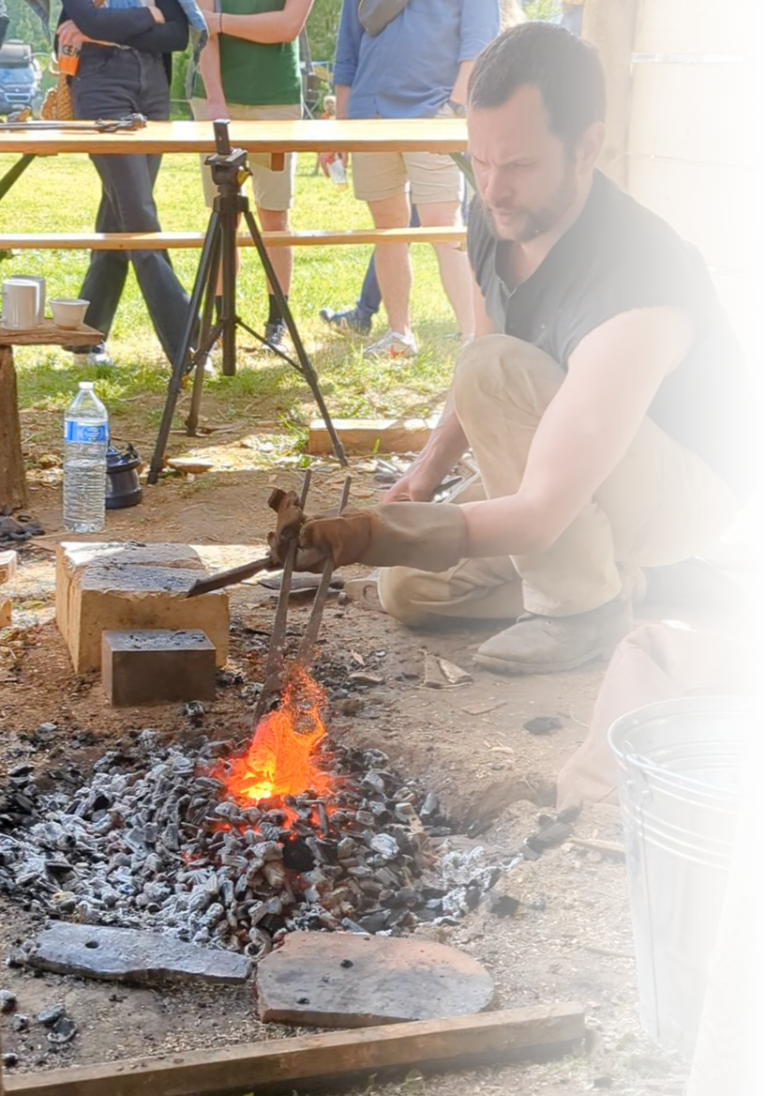
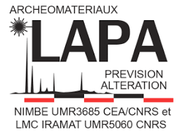
Acies Ferri
Construction of Merovingian Seaxes from 5th-8th century Alsace
Notes:
Talking today about my PhD, Acies Ferri, study of Merovingian weaponry between the Seine and Rhine rivers, and specifically today I’m going to be talking about the construction of seaxes from 5th to 8th century Alsace.

Slide 2
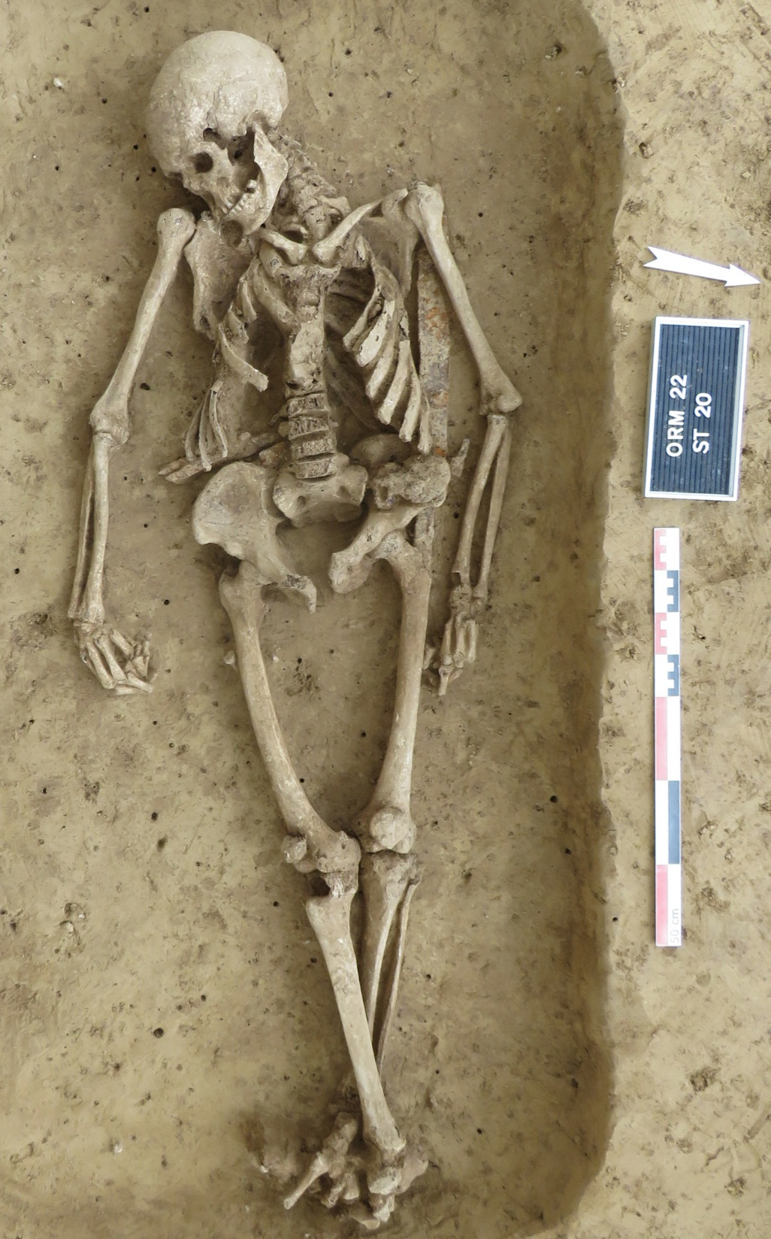
Acies Ferri
Study of Merovingian weaponry
Typology
Construction
Provenance
Notes:
So, a bit about my PhD, I am undertaking this PhD between the university of Liège in Belgium and the Laboratoire Archéomatériaux et Prévision de l’Altération in France and I’m interested in Merovingian weaponry.
I look at these from three different levels, macroscopic, microscopic and chemical, and these levels roughly correspond to the outline I’ve given here of typology, construction and provenance.
Specifically I’m interested in the intersection of these aspects, notably the chaîne opératoire of sword and seax construction, the potential existence of technical traditions that might be correlated with typology, social status of the individual, and of course, the provenance of iron. I’m also interested in how centralised and normalised the production of these weapons was and consider how this might relate to the trade of iron more broadly

Slide 3
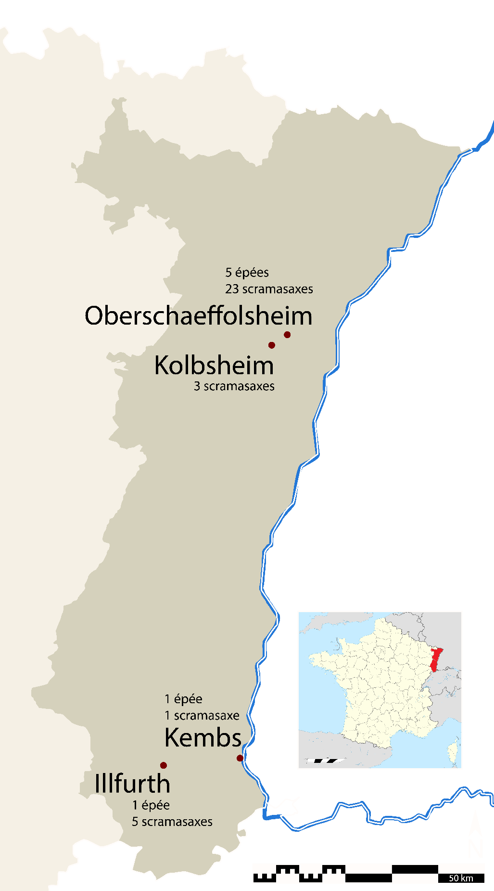
Acies Ferri
12 swords and 32 seaxes
Oberschaeffolsheim
Kembs
Illfurth
Kolbsheim
Notes:
To do this I’ve been looking at a wide range of swords and seaxes and so far, my study has focused on samples from weapons found in Alsace in North-Eastern France. Currently, in terms of sampled weapons, I have a total of 12 swords and 32 seaxes and these come from for Merovingian cemeteries across the region.

Slide 4
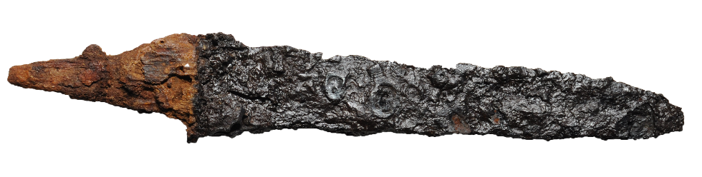
Seax
What is a seax?
Notes:
Now, I’ve been talking about seaxes for some time already, but I realise that those not familiar with early medieval weaponry probably have no idea what a seax is, so to put it simply, a seax is a large knife, in fact, it is simply the old English word for “knife”.
More specifically, seaxes are single edged blades, they possibly originated as long and thin single edged cavalry sabres, used by central Asian peoples who migrated to Europe like the Huns and Alans, but they were quite quickly adopted in Europe and by the 5th century they are typically associated with Germanic peoples, like the Franks, the Lombards, the Gepids, and many others. They were also adapted quite a bit, the earliest seaxes are long and thin like sabres but from the 6th century, they had become quite small, about the size of a standard kitchen knife, but then the trend reversed and over the course of the 6th and 7th centuries, they got longer and heavier, leading to some extreme examples which were almost a meter long from point to tang.
On the continent, seaxes start to disappear from the 8th century onwards, roughly coinciding with the rise in power of the Carolingian dynasty, though in Nothern Europe, Especially Scandinavia and England, their use continued all the way up to the 11th century.

Slide 5
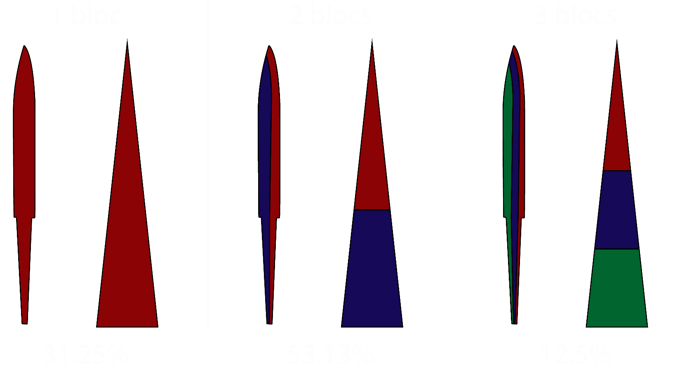
Seax
Raw materials
1, 2 or 3 blocks
Notes:
So, moving on to construction, how does one make a seax? Well, you start with raw materials, those who know anything about blades will know that it’s generally a good idea to use steel rather than iron, as it keeps an edge for longer. And this is how most of the seaxes I’ve been looking at were made, but there is quite a lot of variation. I haven’t yet seen an example of a seax made entirely of iron, but especially when looking at the spine, it’s not rare for the microstructure to be entirely ferritic.
In general, when approaching the edge of the sample, carbide phases increase, either because there is a gradual shift from iron to steel, or because two or more pieces of metal were used, which I have been referring to as “blocks”.
This two block structure, using steel in the edge and iron in the spine, corresponds to a little over half of the seaxes I’ve looked at so far, though it is likely that the actual proportion is slightly higher. The steel used in the edge is sometimes quite small, and as it is the thinnest part of the blade, it is also the first to be lost to corrosion, so it is entirely possible that some of the single block seaxes may have originally had a steel edge that has since corroded away.
Interestingly, alongside the one and two block constructions that I expected to find, I have also seen 6 three block seaxes, with a central block that, in most cases, seems to be made from a separate piece of iron or steel from the either the edge or spine. This wasn’t something that I expected to see at all because I would have thought that introducing an additional weld, even a well executed weld, would add a weak point to the blade without any clear practical advantage. The closest parallel that I’ve been able to find so far is a byzantine sword found in Kiskundorozsma, near Szeged in Hungary, but there too, there’s no clear explanation as to why, so if anyone here has any suggestions, I’ll gladly listen to them.

Slide 6
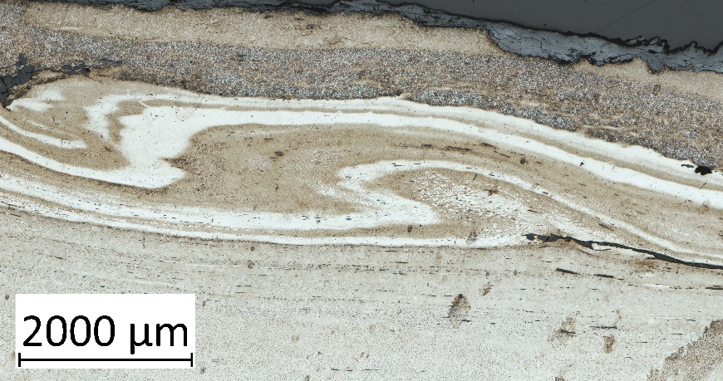
Seaxes
Initial forging
Folding
Notes:
Moving on, once the number of blocks is decided, there are several options to continue making the seax. Either, the raw materials can be assembled as is and worked to shape, which is 11 of the seaxes I’ve looked at, or the raw materials can under go some initial forging before being welded together. The most common process is folding. This is a fairly standard technique as it decreases the size of slag inclusions by spreading them more evenly throughout the blade. In cases of an assembly of iron and steel, intensive folding can also average out carbon content by distributing carbide phases throughout the piece, and the image to the right here is a pretty clear example of that.
18 out of the 32 seaxes show some evidence of folding, ranging from a few folds as can be seen on the left, to tens or even hundreds of folds as can be seen on the right. Folding is typically only seen in blocks used for the spine, though 8 out of the 10 seaxes with only one block show folding right up to the edge, though again, this could be biased by the loss of the edge to corrosion.

Slide 7
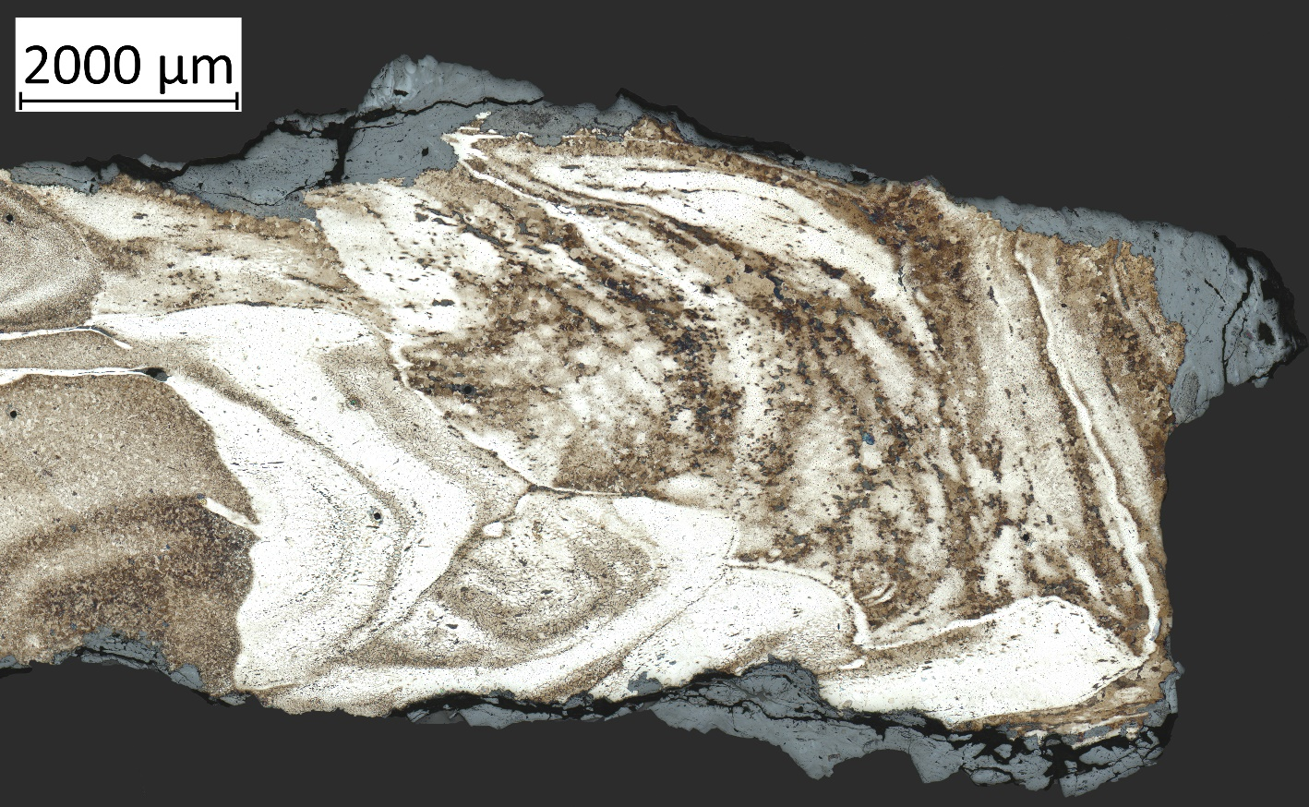
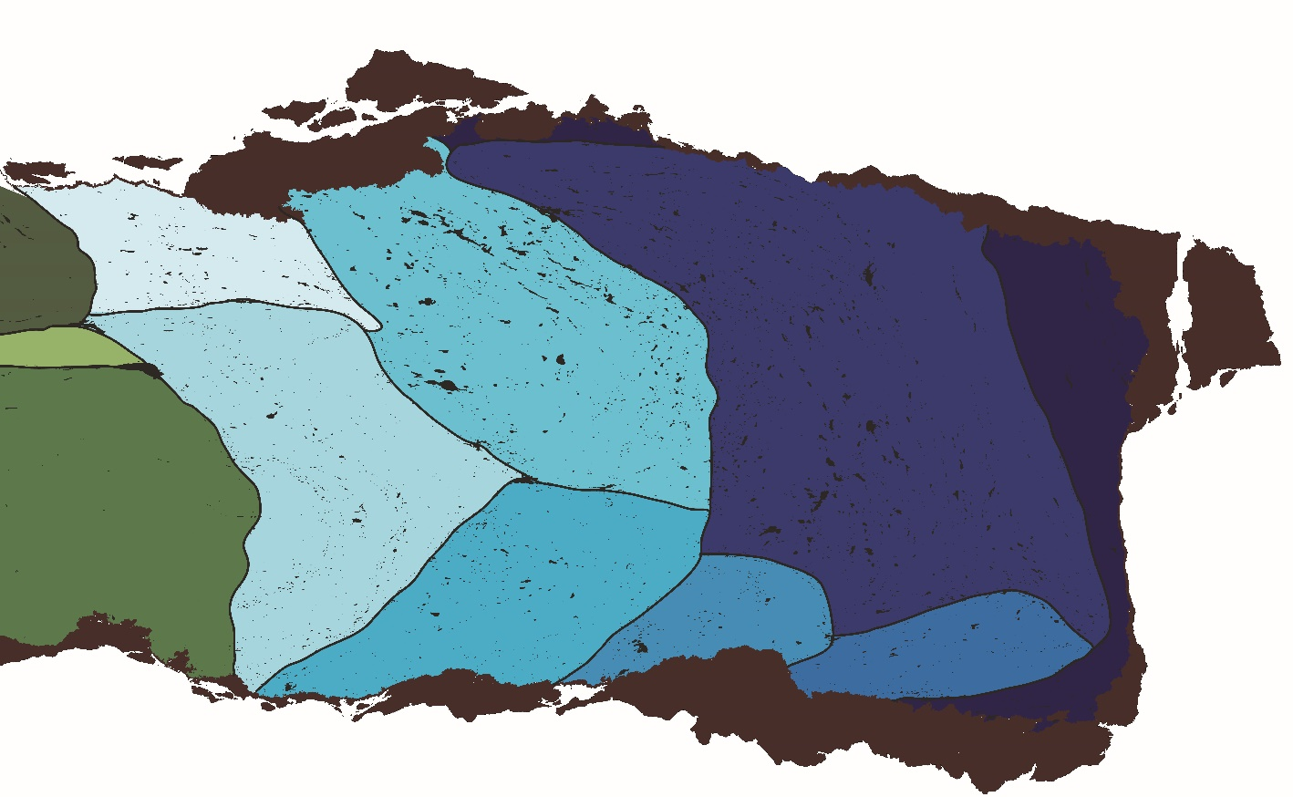
Seaxes
Initial forging
Recycling
Notes:
The other kind of initial forging that I’ve seen so far is the assembly of multiple pieces of iron to create a single block. There is a lot of overlap between this process and folding, because a lot of the folded blocks contain quite clear evidence of having been made from multiple pieces of iron that were folded together. Furthermore, this gets quite complex quite quickly because I have seen some indication of individual sub blocks being folded and then assembled with other pieces of iron, some folded some not, and then they were all folded together, so the complexity increases quite quickly.
I’ve decided to highlight this piece because there’s a bit of a clearer indication of some as to how it was put together, you can see in the spine of this seax that it’s made from multiple pieces of iron, that I’ve coloured in shades of blue on the right here, I would imagine that these pieces are bars running the length of the spine.

Slide 8
Seaxes
Initial forging
Recycling
Notes:
What’s particularly interesting is this piece on the very spine which wraps around the back and reappears at the top there, it’s quite corroded but to me this looks like it was used as a container of sorts to hold the other pieces together as they were being welded.

Slide 9
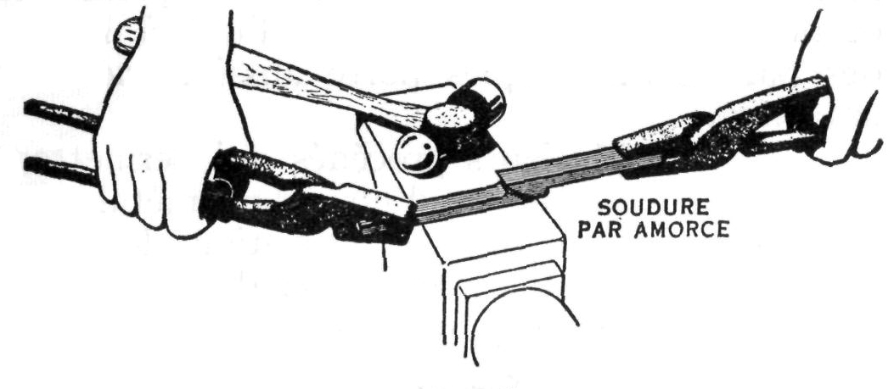
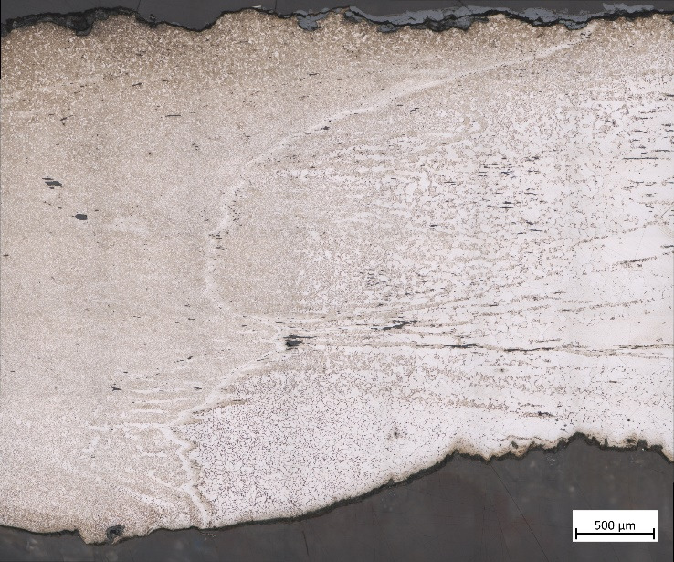
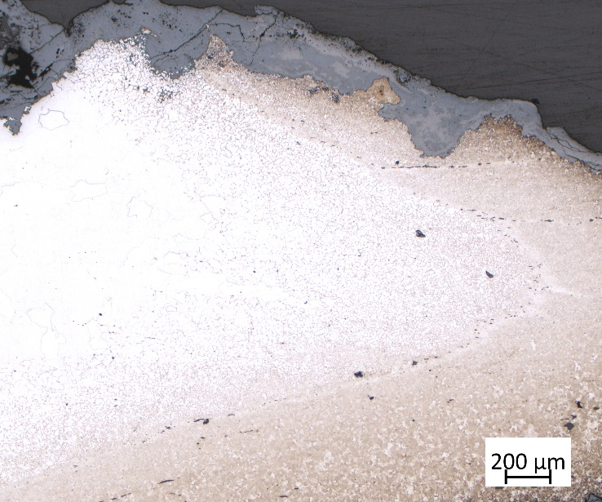
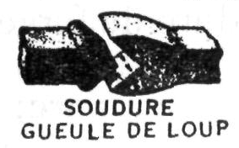
Seaxes
Assembly
Notes:
Once the blocks are ready, they need to be assembled and two methods seem to have been employed for this, either welding two pieces at an angle, as can be seen above, or welding the pieces together in a V shape. In the latter case, the point of the V is usually oriented towards the spine, though not always.
One thing that is abundantly clear from all of the seaxes I’ve looked at is that these major welds between the different blocks are always extremely clean, no cracking, no oxidation very few slag inclusions, it’s very clear that a lot of care was taken in their execution.

Slide 10
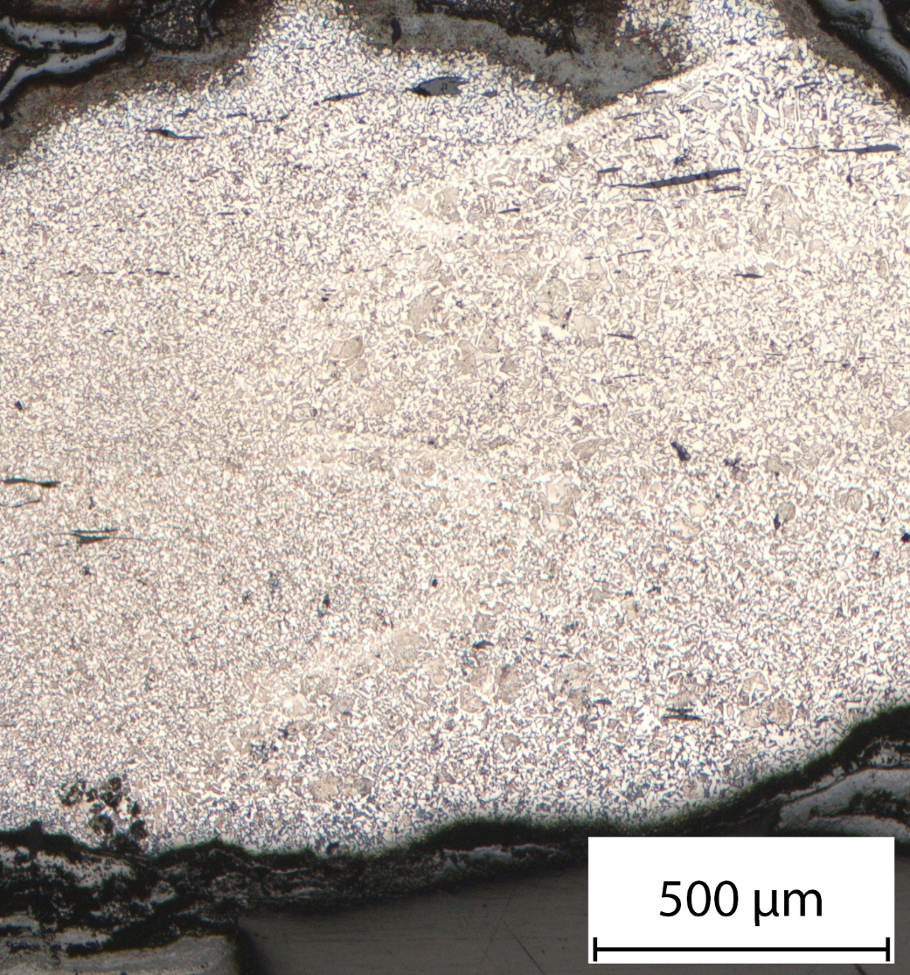
Seaxes
Assembly
Notes:
This is interesting because it’s in direct contrast to the welds that have been observed in the spine of the same seaxes. So there’s a very clear example of this here, this is a seax from Oberschaeffolsheim, near Strasbourg, and on the left you can see the weld between the spine and the edge, it’s almost inivisble, so much so that I don’t know how well you’ll be able to see it on the screen, but take my word for it, it’s there. And in contrast, on the right is the spine of the same seax which has this massive weld running down the middle of it, it’s full of very large inclusions, there’s some oxidation, several cracks, all in all it’s kind of ugly. But this contrast is a trend present in over 10 of the seaxes made from 2 and 3 blocks, it really seems that the welds in the spine are of secondary importance.

Slide 11
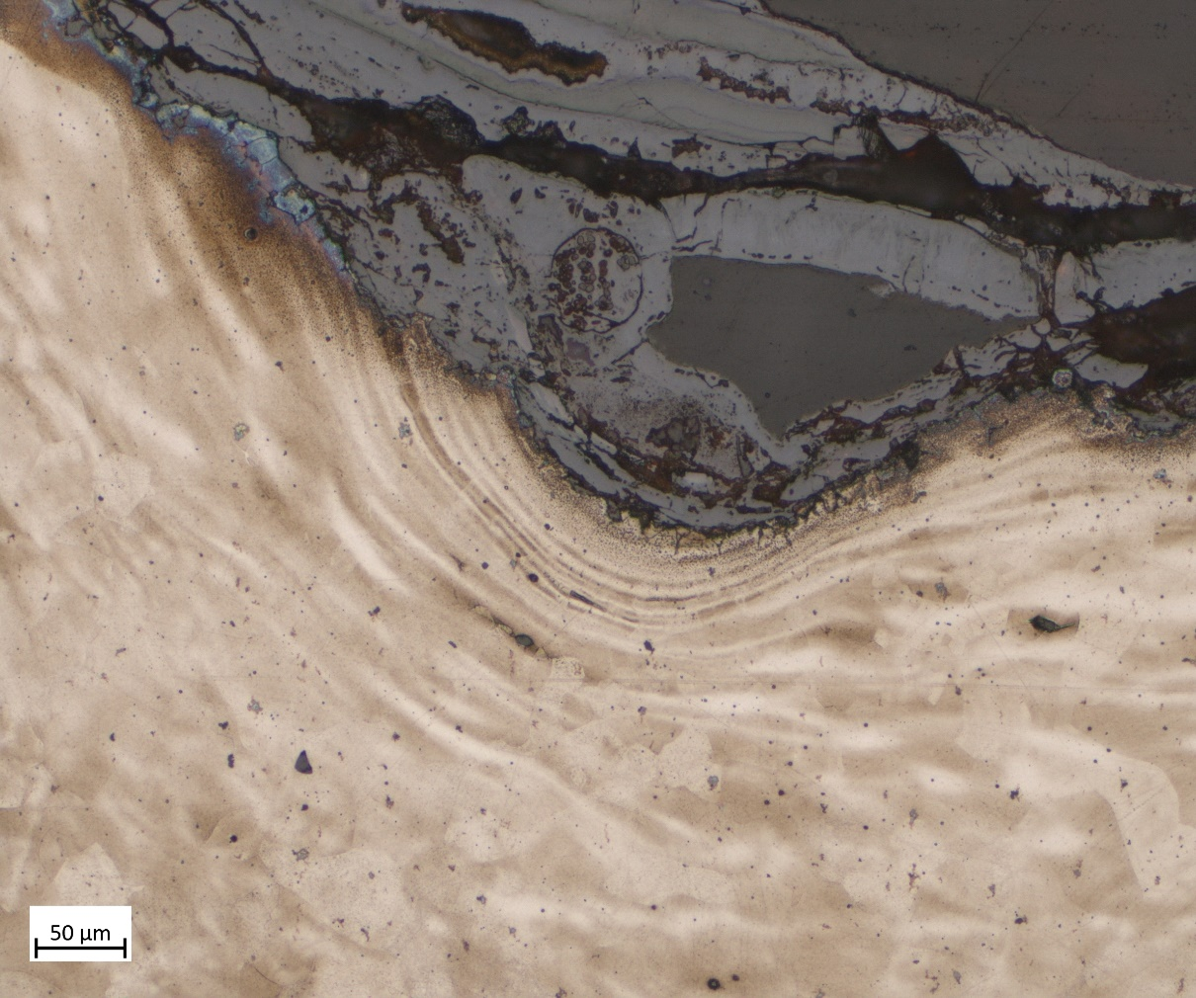
Seaxes
Decoration
Notes:
Once the blocks are welded together, the blade is worked to shape, and there’s honestly not much to say about that process, so I’ll skip to the next one, which is decoration. A lot of seaxes have a series of striations running along the side of the blade. These are usually only preserved in the corrosion, but in the rare cases they are preserved in the metal, they present a clear flattening of the grain. This suggests that the decoration was stamped into the iron at the very end of the shaping process because any high temperature reheat would lead to a recrystallization of the grain, and that flattening would be lost.
This also means that any subsequent activities must have been undertaken at low to medium temperature, certainly nothing over 700°C.

Slide 12
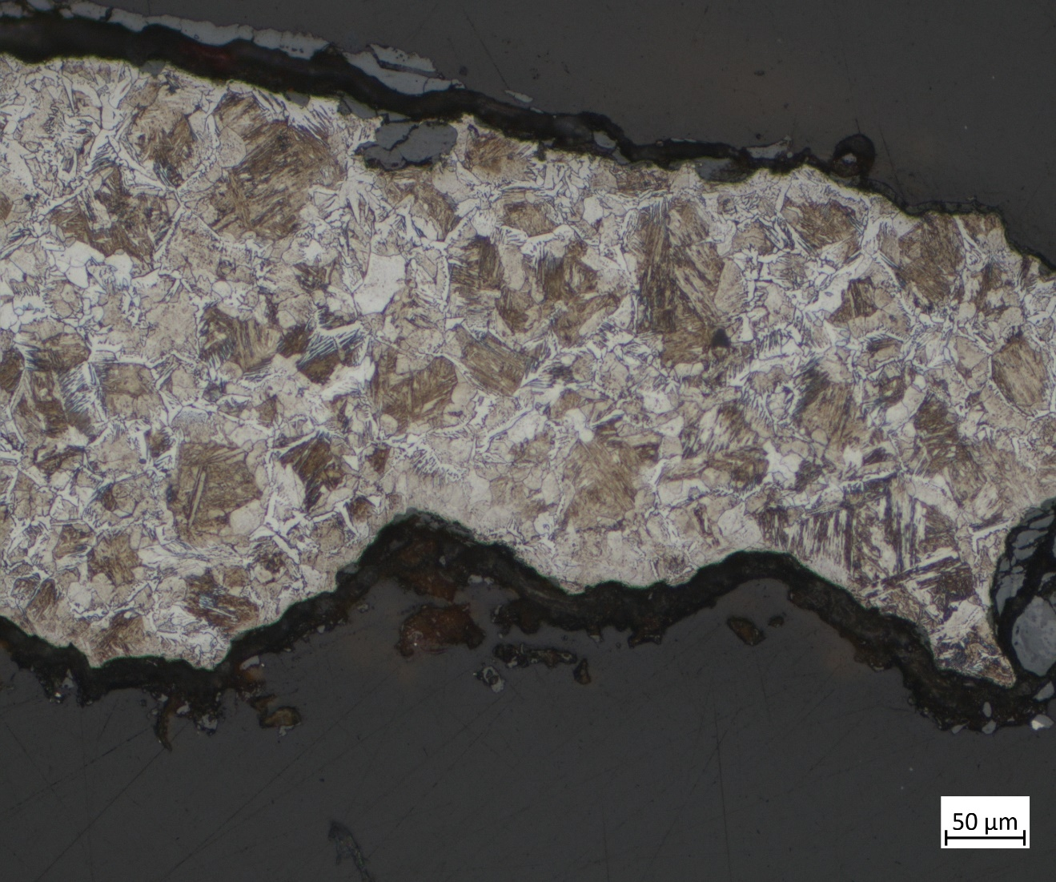
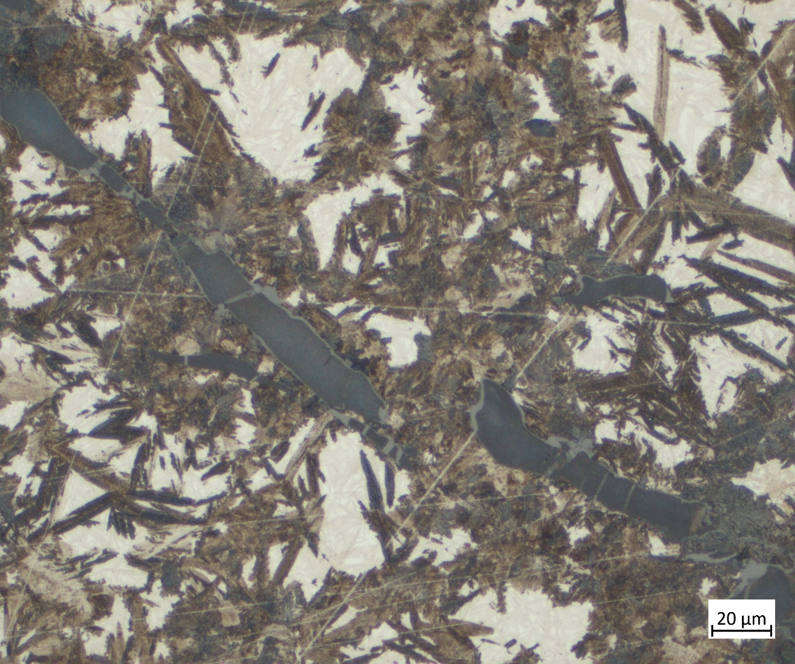
Seaxes
Quenching
Notes:
Speaking of subsequent activities, the most common evidence for treatment post shaping is quench hardening. 23 out of the 32 seaxes contain martensite or bainite, though almost universally solely at the very edge of the blade. Interestingly, this is the case even for high carbon steel edges, only the very edge will be martensite, despite the presence of carbide phases from one side of the blade to the other, which should theoretically have undergone the same transformation. This could be an indication of differential hardening, a well documented technique in sword manufacture, most famously for Japanese katana where the non hardened areas are protected with clay during the quench to prevent a martensitic transformation.
This by itself is not very surprising, and in fact I would say that it is more surprising that 9 seaxes are not quenched at all, though there again there could be a bias due to microstructure lost to corrosion.

Slide 13
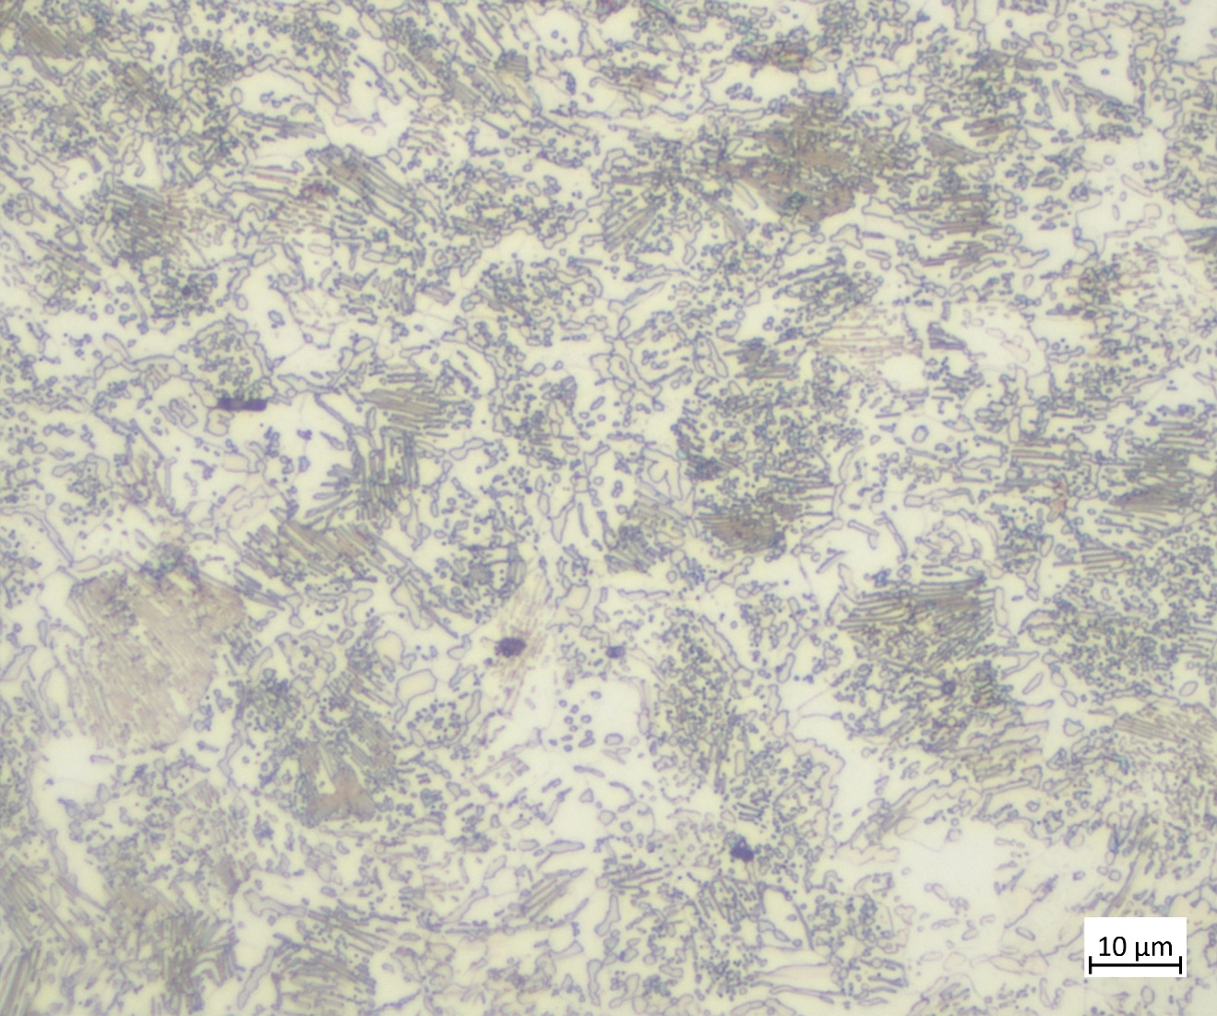
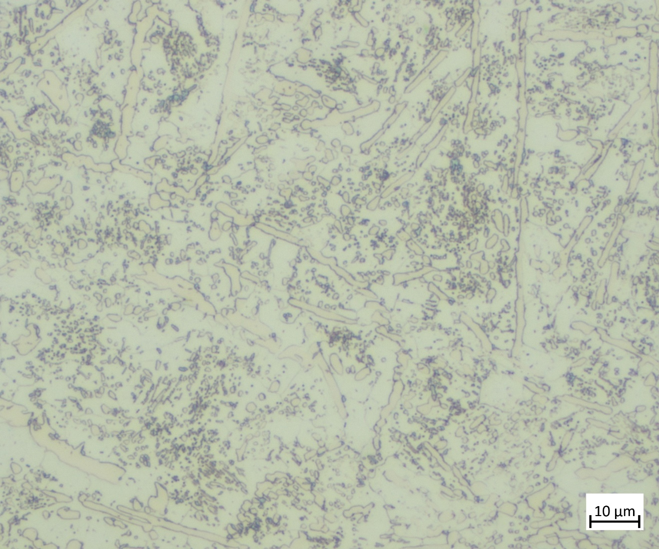
Seaxes
Heat treatment
Globular cementite
Lamellar pearlite
Larger cementite (carbide) phases
Notes:
Quenching, of course raises the question of tempering and heat treatment more broadly, and there are certainly examples of this. The typical evidence for a heat treatment is globular cementite, rather than forming lamellae, the carbide phases coalesce into roughly spherical globules, and there are examples of such a microstructure in 12 seaxes. Interestingly, 5 of these 12 did not have any evidence of a quench, and in contrast 16 of the quenched seaxes did not show any evidence of tempering, though it is possible that I missed something.
The exact microstructure varies considerably, from globular cementite with preserved lamellar pearlite as can be seen on the left, all the way to fully globular cementite with, in this example, some larger cementite phases that suggest a high initial carbon content. This could suggest that heat treatment took place at higher or lower temperatures, though given the deformed grain left over from the decoration, it might be more likely that the blades were maintained at moderate temperatures for long periods of time before being allowed to cool very slowly.

Slide 14
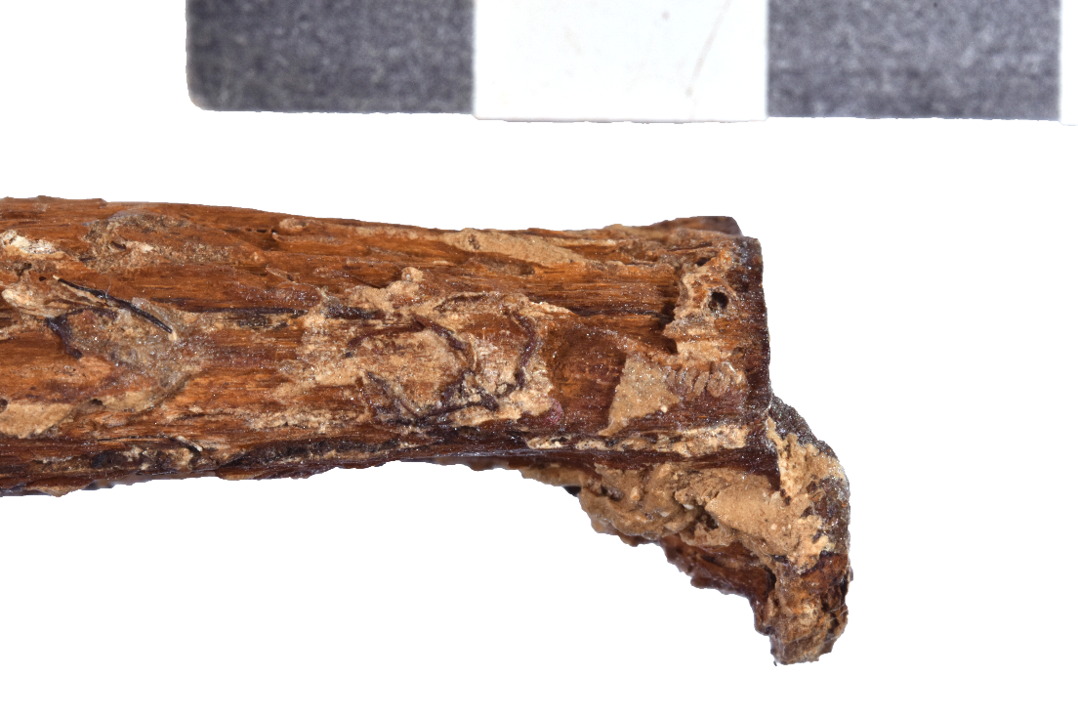
Seaxes
Final details
Notes:
Once the heat treatment is finished, the blade is done, and the seax itself only needs a few final touches. Some have a pommel, some don’t, some have a guard, some don’t, though what they all have is a wooden grip, and I’ll finish talking about the construction with a very interesting little thing I noticed on some of the longer 7th century seaxes, several of these have a little fold at the end of the tang, and thanks to one exceptionally well preserved seax you can see in the lower image, you can see how this little fold was implemented to keep the grip in place in the absence of a pommel. This was almost certainly done cold to avoid damaging the grip.

Slide 15
Seaxes
Provenance
Notes:
To wrap up, I did promise some provenance results in my abstract, but unfortunately, when I submitted that abstract I had somewhat underestimated just how much the complexity of seax construction would affect the interpretation, so I am still processing those results. However, I won’t leave you with nothing, because I have been able to establish the likely provenance of one of the seaxes. This seax was found in Oberschaeffolsheim, near Strasbourg, and has a simple two block construction.
Without going into detail, in our lab we establish provenance based on the similarity of trace element content in slag inclusions with the trace element content of iron ore and smelting slag that is collected in the CHIPS database, which my supervisor, Alexandre Disser, will be talking about later today.
What I was able to find is that the trace element content of inclusions in the spine matched very closely with slag found at several sites around Ingolstadt in Bavaria, while the inclusions in the edge matched with slag found near Ulm, in Baden-Württemberg. These are both very close to Alsace, so they are entirely coherent results and I think it’s quite safe to assume that this is where the iron used in this seax came from.

Slide 16
Thanks for listening
Notes:
So that’s my presentation, thank you very much for listening, and I will gladly answer any questions you might have

Slide 17
Acies Ferri
Notes:
To pre-empt a question that I get quite a lot, the weapons that I’m looking at come from cemeteries, partly because that’s where most of them are found, but also because they are the sites with the best established archaeological context, which is crucial for my study.
However, this leads to the valid question: can I be certain that the weapons I’m looking at are representative given that they are found solely in burial contexts. Now obviously, I can’t be 100% certain, but what I can say is that within these early medieval cemeteries, burial goods all show signs of wear and use, it is generally accepted that creating objects specifically for burial does not seem to have been a phenomenon in this time and place.
Amongst weapons, this is particularly clear with the seaxes, with a lot showing very clear evidence of use, so you can see a few examples here from cemeteries in Alsace and also in Belgium, and you can see a very consistent pattern of wear towards the centre of the blade, which very much looks like the sort of wear that is caused by extensive sharpening. So I feel quite confident in saying that these seaxes were used and were not solely created as burial goods.

Slide 18
Acies Ferri
Notes:
To pre-empt a question that I get quite a lot, the weapons that I’m looking at come from cemeteries, partly because that’s where most of them are found, but also because they are the sites with the best established archaeological context, which is crucial for my study.
However, this leads to the valid question: can I be certain that the weapons I’m looking at are representative given that they are found solely in burial contexts. Now obviously, I can’t be 100% certain, but what I can say is that within these early medieval cemeteries, burial goods all show signs of wear and use, it is generally accepted that creating objects specifically for burial does not seem to have been a phenomenon in this time and place.
Amongst weapons, this is particularly clear with the seaxes, with a lot showing very clear evidence of use, so you can see a few examples here from cemeteries in Alsace and also in Belgium, and you can see a very consistent pattern of wear towards the centre of the blade, which very much looks like the sort of wear that is caused by extensive sharpening. So I feel quite confident in saying that these seaxes were used and were not solely created as burial goods.

