Slide 1
Between economic imperatives, diplomatic negotiations and institutional difficulties: the case of cross-border territorial management in the Principality of Liège (1772-1779)
Presentation given at Rome, 12/12/2024
Contact : antoine.leclere@Uliege.be / antoine.leclere@vub.be
Antoine Leclère : Research fellow of the F.R.S – F.N.R.S – ULiege - VUB

Slide 2
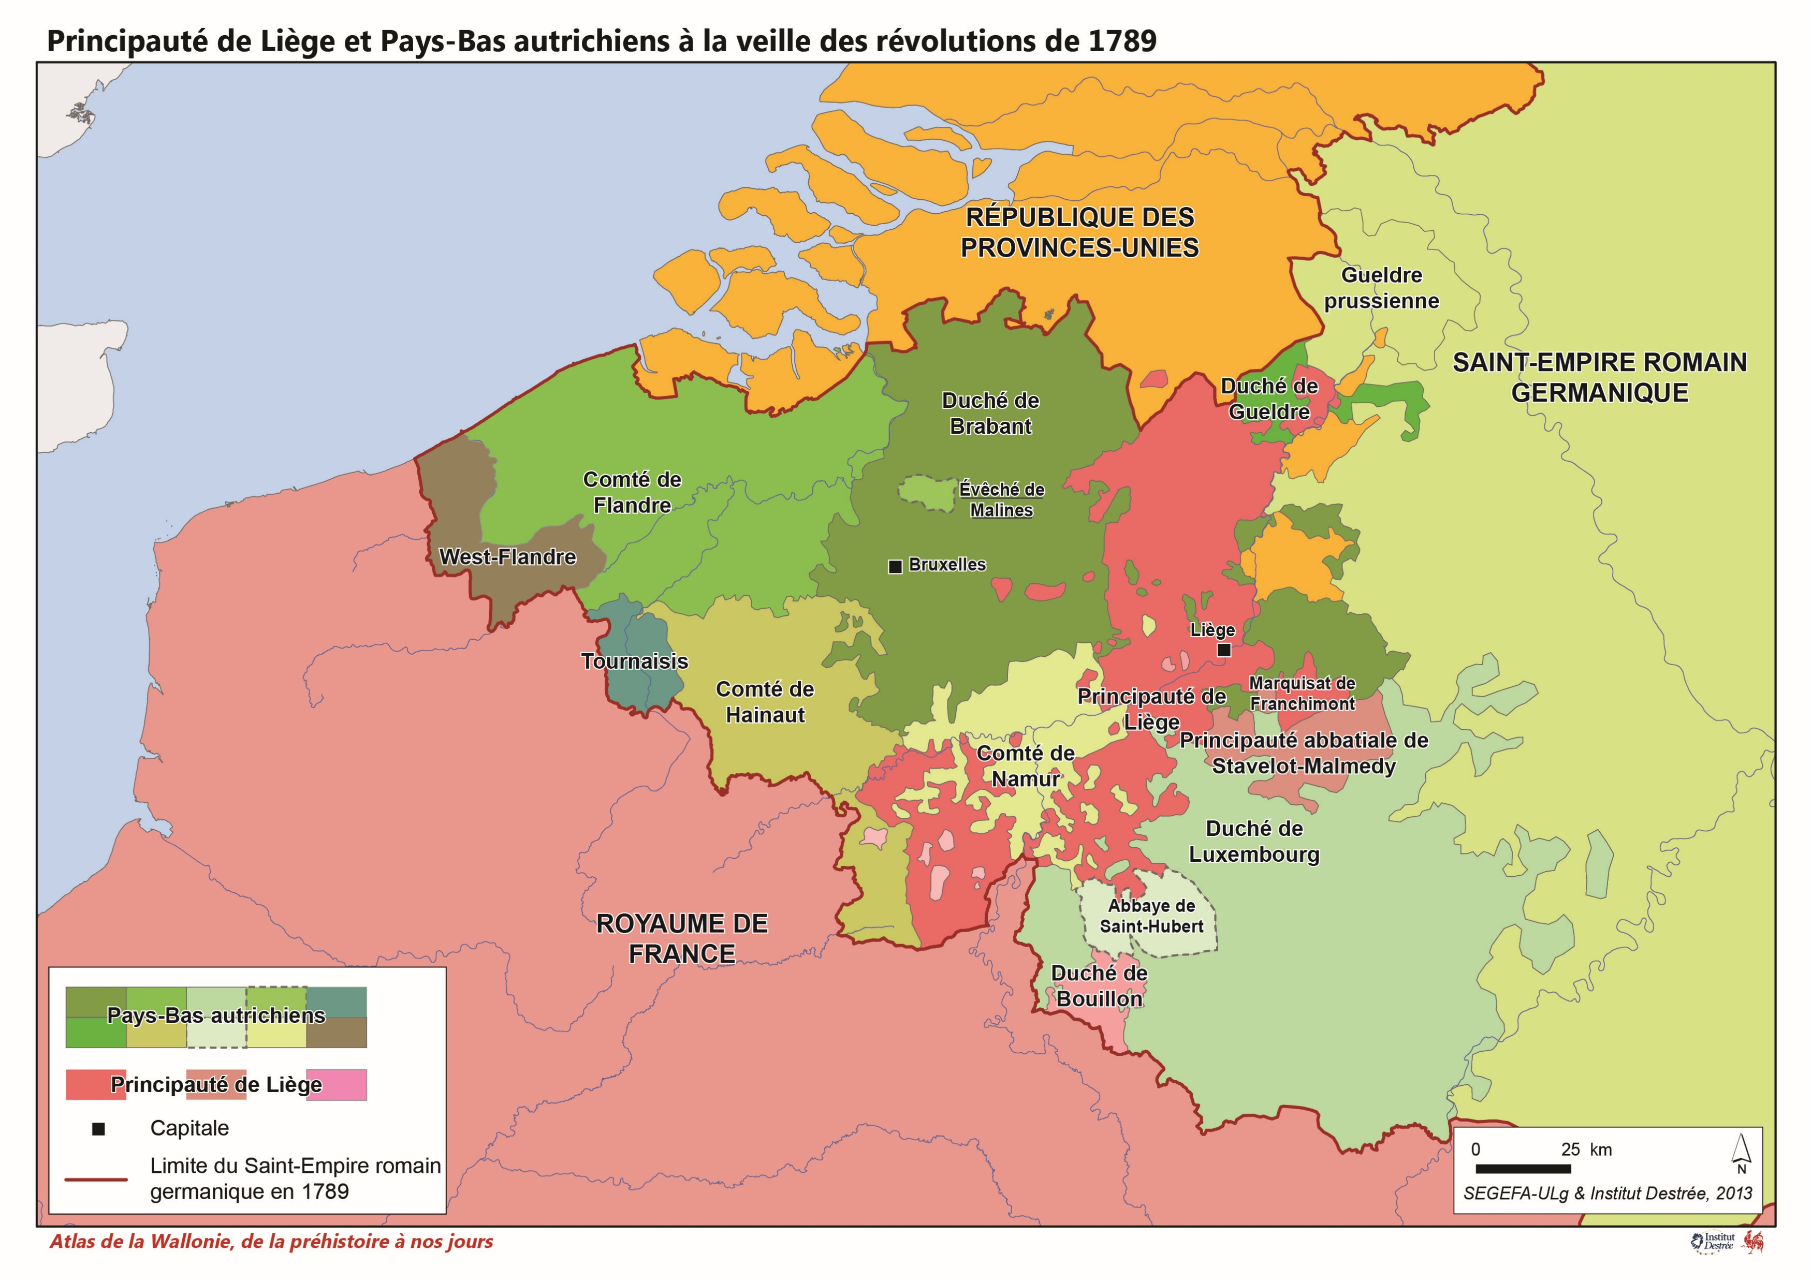
A Polity at the Crossroads of influences (1)
The Principality of Liège is a polity at the crossroads of European interests with a complex political system.
The population was divided into three estates: the clergy, the nobility, and the third estate.
These formed an eponymous institution where the deputies convened upon the prince-bishop's summons.
The clergy was further divided into the primary clergy, consisting solely of the canons of the cathedral, and the secondary clergy, encompassing all other clerics.
The nobility was limited to seventeen members from old established families.
The third estate were represented solely by twenty-three privileged towns.

Slide 3
The Treaty of Limits: Stakes and Negotiations (1)
The Principality of Liège is not a unified entity.
In 1769, the prince-bispho started extensive negotiations with France to redraw borders between the two countries.
Negotations were also about trading policies against the Austrian Low Countries.
Discussions were held between 1769 and 1772 with success for each one.
= territory under negotiation

Slide 4
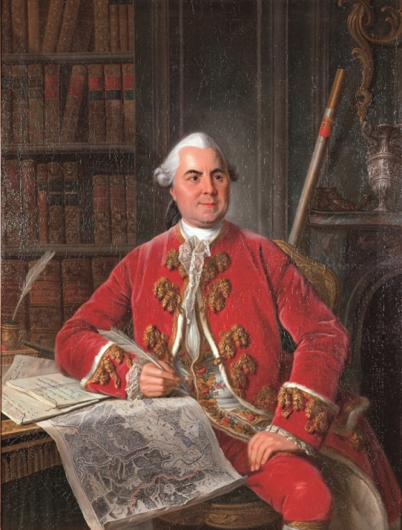
The Treaty of Limits: Stakes and Negotiations (2)
The prince-bishop send a former controller of the third estate budget : Jacques de Heusy.
He negotiated the cession of several villages, including Agimont, and the preservation of feudal rights for the local nobility despite the border modification.
Heusy was a double agent working for France and Liège. He developed strong ties with the French Secretary for Foreign affairs Choiseul.
Around 1771, Louis XV granted Heusy with the title of lord of Agimont in exchange of 8.000 écus. Heusy received the title and all the rights attached to it.
In 1771, Heusy and the new prince-bishop, François-Charles de Velbrück, disliked each other. Velbrück replaced the old controller who was now part of the French nobility.
Portrait of Jacques de Heusy at his work table, painted around 1769 by Louis-Michel van Loo.
Oil on canvas, 136 x 104 cm, acquired by the Fonds du Patrimoine, 2003, Musée d'Ansembourg, Liège.

Slide 5
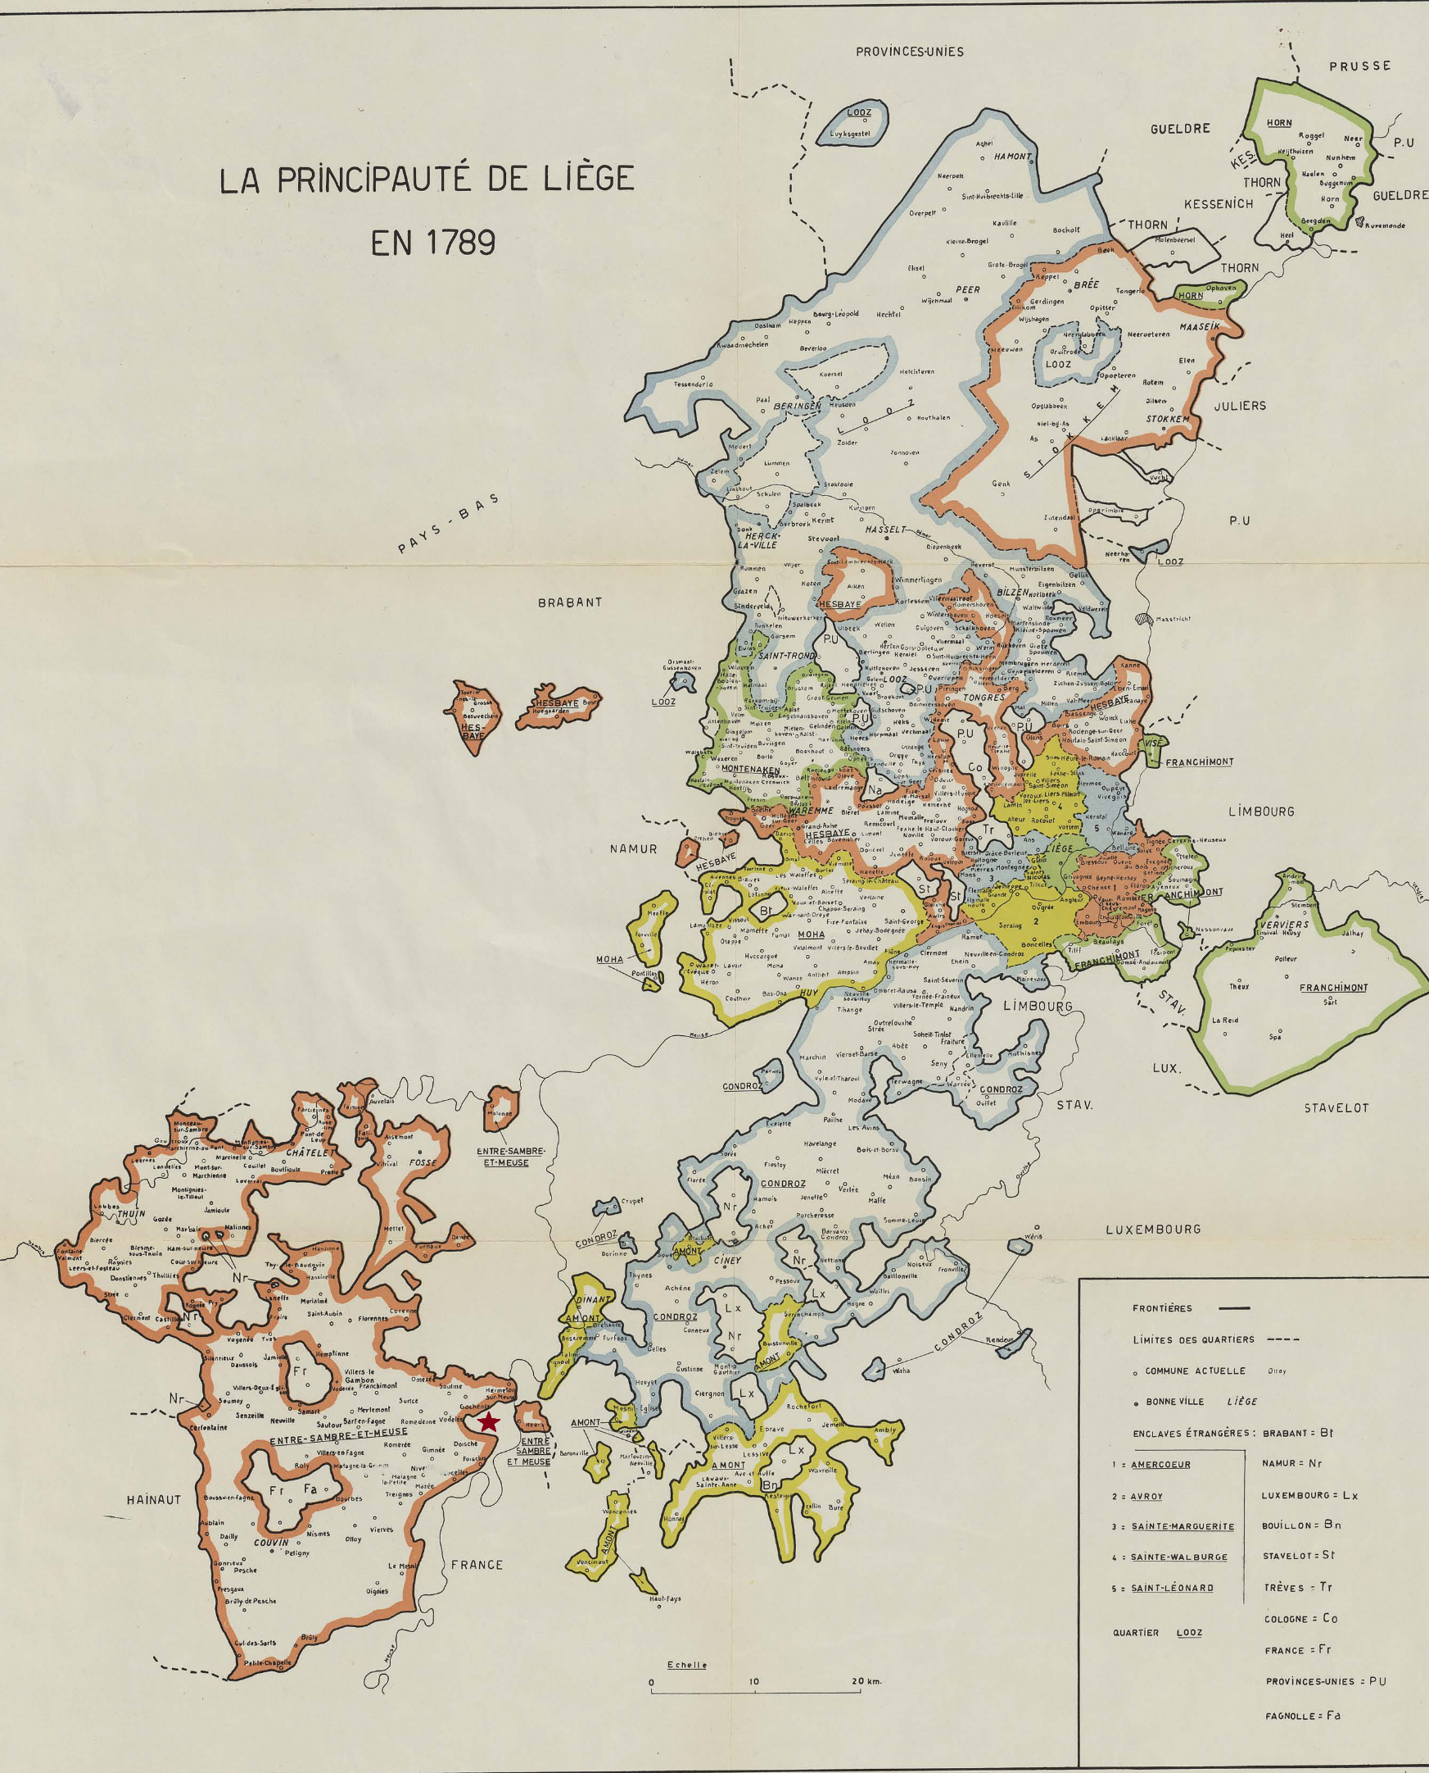
The Conflict over Water Passage in the Fief of Agimont: The River as a Stake (1)
Agimont was a small fief but was renowed because of the water passage on the Meuse between France and Liège.
The fief was situated near Heer, a mandatory customs post for every merchant wishing to pass through Liège from France to the Holy Roman Empire or the Dutch Republic.
The local nobility main income derived from the water passage that was a possession of the lord of Agimont alone before 1772.
The Treaty of Limits (1772) had provided the cession of Agimont to the Liege government (prince-bishop, estates and cathedral chapter) in exchange of a customs exemption from Givet to Heer.
The right of passage on the Meuse was maintained because not discussed during the negotiation of the treaty.
= Approximate location of the seigneury of Agimont
Ruwet J., Carte de la principauté de Liège vers 1789, Bruxelles, Commission royale d’histoire, 1958.

Slide 6
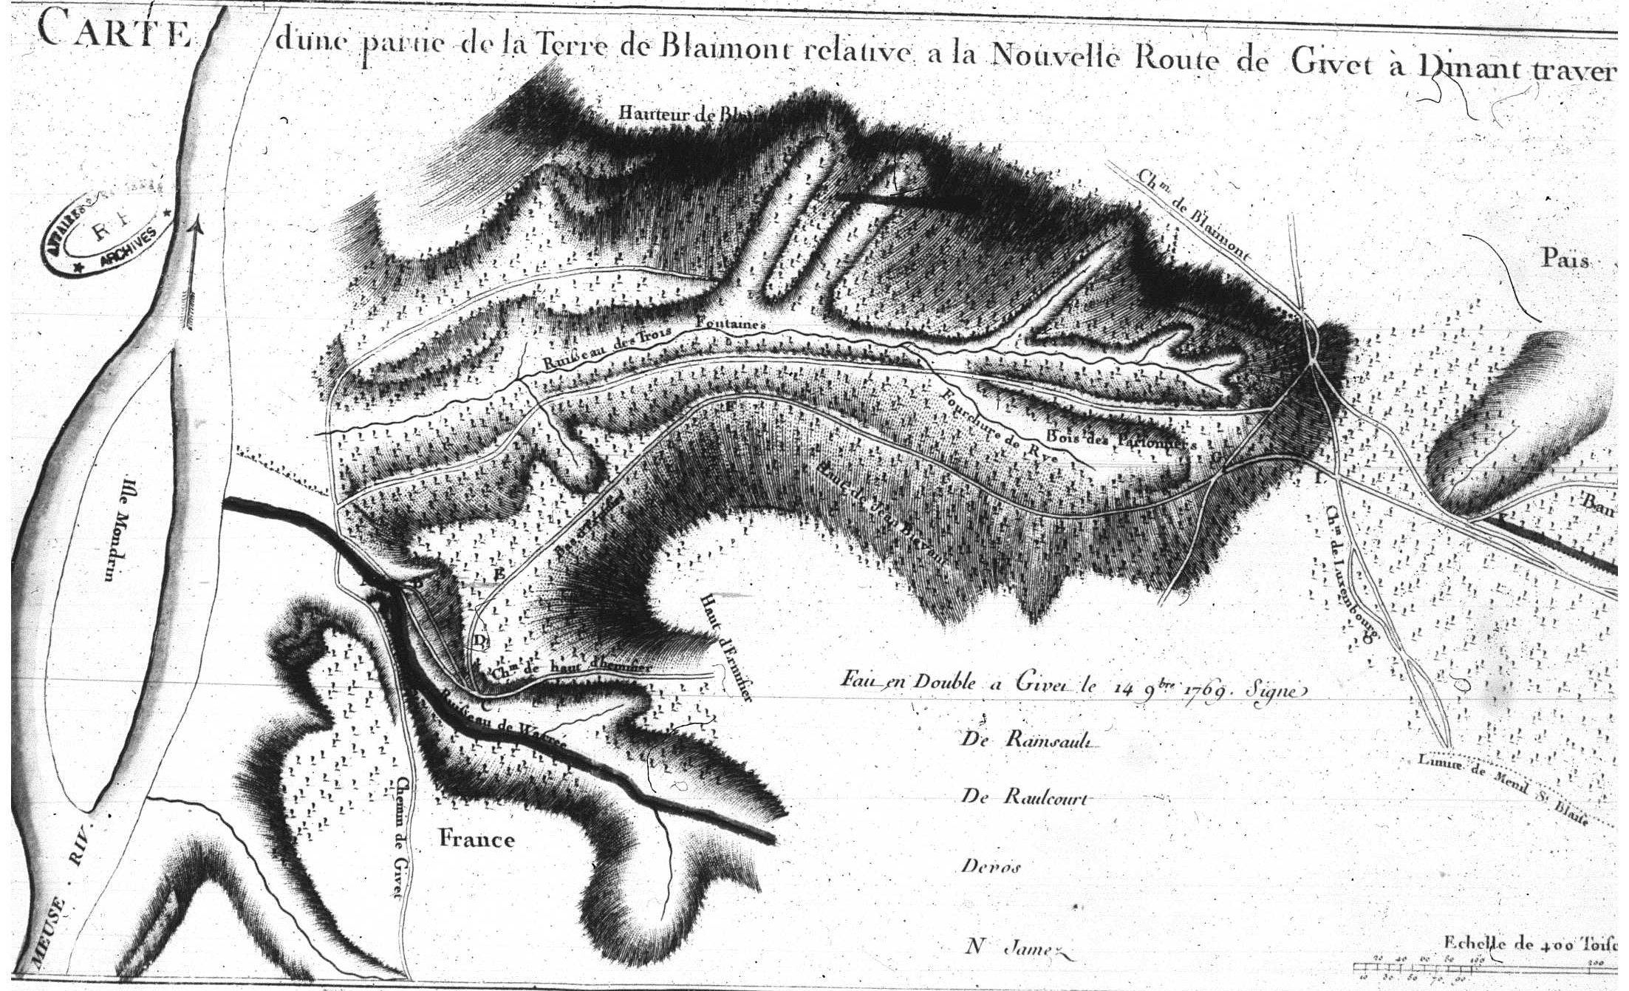
The Conflict over Water Passage in the Fief of Agimont: The River as a Stake (2)
In 1776, Velbrück and the Estates decided to buil a ferry on the Meuse between Heer and Hermeton wich was under the jurisdiction of Agimont.
Considering that the money used for the construction was from the State Budget and the Treaty of Limits cessions, the prince-bishop considered that the income from Agimont ferry would be his property.
But, Jacques de Heusy obtained the title of Agimont before the ratification of the Treaty by Louis XV and Velbrück wich occurred on May 24, 1772, Moreover, Louis XV confirmed his ennoblement before the validation of the Holy Roman Empire Diet in 1774.
Relying on the clauses preserving the rights of the local nobility, Heusy judged that the income from the new ferry belonged to him.
Liège
France
Carte d’une partie de la terre de Blaimont relative à la nouvelle route de Givet à Dinant, dressée par le Ministère français des Affaires étrangères en 1769, Paris, AMAE, correspondance politique, vol. 63.
= New ferry

Slide 7
The Conflict over Water Passage in the Fief of Agimont: The River as a Stake (3)
The case was immediately presented to the French Secretary of State of Foreign Affairs, Charles-Gravier de Vergennes.
The affair turned into an international legal conflict against the backdrop of a latent conflict with the Austrian Netherlands wich had taken retaliatory measures since the Treaty of Limits.
Velbrück contested the validity of the French title of Heusy before the Aulic Council in Vienna, one of the two supreme courts of the Holy Roman Empire.
The French minister’s position was precarious. By following the prince-bishop, he would contribute to strengthening the sovereignty of the Liege government against the French local nobility. Moreover, Vienna was negotiating the full control over the Meuse including the former French fiefs ceded in 1772
By supporting Heusy, Vergennes would be too openly against a prince of the Holy Roman Empire who was supported by Austria. It would results in a weakened position for France in the Low Countries region.

Slide 8
The Conflict over Water Passage in the Fief of Agimont: The River as a Stake (4)
Based on Freminville’s work, Vergennes argued that ferries and river crossings, unlike tolls and customs posts, belonged to the local nobility.
The government of Liege did only have a police power to maintain public safety by, for exemple, constructing new infrastructures.
The single payment required to cross the Meuse was to be considered a "privilege granted simply to the one who holds it, rather than a tax," if it remained within the limits of the fief.
Vergennes thus suggested that the prince-Bishop should retrocede the ferry rights to Louis XVI in exchange for financial compensation.
In 1778, Heusy informed France that he had lost his cases before the Holy Roman Empire courts. Pressed by the imminent conclusion of negotiations between Austria and Liège, Vergennes directed a final arbitration.

Slide 9
The Conflict over Water Passage in the Fief of Agimont: The River as a Stake (5)
In exchange for the rights to the Agimont ferry, the estates and the Prince-Bishop were to pay 12,000 florins to Jacques de Heusy and confirm the customs exemptions for French goods passing through Givet.
The French arbitration ultimately concluded on March 4, 1779.
Nevertheless, the issue of sovereignty over the Meuse was far from resolved.
Maria Theresa and Velbrück reached a commercial and border agreement, which they officially ratified on August 26, 1780.
The Prince-Bishop had realized Vergennes' fears about a full sovereignty of Austria over the Meuse.
Recès de l’état de la noblesse du pays de Liège, daté de Liège du 4 mars 1779, Paris, AMAE, correspondance politique, vol. 68.

Slide 10
Conclusions
This brief examination highlights the economic, diplomatic, and legal stakes involved in managing cross-border natural spaces, particularly rivers, in the late 18th century.
From a legal standpoint, ownership of the Agimont ferry and, more broadly, the banks of the Meuse in the border region between Liège and France raises an important question: who truly holds sovereignty over border regions, especially in the Holy Roman Empire?
In terms of diplomacy and economics, our case study proves the major stakes of the region of present-day Belgium and the Meuse for European diplomacy.
The Low Countries and the former Principality of Liège were divided between the suzerainty exercised by Austria and the power of France, which also had a right of intervention in imperial affairs since 1648,
The Meuse and its natural banks were both a priority for maintaining free transit between France, Liège, the Dutch Republic, and the rest of the Holy Roman Empire, and an opportunity to challenge the absolutist tendencies of the Prince-Bishops.

Slide 11
Between economic imperatives, diplomatic negotiations and institutional difficulties: the case of cross-border territorial management in the Principality of Liège (1772-1779)
Presentation given at Rome, 12/12/2024
Contact : antoine.leclere@Uliege.be / antoine.leclere@vub.be
Antoine Leclère : Research fellow of the F.R.S – F.N.R.S – ULiege - VUB

