Slide 1
Le droit constitutionnel révolutionnaire de la principauté de Liège et des Pays-Bas autrichiens : entre innovation, tradition et influence (1772-1804)
Presentation given at Lille, 14/11/2024
Contact : antoine.leclere@uliege.be / antoine.leclere@vub.be
Antoine Leclère : Research fellow of the F.R.S – F.N.R.S – ULiege - VUB

Slide 2
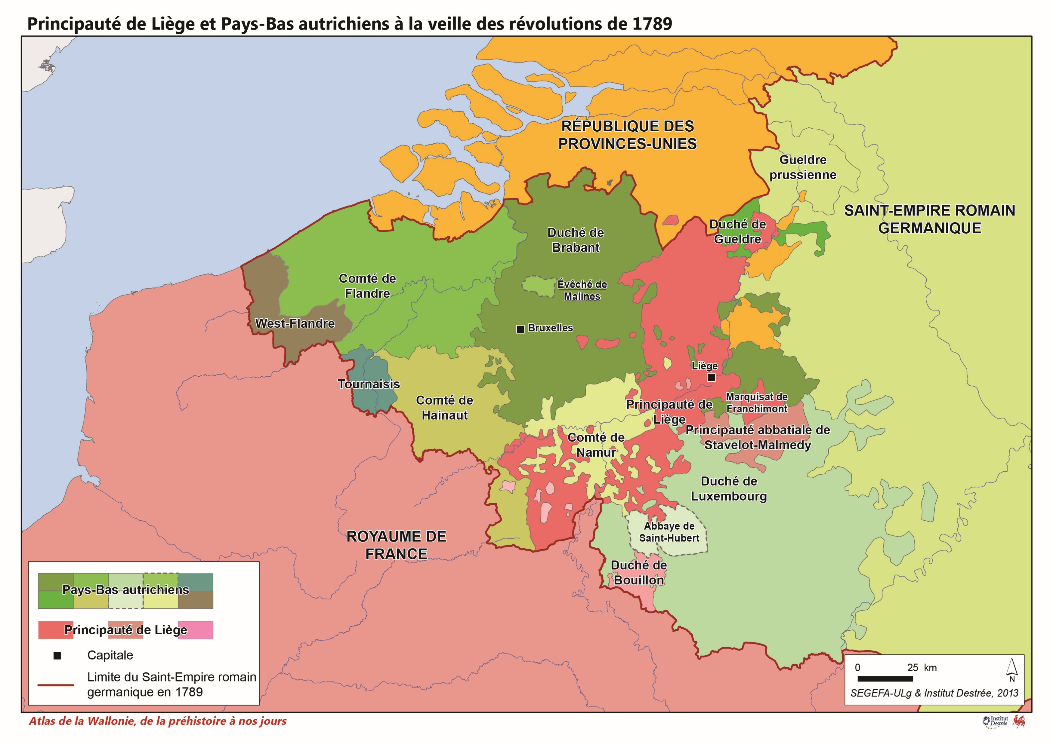
A Principality at the Crossroads of influences
The Principality of Liège is at the crossroads of European interests with a complex political system.
The aim is to highlight the potential originality of the constitutional law constructed by the Liège Revolution (1789-1795) and situate the Liège constitutional work within the European context by examining the influences exerted by neighboring spaces on revolutionary discussions.
vast documentary corpus :
- Institutional sources
- Judicial sources
- Diplomatic sources

