Slide 2
Symptomatic huge thrombus of the descending thoracic aorta Ines Zekhnini MD , Arnaud Kerzmann MD, Evelyne Boesmans MD, Quentin Desiron MD, Jean-Olivier Defraigne PHD Department of Cardiovascular and Thoracic Surgery, University Hospital of Liège, Belgium
Notes:
I’am going to present a case report about a symptomatic huge thrombus of the descendant thoracic aorta

Slide 3
No disclosure

Slide 4
Introduction :
Aortic thrombus is a rare cause of distal arterial embolization
The true incidence is unkwown because the majority is asymptomatic
Machleder & al 1986: 10 671 autopsies → 0.45% (48 cases) thoracic aortic thrombus (TAT) → 17% (8 cases) distal embolization.
Notes:
The aortic thrombus is a rare cause of distal arterial embolization
The true incidence remains unknown because the majority of the patients are asymptomatic.
In 1986, Machleder and his colleagues did more than 10 000 autopsies and they observed that 48 cases had a thoracic aortic thrombus and among them 8 cases had distal embolization.

Slide 5
Introduction :
Verma & al 2014, Fayad & al 2013 : thoracic descending aorta is the most frequent aortic thrombus localization (38%).
No established guidelines for Thoracic Aortic Thrombus treatment :
Conservative treatment (anticoagulation)
Open surgery : thrombectomy with or without thoracic aortic replacement
Endovascular approach by exclusion of the thrombus (TEVAR)
Notes:
Regarding the localization of the thrombus, Verma & his colleagues and Fayad & his colleagues had the same conclusions. the descending thoracic aorta is the most frequent localization of the thrombus.
What is very important is that there is no established guidelines for the aotic thoracic thrombus
3 therapeutic strategies exists :
The conservative treatment which consists of an anticoagulation
The open surgery with a thrombectomy and a thoracic aortic replacement.
The endovascular approach by exclusion of the thrombuse.
The case report I’m going to talk to you illustrates the advantages of the endovascular approach.

Slide 6
Case report :
49 y-o man, left calf pain persisting for 4 months slowly improving
Medical history : active smoking ( 15 -20 cig/d for 40 years), HTA, dyslipidemia , obesity (BMI : 30 kg/m2)
Physical examination : ABI : 0.46 in the right side, 0.40 in the left side
Notes:
Here is the case of a 49 year old man which presented a left calf pain for 4 months slowly improving.
His medical history includes active smoking, hypertension dyslipidemia and obesity.
His ABI are low : 0.46 in the right side and 0.40 in the left side.

Slide 7
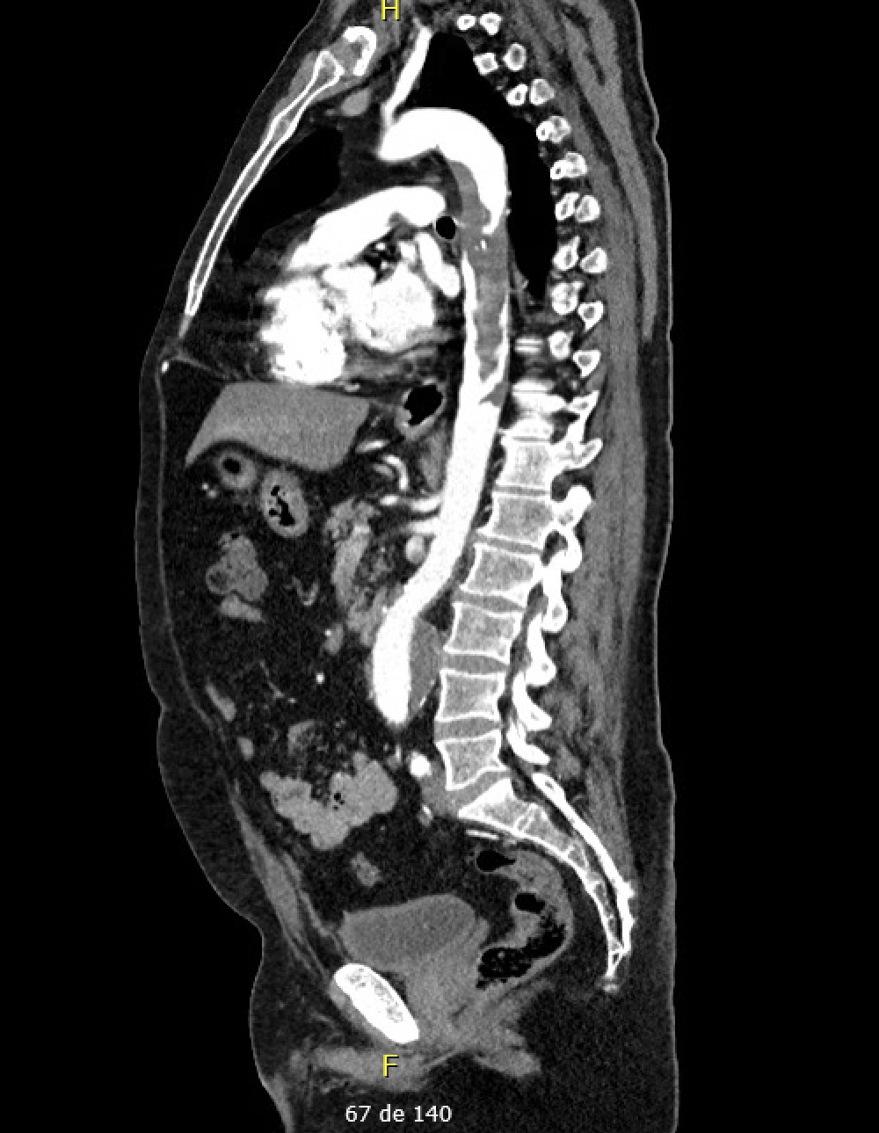
Angio CT :
- occlusion of the left popliteal artery,
a right common femoral artery stenosis,
a 43 mm infra-renal abdominal aortic aneurysm
a huge thrombus of the descending thoracic aorta
→ distal embolization of the thrombus in the left popliteal artery
Notes:
The computed tomography angiography revealed an occlusion of the left popliteal artery, a right common femoral artery stenosis, a 43 mm infra-renal abdominal aortic aneurysm and a huge thrombus of the descending thoracic aorta The distal part of the thrombus had a floating configuration..
We concluded that a distal embolization of the thrombu occurred in the left popliteal artery.

Slide 8
TEVAR :
Two VALIANT stentgrafts measuring 30x157mm are deployed from 10cm proximal to the origin of the left subclavian artery to 5cm distal to the celiac trunk.
Post operative evolution :
J1 : AF, managed with amiodarone
4 days of hospitalization
Notes:
) We decided to perform an endovascular exclusion of the thrombus by depoloying two stent grafts from 10 cm proximal to the origin of the left subclavian artery to 5 cmy distal to the coeliac trunk.
The patient experienced 24 hours of atrial fibrillation, managed with amiodarone, leading to sinus rhythm restoration within 24 hours. A follow-up angio CT performed 4 days postoperatively showed reassuring results, allowing the patient's discharge

Slide 9
Conclusion :
Advantages of the endovascular approach for the TAT treatment :
Lower risk of recurrence compared to the conservative treatment (0-50% Pagni & al 2011, Bowdich & al 2002, Meyerman & al 2017, Lau & al 1997).
Lower morbidity and operaritve complications compared to the open surgery. (mortality : 2.4% (Goueffic & al 2002), complications : 28-71%( Turley & al 2014, Choukroun & al 2002))
Risk of iatrogenic distal embolization ( Meyermann & al 2017)
Notes:
9) In conclusion, here are the advantages of the endovascular approach :
It offers lower risk of recurrence compared to conservative treatment.
For the conservative treatment the recurrence rate varies from 0-50% in the litterature.
The endovascular repair allows a lower morbidty compared to the open surgery. The mortality rate for the open surgery is 2.4% but the rank of peri operative complications varies from 28 to 71% in the literature for the open surgey.
We also must take into account that there is a iatrogenic risk of distal embolization during wire manipulation . However it never has been reported in the litterature.
Multiples techniques exists to avoid such risks for instance: the use of balloon of occlusion, intravascular ultrasound to avoid the use of contrast bolus and to localize the thombus. a seal zone of at least 2cm proximal and distal to the thrombus .
A pré operative anti coagulation to limit the clot burden could be useful too.
In conclusion, the ATT is a rare condition with potential devastating complications.
More studies are needed on this subject.

Slide 10
Thank you for your attention

Slide 11
References :
Tsilimparis N, Hanack U, Pisimisis G, Yousefi S, Wintzer C, Rückert RI. Thrombus in the non-aneurysmal, non-atherosclerotic descending thoracic aortadan unusual source of arterial embolism. Eur J Vasc Endovasc Surg 2011;41:450-7.
Boufi M, Mameli A, Compes P, Hartung O, Alimi YS. Elective stent- graft treatment for the management of thoracic aorta mural thrombus. Eur J Vasc Endovasc Surg 2014;47:335-41.
Goueffic Y, Chaillou P, Pillet JC, Duveau D, Patra P. Surgical treatment of nonaneurysmal aortic lesions in patients with systemic embolization. J Vasc Surg 2002;36:1186-1193.
Meyermann K, Trani J, Caputo FJ, et al. Descending thoracic aortic mural thrombus presentation and treatment strategies. J Vasc Surg 2017; 66: 931–936
Verma H, Meda N, Vora S, George RK, Tripathi RK. Contemporary management of symptomatic primary aortic mural thrombus. J Vasc Surg. 2014 Dec;60(6):1524-34. doi: 10.1016/j.jvs.2014.08.057. Epub 2014 Sep 22. PMID: 25256613.
Nguyen Q, Ma X, Vervoort D, Luc JGY. Management Strategies for Descending Thoracic Aortic Thrombus: A Review of the Literature. Innovations (Phila). 2022 Jul-Aug;17(4):283-296. doi: 10.1177/15569845221107011. Epub 2022 Jul 21. PMID: 35866207; PMCID: PMC9403384.
Fayad ZY, Semaan E, Fahoum B, Briggs M, Tortolani A, D’Ayala M. Aortic mural thrombus in the normal or minimally atherosclerotic aorta. Ann Vasc Surg 2013;27:282-90
Machleder HI, Takiff H, Lois JF, Holburt E. Aortic mural thrombus: an occult source of arterial thromboembolism. J Vasc Surg 1986;4:473e8.
Siani A, Accrocca F, De Vivo G, Mounayergi F, Marcucci G. Endovascular Treatment of Symptomatic Thrombus of the Descending Thoracic Aorta. Ann Vasc Surg. 2016 Oct;36:295.e13-295.e16. doi: 10.1016/j.avsg.2016.03.027. Epub 2016 Jul 15. PMID: 27423712.
Turley R, Unger J, Cox M, Lawson J, McCann R, Shortell C, Atypical Aortic Thrombus: Should Non-Operative Management Be First Line?, Annals of Vascular Surgery (2014), doi: 10.1016/j.avsg.2014.03.028.
Pagni S, Trivedi J, Ganzel BL, Williams M, Kapoor N, Ross C, et al. Thoracic aortic mobile thrombus: is there a role for early surgical intervention? Ann Thorac Surg 2011;91:1875-81 .
Lau LS, Blanchard DG, Hye RJ. Diagnosis and management of patients with peripheral macroemboli from thoracic aortic pathology. Ann Vasc Surg 1997;11:348-53.
Choukroun EM, Labrousse LM, Madonna FP, Deville C. Mobile thrombus of the thoracic aorta: diagnosis and treatment in 9 cases. Ann Vasc Surg 2002;16:714-22.
Bowdish ME, Weaver FA, Liebman HA, Rowe VL, Hood DB. Anticoagulation is an effective treatment for aortic mural thrombi. J Vasc Surg 2002;36:713-9

