Slide 2
Hybrid endovascular approach of a symptomatic aneurysm in aberrant right subclavian artery (Arteria Lusoria)
J. PUDZEIS, A. KERZMANN, N. SAKALIHASAN, E. BOESMANS, C. HOLEMANS, D. SZECEL and J-O. DEFRAIGNE
Department of Cardiovascular and Thoracic Surgery, CHU, Liege, Belgium

Slide 3
No disclosure

Slide 4
Arteria Lusoria
Most common congenital anomaly of the aortic arch
Occasional associated vascular anomalies :
Kommerell diverticulum (15%-60%)
Truncus bicaroticus (19%-29%)
Aneurysm of the anomaly (13%)
Right-sided aortic arch (9%)
Options treatments :
Open surgery
Hybrid endovascular approach

Slide 5
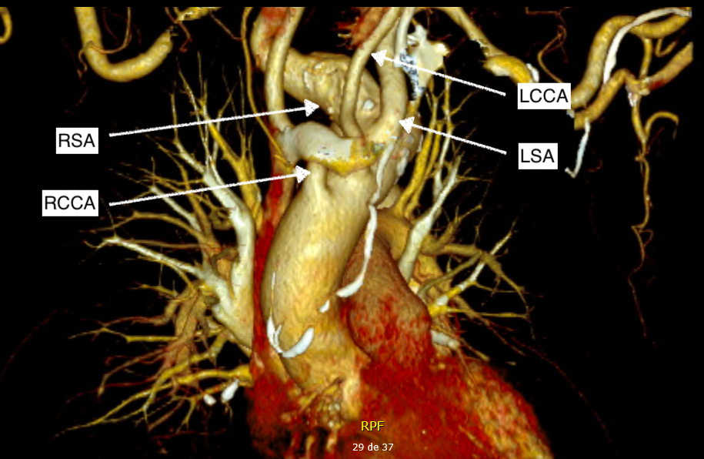
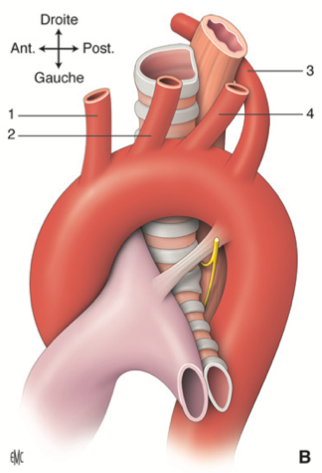
Case report
Computed tomography
89 years old caucasian man
Chest tightness
Dyspnea
History :
Coronary angioplasty 1999
EVAR 2018

Slide 6
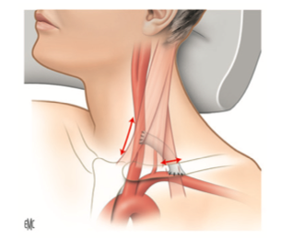
Treatment & postoperatively
Two stages :
Right prosthetic carotid-subclavian bypass via a supraclavicular approach
- Left prosthetic carotid-subclavian bypass
Embolization of the origins of the bilateral subclavian arteries
Thoracic stent graft
Postoperatively
Patent bilateral carotid-to-subclavian artery bypasses
Absence of type I endoleak.

Slide 7
Conclusion
Advancements in TEVAR have offered a feasible option for patients who would otherwise face significant morbidity risks with traditional open techniques.
Recent reports on the hybrid technique suggest symptomatic relief for most patients, likely due to sac depressurization by excluding aneurysm inflow and outflow.

