Slide 1
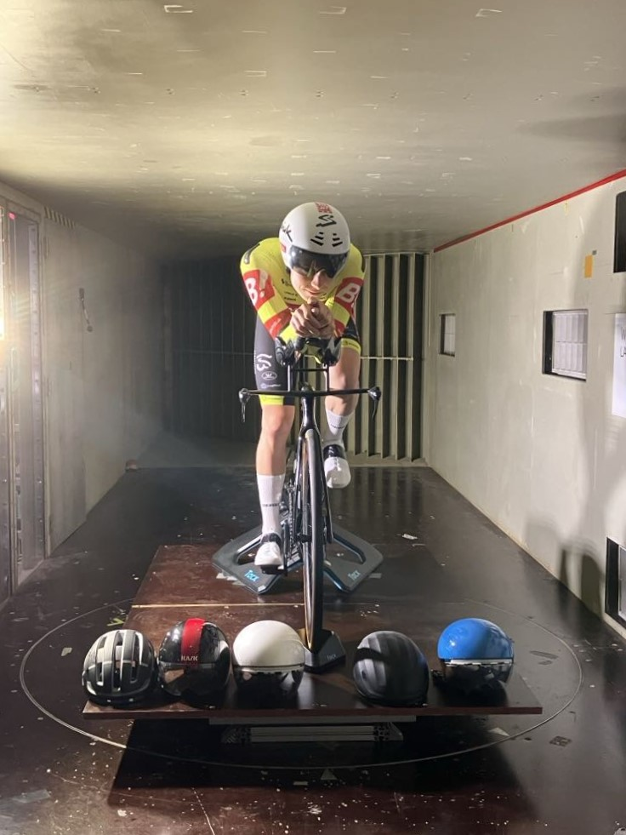
BBAA IX
Different assessments of aerodynamic performances of cycling helmets
Léonore Foguenne, Thomas Andrianne, Cédric Schwartz & Jonathan Wiggins

Slide 2
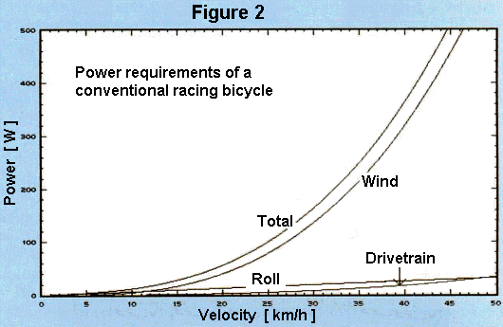
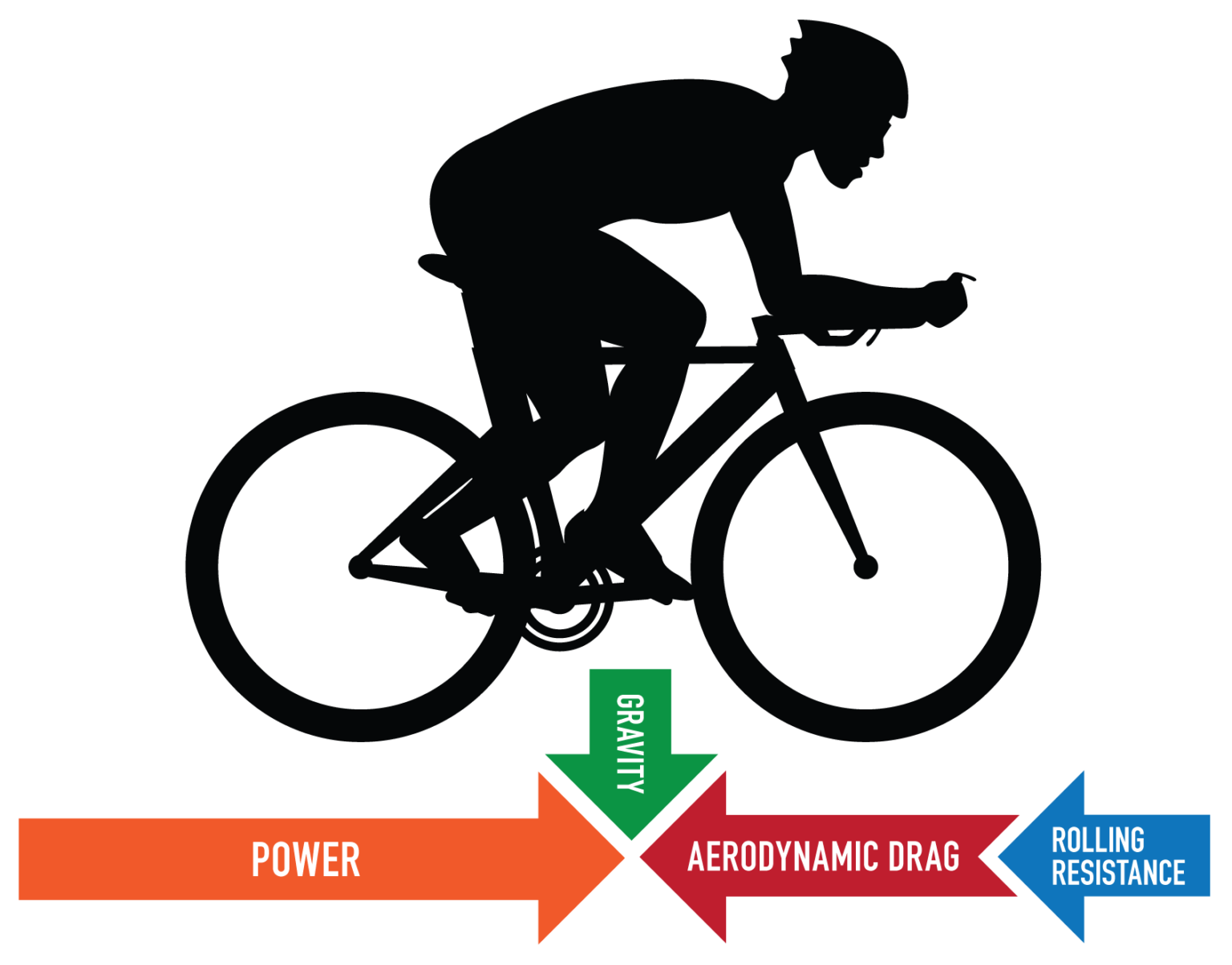
INTRODUCTION
Introduction
M
R
C
Minimize drag
Aerodynamic positions
Specialized equipment
M
~90%
Rainer Pivit, 1990; Ryan Cooper; Defraeye et al., 2010; Barry et al., 2014; Debraux et al., 2011; Crouch et al., 2014; Blocken et al., 2018
1
Notes:
Aerodynamic drag is a critical factor for cyclists, especially at high speeds where it accounts for up to 90% of the total resistance experienced when exceeding 40 km/h. This significant impact on performance has driven cyclists to adopt more aerodynamic positions and to experiment with specialized equipment aimed at minimizing the drag area, thereby gaining a competitive edge by saving precious watts.

Slide 3
INTRODUCTION
Introduction
M
R
C
Minimize drag
Aerodynamic positions
Specialized equipment
M
M
~90%
Traditional Testing:
Cyclist model
Isolate equipment performance
May not reflect real-world conditions
VS.
Dynamic Testing:
Pedalling cyclist
More realistic
Introduces variability due to cyclist movement
V
X
V
X
Rainer Pivit, 1990; Ryan Cooper; Defraeye et al., 2010; Barry et al., 2014; Debraux et al., 2011; Crouch et al., 2014; Blocken et al., 2018
1
Notes:
Traditionally, evaluations of cycling equipment have been conducted using static models of cyclists to avoid errors introduced by human variability. While such methods help isolate equipment performance, they may not accurately represent real-world conditions where equipment interacts with the cyclist body. An alternative method involves testing with the cyclist pedaling in a wind tunnel. This setup offers a more realistic simulation, but it introduces another challenge: the cyclists' movement during and between measurements can lead to variability in the results.

Slide 4
INTRODUCTION
Introduction
M
R
C
Minimize drag
Aerodynamic positions
Specialized equipment
M
M
~90%
Traditional Testing:
Cyclist model
Isolate equipment performance
May not reflect real-world conditions
VS.
Dynamic Testing:
Pedalling cyclist
More realistic
Introduces variability due to cyclist movement
V
X
V
X
OBJECTIVES:
Determine the best way to test helmets
Determine how to chose a helmet
Rainer Pivit, 1990; Ryan Cooper; Defraeye et al., 2010; Barry et al., 2014; Debraux et al., 2011; Crouch et al., 2014; Blocken et al., 2018
1
Notes:
Our study aims to determine the most effective way to test helmets. We aimed to compare traditional static testing methods with dynamic testing methods involving actual cyclists. By assessing the benefits and limitations of each method, we sought to establish which approach provides the most accurate and reliable measurements of aerodynamic performance.
We also aimed to identify which helmet design offers the best aerodynamic performance under different conditions.
This involved:
Testing various helmet designs, including road and aero-helmets.
Evaluating the helmets under different yaw angles, pitch angles, and wind speeds to determine which design consistently minimizes drag.
Analyzing the aerodynamic performance in both static and dynamic testing scenarios to provide comprehensive recommendations for cyclists seeking to optimize their equipment for reduced drag.

Slide 5
Methodology: Helmets tested
METHODOLOGY
I
R
C
Total: 5 helmets tested
3 aero-helmets
Helmet 1
Helmet 2
Reference helmet
(road helmet)
compared to
Helmet 5
Helmet 3
Helmet 4
1 road helmet
2
3
Notes:
In total, we tested 5 different helmets on both setups. 3 were aero-helmets and 2 were road-helmets. The helmet 5, that is a road-helmet was chosen as the reference and the other helmets will be compared to this helmet in order to express the results. The helmets 2 and 3 have a similar shape, but their differences lie in the ventilations and corrugations.

Slide 6
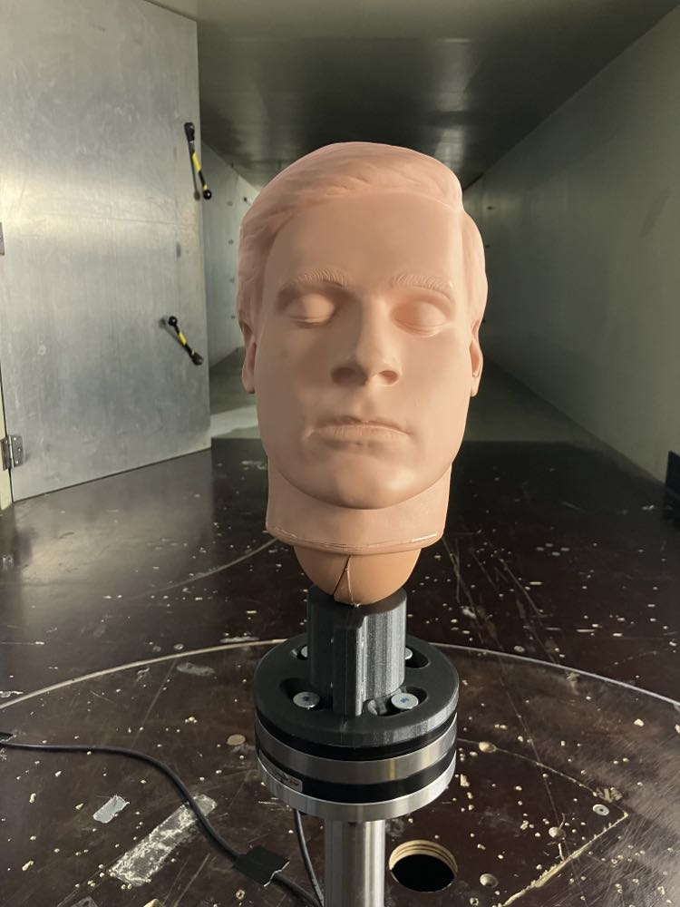
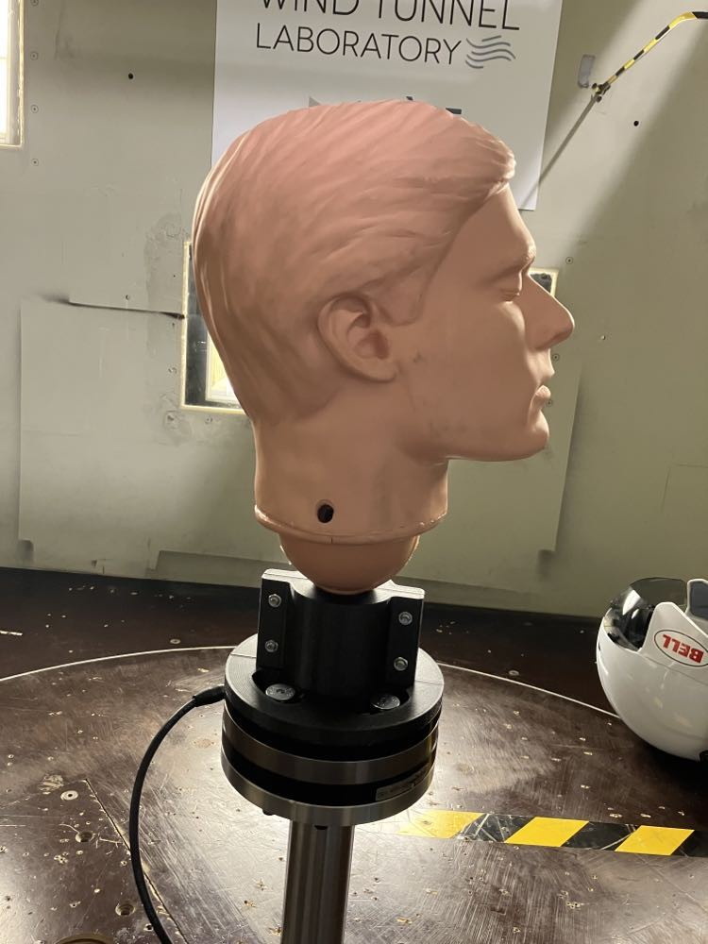
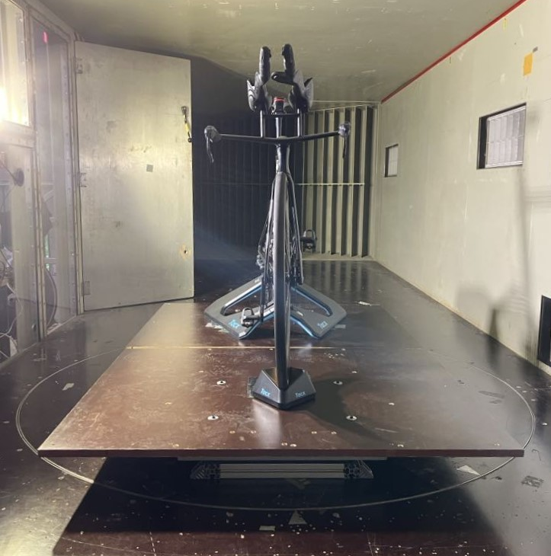
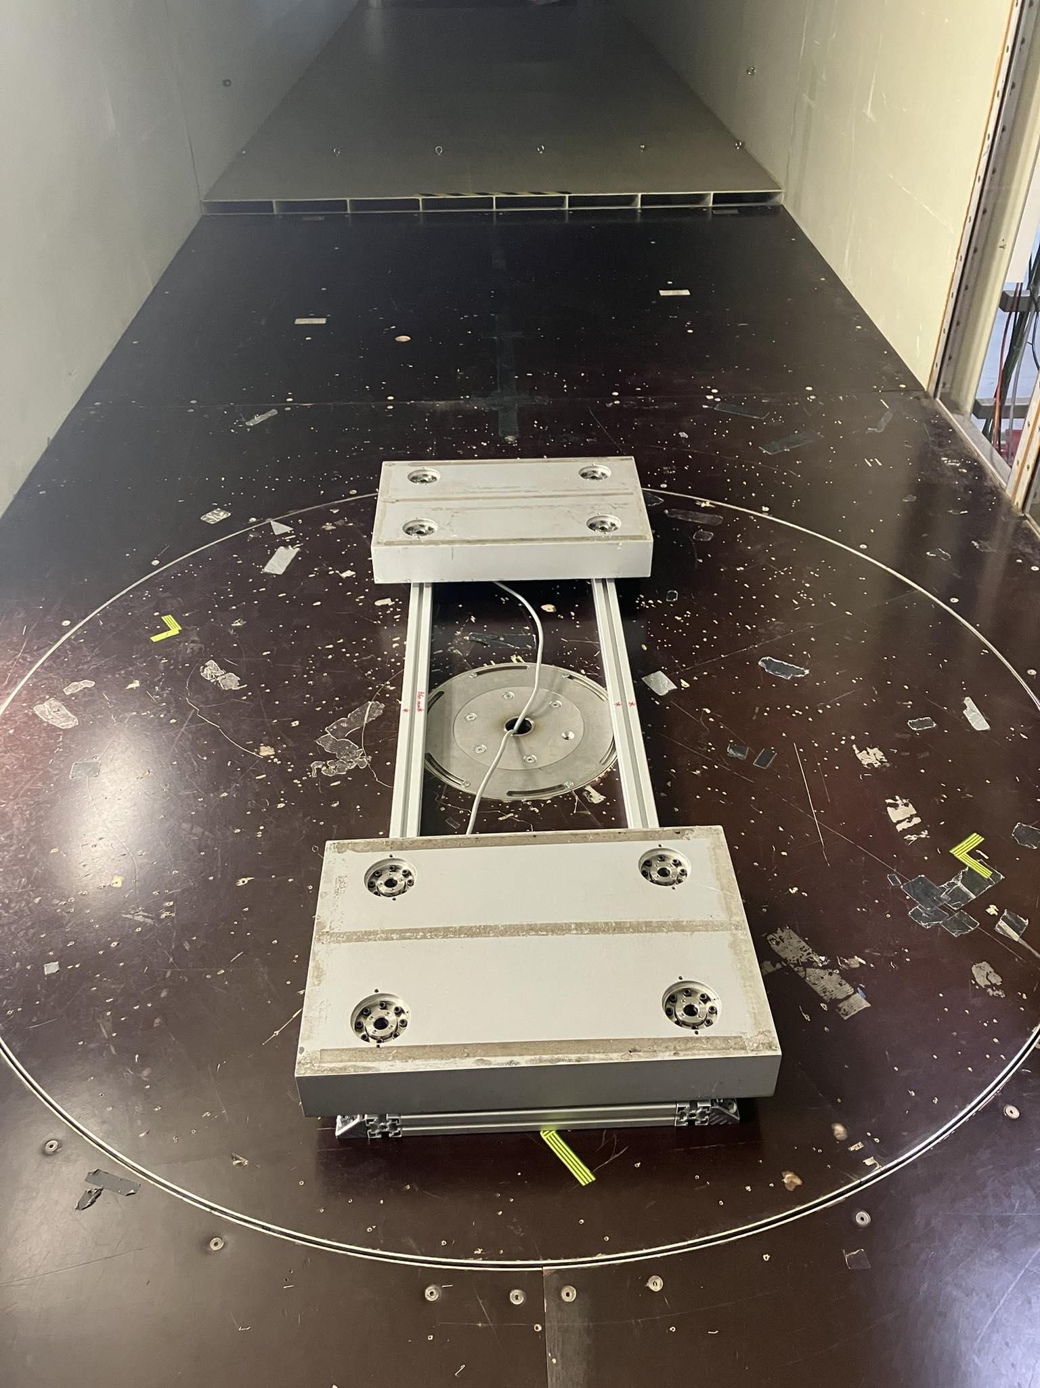
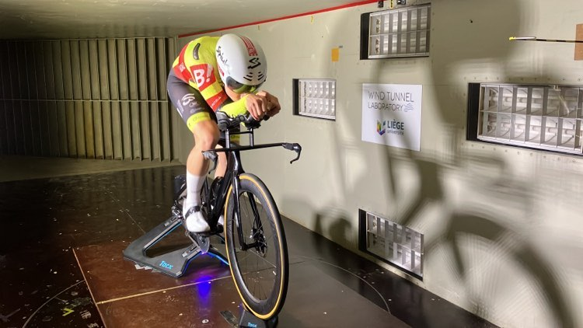
Methodology: Setups
METHODOLOGY
I
R
C
Mannequin head
Cyclist
90°
0°
0°
Force plates
Yaw angle
Pitch angle
0°
Yaw angle
Yaw angles | 0°, 15°
Pitch angles | 45°, 60°, 90°
Wind speeds | 11.4 m/s, 13.8 m/s, 15.1 m/s
Yaw angles | 0°, 15°
Positions | 1 (TT)
Wind speeds | 12.5 m/s, 13.5 m/s, 14.8 m/s
3
Notes:
Two setups were implemented to test the helmets. Both were installed in the wind tunnel of the university of Liège.
The first one is a mannequin head, securely attached to a force and torque sensor using a custom 3D printed piece. It served as a controlled environment for measurements. This setup reduced complexity, and improved measurement repeatability. It was validated, confirming the stability/reproducibility of the measurement during wind tests. On this head the helmets were tested at 2 yaw angles, 3 pitch angles and 3 wind speeds.
The second set up consisted of force plates with a fixed home trainer and bike aligned with the wind. The cyclist pedalled on the bike in a time-trial position, at 2 different yaw angles and at 3 speeds.

Slide 7
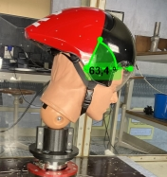
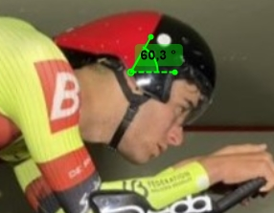
METHODOLOGY
Methodology: link between head and cyclist setups
I
R
C
Mannequin head
Cyclist
Helmets | 5
Yaw angles | 0°, 15°
Pitch angles | ~60°
Wind speeds | 11.4 m/s, 13.8 m/s, 15.1 m/s
V
Helmets | 5
Yaw angles | 0°, 15°
Pitch angles | ~60°
Wind speeds | 12.5 m/s, 13.5 m/s, 14.8 m/s
V
V
V
V
V
X
X
Can we use the C_{D}A ?
4
Notes:
If we compare both setups, the same helmets were tested, we have the same yaw angles and a pitch angle of approximatively 60° for both. Only the wind speeds are different so we would have to check if we can use the drag area in order to compare both setups.

Slide 8
Results: Reynolds effect
RESULTS
I
M
C
Mannequin head
Cyclist
Negligeable Reynolds effect
Results expressed as a gain in power at 12.5 m/s compared to Helmet 5
5
Notes:
If we analyse the evolution of the drag area with the wind speed for both the mannequin head and the cyclist, we can see that it stays approximately the same as the wind speed increases. This way we can consider that Reynolds effects are negligeable and go through the drag area to compare both setups. In the following of the study, we will use this drag area to compute the power at 12.5 m/s for each helmet, and then we will express the results as a gain in power compared to the helmet 5.

Slide 9
Results: Pitch angle effect
RESULTS
I
M
C
Power gain [W] compared to reference helmet
Mannequin head
Cyclist
6
Notes:
Now for the results, let’s first analyse them separately for both setups. Varying the pitch angle impacts the position of the tail and the way it meets the air. As we can see, it has a big impact on the power gain, but each helmet responds differently. Overall, a 45° pitch angle results in more gain power for the aero-helmets, but a 60° pitch angle is better for the road-helmet.

Slide 10
Results: Yaw angle effect
RESULTS
I
M
C
Power gain [W] compared to reference helmet
Mannequin head
Cyclist
7
Notes:
Now for the effect of the yaw angle, a first observation is that the power gain is much higher for the cyclist setup than for the mannequin head at a 0° yaw, but this difference is largely reduced at 15°. The differences between the values at 0° and 15° show the importance of variating the yaw angle, as in reality the wind isn’t always aligned with the cyclist.

Slide 11
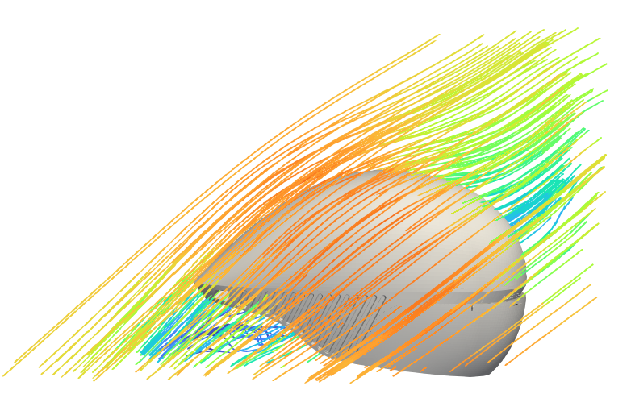
Discussion
RESULTS
I
M
C
Reference helmet
Mean stream
8
Notes:
Now, if we compare the results obtained for the mannequin head setup and for the cyclist, we can see that we obtain totally different results for the cyclist and the mannequin head. First, there were higher differences between the reference helmet and the other helmets when tested on the cyclist, and the best performing helmets are different on both setups.
Those differences are mainly due to the interaction between the helmet's tail and the cyclist's shoulders, which does not occur with the mannequin head. The helmet's tail is designed to streamline airflow. This streamlined airflow is disturbed when the helmet interacts with the shoulders, resulting in varying levels of drag reduction that are not captured when using a static mannequin head. As a conformation, we can see that for the helmet 4 that does not have a tail, the difference in power gain between the setups is highly reduced.
This insight emphasizes the importance of incorporating real-world testing conditions to accurately gauge the effectiveness of aerodynamic equipment designed for athletes. But it is important not to forget the variability that is induced by testing pedalling cyclists, due to their movement.

Slide 12
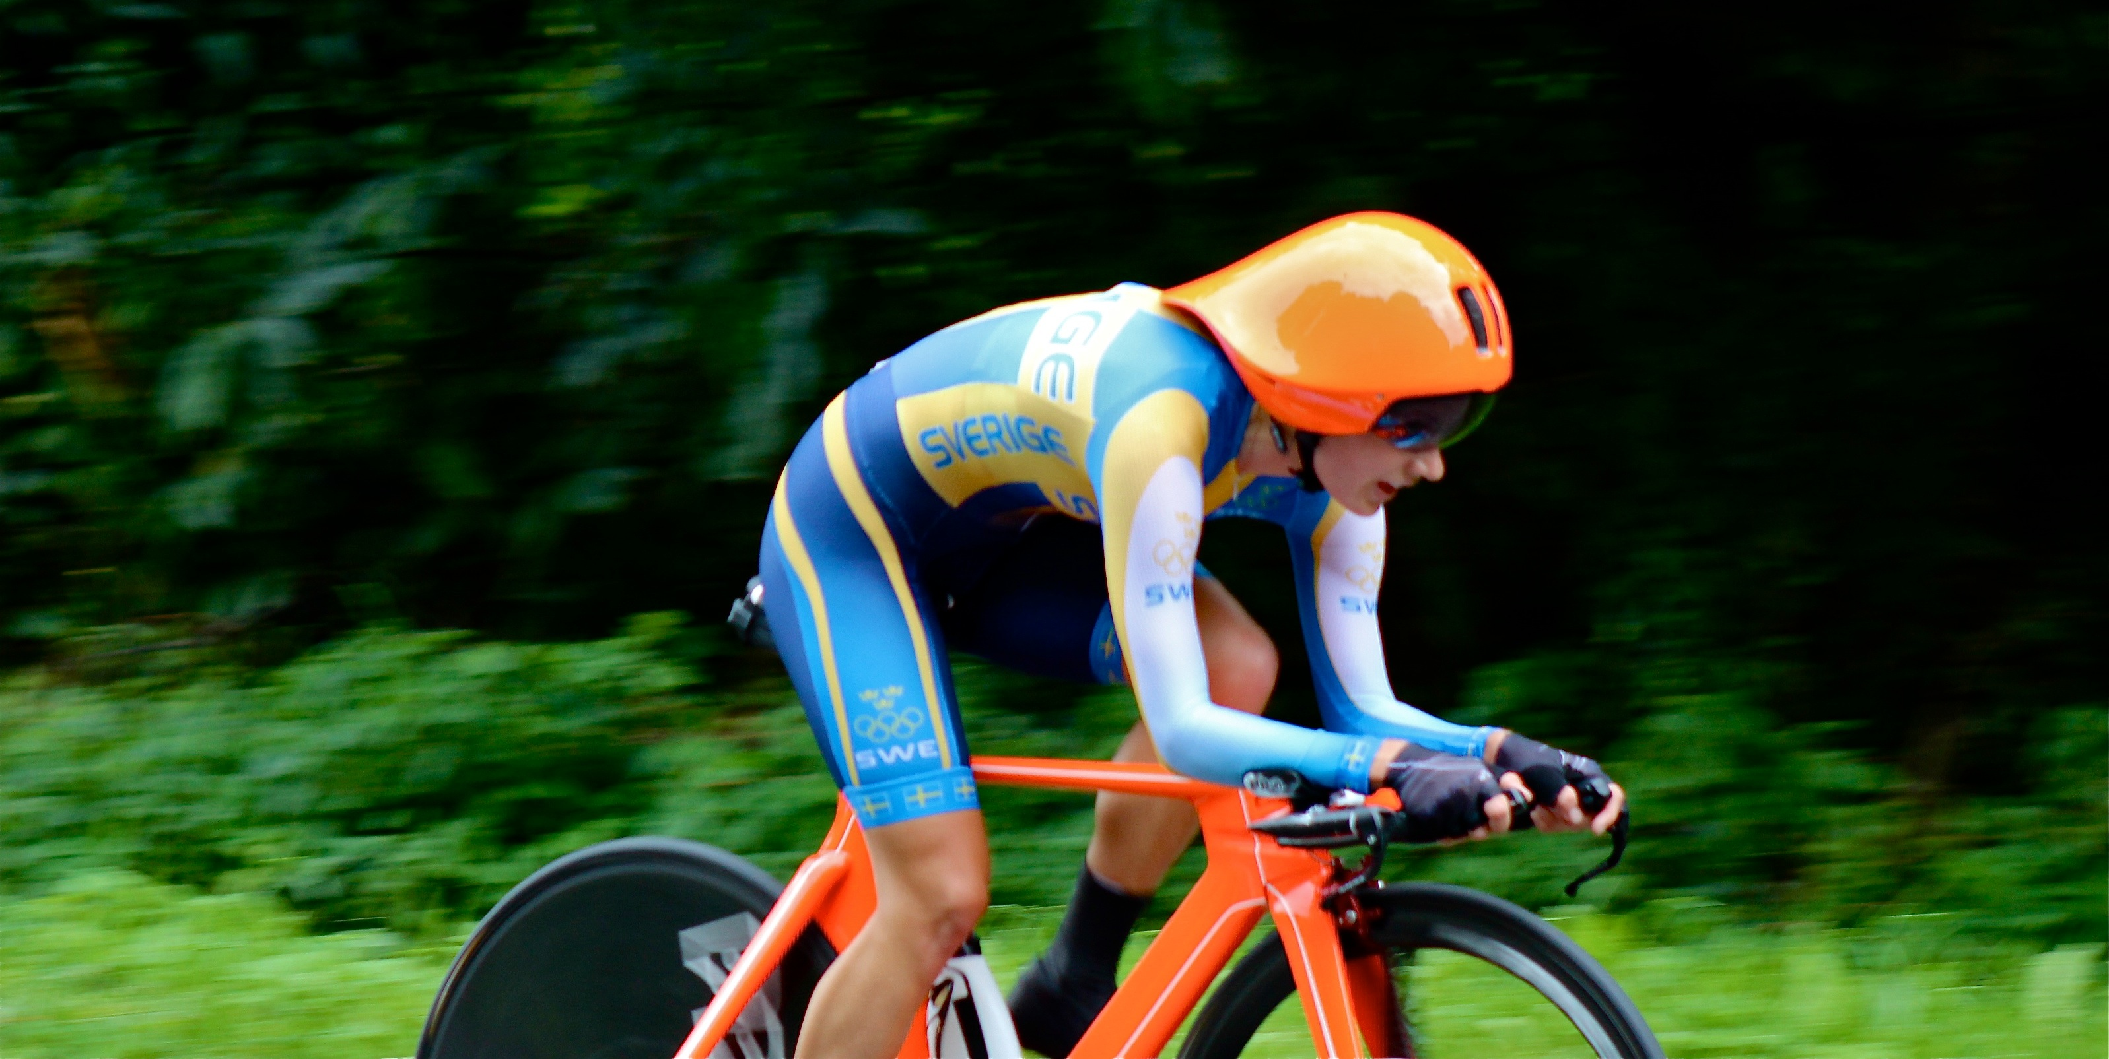
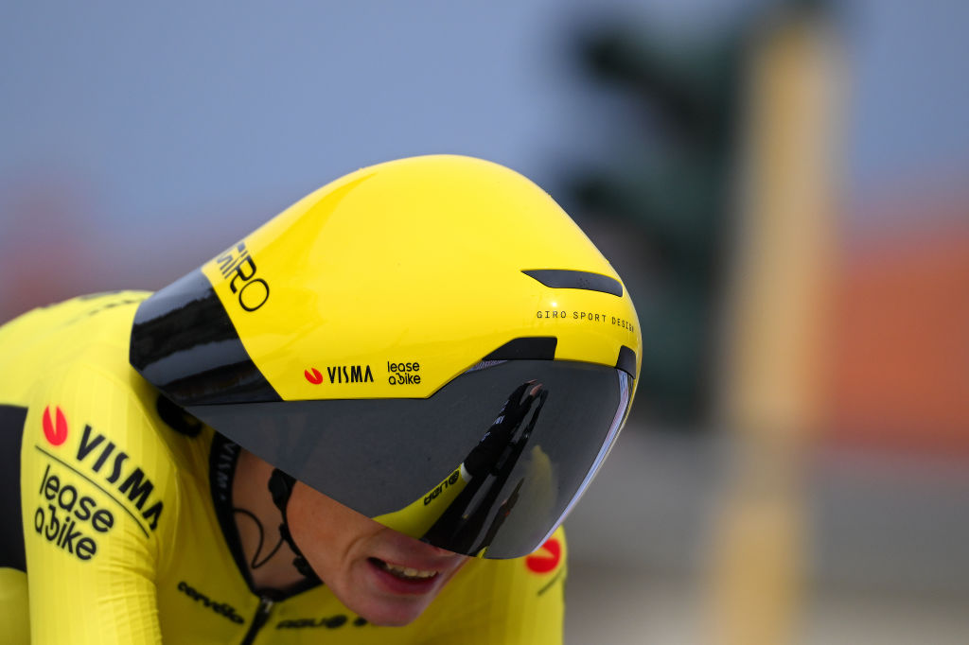
Conclusion & Perspectives
I
CONCLUSION
M
R
Testing on cyclists add a great insight on the interaction between the helmet and the body
Different results for both setups
BUT
Way more variability in between measures with the cyclist
Testing on cyclists are great for comparison
For more exact values, testing on the head is preferable
POC Tempor TT helmet with visor
Giro Aerohead II time trial helmet
9
Notes:
In conclusion, our study underscores the importance of considering both static and dynamic testing methods for a comprehensive evaluation of cycling helmets. Testing on cyclists provides valuable insights into the interaction between the helmet and the body, but it introduces more variability between measurements. On the other hand, testing with a mannequin head offers more repeatable results due to less variation, but does not allow to take into account the relation between the helmets and the cyclist’s body. Thus, for precise measurements, testing with a mannequin head is preferable, whereas testing on cyclists is beneficial for comparative assessments.
Future research should focus on developing standardized testing protocols that combine the strengths of both methods to provide accurate and reliable aerodynamic assessments, as we tend to go towards helmets that interacts more and more with the cyclists’ bodies.

Slide 13
Thank you for your attention !

Slide 14
References
Drag Force Formulas, edited by Rainer Pivit, published in Radfahren 2/1990, pp.44-46, https://www.sheldonbrown.com/rinard/aero/formulas.html, consulted on: 07.07.2024
Understanding Rolling Resistance, by Ryan Cooper, https://www.trainingpeaks.com/blog/understanding-rolling-resistance/, consulted on: 07.07.2024
García-López, J., Rodríguez-Marroyo, J. A., Juneau, C.-É., Peleteiro, J., Martínez, A. C., & Villa, J. G. (2008). Reference values and improvement of aerodynamic drag in professional cyclists. European Journal of Applied Physiology, 102(6), 681-686.
Defraeye, T., Blocken, B., & Carmeliet, J. (2010). CFD analysis of cyclist aerodynamics: Performance of different turbulence-modelling and boundary-layer modelling approaches. Journal of Biomechanics, 43(12), 2281-2287.
Martin, J. C., Milliken, D. L., Cobb, J. E., McFadden, K. L., & Coggan, A. R. (2006). Validation of a mathematical model for road cycling power. Journal of Applied Biomechanics, 22(2), 218-224.
Barry, N., Burton, D., Sheridan, J., Brown, N. A., & Gregory, R. (2014). Aerodynamic performance and riding posture in road cycling and triathlon. Journal of Sports Sciences, 33(10), 1029-1035.
Debraux, P., Grappe, F., Manolova, A. V., & Bertucci, W. (2011). Aerodynamic drag in cycling: Methods of assessment. Sports Biomechanics, 10(3), 197-218.
Crouch, T. N., Burton, D., LaBry, Z. A., Blair, K. B., & Sheridan, J. (2014). Wind tunnel and computational fluid dynamics study of the aerodynamic drag of a cyclist. Procedia Engineering, 72, 720-725.
Blocken, B., Toparlar, Y., & Andrianne, T. (2018). Aerodynamic benefit for a cyclist by a following motorcycle. Journal of Wind Engineering and Industrial Aerodynamics, 177, 278-287.
Lucas, B. D., & Kanade, T. (1981). An Iterative Image Registration Technique with an Application to Stereo Vision. Proceedings of the 7th International Joint Conference on Artificial Intelligence
Bouguet, J.-Y. (2001). Pyramidal Implementation of the Lucas Kanade Feature Tracker: Description of the Algorithm. Intel Corporation.
10

