Slide 1



ISEA 2024
A New Protocol for Real-Time Position Feedback in Cycling Aerodynamics
Léonore Foguenne, Cédric Schwartz, Floren Colloud & Thomas Andrianne

Slide 2
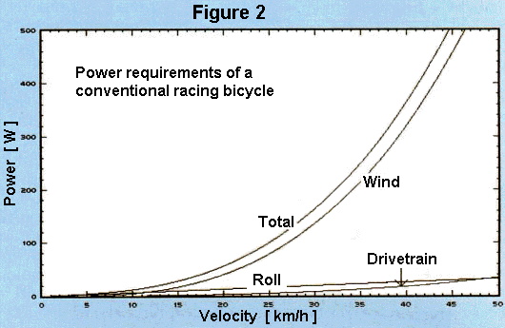
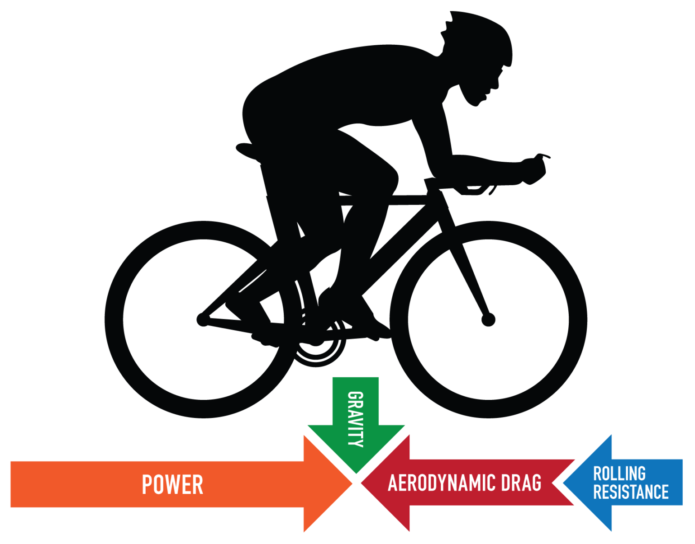
INTRODUCTION
Introduction
M
R
C
Minimize drag
Aerodynamic positions
Specialized equipment
M
~90%
Rainer Pivit, 1990; Ryan Cooper; Defraeye et al., 2010; Barry et al., 2014; Debraux et al., 2011; Crouch et al., 2014; Blocken et al., 2018
1
Notes:
Aerodynamic drag is a critical factor for cyclists, especially at high speeds where it accounts for up to 90% of the total resistance experienced when exceeding 40 km/h. This significant impact on performance has driven cyclists to adopt more aerodynamic positions and to experiment with specialized equipment aimed at minimizing the drag area, thereby gaining a competitive edge by saving precious watts.

Slide 3
INTRODUCTION
Introduction
M
R
C
Minimize drag
Aerodynamic positions
Specialized equipment
M
M
~90%
Traditional Testing:
Cyclist model
Isolate equipment performance
May not reflect real-world conditions
VS.
Dynamic Testing:
Pedalling cyclist
More realistic
Introduces variability due to cyclist movement
V
X
V
X
Rainer Pivit, 1990; Ryan Cooper; Defraeye et al., 2010; Barry et al., 2014; Debraux et al., 2011; Crouch et al., 2014; Blocken et al., 2018
1
Notes:
Traditionally, evaluations of cycling equipment have been conducted using static models of cyclists to avoid errors introduced by human variability. While such methods help isolate equipment performance, they may not accurately represent real-world conditions where cyclists are constantly moving and adjusting their positions. An alternative method involves testing with the cyclist pedaling in a wind tunnel. This setup offers a more realistic simulation, but it introduces another challenge: the cyclists' movement during and between measurements can lead to variability in the results.

Slide 4
INTRODUCTION
Introduction
M
R
C
Minimize drag
Aerodynamic positions
Specialized equipment
M
M
~90%
Traditional Testing:
Cyclist model
Isolate equipment performance
May not reflect real-world conditions
VS.
Dynamic Testing:
Pedalling cyclist
More realistic
Introduces variability due to cyclist movement
V
X
V
X
OBJECTIVES:
Investigate the error margin associated with cyclists' repositioning in wind tunnel tests
Compare these errors to values obtained using a static model equipped with different helmets
Explore a possible methodology to mitigate the errors induced by cyclists' movements
Rainer Pivit, 1990; Ryan Cooper; Defraeye et al., 2010; Barry et al., 2014; Debraux et al., 2011; Crouch et al., 2014; Blocken et al., 2018
1
Notes:
Given these potential movements, it raises the question of whether wind tunnel measurements are repeatable and precise enough to account for minor adjustments in equipment.
This presentation investigates the error margin associated with cyclists' repositioning in wind tunnel tests. It compares these errors to the values obtained using a static model equipped with different aerodynamic equipment. Additionally, it explores a possible methodology to mitigate the errors induced by cyclists' movements, aiming to enhance the accuracy and repeatability of aerodynamic assessments in cycling.

Slide 5
Methodology
METHODOLOGY
I
R
C
Helmets testing
Feedback development and accuracy assessment
Repositioning in the wind tunnel
2
Notes:
The methodology of this presentation is divided in three parts. First, the testing of helmets that will indicate the order of magnitude of equipment evaluation. Then, the development of the feedback on the position and finally, the testing in the wind tunnel.

Slide 6
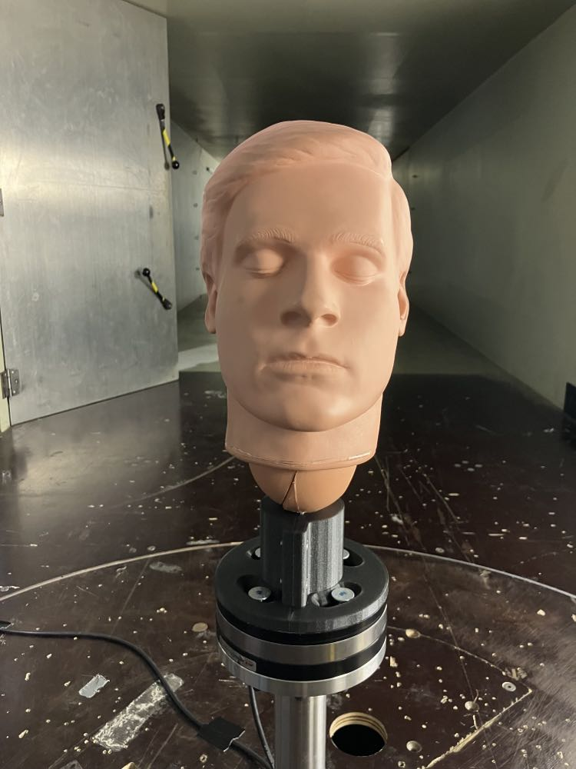
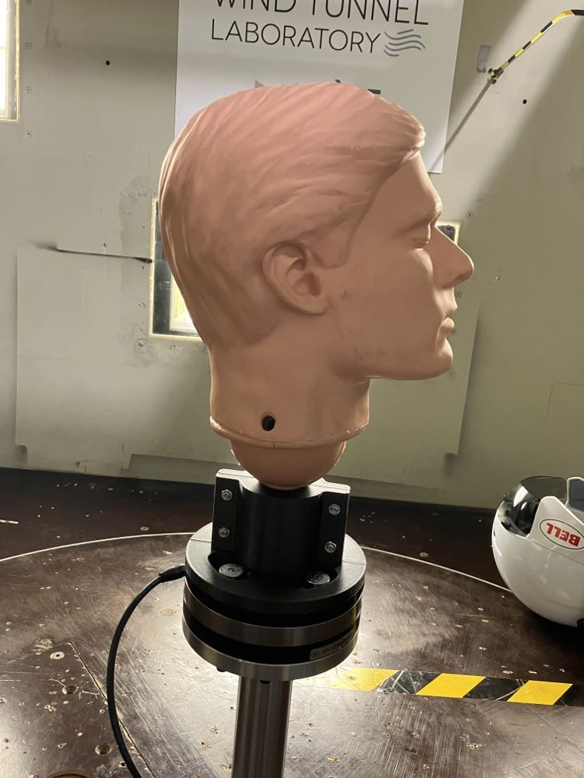
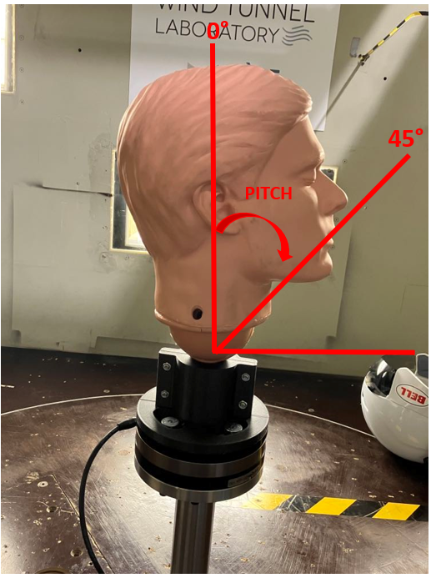
Helmets testing
METHODOLOGY
I
R
C
Helmets testing
Feedback development and accuracy assessment
Repositioning in the wind tunnel
Helmet 1
Helmet 2
Helmet 3
AERO-HELMETS
Wind Tunnel Lab, Uliège
Setup:
Helmet 4
Helmet 5
Helmet 6
ROAD-HELMETS
Helmet 7
Helmet 8
Helmet 9
3

Slide 7
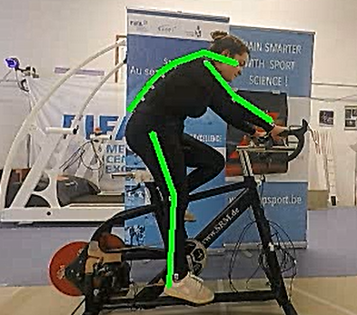
Feedback development and accuracy
METHODOLOGY
I
R
C
Helmets testing
Feedback development and accuracy assessment
Repositioning in the wind tunnel
Point Tracking
Lucas et Kanade, 1981; Bouguet, 2001
4

Slide 8
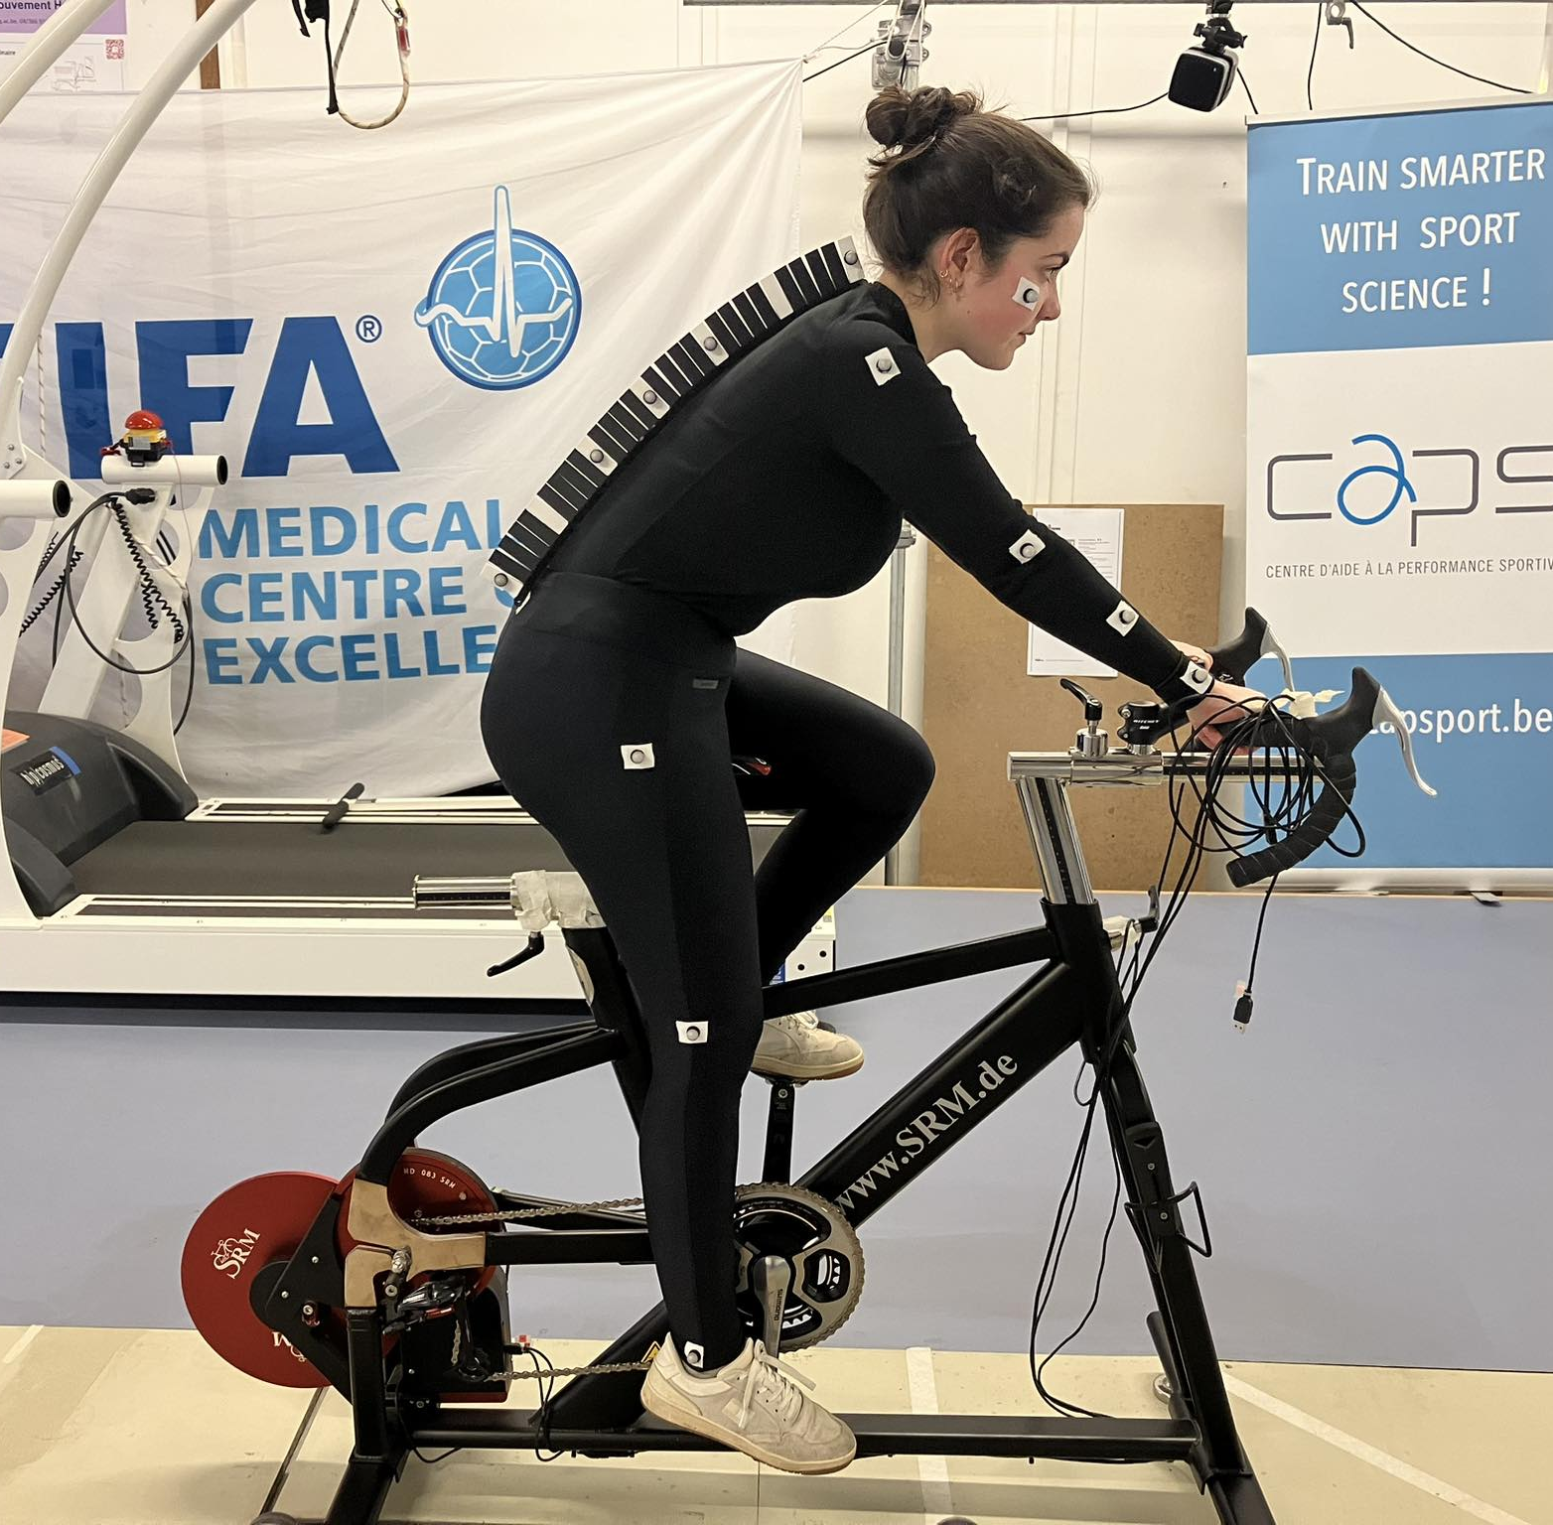
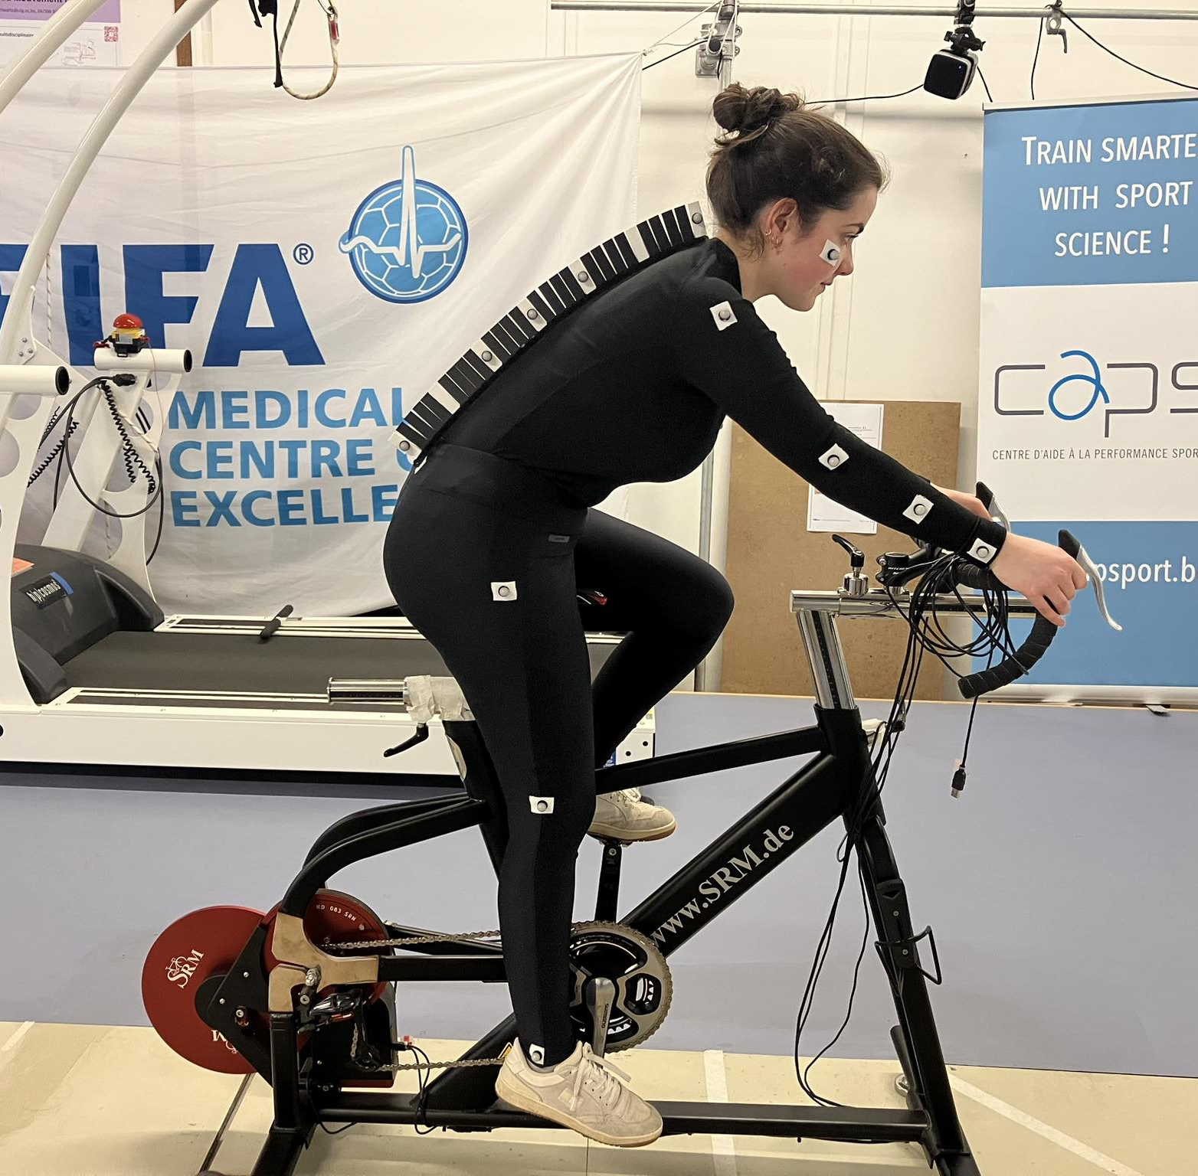
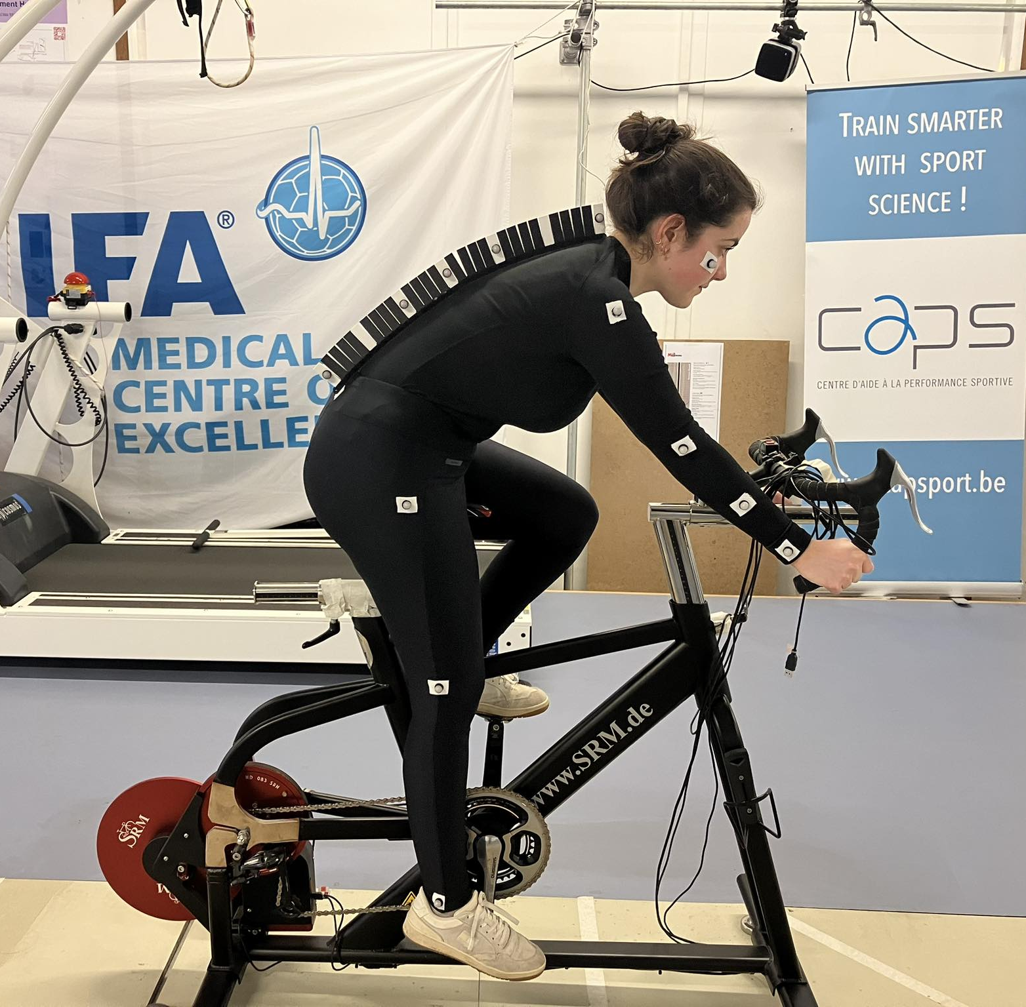
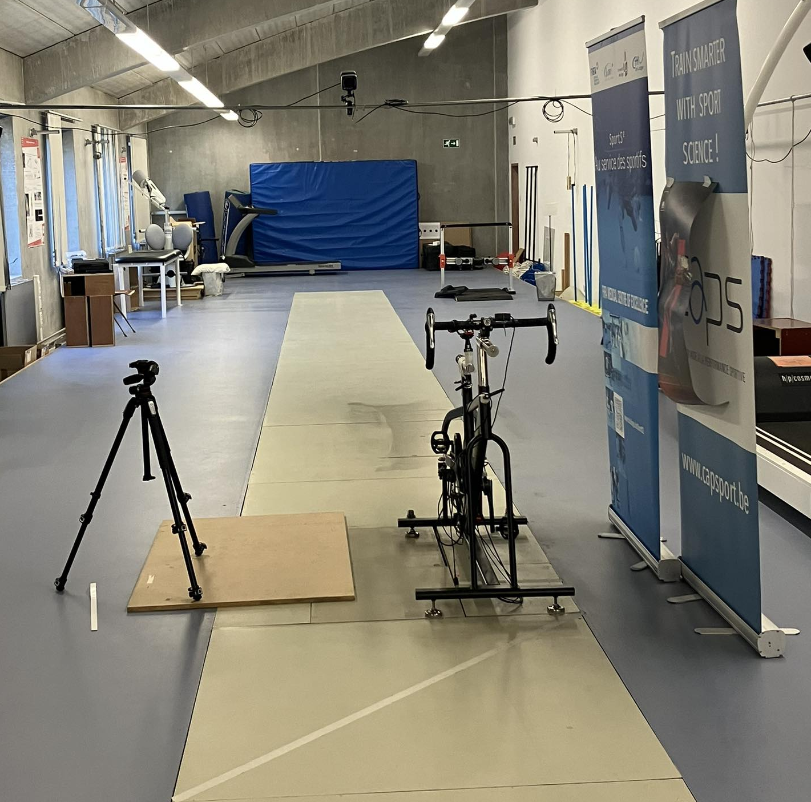
Feedback development and accuracy
METHODOLOGY
I
R
C
Helmets testing
Feedback development and accuracy assessment
Repositioning in the wind tunnel
Position 1: hands on handlebars
Position 2: hands on brake hoods
Position 3: hands on drops
LAM-Motion Lab, Uliège
Setup:
3
Angles measured:
Forearm
Shoulder
Head
Back
2
4
1
Measurement | RMSE | STD
Angle accuracy | < 5° | <2°
Position Tracking click error | <10mm
Lucas et Kanade, 1981; Bouguet, 2001
5

Slide 9
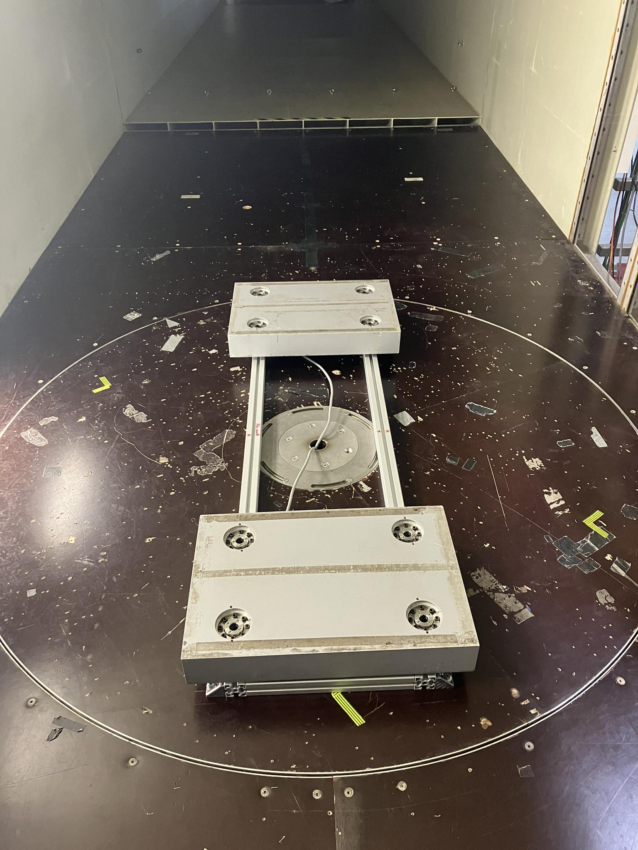
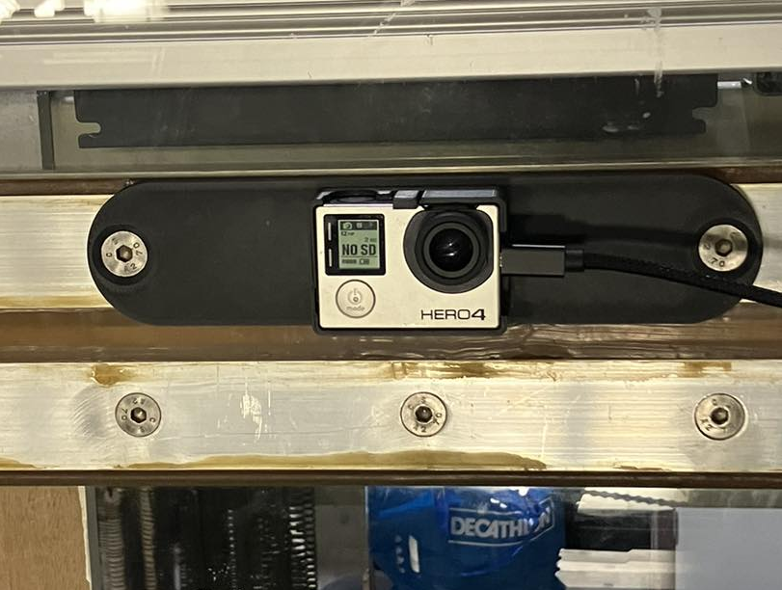
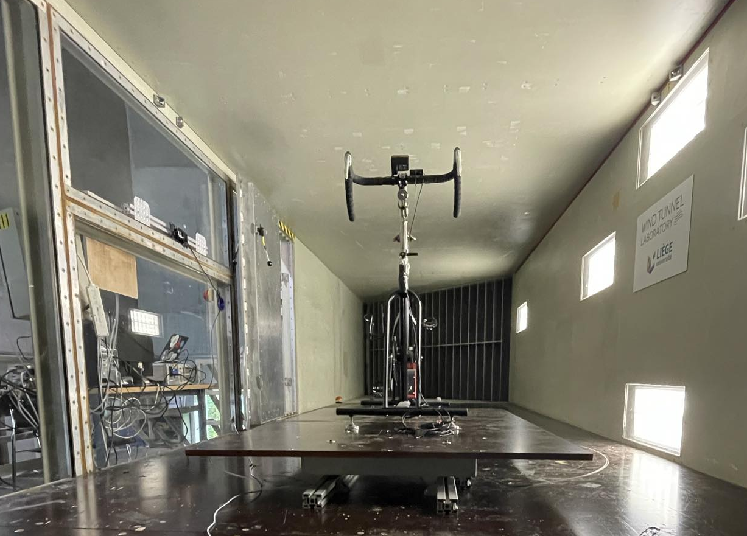
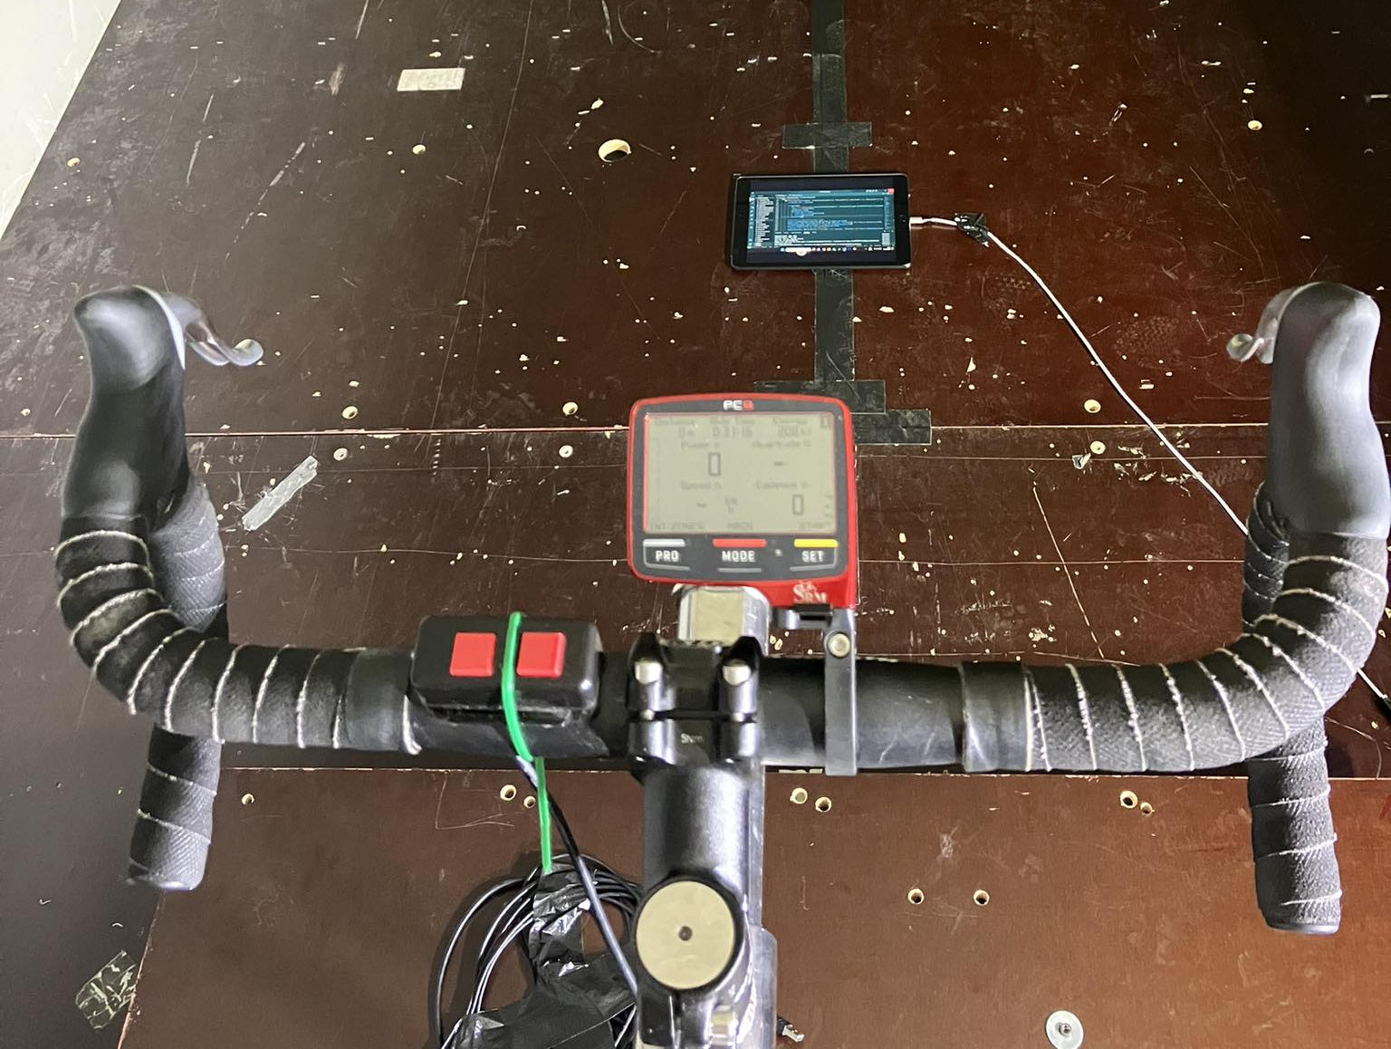
Wind tunnel testing
METHODOLOGY
I
R
C
Helmets testing
Feedback development and accuracy assessment
Repositioning in the wind tunnel
Force plates
Camera
Feedback
6

Slide 10
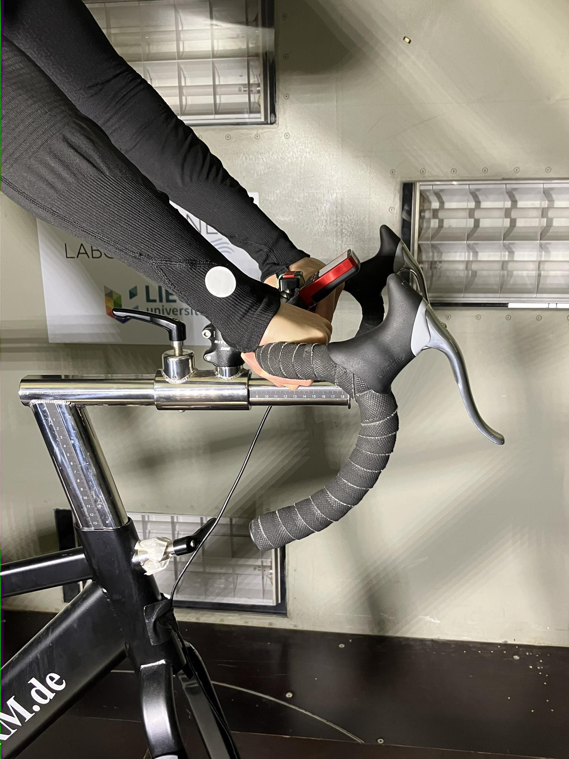
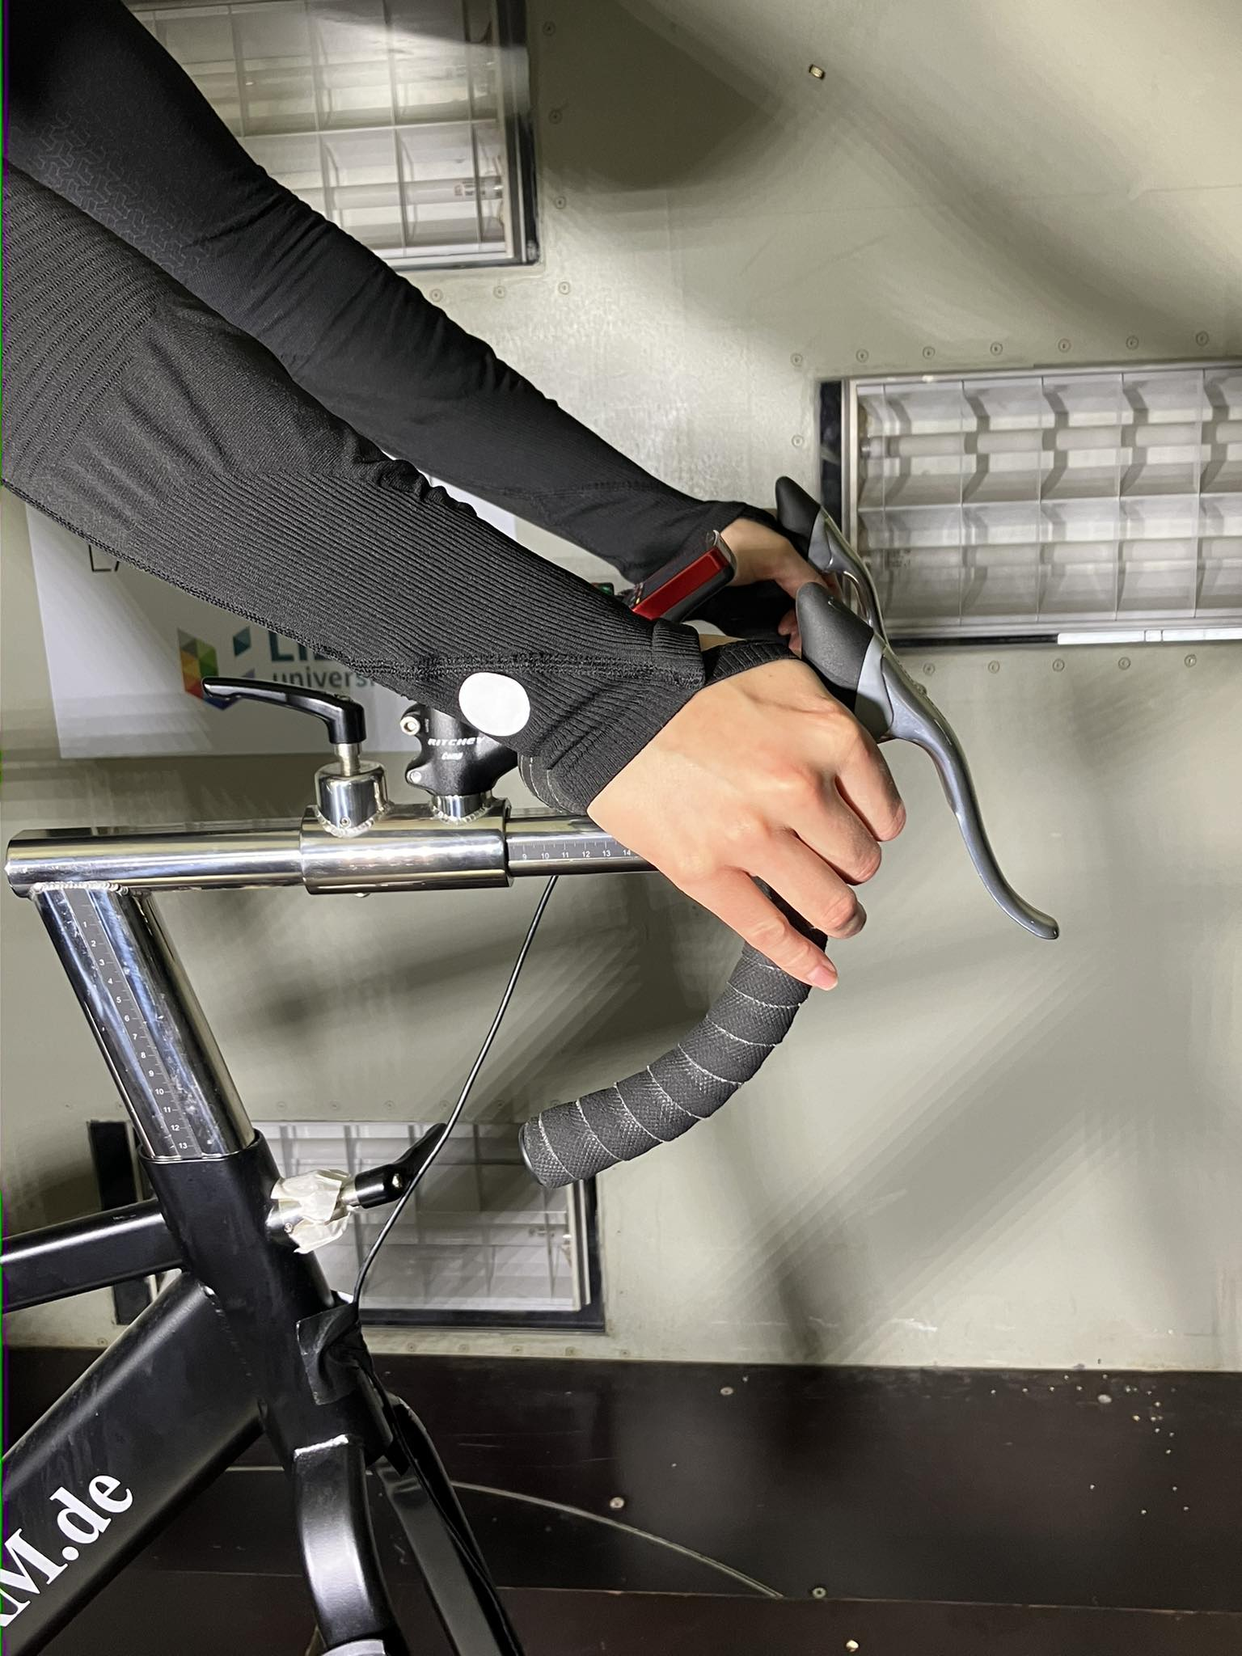
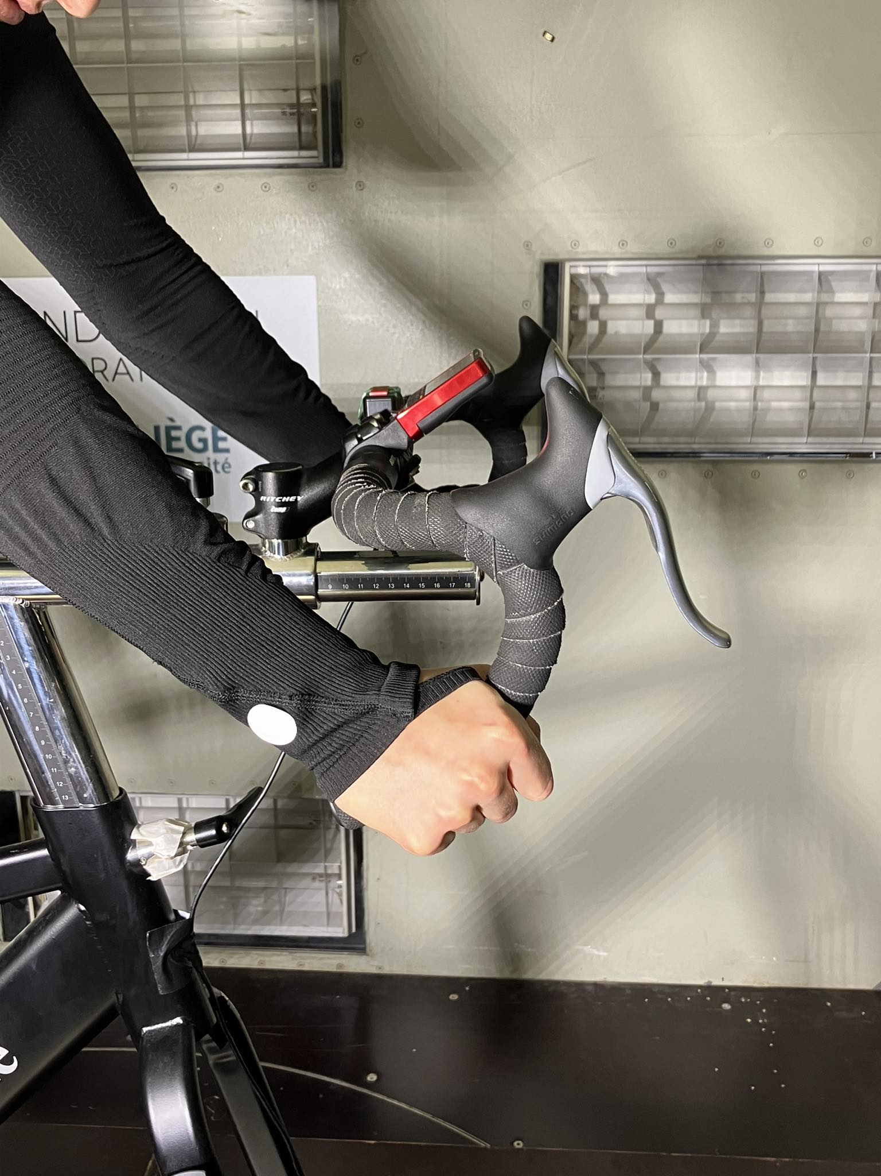
Wind tunnel testing
METHODOLOGY
I
R
C
Position 1: hands on handlebars
Position 2: hands on brake hoods
Helmets testing
Feedback development and accuracy assessment
Repositioning in the wind tunnel
Number of positions | 3
Number of repetitions of each position | 3
Wind speed | 12.2m/s
Number of participants | 9 (3 advanced and 7 amateurs)
Cycling background of participants | Advanced and amateurs
Force plates accuracy | 250 mN
Position 3: hands on drops
7

Slide 11
Helmets testing and Repositioning
RESULTS
I
M
C
+0.016 m²
Aero-helmets
Road-helmets
Participant A = Advanced cyclist → less variability
Participant B = Amateur cyclist → more variability
Low C_{D}A values
Highest variability: 0.0039 m²
Lowest variability: 0.00037 m²
8

Slide 12
Helmets testing and Repositioning
RESULTS
I
M
C
C_{D}A error during repositioning
HIGHER
than C_{D}A variability between helmets
0.0039 m²
0.00037 m²
10

Slide 13
Drag errors without vs. with feedback
RESULTS
I
M
C
Comparison of the repositioning C_{D}A error with feedback and without feedback:
Amateur cyclist: big improvements (smaller error)
Advanced cyclist: improvements except for position 2
11

Slide 14
Drag errors without vs. with feedback
RESULTS
I
M
C
Comparison of the repositioning C_{D}A error with feedback and without feedback:
Amateur cyclist: big improvements (smaller error)
Advanced cyclist: improvements except for position 2
BUT
Still more than the helmets variation
0.0039 m²
0.00037 m²
11

Slide 15
Drag errors without vs. with feedback
RESULTS
I
M
C
mean+1.96*STD
mean+1.96*STD
mean
mean+1.96*STD
mean
mean
mean-1.96*STD
mean-1.96*STD
mean-1.96*STD
Extend to more participants (9):
Overall better results with feedback
BUT
High variability inter & intra participants
No significant difference between with and without feedback (p-value>0.05)
12

Slide 16
Conclusion & Perspectives
I
CONCLUSION
M
R
Variability due to the cyclist’s repositioning do not allow to evaluate the impact of the equipment
The use of the feedback slightly reduces this variability
BUT
The reduction is not enough to evaluate the impact of the equipment
There is a high variability inter and intra participants
Perspectives:
Try to measure more repetitions to mitigate the random variability
Improve the feedback (deep learning)
Try other types of feedback rather than visual
13

Slide 17
References
Drag Force Formulas, edited by Rainer Pivit, published in Radfahren 2/1990, pp.44-46, https://www.sheldonbrown.com/rinard/aero/formulas.html, consulted on: 07.07.2024
Understanding Rolling Resistance, by Ryan Cooper, https://www.trainingpeaks.com/blog/understanding-rolling-resistance/, consulted on: 07.07.2024
García-López, J., Rodríguez-Marroyo, J. A., Juneau, C.-É., Peleteiro, J., Martínez, A. C., & Villa, J. G. (2008). Reference values and improvement of aerodynamic drag in professional cyclists. European Journal of Applied Physiology, 102(6), 681-686.
Defraeye, T., Blocken, B., & Carmeliet, J. (2010). CFD analysis of cyclist aerodynamics: Performance of different turbulence-modelling and boundary-layer modelling approaches. Journal of Biomechanics, 43(12), 2281-2287.
Martin, J. C., Milliken, D. L., Cobb, J. E., McFadden, K. L., & Coggan, A. R. (2006). Validation of a mathematical model for road cycling power. Journal of Applied Biomechanics, 22(2), 218-224.
Barry, N., Burton, D., Sheridan, J., Brown, N. A., & Gregory, R. (2014). Aerodynamic performance and riding posture in road cycling and triathlon. Journal of Sports Sciences, 33(10), 1029-1035.
Debraux, P., Grappe, F., Manolova, A. V., & Bertucci, W. (2011). Aerodynamic drag in cycling: Methods of assessment. Sports Biomechanics, 10(3), 197-218.
Crouch, T. N., Burton, D., LaBry, Z. A., Blair, K. B., & Sheridan, J. (2014). Wind tunnel and computational fluid dynamics study of the aerodynamic drag of a cyclist. Procedia Engineering, 72, 720-725.
Blocken, B., Toparlar, Y., & Andrianne, T. (2018). Aerodynamic benefit for a cyclist by a following motorcycle. Journal of Wind Engineering and Industrial Aerodynamics, 177, 278-287.
Lucas, B. D., & Kanade, T. (1981). An Iterative Image Registration Technique with an Application to Stereo Vision. Proceedings of the 7th International Joint Conference on Artificial Intelligence
Bouguet, J.-Y. (2001). Pyramidal Implementation of the Lucas Kanade Feature Tracker: Description of the Algorithm. Intel Corporation.
14

