Slide 1
Hosting capacity of low-voltage distribution networks
Doctoral thesis public defence
Amina Benzerga
December 6th , 2024

Slide 2
(Image from https://www.synox.io/cat-smart-energy/smart-grid-definition)

Slide 3
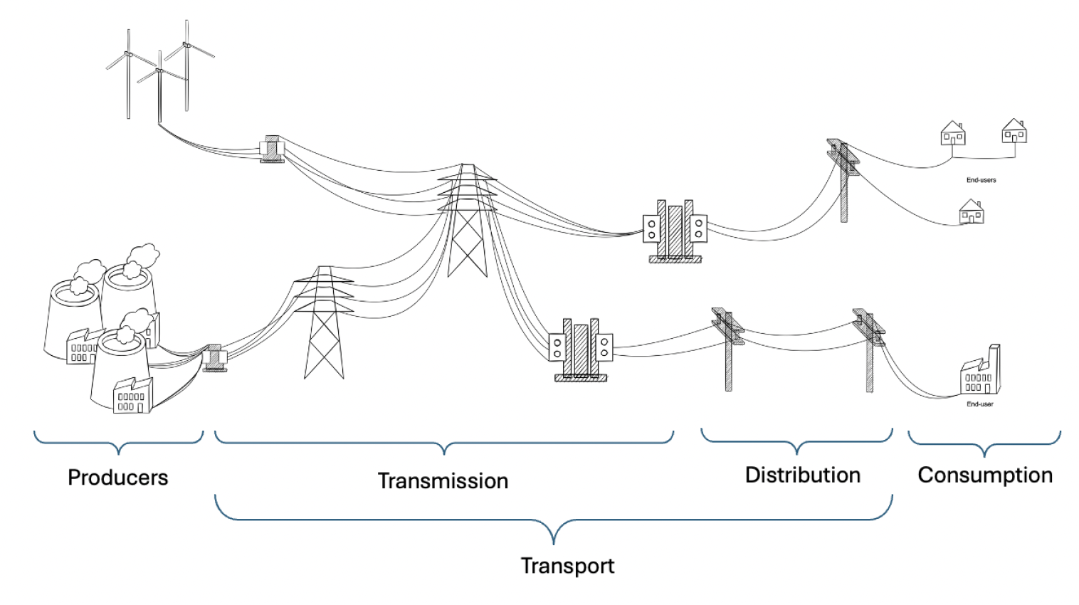
Power System
Traditional power system, one way power flow.
Production
Demand

Slide 4
Power System
Production
Demand

Slide 5
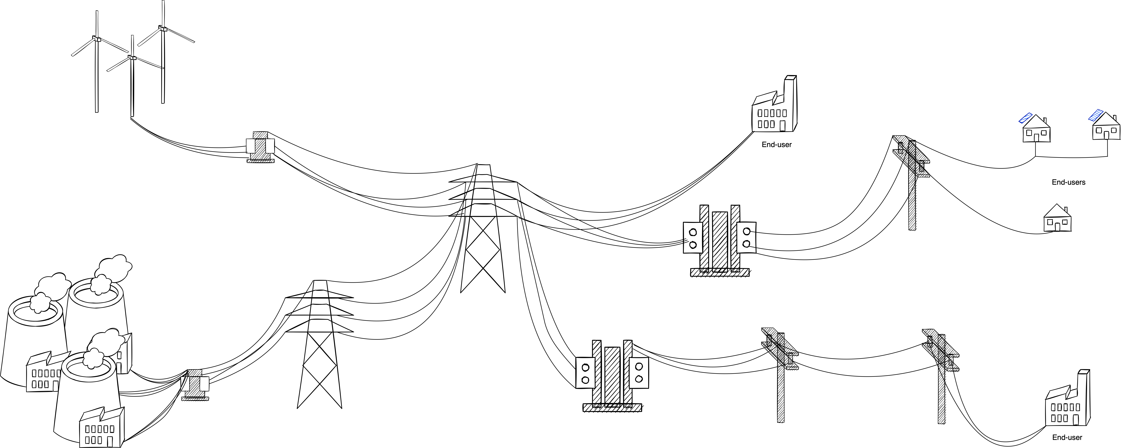
Power System
Production
Demand / Production

Slide 6
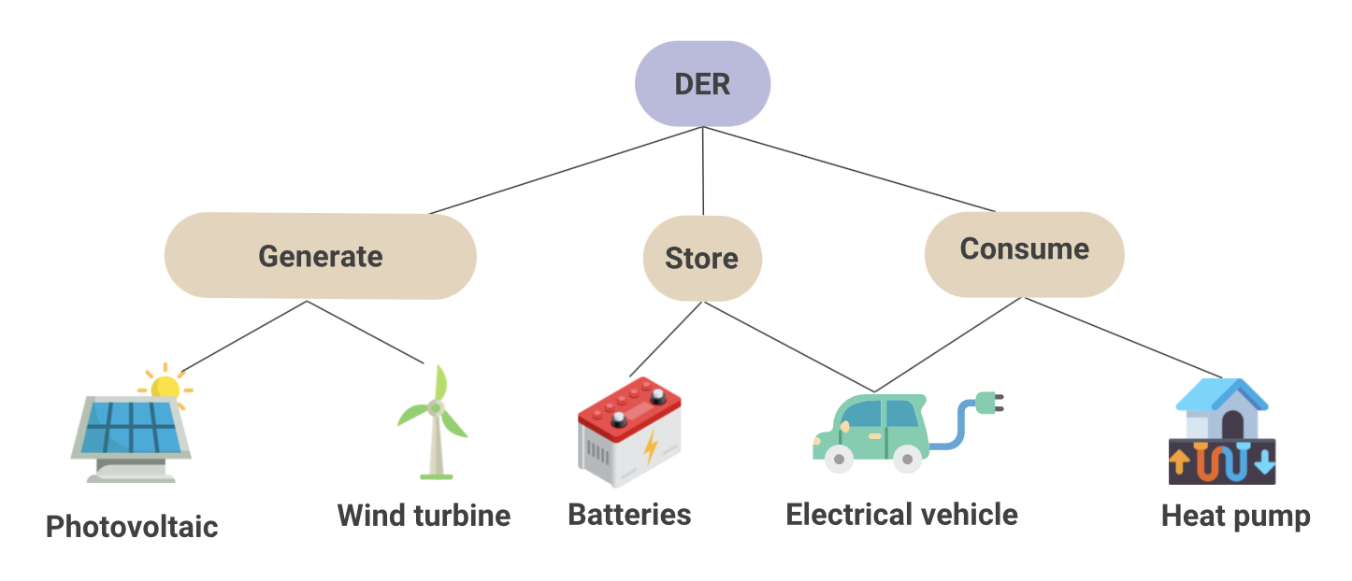
Distributed Energy Resources (DERs)
Small-scale energy assets that generate, store or consume energy.
e.g.:

Slide 7
BREAKING
NEWS

Slide 8
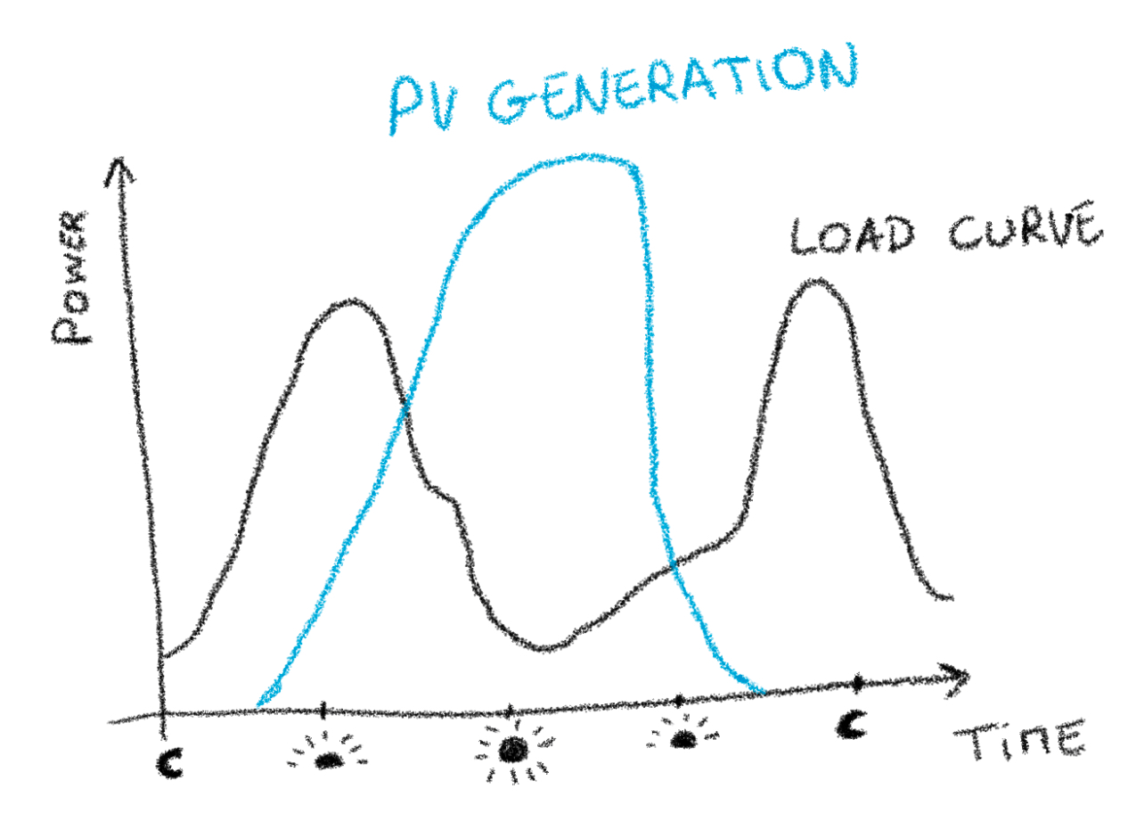
DERs issues – Photovoltaic (PV) panels example

Slide 9
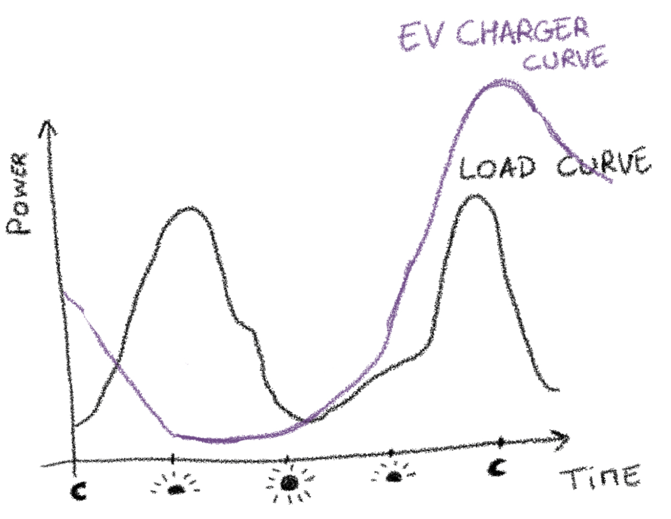
DERs issues – Electrical Vehicle (EV) example

Slide 10
DERs issues
Two examples of issues from the network point of view:
Voltage rises or drops (produce or consume more than expected, beyond voltage limits)
Congestion (due to high demand, network limits to deliver electricity are reached)

Slide 11
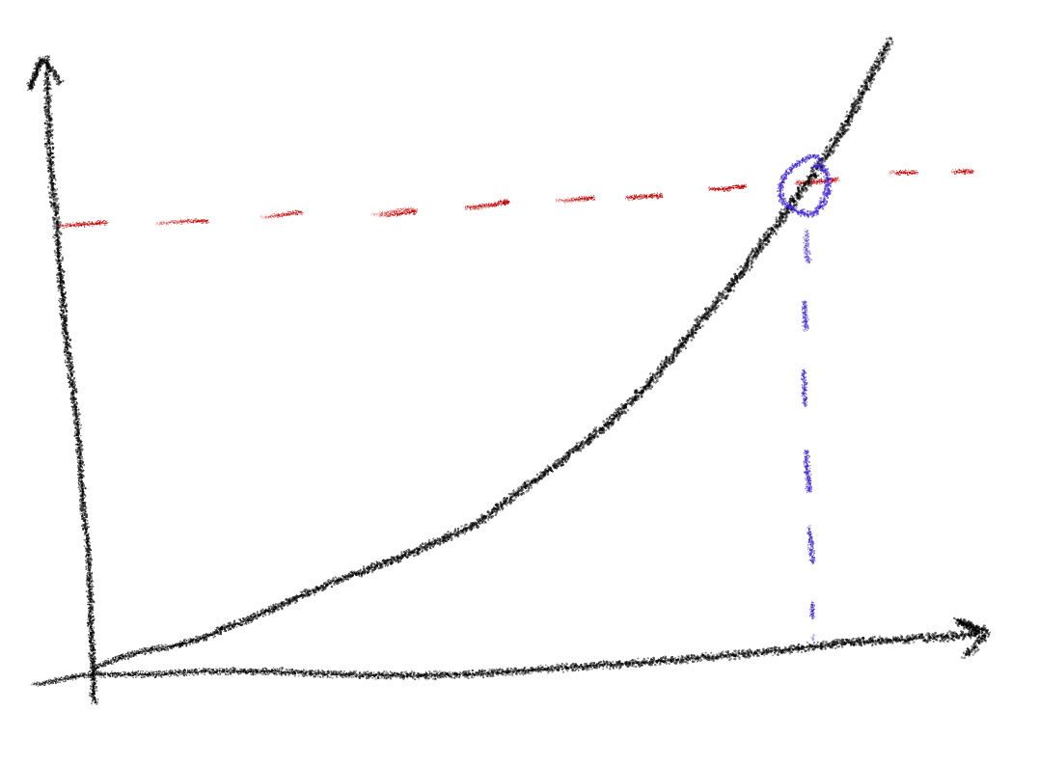
The scope of this thesis
The hosting capacity is the amount of new resources that can be hosted by a network before facing any issues, i.e., compromising its operational limits or violating safety constraints.
Unacceptable operation
Performance indicator
Acceptable operation
Hosting capacity
Amount of photovoltaic panels

Slide 12
Topology identification
Single technology HC
Unified HC definition
Combined HC

Slide 13
Topology identification

Slide 14
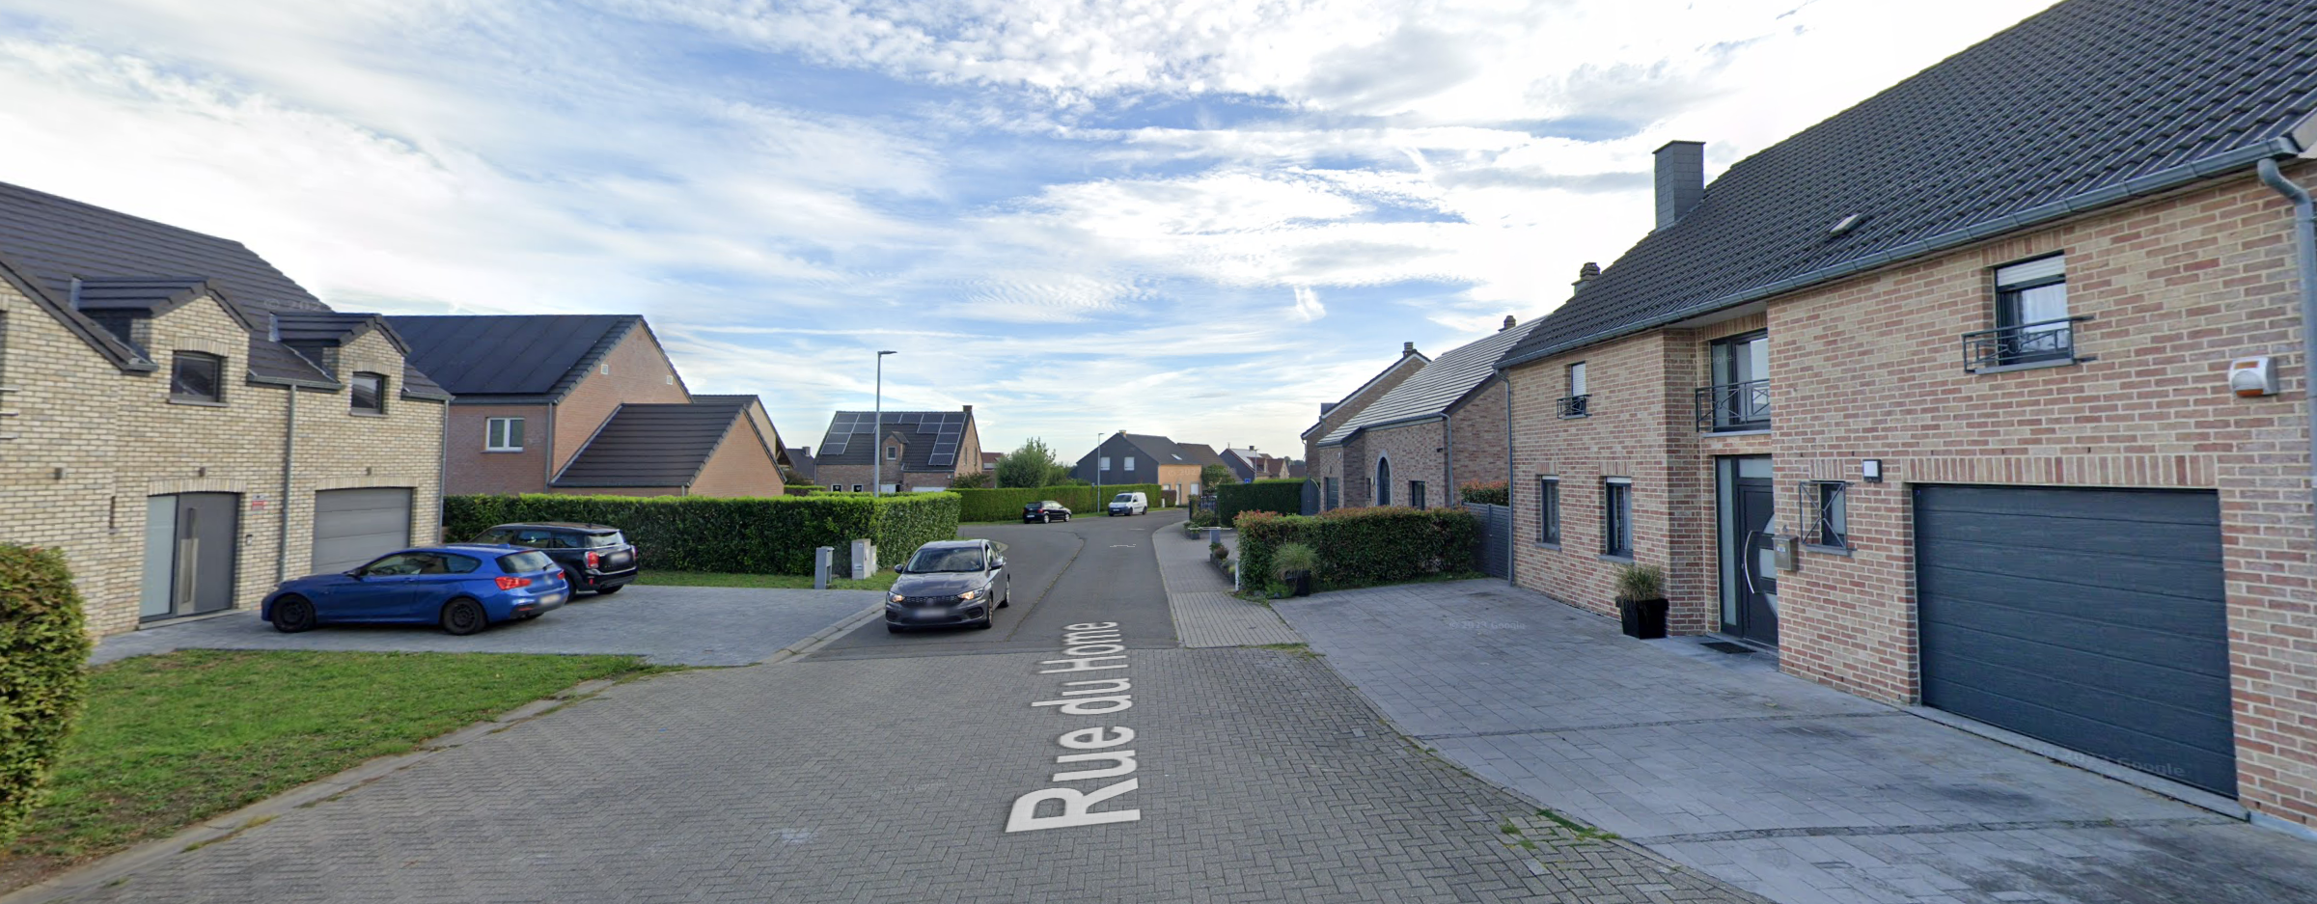

Slide 15
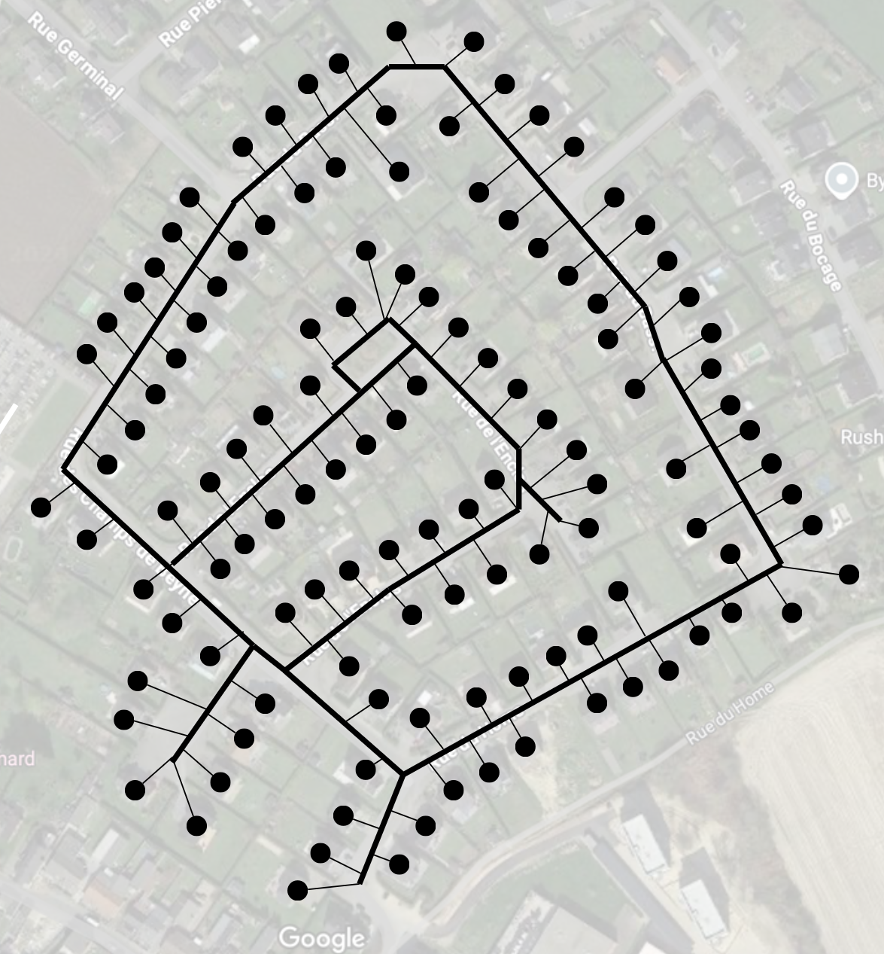
Street map

Slide 16
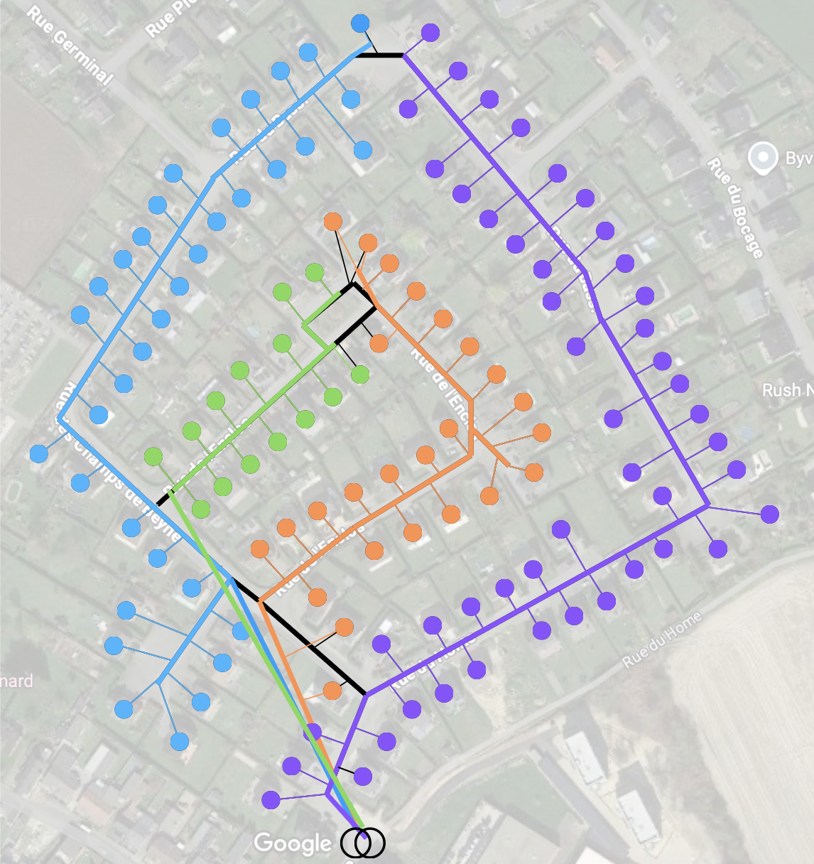
Electrical network topology
Substation
Feeder 1
Feeder 2
Feeder 3
Feeder 4

Slide 17
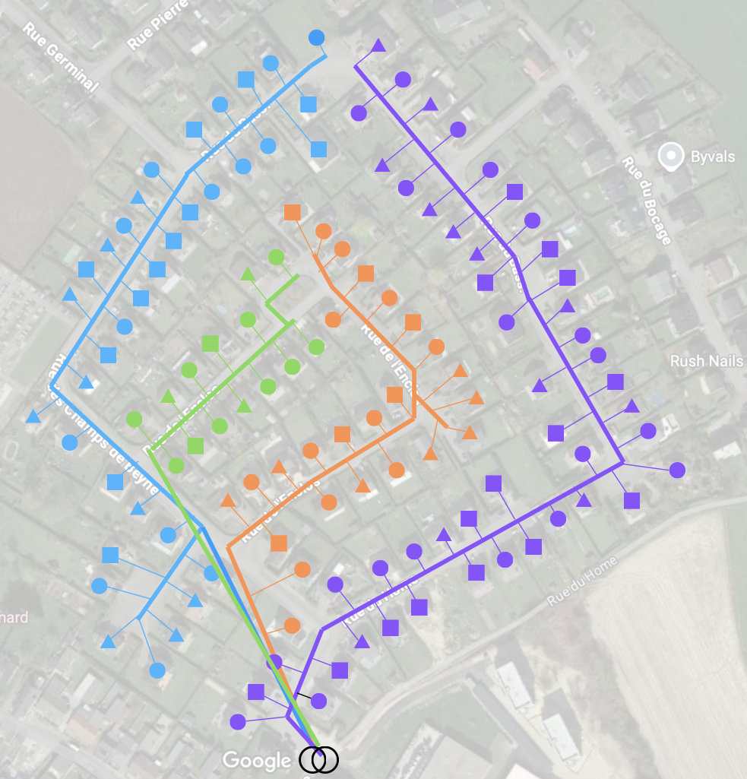
Electrical network topology
Substation
Feeder 1
Feeder 2
Feeder 3
Feeder 4
Phase 1
Phase 2
Phase 3

Slide 18
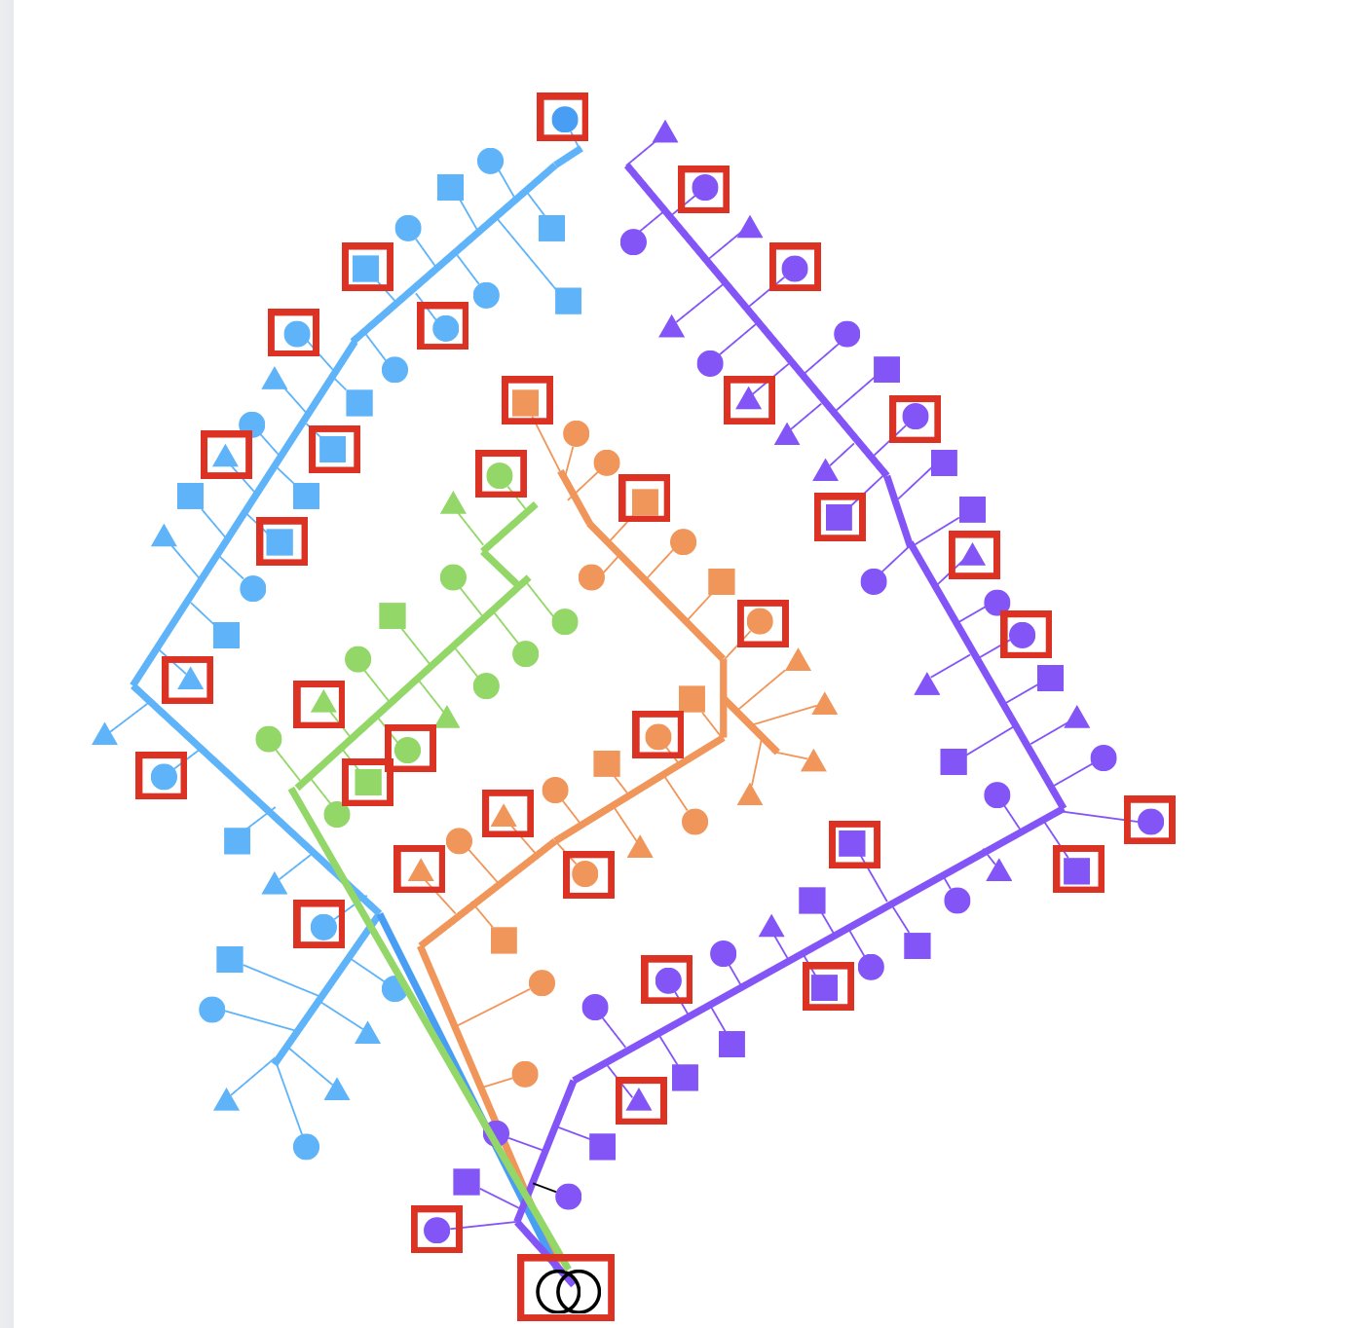
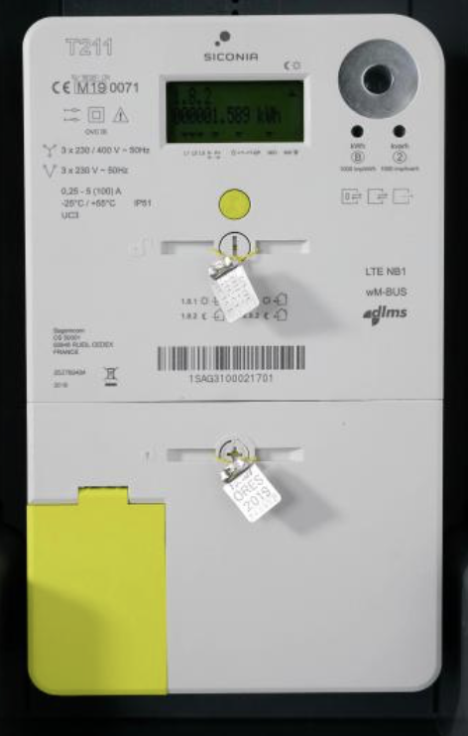
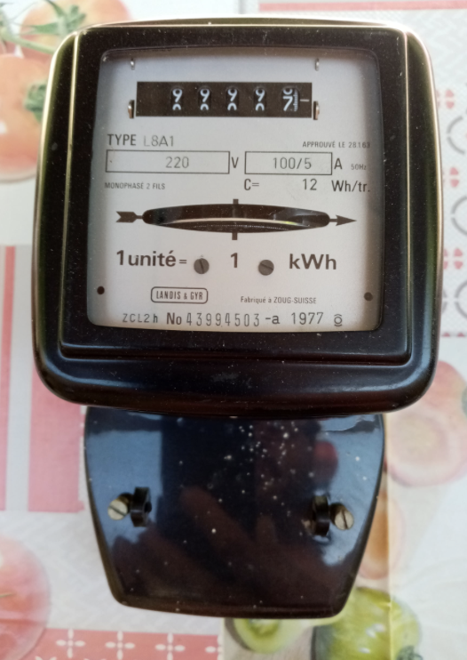
Smart meters
Substation
Feeder 1
Feeder 2
Feeder 3
Feeder 4
Phase 1
Phase 2
Phase 3
Smart-meters

Slide 19
Available data

Slide 20
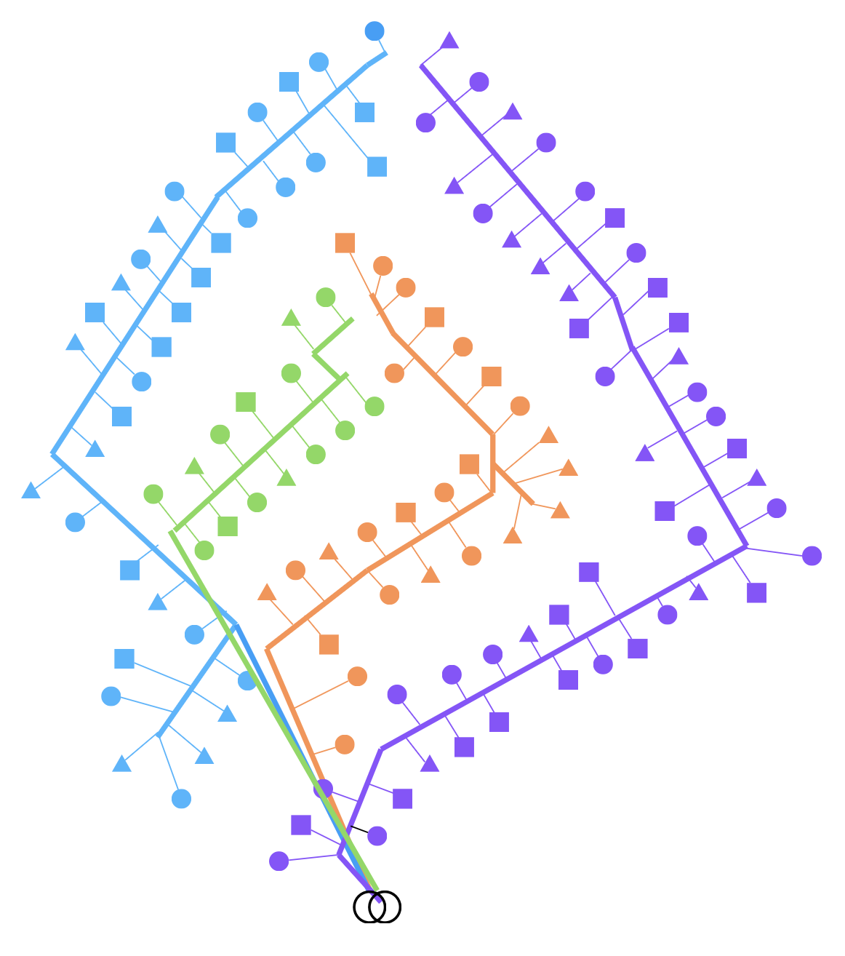
Topology reconstruction goal

Slide 21
Assumptions
During the observation period, the network topology does not change
Customer connections to the main feeder are single-phase
Customers connection phase is known
There is at least one smart-meter connected at every phase of every feeder
Three-phase measurements of feeders at the substation are available

Slide 22
Methodology
Step 1
Step 2
Metered nodes
Single-phase topologies
Three-phase topology
Two steps:
1. Construct single-phase estimates of the network topology for each.
2. Merge the three single-phase estimated typologies to form a three-phase feeder model

Slide 23
Methodology – single phase reconstruction
Available data
Topology estimation
Topology validation
Real network
Unavailable

Slide 24
Methodology – single phase reconstruction
Hidden nodes detection

Slide 25
Methodology – single phase reconstruction
Available data
Topology estimation
Topology validation
Hidden node detection
Real network
Unavailable
Single phase reconstruction

Slide 26
Methodology
Step 1
Step 2
Metered nodes
Single-phase topologies
Three-phase topology
Two steps:
1. Construct single-phase estimates of the network topology for each.
2. Merge the three single-phase estimated typologies to form a three-phase feeder model

Slide 27
Methodology – Three-phase topology formation
Feeder 1

Slide 28
Methodology – three-phase topology formation
Feeder 1
Feeder 2
Feeder 3

Slide 29
Methodology – three-phase topology formation
Feeder 1

Slide 30
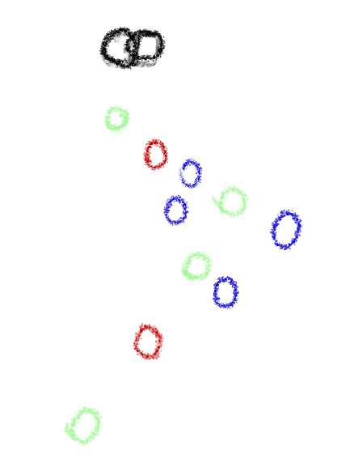
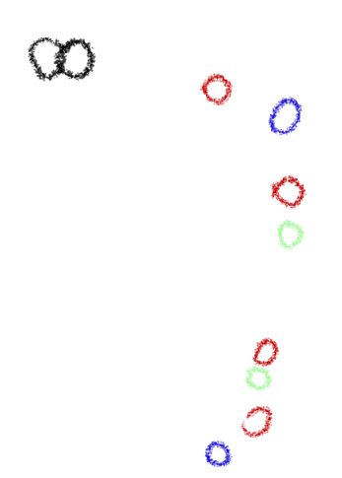
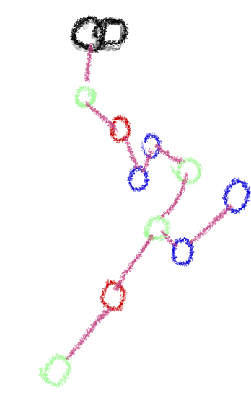
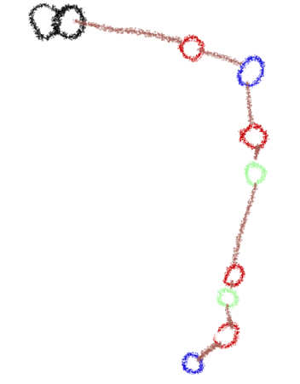
Methodology – three-phase topology formation
Feeder 2
Feeder 3
Three-phase topology

Slide 31
Methodology
Step 1
Step 2
Metered nodes
Single-phase topologies
Three-phase topology
Two steps:
1. Construct single-phase estimates of the network topology for each.
2. Merge the three single-phase estimated typologies to form a three-phase feeder model

Slide 32
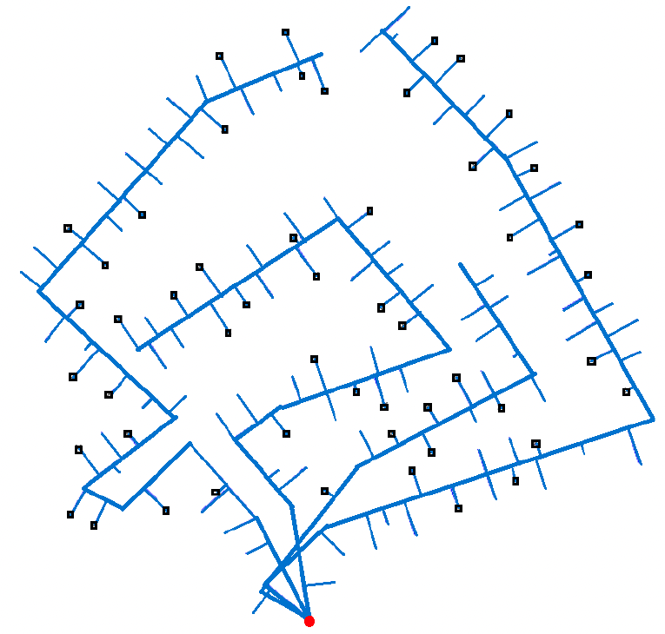
Test case
1 substation (red dot)
4 feeders
216 nodes
128 customers
52 Smart meters (black rectangles)

Slide 33
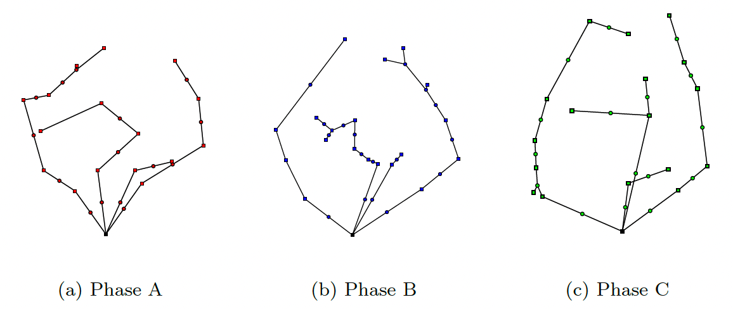
Results

Slide 34
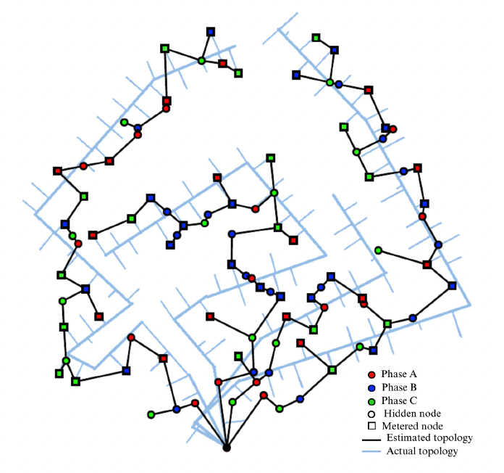
Results

Slide 35
Results validation

Slide 36
Topology identification
Single technology HC
Unified HC definition
Combined HC

Slide 37
Determining a Hosting Capacity

Slide 38
Single technology hosting capacity
For a given technology, how many of that technology can we install before facing any issues?

Slide 39
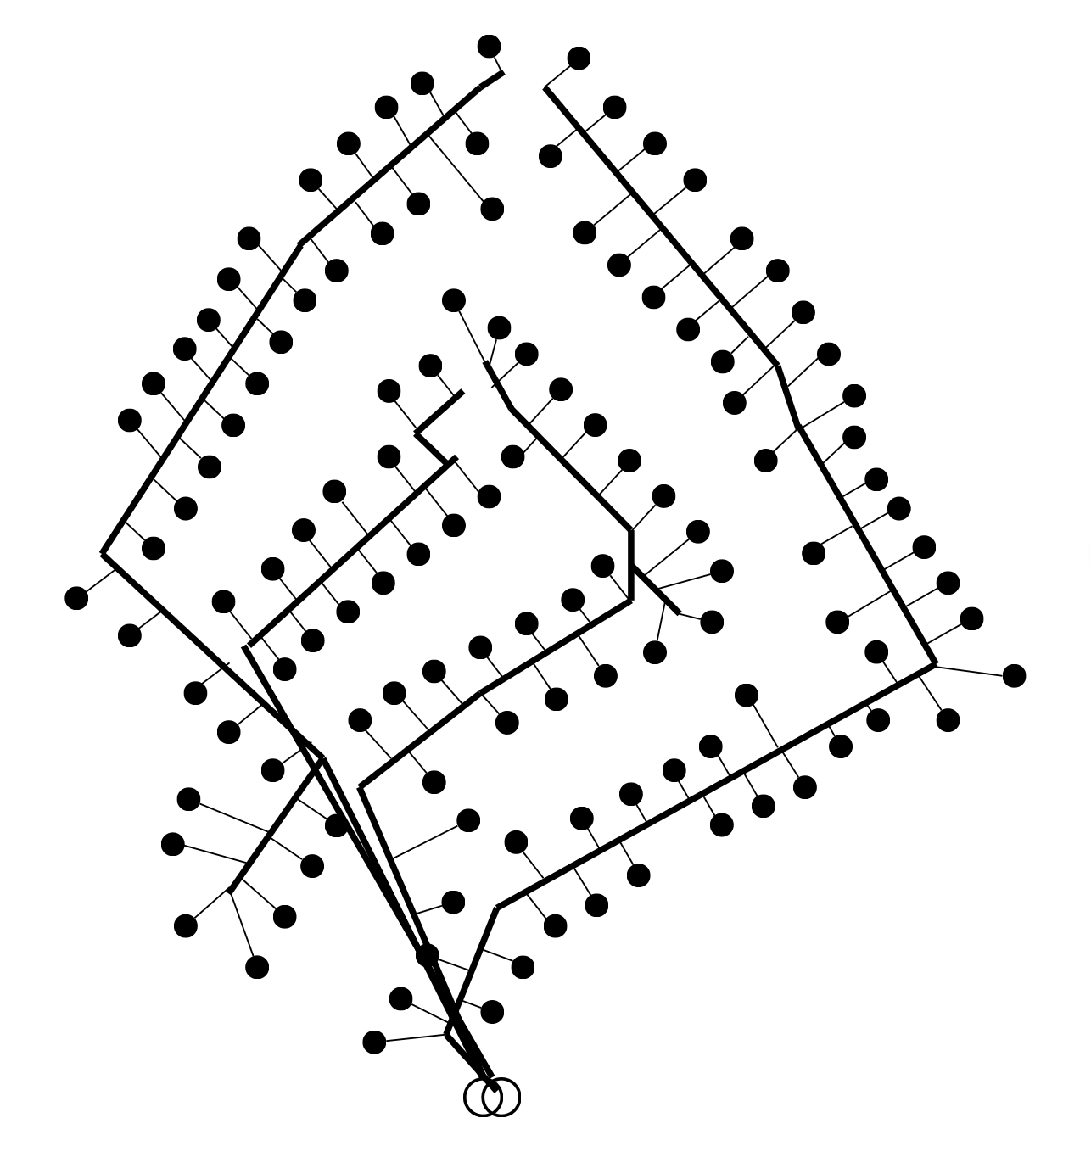
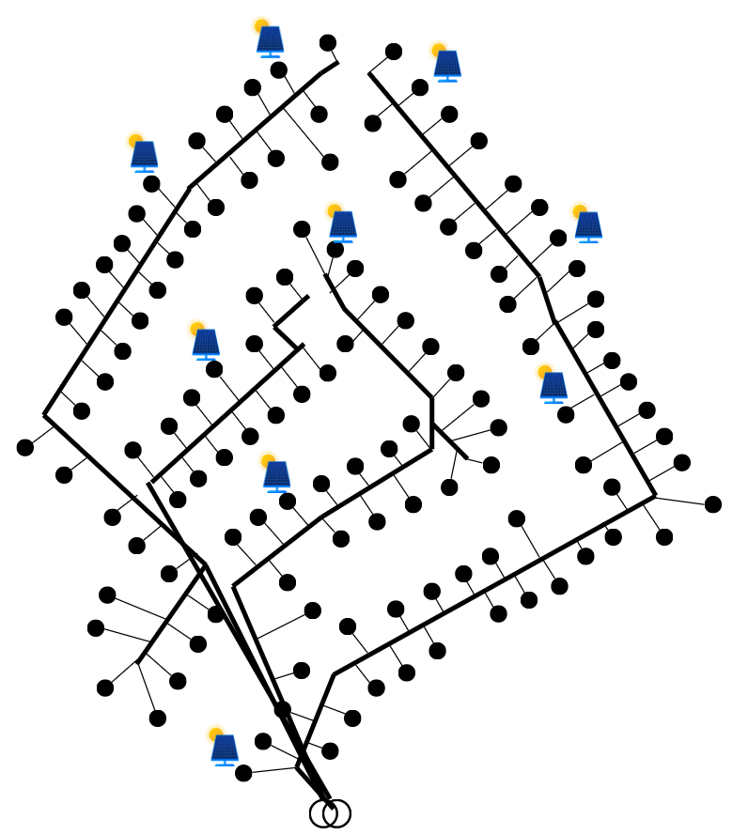
Methodology idea
Add new technologies (e.g. PV, EV) to a network and simulate over time and see what happens !

Slide 40
Key performance indicators
Measure of the performance of the network.
Unacceptable operation
Performance indicator
Acceptable operation
Hosting capacity
Amount of photovoltaic panels

Slide 41
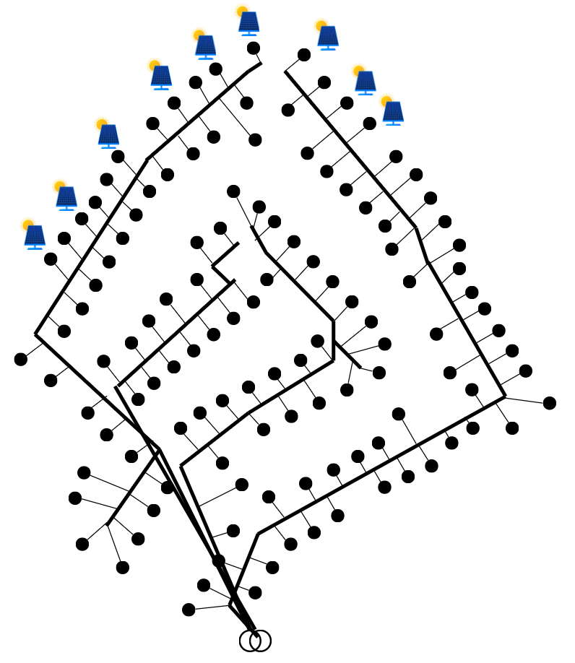
Configurations
12 Photovoltaic panels
No issues
Issues

Slide 42
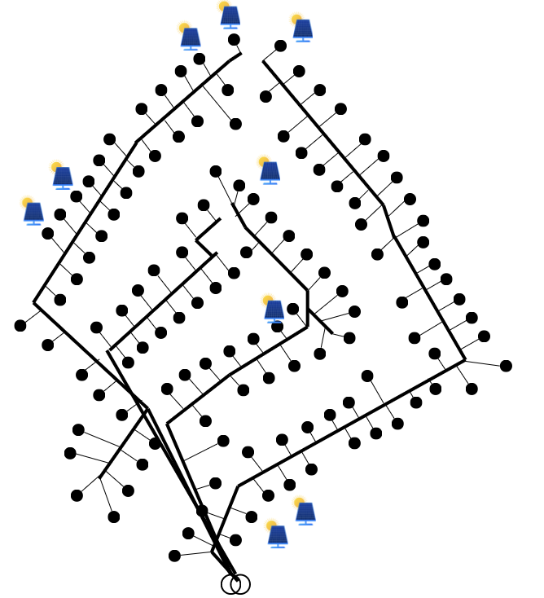
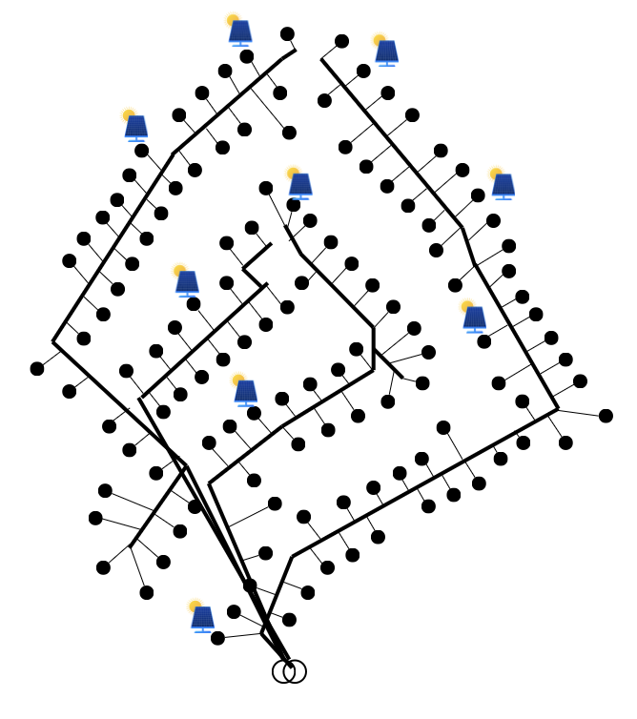
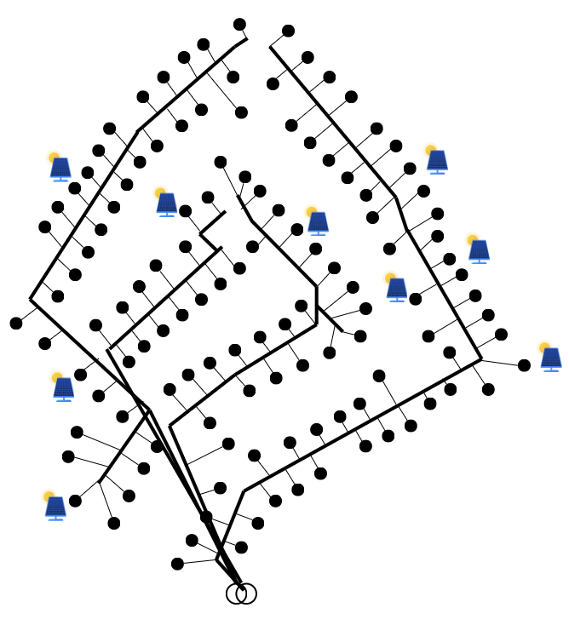
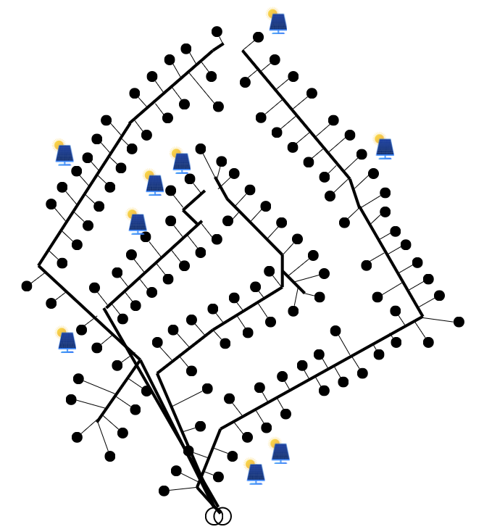
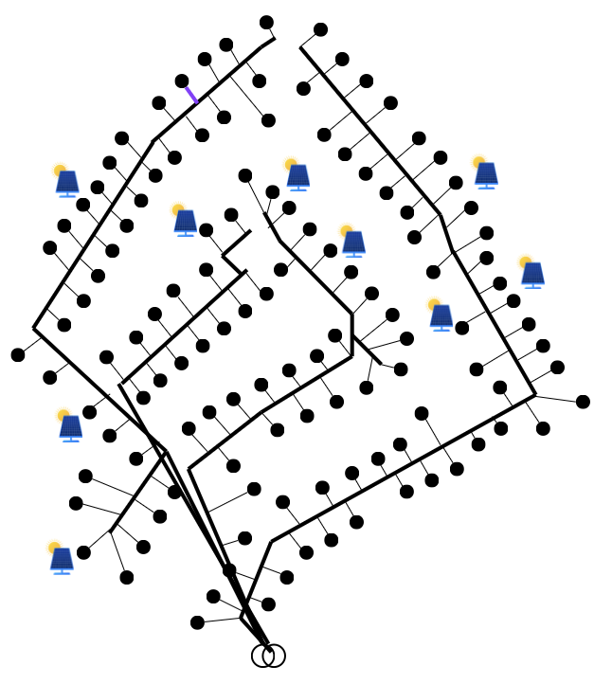
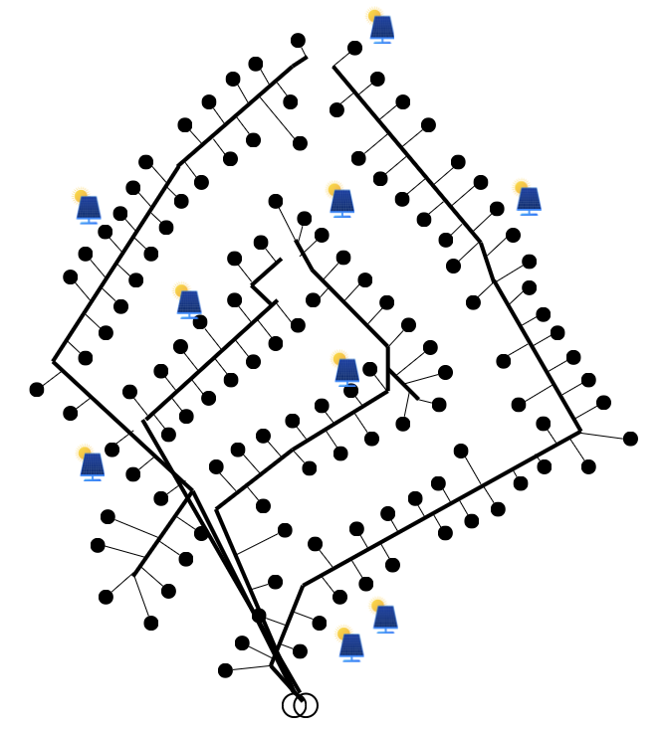
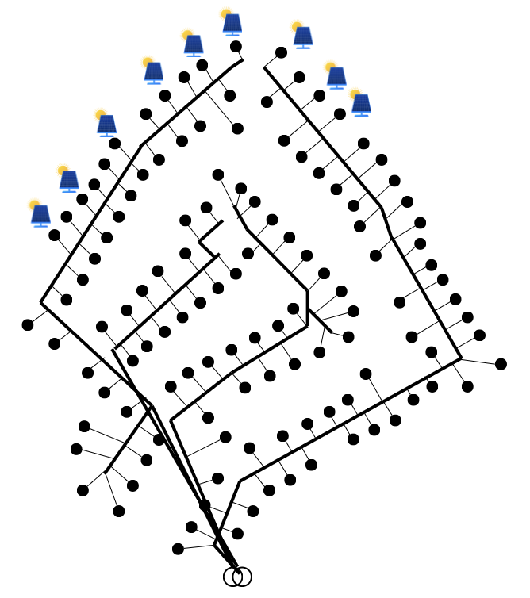
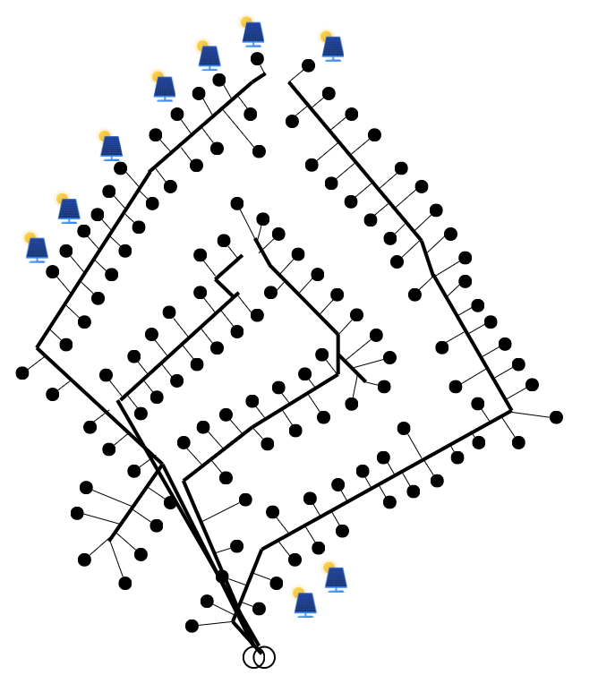
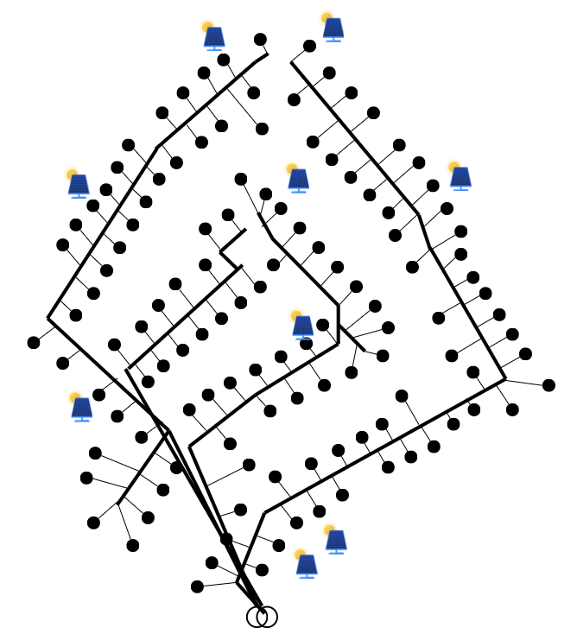
Configurations
12 Photovoltaic panels

Slide 43
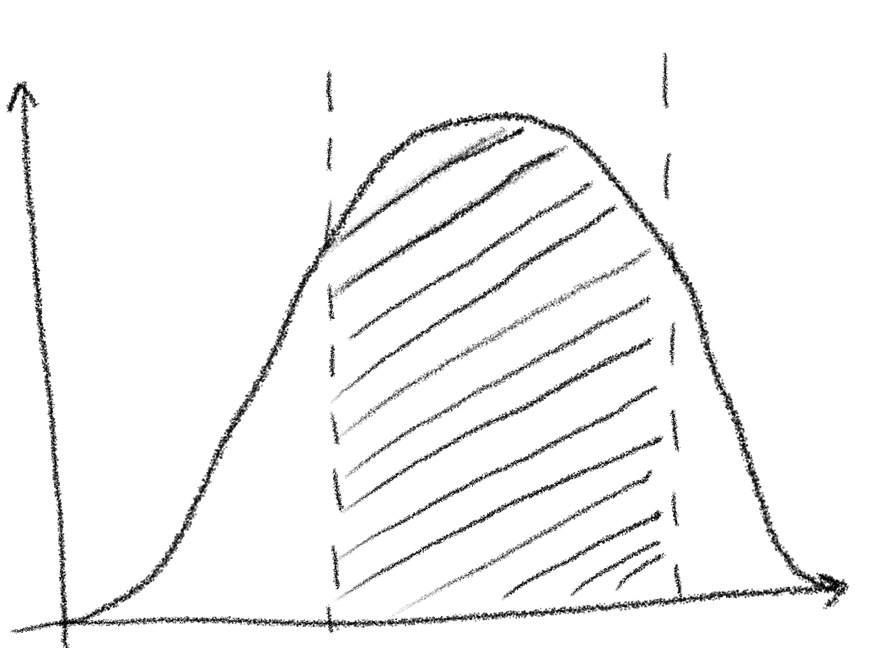
Configurations (2)
For instance, for 40 new installations and 100 customers, there are $C_{100}^{40}= {10}^{28}$possible configurations.
Probability density function (PDF) for the indicators:
Density
Performance indicator

Slide 44
Methodology - summary
Initial network
For each penetration rate (e.g. amount of PV):
Power flow
Performance indicators
Density
…
Select type:
Performance indicator
Power flow
Performance indicators
Number of configurations

Slide 45
Test case
Topology reconstructed
500 configurations per penetration
1 week time series
Penetrations [0, 1, …, 100]
13 PVs of 290 W
peak

Slide 46
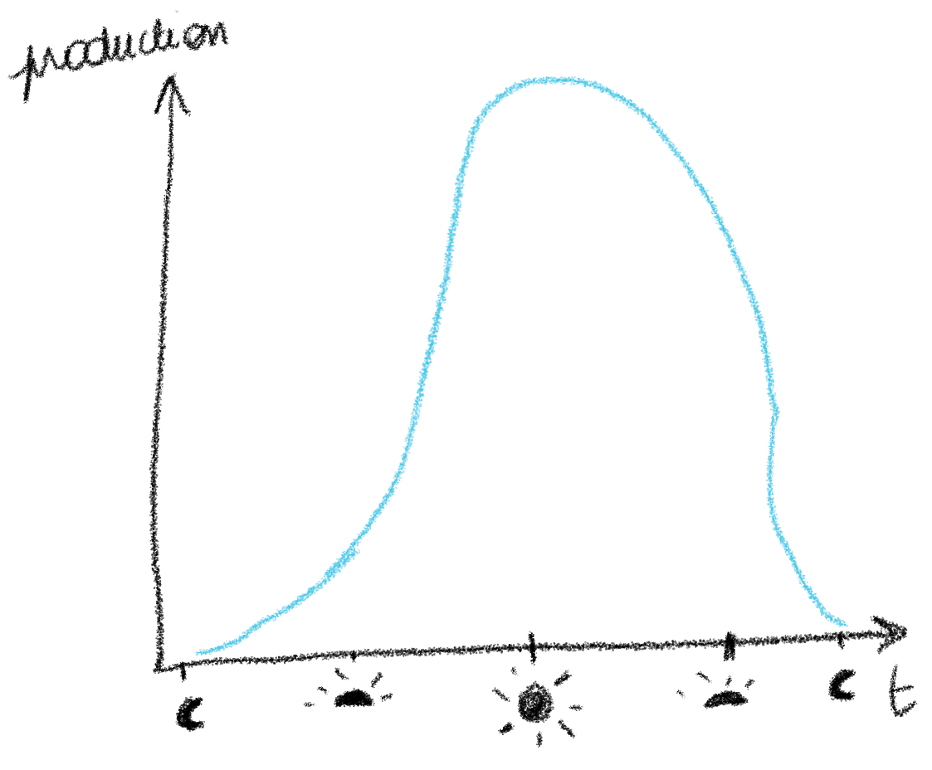
PV Performance indicator – Energy spilled

Slide 47
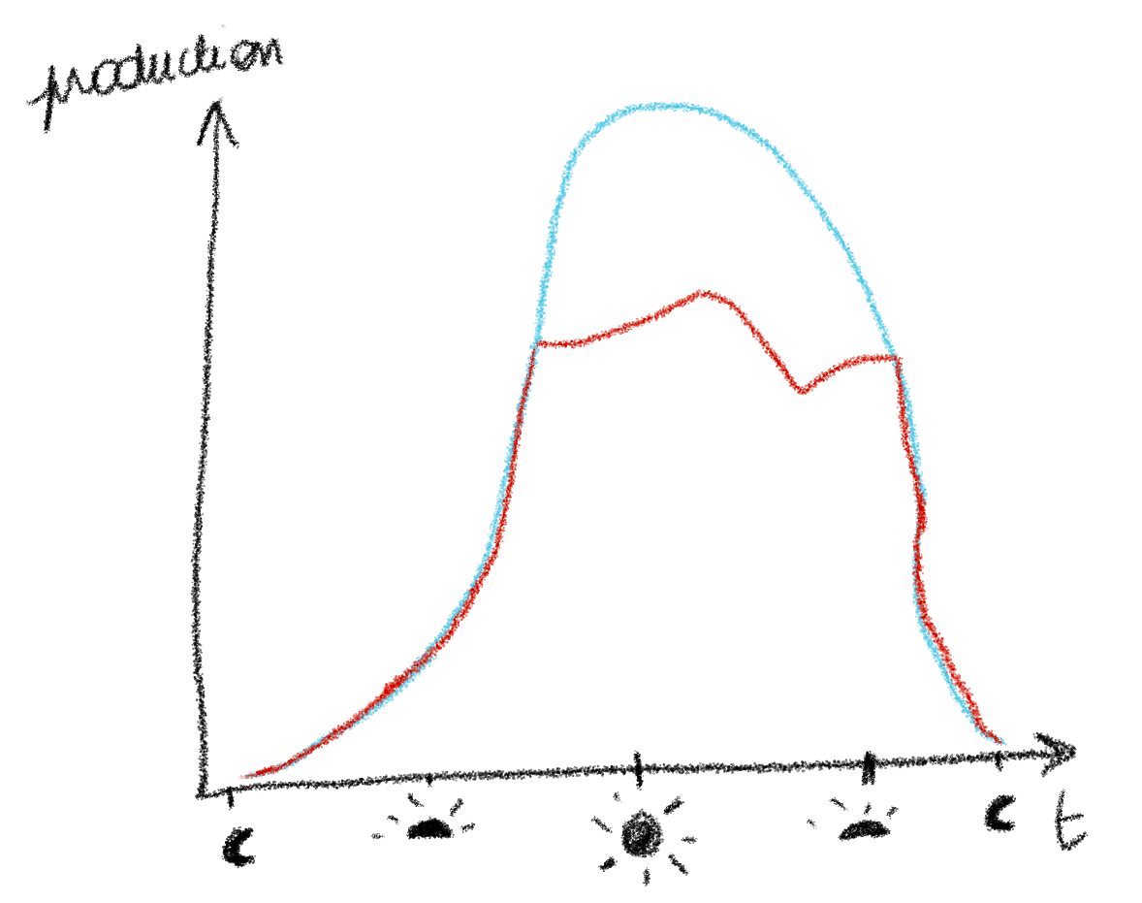
PV Performance indicator – Energy spilled

Slide 48
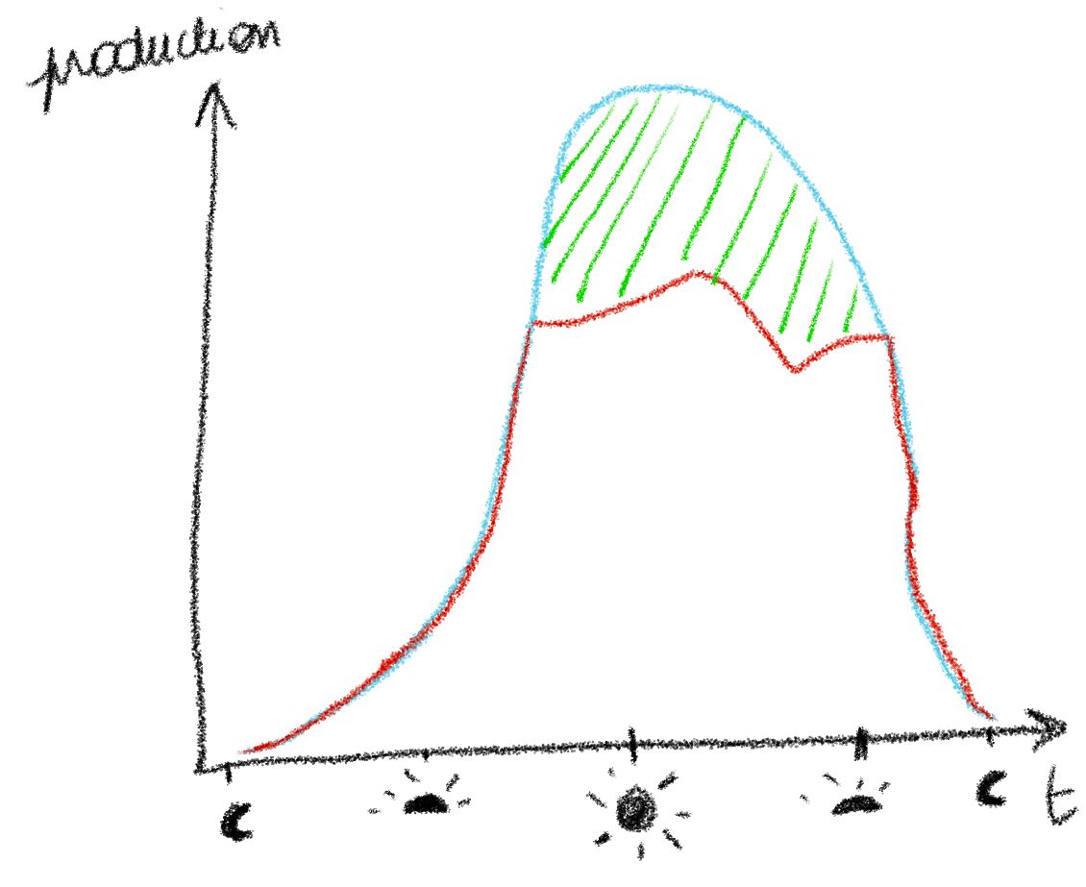
PV Performance indicator – Energy spilled
Energy spilled

Slide 49
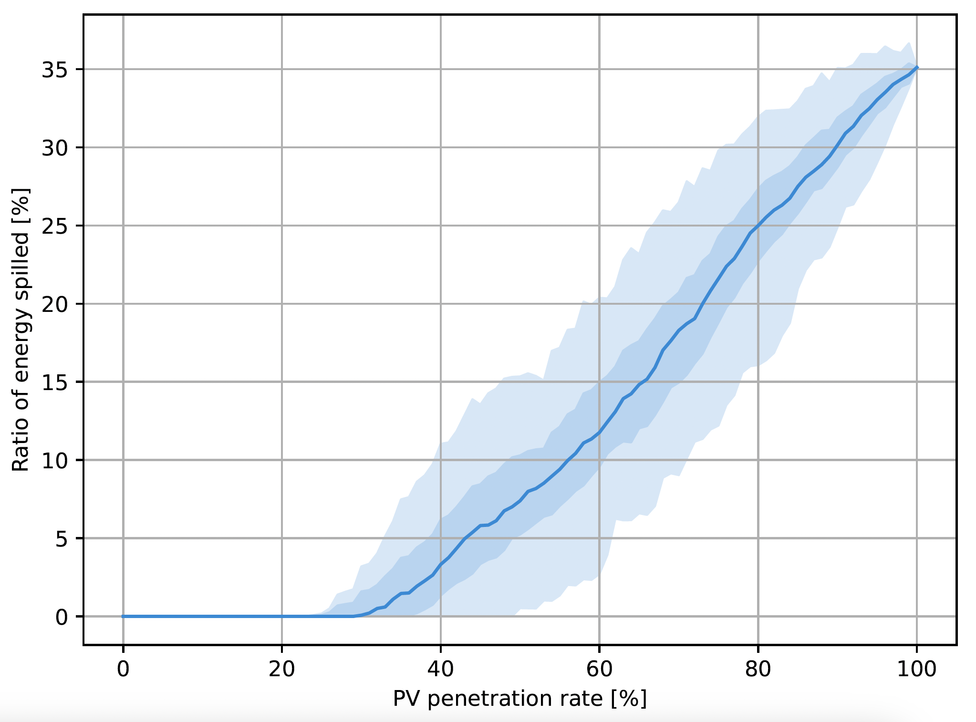
Test case – PV results

Slide 50
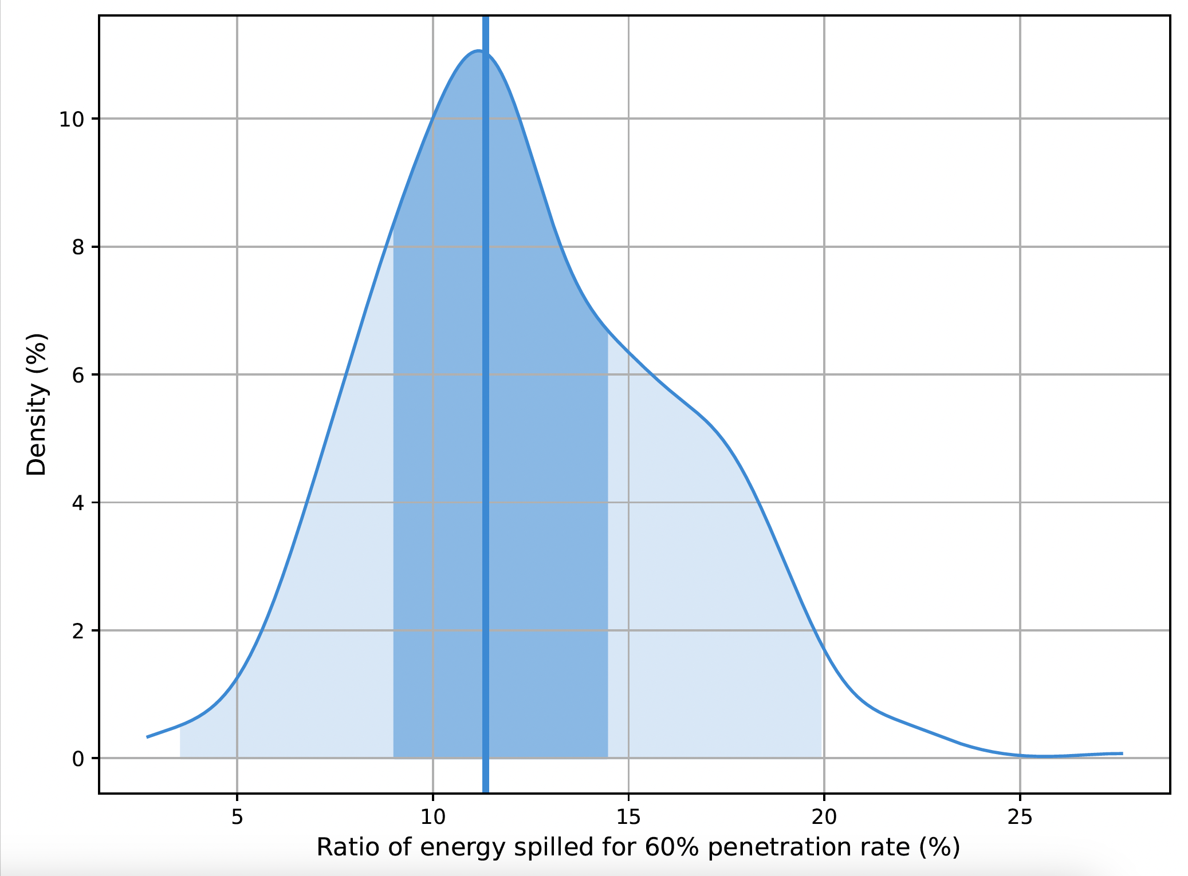
Test case – PV results
Q1
Q3

Slide 51
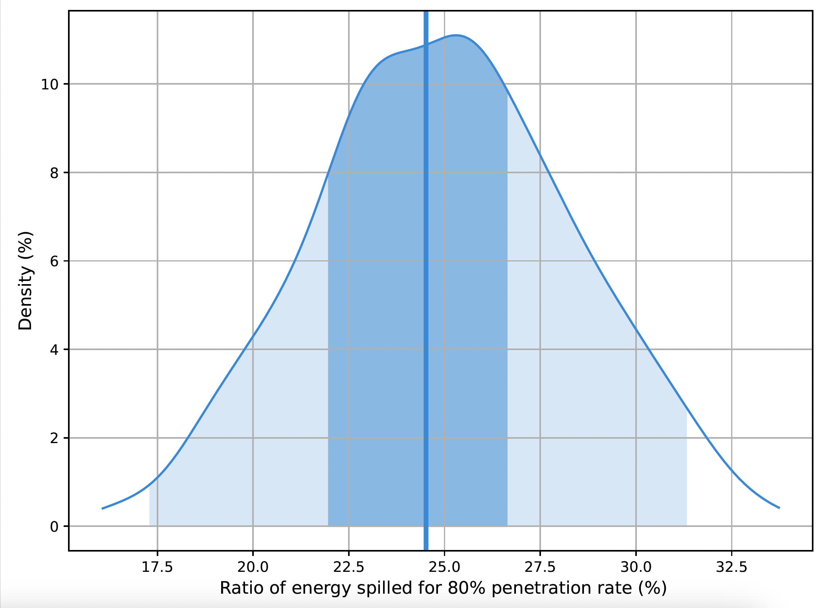
Test case – PV results

Slide 52
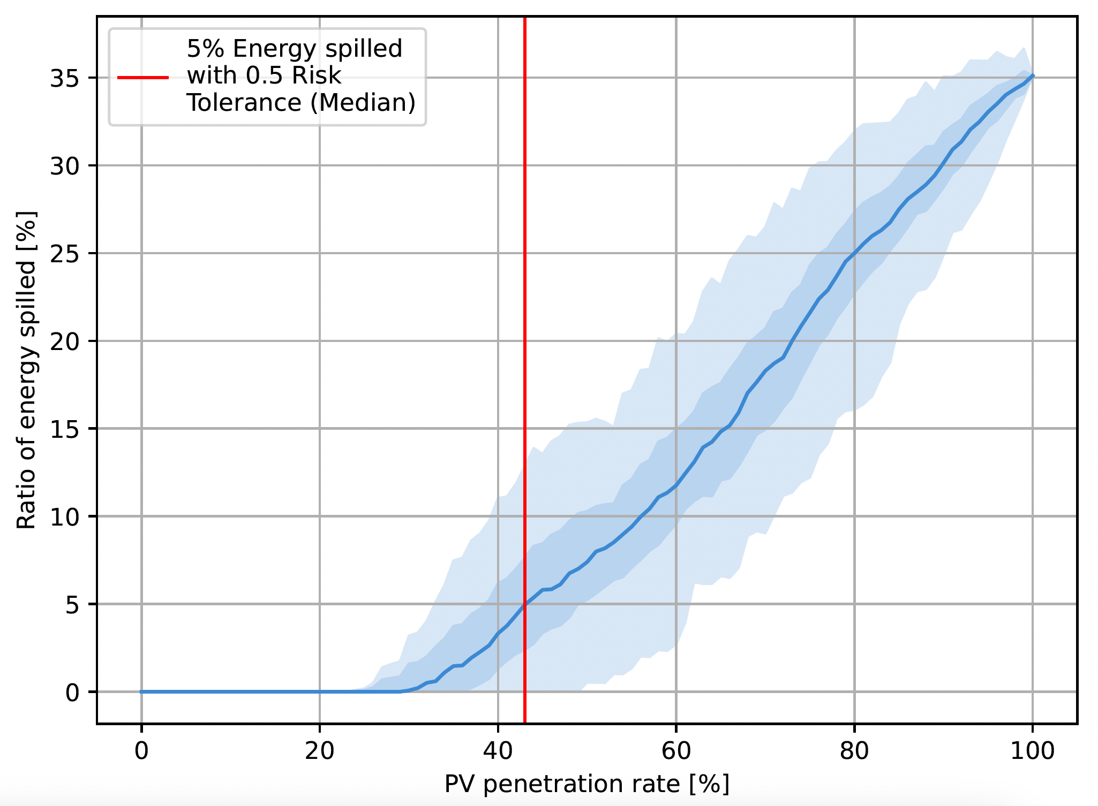
Test case – PV results

Slide 53
Topology identification
Single technology HC
Unified HC definition
Combined HC

Slide 54
Hosting Capacity Definition

Slide 55
Hosting capacity (HC)
The HC is the amount of new resources (DER) that can be hosted by a network before facing any issues, i.e., compromising its operational limits or violating safety constraints.
Unacceptable operation
Performance indicator
Acceptable operation
Hosting capacity
Amount of DER

Slide 56
For a given network, with customers

Slide 57
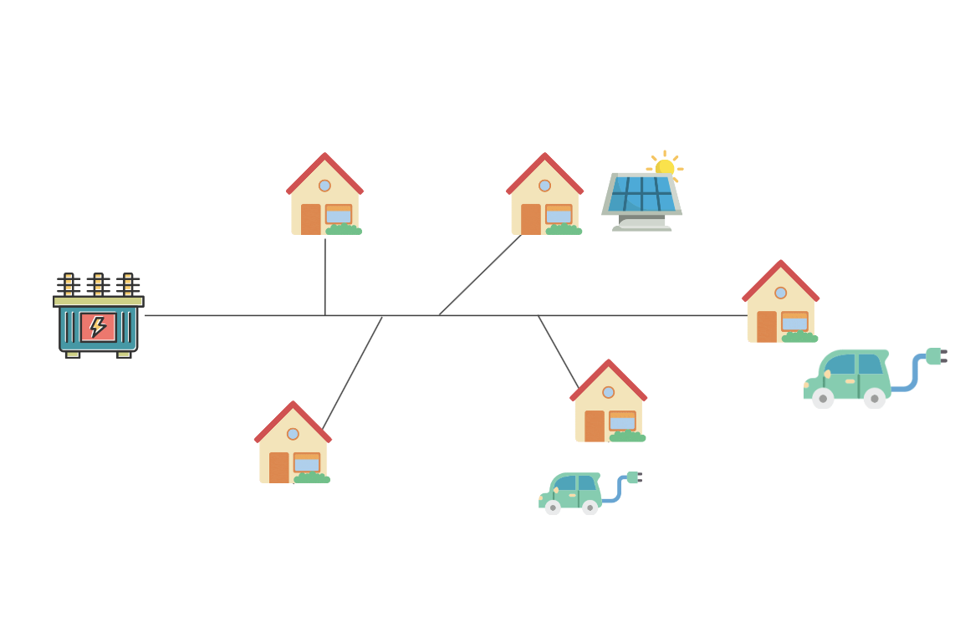
State:
These customers can add different types of DERs with different options, for instance their size.

Slide 58
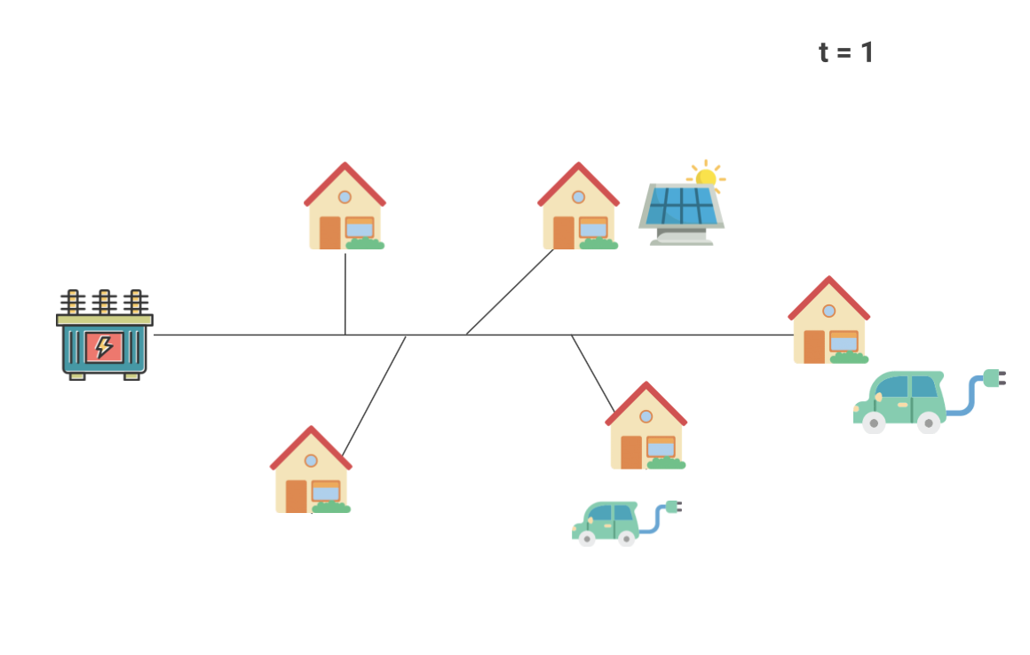
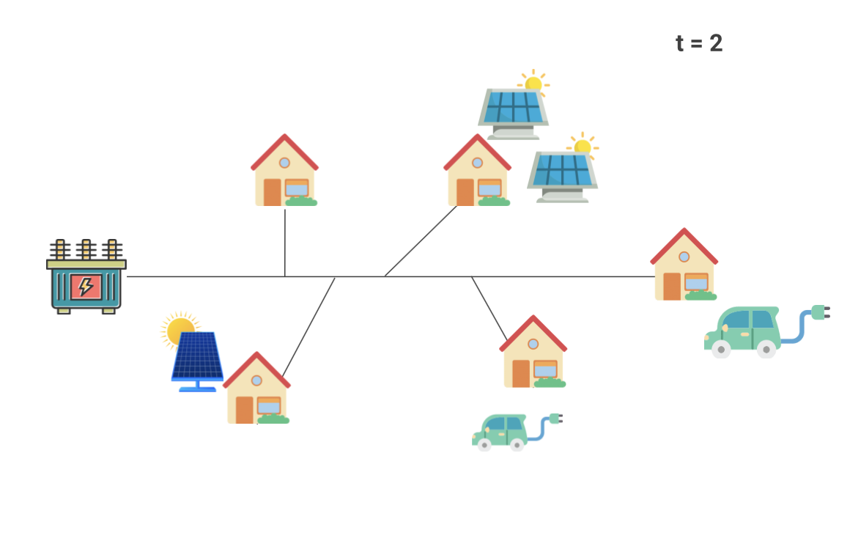
Scenario:

Slide 59
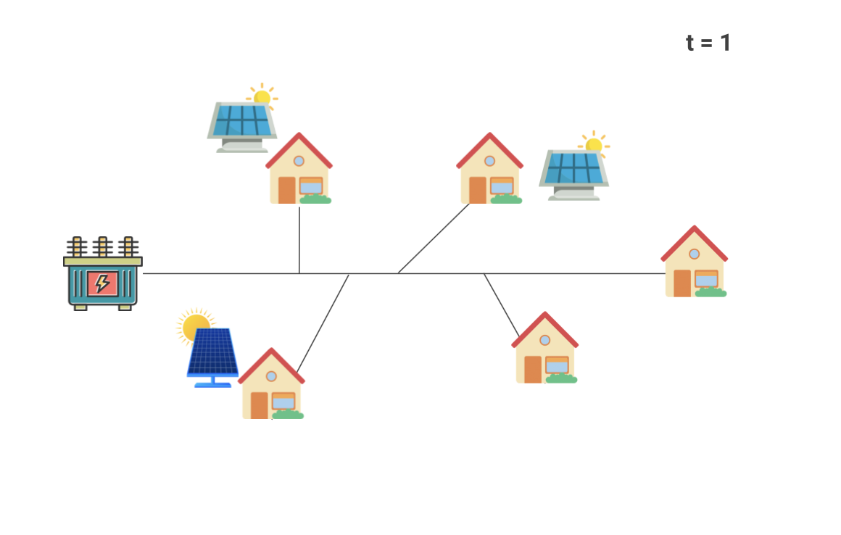
Set of scenarios :
Set of considered scenarios :
Scenario 1:
Scenario 2:
Scenario 3:
Scenario ….:

Slide 60
A scenario :
Penetration :

Slide 61
Set of scenarios :
Set of penetrations
Scenario 1:
Scenario 2:
Set of considered penetrations
Scenario 3:
…
Set of considered scenarios :
Scenario ….:
…

Slide 62
Exogenous data

Slide 63
Scenarios
Penetrations
Notes:
-

Slide 64
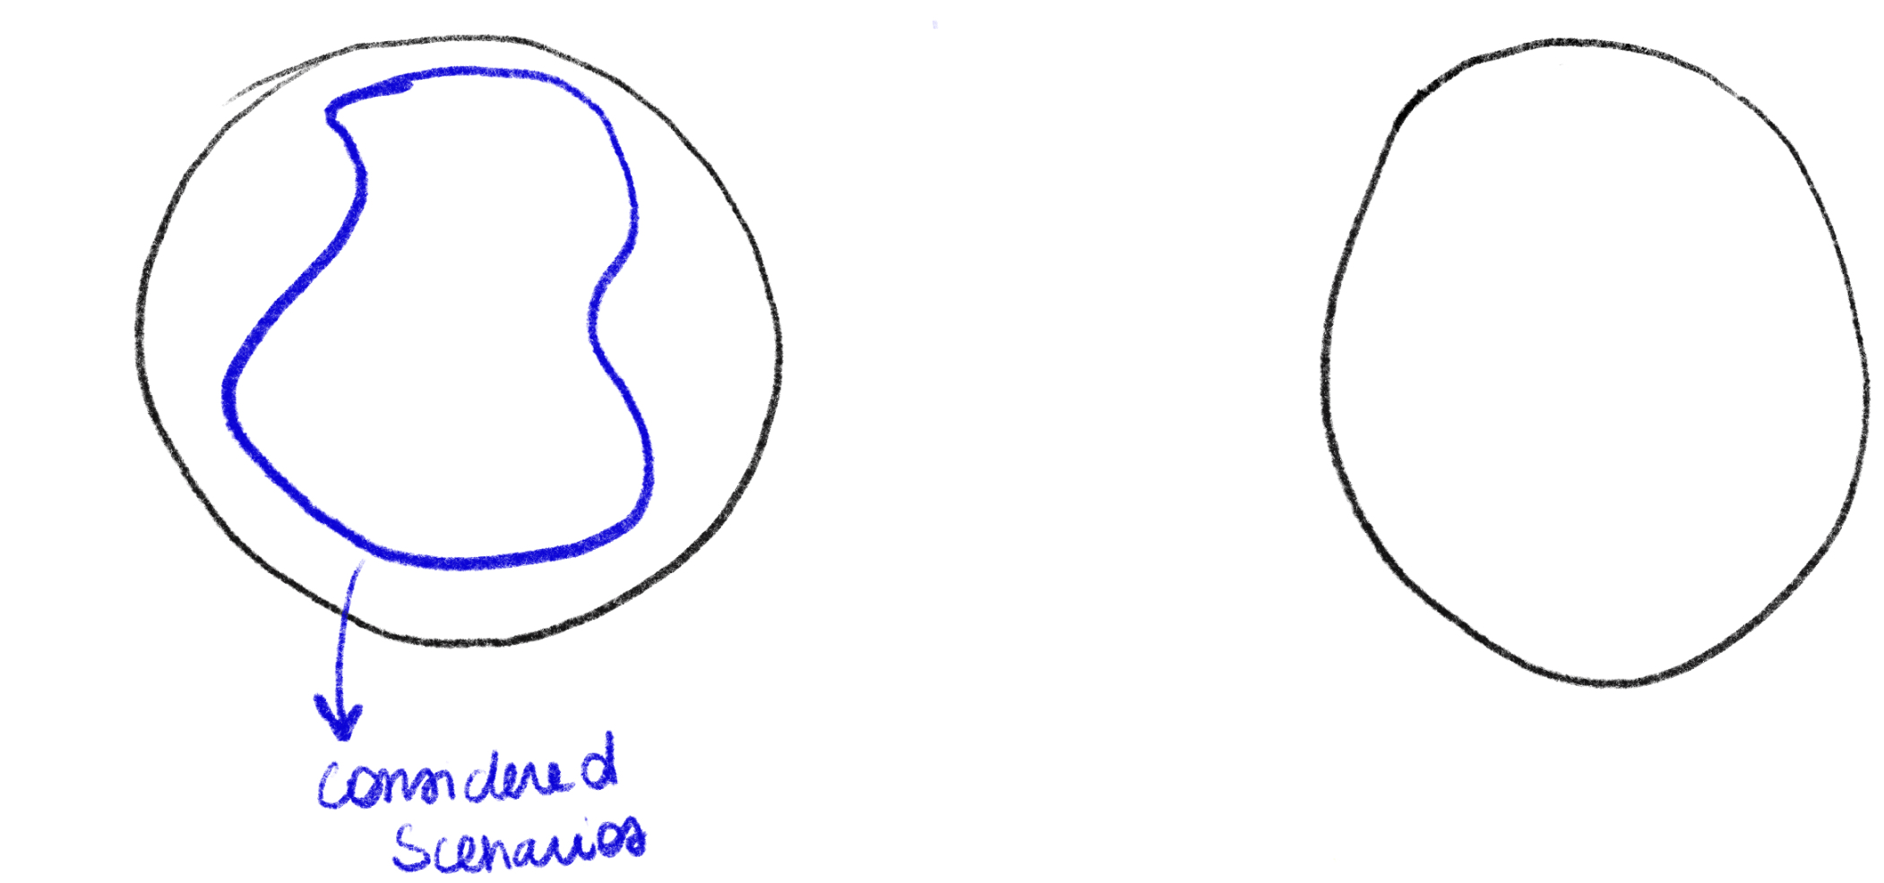
Scenarios
Penetrations
Considered Scenarios

Slide 65
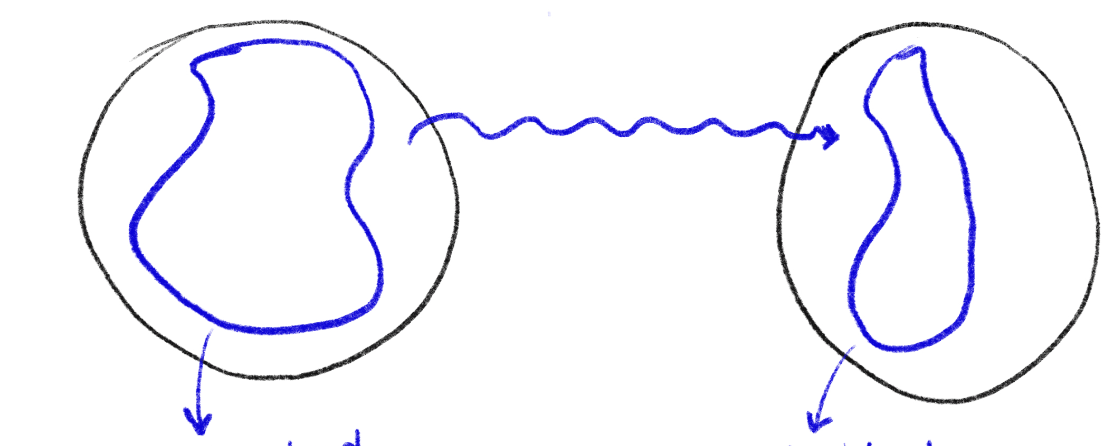
Scenarios
Penetrations
Considered scenarios
Considered penetrations

Slide 66
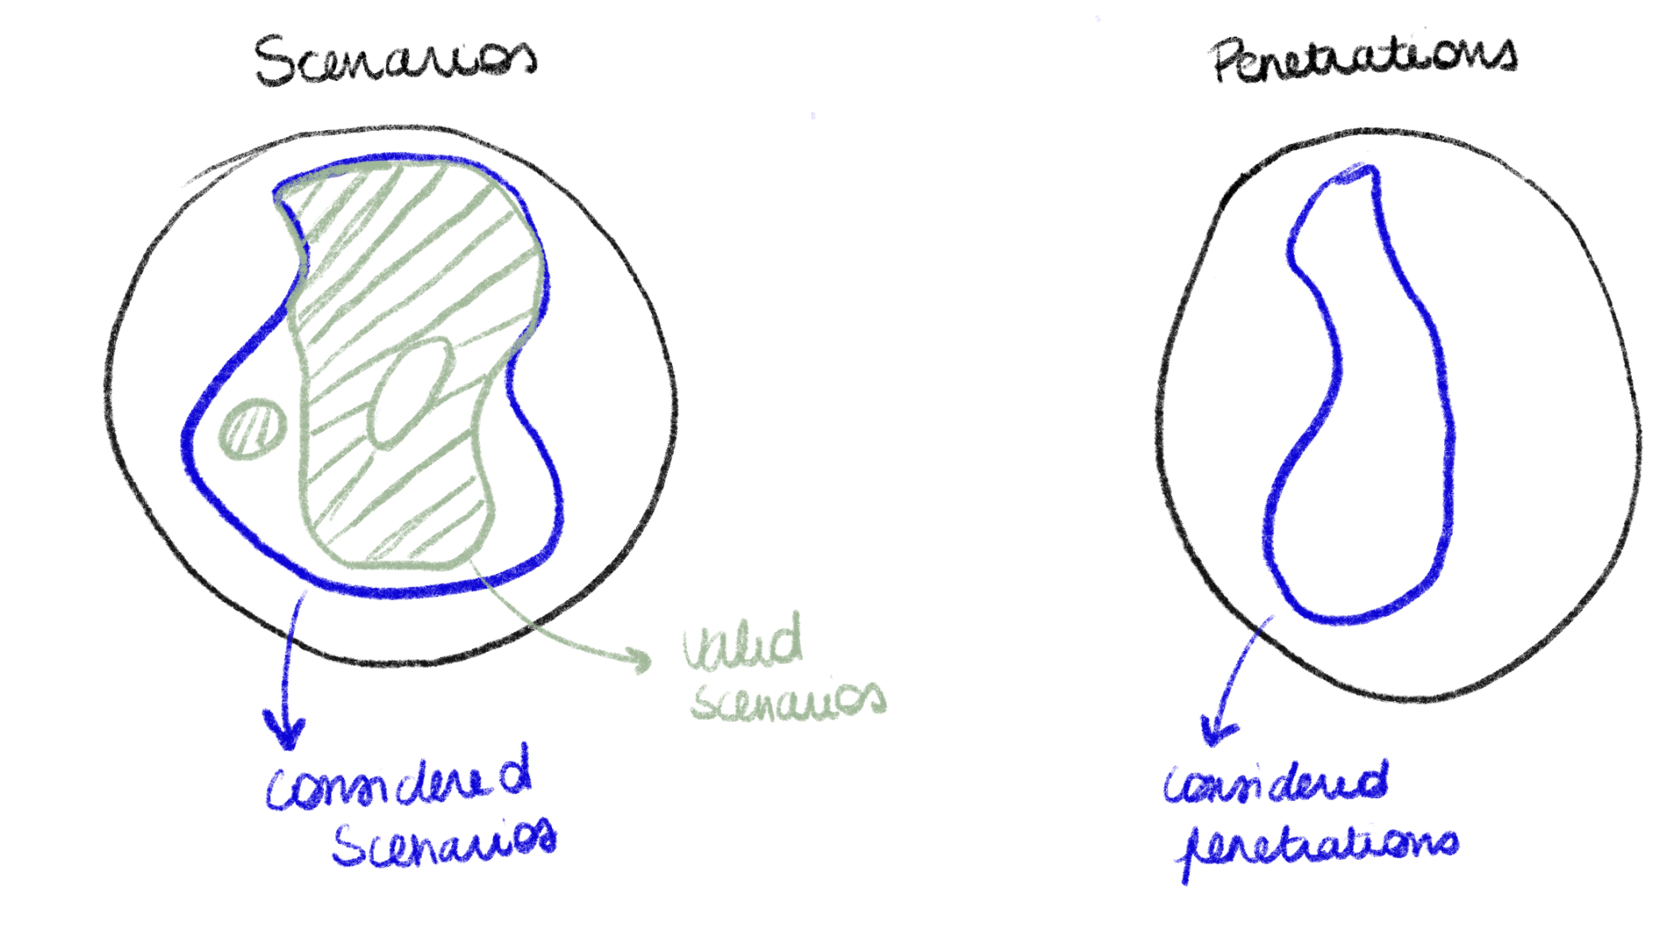
Scenarios
Penetrations
Valid scenarios
Considered scenarios
Considered penetrations

Slide 67
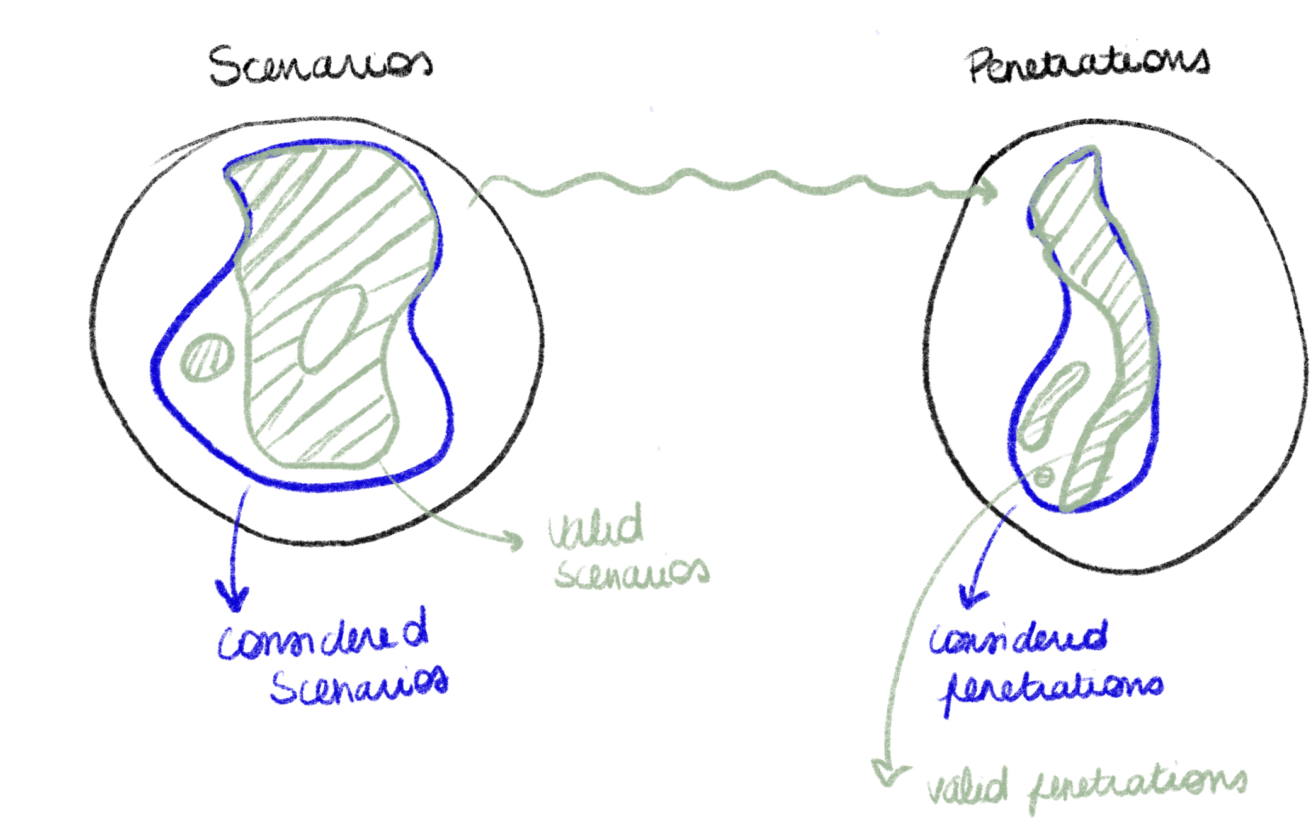
Scenarios
Penetrations
Valid scenarios
Considered scenarios
Considered penetrations
Valid penetrations

Slide 68
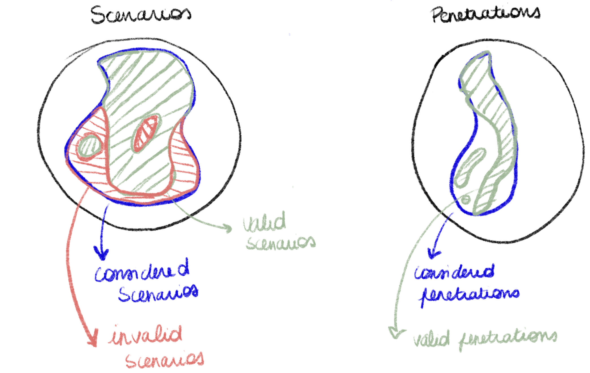
Scenarios
Penetrations
Valid scenarios
Considered scenarios
Considered penetrations
Invalid scenarios
Valid penetrations

Slide 69
Scenarios
Penetrations
Valid scenarios
Considered scenarios
Considered penetrations
Valid penetrations
Invalid scenarios
Invalid penetrations

Slide 70
Scenarios
Penetrations
Valid scenarios
Considered penetrations
Considered scenarios
Valid penetrations
Invalid scenarios
Invalid penetrations
Feasible penetrations

Slide 71
Scenarios
Penetrations
Valid scenarios
Considered scenarios
Considered penetrations
Feasible scenarios
Valid penetrations
Invalid scenarios
Invalid penetrations
Feasible penetrations

Slide 72
N-dimensional hosting capacity

Slide 73
One Dimensional Hosting capacity
Safe penetrations
Feasible penetrations
Number of Photovoltaic panels

Slide 74
Summary of the formalism
Exogenous data
A network
t=…
Scenario
Valid / invalid sets
State
Technologies
Options for the technologies
Feasible/safe penetrations
Penetrations
Hosting capacity

Slide 75
Topology identification
Single technology HC
Unified HC definition
Combined HC

Slide 76
Combined PV-EV-HP Hosting Capacity

Slide 77
Methodology
Considered scenarios
Penetrations
Issues

Slide 78
Case study – considered scenarios
Technologies size:
Photovoltaic size: 20 x 290W
Electric vehicle charger sizes: 3kW and 7kW
Heat pump sizes: 7.5kW and 15kW
peak
Probability of installing a technology:
Use a probability to install a new technology for each customer and technology type.

Slide 79
Case study
Representative days:
Reduce the number of time steps considered

Slide 80
Case study – Functions
Issues:
Under-voltage limit
<
<
Over-voltage limit
Node voltage
Loads of a line
<
Line capacity
Penetrations:
Number of customers with new technologies (DERs)
Total number of customers

Slide 81
Case study – Belgian network
1 substation
2 feeders
23 customers
15 customers with Smart Meters
Penetration levels:
[25%, 50%, 75%, 100%]
100 scenarios per penetration level

Slide 82
Results - Voltage

Slide 83
Results - Voltage
25% EV
25% PV

Slide 84
Results - Voltage
Acceptable for a penetration around 50% for all technologies
Under-voltage is encountered rapidly for both EV and HP penetrations higher than 50%.
Over-voltage is not faced before 75% of PV penetration.

Slide 85
Results – Loads
Even with high penetration rates for all three technologies, the lines of the case study network are not overloaded.

Slide 86
Topology identification
Single technology HC
Unified HC definition
Combined HC

Slide 87
Conclusion – Journey summary
In this presentation:
Reconstruction of the topology of distribution network using smart meter data
Single technology hosting capacity methodology with application on a Belgian inspired network with photovoltaic panels.
Definition of the hosting capacity
Combined hosting capacity of PV-EV-HP
In addition, in the manuscript:
Impact of optimal phase connection on HC

Slide 88
Future work
Representative days
Socio-economic behaviour
Coupling the HC formalism with investment strategies and active network management.

Slide 89
Further information
In the thesis:
A. Benzerga, “Hosting Capacity of Low-Voltage Distribution Networks”, https://hdl.handle.net/2268/323245
And the corresponding papers:
Benzerga, A., Maruli, D., Sutera, A., Bahmanyar, A., Mathieu, S., & Ernst, D. (2021, June). Low-voltage network topology and impedance identification using smart meter measurements. In 2021 IEEE Madrid PowerTech (pp. 1-6). IEEE.
Marulli, D., Mathieu, S., Benzerga, A., Sutera, A., & Ernst, D. (2021, October). Reconstruction of low-voltage networks with limited observability. In 2021 IEEE PES Innovative Smart Grid Technologies Europe (ISGT Europe) (pp. 1-5). IEEE.
Benzerga, A., Mathieu, S., Bahmanyar, A., & Ernst, D. (2021, July). Probabilistic capacity assessment for three-phase low-voltage distribution networks. In 2021 IEEE 15th International Conference on Compatibility, Power Electronics and Power Engineering (CPE-POWERENG) (pp. 1-6). IEEE.

Slide 90
And more
Benzerga, A., Bahmanyar, A., Derval, G., & Ernst, D. (2024). A unified definition of hosting capacity, applications and review. ORBi-University of Liège. https://orbi.uliege.be/handle/2268/315915.
Benzerga A., Vassallo M., Gerard S., Vandeburie J., and Ernst D. (2024). Combined PV-EV-HP Hosting Capacity Analysis of a Belgian Low- Voltage Distribution Network. In Proceeding of the 34th Australasian Universities Power Engineering Conference (AUPEC). 2024.
Benzerga, A., Bahmanyar, A., & Ernst, D. (2022). Optimal Connection Phase Selection of Residential Distributed Energy Resources and its Impact on Aggregated Demand. arXiv preprint arXiv:2207.05059.
Benzerga, A., Gérard, S., Lachi, S., Garnier, Q., Bahmanyar, A., & Ernst, D. (2022). Optimal connection phase selection for single-phase electrical vehicle chargers.
Vassallo, M., Benzerga, A., Bahmanyar, A., & Ernst, D. (2023, June). Fair reinforcement learning algorithm for pv active control in lv distribution networks. In 2023 International Conference on Clean Electrical Power (ICCEP) (pp. 796-802). IEEE.

Slide 91
“Happiness can be found, even in the darkest of times, if one only remembers to turn on the light.”
- Albus Dumbledore

