Slide 1


Influence of gammaherpesvirus infections on the antibody repertoire of their host
Jérôme BAIWIR
BELVIR 2021
Promoter : Laurent GILLET
Co-promoter : Bénédicte MACHIELS
Notes:
Hello everyone, today I am going to speak about the influence of gammaherpesvirus infections on the antibody repertoire of their host.

Slide 2
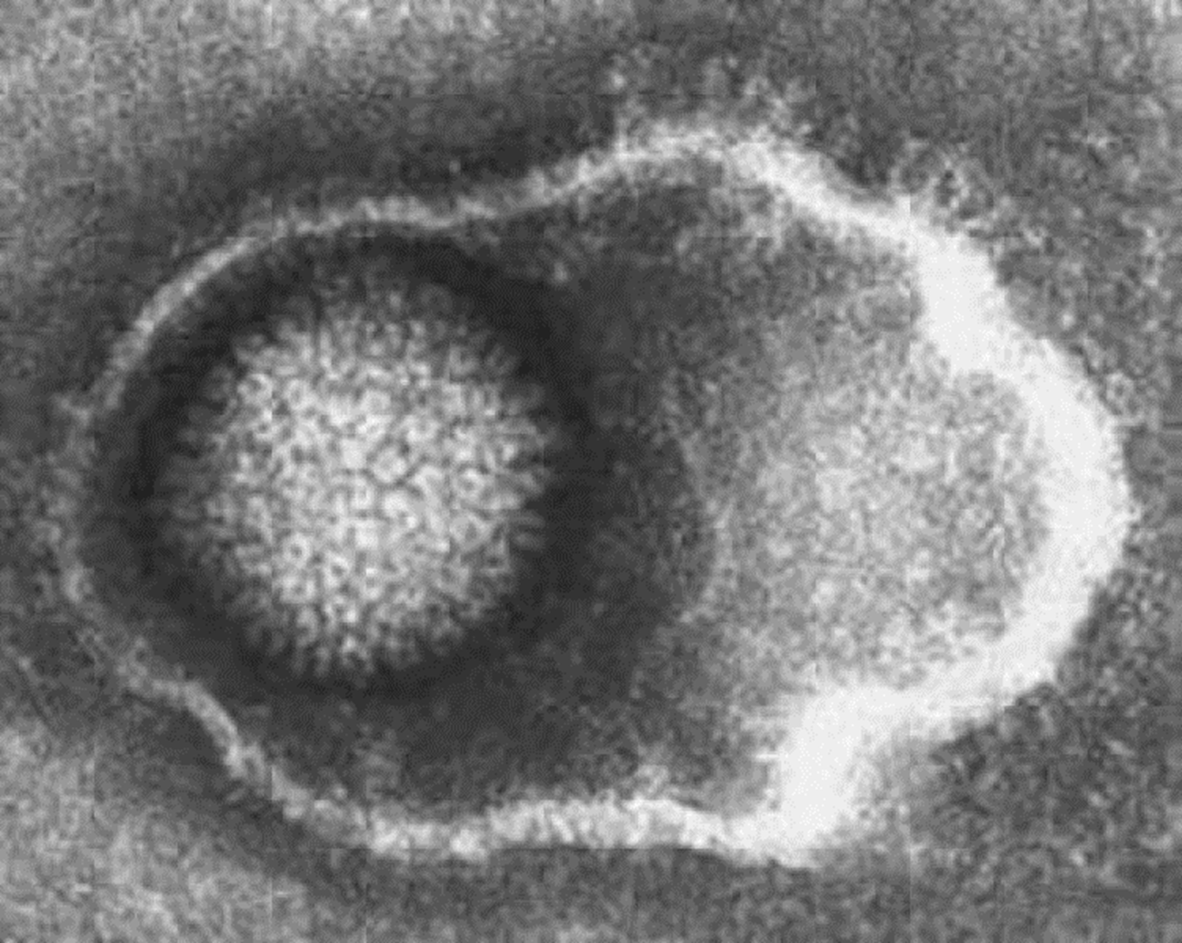
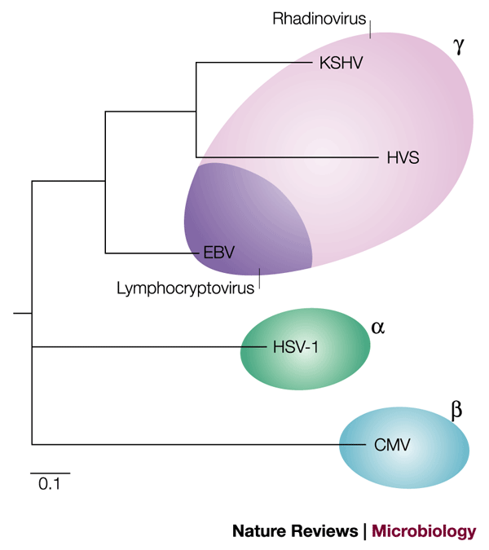
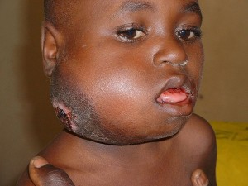
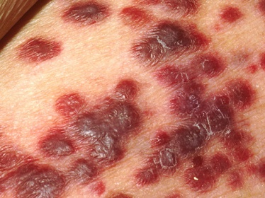

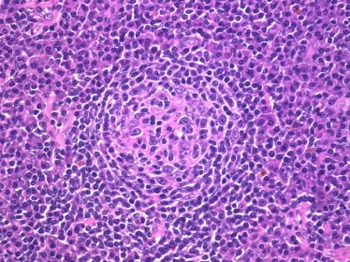
Gammaherpesviruses
Introduction
EBV
KSHV
Prevalence
> 90%
Up to 75 %
Primary infection
Usually asymptomatic
Infectious mononucleosis
Latency
Long-term latency establishment
(B lymphocytes, dendritic cells, macrophages, …)
What is the imprinting on the immune responses of infected individuals?
Immunocompromised individuals
(HIV, Malaria, immunosuppressive treatments, ... )
Herpesviridae
Cancers
Burkitt’s lymphoma
Kaposi’s sarcoma
Hodgkin lymphoma
Castleman’s disease
Notes:
Gammaherpesviruses are very prevalent viruses, both in animals and humans. Once the primary replication is controlled, these viruses latently infect their hosts and persist for life. In a minority of cases, mainly in immunocompromised individuals, these viruses can induce the development of cancer. However, in the vast majority of cases, infections with gammaherpesviruses are asymptomatic. Since these viruses establish their long-term latency mainly in B cells, in this project, we want to examine the imprinting of these infections on the antibody repertoire of infected individuals.

Slide 3



B cells
Introduction
Membrane antibody
=
B Cell Receptor (BCR)
=
Identifier of the B cell
Set of the BCR = repertoire
Notes:
B cells express membrane antibodies called B cell receptor (BCR) which correspond to the translation of rearranged DNA sequences, giving a bar code identifying each clone. All of these BCRs represent the BCR repertoire. Based on this identity, the phylogeny of B lymphocytes can be determined, but also some of their functional properties such as the rate of somatic hypermutation or isotype switching.

Slide 4
Method
Notes:
In order to address the question of the imprinting of gammaherpesviruses on the immune responses of infected individuals, we need an animal model, due to the strict tropism of EBV and KSHV. The Murid gammaHerpesVirus 4 (MuHV-4) is a gammaherpesvirus closely related to EBV and KSHV. As part of this project, we will harvest the lymphocytes of mice having undergone different experimental designs in order to extract the messenger RNAs encoding the heavy chains of immunoglobulins and to sequence them via next generation sequencing.

Slide 5


Method
Murine model
MuHV-4
B cells
AAA
mRNA
Next generation sequencing
Notes:
In order to address the question of the imprinting of gammaherpesviruses on the immune responses of infected individuals, we need an animal model, due to the strict tropism of EBV and KSHV. The Murid gammaHerpesVirus 4 (MuHV-4) is a gammaherpesvirus closely related to EBV and KSHV. As part of this project, we will harvest the lymphocytes of mice having undergone different experimental designs in order to extract the messenger RNAs encoding the heavy chains of immunoglobulins and to sequence them via next generation sequencing.

Slide 6

Method
B cells germinal DNA
VDJ rearrangements
V
D
J
C
AAA
mRNA
CDR3
NGS
Notes:
As a reminder, the germinal DNA of B cells contains a whole series of V, D and J regions for the heavy chain of immunoglobulins which undergo a rearrangement during cell maturation. These rearranged sequences include the CDR3 region, which is very important in the recognition of antigens, and representing the signature of B lymphocytes.

Slide 7
Results

Slide 8
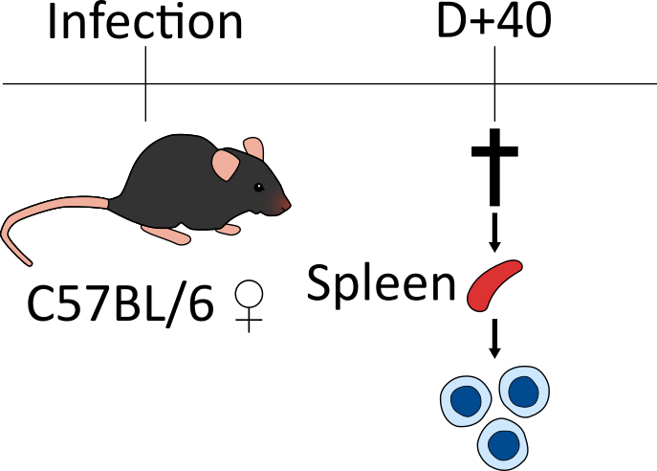

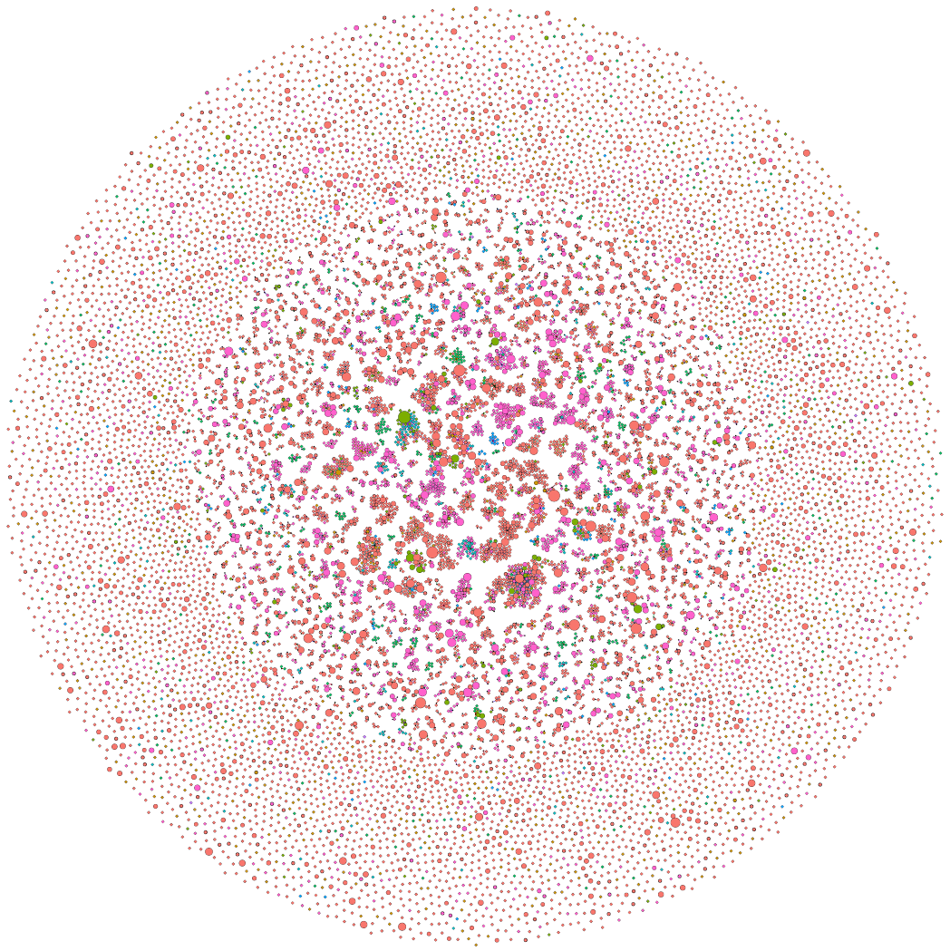
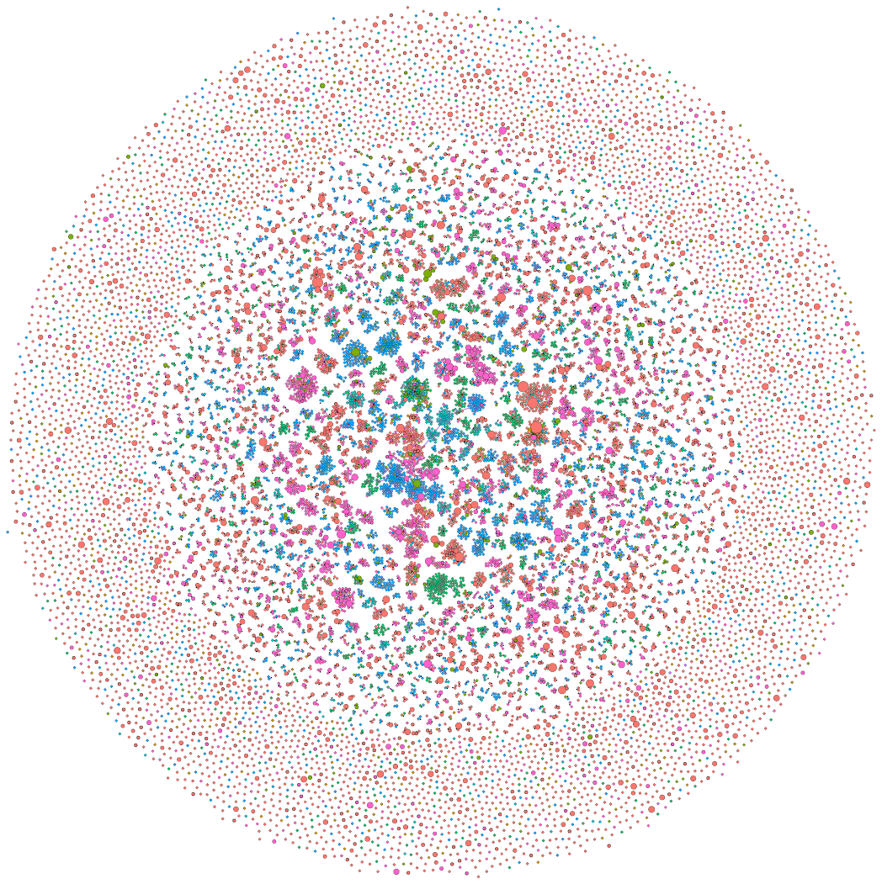
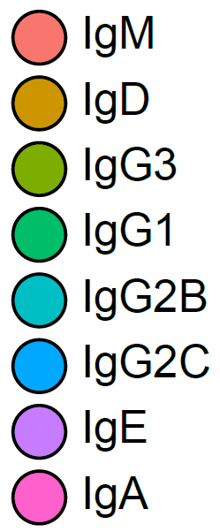
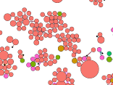

1. Effects of γHV infection on the BCR repertoire of their host
Results
Mock
MuHV-4
Notes:
Here are two representations of the BCR repertoire of uninfected and infected mice coming from preliminary results generated in our laboratory. The different circles represent different clones of B lymphocytes, and the larger the circle, the greater the number of lymphocytes having an identical sequence. These circles are linked to others when we can infer mutations or when isotype switching has been made, giving clusters. The different colors correspond to the isotypes of these clones. We thus trace here part of the phylogeny of these lymphocytes. As you can see, we have a difference in the colors shown in both repertoires.

Slide 9

1. Effects of γHV infection on the BCR repertoire of their host
Results
Mock
MuHV-4
* Significantly higher
* Significantly lower
Notes:
Indeed, the proportions of isotypes are different between the repertoire of uninfected mice and that of mice 40 days post-infection with MuHV-4. I was also able to demonstrate which isotype switches were responsible for these differences.

Slide 10
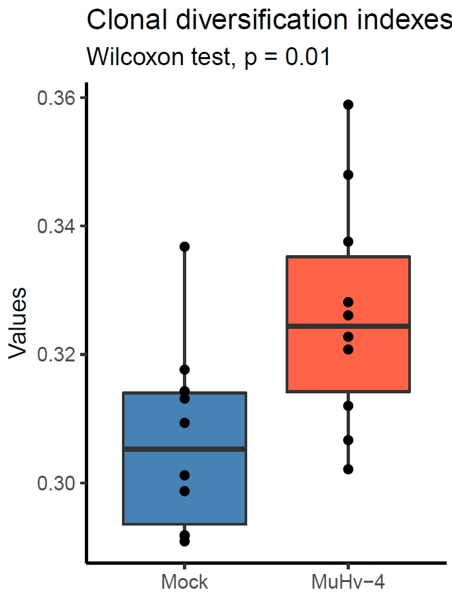
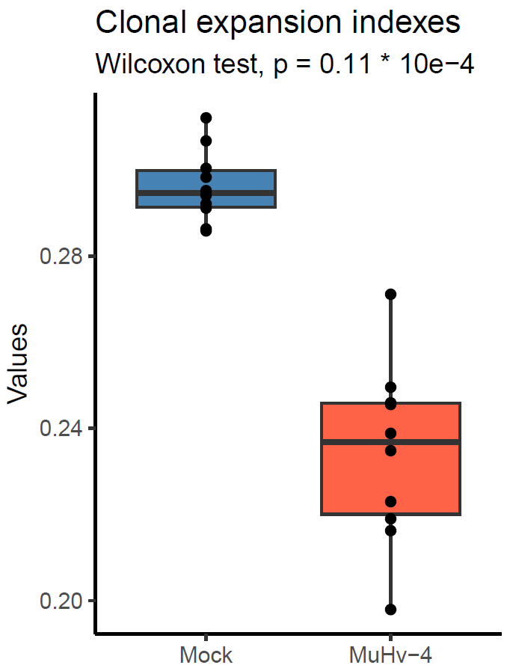
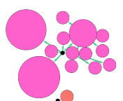
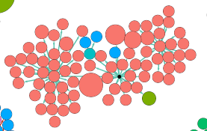
1. Effects of γHV infection on the BCR repertoire of their host
Results
Mock
MuHV-4
Notes:
Another thing that appears clearly is the size of the clusters, bigger in infected mice. And not only the clusters of B cells in infected mice are bigger, so have more clones with distinct sequences, but the clusters of infected mice have less sequences for each clone. Giving rise to this kind of cluster in infected mice, and this kind for uninfected mice.

Slide 11
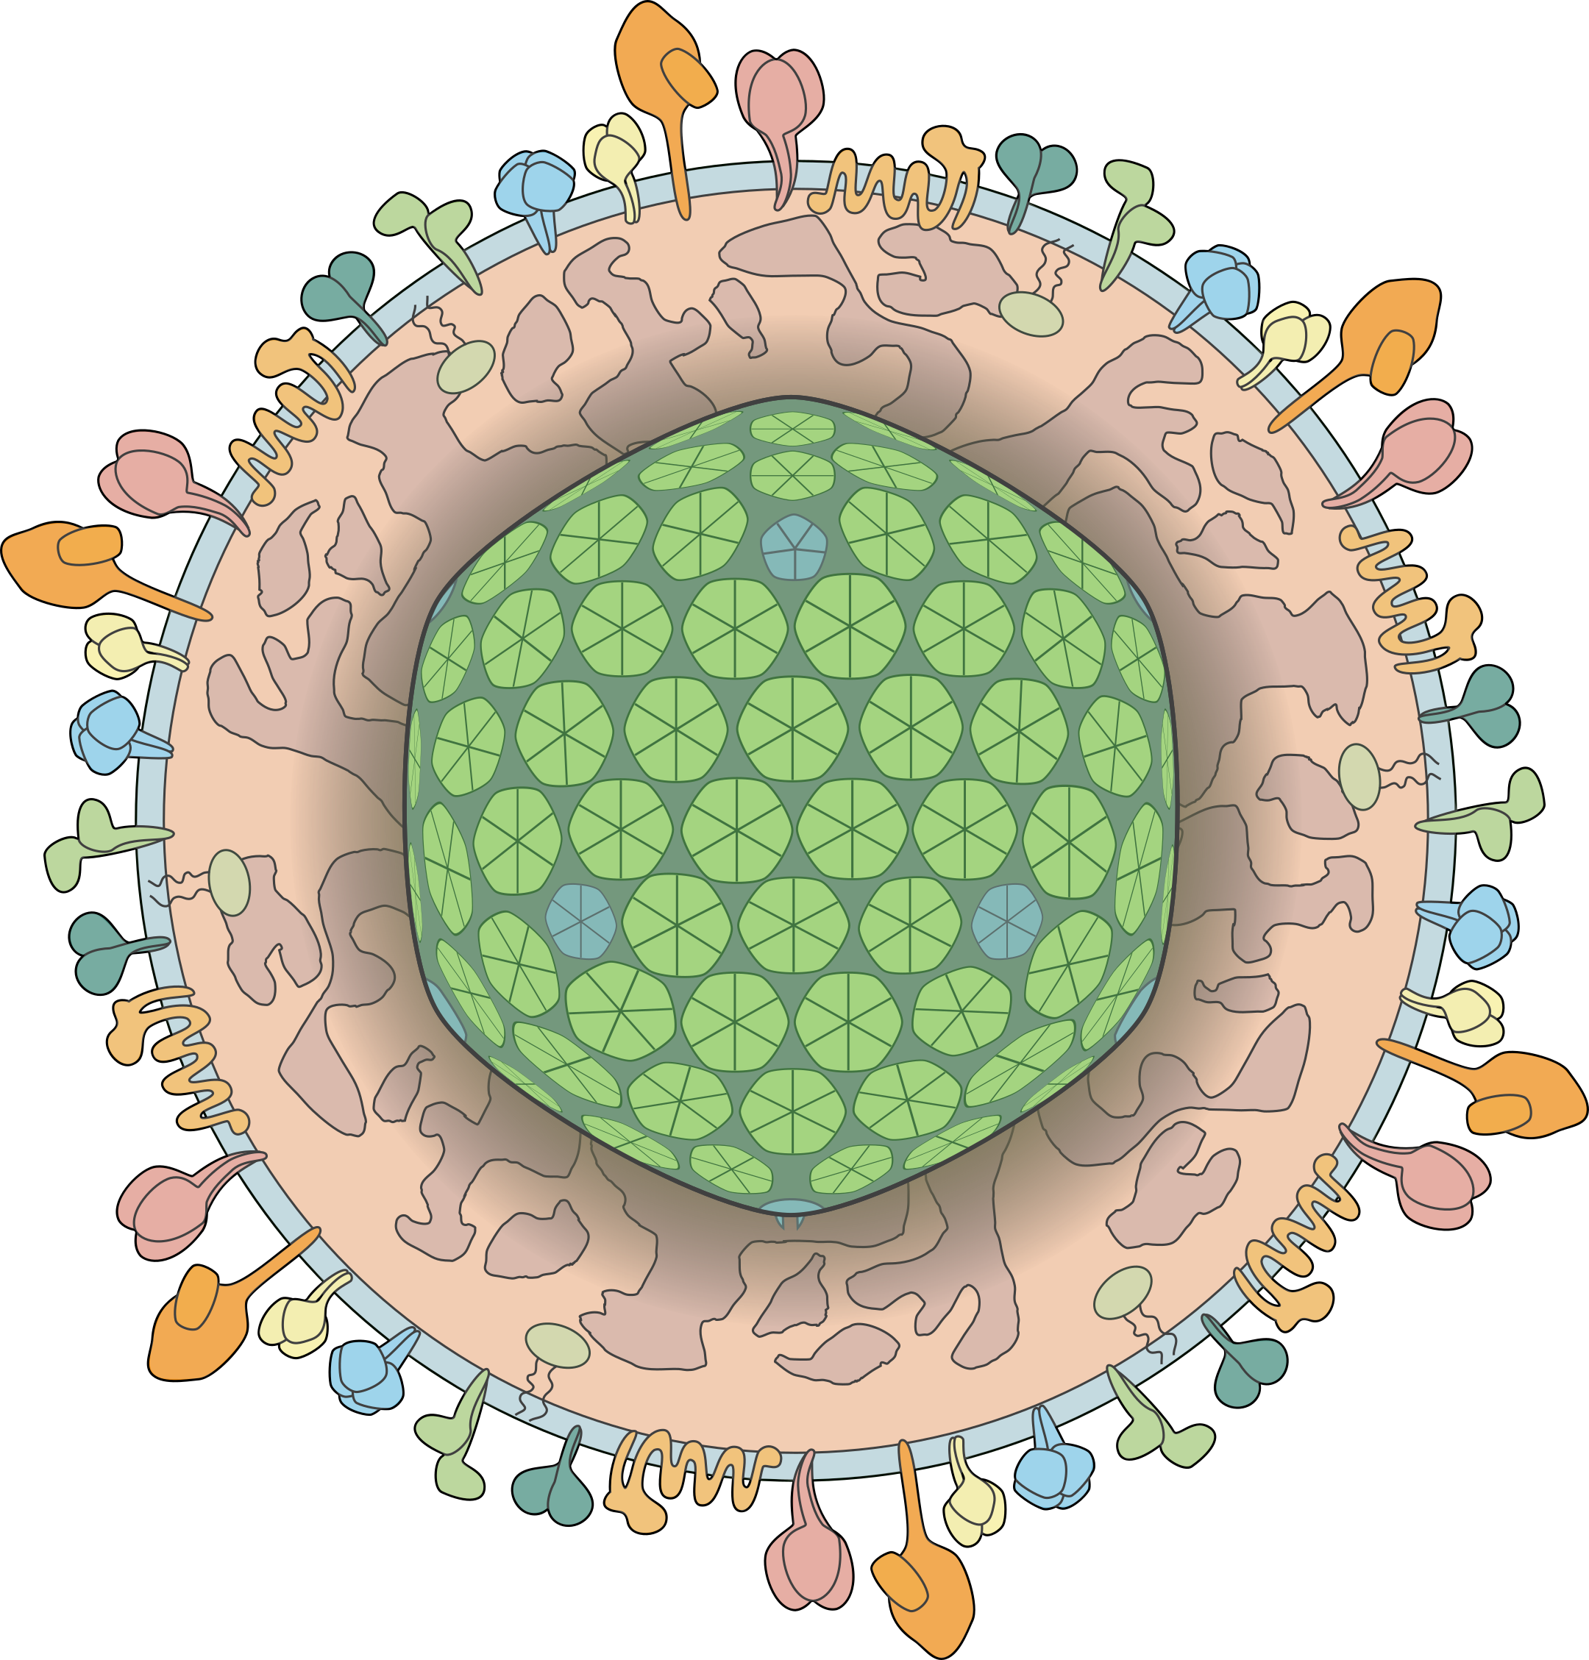
2. Characterization of the repertoire of B cells infected with a γHV
Results
Does these effects come from the environment or from within the infected B cells?
MuHV-4 YFP-H2B
Non infected B cells
Infected B cells
B cells
Notes:
But does these effects come from the environment or within the infected B cells? To assess this question, we infected mice with a fluorescent virus in order to compare the repertoire of infected and non infected b cells.

Slide 12


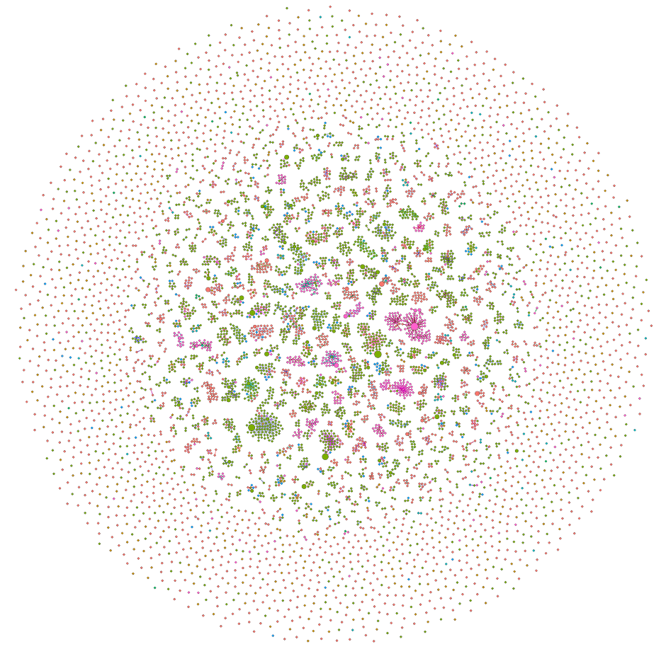
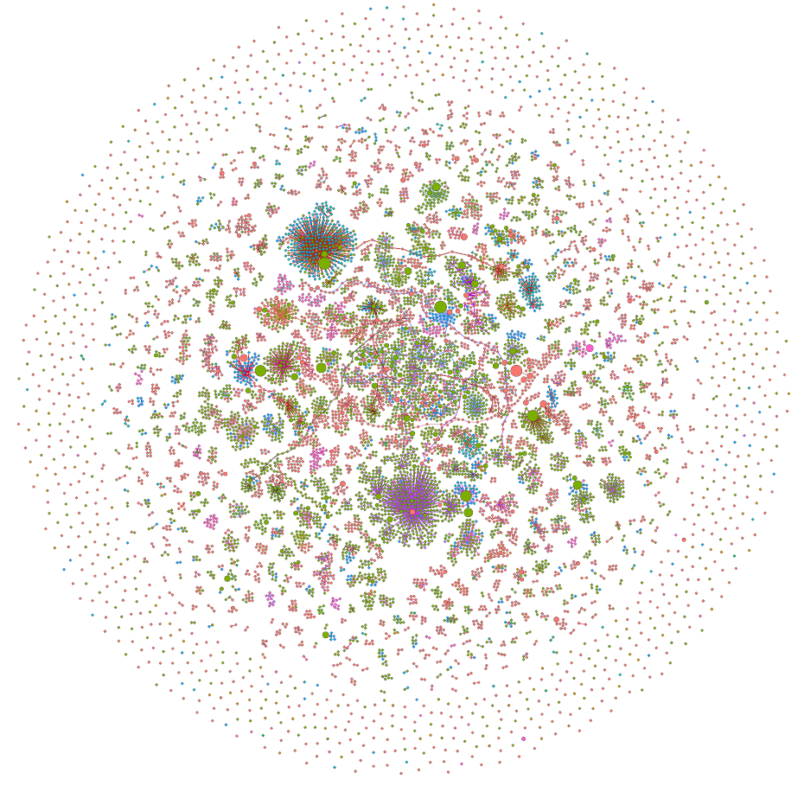

2. Characterization of the repertoire of B cells infected with a γHV
Results
YFP- B cells
YFP+ B cells
Notes:
Similarly to earlier, here are two representations of the BCR repertoire of uninfected and infected B lymphocytes. We can also see that isotype use is different between infected and non-infected B cells.

Slide 13

2. Characterization of the repertoire of B cells infected with a γHV
Results
YFP-
YFP+
* Significantly higher
* Significantly lower
Notes:
Here are the representations of the isotype use in infected and non infected B cells, with the isotype switches responsible for such changes.

Slide 14
2. Characterization of the repertoire of B cells infected with a γHV
Results
Notes:
As earlier, we also find bigger cluster in infected B cells in comparison to the uninfected ones. Unfortunately, we could not observe differences in the size of the clones here.

Slide 15
Conclusions
Notes:
In conclusion

Slide 16
Effects of MuHV-4 infection on the BCR repertoire of its host
Conclusion
MuHV-4 infection modulates the functionality of B cells: B cells of infected mice and infected B cells display different isotypes proportions in comparison with uninfected mice and uninfected B cells respectively
MuHV-4 infection modulates the proliferation of B cells: B cells of infected mice and infected B cells have a higher rate of SHM in comparison to their uninfected counterparts
These modulations come partly from within infected B cells and is not an environment effect only

Slide 17
Thank you
Many thanks to
Pr. Laurent Gillet
Dr. Bénédicte Machiels
Dr. Xue Xiao
Dr. Céline Lété
And all the lab members
Notes:
Thank you for your attention.

