Slide 1
Investigation of gammaherpesvirus-induced lymphoproliferation through sequencing of the B cell receptor repertoire
Jérôme BAIWIR, Ph.D student
Promoters: Laurent GILLET & Bénédicte MACHIELS
Notes:
Hello everybody.
In my project, I am studying the lymphoproliferation induced by a gammaherpesvirus through the sequencing of the B cell receptors.

Slide 2
Mouse model
Investigation of gammaherpesvirus-induced lymphoproliferation through sequencing of the B cell receptor repertoire
Notes:
More specifically, I study the impact of a gammaherpesvirus on B cells in the context of an hematopoietic stem cell transplantation, in a mouse model.
Let me explain.

Slide 3
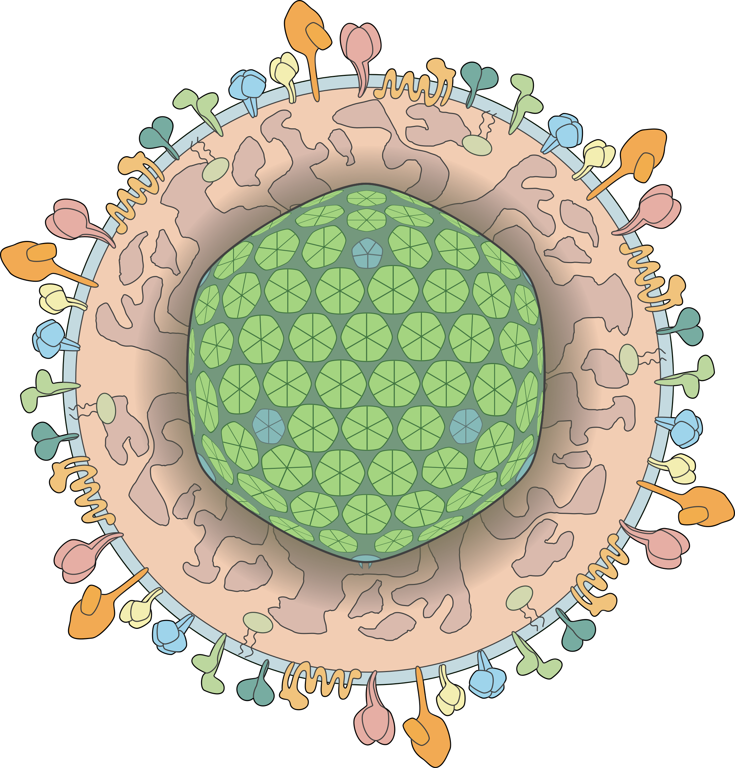
The Epstein-Barr virus
Investigation of gammaherpesvirus-induced lymphoproliferation through sequencing of the B cell receptor repertoire
Very prevalent
>90% of the adult population is infected worldwide
Latency: lifelong infection
Major reservoir: B lymphocytes
Generally asymptomatic infection
Notes:
Gammaherpesviruses are very prevalent viruses. In humans, more than 90% of the adult population is infected by the Epstein-Barr virus.
Once you are infected, you never get rid of this virus, you are infected for life. In your body, the main cell type reservoir is the B cells.
For the majority of the population, the infection is not an issue as this will not cause any symptom.

Slide 4
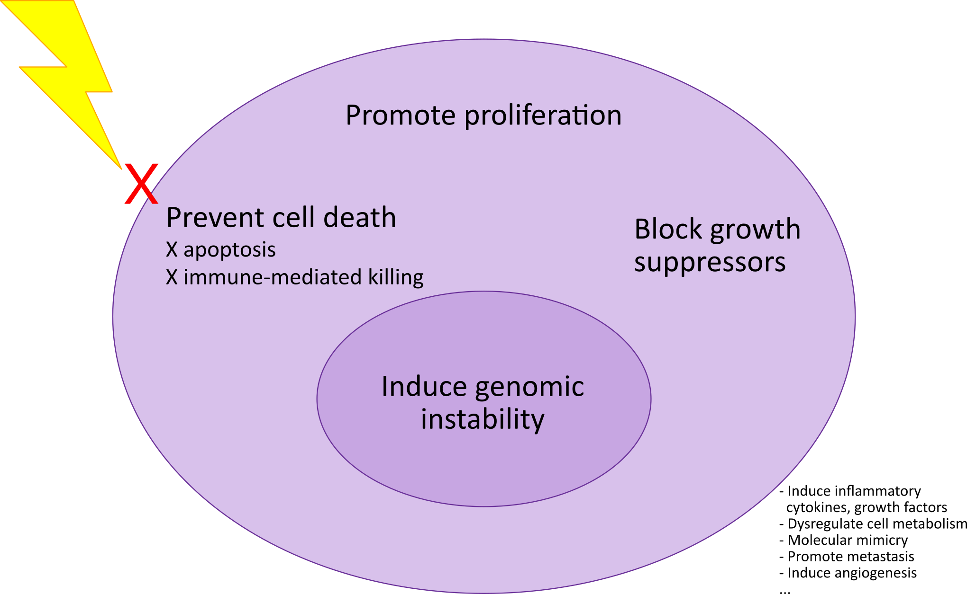
Cell cycle manipulation
Investigation of gammaherpesvirus-induced lymphoproliferation through sequencing of the B cell receptor repertoire
Immunodeficient people: γHV infection = higher risk of lymphoproliferative disorder (LPD)
Notes:
However, in immunodeficient people, the EBV infection is a major risk factor to develop a lymphoproliferative disorder.
Indeed, gammaherpesviruses are known to manipulate the cell cycle.
So people having an immune system struggling to kill cells that behave aberrantly are prone to develop a lymphoproliferative disorder.

Slide 5
Biases of infection
Investigation of gammaherpesvirus-induced lymphoproliferation through sequencing of the B cell receptor repertoire
Infection
B cells
γHV persists in some B cells
Notes:
The main reservoir of gammaherpesviruses are B cells.
And the infection is not random. The gammaherpesviruses preferentially infect and persist in some B cells, based on the B cell receptor.

Slide 6
The B cell receptor (BCR)
Investigation of gammaherpesvirus-induced lymphoproliferation through sequencing of the B cell receptor repertoire
Variable genes of the heavy chain
V
D
J
1
2
3
1
2
3
1
2
3
B cell maturation
2
2
1
1
3
2
3
1
3
BCR repertoire
Notes:
Long story short, the B cell receptors are antibodies at the surface of B cells that act as a receptor to activate them when they encounter a complementary antigen.
They are generated dynamically during the B cell maturation. All the BCR of an individual are called the BCR repertoire.

Slide 7
Biases of infection
Investigation of gammaherpesvirus-induced lymphoproliferation through sequencing of the B cell receptor repertoire
Infection
B cells
MECHANISM?
γHV persists in some B cells
Notes:
So the infection is not random, but the mecanism behind the preference of infection is however poorly understood.

Slide 8
Immunodeficiency, EBV, and transplantation
Investigation of gammaherpesvirus-induced lymphoproliferation through sequencing of the B cell receptor repertoire
Transplantation
Immunodeficiency
EBV-
Immunosuppressive treatment
EBV+
Risk of LPD ↗
Risk of LPD ↗↗↗
Notes:
And I said that immunodeficient individuals have higher risk of developping lymphoproliferative disorders.
It is even worse when the person has never been infected by the EBV, needs a transplant, and the donor has been infected by the EBV. Here, the recipient needs to take an immunosuppressive treatment to avoid the engraftment rejection. It is one of the reason of the immunodefiency.
But we lack models that study such cases, and people are dying every year of that lack of data.

Slide 9
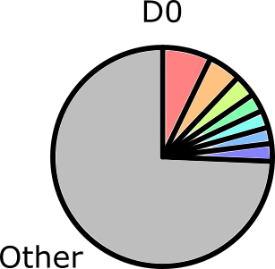
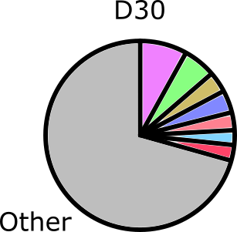
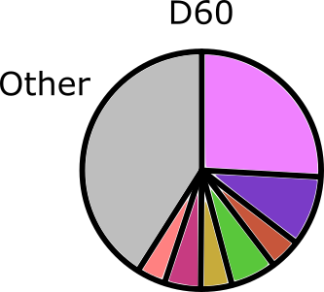
Follow-up of the lymphoproliferation
Investigation of gammaherpesvirus-induced lymphoproliferation through sequencing of the B cell receptor repertoire
?
What type of B cell?
Infected or not?
?
?
Notes:
So here I am! In my project, I then study the impact of the Murid HerpesVirus 4 on B cells in mice that undergo an immunosuppressive treatment after an hematopoietic stem cell transplant.
I will take a picture of the BCR repertoire of mice before transplant, and 30 and 60 days after.
I will then try to highlight which B cells were proliferating too much, and what BCR they have and characterize them.
I hope this will give us more information on the B cells that are more prone to be an issue in such cases.

Slide 10
Thank you!
Many thanks to my promoters:
Laurent GILLET
Bénédicte MACHIELS
Special thanks to:
Rémy SANDOR
Justine JAVAUX
Malyvanh PATHAMMAVONG
Mickaël DOURCY
Lucie GILLARD (#duckmom)
& everyone in the team!
Audacious Medical Grant 2022
Notes:
Thank you!

