Slide 1


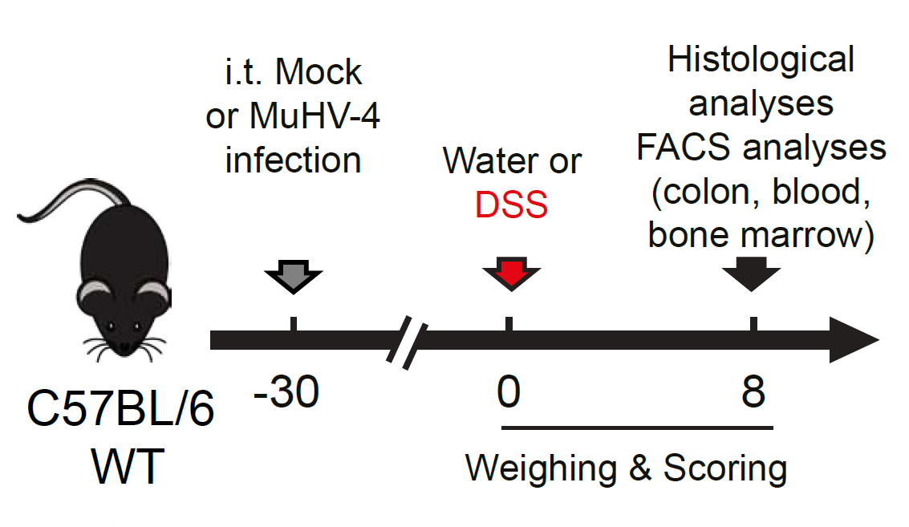
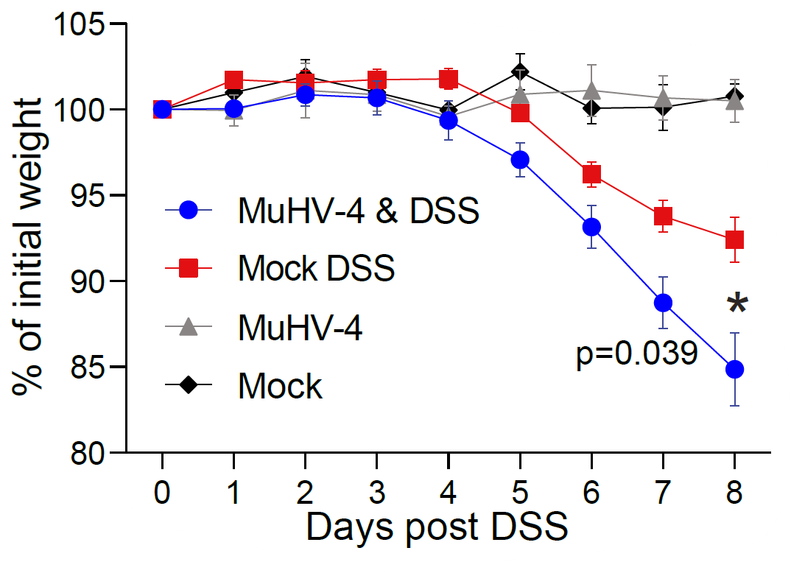
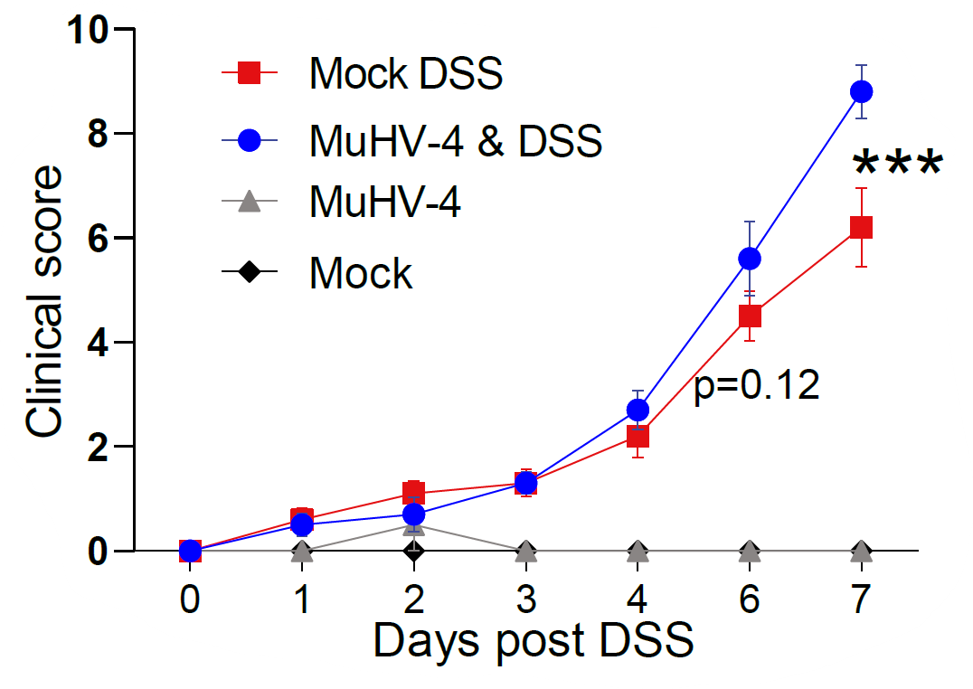
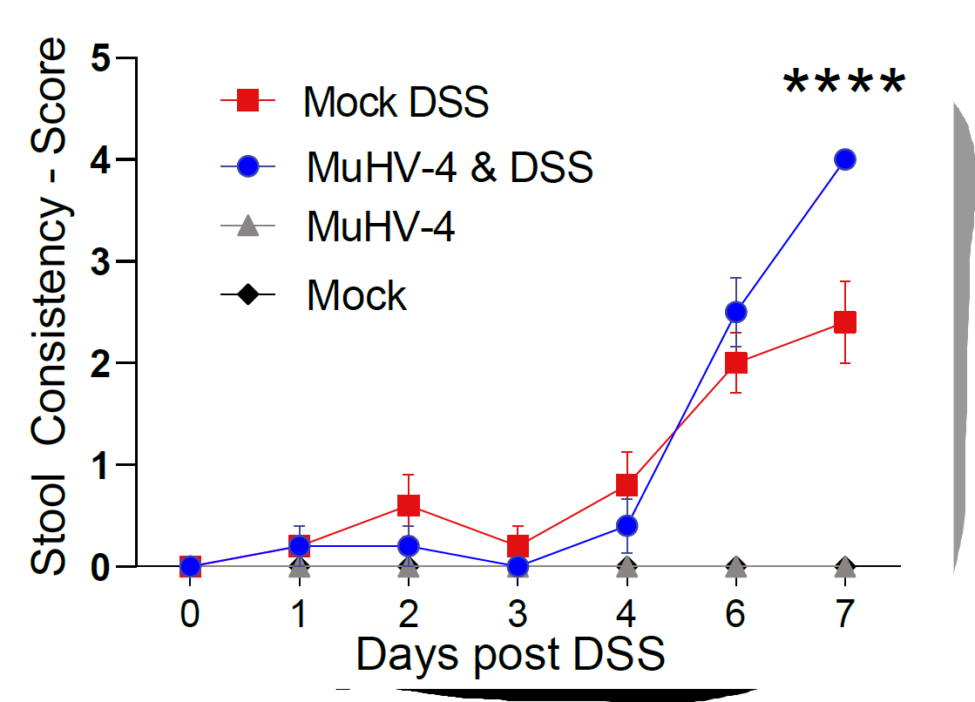
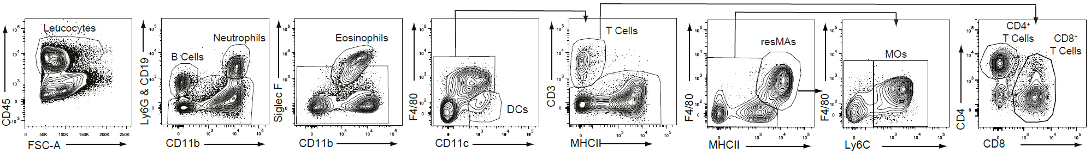
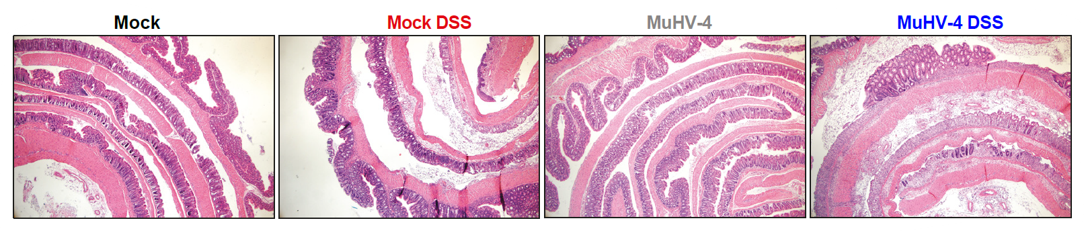
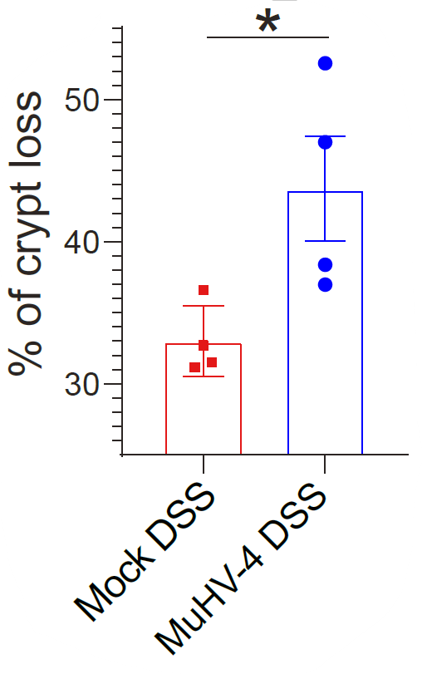
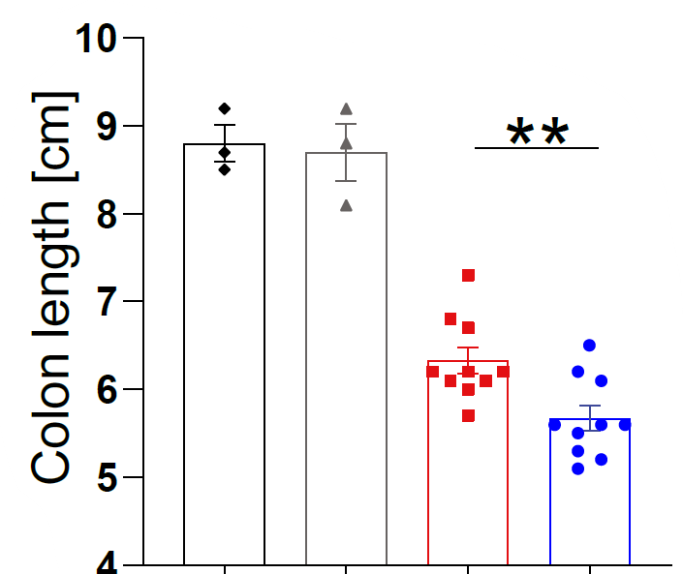
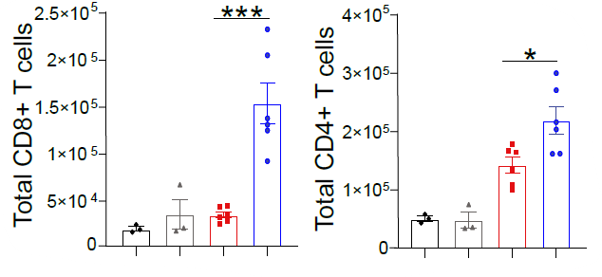
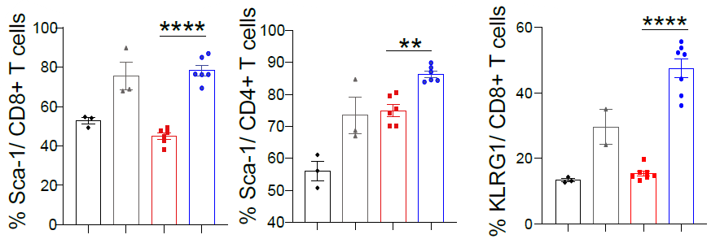
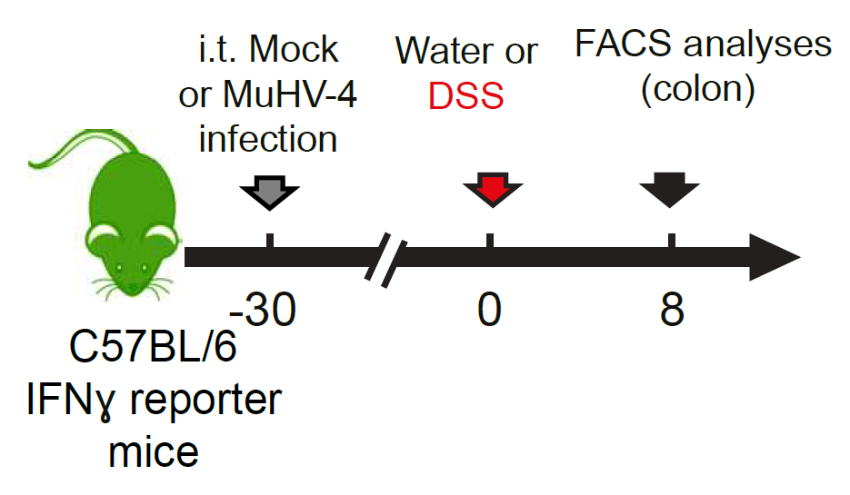
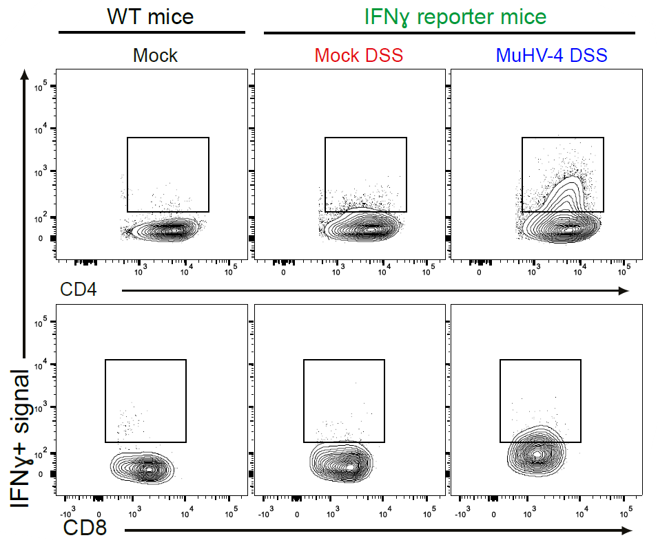
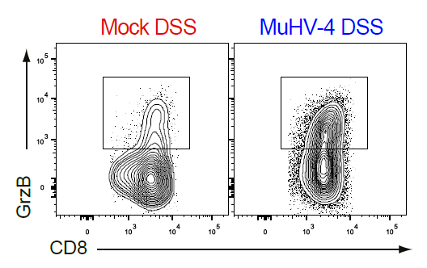
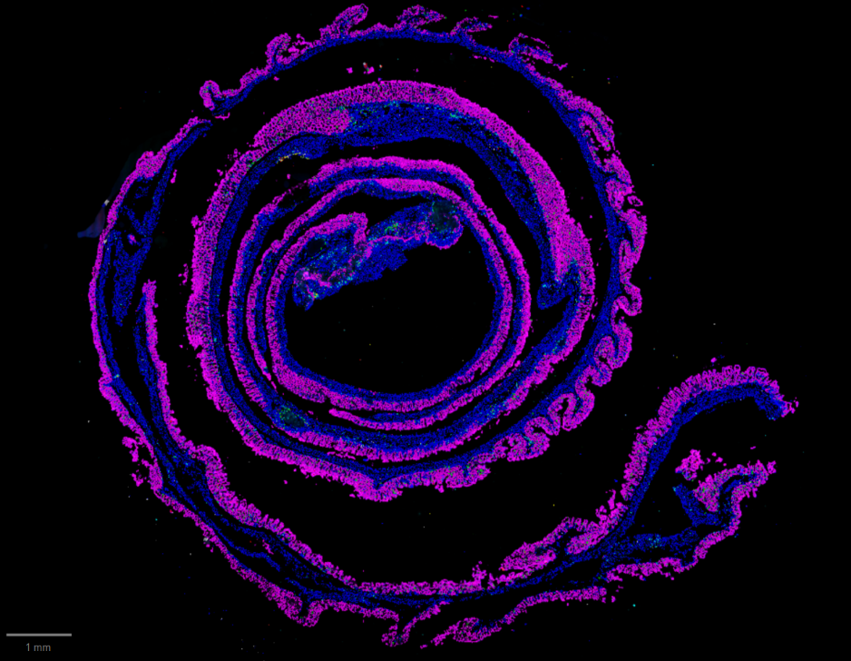
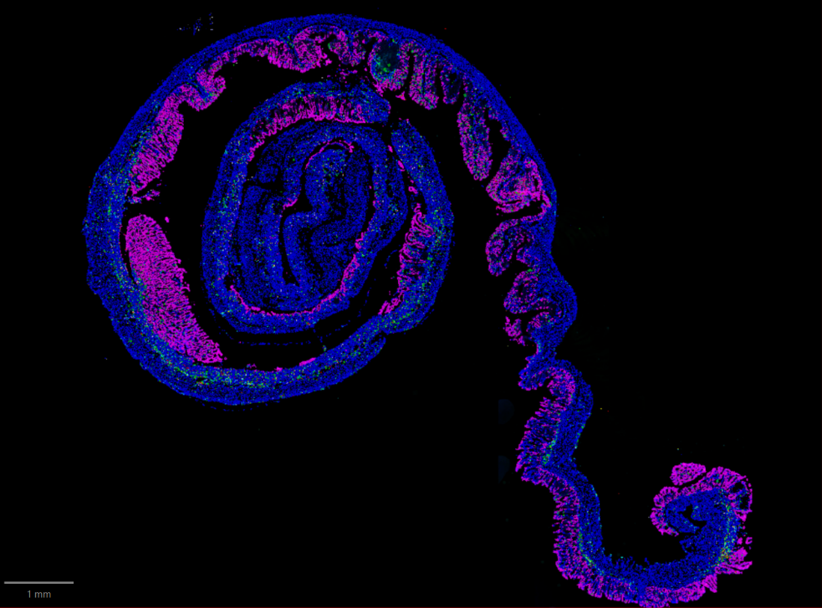
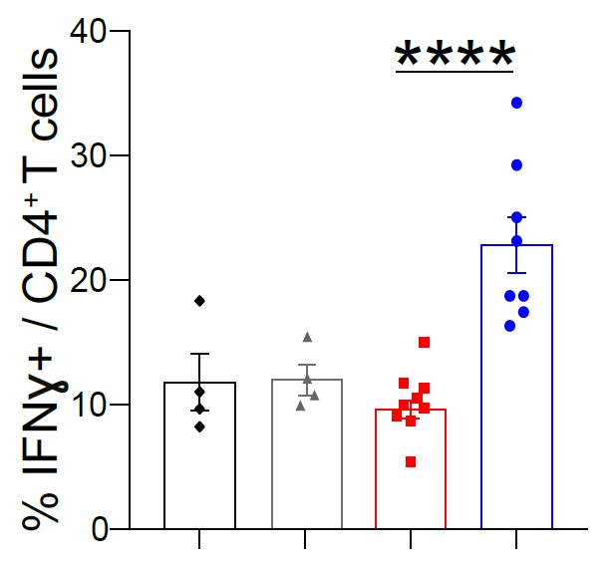
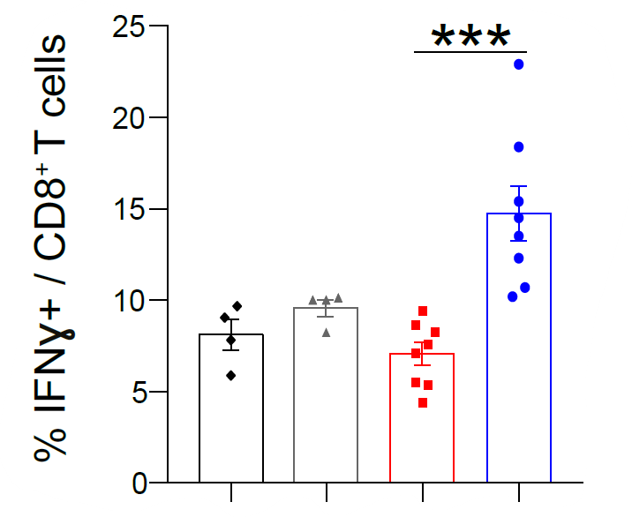
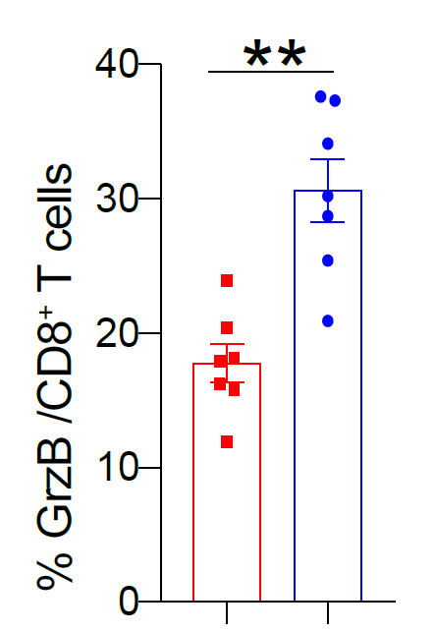
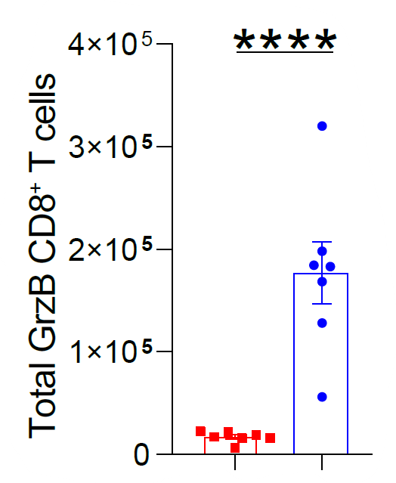
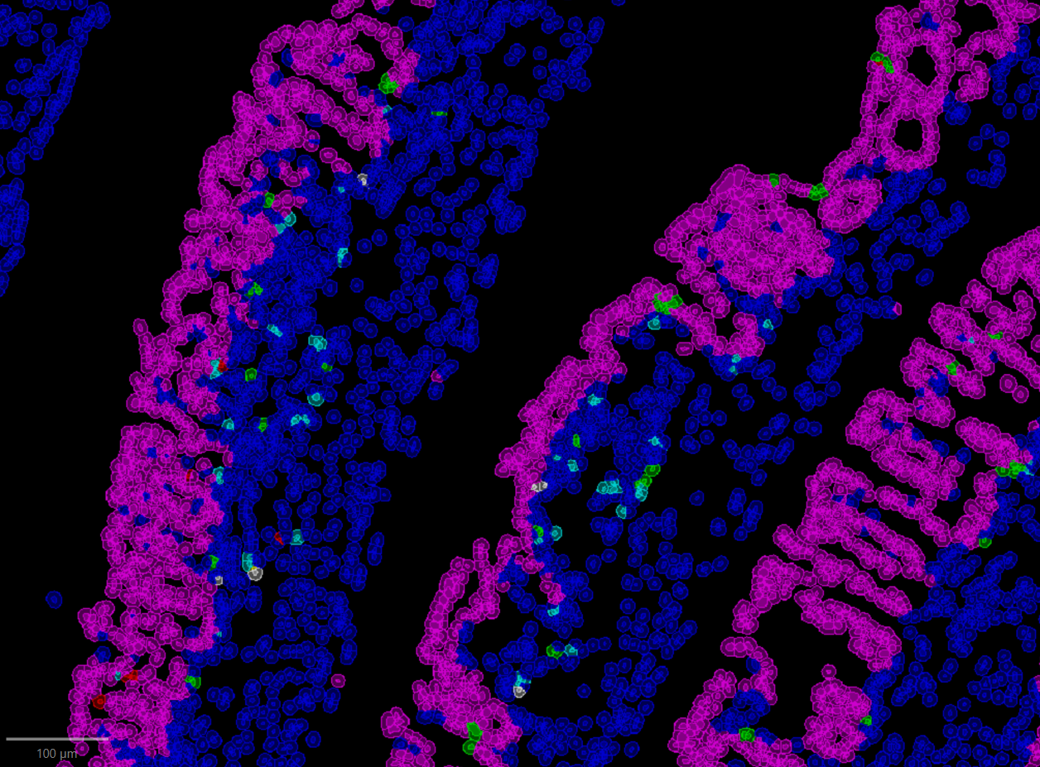
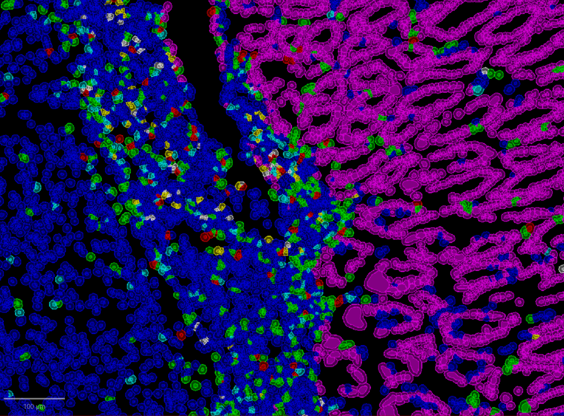
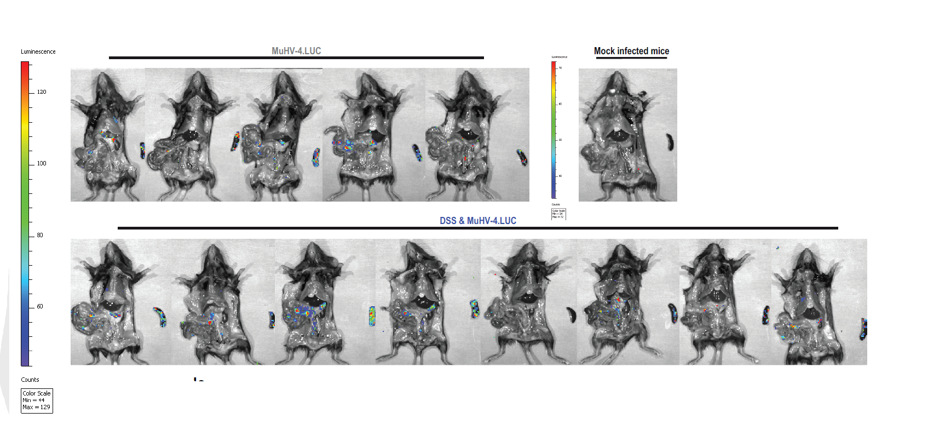
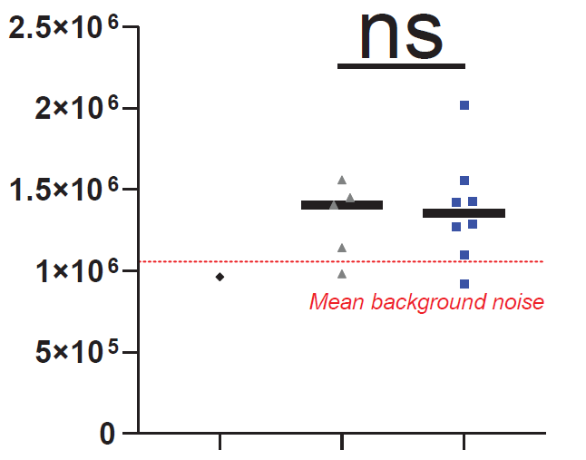
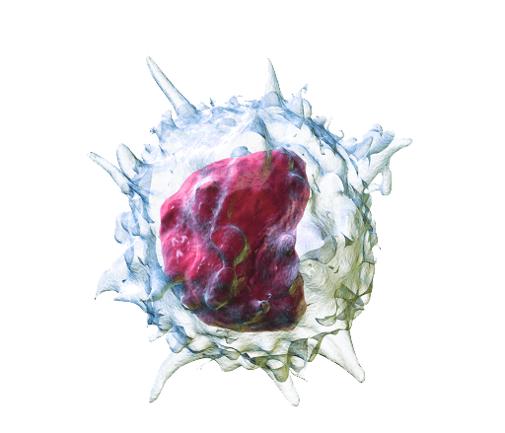
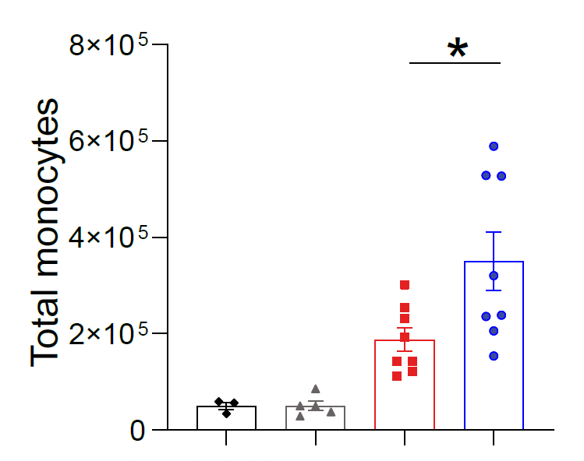
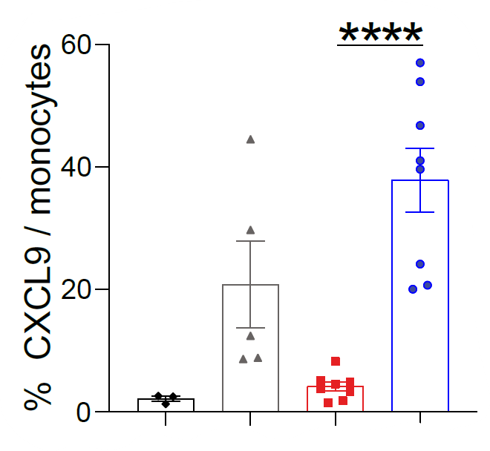
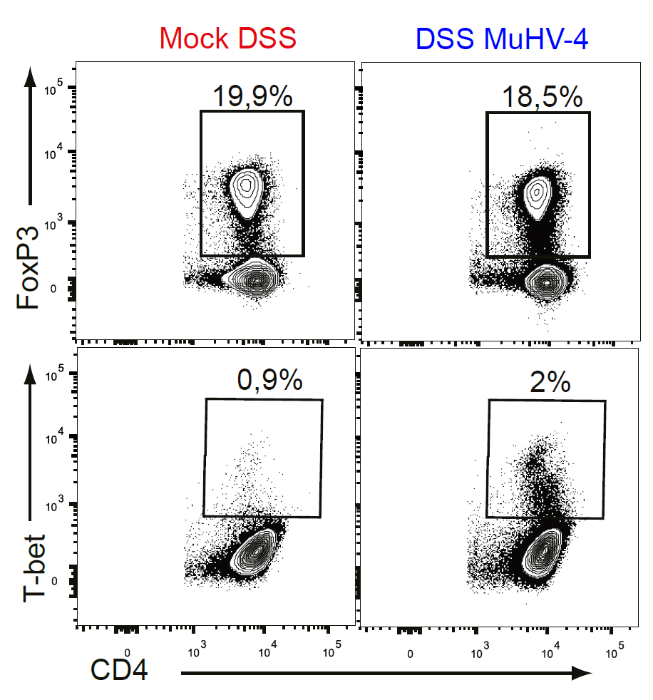
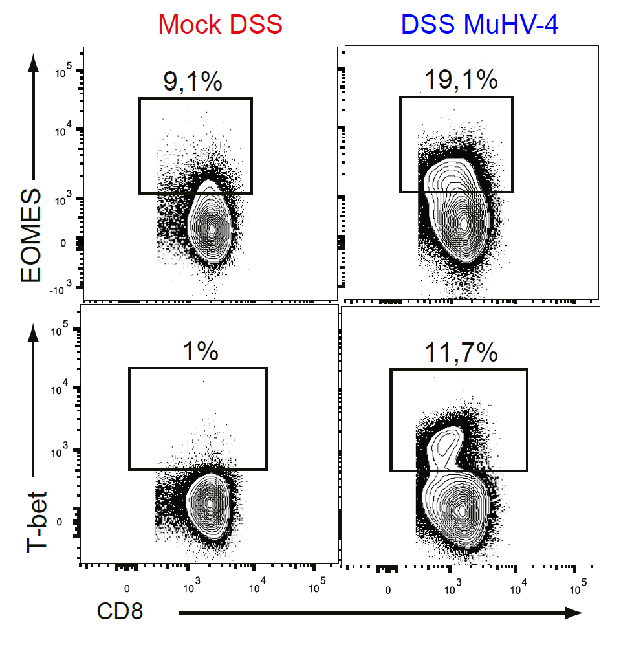

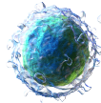
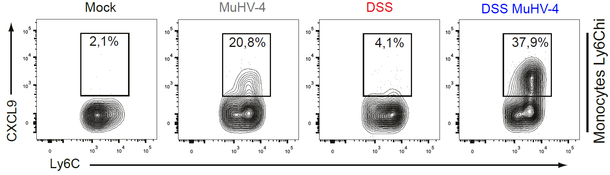
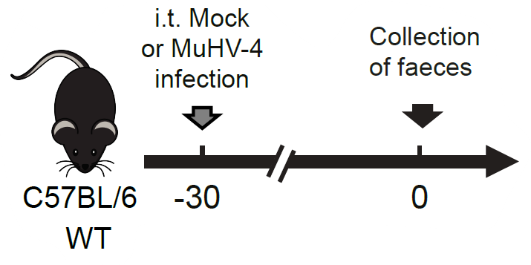

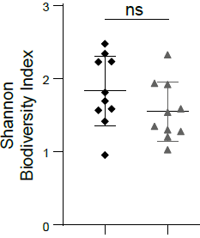
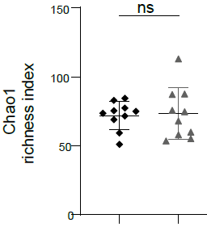
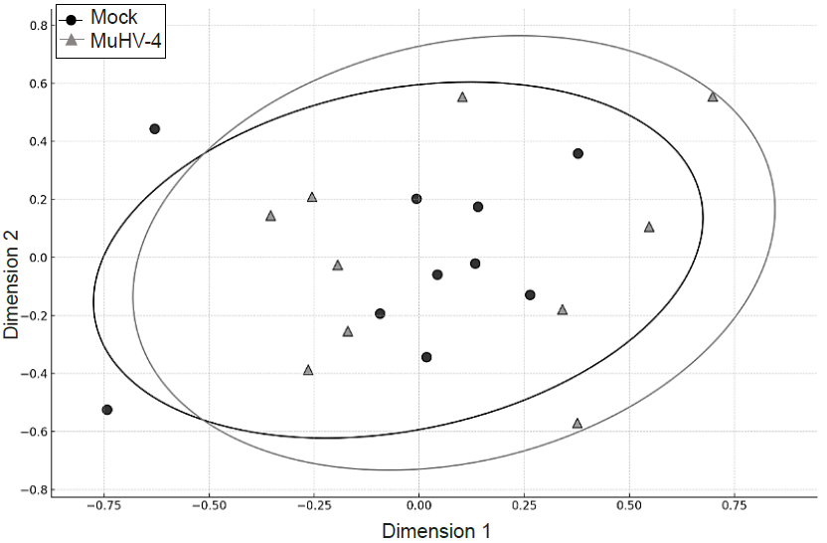
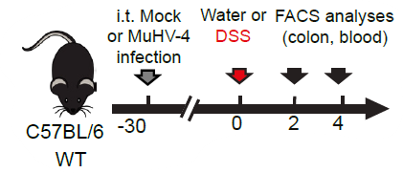
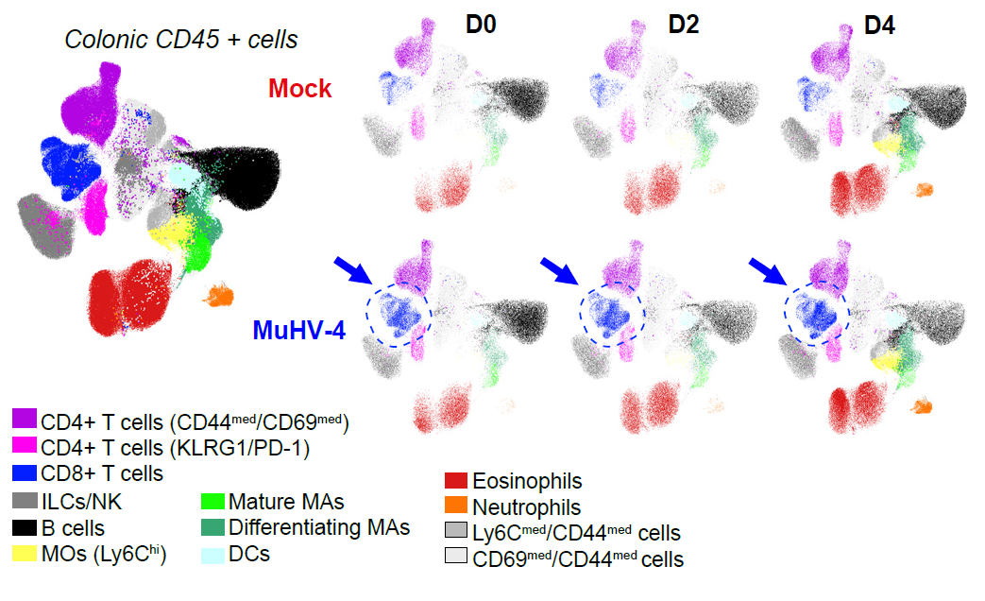
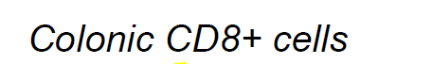
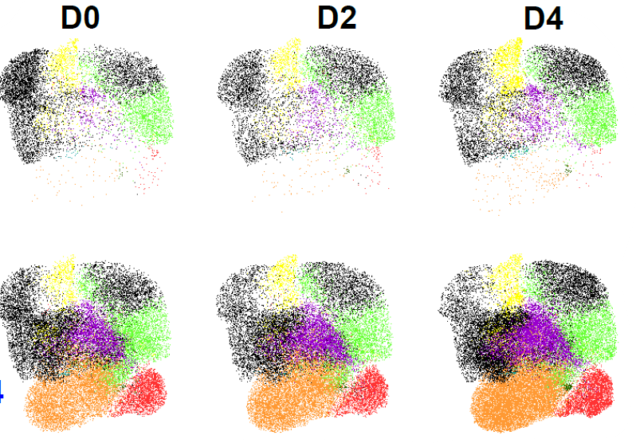
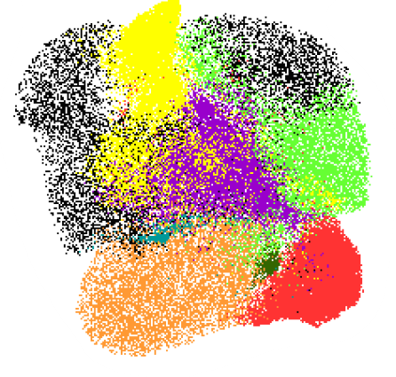
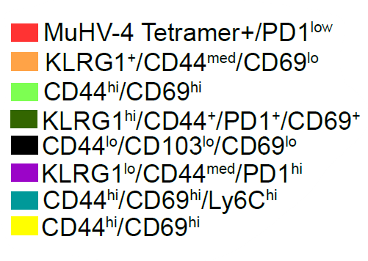
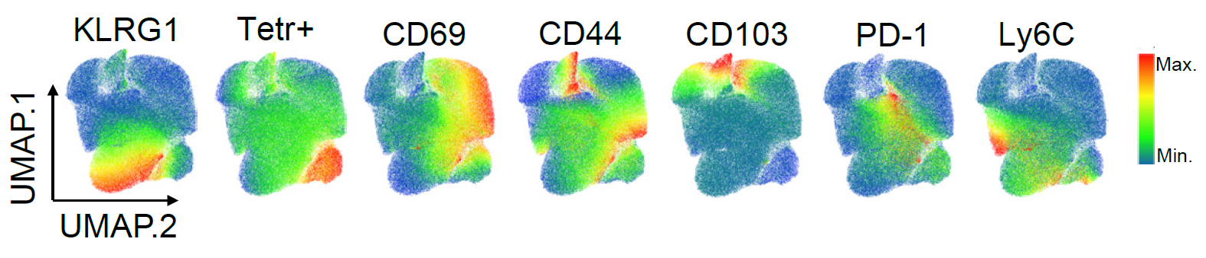



Respiratory gammaherpesvirus infection exacerbates experimental model
of inflammatory bowel disease
Alexis Balthazar ¹, Rémy Sandor ¹, Justine Javaux ¹, Laurent Gillet¹, Bénédicte Machiels¹.
¹Laboratory of Immunology and Vaccinology, Faculty of Veterinary Medicine, FARAH, ULiège, Liège, 4000, Belgium.
Inflammatory bowel diseases (IBD) is a widespread disease worldwide that affects the quality of life of all age groups. Although the precise etiology is still poorly defined, multiple factors, such as genetic background, environmental triggers, and mucosal immune dysregulation, have been associated to the pathogenesis. Epidemiological studies in humans have proposed a key influence of gammaherpesvirus (γHV) infections given that Epstein Barr virus has been associated with the development and exacerbation of IBD. However, the presence of confounding factors makes it difficult to distinguish between a causal role from an innocent side effect.
In this study, we used dextran sulfate sodium (DSS)-induced colitis and Murid herpesvirus 4 (MuHV-4) to investigate in mice whether and how γHV infection could shape deleterious immune responses responsible for IBD exacerbation.
MuHV4 respiratory infection is associated with the exacerbation of DSS-induced colitis
2
Exacerbation of DSS-induced colitis correlates with a massive increase of T cells in the lamina propria of MuHV-4 infected mice
1
A
B
C
D
A
E
F
G
B
T cell increase
C
Activation markers
(A) Experimental design: 7-week old WT C57BL/6J mice were mock- or intratracheally (i.t.) infected (1.104 PFU in PBS) with the WT strain of MuHV-4. (B) Weight loss as % of initial weight. (C) Clinical scoring gathering 3 parameters: weight loss, stool consistency, blood in stool. Each parameter ranges from 0 to 4 and is summed. (D) Stool consistency score (0=Normal; 2=soft stool; 4=diarrhea). (E) Histological sections of colon stained with hematoxylin & eosin (H&E). (F) % of crypt loss expressed as % of total colon length. (G) Colon length measured from the anus to the ileo-caecal junction.
(A) Gating strategy of the leucocytes isolated from the lamina propria. (B) Total numbers of CD4⁺ and CD8⁺ T cells. (C) % of Sca-1 and KLRG1 expression by CD8⁺ or CD4⁺ T cells isolated from the lamina propria.
T cells infiltrating the lamina propria of MuHV-4 DSS mice display exacerbated cytotoxic properties
3
Enhanced IFN-γ production by T cells
Exacerbated cytotoxic profile of T cells
A
C
D
Cytotoxic granules accumulation
F
Increased degranulation
G
Mock DSS
MuHV-4 DSS
B
E
DAPI
EpCAM
CD8+
CD3+ CD8-
GrzB+ CD3- CD8-
CD8+ GrzB+
CD3+ CD8- GrzB+
(A) Experimental design using 7-week old IFNγ reporter mice (GREAT) (B, C) FACS plots and % of IFNɣ expression by CD8⁺ and CD4⁺ T cells isolated from the lamina propria. (D) FACS plots of granzyme B production by CD8⁺ T cells isolated from the lamina propria (E) % of granzyme B expression and total number of granzyme positive CD8⁺ T cells isolated from the lamina propria. (F) % of CD8⁺ T cells expressing CD107a. (G) Granzyme B, CD3, CD8, EpCam, DAPI immunostainings of whole colon cryosections analyzed with QuPath.
MuHV-4 pre-infection induces a strong Th1 bias in the mesenteric lymph node upon DSS treatment
Exacerbation of DSS-induced colitis seems independent of MuHV-4 reactivation
4
Th1 Priming of T cells in MLN
Monocytes attract and polarize T cells towards a Type 1 exacerbated immune response
5
A
MuHV4.LUC
DSS & MuHV-4.LUC
B
A
CD4 T cells
B
CD8 T cells
CXCL9
C
MOCK
Fox-P3
EOMES
(A) Mice infected with a recombinant strain of MuHV-4 expressing luciferase, euthanized on day 8 post DSS after luciferin injection. (B) Luminescence quantification measured in vivo from the abdominal cavity on day 8 of DSS treatment (photons/sec).
T-bet
T-bet
D
6
MuHV-4 infection alone does not affect the biodiversity of commensal flora
A
B
C
(A) FACS plots and % of FoxP3 or T-bet expression by CD4⁺ T cells isolated from the mesenteric lymph nodes (MLN). (B) FACS plots and % of EOMES or T-bet expression by CD8+ T cells isolated from the MLN. (C) Total numbers and % of CXCL9 expression by monocytes isolated from the MLN. (D) FACS plots of CXCL9 expression by monocytes isolated from the MLN. Analysis performed on day 8 of DSS treatment.
(A) Experimental design (B) Alpha diversity. (C) Bray-Curtis dissimilarity matrix based on the sequencing of the gene encoding the 16S ribosomal RNA from stool samples of 20 mice.
Exacerbation of DSS-induced colitis correlates with an early infiltration of activated CD8⁺ T cells in the lamina propria of MuHV-4 infected mice
7
A
B
C
Characterisation of the cluster of T Cells that expands in l.p of MuHV-4 DSS mice
F
B
D
CD8 T cells
E
Checkpoints inhibitors
(A) Experimental design: 7-week old WT C57BL/6J mice were mock- or intratracheally (i.t.) infected (1.104 PFU in PBS) with the WT strain of MuHV-4. (B) Blood loss score (0=No bleeding; 1=occult blood in feces; 2=Visible blood in feces; 4=Gross bleeding). (C) Lipocalin-2 in stool after 3 days of DSS treatment. (D) Total numbers of CD8⁺ T cells isolated from the lamina propria before and after 2 or 4 days of DSS-treatment. (E) % of PD-1 CD8 T cells or % of PD-L1 monocytes and PD-L1 macrophages isolated from the lamina propria. (F) Unsupervised clustering analysis of flow cytometry data of CD45+ cells or CD8+ T cells isolated from the l.p. at the indicated times post DSS treatment. UMAP visualization of the distribution of cells concatenated according to the markers CD45/B220/MHCII/SiglecF/Ly6G/CD11b/Ly6C/TCRb/CD4/CD8/CD44/ CD69/PD1/CD25/PD-L1 (all leucocytes) or CD44/CD103/CD69/PD1/ KLRG1/Ly6C/Sca1/MuHV-4 tetr. (pre-gated CD8+ T cells). UMAPs represent an overlay of all the cells, while the right UMAPs represent the cells isolated from the indicated groups in a proportion corresponding to the numbers of cells calculated for each group.
By monitoring weight loss, clinical scoring and pathological lesions, we demonstrated a significant exacerbation of experimental colitis in MuHV-4-infected mice. Interestingly, immunophenotyping of leukocytes isolated from the lamina propria revealed a massive increase in T cell infiltration in the colon of MuHV-4 pre-infected mice. These T cells show major phenotypic changes such as overexpression of activation markers and exacerbation of cytotoxic properties. These differences correlate with an enhanced Th-1 response in draining lymph nodes, consistent with a significant accumulation of CXCL9-producing monocytes that could attract T cells but also dictate their cytotoxic polarization.
Overall, these initial data highlight the ability of certain γHV to trigger deleterious intestinal immune responses that could explain some inter-individual differences in IBD susceptibility.
Contact information : alexis.balthazar@uliege.be

