Slide 1
L’IMPACT DES SERVICES A LA DEMANDE SUR LES MARCHES AUDIOVISUELS EUROPEENS Contribution au séminaire organisé par le Centre d’études des médias (Montréal, 30 octobre 2015) André LANGE Expert indépendant

Slide 2
BREAKDOWN OF THE AUDIOVISUAL WORLDWIDE MARKET (2009-2013) : EU COMPANIES HAVE LOST 5,3 % OF MARKET SHARE IN 5 YEARS Film-TV-Radio-Recorded Music – Video games Source : European Audiovisual Observatory

Slide 3
WORLDWIDE AUDIOVISUAL REVENUES OF 4 LEADING US INTERNET PLAYERS (2009-2013) – USD Million Source: European Audiovisual Observatory

Slide 4
« BRICK AND MORTAR » vs ONLINE DISTRIBUTION OF CULTURAL GOODS OPERATING REVENUES OF THE 5 EU LEADING RETAILERS (2009-2013) – EUR billions

Slide 5
« BRICK AND MORTAR » vs ONLINE SALES OF DVD/BD IN EU (2009-2013) – EUR billion Source : IHS / IVF

Slide 6
QUESTIONS
Will the physical home video market survive ?
If yes, will the « brick and mortar » business survive or only the online delivery market ?
What future for the retail business and for the duplication business ?

Slide 7
OPERATING REVENUES OF MAIN DIGITAL CONTENT PROVIDERS IN EUROPE (2008-2013) – EUR million Source: AMADEUS database / OBS
Not avaialble : Google (YouTube, Google Play Movies)

Slide 8
EVOLUTION OF THE VoD MARKET IN THE EU (2009-2013) EUR million Source : IVF/IHS

Slide 9
RATE OF GROWTH OF THE VARIOUS VoD SEGMENTS IN THE EU (2009-2013) Source : IHS / IVF / OBS

Slide 10
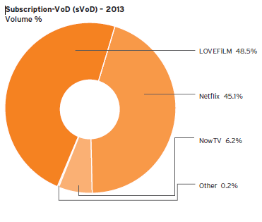
SVoD MARKET SHARE IN UK (2013) Source : BVA

Slide 11
QUESTIONS
Will the market allow various major players on the SVoD segment ?
Will SVoD cannibalize other segments of the VoD market, in particular the TV VoD ?
Will SvOD cannibalize linear film and series TV pay channels ?

Slide 12
CONSUMERS’ EXPENSES IN THE EU (2009-2013) EUR million Source : IHS and OBS

Slide 13
RATE OF GROWTH OF PAY-TV CONSUMERS’ EXPENSES AND OF SVoD EXPENSES (2009-2013) Source : IHS / IVF / OBS

Slide 14
PAY-TV vs SVoD vs transactionnal TV
Some pay-TV distributors will try to compete with Netflix on the Netflix market (eg. Skk > Sky Now ; Canal Plus > Canal Infinity, but Vivendi wish to sell Watchever in Germany)
Most of the pay-TV distributors will look for deals with Netflix, but they will probably continue to provide their own transactional VoD service or third services (France, Nordic countries) – 10 % of Netflix revenues to the distributors
Arrival of other major SvoD players (HBO, CBS,…) ?

Slide 15
QUESTIONS ON THE TRANSACTIONAL VoD MARKET
Strategy of Apple / iTunes ? Will iTunes look for alliance with pay-TV operators or continue a lonely strategy with its own environment (Apple TV and mobile devices) ?
Will Google Play Movies and Microsoft XboX take advantage of their first choice position on tablets ?
What role for the video game consoles ?
What place for the various VoD services specialising in national/European films ?

Slide 16
EVOLUTION OF ADSPEND IN THE EU (2009-2013) EUR million Source : Warc

Slide 17
BREAKDOWN OF ADSPEND IN THE EU (2009-2013) in % Source : Warc / OBS

Slide 18
IN EUROPE, VIDEO ADSPEND IS STILL A TINY PART OF INTERNET ADSPEND 3,4 % in 2012, 4,5 % in 2013 Source : OBS on eMarketer and Warc data

Slide 19
QUESTIONS
What are video adpsend market shares between the various players ?
Youtube, DailyMotion
Facebook
Broadcasters websites
Newspapers websites with video
Portals (MSN, Yahoo,…)
Free VoD (Viewster)
Level playing field between free TV and Ad financed online services ?
Role of those services in financing the production ?

Slide 20
THE ROLE OF THE ON-DEMAND AUDIOVISUAL SERVICES AND PLATFORMS IN THE PROMOTION AND PRODUCTION OF EUROPEAN WORKS
The European Audiovisual Observatory is currently handling a questionnaire send to providers of operators – Around 60 answers received sofar
The Observatory has also commissionned to ROVI an in depth analysis of 7 VoD catalogues
A report on the role of providers of VoD services and distribution platforms in the financing of production is also in preparation

Slide 21
INVESTMENTS BY BROADCASTERS IN PRODUCTION (Co-production, pre-sales)
Definition in the general mission of public broadcasters
Volontary investement by public broadcasters : DE, DK, NL
Negotiated framework : AT, CH, DE
Quota of independent production : GB (25 %)
Mandatory investements :
BE (CFB) : Contrat de gestion de la RTBF 2013-2017 : 7,2 M EUR
ES : 5 % of gross revenues
FR : « Cahiers des charges », different for each channel
GR : 1,5 % of revenues of public and private broadcasters
IT : PSB : 3.6% of its revenues to the production, financing, pre-acquisition or acquisition of Italian works; 0.75% of its revenues to animation works for the education of children. Private : 3.2% of their revenues

Slide 22
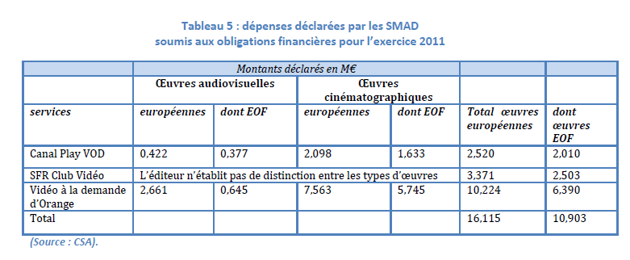
MANDATORY INVESTMENTS BY PROVIDERS OF VoD SERVICES IN France (2011) Source : CSA

Slide 23
MANDATORY CONTRIBUTIONS TO FILM FUND
 | Exhibitors | Public broadcasters | Private broadcasters | Services distributors | Distributors video | Providers VoD | Open video platforms
BE (CFR) |  |  | X (or co-prod invest.) | Cable X (or co-prod invest.)
CZ |  |  | X
DE | X |  | X |  | X | X
FR | X | X | X | X | X | X
GR |  | X | X
HR | X | X | X | Cable, IPTV (fixed and mobile), ISP | X
PL | X | X | X | Cable, digital platforms | X
PT | X | X | X | \ | X | X
RO | X | X | X | X | X
SE |  | X
SI |  | X | X
SK |  |  | X

Slide 24
ESTABLISHMENT OF AVAILABLE VoD SERVICES IN EU COUNTRIES (2013) Source : European Audiovisual Observatory / MAVISE database
60 % of VoD services established outside of the country of reception

Slide 25
THE ISSUE OF DE-LOCALISATION vs FREE CIRCULATION OF SERVICES
TV services : exemple : RTL-Tvi established in LU, but targeting French Community of Belgium
Distribution platforms : ex. Télésat, established in LU, but targeting French Community of Belgium ;
VoD services :
iTunes and XboX, established in LU
Netflix established in NL
Google Play Movies established in US ;
Viewster established in CH
Open platforms :
Youtube established in US
Facebook established in US

Slide 26
France – PRIVATE BROADCASTERS USE THE ARGUMENT OF EXTERNAL COMPETITION TO OBTAIN REVIEW OF THE OBLIGATIONS
Mid-February : Letter of the 3 Presidents of major private TV groups (TF1, M6, Canal+) to the Minister : asking review of the regulation
« Comment appréhendez-vous l’arrivée de Netflix, qui en s’implantant au Luxembourg, contournera la réglementation française ?
Je lui souhaite la bienvenue ! En nous percutant, l’iceberg Netflix révèle à quel point notre réglementation est obsolète et qu’il est urgent de l’adapter »
(Nonce Paolini, CEO, TF1, Interview in Le Film Français, 23 mai 2014)

Slide 27
THE HYPOTHESIS OF TAXING REVENUES OF FOREIGN SERVICES - France : Proposed by the Lescure report and recommanded by the CSA (December 2013) Mrs Pellerin proposing revieweing of the principle of country of establishment (October 2014) Notification to the Commission (October 2014) - Germany : Currently in discussion with the Commission : possibility of taxing foreign services if they do not contribute in the country of establishment

Slide 28
AND A LAST QUESTION
Who will take care of transparency of the on-demand audiovisual market ?

Slide 29
THANK YOU !
http://www.obs.coe.int
http://mavise.obs.coe.int
European Audiovisual Observatory Report published by the European Commission in July 2014
Yearbook 2013
Yearbook 2014 (forthcoming)
andre.lange@coe.int

