Slide 1
LLMs: generating innovative and effective collaborations in AI
Prof. Damien Ernst and Lize Pirenne
NRB AI &c Data Xperience

Slide 2
Introduction to AI
Artificial Intelligence
This refers to the simulation of human intelligence in machines to learn, reason and adapt.
Used in multiple industries and domains such as healthcare, finance, entertainment, autonomous vehicles.
AI research communities are organised around several sub-communities, for example:
Natural Language Processing (NLP)
Computer Vision (CV)
Intelligent Robotics (that benefits from progresses in NLP and CV)
Reinforcement learning

Slide 3
The rise of LLMs in AI
A large language model (LLM) is a computational model capable of language generation or other natural language processing tasks.
https://www.bureauworks.com/blog/what-is-large-language-models-llm
Inside the LLM, everything is represented as embeddings (vectors of fixed size).
This is a very useful representation that can be shared with numerous other AIs.
LLMs were initially introduced in the AI NLP community. Today they are being effectively applied accross the board, such as in reinforcement learning.

Slide 4
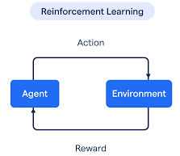
What is Reinforcement Learning?
Reinforcement Learning (RL) is probably the most powerful AI paradigm where an agent interacts with its environment to maximise rewards it accumulates.
The key problem in RL: the design of the correct reward function. For simple tasks, a simple reward function that can be hand-crafted can work well, e.g., reward = cos θ for the inverted pendulum swinging on a cart.
What about designing the right reward function for the pen spinning problem?
Here is a simple case: Simply keep the pole straight up ([EXPRESS REARD]!
What about pen spinning?

Slide 5
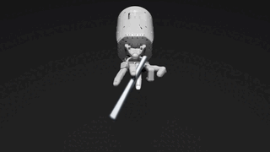
Eureka: LLM for crafting the reward function in RL
Let the LLM figure out what a good reward is by trial and error.
Start with a human-designed reward: Reward at time t = distance(pen_position(t), ideal_position(t))
Pen position
Average
Add angular velocity
Entire process is automatic!
A little better
Add rotation reward
Much better!
Eureka: Human-Level Reward Design via Coding Large Language Models

Slide 6
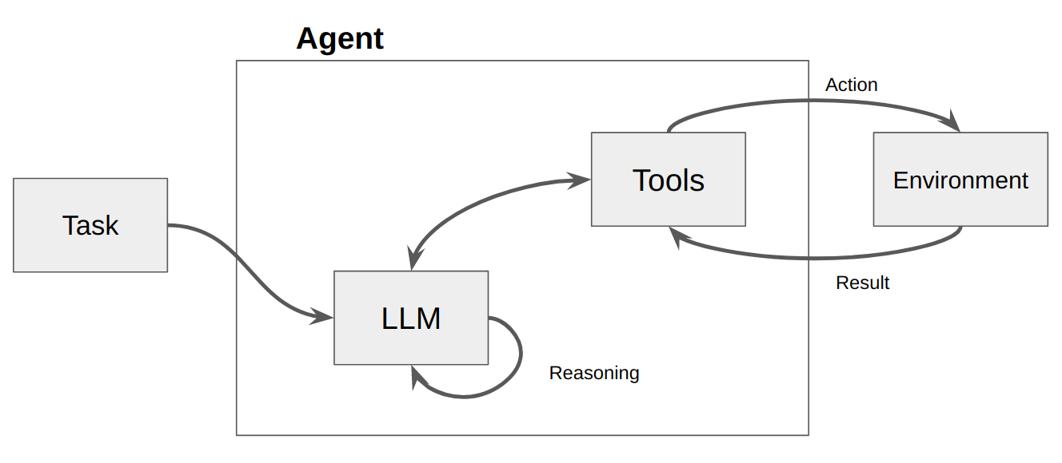
LLMs can also use external tools at their own pace
Eureka
These tools include
Databases used for memory
Internet searches for knowledge
Robot controls for movement

Slide 7
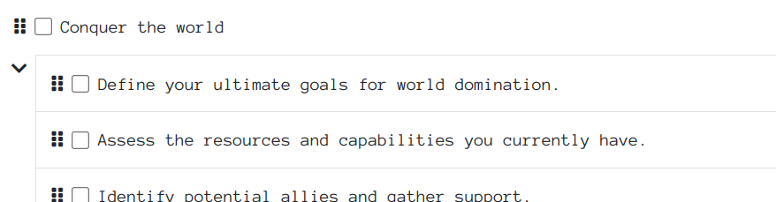
LLMs as agents directly controlling a robot from input goals, without using a reward function
Let us use everything!
Task breakdown
High-level initial task
Multiple-level atomic tasks
Usage of tools
Motion (API to robots)
Memory (API to databases)
goblin.tools
nvidia ReMEmbR

Slide 8
Usefulness of embeddings for multi-modality and interacting with other AIs
At the heart of the representation inside an LLM, there are the embeddings. You can embed everything (music, video, etc) the ‘same way’.
The differents embeddings can be processed by the same LLM to create a powerful representation that can also be useful for other AI (e.g., diffusion models that generate images).
Embeddings
LLM
Embeddings
Other AI

Slide 9
Embeddings are so powerful that LLMs can deal directly without needing to go through any text
USER VOICE
Encoder
Embeddings
LLM
Embeddings
Interactions
Decoder
AI VOICE
OpenAI
Advanced
Voice
Voice to Voice directly!

Slide 10
The architecture behind making movies from a script looks so simple
Let us enter a prompt corresponding to the script of a movie!
LLM
Embeddings
Diffusion
ByteDance:
SeaWeed
& PixelDance
Presentation
We can output images!

Slide 11
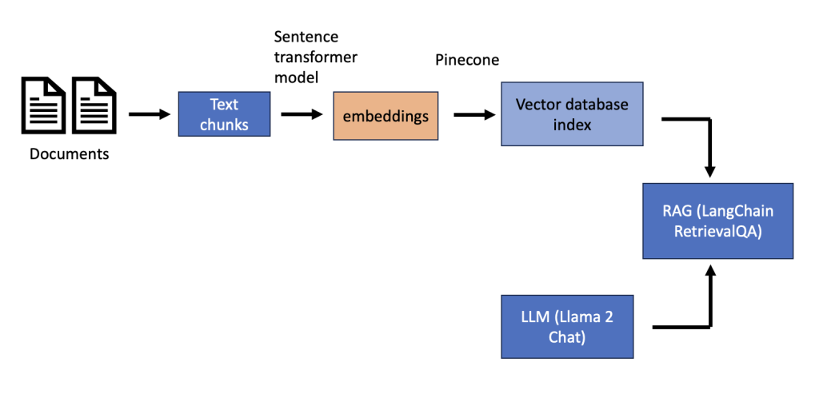
Information retrieval: A common-use case for LLMs in the software industry
A common issue shared by many customers is finding information on demand in technical documents.
Often, the Retrieval Augmented Generation (RAG) framework is used for this purpose.
https://agi-sphere.com/retrieval-augmented-generation-llama2/

Slide 12
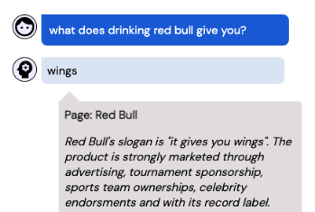
More than retrieval: Rationale extraction
Does Retrieval Augmented Generation (RAG) solve everything? Not really: out of context data can be hard to understand, and often leads to incorrect answers
Need for humans in the loop to verify the soundness. But how do we facilitate the tasks for humans? Rationale extraction!
An example of rationale extraction. Needs to be short and include all reasoning (a difficult but common challenge)

Slide 13
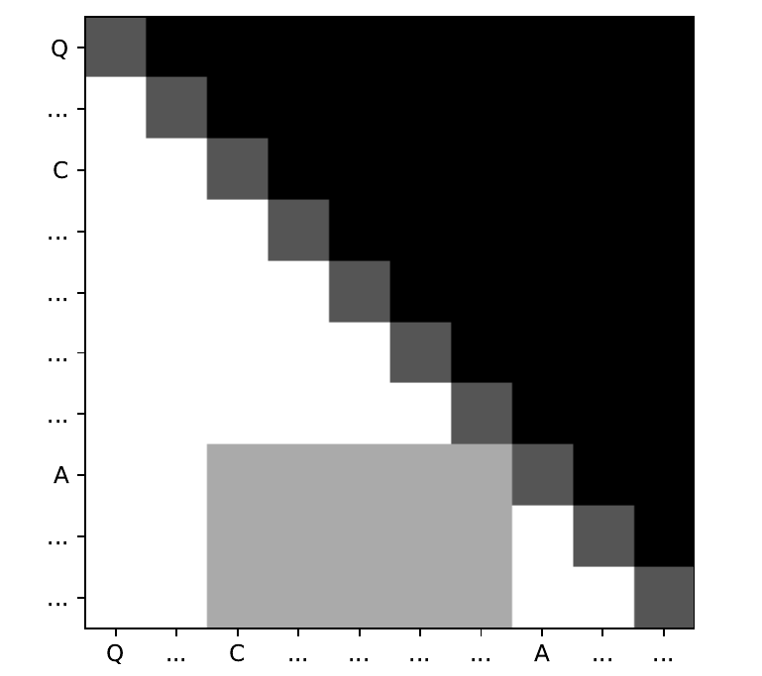
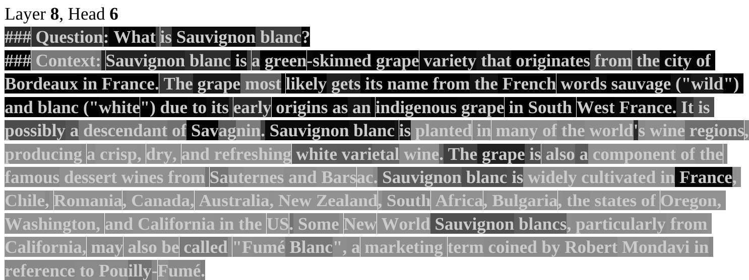
Our method for rationale extraction with LLMs
Our solution was to use the inner workings of an LLM to see what it pays attention to. More specifically, we were analysing the attention matrix to find the sentences in the context needed for generating the answer.
~ Auto-correlation of the input
Rationale In black
Irrelevant in grey
Reference: Pirenne, L., Mokeddem, S., Ernst, D., & Louppe, G. (2024). Exploration of Closed-Domain Question Answering Explainability Methods With a Sentence-Level Rationale Datase. ORBi-University of Liège. https://orbi.uliege.be/handle/2268/322654.

Slide 14
This Rationale Extraction problem underlines one of the needs for mutually beneficial collaborations between the industry and universities. Others exist!
Universities needs that can be fulfilled by the industry:
research problems that are relevant to the industry
computing resources
high quality data
funding.
Industry needs that can be fulfilled by universities:
capacity to provide solutions to problems requiring research efforts
access to top-notch knowledge in AI
access to brilliant minds.
Flow.1-schnell

Slide 15
NRB and the Montefiore Research Unit of the ULiège have launched a Research Chair in AI for the industry
Significant funding over four years.
Two professors involved.
Considerable thought has gone into putting in place the correct organisational aspects that ensure optimum synergies.
Photo taken during the Chair launch meeting at the NRB premises. Image Left: Prof. Gilles Louppe (L) and Damien Ernst (R). Image Right: the CEO of NRB, Laurence Mathieu with her colleagues.

