Slide 1



Are there biomarkers to predict acute kidney injury after aneurysm repair?
Arnaud Kerzmann, MD
Cardiovascular and Thoracic Surgery Department (Pr Defraigne)
CHU Liège, Belgium

Slide 2
Disclosures
Consultant:
BD, Boston Scientific, Artivion
Grant/research support:
Medicor, iVascular, Medtronic, DMB Medical

Slide 3
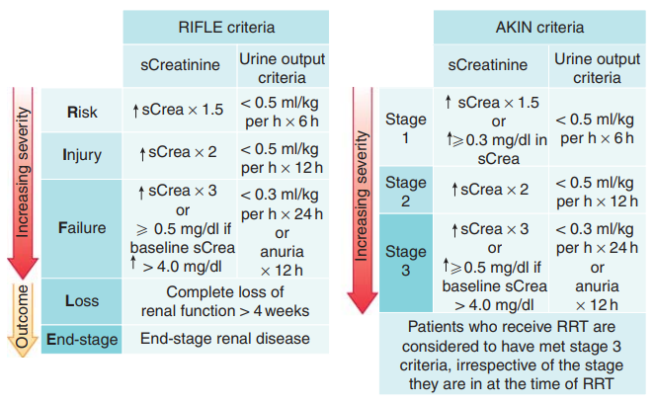
Definition of AKI
2 similar definitions
based on serum creatinine
and urine output (RIFLE
and AKIN) proposed and
validated
Bellomo R, Ronco C, Kellum JA, et al. Acute renal failure—definition, outcome measures, animal models, fluid therapy and information technology needs: the Second International Consensus Conference of the Acute Dialysis Quality Initiative (ADQI) Group. Crit Care 2004;8:R204-12.
Mehta RL, Kellum JA, Shah SV, et al. Acute Kidney Injury Network: report of an initiative to improve outcomes in acute kidney injury. Crit Care 2007;11:R31.

Slide 4
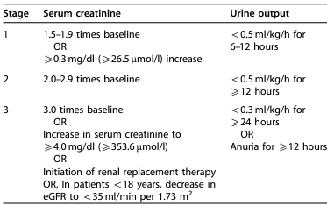
Staging of AKI
Section 2: AKI Definition. Kidney Int Suppl. 2012; 2: 19-36.

Slide 5
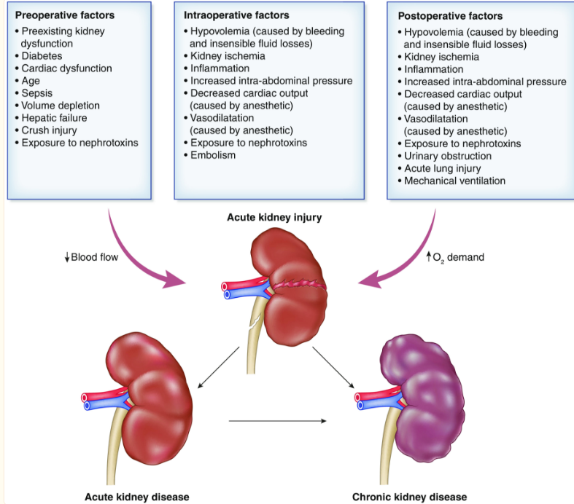
Physiopathology of postoperative AKI
Boyer N, Eldridge J, Prowle JR, et al. Postoperative Acute Kidney Injury. Clin J Am Soc Nephrol. 2022 Oct;17(10):1535-1545.

Slide 6
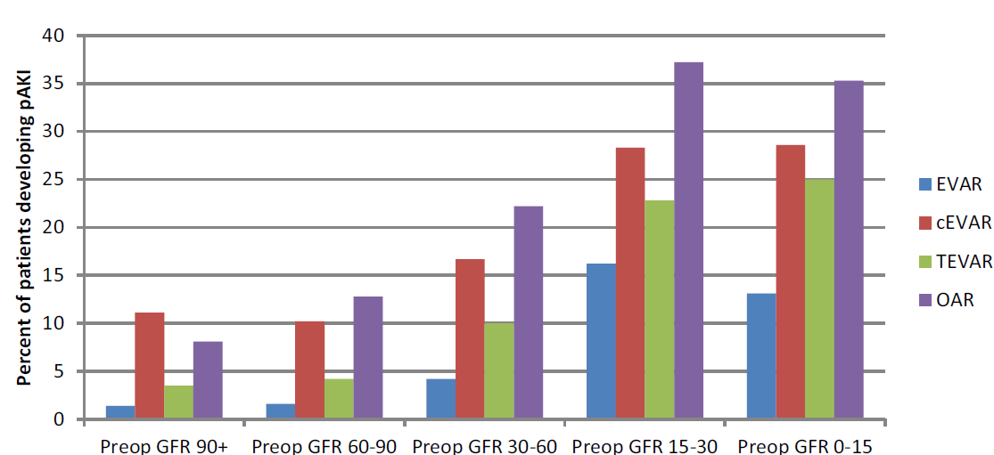
Incidence of AKI
Novak Z, Zaky A, Spangler EL, McFarland GE, et al. Incidence and predictors of early and delayed renal function decline after aortic aneurysm repair in the Vascular Quality Initiative database. J Vasc Surg. 2021 Nov;74(5):1537-1547.

Slide 7
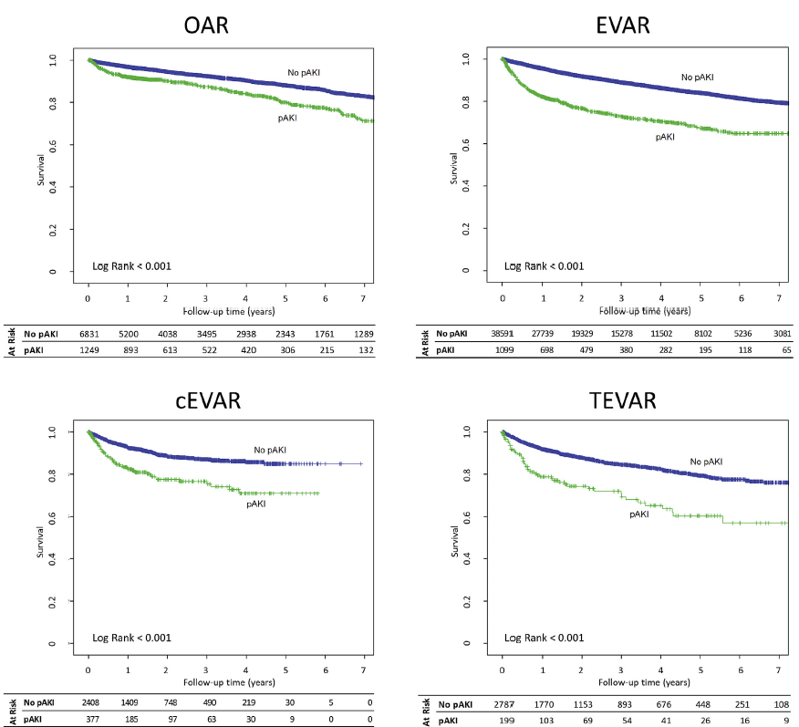
Clinical relevance: survival
Novak Z, Zaky A, Spangler EL, McFarland GE, et al. Incidence and predictors of early and delayed renal function decline after aortic aneurysm repair in the Vascular Quality Initiative database. J Vasc Surg. 2021 Nov;74(5):1537-1547.

Slide 8
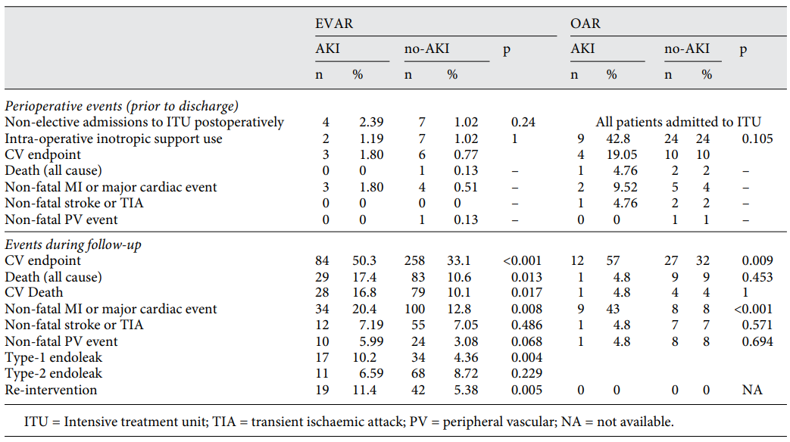
Clinical relevance: cardiovascular events
Saratzis A, Harrison, S, Barratt J, et al. Intervention Associated Acute Kidney Injury and Long-Term Cardiovascular Outcomes. Am J Nephrol. 2015;42(4):285-94.

Slide 9
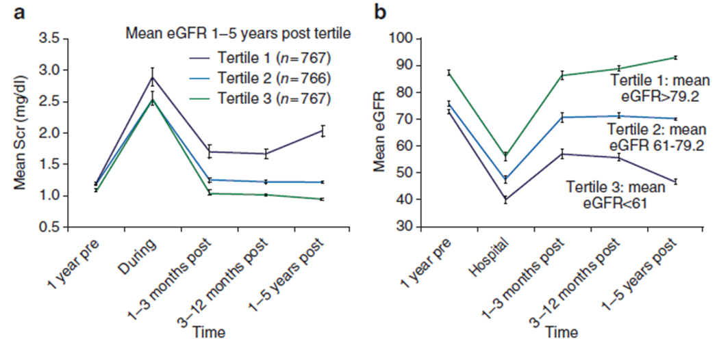
Clinical relevance: AKI and CKD
AKI after aortic repair is an independent risk factor for eGFR decline
Sarafidis P, Martens S, Saratzis A, et al. Diseases of the Aorta and Kidney Disease: conclusions from a Kidney Disease: Improving Global Outcomes (KDIGO) Controversies Conference. Cardiovasc Res. 2022 Sep 20;118(12):2582-2595.
Chawla LS, Kimmel PL. Acute kidney injury and chronic kidney disease: an integrated clinical syndrome. Kidney Int. 2012 Sep;82(5):516-24.

Slide 10
Biomarkers in AKI
serum creatinine increase → low sensitivity
→ late event
urine output → low specificity
→ not accurate evaluation
need for others biomarkers !
many serum and/or urine biomarkers in AKI
Koyner JL, Zarbock A, Basu RK, et al. The impact of biomarkers of acute kidney injury on individual patient care. Nephrol Dial Transplant. 2020 Aug 1;35(8):1295-1305.

Slide 11
Biomarkers in AKI
serum
urine
Cr, NGAL, MCP-1, PTX3, ST-2, IL-10, IL1-RA, cystatin C, PENK, suPAR, SLPI, NT-proBNP, IFN-γ, SCGF-β, …
NGAL, cystatin C, TIMP-2, IGFBP7, CCL14, L-FABP, KIM-1, IL-18, MCP-1, DKK3, suPAR, CHI3L1, RBP, NAG, alb, …

Slide 12
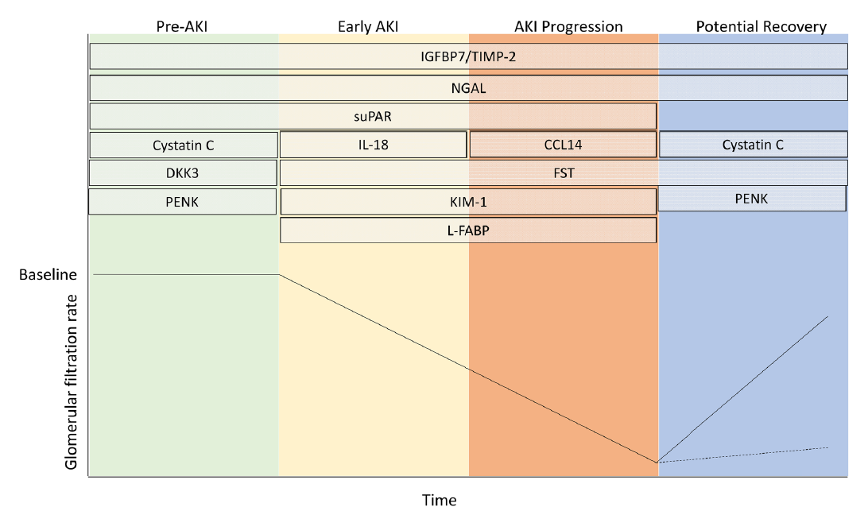
Biomarkers in the stage of renal injury
Rossiter A, La A, Koyner JL, et al. New biomarkers in acute kidney injury. Crit Rev Clin Lab Sci. 2024 Jan;61(1):23-44.

Slide 13
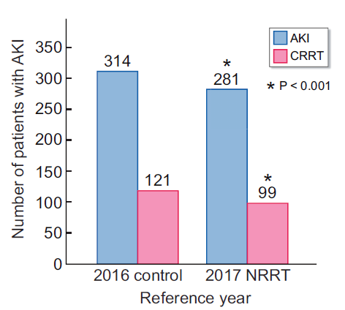
Value of early biomarkers
early identification of kidney injury = better management
routine checking of TIMP-2*IGFBP7 and nephrology rapid response team (NRRT)
Koyner JL, Zarbock A, Basu RK, et al. The impact of biomarkers of acute kidney injury on individual patient care. Nephrol Dial Transplant. 2020 Aug 1;35(8):1295-1305.

Slide 14
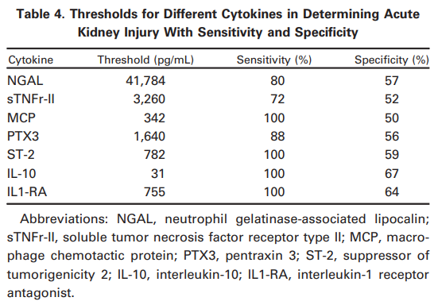
Limitations of biomarkers
urine biomarker and oliguria
cost
measuring method
long follow-up
need for complex studies
Boyer N, Eldridge J, Prowle JR, et al. Postoperative Acute Kidney Injury. Clin J Am Soc Nephrol. 2022 Oct;17(10):1535-1545.
Brinkman R, HayGlass KT, Mutch WA, et al. Acute Kidney Injury in Patients Undergoing Open Abdominal Aortic Aneurysm Repair: A Pilot Observational Trial. J Cardiothorac Vasc Anesth. 2015 Oct;29(5):1212-9.

Slide 15
Ideal biomarker
pre-injury
easily detectable
usable in the daily clinical practice
accurate (sensitive and specific)
cost-effective
→ prevention treatment
→ timely treatment
→ aortic repair strategy

Slide 16
DKK3
Dickkopf-3 (DKK-3) glycoprotein
belongs to a family of 4 molecules
modulation of Wnt signaling pathways
expressed in the developing kidney (tubular cells), suppressed in adult life and neo-expressed under pathological conditions (fibrosis)
also expressed in other organs, DKK3 is present in plasma
Schunk SJ, Speer T, Petrakis I, et al. Dickkopf 3-a novel biomarker of the 'kidney injury continuum’. Nephrol Dial Transplant. 2021 Apr 26;36(5):761-767.

Slide 17
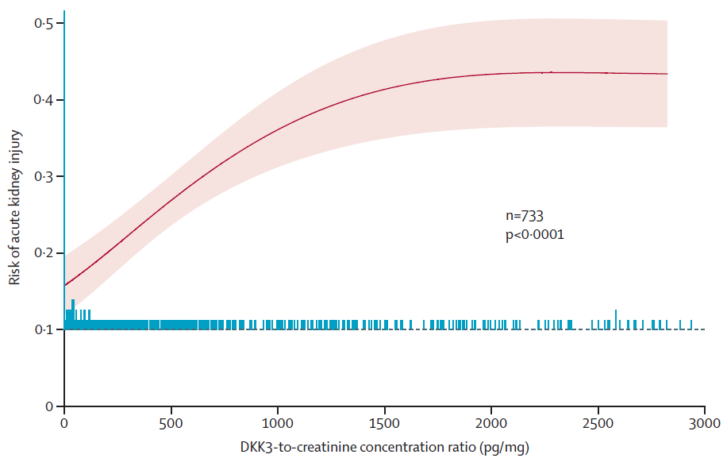
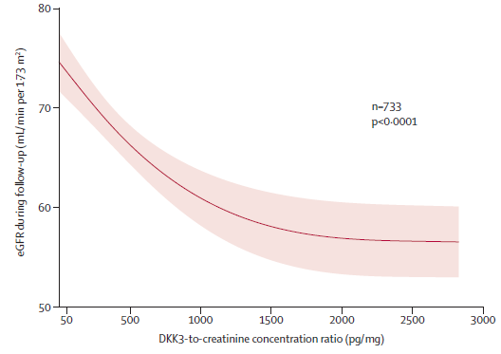
DKK3
Preoperative urinary DKK3 is an independent predictor for postoperative AKI and for subsequent loss of kidney function in patients undergoing cardiac surgery.
Schunk SJ, Zarbock A, Meersch M, et al. Association between urinary dickkopf-3, acute kidney injury, and subsequent loss of kidney function in patients undergoing cardiac surgery: an observational cohort study. Lancet. 2019 Aug 10;394(10197):488-496.

Slide 18
Call for participation
ADICA trial
Association between Dickkopf 3 (DKK3) and Acute Kidney Injury (AKI) in patients treated with endovascular abdominal aortic aneurysm repair (EVAR)
Multicenter prospective trial
→ akerzmann@chuliege.be

