Slide 1
Connective tissue diseases (CTD): Case presentation
Arnaud Kerzmann, MD
Cardiovascular and Thoracic Surgery Department (Pr Defraigne)
CHU Liège, Belgium

Slide 2
Disclosures
Consultant:
BD, Boston Scientific, Artivion
Grant/research support:
Medicor, iVascular, Medtronic, DMB Medical
Notes:
Here are my disclosures

Slide 3
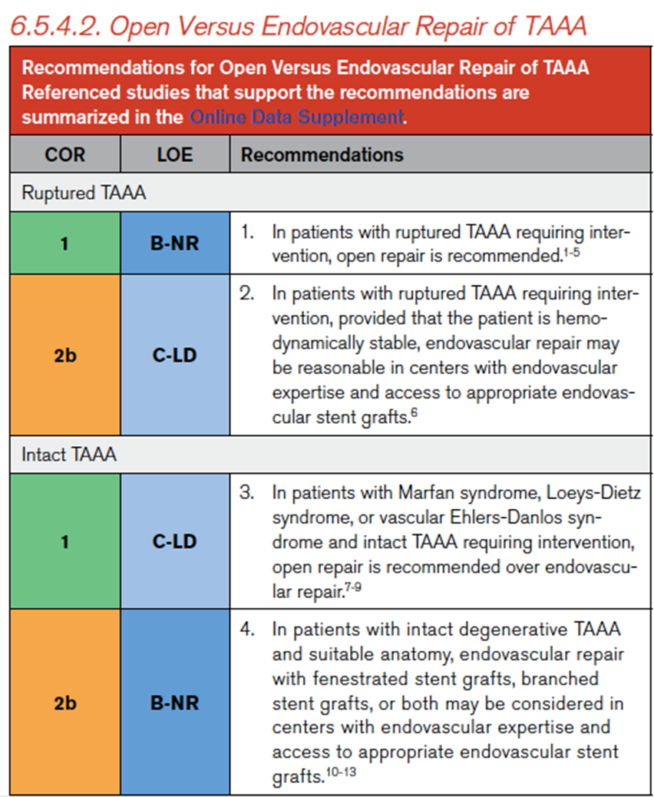
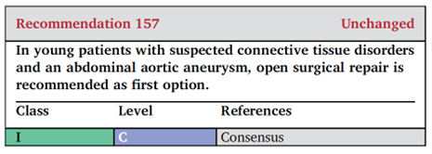
Guidelines
Wanhainen A, Van Herzeele I, Bastos Goncalves F, et al. European Society for Vascular Surgery (ESVS) 2024 ClinicalPractice Guidelines on the Management of Abdominal Aorto-Iliac Artery Aneurysms. Eur J Vasc Endovasc Surg. 2024;67:192-331.
Isselbacher EM, Preventza O, Hamilton Black J 3rd, et al. 2022 ACC/AHA guideline for the diagnosis and management of aortic disease: A report of the American Heart Association/American College of Cardiology Joint Committee on Clinical Practice Guidelines. Circulation. 2022;146(24):e334-e482.
Notes:
The recent guidelines about AAA management recommand in case of connective tissue disease open surgery. The recommandation and its level 1C is the same for thoraco-abdominal aortic aneurysms, when intervention is needed.

Slide 4
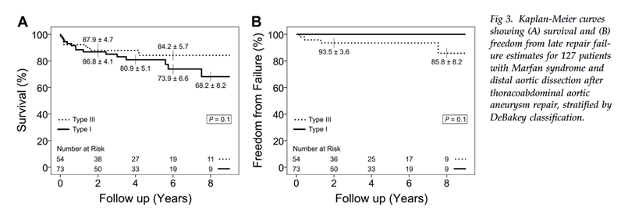
Guidelines
open repair with CTD versus without:
less mortality
less major complications (stroke, SCI)
excellent freedom from aortic reintervention
excellent long-term survival
Coselli JS, Green SY, Price MD, et al. Results of Open Surgical Repair in
Patients With Marfan Syndrome and Distal Aortic Dissection. Ann
Thorac Surg. 2016;101:2193–201.
Notes:
Aortic open repair in patients with connective tissue disease and aortic dissection requiring intervention shows less mortality, less major complications, excellent freedom from aortic reintervention and excellent long-term survival, compared to open repair in patients without connective tissue disease.

Slide 5
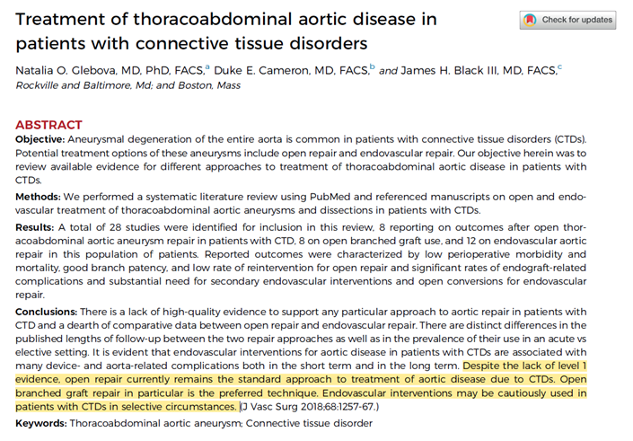
Guidelines
Notes:
In this systematic review from 2018, open repair appears as the standard approach to treat aortic disease associated with connective tissue disease. Endovascular repair should be realized only with precautions in selected cases.

Slide 6
Case report
caucasian man born in 1979
connective tissue disease : Marfan syndrome
heterozygous mutation c.1585 C>T (p.Arg529X) in the gene FBN1
diagnosis in 2012
Notes:
Our case is about a caucasian man born in 1979 who had Marfan syndrome. Diagnosis was made in 2012.

Slide 7
Case report
obesity
arterial hypertension
Bentall operation for type A acute aortic dissection in 2006
open repair for descending thoracic aortic aneurysm in 2007
right ischemic stroke following anticoagulant withdrawal in 2013
endocarditis with septic embolisms in the right anterior and posterior tibial arteries in 2014
Notes:
He was obese and had arterial hypertension. He had in 2006 Bentall operation for acute type A aortic dissection, in 2007 open repair for descending thoracic aortic aneurysm, in 2013 right ischemic stroke following anticoagulant withdrawal, and in 2014 endocarditis with septic embolisms in the right anterior and posterior tibial arteries.

Slide 8
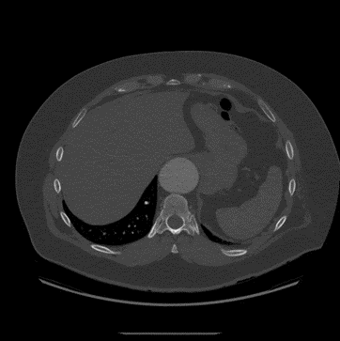
Case report
type 5 TAAA with maximum diameter of 54 mm in 2023
open repair refused
Notes:
He came in 2023 to the consultation with a type 5 thoraco-abdominal aortic aneurysm. Maximum diameter was 54 mm. He visited before a vascular surgeon from another institution who planned open repair but the patient refused because he desired endovascular repair.

Slide 9
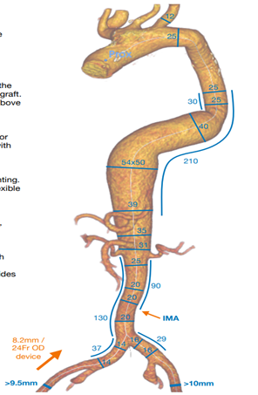
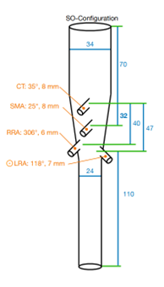
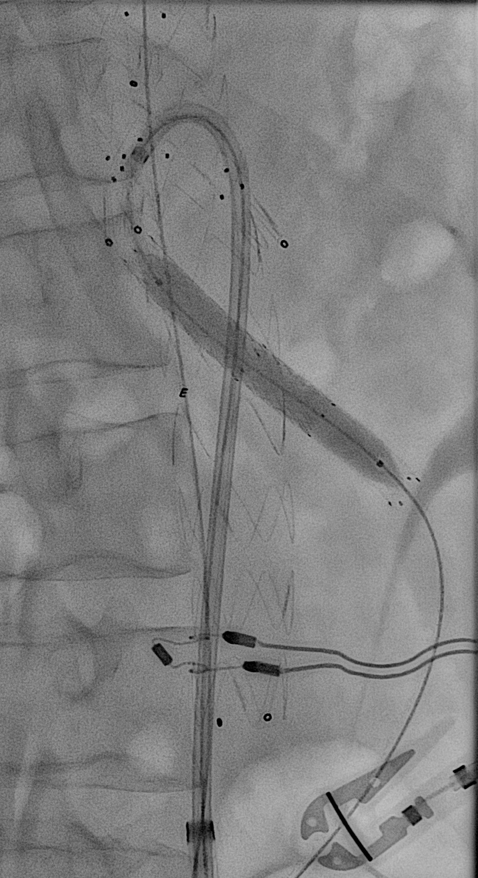
Case report
2 steps procedure (June and August 2023)
proximal TEVAR
long sealing zones
steerable sheath
self-expandable stents in the branches
balloon-mounted stents as bridges
IMA preserved
CSF drainage for the second step
Notes:
After we had clearly explain the risk of complications and reintervention, we planned the endovascular approach. To reduce the risk of spinal cord ischemia, we performed a 2 steps procedure. The first step in June 2023 consisted of proximal TEVAR with abdominal BEVAR. We took care to have long proximal and distal sealing zones, at least 4 cm, to use steerable sheath to avoid axillary access, and to implant self-expandable covered stents in the target vessels to reduce the arterial wall traumatism. Balloon-mounted stents were used as bridges. Inferior mesenteric artery was preserved to reduce risks of bowel and spinal cord ischemia. The coeliac trunk was not stented in the first stop.
The second step in August 2023 consisted in stenting of the coeliac trunk. It was realized with preventive cerebro-spinal fluid drainage. There was no early complication.

Slide 10
Case report
computed tomography angiography in December 2023 : endoleak
type?
Notes:
In December 2023, control CT was realized. It revealed endoleak, but which type? We decided to look for the origin of the endoleak in the operating room.

Slide 11
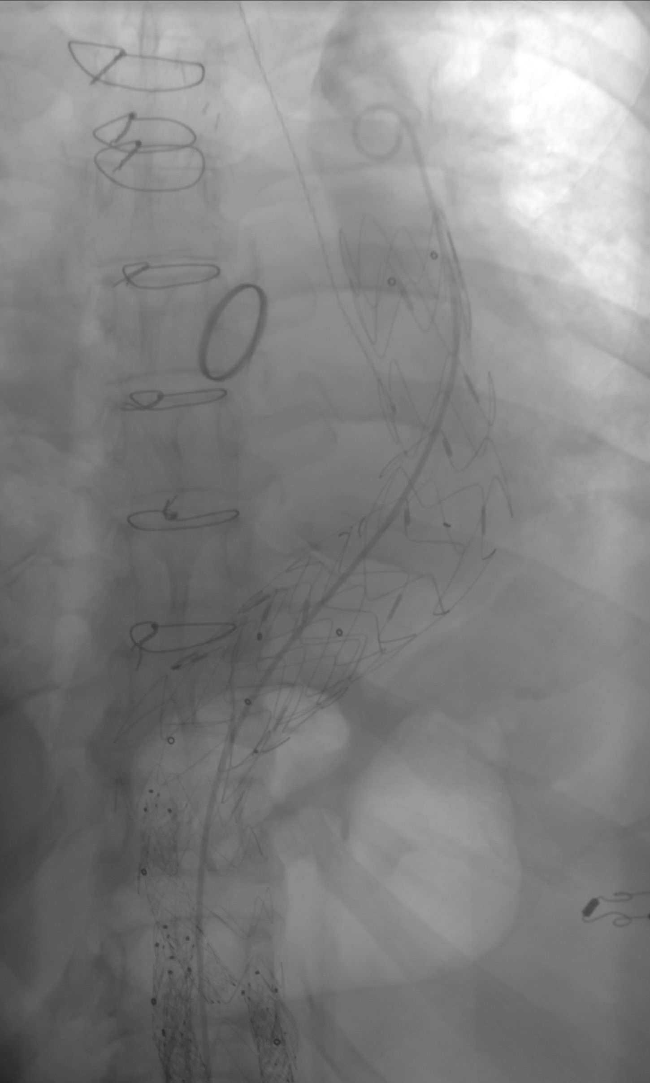
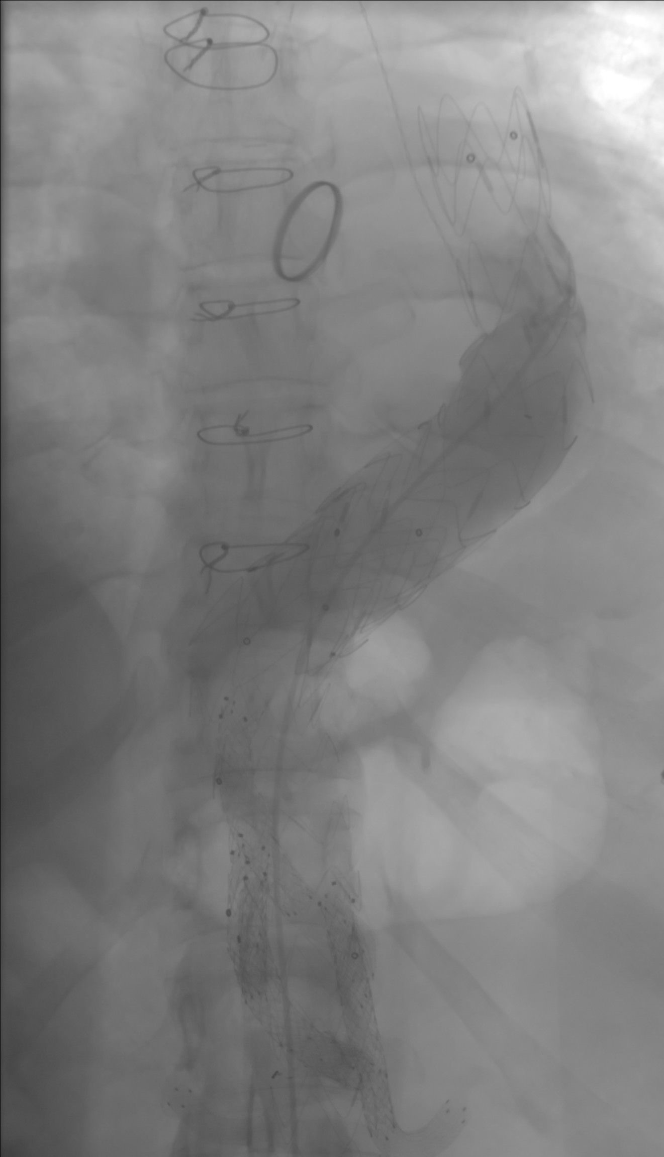
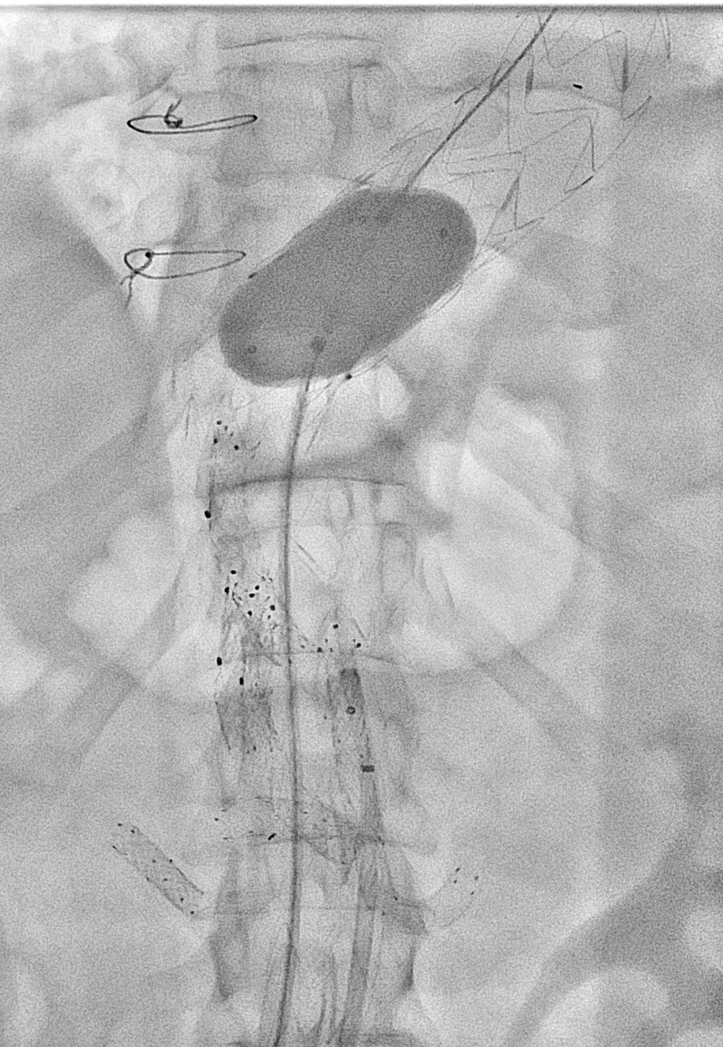
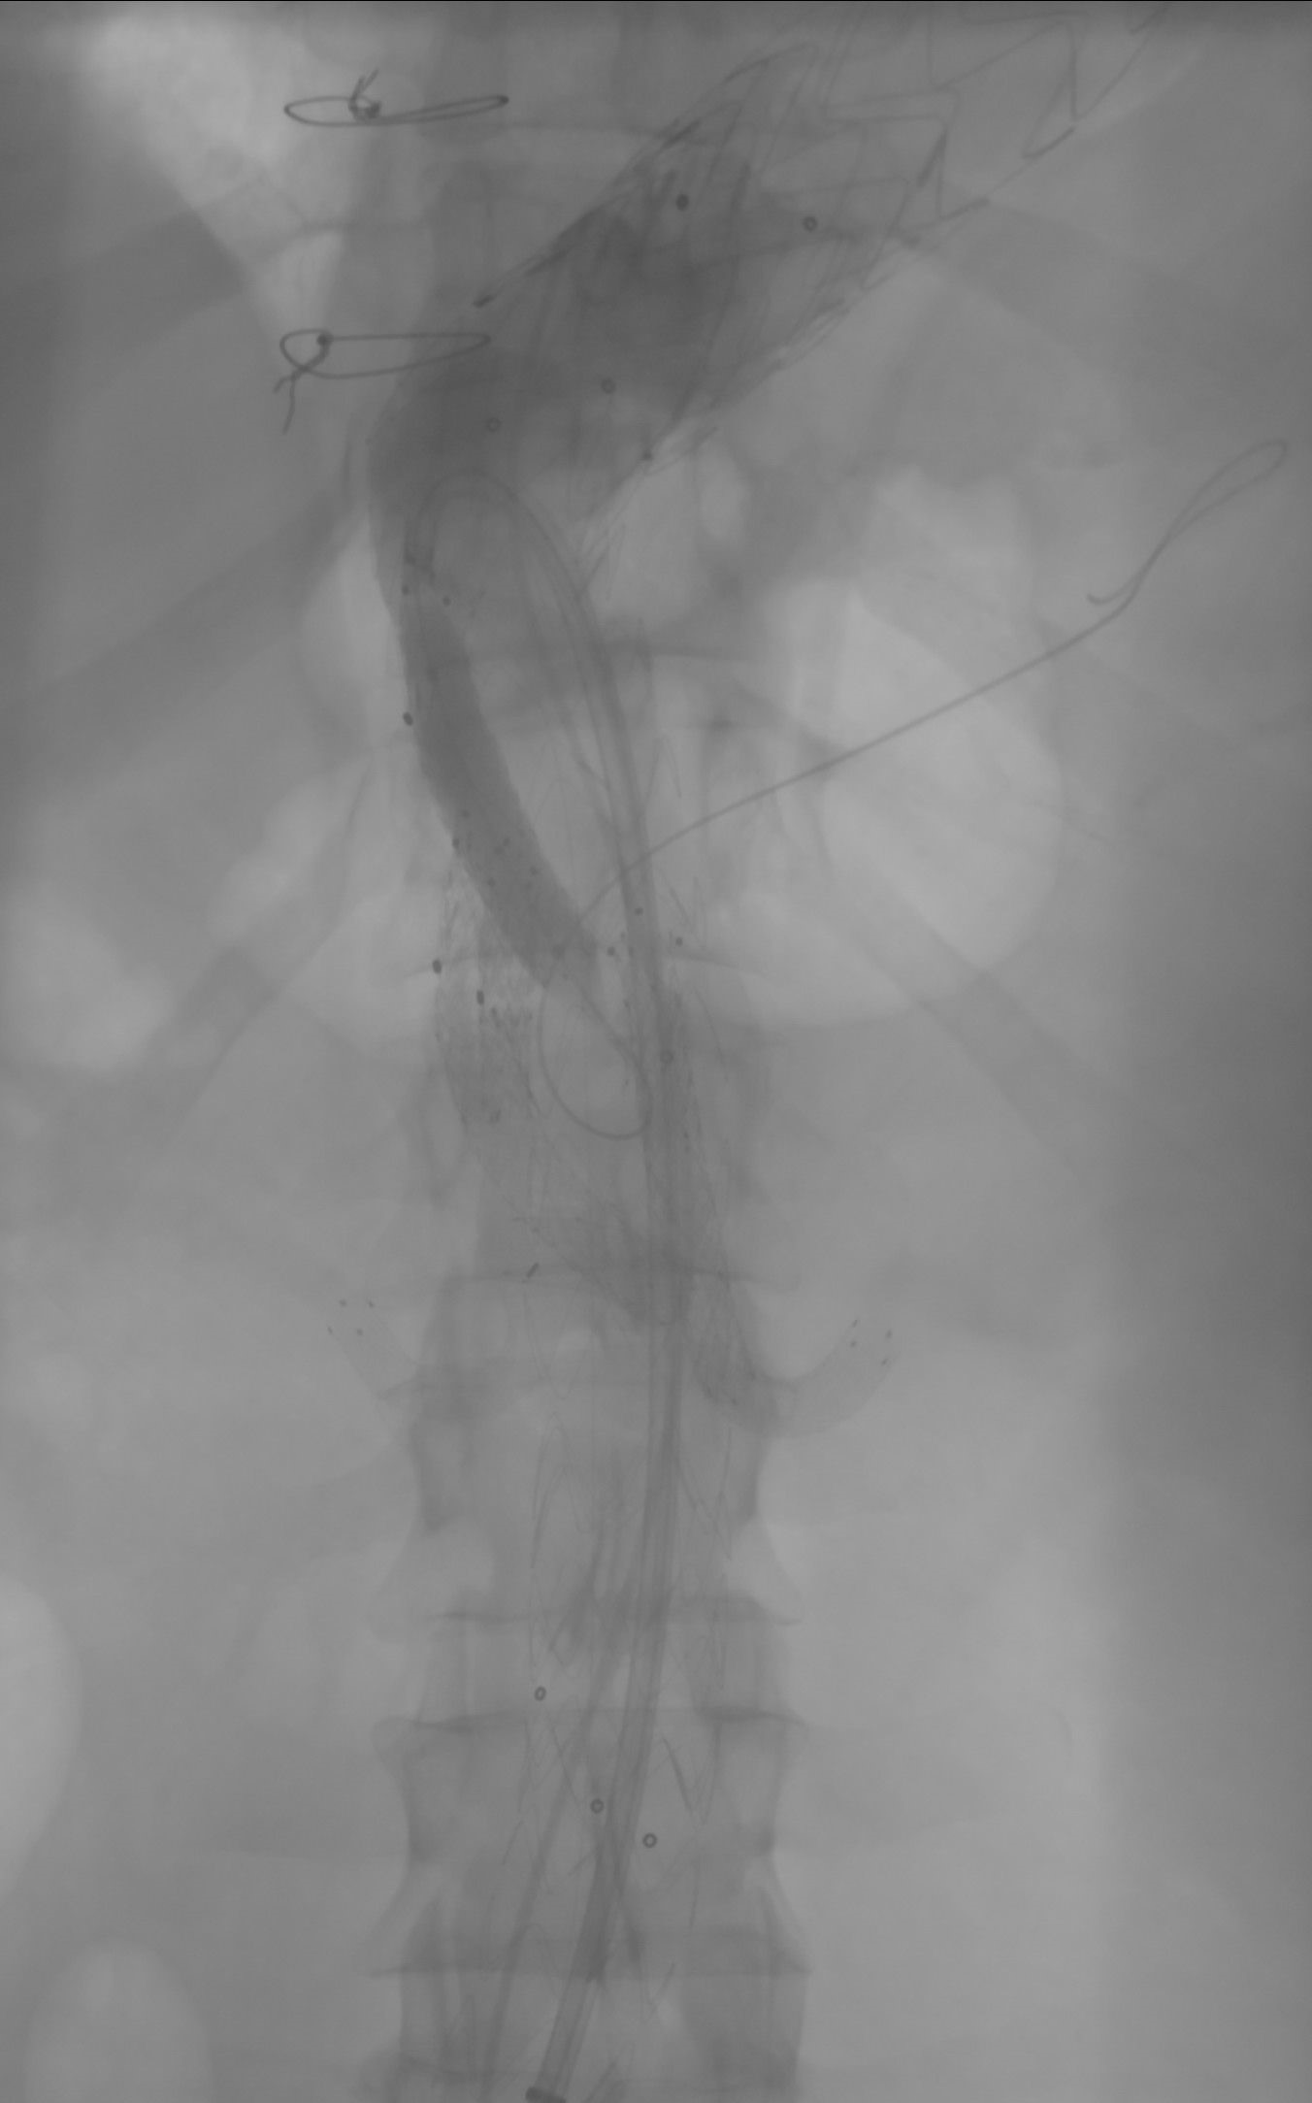
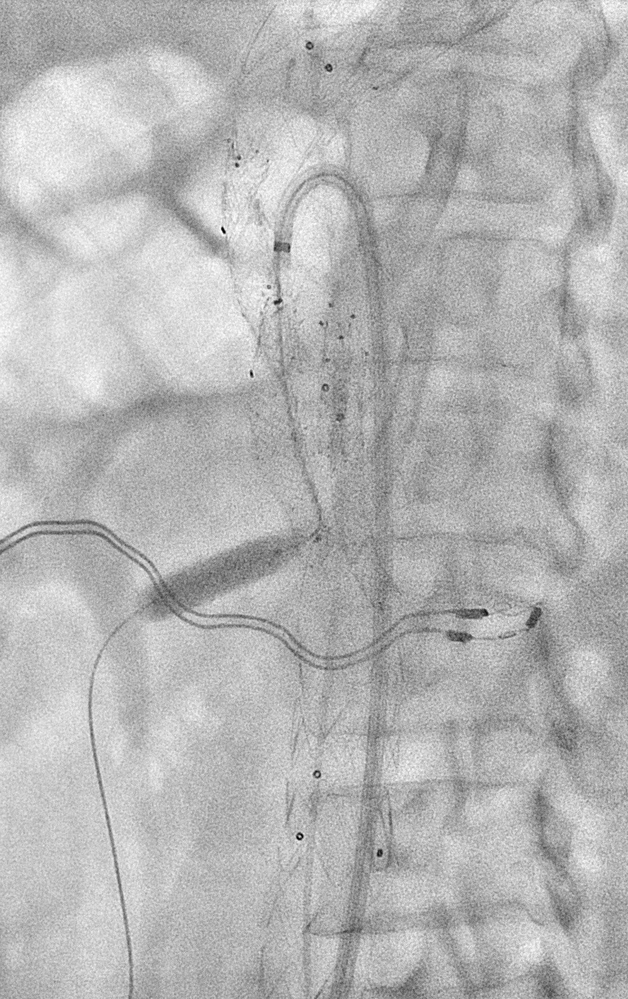
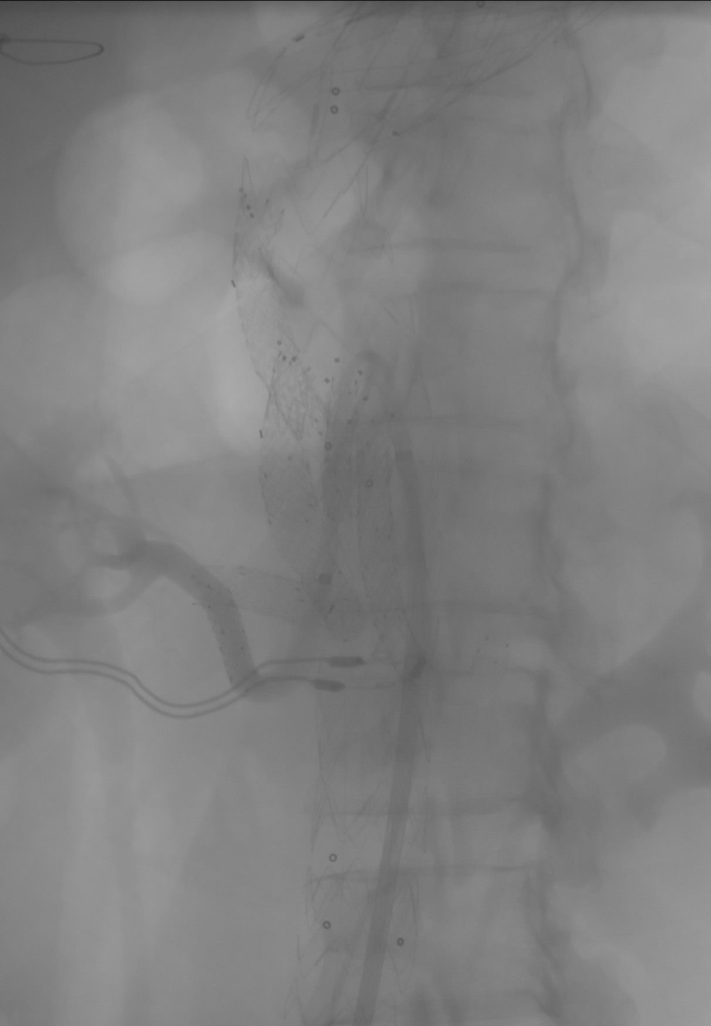
Case report
arteriography in March 2024 :
no type 1a or b
no type 3
no type 4
maybe 1c or 2
stents in the SMA and right renal artery
Notes:
The arteriography was performed in March 2024. It could exclude type 1a and b endoleak. Despite there was no evidence of type 3 endoleak, we dilated the overlap between the TEVAR and the abdominal BEVAR.We had some doubt about type 1c endoleak, so we stented the superior mesenteric artery end the right renal artery.

Slide 12
Case report
computed tomography angiography in May 2024
Notes:
At the control CT from May 2024, there was still endoleak.

Slide 13
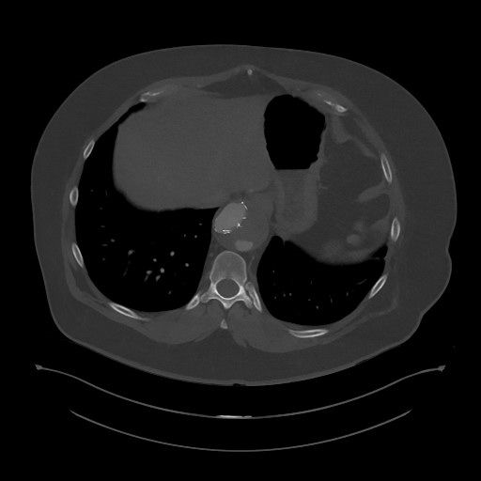
Case report
computed tomography angiography in May 2024 :
- type 2 endoleak
- maximum diameter 54 mm
Notes:
Maximum diameter of the aneurysm didn’t increase. It was stable with 54 mm. There was clear type 2 endoleak arising from lumbar arteries.

Slide 14
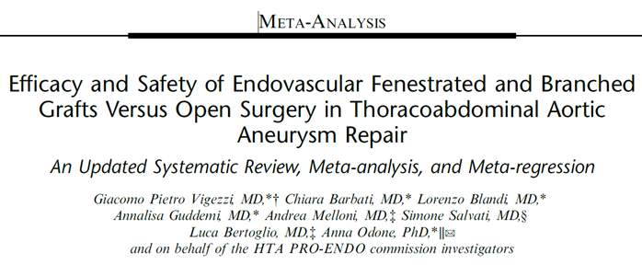
Place of endovascular therapy in TAAA?
limitations and lack of RCT
patients with endovascular repair oldier and more comorbidities
endovascular could be safer than open repair
Ann Surg 2024;279:961–972.
Notes:
As recently published, the place of endovascular therapy compared to open repair to threat thoraco-abdominal aortic aneurysms is not évident.

Slide 15
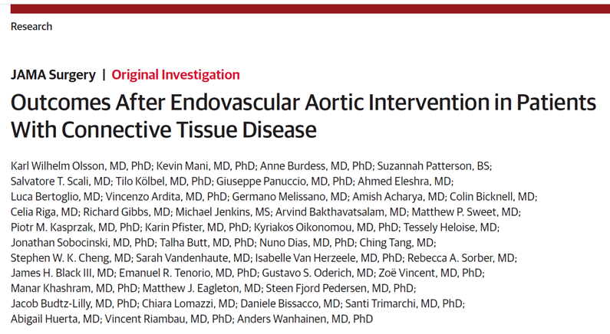
JAMA Surg. 2023;158(8):832-839.
Notes:
A systematic review of endovascular aortic repair in patients with connective tissue diease was reported last year.

Slide 16
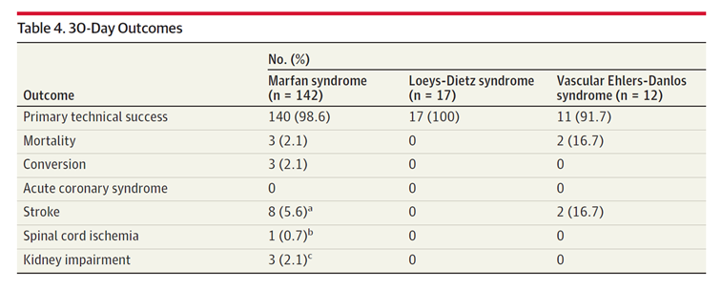
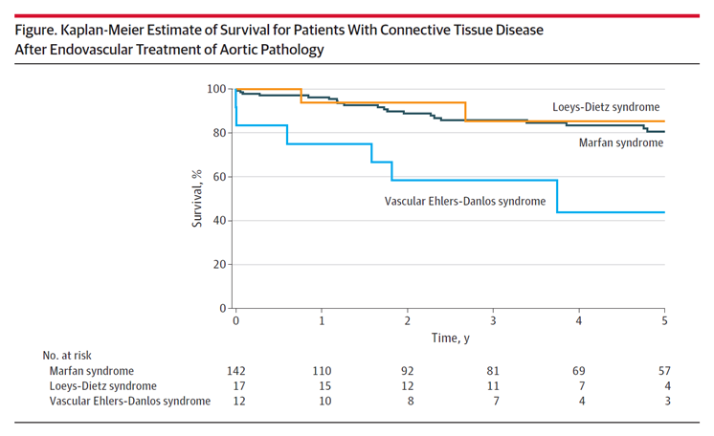
Notes:
It showed good technical success, complications and survival rates. Reintervention rate was high but it was most of the time with endovascular approach. Authors suggested to include endovascular aortic treatment for âtients with connective tissue disease.

Slide 17
Endovascular aortic repair with CTD?
in selected patients : - high operative risk
- prosthetic sealing zone
- bridge to open repair
- patient’s wish
with specific precautions : - long sealing
- as atraumatic as possible (access, wires, target vessels)
- patient’s informed consent
- rigorous follow-up
The debate is open!

