Slide 1
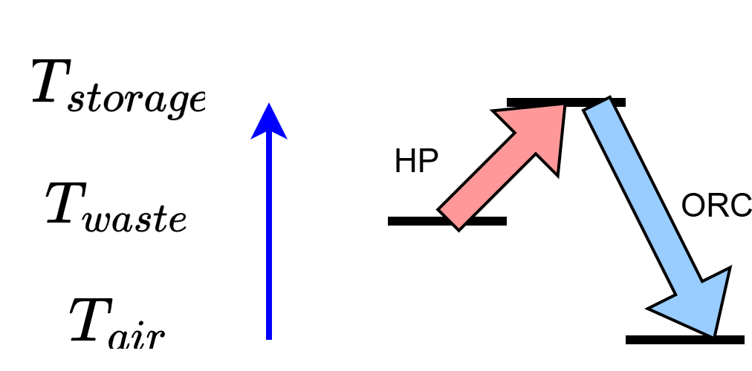
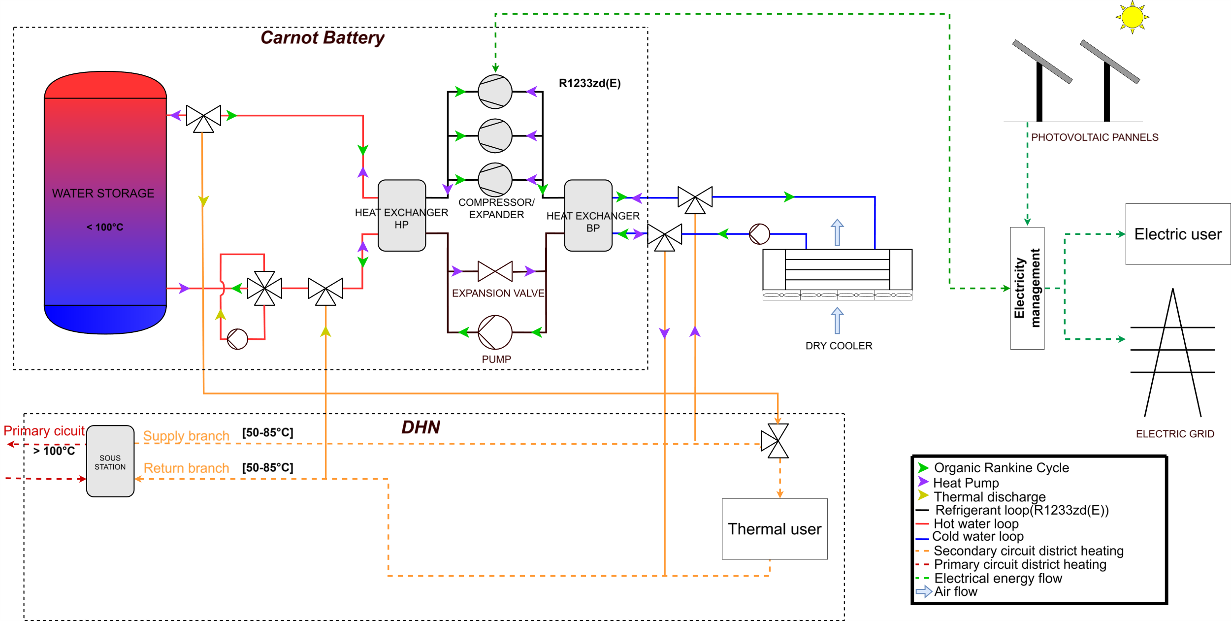
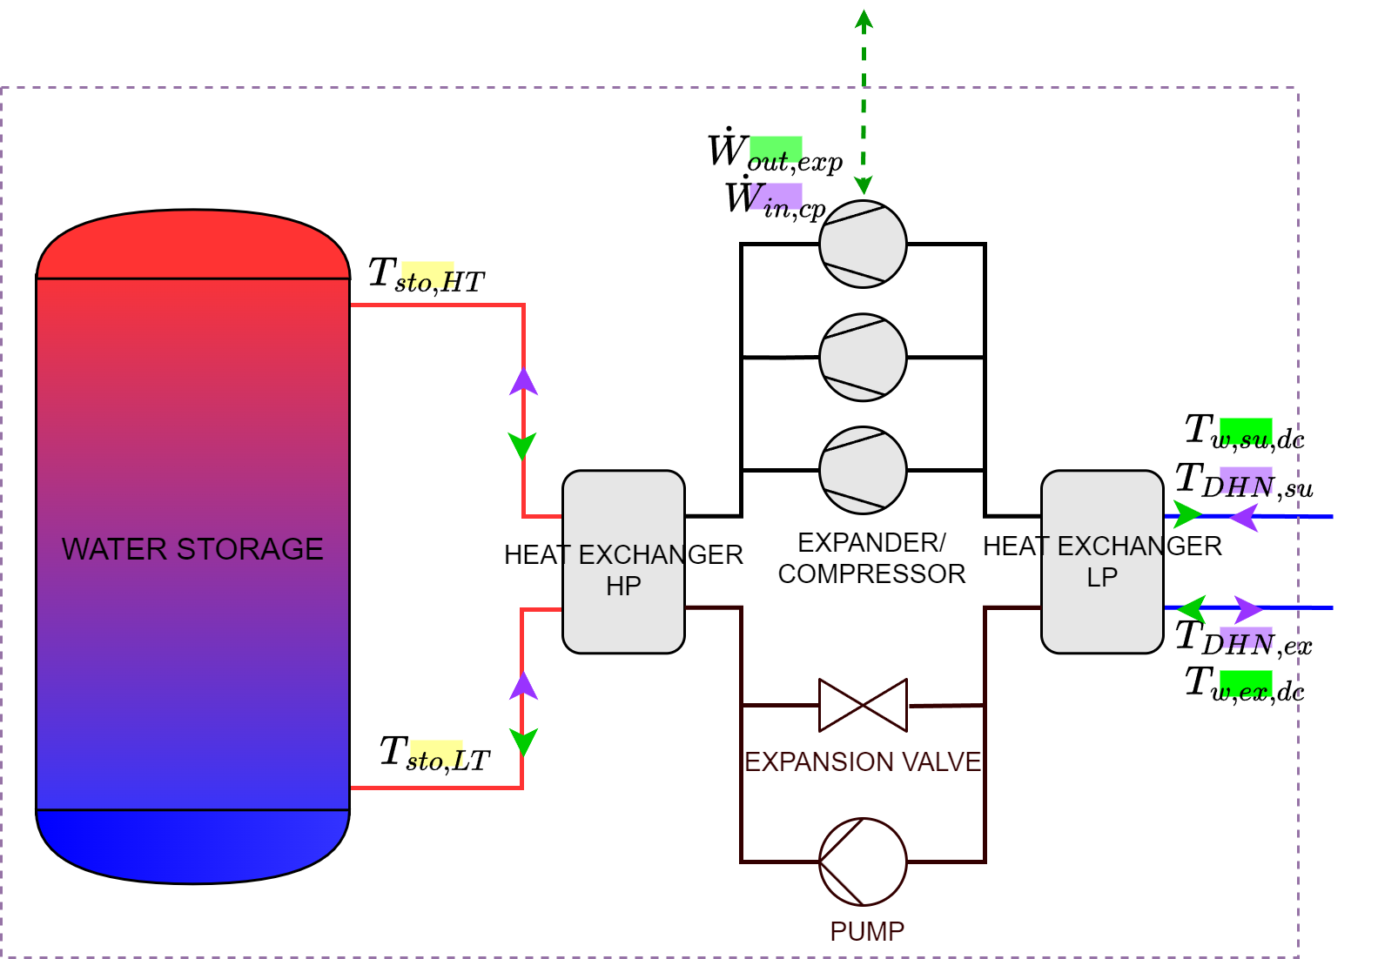
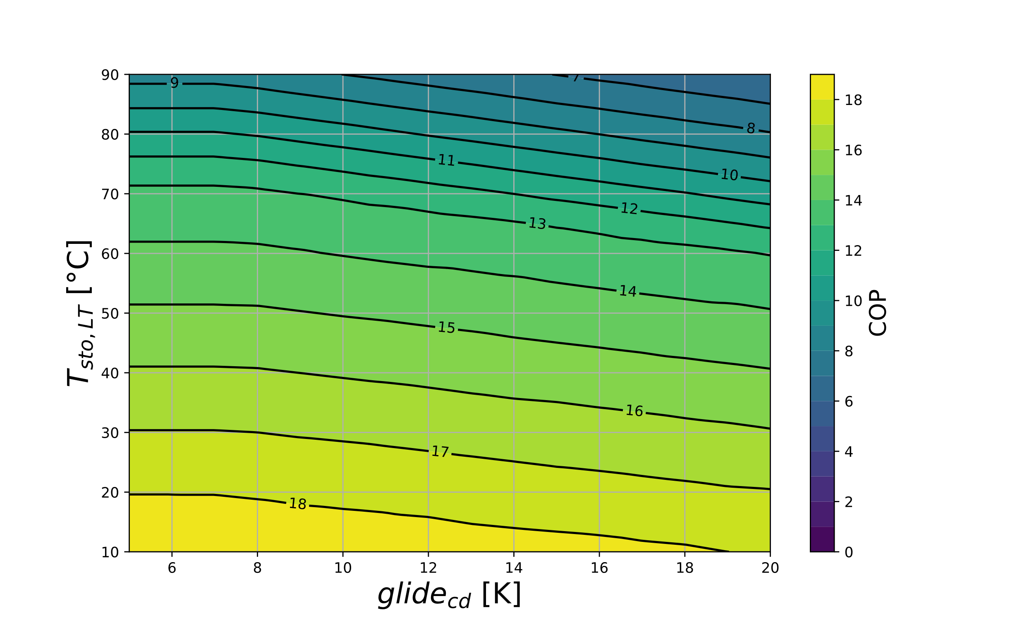
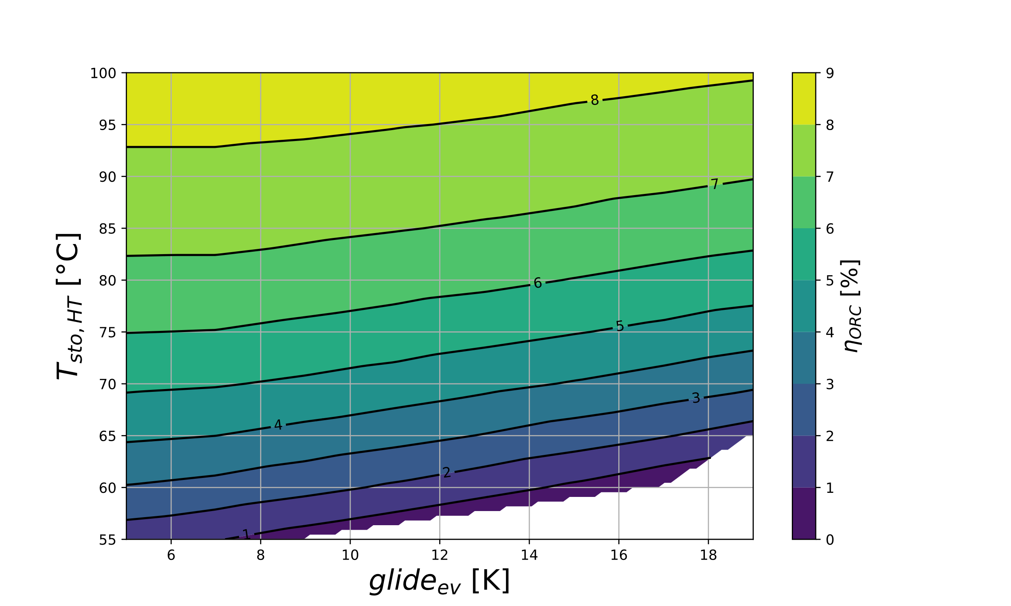
Off-design model of a 10 kWe thermally integrated Carnot battery demonstration plant using a reversible HP/ORC
Elise Neven ^{(1*)}, Olivier Dumont ⁽¹⁾, Olivier Thomé ⁽¹⁾, Vincent Lemort ⁽¹⁾
^{(*)} Neven Elise (elise.neven@uliege.be)
⁽¹⁾ Laboratoire de Thermodynamique de l’Université de Liège, Allée de la Découverte 17, 4000 Liège
Context
The Carnot Battery (CB) is a promising new storage solution that stores electric energy as heat and converts it back into electricity.
Key Advantages:
- Long Lifespan
- Favorable Life Cycle Analysis
- Reduced Reliance on Sensitive Minerals compared to lithium-ion batteries
Figure 1: Demonstration plant (CB) working principle.
Challenge:
- Low Round-Trip Efficiency
Thermally Integrated Carnot Batteries (TICB):
TICB integrate heat streams to enhance the heat pump Coefficient Of Performance (COP), resulting in improved round-trip efficiency over traditional CB designs.
Demonstration plant
Figure 2: Levels of temperature TICB.
Location:
- Laboratory of Applied Thermodynamics of the University of Liège.
System:
Reversible CB (HP/ORC)
Hot water reservoir
Dry cooler
Solar panels
Integration with the District Heating Network (DHN).
Thermal Discharge:
High thermal demand in the DHN.
Thermal energy from the reservoir is injected into the network.
Electrical Discharge:
Electrical consumption exceeds solar panel production.
ORC mode: converting thermal energy from the reservoir into electricity.
Thermal Charge:
Solar panel production exceeds electrical consumption.
HP mode: converting excess electricity into heat.
Test bench design
Figure 3: Demonstration plant schematic.
The test bench is sized with an on-design model to meet the following specifications
[1]:
- Heat Reservoir: Designed to cover thermal consumption peaks in buildings (400 kW) during morning peak periods (15 minutes).
- DHN temperature level: Ranges between 60°C and 80°C.
- Heat Pump: Sized to charge the storage (100 kWh) in one hour (100 kW).
Control variables
Control variables:
Evaporator glide
Condenser glide
Rotation speed of the compressor/expander
The actual physical system encountered limitations due to industrial constraints, resulting in a mismatch between required and selected components.
/!\ Fixed at 6000RPM
=> Need for a new model incorporating the real components.
Two compressors in HP mode and three expanders in ORC mode.
Figure 4: Variables/external conditions.
Off-design model
Component | Model
Compressor/Expander | Semi-empirical model [2]
Heat exchanger | Moving boundary model [3]
Pump | Based on characteristic curve
Water tank (Thermocline) | Moving boundary model [4]
HP mode:
Imposed conditions:
Cold temperature in the storage $T_{sto,LT}$
Supply temperature district heating $T_{DH,su}$
Control variables:
$glide_{ev}$= $T_{DH,su}−T_{DH,ex}$
$glide_{cd}$= $T_{sto,HT}−T_{sto,LT}$
ORC mode:
Imposed conditions:
Hot temperature in the storage $T_{sto,HT}$
Exhaust temperature dry cooler${ T}_{w,ex,dc}$
Control variables:
$glide_{ev}$= $T_{sto,HT}−T_{sto,LT}$
$glide_{cd}$= $T_{w,ex,dc}−T_{w,su,dc}$
Key Objectives:
Predict system performance under varying external conditions.
Identify the optimal point of operation for each external conditions.
Calibrated with data from manufacturer!
Results HP
Results ORC
The off-design model of the HP is run for different scenarios by varying the following conditions:
$T_{DH,su}$: 40°C to 85°C
$T_{sto,LT}$:10°C to 90°C
Using these variations, we generate different operating maps as shown in Figure 5.
The off-design model of the ORC is run for different scenarios by varying the following conditions:
-${ T}_{w,ex,dc}$: 0°C to 30°C
-${ T}_{sto,HT}$: 40°C to 100°C
Using these variations, we generate different operating maps as shown in Figure 6.
- $glide_{cd}$: 5K to 20K
- $glide_{ev}$: 5K to 20K
- $glide_{cd}$: 5K to 20K
- $glide_{ev}$: 5K to 20K
Conclusions:
1. Better COP for:
Higher $T_{DH,su}$
Lower $T_{sto,LT}$
Lower $glide_{cd}$
2. For each combination of $T_{sto,LT}$ and ${\dot{W}}_{comp}$ there’s a $glide_{cd}$ that maximizes the COP.
Conclusions:
1. Better efficiency for:
Lower${ T}_{w,ex,dc}$
Higher $T_{sto,HT}$
Lower $glide_{ev}$
2. For each combination of $T_{sto,HT}$ and ${\dot{W}}_{exp}$ there’s a $glide_{ev}$ that maximizes the efficiency.
Figure 5: Performance map for a $glide_{ev}$=10K and $T_{DH,su}$=80°C.
Figure 6: Performance map for a $glide_{cd}$=10K and $T_{ex,dc}$=10°C.
References
[1] Dumont, O., Poletto, C., Thomé, O., & Lemort, V. (n.d.). Methodology for the sizing of a Carnot battery based on a rankine cycle and application to a 10 kWe system for district heating application. In https://ecos2023.com/. ECOS, Spain.
[2] Vincent Lemort et al. “Testing and modeling a scroll expander integrated into an Organic Rankine Cycle”. In: Applied Thermal Engineering 29.14-15 (2009), pp. 3094–3102.
[3] Ian H. Bell et al. “A generalized moving-boundary algorithm to predict the heat transfer rate of counterflow heat exchangers for any phase configuration”. In: Applied Thermal Engineering 79 (2015), pp. 192–201.
[4] Dickes R, Desideri A, Lemort V, Quoilin S, “Model reduction for simulating the dynamic beavior of parabolic throughs and a thermocline energy storage in a micro-solar power unit” In https://ecos2015.sciencesconf.org ECOS France

