Slide 1
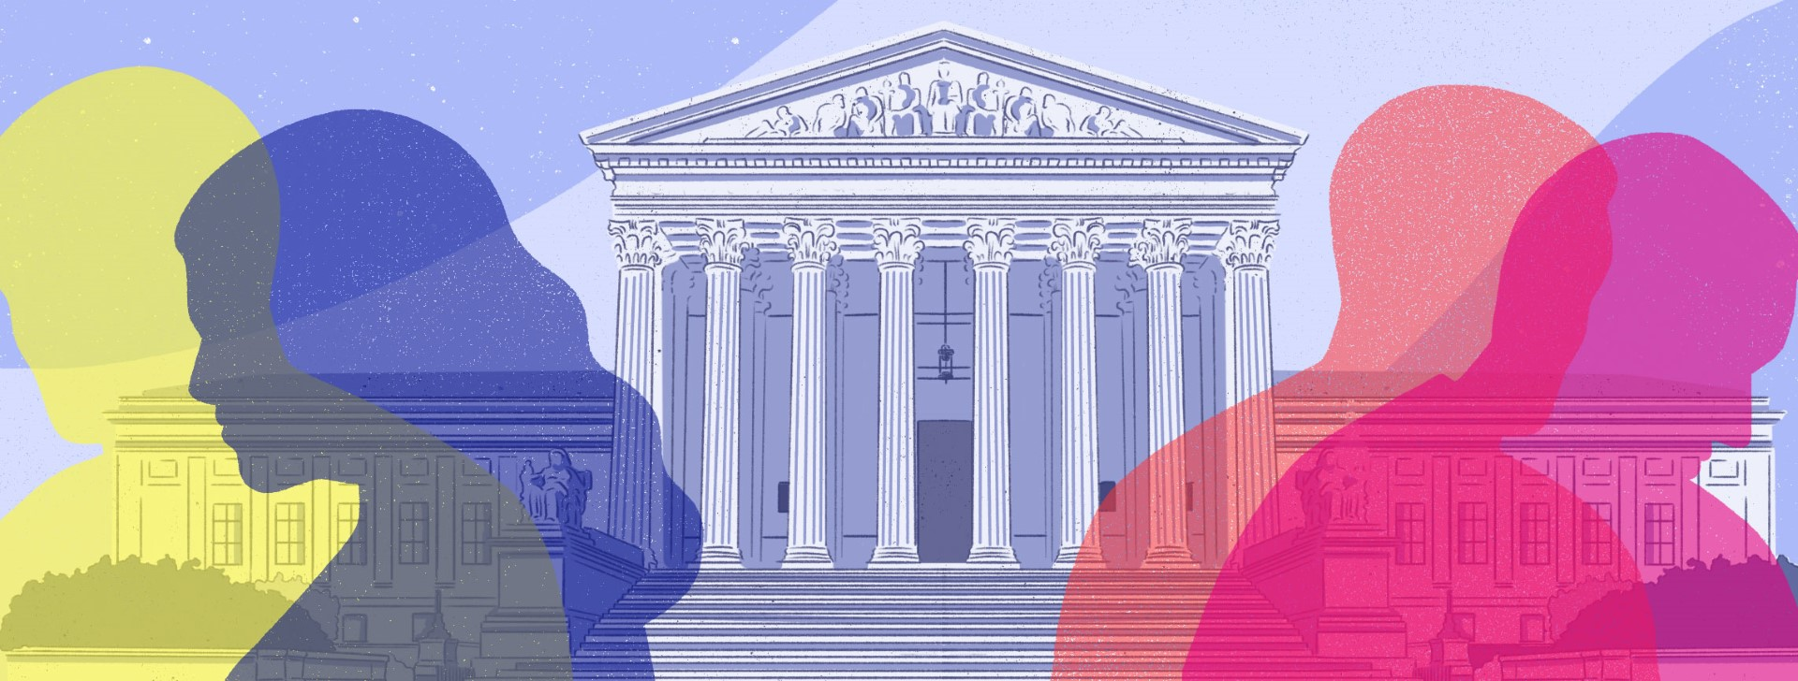
Trust in political institutions:
the constitutional law’s part
Léna Geron (ULiège) & Céline Romainville (UCLouvain)
ICONS | Madrid 2024 | 9 July 2024
The role of trust in governance systems

Slide 2
Introduction
What is our research about?
How do we conduct this research?
Why do we conduct this research?

Slide 3
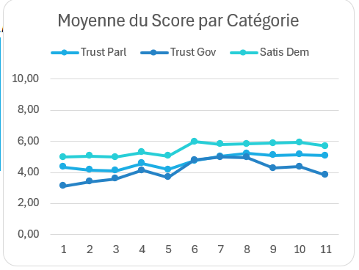
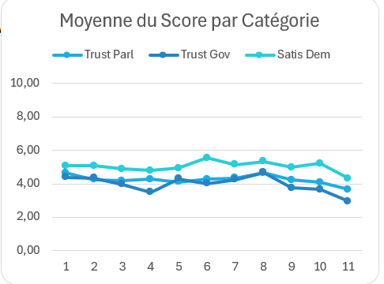
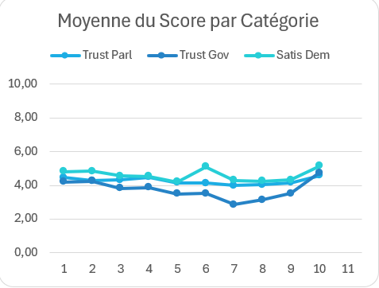
Introduction
« Declared » trust:
Germany
(European Social survey)
United Kingdom
(European Social survey)
France
(European Social survey)

Slide 4
Introduction
« Revealed » trust:
Decline of interest in political institutions
Electoral abstention
Rise of negative feelings about politics

Slide 5
Introduction
3 main theses in our book:
Theories of democracy have had and continue to have an impact on the approach to trust in representative regimes.
2) It is possible to use the social sciences to better understand trust in constitutional law and to identify its main issues.
3) Under certain conditions and in certain contexts, legal rules can generate or reduce trust.

Slide 6
I. The impact of democratic theories on the understanding of trust in constitutional law
I.1. Democratic theories presuppose mistrust of political power
I.2. … and prescribe trust in political power at the same time

Slide 7
II. Using social sciences to understand constitutional law
Relationship of trust in political institutions:
Citizens
Parliament
Citizens
MPs
1.
2.
3.
Parliament
Gvt
Citizens
Gvt

Slide 8
II. Using social sciences to understand constitutional law
II.1. ″Working definition″ of trust
Trust is
« the complex cognitive and motivational state, a mixture of rationality, feelings and commitments" of a person, the "trustor", who enters into a social relationship with others, the "trustee(s)", whether individuals or institutions, based on the expectation that the said person or institution will fulfill its commitments; it being understood that the "trustee" has a certain degree of freedom to realize the expectations of the "trustor". Trust therefore implies a certain degree of risk-taking, and the acceptance of a form of vulnerability on the part of the trustor ».

Slide 9
II.2. The main issues of trust in the social sciences and their application in constitutional law
1. Trust has a limited object

Slide 10
Object of trust | Formalized in constitutional law | Real object of trust (empirical theories)
Represented citizens // Parliament | Fulfilment of Parliament's functions in the respect of the principles stated by the Constitution | Ensuring a stable social order
Represented citizens // representatives | Acting in the public interest, law makes it possible to deviate from election promises (>< imperative mandate) Integrity, probity, transparency | Act according to category/individual interests, respect electoral promises Efficiency and expertise
Parliament // Government | Government policy statement Efficiency of government action Integrity, probity, transparency | Agreements between political parties Efficiency and expertise
Citizens// Government | Fulfilment of Government’s functions (established by the Constitution) in the respect of the principles stated by the Constitution) | Readibility, sincerity, reactivity, accountability

Slide 11
II.2. The main issues of trust in the social sciences and their application in constitutional law
2. Constitutional law formalises sometimes relationship of political trust

Slide 12
 | Degree of formalisation of trust by constitutional law | Formalisation of mechanisms for controlling and sanctioning the loss of trust
Parliament/represented citizens | Very little formalisation (vote) | None but other mechanisms can be activated (constitutional Court)
Representatives/represented citizens | Very little formalisation (vote) | Non-re-election of elected representatives Recall
Parliament/Government/Ministers | Varies considerably (rationalisation of relations Parliament/Government vs absence of rationalisation of ministerial responsibility) | Motions of no confidence >Tools weakened by the role of political parties
Government/Citizens | Little or no formalisation > Political responsibility | Little or no formalisation

Slide 13
II.2. The main issues of trust in the social sciences and their application in constitutional law
3. Inter-institutional trust cannot be analysed in the same way as interpersonal trust

Slide 14
Inter-institutional trust is “a subjective evaluation made by boundary spanners, comprising the intentional and behavioural suspension of vulnerability on the basis of their expectations about a trustee organization”

Slide 15
II.2. The main issues of trust in the social sciences and their application in constitutional law
4. Institutionalised and non-institutionalised trusts can come into tension

Slide 16
III. The role of law in generating trust in political institutions

Slide 17
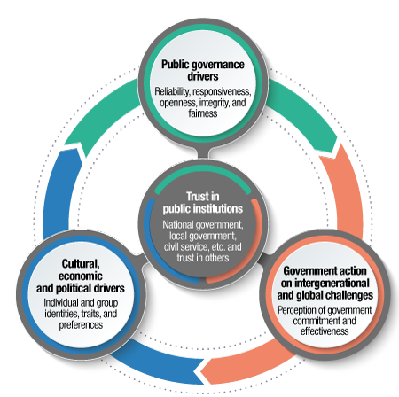
III. 1. Can law generate political trust?
The drivers of trust
Drivers of trust OECD

Slide 18
III. 2. The gap between normative and empirical approaches to generate political trust
How can law restore trust?
How can law restore trust? | constitutional law | effects of these rules | Rules that could restore trust
Represented citizens // Parliament | Reorganizing and clarifying the work of parliament Increasing control over the institution of parliament Include citizens in the parliamentary processus | Participatory or deliberative processes: positive effect on trust for those who have participated | Rules that reinforce the quality of the law, the principles of good legislation (P. Popelier) Rules that reinforce the effective exercise of Parliament's functions (elective, control, support, information, legislative) strengthen trust Rules that restore the ability of Parliament to act effectively
Represented citizens // representatives | Rules that reinforce the requirements of transparency, professional ethics, publicity, ethics and conflicts of interest | Paradoxical, counterproductive effects | Hypothesis: rules that aim to strengthen requirements in terms of conflicts of interest, ethics and transparency, and that succeed in doing so.

Slide 19
III. 2. The gap between normative and empirical approaches to generate political trust
How can law restore trust?
Citizens/ Government | Rules designed to reinforce ethics, integrity and transparency | Risks and paradoxical effects Complex relationship between ethical rules and political responsibility ("eclipse" of responsibility under pressure from deontology) Ineffectiveness | Reinforcement of responsibility, reactivity and rules readability Reinforcement of capacity of action

Slide 20
Conclusion

Slide 21
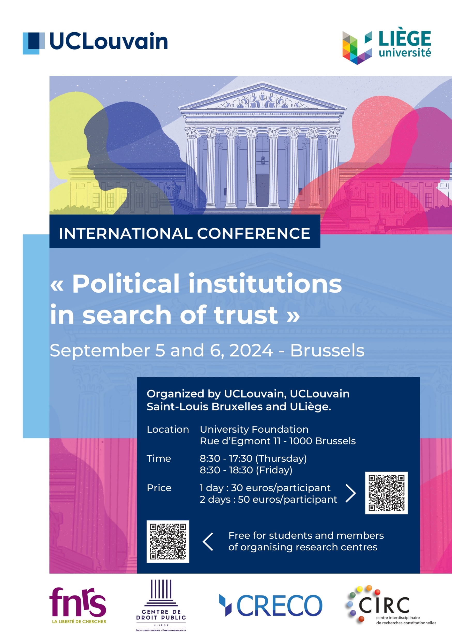

Slide 22
Many thanks
✉ celine.romainville@uclouvain.be
✉ lena.geron@uliege.be

