Slide 1
PARAMETRIC EXPERIMENTAL STUDY ON GLT COLUMNS STABILITY
DURING NATURAL FIRE TESTS INCLUDING THE COOLING PHASE
Silvio RENARD, Fabienne ROBERT Fire Testing Centre, CERIB France
Thomas GERNAY Johns Hopkins University USA
Jochen ZEHFUSS Techn. Univ. Braunschweig Germany
Robert MCNAMEE RISE Res. Inst. of Sweden and Lund Univ. Sweden
Patrick BAMONTE Politecnico di Milano Italy
Jean-Marc FRANSSEN Univ. of Liege Belgium

Slide 2
1. The context
1. The context
1.1 Unprotected Glue Laminates Timber columns
in short, unattended non-standard fires
T
Fire Resistance Rating
time

Slide 3
1. The context
1.1 Timber columns in non-standard fires
1.2 General concern
1) The heat wave continues propagating in the section after the peak of the fire.
2) Temperatures in the centre of a timber section as low as 200°C or 100°C
lead to a significant reduction of compressive strength.

Slide 4
1. The context
Green zone = 0,2 to 0,5 FRR
1.1 Timber columns in non-standard fires
1.2 General concern
1.3 Numerical analyses with SAFIR®
Gernay, Fire resistance and burnout resistance of timber columns, Fire Safety Journal, 122, 103350, 2021
T
Fire Resistance Rating
T
Fire Resistance Rating
t
t
DHP
DHP

Slide 5
1. The context
1.1 Timber columns in non-standard fires
1.2 General concern
1.3 Numerical analyses with SAFIR®
1.4 Furnace tests (iBMB, Braunschweig)

Slide 6
Gernay et al., Experimental investigation of structural failure during the cooling phase of a fire: Timber columns, Fire and Materials, 1-16, 2022
Loaded unprotected GLT Column, 28 cm x 28 cm, designed to have a FRR of 60 minutes.
Rmean = 56,5 min.
(55 and 58 min.)

Slide 7
Same columns, heating for 10 minutes (0,18 x Rmean) => cooling at -10°C/min
-10°C/min
No collapse
(2 specimens)
10

Slide 8
Same columns, heating for 15 minutes (0,27 x Rmean) => cooling at -10°C/min
Collapse after 98 and 153 minutes (2 specimens)
-10°C/min
15

Slide 9
1. The context
1.1 Timber columns in non-standard fires
1.2 General concern
1.3 Numerical analyses with SAFIR®
1.4 Furnace tests (iBMB, Braunschweig)
1.5 Compartment fires (CERIB, France), series 1.
Robert et al., Natural fire tests on GLT columns including the cooling down phase, WCTE, Oslo 2023, 1848-1854

Slide 10
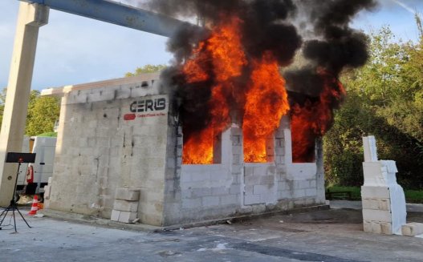
The compartment
Length: 6 meters
Width: 4 meters
Height: 3,10 meters

Slide 11
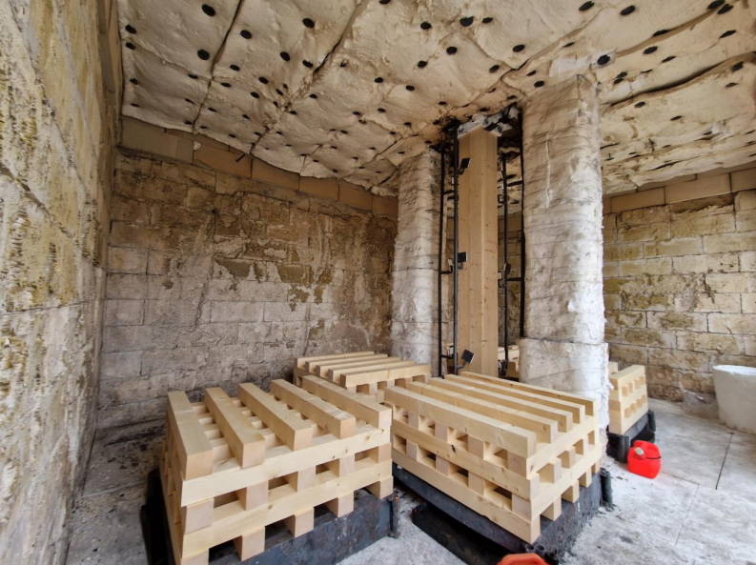
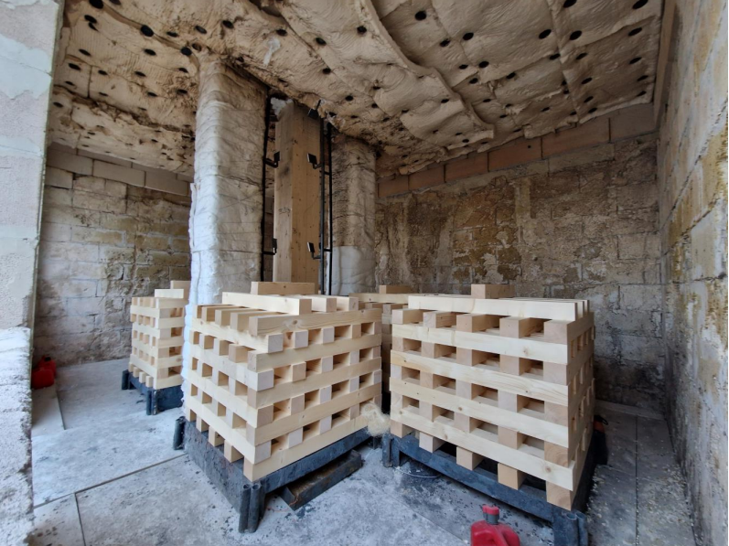
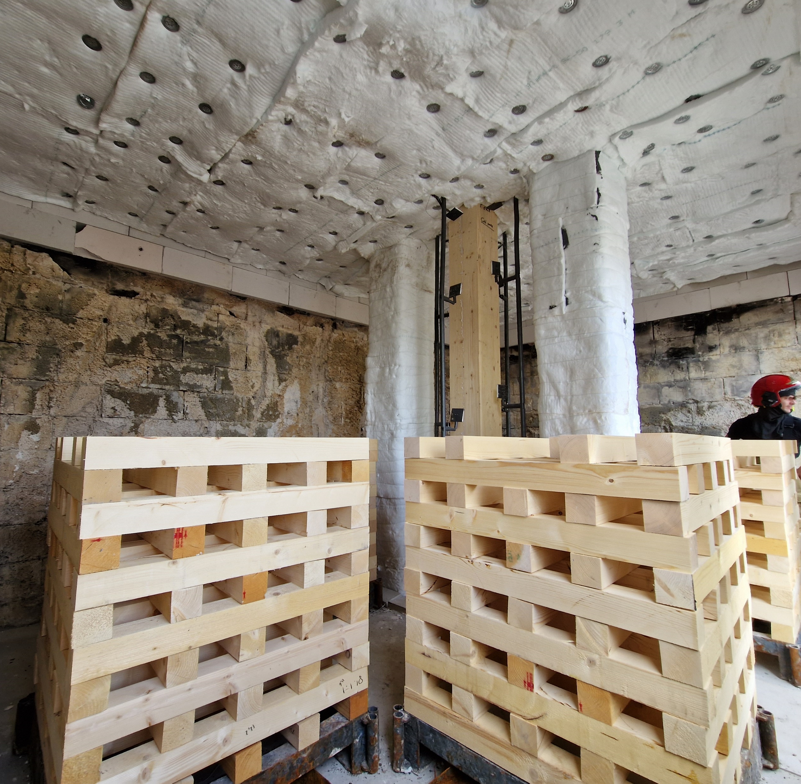
The fire loads
420 MJ/m²
Average value for offices in EC1
1 test
780 MJ/m²
≈ average value for dwellings in EC1
5 tests
950 MJ/m²
≈ 80% fractile for dwellings in EC1
1 test

Slide 12
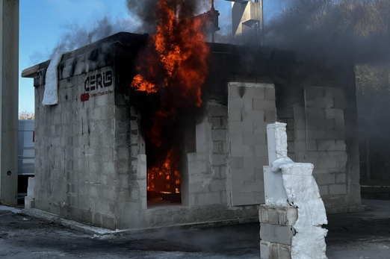
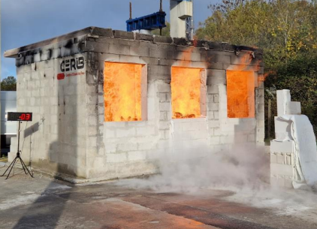
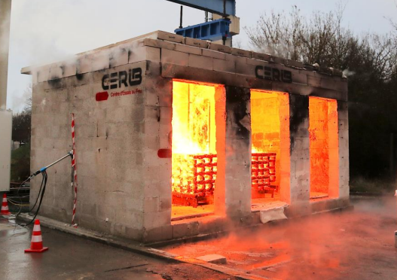
The openings
O = 0.032 m^0.5: 1 test
O = 0,065 m^0.5: 5 tests
O = 0.144 m^0.5: 1 test

Slide 13
The column
L = 3,72 meters - Pinned-pinned;
N = 322 kN - e = 20 mm / 20 mm
Section;
28 x 28 cm² : 5 tests (same as in Braunschweig)
34 x 34 cm² : 1 test
36 x 36 cm² : 1 test

Slide 14
36 x 36
Instability of the loading system ☹
34 x 34

Slide 15
1. The context
1.1 Timber columns in non-standard fires
1.2 General concern
1.3 Numerical analyses with SAFIR®
1.4 Furnace tests (iBMB, Braunschweig)
1.5 Compartment fires (CERIB, France), series 1.
1.6 Conclusions of series 1.3, 1.4 and 1.5
Timber columns can collapse in the decay or the cooling phase of a fire.
Self-extinction of the column does not solve the problem.

Slide 16
The context
New compartment fires (CERIB, series 2.)
1) Lower temperatures in the compartment: Test 17 (thicker sticks)
28 x 28 cm²

Slide 17
The context
New compartment fires (CERIB, series 2.)
1) Lower temperatures in the compartment: Test 17 (thicker sticks)
28 x 28 cm²

Slide 18
New compartment fires (CERIB, series 2.)
Lower temperatures in the compartment: Test 17
Increased section size 40 x 40 cm²: Tests 18, 19, 20

Slide 19
Test 18
Survival ☺ ….
until 11 hours 28 minutes ☹

Slide 20
Test 18
Yet, local defect in the gluing plane, filled with intumescent paint.

Slide 21
Test 18
Conclusions of Test 18:
Cannot be considered to derive a calculation method.
Influence of longitudinal cracks…
if the member is left unattended after the fire

Slide 22
Test 19 = Test 18 without any thermocouple inside
Survival ☺ ….
until 16 hours 18 minutes ☹

Slide 23
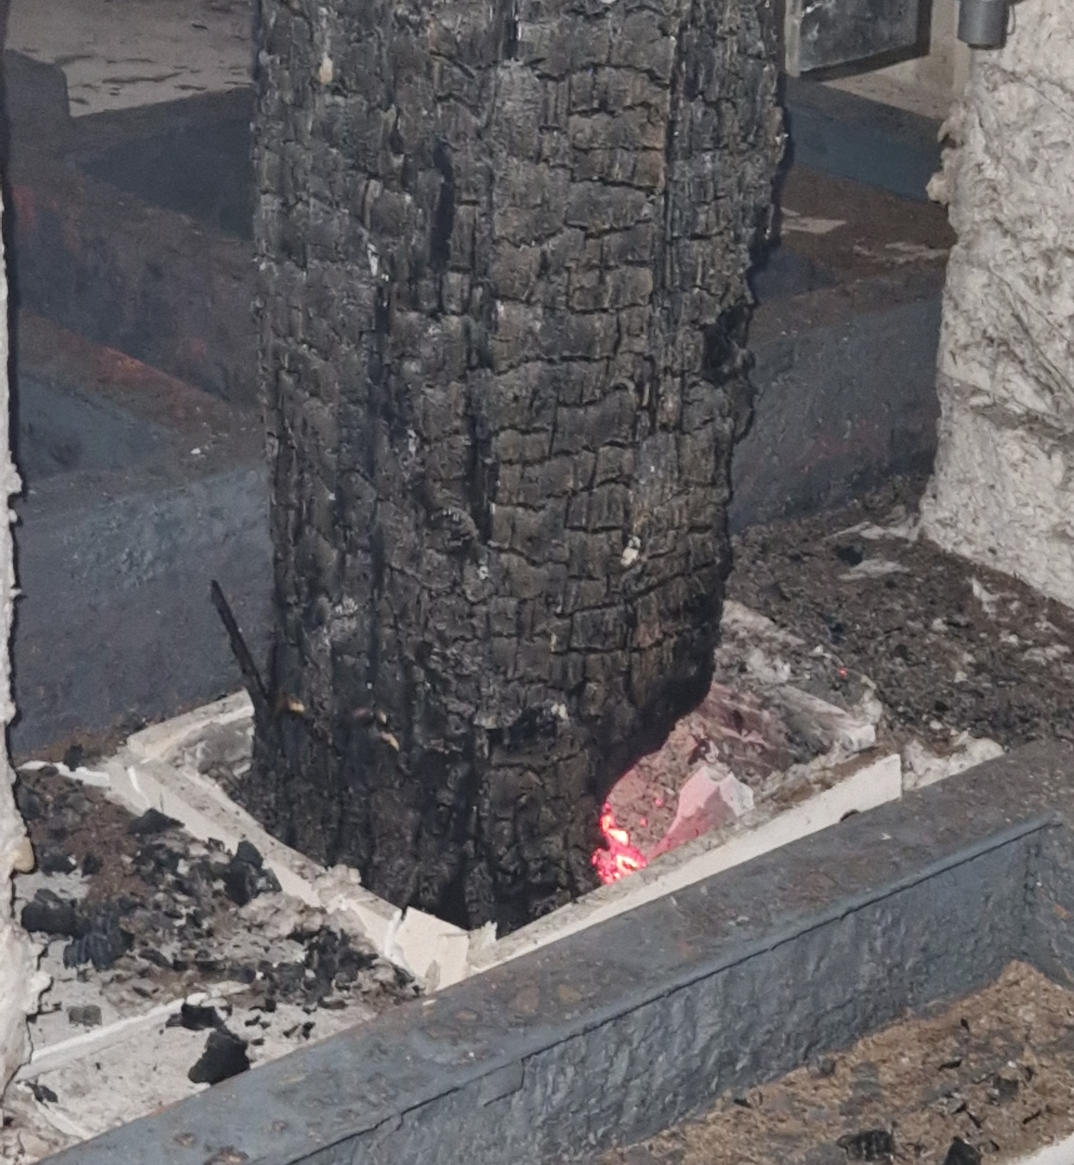
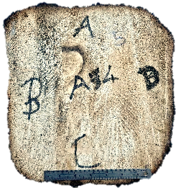
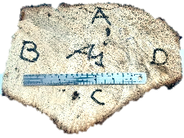
Test 19
Yet, local glowing / smouldering at the foot of the column.
Residual section
after the test
at mid-level
at the foot
Foot of the columns after the test

Slide 24
Test 19
Yet, local glowing / smouldering at the foot of the column.
Explanation
???
Also observed by
Wiesner et al., Fire Techn., 2021
Mitchell et al., FSJ, 2023
Foot of the columns after the test

Slide 25
Test 20, reduced temperatures (thicker sticks)
Survival ☺ ….
until 12 hours 18 minutes ☹

Slide 26
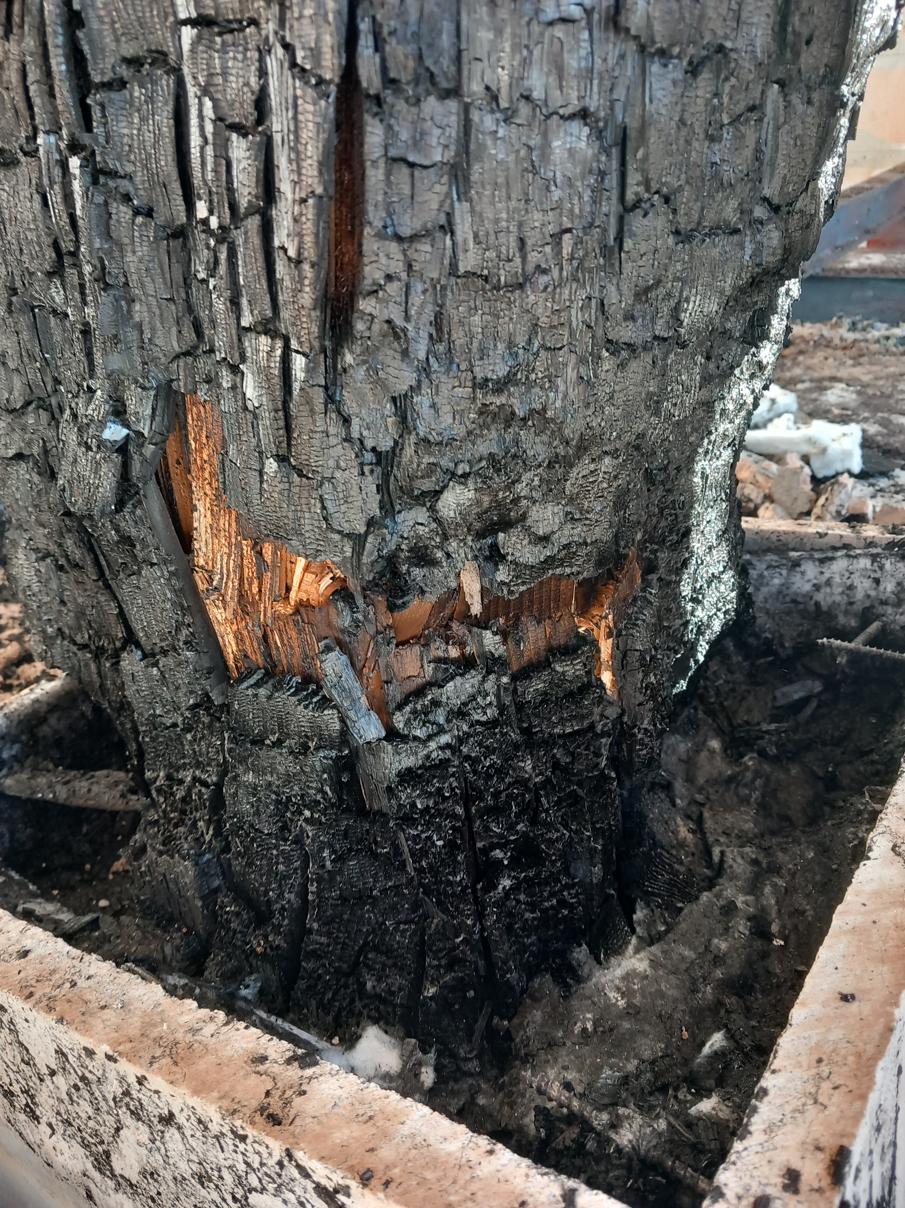
Test 20, reduced temperatures
Survival ☺ ….
until 12 hours 18 minutes ☹
Again with smouldering at the foot

Slide 27
New compartment fires (CERIB, series 2.)
Lower temperatures in the compartment: Test 17
Increased section size 40 x 40 cm²: Tests 18, 19 20
Fire fighters' intervention: Test 21 (28 x 28 cm², thick sticks)
At 35 minutes, fire fighters:
extinguished the wood cribs from outside,
sprayed the column,
Scratched the charred layers away.
Survival ☺

Slide 28
Nothwistanding this aggressive intervention (2, fire men; 1 m³ of water + scratching)
temperatures in the centre of the column increased until 4 hours !

Slide 29
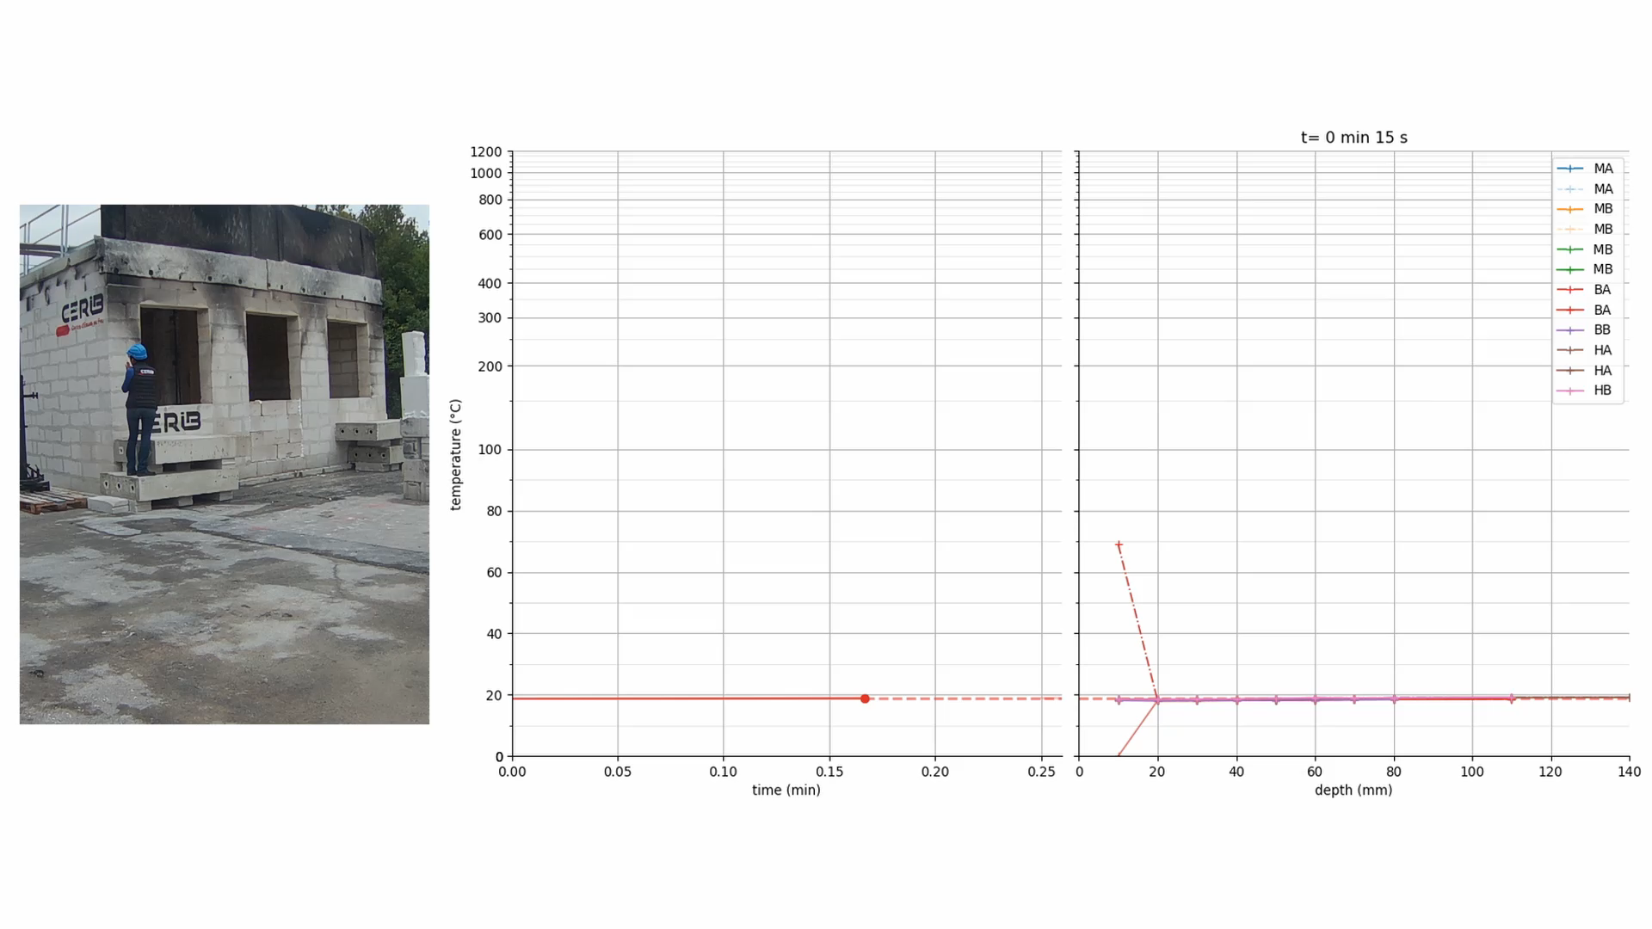

Test 21 – TCs measurement

Slide 30
Conclusions at this stage:
Collapse can occur in the decay or cooling phase of a fire.
Severe influence of longitudinal cracks.
Smouldering at the foot, still to be explained.
Never leave a timber column unattended after a fire,
collapse can occur after several hours.
Rapid extinction is a must.

Slide 31

Thank you
Test data on : https://www.burnout-resistance.eu/

