Slide 1
Geocamb, funded by the
Belgian Science Policy (Belspo)
Studying interactions of five adjacent Aquifer Thermal Energy Storage (ATES) systems in Cenozoic and Palaeozoic aquifers in Brussels (Belgium)
C. De Paoli, Ph.Orban, M. Agniel, E. Petitclerc,Th. Duren, J. Peret, A. Dassargues

Slide 2
The underground… a source of energy/storage
geothermal systems are important for decarbonizing the heating/cooling of buildings
open loop geothermal systems
efficient for high power demand
P proportional to the water flow rate Q → large pumping rate needed
need of long-term efficiency
what are the interactions between adjacent systems?
From Hoegaerden & Hagedoorn, 2007
Notes:
While the closed loop systems only use conduction between bedrock and pipes, open loop system use directly water pumped from the underground. It can thus benefit from of the high heat capacity of the groundwater. But, as the power of the system is proportional to the flow rate of water, these systems have to be installed in aquifer where the hydraulic conductivity of the media is high enough. Unfortunately, these aquifers are generally used for other uses and this can generate water use conflicts

Slide 3
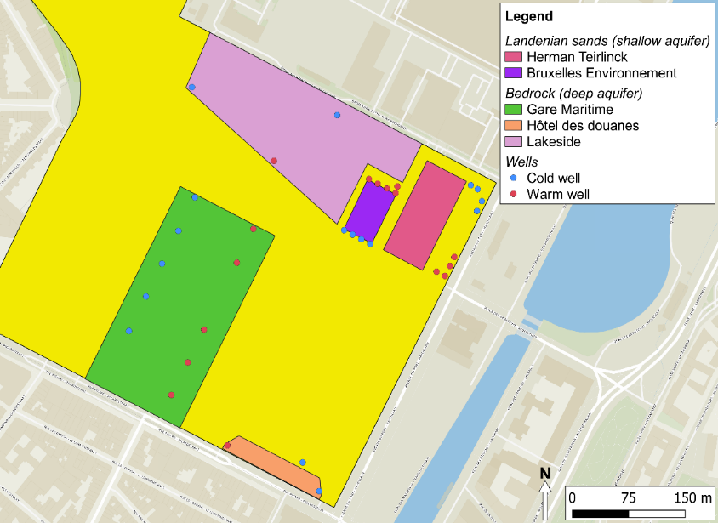
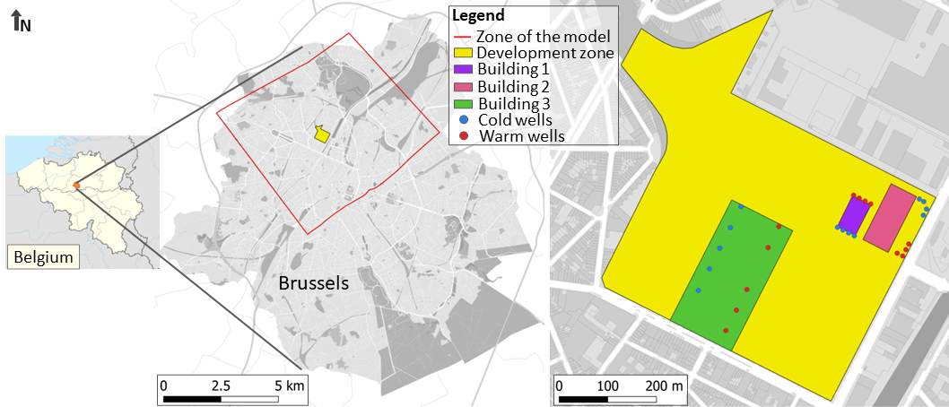
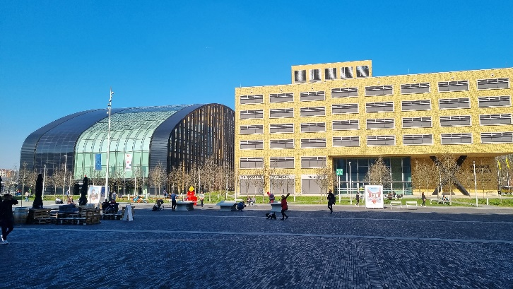
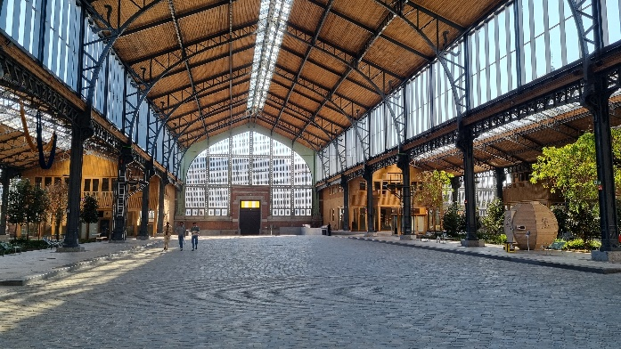
Case study: Tour & Taxi site
5
1
2
Shallow aquifer
3
4
Deep aquifer
2
1
3

Slide 4
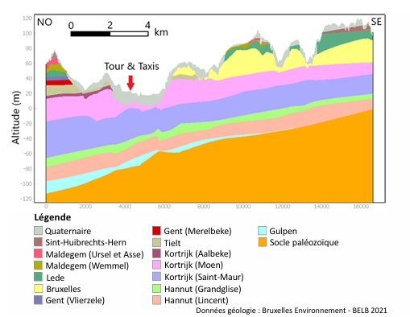
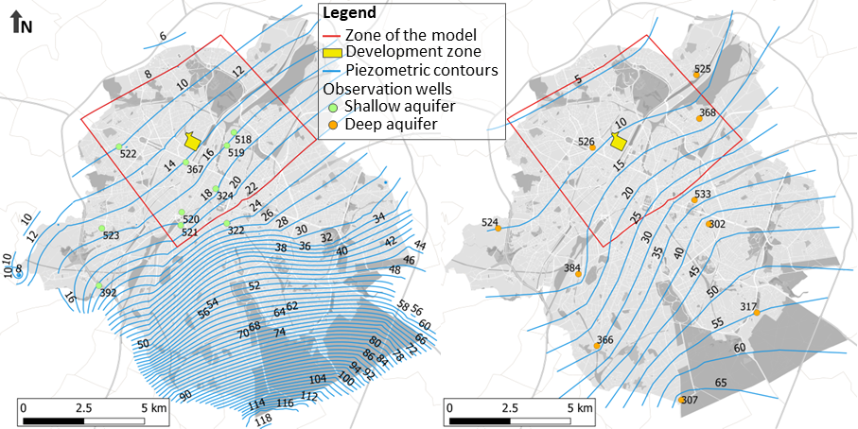
Methodology : Compilation of data

Slide 5
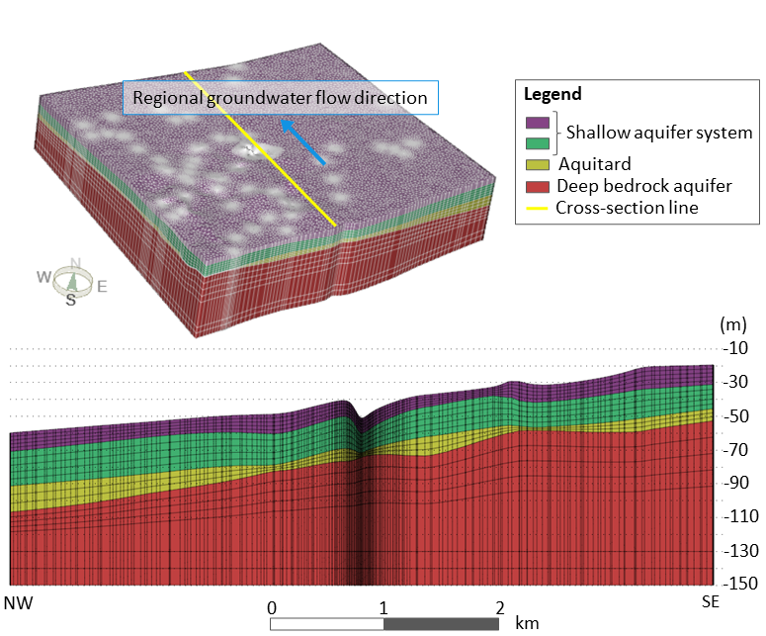
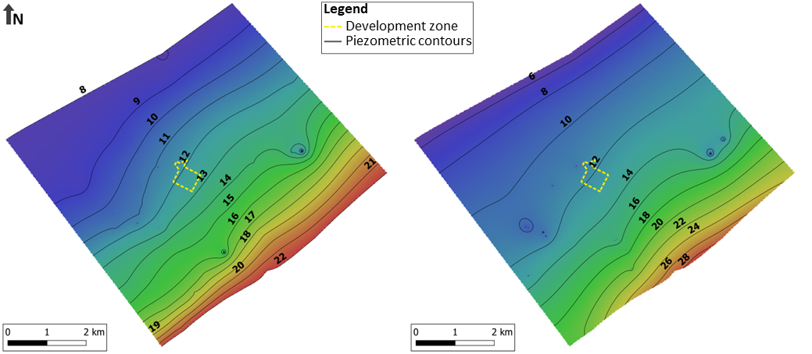
Methodology: Transient state 3D groundwater flow and heat transfer model
Feflow: 20 layers of 62,421 elements each

Slide 6
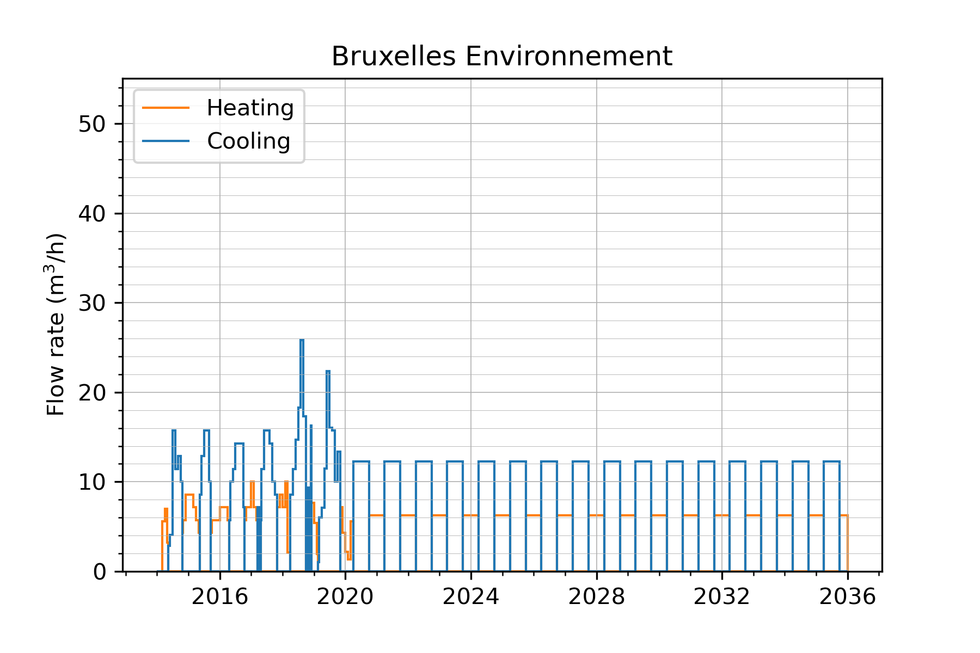
ATES main characteristics: Building 1 – based on historical data
Heating : October 1st – March 31st
Cooling : April 1st – September 30th
Start : 1 March 2014
1
Shallow aquifer, $∆T=6°C$
Cooling demand > Heating demand

Slide 7
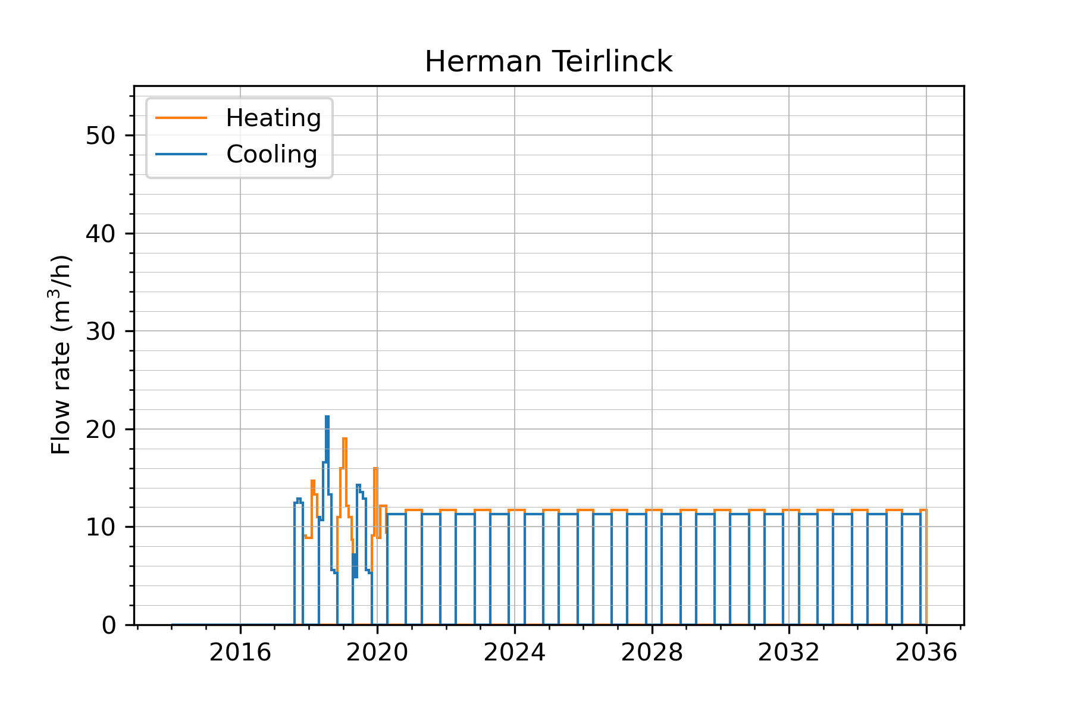
ATES main characteristics: Building 2 – based on historical data
Heating : November 1st – April 15th
Cooling : April 16th – October 31st
Start : 1 August 2017
2
Shallow aquifer, $∆T=6°C$
$$\text{Cooling} \text{demand} \text{=} \text{Heating} \text{demand}$$

Slide 8
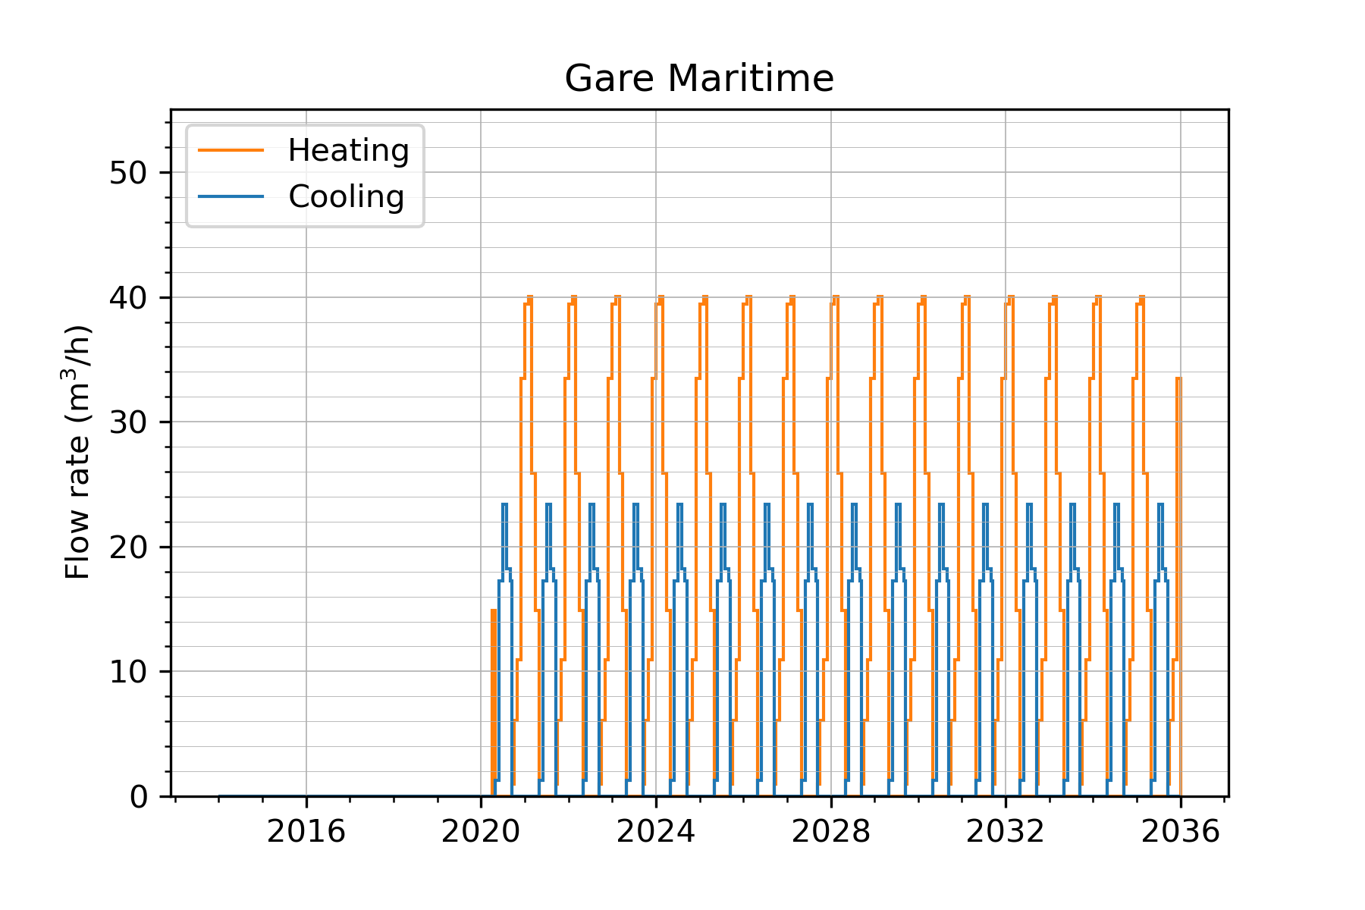
ATES main characteristics: Building 3 – based on historical data
Heating : September 15th – March 31st
Cooling : April 1st – September 14th
Start : 1 April 2020
3
Deep aquifer, $∆T=6°C$
Demand for cooling < Demand for heating
Notes:
hybrid (housing, offices, and retail space) building with large halls, more heating than cooling

Slide 9
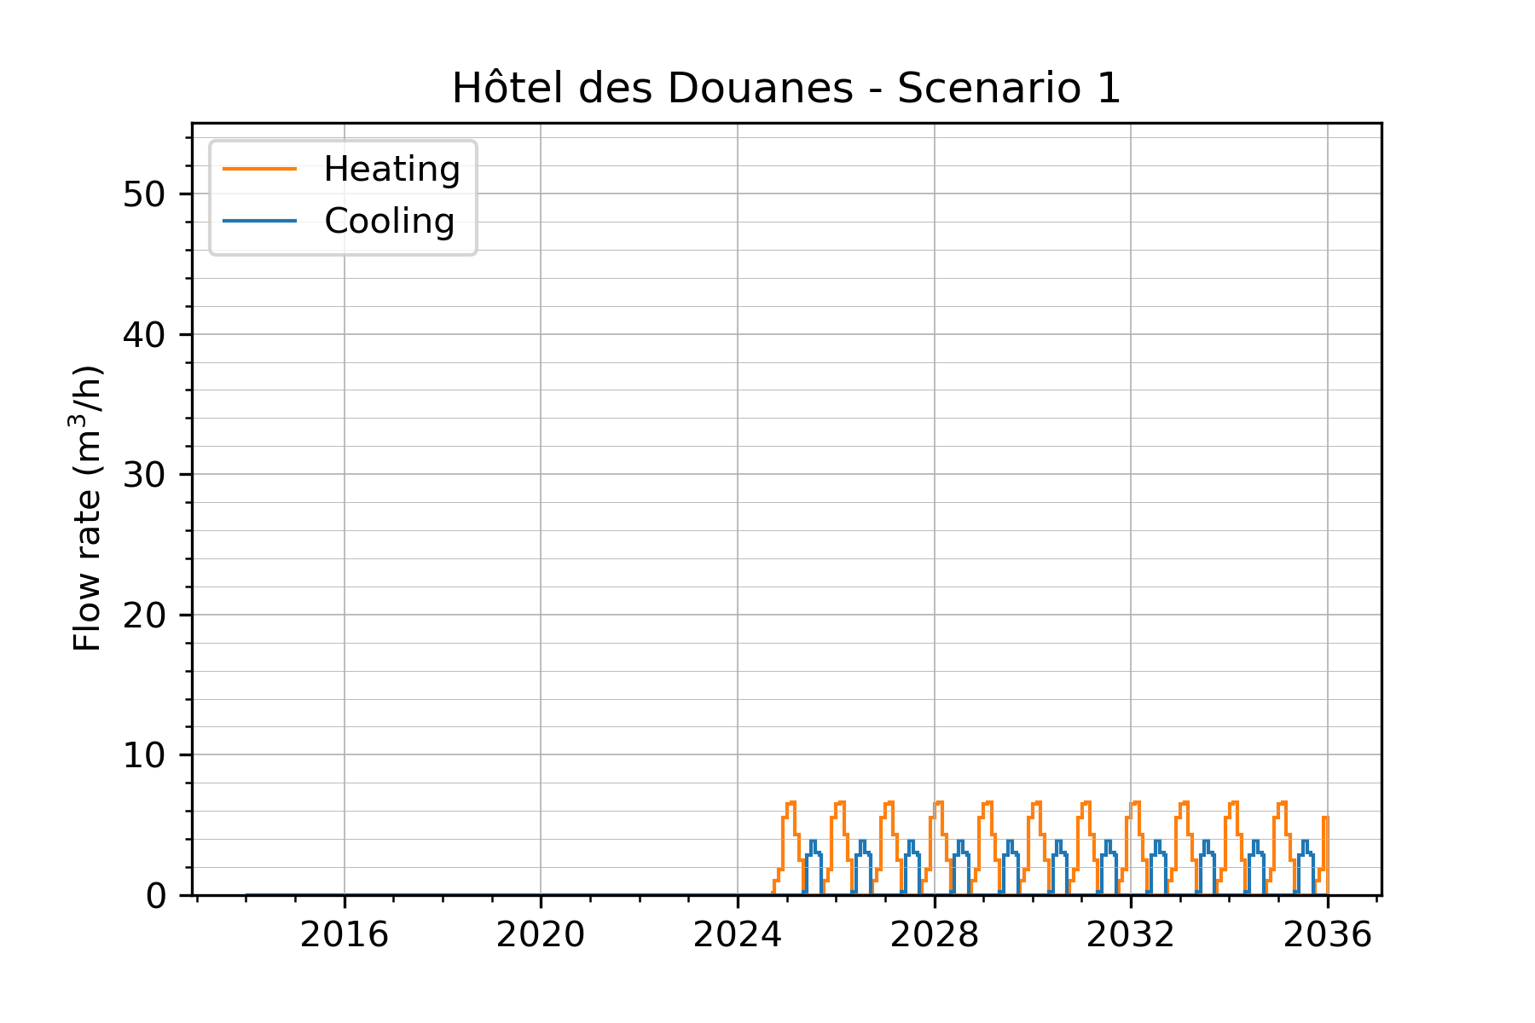
ATES main characteristics: Building 4 – Scenario 1
Heating : September 15th – March 31st
Cooling : April 1st – September 14th
Scenario1 : Same demand/surface as building 3
Start : 1st October 2024
Deep aquifer, $∆T=6°C$
Scenario 1 : Cooling demand < Heating demand
4
Notes:
Scenario 1: same demand/surface as in Gare Maritime (building 3) that is an hybrid (housing, offices, and retail space) building with large halls.

Slide 10
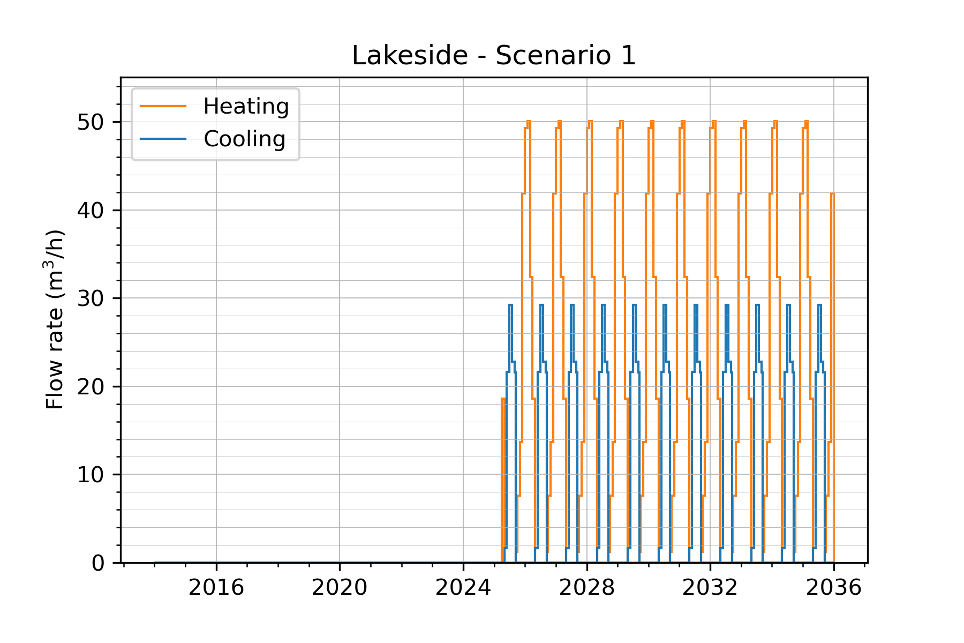
ATES main characteristics: Building 4 – Scenario 1
Heating : September 15th – March 31st
Cooling : April 1st – September 14th
Scenario1 : Same demand/surface as building 3
Start : 1st April 2025
5
Deep aquifer, $∆T=6°C$
Scenario 1 : Cooling demand < Heating demand
Notes:
Scenario 1: same demand/surface as in Gare Maritime (building 3) that is an hybrid (housing, offices, and retail space) building with large halls. Gare Maritime : 40 000 m²
Hôtel des Douanes : 6 625 m²
Lakeside (utilisation mixte) : 50 000 m²

Slide 11
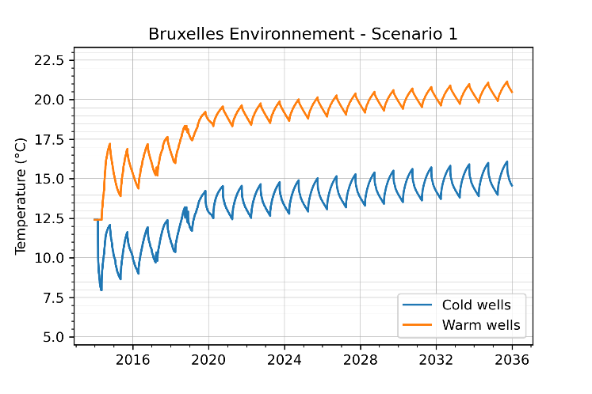
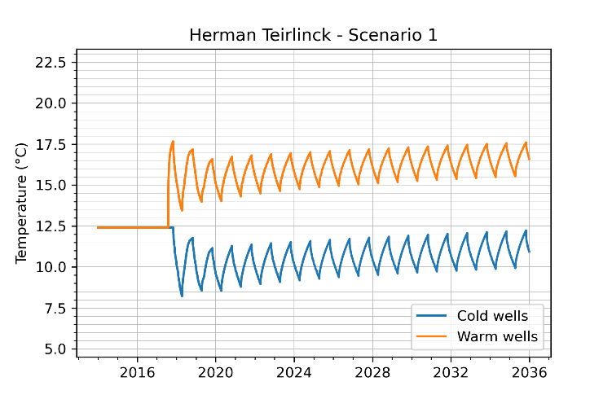
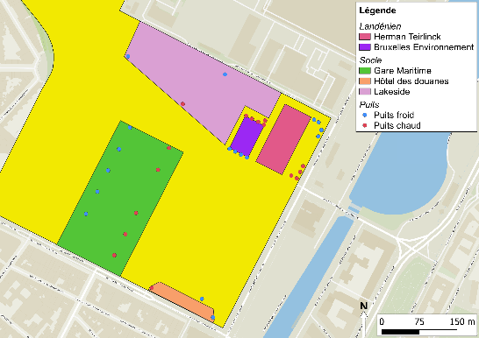
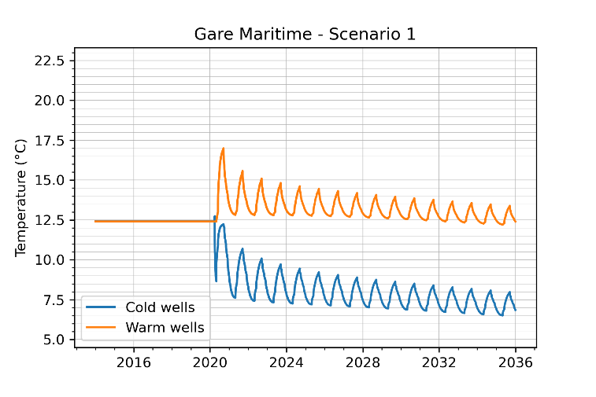
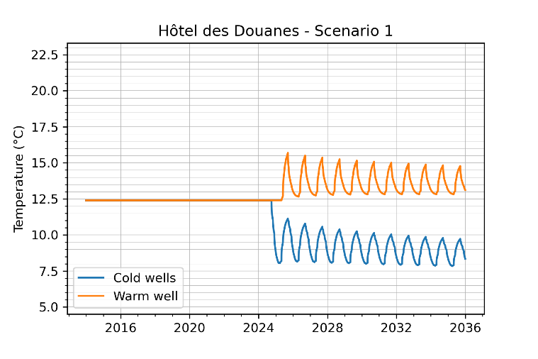
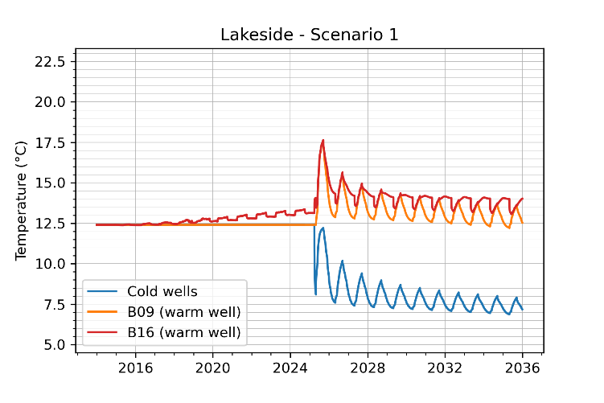
Scenario 1: shallow aquifer
Temperature evolution in the hot and cold wells
Building 1
Building 2
5
1
2
3
4
Scenario 1: deep aquifer
Building 3
Building 4
Building 5
Notes:
B16 is very close to the warm wells of Building 1 but in the deep aquifer

Slide 12
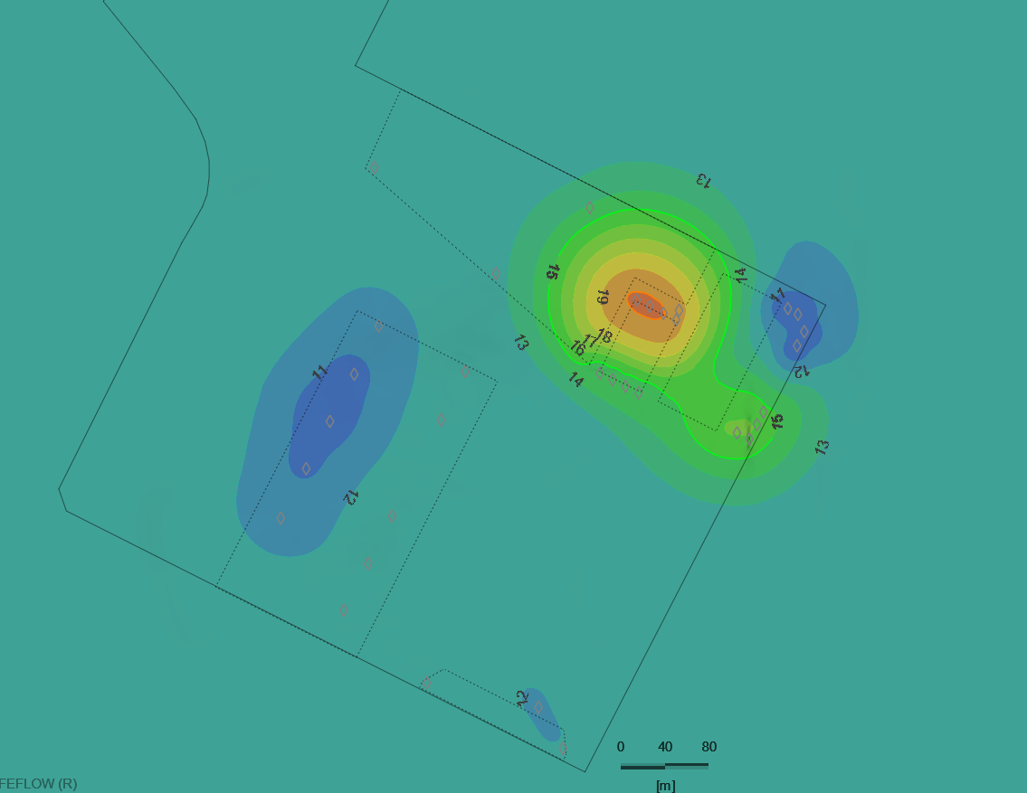
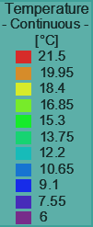
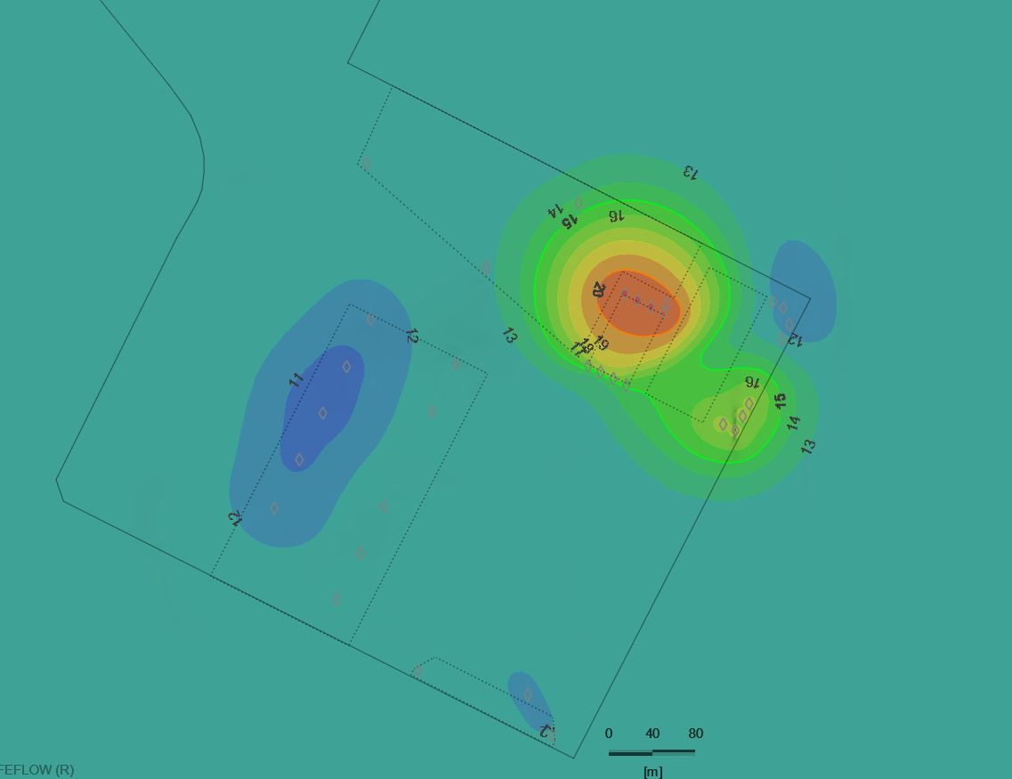
End of winter
Hot and cold plumes in the shallow aquifer – Scenario 1
after 10 years of operating building 5 (2035)
End of summer

Slide 13
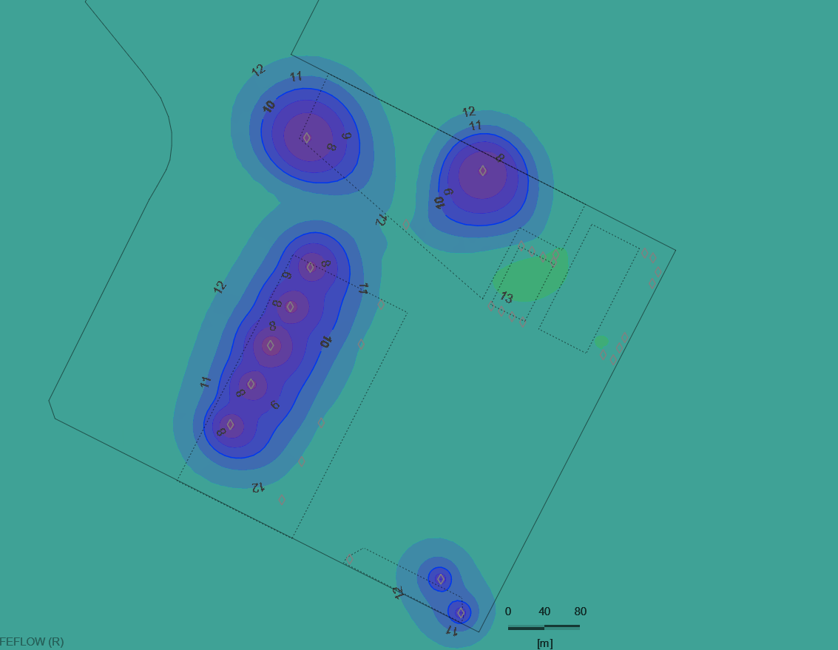
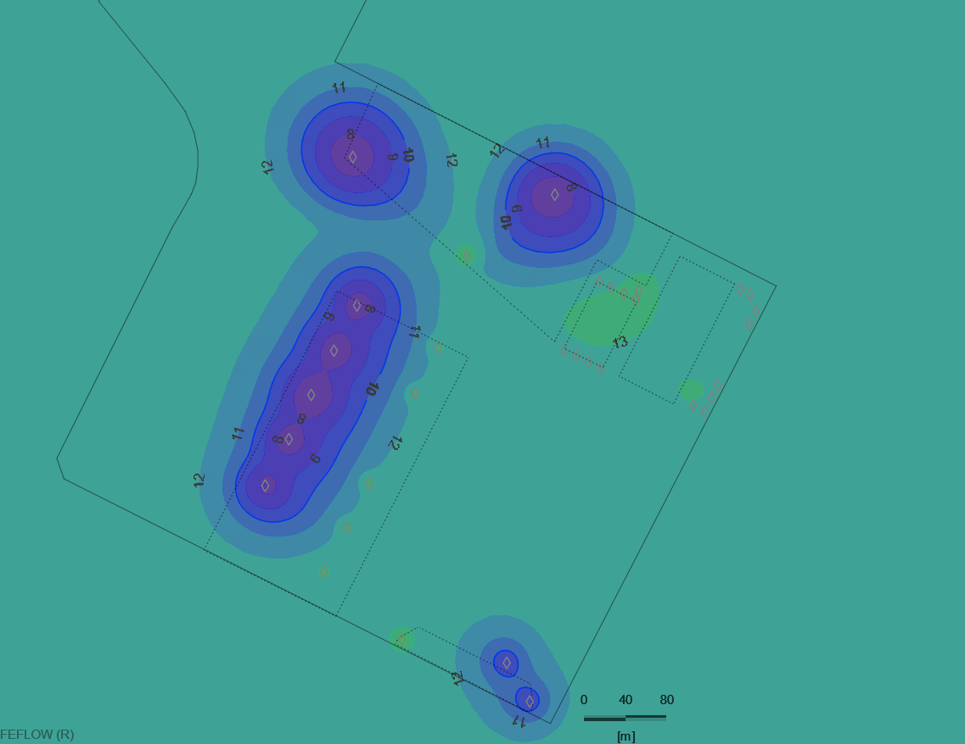
End of winter
Hot and cold plumes in the deep aquifer – Scenario 1
after 10,5 years of operating building 5 (2035)
End of summer

Slide 14
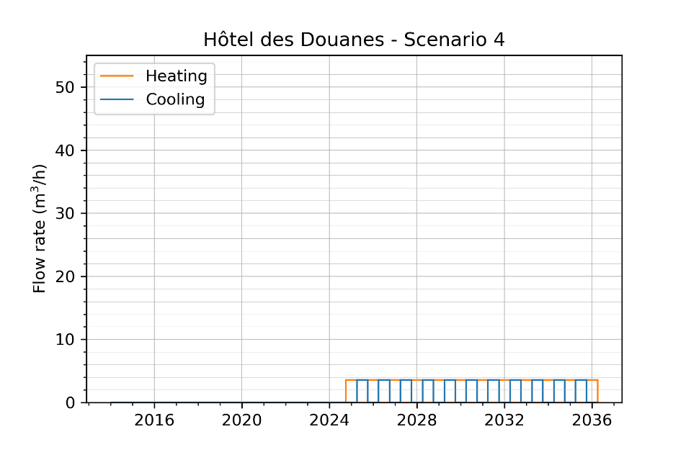
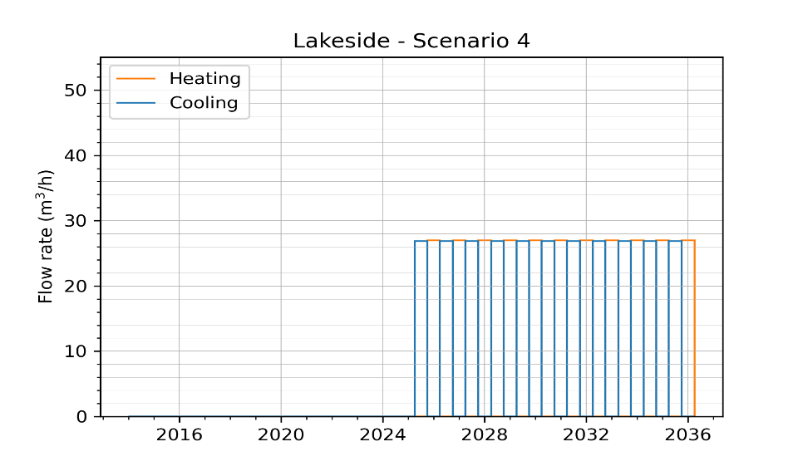
ATES main characteristics : Building 4 and 5
2
Heating : October 1st – March 31st
Cooling : April 1st – September 30th
Start : 1st November 2024
2
5
Heating : October 1st – March 31st
Cooling : April 1st – September 30th
Start : 1st April 2025
1
2
3
Deep aquifer, $∆T=6°C$
$$\text{Cooling} \text{demand} \text{=} \text{Heating} \text{demand}$$
4
Notes:
Scenario 3: yearly thermal equilibrium

Slide 15
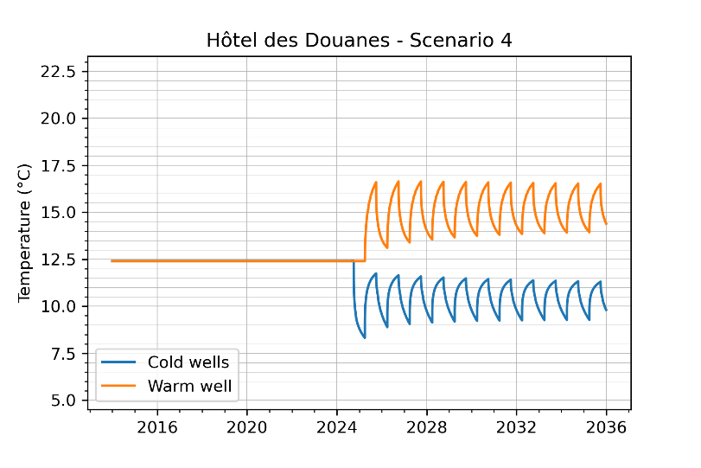
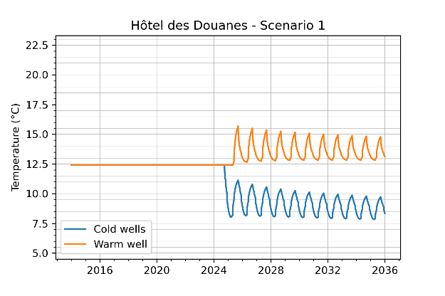
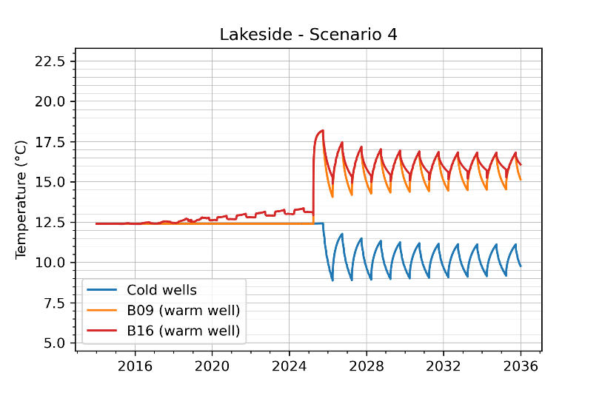
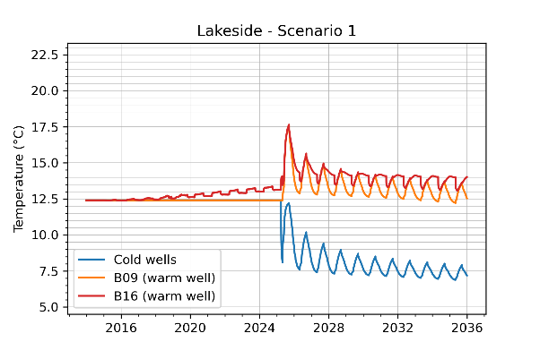
Temperature evolution in the hot and cold wells
Scenario 2: deep aquifer
Building 4
Building 4
5
1
2
3
4
Building 5
Building 5
Notes:
B16 is very close to the warm wells of Building 1 but in the deep aquifer

Slide 16
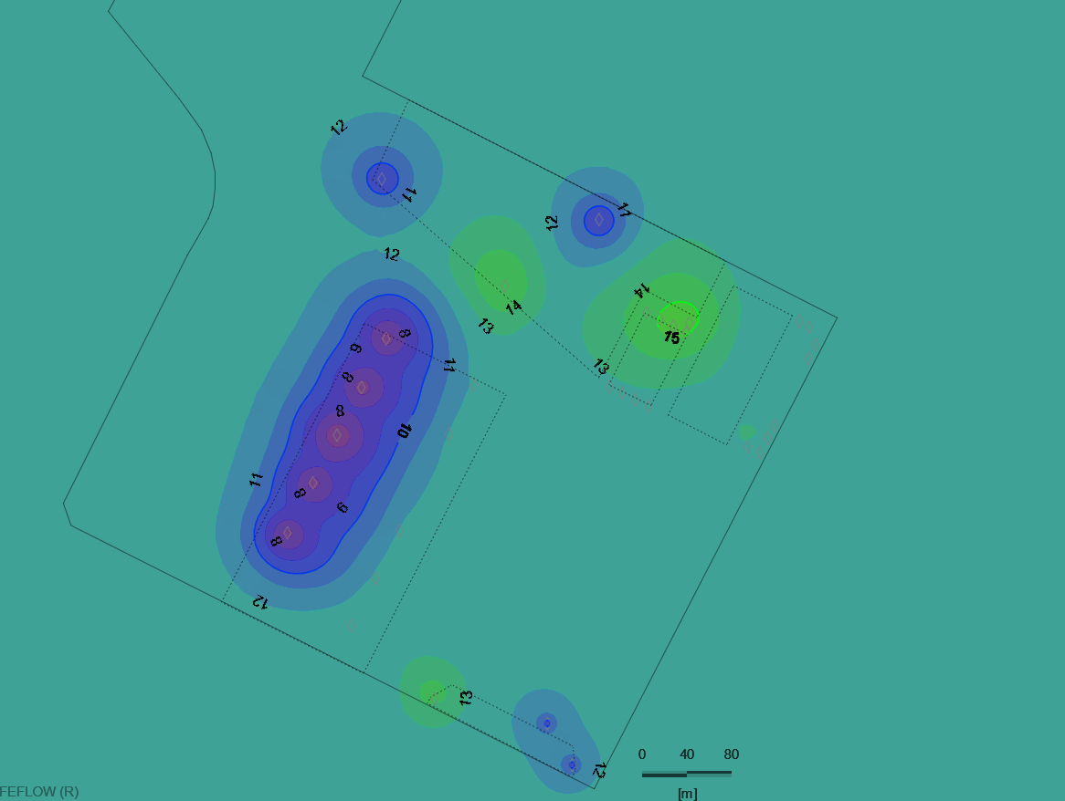
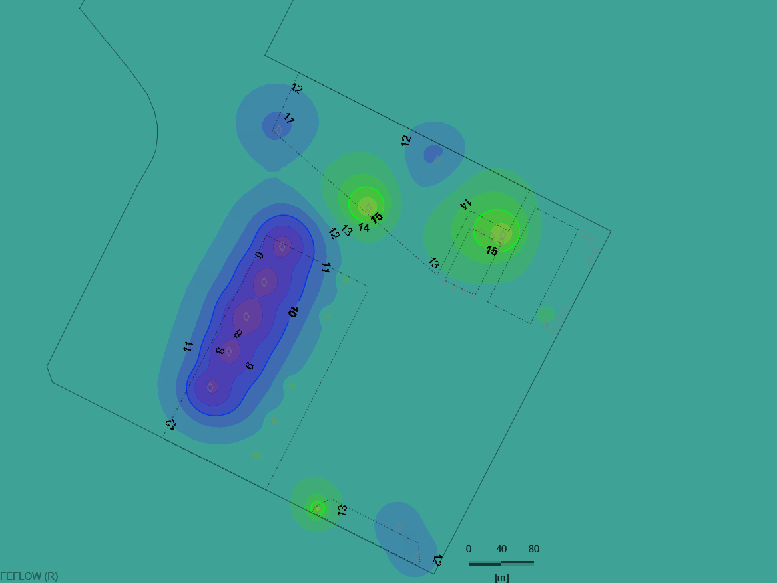
End of winter
Hot and cold plumes in the deep aquifer – Scenario 2
after 10,5 years of operating building 5 (2035)
End of summer

Slide 17
Conclusions, lessons …
Advection remains limited and the storage is efficient but the cool and heat demands have to be balanced
Limited heat transfers simulated between the two aquifers through the aquitard and no significant impact on the efficiency of the individual systems
New data should be collected (pressure and temperature in the wells) but also temperature in the aquifer
Data on the real heating and cooling demands of the buildings are needed to improve the model
Geocamb, funded by the Belgian Science Policy (Belspo)

