Slide 1
Into the depths: the challenge of belowground VOC sampling
Marie-Laure Fauconnier¹, Manon Genva¹, Clément Burgeon¹ and Benjamin Delory²
1: Laboratory of Chemistry of Natural Molecules, Gembloux Agro-Bio Tech, University of Liège, Belgium
2: Environmental Sciences | Copernicus institute of sustainable development | Utrecht University, The Netherlands
Naples 16/08/2024
Notes:
PAGE D'INTRODUCTION 1 / page permettant l'insertion du titre de la présentation ainsi que d'autres infos (date, lieu, orateur, sous-titre,…)
Si vous souhaitez modifier la photo de fond :
Allez dans le menu « Affichage » > « Masques » > « Masque des diapositives »
Supprimez l’image du drapeau déjà présente
Allez dans « Insertion » > « Photo » et chargez votre image (en veillant à la bonne qualité de celle-ci)
Placez celle-ci en « Arrière-plan » via le menu « Réorganiser »

Slide 2
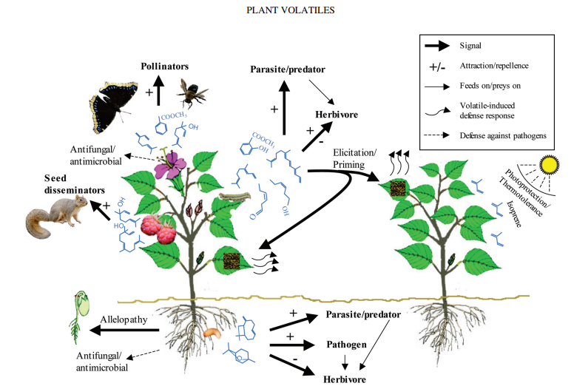

Why study belowground VOCs?
- The importance of VOCs in plant interactions with their environment
- Research mainly focuses on aerial VOCs
Critical Reviews in Plant Sciences, (2006) 25:5, 417-440

Slide 3

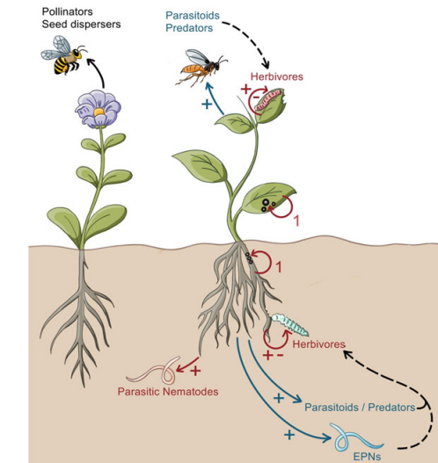
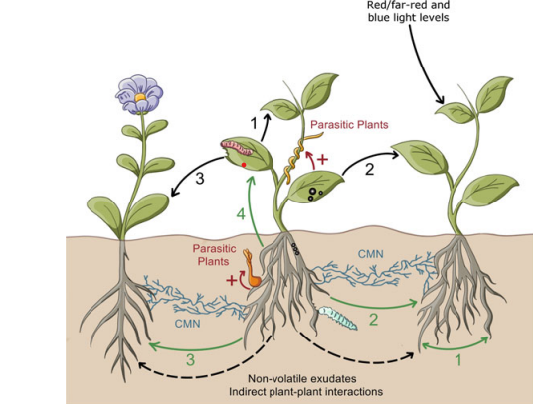
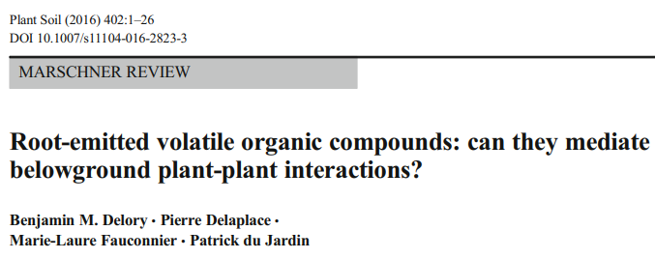
Why study belowground VOCs?
Belowground VOCs are involved in many bi- and tri- trophic interactions
Either beneficial or deleterious for plants

Slide 4
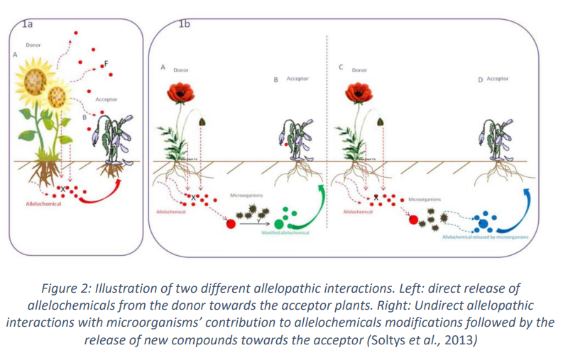
Selected examples of belowground VOCs studies: allelopathy
Allelopathy is a biological phenomenon where certain plants release chemicals (known as allelochemicals) into the environment that affect the growth, survival, or reproduction of other plants (A direct allelopathy, B indirect allelopathy).

Slide 5

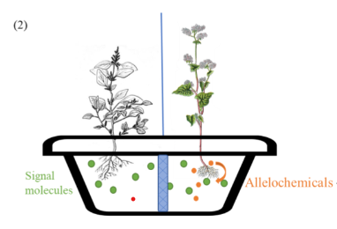
Selected examples of belowground VOCs studies: allelopathy
Not a simple “herbicide effect”, more complex plant-plant interactions
Acceptor plant
Donor plant
In induced allelopathy, signal molecules from the acceptor plant induces allelochemical release by the donor plant (non-kin recognition)
We are studying the role of VOCs as potential signal molecules or as allelochemicals

Slide 6
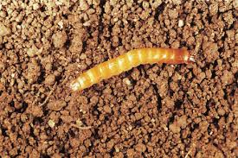
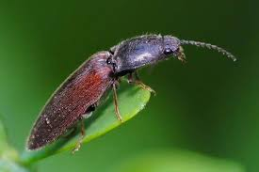
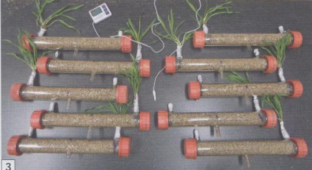
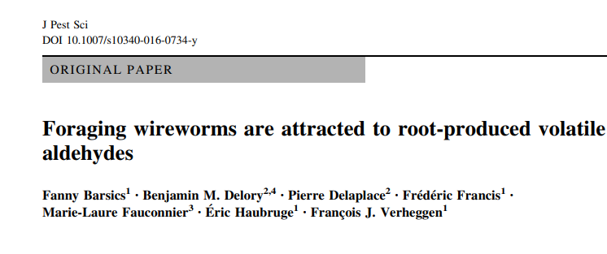
Selected examples of belowground VOCs studies: wireworm (click beetle larva)
Wireworm larvae feed on plant roots, causing significant damage to crops.
The larvae first locate the roots by detecting CO₂ and then by sensing root-emitted VOCs.
We have identified the VOCs present in crushed roots (barley, potato) that are responsible for this attraction.
Various strategies are being explored (trapping, low VOC-emitting root crop varieties, rotation with repellent crops).

Slide 7
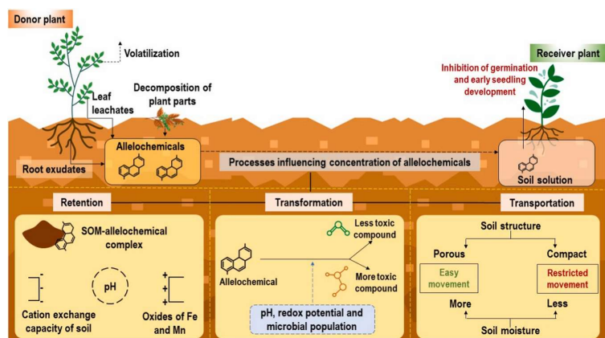
The challenge of belowground VOCs sampling
1. The soil:
very complex matrix
  VOCs can undergo
  Retention (depends on soil composition and physico-chemical parameters
  Transformation (chemically or by microorganims)
  Transportation (depends on soil structure, moisture, etc)
➔ hydropony or artificial soils (vermiculite, glass beads) but …

Slide 8
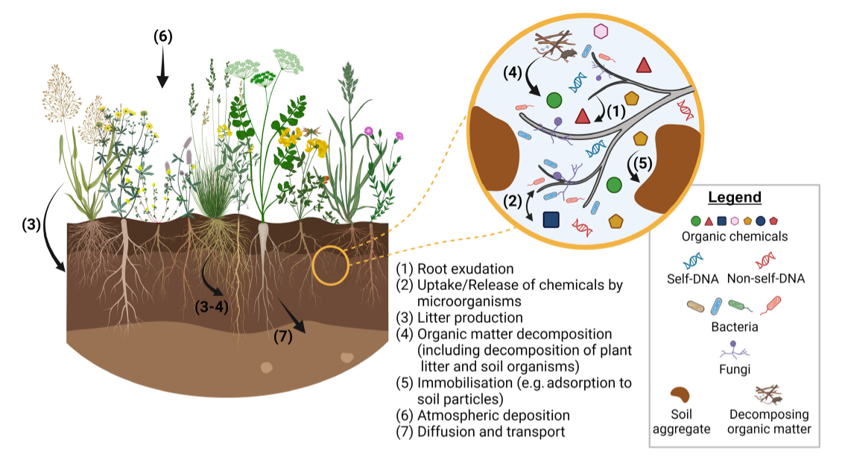

The challenge of belowground VOCs sampling
2. The plant
Important not to stress the plant by the sampling (injuries can induce VOCs production)
Important to study only one parameter (e.g. allelopathy and not water/nutriment/light competition
Soil legacy will modify plant-plant interactions (order can be important)
Delory et al.

Slide 9
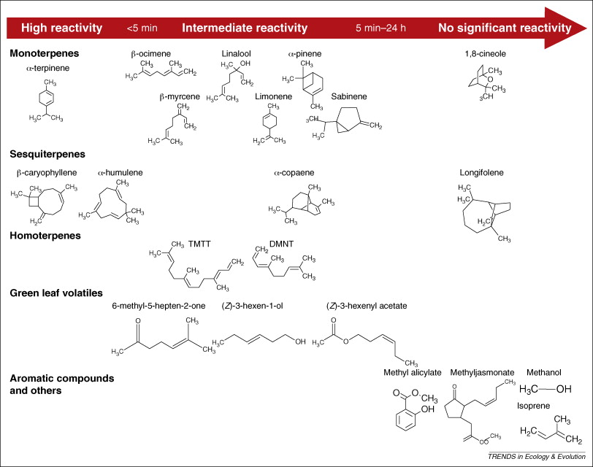
The challenge of belowground VOCs sampling
3. The sampling
VOCs belong to many chemical classes (mass, polarity, …)
Often present at very low concentration
Can be soluble in water or not
Difficult to distinguish what has emitted the VOCs (roots and from which plant, microorganisms, …)
Are volatile and not always stable

Slide 10

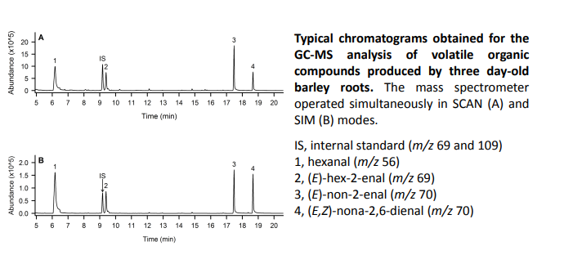
Solutions: removing roots (emission/contain)
+
Simple and cost-effective device
Clean sample
Detection of low VOCs amount
Easy, rapid, versatile
VOCs originate from roots only
Quantification is possible
Plant can be ground in real soil
No organic solvant
-
Far from biological context
Injuries can promote VOCs emission (more if crushed)
One-time only sample (SPME)
Quantification can be tricky
SPME sampling on fresh washed roots or crushed roots

Slide 11
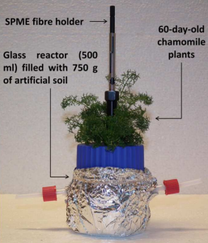
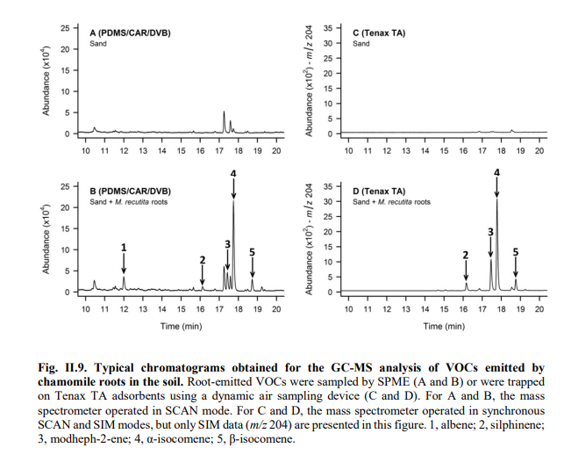
Solutions: in situ SPME sampling
The plant is grown with an inox perforated tube in the substrate ready for SPME sampling
+
More physiologic
No stress for the plant
Allow sampling at different time points
-
Still artificial substrate
Still SPME constraints
B. Delory

Slide 12
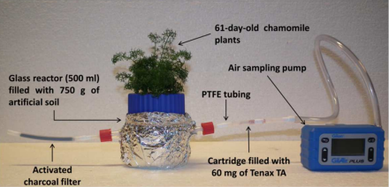
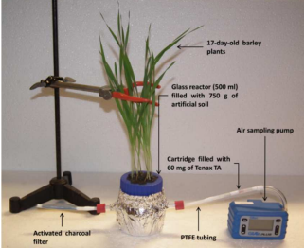
Solutions: in situ DHS sampling
Same device but DHS-TDU-GC-MS
+
Same advantages as before
Quantification easier and more acurate
-
Still artificial substrate
Air flow can stress the plant
Require additional equipment

Slide 13
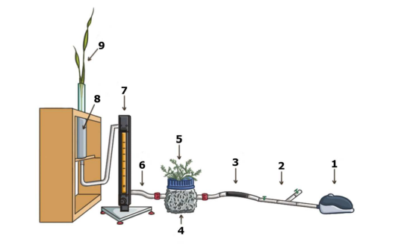
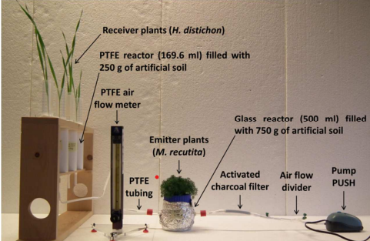
Plant-plant interactions
Experimental device designed to study plant-plant interactions mediated by root VOCs.

Slide 14
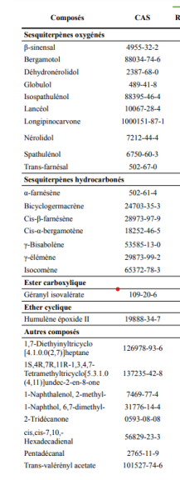
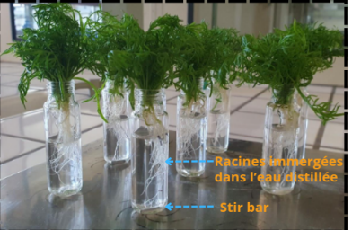
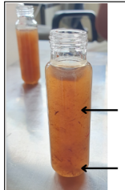
Solutions: in situ (or not) SBSE) sampling
Grinded roots
Roots
Stir Bar Sorptive Extraction
+
Versatile and easy to use
High sensitivity
-
Adapted only to liquid medium
Need for a TDU injector

Slide 15
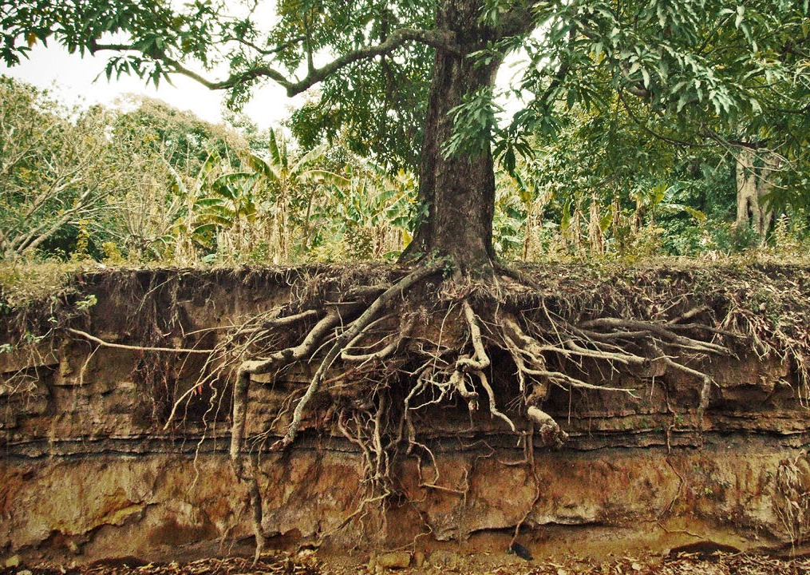
Conclusions:
VOCs are important chemical mediators in plant biotic and abiotic interactions
Belowground VOCs are understudied
Advances are made to capture and analyze soil-borne VOCs
Due to the numerous constraints no « miracle solution exist » at this time
Still a lot of work before being able to study VOCs in field conditions and to include belowground volatilomics in physiology and biodiversity research
Can VOC sensor be helpful?

Slide 16

Thank you for your attention
Grazie per la vostra attenzione
Merci pour votre attention

