Slide 1
Landmark Events in the Energy Sector:
Understanding their Effects on International Politics
Prof. Dr. Ir. Damien Ernst and Prof. Dr. Corentin de Salle

Slide 2
In this conference, we will adopt a realist approach to our analyses.
The statesman must think in terms of the national interest, conceived as power among other powers. The popular mind, unaware of the fine distinctions of the statesman's thinking, reasons more often than not in the simple moralistic and legalistic terms of absolute good and absolute evil.
Hans Morgenthau
Hans Joachim Morgenthau (1904-1980) is a theorist of international relations reknown for his academic approach, being defined as a realist one.

Slide 3
Why adopting a realist approach?
All over the world, conflicts have resurfaced. Threats are increasing everywhere. Several great powers (China, Russia, Turkey, Iran, etc) are waging war and have been making virulent declarations against “the West”, “liberal democracy” and the “moralism of human rights”.
If the EU wants to continue to defend its democratic ideals, it must become a great power again, which means a great economic, industrial and military power (with all the technology that implies). In such a context, it seems obvious that its energy policy, the success of which will condition its status as a great power, should once again be developed according to a realist approach to international relations.*
*Two elements of the EU's energy policy which illustrate the fact that it has not in the last decades adopted a realist approach to developing its energy policy: (i) the closure of existing nuclear power plants in the EU (ii) its dependence on fossil fuel imports while hampering the development of its own fossil fuel industry.

Slide 4
Organisation of this presentation
In the following, we will interlace the factual description of landmark events happening in the field of energy with discussions about the possible outcomes and the effects that these events will have on international politics and the power struggle between nations.
Five landmark events will be discussed:
Event 1: The rise of oil production in the Americas;
Event 2*: The rise of the liquefied natural gas (LNG) industry and the end of the golden age of gas pipelines;
Event 3: Prices of photovoltaic panels and batteries slashed by the mighty Chinese industry machine;
Event 4: Development of remote renewable energy hubs (RREH) for the production of carbon-neutral energy-rich molecules;
Event 5*: Military strikes on energy infrastructures.
*Events 2 and 5 have been partially caused by the “Russian-Ukrainian war”.

Slide 5
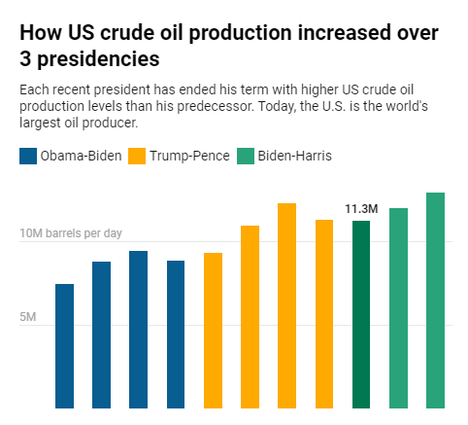
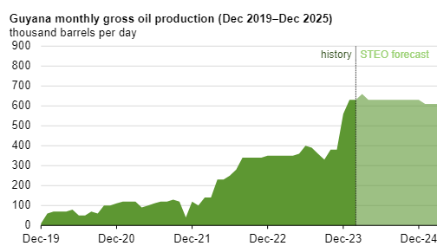
Event 1: The rise of oil production in the Americas
Oil production is increasing in North America, Central America and South America. The Americas are becoming a net oil producer!

Slide 6
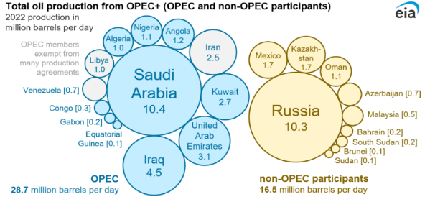
Consequences of Event 1
The United States will probably intervene much less than before in the Middle East, since it will no longer depend on this region of the world for its oil supply. Note that events occurring in this region of the globe will still affect the price that US consumers pay for petroleum-based products, but not much the US trade balance.
The power of OPEC+ to manipulate market prices through production cuts will significantly weaken. Indeed, with the increase in oil production in the Americas, these countries are losing market share and their ability to maintain high oil prices. This could result in great financial difficulties for these countries.

Slide 7
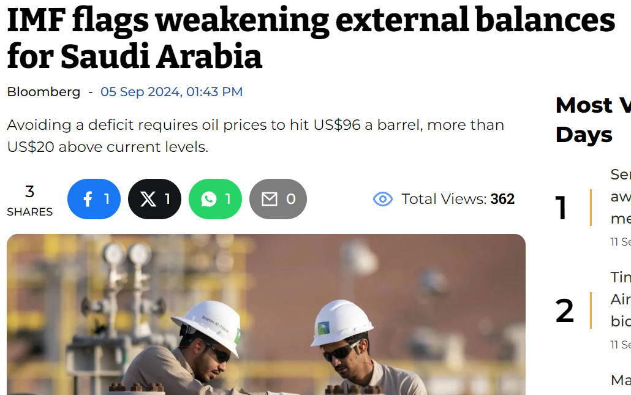

Slide 8
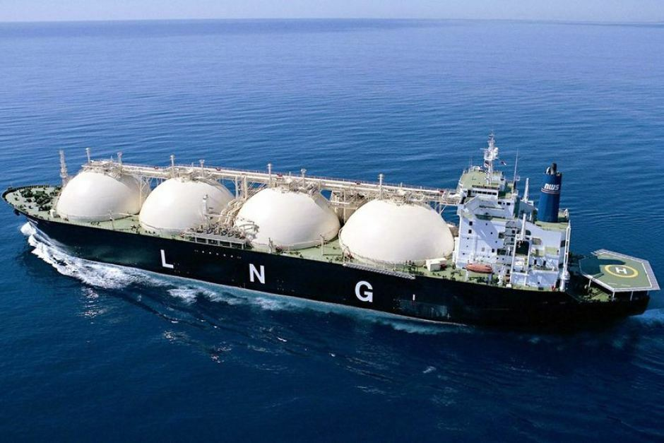
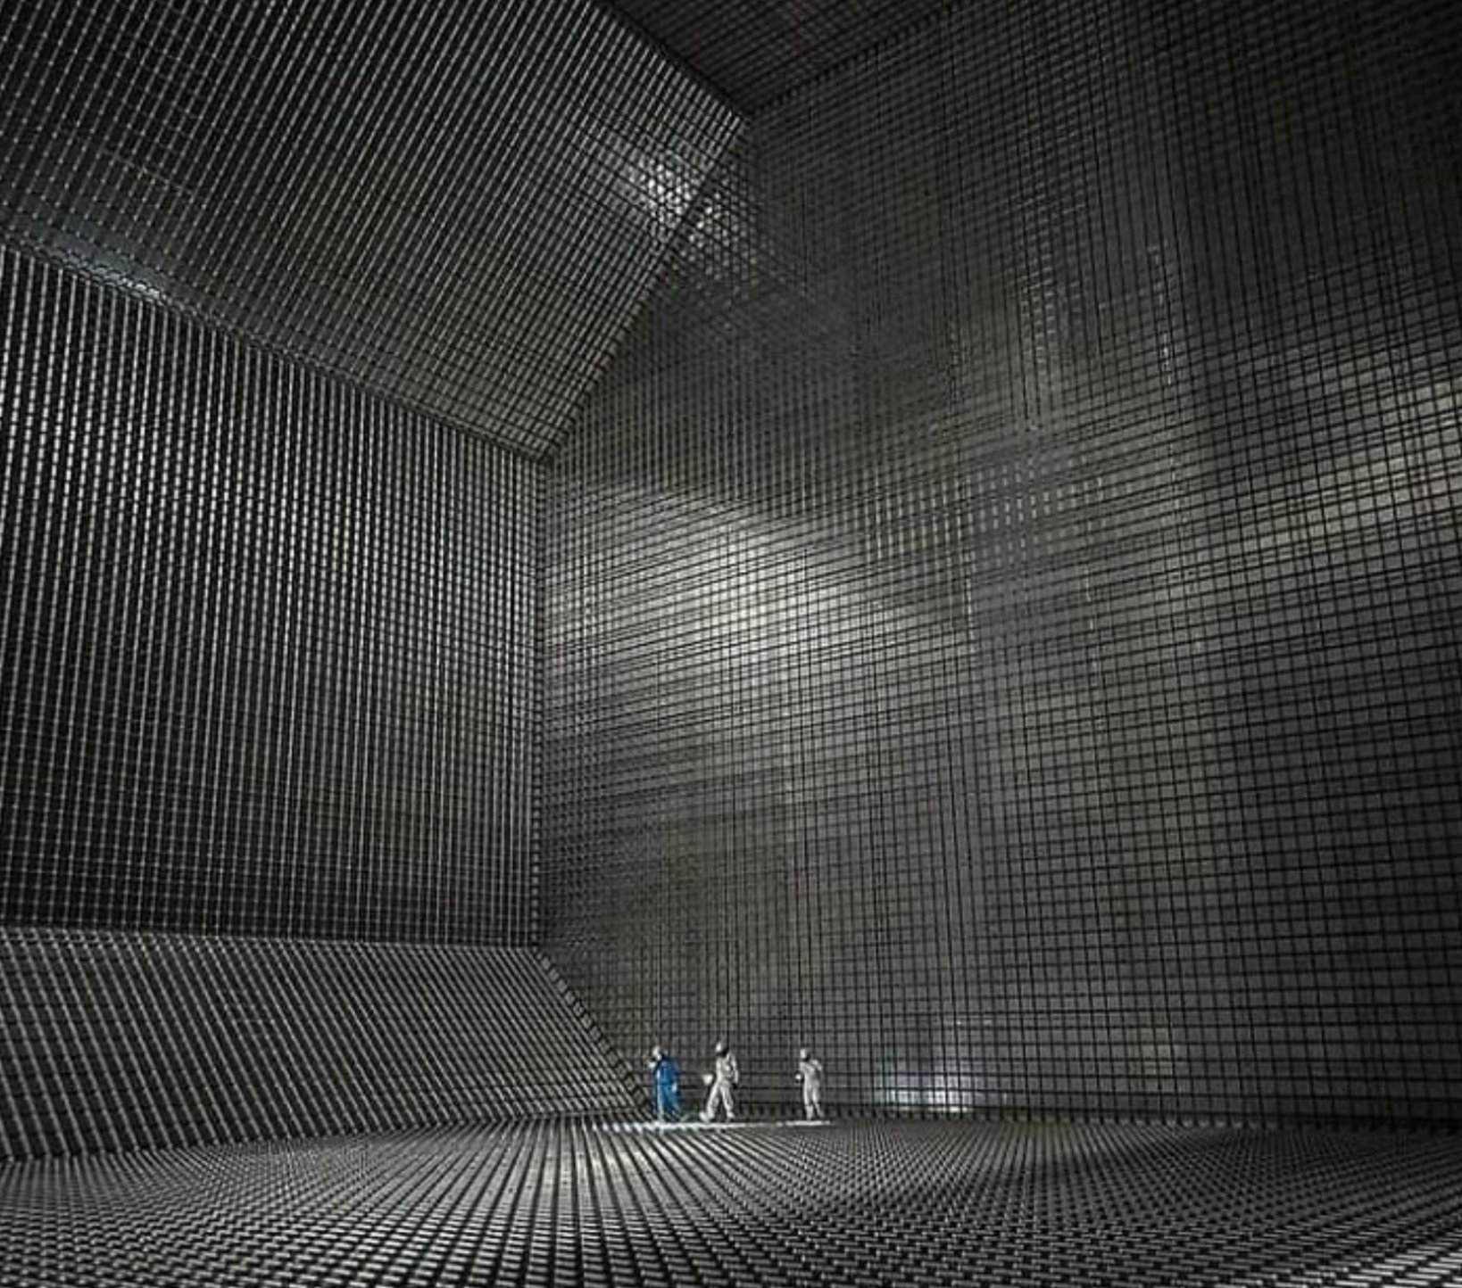
Event 2: The rise of the LNG industry and the end of the golden age of gas pipelines
Liquefied natural gas (LNG) carrier Tank of an LNG carrier

Slide 9
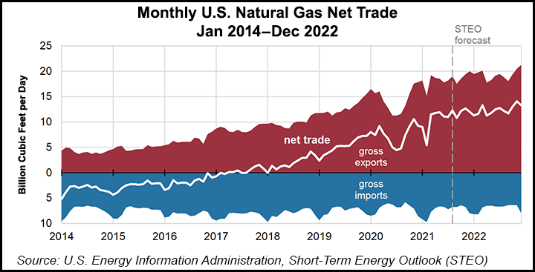
Rise driven by several factors
New cheap gas extraction technologies (e.g., fracking) are leading to new regions of the world having a large surplus of gas that can only be exported via LNG terminals.
Since the energy crisis of 2022, where Russia partially interrupted gas supplies to Europe, countries no longer want a significant volume of their gas to be imported by pipeline from a single supplier country, in which they cannot fully trust. They have more confidence in the LNG market where it is easy to change suppliers.

Slide 10
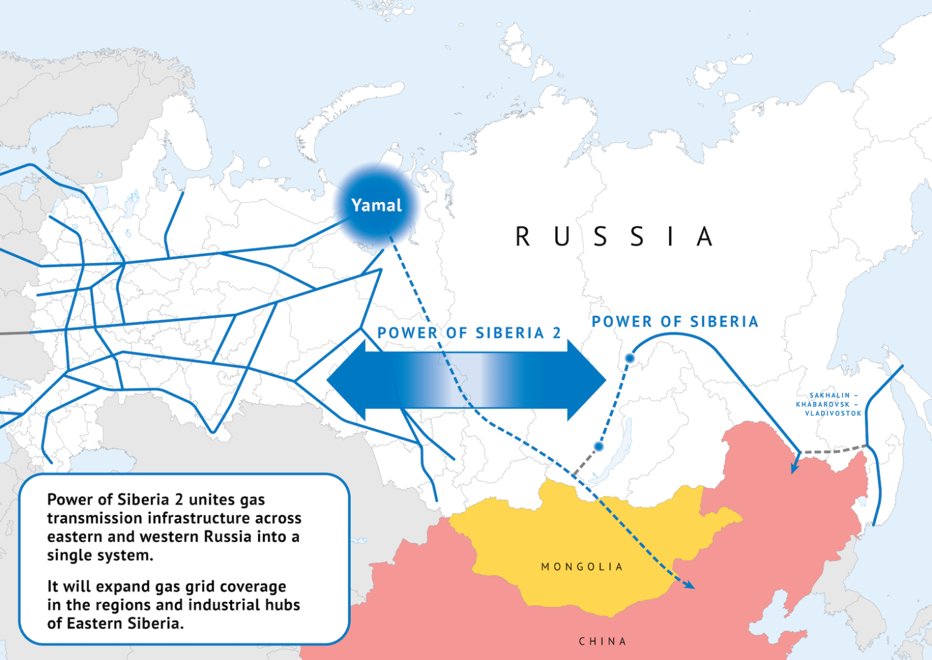
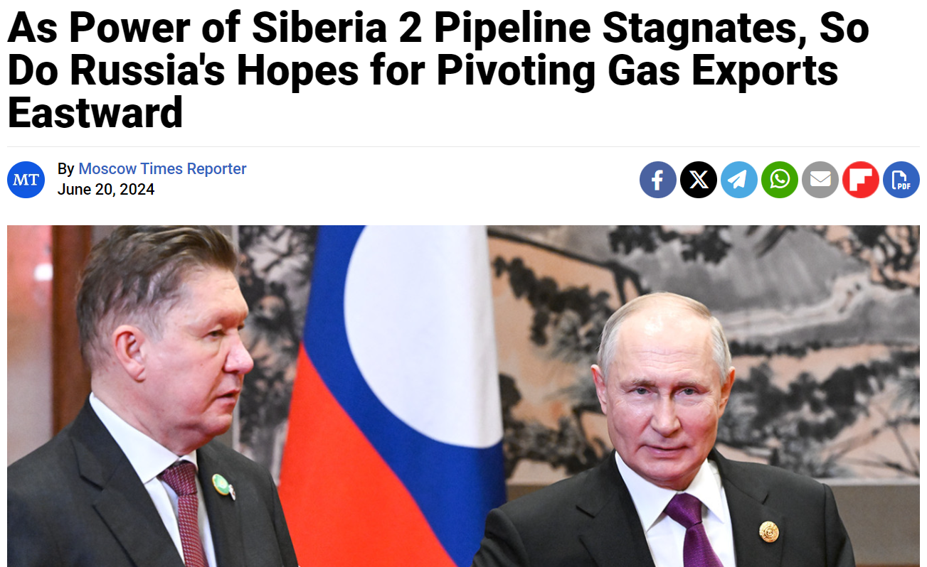
The Power of Siberia 2 pipeline will
probably never be built

Slide 11
Consequences of Event 2
The concept of a nation having significant influence over other nations because of its gas wealth will tend to disappear.
LNG prices will fall significantly. Indeed, given the number of new players in the LNG market, the price of gas is likely to converge towards the marginal production cost of the most expensive producer. Gas-rich countries could become less wealthy.
In terms of price, LNG will always be significantly more expensive than coal that only costs around 15 Є/MWh. Only gas transported by pipeline can currently compete with coal, which emits a lot of CO2. It is very likely that Asian countries will never switch from coal to gas for their electricity supply, even if coal-fired power plants emit a lot of CO2 (900 kg of CO2 per MWh of electricity produced compared to 400 kg for gas-fired power plants). This could lead to significant tension between Asia and Europe regarding climate change negotiations.

Slide 12
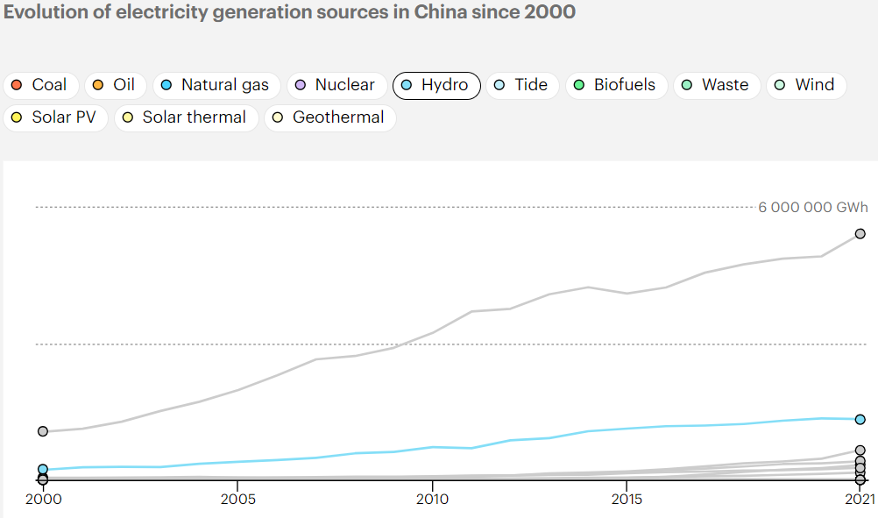
China: a wealth built on coal

Slide 13
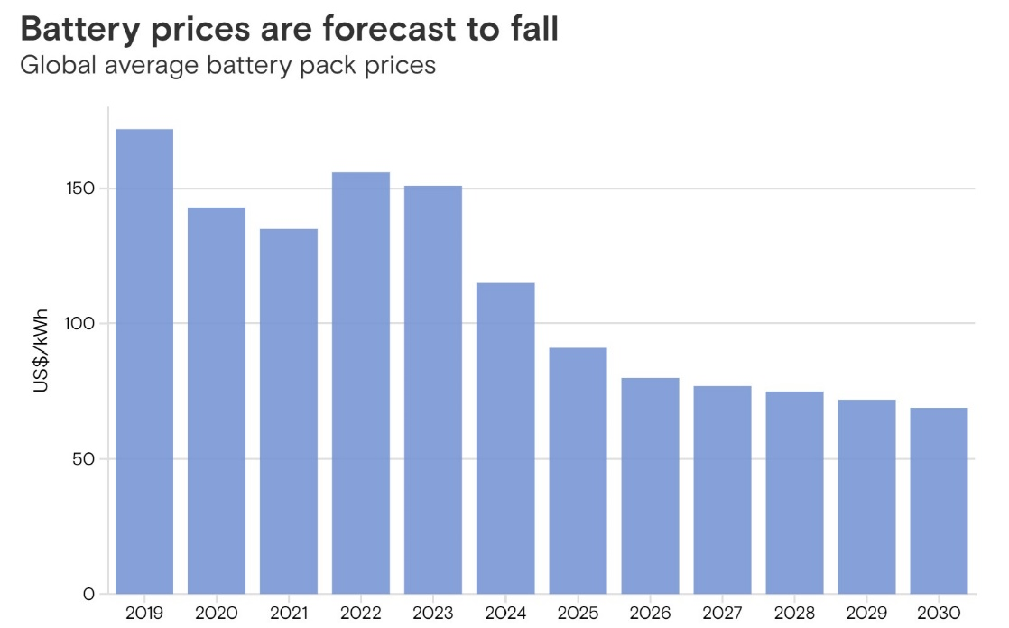
Event 3: Prices of photovoltaic panels and batteries slashed by the mighty Chinese industrial machine
PV panels now cost around 0.1Є/Wp.
In China, factories are already able to produced battery packs at around 50 Є/kwh.

Slide 14
Price for PV + battery electricity at the equator
Let us estimate the cost of the electricity produced by a PV installation of 1 MWp combined with batteries to smooth out the fluctuations energy produced by the PVs.
Let us assume a load factor of 25% for the PV panels and that they produce the same quantity of electricity everyday (reasonable assumption at the equator). We also assume that the batteries are sized for storing half of the daily amount of electricity generated. Since the 1 MWp PV installation would produce 1 x 0.25 x 24 = 6 MWh per day, that would require investing in a 3 MWh battery pack.
The CAPEX cost for the PV installation + battery pack would be: (0.1 x 1,000,000) + (3 x 1000 x 50) = 250,000 Є. By neglecting losses in the batteries, the PVs + battery pack would generate over its lifetime of 20 years 1 x 8760 x 20 x 0.25 = 43,800 MWh.
That would lead to an average CAPEX cost per MWh produced of 5.7 Є/MWh.

Slide 15
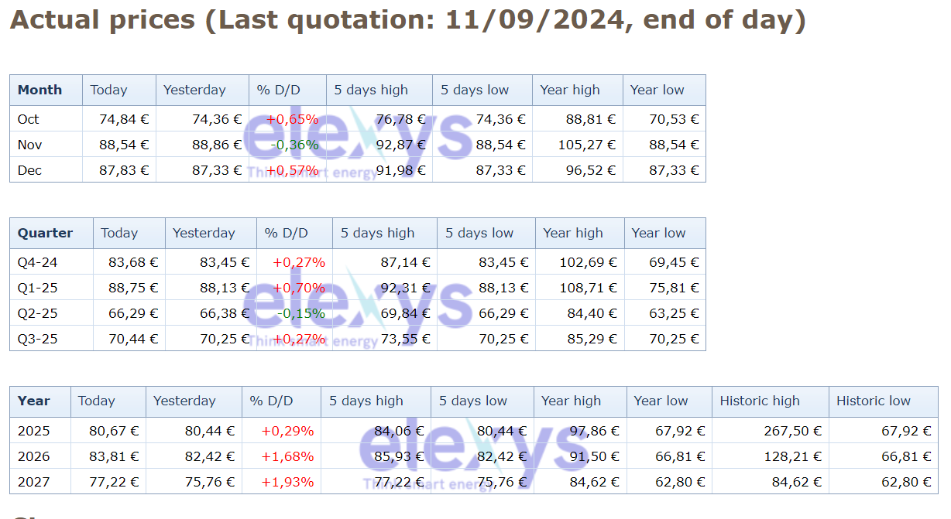
Prices for forward electricity products in Belgian in Є/MWh
Observation: it would hardly be excessive to describe electricity priced at 5.7 Є/MWh as “free electricity”.
That gives you an idea of how cheap PV panels and batteries have become!

Slide 16
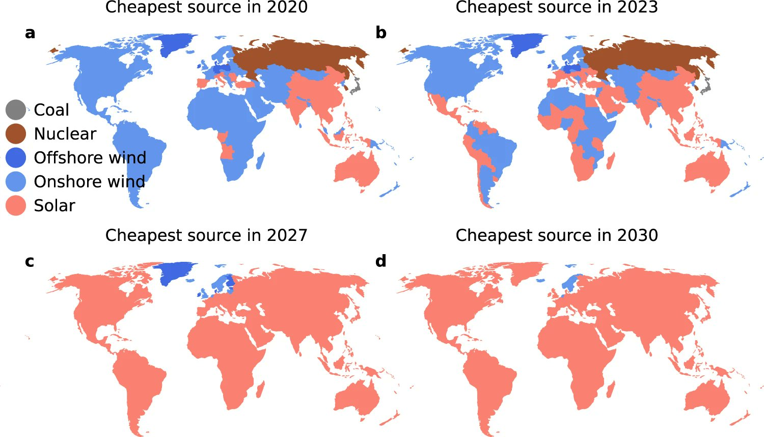
Will solar PV soon be the cheapest source of electricity in most places around the world? A recent research paper published in Nature Communication says yes. Most surprisingly this is after including short- and long-term storage costs for renewable energy sources.
Reference to the paper: Nijsse, F.J.M.M., Mercure, JF., Ameli, N. et al. The momentum of the solar energy transition. Nature Communications, 14, 6542 (2023). https://doi.org/10.1038/s41467-023-41971-7

Slide 17
Consequences of Event 3
Countries/companies that have invested in gas production by believing that gas is key to energy transition to renewables due to the flexibility of gas-fired power plants are mistaken. It is mainly the batteries which will manage the majority of the fluctuations of renewable energies.
The social and economic development of African countries has often been hampered by their inability to provide cheap and abundant electricity to their citizens/businesses. Photovoltaic and battery installation projects can easily be developed under the abundant African sun. The development in the coming years of African countries, powered by photovoltaic energy* and with high demographics, could become phenomenal!
Energy-intensive industries could relocate to countries close to the equator because they will have access to very cheap electricity (lots of sunshine and no inter-seasonal fluctuation in photovoltaic production which is costly to manage). This could be bad news for countries like Germany that have energy-intensive industries and that will not be able to benefit the same way from cheap photovoltaic power.
*While PV energy becomes dirty cheap, let us however not underestimate the ability of the fossil fuel industry to sill compete on price with it, even in Africa. Indeed, even if gas is sold at around 35 Є/MWh on the Dutch TTF (reference price for the EU market), US gas producers are doing just fine with a gas price below 10 Є/MWh on the Henri hub. Furthermore, it is reported that Qatar can produce LNG at a cost of less than 2 Є/MWh.

Slide 18
Countries that do not benefit from abundant solar energy could alleviate this problem by taking the initiative to develop a Global Grid to globalise the electricity commodity in a way that ensures it is more or less the same price everywhere. Due to its ability to naturally mitigate the problem of renewable energy fluctuations, a Global Grid would also significantly reduce renewable electricity costs.
A mapped prototype of the Global Grid proposed by GEIDCO.
More on the Global Grid: Chatzivasileiadis, S., Ernst, D., & Andersson, G. (2013). The global grid. Renewable Energy, 57, 372-383. https://hdl.handle.net/2268/144423

Slide 19
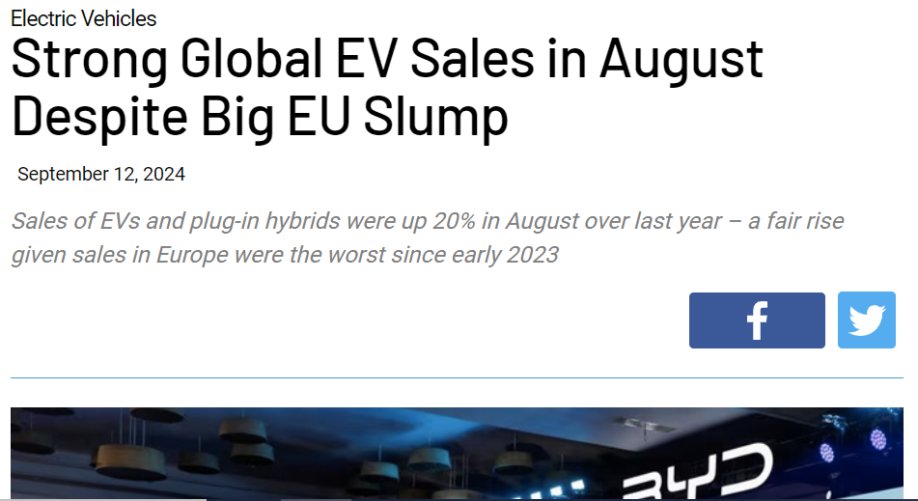
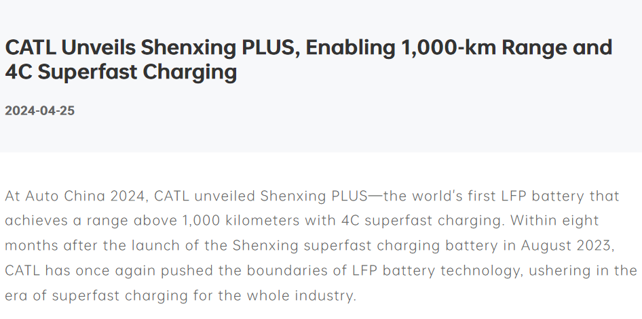
The collapse in battery prices starts making electric vehicles significantly cheaper per kilometre driven than cars with an internal combustion engine (ICE). The increase in the energy density of batteries also makes it possible to now build inexpensive electric vehicles with a range of more than 1,000 km. And with the arrival of 4C batteries, you can recharge them very quickly (in 60min/4 = 15min) at a fast-charging station. These elements suggest that the ICE market may collapse in the decades, or even just years, to come.

Slide 20
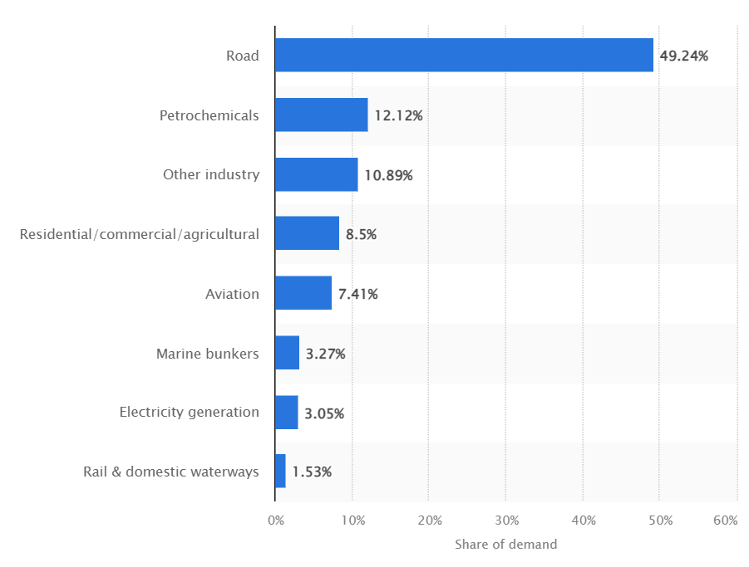
This is very bad news for OPEC+. The organisation is already losing market share (see Event 1) and will now gradually lose its business linked to road transport, which represents around half of oil demand.
Given this, the power of many OPEC+ countries may disappear over time if they do not reform. They must reinvent themselves as dynamic economies, no longer subsidised by their oil industry, if they want to remain significant on the international stage. Big challenges await Iran, Russia and Saudi Arabia.
Distribution of oil demand in the OECD in 2022, by sector

Slide 21
If policies are unchanged, China is poised to become the world's factory for photovoltaic panels, batteries and electric vehicles.
Many tensions are likely to rise between China and other countries that do not want to see their industry, particularly their automobile industry, destroyed by China in a globalised cleantech market.
Tariffs on Chinese products until their domestic industries can catch up could be a good solution, especially for the EU that should not switch from a dependence on fossil fuel imports to a dependence on cleantech imports.
The Chinese carmaker BYD sells about twice as many electric vehicles as all German carmakers combined.

Slide 22
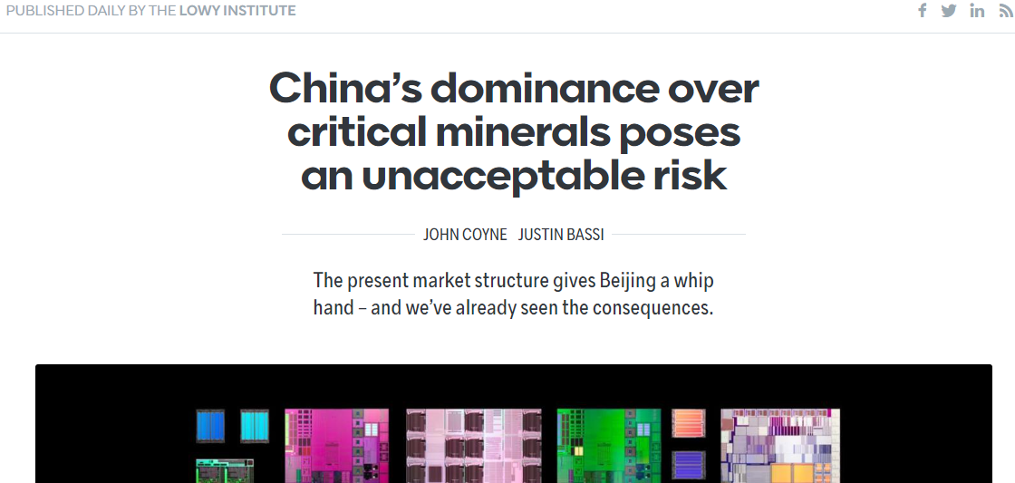
China’s cleantech industry benefits from China’s control over minerals critical to the energy transition. Let us adopt a realist approach: the EU will never be a cleantech superpower without regaining control of the supply of these essential minerals.
Two main realist approaches for the EU to solve this problem: (i) the development of mines in EU territory and (ii) deep-sea mining (in the exclusive economic zones of EU countries or in international waters).

Slide 23
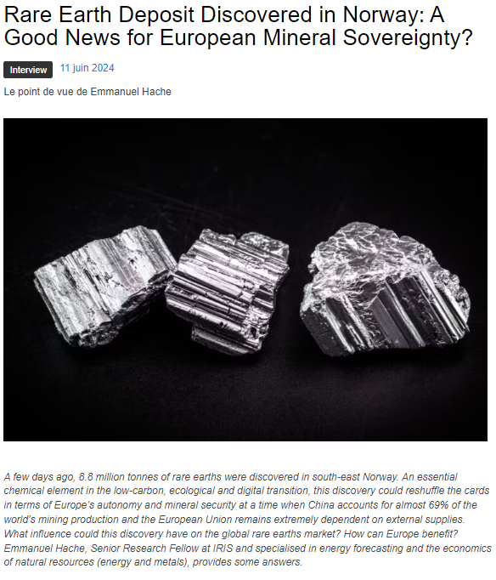
Development of mines in the EU territory
The EU has many mineral resources which have been neglected. The EU mining industry has been hampered by strict environmental regulations severely restricting mining opportunities.
Thanks to new clean mining technologies, we could develop mines with a much lower environmental impact than that associated with third-world mines.
Additionally, mining robots can be used to prevent workers from being exposed to unsafe working conditions.

Slide 24
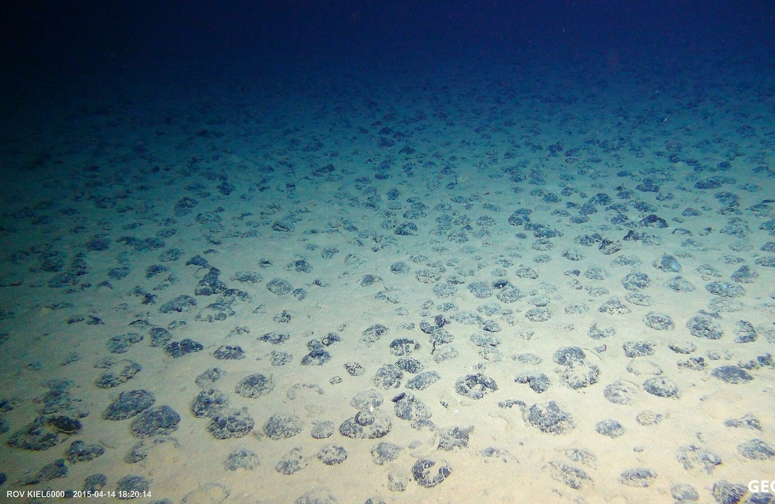
Deep sea mining
Polymetallic nodules are found at depths of 4–6 km in all major oceans, but also in shallow waters like the Baltic Sea.
The exploitation of polymetallic nodules must be a European priority to provide the materials necessary for the clean technology industry. The environmental impact of such “mining” is much lower than that associated with land-based mining operations.
A European company called DEME (based in Belgium) is among the world leaders in deep-sea mining. It has developed machines capable of efficiently and effectively harvesting these nodules.

Slide 25
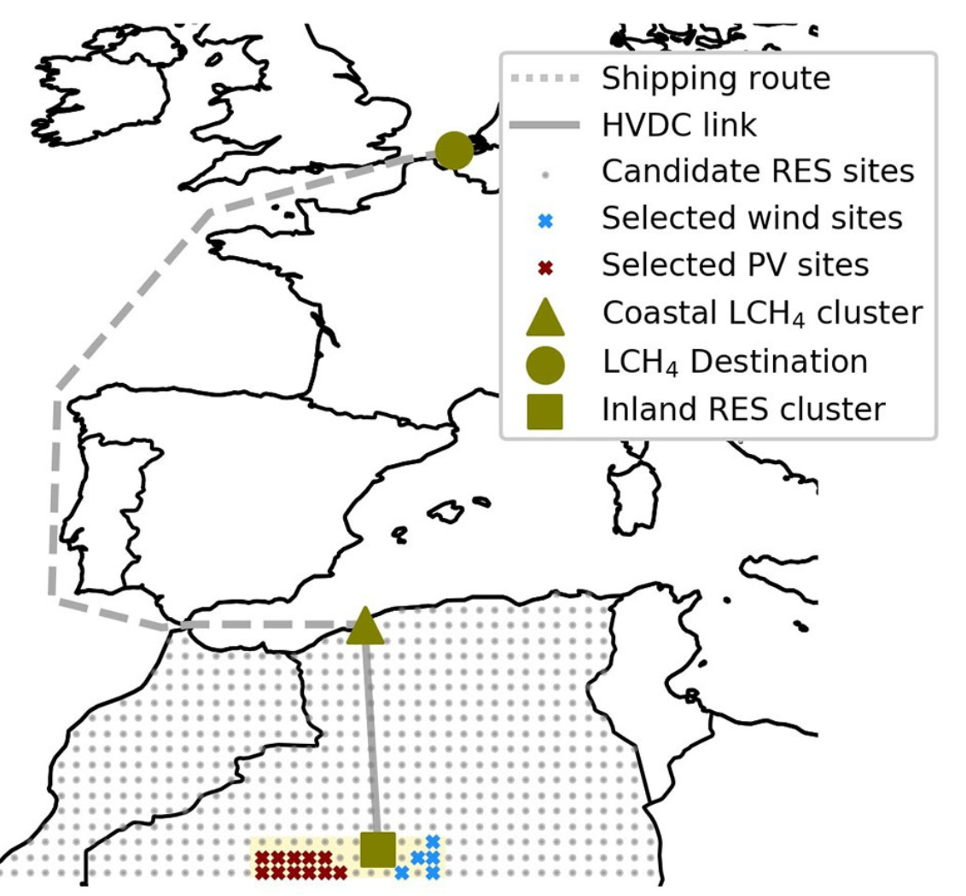
Event 4: Development of RREH for the production of carbon-neutral energy-rich molecules
A remote renewable energy hub (RREH) is an energy hub located far away from large load centres where abundant, high-quality renewable energy is harvested.
An example of an RREH where solar and wind energy is collected in the Algerian desert, carried to the shore via an HVDC link, transformed into carbon-neutral CH4 and then shipped to EU.

Slide 26
Why RREH is the new hot thing in the energy sector?
The potential of renewable energy production near load centres is often limited (mostly space contraints) and the renewable energy primary sources of lower quality. Thus, RREH may create new opportunities for decarbonising economies at a low price.
There is the possibility of producing decarbonized fuels in an RREH such as H2 or NH3 but also non-decarbonised but CO2-neutral fuels using, for example, a combination of direct air capture (DAC), electrolysis and Fischer-Tropsch technologies. Immense opportunities exist for decarbonising difficult sectors, such as the aviation.
RREH can be built very quickly, in parallel, in many places around the world using the same technology and can also benefit local communities.
More on those RREH in: Dachet, V., Lokotar, I., & Ernst, D. (2024). Remote renewable energy hubs: A leadership opportunity that Europe must seize. Confrontations Europe. https://hdl.handle.net/2268/318392

Slide 27
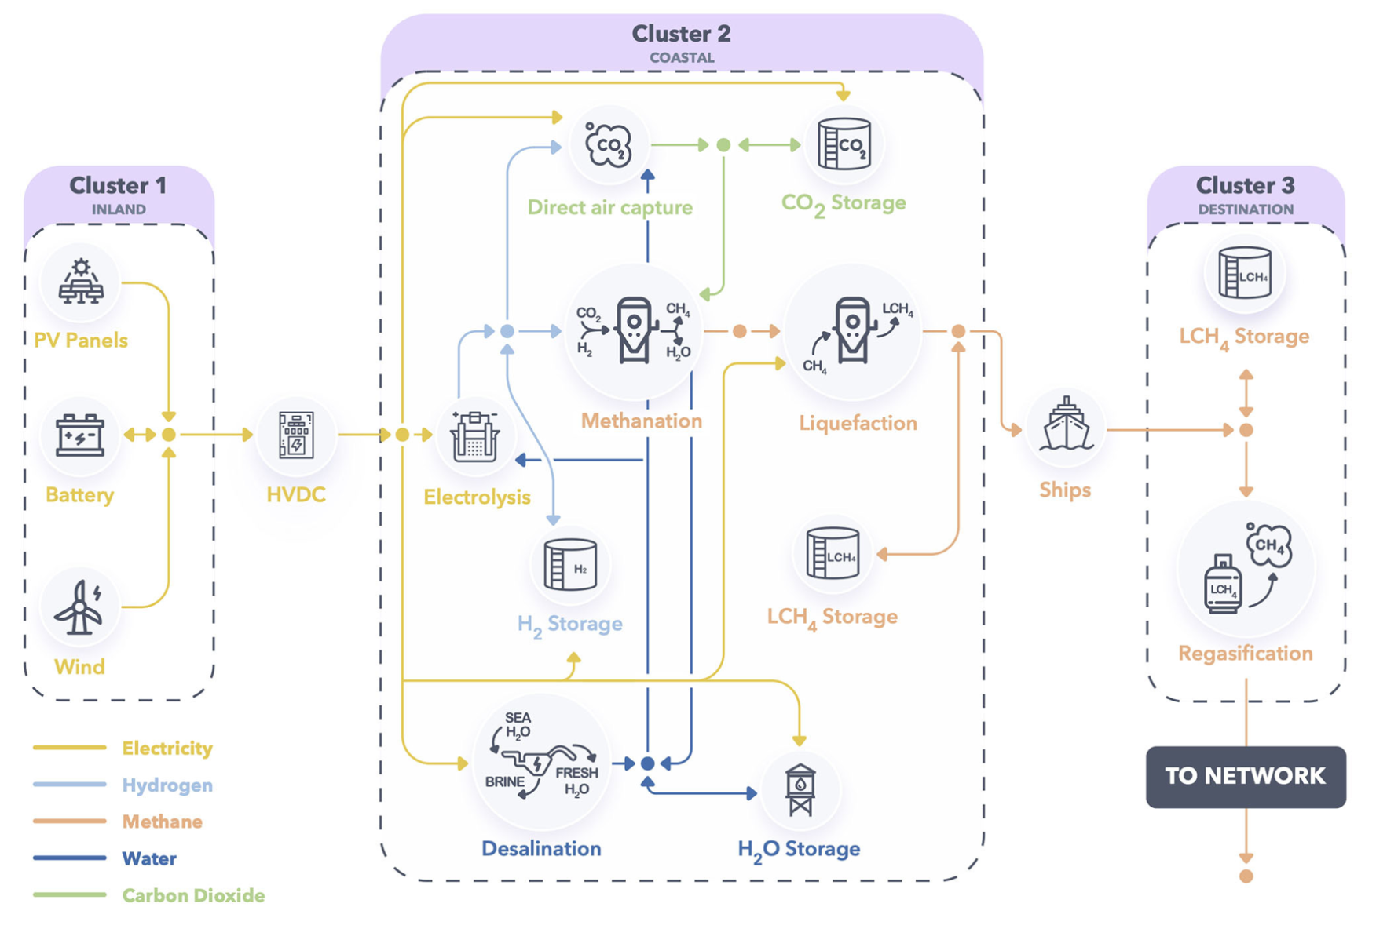
An example of a RREH for CH4 production

Slide 28
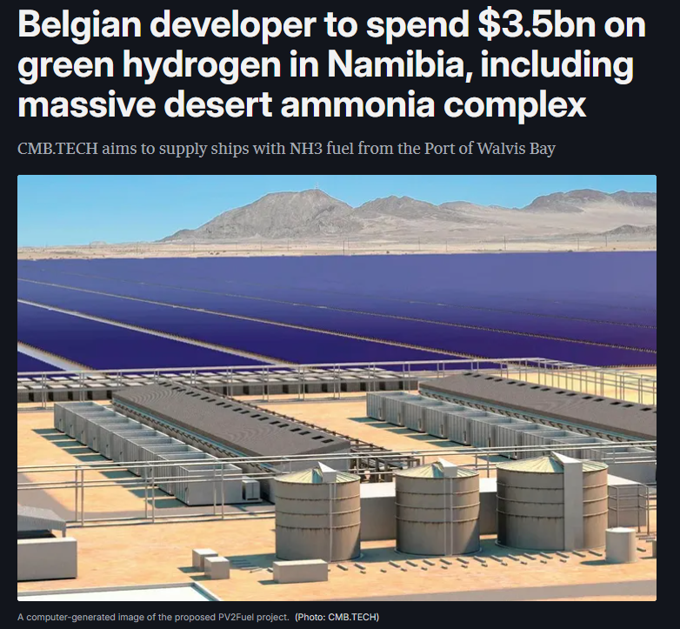
Many RREH projects are already appearing for the synthesis of NH3, which is the cheapest energy-rich molecule to produce in those hubs.
NH3 is very important for food production since it is widely used for nitrogen fertilizer production.
For now, it is mostly synthesised from CH4.

Slide 29
Consequences of Event 4
RREH will compete directly with the fossil fuel industry and, in particular, with this latter one for the supply of kerosene to the aeronautics sector wishing to decarbonise and for the supply of NH3.
This is very bad news for oil and gas-rich countries, as RREHs benefit directly from falling prices of clean technologies. Since they can be built very quickly and in parallel, they could quickly replace major portions of the upstream sector of the fossil fuel industry.
Oil- and gas-rich nations may lose a considerable amount of their wealth due to the rise of RREHs, and more rapidly that they may have anticipated. This may swiftly reshape the balance of power between many nations.

Slide 30
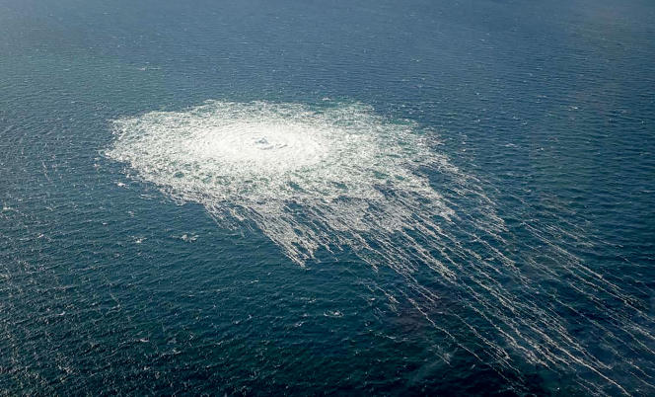
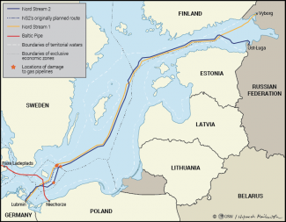
Event 5: Military strikes on energy infrastructures
09/28/2022: Attack on NS1 and NS2 (Baltic Sea)

Slide 31
06/01/2024: Electricity in the Belgorod region of Russia was cut off after a drone attack and explosions at substations in Stary Oskol.

Slide 32
09/01/2024: Drone attack on the 2520 MW Konakova power station (North of Moscow) and on the gas distribution network to which it was connected.

Slide 34
Consequences of Event 5
Countries realised that even if they are very wealthy and with a powerful military, cheap drones/technologies can inflict untold damage and “unbearable” losses to their energy infrastructure. This could significantly alter the balance of power between nations, as drones have already altered it on the Ukrainian battlefield.
Such actions will also accelerate the rise of distributed energy systems that are inherently more resilient to attacks. This will also promote the development of completely new mechanisms for managing electricity networks, in order to make them more resistant to strategic attacks.

