Slide 1
SYMPOSIUM
To regress out or not?
An update on the fMRI global signal debate
Monday June 24 | 3.15pm-4.30pm
Room: Grand Ballroom 103

Slide 2
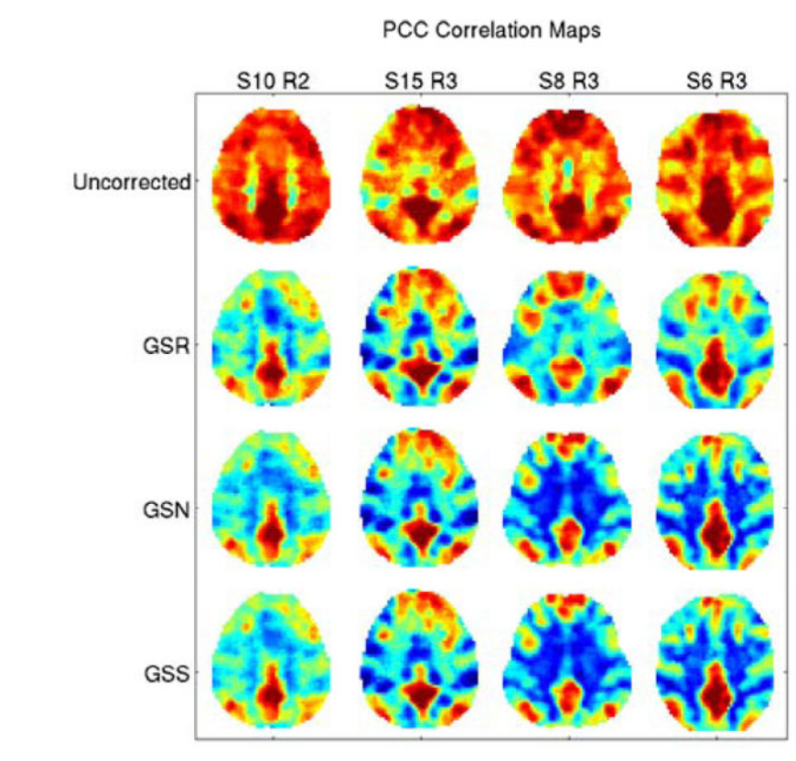
Is it noise only?
The Global Signal
Average voxel timeseries
Zarahn, Aguirre, D’Esposito, NeuroImage 1997
(“Global flow’’ in PET, Friston et al., 1990)
Liu et al, NeuroImage 2017
Notes:
Fig 6. Posterior-cingulate cortex (PCC) and white-matter (WM) seed correlation maps obtained prior to GSR and after the application of GSR, global signal normalization (GSN), and global signal subtraction (GSS)

Slide 3
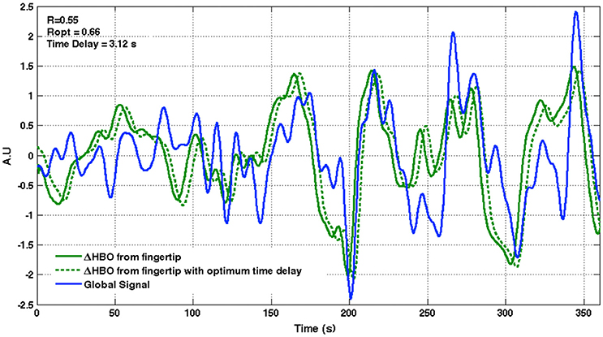
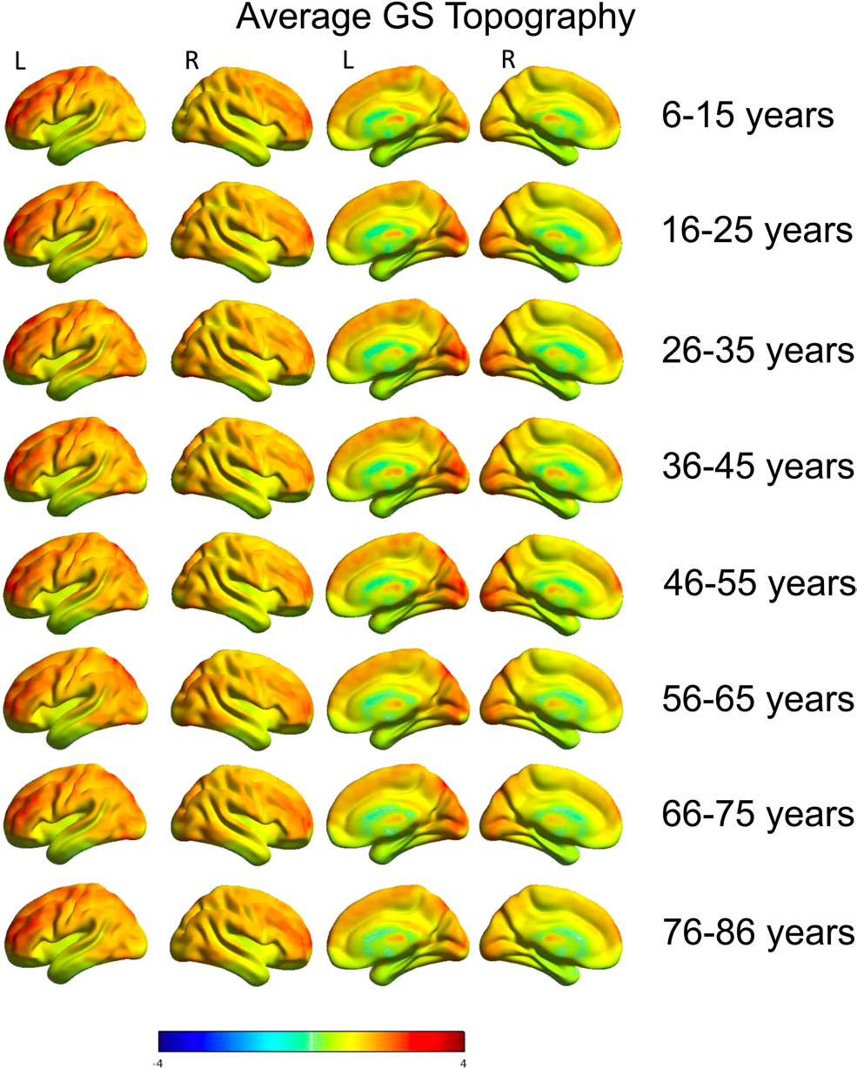
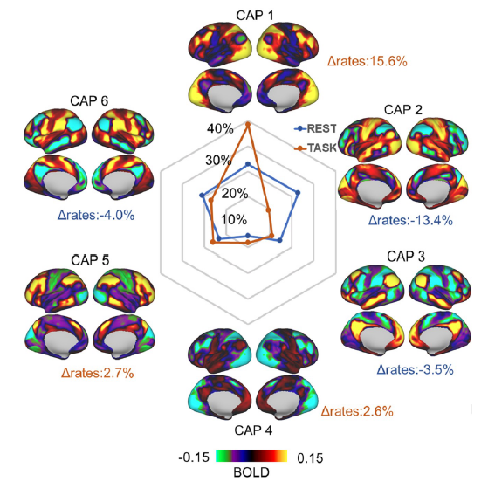
The GS is everywhere
GS topography across lifespan
NIRS
fMRI
Erdoğan et al, Front Hum Neurosci 2016
Nomi et al, Imaging Neurosci 2024
Rest-task modulation of GS topography
GS amplitude and mental states
Psilocybin - Placebo
Zhang et al, PLOS Biol 2020
Mortaheb et al, Biol Psych:CNNI 2024
Notes:
Erdogan et al, 2016: we propose that global signal from resting state fMRI is composed primarily of systemic low frequency oscillations (sLFOs) that propagate with cerebral blood circulation throughout the brain.
FIGURE 3. LOW FREQUENCY SYSTEMIC OSCILLATIONS MEASURED FROM THE PERIPHERY WITH NIRS SHOW A CLOSE RESEMBLANCE TO THE GLOBAL SIGNAL FROM FMRI. Time courses of the low frequency NIRS-HbO signal measured from the fingertip (green) and the whole brain global signal from fMRI-BOLD data are shown for a representative subject, together with an optimally delayed version of the fingertip NIRS-HbO signal (dashed green line). R, correlation between fingertip NIRS-HbO and brain global signal; R_{opt}, Maximum cross correlation between the two signals; Time delay, Optimum time delay applied to fingertip NIRS-HbO signal to achieve maximum cross correlation.
[Zhang et al, PLOS Biol., 2020]: Modulation of GS-CAPs during task

Slide 4


Slide 5
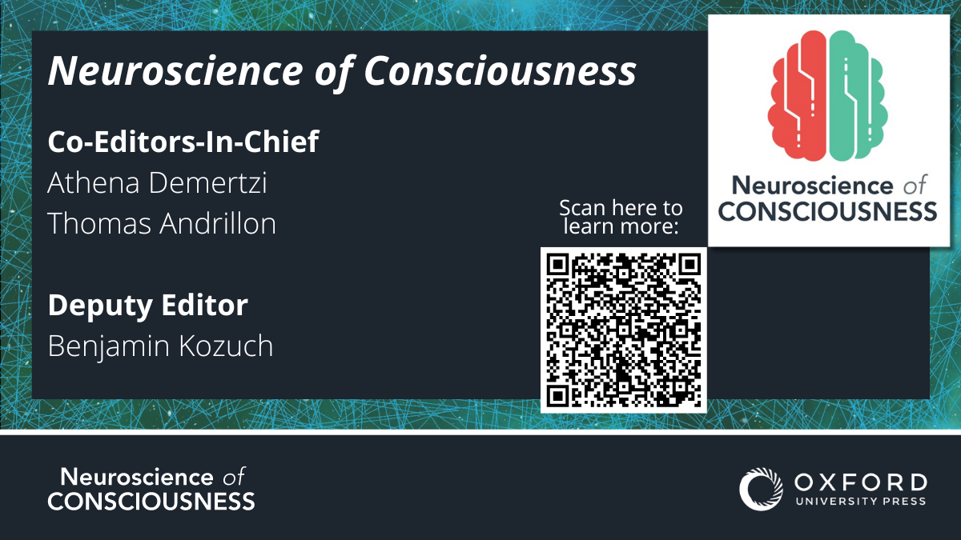
Impact Factor (2022): 4.1

Slide 6

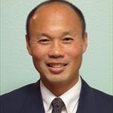
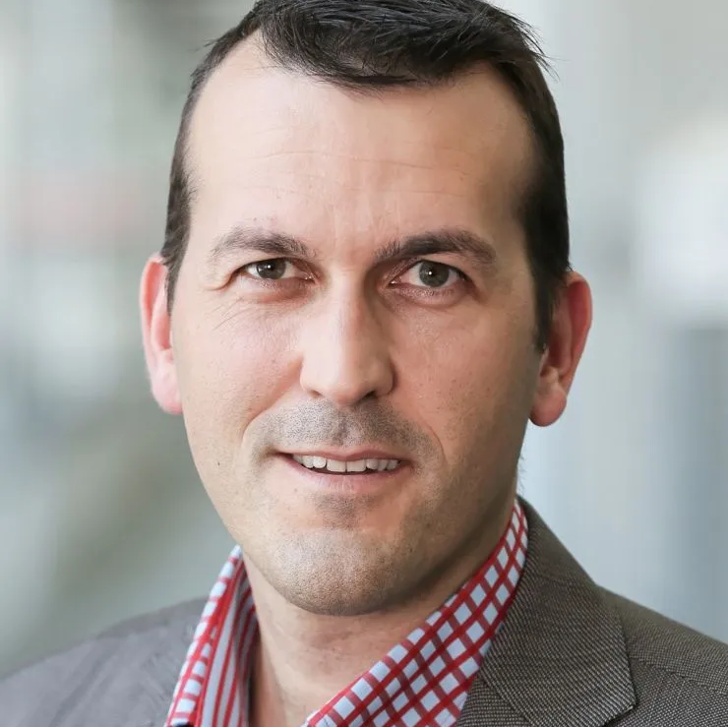
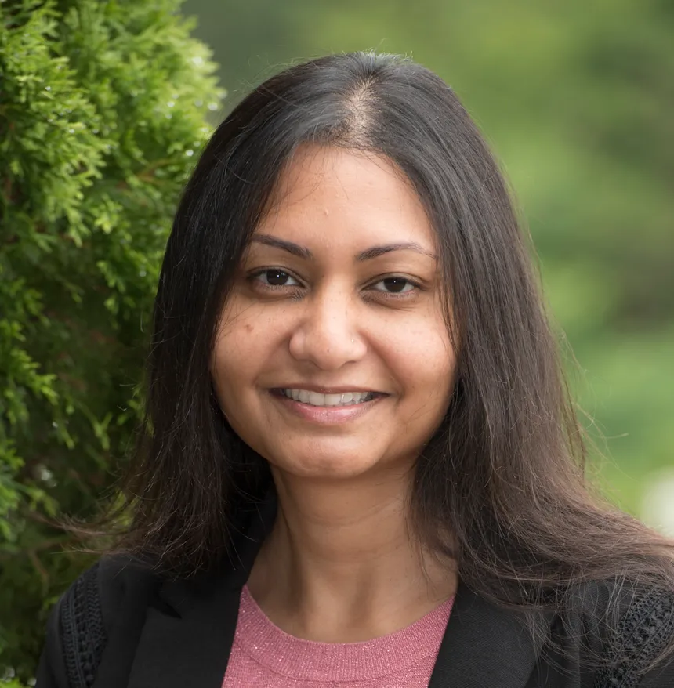
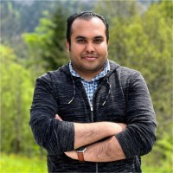
Panel
DEMERTZI Athena
University of Liège
BELGIUM
Organizer & Chair
Thomas LIU
UC San Diego
California
USA
Dimitri VAN DE VILLE
Neuro-X Institute
Geneva
Switzerland
Lucina UDDIN
University of California Los Angeles
USA
Sepehr MORTAHEB
University of Antwerp
Antwerp
BELGIUM

Slide 8
To regress out or not?
An update on the fMRI global signal debate
Organizer & Chair
OHBM 2024 SYMPOSIUM
DEMERTZI Athena
University of Liège
BELGIUM
Monday June 24 | 3.15pm-4.30pm | Room: Grand Ballroom 103
Thomas LIU
UC San Diego
California
USA
Dimitri VAN DE VILLE
Neuro-X Institute
Geneva
Switzerland
Lucina UDDIN
University of California Los Angeles
USA
Sepehr MORTAHEB
University of Antwerp
Antwerp
BELGIUM

