Slide 1
The Punctuation of Ems and the rights of the bishops of the Holy Roman Empire in the Age of Enlightenment: the Case of the Ecclesiastical Principality of Liege (1786-1789)
Presentation given at the XXVIII Annual Forum of Young Legal Historians (Milan, 4-7/09/2024)
Contact : antoine.leclere@Uliege.be / antoine.leclere@vub.be
Antoine Leclère : Research fellow of the F.R.S – F.N.R.S – ULiege - VUB

Slide 2
Outline of the Presentation
Brief geographical and institutional overview of the Principality of Liege at the end of the 18th century.
The motives and objectives of the Congress of Ems.
The resistance of the ecclesiastical and imperial principalities, particulary that of Liege.

Slide 3
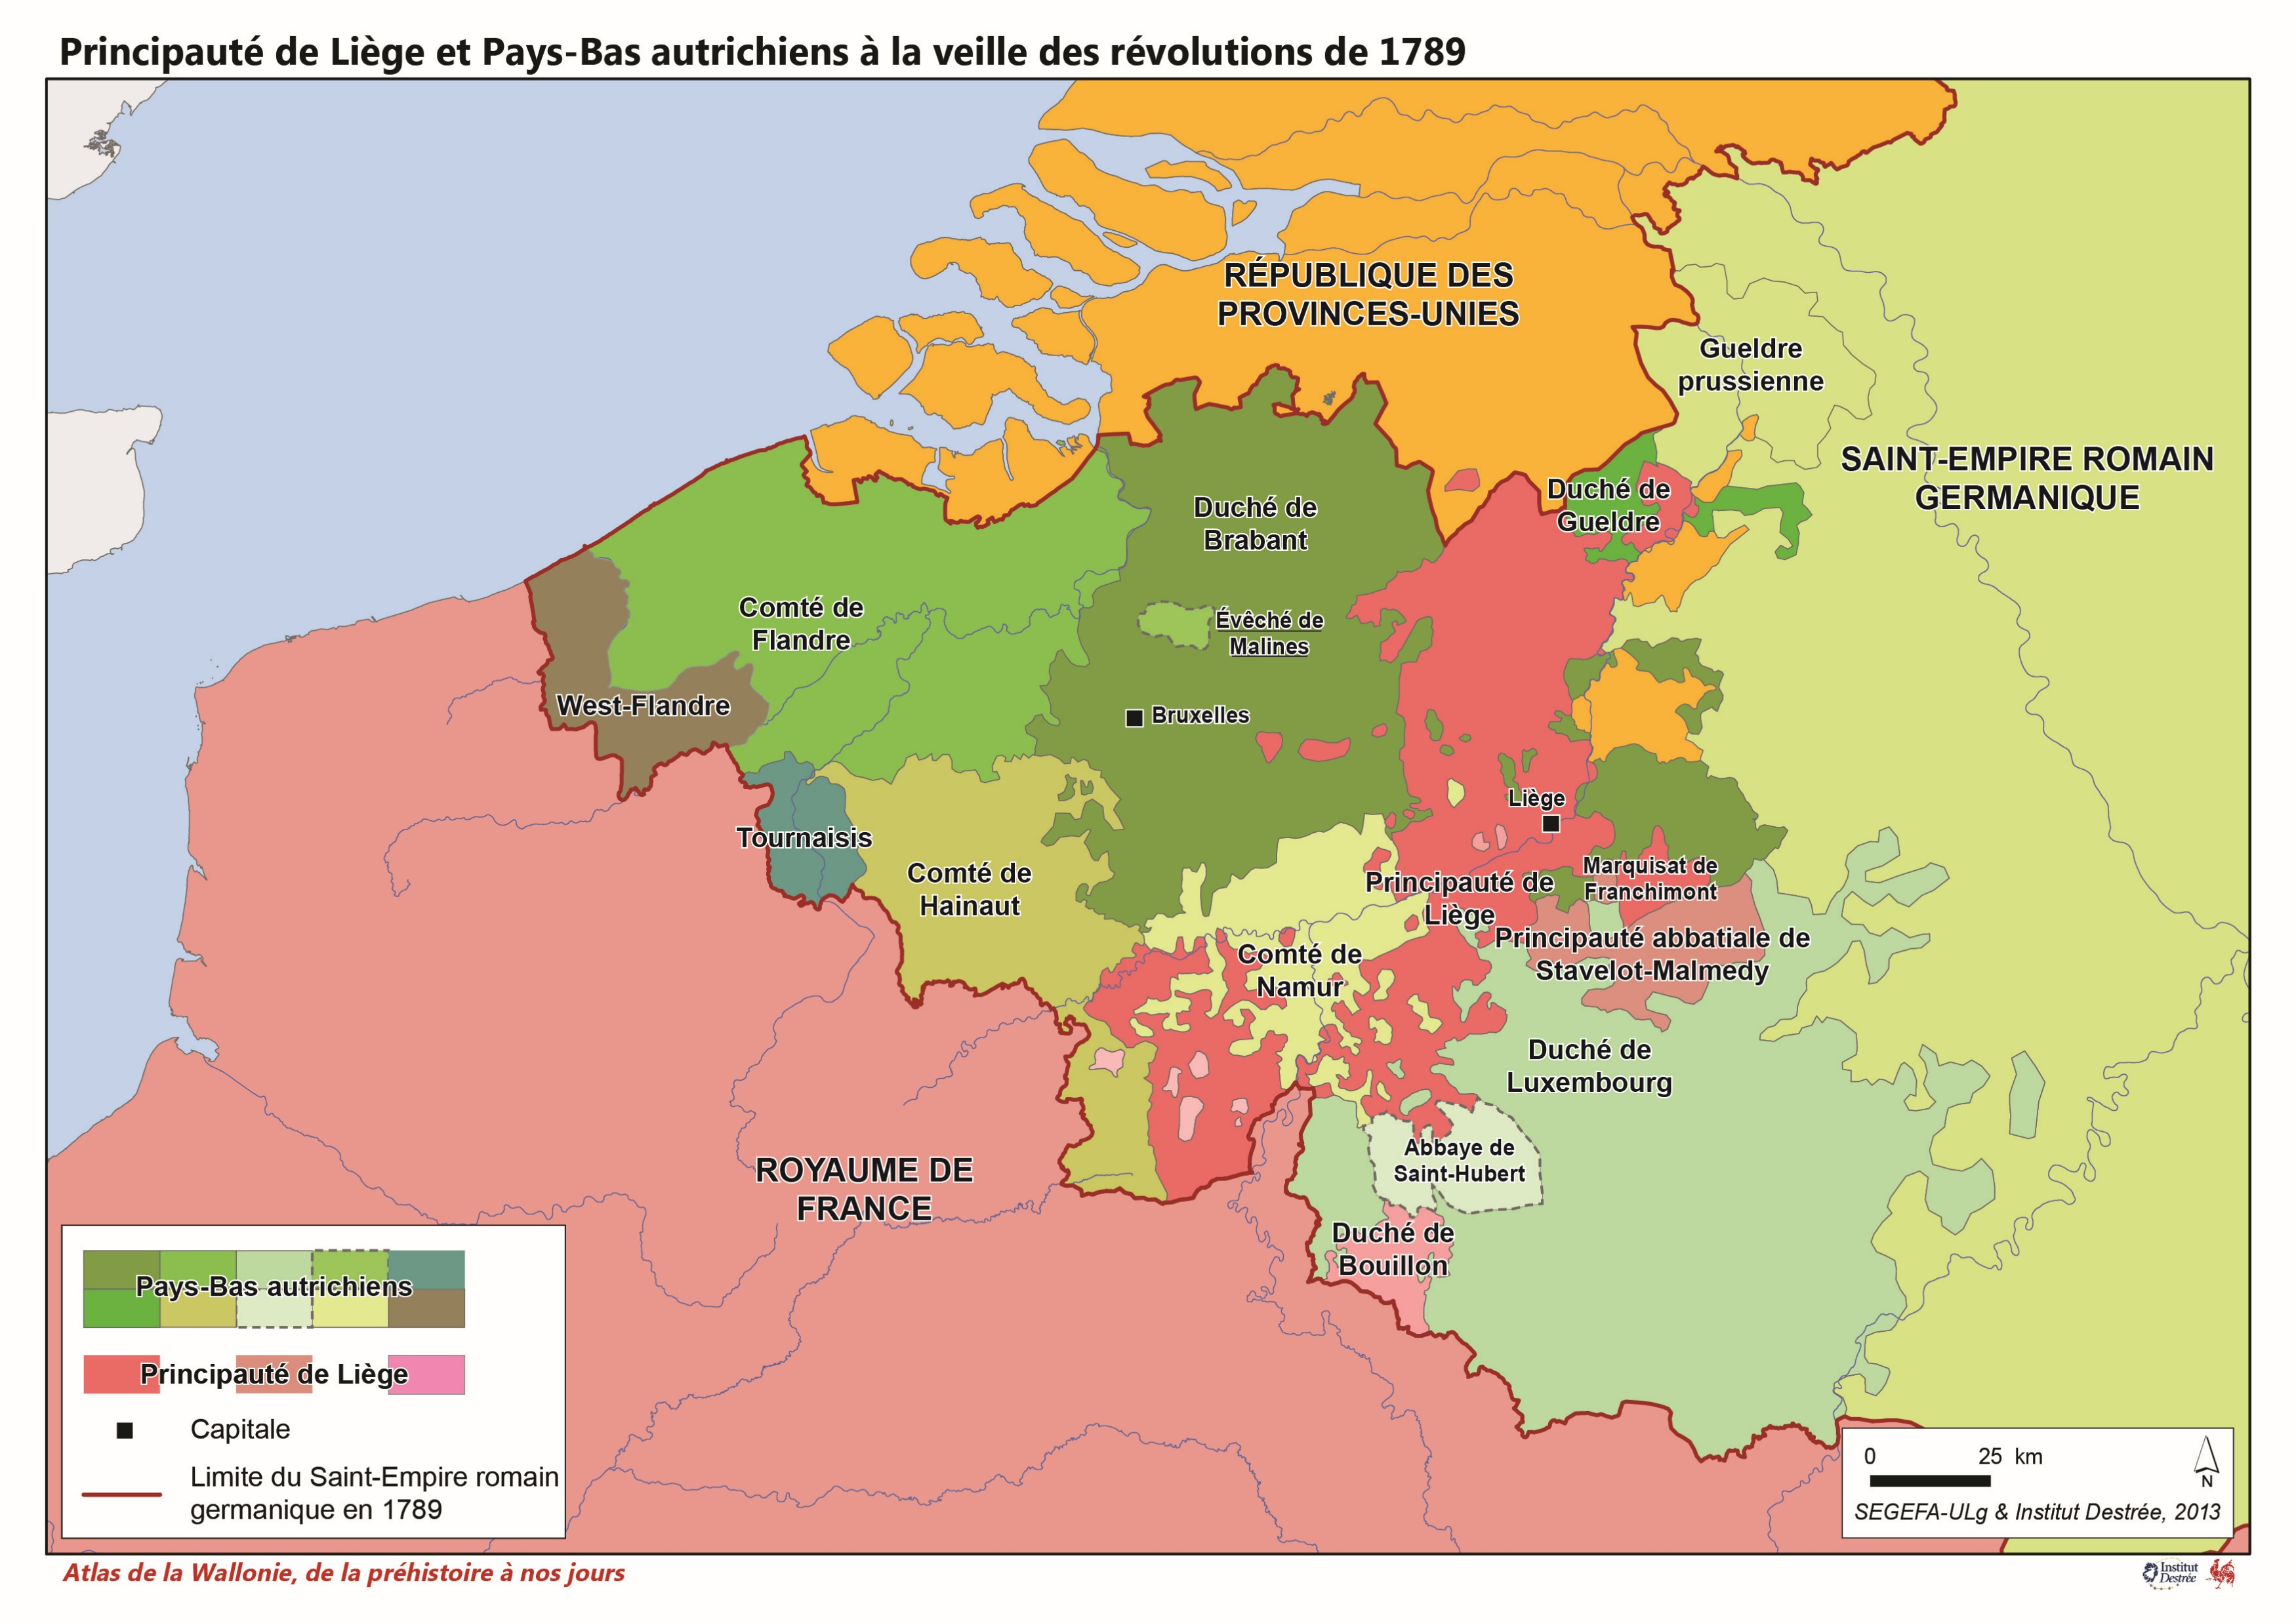
A Polity at the Crossroads of influences (1)
The Principality of Liège is a polity at the crossroads of European interests with a complex political system,
The population was divided into three estates: the clergy, the nobility, and the third estate.
These formed an eponymous institution where the deputies convened upon the prince-bishop's summons.
The clergy was further divided into the primary clergy, consisting solely of the canons of the cathedral, and the secondary clergy, encompassing all other clerics.
The nobility was limited to seventeen members from old established families.
The third estate were represented solely by twenty-three privileged towns,

Slide 4
A Polity at the Crossroads of influences (2)
The cathedral chapter aspired to co-sovereignty with the prince and was endowed with significant prerogatives.
The nobility, eager to increase its power, was in constant conflict with the clerics' dominance.
The third estate was dominated by the prince-bishop.
This conflict extended into the Privy Council wich was constitutionally necessary.
Half of its seats were reserved for the clergy.
Positions of power, like the Chancellor of the Privy Council, were reserved for the primary clergy.

Slide 5
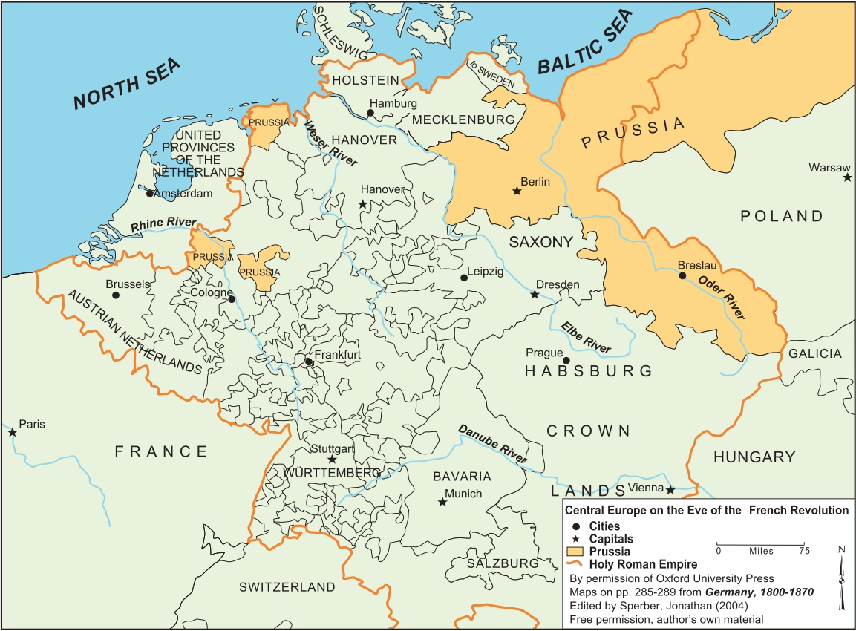
The Congress of Ems : Reform or Separation ? (1)
Conflict between the Elector of Bavaria and the archiepiscopal electors, whose religious jurisdiction extended over part of the Duchy of Bavaria.
Appointment of an apostolic nuncio in Bavaria to counter this influence (15 February 1785).
The new nuncio was associated with those of Flanders and Cologne, under whose jurisdiction of Liege fell.
The initiative was rejected by the four archbishops, who then convened at Ems (24 July 1786).

Slide 6
The Congress of Ems : Reform or Separation ? (2)
The Punctuation of Ems was a programme consisting of twenty-three articles inspired by anti-curialism.
It challenged the primacy of Rome in favour of national conciliarist theories.
This initiative was part of an older movement questioning the imperial Church system, attempting to align the medieval framework with the new constitutional realities of the Empire.
In 1787, the Privy Council issued an opinion on the Punctuatio of Ems, the structure of which we outline here.
The Council rejected all proposals.

Slide 7
The Congress of Ems : Reform or Separation ? (3)
Firstly, the project proposed subjecting clerical exemptions solely to the authority of the archbishops, thereby eliminating the powers of ecclesiastical superiors, bishops with delegated authority, and the Pope.
Additionally, it sought to grant bishops the unlimited right to dispense others from ecclesiastical discipline.
The first was dismissed because the Pope was seen as one of the few external authorities neutral to the frequent conflicts within the Empire.
The second was rejected due to concerns that a trade similar to the sale of indulgences might emerge.

Slide 8
The Congress of Ems : Reform or Separation ? (4)
Thirdly, the archbishops proposed that bishops, under their supervision, become the sole managers of the assets and purposes of all religious foundations.
The Prince-Bishop of Liege personally opposed this, arguing that, as it stood, the approval of both the Pope and the Emperor was required to alter the assets and purposes of religious foundations.
The Ems document, however, removed only the Pope while maintaining the Emperor’s role, thereby creating a breach in the independence of episcopal principalities.
Fourthly, the Punctuatio aimed to abolish the extravagantes ad Regimen and Exsecrabilis, which regulated the collation of benefices, in favour of the Emperor alone.
The Prince-Bishop also resisted this proposal, as the allocation of seats within the cathedral chapter was highly political. If the Emperor became the sole controller, the entire political system in Liege risked being placed under imperial supervision.

Slide 9
The Congress of Ems : Reform or Separation ? (5)
Finally, the Punctuatio of Ems proposed to alter the ecclesiastical judicial structure by removing the role of the nunciatures.
Henceforth, cases would be handled by the archbishops in courts modelled after the Imperial Chamber of Wetzlar.
In the event of an appeal to Rome, the Pope would be compelled to appoint German judges selected by the archbishops.
Many denounced these proposals as dangerous, even schismatic. However, Pope Pius VI remained silent while the project was submitted to Joseph II.

Slide 10
Combating Schism : The Fracture of the Imperial Church
Reluctance from princes and Electors, particularly Prussia.
Resistance to Ems proposals came from Liege and Speyer.
France Foreign affairs Secretary, Charles Gravier de Vergennes, ordered to his agent in Liege to counter the pressure coming from Vienna.
In the Low Countries, the nuncio was expulsed but received the protection of the prince-bishop of Liege.
The archbishop of Cologne condemned the prince of Liege as a disturber of the public peace.

Slide 11
Conclusion
Archbishops of the Empire withdrew from the Punctuation gradually.
Joseph II rejected the text due to overpressure from Berlin.
The Imperial Church was severely damaged by Ems Congress and the Punctuatio.
Pie VI (14 novembre 1789) condemned the Punctuatio by linking it to Febronius thesis wich were anathemised.
If Rome reaffirm it’s primacy, the revolutionary context disturbed it soon.

Slide 12
The Punctuation of Ems and the rights of the bishops of the Holy Roman Empire in the Age of Enlightenment: the Case of the Ecclesiastical Principality of Liege (1786-1789)
Presentation given at the XXVIII Annual Forum of Young Legal Historians (Milan, 4-7/09/2024)
Contact : antoine.leclere@Uliege.be / antoine.leclere@vub.be
Antoine Leclère : Research fellow of the F.R.S – F.N.R.S – ULiege - VUB

