Slide 1

Autonomic arousal states alters mind-blanking report frequency
BAPS 2024
“Integrating Affect and Cognition:
Insights from Psychophysiology, Problem-Solving, and Confidence Judgments”
Boulakis Paradeisios Alexandros, MSc
FNRS Aspirant
Physiology of Cognition Lab
GIGA CRC In vivo imaging
University of Liège
May 31, 2024

Slide 2
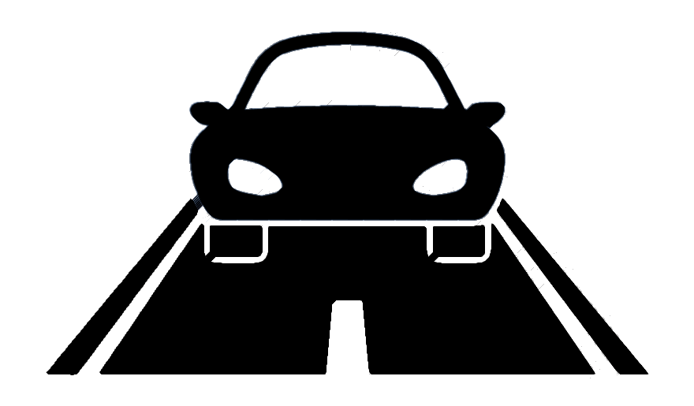


Our mental life has blind spots
“ … personal consciousness …
like a bird's life, it seems to be made of an alternation of flights and perchings ... ”
“… time-gaps during which the consciousness went out altogether to come into existence again at a later moment …”
BUT!
James (1890). The Principles of Psychology.
Ward and Wegner (2013). Mind-blanking: When the mind goes away. Front Psycol

Slide 3
MB is associated with lower cortical arousal
Boulakis & Demertzi (2024). What's the blank about? Relating mind-blanking to aspects of ongoing thinking. psyarxiv

Slide 4
What is the role of physiological arousal in MB?
Hypothesis 1:
Altering physiological states will increase MB reports
Hypothesis 2:
Physiology is beneficial in decoding MB reports
Boulakis, Simos, Zoi, Mortaheb, Schmidt, Raimondo, Demertzi.(2024). Variations of autonomic arousal mediate the reportability of mind-blanking occurrences. biorxiv (Registered Report Stage 2)

Slide 5
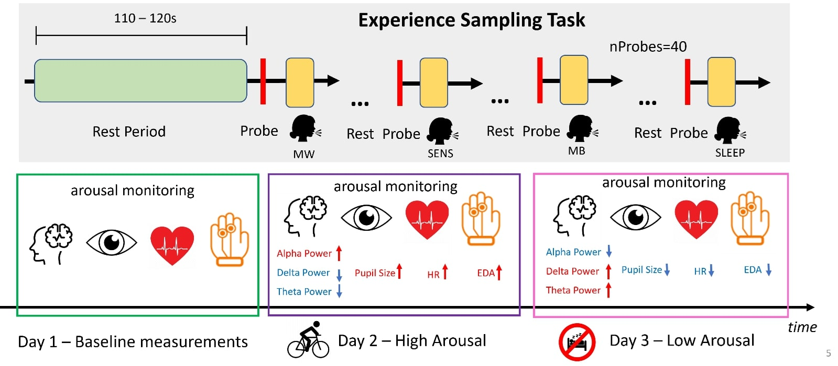
Experimental Design
N = 26, power = .95
Boulakis, Simos, Zoi, Mortaheb, Schmidt, Raimondo, Demertzi.(2024). Variations of autonomic arousal mediate the reportability of mind-blanking occurrences. biorxiv (Registered Report Stage 2)

Slide 6
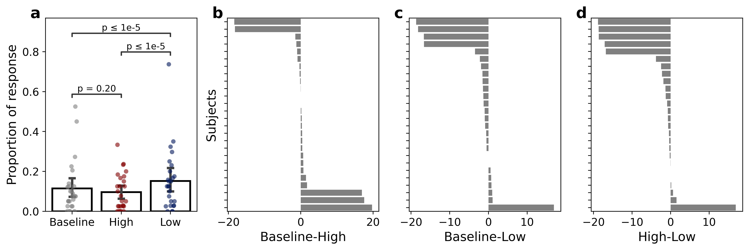
Altered arousal increases MB reports
Low – High Transition Probabilities
-.2
MW
-.23
.01
.07
.09
SENS
MB
.1
.06
BUT MB was more frequent in first half of post-exercise vs. second half (divergence = 4.08, p = 3.2e-02)
.05
.07
Boulakis, Simos, Zoi, Mortaheb, Schmidt, Raimondo, Demertzi.(2024). Variations of autonomic arousal mediate the reportability of mind-blanking occurrences. biorxiv (Registered Report Stage 2)

Slide 7
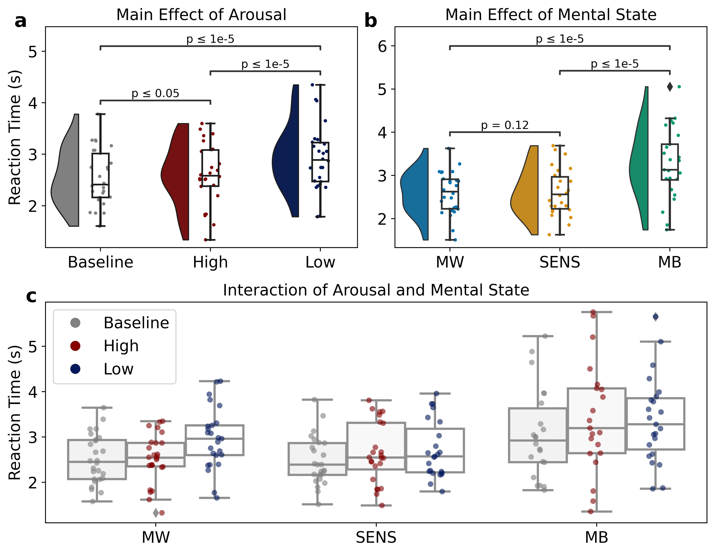
MB reaction times are mediated by arousal
Responses are the slowest after sleep deprivation
Responses are slowest for MB reports
MB the slowest after exercise
Notes:
Main Effects
Responses are the slowest after sleep deprivation
Responses are slowest in MB.
Interaction Effects
MB is slowest in exercise, followed by sleep deprivation and baseline.
MW is slowest in sleep deprivation.

Slide 8
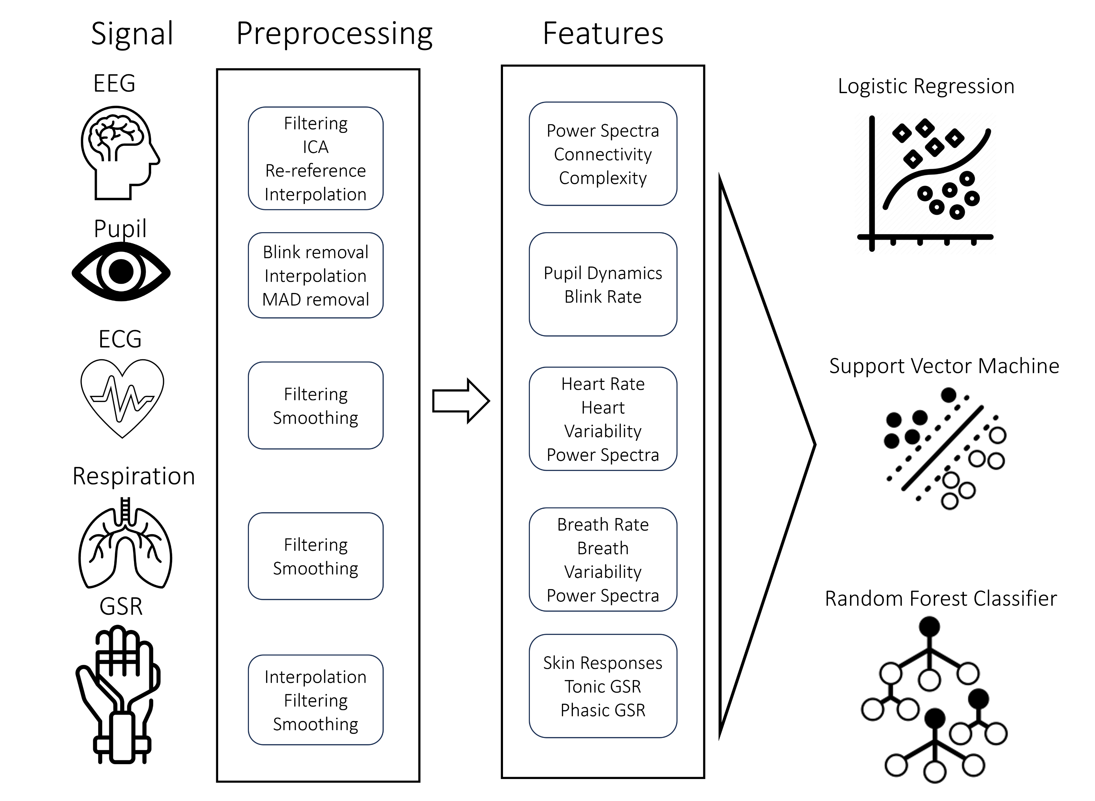
Machine Learning Protocol
Train in all samples -> Validate that MB has unique physiological correlates
Leave one subject out -> Generalize relationships to unknown population
Boulakis, Simos, Zoi, Mortaheb, Schmidt, Raimondo, Demertzi.(2024). Variations of autonomic arousal mediate the reportability of mind-blanking occurrences. biorxiv (Registered Report Stage 2)

Slide 9
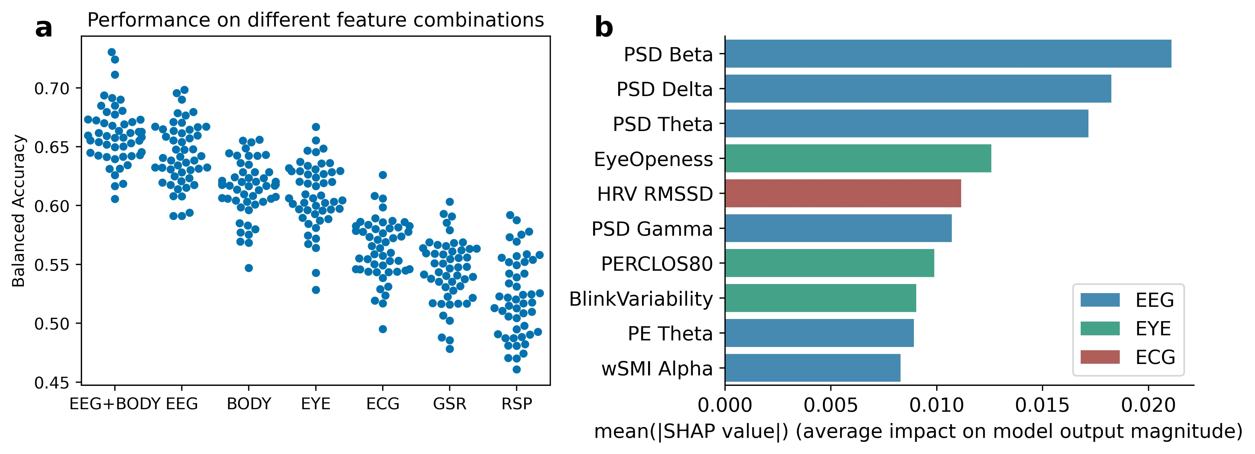
MB has a unique brain-body profile
Boulakis, Simos, Zoi, Mortaheb, Schmidt, Raimondo, Demertzi.(2024). Variations of autonomic arousal mediate the reportability of mind-blanking occurrences. biorxiv (Registered Report Stage 2)

Slide 10
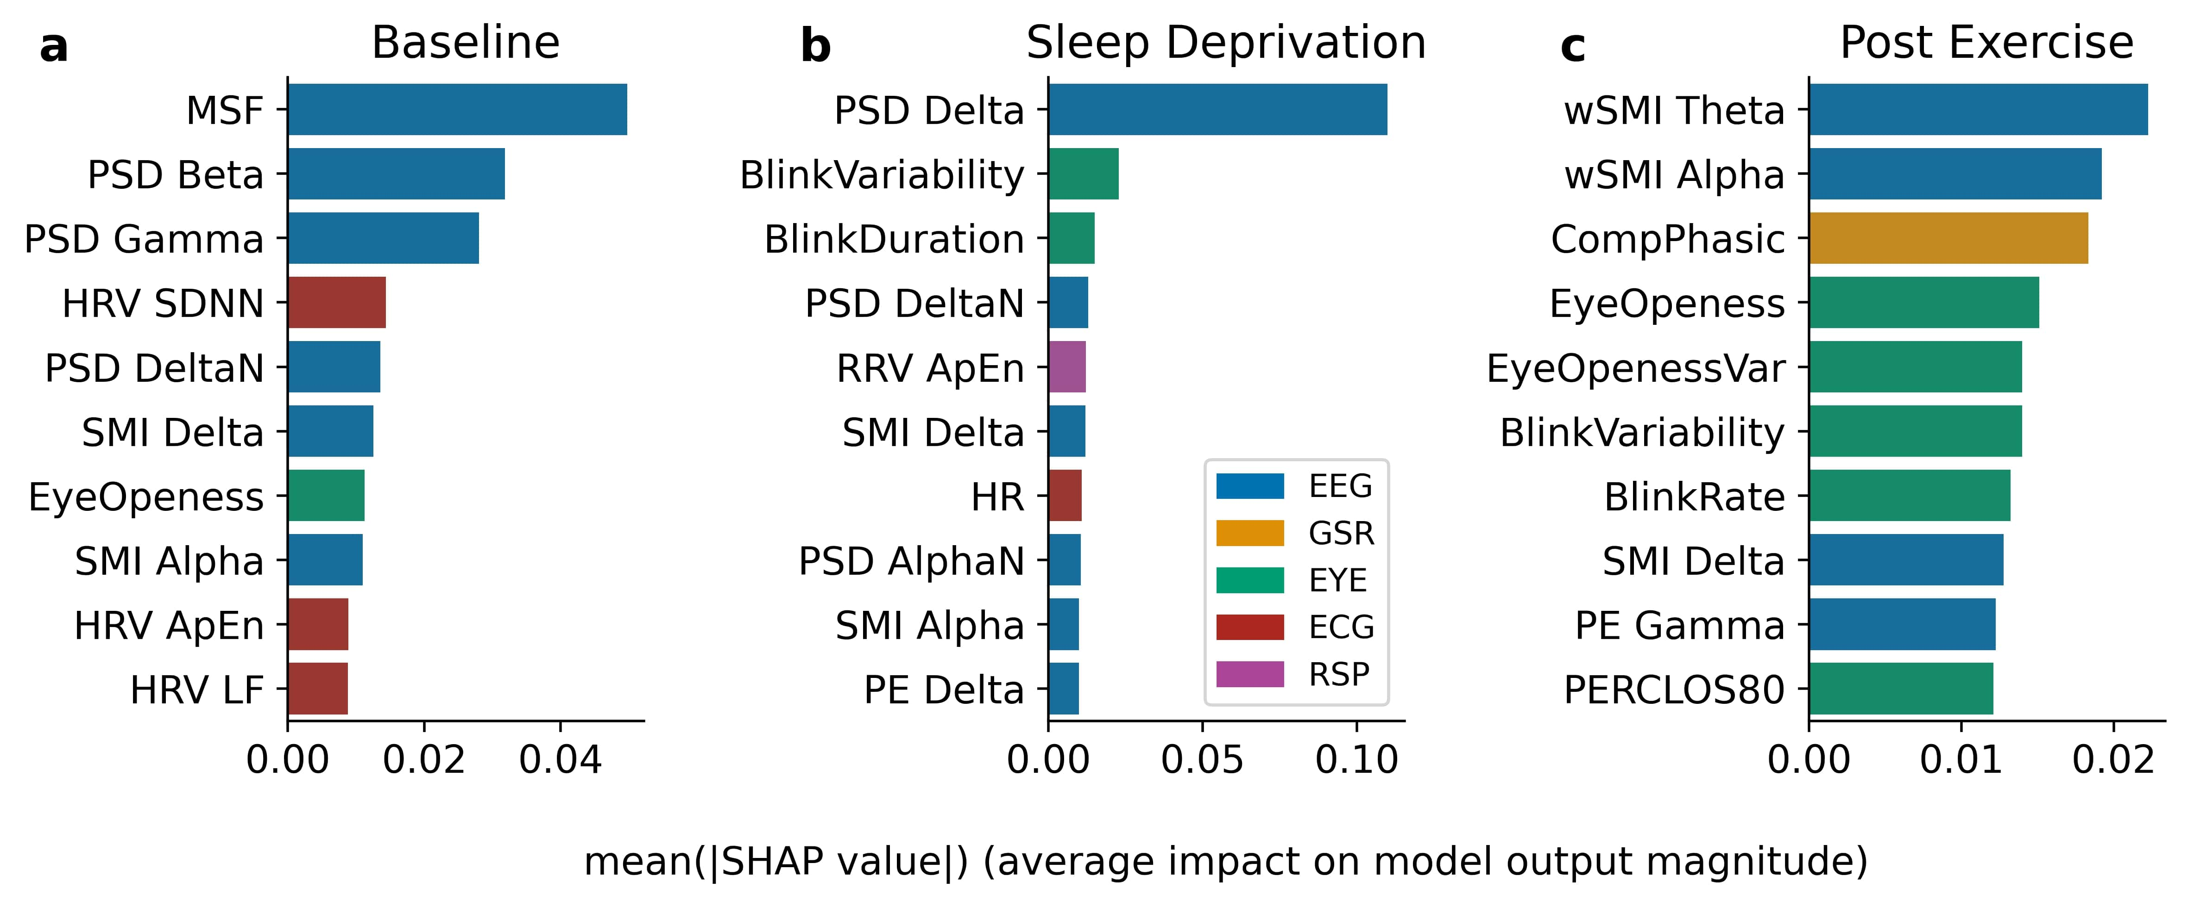
MB profile varies across arousal levels
Boulakis, Simos, Zoi, Mortaheb, Schmidt, Raimondo, Demertzi.(2024). Variations of autonomic arousal mediate the reportability of mind-blanking occurrences. biorxiv (Registered Report Stage 2)

Slide 11
An embodied future for MB …
Hypothesis 1:
Altering physiological states will increase MB reports
Hypothesis 2:
Physiology is beneficial in decoding MB reports
MB in low and (partially) in high arousal.
Low arousal : MW -> less likely to be followed by MW
MW -> more likely to be followed by MB.
Does exercise fatigue can lead to deeper levels of MB ?
BRAIN + BODY > BRAIN or BODY
MB is solely decodable from body markers.
Are there multiple MB pathways?
Boulakis, Simos, Zoi, Mortaheb, Schmidt, Raimondo, Demertzi.(2024). Variations of autonomic arousal mediate the reportability of mind-blanking occurrences. biorxiv (Registered Report Stage 2)

Slide 12



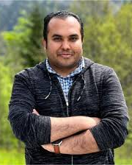







Thank you for your attention
Find more …
BOULAKIS
Paradeisios
SIMOS
Nicholaos
ZOI
Stefania
MORTAHEB
Sepehr
SCHMIDT
Christina
RAIMONDO
Federico
DEMERTZI
Athena

Slide 13
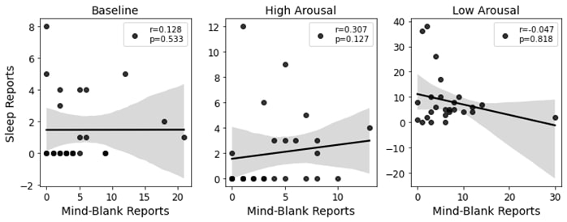
Supplementary I
MB does not correlate with SLEEP reports

Slide 14
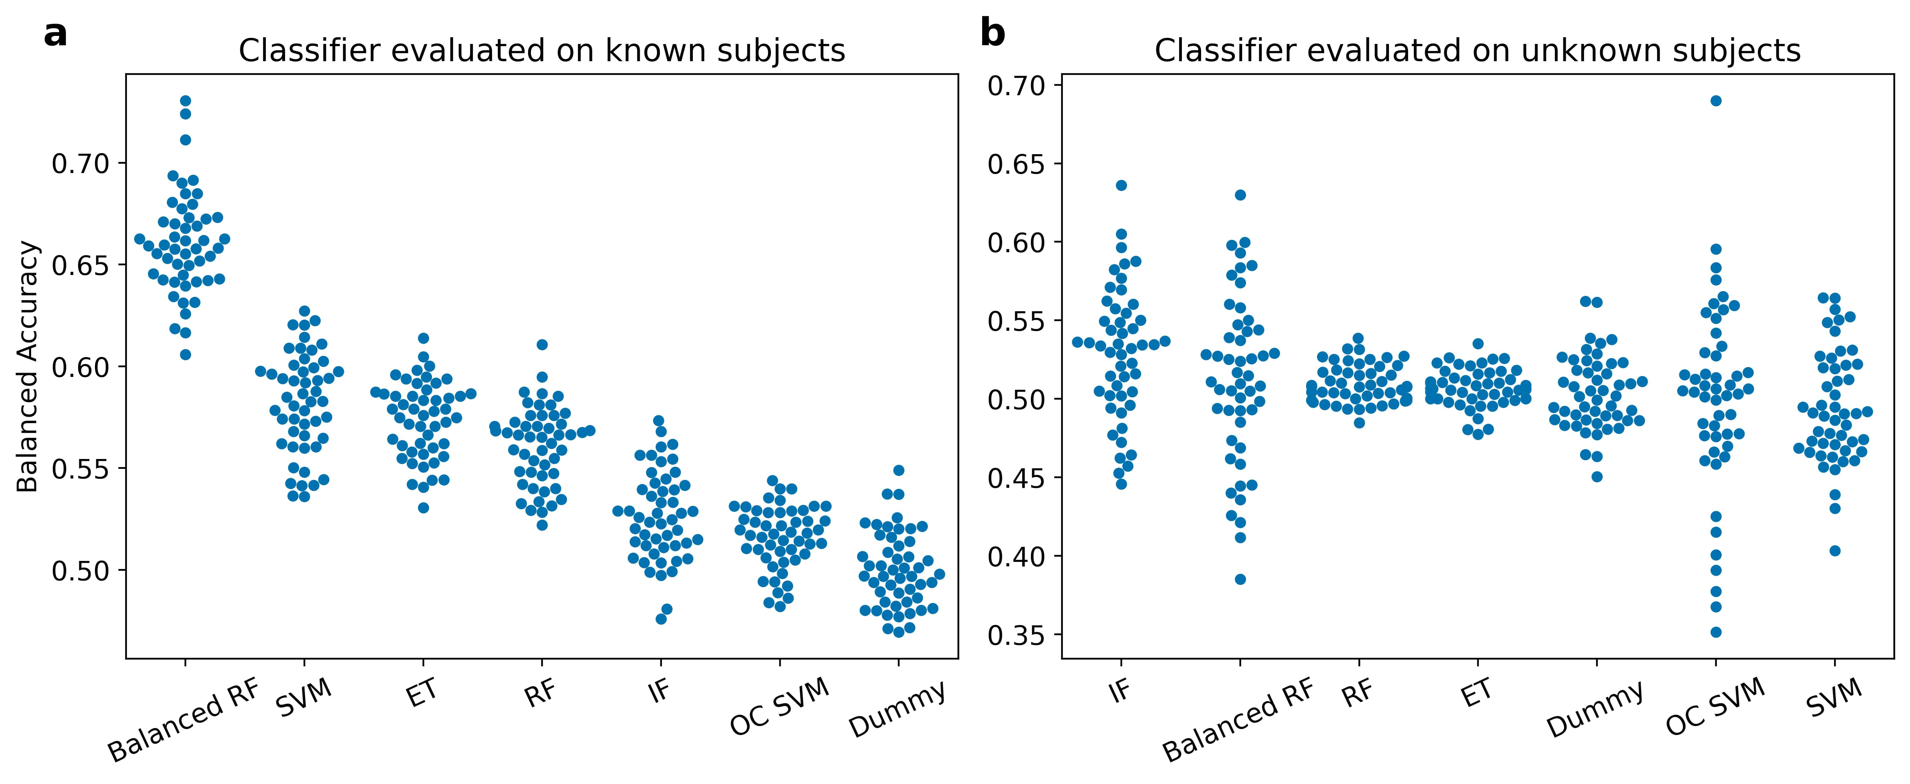
Supplementary II in- and out-sample classification

Slide 15
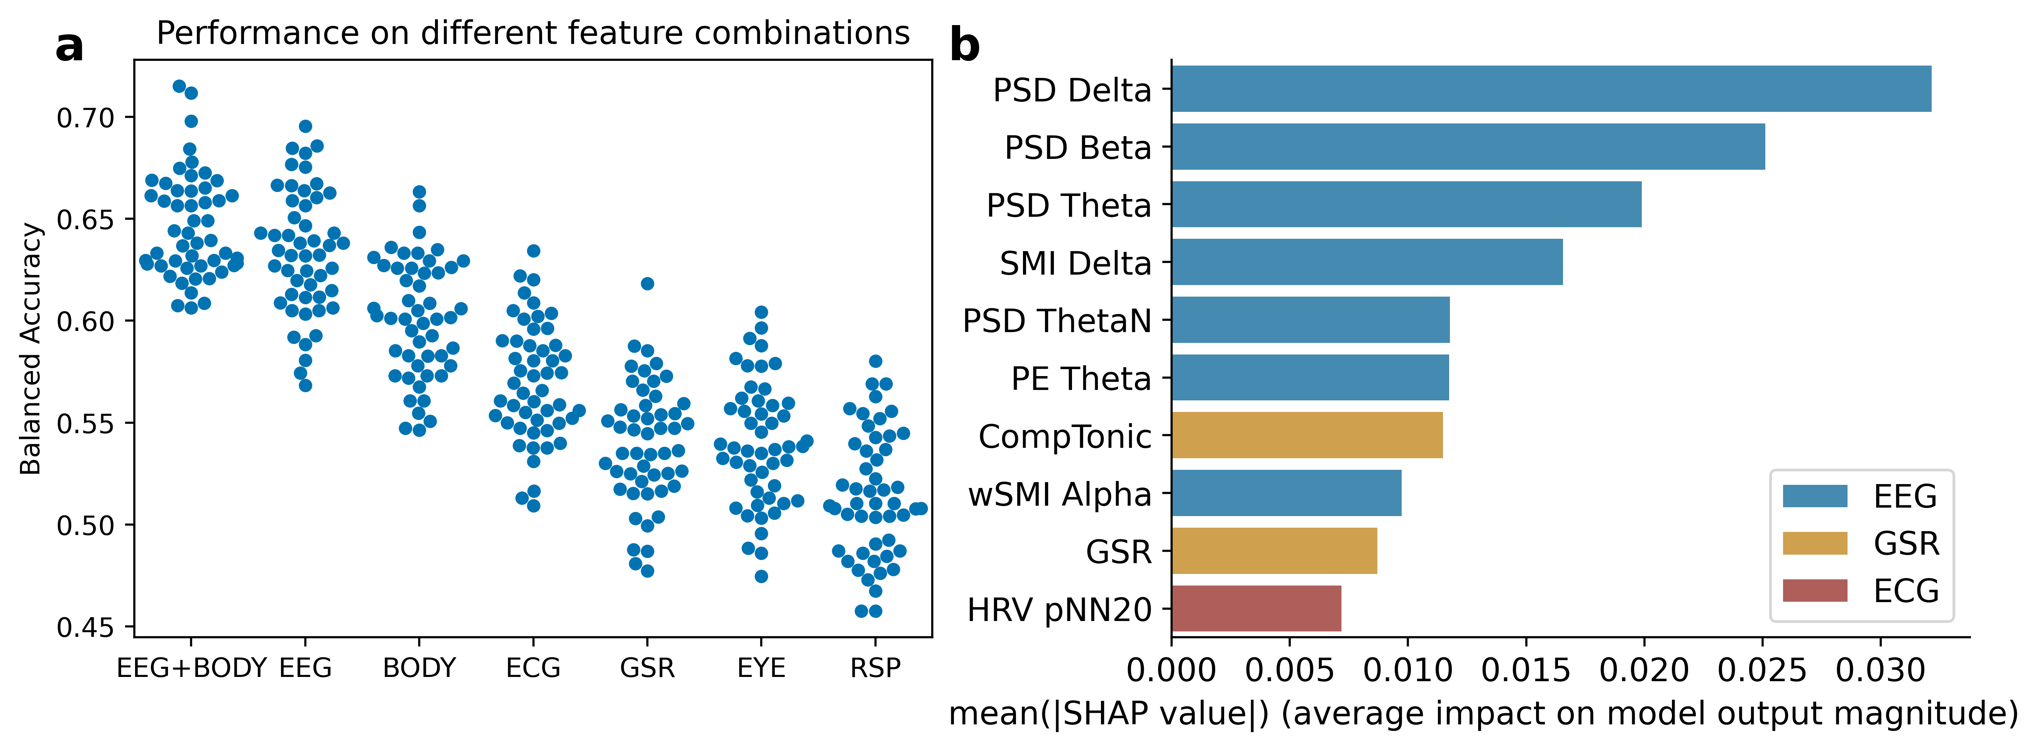
Supplementary III
Classification performance across analysis windows

